Slide 1
Thư Gia Cơ
Dr. Rick Griffith, Singapore Bible College
www.biblestudydownloads.com

Slide 2

Thư Gia Cơ

Slide 3
Do all Christians die in fellowship with the Lord?
In other words, do you think everyone perseveres in their faith or do they sometimes fall away?
What is the key issue here?

Slide 4

The Title
EPISTLE OF
JAMES
BOND
servant
Of Christ Jesus

Slide 5
Summary Statement
267
James exhorts early Jewish believers throughout the Roman Empire that Christian faith is shown through works that they might replace their hypocrisy with good deeds in maturity and holiness
WORKS

Slide 6
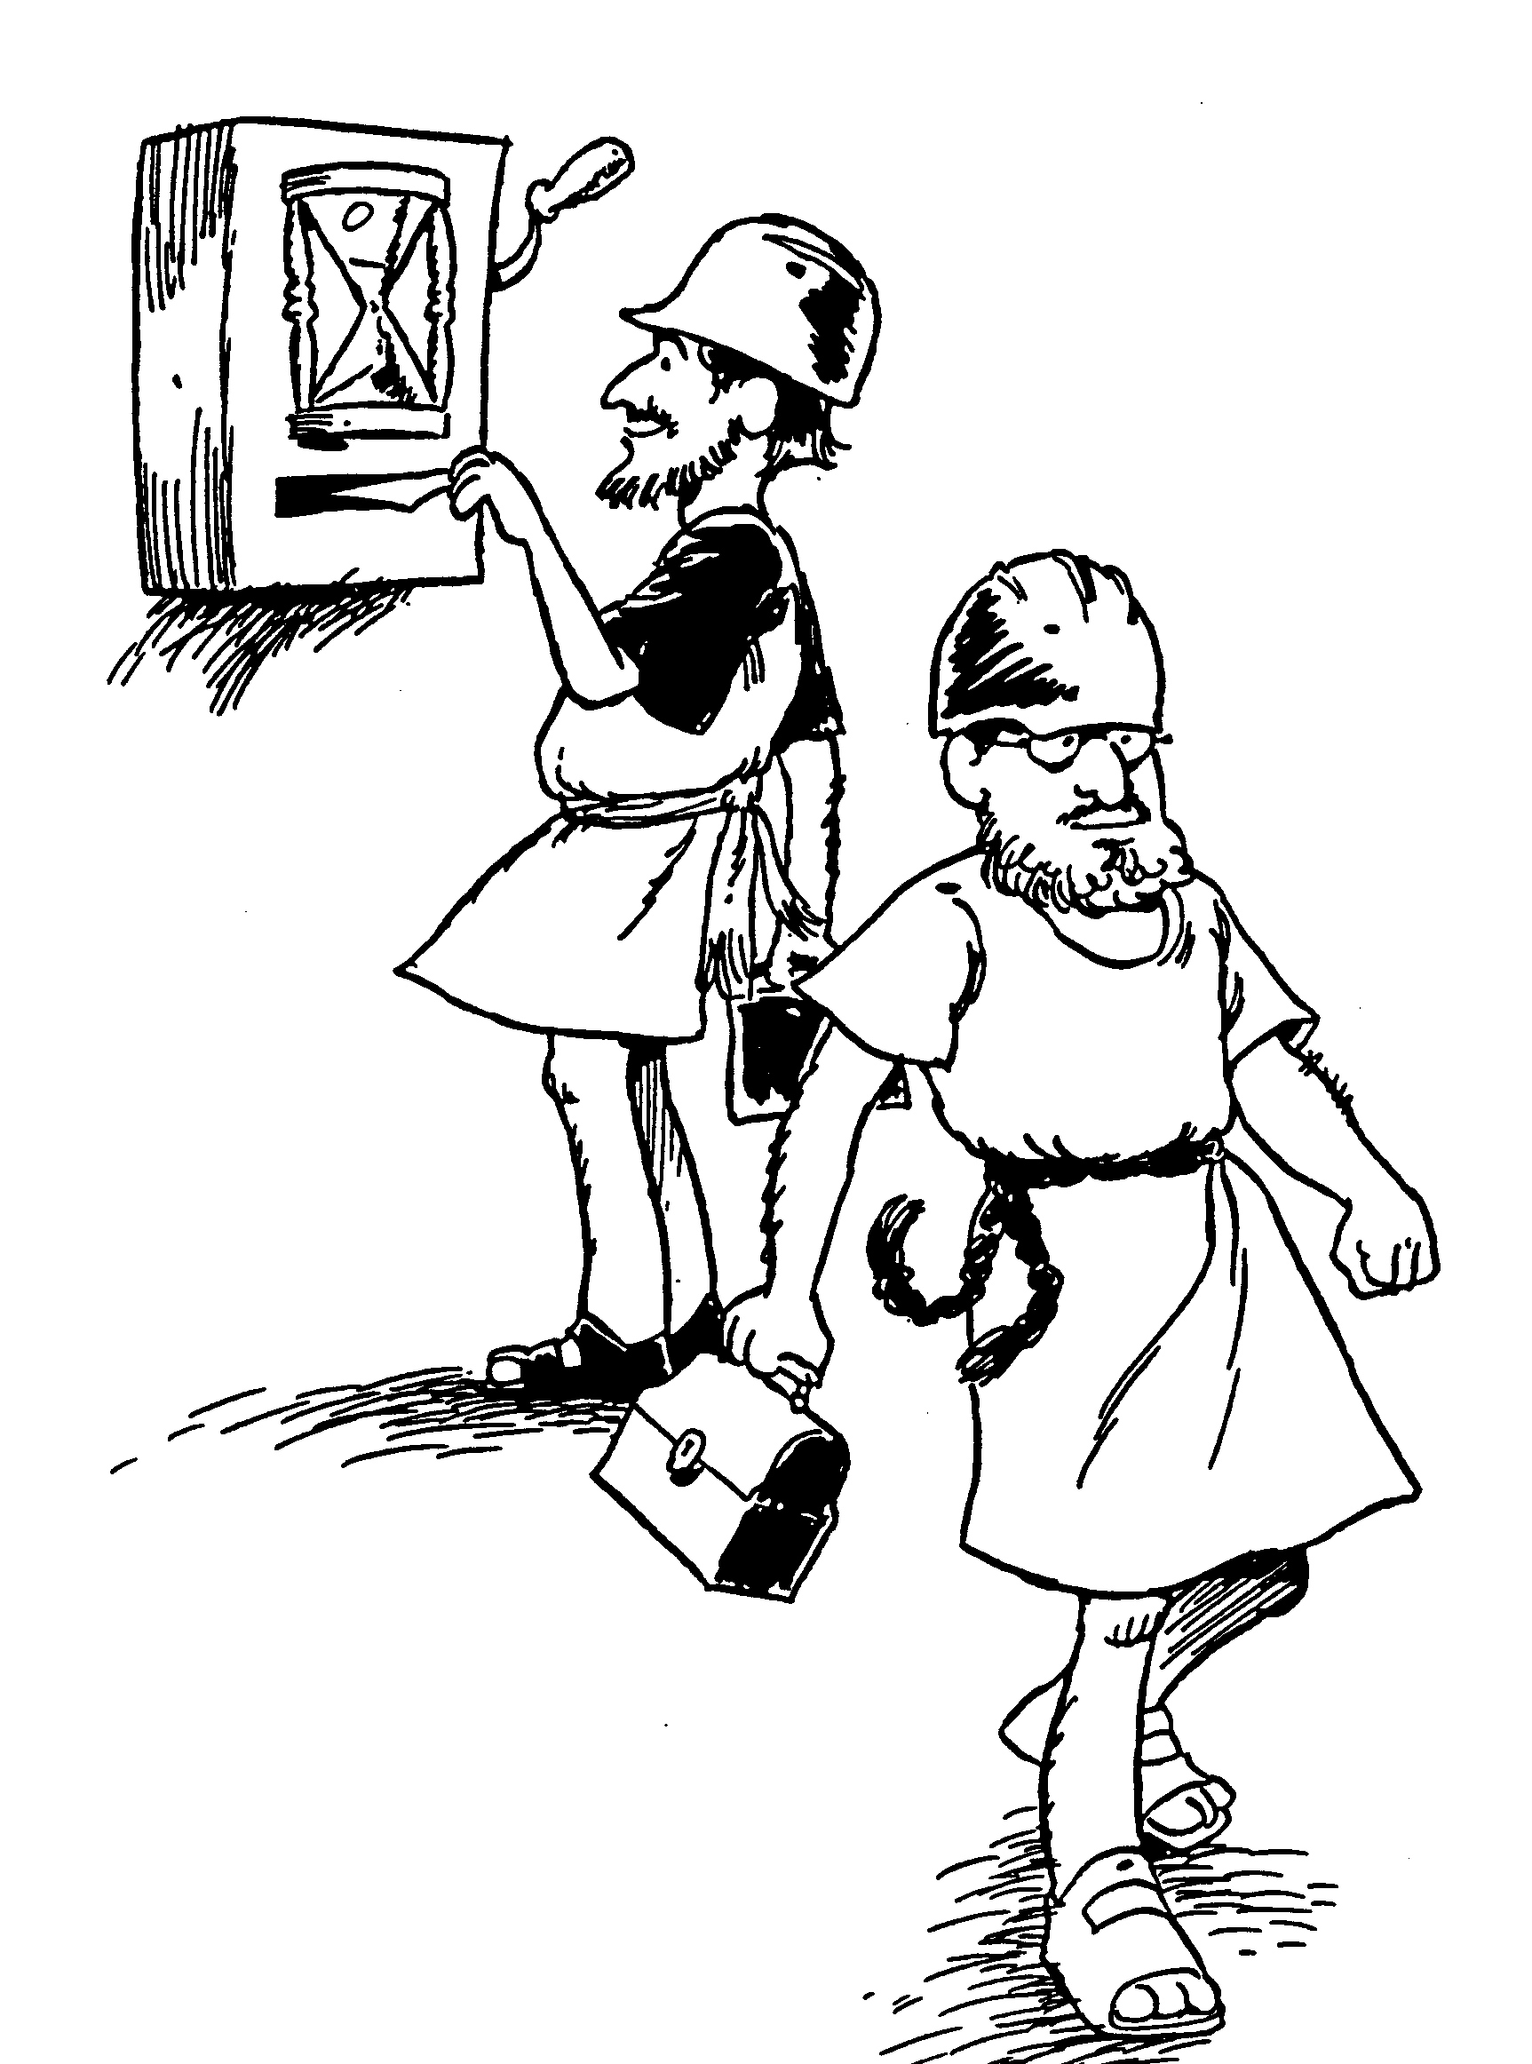
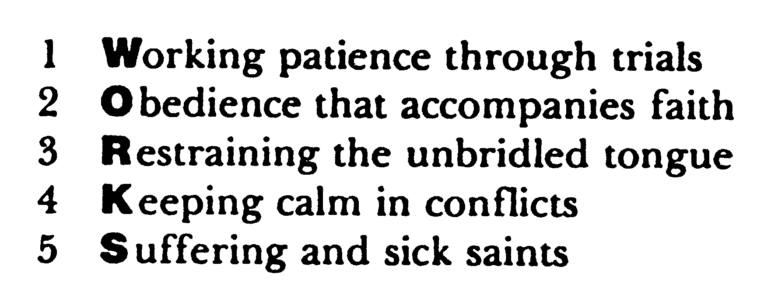
Huddleston Outline
WORKS

Slide 7
Authorship: James the son of Zebedee?
Authorship
James the son of Zebedee
Died before letter was written

Slide 8
Son of Thaddeus or Alphaeus
Authorship
James the son of Alphaeus
James the father of Thaddeaus

Slide 9
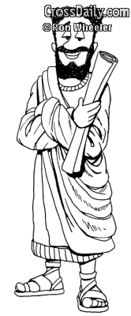
Brother of Jesus
Em của Chúa Jesus
Quyền tác giả
Giacơ em của Chúa
Jesus
Lớn lên với một ông anh hoàn hảo là như thế nào?

Slide 10
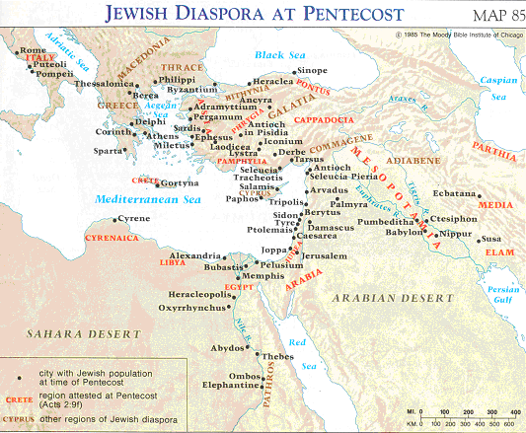
Jewish Diaspora at Pentecost
Xem Công vụ 2:9-11
Addressed To
“gửi 12 bộ tộc đang sống tản lạc khắp nơi..."
Giacơ 1:1

Slide 11
Ways Faith is Seen…
267

Slide 12
Applying the Epistle of James
What specific works noted in the letter of James do you consistently do that reveals your calling as a Christian?

Slide 13
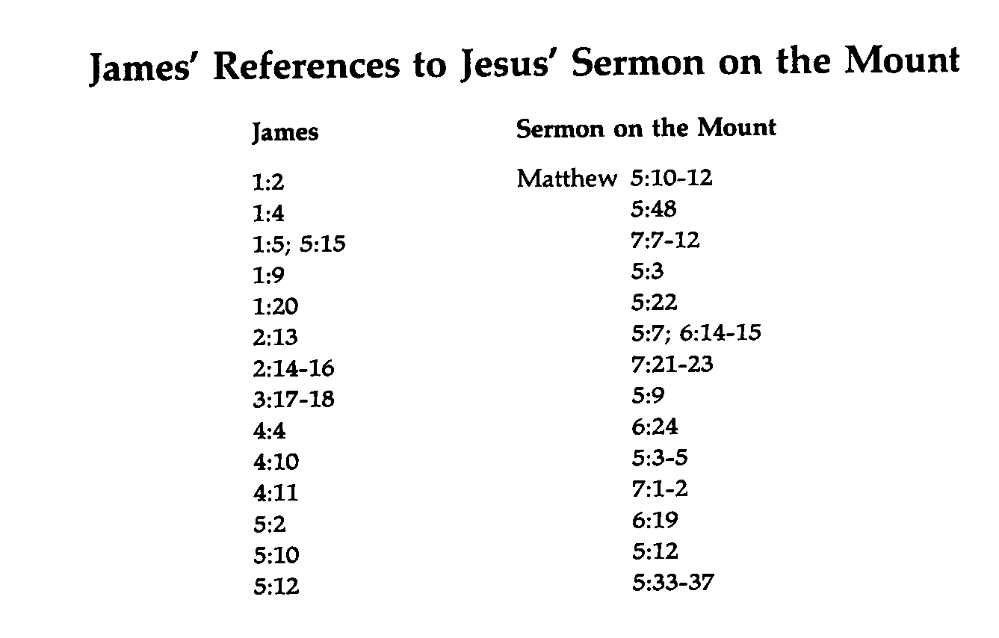
James' References to the Sermon on the Mount
274a
James
Sermon on the Mount
Matthew

Slide 14
Trials, Temptation and Sin

Slide 15
How can you improve on my summary of your assigned section?
1. (2-4) Faith accepts trials with joy because it believes that God allows testing to develop perseverance and maturity (Christ-likeness).

Slide 16
What is the path from trials to joy?
Testing of Faith
when finished
Trial
Perseverance
Mature
&
Complete
Endure
(JOY)
James 1:2-4

Slide 17
How can you improve on my summary of your assigned section?
2. (5-8) Faith accepts trials with prayer for wisdom from God because He delights in giving wisdom without finding fault to believers who ask Him in faith without doubt.

Slide 18
How can you improve on my summary of your assigned section?
3. (9-11) Faith accepts trials with humility because God's approval is superior to wealth during difficulty.

Slide 19
How can you improve on my summary of your assigned section?
4. (12) Faith accepts trials with hope of reward because God blesses perseverance and love for Him.

Slide 20
How can you improve on my summary of your assigned section?
5. (13-18) Faith accepts trials without blaming God because God gives only good gifts.

Slide 21
Why do we face trials and suffering?
Answer:
Job proclaims the sovereignty of God without answering why trials and suffering come our way.
James says we face trials to develop our character

Slide 22
What are some of the results of not handling trials well?
Trial
Giving up
Bitterness
Lacking peace & joy

Slide 23
Wisdom
Q: Why do you think James mentions the lack of wisdom immediately after the verses on trials (1:2-5)?
A: We need wisdom to handle trials. (1:5)

Slide 24
Q6: What is the assurance of asking God for wisdom?
A6: Wisdom will be given to anyone who ask God who gives generously to all without finding fault (1:5)

Slide 25
Which two responses does James encourage when facing trials and suffering?
Perseverance (1:2-4)
Patience (5:7-8)

Slide 26
How are the rich favored in Singapore?
Baby subsidies
Purchased citizenship

Slide 27
Do You Agree?
Favortism !
Our church should have only Singaporeans on certain committees.
Men in church leadership should at least be middle class.
Our pastor should be an American.
It's OK to reserve better seats at church for certain people.
American pastors should earn more than Asians with equal experience and roles.

Slide 28
Other Examples?
What other examples of favoritism do you sometimes see in the church?

Slide 29
“My brothers, as believers in our Lord Jesus Christ, don't show favoritism.”
James 2:1
Don't favor the rich!

Slide 30
Why not favor the rich?

Slide 31
Favoring the rich…
Our outline of James 2…
Indicates impure motives (2-4)

Slide 32
What is favoritism?
“preferential treatment, especially when unjust or narrowly discriminating” (Funk & Wagnalls)
to treat another person based upon his financial status and from an improper motive (James 2:4)

Slide 33
Favoring the rich…
Our outline of James 2…
Indicates impure motives (2-4)
Insults the poor (5-6a)

