Slide 1
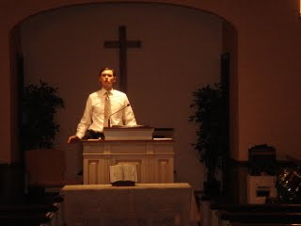
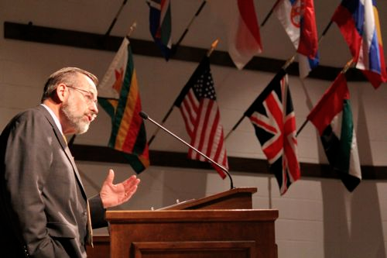
Thugendan:
Biblethu Hilchian na
Thugendan 1 ah Zildingte
Dr Rick Griffith, Singapore Bible College
www.biblestudydownloads.com
Dr Alan Stanley, Mueller School of Ministries, Australia

Slide 2
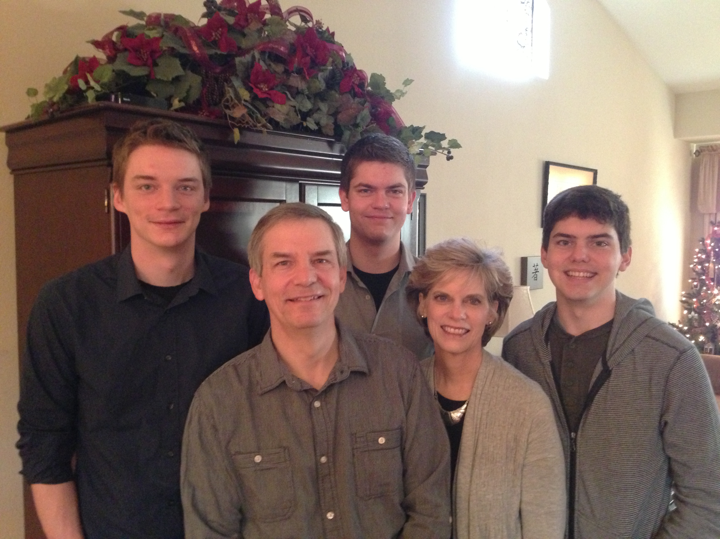
Griffith te Inkuan
Dec 2012
Kurt
26
Stephen
23
John
20
6
Rick
Susan
Notes:
SUSAN: Ka chateu chung ah Lalpa nasep a ki lat gual in Pathian in ka Insung un na sem zing hi. Ka chapau a lian tegel Seattle khawpi’n a sem ua, aneupenpa (John) ahi leh Biola University, California Thanglam in a zil hi. Singapore ah January 5 ka kile kit masiu ei pawimaw hi ti suanlam in John zilna kum kimkhat tiang USA in ka cham den ui.

Slide 3
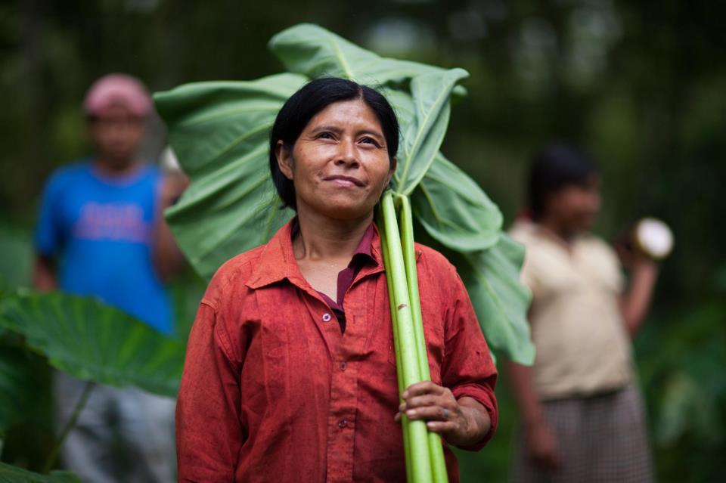


Kurt in sumkawlvei na lam leh ITah sem
6

Slide 4
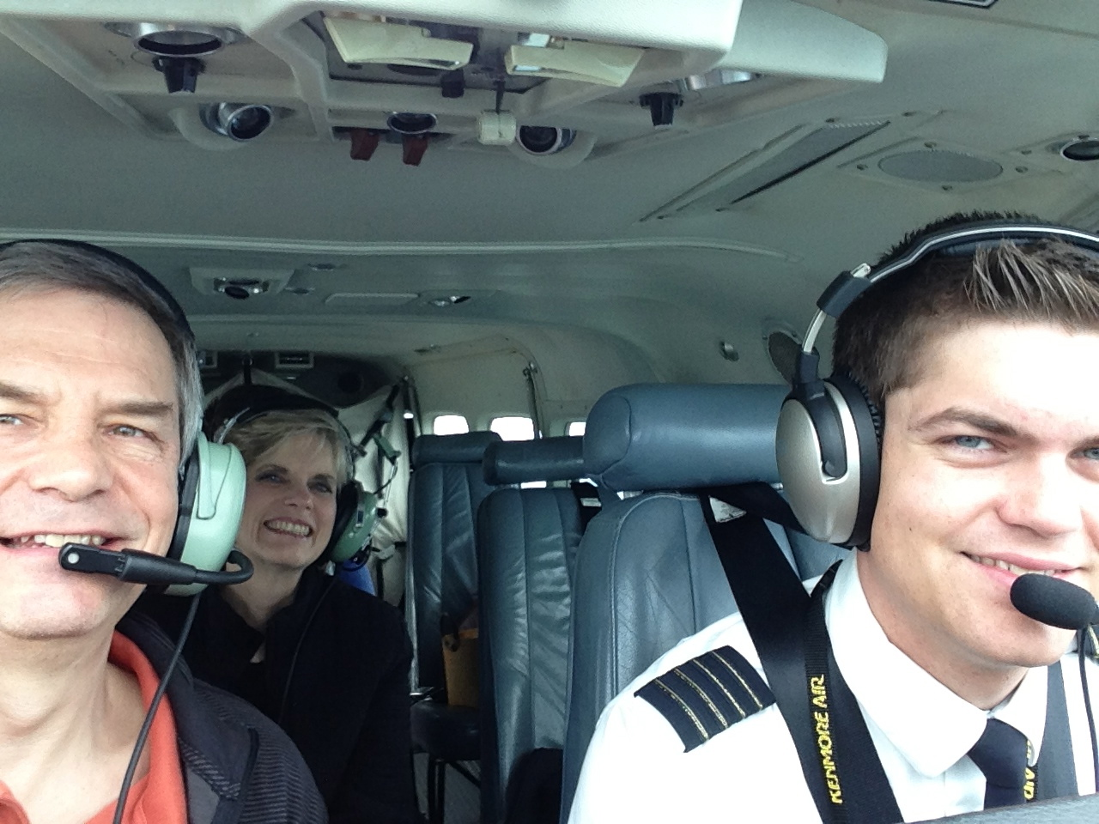
Stephen ahileh Pilot

Slide 5
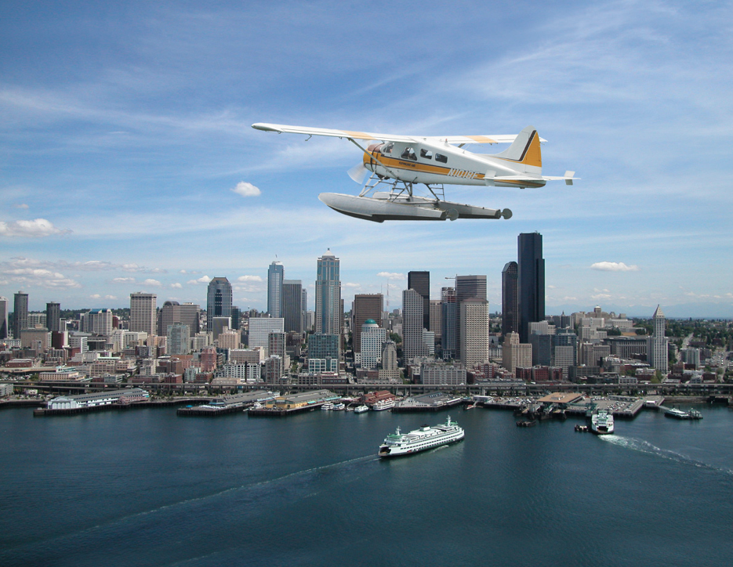
Stephen the Pilot

Slide 6
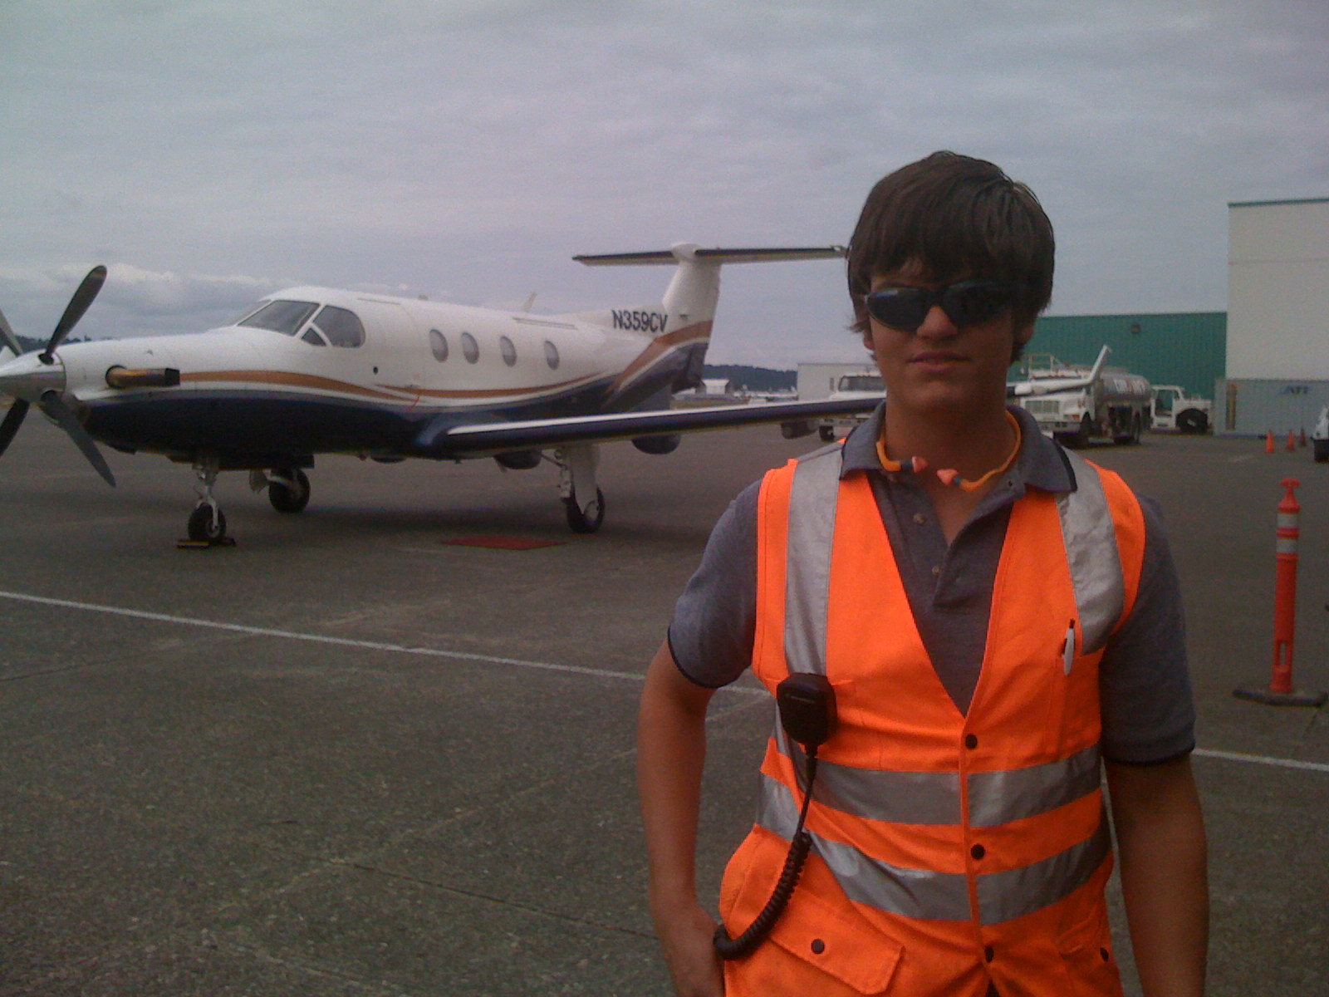
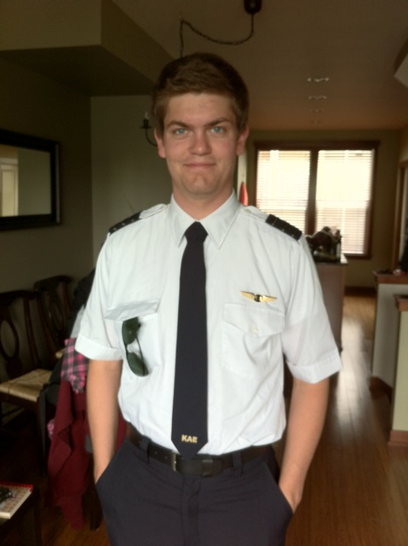
Stephen hi Seattle ah Kenmore Airlines Lenna phual neu ah Sap ahi
6

Slide 7
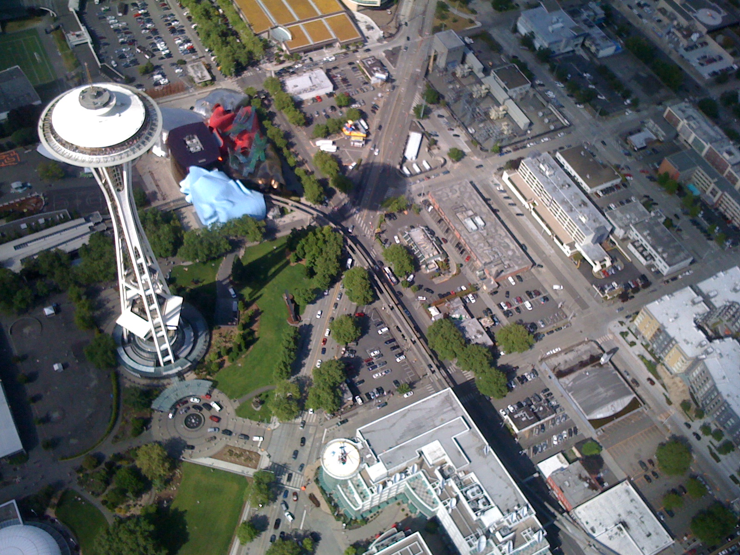
Seattle Chung
6

Slide 8
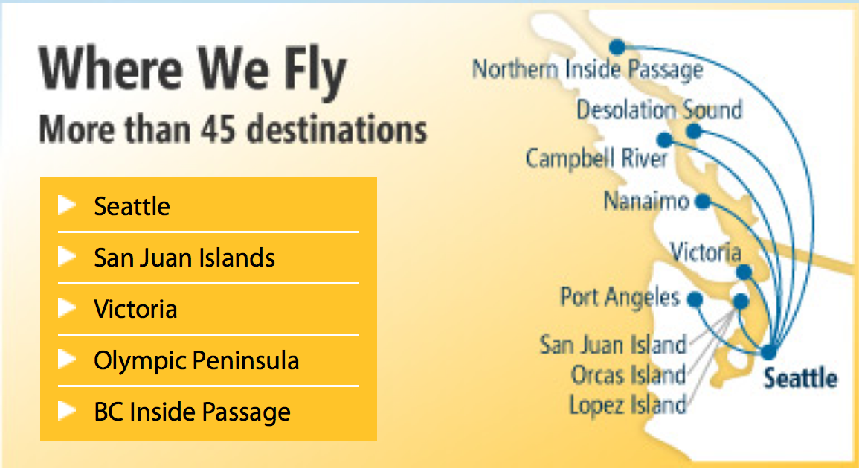
Stephen hi Kenmore Airlines Seattle akipat San Juan Islands kikal ah leng tua sek
Nisin ah Ka Lentua Nau
Mun 45 val
6

Slide 9
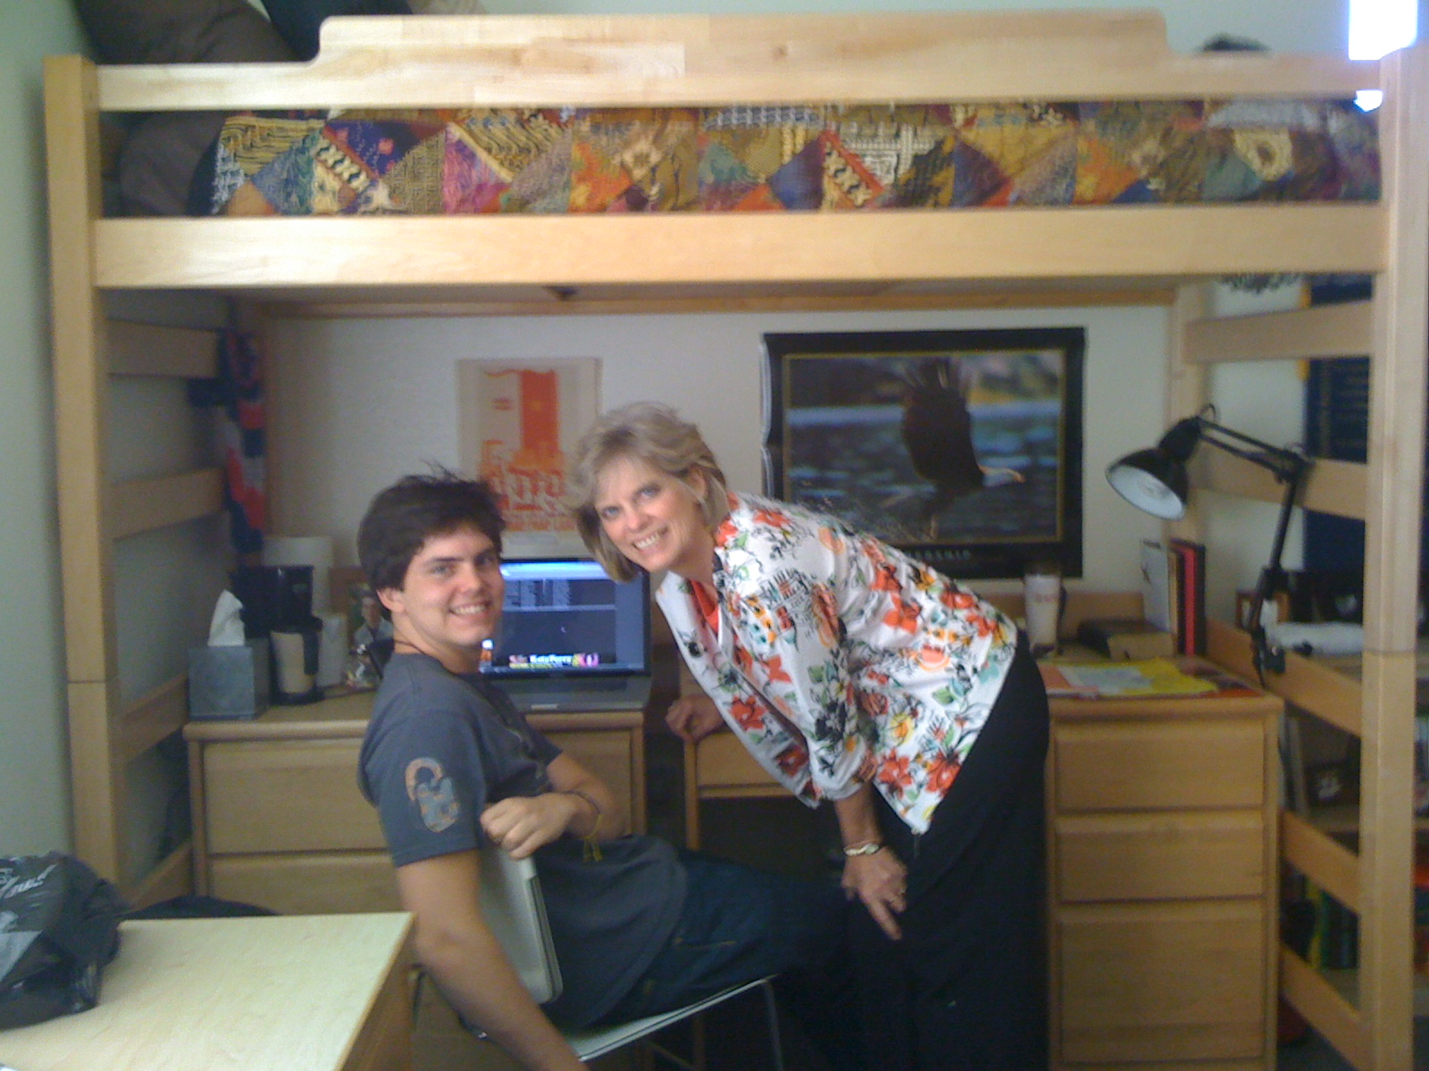
John ahi leh Biola University

Slide 10
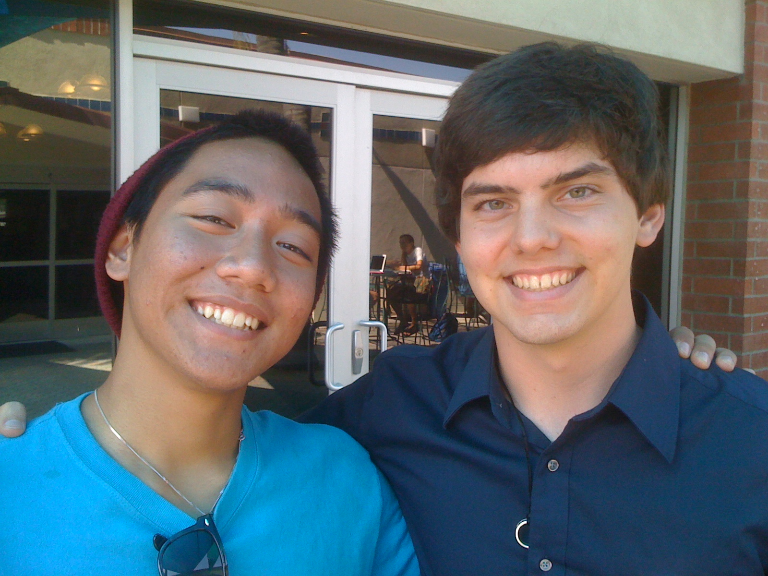
John at Biola University

Slide 11

Ka Mission Organization Uh…

Slide 12
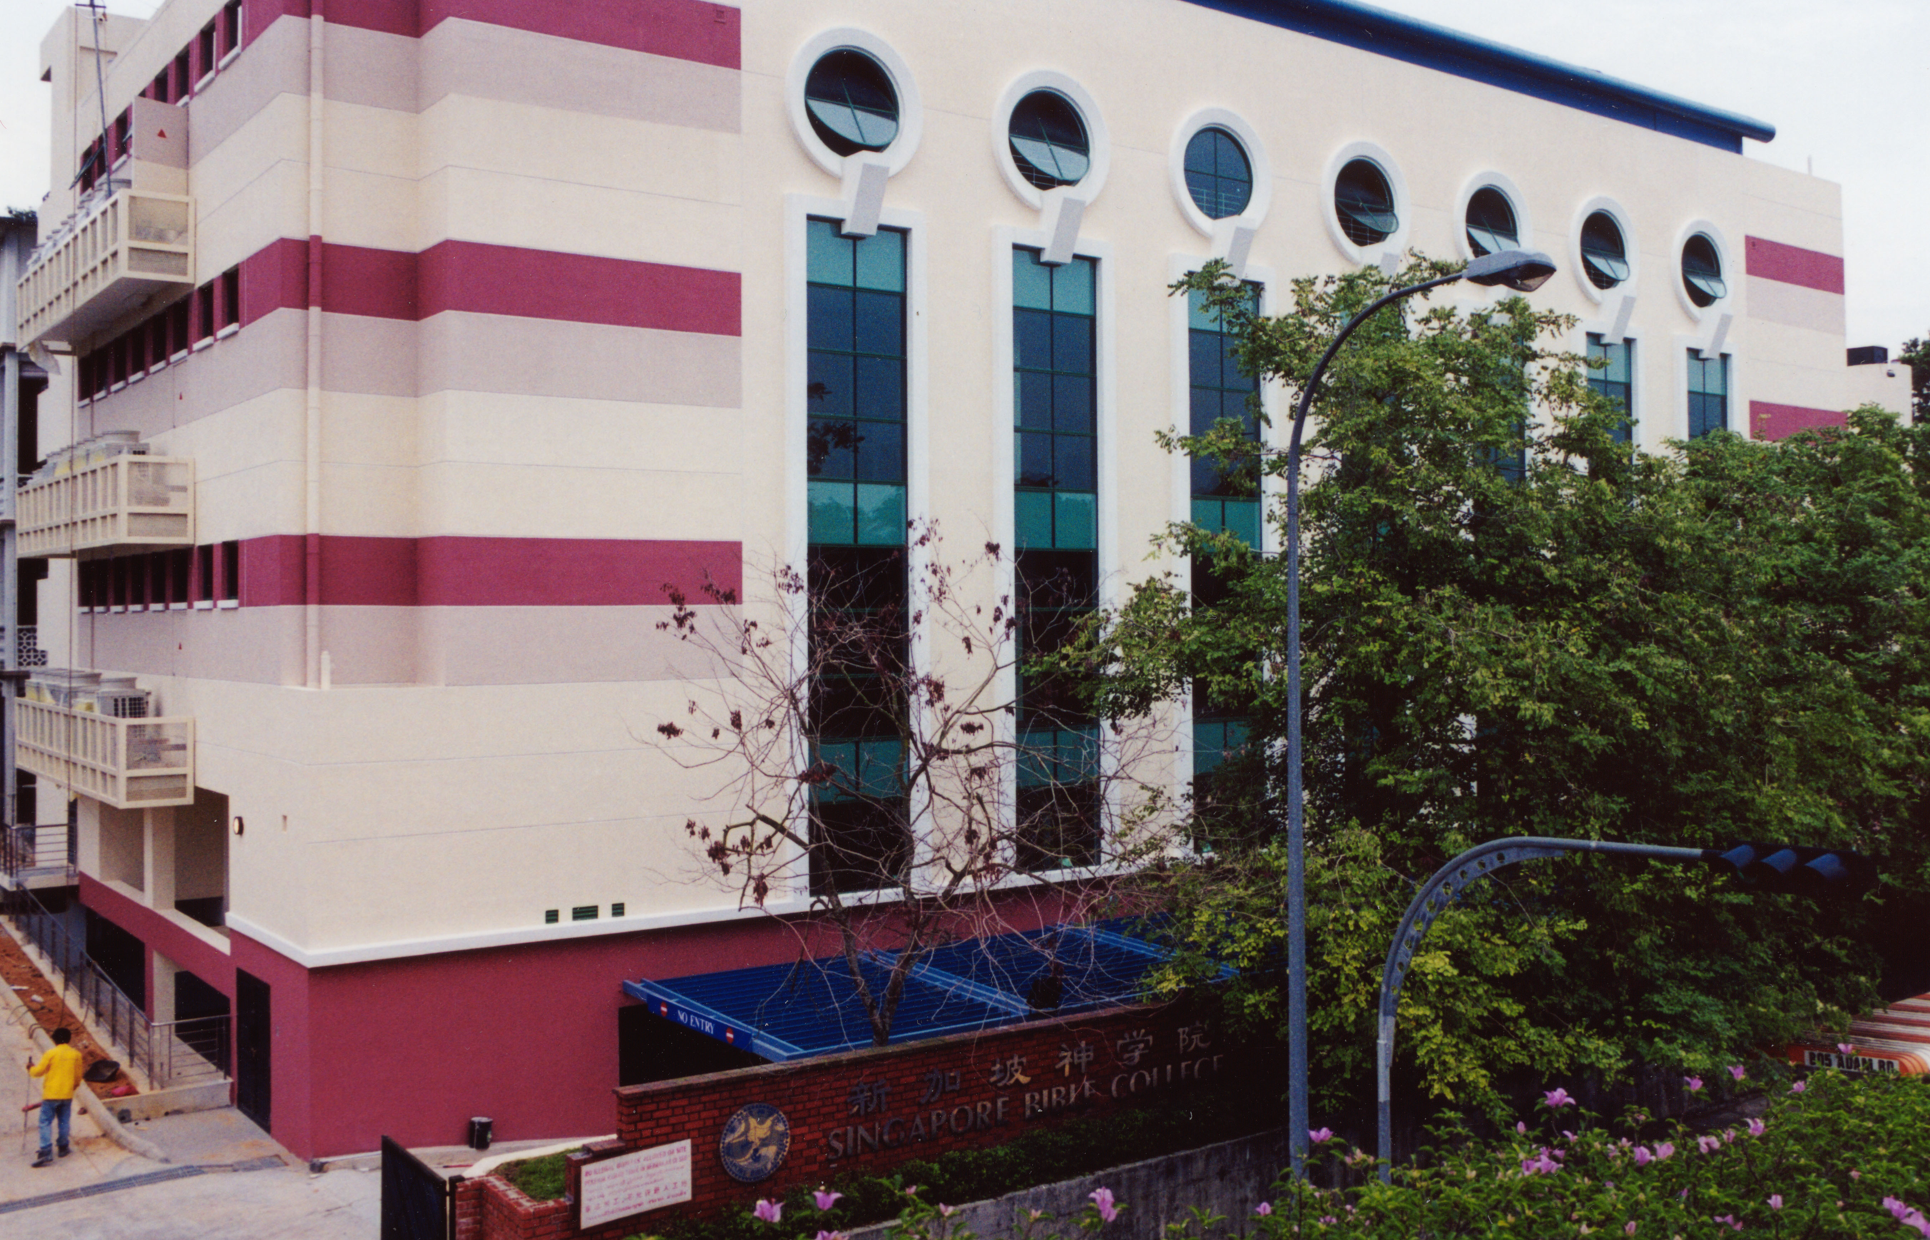
SINGAPORE BIBLE COLLEGE
Notes:
Singapore a ding a Bible Sekul lian pen Singapore Bible College kiti in semtu 30 val toh hotu na ka sem hi.

Slide 13
SBC ah ka Lekha Hilte
(English • Bahasa • Chinese)
Atangpi
Thuthunglui Thuthungthak
Athubul
Thuthunglui Lai Thuthungthak Lai
Thugin
Kochuam Thagauthiang Nunung
Thugendan
Thugendan 1 Thugendan 2
Notes:
Hotu hi ta te leh hotu ding ah zillai te hi zia ah chung ah kitak lang gual in Bibnle tangpi te, thuthung lui leh thak hung kipatdan te, thugin leh thugendan ka sinsak tangpi te chu ahi.

Slide 14
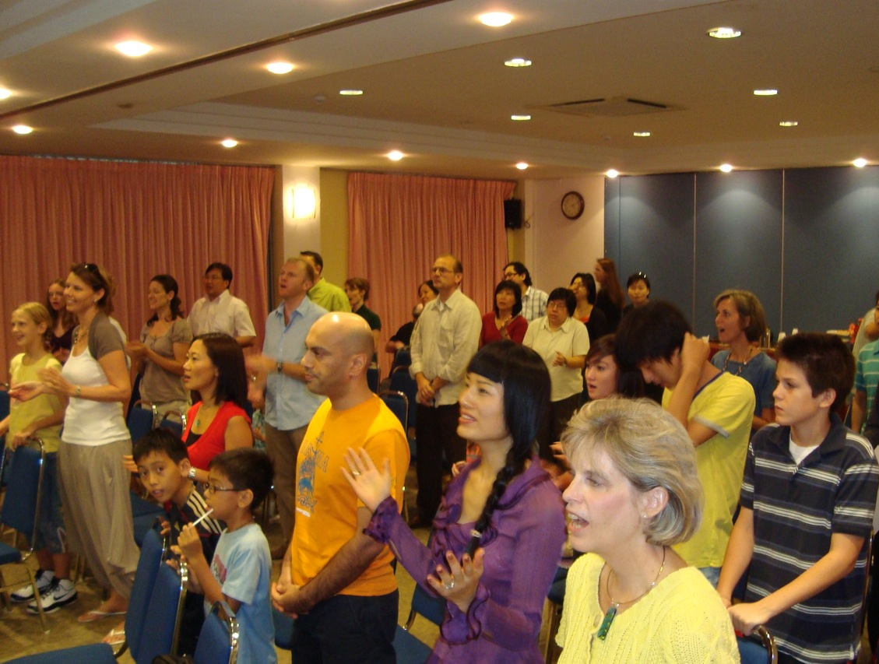

Our People
Gam 8 apat mi 37

Slide 15
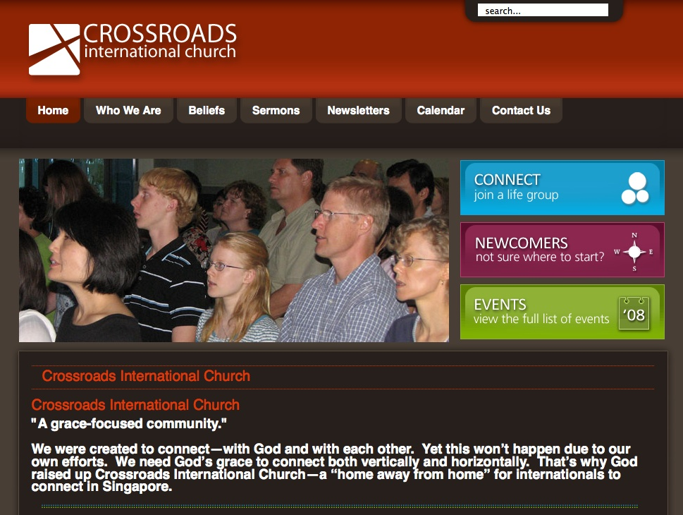

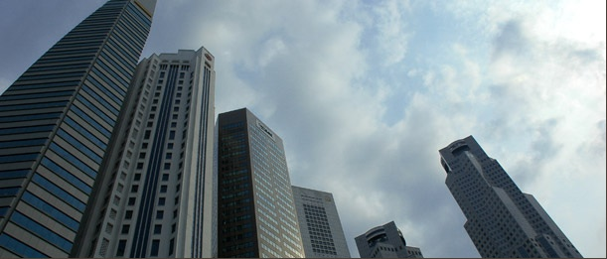
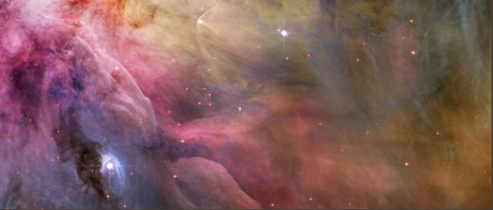

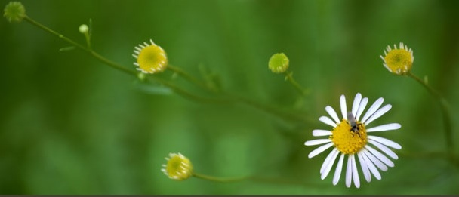

www.cicfamily.com

Slide 16

Pathian Thu Thilhitheina (Isai 55:8-9)
“Ka ngaituana te hi la ngaituanateu tawh ai bang puan,” Lalpa’n a ti ngal ah.
“Chun Ka lampi te chu le la lampiteu sang in a sang zawi.
⁹ Vante khi lei sang ah a san zawk gual in, ka lampite chu le, la lampiteu sang in a sang a sang zaw’n, ka ngaituana te le, la ngaituanau te sang in sang zawi.

Slide 17

Pathian Thu Thilhitheina (Isai 55:10a)
“Van ah kipat vuk leh gawtui a zuk a, lei chapno ah a kile kit lo gual in.

Slide 18
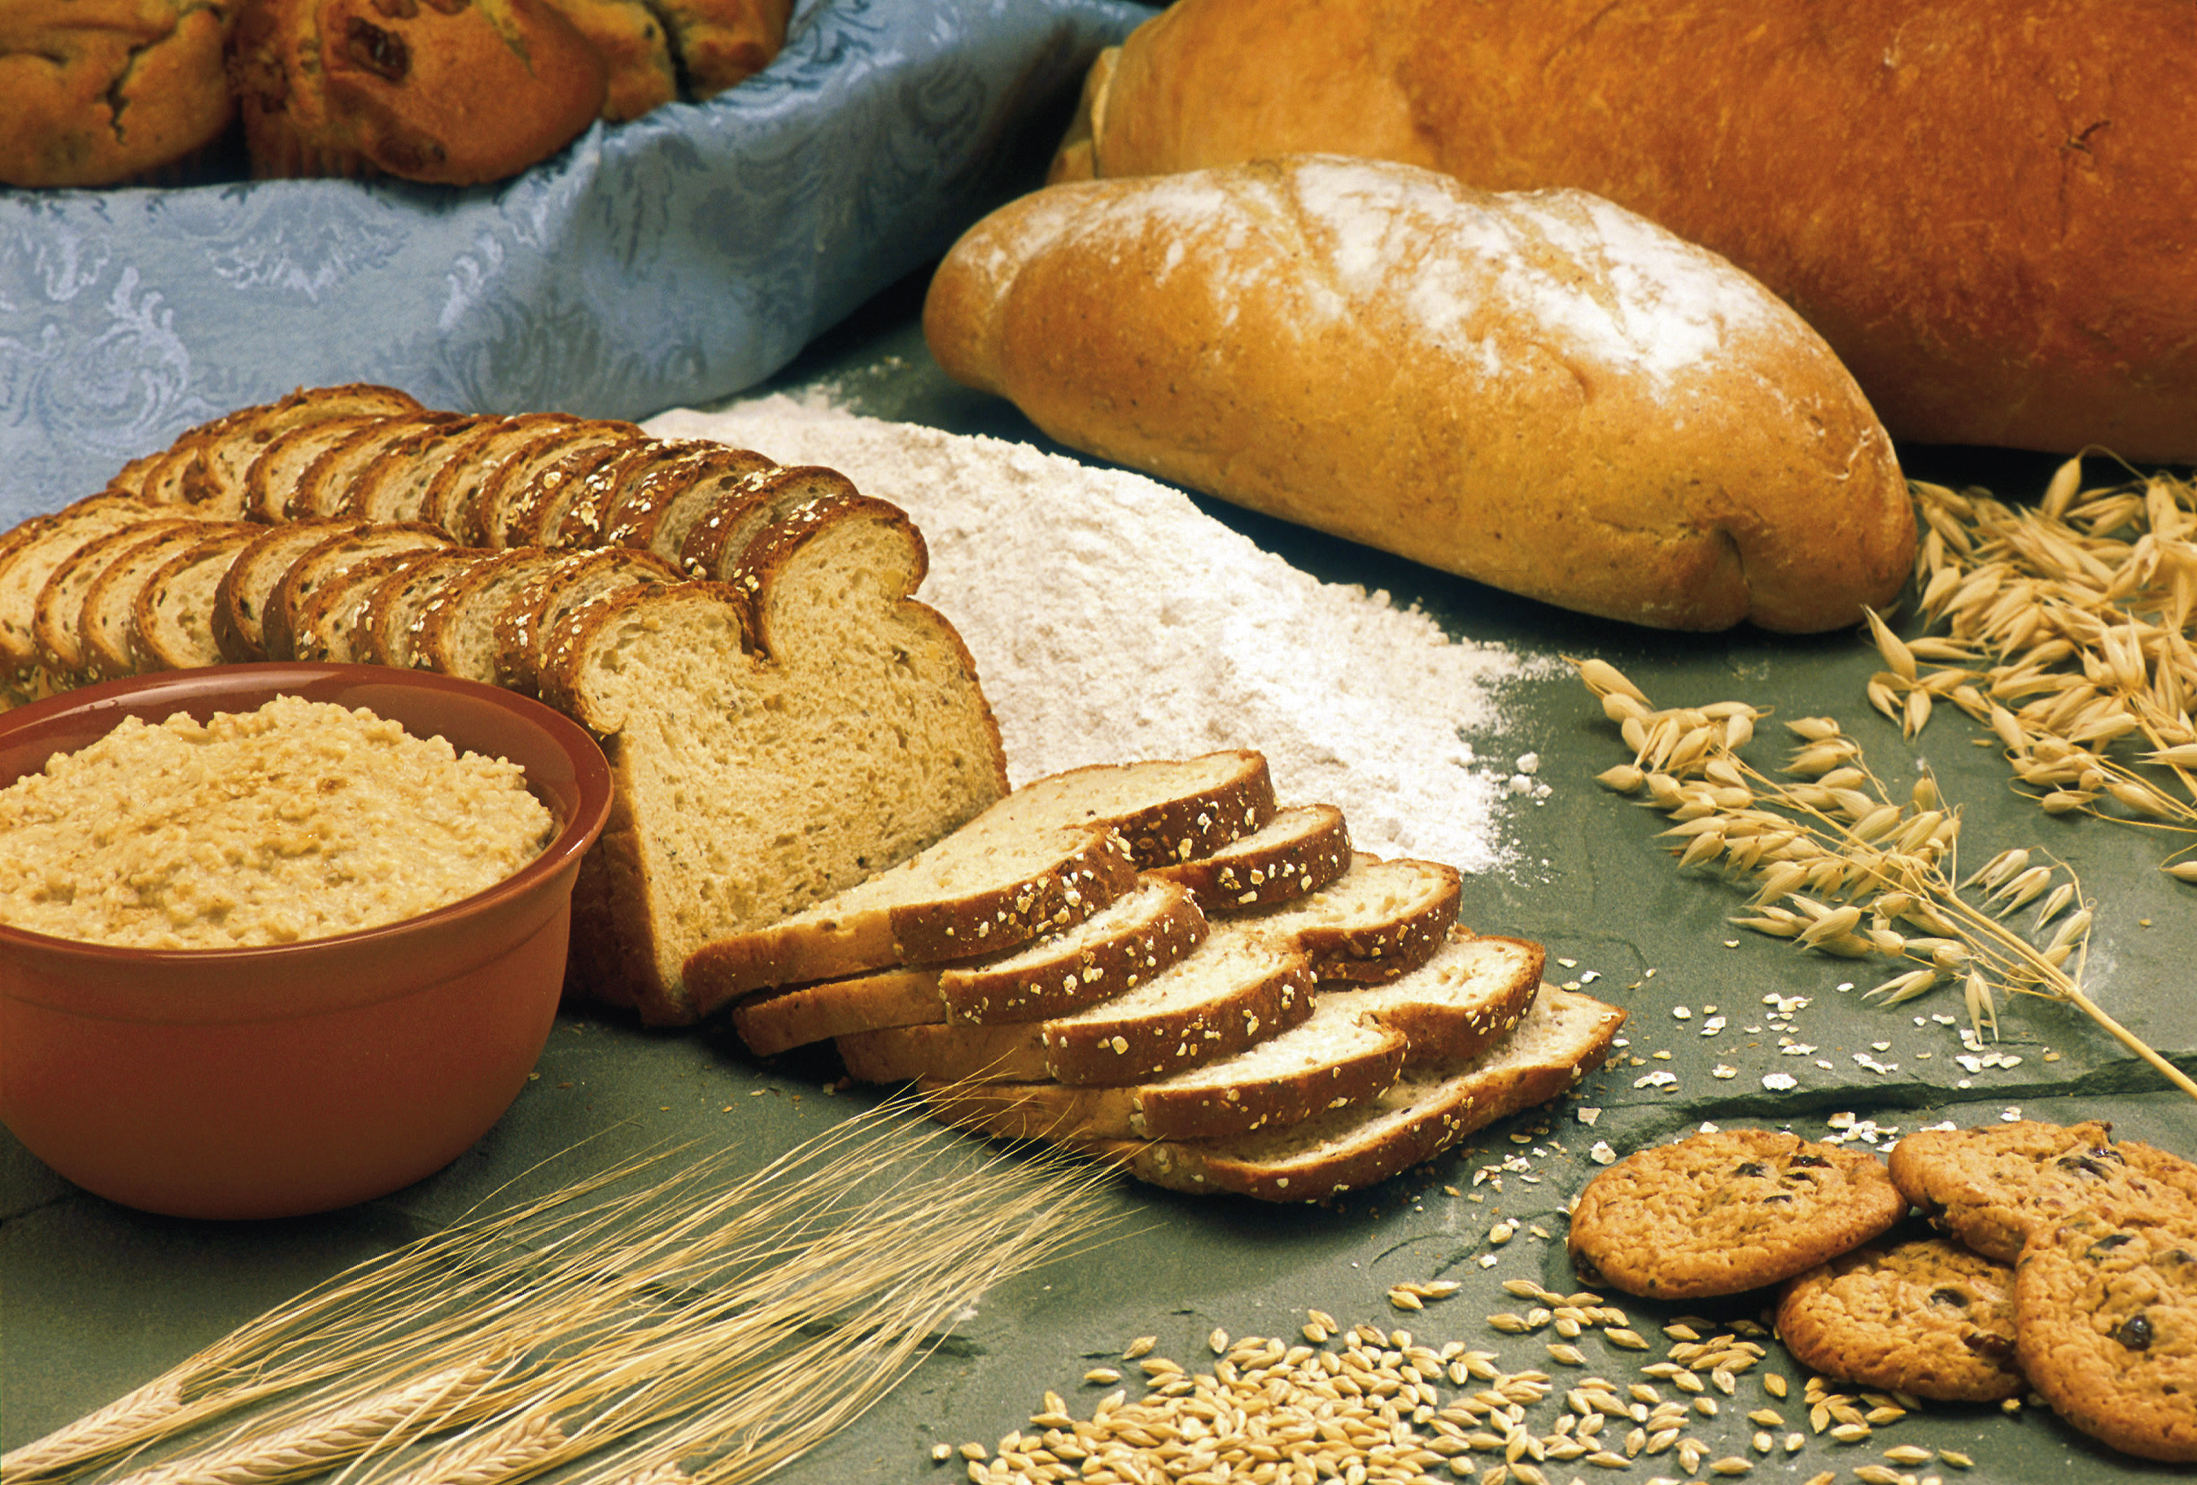
Pathian Thu Thilhitheina (Isai 55:10b)
“Buchi the’pa a ding ah thaichimu ahun ke dawsak ah,
nek ding ah vaithum a pawt daw sak gual in.”

Slide 19
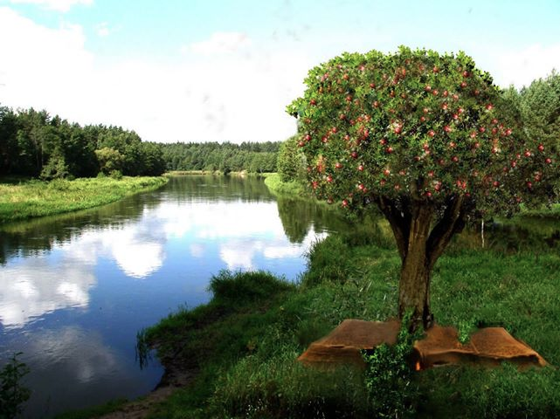
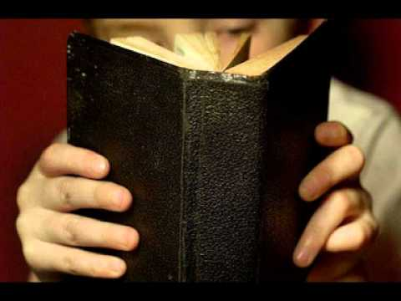
Pathian Thu Thilhitheina (Isai 55:11)
Zia gual tho ah chun, ka kam ah kipat ka thu pawtdok sa chule, a thawn in kile’kit ziang puan tin, ka hi’guat chu hun hi’zo intin, ja sawlna lam lam ah chun, a thil hi’ding zosia.

Slide 20

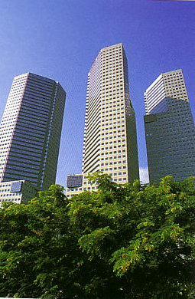
Our Course Goal
Thiltup: A Kikal Zawmtu!

Slide 21
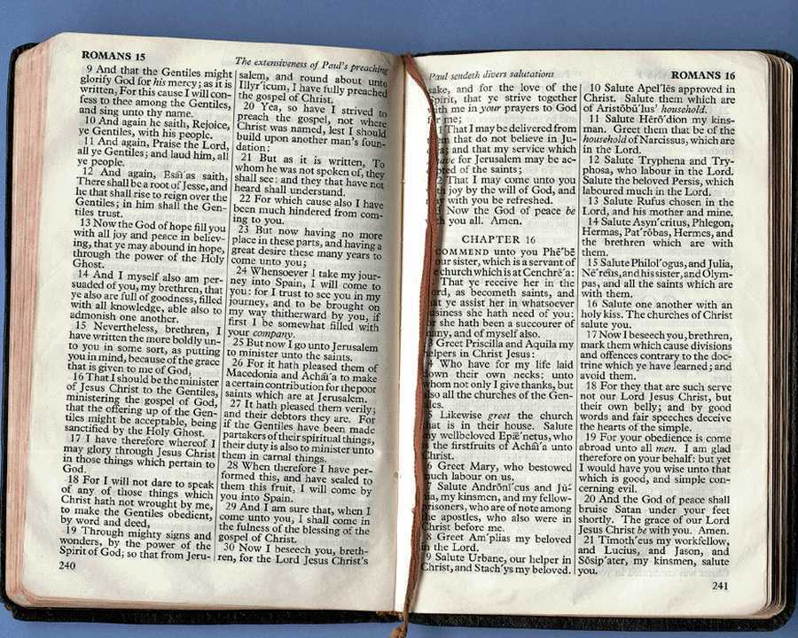
Zil Dingte
v
Atangpi ah Bible thu hilchian hi kawm ah pathianthu gen ding dan, amasapen ah
  I Bible sung ah thu umte a ziaktute hun lai ah a gennawp uh khualchil leh diktak a le ding dan,
  pathianthugen ding dan tangpi,
  ban nei tak ah thugen na ah zuiding thupi zek dan,
  thugen ei panpitu ding ah thil chuamchuam matchak (chialna, tekhinthu, thumapui, thukhakna, adangdangte.) dan,
  thugending kisaklawkna ah lekhazekdan, leh
  atawp pen ah thugen chawm pani te ban a thupi-pani khat vei thu ah gen ding dan.
Thugen hunding leh ni-bik ah thugen ding dante (tuanthu, thupi, mikhat-thugen, pianthaknathu, molawpna’-fuina leh thigalna) haw hi Thugendan 2 na’ zil hiding ahi.

Slide 22

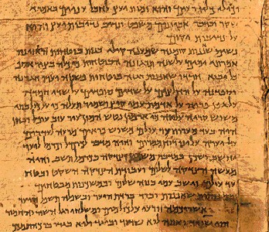
Zillai Thiltupte
v
Zia zillai ki zaw tiang ah hin zia a nuai ah kiziak cheng hi bawl thei tan la…
A. Bangtidan leh bangziak ah hilchianna pathianthu gen thei.
Ban nei tak ah zuiding thupi lian leh neute
hilchianna leh pathianthugen himhim ziak thei.
C.Thumapui, athutak, leh thukhakna gen thei.
D. Lauthawnglo ah thugen pan thei.
E. Ban nei tak ah thugen toh kituak ding tuanthu tel thiam.
F. Thugenna tukhang te zillai ding kawk mu thiam.
G. I Pathianthugente a hawizawk na ding ah endik.
H. Lekhathot leh tuanthu (“bang” ahiu) ti thugen.
I. Adik, ngainawpum, kichian, akituak (“bang gual” ahiu) ti thugen (thiltup tangpi pek 25 na en in).

Slide 23
Thiltup Palite:
I Pathian Thugen chu…
25
Thudik
Ngainawpum
Kichian
Akituak

Slide 24
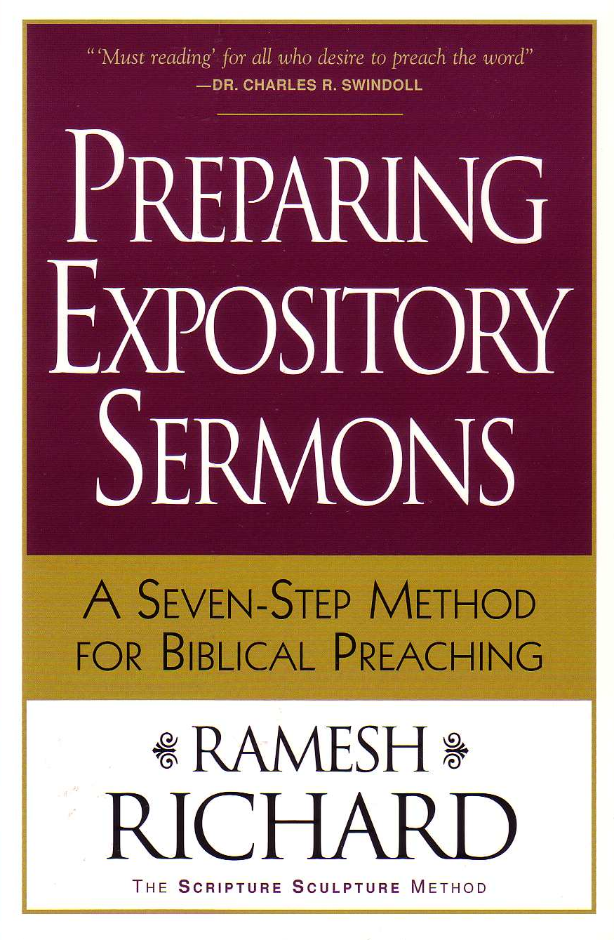


Zilsung ah Bawl lo thei lo te
v
Simding (10%)

Slide 25

Amasa pen ah la sim ding chu
Hun kit masang ah zia lekhabu neu cha pek 20 hi la sim ding ahi

Slide 26
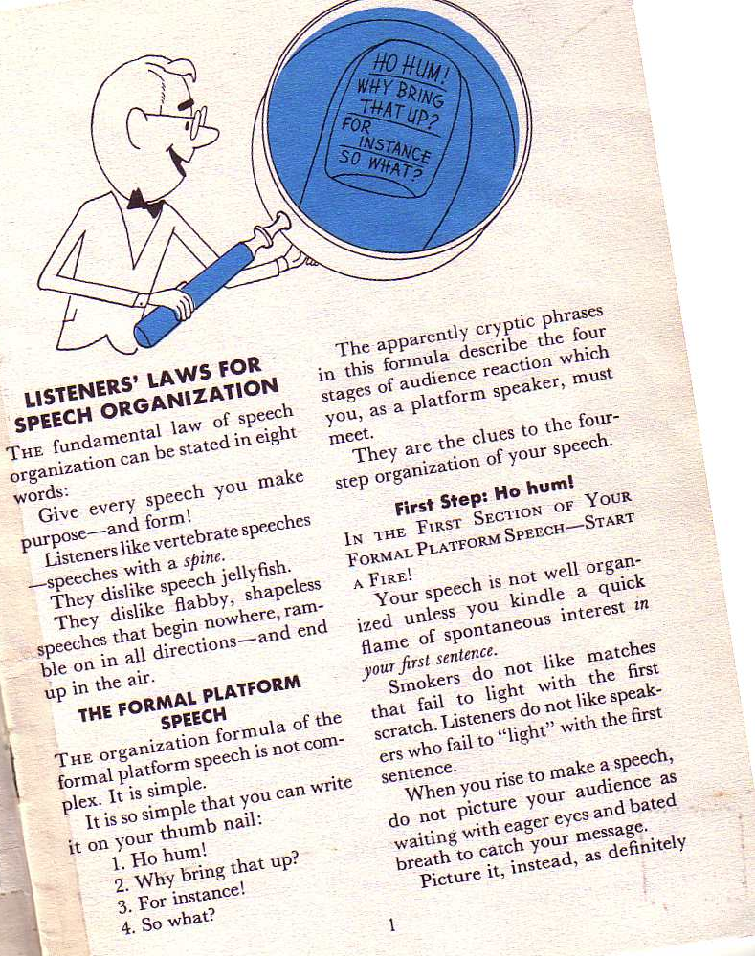
Borden Thuching
10-11
Thugen kisak lawk na ah dan pawimaw zia thumal pagiat in agen chian hi:
La thugen ding zosia aziak pian––amel toh!
Richard Borden, How to Communicate Ideas, 1

Slide 27
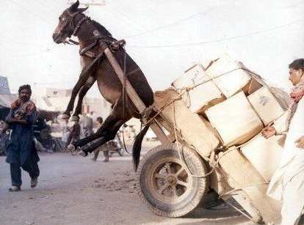
SBC ah kai te’n Abawldiu
v
Simding (10%)
Bawlding (15%)

Slide 28

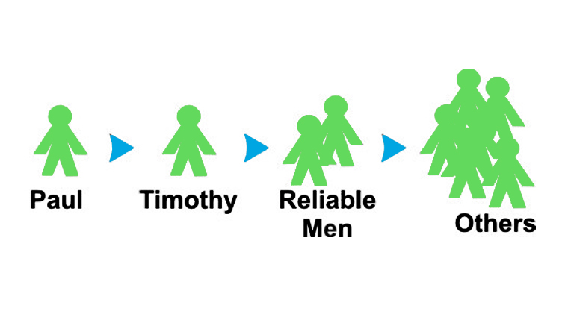

Midangte Le Thugen Ding Dan Hil Hi Tiu!
“Hetpi tamtakte lak ah ka kam ah thu la hiatte kha, mi ginum, midang hilsawn thei dingte kiang in pesawn in." (2 Timothi 2:2).
Nungzuisiam
Paul
Timothy
Muan tak mi
Midang

Slide 29
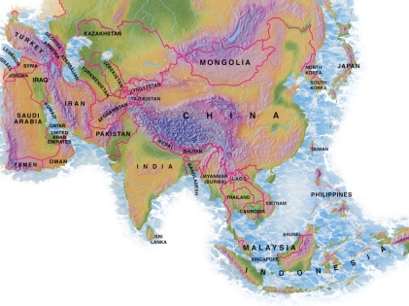
Pathianthu Ziltilna: 1997-2013
ASAN IN: ZIA THU HI KIZILSAK ZOTA TI ETSAK
MONGOLIA
JORDAN
KOREA
CHINA
NEPAL
MYANMAR
INDIA
THAILAND
VIETNAM
MALAYSIA
SRI LANKA
SINGAPORE
INDONESIA
Notes:
Kum 1997 apat July 2013 tiang Pathian in ginum ah ei ngai in pastor te’ nasepna zathuap ding ah zilsak na 50 vei khualzin in gam 12 ka chia tai. Zia cheng lak ah gam 8 vel in taught Thugendan ka hil hi.

Slide 30

biblestudydownloads.com

Slide 31
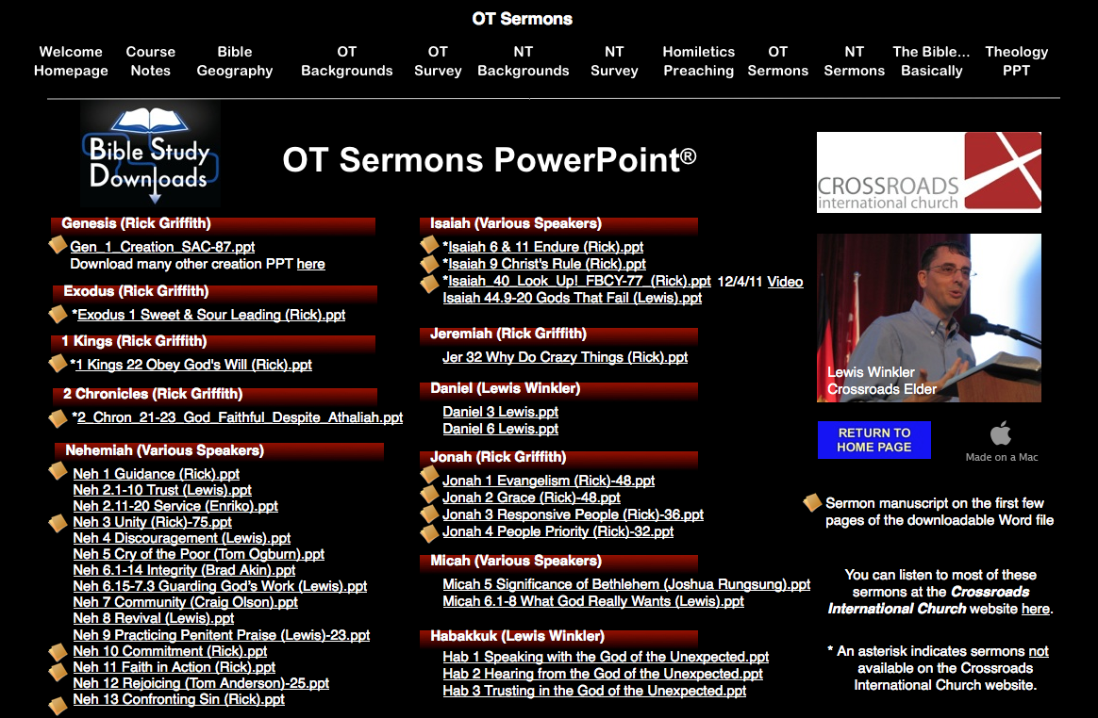
OT Sermons PPT
biblestudydownloads.com

Slide 32
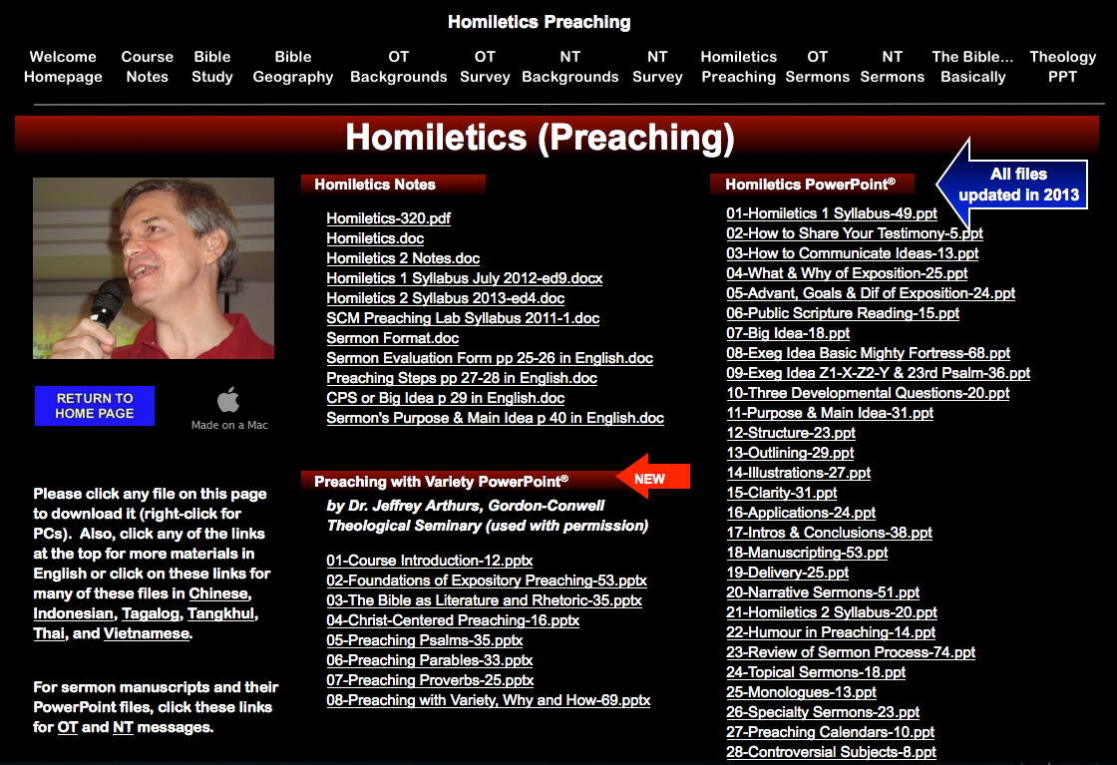
Homiletics PPT
biblestudydownloads.com

Slide 33
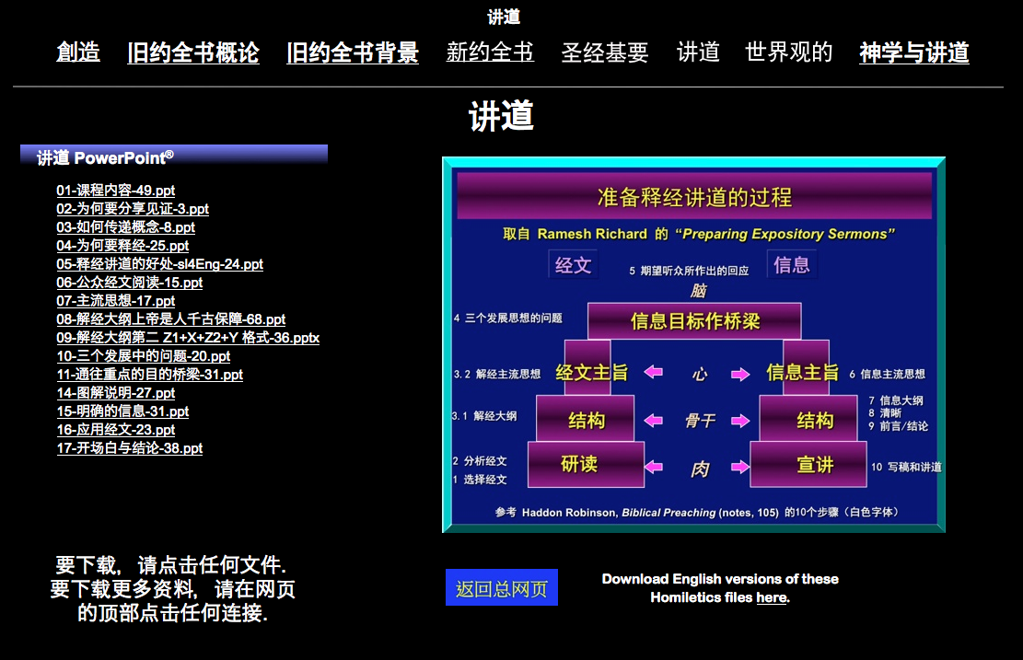
Chinese Homiletics PPT
biblestudydownloads.com

Slide 34
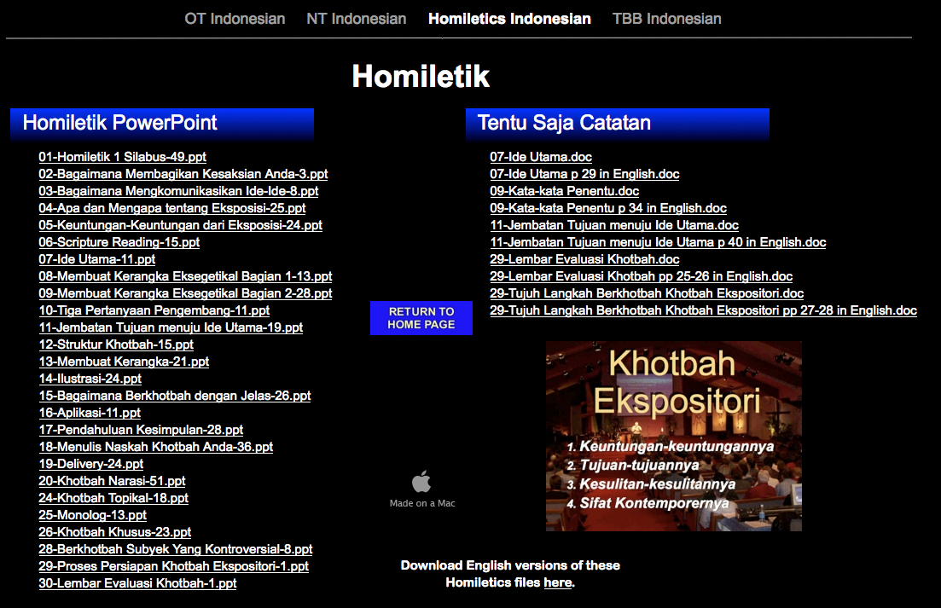
Indonesian Homiletics PPT
biblestudydownloads.com

Slide 35
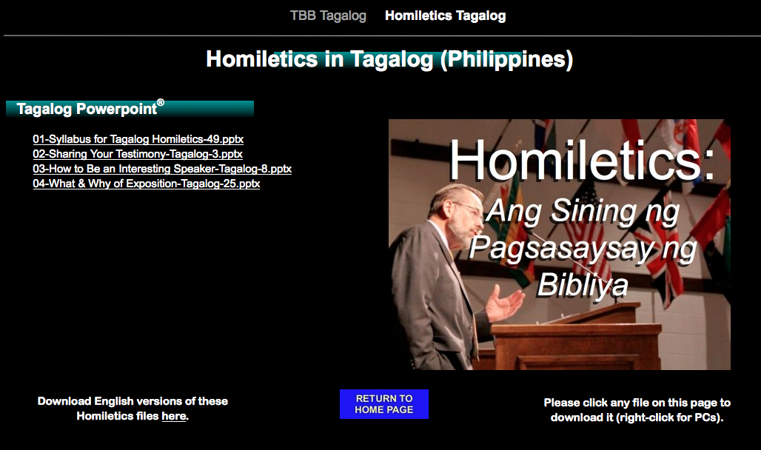
Tagalog Homiletics PPT
biblestudydownloads.com

Slide 36
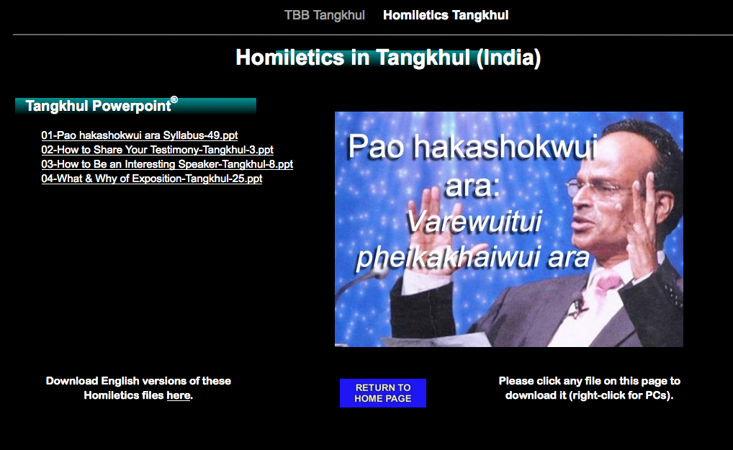
Tangkhul Homiletics PPT
biblestudydownloads.com

Slide 37
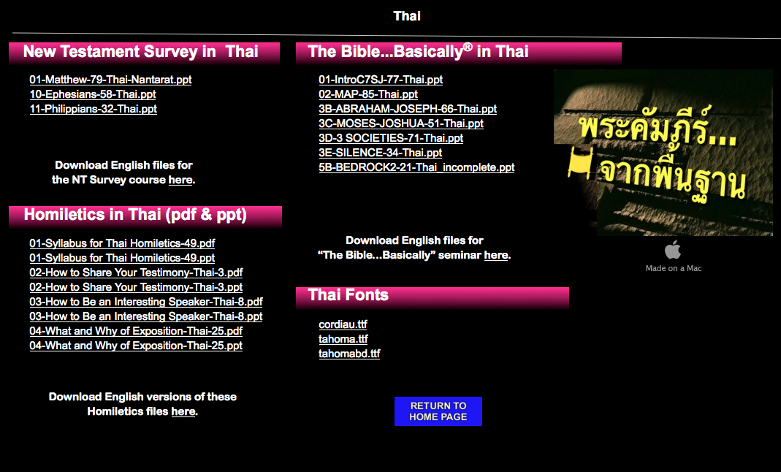
Thai Homiletics PPT
biblestudydownloads.com

Slide 38
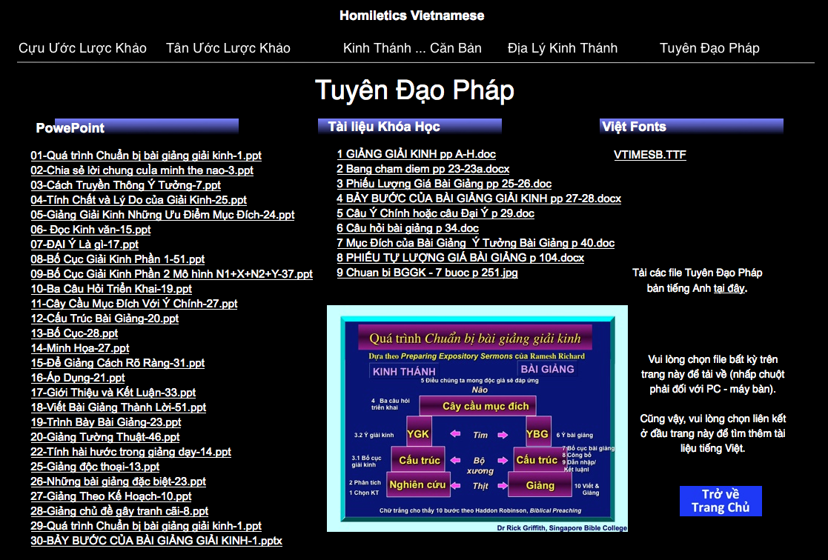
Vietnamese Homiletics PPT
biblestudydownloads.com

Slide 39
SBC ah kai te’n Abawldiu
vi
Simding (10%)
Bawlding (15%)
Zekthawding (25%)

Slide 40

La Zekthaw ding 12 Te
vii
Zia hin la kisakna hun zathuap ding

Slide 41
Bang ziak ah testimony gen?
16
Eima thu kigen bailam
Nang khel ah thiam mi umlo
Midangte’n chanchinpha hiatkhaw law thei
Dr Rick Griffith, Singapore Bible College
www.biblestudydownloads.com

Slide 42
Testimony luan’dan
16
Piantha-Nung:
La ngaitua dan
A kitheng danglam
Chawmkim tak ah!
Piangthakdan:
Khawi tak ah bang ti pianthak ti gen in
La gin bang?
Chawmkim tak ah!
Pianthak-ma:
La ngaitua dan
La thilbawl
Chawmkim tak ah!
Atawp chan in
la thupi
zui in!

Slide 43
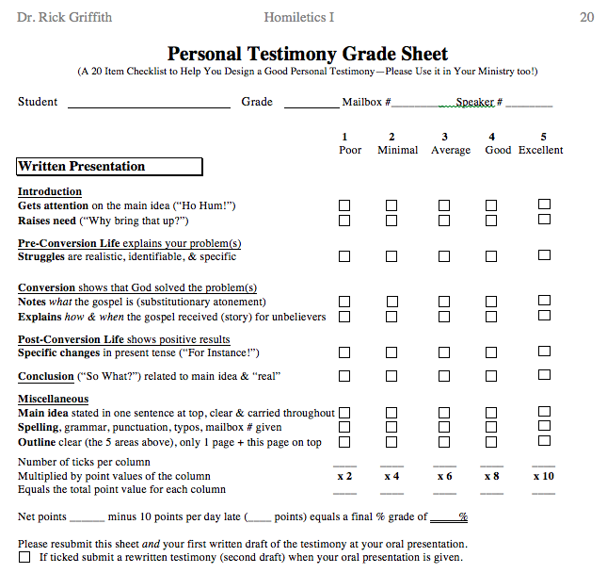
Testimony Grade Sheet
20
Thumapui
Pianthakma
Pianthakdan
Pianthaknung
Thukhakna
Adangdang

Slide 44
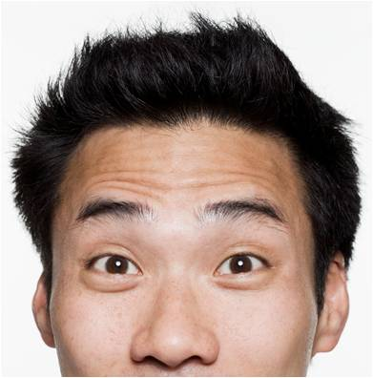
Khawitak kuakiang ah piak di?
Dr Rick
Dr Clive

Slide 45
SBC ah kai te’n Abawldiu
vii
Simding (10%)
Bawlding (15%)
Zekthawding (25%)
Thugending(50%)

Slide 46


Thugen
vii
Thumapui (1 min.)
Mani Testimony (2-3 min.)
Thuzaw ding ah thugen
(2 min.)
Lekhathawtte pansan ah Pathianthugen (15 min.)
Tuanthute pansan ah Pathianthugen (15 min.)

Slide 47
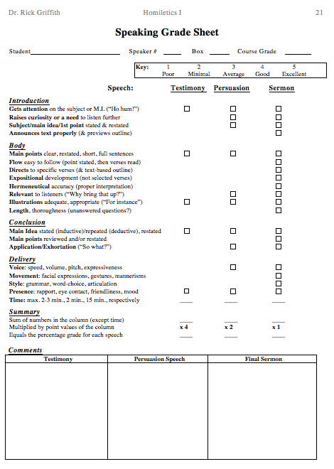
Thugen
21
"Ho hum!"
Thupi lakchom
“A tekakna!"
A thupi
Umchan

Slide 48
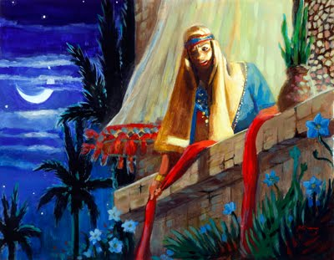
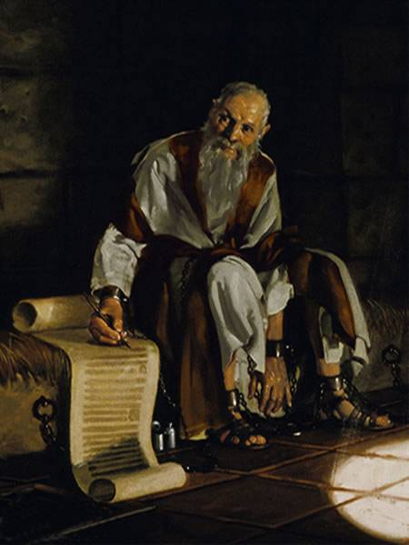
La Pathianthu 2 te
vi
Lekhathot
Bailam zaw
Chang 1-2
Joshua
Haksa zaw
Bung 1

Slide 49
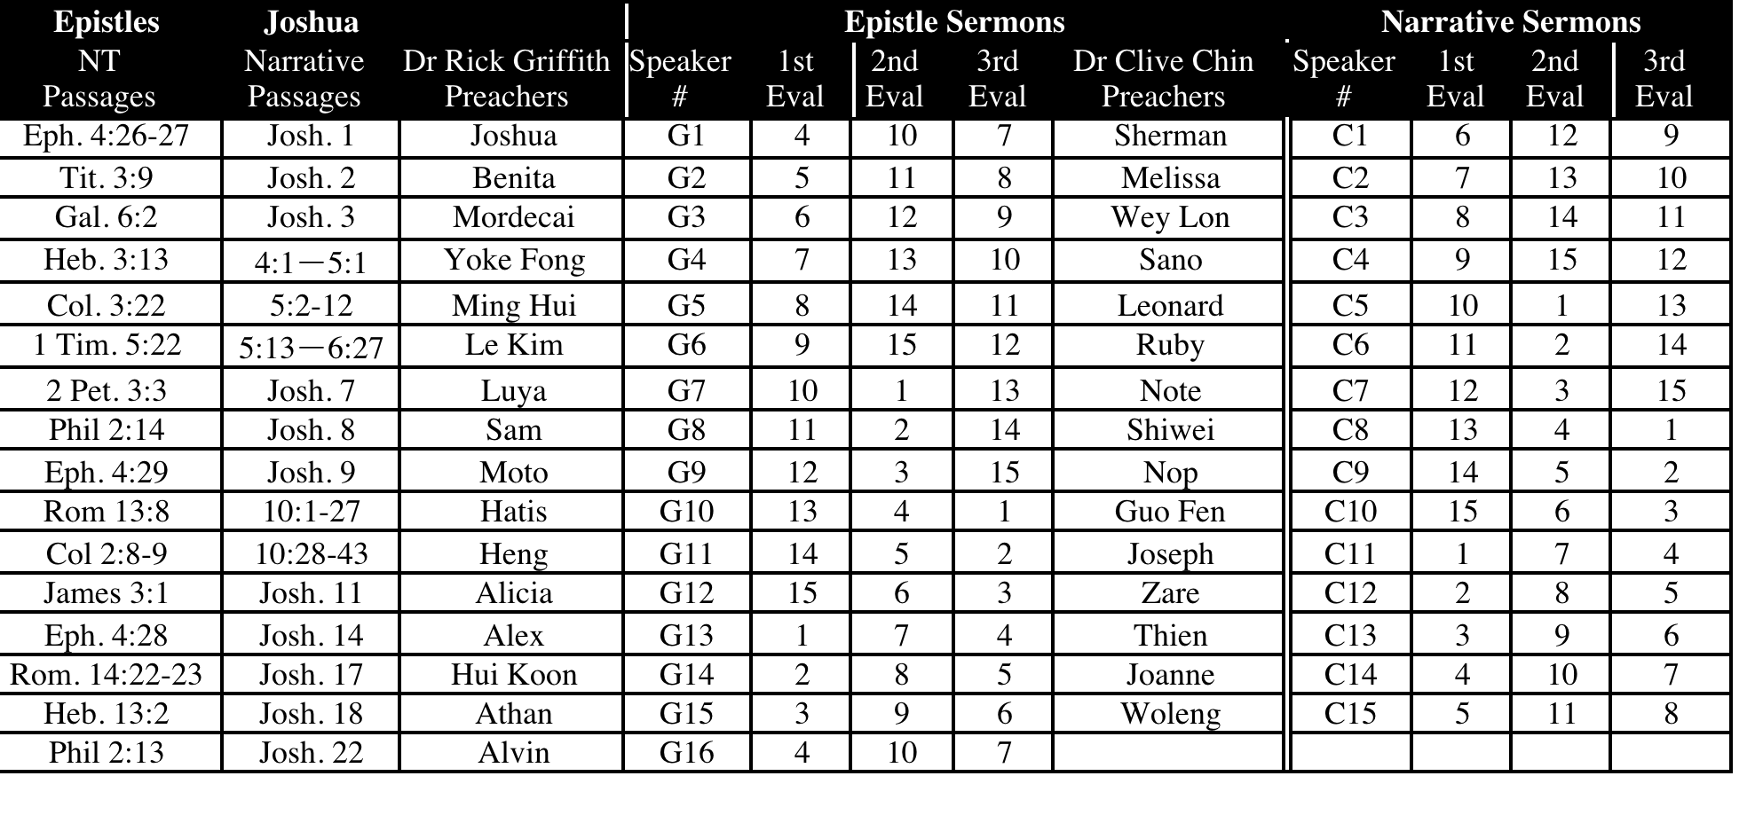
SBC Thugente & En 2013
vi
July-Nov 13

Slide 50
Lekhathotte apat Changtelte
(15 min.)
B
Romte 13:8
Kihepituana beplo chu kuama thil ba kiu in; midang hepitu chun dan chu a hi’bukim ahi.
Romte 14:22-23
²²La ginna nei chu Pathian ma-ang in nang bep het in nei mai in. Ama phatsakna, thiamlo kichan lo mi chu mi hampha ahi. Kuale ki-awimaw kawm kawm ah ne chun ginna ah a nek a hilo ziak in, thiamlo chang ahi ngal hi; ginna lo ah thil kibawl taphot chu gitlona ahi.
Gal 6:2
²La puakgikteu chu kidawn tua chiat un, tichun Krista dan chu la zui uh hi’n a.

Slide 51
Lekhathotte apat Changtelte (15min.)
B
Ephesa 2:10
¹⁰Thilpha hi’ding ah Krista Jesu ah chun siam ah um in, ama khutsuak I hingal un; zia thilpha hi’ ding chu I khawksak dan ding ua Pathian in a siamkholsa ahi.
Ephesa 4:26-27
²⁶"Lungnau un la ahi’n, gilo kiu in": La lungnatnau chu nisa tumpi ki’hen, ²⁷Diabol chu pan mun pe kiu in.
Ephesa 4:28
²⁸Gucha chun gukchak haisan hen la, a tasam kiang ah piak ding a neitheina dingin a khut ah dik tak in semgim zaw ta hen.
Ephesa 4:29
²⁹Thu phalo him him la kam un pawt ki’hen la, a kul dung zui ah mi dang siamphatna ding bep pawt zaw ta hen; tichun a ngaithate chun hepina a piak thein ding in.

Slide 52
Lekhathotte apat Changtelte
(15 min.)
B
Ephesa 6:4
⁴Ahin, nanghaw pate haw, lachateu hi’lunggain kiu inla, Lalpa thununna leh zilgaina chun kaihuai zaw tau un.
Philippi 2:13
¹³A lung lam sem ding ah sepnopna hun pepa chu Pathian ahi ngal a.
Philippi 2:14
¹⁴Phunchiak leh kinial lo in bang kim sem un.
Kolossa 2:8-9
⁸Chingthei tau in,chutilochun, kuan’nle Khrista thu lo gual in, mihingte thugosia leh khawvel thubulte gual in a thupilteu leh thepna mai mai un gallak in hun la kha’n au. Ama ah chun Pathian bukimna zosia chu taksa nei in a um zing ngal a.

Slide 53
Lekhathotte apat Changtelte
(15 min.)
B
1 Timothy 2:11-12
¹¹Numei chun kitulut tak kawm in thipbek in zil hen. ¹²Numei in kuama thu zilsak ah a pan ding a hem, pawsal chung ah thu a nei ding ahem ka phal puai; amau chu thip hiat hiat ah a um diu ahi.
1 Timothy 5:22
²²Kuama chung in la khut ngat pai ziang kin la, midang gitlona ah le pang kin; kikoi thingtho zing in.
Tita 3:9
⁹Ahin, dotna ngolhuaite, phung thute, kinialnate, dan thu ah kinaknate chu haisan in; zia chu phatchuamna bei leh bangmalo mai ahi.
Hebraite 3:13
¹³La lak ua kuale gitlo thepthak ah lung tak la um lona ding un, “tu-ni,” kiti hun a um sung in, nisi’n in kitil hat zing tau in.

Slide 54
Lekhathotte apat Changtelte
(15 min.)
B
Heb 13:2
²Malzin khawtua ding sumsial kiu in; zia gual a bawlnu ah hin khenkhat in a het lo kal un vansawlchakte a la zintun kha sek uh ahi.
1 Peter 2:2
²Hukdamna la khanlet theina ding un, nausen piang limte gual in, thagau lam nawitui thiang chu ducha zing un,
1 Peter 3:7
⁷Pawsal te haw, zia gual ma chun, numei chu bel kek vak zaw leh, hepina hinna gochanpite a hiu he zing kawm in chawihoi un; tichun la pauchap na teu dal in umlo ding ahi.
2 Peter 3:3
³Doitakte haw, la kiang ua ka zik hi ka lekhathot ni veina ahi tai; zia te chun nanguh a vel ah hil in, la lungthim thiangtho uh chu ka choktho hi.

Slide 55

Hawitak ah la gen lo chun, suang te ziang le kiko dawk in’au!
Luka 19:40 Jesu’n a dawnhu a, “Zia mite hi a thip ua leh le, suangchang bek kikodok ding ahi!”

Slide 56
Lungsiatin minit 15 thugen pani tegel pelut in…
vii
La Thugen Ding ni masang in…
Thukhenna Zekthawte. 7 & 8 (or 11 & 12)
Lapathianthu thukhenna PPT slide(te)
Micheng ‘di lapathianthu thukhenna teisawn
Kisaklawkna ’kichian theipen ah zek
La thugen ding ni…
Lungthim ah tepte chu hetzingna chabi
Lathugen Zaw ni ni’…
Lapathianthugen mani’n ki-endik (p. 104)

Slide 57
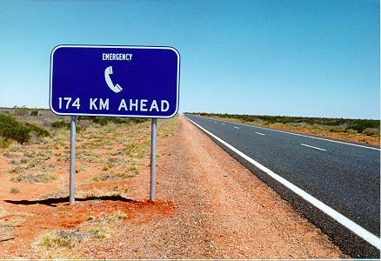
Hiathiam lo la nei kha em?
Panpi na dawn in!

Slide 58
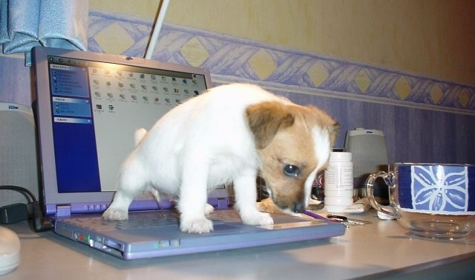
La zekthaw dingdawl te zosia la computer in ziak in
Athawn ah siamtheina lekha le chaw’n !

Slide 59
Apawimaw Dangte
xi
Lekhabu Teisawn
Kei toh kihiattua thei nadingte
SBC box L19 ahiloleh phone (6559-1513)
Mimal phone: 9113-7090
Chenna Veng ahileh SBC Block 2-302
Inn phone ahileh 6762-2011
E-mail: griffith@sbc.edu.sg
Ka office pel hun…
Hung in an le nekhawm hiti!

Slide 60
Black

Slide 61
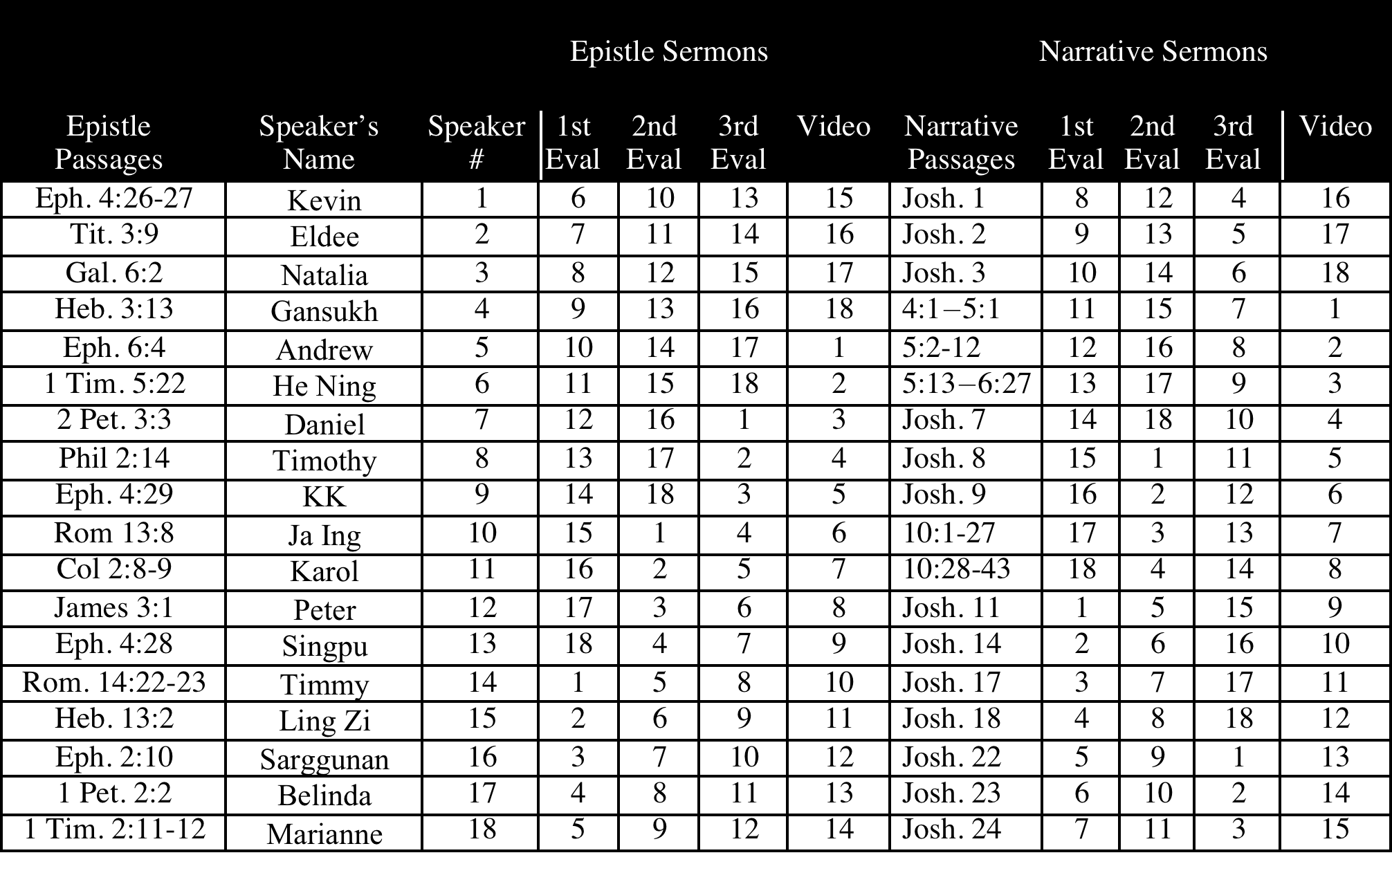
SBC Thugentute & Endiktute 2012
viii
July-Nov 12

Slide 62
LBC Thugentute & Endiktute
B

Slide 63
SBC Thugentute & Endiktute
viii
July-Nov 05

Slide 64
SBC Thugentute & Endiktute
viii
July-Nov 06

Slide 65
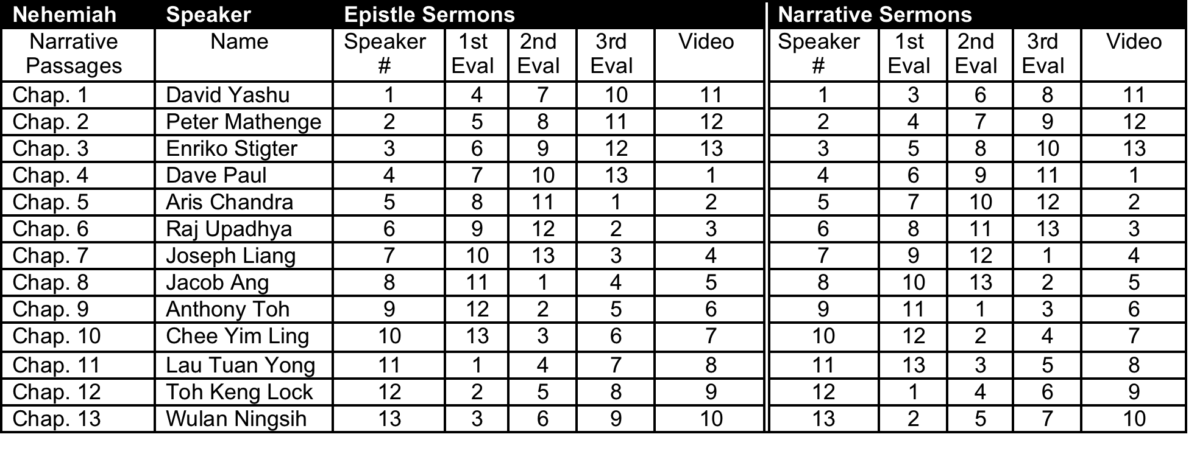
SBC Thugentute & Endiktute
viii
July-Nov 08

Slide 66
HGST Thugentute & Endiktute
B
Thugentu |  | Lekhathotte apat Pathianthu |  |  |  |  | Tuanthu apat Pathianthute
Dr Rick lam a thugentu | Dr Alan lam a thugentu | Thugentu # | 1^{s} | 2nd Endiktu | 3rd Endiktu | Lekhathot bung leh chang | Thugen # | 1st Endik | 2nd Endik | 3rd Endik | Johan bung leh chang
 |  | 1 | 4 | 7 | 6 | Rom 13:8 | 1 | 5 | 8 | 7 | 1:19- 51
 |  | 2 | 5 | 8 | 7 | Gal. 6:2 | 2 | 6 | 9 | 8 | 2:1-11
 |  | 3 | 6 | 9 | 8 | Eph. 2:10 | 3 | 7 | 10 | 9 | 2:12- 25
 |  | 4 | 7 | 10 | 9 | Eph 4:26-27 | 4 | 8 | 1 | 10 | 3:22- 36
 |  | 5 | 8 | 1 | 10 | Eph. 4:28 | 5 | 9 | 2 | 1 | 4:1-42
 |  | 6 | 9 | 2 | 1 | Eph. 4:29 | 6 | 10 | 3 | 2 | 4:43- 54
 |  | 7 | 10 | 3 | 2 | Eph. 6:4 | 7 | 1 | 4 | 3 | 5:1-46
 |  | 8 | 1 | 4 | 3 | 1 Tim. 5:22 | 8 | 2 | 5 | 4 | 6:1-24
 |  | 9 | 2 | 5 | 4 | Tit. 3:9 | 9 | 3 | 6 | 5 | 6:25- 71
 |  | 10 | 3 | 6 | 5 | Heb. 3:13 | 10 | 4 | 7 | 6 | 7:1-52
May 2010

Slide 67
SCM Thugentute & Endiktute
B
January 2011

Slide 68
HGST ah kai te’n Abawldiu
v
Simding (10%)
Zekthawding (25%)
Panding (5%)
Pathianthu gending (60%)

Slide 69
LBC ah Zil te’n Abawldiu
v
Simding (10%)
Zekthawding (25%)
Panding (5%)
Pathianthugending (60%)

Slide 70
SCM ah kai te’n Abaawldiu
A
Simding
(25%)
Zekthawding (25%)
Pathianthugending
(50%)

Slide 71
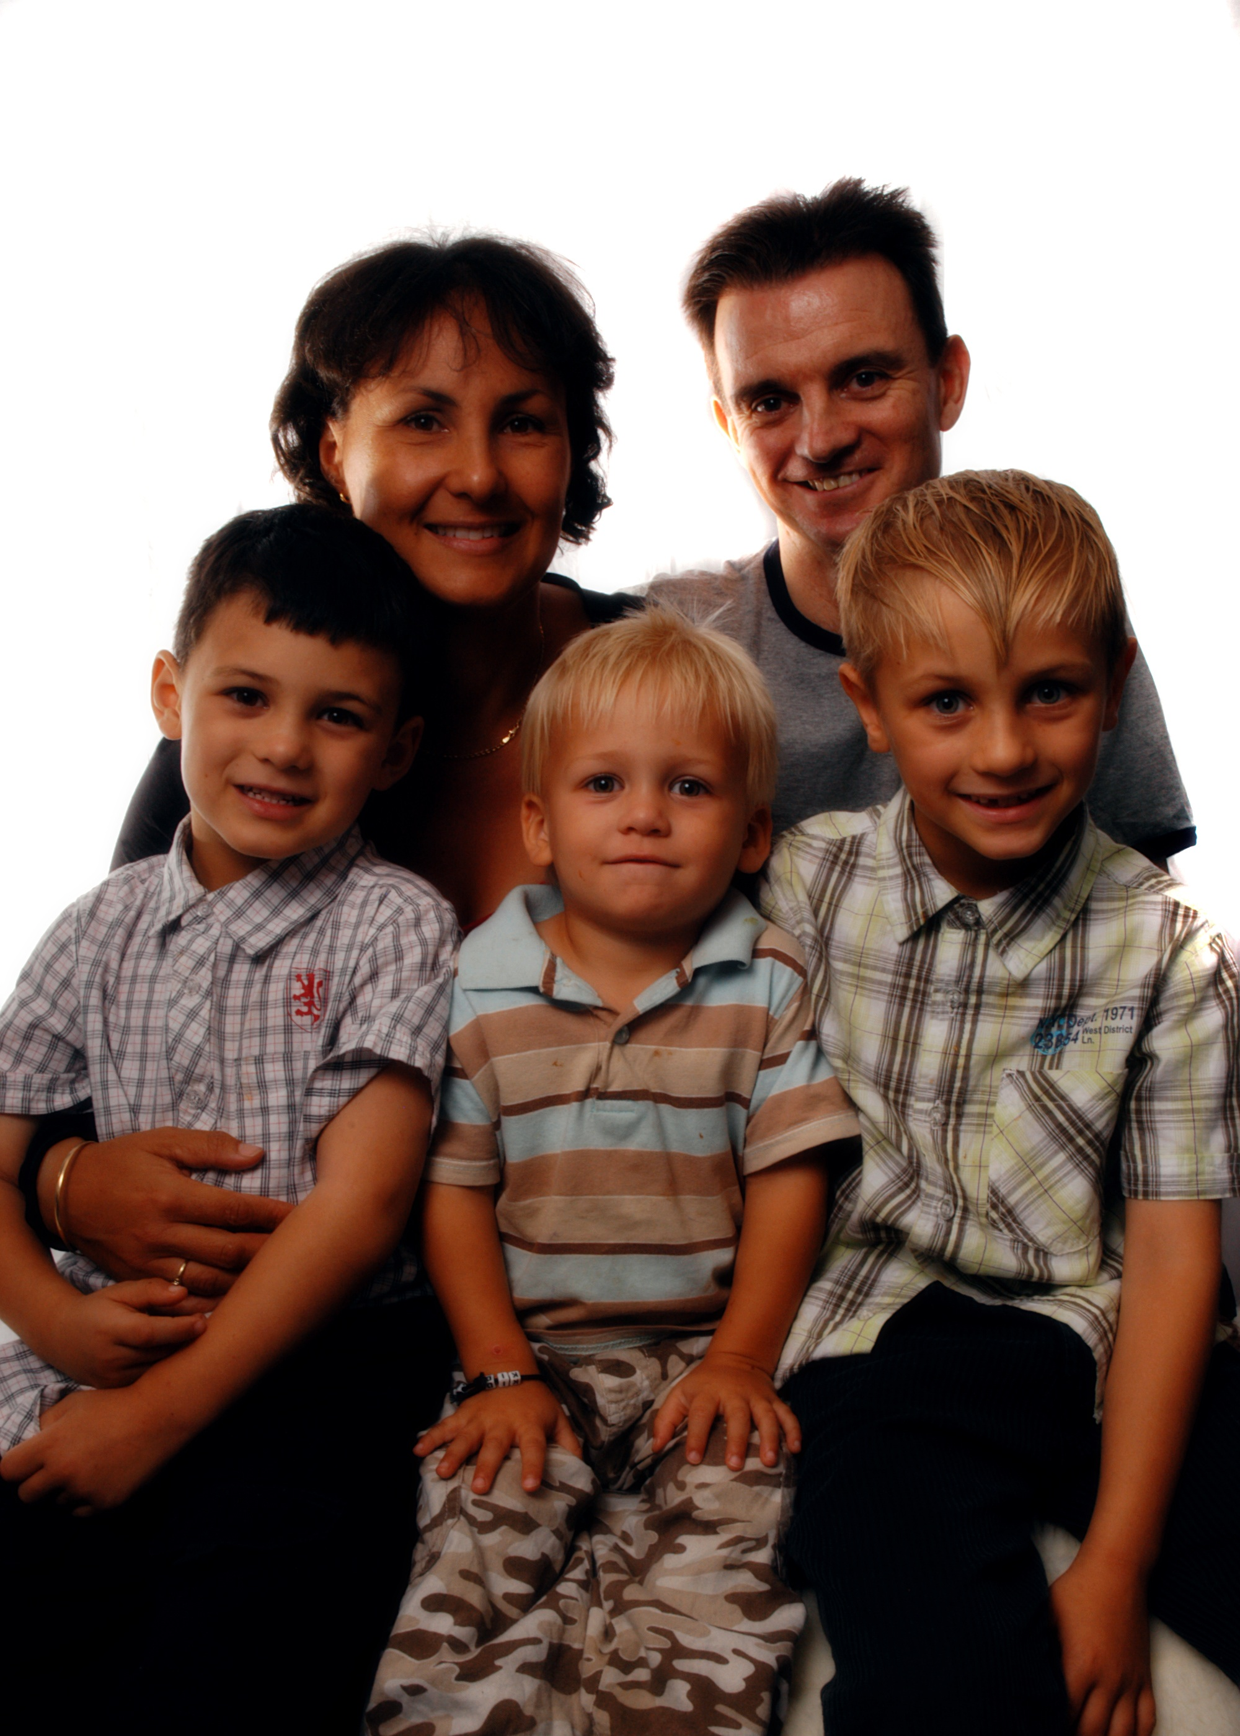
Stanley te Inkuan
Alan
Kathleen
Luke
Jackson
Caleb

Slide 72
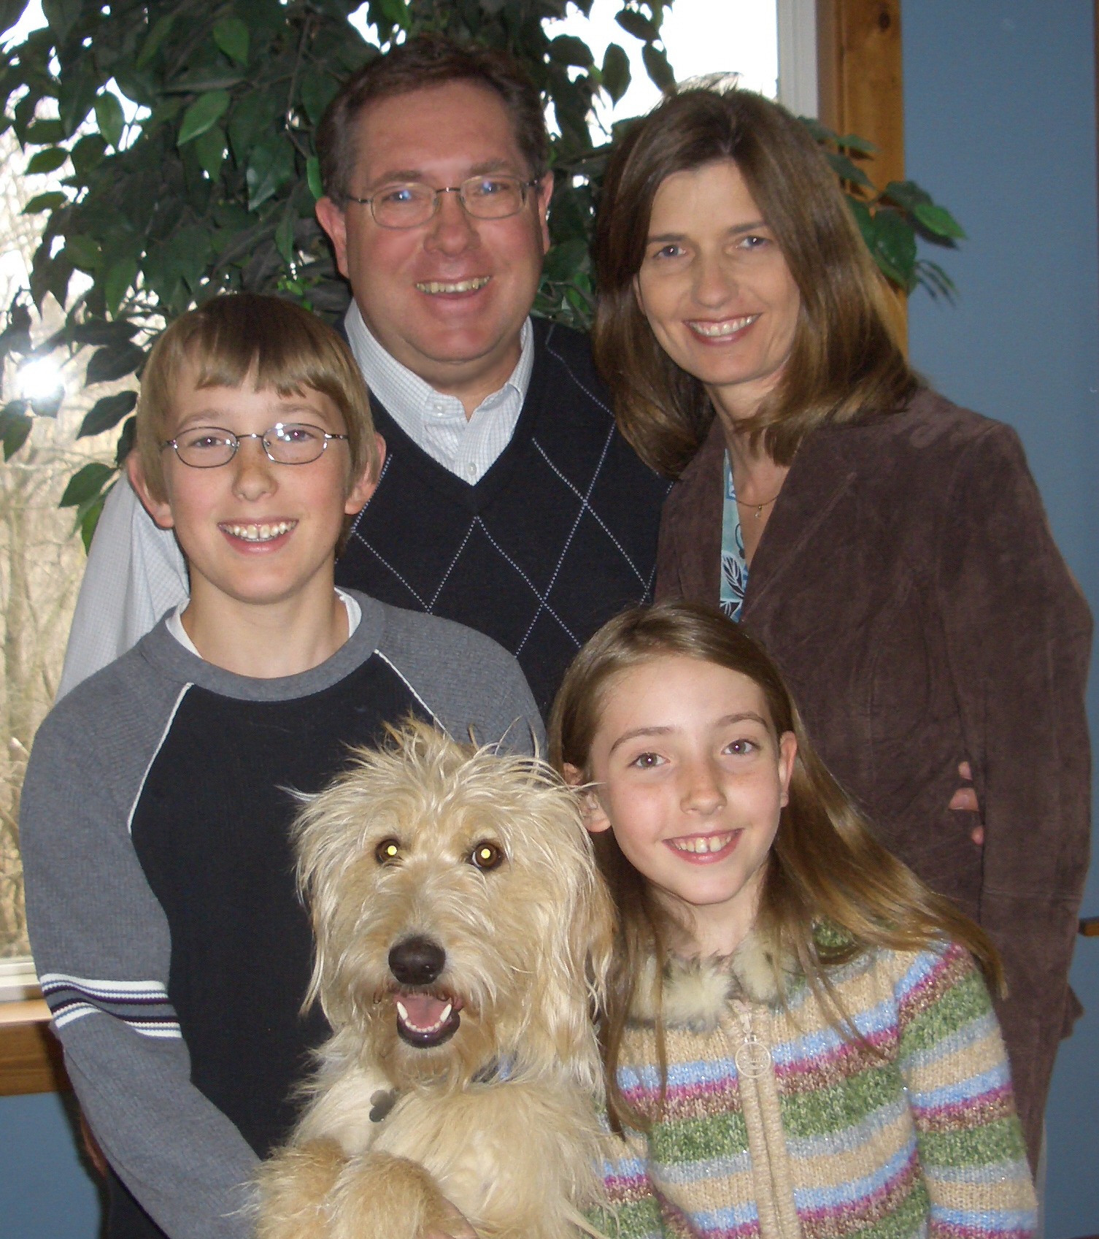
Sheveland te Inkuan
Ron
Jodi
Luke
Jessica
Holly

Slide 73
Etsakna Zekthawding te
v
Bawl Ding Dan…

Slide 74
Etsakna Chidan ding
v
Athu
Analdan
Alaknabul
Achiandan
Abawldan

Slide 75
Tekhinkhinthu Ettawntheiding
vi
HEPINA lawite a ding ah thi ngam (Johan 15:13)
Vietnam gal lai in Americate Lawng Chawlna kiang in Chagavakna a um ah. Ni khat chu Viet Cong (helpawl) te’n meithal in naupang sawm leh ni a that ua, athilo aliam tampi le a um ahi. Kai kiti pawsal chapang khat lawipa le nasa tak ah liam in thisan hawp angai ta. Zia Kai lawipa thisan chi chu a vang ma ma khat ahi, zia chu Kai thisan chi toh akituak kha laizang ta. Naupang Kai chun thisan mi khat leh khat kihawm thei ahi ti’ chu a hekha kei pua himaleh Amarica dactorte apat thisan hawp in mihing hinna a hukdaw thei dan agen chian phat un naupang Kai chu a lawipa thisan hawm ding in ahung kipan ta.
Tichun Kai thisan chu a lawipa thigui aluang phat achun Kai chu lauthawng in ahung uuk ta. Dactorte’n ana em tia adawt ua leh, a na puai ti’n a dawnhu ah. Hun chawmkhat zawa chun ahung uuk kit ah. Dactorte’n a dawt sin ua leh ana puai ti’n a dawnhu ngen ah. Atawp ah chun dactorpa’n, “Bang a tia hem, Kai?” ti’n a dawng ta. A mitthitui abiang ah luang zut zut kawm in Kai chun a dawng ta, “Bangtik leh thiding ka hem, hotupa, bangtik leh thiding ka hem?” ti’n. Entia, naupang Kai chun a thisan tawmcha bep pia ding ahi lam a hepua, a lawipa hukdaw na ding ah a thisan zosia pe ding in ala kisazo man ala hi ahi.
Rick Griffith, SBC Chapel, 4 May 2010

Slide 76
Etdikdan Ettawntheiding
vii
Achawm | A Thupi leh a | A Better Alternative
TC/TI/SD | Pathian dawidan het—Mei vak zawt-zawt | PATHIAN DAWIDAN thupukna lak zaw ah hiatchian na
TI/SD | THEPNA—lekha leng kai | ZE-ETNA gingtute ah ding ah phachuam
TI/SP | Satan thepna ziak ah GEUCHAU | LAWSAPNA’N lawting na ding dal thei

