Slide 1
Динозаври:
Можливо вам і вашим дітям промили мозок?
Д-р Террі Мортенсон

Slide 2


Slide 3
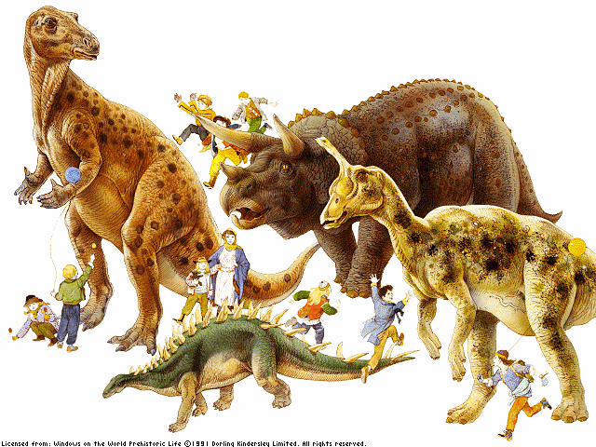

Slide 4
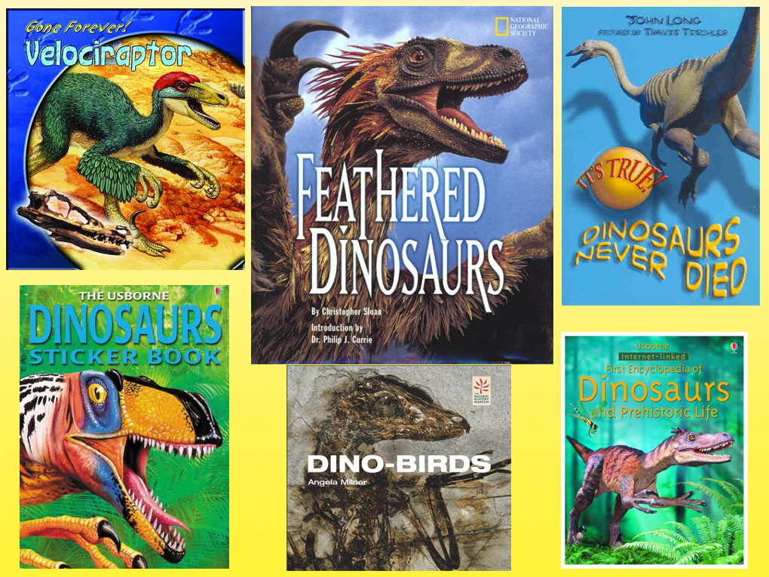

Slide 5
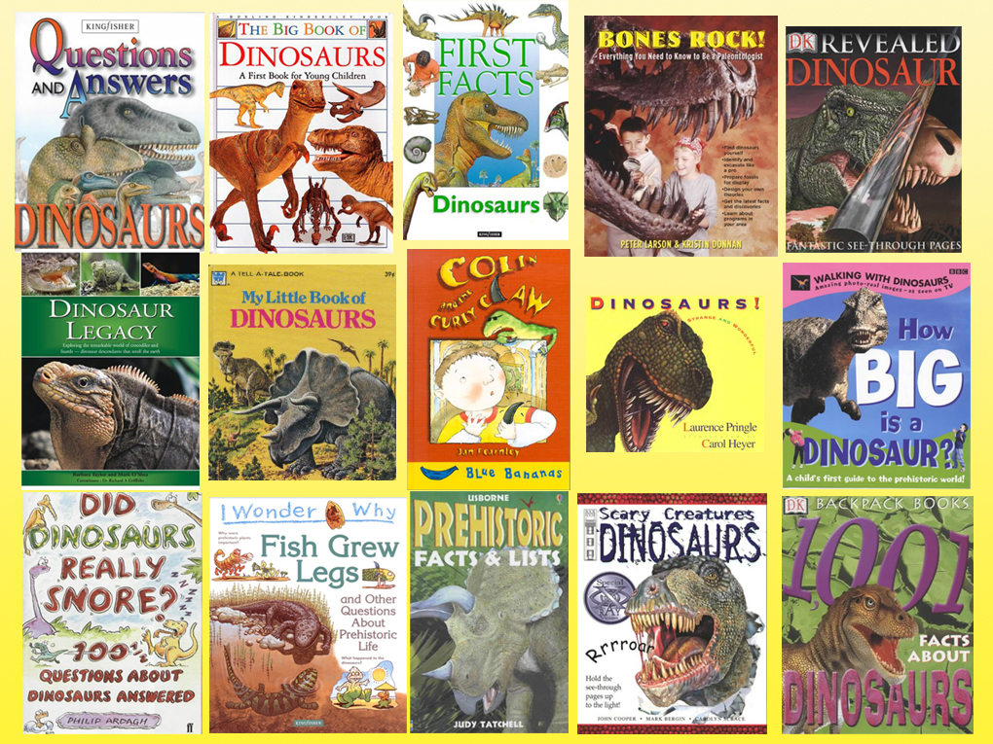

Slide 6


And this is only
some of the books.

Slide 7
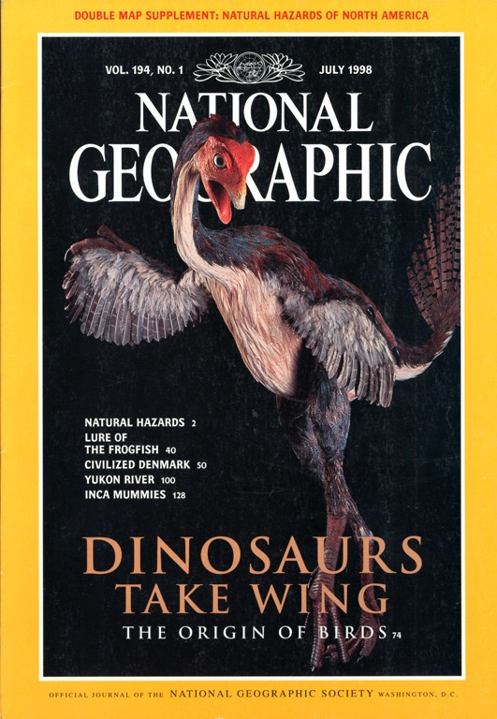
ДИНОЗАВРИ НАБУЛИ КРИЛА
Походження птахів
Липень 1998

Slide 8
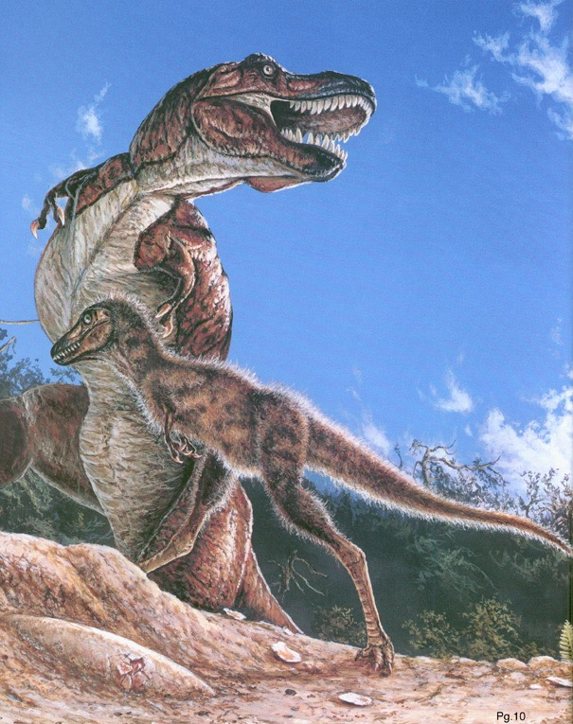
“Пір'я для Тиранозавра Рекса?”
National Geographic
Листопад 1999

Slide 9

Як помістити динозаврів в Біблію?
НІЯК!

Slide 10

Використовуйте Біблію, щоб пояснити динозаврів!

Slide 11
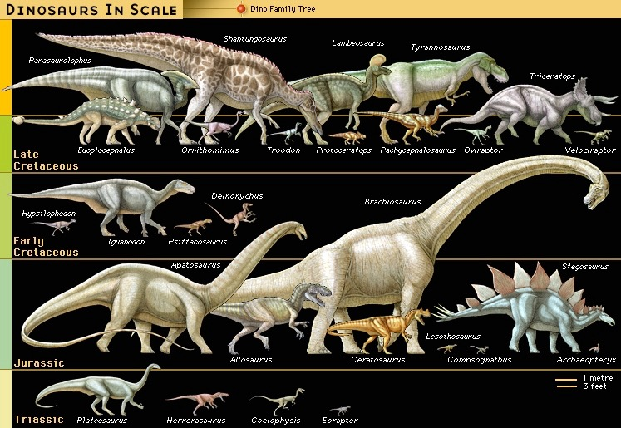
Мільйони
років
65
145
208
245
(Encyclopaedia Britannica, CD, 1999)

Slide 12
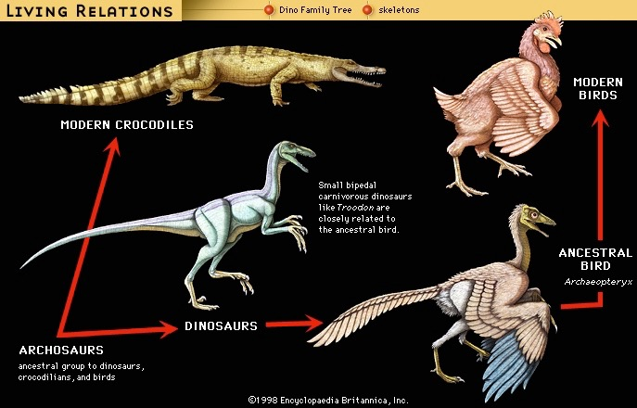

Slide 14

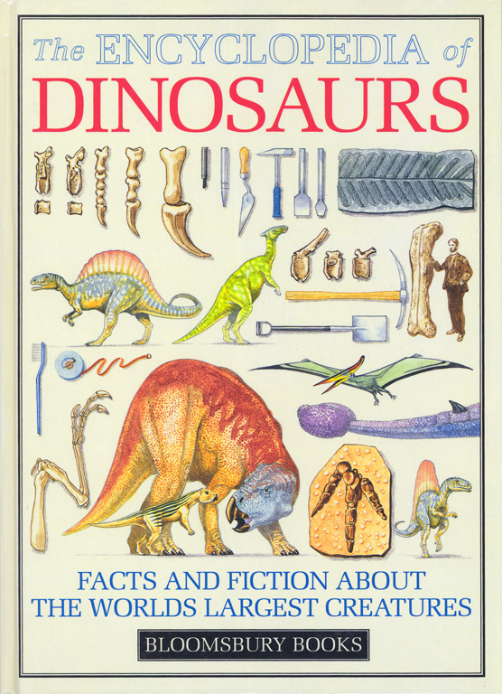
“Evolving reptiles”
“Small lizard-like reptiles evolved from amphibians at least 340 million years ago.”
“From such pioneers evolved several reptile groups identified by differences in the skull behind the eyes.”
David Lambert, The Encyclopedia of Dinosaurs (London: Bloomsbury Books, 1994), p. 16, published in association with the British Museum of Natural History.
Notes:
In one sentence they explain the origin of reptiles.
In the very next sentence they explain the origin of all other reptiles, including dinosaurs.

Slide 15
“Загибель Тиранозавра Рекса та більшості інших динозаврів приблизно 65 мільйонів років назад може захопити усі заголовки. Але палеонтологи так само в роздумах, як же вони всі з'явились. Ким були їх предки?”
Майкл Батлер, “Pint-Sized Predator Rattles the Dinosaur Family Tree,” Science, Vol 331: 6014 (14 Jan. 2011), p. 134.

Slide 17
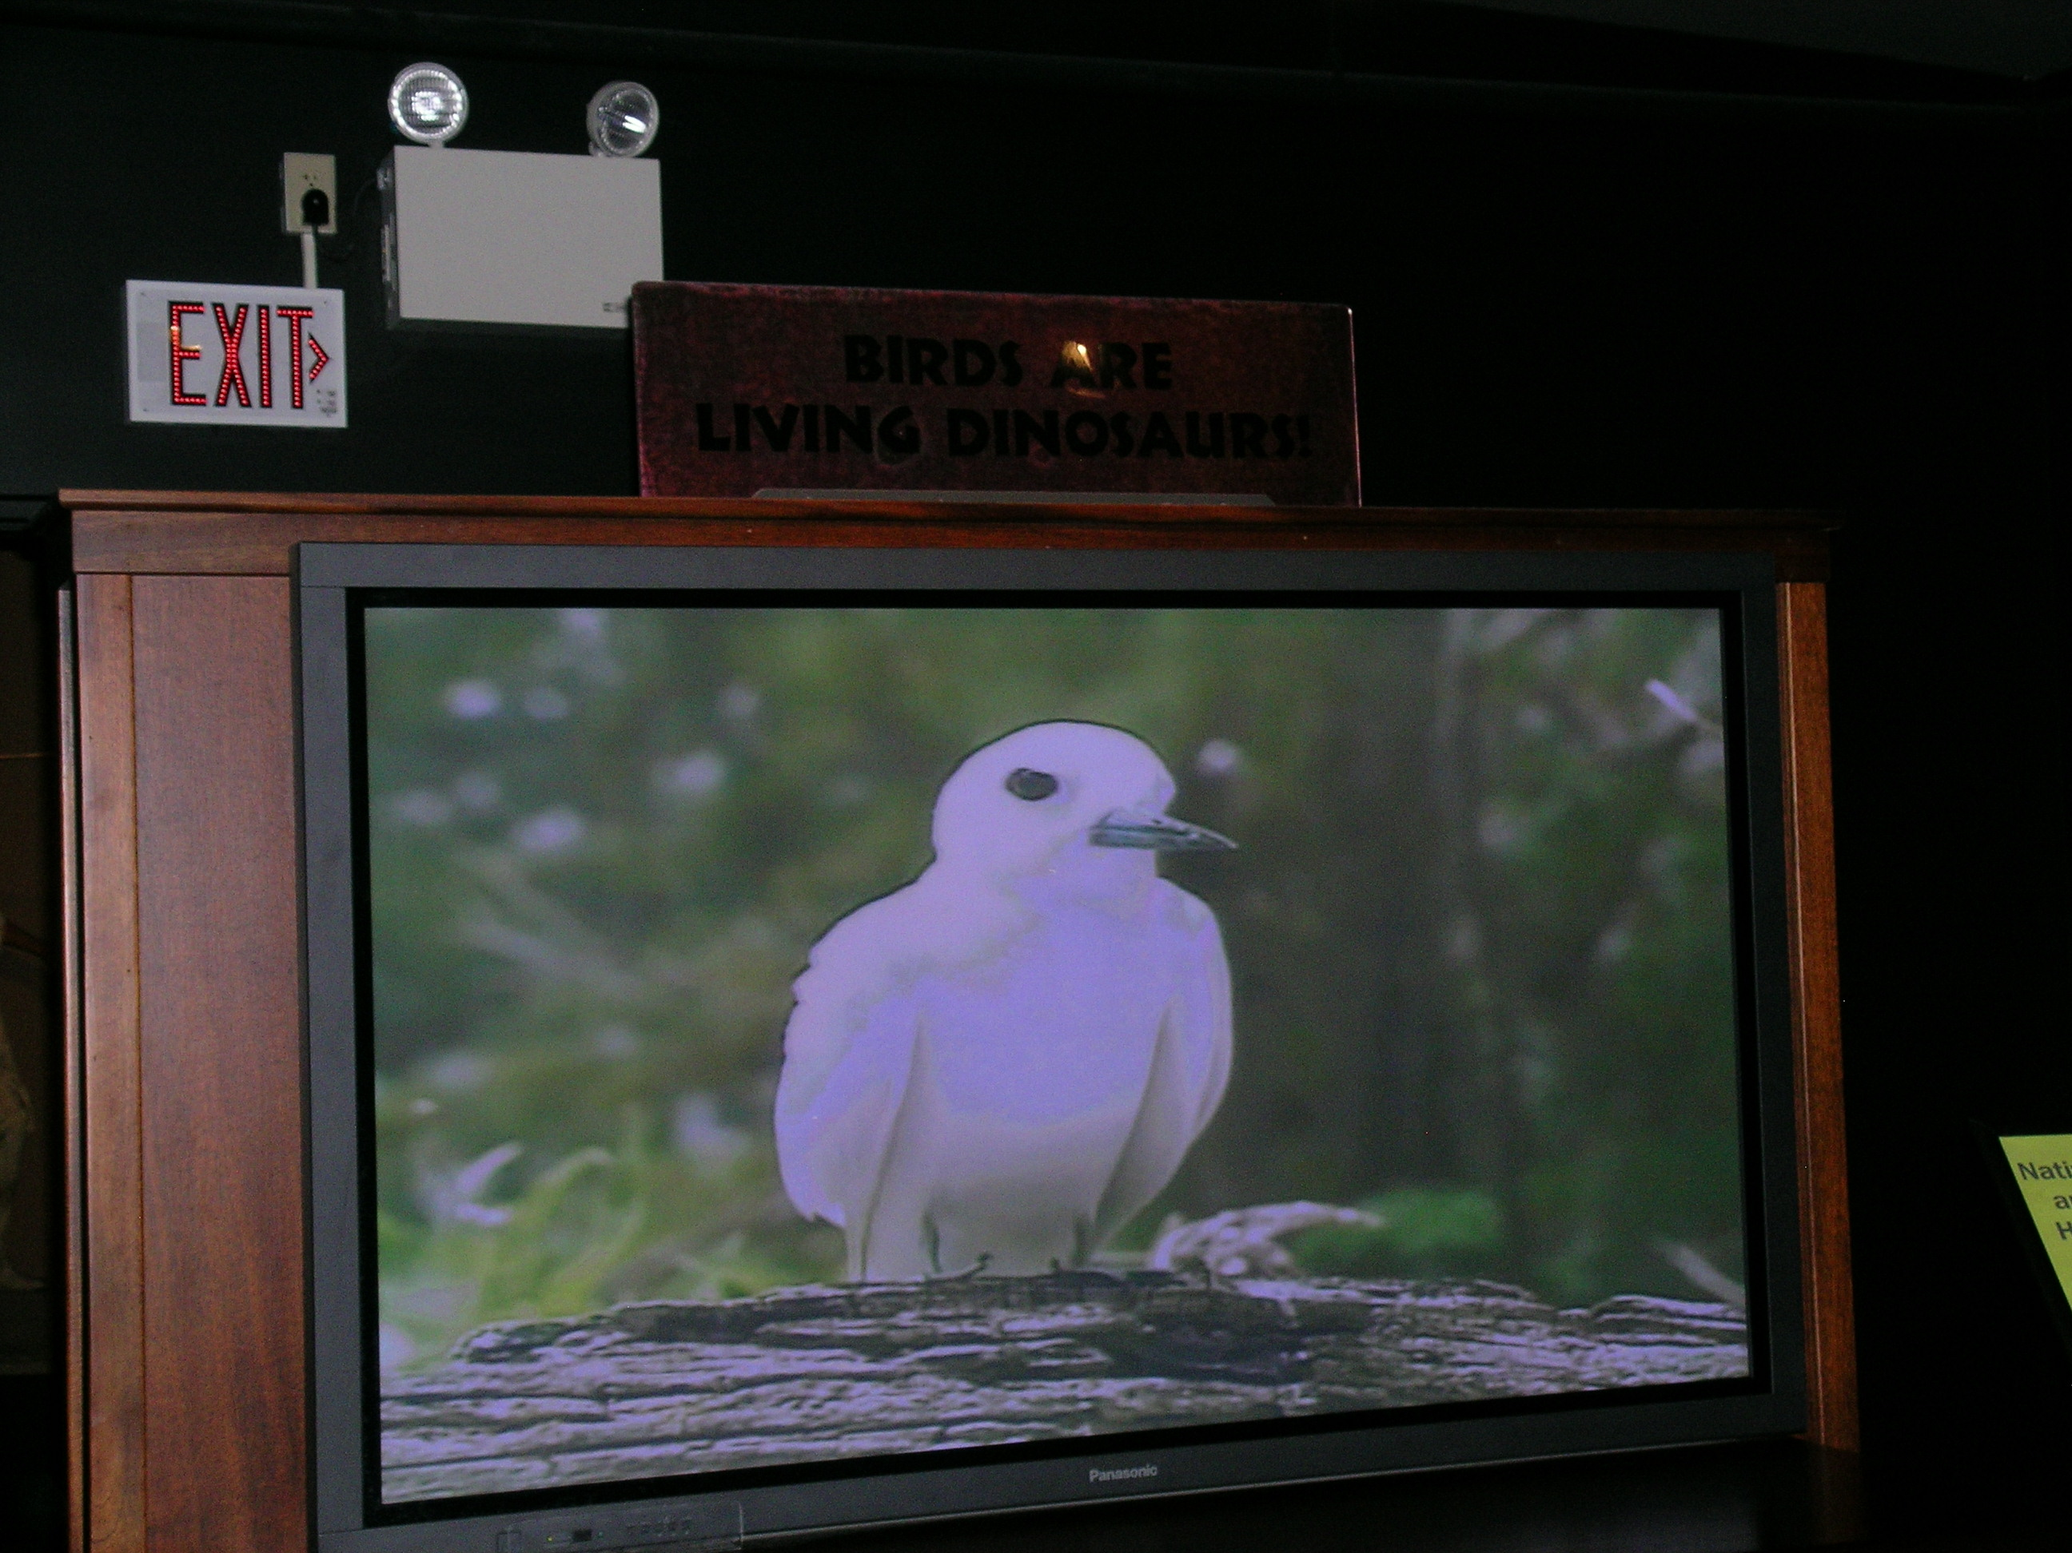
“Птахи – це живі динозаври!”
Музей Рокіс, Боземан, Монтана

Slide 18
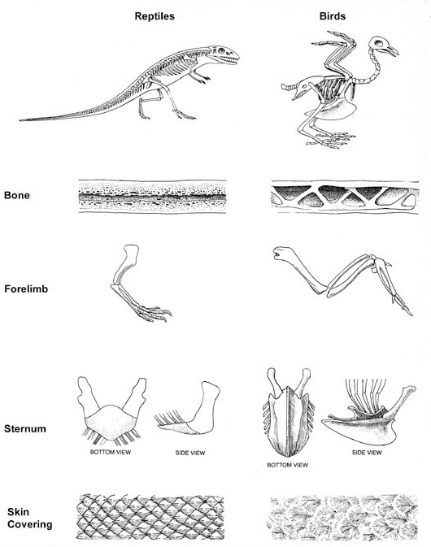
“Еволюція прахів від рептилій може вважатись процесом адаптації завдяки якому птахи ‘вирішили’ ‘проблему’ польоту.”
Річард Левонтін, “Адаптація,” Scientific American (Sept. 1978), p. 214.
Notes:
All bones are hollow after dead.
But reptiles don’t have pneumatic bones. They marrow (which dissolves away after death)
If you close off the trachea of bird and break open a wing bone the bird can still breathe for awhile at least.

Slide 19
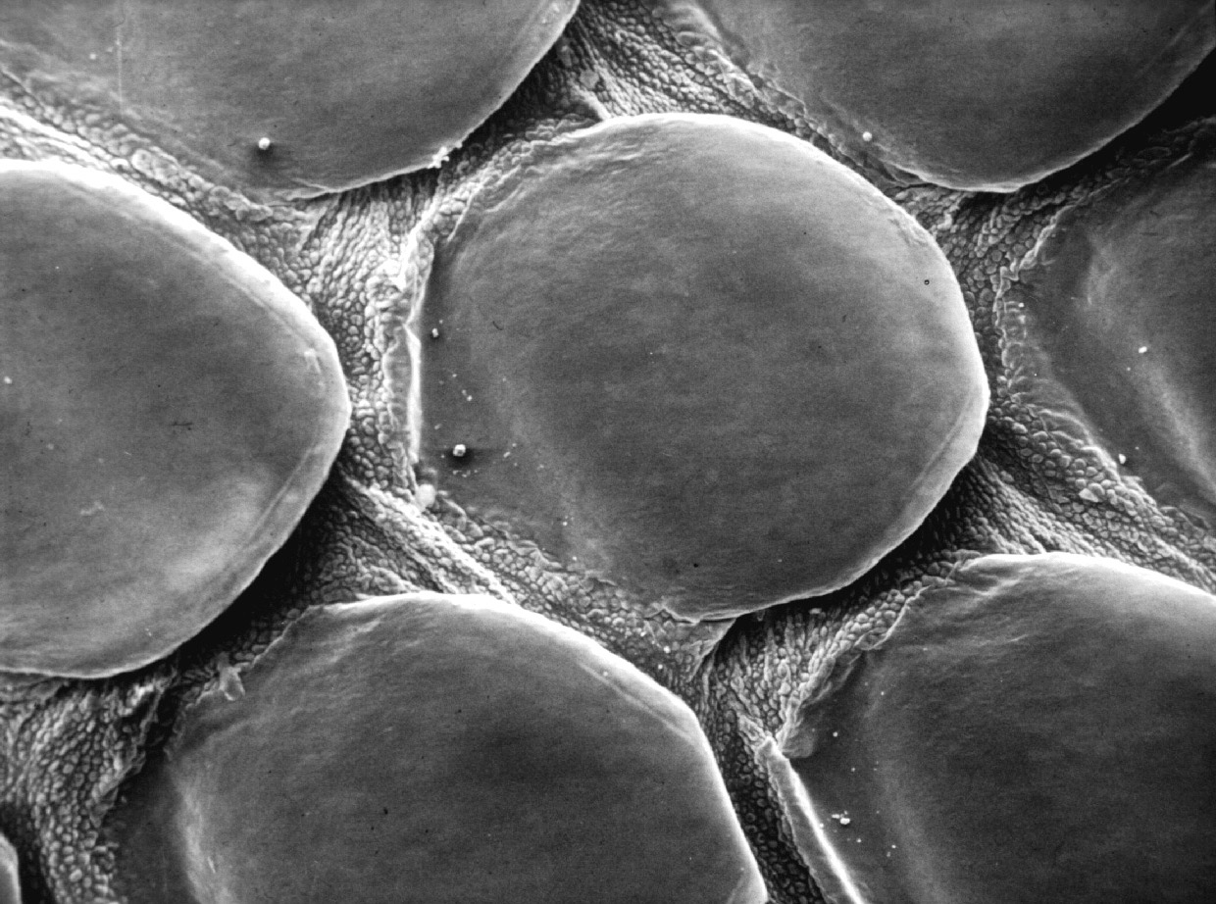

Slide 20
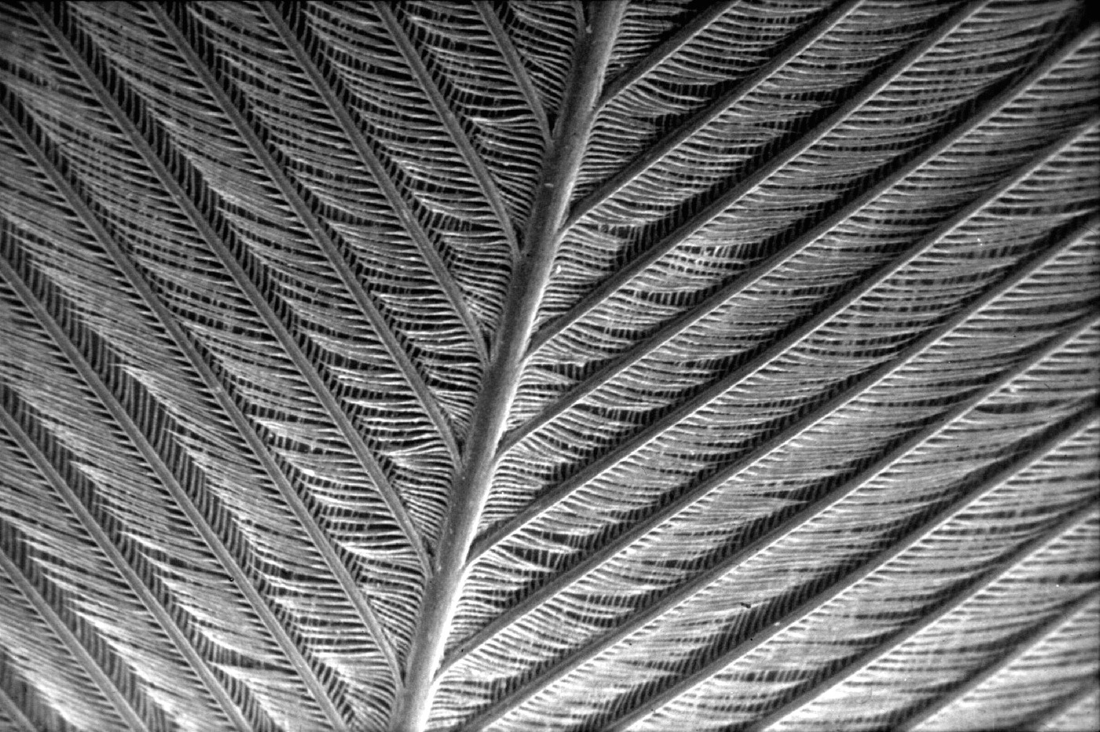

Slide 21
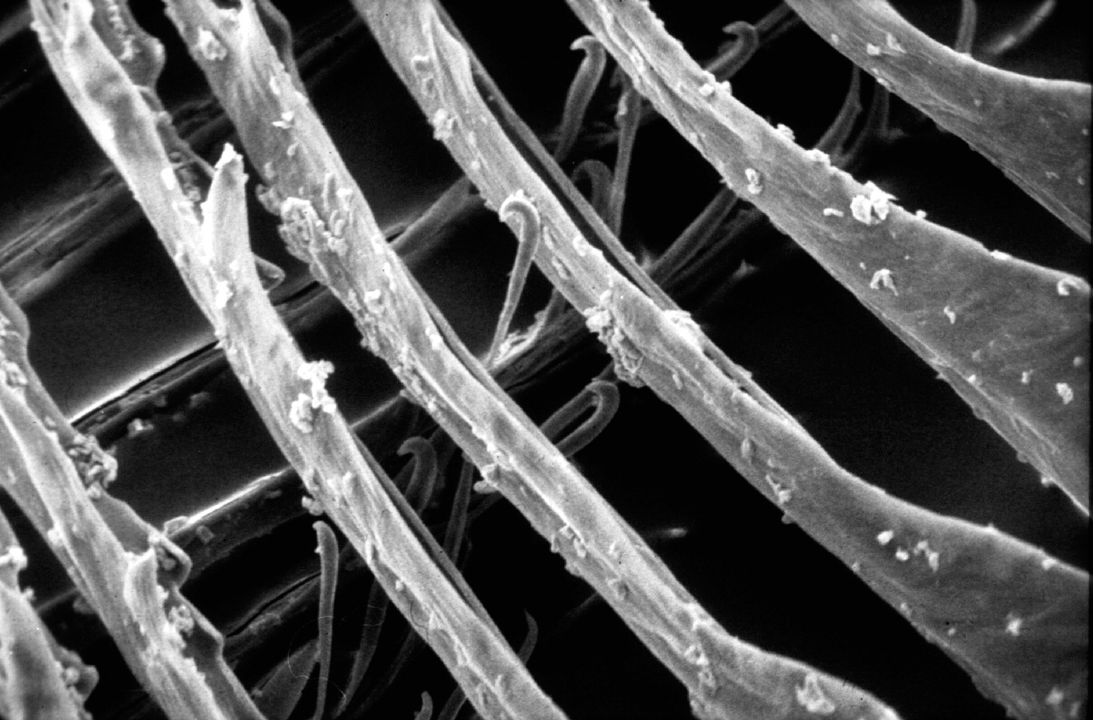
Notes:
From NAB1, ch. 24, David Menton:
In actual fact, feathers are profoundly different from scales in both their structure and growth. Feathers grow individually from tube-like follicles similar to hair follicles. Reptilian scales, on the other hand, are not individual follicular structures but rather comprise a continuous sheet on the surface of the body. Thus, while feathers grow and are shed individually (actually in symmetrically matched pairs!), scales grow and are shed as an entire sheet of skin.
The feather vane is made up of hundreds of barbs, each bearing hundreds of barbules interlocked with tiny hinged hooklets. This incredibly complex structure bears not the slightest resemblance to the relatively simple reptilian scale. Still, evolutionists continue to publish imaginative scenarios of how long-fringed reptile scales evolved by chance into feathers, but evidence of “sceathers” eludes them.

Slide 22
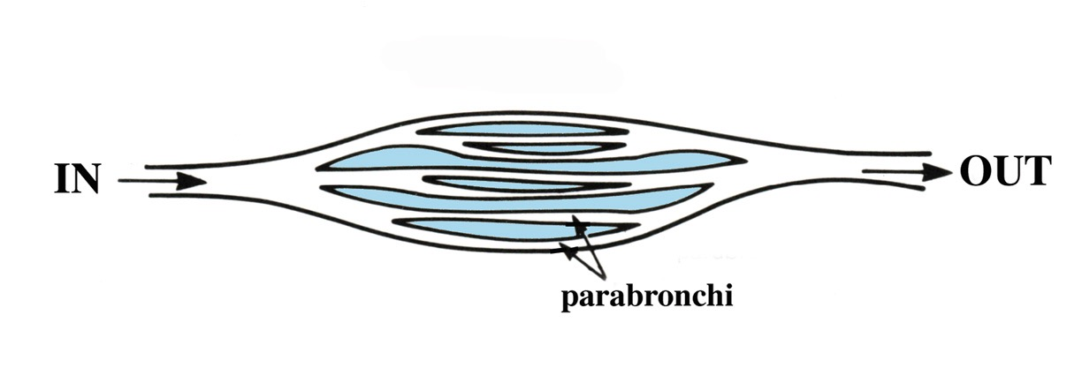
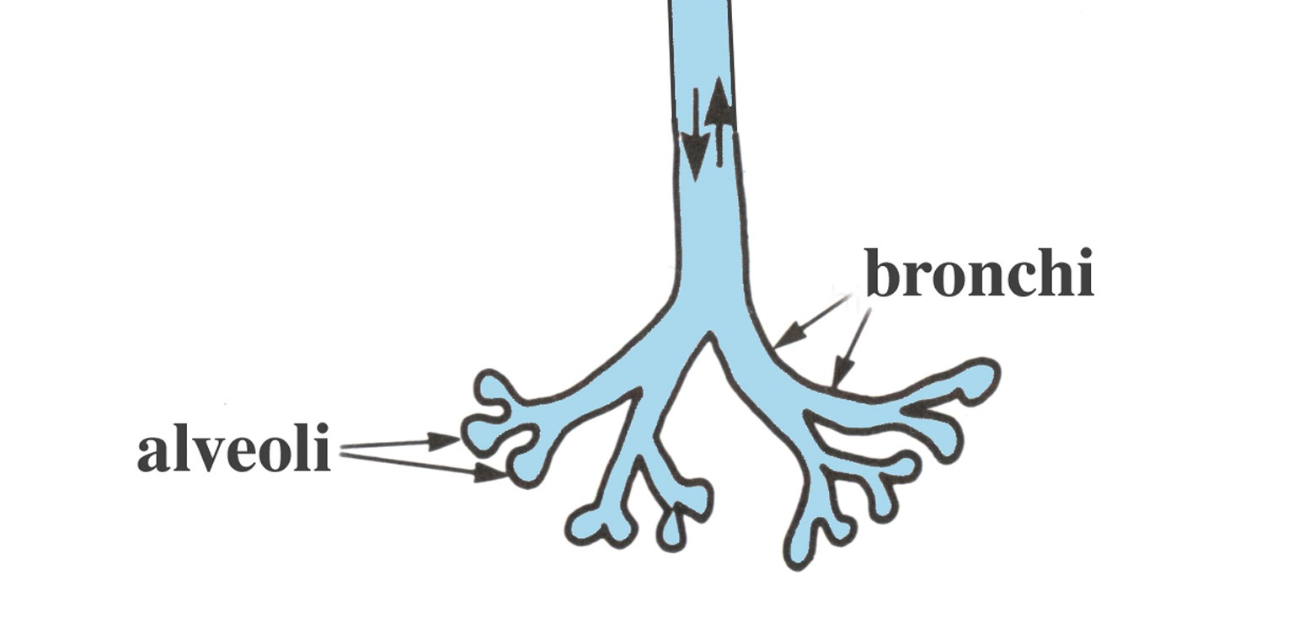
Легеня птаха
Легеня рептилії
Notes:
Bird lung is unique respiratory system. Only Birds have airsacs and have no diaphram.
Dinosaurs may have hollow bones, but don’t have connections between hollow bones and air sacs, as birds have. Dinosaurs and crocodilians do have diaphrams.
Claim that crocodilians have uni-directional flow-through respiratory:
Dave Menton in NAB1 (https://answersingenesis.org/dinosaurs/feathers/did-dinosaurs-turn-into-birds/)
“One of the most distinctive features of birds is their lungs. Bird lungs are small in size and nearly rigid, but they are, nevertheless, highly efficient to meet the high metabolic needs of flight. Bird respiration involves a unique “flow-through ventilation” into a set of nine interconnecting flexible air sacs sandwiched between muscles and under the skin. The air sacs contain few blood vessels and do not take part in oxygen exchange, but rather function like bellows to move air through the lungs.
“The air sacs permit a unidirectional flow of air through the lungs resulting in higher oxygen content than is possible with the bidirectional air flow through the lungs of reptiles and mammals. But in those creatures, the air flow moves through the same tubes at different times both into and out of the lungs of reptiles and mammals, and this results in a mixture of oxygen-rich air with oxygen-depleted air (air that has been in the lungs for awhile). The unidirectional flow through bird lungs not only permits more oxygen to diffuse into the blood but also keeps the volume of air in the lungs nearly constant, a requirement for maintaining a level flight path.”

Slide 23
“Дослідники Університету штата Орегон зробили нове фундаментальне відкриття про те, як птахи дихають і мають здатність, яка дозволяє літати – і це відкриття означає, що навряд чи птахи походять від будь-якого відомого теропода динозаврів.”
“Discovery Raises New Doubts About Dinosaur-Bird Links,” www.sciencedaily.com, 2009 June 9.
Notes:
http://www.sciencedaily.com/releases/2009/06/090609092055.htm, accessed 5 Sept 2014.

Slide 24
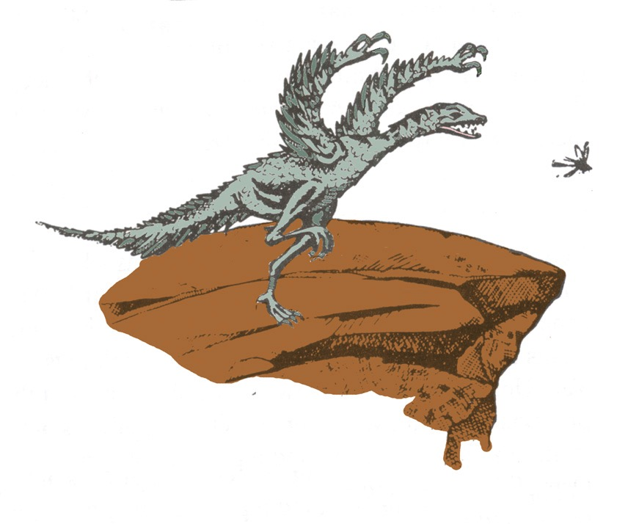
Теорія від землі до повітря
Notes:
Source: Gary Parker, Creation: Facts of Life (Master Books), p. 152.
For a fuller explanation see the summary of the evolutionist theory, proposed by Dr. John Ostrom (Yale U. prof and expert on birds) in Jan 1979. It was abandoned as a bad idea in 1983. See Luther Sunderland, Darwin’s Enigma (Santee, CA: Master Books, 1998, 4 ed.), p. 71-72.

Slide 25
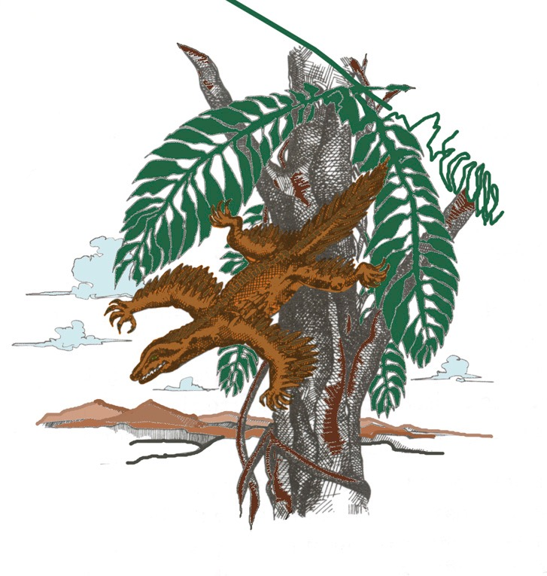
Теорія від повітря до землі
Notes:
Source: Gary Parker, Creation: Facts of Life (Master Books), p. 152. This is the theory of Alan Feduccia, expert ornothologist (see latest statement in his 2012 PDF article on dino-brids in my computer). The proto-bird was a tree-dwelling lizard weighing a couple of pounds, which started as a glider and then evolved into a flyer. Both theories assume reptiles evolved into birds.
Feduccia’s reasons for rejecting the dino-bird ground-up theory (in favor of the tree-down reptile theory):
The time line is all wrong. These alleged dinosaurian ancestors of birds occur 25 million to 80 million years after Archaeopteryx, the earliest known bird.
By the time you get to dinosaurs, you are dealing with fairly large, earthbound creatures, which means they would have had to evolve flight from the ground up, rather than from the trees down. Evolving flight from the ground up is biophysically implausible.
Many of the features of birds and dinosaurs—the hands and teeth for example—don't match. The theropod dinosaur hand consists of the thumb and the next two fingers. The bird hand is made up of the middle three fingers. You can't just flip a switch to go from one type of hand to the other. Of course, it doesn't matter what line of evidence you come up with, you are automatically wrong if it is anything contrary to the dinosaurian origins of birds.
From Kathy A. Svitil, “Discover Dialogue: Ornithologist and Evolutionary Biologist Alan Feduccia
Plucking Apart the Dino-Birds,” Discover, Vol. 24:2 (Feb. 2003), http://www.discover.com/feb_03/breakdialogue.html.

Slide 26
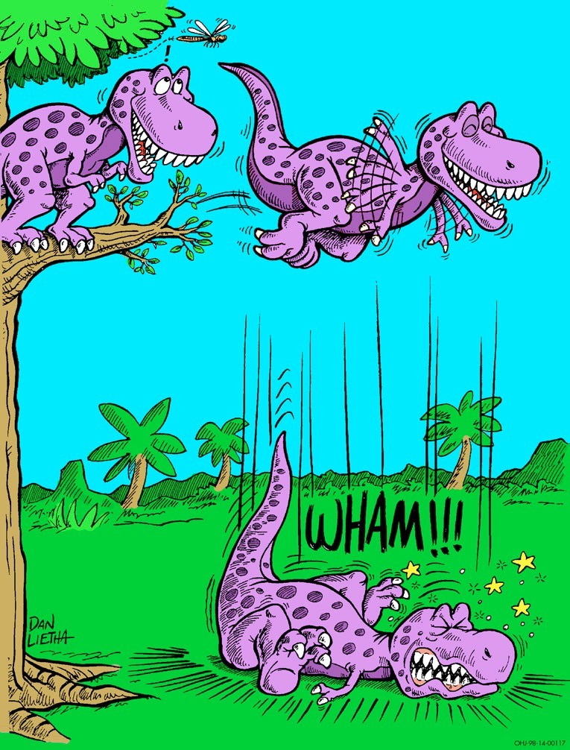
Notes:
Dan Leitha, AiG picture

Slide 27
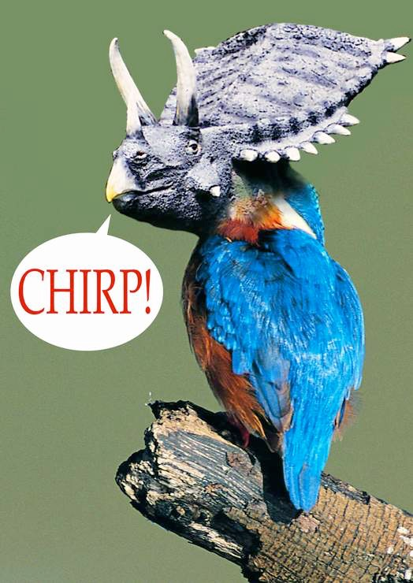
Теорія “Зберігай тепло”
“Дійсно, найпростіше і найбільш глибоке заперечення усім терморегуляторним теоріям є: звідки з'явилось пір'я? піря є дуже складне і по структурі і ембріологічно.”
(Алан Федуччія, The Age of Birds, p. 55)
Бррр!
Трікеракет

Slide 28
1999
Пір'я для Тиранозавра Текса?
“Нові, схожі на птахів скам'янілості, не мають втрачені ланки еволюції в динозаврів.”
Крістофер П. Слоан, “Feathers for T-Rex?,” National Geographic, 196:5 (Nov. 1999), pp. 98-107.

Slide 29
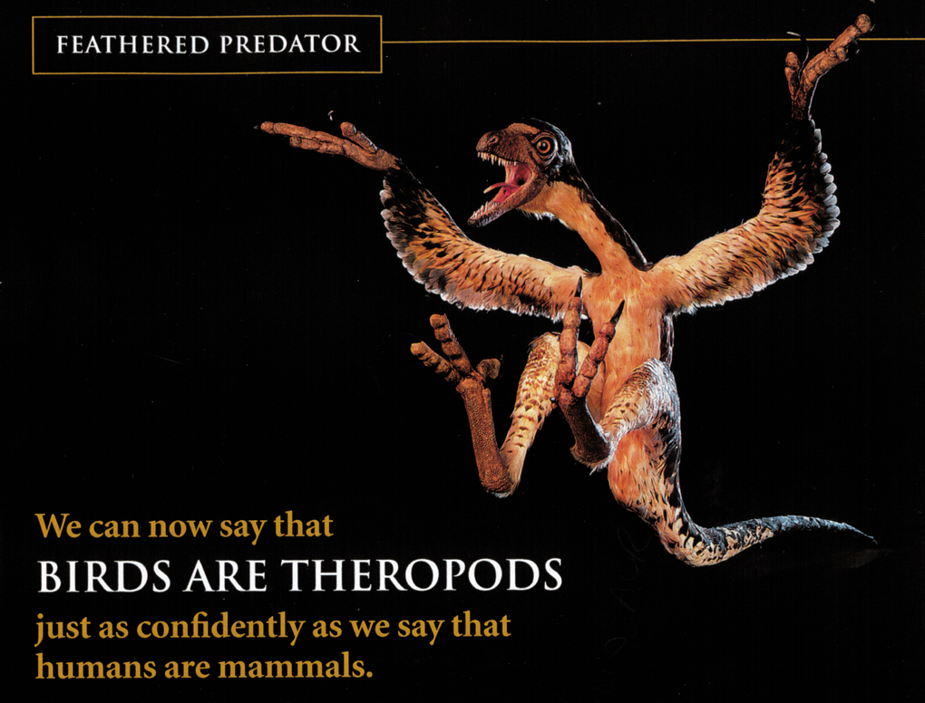
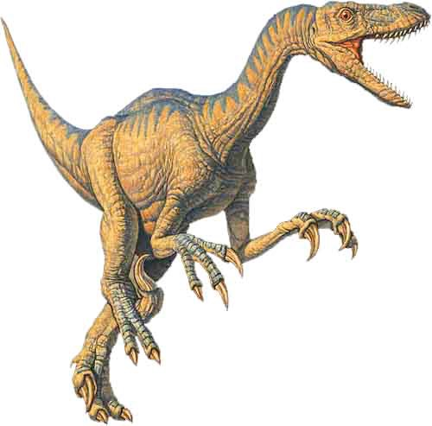

Обман !
Тепер ми можемо сказати, що
ПТАХИ – ЦЕ ТЕРОПОДИ
так само впевнено, як ми кажемо, що люди, це ссваці.
Notes:
This picture in the article is NOT Archaeoraptor liaoningensis, but rather Sinorthosaurus millenii, which is another dino-bird discussed in the article very similar to Archaeoraptor liaoningensis.
Source: National Geographic, 196:5 (Nov. 1999), p. 105.
Therapod (velociraptor) picture: http://www.arizonaskiesmeteorites.com/Dinosaur_Fossils_For_Sale/T_rex_fossils_Tyrannosaurus_rex/Velociraptor/, accessed 1 may 2007

Slide 30
Discover (лютий 2003):
А як щодо інших свідчень про динозаврів з пір'ям?
Алан Федуччія:
Коли ми бачимо справжні пір'я, які збереглись на зразках, ми повинні обережно визначити, чи ми дивимось на нелітаючих птахів, на яких збереглось пір'я, які тільки поверхово нагадують динозаврів, або якщо зразки насправді мають відношення до динозаврів. Це складна справа для нас на даний момент, враховуючи існування проблемних скам'янілостей.
Кетті A. Світіл, “Discover Dialogue: Ornithologist and Evolutionary Biologist Alan Feduccia Plucking Apart the Dino-Birds,” Discover, Vol. 24:2 (Feb. 2003), www.discover.com.
Notes:
www.discover.com/feb_03/breakdialogue.html
Feduccia is ornithologist and evolutionary biologist at Univ. of N. Carolina in Chapel Hill.
Feduccia says that birds and dinosaurs evolved from some common reptile ancestor but that birds did not evolve from dinosaurs.
Based on his teams research, he said in 2005 that the surface patterns in supposed “dino-bird” fossils found in China are not primitive feathers but rather “bits of decomposed skin and supporting tissues that just happen to resemble feathers to a modest degree.”
See “Scientists Say No Evidence Exists That Therapod Dinosaurs Evolved Into Birds,” Science Daily, 10 Oct. 2005, http://www.sciencedaily.com/releases/2005/10/051010085411.htm, accessed 1 May 2007.

Slide 31
Discover: До сих пір, тільки один динозавр з пір'ям, Археораптор, був публічно визнаний, як підробка. Ви думаєте, що є також і інші?
Федуччія: Археораптор є тільки верхівкою айсберга. Є велика кількість проблемних скам'янілостей, і вони кидають темні тінь на усе поле. Коли ви приходите на такі виставки скам'янілостей, важко сказати, який з них підробка, а який ні. Я чув, що є фабрика підробок скам'янілостей на північному сході Китаю, в провінції Ліаонінг, де є багато таких підробок динозаврів з пір'ям.
Notes:
www.discover.com/feb_03/breakdialogue.html
Kathy A. Svitil, “Discover Dialogue: Ornithologist and Evolutionary Biologist Alan Feduccia Plucking Apart the Dino-Birds,” Discover, Vol. 24:2 (Feb. 2003), <www.discover.com>.

Slide 32
“Майже кожна [з китайський скам'янілостей птахів], які я бачив на комерційному ринку, має певне відновлення, щоб виглядати краще. ... Підроблені камені стали дуже простим [для китайських селян] способом заробити, що важко розрізнити. ... Ви не можете побачити [фальшиву скам'янілість] без мікроскопу або ультрафіолетових чи рентгенівських променів.”
Крег Дерстлер (paleontologist, University of New Orleans) quoted in Jeff Hecht, “F is for fake,” New Scientist, 19 Feb 2000, p. 12.

Slide 33
Федуччія продовжує:
“Журнали, такі як Nature не вимагають зразки для підтвердження, і зразки зразу ж опиняються в Китаї, отже ніхто не може їх перевірити. Це можуть бути чудесні відкриття, це можуть бути втрачені ланки, як вони заявляють, але немає жодного способу все це підтвердити.”
Кеті A. Світіл, “Discover Dialogue: Ornithologist and Evolutionary Biologist Alan Feduccia Plucking Apart the Dino-Birds,” Discover, Vol. 24:2 (Feb. 2003), www.discover.com.
Notes:
www.discover.com/feb_03/breakdialogue.html

Slide 34
Федуччія сказав, що публікація і просування динозаврів з пір'ям відомими ЗМІ і престижними журналами, включаючи National Geographic, Nature і Science, зробили так, що складно почути протилежне баченням. Він сказав:
“З появою ‘динозаврів з пір'ям,’ ми дійсно стаємо свідками початку падіння поля палеонтології.”
2005
Д. Вільямсон, “Latest study: scientists say no evidence exists that theropod dinosaurs evolved into birds,” DUNC News Services, www.unc.edu, 10 Oct. 2005.
Notes:
http://www.unc.edu/news/archives/oct05/feducci100705.htm, accessed 12 May 2014
Whole article:
CHAPEL HILL -- No good evidence exists that fossilized structures found in China and which some paleontologists claim are the earliest known rudimentary feathers were really feathers at all, a renowned ornithologist says. Instead, the fossilized patterns appear to be bits of decomposed skin and supporting tissues that just happen to resemble feathers to a modest degree.
Led by Dr. Alan Feduccia of the University of North Carolina at Chapel Hill, a team of scientists says that as a result of their new research and other studies, continuing, exaggerated controversies over "feathered dinosaurs" make no sense.
"We all agree that birds and dinosaurs had some reptilian ancestors in common," said Feduccia, professor of biology in UNC’s College of Arts and Sciences. "But to say dinosaurs were the ancestors of the modern birds we see flying around outside today because we would like them to be is a big mistake.
"The theory that birds are the equivalent of living dinosaurs and that dinosaurs were feathered is so full of holes that the creationists have jumped all over it, using the evolutionary nonsense of ‘dinosaurian science’ as evidence against the theory of evolution," he said. "To paraphrase one such individual, ‘This isn’t science . . . This is comic relief.’"
A report on the team’s latest research appears in the Journal of Morphology published online Monday (Oct. 10). Other authors are Drs. Theagarten Lingham-Soliar of the University of KwaZulu-Natal in South Africa and Richard Hinchliffe of the University College of Wales.
Using powerful microscopes, the team examined the skin of modern reptiles, the effects of decomposition on skin and the fossil evidence relating to alleged feather progenitors, also known as "protofeathers."
They found that fossilized patterns that resemble feathers somewhat also occur in fossils known not to be closely related to birds and hence are far more likely to be skin-related tissues, Feduccia said. Much of the confusion arose from the fact that in China in the same area, two sets of fossils were found. Some of these had true feathers and were indeed birds known as "microraptors," while others did not and should not be considered birds at all.
"Collagen is a scleroprotein, the chief structural protein of the connective tissue layer of skin," he said. "Naturally, because of its low solubility in water and its organization as tough, inelastic fiber networks, we would expect it to be preserved occasionally from flayed skin during the fossilization process."
Although a few artists depicted feathered dinosaurs as far back as the 1970s, Feduccia said the strongest case for feathered dinosaurs arose in 1996 with a small black and white photo of the early Cretaceous period small dinosaur Sinosauropteryx, which sported a coat of filamentous structures some called "dino-fuzz."
"The photo subsequently appeared in various prominent publications as the long-sought ‘definitive’ evidence of dinosaur ‘feathers’ and that birds were descended from dinosaurs," he said. "Yet no one ever bothered to provide evidence -- either structural or biological -- that these structures had anything to do with feathers. In our new work, we show that these and other filamentous structures were not protofeathers, but rather the remains of collagenous fiber meshworks that reinforced the skin."
Belief in the existence of the "dino-fuzz feathers" caused some scientists to conclude that they served as insulation, and hence dinosaurs were warm-blooded.
The researchers also examined evidence from five independent, agreeing studies involving structural and genetic analyses related to the "tridactyl," or three-fingered, hand, which is composed of digits 1, 2 and 3 in dinosaurs, Feduccia said. That is the most critical characteristic linking birds to dinosaurs. They found that embryos of developing birds differed significantly in that bird wings arose from digits 2, 3 and 4, the equivalent of index, middle and ring fingers of humans. To change so radically during evolution would be highly unlikely.
"If birds descended from dinosaurs, we would expect the same 1, 2 and 3 pattern," he said.
Current dinosaurian dogma requires that all the intricate adaptations of birds’ wings and feathers for flight evolved in a flightless dinosaur and then somehow became useful for flight only much later, Feduccia said. That is "close to being non-Darwinian."
Also, the current feathered dinosaurs theory makes little sense time-wise either because it holds that all stages of feather evolution and bird ancestry occurred some 125 million years ago in the early Cretaceous fossils unearthed in China.
"That’s some 25 million years after the time of Archaeopteryx, which already was a bird in the modern sense," he said. Superficially bird-like dinosaurs occurred some 25 million to 80 million years after the earliest known bird, which is 150 million years old."
Feduccia said the publication and promotion of feathered dinosaurs by the popular press and by prestigious journals and magazines, including National Geographic, Nature and Science, have made it difficult for opposing views to get a proper hearing.
"With the advent of ‘feathered dinosaurs,’ we are truly witnessing the beginnings of the meltdown of the field of paleontology," he said. "Just as the discovery a four-chambered heart in a dinosaur described in 2000 in an article in Science turned out to be an artifact, feathered dinosaurs too have become part of the fantasia of this field. Much of this is part of the delusional fantasy of the world of dinosaurs, the wishful hope that one can finally study dinosaurs at the backyard bird feeder.
"It is now clear that the origin of birds is a much more complicated question than has been previously thought," Feduccia said.
The UNC scientist is the author of more than 150 papers and six major books, including The Age of Birds, which Harvard University Press published in 1980 and The Origin and Evolution of Birds, published by Yale University Press in 1996.
Among other discoveries, Feduccia found by a careful examination that Archaeopteryx, the earliest known bird and one of the world’s most famous fossils, could fly. Previously, many scientists thought the animal to be an Earth-bound dinosaur.
He determined its flying ability by observing that the fossil’s feathers had leading edges significantly shorter than their trailing edges, which is characteristic of all modern flying birds. The edges of feather of birds incapable of flight, such as ostriches, are symmetrical.

Slide 35
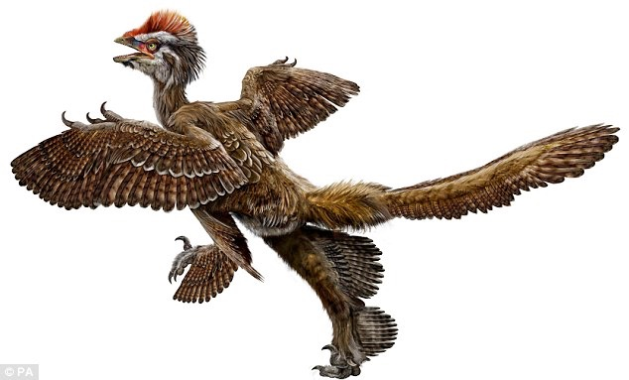
“Скам'янілості з пір'ям доводять, що птахи еволюціонували з динозаврів, кажуть китайські вчені.”
Лондон, Daily Mail, вересень 2009
Анхіорніс хакслей
Notes:
Anonymous, “Feathered fossils prove birds evolved from dinosaurs, say Chinese scientists,” http://www.dailymail.co.uk/sciencetech/article-1215998/Feathered-fossils-prove-birds-evolved-dinosaurs-say-Chinese-scientists.html, 25 Sept 2009, accessed the same day.
The team - lead by the man dubbed the 'real-life Indiana Jones' - say the fossils represent five different species from two different rock sequences in north-eastern China. All the species have feathers or feather-like structures. The new finds are 'indisputably' older than archaeopteryx, the oldest known bird, which scientists claim provides exceptional evidence that birds evolved from dinosaurs. The theory that birds evolved from dinosaurs has always been troubled by the absence of feathers more ancient than those on the famous archaeopteryx. Addressing the annual meeting of the Society of Vertebrate Paleontologists (SVP) in Bristol, Dr Xu Xing, one of the lead scientists behind the discovery, said: 'These exceptional fossils provide us with evidence that has been missing until now. Now it all fits neatly into place and we have tied up some of the loose ends.‘ The oldest bird, archaeopteryx, was older than the feathered dinosaurs previously found. Therefore, critics claimed, feathered dinosaurs could not have been ancestral to birds.
The dangers Dr Xing faces while searching for dinosaur fossils in some of the remotest regions of China have led him to be compared to Indiana Jones, the fictional archaeologist and action hero played by Harrison Ford.
His latest fossils were found in two separate rock formations - the tiaojishan, which would put the fossils at 168 to 151 million years old, and the daohugou formation, which would make them 164 to 158 million years old.
Archaeopteryx lived 150 to 145 million years ago, so was significantly younger than these new dinosaurs, Dr Xing's team said.
One of the dinosaurs, named anchiornis huxleyi has extensive plumage and profusely feathered feet.
Dr Xing said it had provided important new information on the origins of birds and the evolution of feathers.
He said: 'This fossil provides confirmation that the bird-dinosaur hypothesis is correct and supports the idea that birds descended from theropod dinosaurs, the group of predatory dinosaurs that include allosaurus and velociraptor.'

Slide 36
“Проблема з підробними скам'янілостями в Китаї є серйоpною і зростаючою. Заміст того, щоб бути викопаними палеонтологами під час розкопок скам'янілостей, більшість скам'янілостей того регіону витягнуті з землі дуже бідними фермерами і потім продані дилерам і музеям.”
John Pickrell, “The great dinosaur fossil hoax,” cosmosmagazine.com, 27 July 2015.
Notes:
https://cosmosmagazine.com/life-sciences/great-dinosaur-fossil-hoax

Slide 37
Перетворення рептилій в прахів?
Розвиток пір'я
Зміна респіраторної системи
Зміна системи скелету – порожнисті кістки
Зміна системи травлення
Зміна нервової системи
Поява дзьобу
Придбання здібності будувати гнізда
Вчаться літати і визначати напрямок
Розвиток органу вироблення звуків і вивчення пісень
Збір часу динозаврів і появи першої пташки

Slide 38
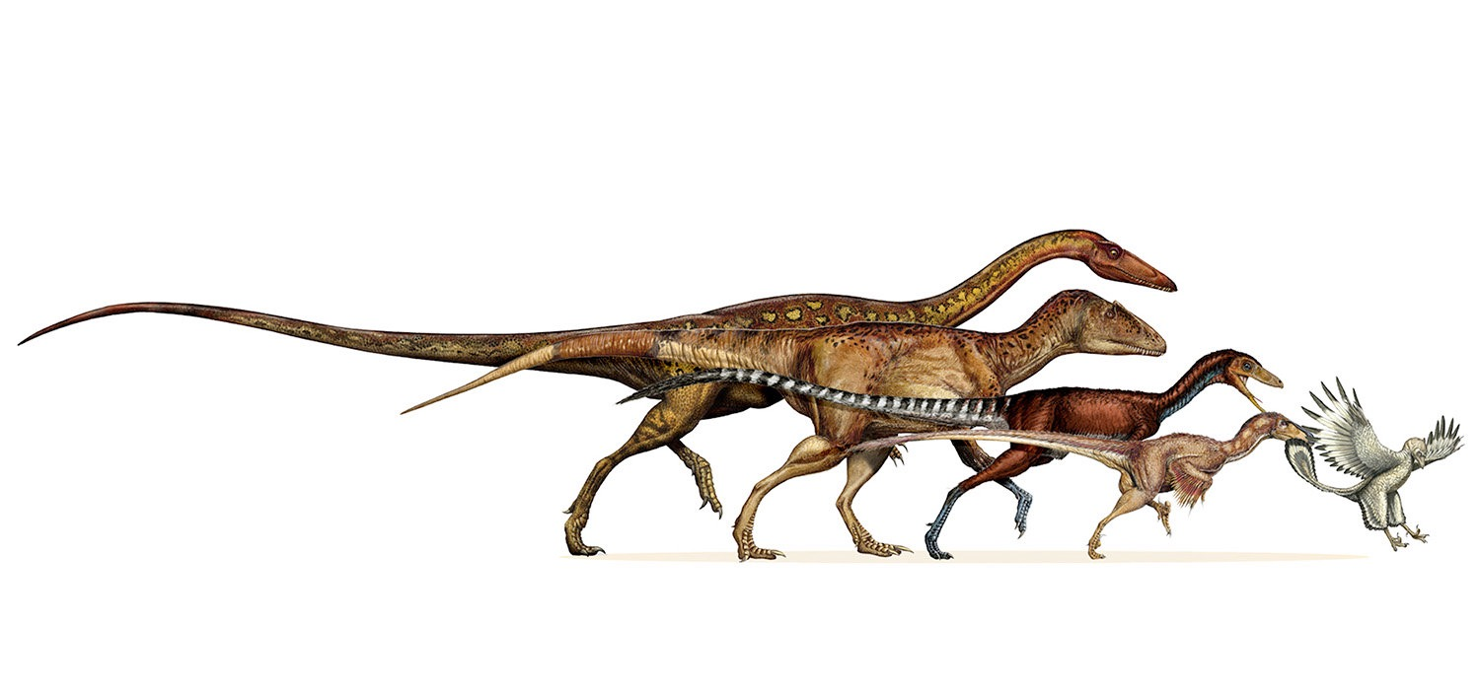
Постійне зменшення протягом 50 мільйонів років!
Майкл С. Лі, Andrea Cau, Darren Naish, and Gareth J. Dyke, “Sustained miniaturization and anatomical innovation in the dinosaurian ancestors of birds,” Science, Vol 345:6196 (1 Aug. 2014), pp. 562-566.
Notes:
http://news.yahoo.com/study-traces-dinosaur-evolution-early-birds-180059316.html, Seth Borenstein, “Study traces dinosaur evolution into early birds,” 31 July 2014, accessed 21 Aug 2014.
see next slide for description of how this happened, taken from the paper cited by Borenstein.

Slide 39
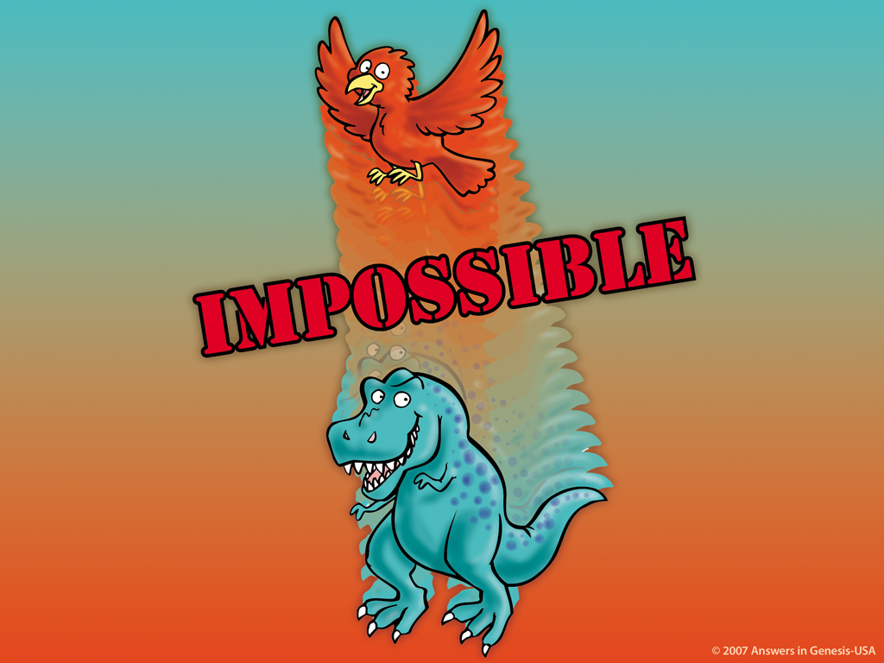

НЕМОЖЛИВО!

Slide 40
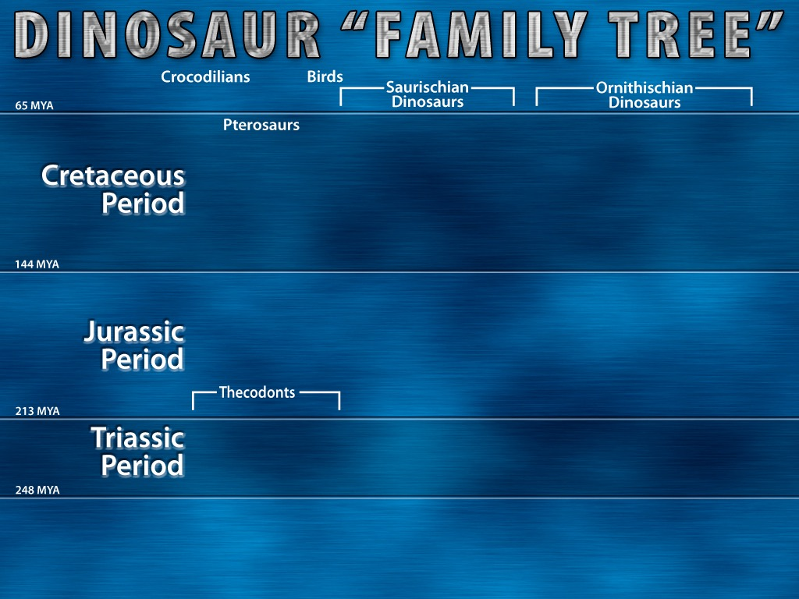

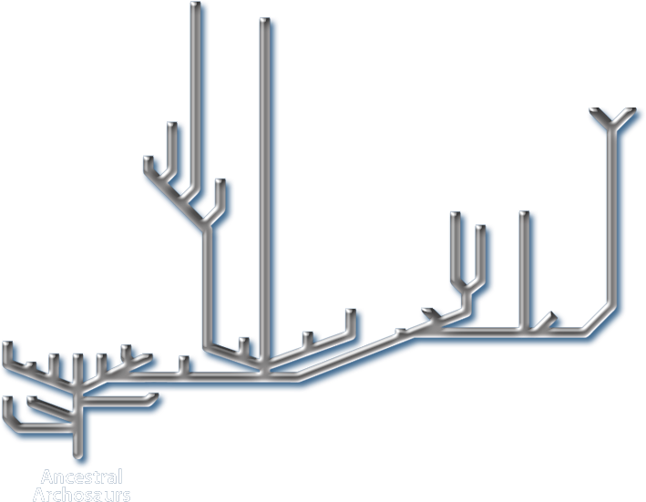
“[Yellow] lines indicate solid fossil evidence”
Notes:
In small print at the bottom of the chart it says: “Tinted areas indicate solid fossil evidence”. The tinted areas were grey [my yellow], the rest of the chart was white [my grey].
“Thecodont ("socket-toothed" reptile), now considered an obsolete term, was formerly used to describe a diverse range of early archosaurs that first appeared in the Latest Permian and flourished until the end of the Triassic period. The group includes the ancestors of dinosaurs (including birds), and ancestors of pterosaurs, and crocodilians, as well as a number of extinct forms that did not give rise to any descendants. … Teeth were set in sockets in the jawbones; an archosaurian characteristic that was inherited by the dinosaurs. … All current vertebrate paleontology textbooks, (e.g. Michael Benton's Vertebrate Palaeontology (first ed. 1990, 2nd ed. 1997), follow the cladistic approach, and so the name Archosauria is used instead. This includes both the Thecodonts and all their descendants.” http://en.wikipedia.org/wiki/Thecodont, accessed 18 April 2008.
Chart from David Lambert, The Encyclopedia of Dinosaurs (London: Bloomsbury Books, 1994), p. 26-27, published in association with the British Museum of Natural History.

Slide 41
“Істина, каже Маковіки, що вчені насправді не знають, що сталось з [з динозаврами]. Кожна гіпотеза сама по собі не зовсім підходить. Було вимирання повільне чи раптове? Нестача даних не дозволяє нам відповісти на питання’.”
Майкл С. Келлер, “Imagining life of dinosaurs Field Museum show aims to transport,” Chicago Tribune, 28 Mar 2007, Metro section, p. 1.
Notes:
Peter Makovicky is curator of dinosaurs at the Chicago Field Museum.
http://www.topix.net/content/trb/1345906430078534802600492800613923403796. accessed 15 Aug. 2007.

Slide 42
Використовуйте Біблію, щоб пояснити динозаврів!

Slide 43




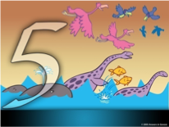

ДНІ ТВОРІННЯ В БУТТІ 1
ДЕНЬ
ДЕНЬ
ДЕНЬ
ЗЕМЛЯ, ПРОСТІР, ЧАС, СВІТЛО
ТВЕРДЬ
СУХОДІЛ & РОСЛИНИ
ДЕНЬ
ДЕНЬ
ДЕНЬ
СОНЦЕ, МІСЯЦЬ & ЗІРКИ
МОРСЬКІ СТВОРІННЯ & ПРАХИ
ЗЕМНІ ТВАРИНИ & ЛЮДИНА

Slide 44
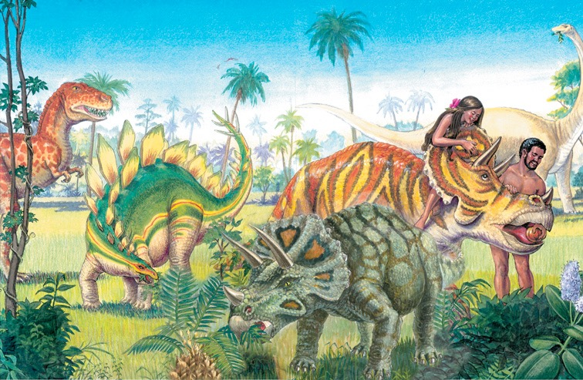
Notes:
We are finding some fossilized dino skin and since melanin is a durable pigment we are able to tell what color some were.

Slide 45

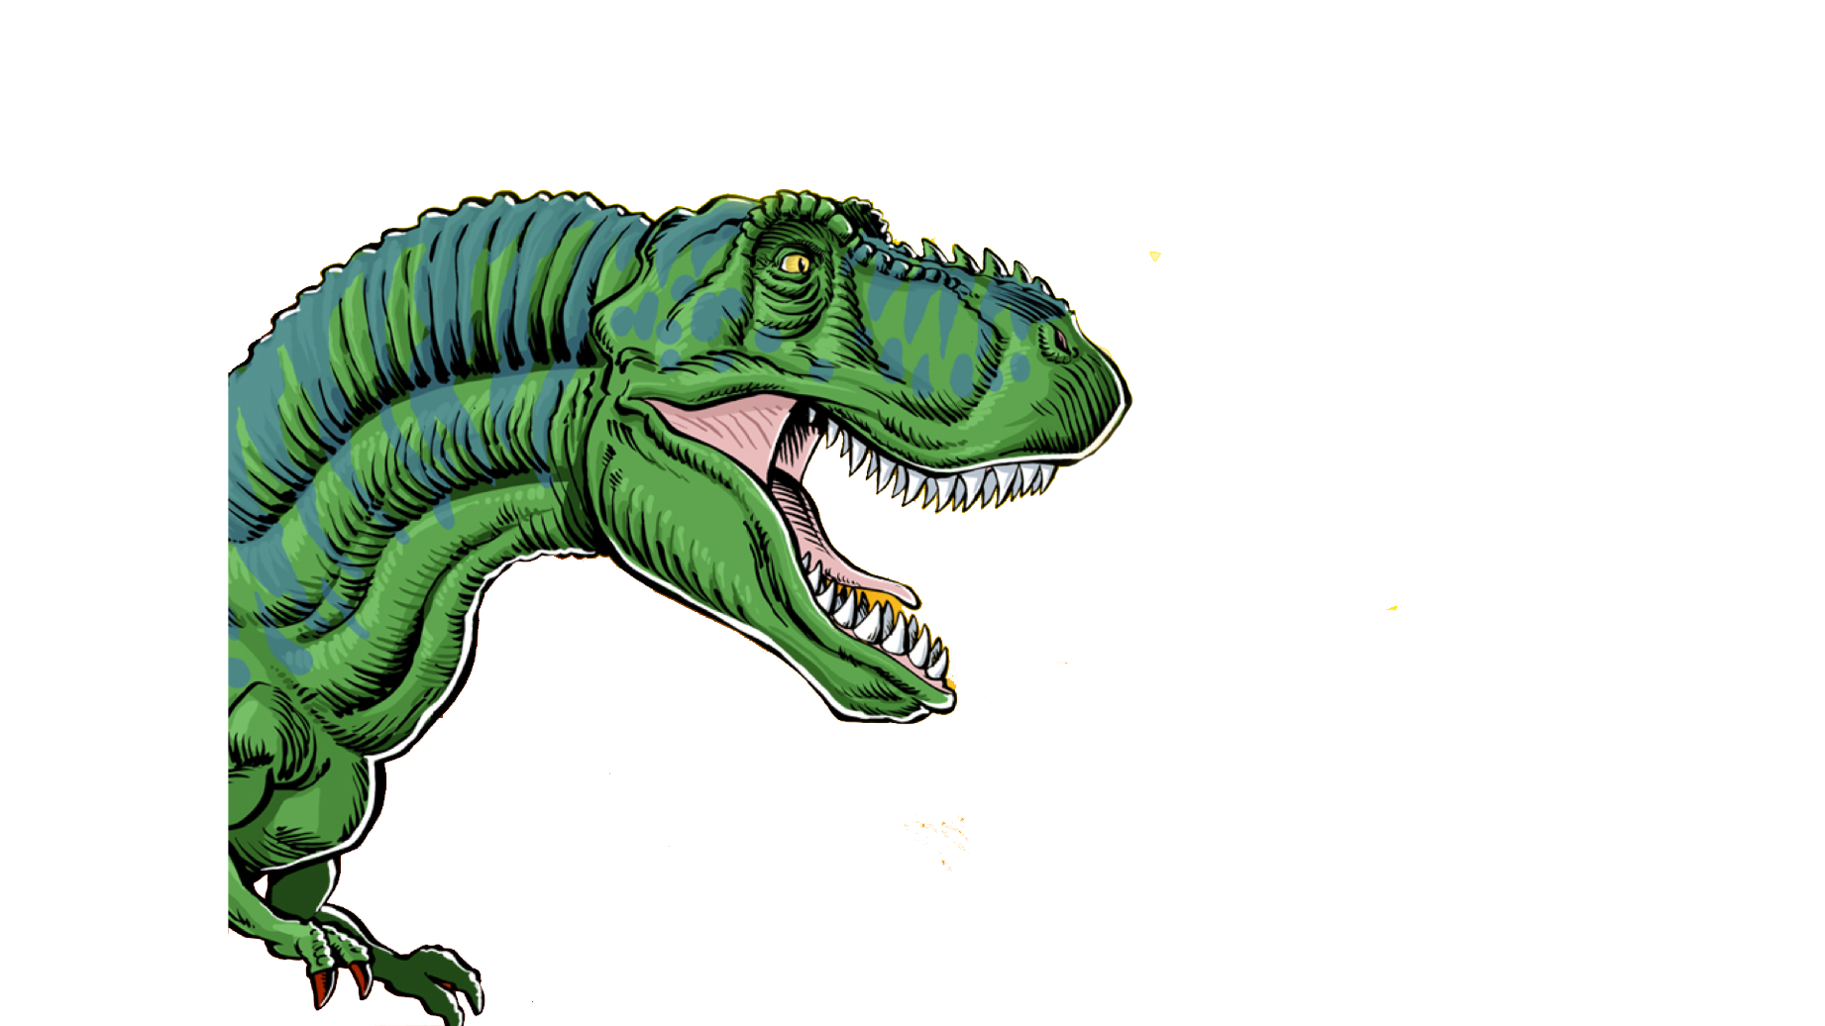
Тиранозавр Рекс
Мав зуби довжиною до 15 см!

Slide 46
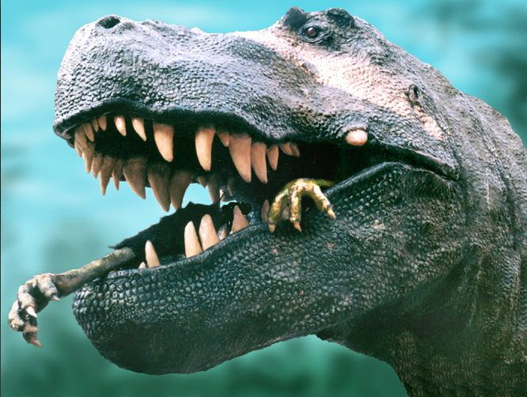
Notes:
Dino expert, Jack Horner (curator of paleontology at the Museum of the Rockies in Montana and technical adviser to Stephen Spielberg for the Jurassic Park films) argues that the monster’s forelegs were too short, its eyes too small and its speed too slow to make it a hunter. On the other hand, like a vulture, a large part of its brain was dedicated to sensing smells and it could travel long distances. So, he concludes, it was a scavenger, not a violent predator. See http://www.msnbc.com/news/922540.asp#BODY

Slide 47

Тиранозавр Рекс
Мав зуби довжиною до 15 см!
Як цей динозавр був описаний на початку?
a. Їв траву
b. Їв м'ясо
c. Їв падаль
d. Їв рослини & м'ясо
Notes:
6 inches = 15 centimeters

Slide 48
Буття 1:29-30
29. І сказав Бог: Оце дав Я вам усю ярину, що розсіває насіння, що на всій землі, і кожне дерево, що на ньому плід деревний, що воно розсіває насіння, нехай буде на їжу це вам! 30. І земній усій звірині і всьому птаству небесному, і кожному, що плазує по землі, що душа в ньому жива, уся зелень яринна на їжу для них. І сталось.
Notes:
NASB

Slide 49

“Буде на їжу це вам.”
Буття 1:29-30

Slide 50
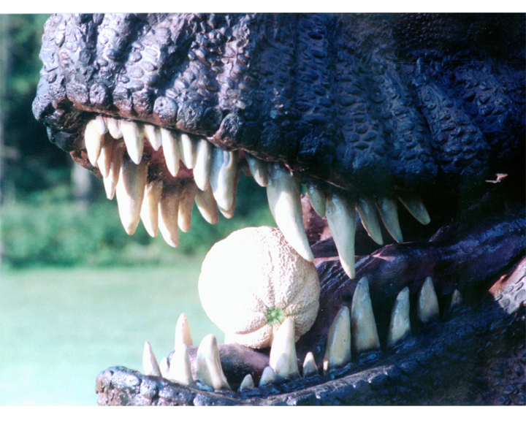

Slide 51
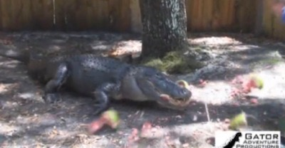
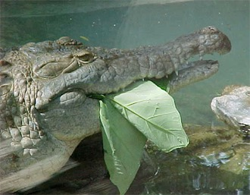
Алігатори їдять кавуни і листя
Дослідження: приблизно 3/4 видів крокодилів їдять фрукти часто і навмисно. (Журнал по Зоології 2013)
Notes:
Research: S. Platt et al., “Frugivory and seed dispersal by crocodilians: an overlooked form of saurochory?” Journal of Zoology 291(2013):87–99, doi:10.1111/jzo.12052.
Video of watermelon eating: http://www.youtube.com/watch?v=9xVwIuB-Xm4. Still shot from: http://www.answersingenesis.org/articles/2013/12/02/vegetarian-crocs
See also http://scienceblogs.com/tetrapodzoology/2009/06/27/alligators-vs-melons/ for evidence of them eating other fruits (e.g., lemons, kumquats) and leaves (picture above). This article cites research here: Brito, S. P., Andrade, D. V. & Abe, A. S. 2002. Do caimans eat fruit? Herpetological Natural History 9, 95-96.
Brueggen, J. 2002. Crocodilians: fact vs. fiction. In International Union of the Conservation of Nature, Crocodile Specialist Group 1, pp. 204-210.

Slide 52
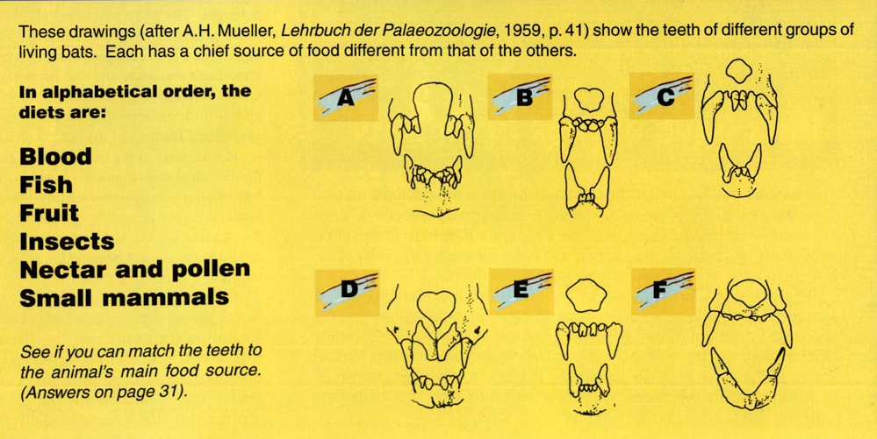

Які кажани їдять малих ссваців?
Кров
Риба
Фрукти
Комахи
Нектар & пилок
Маленькі ссавці
Notes:
Creation, 21:1 (Dec. 1998—Feb. 1999), p. 30.

Slide 53
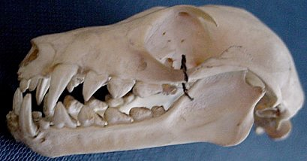
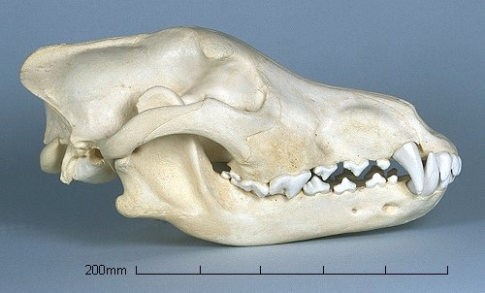
Череп кажана
Він їсть фрукти.
Череп вовка
Він їсть м'ясо.
Notes:
Wolf: http://www.skullsite.co.uk/Wolf/wolf.htm, accessed 1 May 2007
Bat: http://www.hitchams.suffolk.sch.uk/skeletons/bat.htm, accessed 1 May 2007

Slide 54
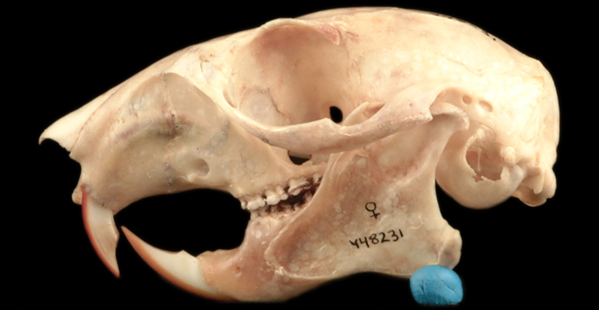
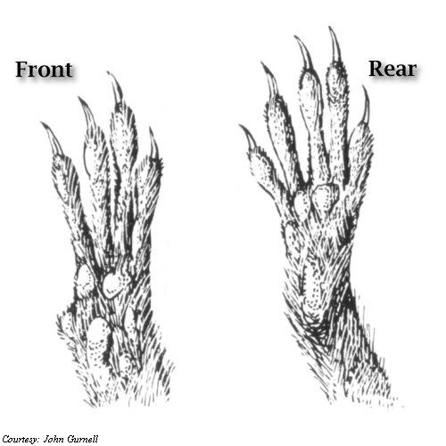
Череп білки
Білки в основному вегетаріанці!
Лапи білки
Notes:
Skull: western gray squirrel: http://naturalhistory.si.edu/lewisandclark/popup.cfm?id=888
Feet: http://unexco.com/sqfeet.jpg

Slide 55

“Хоча усі ведмеді мають зуби призначені для споживання м'яса, їх дієта складається в основному з рослин.”
Виставка ведмедів, зоопарк Таронга
Сідней, Австралія,
липень 1999.
Notes:
Photo: http://www.sphoto.com/medium/panda_eating_3370_473.jpg, accessed 3 Nov 2007.

Slide 56
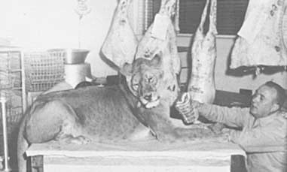
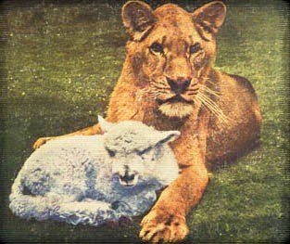
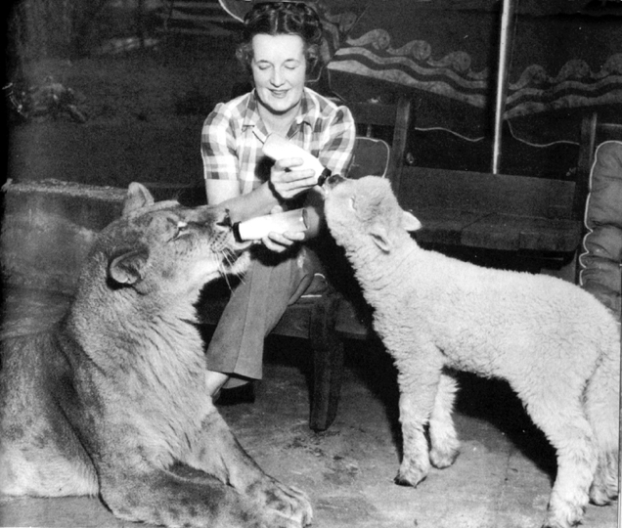
The Lioness That Refused To Eat Meat
Little Tyke drinking milk
“Little Tyke” refusing meat
“Little Tyke” with her best friend “Becky”
Notes:
In the 1950‘s Georges and Margaret Westbeau rescued new-born “Little Tyke” from a cage where her mother was trying to killer her. They nursed her back to health on their ranch near Seattle, WA. Refusing repeated attempts to get her to eat meat, she lived a normal healthy life on a diet of milk, eggs and grains. Here favorite friend at the ranch was Becky the lamb. She was filmed in California for the “You Asked For It” TV series when she was 4 years old. During those three weeks she contracted viral pneumonia and died peacefully a few weeks later.
Info and photos from http://www.vegetarismus.ch/vegepet/tyke.htm and http://www.animalliberationfront.com/Saints/Authors/Stories/LittleTyke.htm, accessed 2014 Feb 20

Slide 57
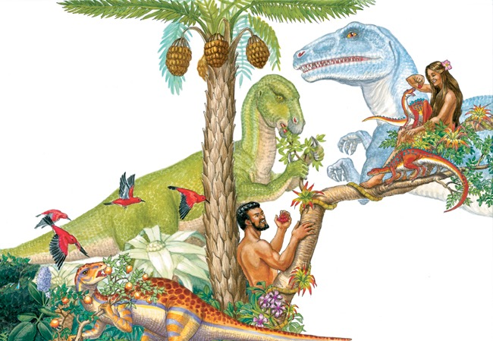

Slide 58
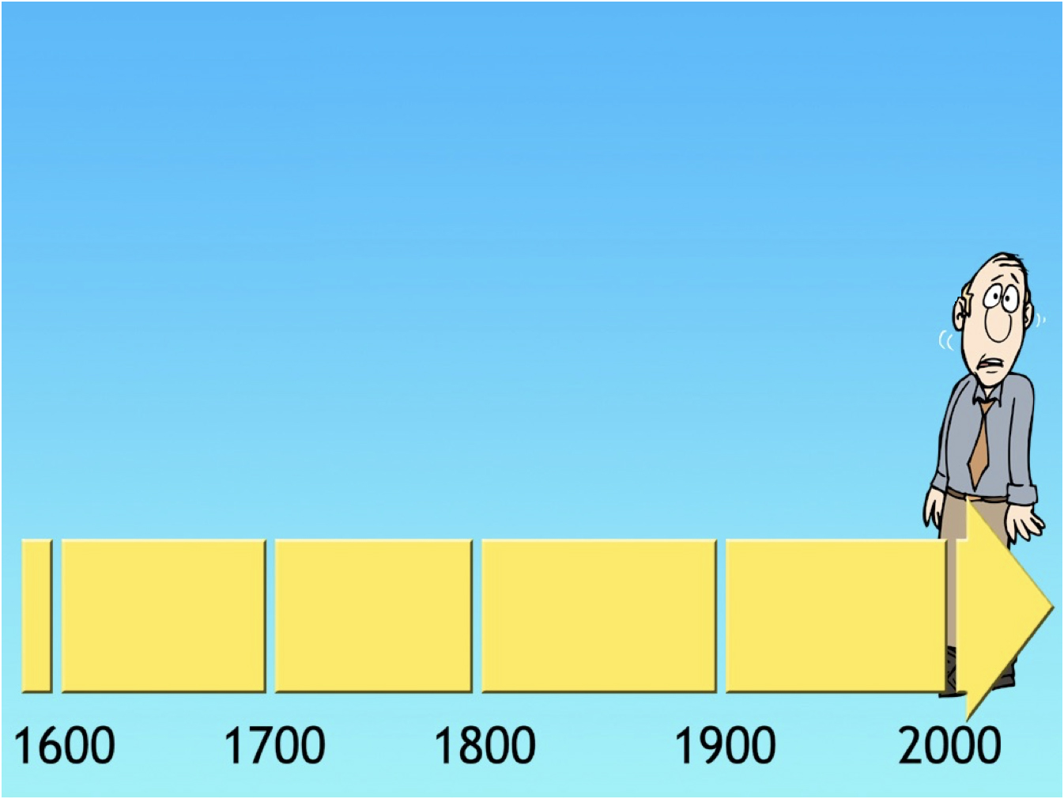
Чому я
не знаходжу
в Біблії слово
“Динозавр”?

Slide 59


Біблія
Короля Якова
переклад на англійську
1611

Slide 60
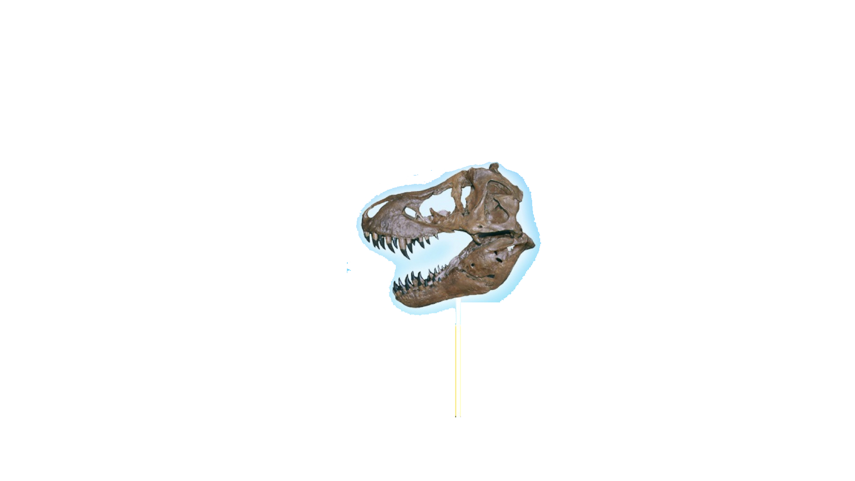


Біблія
Короля Якова
переклад на англійську
1611
“Динозавр”
винайдений у
1841
KJV Bible
translated
into English
1611

Slide 61


Біблія
Короля Якова
переклад на англійську
1611
“Динозавр”
винайдений у
1841
KJV Bible
translated
into English
1611
230 РОКІВ

Slide 62
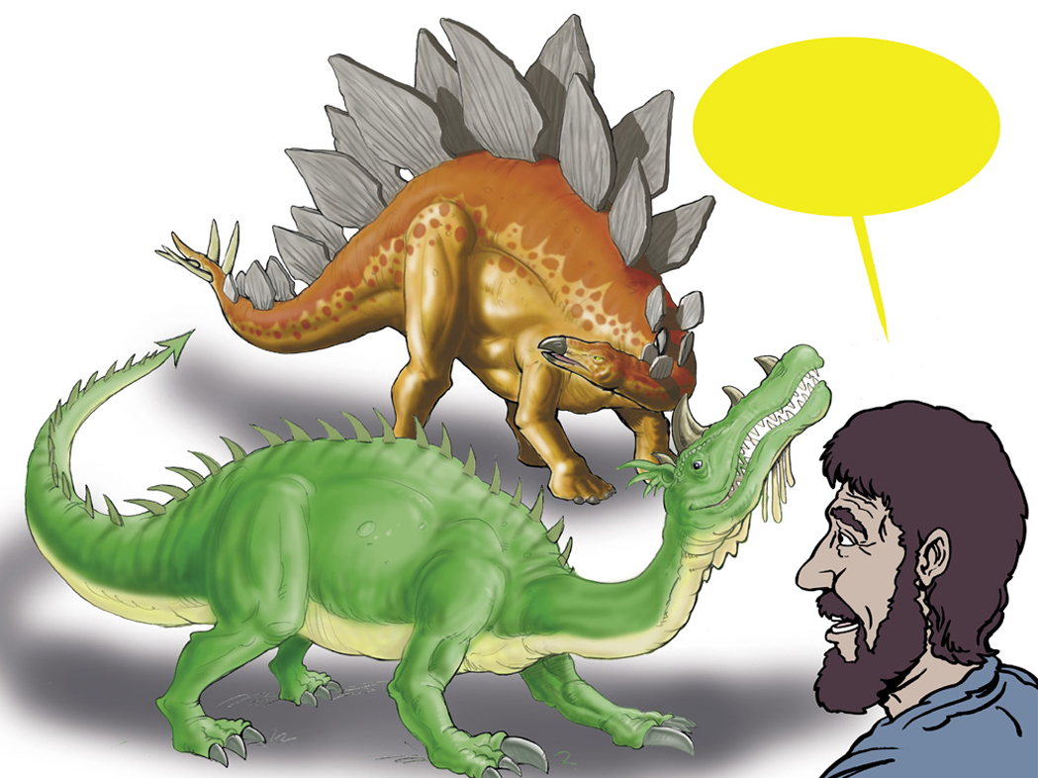
Єврейське слово Дракон?
“Таннін”
Notes:
Tannin is used of sea creatures (Isa. 27:1) and land animals (Ps. 91:13). It may be the equivalent of our “reptile,” although the passages where it is used generally seem to refer to great and fearsome creatures.

Slide 63
Isaiah 27:1
In that day the LORD will punish Leviathan, the fleeing serpent, with His fierce and great and mighty sword, even Leviathan, the twisted serpent; And He will kill the dragon who lives in the sea.
Notes:
“Dragon” is tannin in Hebrew.
NASB

Slide 64
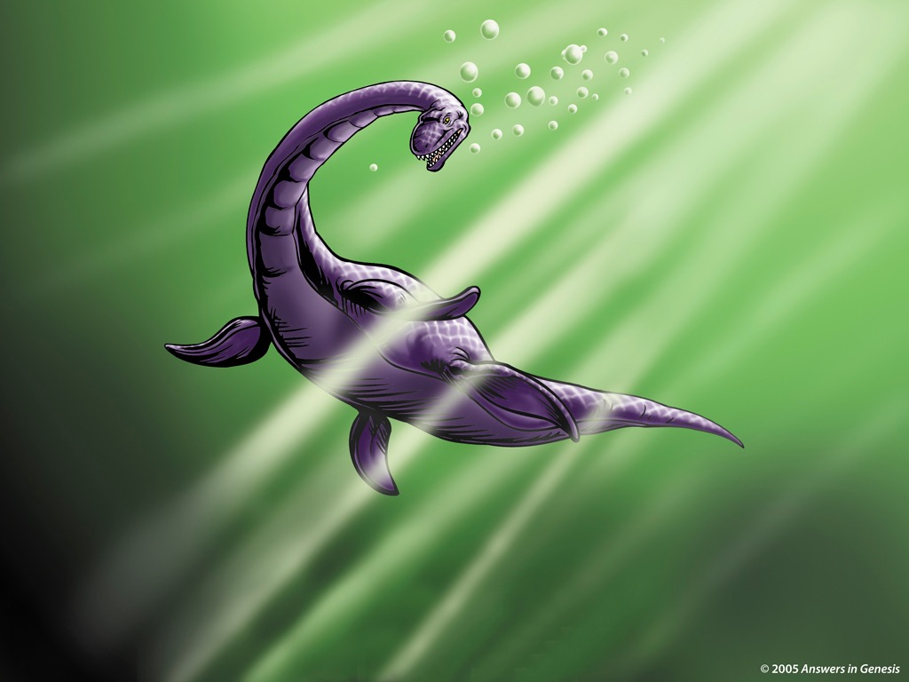

Notes:
Revised: September 2005. The plesiosaur’s name is a separate element that can be individually animated.

Slide 65
Ісаї 30:6
Пророцтво про Бегемота півдня. В краю утиску та переслідування, звідки левиця та лев, гадюка й огнистий летючий дракон, носять багатство своє на хребті молодих ослюків, і скарби свої на верблюжім горбі до народу, який не поможе.
Notes:
NASB

Slide 66
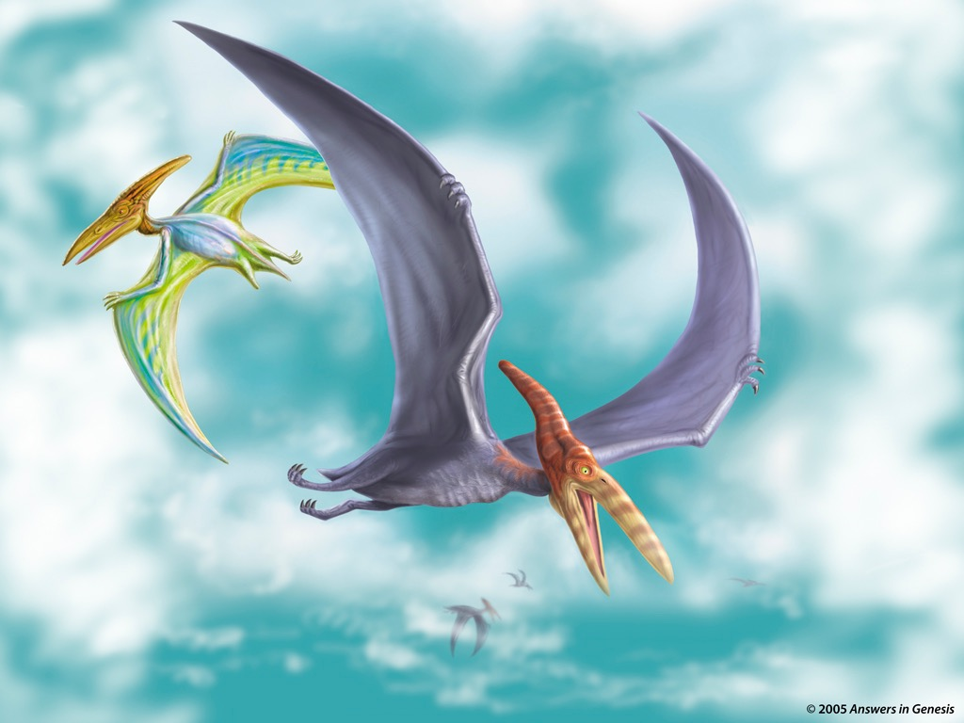

Notes:
http://thescotsman.scotsman.com/index.cfm?id=1911852005 says that according to fossil evidence reported on in Sept. 2005 pterosaurs (the group that included pteranodons) could reach a size of 18m (60 ft) wingspans, the size of a medium-sized commercial plane, which was twice the size scientists previously thought.
Revised: September 2005. The pteranodon’s name is a separate element that can be individually animated.

Slide 67
Йова 40:15-16
15. А ось бегемот, що його Я створив, як тебе, траву, як худоба велика, він їсть.
16. Ото сила його в його стегнах, його ж міцність у м'язах його живота.
Notes:
Job 38, 39 and first part of chapter 40 mention the horse, lion, eagle, deer, mountain goat, donkey, ox, ostrich and locust, all creatures which Job clearly saw around him.
NIV

Slide 68
Йова 40:18-19
18. Його кості немов мідяні оті рури, костомахи його як ті пруття залізні.
19. Голова оце Божих доріг, …
Notes:
NIV

Slide 69
Йова 40:17
Випростовує він, немов кедра …
“Можливо гіпопотам або слон.”
(Біблія NIV)
Notes:
NIV

Slide 70
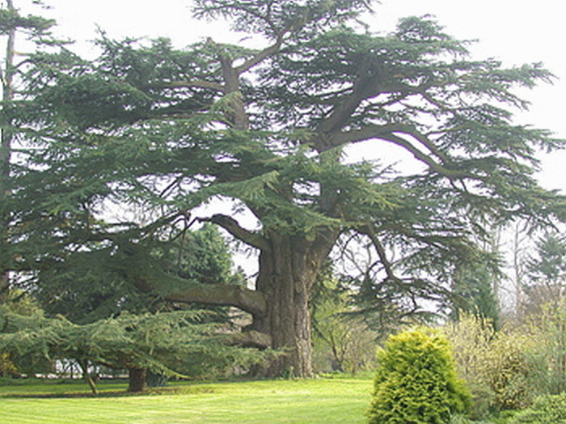
Ліванський керд

Slide 71





Slide 72
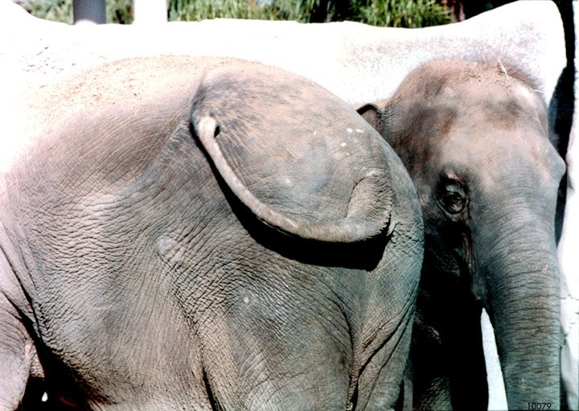

Slide 73
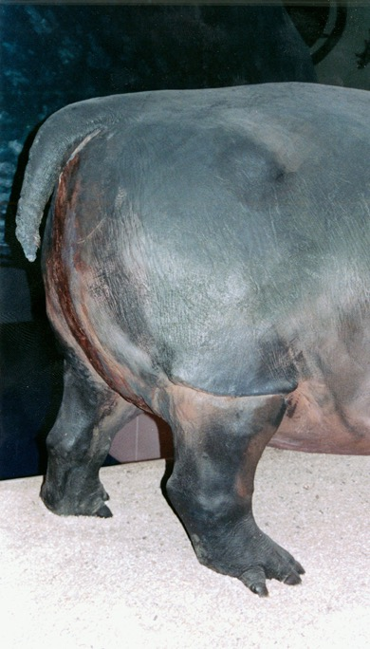

Slide 74

Notes:
Brachiosaur

Slide 75

Що
сталось?

Slide 76

DEATH
Suffering Disease Bloodshed
ГРІХ
СМЕРТЬ

Slide 77
Буття 3:14
І до змія сказав Господь Бог: За те, що зробив ти оце, то ти проклятіший над усю худобу, і над усю звірину польову! На своїм череві будеш плазувати, і порох ти їстимеш у всі дні свойого життя.”
Notes:
NASB

Slide 78


Бо знаємо, що все створіння разом зідхає
й разом мучиться аж досі.
Римлян 8:22
ГРІХ
Notes:
NASB

Slide 79

Notes:
From Bodie – here is a link to the Black Hills Institute of Geological Research that excavated Sue, the T-Rex, which had stomach contents of of both an Edmontosaurus (duck-billed dino) and even a couple of Tyranosaurids in the stomach contents too:
http://www.bhigr.com/pages/info/info_sue_3.htm
Live Science has also reported that T-Rexes have cannibalized their own:
http://www.livescience.com/10829-gashes-bones-suggest-rex-cannibal.html
Here is a PNAS article that discussed the failed attack of a T-Rex on a Hadrosaur but left distinct teethmarks on the hadrosaur.
http://www.pnas.org/content/early/2013/07/10/1216534110.full.pdf
A T-rex coprolite was discovered and reported by Dr. Karen Chin and colleagues, (June, 1998 issue of Nature), that a T-Rex had eaten a ceratopsian (Triceratops on this one). Here is the abstract:
http://www.nature.com/nature/journal/v393/n6686/full/393680a0.html

Slide 80

Пухлина мозку
Рак
Зламані
кістки
Артрит
Notes:
John Whitfield, “Dinosaurs got cancer,” Nature, 21 Oct 2003, http://www.nature.com/news/1998/031020/full/news031020-2.html, doi:10.1038/news031020-2, accessed 25 July 2016.
From the article:
Many dinosaurs had cancer, researchers have discovered.
Their tumours were like those of human patients, showing that cancer has been around, essentially unchanged, for a very long time. "Diseases look the same independent of what critter is affected," says radiologist Bruce Rothschild of the Northeastern Ohio Universities College of Medicine in Rootstown.
Rothschild's team travelled North America with a portable X-ray machine, scanning 10,000 dinosaur vertebrae from more than 700 museum specimens. They looked at such well-known dinosaurs as Stegosaurus, Triceratops and Tyrannosaurus.
Only one group - the hadrosaurs, or 'duck-billed dinosaurs' - suffered from cancer (fn 1). The team found 29 tumours in bones from 97 individuals of this herbivorous group from the Cretaceous period, about 70 million years ago.
Dinosaur tumours have been mooted before, but this is the first large-scale survey of them. The researchers found that some bones suggested to be cancerous were just poorly healed fractures.
It's not known for certain what made the hadrosaurs sick, although Rothschild points out that they ate conifers, which are high in carcinogenic chemicals. The structure of their bones also suggests they were warm-blooded, which might have increased their cancer risk.
"We know very little about dinosaur diseases," says palaeontologist David Norman of the University of Cambridge, UK. "Quite why hadrosaurs should be prone to lesions in their tails is a fascinating, if ultimately unanswerable, question." The animals might have been unusually long-lived, allowing more time for tumours to develop, he suggests.
The commonest growths were hemangiomas - benign tumours of the blood vessels that are present in about 10% of humans. "If I showed [the dinosaur bones] to a pathologist, he'd make the same diagnosis," says Rothschild.
The 3.5 metre species Edmontosaurus was most cancer-prone and was the only one with a malignant tumour. About 3% of its bones contained a lump of some sort.
Cancers have been found in everything from coral to budgerigars, but their frequency in most species is unknown.
Understanding what causes tumours in wild and extinct animals might help us to treat and prevent them in humans, says Rothschild. Studying museum specimens could shed light on how diseases have changed over time, he adds: "Routine X-rays would be very valuable in zoological and human collections."
Rothschild, B. M., Tanke, D. H., Helbling, M.II & Martin, L.D.. Epidemiologic study of tumors in dinosaurs. Naturwissenschaften, published online, doi:10.1007/s00114-003-0473-9 (2003).
Also Medical schools are studying dino cancer:
Dinosaur Tumor Studied for Human Cancer Clues
Heather Whipps
3 April 2006
http://www.livescience.com/4013-dinosaur-tumor-studied-human-cancer-clues.html, accessed 28 April 2011. The article begins:
Cancer in dinosaurs and illnesses in other animals are being studied in a groundbreaking new program that combines medical school with the study of natural history.
Educators hope the effort will produce doctors with a better understanding of why we get sick.
Despite being millions of years removed from our time and our own species, illnesses in animals like the dinosaurs can shed light on the evolution of human disease, says Christopher Beard, curator and specialist in vertebrate paleontology at Carnegie Museum of Natural History in Pittsburgh.
"Some diseases that afflict humans today, such as malaria, gout, and cancer, are truly ancient and were handed down to us from our distant ancestors," Beard told LiveScience. "By studying the distribution of these diseases in other living and fossil organisms, we can gain insights into the nature of these diseases.“
Students will now be offered the chance to learn about the history of disease as part of their regular medical school training, the University of Pittsburgh Medical Center announced recently.

Slide 81

Notes:
John Morris, Noah’s Ark and the Ararat Adventure (Master Books, 1994, 2nd ed.), p. 11. Used by permission of the publisher.
From: Laura Welch <lwelch@nlpg.com>
Date: Wednesday, December 14, 2016 at 5:00 PM
To: Terry Mortenson <TMortenson@AnswersinGenesis.org>
Subject: RE: copyright permission
Yes. You may use this image from Noah’s Ark and the Ararat Adventure for your DVD lecture as noted. We apologize that we do not have the original artwork to send you so I hope what you have will work.
Please note that the illustration is by Jonathan Chong and permission for use is from Master Books in small text below the image on your slide if possible.
Thanks!
Laura
New Leaf Publishing Group
NLPG.COM

Slide 82

По двоє з кожного роду земних тварин & птахів
Notes:
For translation: “kind” is the word used in the phrase “after its kind” or “after their kind” in Gen. 1:11-12, 21, and 24-25 and Gen. 6:20 and 7:14.
It should NOT be translated with the modern scientific word “species.”

Slide 83


Slide 84

15 м.
Світло неба
Палуба 1
Палуба 2
Палуба 3
26 м.
155 м.
Рампи
Люди і динозаври показані в масштабі.
Notes:
510 ft = 155 meters
51 ft = 15 meters
85 ft = 26 meters

Slide 85


Модель Ковчега
Вільямстаун, Кентуккі
Notes:
About 1.5 times the length and half the width
With the end zones, a football field is 360 feet (Without the end zones, a football field is 300 feet long.)
A football field is 160 feet wide

Slide 86

Notes:
Compsognathus was one of the smallest dinos (2.5 feet long and wighed only 6.5 pounds). Only two known specimens (found in Germany and France)

Slide 87


Notes:
Crocodile in egg: http://pixdaus.com/single.php?id=49609, accessed 17 Oct 2011
Large crocodile with man: http://mackaycartoons.blogdrive.com/archive/50.html

Slide 88

Notes:
Protoceratops

Slide 89

Апатозавр
Зростання
Тонни
взятий на Ковчег
висаджений
Вік (роки)
Based on Gregory M. Erickson et al, “Dinosaurian growth patterns and rapid avian growth rates,” Nature 412:6845 (26 July 2001), p. 431, fig. 2.
Notes:
According to the article, the microscopic study of dinosaurs bones from most major dinosaurian clades showed that they all had similar growth patterns and all the large dinosaur kinds were like Apatosaurus above—very little growth in the first 5 years and then exponential growth in the next few years. “All dinosaurs grew at rates more rapid than those of extant reptiles, but as a whole they did not show rates intermediate between reptiles and birds/mammals, nor values equivalent to the latter. Unexpectedly, our results show that growth in the Dinosauria was unique among major vertebrate groups…” (pp. 429-30).

Slide 90

Еволюціоністи кажуть:
550 родів і більше 1000 видів
Notes:
genera prounced as “jen’-er-a”
(not to be confused with genre [e.g., of literature]: pronounced as “zhahn-ruh”)

Slide 91


Апатозавр екселс
Диплодок карнегіі
Notes:
Apatosaurus was known previously by the now obsolete name Brontosaurus.
Both are sauripods (two genuses [or genera] in the family of Diplodocidae), surely the same created kind: http://landbeforetime.wikia.com/wiki/Apatosaurus, accessed 28 Aug 2013

Slide 92



Німецька вівчарка
Пітбультер’єр
Боксер
Усі одного виду: Canis familiaris
(домашня собака)
Notes:
Boxer: http://www.skullsite.co.uk/Boxer/boxer.htm, accessed 2012 Feb 27
Pit bull: http://www.boneclones.com/BC-186.htm, accessed 2012 Feb 27
German Shepherd: http://skullandbone.tumblr.com/post/15556802309/german-shepherd-skull-by-liquidonyx-on-flickr, accessed 2012 Feb 27

Slide 93


Цератопси
Notes:
You don’t need to translate the names of the different varieties of ceratops.
Some of the differences may reflect the different stages of development from juvenile to adult, some may be due to genetic variation within the kind, and some possibly due to mutations.

Slide 94


ВАРІАЦІЇ СОБАК
Notes:
You don’t need to translate the names of the different breeds of dogs.

Slide 95

Тільки 50-80
Видів
Динозаврів

Slide 96


Notes:
Paul S. Taylor, The Great Dinosaur Mystery and the Bible (Colorado Springs, CO: Chariot Victor Publ.), p. 24-25.

Slide 97

Мільярди мертвих речей
поховані в шарах каміння
залиті водою
по всій землі

Slide 98

Notes:
From Baumgardner slide—Dinosaur National Monument photo

Slide 99

Скам'яніла шкіра динозавра
Notes:
Fossilized skin of dinosaur ‘Minmi’, Queensland. (Photo by Lorraine Walker)
Creation 24:3 (June 2002), p. 7.

Slide 100

Тиранозавр перед смертю кидається у воду
Notes:
This posture is quite common among dinosaur fossils—so much so it has a name: the opisthotonic death posture. Research has suggested that death associated with immersion in water produces this posture. The violent rising waters of the global Flood would have provided the loads of sediment needed to catastrophically bury billions of animals and plants, triggering opisthotonus in dying dinosaurs and ultimately providing the conditions that preserved many as fossils. https://answersingenesis.org/dinosaurs/extinction/dinosaur-deaths-pose-link-immersion-water/, 10 Dec 2011, accessed 29 Oct 2014.
Source article: http://www.newscientist.com/article/dn21207-watery-secret-of-the-dinosaur-death-pose.html.com/#.VFD77r54NVg, accessed 29 Oct 2014
Photo: http://www.therpf.com/f9/help-please-jurassic-park-fossil-dig-photos-120038/, accessed 2 Dec 2011,
similar photo with man in picture: http://www.sciencebuzz.org/science-topic-areas/life-science/diversity-organisms?page=1, accessed 29 Oct 2014
One of the most complete T-rex skeletons in the world. It is on display in the Royal Tyrell Museum near Drumheller, Alberta, Canada

Slide 101


“Немає живих динозаврів”
“65 мільярдів років”
немає скам'янілостей людей або динозаврів
“Немає скам'янілостей людей”

Slide 102


Целакантоподібні
Знайдені живими у 1938 році
“17”
“65 мільйонів років”
немає скам'янілостей целакантоподібних
“Вимерли з динозаврами!”
Notes:
Previously the coelacanth was thought to have become extinct at time that the dinosaurs did, about 65 million years ago, because that was the highest rock layer where fossils have been found. It first appears in the strata dated at about 400 million years. Their fossils have been found in both (supposedly) fresh-water and (supposedly) salt-water deposits.
But then in the 1938 it was captured alive while swimming off the coast of Madagascar and it is virtually identical to the fossil forms. Many more have been accidently captured by fishing trawlers but in captivity they never have survived longer than 20 hours. They were first filmed in 1987 (for 8.5 hours, one fish for 6 hours), swimming in their natural habitat off the coast of Comoro Islands, NW of Madagascar.
In about 2011 a skull of an “anatomically modern coelacanth” was found in rocks dated to be only 17 million years old: http://www.nature.com/ncomms/journal/v3/n4/full/ncomms1764.html (“Earliest known coelacanth skull extends the range of anatomically modern coelacanths to the Early Devonian”), 10 April 2012.
It is a blue sluggish fish and apparently eats squid and other fish. Unlike most fish, it gives birth to live babies. It can swim backward and sometimes swims belly up. At first glance, it looks like a very uncoordinated swimmer. But careful analysis the films of the fins in action shows them to very synchronized like the gait of a trotting horse. They apparently find their food by their generated electric fields, The closest living relative (according to evolutionists) is the lungfish. It apparently lives at depths of about 150-200 meters (480-630 feet). Contrary to what evolutionists stated for decades, the fish never walks on the bottom on the ocean with its fins. It is not a transitional form on the way to becoming an amphibian. It is a 100% fish and beautifully designed that hasn’t changed really at all in supposedly 400 million years. This is all documented by Hans Fricke (who filmed them), “Coelacanths: The Fish That Time Forgot,” National Geographic (June 1988), pp. 824-838.
Since 1988, it has been found in the waters of Japan and Indonesia.

Slide 103
WHY did they become extinct,
if they did?

Slide 104
Possible Causes of Extinction
Man over-hunted them.
Man destroyed their habitat.
Man brought disease into their population.
Rapid climate changes in the post-Flood world.
But they might not be extinct—remember the coelacanth!!!
Notes:
If still alive, the most likely place dinosaurs would be is in biologically rich areas with limited or no human settlements, such as parts of the Congo and Papua New Guinea. Mokole-mbembe is a name of a creature reportedly seen from time to time on the edge of the deep jungles in the Congo and Murray is the T-rex type creature reportedly seen by natives and a Seventh Day Adventist pastor along the shores of Lake Murray in PNG. See Dave Woetzel, “The Cryptid of Lake Murray--a Living Theropod?” Creation Matters 20:3 (May/June 2015), pp. 2-3 (Creation Research Society newsletter).

Slide 105
Коли вони вимерли, якщо це дійсно так?

Slide 106

“Свіжі” кістки тиранозавра?
“Воно виглядає точно як шматок сучасної кістки. Але, звичайно,
я не могла в це повірити. Я сказала працівнику лабораторії: ‘Кісткам, врешті решт, 65 мільйонів років. Як клітини крові могли так довго зберегтись?’”
Мері Швейцер
1993
Virginia Morell, “Dino DNA: The Hunt and the Hype,” Science 261 (9 July 1993), p. 160.
Notes:
1993 Schweitzer-- grad student at Montana St. Univ. Museum of the Rockies, discovery--early 1992.
2005 Schweitzer --professor at U of N. Carolina, Chapel Hill.
David DeWitt explains: “Conventional wisdom held that proteins and DNA could not survive for millions of years. Indeed, an upper limit to the preservation of a stable protein such as collagen was presumed to be about 2.7 million years at 0°C, 180,000 years at 10°C, and only 15,000 years at 20°C.(1) Thus, there was much skepticism that what Schweitzer found was really dinosaur soft tissue when it was initially reported. Secular scientists were hesitant to believe that such tissue and proteins could persist for 65 million years.”
(1): Nielsen-Marsh, C., Biomolecules in fossil remains: A multidisciplinary approach to endurance, The Biochemist June 2002 pages 12–14, http://www.biochemist.org/bio/02403/0012/024030012.pdf. Quoted from DeWitt’s article: http://www.answersingenesis.org/articles/2007/04/13/t-rex-big-chicken#fnList_1_5, “Tyrannosaurus rex: a big chicken?”, 13 April 2007.
Picture from http://www.meas.ncsu.edu/faculty/schweitzer/schweitzer.htm, downloaded 29 March 2005.

Slide 107

Знайдені м'які тканини тиранозавра
Фрагмент тканини (зліва) це “гнучкий і стійкий і, коли розтягується (стрілка), повертається до своєї початкової форми” райони кістки (справа) показують волокнистий характер, “зазвичай цього не видно в скам'янілій кістці.”
2005
Mary H. Schweitzer, et al, “Soft-Tissue Vessels and Cellular Preservation in Tyrannosaurus rex,” Science 307:5717 (25 March 2005), pp. 1952-55.
Notes:
By 2005 Schweitzer was professor at U of N. Carolina, Chapel Hill.

Slide 108

Мяка тканина тиранозавра піднімає жахливі перспективи
CREDIT:
Mary Schweitzer
“Знайдена кістка тиранозавра bone мала гнучкі, розгалужені судини (зліва), деякі з яких містять клітинно-подібні структури (справа).”
Elizabeth Pennisi, “Tyrannosaurus rex Soft Tissue Raises Tantalizing Prospects,” Science 307: 5718 (25 March 2005), pp. 1852-53.
Notes:
Since 2005 this research has been further confirmed by Schweitzer and other researchers many times.
In 2009 she and her colleagues studied hadrosaur bones that show evidence of having been buried rapidly in a deep deposit of sandstone in the Judith River formation in Montana. See summary of the May 2009 Science article in “Proteins, Soft Tissue from 80 Million-Year-Old Hadrosaur Add Weight to Theory that Molecules Preserve Over Time,” http://www.physorg.com/news160320581.html, 30 April 2009, accessed 3 Aug. 2009. Further support is in M.H. Schweitzer et al, “Molecular analyses of dinosaur osteocytes support the presence of endogenous molecules,” Bone 52:1 (2013), pp. 414-423.
See also this 2007 article arguing for the authenticity of Schweitzer's conclusions: http://news.nationalgeographic.com/news/2007/04/070412-dino-tissues.html, accessed 2011 June 29.
Now dino DNA recovered: Schweitzer, M. H. et al. Molecular analyses of dinosaur osteocytes support the presence of endogenous molecules, Bone, 17 October 2012 | doi:10.1016/j.bone.2012.10.010. See also Thomas, B., Did scientists find T. Rex DNA? icr.org/article/7093/, 7 November 2012, Also Jonathan Sarfati’s article: http://creation.com/dino-dna-bone-cells, 2012 Dec. 11, accessed 2013 Jan 10, and these AiG News-to-Note: http://www.answersingenesis.org/articles/2012/10/27/news-to-note-10272012#three. AiG also covered the discovery cited in footnote 18 of this article in http://www.answersingenesis.org/articles/2012/10/20/news-to-note-10202012#three.
Triceratops soft tissue discovered: Mark H. Armitage and Kevin L. Anderson, “Soft sheets of fibrillar bone from a fossil of the supraorbital horn of the dinosaur Triceratops horridus,” Acta Histochemica *** (2013), pp. ***-*** (get details from Andrew Snelling). Abstract concludes: “This is the first report of sheets of soft tissues from Triceratops horn bearing layers of osteocytes, and extends the range and type of dinosaur specimens known to contain non-fossilized material in bone matrix.” Both authors are professors in biology at state universities. Both are YECs.
in 2015: Blood cells and collagen apparently in T-Rex book of poor quality: Andy Coghlan, “Dinosaur blood extracted from 75-million-year-old fossil,” http://www.newscientist.com/article/dn27687-dinosaur-blood-cells-extracted-from-75millionyearold-fossil.html#.VXdETFxVhHx, 2015 June 9, accessed the same day.

Slide 109

“80 мільйонів років назад” кровоносні судини Гадрозаврида
“Крихітні, тендітні судини, які переносили кров крізь гадрозаврида 80 мільйонів років назад ніколи не скамяніли і все ще містять тканини тварини, знайшло нове вивчення.”
2015
Laura Geggel, “80-Million-Year-Old Dinosaur Flood Vessels Never Fossilized,” news.discovery.com (10 Dec. 2015).
Notes:
http://news.discovery.com/animals/dinosaurs/80-million-year-old-dinosaur-blood-vessels-never-fossilized-151210.htm, accessed 22 Dec. 2015.

Slide 110
Вуглець-14 в кістках динозавра
Динозавр
“Вік” C-14
Зразок
Трицератопс, MT
Тріцератопс , MT
Гадрозавриди, MT
Гадрозавриди, MT
Акрокантозавр, TX
~30,890 років
~33,830 років
~22,380 років
~22,990 років
~23,760 років
Внутрішня кістка
Зовнішня кістка
Внутрішня кістка
Зовнішня кіска
Поверхня кістки—дуже великий зразок
Подібні результати з кісток динозаврів, знайдені в Китаї і Бельгії.
Notes:
http://www.dinosaurc14ages.com/carbondating.htm
See also http://crev.info/2015/06/c14-dinosaur-bone/ (Dave Coppedge’s site)

Slide 111

Майже кожна культура має легенди про драконів.
Музей для дітей в Канаді
Notes:
Dragons do not look like any living animal, but they do look remarkably similar to dinosaurs.

Slide 112


Прапор Уельсу

Slide 113
“Є петрогліф у Національному Монументі Природні мости, який має вражаючу схожість з динозавром, особливо Бронтозавра, з довгим хвостом і шиєю, малою головою і всім.”
Fran Barnes (authority on rock art of southwest America) “Messages on Stone,” Creation ex nihilo Vol. 19:2, p. 23.
Notes:
Natural Bridges National Monument is a located about 50 miles (80 km) northwest of the Four Corners boundary of southeast Utah, at the junction of White Canyon and Armstrong Canyon, part of the Colorado River drainage. It features the second and fourth largest natural bridges in the world, carved from the white Permian sandstone of the Cedar Mesa Formation.
This has been disputed here: http://www.foxnews.com/scitech/2011/03/29/creationists-claim-humans-lived-dinosaurs-scientists-disagree/?test=faces.
But AiG’s response is here: http://www.answersingenesis.org/articles/2011/03/18/feedback-senter-and-cole.

Slide 114

Національний Монумент Природні мости, Юта
Notes:
Natural Bridges National Monument is a located about 50 miles (80 km) northwest of the Four Corners boundary of southeast Utah, at the junction of White Canyon and Armstrong Canyon, part of the Colorado River drainage. It features the second and fourth largest natural bridges in the world, carved from the white Permian sandstone of the Cedar Mesa Formation.
This has been disputed here: http://www.foxnews.com/scitech/2011/03/29/creationists-claim-humans-lived-dinosaurs-scientists-disagree/?test=faces.
But AiG’s response is here: http://www.answersingenesis.org/articles/2011/03/18/feedback-senter-and-cole.

Slide 115

Notes:
Natural Bridges National Monument is a located about 50 miles (80 km) northwest of the Four Corners boundary of southeast Utah, at the junction of White Canyon and Armstrong Canyon, part of the Colorado River drainage. It features the second and fourth largest natural bridges in the world, carved from the white Permian sandstone of the Cedar Mesa Formation. The petroglyph is under Kachina Bridge.
This has been disputed here: http://www.foxnews.com/scitech/2011/03/29/creationists-claim-humans-lived-dinosaurs-scientists-disagree/?test=faces.
But AiG’s response is here: http://www.answersingenesis.org/articles/2011/03/18/feedback-senter-and-cole.

Slide 116


Ангкор Том (храм), Камбоджа
Руїни кхмерської цивілізації 12^{го} століття
Notes:
12th century bas-relief picture of a dinosaur in the ruins of Angkor outside of Siem Reap, Cambodia. The ruins of Angkor Thom have purposely not been restored, though other ruins of this ancient Khmer kingdom (9th--12th century) have been restored. The original edifices of Angkor Thom were constructed during the latter end of the kingdom. The most significant of the buildings of Angkor Thom is the great temple-monastery of Ta Prohm.
On the side of the west entrance to the temple are stone carvings of various common animals—pigs, monkeys, water buffaloes, roosters, snakes—and what appears to be a dinosaur! There are no mythological figures among them, so one can reasonably conclude that these figures depict the animals that were commonly seen by the ancient Khmer people in the twelfth century. Some have questioned the authenticity of the relief.
http://www.answersingenesis.org/docs2007/0115angkor.asp for pictures and info.
Inset photo and info: http://www.unexplainedearth.com/angkor.php, accessed 15 Sept 2007,
Further documentation of the authenticity of this from a different investigator is here: http://www.bible.ca/tracks/tracks-cambodia.htm, accessed 11 Aug. 2008

Slide 117



Бронзова кришка на гробі єпископа Белла (помер у 1496), на підлозі кафедрального собору в м. Карлайл, Великобританія
Notes:
Also engraved in the plate and easily recognizable are a bat, dogs, fish, a bird, an eel, a wild pig and a fox.
Photo taken by Phillip Bell, when he was with AiG-UK

Slide 118

“Жива скам'янілість”
“Вона вимерла 150 мільйонів років назад.”
Знайдена живою у 1994 році
“Відкриття сосни Воллемії можна порівняти з знайденням на землі все ще живого малого динозавра.”
Сосна Воллемія
Notes:
Supposedly went extinct 150 million years ago (Jurassic period—age of Dinosaurs) but found alive and healthy in 1994 in Wollemi National Park 200 km (125 mi) northwest of Sydney, Australia, and virtually identical to the fossil form found about 100 km (62 miles) away. Soon they will growing in gardens all over the world.
Wollemi pines are now well known to have the capacity to re-sprout after a catastrophe. New trunks can grow from old roots that may be 1000s of years old.
See Andrew Snelling’s ICR Impact article, No. 394 (April 2006), at www.ICR.org.
Photo from Ken Ham 27 Mar 2008
For Dr. Carl Werner’s list of living fossils (from his book, Living Fossils, New Life Publ, 2008): https://docs.google.com/document/d/1ixDBEuNJxwlbKDBV-54fLRkLmZs8SyJ1k0mYF0LgxUQ/edit

Slide 119


Біблії не можна
довіряти в цей
вік науки!

Slide 120


Світ
Еволюція
Мавполюдина
Теїстична
еволюція
Мільйони
років
Не було
всесвітнього
потопу
Біблійна
історія
не правдива
Методи
датування

Slide 122

Notes:
http://www.dinosoria.com/diapo_jurassic/images/jurassic_park019(1)_jpg.jpg

Slide 123

Музей природознавства, Лондон

Slide 124

Я б хотів бачити, що церква може зараз зробити!

Slide 125


Довірся Ісусу
Церква

Slide 126


Музей Творіння, Цинциннаті, Огайо

Slide 127


Печера динозавра

Slide 128


Палм Плаза

Slide 129


Еберезер Алозавр
Notes:
Found in western Colorado, we have 97% of the skull and over 50% of the skeleton
When alive Ebenezer was 30-foot-long, 10-foot-high.
Valued professionally at $1,000,000.
Andrew Snelling: “Of the 60 Allosaurus specimens found, only a half-dozen have such a complete skull, and it may be one of the two finest allosaur skulls in the world. It is also much larger than the famous ‘Big Al’ dinosaur at the Museum of the Rockies in Montana.”
Went on display at the Creation Museum in late May 2014.
https://answersingenesis.org/ministry-news/creation-museum/15-million-dinosaur-exhibit-dedicated-today/?utm_source=homepage&utm_medium=featured-slider&utm_campaign=allosaurus

Slide 130

ДИНОЗАВРИ
Ящірки місіонери!

Slide 131


ПРОПОВІДЬ ЄВАНГЕЛІЇ
СМЕРТЬ
ГРІХ

Slide 132
Використовуйте Біблію, щоб пояснити динозаврів!
По гріхопадіння не було смерті
Тисячі років
Динозаври і людина в День 6
Усі на початку вегетаріанці
Скамянілості від потопу Ноя

Slide 133


Наші роздумі
в кожній сфері!

Slide 134


Slide 135




Answers Book 1, 2, 3 & 4
whole books—FREE online
www.AnswersInGenesis.org
Answers/Online Books.
90-7-538_NewAnswersBookSet
Notes:
Answer the 130 most asked questions

Slide 136

The New Answers Book 1
gap theory?
races?
day-age theory?
global Flood?
Cain’s wife?
carbon-dating?
distant starlight?
dinosaurs?

Slide 137






Answers for Kids Vol. 1, 2, 3, 4, 5 & 6

Slide 138
Музей Творіння, Цинциннаті, Огайо

Slide 139


Модель Ковчега, Вільямстаун, Кентуккі

Slide 140
Black

Slide 141


Get this presentation for free!
Творіння • BibleStudyDownloads.org
Notes:
The Bible…Basically (bb)

