Slide 1

mbikj;jdk;
Kunta Kinte
lhf;lu; upf; fpup/gpj; rpq;fg;G+u; iggps; fy;Y}up
BibleStudyDownloads.org

Slide 2
tpsf;ff;fhl;rp
m- mbikj;jdj;jpd; mwpKfk; kw;Wk; tiuaiw
M - gz;ila r%fq;fspy; mbikfs;
, - mbikfspd; rpfpr;ir
< - mbikj;jdk; kf;fisg; gw;wp vd;d ntspg;gLj;JfpwJ?
c - mbikj;jdj;ijg; gw;wp nkhirf; rl;lk; fw;gpj;jJ
C - nkhirf; vjpuhf ghfhs; mbikr; rl;lq;fs;
v- Nuhkhdpa Nguurpd; mbikj;jdk;
V- mbikj;jdk; Fwpj;j ghypd; Nghjid
I - KbT

Slide 3
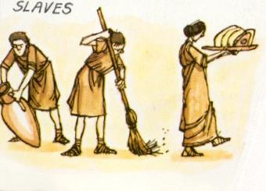
mbikj;jdk;
mup];lhl;by;
"mbik xU tho;f;if fUtp
fUtp xU capuw;w mbik "
Notes:
Paraphrase Aristotle and illustrate how slavery today has different terms: prostitution, human trafficking, work pass where the salary of the first 7 months of the year goes to the agent.

Slide 4

mbikj;jdj;jpd; Njhw;wk;:
mwpKfk; kw;Wk; tpsf;fk;
mbikj;jdk; vt;thW cUthdJ vd;gij Jy;ypakhf mwpa KbahJ
mbikj;jdj;jpd; Muk;g rhd;Wfs; fpK 3000 f;F Ke;ijait njw;F nknrhg;nghj;Njkpahtpy; (etPd <uhf;) rhkupa ehfupfj;jpypUe;jit

Slide 5
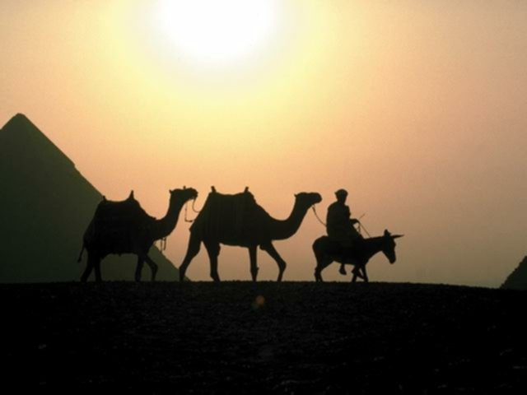
mbikj;jdj;jpd; Mjhuq;fs;
Introduction and definitio
mwpKfk; kw;Wk; tpsf;fk;
1. Nghu; ifjpfs;
2. fld;
3. fldhspfSf;F gpwe;jtu;fs;
4. rpiwgpbg;G - NahNrg;G rpiwgpbf;fg;gl;L 20 nts;sp Jz;LfSf;F mbikahf tpw;fg;gl;lhu;
5. jd;dhu;t mbik

Slide 6
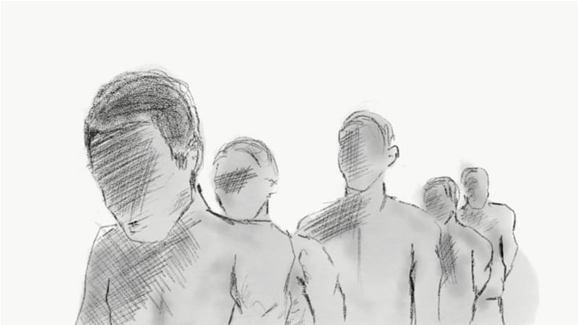
mbikj;jdj;jpd; tbtq;fs;
mwpKfk; kw;Wk; tpsf;fk;
mbikj;jdj;jpd; ntt;NtW tbtq;fs;
r%f Vzpapy; kpff; FiwT
tPl;L mbikfs; (c.j. Mgpufhkpd; tPl;by; vfpg;jpa `hfu;)
Nfhapy; mbikfs;
Ntiy mbikfs;
uh[hf;fSf;F mbikfs; –– rpy
Gdpj
efu mbikfs;
iftpidQu;fs;

Slide 7
rhkhupa tpsf;fk
mwpKfk; kw;Wk; tpsf;fk;
mbikf;fSdf;F rhkhupa thu;j;ijapd; mu;j;jk; "xU ntspehl;L Njrj;ijr; Nru;e;j egu;"
rpiwg;gpbf;fg;gl;ltu;fs; "tiwaiug;gLj;jg;gl;l Rje;jpuj;jpd; kf;fs;"
rpiwg;gpbf;fg;gl;ltu;fs; Nghupy; ifg;gw;wg;gl;ldu;> “cs;Shu; kf;fs; my;y”
fhy;tha;fs;> jhtu kw;Wk; mWtil gapu;fis fl;l gad;gLfpwJ
tiwaiug;gLj;J

Slide 8
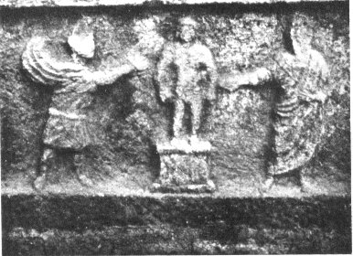
kw;W; tpsf;fk :
mwpKfk; kw;Wk; tpsf;fk;
xU egupd; epiy kw;nwhUtuhy; thq;fg;gl;lJ
fl;lha ciog;gpd; mikg;G
xU egupd; tpUg;gj;jpw;F vjpuhf mtupd; fl;Lg;ghL
kpff; Fiwe;j my;yJ Cjpak; ,y;yhky; fLikahd R+o;epiyapy; xUtuplkpUe;j Ntiyiag; ghJfhj;jy;
mbik Muhag;gLfpwhd;

Slide 9
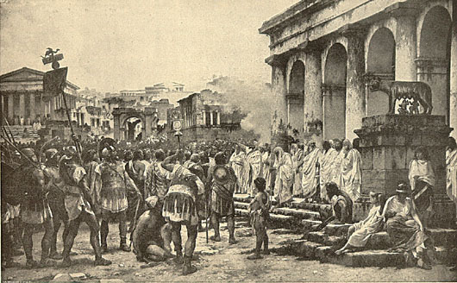
mwpKfk; kw;Wk; tpsf;fk;
Nuhkpy; gz;ila mbikj;jdk;
Nuhkhdpa rl;lk;: mbik vd;gJ xU tp\ak;> xU rhl;ly;> xU kuz nghUs;

Slide 10
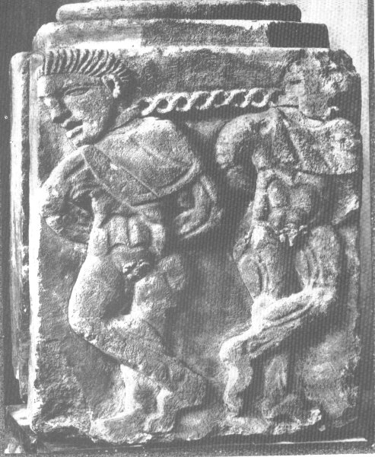
Nuhkhdpa kw;Wk; fpNuf;f rl;lq;fs;
mwpKfk; kw;Wk; tpsf;fk;
Nuhkhdpa rl;lk;
mbikfs; fhy;eilfspypUe;J NtWgLtjpy;iy
nrhj;jpd; Jz;L
ngUk;ghd;ikahd mbg;gil cupikfs;> jpUkzk; nra;aNth my;yJ FLk;gq;fis cUthf;fNth mDkjpf;fg;gltpy;iy
fpNuf;f rl;lk;
mbikfSf;F rpy Rje;jpuq;fs; ,Ue;jd
nrhe;j gpujpepjpahf ,Uf;f Ntz;Lk;
mtu; nry;y tpUk;Gk; ,lj;jpw;Fr; nry;yyhk;
mtu; nra;a tpUk;Gtijr; nra;ayhk;
,uz;L mbikfspd; fy; ntl;lf;fs;

Slide 11
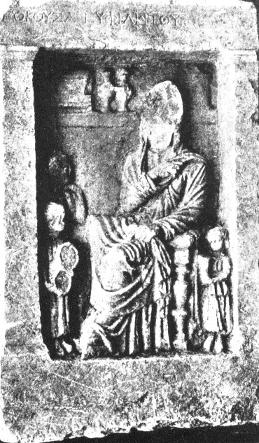
Kf;fpa tpjpKiwfs;
mwpKfk; kw;Wk; tpsf;fk;
ngf;Fypak; - nfhLg;gdT
ifahSjy; - mbik Rje;jpuk; mspj;J> jdJ vy;yh flikfspypUe;Jk; tpLtpf;fg;gl;lhu;
Nuhkhdpau; jdJ mbikfis ifahSk; 3 nghJthd Kiwfs;
1kf;fs; njhif
2fzf;nfLg;G
3 tpd;lpfh Vw;ghL
ngz; mtSila
mbikfSld;
Notes:
Census
Vindicta
Testamentum

Slide 12
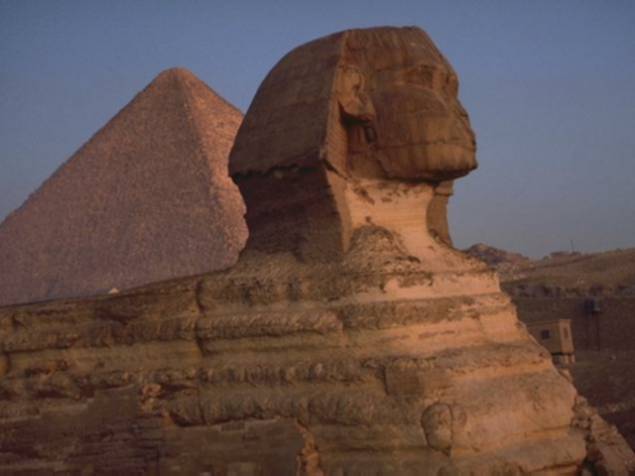
gz;ila r%fq;fspy; mbikfs;
gz;ila r%f gbepiyfspd; Kf;fpa kf;fs; FO
midj;J gz;ila ehfupfq;fspSk;
mbikj;jdk; ,Ue;jJ
mbik tpahghuk; nghJthdJ - NahNrg;G
vfpg;jpy; mbikj;jdj;jpw;F tpw;fg;gl;lhu;

Slide 13

gz;ila r%fq;fspy; mbikfs;
ghgpNyhdpy; r%f gbepiyfs; :
1.murd;
2.gpuGf;fs; - mtpY
3.Fiwe;j nrhj;J - K\;NfDtpd; ,ytr Fbkf;fs;
4.mbik -tUL
ngUk;ghyhd mbikfs; Nghu; ifjpfs;
,ytr Fbkf;fs; Fw;wq;fs; my;yJ fld;fs; fhuzkhf mbikj;jdj;jpw;F tpw;fg;glyhk;
mbikfs; Rje;jpukhf khWtJ fpl;lj;jl;l rhj;jpakw;wJ
Notes:
POW

Slide 14
gz;ila r%fq;fspy; mbikfs;
Njhw;fbf;fg;gl;l KO epyj;jpd; kf;fs;njhifia mbikj;jdj;jpw;F vLj;Jf; nfhs;sg;gl;ldu; :
III Jl;Nkh]; Ml;rpapd; NghJ vjpupahy; Njhw;fbf;fg;lL nrYj;jpa ghuhl;lpd; xU gFjpahf mbikfs; ,Ue;jdu :
  "… me;j Mz;by; 295 Mz; kw;Wk; ngz; mbikfs;> 68 Fjpiufs;> 3 jq;f jl;Lf;fs;> 3 nts;sp jl;Lf;fs; "
  (%d;whk; Jl;Nkh]; Ml;rpapd; 42 tJ (?) Mz;bypUe;J mwpf;if)
NahRth fpgpNahdpau;fis mbikj;jdj;jpw;F cl;gLj;jpdhu;:
“ePq;fs; xUNghJk; mbikfshf ,Ug;gij epWj;j khl;Bu;fs;> vd; flTspd; tPl;bw;F kuk; ntl;LNthu; kw;Wk; jz;zPu; ,Og;gtu;fs;" (NahRth 9:23)

Slide 15
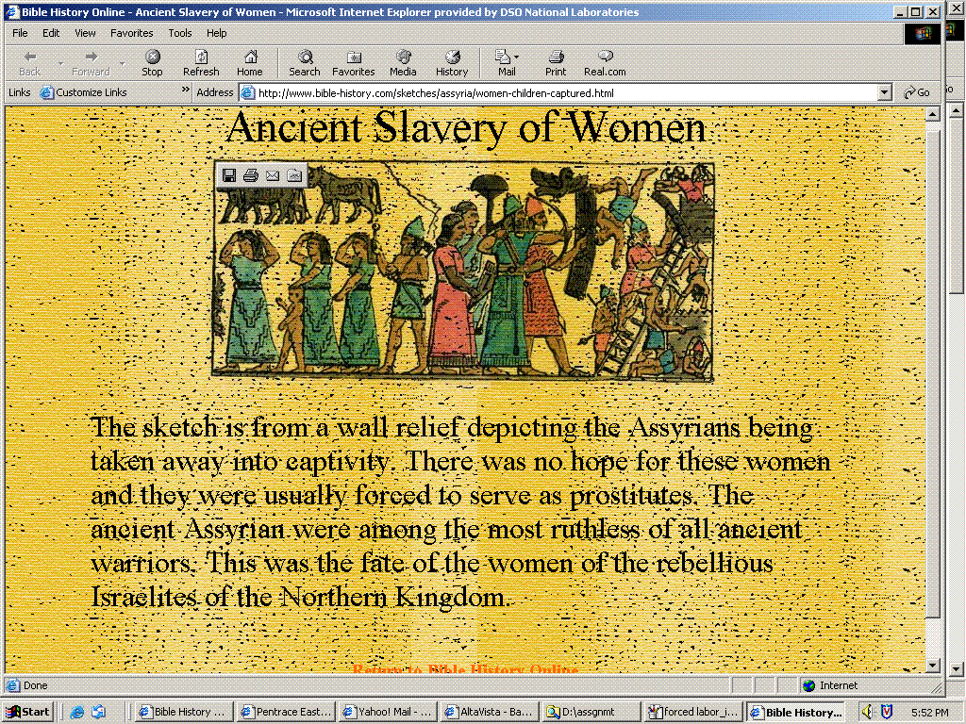
gz;ila r%fq;fspy; mbikfs;
Ancient Slavery of Women
The sketch is from a wall relief depicting the Assyrians being taken away into captivity. There was no hope for these women and they were usually forced to serve as prostitutes. The ancient Assyrians were among the most ruthless of all ancient warriors. This was the fate of the women of the rebellious Israelites of the Northern Kingdom.

Slide 16
gz;ila r%fq;fspy; mbikfs;
mbikj;jdk; cldbahf rl;lG+u;tkhf;fg;gl;lJ
gz;ila ehfupfq;fspd; nray;ghl;bw;F mj;jpahtrpakhFk;
gz;ila ehfupfk; tptrhaj;ijAk;> ciog;igAk; jPtpug;gLj;JfpwJ
ngUk;ghyhd gz;ila efuq;fs; mbikfshy; fl;lg;gl;ld
vfpg;jpa gpukpLfs; ,j;jifa eilKiwfspd; epidTr;rpd;dkhf ,Ue;jpUf;fyhk;

Slide 17
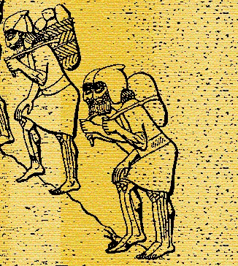
gz;ila r%fq;fspy; mbikfs;
Guhjhz fpof;F mUfpYs;s nghJthd gapw;rp
gz;ila mUfpYs;s <];l; ehfupfj;jpd; Fiwe;j xOf;fj;ij gpujpgypj;jJ
flTs;fSf;fhf cUthf;fg;gl;l mbikfshf kdpju;fisg; ghu;g;gjhy; kdpj tho;f;ifapy; nfhQ;rk; kjpg;G ,Uf;fpwJ
mbikfs; nrhj;jhfTk; ngUk;ghYk; tpyq;Ffisg; NghyNt elj;jg;gLfpwhu;fs;

Slide 18
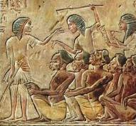
mbikfspd; rpfpr;ir
rpfpr;ir ngUk;ghYk; v[khdupd; jd;ikiag; nghWj;jJ :
Muk;gfhy vfpg;J - mbikfs; ,we;j ,uh[hTld; mlf;fk; nra;ag;gl;ldu;

Slide 19
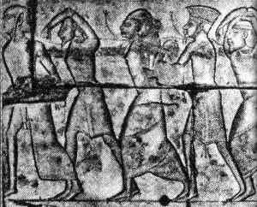
mbikfspd; rpfpr;ir
Ruq;fq;fspy; Ntiy nra;Ak; mbikfs; kpff; Fiwe;j czTld; ePz;l Neuk; cioj;jdu;
- mtu;fs; "xU ,ae;jpuj;ij mzpe;jpUg;gjhy;" kuzj;jpw;F Ntiy nra;jdu; "

Slide 20
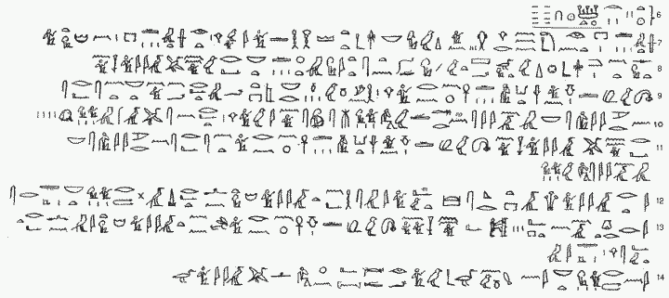
mbikfspd; rpfpr;ir
nrhj;jhf> mbikfis capyhf tpw;fyhk :
gu;kpq;fhkpy; myghkh gy;fiyf;fofk; jahupj;j nrhj;jpd; jiyg;G
mjpy; mbikfs; mtUila kidtpf;F toq;fg;gl;l nrhj;J. jdf;F gpwe;j Foe;ijfis jdJ mbikfshy; nfhLf;f kidtpAk; Rje;jpukhf ,Ue;jhs;.

Slide 21
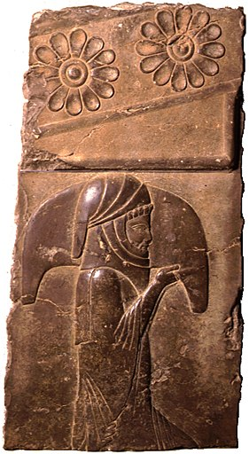
mbikfspd; rpfpr;ir
tpjptpyf;fhd jpwd;fisf; nfhz;l rpy rpWghd;ikapdu; rpwg;ghf elj;jg;gl;ldu;.
vLj;Jf;fhl;Lfs;:
1. jhdpay;
2. NahNrg;G
நீதிமன்ற ஊழியர் - அநேகமாக ராஜாவுக்கு சேவை செய்யும் ஒன்று

Slide 22
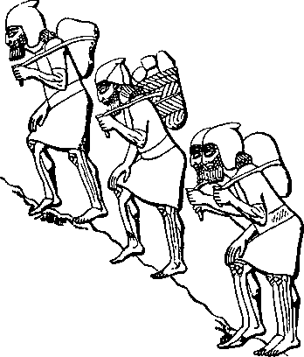
mbikj;jdk; kf;fisg; gw;wp vd;d ntspg;gLj;JfpwJ?
mbikj;jdk; vd;gJ kdpjdpd; tPo;r;rpapd; xU jahupg;G kw;Wk; tPo;r;rpf;Fg; gpd;du; ,Ue;J tUfpwJ
mbikj;jdk; capu;tho;tjw;fhd xU topKiwahf ,Ue;jJ
nfhiyf;F khw;whf mbikj;jdk; kpfTk; kdpjhgpkhdkhdJ
  vjpupfisf; nfhy;tjw;Fg; gjpyhf> mtu;fs; rpy rkaq;fspy; mbikfshf;fg;gl;lhu;fs; (cgh. 20:11)
  fpgpNahdpau;fs; kuzj;ij tpl mbikj;jdj;ij tpUk;gpdu; (N[h\; 9: 3-27)
  nfhiy nra;ag;gLtjw;F gjpyhf NahNrg;G mbikahf tpw;fg;gl;lhu; (Mjp. 37: 12-38)

Slide 23
mbikj;jdk; kf;fisg; gw;wp vd;d ntspg;gLj;JfpwJ?
v[khdUf;Fk; mbikf;Fk; ,ilapy; md;ghd ghrk; ,Uf;ff;$Lk;:
v[khdupd; kidtpia ghypay; gyhj;fhuk; nra;a Kad;wjw;fhd jz;lid kuzk;. ,Ug;gpDk;> Nghbghu; NahNrg;G mtu;fspd; neUf;fk; fhuzkhf kl;LNk rpiwapy; milj;jhu; (Mjp. 39:4-6> 19-20)
fhdhdpau;fs; ,];uNtYf;F mbikfshfj; njhlq;fpdu;> Mdhy; mtu;fisj; jpUkzk; nra;Jnfhz;L ghiy tzq;f Kbe;jJ (epahahjpgjp 1:27–3:6)
A+j mbikfs; 6 Mz;LfSf;Fg; gpwF tpLtpf;fg;gLtij tpl jq;fs; v[khDld; jq;fj; Nju;T nra;ayhk; (ahj;jpuhfkk; 21:6)

Slide 24
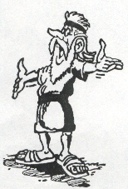
mbikj;jdj;ijg; gw;wp nkhirf; rl;lk; vd;d fw;gpf;fpwJ?
lTs; NkhNrf;F epahag;gpukhzj;ijf; nfhLj;jNghJ> ​​mbikj;jdk; cyfpd; xU gFjpahf ,Ue;jJ> vdNt flTspd; rl;lk; mbikj;jdj;ij mq;fPfupj;jJ
mbikj;jd rl;lq;fspd; tiffs;:
mbikfis ifafg;gLj;Jjy;
mbikj;jdj;jpypUe;J tpLtpj;jy;
kj cupikfs;
r%f cupikfs;
jpUkzq;fs;

Slide 25
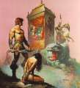
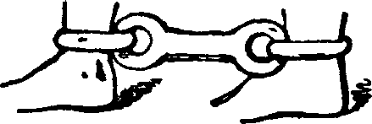
1. mbikfisg; ngWtjw;fhd rl;lq;fs;
mbikj;jdj;ijg; gw;wp nkhirapd; rl;lk; vd;d fw;gpf;fpwJ?
ntspehl;L mbikfis kl;LNk epue;ju mbikfshf;f KbAk;. vgpNua mbikfs; 6 Mz;Lfs; my;yJ ngU tpohf; nfhz;lhl;lk; Mz;Lf;Fg; gpwF tpLtpf;fg;gl;ldu;.
Nghu;f; ifjpfis mbikfshf;fyhk; (cgh. 20: 10-11)
jpUl;Lf;F kWrPuikg;ghf (ahj;jpuhfkk; 22:1-3)
fld;fspy; Kd;dpUg;ghf (cgh. 15: 1-2)

Slide 26

1. mbikfisg; ngWtjw;fhd rl;lq;fs;
mbikj;jdj;ijg; gw;wp nkhirapd; rl;lk; vd;d fw;gpf;fpwJ?
thq;Ftjd; %yk; (Nyt; 25: 44-46)
ntspehl;bdiu mbikfshf thq;fp tpw;fyhk;> nrhj;jhf fUjyhk;
Rje;jpukhf gpwe;j egiu mbikahf tpw;f mDkjpf;fg;gltpy;iy (ahj;jpuhfkk; 21:16; cgh. 24: 7)
mbikfspd; tpiyfs; gutyhf NtWgLfpd;wd Mz;Lfspd; vz;zpf;ifapd; taJ> ghypdk; kw;Wk; ngU tpohf; nfhz;lhl;lk; gb (Nytp 25: 47-53)
gpwg;ghy; (ahj;jpuhfkk; 21: 4; Nytp 25:54)

Slide 27


2. கையாளுதல் சட்டம் ahj;jpuhfkk;. 21: 1-11; nyt;. 25: 39-55; cgh. 15: 12-18
mbikj;jdj;ijg; gw;wp nkhirapd; rl;lk; vd;d fw;gpf;fpwJ?
nghUshjhu neUf;fbapd; NghJ mbikfs; mjpf vz;zpf;ifapy; ,Ug;gjw;fhd mghaj;ijj; jtpu;f;f ,e;j rl;lk; cjtpaJ
6 Mz;Lfs; Nrit nra;jgpd; vgpNua mbikfs; tpLtpf;fg;gLthu;fs; (ahj;jpuhfkk; 21: 2)
- v[khdu; nfhLj;j kidtpAld; mbikfs; jdpahf nry;y Ntz;Lk;
- epue;jukhf jq;f tpUk;Gk; mbikfs; mt;thW nra;ayhk;> Mdhy; mtu;fs; fhJfisj; Jisapl;ldu;
- tpLtpf;fg;gl;l mbikfs; jhuhsthj Cjpaj;Jld; tpLtpf;fg;gl;ldu; (cgh. 15: 12-15)
Notes:
6 Mz;Lfs; Nrit nra;jgpd; vgpNua mbikfs; tpLtpf;fg;gLthu;fs; (ahj;jpuhfkk; 21: 2)
v[khdu; nfhLj;j kidtpAld; mbikfs; jdpahf nry;y Ntz;Lk;
epue;jukhf jq;f tpUk;Gk; mbikfs; mt;thW nra;ayhk;> Mdhy; mtu;fs; fhJfisj; Jisapl;ldu;
tpLtpf;fg;gl;l mbikfs; jhuhsthj Cjpaj;Jld; tpLtpf;fg;gl;ldu; (cgh. 15: 12-15)

Slide 28

2. கையாளுதல் சட்டம்
mbikj;jdj;ijg; gw;wp nkhirapd; rl;lk; vd;d fw;gpf;fpwJ?
jg;gpNahbatu;fs; jpUk;gpr; nry;tJ jilnra;ag;gl;ljhy;> Xbg;Nghd mbikfs; tpLtpf;fg;gl Ntz;Lk; (cgh. 23:15-16)
ngU tpohf; nfhz;lhl;lk; Mz;by;> nrhj;J kw;Wk; epyj;ij kPl;nlLg;gJ njhlu;ghf> vgpNua mbikfs; midtUk; tpLtpf;fg;gl;ldu; (Nytp. 25:39-40)

Slide 29
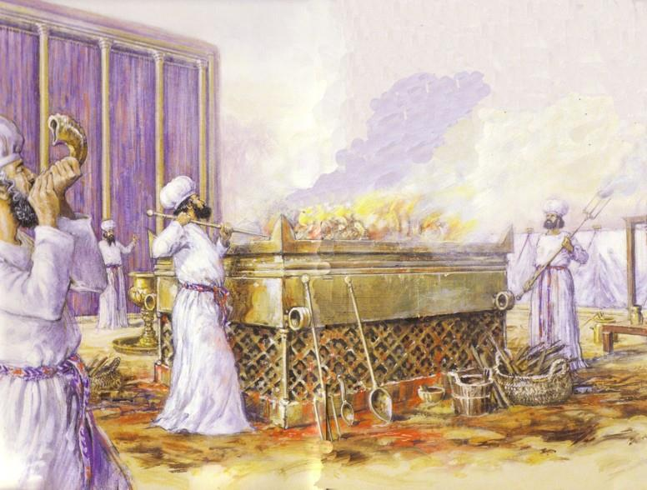
kj cupikfs; njhlu;ghd rl;lk;
mbikj;jdj;ijg; gw;wp nkhirapd; rl;lk; vd;d fw;gpf;fpwJ?
mbikfspd; cupikahsupd; FLk;gj;jpd; xU gFjpahff; fUjg;gl;L FLk;gj;jpd; kj tho;f;ifapy; gq;Ff;nfhz;ldu;
mbikfSf;F Xa;TehSf;fhd cupik toq;fg;gl;lJ (ahj;jpuhfkk; 20:10; 23:12)
mbikfs; tpUj;jNrjdk; nra;ag;gl;L tpUe;Jfspy; gq;nfLf;f Ntz;Lk; (ahj;jpuhfkk; 12: 43-45)
Notes:
Mark

Slide 30

4. rptpy; cupikfs; njhlu;ghd rl;lq;fs;
mbikj;jdj;ijg; gw;wp nkhirapd; rl;lk; vd;d fw;gpf;fpwJ?
v[khdu;fs; jq;fs; mbikfis nfhd;why; mtu;fs; jz;bf;fg;gLthu;fs; (ahj;jpuhfkk; 21:20)
mbikfs; jq;fs; v[khdhy; ghjpf;fg;gl;bUe;jhy; tpLtpf;fg;gl;lhu;fs; (ahj;jpuhfkk; 21: 26-27)

Slide 31
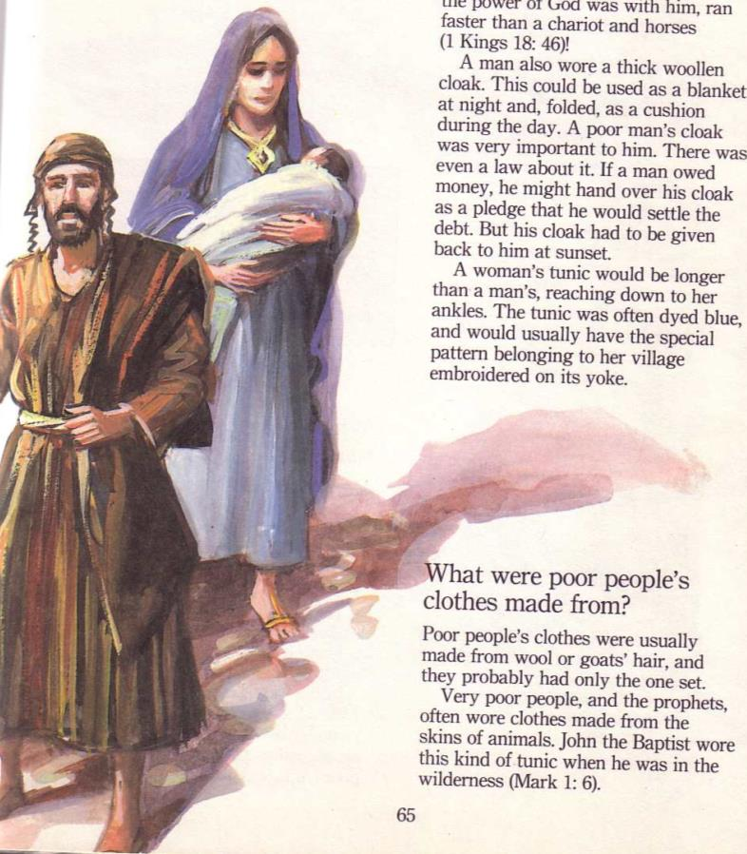
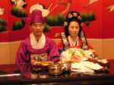
5. mbikfspd; jpUkzq;fs; njhlu;ghd rl;lq;fs;
mbikj;jdj;ijg; gw;wp nkhirapd; rl;lk; vd;d fw;gpf;fpwJ?
xw;iw mbikfSf;F jq;fs; v[khdhy; kidtpfs; nfhLf;fg;glyhk; (ahj;jpuhfkk; 21: 2-4)
,j;jifa kidtpfs; nghJthf ntspehl;bdu;
xU v[khdhy; toq;fg;gl;l kidtpfs; epue;ju mbikfs;> MW Mz;LfSf;Fg; gpwF tpLtpf;fg;gltpy;iy

Slide 32

Comparing Mosaic Laws and Pagan Laws
nkhirf; rl;lk; kw;Wk; ghfho; rl;lq;fis xg;gpLjy;
1. ntspaPl;bw;F Kd; Nrit fhyk;
`k;Kuhgpapd; rl;lk; § §117
[§117] xU kdpjDf;F vjpuhf xU nghWg;G Vw;gl;lhy;> mtu; (ghg;. mdh fh];gpk;) jdJ kidtpiaAk; kfidAk; kfisAk; tpw;Wtpl;lhy; my;yJ mtu;fisf; fl;bnaOg;gpdhu;> my;yJ mtu;fs; xt;nthUtUk; my;yJ mtNu (ghg;. ,l;-lh-md; -b-,d;) mbikj;jdj;jpw;Fs; (ghg;> mdh fp];]hl;bk;)> 3 Mz;LfSf;F mtu;fs; mtw;iw thq;fpa my;yJ mbikj;jdj;jpy; mioj;Jr; nrd;w tPl;by; Ntiy nra;thu;fs;; ehd;fhk; Mz;by; mtu;fspd; tpLjiy epWtg;gLk;.
nkhirf; rl;lk; (cgh 15: 12-14)
xU rf vgpNuau;> xU MNzh ngz;Nzh jd;id cq;fSf;F tpw;W MW Mz;Lfs; cq;fSf;F Nrit nra;jhy;> Vohk; Mz;by; ePq;fs; mtiu tpLtpf;f mDkjpf;f Ntz;Lk;. ePq;fs; mtiu tpLtpf;Fk;NghJ> ​​mtiu ntWq;ifAld; mDg;g Ntz;lhk;. cq;fs; ke;ijapypUe;Jk;> cq;fs; fjTfspypUe;Jk;> jpuhl;irj; Njhl;lj;jpypUe;Jk; mtUf;F jhuhskhf toq;Fq;fs;. cq;fs; Njtdhfpa fu;j;ju; cq;fis MrPu;tjpj;jgbNa mtUf;Ff; nfhLq;fs;.

Slide 33

Comparing Mosaic Laws and Pagan Laws
nkhirf; rl;lk; kw;Wk; ghfho; rl;lq;fis xg;gpLjy;
mbikfspd; jpUkzk;
cu;-ek;K my;yJ Ry;fpapd; rl;lk;
xU Mz; mbik xU ngz; mbikia kze;jhy;> mtdJ fhjyp> gpd;du; me;j Mz; mbikf;F mtdJ Rje;jpuk; toq;fg;gl;lhy;> mts; /
mtd; tPl;bypUe;J ntspNaw;wg;glkhl;lhs;.
xU Mz; mbik xU gpwg;gupik ngz;iz kze;jhy;> mts; /
mtd; xU Mz; Foe;ijia jd; v[khdupd; Nritapy; itg;ghu;; … gpwg;gupik ngz;zpd; NtW ve;jf; Foe;ijAk; v[khdUf;Fr; nrhe;jkhdjhf ,Uf;fhJ> mbikj;jdj;jpw;Fs; js;sg;glkhl;lhJ
nkhirf; rl;lk; (ahj;jpuhfkk; 21: 2-4)
"ePq;fs; xU vgpNua Copaiu thq;fpdhy;> mtu; cq;fSf;F MW tUlq;fs; Nrit nra;a Ntz;Lk;. Mdhy; Voahk; Mz;by;> mtu; vijAk; nrYj;jhky; tpLtpg;ghu;. mtu; jdpahf te;jhy;> mtu; jdpahf tpLgl Ntz;Lk;; Mdhy; mtUf;F kidtp ,Ue;jhy;. mtd; tUk;NghJ> ​​mts; mtDld; nry;y Ntz;Lk;. mtDila v[khd; mtDf;F xU kidtpiaf; nfhLj;jhy;> mts; mtDf;F kfd;fisNah kfs;fisNah ngw;why;> me;jg; ngz;Zk; mtSila gps;isfSk; mtSila v[khDf;Fr; nrhe;jkhdtu;fshf ,Ug;ghu;fs;> me;j kdpjd; kl;LNk tpLgLthd;.
Notes:
/

Slide 34

Comparing Mosaic Laws and Pagan Laws
nkhirf; rl;lk; kw;Wk; ghfho; rl;lq;fis xg;gpLjy;
mLikg; ngz;zpd; kPwy;
cu;-ek;K my;yJ Ry;fpapd; rl;lk;
xU kdpjd; ,d;ndhUtdpd; cupikfSfF kPwp nray;gl;L> xU Mzpd; mbikg; fd;dp ngz;izf; Fiwf;fpwhd; vd;why;> mtd; Ie;J n\f;fy; nts;spia vilNghl;L toq;Fthd;
nkhirf; rl;lk; (Nytp 19:20)
'xU Mz; NtnwhU MZf;F thf;FWjpaspj;j mbikg; ngz;zhd xU ngz;Zld; J}q;fpdhYk;> kPl;fg;glhkNyh my;yJ mtSf;F Rje;jpuk; toq;fg;glhkNyh ,Ue;jhy;> mjw;fhd jz;lid ,Uf;f Ntz;Lk;.
MapDk; mts; tpLtpf;fg;glhjjhy; mtu;fs; nfhy;yg;glkfhl;lhu;fs;
v\;Dd;dhtpd; jhJ\htpd; rl;lk;
xU kdpjd; NtnwhU Mzpd; mbikg; ngz;izf; Fiwf;f Ntz;Lnkd;why;> mtd; ,UgJ Nrf;fy; nts;spia vilNghl;L toq;Fthd;> Mdhy; mbikg; ngz; jd; v[khdpd; nrhj;jhfNt ,Uf;fpwhs;
Notes:
3. mbikg; ngz;zpd; kPwy;

Slide 35
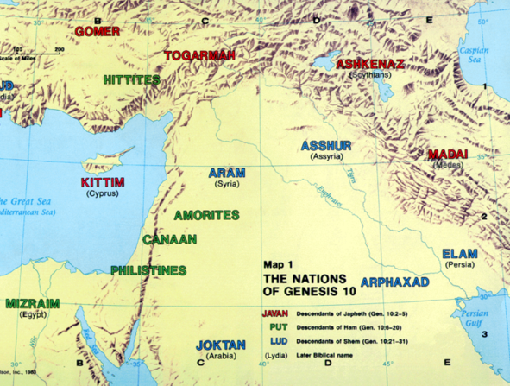
Comparing Mosaic Laws and Pagan Laws
nkhirf; rl;lk; kw;Wk; ghfho; rl;lq;fis xg;gpLjy;
Xbg;Nghd mbikfSf;fhd eltbf;if
cu;-ek;K my;yJ Ry;fpapd; rl;lk;
xU mbik my;yJ (?)] xU mbikg; ngz;… mtd; my;yJ mts; efuj;jpd; vy;iyfisj; jhz;b xU kdpjd; mtid my;yJ mtisj; jpUg;gpj; nfhz;L te;jhy;> mbikapd; v[khdu; mbikiaj; jpUg;gpa kdpjDf;F nts;sp n\f;fy;fs; vilNghl;L toq;Fthu;
nkhirf; rl;lk; (cgh 23:15-16)
xU mbik cd;dplk; milf;fyk; ngw;wpUe;jhy;> mtid jd; v[khdplk; xg;gilf;fhNj. mtu; vq;F Ntz;LkhdhYk; mtu; Nju;e;njLf;Fk; ve;j CupYk; mtu; cq;fspilNa thol;Lk;. mtiu mlf;f Ntz;lhk;.

Slide 36
Comparing Mosaic Laws and Pagan Laws
nkhirf; rl;lk; kw;Wk; ghfho; rl;lq;fis xg;gpLjy;
Xbg;Nghd mbikfSf;fhd eltbf;if
ypg;gpl;-,\;lhu; rl;lk;
xU Mzpd; ngz; mbik my;yJ Mz; mbik xU efuj;jpw;Fs; jg;gp Xbdhy;>
mbik xU kdpjdpd; tPl;by; xU khj fhyk; jq;fpapUg;gJ cWjpg;gLj;jg;gl;Ls;sJ> jg;gpNahbatUf;F milf;fyk; nfhLj;jtd; mbikf;F mbikiaf; nfhLg;ghd;.
mtUf;F mbik ,y;iynad;why;> mtu; vil kw;Wk; gjpide;J Nrf;fy; nts;spia toq;Fthu;.
xU kdpjdpd; mbik jd; v[khDf;F vjpuhf jdJ mbik me;j];ij vjpu;j;Jg; Nghl;bapl;lhy;> mtDila mbikj;jdj;jpw;F ,Uklq;F <Lnra;ag;gl;bUg;gJ ep\&gpf;fg;gl;lhy;> me;j mbik tpLtpf;fg;gLthd;.

Slide 37

Comparing Mosaic Laws and Pagan Laws
nkhirf; rl;lk; kw;Wk; ghfho; rl;lq;fis xg;gpLjy;
5.mbikia fhag;gLj;Jtjw;fhd fl;lzk;
`pl;bl; rl;lq;fs;
ahuhtJ xU Mz; my;yJ ngz; mbikia fz;%bj;jdkhf my;yJ gw;fisj; jl;bdhy;> mtu; gj;J Nrf;fy; nts;spiaf; nfhLf;f Ntz;Lk;. mjw;fhf mtu; jdJ tPl;ilg; ghu;g;ghu;.
nkhirf; rl;lk; (ahj;jpuhfkk; 21: 26>27)
"xU kdpjd; xU Ntiyf;fhud; my;yJ Ntiyf;fhupiaj; fz;zpy; jhf;fp mopj;jhy;> mtd; fz;Zf;F <Lnra;a Ntiyf;fhuid tpLtpf;f Ntz;Lk;. NkYk; mtd; xU Ntiyf;fhud; my;yJ Ntiyf;fhupapd; gy;iyj; jl;bdhy;> mtd; Ntiyf;fhuid tpLtpf;f mDkjpf;f Ntz;Lk; gy;Yf;F <Lnra;aTk;.

Slide 38
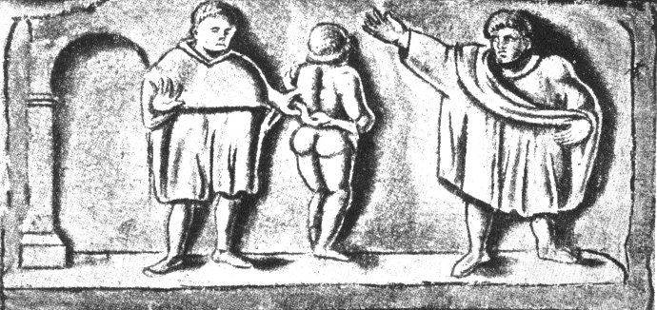
Features of slavery during Roman
Nuhkhdpag; Nguurpd; NghJ mbikj;jdj;jpd; mk;rq;fs;
Nuhkhdpau;fs; kj;jpajiuf; fliyf; ifg;gw;wpaNghJ> ​​mtu;fs; kpy;ypad; fzf;fhd mbikfis ,j;jhypf;F mioj;Jr; nrd;wdu;. ,j;jhypau;fs; mbikfis Kf;fpa ,wf;Fkjpahsu;fshff; nfhz;bUe;jdu;> mbikfs; kf;fs;njhifapy; 40 rjtpfpjk;;!
Nuhkhdpa mbik Kiwia fl;Lg;gLj;Jk; rl;lq;fs;:
nyf;]; nghl;nlypah (fpK 326)
nyf;]; Vypah nrd;bah (fp.gp 4)
nyf;]; /G/gpah fdpdpah (fp.gp. 2)
nyf;]; Y}dpah Nrhu;gdh
Nuhkhdpy; tpw;fg;gl;l mbik tu;j;jfk;

Slide 39
Nuhkhdpag; Nguurpd; NghJ mbikj;jdj;jpd; mk;rq;fs;
Nehf;fq;fs;
  Nuhkhdpa v[khdu;fs; kpfTk; tYthd tho;f;if Kiwia tpl nghUshjhu Ruz;lypy; Mu;tk; fhl;ltpy;iy.
  gzf;fhu Nuhkhdpau;fisg; nghWj;jtiu> Nehf;fk; mbg;gilapy; me;j];Jjhd;.

Slide 40
Nuhkhdpag; Nguurpd; NghJ mbikj;jdj;jpd; mk;rq;fs;
mbikj;jdj;jpw;Fs; Eiojy;
  Nuhkhdpa ,uhZt ntw;wpfs;
  ,aw;if ,dg;ngUf;fk;
  ntspg;ghl;bypUe;J kPl;G
  ru;tNjr tu;j;jf
  flw;nfாs;is
  gy;NtW fhuzq;fSf;fhf jq;fis mbikj;jdj;jpw;F tpw;Wtpl;lhu;fs;

Slide 41
Nuhkhdpag; Nguurpd; NghJ mbikj;jdj;jpd; mk;rq;fs;
rpfpr;ir
  v[khdupd; jd;ik kw;Wk; MSikiag; nghWj;J
  gz;izfs; kw;Wk; gz;izfspy; Ntiy nra;Ak; mbikfis tpl jdpahu; tPLfspy; gzpGupAk; mbikfs; rpwe;j Kiwapy; elj;jg;gl;ldu;

Slide 42
Nuhkhdpag; Nguurpd; NghJ mbikj;jdj;jpd; mk;rq;fs;
KJepiy kPJ rl;l fl;Lg;ghLfs;
  mbikfsplk; jtwhf ele;J nfhs;Sk; rl;lj;jpw;F mbik cupikahsu;fs; gjpyspj;jdu;
  mbik cupikahsu;fs; jq;fs; mbikfis kuzjz;lid nra;tjpypUe;J jil nra;ag;gl;ldu;
  rl;l ePjpkd;wq;fs; ngUk;ghYk; v[khdu;fSf;F vjpuhd mbikfSld; gf;fgykhf ,Uf;fpd;wd

Slide 43
Nuhkhdpag; Nguurpd; NghJ mbikj;jdj;jpd; mk;rq;fs;
mbikfspd; rl;l cjtp
  mbikfs; jq;fs; rhu;ghf tof;Fj; njhluyhk; (jhf;Fjy; / J\;gpuNahfk;)
  mbikfs; Rje;jpuj;ij ehLtjw;fhd rl;l topKiwfs;
  mbikfs; cupikia khw;Wtij ghjpf;fyhk;
  rl;l mjpfhuj;jpw;F $Ljyhf> mbikfSf;F Fwpg;gpl;l nghUshjhu rf;jp ,Ue;jJ

Slide 44
Nuhkhdpag; Nguurpd; NghJ mbikj;jdj;jpd; mk;rq;fs;
rl;l Kftupd; epiy
  nrhj;Jf;fis itj;jpUf;f KbAk;> fld;fs;> Fj;jiffs; my;yJ Nrit xg;ge;jq;fs; Nghd;w rl;l guptu;j;jidfspy; Eioa KbAk;
  fld;fs;> tpw;gid> urPJfis toq;Fjy; Nghd;w tzpf eltbf;iffspy; mtu;fspd; v[khdupd; rhu;ghf nray;gl;lhu;.
  mtu;fs; mbikfis nrhe;jkhf itj;jpUf;f KbAk;

Slide 45
Nuhkhdpag; Nguurpd; NghJ mbikj;jdj;jpd; mk;rq;fs;
rl;l ntspNaWjy; / ifahSjy;
  ifahSjy; gutyhf ,Ue;jJ> mbf;fb kw;Wk; ngUk;ghd;ikahd mbikfshy; vjpu;ghu;f;fg;gl;lJ
  ,J mbf;fb te;jjhy; mjw;F rpy tuk;Gfs; Njitg;gl;ld
  njhlu;r;rpahd ifahSjy;fSf;fhf cUthf;fg;gl;l mikg;gpd; r%f epiy ce;Jjy;
  rpy ifahSjy;fs; cd;djkhd tp\aq;fSf;fhf ,Ue;jd

Slide 46
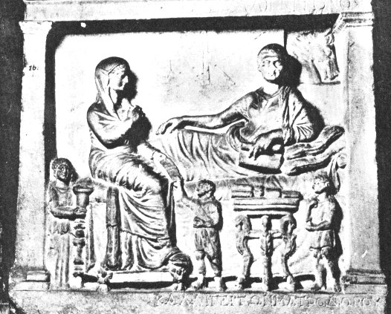
Nuhkhdpag; Nguurpd; NghJ mbikj;jdj;jpd; mk;rq;fs;
ifahsg;gl;l mbikfs; nrhj;jhf ,Ue;J xU ,ytr Nuhkhdpa Fbkfdhf khw;wg;gl;ldu;. Mdhy; mtu;fs; nghJthf Nuhkpd; Rje;jpukhd Fbkf;fshy; ghu;f;fg;gl;ldu;.
gpe;ija ifahSjy; eilKiwfs;
:xg;nrf;fpak; - Kd;dhs; v[khdu;fspd; Kd;dpiyapy; ntspg;gilahfj; Jilf;f Rje;jpukhdtu;fSk; ngz;fSk; Njit
Xguh - Kd;dhs; mbik Mz;LNjhWk; xU Fwpg;gpl;l vz;zpf;ifapyhd ehl;fSf;F jq;fs; mbikj; njhopy;fSf;Fj; jpUk;g Ntz;Lk;
mbikfs; ngUk;ghYk; rpwpatu;fshf rpj;jupf;fg;gl;ldu;

Slide 47
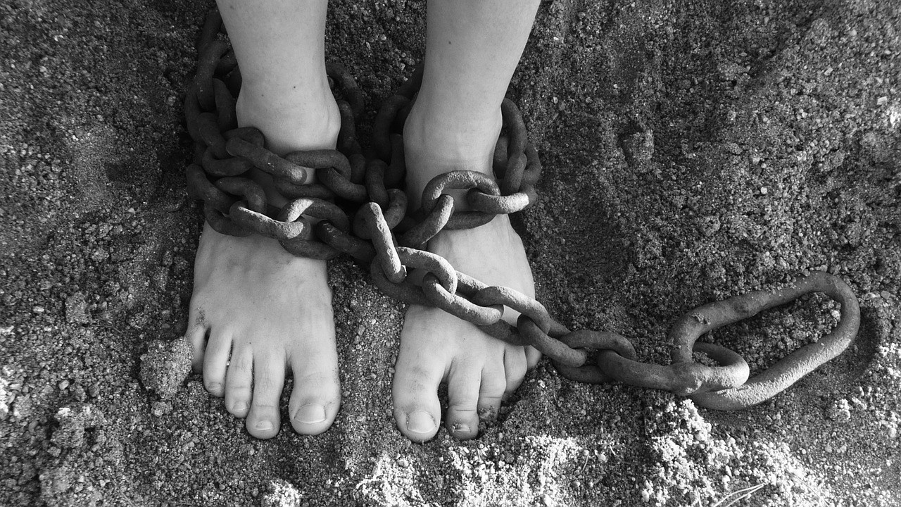
"xU kdpjd; xU mbikg; ngz;Zld; clYwT nfhz;lhy;> mjd; Rje;jpuk; xUNghJk; thq;fg;gltpy;iy> Mdhy; NtnwhU Mzpd; kidtpahf khw cWjpG+z;lhy;> mtd; jd; v[khDf;F KO ,og;gPLk; nrYj;j Ntz;Lk;. Mdhy; mts; xU Rje;jpukhd ngz; my;y vd;gjhy;> MNzh my;yJ ngz;Nzh nfhy;yg;gLthu; "(Nytp 19:20 vd;.vy;.b).

Slide 48
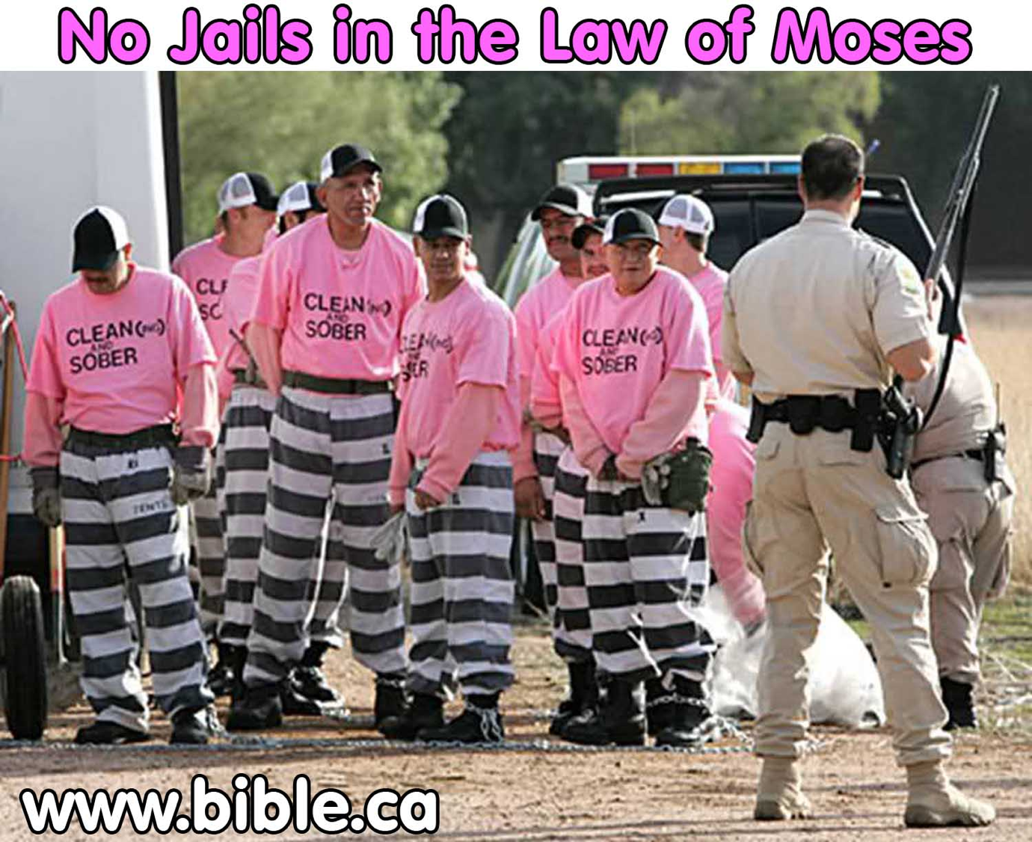
"MfNt> fpwp];J vq;fis cz;ikapNyNa tpLtpj;jpUf;fpwhu;> ,g;NghJ ePq;fs; Rje;jpukhf ,Ug;gij cWjpg;gLj;jpf; nfhs;Sq;fs;> rl;lj;jpd; mbikj;jdj;jpy; kPz;Lk; gpizf;fg;gl Ntz;lhk;" (fyh. 5: 1 vd;.vy;.b)
NkhNrapd; rl;lj;jpy; rpiwfs; ,y;iy
Notes:
Slavery Instead of Jails in Mosaic Legal System!
Have you ever noticed that there were no prisons in the law of Moses? People were stoned, beaten, fined but NEVER sent to prison or confined in any way including shackles or stocks etc. This brand new study sheds a positive light on the role slavery had in rehabilitating criminals and providing welfare for the poor. Confinement was something completely foreign in the Jewish Legal system. It was far better rehabilitation to put criminals in a family context to take care of children and learn important life skills than to put them in a cell and prisoner context where they would turn bitter and become better educated on how to commit further crimes without getting caught. The USA return rate to prison has been as high as 80%, so perhaps we should learn some good lessons from how God brought about change to individuals in ancient Israel. Slavery is far better than imprisonment.
See the full article at http://www.bible.ca/sin-no-jails-prisons-in-judaism-old-testament-law-of-moses-slavery-welfare-jewish-comparison.htm

Slide 49
G.V mbikj;jdk; Fwpj;j gTypd; Nghjid
gTy; yl;rpa fhuzq;fSf;fhf jd;dhu;t mbikj;jdj;ij fz;bj;jhu; (1 nfhup. 7:23)
mbikfsplk; jtwhf ele;Jnfhs;tij gTy; Mjupf;ftpy;iy> Mdhy; mbik tu;j;jfj;ij Fwpg;ghf jil nra;atpy;iy (1 jPNkh. 1: 9-10)
kw;wtu;fsplk; fUiz> kupahij kw;Wk; v[khdu;fshy; mbikfis J\;gpuNahfk; nra;tijj; tptpypa jLj;jJ mOj;jkhf $W (vNg 6: 5; nfhNyh. 3:22; 1 jPNkh. 6: 2; jPj;. 2: 9)
fpwp];Jtpy; xU Gjpa gilg;ghf ,Ug;gjw;fhd tptpypa Kf;fpaj;Jtk; kf;fSf;F ,ilapyhd gy ,d> r%f my;yJ fyhr;rhu jilfis ePf;f thjpLfpwJ (fyh. 3:28; nfhNyh. 3:11; gpNyNkhd; 16)
Notes:
note

Slide 50
mbikj;jdk; njhlu;ghd gpNyNkhdpd; tpsf;fk;
G.V mbikj;jdk; Fwpj;j gTypd; Nghjid
rl;lg;G+u;tkw;wj> tiuaWf;fg;gl;l gbepiy mjpfhuk; kw;Wk; kdrhl;rpia mbg;gilahff; nfhz;l KbntLg;gJ Mfpatw;wpd; Kf;fpaj;Jtk; njhlu;ghd KbTfs; ve;jnthU jiytd;-mbik R+o;epiyfAis xUjiyg;gl;r mwptpg;Gfshy; jPu;f;fg;glhJ> khwhf R+o;epiyf;F eLtpy; cs;s jdpegu;fshy; jPu;f;fg;glhJ.
,e;j epiyik gpNyNkhd; Gj;jfj;jpy; tpsf;fg;gl;Ls;sJ.

Slide 51
gpNyNkhdpd; tpsf;fk; mbikj;jdj;jpw;F
G.V mbikj;jdk; Fwpj;j gTypd; Nghjid
xNdrpki] jpUk;gpaJk; tpLtpf;f gTy; tpUk;Gfpwhu; (tr. 15-17)
gpNyNkhDf;F mt;thW fl;lisapl gTYf;F mjpfhuk; ,Ue;jJ (tr. 17)
gpNyNkhdpd; nraiy kdrhl;rp rhu;e;jjhfTk;> fpwp];jt md;gpd; newpKiwapypUe;Jk; gTy; Kay;fpwhu; (tr. 9> 14> 20> 21)

Slide 52
KbTiu

Slide 53
Bibliography
Arnold, Bill T. and Beyer, Bryan E. Readings from the Ancient Near East. Grand Rapids: Baker, 2002
Chirichigno, Gregory C. Debt-Slavery in Israel and the Ancient Near East. Sheffield: JSOT Press, 1993
Rupprecht, A. "Slave, Slavery" in The Zondervan Pictorial Encyclopedia of the Bible. Vol. 4. ed. Merrill C. Tenney. Zondervan, 1976. pp. 453–460

Slide 54
Useful Websites
http://www.christian-thinktank.com, Glenn Miller, "Does God Condone Slavery in the Bible?"
http://www.bible.org, Daniel Wallace, "Some Initial Reflections on Slavery in the New Testament"
http://www.brfwitness.org, Harold Martin, "The Bible Teaching on Slavery"

Slide 55
Black

Slide 56


பழைய ஏற்பாடு பின்னனிகள்BibleStudyDownloads.org
இந்த விளக்கக்காட்சியை இலவசமாகப் பெறுங்கள்!
Notes:
Bible Study (bs)

