Slide 1

jpUkiwapd;…
mbg;gil
Designed by Dr. John Fryman, Texas, USA • BibleBasically.org
Taught by Dr. Rick Griffith, Singapore Bible College
All files in many languages for free download at BibleStudyDownloads.org

Slide 2


I
II
III
IV
V
VI
VII
VIII
IX
X
NkhNrNahL Njtd; nra;j rpwg;G Vw;ghL
gioa Vw;ghl;bypUe;J ahj;jpuhfk Gj;jfk;
“NkhNrapd; thf;Fjj;jk;”
,e;j Vw;ghL vj;jifaJ
cjtpg; Gj;jfk; #15
8.0.05B.
©2004 TBBMI
01

Slide 3
I
II
III
IV
V
VI
VII
VIII
IX
X
NkhNr
Ahj;jpuhfkk;
rPdha;
eP-r-r
“eP-r-r”
ePjp
rKjhak;
rlq;Ffs;
fhNj]; gh;Ndah
40
5 gpurq;fq;fs;
02
1

Slide 4
nfhLf;f;gl;l re;jh;g;gj;ij epidTf;$Uq;fs;.
I
II
III
IV
V
VI
VII
VIII
IX
X
• vfpg;jpa mbikj;jdk; : 400 tUlq;fs;
• Nkhrkhd fyhr;rhuKk; & rKjha Kd;Ndw;wKk;
• flTisf; Fwpj;J : xU tpsq;fhnra;jpah?
mjdhy;…
• ‘NkhNrapd; epahag;gpukhzk; ,];uNtypd; Kd;Ndw;wj;jpw;F Kf;fpa gbf;fy;yhf mikfpwJ’ Mz;ltupd; cutpy; … … kw;Wk;
mtHfSf;Fs;Sk; !
03
4
©2004 TBBMI
8.0.05B.

Slide 5
I
II
III
IV
V
VI
VII
VIII
IX
X
NtWghL :
NkhNrapd; thf;Fjj;jk;
mjpy; xU Jtf;fKk; KbTk; cs;sJ!
04
1
03

Slide 6
“NkhNrapd; thf;Fjj;jk;”
I
II
III
IV
V
VI
VII
VIII
IX
X
“eP”
ahj;jpuhfkk; 20:
“gj;J fl;lisfs;”
ePjp
Kjy; fl;lk; –
NjtDf;fhdf; flikfs; (trdk; 1-12)
cd;; Njtdhfpa fHj;jH mth;
NtNw NjtH mtHKd; ,y;iy
ahnjhU nrhUgNkh tpf;fufNkh ,y;iy
NtnuhU nja;tj;ij tzq;Ftjpy;iy
NjtDila ehkj;ij ghpRj;jkhf;Fjy;
Xa;T ehis ghpRj;jkhf Mrhpj;jy;
MW ehs; Ntiy nra;J
Xa;T ehspy; Xa;e;jpUj;jy;….
05
12

Slide 7
“NkhNrapd; thf;Fjj;jk;”
I
II
III
IV
V
VI
VII
VIII
IX
X
“eP”
ahj;jpuahfkk; 20
“gj;J fl;lisfs;”
ePjp
Kjy; fl;lk; –
NjtDf;fhdf; flikfs; (trdk; 1-12)
,uz;lhk; fl;lk; –
kD\Uf;fhdf; flikfs; (trdk; 13-17)
ngw;Nwhiu fdk; gz;Zjy;
nra;af;$lhjit :
nfhiy
tpgr;rhuk;
fsT
ngha;
gpwUf;Fhpatw;iw ,r;rpj;jy;
06
7

Slide 8
“NkhNrapd; thf;Fjj;jk;”
I
II
III
IV
V
VI
VII
VIII
IX
X
ahj;jpuahfkk;;; 20
“eP”
“gj;J fl;lisfs;”
Kjy; fl;lk; –
NjtDf;fhdf; flikfs; (trdk; 1-12)
,uz;lhk; fl;lk; –
kD\Uf;fhdf; flikfs; (trdk; 13-17)
“r”
Mjpfhuk; : 21-24:
rKjha chpikf;fl;lisfs;
rKjha
jdpkdpjh; rhh;e;j chpikfs;
nrhj;Jhpikfs;
jdpkdpjdpd; Neh;ikf;fhd Njitfs;…
07
4

Slide 9
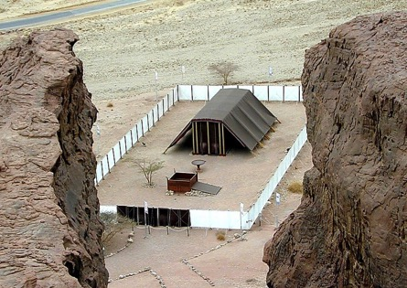
“NkhNrapd; thf;Fjj;jk;”
I
II
III
IV
V
VI
VII
VIII
IX
X
ahj;jpuahfkk;;;;;;;;;;;;;;;;;;; :20
“M”
“gj;J fl;lisfs;”
Cld;gbf;ifg;ngl;b> Nki[>Fj;Jtpsf;F
The First Table –
Duties to God (Verses 1-12)
Special Ordinances
rhjuzkhd fl;Lkhdk;
nrk;gpdhy; nra;ag;gl;l gypgPlKk; ];jyKk;
The Second Table –
Duties to Men (verses 13-17)
A System of Worship
Mrhhpaj;Jtk;
Mrhhpaj;Jtj;jpd; Rj;jpfhpg;G
“r”
Guidelines for Living
CHAPTER 21-24:
THE SOCIAL ORDINANCES
J}ggPlKk; njhOJf;nfhs;gth;fSk;
Ntiyahl;fSk; Xa;TehSk;
“r”
Mjpfhuk; 25-31:
NjtDila $lhuj;jpd; fl;lisfs;
rlq;Ffs;
08
11

Slide 10
I
II
III
IV
V
VI
VII
VIII
IX
X
“NkhNrapd; thf;Fjj;jk;”
xU njhFg;G :
“eP”
Mjpfhuk; 20:
gj;Jf;fl;lisfs;
“r”
Mjpfhuk; 21-24:
rKjhak; rhh;e;jf; fl;lisfs;
“r”
Mjpfhuk; 25-31:
NjtDila $lhuj;jpd; fl;lisfs;
09
3

Slide 11
“NkhNrapd; thf;Fjj;jjpd; cs;slf;fk;”
1. epge;jidapd; mbg;gilapyhd xg;ge;jk;
2.jw;fhypfkhd xOq;F
3.,NaR fpwp];Jtpd; Copaj;jpd; Kbtpy; ,jd; Nehf;fk; epiwNtwpaJ. ,J mq;F Kw;Wg;ngw;wJ.
4.ghpRj;j Mtpahdth; cyfj;jpw;F mwpKfg;gLj;jg; gl;lgpd;> epahagpukhzk; xt;nthU tpRthrpap;d; tho;tpYk; cs;sj;jpYk; mq;fkha; khwpaJ.
8.0.05B.
4
©2004 TBBMI
10

Slide 12
kj;NjA 5:17
,NaR nrhd;dhH :
“epahag;gpukhzj;ijahdhYk; jPHf;fjhprdq;fisahdhYk; mopf;fpwjw;F te;Njd; vd;W vz;zpf;nfhs;shNjAq;fs;;@
mopf;fpwjw;F my;y epiwNtw;Wfpwjw;Nf te;Njd;”
11
1

Slide 13

Mgpufhkpd; cld;gbf;if
Mgpufhkpd;
miog;G
Mjp:12:1-3
cld;gbf;if
Mjp: 15:9-18
mjpf jfty;fs; mlq;fpa cld;gbf;ifapd; cs;slf;fk;
cjtpg; Gj;jfk; #14
Ntjhfk ntspg;ghl;bd; KJnfYk;G
12
©2004 TBBMI
7.2.05B.

Slide 14
Mgpufhkpd; cld;gbf;if
Mgpufhkpd;
miog;G
Mjp:12:1-3
cld;gbf;if
Mjp: 15:9-18
epj;jpakhdJ
Neh;rhpahdJ
mstplKbahjJ
Mjp:13:15
Mjp:13:14-16
Mjp:15:9-18
Njrk;
tpij
MrPh;thjk;
mjp12:1
Mjp:12:3
Mjp:12:2
Ntjhfk ntspg;ghl;bd; KJnfYk;G
13
©2004 TBBMI
7.2.05B.

Slide 15
Mgpufhkpd; cld;gbf;if
Mgpufhkpd;
miog;G
Mjp:12:1-3
cld;gbf;if
Mjp: 15:9-18
epj;jpakhdJ
Mjp:13:15
Neh;rhpahd
mstplKbahjJ
Gen 13:15
Mjp 13:14-16
Mjp 15:9-18
Njrk;
tpij
MrPh;thjk;
Mjp 12:1
Mjp 12:2
Mjp 12:3
Mjpf jfty;fs; mlq;fpa cld;gbf;ifapd; cs;slf;fk;
Njrk;
Cgh 30: 1-10
Ntjhfk ntspg;ghl;bd; KJnfYk;G
14
©2004 TBBMI
7.2.05B.

Slide 16
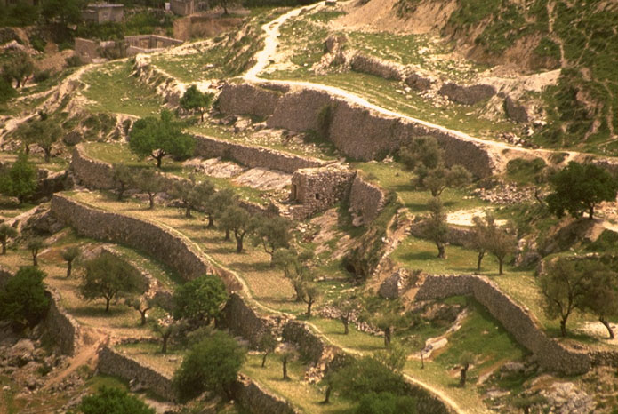
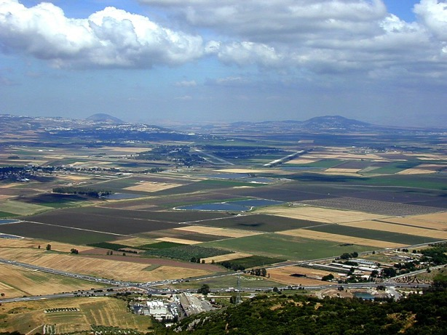
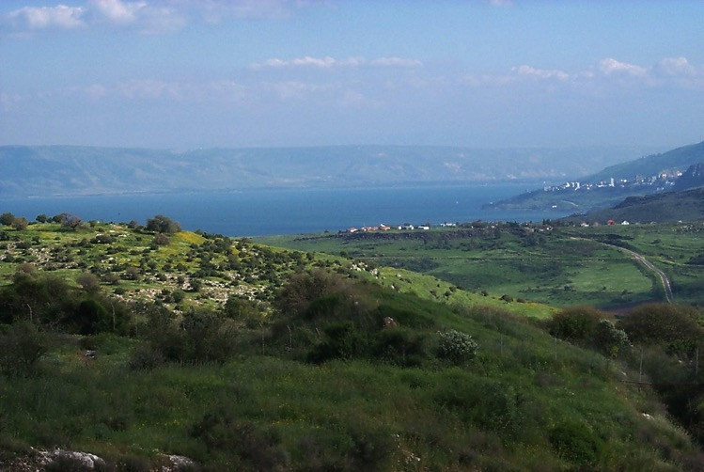
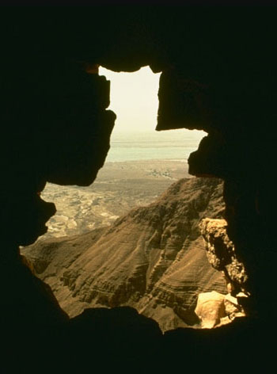
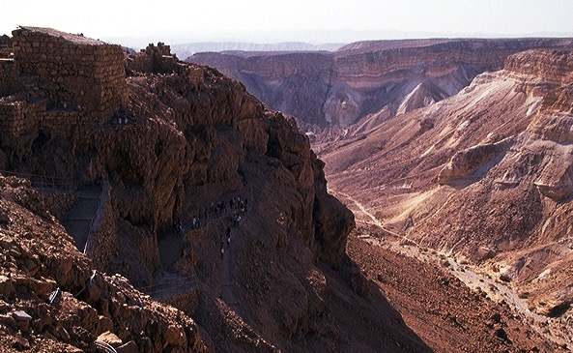
Mgpufhk; re;jjpahhpd; Njrk;
15

Slide 17
cghfkk; 30
Njrj;jpw;fhd thf;Fjj;jk;
⁵ cd; gpjhf;fs; Rje;jhpj;jpUe;j Njrj;ij eP Rje;jhpf;Fk;gbf;F> cd; Njtdhfpa fh;j;jh; mjpy; cd;idr; Nrh;j;J> cdf;F ed;ik nra;J> cd; gpjhf;fisg; ghh;f;fpYk; cd;idg; ngUfg;gz;Zthh;.
; 6 cd; Njtdhfpa fh;j;jhpy; eP cd; KO ,Ujaj;NjhLk; cd; KO Mj;JkhNthLk; md;G$h;e;J gpiof;Fk;gb> cd; Njtdhfpa fh;j;jh; cd; ,Ujaj;ijAk;
cd; re;jjpahhpd; ,Ujaj;ijAk; tpUj;jNrjdk;gz;Zthh;
16
2

Slide 18
nropg;ghd mofhd Njrk;
17

Slide 19
Mgpufhkpd; cld;gbf;if
Mgpufhkpd;
miog;G
Mjp:12:1-3
cld;gbf;if
Mjp: 15:9-18
epj;jpakhdJ
Neh;rhpahd
mstplKbahjJ
Mjp: 13:15
Mjp: 13:14-16
Mjp: 15:9-18
Njrk;
tpij
MrPh;thjk;
Mjp: 12:1
Mjp: 12:2
Mjp: 12:3
mjpf jfty;fs; mlq;fpa cld;gbf;ifapd; cs;slf;fk;
Njrk;
jhtPjpd;cld;gbf;if
cgh 30: 1-10
2 rhK 7: 4-16
cjtpg; Gj;jfk; #16
18
©2004 TBBMI
7.2.05B.

Slide 20

jhtPjpd; cld;gbf;if
mjd; %d;W cWjpfs;
2 rhKNty; 7
¹⁶ cd; tPLk;> cd; uh[paKk;> vd;nwd;iwf;Fk; ];jpug;gl;bUf;Fk;@ cd; uh[hrdk; vd;nwd;iwf;Fk; epiyngw;wpUf;Fk;.
19
6
©2004 TBBMI
8.0.05B.

Slide 21
mg;gbahdhy; jhtPjpd; rpq;fhrdj;jpy; cl;fhUtjw;F jFjpahdth; ahh;? vd;w Nfs;tp Nfl;f;fg;glNtz;Lk;.
20
©2004 TBBMI
8.0.05B.

Slide 22
jhtPjpd; uh[pak;
,NaR fpU];Jtpd; uh[ tk;r tuyhW
cjtpg; Gj;jfk; #16
21
1
©2004 TBBMI
8.0.05B.

Slide 23
jhtPjpd; top:,NaR fpU];Jtpd; uh[ tk;r tuyhW
*tphpTiuapd; RUf;fk;
22
1

Slide 24
jhtPjpd; top:,NaR fpU];Jtpd; uh[ tk;r tuyhW
Mjhk; Vths;
Ntjhfkj;jpd; ,Ug;gplk;:
Mjpahfkk;3:20
*tphpTiuapd; RUf;fk;
23

Slide 25
jhtPjpd; top:,NaR fpU];Jtpd; uh[ tk;r tuyhW
Mjhk; Vths;
Ntjhfkj;jpd; ,Ug;gplk;:
Mfpahfkk;4:1-2; 4:8
fhapd; MNgy;
*tphpTiuapd; RUf;fk;
24
1

Slide 26
jhtPjpd; top:,NaR fpU];Jtpd; uh[ tk;r tuyhW
Mjhk; Vths;
Ntjhfkj;jpd; ,Ug;gplk;:
Mjpahfkk;: 4:25
fhapd; MNgy; Nrj;
*tphpTiuapd; RUf;fk;
25

Slide 27
jhtPjpd; top:,NaR fpU];Jtpd; uh[ tk;r tuyhW
Mjhk; Vths;
Ntjhfkj;jpd; ,Ug;gplk;:
Mjpahfkk;: 5:29
fhapd; MNgy; Nrj;
Nehth
* tphpTiuapd; RUf;fk;
26

Slide 28
jhtPjpd; top:,NaR fpU];Jtpd; uh[ tk;r tuyhW
Mjhk; Vths;
Ntjhfkj;jpd; ,Ug;gplk;: :
Mjpahfkk;: 11:26
fhapd; MNgy; Nrj;
Nehth
Mgpufhk;
* tphpTiuapd; RUf;fk;
27

Slide 29
jhtPjpd; top:,NaR fpU];Jtpd; uh[ tk;r tuyhW
Mjhk; Vths;
Ntjhfkj;jpd; ,Ug;gplk;:
&j; :4:22
fhapd; MNgy; Nrj;
Nehth
Mgpufhk; ( rhuhs; )
*tphpTiuapd; RUf;fk;
jhtPJ
28

Slide 30
jhtPjpd; top:,NaR fpU];Jtpd; uh[ tk;r tuyhW
Mjhk; Vths;
Ntjhfkj;jpd; ,Ug;gplk;:
2 rhK 12:24
fhapd; MNgy; Nrj;
Nehth
Mgpufhk;
*tphpTiuapd; RUf;fk;
jhtPJ gj;Nrghs;
29

Slide 31
jhtPjpd; top:,NaR fpU];Jtpd; uh[ tk;r tuyhW
Mjhk; Vths;
Ntjhfkj;jpd; ,Ug;gplk;:
2 rhK 5:14
fhapd; MNgy; Nrj;
Nehth
Mgpufhk;
*tphpTiuapd; RUf;fk;
jhtPJ gj;Nrghs;
30

Slide 32
jhtPjpd; top:,NaR fpU];Jtpd; uh[ tk;r tuyhW
Mjhk; Vths;
Ntjhfkj;jpd; ,Ug;gplk;:
Y}f;fh: 3:23
kw;witfs;
fhapd; MNgy; Nrj;
Nehth
Mgpufhk;
*tphpTiuapd; RUf;fk;
jhtPJ gj;Nrghs;
jhtPJ gj;Nrghs;
Y}f;fh: 3:23
(kw;w Ntjghfq;fis ghh;f;fTk; )
khpahs;
31

Slide 33
jhtPjpd; top:,NaR fpU];Jtpd; uh[ tk;r tuyhW
Yhf;fh 3:23 (kw;w Ntjghfq;fis ghh;f;fTk; )
Yhf;fh 3:23: “mg;nghOJ ,NaR Vwf;Fiwa Kg;gJ taJs;stuhdhh;. mth; NahNrg;gpd; Fkhundd;W vz;zg;gl;lhh;. Me;j NahNrg;G Vypapd; Fkhud;.”
“Yhf;fh khpahspd; tk;r topia MuhAk;NghJ. mNef tphpTiuahsh;fspd; (gyj;jppug;gl;l gjtpfspy;
cs;Nshh;) thjk; vd;dntd;why;> Yhf;fh khpahspd; tk;r topia vOJk; NghJ> mts; jhtPjpd; tk;r topapy; te;jjhy; ,NaR fpwp];J Nkrpah Mtjw;F jFjpahdth; vd;Wk; NahNrg;gpd; topapy; (Vndd;why; ,JNt goikahd tk;rtop ) kl;Lky;yhJ khpahspd; tk;r topapYk; ,NaR fpwp];J Nkrpahjhd;.”
The Bible Knowledge Commentary, John Walvoord & Roy Zuck, editors, Victor Books, 1983. Page 212.
32
1

Slide 34
jhtPjpd; top:,NaR fpU];Jtpd; uh[ tk;r tuyhW
Mjhk; Vths;
Ntjhfkj;jpd; ,Ug;gplk;:
kj;NjA : 1:16
fhapd; MNgy; Nrj;
Nehth
Mgpufhk;
*tphpTiuapd; RUf;fk;
jhtPJ gj;Nrghs;
jhtPJ gj;Nrghs;
khpahs; NahNrg;G
33

Slide 35
jhtPjpd; top:,NaR fpU];Jtpd; uh[ tk;r tuyhW
Mjhk; Vths;
Ntjhfkj;jpd; ,Ug;gplk;:
kj;NjA : 1:16
fhapd; MNgy; Nrj;
Nehth
Mgpufhk;
*tphpTiuapd; RUf;fk;
jhtPJ gj;Nrghs;
ehjhd; rhnyhNkhd;
khpahs; NahNrg;G
,NaRfpU];J
34

Slide 36
jhtPjpd; top:,NaR fpU];Jtpd; uh[ tk;r tuyhW
Mjhk; Vths;
fhapd; MNgy; Nrj;
Nehth
Mgpufhk;
jhtPJ gj;Nrghs;
ehjhd; rhnyhNkhd;
,uj;jk; rhh;e;jchpikfs;;;;;;
rl;lk; rhh;e;j chpikfs;
FLk;gk;; rhh;;;;;;e;j chpikfs;
Yhf;fh:3: 23-38
rl;;lk; rhh;e;j chpikfs;
kj;: 1: 1-17
khpahs; NahNrg;G
,NaRfpU];J
35
3

Slide 37
Mj
jhtPjpd; top:,NaR fpU];Jtpd; uh[ tk;r tuyhW
Rex Clement:
Mjhk; Vths;
fhapd; MNgy; Nrj;
Nehth
Mgpufhk;
jhtPJ gj;Nrghs;
ehjhd; rhnyhNkhd;
FLk;gk;; rhh;;;;;;e;j chpikfs;
Yhf;fh 3: 23-38
rl;lk; rhh;e;j chpikfs;
kj;: 1: 1-17
,uj;jk;; rhh;e;jchpikfs;;;;;;
khpahs; NahNrg;G
,NaRfpU];J
36

Slide 38
jhtPjpd; top:,NaR fpU];Jtpd; uh[ tk;r tuyhW
Mjhk; Vths;
fhapd; MNgy; Nrj;
Nehth
Mgpufhk;
jhtPJ gj;Nrghs;
ehjhd; rhnyhNkhd;
rl;lk; rhh;e;j chpikfs;
kj;: 1: 1-17
FLk;gk;; rhh;;;;;;e;j chpikfs;
Yhf;fh 3: 23-38
,uj;jk; rhh;e;j chpikfs;
rl;lk; rhh;e;j chpikfs;
khpahs; NahNrg;G
,NaRfpU];J
37

Slide 39
fpwp];nty; W. A.
Nld;fh;, gnubhpf;
vyp];, E. vh;yp
Fitzmeyer, Joseph
Godet, F. A.
Hendricksen, William
Hoehner, Harold
Ironside, F. A.
Marshall, I. Howard
McGee, J. Vernon
Morgan, G. Campbell
MacArtuhur, John
Scofield, C. I
Swindoll, Charles
Unger, Merrill
Walvoord, John
Zuck, Roy
,NaR fpwp];Jtpd; tk;r topia vOjpa mNdfhpy; rpyuJ ngah;fs; :
38
©2004 TBBMI
8.0.05B.

Slide 40

fpwp];Jtpd; gpwg;G kw;Wk; mtuJ tho;T epfof;$ba rhj;jpaf;$Ufisg; gw;wp vd;whtJ epidj;Js;sPh;fsh?
fpwp];Jtpd; gpwg;G xU tpgj;jh?
cjtpg; Gj;jfk; #17
39
2
©2004 TBBMI
8.0.05B.

Slide 41
fpwp];Jtpd; gpwg;G kw;Wk; mtuJ tho;T epfof;$ba rhj;jpaf;$Ufisg; gw;wp vd;whtJ epidj;Js;sPh;fsh?
*
fpwp];Jtpd; gpwg;G xU tpgj;jh?
Gioa Vw;ghl;by;: 300f;Fk; mjpfkhd Ntjtrdq;fs; Nkrpahtpd; gpwg;gpy;> tho;tpy; kw;Wk;> kuzj;jpy; epiwNtwpaJ.
cjtpg; Gj;jfk; #17
*Source: Josh MacDowell, Evidence That Demands A Verdict, 1972, page 175; Peter Stoner, Science Speaks, Moody Press, 1963.
40

Slide 42
fpwp];Jtpd; gpwg;G xU tpgj;jh?
xUtUila tho;tpy; Kd;Gk; gpd;Gk; 8 jPh;f;fjhprdq;fs; epiwNtwpa tha;gGfs; cz;lh?
tpil : 1:100,000,000,000,000,000
*Source: Josh MacDowell, Evidence That Demands A Verdict, 1972, page 175; Peter Stoner, Science Speaks, Moody Press, 1963.
2
41

Slide 43
fpwp];Jtpd; gpwg;G xU tpgj;jh?
Mg;gbahdhy;…ntWk; 48 ( 300apy;) xUtUila tho;tpy; Kd;Gk; gpd;Gk; jPh;f;fjhprdq;fs; epiwNtwpa tha;gGfs; cz;lh?
_{tpil: 10}¹⁵⁷ xU rhj;jpaf;$W
1:10,000,000,000,000,000,000,000,000,000,000,000,000,000, 000,000,000,000,000,000,000,000,000,000,000,000,000,000, 000,000,000,000,000,000,000,000,000,000,000,000,000,000, 000,000,000,000,000,000,000,000,000,000,000,000
*Source: Josh MacDowell, Evidence That Demands A Verdict, 1972, page 175; Peter Stoner, Science Speaks, Moody Press, 1963.
3
42

Slide 44
jhtPjpd; top:,NaR fpU];Jtpd; uh[ tk;r tuyhW
cjtpg; Gj;jfk; #16
khpahs;
NahNrg;G
Yhf;fh3: 23-38
kj;:1: 1-17
• ,uj;jrk;ge;jkhd top
• gpd;dpUe;J Mjhk;tiu
khpahs; topahf
tk;r topahd guk;giu
• jdpg;gl;l tk;rtop>
khpahs; topahf
• jhtpjpd; FLk;gj;jpypUe;J xU
tpj;J
(2 rhK 7: 12, 13; Nuh 1:3)
• uh[ rl;lk; rhh;e;j top
• Mgpuhk; Jtq;fp
jhtPjpd; Fkhud;,
NahNrg;gpd; topahf
• rl;lk; rhh;e;j top
• AjUf;F xU
ntspg;gLj;Jjy;;;;;;;;;
,NaR fpwp];Jtpd; uh[hPf gpwg;G
43
16

Slide 45

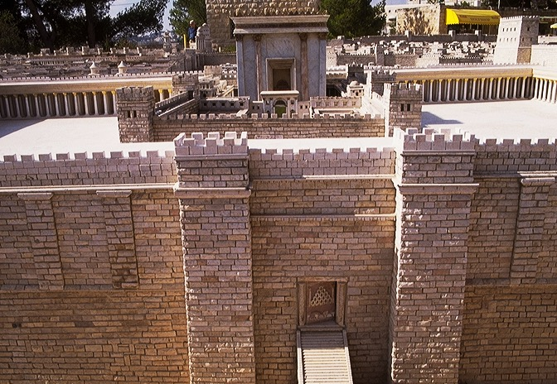
,NaRtpd; fhyj;jpy; ,Ue;j VUrNyk; Njthyaj;jpd; khjphp
,NaRtpd; fhyj;jpy; VNuhJ fl;ba Njthyaj;jpDila fpof;F thry;
44
1

Slide 46

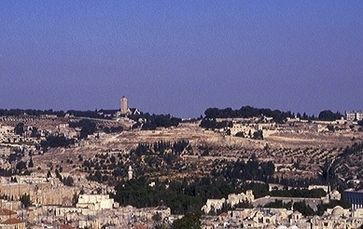
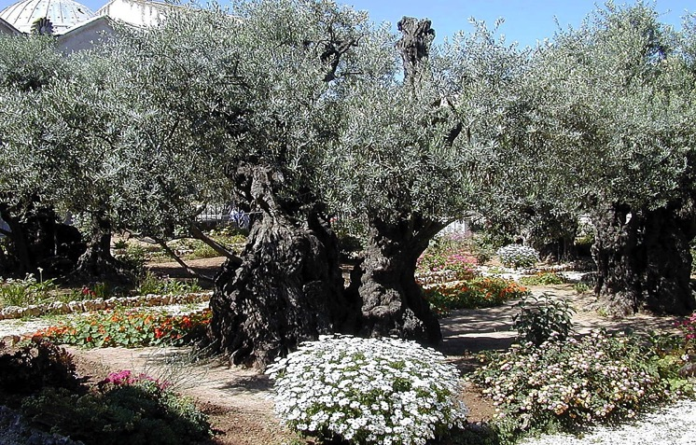
VNuhJ uh[hthy; fl;lg;gl;l ,uz;lhtJ Njthyak;
Xypt kiy
nfj;nrkNd Njhl;lj;jpy; cs;s gioa xypt kuk;
45
2

Slide 47
Mgpufhkpd; cld;gbf;if
Mgpufhkpd;
miog;G
Mjp:12:1-3
cld;gbf;if
Mjp: 15:9-18
epj;jpakhdJ
Nehpakhd
mstplKbahjJ
Mjp:13:15
Mjp:13:14-16
Mjp:15:9-18
Njrk;
tpij
MrPh;thjk;
Mjp12:1
Gen2
Gen 12:3
mjpf jfty;fs; mlq;fpa cld;gbf;ifapd; cs;slf;fk;
Njrk;
jhtPjpd;cld;gbf;if
Gjpa cld;gbf;if
Deut 30: 1-10
2 Sam 7: 4-16
Jer 31:31-34
Ntjhfk ntspg;ghl;bd; KJnfYk;G
46
1
©2004 TBBMI
8.0.05B.

Slide 48
vNukpah 31
Gjpa cld;gbf;if
vNukpahtpd; #o;eiy Nkhrkhdjhf ,Ue;jJ…
ROYALTY
(1000 fp.K)
S - D - S
•••gphpT•••
tlf;F njw;F
,];Nuy;
A+jh
10 2
jPHf;fjhprpfs;
20-J 20-R
200 350
“A+jh rpf;fypy; ,Ue;jJ”
mrPhpah ghgpNyhd;
47
2

Slide 49
vNukpah 31
Gjpa cld;gbf;if
³¹ “,Njh ehl;fs; tUnkd;W fh;j;jh; nrhy;Yfpwhh;, mg;nghOJ ,];uNty; FLk;gj;NjhLk; [tlf;F uh[pak;] Ajh FLk;gj;NjhLk;
[njw;;F uh[pak;].
48
4

Slide 50
vNukpah 31
Gjpa cld;gbf;if
32 ehd; mth;fs; gpjhf;fis vfpg;J Njrj;jpypUe;J mioj;j tuf; ifg;gpbj;j ehspNy mth;fNshNl gz;zpd cld;gbf;ifapd;gb my;y@ Vnddpy; ehd; mth;fSf;F ehafuhapUe;Jk;> me;j vd; cld;gbf;ifia mth;fs; kPwp mtkhf;fpg;Nghl;lhh;fNs vd;W fh;j;jh; nrhy;Yfpwhh;.
(NIV)
49

Slide 51
vNukpah 31
Gjpa cld;gbf;if
³³ “me;ehl;fSf;Fg;gpw;ghL> ehd; ,];uNty; FLk;gj;NjhNl gz;zg;Nghfpw cld;gbf;ifahtJ@ ehd; vd; epahag;gpukhzj;ij mth;fs; cs;sj;jpNy itj;J> mij mth;fs; ,Ujaj;jpNy vOjp> ehd; mth;fs; NjtdhapUg;Ngd;> mth;fs; vd; [dkhapUg;ghh;fs; vd;W fh;j;jh; nrhy;Yfpwhh;
50
1

Slide 52
Gjpa Vw;ghl;bd; mwptpg;G
Yhf;fh 22:19-20
¹⁹ gpd;G mth; mg;gj;ij vLj;J> ];Njhj;jpuk;gz;zp> mij gpl;L> mth;fSf;Ff; nfhLj;J: ,J cq;fSf;fhf nfhLf;fg;gLfpw vd;Dila rhPukhapUf;fpwJ@
20 Ngh[dk; gz;zpdgpd;G mth; me;jg;gbNa ghj;jpuj;ijAk; nfhLj;J: ,e;jg; ghj;jpuk; cq;fSf;fhf rpe;jg;gLfpw vd;Dila ,uj;jj;jpdhyhfpa Gjpa cld;gbf;ifahapUf;fpwJ vd;whh;.
51
4

Slide 53
Gjpa Vw;ghl;bd; mwptpg;G
kj;NjA :26:26-28
26. mth;fs; Ngh[dk;gz;Zfapy;> ,NaR mg;gj;ij vLj;J> MrPh;tjpj;J> mijg; gpl;L> rP\h;fSf;Ff; nfhLj;J: ePq;fs; thq;fpg; GrpAq;fs;> ,J vd;Dila rhpukhapUf;fpwJ vd;whh;.
27. Gpd;G> ghj;jpuj;ijAk; vLj;J> ];Njhj;jpuk;gz;zp> mth;fSf;Ff; nfhLj;J: ePq;fs; vy;yhUk; ,jpNy ghdk;gz;Zq;fs;;@
28. ,J ghtkd;dpg;Gz;lhFk;gb mNefUf;fhfr; rpe;jg;gLfpw GJ cld;gbf;iff;Fhpa vd;Dila ,uj;jkhapUf;fpwJ.
52
4

Slide 54

Sunset from Kursi
,q;Nf vd;d elf;fpwJ ?
tpil : rpU\;bfUf;Fk; rpU\;bf;Fk; cs;s cwtpy; xU nghpnjhU khw;wk;!
WHAT IS HAPPENING HERE?
53
1
©2004 TBBMI
8.0.05B.

Slide 55
gioa Vw;ghl;bd;
“nra;jhfNtz;Lk;” vd;w
kdg;ghd;ik
toptpl;Lepd;wJ……
54
©2004 TBBMI
8.0.05B.

Slide 56
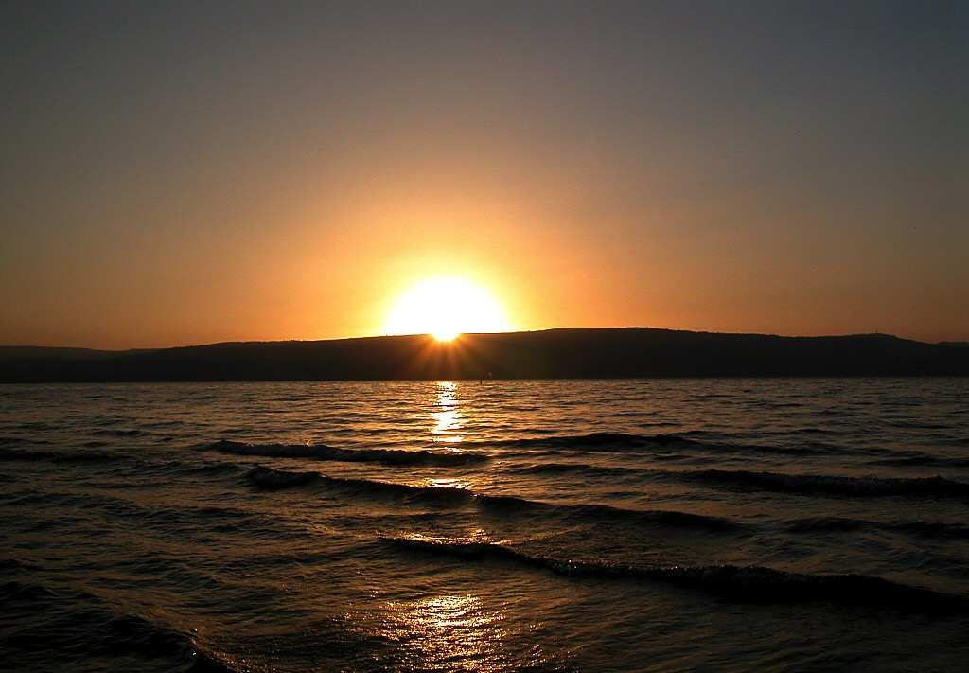
Sunset over Sea of Galilee
gioa Vw;ghl;bd; “nra;jhfNtz;Lk;” vd;w kdg;ghd;ik toptpl;Lepd;wJ……
……. Gjpa Vw;ghl;bd; “nra;aNtz;Lk;” vd;w kdg;ghd;ikf;F.
vg;gb? ghpRj;j Mtpahdthpd; cs;shd ce;Jjypd; epkpj;jk; --
Nkrpahtpd; RtpNrj;jhy; xt;nthU tpRthrpf;Fk; ,J toq;fg;gLfpwJ !
55
2
©2004 TBBMI
8.0.05B.

Slide 57
Sunset over Sea of Galilee
epahag;gpukhzk;
toptpl;Lepd;wJ…
fpUigf;fhf
56
©2004 TBBMI
8.0.05B.

Slide 58

,g;nghOJ Ntjhfk fijapd; njhlh;r;rpapd; Kf;fpaj;Jtj;ij Ghpe;Jf;nfhs;SfpNwhk;…
CREATION
ABRAHAM
JOSEPH
MOSES
JOSHUA
ANARCHY
ROYALTY
CAPTIVITY
SILENCE
kPl;gpd; gpukhz;lkhd fhl;rp
JESUS
57

Slide 59
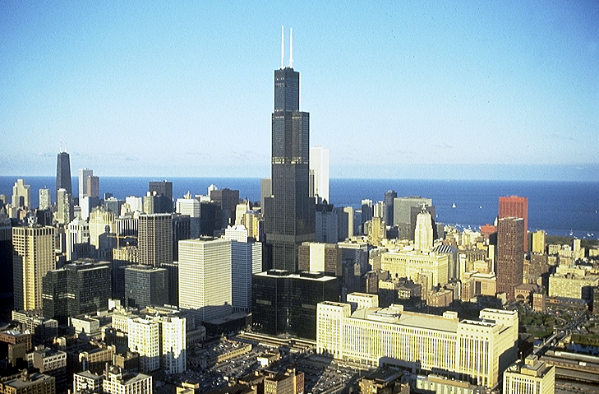


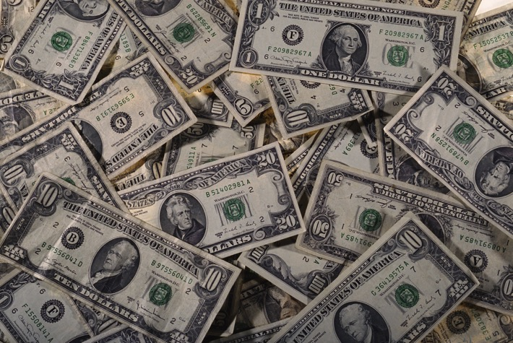

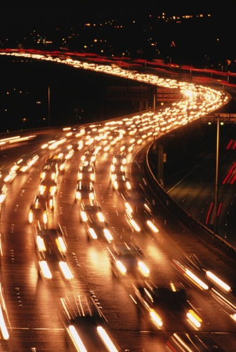
Nfs;tp: etPd cyfpy;, ,NaR fpwp];Jtpd; ,uj;jk; vg;gbg; gl;lJ?
58

Slide 60
“,uj;jk;”- mjd; mh;j;jkhtJ…
vgpNuah; 9: 15-22
15. Mifahy; Kjyhk; cld;gbf;ifapd; fhyj;jpNy ele;j mf;fpukq;fis epth;j;jpnra;Ak;nghUl;L mth; kuzkile;J>miof;fg;gl;lth;fs; thf;Fj;jj;jk;gz;zg;gl;l epj;jpa Rje;jpj;ij mile;Jnfhs;tjw;fhf>GJ cld;gbf;ifapd; kj;a];juhapUf;fpwhh;.
59
2

Slide 61
“,uj;jk;”- mjd; mh;j;jkhtJ…
vgpNuah; 9: 15-22
16. Vndd;why;> vq;Nf kuzrhrdKz;Nlh> mq;Nf me;jr; rhrdj;ij vOjpdtDila kuzKk; cz;lhf Ntz;Lk;.
17. Vg;gbnadpy;> kuzKz;lhd gpd;Ng kuzrhrdk; cWjpg;gLk;@ mij vOjpdtd; capNuhbUf;ifapy; mjw;Fg; ngydpy;iyNa.
60
1

Slide 62
“,uj;jk;”- mjd; mh;j;jkhtJ…
vgpNuah; 9: 15-22
18. me;jgb > Kjyhk; cld;gbf;ifAk; ,uj;jkpy;yhky; gpujp\;ilgz;zg;gltpy;iy
61

Slide 63
19.vg;gbNadpy;> NkhNr> epahagpukhzj;jpd;gb> rfy [dq;fSf;Fk; vy;yhf; fl;lisfisAk; nrhd;d gpd;G> ,sq;fhis nts;shl;Lf;flh ,itfspd; ,uj;jijj; jz;zPjNuhLk;> rptg;ghd Ml;LkapNuhLk;> <Nrhg;NghLq;$l vLj;J> G];jfj;jpd;NkYk; [dq;fnsy;yhh;NkYk; njspj;J:
“,uj;jk;”- mjd; mh;j;jkhtJ…
vgpNuah; 9: 15-22
62

Slide 64
“,uj;jk;”- mjd; mh;j;jkhtJ…
vgpNuah; 9: 15-22
20. Njtd; cq;fsf;Ff; fl;lisapl;l cld;gbf;ifapd; ,uj;jk; ,JNt vd;W nrhd;dhd;.
63
1

Slide 65
“,uj;jk;”- mjd; mh;j;jkhtJ…
vgpNuah; 9: 15-22
21. ,t;tpjkhf $lhuj;jpd;NkYk; Muhjidf;Fhpa rfy gzpKl;Lfspd; NkYk; ,uj;jijj; njspj;jhd;.
64

Slide 66
“,uj;jk;”- mjd; mh;j;jkhtJ…
vgpNuah; 9: 15-22
22. epahagpukhzj;jpd;gb nfhQ;rq;Fiwa vy;yhk; ,uj;jjpdhNy Rj;jpfhpf;fgLk;@ ,uj;jQ;rpe;Jjypy;yhky; kd;dpg;G cz;lhfhJ
65

Slide 67
“,uj;jk;”- mjd; mh;j;jkhtJ…
vgpNuah; 9: 15-22
22. epahagpukhzj;jpd;gb nfhQ;rq;Fiwa vy;yhk; ,uj;jjpdhNy Rj;;jpfhpf;fgLk;@ ,uj;jQ;rpe;Jjypy;yhky; kd;dpg;G cz;lhfJ
66
1

Slide 68
“,uj;jk;”- mjd; mh;j;jkhtJ…
vgpNuah; 9: 15-22
Me;j gypapy;yhky;, kd;dpg;G ,y;iy. ek; Njtd; fy;thhpf;F nrd;W kuzj;ij ntd;wjd; Kyk; cd;djkhd gypia ekf;F mUspdhh; - ^{ek; rhh;ghf}
67

Slide 69

STUDY HELP #14 & #32
Mgpufhkpd;
miog;G
Mjp:12:1-3
cld;gbf;if
Mjp: 15:9-18
Mgpufhkpd; cld;gbf;if
epj;jpakhdJ
Neh;rhpahd
mstplKbahjJ
Mjp 13:15
Mjp 13:14-16
Mjp 15:9-18
Njrk
Njrk
MrPh;thjk;
Mjp 12:1
Mjp 12:2
Mjp 12:3
mjpf jfty;fs; mlq;fpa cld;gbf;ifapd; cs;slf;fk;
The Amplified Subcovenants
Jer. 31:31-34
Njrk
jhtPjpd;cld;g
Deut. 30:1-10
2 Sam. 7:4-16
cjtpg; Gj;jfk; #14
68
5
©2006 TBBMI
9.65.05B.
Notes:
So..with Study Helps 14 and 32 in hand…the Abrahamic Covenant can be seen now in its full grandeur...
//// …a Call to Abraham in Genesis 12…followed by…
//// …the making or "cutting" of the Covenant itself... in Genesis 15...
//// proclaiming its LAND, SEED AND BLESSING aspects....
//// …and seen to be ETERNAL IN ITS DURATION...LITERAL IN ITS MEANING...AND UNCONDITIONAL IN ITS APPLICATION...with each of the three parts amplified through later centuries
//// …in the form of the Land Covenant of Deuteronomy given through Moses...the Davidic Covenant of Second Samuel...and finalized in the New Covenant in the writings of Jeremiah.
//// THIS IS THE FULL IMPACT OF THE ABRAHAMIC COVENANT…THE VERY BACKBONE OF BIBLICAL REVELATION.

Slide 70



me;j Ehypio nea;Ak; jhp QhgfKs;sjh!
nea;agl;l Jzpg;Nghd;w fhythpirg;gLj;jg;gl;l Ntjhfkk;
cjtpg;Gj;jfk; #08
69
© 2004 TBBMI
8.0.05B.

Slide 71
me;j Ehypio nea;Ak; jhp QhgfKs;sjh!
nea;agl;l Jzpg;Nghd;w fhythpirg;gLj;jg;gl;l Ntjhfkk;
70
© 2004 TBBMI
8.0.05B.

Slide 72
fhythpirg;gLj;jg;gl;l Ntjhfkj;jpd; xU nea;agl;l Jzp
7
Ml;Lf; Fl;bahdthpd; fy;ahdtpUe;J
Rpwe;j nts;is Mrd epahak;
Gkpapy; fpwp];JtpdMl;rp
Gjpa thdk; Gjpa Gkp
4P
3S
,uz;lhk; tUif
J
C
A
J
M
J
A
R
C
S
71
© 2004 TBBMI
8.0.05B.

Slide 73
A FABRIC OF THE BIBLE’S CHRONOLOGY
7
4P
3S
EARTHLY REIGN OF CHRIST
MARRIAGE SUPPER OF
THE LAMB
NEW HEAVEN, NEW EARTH
GREAT WHITE THRONE
JUDGMENT
J
THE SECOND COMING
C
A
J
M
J
A
R
C
S
Ml;Lf; Fl;bahdthpd; fy;ahdtpUe;J
ABRAHAMIC COVENANT
Rpwe;j nts;is
Mrd epahak;
,uz;lhk; tUif
Gjpa thdk;
Gjpa Gkp
LAND COVENANT
Gkpapy; fpwp];Jtpd;
Ml;rp
DAVIDIC COVENANT
NEW COVENANT
73
4
© 2004 TBBMI
8.0.05B.

Slide 74
fhythpirg;gLj;jg;gl;l Ntjhfkj;jpd; xU nea;agl;l Jzp
7
Ml;Lf; Fl;bahdthpd; fy;ahdtpUe;J
Rpwe;j nts;is Mrd epahak;
Gkpapy; fpwp];JtpdMl;rp
Gjpa thdk; Gjpa Gkp
4P
3S
,uz;lhk; tUif
J
C
A
J
M
J
A
R
C
S
Mgpufhkpd; cld;gbf;if
Njrj;jpd; cld;gbf;if
jhtPjpd; cld;gbf;if
Gjpa cld;gbf;if
74
© 2004 TBBMI
8.0.05B.

Slide 75
,q;Nf xU Nfs;tp cs;sJ:
,e;j etpdkhd ,Ugj;Njhuhk; Ehw;whd;wpy;, 4>000-tUlk; goikahd, Mz;ltUf;Fk; mtUila Njhodhd MgpufhKf;Fk; ,ilNa ele;j xg;ge;jj;ij ehk; Vw;Wf;nfhs;s KbAkh? (Mjp 12 & 15)
(ftdpf;f: ,J cyfk; KYtJk; nkhopahf;fk; nra;ag;gl;l vy;yh nkhopngah;g;GfspYk; kpf Js;spakhf nkhopngah;f;fg;gl;Ls;sJ!)
Mkhk;… kpf Js;spakhf …
Mz;lth; jpUk;g <rhf;fplk; epidTf;$h;e;jhh; Mjpahfkk; 26.
ahf;Nfhgplk; jpUk;g Ngrpdhh; Mjpahfkk; 35.
kWgbAk; NahNrg;NghL Mjpahfkk; 48.
NkhNrNahL, ahj; 6…NahRthNthL NahRth 1.
filrpahf …. Kf;fpakhf ….. Nkrpah ,ij epiwNtw;w te;jhh;!
75
8
©2004 TBBMI
8.0.05B.

Slide 76
mjdhy;…,itnay;yhk; nrhy;yg;gl;bUf;f:
Mifahy; ,g;gbg;gl;l mstplKbahj, Neh;rhpahd thf;Fjj;q;fs; cq;fs; Ntjhfkj;jpy; ,Ug;gjhy; …mij vg;gbahfpYk; ehk; ifahs Ntz;Lk; !
76
1

Slide 77
“ek;Kila tpRthrk; mbg;gilapy; epiyg;ngwhtpl;lhy; , mJg; NghJkhd
Miles Stanford
Principles of Spiritual Growth
cz;ikapd;
mbg;gilapy;yhjJk;>
Klek;gpf;ifAk;> MuhahJ Vw;Wf;nfhs;tJkhapUf;Fk;.”
77
4

Slide 78
cq;fs; njhpe;njLg;Gfs; ,q;Nf cs;sJ:
1. njhlh;G ,y;yhjJ vd;W Gwf;fdpj;jy;
2. gioa Vw;ghL Mdjhy; kwe;J tplyhk;.
3. Qhdkha; mtw;wpd; mh;j;jq;fis Muha;e;J vjph;fhyj;jpw;F Vw;wthU rk;ge;jg;Lj;Jjy;.
78
3

Slide 79
cq;fs; njhpe;njLg;Gfs; ,q;Nf cs;sJ:
1. njhlh;G ,y;yhjJ vd;W Gwf;fdpj;jy;
2. gioa Vw;ghL Mdjhy; kwe;J tplyhk;.
3. Qhdkha; mtw;wpd; mh;j;jq;fis Muha;e;J vjph;fhyj;jpw;F Vw;wthU rk;ge;jg;Lj;Jjy;.
#3 ePq;fs; njhpe;njLj;jhy;, ePq;fs; epr;rakhf…
4. cq;fs; vjph;fhyj;jpw;F mJ vg;gb mh;;j;jk; nfhs;Sk; vd;gijAk; ,naR fpwp];JNthL cq;fs; cwT vg;gb ,Uf;Fk; vd;Wk; jPh;khzpf;fNtz;Lk;
79
1

Slide 80
rpf;fyhd> jdpg;gl;l Nfs;tp:
Mz;ltUila thh;j;ij cz;ikah ,y;iyah?
cq;fs; gjpy; vd;dthapUe;jhYk;, xU Gjpa Nfs;tp njhlh;fpwJ.
80
2

Slide 81
,e;j ,NaRit ehk; vd;d nra;ahyhk;?
81

Slide 82
“mtiuf; Fwpj;J kf;fs; nghJthf nrhy;Yk; Kl;lhs;j;jdkhf thf;if jtph;f;f Kw;gLfpNwd;:
‘ehd; ,NaRit rpwe;j Nghjfuhf Vw;Wf;nfhs;Ntd; Mdhy; mtiu flTshf Vw;Wf;nfhs;s KbahJ.’
,e;j xd;iw kl;Lk; ehk; nrhy;yf;$lhJ.
xU rhjhud kdpjdhapUe;J ,NaR Nghjpj;jitfis ghh;f;Fk; NghJ mth; xU rpwe;j Nghjfuhf kl;Lk; ,Uf;f KbahJ.
mth; xUNtis igj;jpakhf ,Uf;fNtz;Lk; -- my;yJ – mth; eufj;jpd; gprhrhf ,Uf;fNtz;Lk;.
ePq;fs; cq;fs; Kbit njhpe;njLf;f Ntz;Lk;.
,e;j kdpjd; md;Wk; ,d;Wk; NjtDila Fkhudh my;yJ ,th; xU igj;jpakh my;yJ mjw;Fk; Nkhrkhdtuh”
C.S. Lewis’ Mere Christianity, pp 40-41
82
7

Slide 83
kWgbAk; mNj Nfs;tp : ,e;j ,NaRit eP vd;d nra;a Nghfpwha;?
83

Slide 84

Ntjk; …..mbg;gilahf> ,jd; Kyk; ,g;nghOJ cq;fs; rpe;jidapy; ,Ug;gJ…….
•”Ntjhfk Nfhg;Gfs;” vd;w vz;zk;
• “Ntjhfk Nfhg;Gfs;;” - ,tw;iw jpwg;gjw;fhd rhtp C 7 S J
•Kf;fpa Ntjhfk efo;Tfis epidtpw;Ff; nfhz;LtUk; kdjpd; tiuglk;
• Ntjhfkj;jpd; “fijfs;” mbg;gilahdJ: “tphpthd fhythpirg;gLj;jg;gl;l ml;ltid”
•Ntjhfkj;jpy; Mgpufhkpd; m];jpthuk; Neuhf ,NaR fpwp];Jtpd; Copag;ghijf;F mioj;J nry;fpwJ
84
1

Slide 85
fhythpirg;gLj;jg;gl;l Ntjhfkj;jpd; xU nea;agl;l Jzp
7
jpUr;rig
4P
3S
EARTHLY REIGN OF CHRIST
MARRIAGE SUPPER OF
THE LAMB
NEW HEAVEN, NEW EARTH
GREAT WHITE THRONE
JUDGMENT
J
THE SECOND COMING
C
A
J
M
J
A
R
C
S
Mgpufhkpd; cld;gbf;if
Njrj;jpd; cld;gbf;if
jhtPjpd; cld;gbf;if
Gjpa cld;gbf;if
72
6
© 2004 TBBMI
8.0.05B.

Slide 86
THE BIBLE... BASICALLY
jpUkiwapd;…
mbg;gil

Slide 87


jpUkiwapd;…mbg;gil • BibleStudyDownloads.org
,g;ghlf;Fwpg;Gfis ,ytrkhf ngw;Wf;nfhs;s
Notes:
The Bible…Basically (bb)

Slide 88
81
©2004 TBBMI
8.0.05B.
86

