Slide 1

THE BIBLE... BASICALLY
jpUkiwapd;…
mbg;gil
Designed by Dr. John Fryman, Texas, USA • BibleBasically.org
Taught by Dr. Rick Griffith, Singapore Bible College
All files in many languages for free download at BibleStudyDownloads.org

Slide 2

,naR
“...fhyk; epiwntwp.dnghJ”
fyh. 4:4
2,000 years after God’s Promise to old Abraham…
CREATION
ABRAHAM
ABRAHAM
ABRAHAM
JOSEPH
ABRAHAM
MOSES
JOSHUA
ANARCHY
Mz;lthpd;
g[jpa jpl;lk;
ROYALTY
CAPTIVITY
,naR
SILENCE
JESUS
Handbook pg. 39-41
6
01

Slide 3
Matthew, Mark, Luke, John
7
,naR
thH;t[
rpYit
rig
,naR
Mgpufhk; cld;gOf;ifapd;
mstpy;yh thf;Fjj;jk;
kWgOa[k;.... xU nknyhl;l ghh;it
... tptuk; ,y;iy
Handbook pg. 39-41
5
02

Slide 4
Matthew, Mark, Luke, John
7
,naR
thH;t[
FHe;ijg; gUtk; : “ fypnyad;”
Kjy; vUrnyk; CHpak;
fypnyaht[f;F jpUk;g[jy;
jiyefh; fg;gh;eTk;
nghpad; CHpak;
Kot[ vUrnyk; CHpak;
,naR
thH;t[
Handbook pg. 39-41
6
03

Slide 5
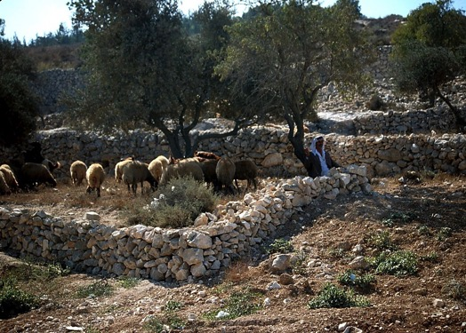
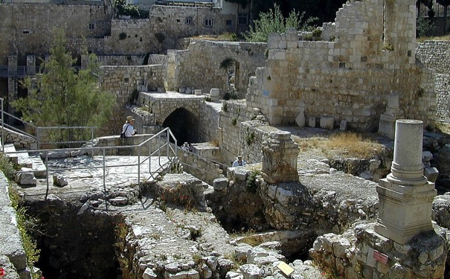
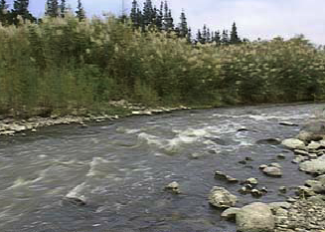

kj;: 4:11-16
bgj;ynfk; mUfpy; nka;g;gh;fs;
fg;gh;eFkpd; Fd;Wg;gFjp
,naR
thH;t[
nky; nahh;jhd; ejp
bgj!;jhf; Fsk;
ek; njtdpd; mDjpd thH;tpd; gpd;ddp ...
ek; ,ul;rfh; jd; fz;fshy; fz;l fhl;rpfs; ...
Handbook pg. 39-41
04

Slide 6
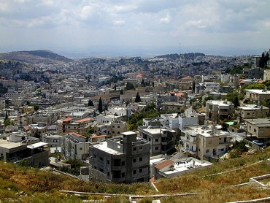
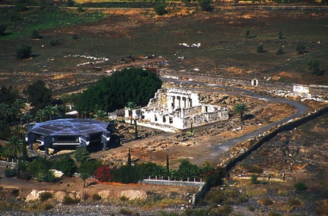
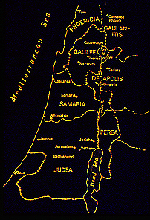
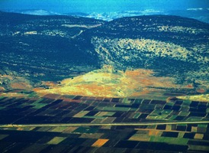
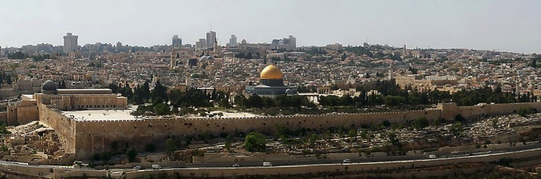
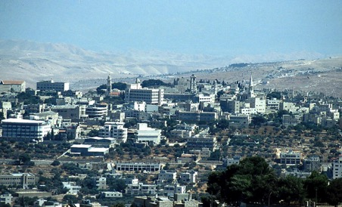
7
fg;gh;eTk;
,naR fpwp!;Jtpd; thH;t[ gazk;
- 6 Kf;fpa Fwpg;g[fs;
ehrnuj;
fypnyah
fhdh
,naR
thH;t[
vUrnyk;
bgj;ynfk;
Handbook pg. 39-41
05
6

Slide 7
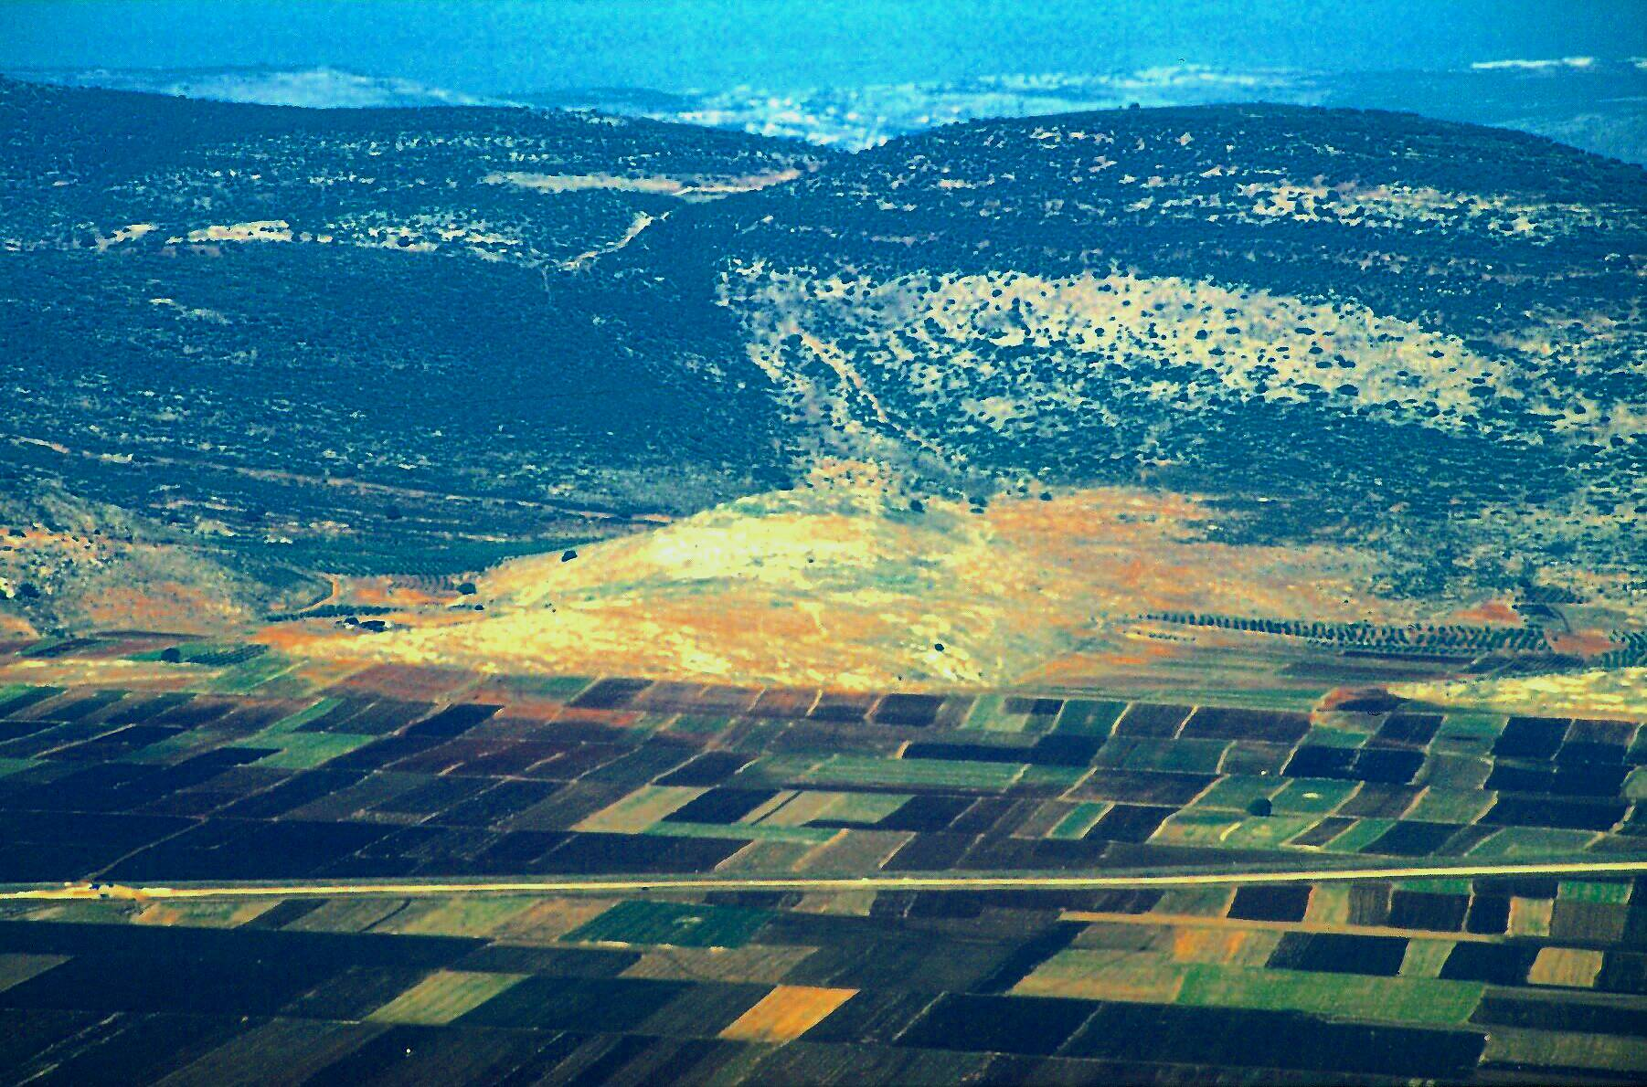
nah : 2:1-11
JESUS
,naR
thH;t[
Jesus Traveled His Land:
fhdh Ch; - ,naR bra;j Kjy; mw;g[jk;
06

Slide 8




7
JESUS
Life
Kl;bro Edpia epidj;Jg; ghh;
Handbook pg. 39-41
07
1

Slide 9
7
Acts 17:16-34
JESUS
Life
,naR fpwp!;Jtpd; CHpag;gazk;;;
Handbook pg. 39-41
08
1

Slide 10
nah 2:13-2:25
7
Cjtpf; Fwpg;g[ #07
JESUS
Life
1. ek; njtdpd;
Kjy; vUrnyk;
CHpak;
Handbook pg. 39-41
09
1

Slide 11
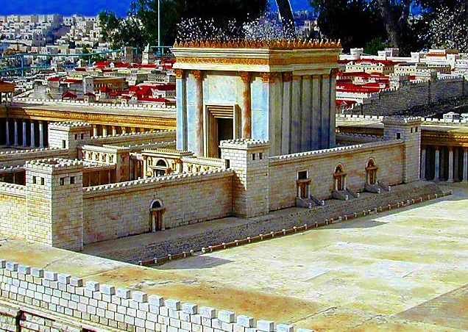
nah 2:13-2:25
7
JESUS
Life
VnuhJ uhIh fl;oa vUrnyk; n;jthyak;
Handbook pg. 39-41
10

Slide 12

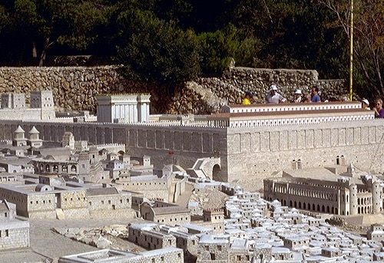
nah 2:13-2:25
vUrnyk; -,naR thH;e;j fhyj;jpy;
JESUS
Life
vUrnyk; - R{w;wpa[s;s gl;lzk;
kiy nky; mike;Js;s njthyak;/
Me;njhdpah nfhl;il
Location Credit: Holyland Hotel, Jerusalem
Handbook pg. 39-41
11

Slide 13
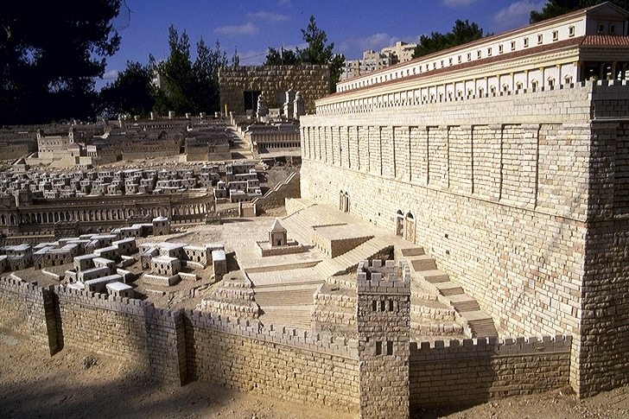

Mark 11:27
vUrnyk; -,naR thH;e;j fhyj;jpy;
JESUS
Life
kiy nky; mike;Js;s njthyaj;jpd; bjw;Fg; ghij
fpHf;F thry;
Location Credit: Holyland Hotel, Jerusalem
Handbook pg. 39-41
12

Slide 14
nah 4:1-6
7
2. …….
rkhhpah..
tHp bry;Yjy;
JESUS
Life
1.ek; njtdpd;
Kjy; vUrnyk;
CHpak;
rpnyh njtDila Tlhuk;
,naR fpwp!;Jtpd; Kl;bronghd;w CHpak;...
Handbook pg. 39-41
3
13

Slide 15
kj; . 4:13-16; 9:1
3. fg;gh;eTkpy; fypnyah CHpak;
2. rkhhpah..
tHp bry;Yjy;
JESUS
JESUS
Life
1.ek; njtdpd;
Kjy; vUrnyk;
CHpak;
,naR fpwp!;Jtpd; Kl;bronghd;w CHpak;...
Handbook pg. 39-41
14

Slide 16
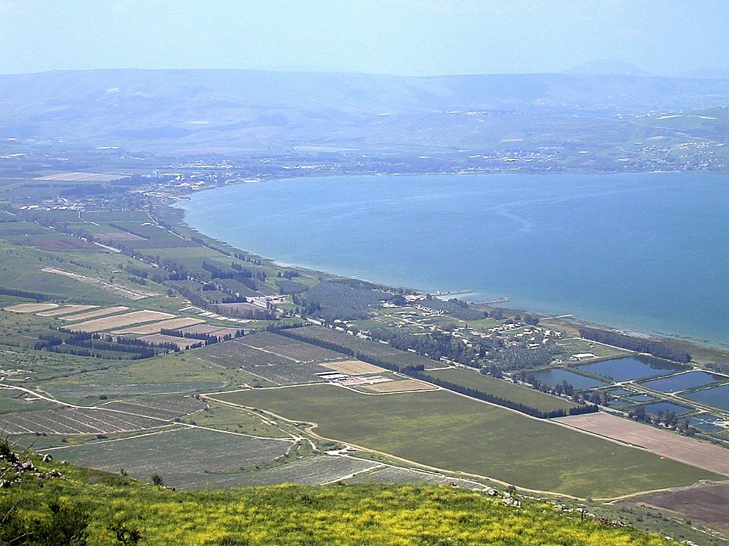
; fg;gh;eTk; : CHpa jiyefh;
JESUS
JESUS
Life
,naR fpwp!;J ,t;tplj;jpy; gazk; bra;jhh;
tlnkw;F/ fypnyah fly;
15

Slide 17
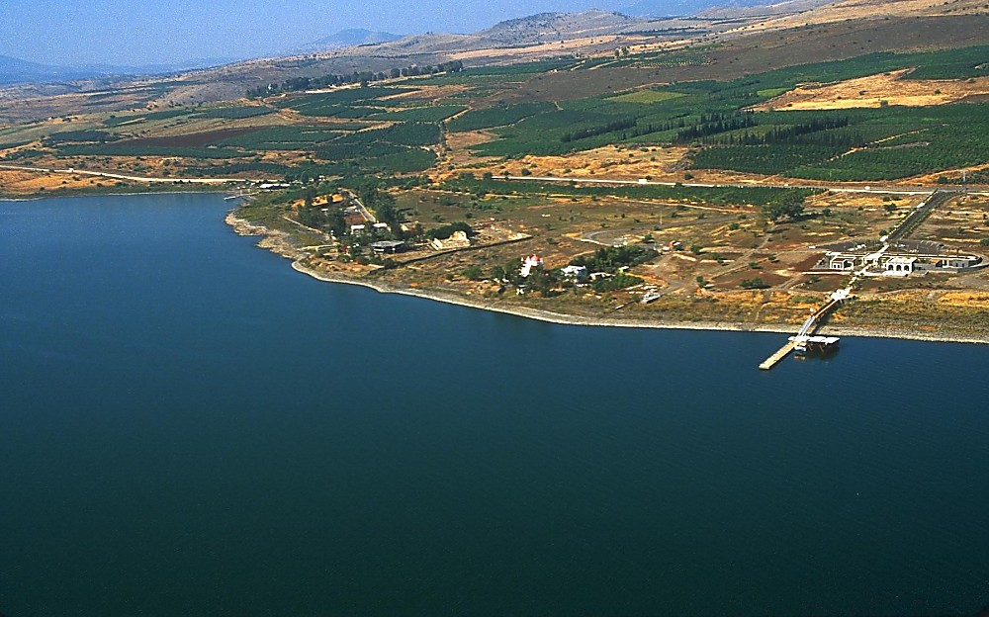
JESUS
JESUS
Life
,naR fpwp!;J ,t;tplj;jpy; gazk; bra;jhh :
fg;gh;eTk; : tpz;zpypUe;J xU ghh;it
16

Slide 18
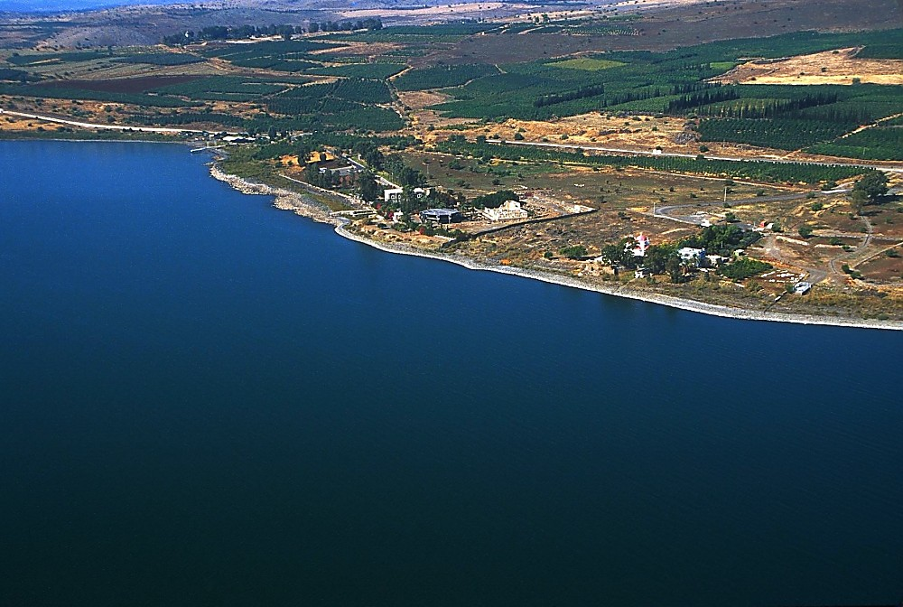
JESUS
JESUS
Life
,naR fpwp!;J ,t;tplj;jpy; gazk; bra;jhh :
fg;gh;eTk; : tpz;zpypUe;J xU ghh;it
17

Slide 19
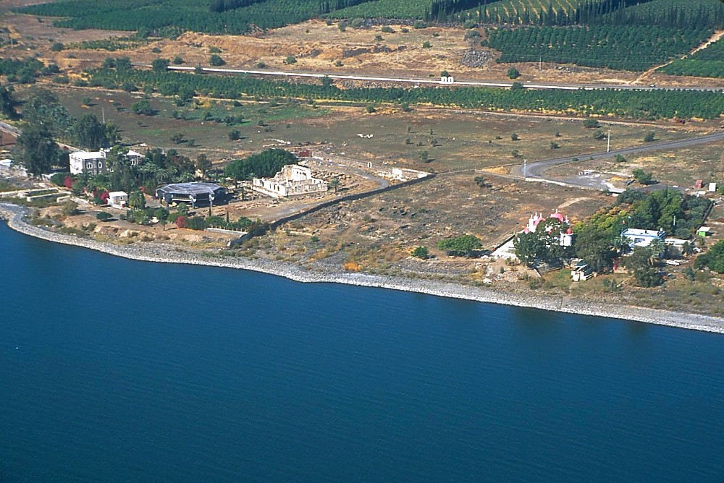
JESUS
JESUS
Life
,naR fpwp!;J ,t;tplj;jpy; gazk; bra;jhh :
fg;gh;eTk; : tpz;zpypUe;J xU ghh;it
18

Slide 20
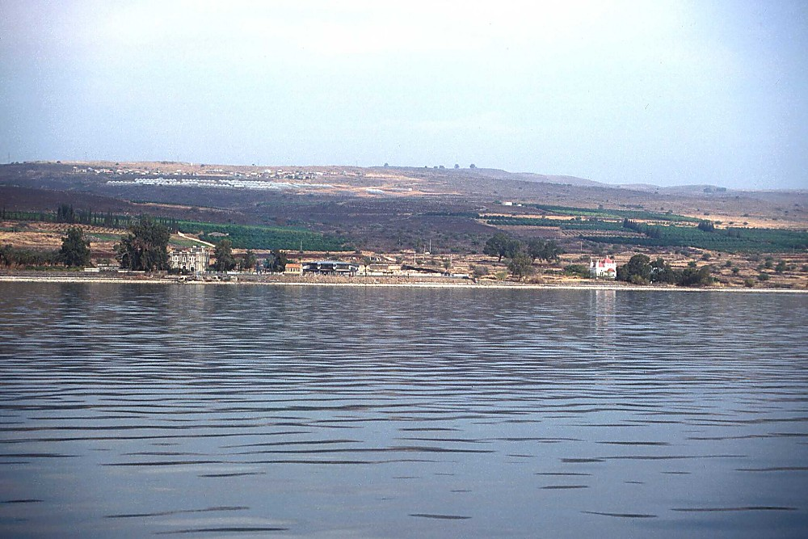
JESUS
JESUS
Life
,naR fpwp!;J ,t;tplj;jpy; gazk; bra;jhh :
fg;gh;eTk; : glfpypUe;;J xU ghh;it
19

Slide 21
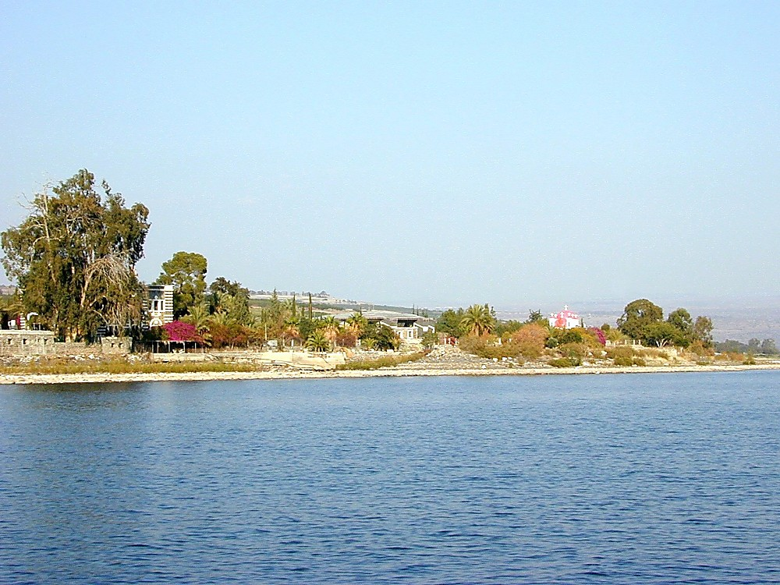
JESUS
JESUS
Life
,naR fpwp!;J ,t;tplj;jpy; gazk; bra;jhh :
fg;gh;eTik glFKyk; mDfjy;
20

Slide 22
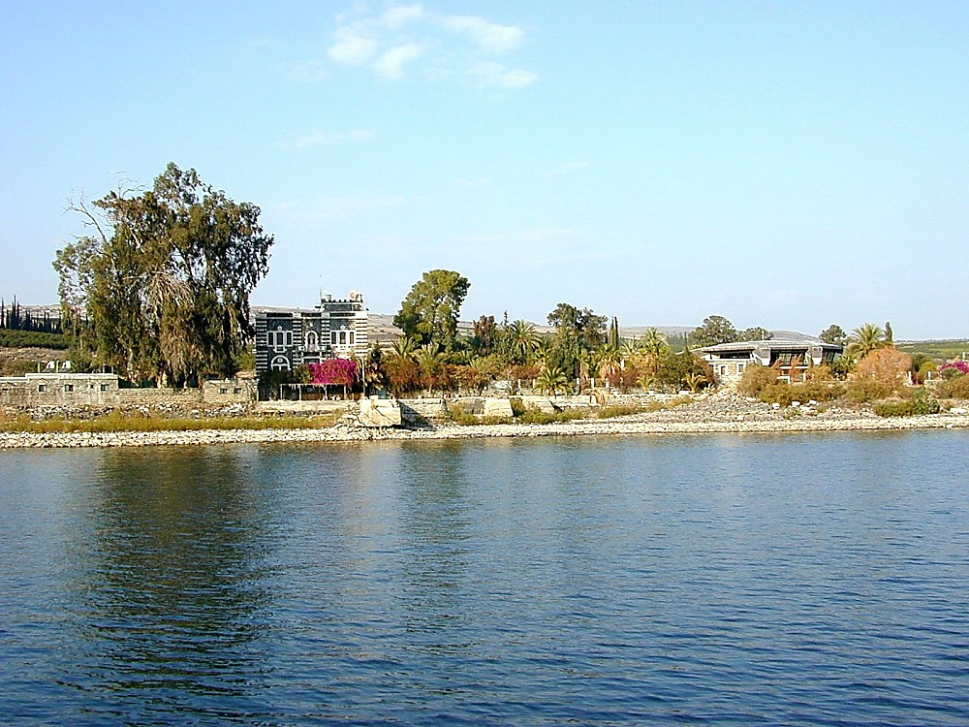
JESUS
JESUS
Life
,naR fpwp!;J ,t;tplj;jpy; gazk; bra;jhh :
fg;gh;eTk; : glfpypUe;;J xU ghh;it
21

Slide 23
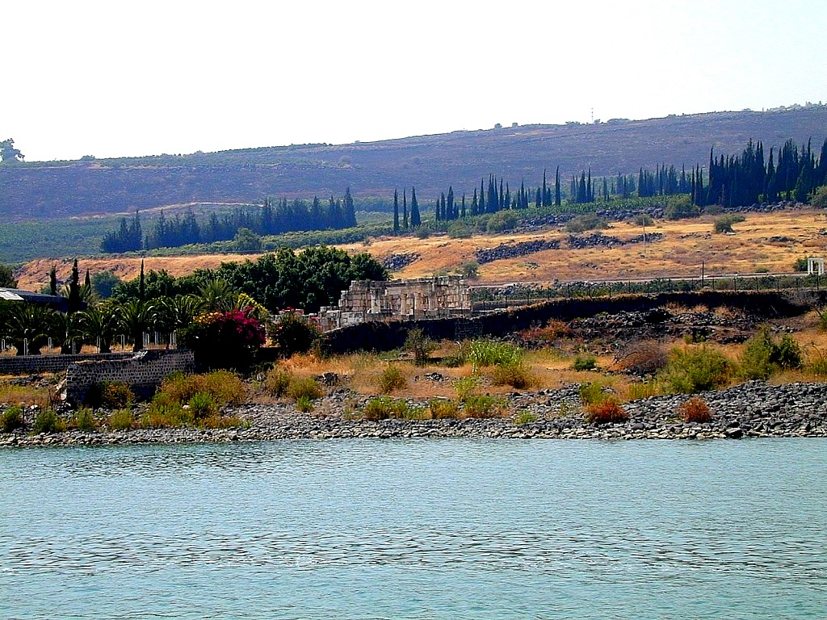
JESUS
JESUS
Life
,naR fpwp!;J ,t;tplj;jpy; gazk; bra;jhh; :
fg;gh;eTik te;jilfpnwhk; - a[j njthyak;
22

Slide 24
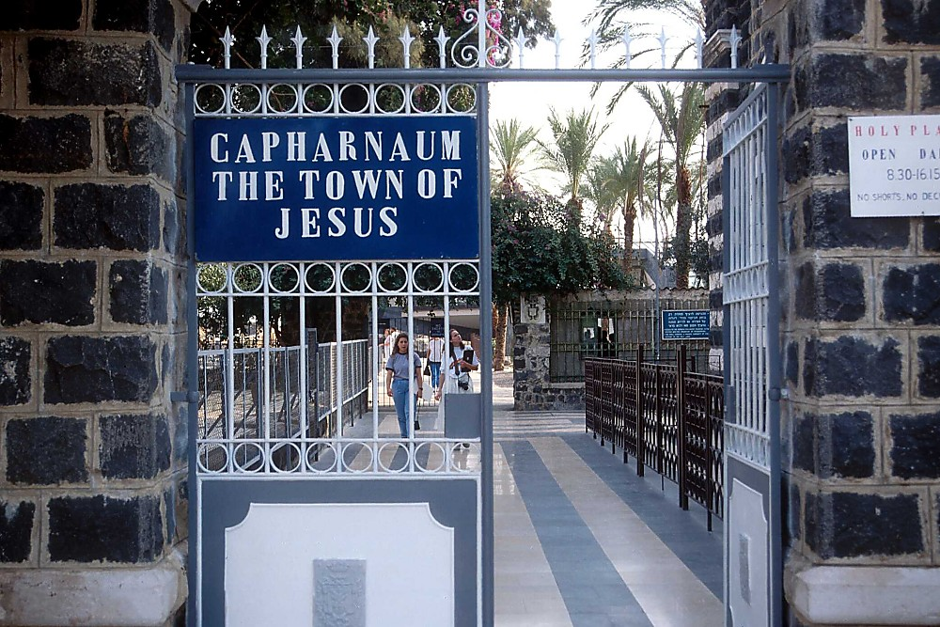
JESUS
JESUS
Life
,naR fpwp!;J ,t;tplj;jpy; gazk; bra;jhh :
,naR fpwp!;Jtpd; Ciu milfpnwhk;
23

Slide 25
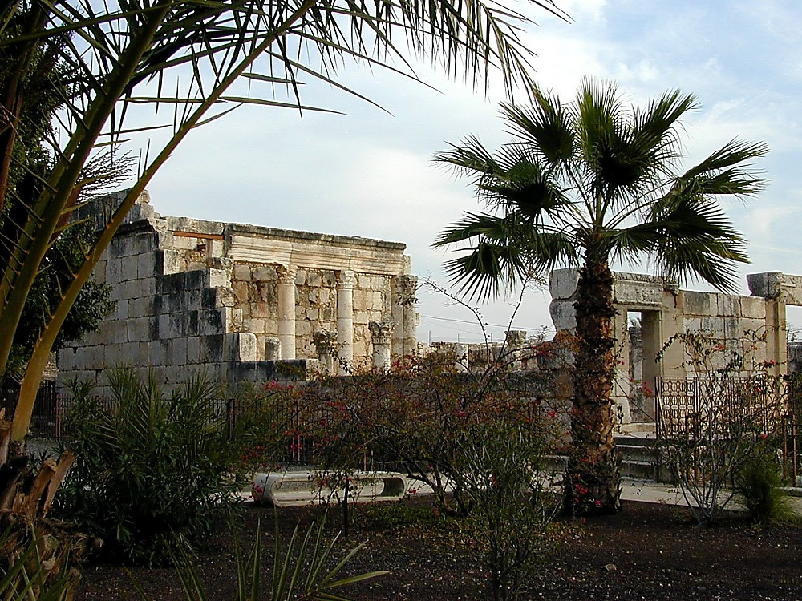
JESUS
JESUS
Life
,naR fpwp!;J ,t;tplj;jpy; gazk; bra;jhh :
gpw;gl;l fg;gh;eTk; - a[j njthyak;
24

Slide 26
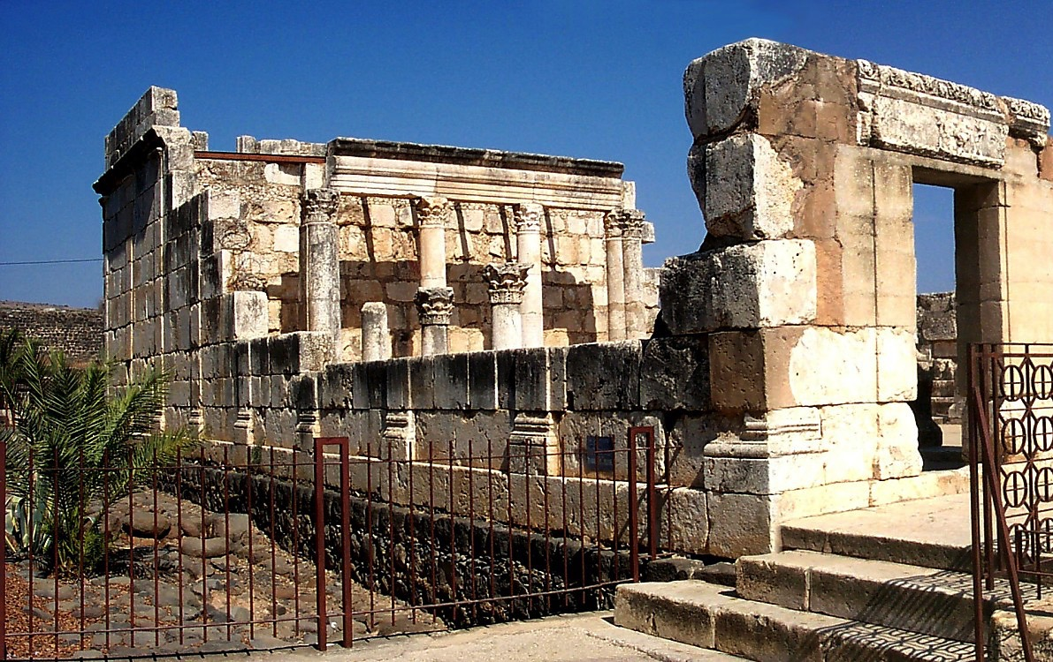
JESUS
JESUS
Life
,naR fpwp!;J ,t;tplj;jpy; gazk; bra;jhh :
gpw;gl;l fg;gh;eTk; - a[j njthyak;
25

Slide 27
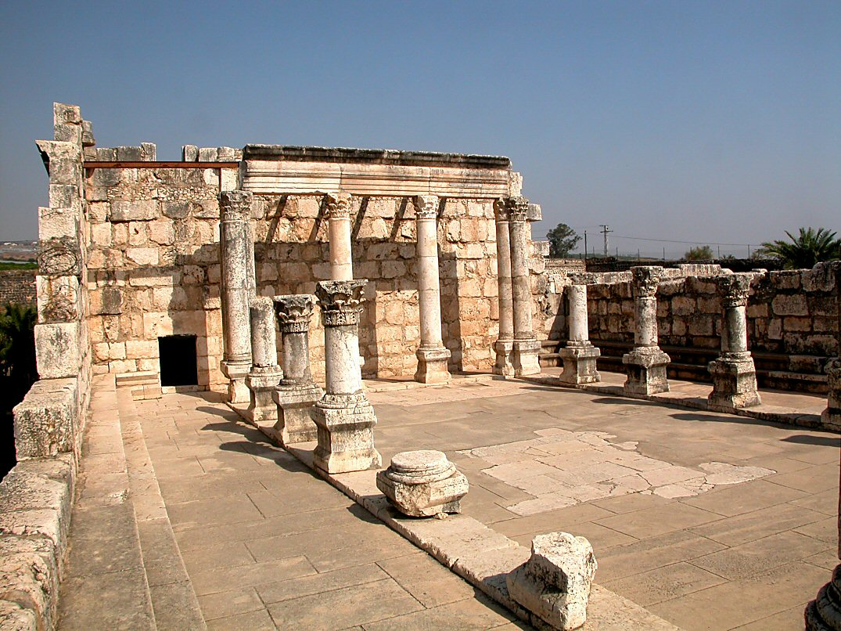
Mark 1:21; John 6:59
JESUS
Life
,naR fpwp!;J ,t;tplj;jpy; gazk; bra;jhh :
gpw;gl;l fg;gh;eTk; - a[j njthyak;
26

Slide 28
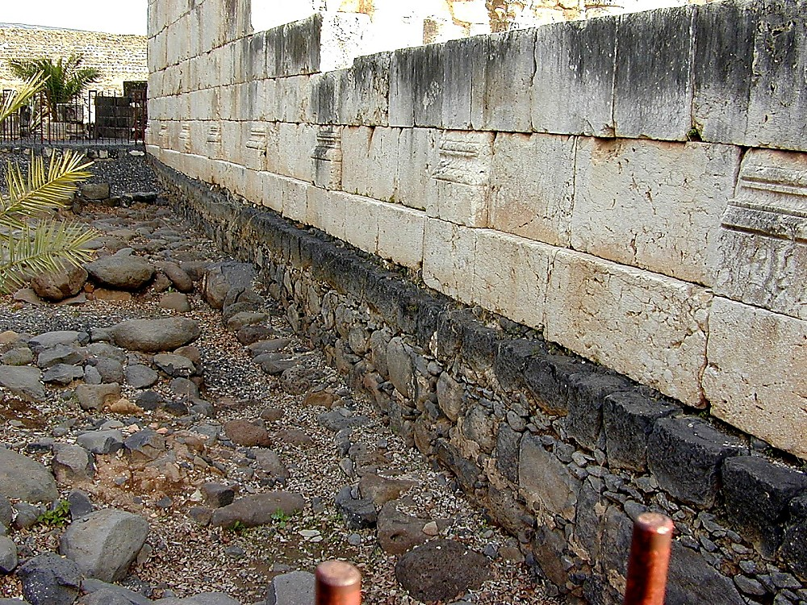
JESUS
JESUS
Life
,naR fpwp!;J ,t;tplj;jpy; gazk; bra;jhh :
gYjile;j fg;gh;eTkpd; bjUf;fs;
27

Slide 29
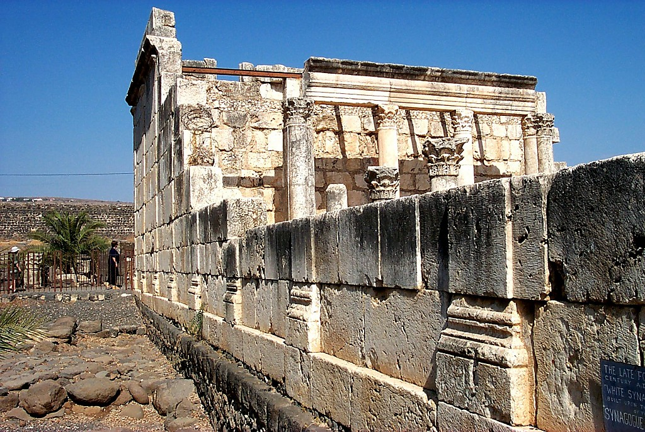
JESUS
JESUS
Life
,naR fpwp!;J ,t;tplj;jpy; gazk; bra;jhh :
gYjile;j fg;gh;eTkpd; bjUf;fs;
28

Slide 30
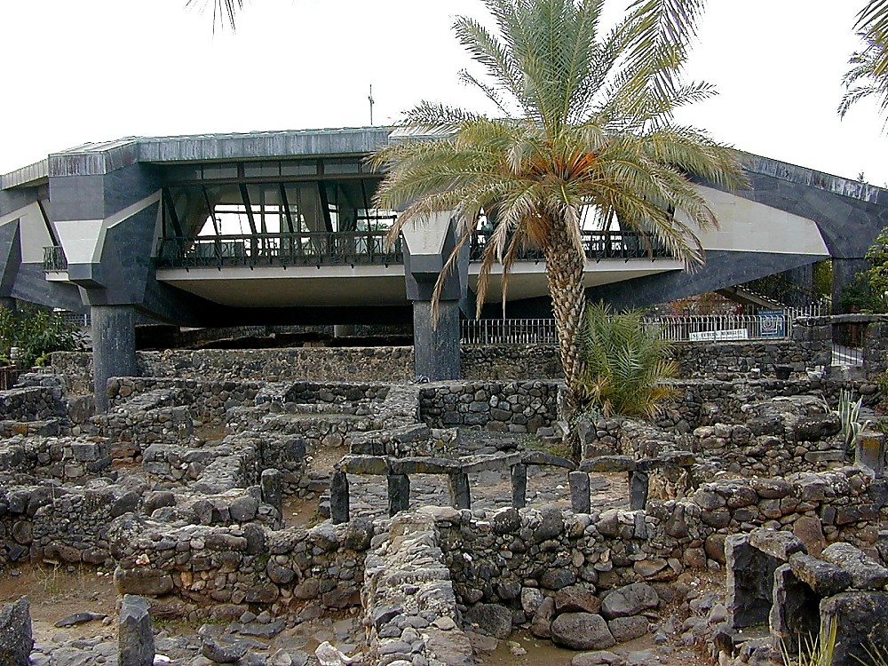
JESUS
JESUS
Life
,naR fpwp!;J ,t;tplj;jpy; gazk; bra;jhh :
fg;gh;eTkpYs;s ngJUtpd; tPL
29

Slide 31
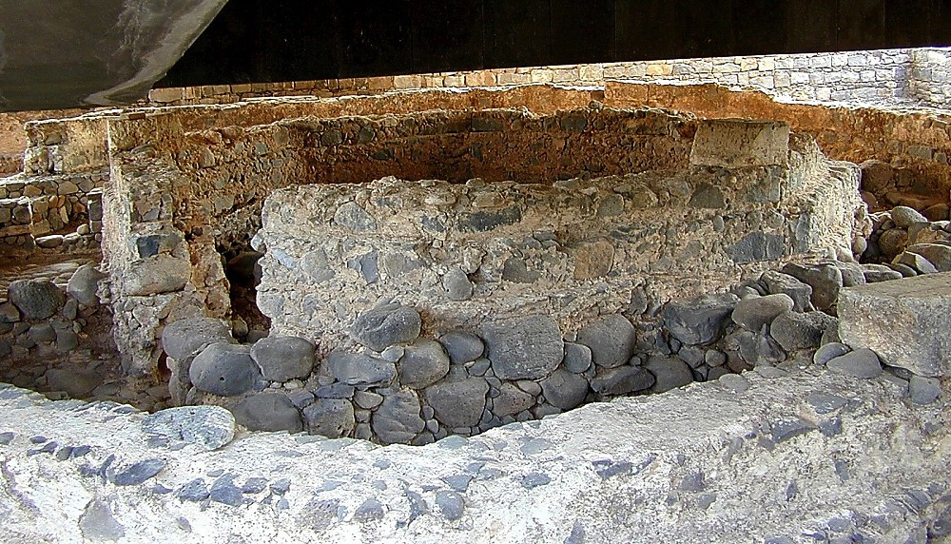
JESUS
JESUS
Life
,naR fpwp!;J ,t;tplj;jpy; gazk; bra;jhh :
fg;gh;eTkpYs;s ngJUtpd; tPL - ,d;iwa epiy
30

Slide 32

JESUS
JESUS
Life
,naR fpwp!;J ,t;tplj;jpy; gazk; bra;jhh :
Nhpad; kiwt[ - fypnyahf; fly;
31

Slide 33
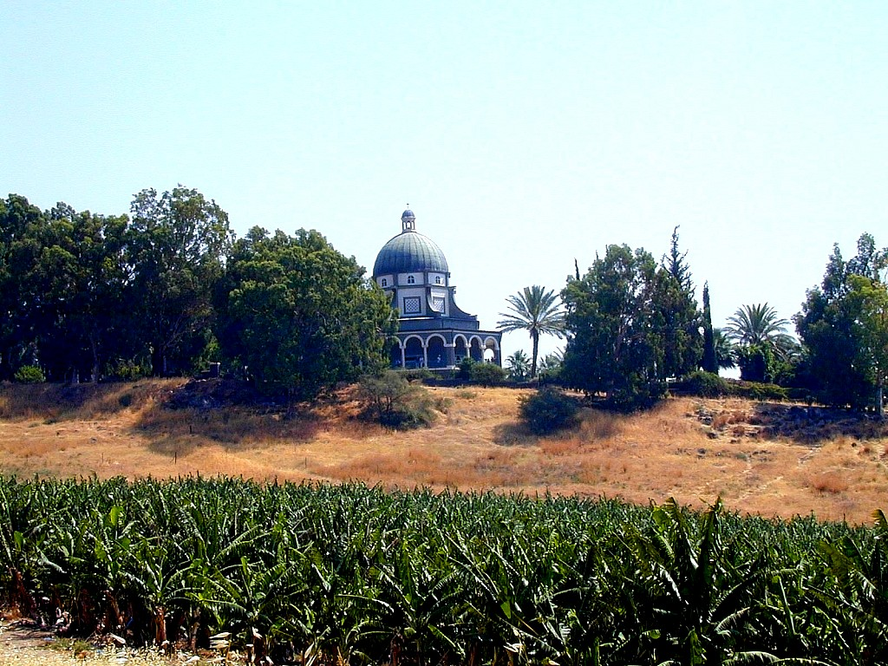
JESUS
JESUS
Life
,naR fpwp!;J ,t;tplj;jpy; gazk; bra;jhh :
kiyg; gpurfk; bra;j ,lk;
32

Slide 34
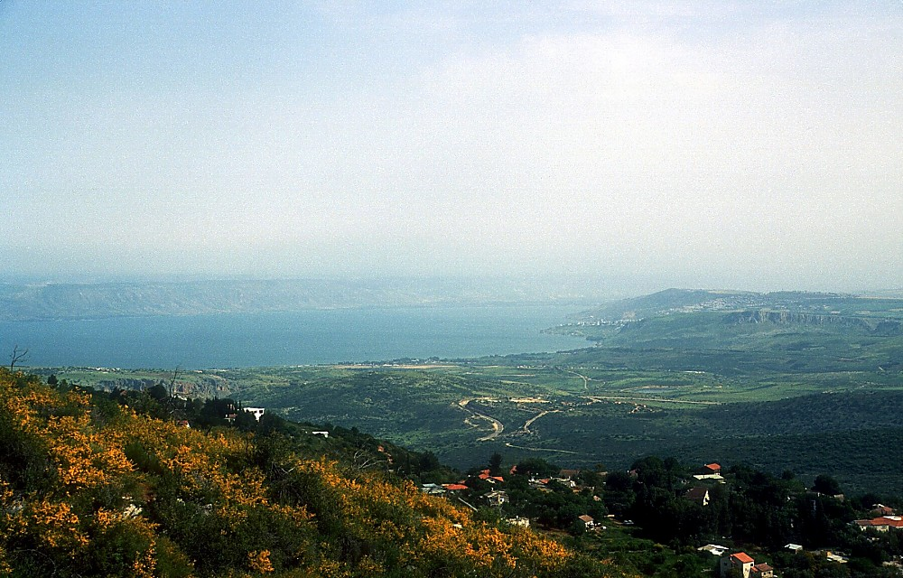
JESUS
JESUS
Life
,naR fpwp!;J ,t;tplj;jpy; gazk; bra;jhh :
fypnyahtpd; cau;thd ,lk;
33

Slide 35
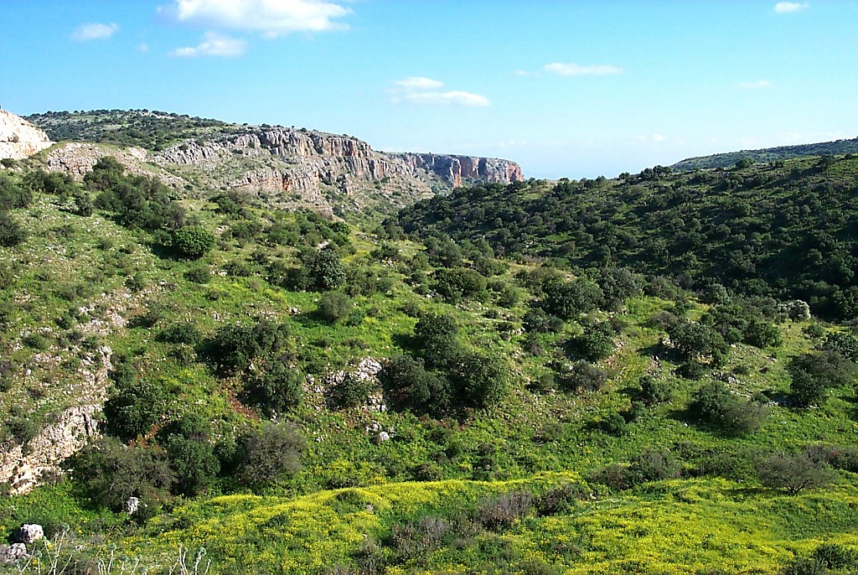
JESUS
JESUS
Life
,naR fpwp!;J ,t;tplj;jpy; gazk; bra;jhh :
fypnyahtpd; cau;thd ,lj;jpYs;s gl;lzk;
34

Slide 36
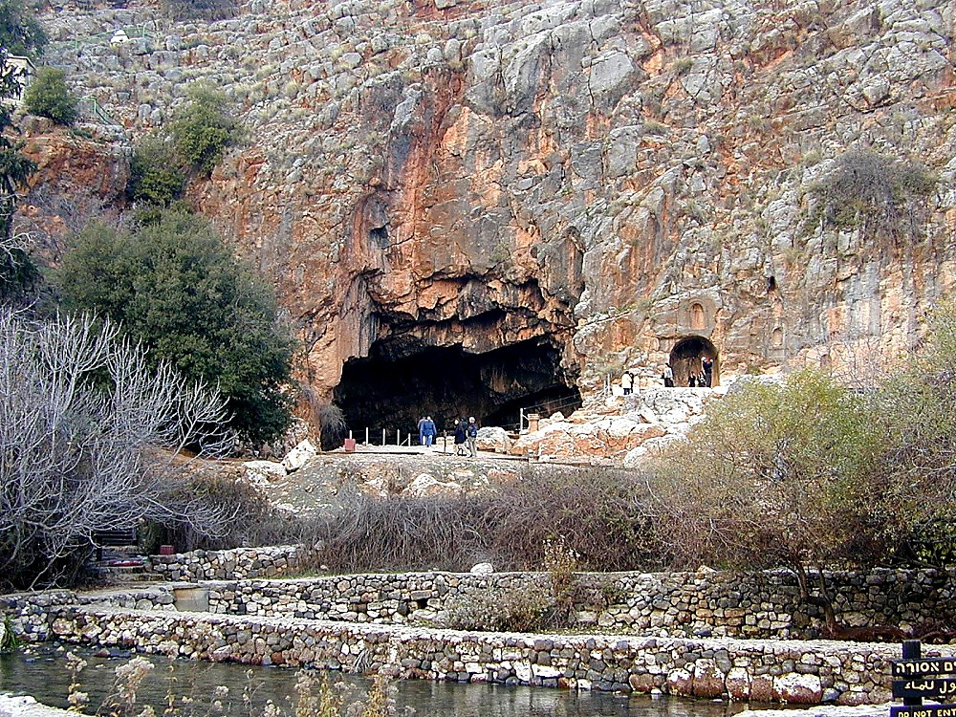
Matt 16:13-28
JESUS
JESUS
Life
,naR fpwp!;J ,t;tplj;jpy; gazk; bra;jhh :
Rprhpah gpypg;gp -- ngJUt[f;F: “…,e;j fy;ypd; nky; !”
35

Slide 37
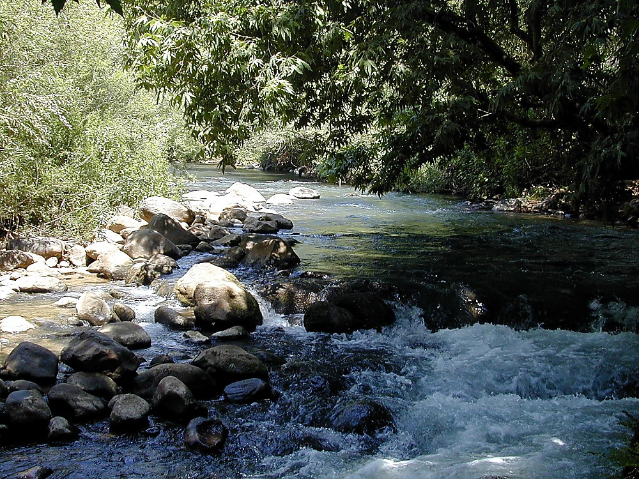
JESUS
JESUS
Life
,naR fpwp!;J ,t;tplj;jpy; gazk; bra;jhh :
nky; nahh;jhdpd; jz;z&u;
36

Slide 38
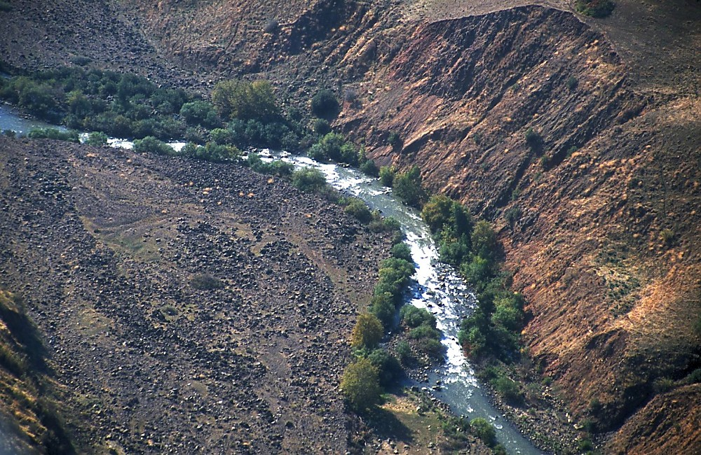
JESUS
JESUS
Life
,naR fpwp!;J ,t;tplj;jpy; gazk; bra;jhh :
nahh;jhd; ejp bjw;F nehf;fp gha;fpwJ
37

Slide 39
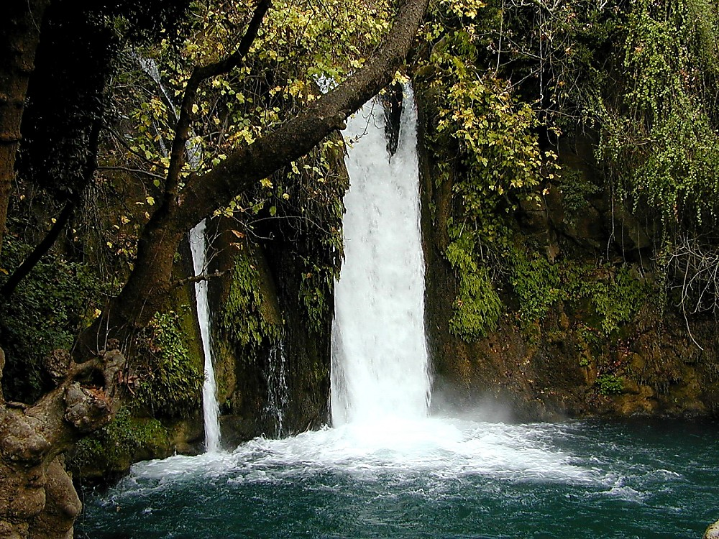
JESUS
JESUS
Life
,naR fpwp!;J ,t;tplj;jpy; gazk; bra;jhh :
fypnyahtpd; jhuhskhd jz;z&u;
38

Slide 40
kj;. 4:25; khw;F 7:31
3. fg;gh;eTkpy; fypnyah CHpak;
2. rkhhpah..
tHp bry;Yjy;
JESUS
Life
1.ek; njtdpd;
Kjy; vUrnyk;
CHpak;
,naR fpwp!;Jtpd; Kl;bronghd;w CHpak;...
39
2

Slide 41
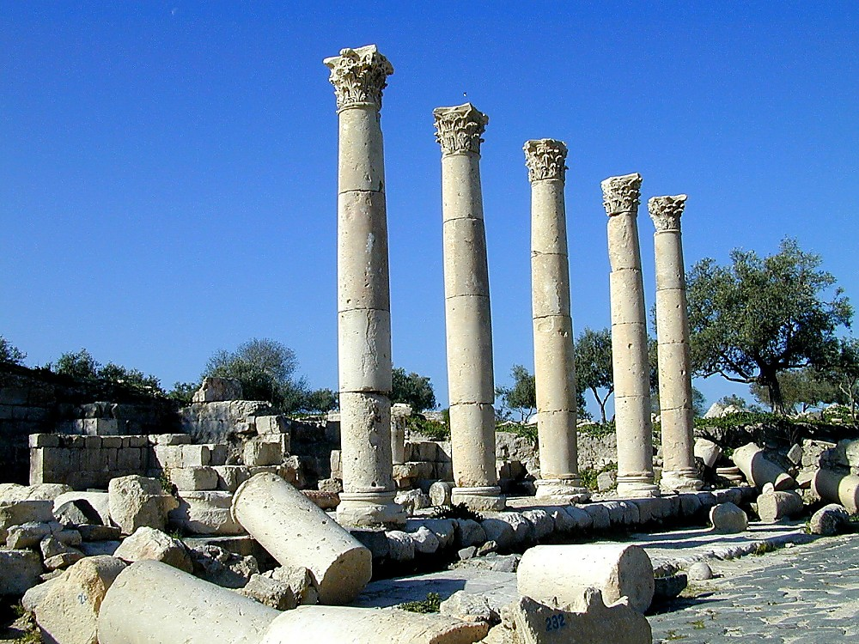
Mark 5:1; Luke 8:26,37; Matt 8:28
JESUS
JESUS
Life
,naR fpwp!;J ,t;tplj;jpy; gazk; bra;jhh :
fjhuh- fpnuf;f - Kiw fl;llk;
40

Slide 42
kj; . 4:13-16; 9:1
3. fg;gh;eTkpy; fypnyah CHpak;
2. rkhhpah..
tHp bry;Yjy;
JESUS
JESUS
Life
1.ek; njtdpd;
Kjy; vUrnyk;
CHpak;
,naR fpwp!;Jtpd; Kl;bronghd;w CHpak;...
Handbook pg. 39-41
14

Slide 43
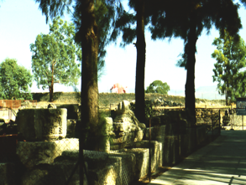
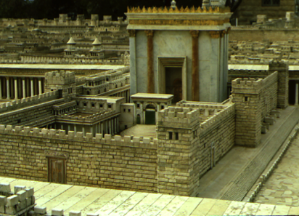
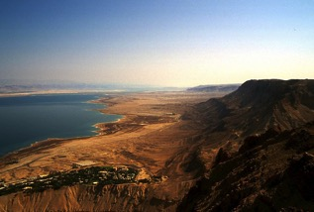
John 2:23; 4:45; 5:1; 10:22; 12:12
fg;gh;eTkpypUe;J vUrnyk; - 80 iky;
JESUS
fypnyah fly; / nahh;jhd; ejp –
rtf;fly; 75 iky;
JESUS
Life
Handbook pg. 39-41
2
42

Slide 44
kj; . 4:13-16; 9:1
3. fg;gh;eTkpy; fypnyah CHpak;
2. rkhhpah..
tHp bry;Yjy;
JESUS
JESUS
Life
1.ek; njtdpd;
Kjy; vUrnyk;
CHpak;
,naR fpwp!;Jtpd; Kl;bronghd;w CHpak;...
Handbook pg. 39-41
14

Slide 45
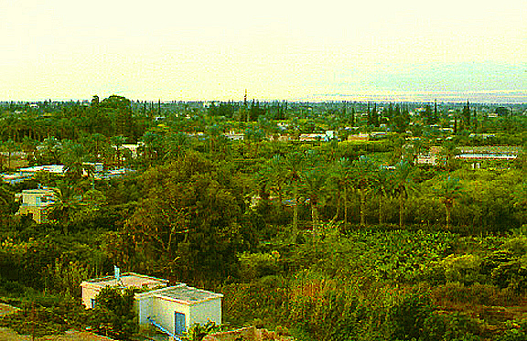
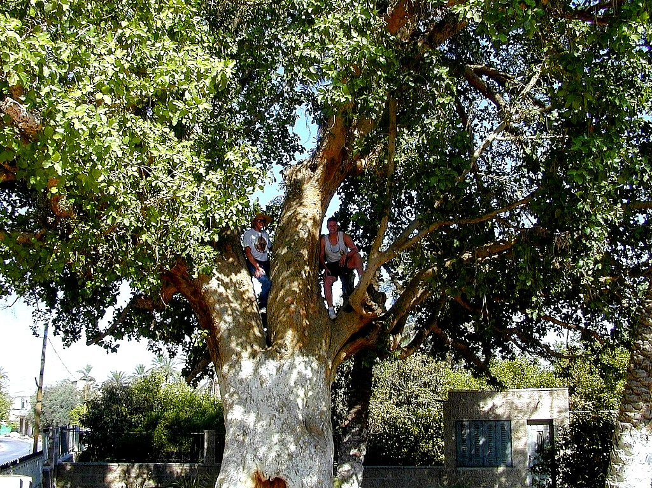
Yhf; 19:2-10
JESUS
Life
Jesus Traveled His Land:
Zacheus In The Sycamore Tree
Handbook pg. 39-41
1
44

Slide 46
Matt 21:10-14; John 12:13
3. fg;gh;eTkpy; fypnyah CHpak;
2. rkhhpah..
tHp bry;Yjy;
4. nghpad; CHpak;
JESUS
Life
1.ek; njtdpd;
Kjy; vUrnyk;
CHpak;
Kot[ vUrnyk; CHpak;
,naR fpwp!;Jtpd; Kl;bronghd;w CHpak;...
45

Slide 47
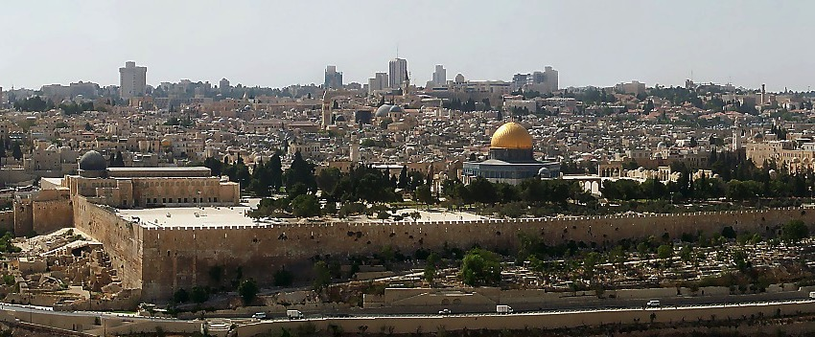
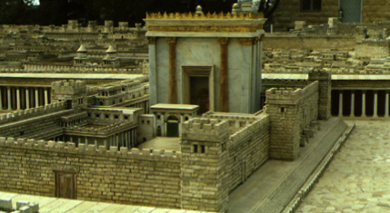
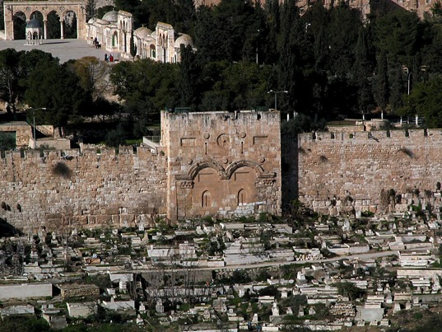
kj; 21:12
vUrnyk; njthyak; - ,d;W
JESUS
Life
njthyaj;jpw;F bry;Yk; fpHf;F thry;
Mgpufhkpd; nkhhpah kiy
a[{j njthyak;
Handbook pg. 39-41
46
2

Slide 48
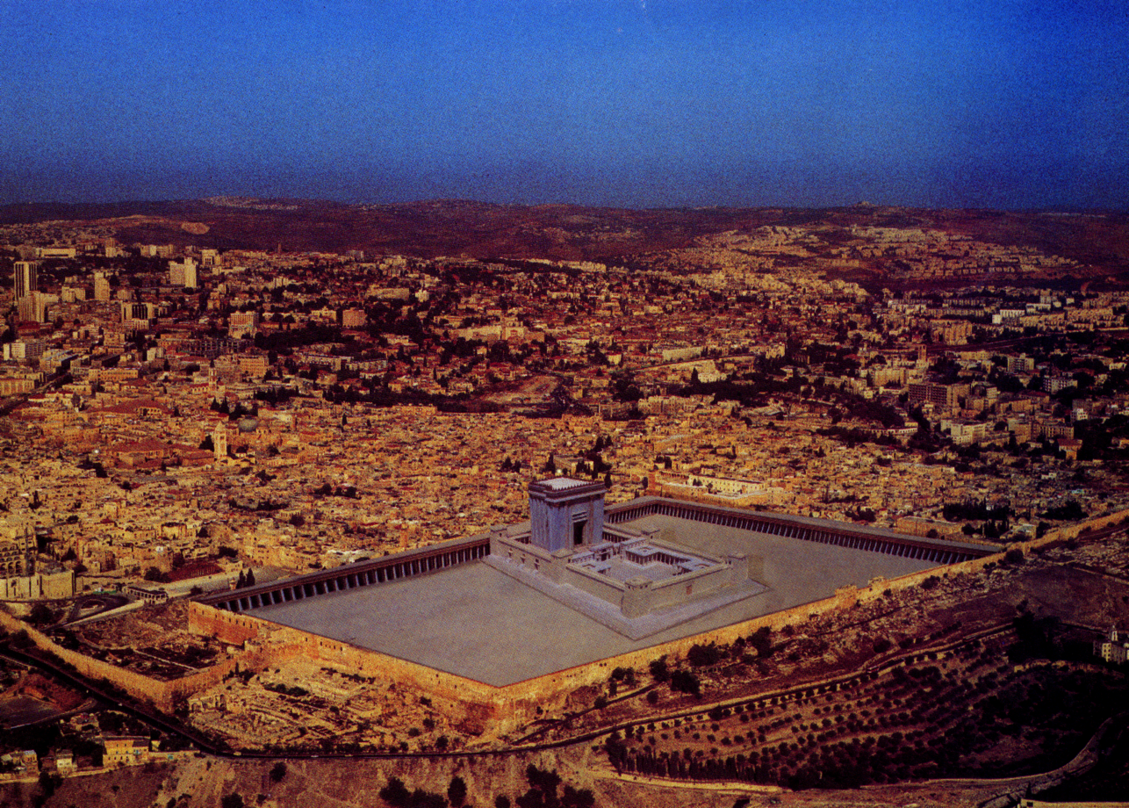
kj; 21:12
JESUS
Life
,naRtpd; fhyj;jpy; cs;s njthyak; ,g;nghJ ,Ue;jhy;
Handbook pg. 39-41
47

Slide 49
kj;. 26:28; khw;F 14:24; Yhf;fh 22:20
7
,naR
thH;t[
rpYit
g[jpa cld;gof;if
JESUS
Life
Cross
Handbook pg. 39-41
48

Slide 50
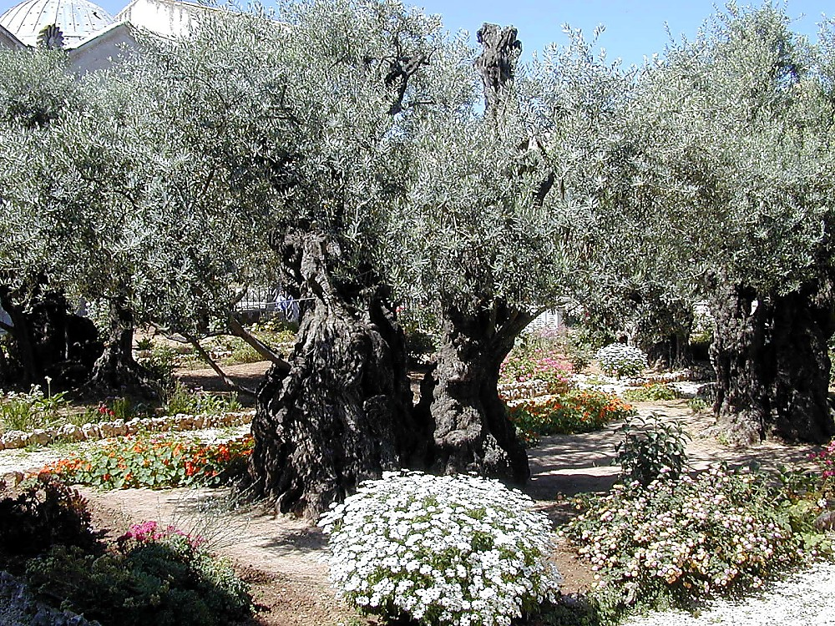
Yhf;fh 22:42
7
JESUS
Life
Cross
Xypt kiy - bfl;rknd njhl;lk;
gpjhnt/ ckf;F rpj;jkhdhy; ,e;jg; ghj;jpuk; vd;id tpl;L e&Fk;go ;bra;a[k;;;/ MapDk; vd;Dila rpj;jj;jpd;goay;y/ ck;Kila rpj;jj;jpd;gona Mff;fltJ
Handbook pg. 39-41
1
49

Slide 51
kj;nja[. 26-28; khw;F 14-16; Yhf;fh 23-24; nahthd; 19-20
7
,naR
thH;t[
rpYit
g[jpa cld;gof;if
Koe;jJ
JESUS
Life
,naRtpd; kuzk;
Cross
mth; mlf;fk;
mth; caph;bjGjy;
Handbook pg. 39-41
4
50

Slide 52
kj; 16:18; 28:19
7
,naR
thH;t[
rpYit
jpUr;rig
“vf;yprpah” -
bjhpe;bjLf;fg;gl;lth;fs;
JESUS
Life
Cross
Church
Jtf;fk; - vUrnyk;
..... cyfk; KGtJk;
Handbook pg. 39-41
4
51

Slide 53
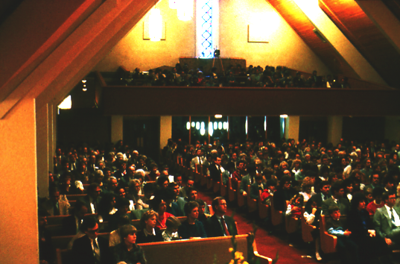
jpUr;rig
ehnk me;j nguiyapd; cr;rf;fl;lk;
JESUS
Life
Cross
Church
Handbook pg. 39-41
2
52

Slide 54
... vUrnykpYk;/ a[{njah KGtjpYk;/ rkhhpahtpYk;/ g[{kpapd; filrpg;ghpae;jKk;/ vdf;F rhl;rpfshapUg;g&h;fs;
The Church:
What are we doing about it?
JESUS
Life
Cross
Church
Handbook pg. 39-41
1
53

Slide 55
kj;nja[.; khw;F Yhf;fh nahthd;
7
cz;ika[k;
,iwikapYk;
,naR
thH;t[
rpYit
jpUr;rig
Rtpnr\k;
JESUS
Life
Cross
Church
Gospels
Handbook pg. 39-41
54

Slide 56
mg;.elgofs;
7
cz;ika[k;
,iwikapYk;
,naR
thH;t[
jpUr;rigapd;
Rhpj;jpuk;
rpYit
jpUr;rig
Rtpnr\k;
JESUS
mg;.elgofs;
Life
Cross
Church
Gospels
Acts
Handbook pg. 39-41
55

Slide 57
nuhkh; Kjy; a[jh tiu
7
cz;ika[k;
,iwikapYk;
,naR
thH;t[
jpUr;rigapd;
Rhpj;jpuk;
rpYit
jpUr;rig
Rtpnr\k;
JESUS
mg;.elgofs;
jpUr;rigapd;
gpur;;ridfs;
Life
Cross
Church
fojk;
Gospels
Acts
Epistles
Handbook pg. 39-41
56

Slide 58
bt.tpnr\k;
7
cz;ika[k;
,iwikapYk;
,naR
thH;t[
rpYit
jpUr;rig
jpUr;rigapd;
Rhpj;jpuk;
Rtpnr\k;
JESUS
mg;.elgofs;
jpUr;rigapd;
gpur;;ridfs;
Life
Cross
Church
fojk;
Gospels
Acts
Epistles
bt.tpnr\k;
Revelation
epj;jpakhd
Vjph;fhyk;
Handbook pg. 39-41
57

Slide 59
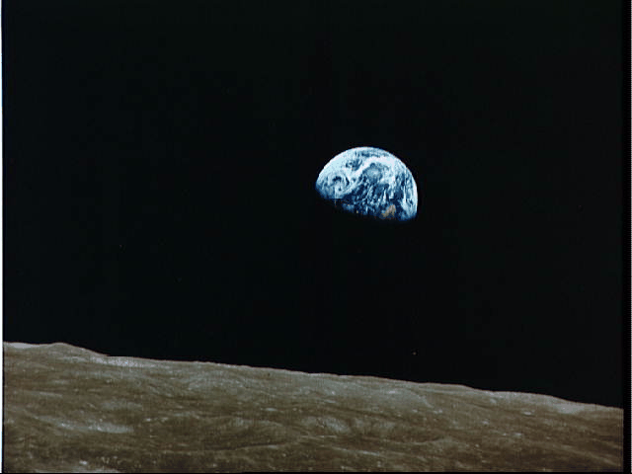
jpUkiwapd; fhl;rp bjhFg;g[fs;/ bt.tpnr\j;ij mila[k; nghJ cd;djkhd Koit milfpwJ.
There, in the millennial context, all the many streams of history and God's unconditional covenants flow together toward completion.
All that was promised has been fulfilled.
JESUS
Life
Cross
Church
That ancient understanding between God and his friend, ABRAHAM, is accomplished."
Gospels
Acts
Epistles
Revelation
John Walvoord
Handbook pg. 39-41
3
8.0.03f.
© 2004 TBBMI
PHOTO ©NASA
58

Slide 60

Mgpufhkpd; cld;gof;if
(“miHg;g[”)
Mjpahfkk; 12: 1-3
JESUS
njrk;
re;jjp
Mrph;thjk;
Life
Cross
Church
Gospels
Acts
njrk;
jhtpjpd;
g[jpa
Epistles
Revelation
cghfkk;
30: 1-10
2 rhKnty;
7: 4 -16
vnukpah
31: 31-33
Handbook pg. 39-41
59

Slide 61
Mgpufhkpd; cld;gof;if
(“miHg;g[”)
Mjpahfkk; 12: 1-3
JESUS
njrk;
re;jjp
Mrph;thjk;
Life
Cross
Church
Gospels
Acts
njrk;
jhtpjpd;
g[jpa
Epistles
Revelation
cghfkk;
30: 1-10
2rhKnty;
7: 4 -16
vnukpah
31: 31-33
Handbook pg. 39-41
60

Slide 62
Mgpufhkpd; cld;gof;if
(“miHg;g[”)
Mjpahfkk; 12: 1-3
JESUS
njrk;
re;jjp
Mrph;thjk;
Life
Cross
Church
Gospels
Acts
njrk;
jhtpjpd;
g[jpa
Epistles
Revelation
cghfkk;
30: 1-10
2rhKnty;
7: 4 -16
vnukpah
31: 31-33
Handbook pg. 39-41
61

Slide 63
Mgpufhkpd; cld;gof;if
(“miHg;g[”)
Mjpahfkk; 12: 1-3
JESUS
njrk;
re;jjp
Mrph;thjk;
Life
Cross
Church
Gospels
Acts
njrk;
jhtpjpd;
g[jpa
Epistles
Revelation
cghfkk;
30: 1-10
2 rhKnty;
7: 4 -16
vnukpah
31: 31-33
Handbook pg. 39-41
1
62

Slide 64
Mgpufhkpd; cld;gof;if
rpU\;og;g[
(“miHg;g[”)
Mgpufhk;
nahnrg;g[
Mjpahfkk; 12: 1-3
nkhnr
nahRth
epahjpgjpfs;
murhl;rp
JESUS
njrk;
SEED
moik
Life
Cross
mikjp
Church
Gospels
Acts
njrk;
jhtpjpd;
New
Epistles
,naR
Revelation
cghfkk;
30: 1-10
2rhKnty;
7: 4 -16
Jeremiah
31: 31-33
Handbook pg. 39-41
1
63

Slide 65
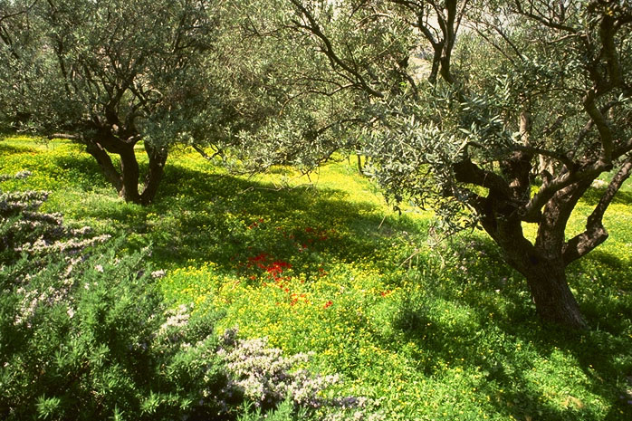
mjdhy;
vd;d ?
JESUS
Life
Cross
Church
Gospels
Acts
Epistles
Revelation
bfl;rbkndj; njhl;lk;/ xypt kiy/ vUrnyk;
64
1

Slide 66
“...mJKjy; ,naR : kdk;jpUk;g[fs;/ gunyhfuhIpak; rkPgpj;jpUf;fpwJ vd;W gpurfpj;jhh;...,naR fypnyah vFk; ele;J..uhIpaj;jpd; Rtpn\j;ij gpurfpj;J... tpahjpfis..brh!;jkhf;fpdhh; ” kj; . 4:17,23
JESUS
Life
Cross
Church
Gospels
Acts
Epistles
Revelation
65

Slide 67
“KjyhtJ njtDila uhIpaj;ija[k; mtWila ePjpiaa[k; njLfs;/ mg;bghGJ ,itfbsy;yhk;... bfhLf;fg;gLk;.” kj;. 6:33
JESUS
Life
Cross
Church
Gospels
Acts
Epistles
Revelation
66

Slide 68
“,Uspd; mjpfhuj;jpdpd;W ek;ik tpLjiyahf;fp/ jkJ md;gpd; FkhuDila uhIpaj;jpw;F cl;gLj;jpdtUkhapUf;fpw gpjhit !;njhj;jhpf;fpnwhk;.”
bfh. 1:13
JESUS
Life
Cross
Church
Gospels
Acts
Epistles
Revelation
67

Slide 69
jpUkiwapd; 2 Kf;fpa bra;jpfs;
#1: Mz;lthpd; kfpikia bfhz;lhLtJk; g[hpe;Jbfhs;tJk;
JESUS
Life
Cross
Church
Gospels
Acts
#2:njtDila uhIpaj;jpw;F
ek;ik tHpelj;Jjy;
Epistles
Revelation
68
2

Slide 70
Jesus Christ came to save that which was lost…and that to acquire eternal life, one must come to it through belief in the gospel message of the Messiah.
JESUS
Life
Cross
Church
Gospels
Acts
Epistles
Revelation
Mjyhy; :
ehk; brd;W mwptpf;fntz;Lk;
69
1

Slide 71

Genesis - Revelation
7
Gilg;G
jiythpd;ik
1st Man & Woman
Judges
g
1st Sin
350
1st Gospel
350
1st Family
(1000 B.C.)
1st Murder
,uh[j;Jtk;
(1000 B.C.)
Flood/Rainbow
S - D - S
jc
Tower
••• SPLIT •••
North South
(2000 B.C.)
Mgpufhk;
(2000 B.C.)
Judah
Israel
Mc
10 2
3 rKjhaq;fs;
Gc
g 7 k ,
The CALL
THE PROPHETS
L - S - B
20-J 20-R
…
I - I
200 350
J - E
Assyria Babylon
12
rpiwapUg;G
7 = 4 + 3
NahRg;G
70 Years
JESUS
Slavery
3 Treks
Life
4 kdpjh;fs;
430
100 Years / 50,000
Cross
100 Years / 50,000
Church
Z - E - N
Gospels
(1500 B.C.)
Acts
NkhNr
(1500 B.C.)
(500 B.C.)
Epistles
k
S
kTdk;
(500 B.C.)
Revelation
Exodus
Alex the Greek
Sinai
Roman Systems
M - C - C
Kadesh Barnea
epx
,NaR
40
40
Life
ifnaL #04 & #31
5 Sermons
,
Cross
NahRth
Church
Gospels
Jericho/Ai
Acts
Land Divided
Epistles
Revelation
70
19

Slide 72



Genesis - Revelation
7
CREATION
ANARCHY
1st Man & Woman
Judges
1st Sin
350
1st Gospel
350
1st Family
(1000 B.C.)
1st Murder
ROYALTY
(1000 B.C.)
Flood/Rainbow
S - D - S
jc
Tower
••• SPLIT •••
North South
(2000 B.C.)
ABRAHAM
(2000 B.C.)
Judah
Israel
The CALL
Mc
10 2
Gc
L - S - B
THE PROPHETS
I - I
20-J 20-R
J - E
200 350
Assyria Babylon
12
CAPTIVITY
JOSEPH
70 Years
Slavery
3 Treks
430
100 Years / 50,000
100 Years / 50,000
Z - E - N
(1500 B.C.)
MOSES
(1500 B.C.)
(500 B.C.)
SILENCE
(500 B.C.)
Exodus
Alex the Greek
Sinai
Roman Systems
M - C - C
Kadesh Barnea
epx
JESUS
40
40
Life
5 Sermons
Cross
JOSHUA
Church
Gospels
Jericho/Ai
Acts
Land Divided
Epistles
Revelation
71

Slide 73


7
,!;untypd; bea;ag;gl;l Jzp
-,J vd;d?
ifnaL #08
72
2

Slide 74


Mlh;j;jpaha; bea;ag;gl;l ,!;untypd; Jzpiaf;Fwpj;J nahrpj;Jg;ghh;
bertpd; FWf;fpiH
ght[ Ehy;
,uz;ila[k; gpoj;Jf;bfhs;tJ vJ ?
73
5
© 2004 TBBMI
8.0.03f.

Slide 75


nahrpj;Jg;ghh; : Jzp bea;a[k; bghwpapy; e@ Ehiy bea;fpwha;
bea;ag;gl;l Jzpiag;nghd;w fhythpirg; gLj;jg;gl;l jpUkiw
74
1
© 2004 TBBMI
8.0.03f.

Slide 76
nahrpj;Jg;ghh; : Jzp bea;a[k; bghwpapy; e@ Ehiy bea;fpwha;
bea;ag;gl;l Jzpiag;nghd;w fhythpirg; gLj;jg;gl;l jpUkiw
75
© 2004 TBBMI
8.0.03f.

Slide 77
nahrpj;Jg;ghh; : Jzp bea;a[k; bghwpapy; e@ Ehiy bea;fpwha;
10
5
76
© 2004 TBBMI
8.0.03f.

Slide 78
nahrpj;Jg;ghh; : Jzp bea;a[k; bghwpapy; e@ Ehiy bea;fpwha;
rpU\;og;g[
Mgpufhk;
nahnrg;g[
nkhnr
nahRth
epahjpgjpfs;
murhl;rp
moikj;jdk;
mikjp
,naR
filrpf; fhyk;
77
2
© 2004 TBBMI
8.0.03f.

Slide 79
bea;ag;gl;l Jzpiag;nghd;w fhythpirg; gLj;jg;gl;l jpUkiw
7
rp 7 m ,
4k
3S
,
rp
m
nah
nkh
nah
ep
m
m
m
rpU\;og;g[
Mgpufhk;
nahnrg;g[
nkhnr
nahRth
epahjpgjpfs;
murhl;rp
moikj;jdk;
mikjp
,naR
78
4
© 2004 TBBMI
8.0.03f.

Slide 80
bea;ag;gl;l Jzpiag;nghd;w fhythpirg; gLj;jg;gl;l jpUkiw
7
C 7 S J
4P
3S
J
C
A
J
M
J
A
R
C
S
79
© 2004 TBBMI
8.0.03f.

Slide 81
bea;ag;gl;l Jzpiag;nghd;w fhythpirg; gLj;jg;gl;l jpUkiw
7
C 7 S J
4P
3S
J
C
A
J
M
J
A
R
C
S
Mgpufhkpd; cld;gof;if
Mjpahfkk; 12 & 15
80
2
© 2004 TBBMI
8.0.03f.

Slide 82
bea;ag;gl;l Jzpiag;nghd;w fhythpirg; gLj;jg;gl;l jpUkiw
7
C 7 S J
4P
3S
J
C
A
J
M
J
A
R
C
S
Mgpufhkpd; cld;gof;if
njrj;jpd; cld;gof;if
cghfkk; 30
81
2
© 2004 TBBMI
8.0.03f.

Slide 83
bea;ag;gl;l Jzpiag;nghd;w fhythpirg; gLj;jg;gl;l jpUkiw
7
C 7 S J
4P
3S
J
C
A
J
M
J
A
R
C
S
Mgpufhkpd; cld;gof;if
njrj;jpd; cld;gof;if
jhtPjpd; cld;gof;if
2 rhKnty; 7
82
2
© 2004 TBBMI
8.0.03f.

Slide 84
bea;ag;gl;l Jzpiag;nghd;w fhythpirg; gLj;jg;gl;l jpUkiw
7
C 7 S J
4P
3S
J
C
A
J
M
J
A
R
C
S
Mgpufhkpd; cld;gof;if
jhtPjpd; cld;gof;if
njrj;jpd; cld;gof;if
g[jpa cld;gof;if
Vnukpah 31
83
3
© 2004 TBBMI
8.0.03f.

Slide 85
bea;ag;gl;l Jzpiag;nghd;w fhythpirg; gLj;jg;gl;l jpUkiw
7
C 7 S J
4P
3S
EARTHLY REIGN OF CHRIST
MARRIAGE SUPPER OF
THE LAMB
NEW HEAVEN, NEW EARTH
GREAT WHITE THRONE
JUDGMENT
J
THE SECOND COMING
C
A
J
M
J
A
R
C
S
Mgpufhkpd; cld;gof;if
THE END TIMES
njrj;jpd; cld;gof;if
jhtPjpd; cld;gof;if
g[jpa cld;gof;if
84
5
© 2004 TBBMI
8.0.03f.

Slide 86
bea;ag;gl;l Jzpiag;nghd;w fhythpirg; gLj;jg;gl;l jpUkiw
7
C 7 S J
4P
3S
EARTHLY REIGN OF CHRIST
MARRIAGE SUPPER OF
THE LAMB
NEW HEAVEN, NEW EARTH
GREAT WHITE THRONE
JUDGMENT
J
THE SECOND COMING
C
A
J
M
J
A
R
C
S
?
Mgpufhkpd; cld;gof;if
,e;j gf;fk; Vnjh elf;fpwJ
LAND COVENANT
DAVIDIC COVENANT
g[jpa cld;gof;if
© 2004 TBBMI
8.0.03f.
85
3

Slide 87
A FABRIC OF THE BIBLE’S CHRONOLOGY
7
C 7 S J
4P
3S
EARTHLY REIGN OF CHRIST
MARRIAGE SUPPER OF
THE LAMB
NEW HEAVEN, NEW EARTH
GREAT WHITE THRONE
JUDGMENT
J
THE SECOND COMING
C
A
J
M
J
A
R
C
S
Mgpufhkpd; cld;gof;if
LAND COVENANT
Vd; ?
jhtPjpd; cld;gof;if
g[jpa cld;gof;if
WHAT
86
1
© 2004 TBBMI
8.0.03f.

Slide 88
A FABRIC OF THE BIBLE’S CHRONOLOGY
7
C 7 S J
4P
3S
EARTHLY REIGN OF CHRIST
MARRIAGE SUPPER OF
THE LAMB
NEW HEAVEN, NEW EARTH
GREAT WHITE THRONE
JUDGMENT
J
THE SECOND COMING
C
A
J
M
J
A
R
C
S
ABRAHAMIC COVENANT
wA R P
LAND COVENANT
DAVIDIC COVENANT
NEW COVENANT
WEFT
87
1
© 2004 TBBMI
8.0.03f.

Slide 89
bea;ag;gl;l Jzpiag;nghd;w fhythpirg; gLj;jg;gl;l jpUkiw
7
C 7 S J
4P
3S
EARTHLY REIGN OF CHRIST
MARRIAGE SUPPER OF
THE LAMB
NEW HEAVEN, NEW EARTH
GREAT WHITE THRONE
JUDGMENT
J
THE SECOND COMING
C
A
J
M
J
A
R
C
S
Mgpufhkpd; cld;gof;if
WARP
LAND COVENANT
jhtPjpd; cld;gof;if
g[jpa cld;gof;if
WEFT
88
© 2004 TBBMI
8.0.03f.

Slide 90
bea;ag;gl;l Jzpiag;nghd;w fhythpirg; gLj;jg;gl;l jpUkiw
7
C 7 S J
4P
3S
EARTHLY REIGN OF CHRIST
MARRIAGE SUPPER OF
THE LAMB
NEW HEAVEN, NEW EARTH
GREAT WHITE THRONE
JUDGMENT
J
THE SECOND COMING
C
A
J
M
J
A
R
C
S
Mgpufhkpd; cld;gof;if
Mgpufhkpd; epfH;t[fs; Kd;ndwp bry;fpd;wJ
wa r p
LAND COVENANT
DAVIDIC COVENANT
ifnal;ilg; ghh;f;ft[k; #08
g[jpa cld;gof;if
w e f t
89
© 2004 TBBMI
8.0.03f.

Slide 91


,naR fpwp!;Jnt thUk;
ekJ tpRthrj;jpd; mog;gil bjhFg;g[
90
1

Slide 92


ifnaL #09
THE QUICK CHRONOLOGY FLASH CARD SET
91

Slide 93

By now in The Bible…Basically, you have in your thinking…
•An Idea Called “The Bible File”
•The Mental Key to Open “The Bible File”…C 7 S J
•A Mental Map locating The Major Biblical Events
•The Bible’s “STORY” Core: “The Quick Chronology”
• mh;j;jk;
• fhuzk;
• nehf;fk;
• ek;gpf;if
92
4

Slide 94
THE BIBLE... BASICALLY
jpUkiwapd;…
mbg;gil

Slide 95
94
©2004 TBBMI
7.2.03f.

Slide 96


jpUkiwapd;…mbg;gil • BibleStudyDownloads.org
,g;ghlf;Fwpg;Gfis ,ytrkhf ngw;Wf;nfhs;s
Notes:
The Bible…Basically (bb)

