Slide 1

THE BIBLE... BASICALLY
jpUkiwapd;…
mbg;gil
Designed by Dr. John Fryman, Texas, USA • BibleBasically.org
Taught by Dr. Rick Griffith, Singapore Bible College
All files in many languages for free download at BibleStudyDownloads.org

Slide 2
,g;nghoJ te;Jtpl;lJ xU nghpa mjh;Fnad;d!
01
1

Slide 3
kpfTk; Kf;fpaJtkhd vz;zq;fis ehk; Muha;e;Js;Nshk;
02

Slide 4
“ekJ ek;gpf;if Ntj rj;jpaj;jpd; mlpg;gilia nfhz;L ;tswhtpl;lhy; me;ek;gpf;if ntUk; Cfp, %lek;gpf;if kw;Wk; klj;Jdpr;ryhFk;
03
4

Slide 5


vd;wpNal;lhtpd; Kj;Jf;fis NfhHgjHnf ehk; mjpf Neuk; nrytypj;Jtpl;Nlhk;
ekJ ek;gpf;ifapd; mbg;gil gj;jpuk;
04

Slide 6
  Ehk; ,g;nghoJ xd;W $btpl;Nlhk;…
ekf;F ,g;nghoJ kpQ;QpapUg;gJ ,uz;L Kf;fpa Nfs;tpfs; kl;LNk.
05

Slide 7
Kjy; Nfs;tp :
flTypd; nrhw;fis nfhz;l ,e;j gazj;jpw;F gpd;…
Ck;Kila cwT ekJ fHjH ,NaR fpwp];JTld; ve;j epiyaps; cs;sJ?
©2005 TBBMI
9.6.09.
2
06

Slide 8
Kd;ghfnt ePq;fs; flTypd; fuq;fypy; ghJfhg;ghf ,Ue;jpWf;fshk;.
,Wg;gpDk; cq;fSf;F mjpy; re;Njfk; ,Ue;jhy;…
©2005 TBBMI
07
1
9.6.09.

Slide 9
xU xg;gtpf;Fk; [gk; cq;fspd; Kbtw;w tho;iff;F xU thrf;fjthFk;…
©2005 TBBMI
08
9.6.09.

Slide 10
,NaR fHjhNt ,,e;j Ntj Gj;jfj;ij ePq;fs; vdf;F nfhLj;jjd; %yk;,ehd; nra;j ghtj;jpHf;F vdJ rhHgpy; ePq;fs; rpYitapy; jz;lid Vw;Wf;nfhz;lij njhptpj;jPH.
09
©2005 TBBMI
9.6.09.

Slide 11
“,NaR fHjhNt ,e;j Ntj Gj;jfj;ij ePq;fs; vdf;F nfhLj;jjd; %yk; ehd; nra;j ghtj;jpHf;F vdJ rhHgpy; ePq;fs; rpYitapy; jz;lid Vw;Wf;nfhz;lij njhptpj;jPH. ehd; ,g;nghOJ cq;fs; Kd; vdJ vd;dq;fisAk; Njho;tpfisAk; xg;Gf;nfhs;fpNud;.
10
©2005 TBBMI
9.6.09.

Slide 12
“,NaR fHjhNt ,e;j Ntj Gj;jfj;ij ePq;fs; vdf;F nfhLj;jjd; %yk; ehd; nra;j ghtj;jpHf;F vdJ rhHgpy; ePq;fs; rpYitapy; jz;lid Vw;Wf;nfhz;lij njhptpj;jPH. ehd; ,g;nghOJ cq;fs Kd; vdJ vz;zq;fisAk; Njho;tpfisAk; xg;Gf;nfhs;fpNud;. ehd; KOikahf ,y;iy.
11
©2005 TBBMI
9.6.09.

Slide 13
“,NaR fHjhNt ,e;j Ntj Gj;jfj;ij ePq;fs; vdf;F nfhLj;jjd; %yk; ehd; nra;j ghtj;jpHf;F vdJ rhHgpy; ePq;fs; rpYitapy; jz;lid Vw;Wf;nfhz;lij njhptpj;jPH. ehd; ,g;nghOJ cq;fs; Kd; vdJ vz;zq;fisAk; Njho;tpfisAk; xg;Gf;nfhs;fpNud;. ehd; KOikahf ,y;iy.ehd; XU ghtp.
12
©2005 TBBMI
9.6.09.

Slide 14
“,NaR fHjhNt ,e;j Ntj Gj;jfj;ij ePq;fs; vdf;F nfhLj;jjd; %yk; ehd; nra;j ghtj;jpHf;F vdJ rhHgpy; ePq;fs; rpYitapy; jz;lid Vw;Wf;nfhz;lij njhptpj;jPH. ehd; ,g;nghOJ cq;fs; Kd; vdJ vz;zq;fisAk; Njho;tpfisAk; xg;Gf;nfhs;fpNud;. ehd; KOikahf ,y;iy.ehd; XU ghtp .ehd; cq;fsJ kd;dpg;igAk; top Nghf;ifAk; kdjhu ehLfpNwd;--,d;Wk; MjpAk; me;jKk; mw;w fhyk; tiu.
13
©2005 TBBMI
9.6.09.

Slide 15
“,NaR fHjhNt ,e;j Ntj Gj;jfj;ij ePq;fs; vdf;F nfhLj;jjd; %yk; ehd; nra;j ghtj;jpHf;F vdJ rhHgpy; ePq;fs; rpYitapy; jz;lid Vw;Wf;nfhz;lij njhptpj;jPH. ehd; ,g;nghOJ cq;fs; Kd; vdJ vz;zq;fisAk; Njho;tpfisAk; xg;Gf;nfhs;fpNud;. ehd; KOikahf ,y;iy.ehd; XU ghtp.ehd; cq;fsJ kd;dpg;igAk; top Nghf;ifAk; kdjhu ehLfpNwd;--,d;Wk; MjpAk; me;jKk; mw;w fhyk; tiu.,t;tpdhbapy; ehd; vdJ fuq;fis ePl;b cq;fsJ ,ul;rpg;ig ngw;Wf;nfhy;fpNwd;
14
©2005 TBBMI
9.6.09.

Slide 16
“,NaR fHjhNt ,e;j Ntj Gj;jfj;ij ePq;fs; vdf;F nfhLj;jjd; %yk; ehd; nra;j ghtj;jpHf;F vdJ rhHgpy; ePq;fs; rpYitapy; jz;lid Vw;Wf;nfhz;lij njhptpj;jPH. ehd; ,g;nghOJ cq;fs; Kd; vdJ vz;zq;fisAk; Njho;tpfisAk; xg;Gf;nfhs;fpNud;. ehd; KOikahf ,y;iy.ehd; XU ghtp.ehd; cq;fsJ kd;dpg;igAk; top Nghf;ifAk; kdjhu ehLfpNwd;--,d;Wk; MjpAk; me;jKk; mw;w fhyk; tiu.,t;tpdhbapy; ehd; vdJ fuq;fis ePl;b cq;fsJ ,ul;rpg;ig ngw;Wf;nfhy;fpNwd;.vdJ tho;it ePq;fs; te;J epug;gp top elj;Jk;.
15
©2005 TBBMI
9.6.09.

Slide 17
“,NaR fHjhNt ,e;j Ntj Gj;jfj;ij ePq;fs; vdf;F nfhLj;jjd; %yk; ehd; nra;j ghtj;jpHf;F vdJ rhHgpy; ePq;fs; rpYitapy; jz;lid Vw;Wf;nfhz;lij njhptpj;jPH. ehd; ,g;nghOJ cq;fs; Kd; vdJ vz;zq;fisAk; Njho;tpfisAk; xg;Gf;nfhs;fpNud;. ehd; KOikahf ,y;iy.ehd; XU ghtp.ehd; cq;fsJ kd;dpg;igAk; top Nghf;ifAk; kdjhu ehLfpNwd;--,d;Wk; MjpAk; me;jKk; mw;w fhyk; tiu.,t;tpdhbapy; ehd; vdJ fuq;fis ePl;b cq;fsJ ,ul;rpg;ig ngw;Wf;nfhy;fpNwd;.vdJ tho;it ePq;fs; te;J epug;gp top elj;Jk;.cq;fsJ vz;zk; gb vd; tho;it tho ePq;fs; vdf;F fw;Wj;jhUk;;
16
©2005 TBBMI
9.6.09.

Slide 18
“,NaR fHjhNt ,e;j Ntj Gj;jfj;ij ePq;fs; vdf;F nfhLj;jjd; %yk; ehd; nra;j ghtj;jpHf;F vdJ rhHgpy; ePq;fs; rpYitapy; jz;lid Vw;Wf;nfhz;lij njhptpj;jPH. ehd; ,g;nghOJ cq;fs; Kd; vdJ vz;zq;fisAk; Njho;tpfisAk; xg;Gf;nfhs;fpNud;. ehd; KOikahf ,y;iy.ehd; xU ghtp.ehd; cq;fsJ kd;dpg;igAk; top Nghf;ifAk; kdjhu ehLfpNwd;--,d;Wk; MjpAk; me;jKk; mw;w fhyk; tiu.,t;tpdhbapy; ehd; vdJ fuq;fis ePl;b cq;fsJ ,ul;rpg;ig ngw;Wf;nfhy;fpNwd;.vdJ tho;it ePq;fs; te;J epug;gp top elj;Jk;.cq;fsJ vz;zk; gb vd; tho;it tho ePq;fs; vdf;F fw;Wj;jhUk;;.vd;id cq;fs; ,y;yj;jpw;F mioj;Jr;nry;Yq;fs;
17
©2005 TBBMI
9.6.09.

Slide 19
“,NaR fHjhNt ,e;j Ntj Gj;jfj;ij ePq;fs; vdf;F nfhLj;jjd; %yk; ehd; nra;j ghtj;jpHf;F vdJ rhHgpy; ePq;fs; rpYitapy; jz;lid Vw;Wf;nfhz;lij njhptpj;jPH. ehd; ,g;nghOJ cq;fs; Kd; vdJ vz;zq;fisAk; Njho;tpfisAk; xg;Gf;nfhs;fpNud;. ehd; KOikahf ,y;iy.ehd; xU ghtp.ehd; cq;fsJ kd;dpg;igAk; top Nghf;ifAk; kdjhu ehLfpNwd;--,d;Wk; MjpAk; me;jKk; mw;w fhyk; tiu.,t;tpdhbapy; ehd; vdJ fuq;fis ePl;b cq;fsJ ,ul;rpg;ig ngw;Wf;nfhy;fpNwd;.vdJ tho;it ePq;fs; te;J epug;gp top elj;Jk;.cq;fsJ vz;zk; gb vd; tho;it tho ePq;fs; vdf;F fw;Wj;jhUk;;.vd;id cq;fs; ,y;yj;jpw;F mioj;Jr;nry;Yq;fs;.,it midw;iwAk; cq;fsJ gupRj;j ehkj;jpy; n[gpf;fpNwd;.
18
©2005 TBBMI
9.6.09.

Slide 20
“,NaR fHjhNt ,e;j Ntj Gj;jfj;ij ePq;fs; vdf;F nfhLj;jjd; %yk; ehd; nra;j ghtj;jpHf;F vdJ rhHgpy; ePq;fs; rpYitapy; jz;lid Vw;Wf;nfhz;lij njhptpj;jPH. ehd; ,g;nghOJ cq;fs; Kd; vdJ vz;zq;fisAk; Njho;tpfisAk; xg;Gf;nfhs;fpNud;. ehd; KOikahf ,y;iy.ehd; xU ghtp.ehd; cq;fsJ kd;dpg;igAk; top Nghf;ifAk; kdjhu ehLfpNwd;--,d;Wk; MjpAk; me;jKk; mw;w fhyk; tiu.,t;tpdhbapy; ehd; vdJ fuq;fis ePl;b cq;fsJ ,ul;rpg;ig ngw;Wf;nfhy;fpNwd;.vdJ tho;it ePq;fs; te;J epug;gp top elj;Jk;.cq;fsJ vz;zk; gb vd; tho;it tho ePq;fs; vdf;F fw;Wj;jhUk;;.vd;id cq;fs; ,y;yj;jpw;F mioj;Jr;nry;Yq;fs;.,it midw;iwAk; cq;fsJ gupRj;j ehkj;jpy; n[gpf;fpNwd;.ePq;fs; vdf;F nra;j midj;J fhhpaq;fSf;F kpf;f ed;wp. MNkd;”
19
©2005 TBBMI
9.6.09.

Slide 21
“,NaR fHjhNt ,e;j Ntj Gj;jfj;ij ePq;fs; vdf;F nfhLj;jjd; %yk; ehd; nra;j ghtj;jpHf;F vdJ rhHgpy; ePq;fs; rpYitapy; jz;lid Vw;Wf;nfhz;lij njhptpj;jPH. ehd; ,g;nghOJ cq;fs; Kd; vdJ vz;zq;fisAk; Njho;tpfisAk; xg;Gf;nfhs;fpNud;. ehd; KOikahf ,y;iy.ehd; xU ghtp.ehd; cq;fsJ kd;dpg;igAk; top Nghf;ifAk; kdjhu ehLfpNwd;--,d;Wk; MjpAk; me;jKk; mw;w fhyk; tiu.,t;tpdhbapy; ehd; vdJ fuq;fis ePl;b cq;fsJ ,ul;rpg;ig ngw;Wf;nfhy;fpNwd;.vdJ tho;it ePq;fs; te;J epug;gp top elj;Jk;.cq;fsJ vz;zk; gb vd; tho;it tho ePq;fs; vdf;F fw;Wj;jhUk;;.vd;id cq;fs; ,y;yj;jpw;F mioj;Jr;nry;Yq;fs;.,it midw;iwAk; cq;fsJ gupRj;j ehkj;jpy; n[gpf;fpNwd;.ePq;fs; vdf;F nra;j midj;J fhhpaq;fSf;F kpf;f ed;wp. MNkd;”
,NaR cq;fis tuNth;fpwhu; !
20
©2005 TBBMI
9.6.09.

Slide 22
Me;j [gj;ij ePq;fs; KO kdJlDk;,jpl ek;gpf;ifAlDk;, miog;NghLk; [gpj;jpUe;jhy;.cq;fspd; ,ul;rpg;G cWjp nra;ag;gl;Ltpl;lJ.
ghpRj;j MtpahdtH; ,e;nehbNa cq;fsJ cs;sj;jpy; FbNawpAs;shu;.cq;fSf;F epj;jpa [Ptd; epr;rag;gLj;jg;gl;Ltpl;lJ
ePq;fs; rhpahf;fg;gl;Ltpl;Bh;fs; !
,g;nghOJ…MtpahdtNuhL cq;fs; tsh;r;rp… cq;fs; Gdpjg;gazk;… ,NaR fpwp];JNthL njhlq;fptpl;lJ
21
3
©2005 TBBMI
9.6.09.

Slide 23
,uz;lhk; Nfs;tp:
flTypd; nrhw;fis nfhz;l ,e;j gazj;jpw;Fg;gpd;…
ckJ cwT Ntj Gj;jfj;JlDk; mjpy; cy;y fUj;Jf;fSlDk; ve;j epiyapy; cs;sJ.
22
2

Slide 24
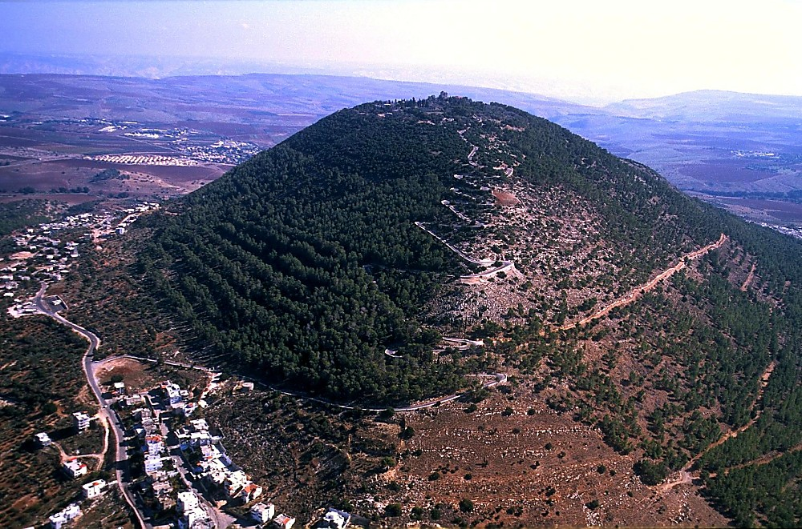

Mt Tabor aerial from northwest
“gjpNdhU rP\h;fSk;,fypNyahtpny ,NaR jq;fSf;F Fwpj;jpUe;j kiyf;Fg; Nghdhh;fs; ”
kj;NjA . 28:16
jhNghh; kiy fypNyah tlf;F ,];uNty;
,NaR fpwp];J mspj;j kpf Kf;fpaj;Jtkhd fl;lis:
“thdj;jpYk; G_kpapYk; rfy mjpfhuKk; vdf;Ff; nfhLf;fg;gl;Ly;yJ. Mifahy; ePq;fy; gwg;gl;L Ngha;,rfy [hjpfisAk; rP\uhf;fp,gpjh Fkhud; ghpRj;j Mtpapd; ehkj;jpNy mtu;fSf;F Qhd];jhdk; nfhLj;J,ehd; cq;fSf;Ff; fl;lisapl;lahitAk; mth;fs; iff;nfhs;Sk;gb mth;fSf;F cgNjrk;gz;Zq;fs;.,Njh, cyfj;jpd; KbTghpae;jk; rfy ehl;fspYk; cq;fSlNd$l ,Wf;fpNwd; vd;whh;.MNkd;. ”………………. kj;NjA 28:18b -20
23
5
©2005 TBBMI
9.6.09.

Slide 25
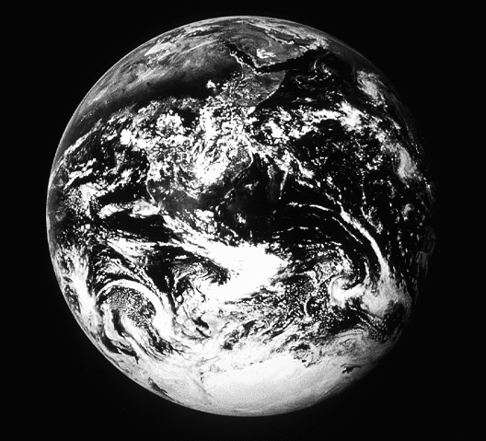

ePq;fs; ek;GNthH vdwhy;…
NgJU ekf;F 1 NgJU 3:15 mjpfhuj;jpy; vij vt;thU nra;tnjd;U $Wfpwhh;!
24
1
©2005 TBBMI
9.6.09.

Slide 26
1 NgJU 3:15
“fh;j;juhfpa Njtid cq;fs; ,Ujaq;fspy; ghpRj;jk;gz;Zq;fs;: cq;fspypUf;fpw ek;gpf;ifiaf;Fwpj;J cq;fsplj;jpy; tprhhpj;Jf; Nfl;fpw ahtUf;Fk; rhe;jj;NjhLk; tzf;fNjhLk; cj;juT nrhy;y vg;nghoJk; Maj;jkhapUq;fs; .”
25
©2005 TBBMI
9.6.09.

Slide 27
1 NgJU 3:15
“fh;j;juhfpa Njtid cq;fs; ,Ujaq;fspy; ghpRj;jk;gz;Zq;fs;: cq;fspypUf;fpw ek;gpf;ifiaf;Fwpj;J cq;fsplj;jpy; tprhhpj;Jf; Nfl;fpw ahtUf;Fk; rhe;jj;NjhLk; tzf;fNjhLk; cj;juT nrhy;y vg;nghoJk; Maj;jkhapUq;fs; .”
26
©2005 TBBMI
9.6.09.

Slide 28
1 NgJU 3:15
“fh;j;juhfpa Njtid cq;fs; ,Ujaq;fspy; ghpRj;jk;gz;Zq;fs;: cq;fspypUf;fpw ek;gpf;ifiaf;Fwpj;J cq;fsplj;jpy; tprhhpj;Jf; Nfl;fpw ahtUf;Fk; rhe;jj;NjhLk; tzf;fNjhLk; cj;juT nrhy;y vg;nghoJk; Maj;jkhapUq;fs; .”
27
©2005 TBBMI
9.6.09.

Slide 29
1 NgJU 3:15
“fh;j;juhfpa Njtid cq;fs; ,Ujaq;fspy; ghpRj;jk;gz;Zq;fs;: cq;fspypUf;fpw ek;gpf;ifiaf;Fwpj;J cq;fsplj;jpy; tprhhpj;Jf; Nfl;fpw ahtUf;Fk; rhe;jj;NjhLk; tzf;fNjhLk; cj;juT nrhy;y vg;nghoJk; Maj;jkhapUq;fs; .”
28
©2005 TBBMI
9.6.09.

Slide 30
1 NgJU 3:15
“fh;j;juhfpa Njtid cq;fs; ,Ujaq;fspy; ghpRj;jk;gz;Zq;fs;: cq;fspypUf;fpw ek;gpf;ifiaf;Fwpj;J cq;fsplj;jpy; tprhhpj;Jf; Nfl;fpw ahtUf;Fk; rhe;jj;NjhLk; tzf;fNjhLk; cj;juT nrhy;y vg;nghoJk; Maj;jkhapUq;fs; .”
29
©2005 TBBMI
9.6.09.

Slide 31
1 NgJU 3:15
“fh;j;juhfpa Njtid cq;fs; ,Ujaq;fspy; ghpRj;jk;gz;Zq;fs;: cq;fspypUf;fpw ek;gpf;ifiaf;Fwpj;J cq;fsplj;jpy; tprhhpj;Jf; Nfl;fpw ahtUf;Fk; rhe;jj;NjhLk; tzf;fNjhLk; cj;juT nrhy;y vg;nghoJk; Maj;jkhapUq;fs; .”
30
©2005 TBBMI
9.6.09.

Slide 32

1 NgJU 3:15
“fh;j;juhfpa Njtid cq;fs; ,Ujaq;fspy; ghpRj;jk;gz;Zq;fs;: cq;fspypUf;fpw ek;gpf;ifiaf;Fwpj;J cq;fsplj;jpy; tprhhpj;Jf; Nfl;fpw ahtUf;Fk; rhe;jj;NjhLk; tzf;fNjhLk; cj;juT nrhy;y vg;nghoJk; Maj;jkhapUq;fs; .”
31
©2005 TBBMI
9.6.09.

Slide 33

1 NgJU 3:15
“fh;j;juhfpa Njtid cq;fs; ,Ujaq;fspy; ghpRj;jk;gz;Zq;fs;: cq;fspypUf;fpw ek;gpf;ifiaf;Fwpj;J cq;fsplj;jpy; tprhhpj;Jf; Nfl;fpw ahtUf;Fk; rhe;jj;NjhLk; tzf;fNjhLk; cj;juT nrhy;y vg;nghoJk; Maj;jkhapUq;fs; .”
32
©2005 TBBMI
9.6.09.

Slide 34

1 NgJU 3:15
“fh;j;juhfpa Njtid cq;fs; ,Ujaq;fspy; ghpRj;jk;gz;Zq;fs;: cq;fspypUf;fpw ek;gpf;ifiaf;Fwpj;J cq;fsplj;jpy; tprhhpj;Jf; Nfl;fpw ahtUf;Fk; rhe;jj;NjhLk; tzf;fNjhLk; cj;juT nrhy;y vg;nghoJk; Maj;jkhapUq;fs; .”
33
©2005 TBBMI
9.6.09.

Slide 35

1 NgJU 3:15
“fh;j;juhfpa Njtid cq;fs; ,Ujaq;fspy; ghpRj;jk;gz;Zq;fs;: cq;fspypUf;fpw ek;gpf;ifiaf;Fwpj;J cq;fsplj;jpy; tprhhpj;Jf; Nfl;fpw ahtUf;Fk; rhe;jj;NjhLk; tzf;fNjhLk; cj;juT nrhy;y vg;nghoJk; Maj;jkhapUq;fs; .”
34
©2005 TBBMI
9.6.09.

Slide 36

1 NgJU 3:15
“fh;j;juhfpa Njtid cq;fs; ,Ujaq;fspy; ghpRj;jk;gz;Zq;fs;: cq;fspypUf;fpw ek;gpf;ifiaf;Fwpj;J cq;fsplj;jpy; tprhhpj;Jf; Nfl;fpw ahtUf;Fk; rhe;jj;NjhLk; tzf;fNjhLk; cj;juT nrhy;y vg;nghoJk; Maj;jkhapUq;fs; .”
35
©2005 TBBMI
9.6.09.

Slide 37
1 NgJU 3:15
“fh;j;juhfpa Njtid cq;fs; ,Ujaq;fspy; ghpRj;jk;gz;Zq;fs;: cq;fspypUf;fpw ek;gpf;ifiaf;Fwpj;J cq;fsplj;jpy; tprhhpj;Jf; Nfl;fpw ahtUf;Fk; rhe;jj;NjhLk; tzf;fNjhLk; cj;juT nrhy;y vg;nghoJk; Maj;jkhapUq;fs; .”
36
©2005 TBBMI
9.6.09.

Slide 38
Cq;fs; cyfk; fhj;Jf;nfhz;L ,Uf;fpwJ.
37
©2005 TBBMI
9.6.09.

Slide 39
cq;fsJ Neuj;jpw;F kpf;f ed;wp!
B iggy;……..Ngrpf;fyp kpdp];jpup]; ,d;lu;Ne\d;dy; Nthh;l; tw;j; nlf;];r];
fUj;J cWthf;fKk; jahhpg;Gk; - [hd; ,.tiukd; g_ na[; l_ .Gifg;gl cjtp - Njhl;Nghyd;,[&ryk;,,];uNty;,bibleplaces.com,NxhypNyd; NXhl;Nly;,kw;Wk; lhf;lh;.tPd; hpl;Nkah;,MNjhh;lPd; M];jpNuypah.
www.biblebasically.com
©2005 TBBMI
38

Slide 40

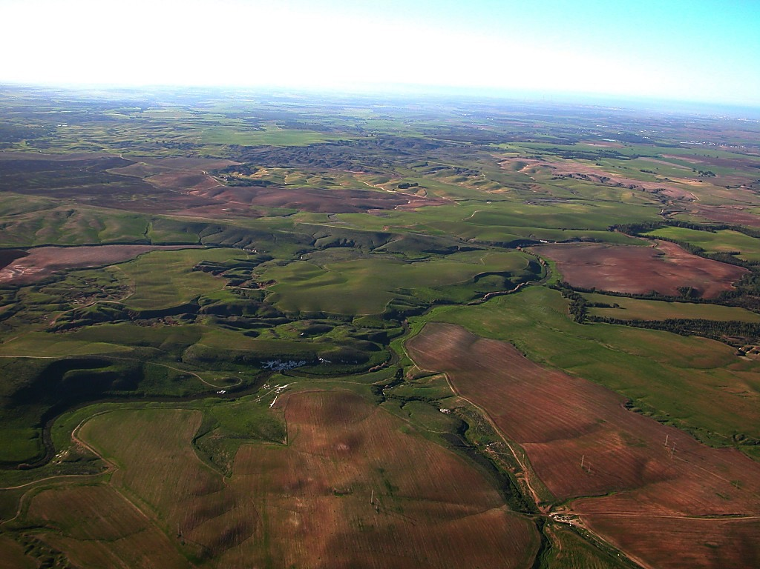
Ntjhfkj;jpd; Njrk; - Xtpa E}yfk;
rNfhjuh; Njhl; nghyDf;F [Todd Bolen] vq;fs; Copak; kpfTk; flikg;gl;Ls;sJ. fhuzk; mtNu Ntjhfkj;jpd; Njrq;fis Xtpa E}yfkhf rpU\;bj;jhh;. ekf;F “Ntjhfkk; Muk;gk;” vDk; ifg;Gj;jfj;jpy; ,lk; ngw;Ws;s Xtpaq;fis KOkdNjhL mh;gzpj;jhh; “Ntjhfkk; Muk;gk®”. ifg;Gj;jfj;ij cgNahfpg;gth;fs; ,izaj;jpy; “BiblePlaces.com” vDk; ,izajsj;jpy; Mapuj;Jf;Nkw;gl;l Xtpaq;fis fhzyhk;. mitfs; ghpRj;j Njrk;, Vfhd;, Nky; rKj;jpuk;, njd; INuhg;gh mjhtJ fpU];jth;fspd; tpRthrk; tpsq;fpa ,lk;. “BiblePlaces.com” Mrphpah;fSf;Fk; jahhpg;ghsUf;Fk; rk mstpshd mjpEl;g Xtpaj;jpw;fhd Gifg;gl tsq;fis toq;FfpwJ.
,izajsj;ij tyk; thUq;fs;.
ed;wp, (Njhl);

Slide 41
THE BIBLE... BASICALLY
jpUkiwapd;…
mbg;gil

Slide 42


jpUkiwapd;…mbg;gil • BibleStudyDownloads.org
,g;ghlf;Fwpg;Gfis ,ytrkhf ngw;Wf;nfhs;s
Notes:
The Bible…Basically (bb)

Slide 43
40
©2005 TBBMI
9.6.09.

