Slide 1

Tamil (Sri Lanka/India)
jpUkiwapd;…mbg;gil
jpUkiwapd;…
mbg;gil
A Presentation of The Bible…Basically Ministries International Inc. Fort Worth, Texas
www.biblebasically.com
©2004 TBBMI
8.0.04.
01

Slide 2



('[f[? 'lflavbfBma?)
tiBmAryi[f.... `FpfpAd
®
pakmf na[fK
viArvak ecalflpfpDmf Evtakm kAtkqf
PowerPoint Slide Version
9.7.04SL.
©2006 TBBMI
02
Notes:
Now we’re going to do the entire Quick Chronology!

Slide 3





Evtakm kAtkAl viArvak ecalfl ~ytftmaKgfkqf!
03
1
Notes:
Now…after your trip through THE QUICK CHRONOLOGY…here’s a challenging question: how quickly could YOU tell that great Bible story -- in all of these books -- to somebody else? It’s a powerful witnessing tool, you know! Yes...the whole thing…and YOU can do it!
//// So…get ready to tell the Bible story in quick time!

Slide 4
p[ir]fD nimidtftilf?
04
Notes:
And how about doing all this is just about twelve minutes? You can, you know! So, we’re going to make this final sprint through THE QUICK CHRONOLOGY in a lightning-fast run taking us across the entire Bible time line…once again: and remember, only an overview!

Slide 5
~ytftma?
(ugfkqf Evtakm kakit EkaAvAy pi[fpbfBgfkqf.)
vaRgfkqf kdnfTcf eclfEvamf!
pad utvi #04 `lflT #31
05
Notes:
Ready? Follow along with your BIBLE FILE Study Helps 04 or 31. Here we go!

Slide 6
~tiyakmmf 1 Mtlf 11 vAr
5+2
pAdpfp<
~pirkaMkfK M[p< 'lfla kalmf
CREATION
1mf ~]f & ep]f
(p>r]mf)
1mf pavmf
(Kbi tvBtlf)
pAdpfp<
ABRAHAM
1mf CviEcxmf
(mIdfprf)
1mf KDmfpmf
(ccfcrv<)
1mf ekaAl
(;zinft pavmf)
jlmf/va[vilf
(1mf tidfdmf: Enava)
Ekap<rmf
(2mf tidfdmf: paEplf)
Handbook pg. 42-45
06
9
Notes:
Beginning with the CREATION folder…
//// Five first things and two great programs are described here in the Creation folder.
//// God has always been eternal and without a beginning, so we can call time before creation of the earth “pre-history,” certainly before the time of Abraham.
//// .... However after the earth was created the FIRST MAN and WOMAN appear on earth in a perfect form and placed in the sinless environment of God’s created perfection.
//// .... The FIRST SIN is committed…where Man is given a test of his gift of free will. He is tempted by Satan and falls from his created state of perfection into a sinful condition, having “missed the mark” for which he was created.
//// .... The FIRST GOSPEL or good news is given to men…
The Creator provides the first announcement that He will send a Redeemer to provide for man a way back to that original state of created perfection, innocence and holiness.
//// .... The FIRST FAMILY appears…
Adam and Eve have children and provide the basis for future development of a race of men who must contend with Satanic efforts to keep them from a restored relationship with the loving Father and Creator.
//// .... The FIRST MURDER is committed…
Sin is committed in its most abusive and abject form, the destruction by man of God’s ultimate gift, life itself.
AND THEN…The first of two great God-ordained programs comes into view…
//// .... Program #1: The GREAT FLOOD and RAINBOW….
….where God determines to wipe out His creation and begin it again. All mankind perishes except eight people who, under the leadership of righteous Noah, have remained true to God, who provides His rainbow promise as the waters recede.
//// .... At a later time, Program #2, during the TOWER OF BABEL event…
Man attempts to climb to an elevation equal to God Himself. God intervenes with a confusion of languages in order to disperse the races.

Slide 7


~tiyakmmf 12 Mtlf 16 vAr
7
~pirkamf
`. 2000 ki. M.
`Azpfp<
~. u
ni - vi - ~
pAdpfp<
ABRAHAM
~pirkamf
I - I
ABRAHAM
ya-"
12
Handbook pg. 42-45
07
6
Notes:
THE SECOND FILE FOLDER…presents the first of the four great people…ABRAHAM, JOSEPH, MOSES AND JOSHUA. First is.... ABRAHAM….TIME FRAME…about 2000 B.C.…remember that these few time frames are roughly in 500 year increments.
//// .... ABRAHAM is called by God out of Ur of the Chaldees when he proclaimed
//// .... his great promise of a LAND, a SEED, and a BLESSING,
//// .... to be later expanded in the unconditional ABRAHAMIC COVENANT. All future biblical events unfold from these single covenant promises! Abraham leaves UR of the Chaldees with his family, moving toward an unknown land. With him were wife SARAH, nephew Lot and father Terah. They journey to ancient Haran where old Terah, ABRAHAM’S father, dies. At a later time, under God’s continued beckoning, they move on to Canaan.
//// ....Eventually ABRAHAM has two sons: I and I…ISHMAEL through Sarah’s maidservant, Hagar; then years later ISAAC through his wife Sarah. ISAAC is the son through which God’s promise to Abraham will be passed.
//// ....ISAAC has two sons... J and E ...JACOB and ESAU. In this case, Jacob is the recognized son through which the promise will pass.
//// ....JACOB then has 12 SONS who become the patriarchs of the 12 TRIBES OF ANCIENT ISRAEL. One of those sons is…

Slide 8
~tiyakmmf 17 Mtlf 50 vAr
EyaEcpfp<
`. 2000 ki. M.
`FAm
430
pAdpfp<
ABRAHAM
~pirkamf
ABRAHAM
EyaEcpfp<
ABRAHAM
Handbook pg. 42-45
08
2
Notes:
THE THIRD FILE FOLDER .... JOSEPH…time frame remains about 2000 B.C.….the second of the four great people…
JOSEPH, is sold into Egyptian slavery by his jealous brothers. He arrives in Egypt and eventually rises to become Governor. The family of JACOB, with all JOSEPH’s brothers, is driven down to Egypt by famine.
//// .... Eventually slavery for the Hebrews follows because they multiplied rapidly! Through time, because of their increasing population, they become a threat to the Egyptian government. Thus, they become SLAVES of the Egyptians.
//// ....They remain in Egypt for 430 years.

Slide 9
~tiyakmmf, yatftirakmmf, elviyrakmmf, ']f]akmmf, upakmmf
EmaEc
`. 2000 ki. M.
yatftirakmmf
cI[ayf
pAdpfp<
ABRAHAM
t-o-ni
~pirkamf
ABRAHAM
EyaEcpfp<
ABRAHAM
EmaEc
kaEtxf prfE[ya
40
ni. u
5 pircgfkgfkqf
Handbook pg. 42-45
09
7
Notes:
THE FOURTH FILE FOLDER.... Now in a time frame of about 1500 B.C.….the third of the four great people…MOSES….rises from among them, leading the Israelites out of Egypt in the great
//// ....EXODUS and into the desert of the Sinai Peninsula. At
//// ....MT. SINAI, MOSES is given the LAW, the Torah...
//// ....in 3 parts ...M-C-C... Moral, Civil and Ceremonial. MOSES
//// ....leads the Israelites on to the oasis of KADESH BARNEA ....where 12 spies are dispatched on a mission to the north to check out The Land of Canaan prior to the Israelites going in to take it as God had commanded.
A majority report comes back, saying they cannot take The Land: the people are too tall, too powerful; Israelites too small, too weak.
However, two spies, Joshua and Caleb, report that with obedience and faithfulness to God, they can enter The Land and victoriously subdue it.
The people rebel against God, having no faith in His provision. The faithless Israelites follow that majority report.
As a result of their disbelief God banishes them to wander in the wilderness until all those above the age of 20 who disobeyed Him have died out.
//// ....After 40 YEARS of wandering, just before entering The Promised Land,
MOSES
//// ....in a series of FIVE SERMONS…teaches the new generation who they are in God's sight, reminds them of all that God expects of them and defines the promises of the unconditional ....
//// ….LAND COVENANT. MOSES dies, never himself, having set foot in Israel’s Promised Land.

Slide 10
EyaCva
EyaCva
`. 2000 ki. M.
'riEka / ~yi
nilmf pgfkiDtlf
pAdpfp<
ABRAHAM
~pirkamf
ABRAHAM
EyaEcpfp<
ABRAHAM
EmaEc
EyaCva
Handbook pg. 42-45
10
2
Notes:
THE FIFTH FILE FOLDER….JOSHUA…the last of the four great people…still in the 1500 B.C. time frame…As MOSES' successor, Joshua takes command as a new generation prepares to go into The Land and to subdue it.
//// ....The Israelites enter Canaan, taking first the cities of Jericho and Ai and begin the long campaign to take possession under God’s direction.
//// After seven years the land is sufficiently subdued to begin dividing up the region among the Israelite tribes. They settle down to their new way of living in the Promised Land. Joshua dies, making way for the first of the three societies.

Slide 11
Niyayatiptikqf, Rtf
`rci[fAm
`. 2000 ki. M.
niyayatiptikqf
350
pAdpfp<
ABRAHAM
~pirkamf
ABRAHAM
EyaEcpfp<
ABRAHAM
EmaEc
EyaCva
`rci[fAm
Handbook pg. 42-45
11
2
Notes:
THE SIXTH FILE FOLDER…the period of ANARCHY in a time frame of about 1000 B.C.….
//// ....the JUDGES appear during a time of national apostasy or falling away from the God of the Hebrews, now called Israelites. The Judges repeatedly call the people back to God and His commandments for their lives.
//// ....Lasting some 350 years, the period ends with the emergence of SAMUEL, whom God commissions to appoint Israel's first king.

Slide 12
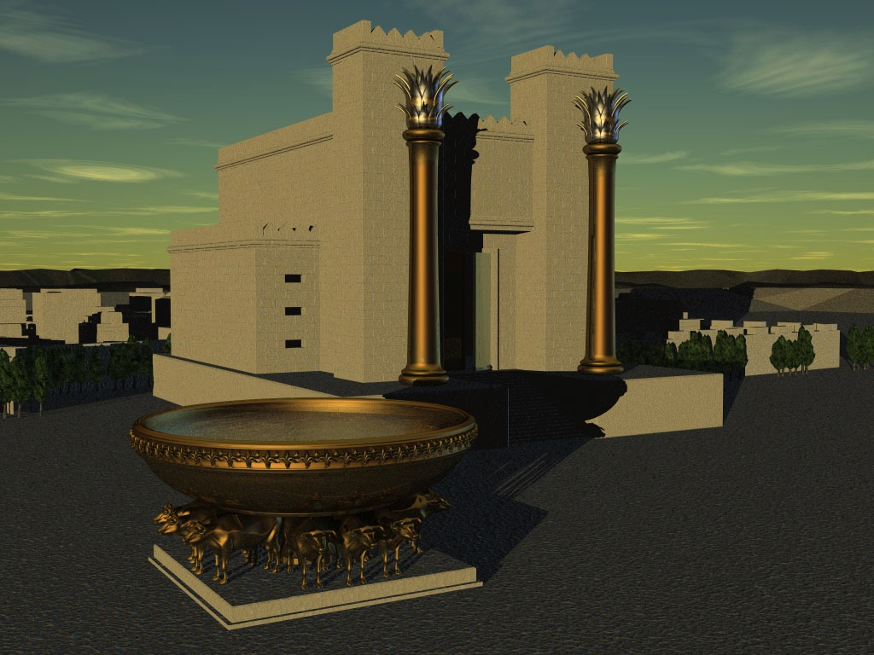
I caMEvlf Mtlf 2 naqakmmf vAr
raj ptvi
`. 1000 ki. M.
ta. u
c-t-ca
<<<< piriv< >>>>
pAdpfp<
ABRAHAM
~pirkamf
vdkfK etbfK
ABRAHAM
EyaEcpfp<
ABRAHAM
EmaEc
;sfrEvlf y<>ta
EyaCva
`rci[fAm
10 2
raj ptvi
p<. u
tIafkfktaicikqf
20-J 20-R
200
350
`ciaiya papiEla[f
Handbook pg. 42-45
12
9
Notes:
Leading to .... THE SEVENTH FILE FOLDER …THE ROYALTY period.....Time frame: 1000 B.C. A united Israel enters its period of ROYALTY under the direction of three kings…
//// ....S-D-S…SAUL, DAVID and SOLOMON…the three kings of a united Israel. SAUL is eventually deposed, replaced by DAVID, who is succeeded by his son SOLOMON.
//// ....Through David God pronounces the unconditional DAVIDIC COVENANT. After Solomon dies there is…
//// ....the great NATIONAL SPLIT…Israel’s tragic CIVIL WAR...
//// ....10 Tribes to the NORTH as a kingdom: calling itself ISRAEL...2 tribes to the SOUTH become the kingdom of JUDAH.
//// ....Now the great Old Testament prophets appear. Through their messages to the people, God begins to chastise both parts of His Chosen People, issuing
//// ....the unconditional NEW COVENANT in which God promises a new arrangement with his creation to appear at some future time. Here the Messiah is clearly prefigured.
//// ....There follow 20 kings in each nation, beginning with JEROBOAM in the NORTH and REHOBOAM in the SOUTH…J before R….North before South.
//// ....After some 200 years, the ASSYRIANS invade and carry off the NORTHERN KINGDOM, ISRAEL, never to be heard from again. It is dispersed.
//// ....Then, after another 150 years or so, the BABYLONIANS invade, destroying Jerusalem and carrying off the SOUTHERN KINGDOM, JUDAH, into the great Babylonian CAPTIVITY

Slide 13
'sfra Mtlf 'sftrf vAr
`FAmtft[mf
`. 500 ki. M.
70 ~]fDkqf
3 pirya[gfkqf
pAdpfp<
ABRAHAM
~pirkamf
100 ~]fDkqf/50,000
ABRAHAM
EyaEcpfp<
ABRAHAM
EmaEc
ec - ' - en
EyaCva
`rci[fAm
raj ptvi
`FAmtft[mf
Handbook pg. 42-45
13
4
Notes:
THE EIGHTH FILE FOLDER ….The CAPTIVITY file....time frame: 500 B.C…
//// ....After 70 Years captivity in Babylon, the Jews are told that they can return to The Land to rebuild the Temple and the city of Jerusalem.
//// ....In 3 different treks back to Israel…
//// ....over a 100-year period, 3 diplomat-priests lead 50,000 people back into The Promised Land.
//// ....Those great leaders are: Z -E-N: ZERUBBABEL, EZRA and NEHEMIAH. And here the Old Testament closes.

Slide 14
mlfkiyav<kfKmf mtfEty<v<kfKmf ;Adyilff (pAzy p<tiy "bfpaD)
`Amti
`. 500 ki. M.
kiErkfkiy `elkfsf
Eram MAbkqf
pAdpfp<
ABRAHAM
~pirkamf
ABRAHAM
EyaEcpfp<
ABRAHAM
EmaEc
EyaCva
`rci[fAm
raj ptvi
`FAmtft[mf
`Amti
Handbook pg. 42-45
14
2
Notes:
THE NINTH FILE FOLDER: SILENCE.... time frame still about 500 B.C., a period of about 400 years called Biblical SILENCE follows…events not recorded in Scripture.
//// ....ALEX THE GREEK -- ALEXANDER the Great –- appears on history’s stage, spreading the GREEK culture and language throughout all his conquered lands…
//// ....followed by ROME and its efficient but difficult SYSTEMS for maintaining civil order while expanding its enormous empire from the Middle East to Britain.

Slide 15
mtfEty< Mtlf evqipDtfti[ viEcxmf vAr
Mtlamf N\bfba[fD
u[fAm &
;Abyiylf
;EyC
vazfkfAk
tiRcfcApyi[f
vrlaB
ciLAv
CREATION
pAdpfp<
ABRAHAM
ABRAHAM
tiRcfcAp
ABRAHAM
~pirkamf
ABRAHAM
ABRAHAM
EyaEcpfp<
JOSEPH
ABRAHAM
ABRAHAM
CviEcxmf
MOSES
EmaEc
EyaCva
JOSHUA
`pfEpasftftlrf
`rci[fAm
tiRcfcApyi[f
pircfcA[kqf
ANARCHY
raj ptvi
ROYALTY
CAPTIVITY
niRpgfkqf
`FAmtft[mf
SILENCE
`Amti
JESUS
Evqi. CviEcxmf
;EyC
nitftiy
'tirf kalmf
Handbook pg. 42-45
15
7
Notes:
THE TENTH AND LAST FILE FOLDER....its time frame: the First Century. Finally…JESUS – the long-promised Messiah -- is introduced in the first chapter of Matthew. We are now into the New Testament where we experience JESUS’
//// ....LIFE, in its many locations in Israel and its infinite lessons of ministry and loving care and message of salvation…to all the world.
//// ....the CROSS — where we encounter the implications of his death, burial and resurrection —
//// ....and finally…the historic spread of His CHURCH, which includes every believer on Planet Earth.
//// ....The record is preserved for us in the facts and theology of the Gospels,
//// ....Jesus’ outworking in the early history of the Church, the Acts,
//// ....and the many letters of instruction and encouragement to the young churches, known as the Epistles.
//// ....Finally…in the great climax to the Biblical chronology…In the Revelation…God's Program of the Ages, originally pronounced unconditionally through THE ABRAHAMIC COVENANT, is consummated. Here we are given a glimpse of the wonder of the future with JESUS CHRIST, the Seed of David, seated eternally on his Davidic Throne providing the blessings of salvation and redemption for all men of the Earth.

Slide 16
pAdpfp<
~pirkamf
EyaEcpfp<
p 7 ` ;
EmaEc
EyaCva
`rci[fAm
raj ptvi
`FAmtft[mf
`Amti
;EyC
 
16
2
Notes:
So we have this great stack of Bibles…each one – through their Old and New Testaments -- with the same assuring and hopeful story of salvation and eternal life.
//// We get a mental handle on all that information with the little memory tool of C, 7, S and J…
//// ….which leads directly to the 10 KEY WORDS as file folder labels…CREATION, ABRAHAM, JOSEPH, MOSES, JOSHUA, ANARCHY, ROYALTY, CAPTIVITY, SILENCE AND JESUS…
….from which the incomparable drama of the scriptures can be recalled, reclaimed and enjoyed all over again…time after time…in every life circumstance…ever mining deeper the great truths of God’s great love letter to May.

Slide 17
mtfEty< 28:19
“~Akyalf, nIgfkqf p<bpfpdfDpfEpayf, ckl jatikAqy<mf cIxrakfki…”
;Tta[f Evtakm kAtkqf… viArvak ecalfl
 
17
1
Notes:
And that’s your Bible…THE QUICK CHRONOLOGY…in quick time!
Master it…and it will return to you untold treasures of insight, instruction and assurance that the Father IS there…a Plan IS in effect…history IS going somewhere! THE GOSPEL OF JESUS CHRIST IS ACTIVE UPON THE EARTH!
The Scriptures clearly demand – our study clearly communicates –– that through Jesus Christ’s Great Commission, it is our assigned and individual responsibility to spread that message to every human being in our own assigned space as long as we are allowed by the Father’s Plan to walk upon Planet Earth.
//// And our assignment is clearly…to “go therefore and make disciples of all nations.”

Slide 18
Tamil (Sri Lanka/India)
jpUkiwapd;…mbg;gil
jpUkiwapd;…
mbg;gil
A Presentation of The Bible…Basically Ministries International Inc. Fort Worth, Texas
www.biblebasically.org
©2004 TBBMI
8.0.04.
18

Slide 19
19
©2006 TBBMI
8.0.04SL.

Slide 20


jpUkiwapd;…mbg;gil • BibleStudyDownloads.org
,g;ghlf;Fwpg;Gfis ,ytrkhf ngw;Wf;nfhs;s
Notes:
The Bible…Basically (bb)

