Slide 1


biblia kwa ujumla
A Presentation of The Bible…Basically Ministries International Inc. Fort Worth, Texas
BibleBasically.org
Designed by Dr. John Fryman, Texas, USA • BibleBasically.org
Taught by Dr. Rick Griffith, Singapore Bible College
All files in many languages for free download at BibleStudyDownloads.org
8.0.01.
©2003 TBBMI
04

Slide 2


HADITHI YA BIBILIA
KATIKA NYAKATI ZA HARAKA.
(Nini? Kitu chote?
BIBILIA…KWA KIFUPI
®
NAFASI YA NNE
PowerPoint Slide Version
9.6.04SL.
©2006 TBBMI
02

Slide 3





KUWATAYARI KUELEZEA HADITHI YA BIBILIA KATIKA NYAKATI ZA HARAKA!
03
1

Slide 4
NA KATIKA DAKIKA KUMI NA MBILI JE?
04

Slide 5
TAYARI?
(FUATA FAILI YA BIBILIA.)
HAPA TUNAENDA!
MSAADA WA MASOMO #04 AMA #31
05

Slide 6
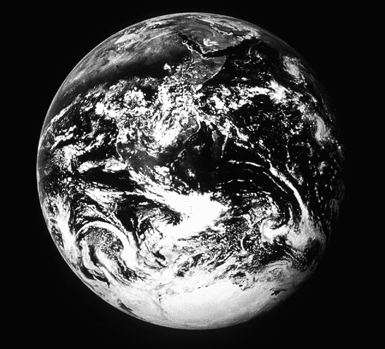
Mwanzo 1 hadi 11
5+2
MAUMBILE
Nyakati zote kabla ya Ibrahimu.
CREATION
MWANAMME WA KWANZA NA MWANAMKE
(NZURI)
DHABI ZA KWANZA
MAUMBILE
(KOZA ALAMA)
ABRAHAM
IJILI YA KWANZA
(MWOKOZI)
FAMILIA YA KWANZA
DHABI KUU
MAUAJI YA KWANZA
(MZOZO)
MAFURIKO/MKUNGA
(Pgm #1: Noa)
JUMBA KUU
(Pgm #2: Babeli)
Kijitabu krs. 42-45
06
9

Slide 7


Mwanzo 12 hadi 36
7
IBRAHIMU
ca. 2000 B.C.
MWITO
AC
L - S - B
MAUMBILE
ABRAHAM
I - I
IBRAHIMU
ABRAHAM
J - E
12
Handbook pg. 42-45
07
6

Slide 8
Mwanzo37 hadi 50
YOSEFU
ca. 2000 B.C.
UTUMWA
MAUMBILE
ABRAHAM
430
IBRAHIMU
ABRAHAM
YUSUFU
ABRAHAM
Handbook pg. 42-45
08
2

Slide 9
Mwanzo,Kutoka,Mambo ya Walawi,Hesabu,Kumbukumbu la Torati
MUSA
ca. 1500 B.C.
KUTOKA
SINAI
CREATION
ABRAHAM
ABRAHAM
M - C - C
ABRAHAM
JOSEPH
ABRAHAM
MOSES
KADESH BARNEA
40
LC
MISA TANO
Handbook pg. 42-45
09
7

Slide 10
Joshua
YOSHUA
ca. 1500 B.C.
JERIKO / AI
NCHI IGAWANYIKAO
MAUMBILE
ABRAHAM
IBRAHIMU
ABRAHAM
YOSEFU
ABRAHAM
MUSA
YUSUFU
Handbook pg. 42-45
10
2

Slide 11
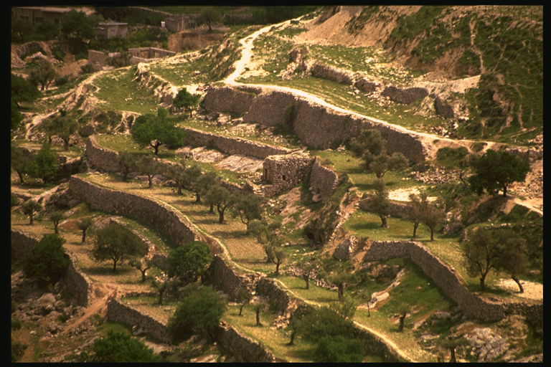
Waamuzi, Ruthu
MSUKOSUKO
ca. 1000 B.C.
WAAMUZI
MAUMBILE
ABRAHAM
IBRAHIMU
350
ABRAHAM
YUSUFU
ABRAHAM
MUSA
YOSHUA
MSUKOSUKO
Handbook pg. 42-45
11
2

Slide 12

I Samweli hadi 2 Mambo ya Nyakati
UFALME
ca. 1000 B.C.
DC
S - D - S
<<<< KUGAWANYIKA >>>>
KAZKAZINI KUZINI
ISRAELI YUDA
MAUMBILE
ABRAHAM
10 2
IBRAHIMU
ABRAHAM
NC
YOSEFU
ABRAHAM
MANABII
MUSA
YOSHUA
MSUKOSUKO
20-J 20-R
UFALME
200
350
SAYRIA
BABILONI
Handbook pg. 42-45
12
9

Slide 13
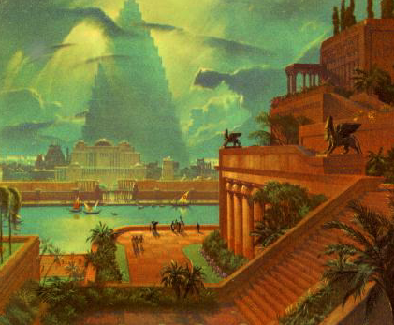
Ezra hadi Esta
KUTEKWA
ca. 500 B.C.
MIAKA 70
SAFARI 3
MAUMBILE
ABRAHAM
IBRAHIMU
MIAKA 100/50,000
ABRAHAM
YOSEFU
ABRAHAM
MUSA
Z - E - N
YOSHUA
MSUKOSUKO
UFALME
KUTEKWA
Handbook pg. 42-45
13
4

Slide 14
Between Malachi and Matthew (Old and New Testaments)
SILENCE
ca. 500 B.C.
ALEX THE GREEK
ROMAN SYSTEMS
CREATION
ABRAHAM
ABRAHAM
ABRAHAM
JOSEPH
ABRAHAM
MOSES
JOSHUA
ANARCHY
ROYALTY
CAPTIVITY
SILENCE
Handbook pg. 42-45
14
2

Slide 15
Matthew through Revelation
The First Century
Facts &
Theology
JESUS
LIFE
CROSS
Church
History
CREATION
ABRAHAM
CHURCH
ABRAHAM
ABRAHAM
JOSEPH
ABRAHAM
MOSES
GOSPELS
JOSHUA
ANARCHY
ACTS
Church
Issues
ROYALTY
CAPTIVITY
EPISTLES
SILENCE
JESUS
REVELATION
Eternity
Future
Handbook pg. 42-45
15
7

Slide 16
CREATION
ABRAHAM
JOSEPH
C 7 S J
MOSES
JOSHUA
ANARCHY
ROYALTY
CAPTIVITY
SILENCE
JESUS
 
16
2

Slide 17
Matt 28:19
AND THAT’S YOUR BIBLE…IN QUICK TIME!
“Go therefore and make disciples of all nations…”
 
17
1

Slide 18
biblia kwa ujumla
Maonyesho ya Biblia…Kwa kifupi adhara ya kimataifa.Fort Worth, Texas
www.biblebasically.com
18
©2003 TBBMI
9.6.04SL.

Slide 19
©2006 TBBMI
8.0.04SL.
19

Slide 20


Biblia Kwa Ujumla link at BibleStudyDownloads.org
Get this presentation for free!
Notes:
The Bible…Basically (bb)

