Slide 1
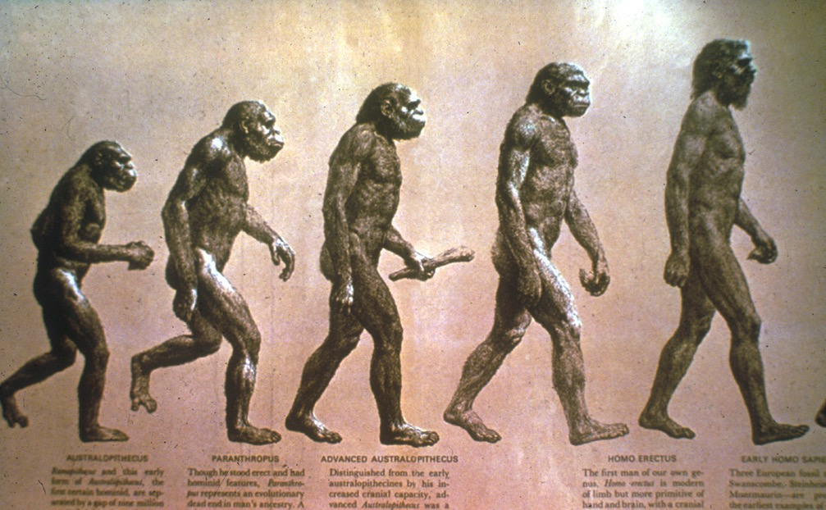

Title 2
Доктор Терри Мортенсон
Человек-обезьяна:
Великая иллюзия
Designed by Dr. Terry Mortenson
Uploaded by Dr. Rick Griffith • Singapore Bible College
All files in many languages for free download at BibleStudyDownloads.org

Slide 2
Evolution of man progression?
Эволюция человека?

Slide 3
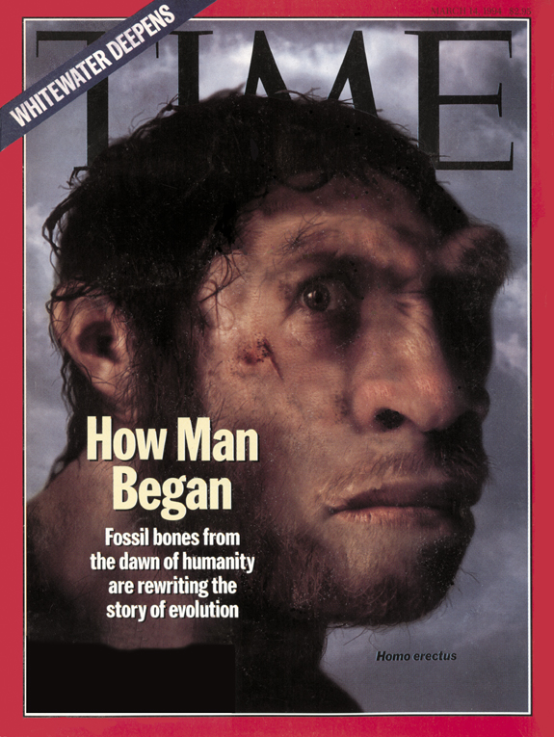
TIME cover, 14 March 1994
14 марта 1994

Slide 4
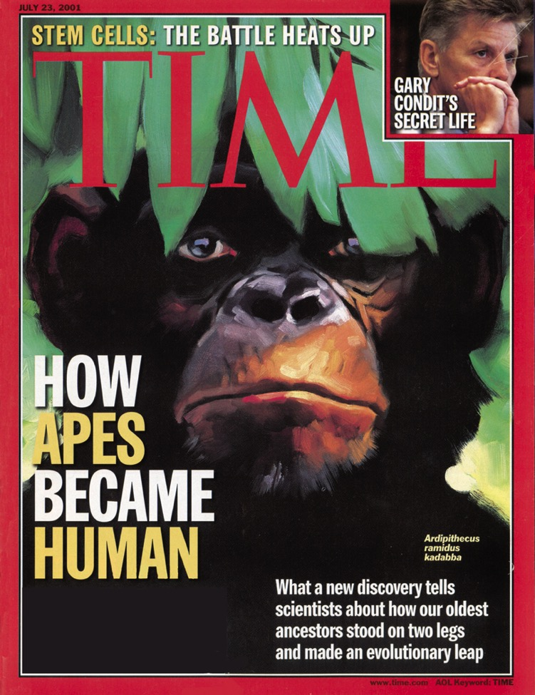
TIME cover, 23 July 2001
23 июля 2001

Slide 5
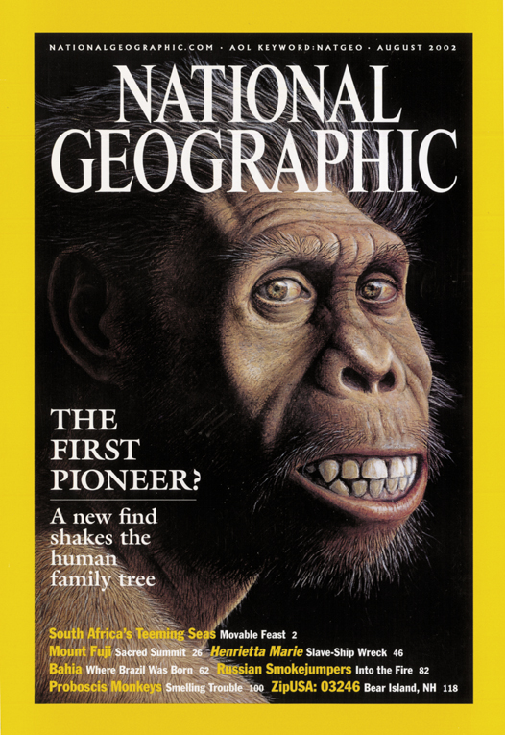
National Geographic cover, August 2002
Август 2002

Slide 6
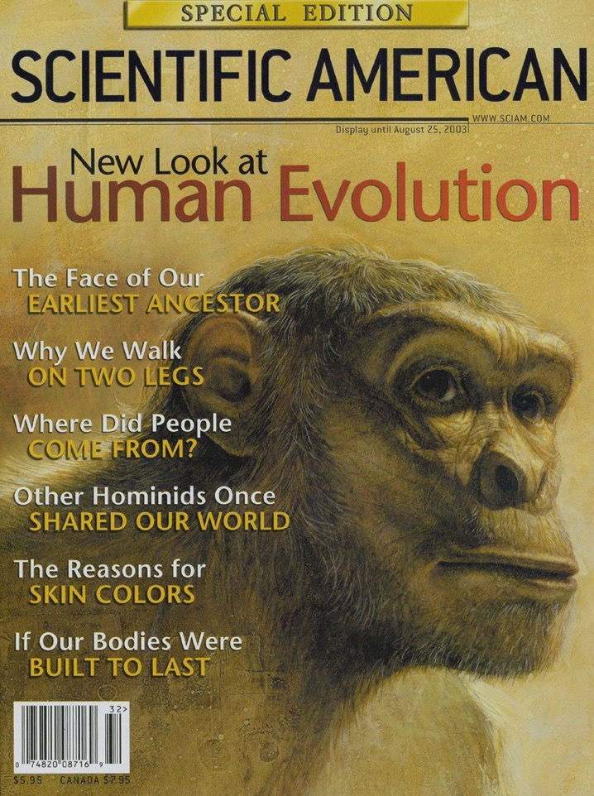
Scientific American cover, August 2003
Август 2003

Slide 7
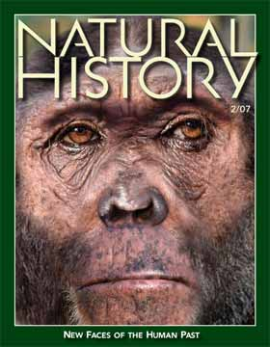
Natural History Feb 2007
Февраль 2007
Новые лица человеческого прошлого

Slide 8
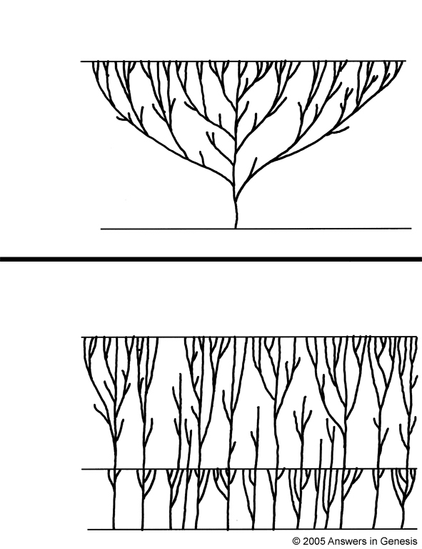
Evolution tree vs creation forest
Эволюционное дерево жизни
Evolution tree
vs creation forest
Настоящее
Начало
Лес жизни сотворения
Настоящее
Потоп
Сотворение

Slide 9
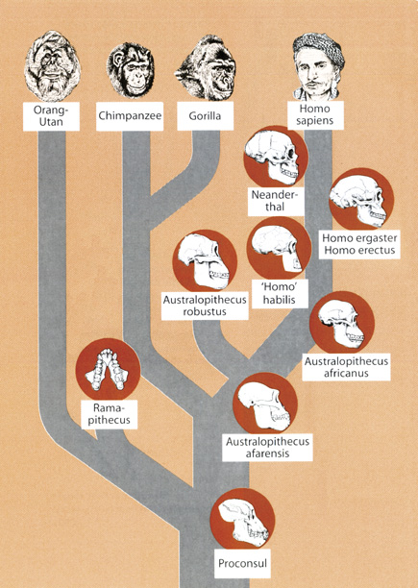
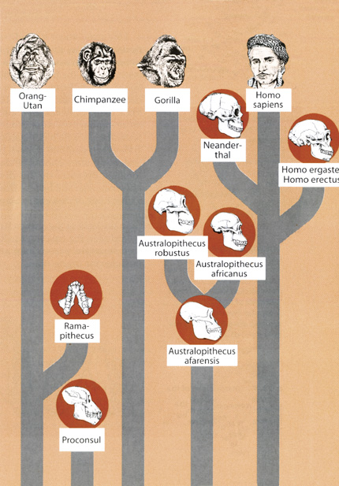
Evolution tree & creation forest
Дерево эволюции
Лес сотворения
Notes:
A hominid is any member of the biological family Hominidae (the "great apes"), including the extinct and extant humans, chimpanzees, gorillas, and orangutans. This classification has been revised several times in the last few decades. These various revisions have led to a varied use of the word "hominid": the original meaning of Hominidae referred only to the modern meaning of Hominina, i.e. only humans and their closest relatives. The meaning of the taxon changed gradually, leading to the modern meaning of "hominid," which includes all great apes.
The primatological term hominid is easily confused with a number of very similar words:
A hominoid or ape is a member of the superfamily Hominoidea: extant members are the lesser apes (gibbons) and great apes.
A hominid is a member of the family Hominidae: all of the great apes.
A hominine is a member of the subfamily Homininae: gorillas, chimpanzees, humans (excludes orangutans).
A hominin is a member of the tribe Hominini: chimpanzees and humans.
A hominan is a member of the sub-tribe Hominina: modern humans and their extinct relatives.
A human is a member of Homo sapiens. The word is sometimes also used to refer to any extinct member of the genus Homo or members from other hominan genera.
A humanoid is a vaguely human-shaped entity; the term is typically used in science fiction.
Certain morphological characteristics are still used conventionally to support the idea that hominid should only denote humans and human ancestors, namely bipedalism (walking on two feet) and large brains. These points of departure between human beings and the other great apes are important, but according to genetically based taxonomic classification, are not enough to divide us into separate families. Genetics, rather than morphology, is more widely accepted as the critical standard. Many scientists, including anthropologists, use the term to mean humans and their direct and near-direct bipedal ancestors.
Two charts from Reinhard Junker, Is Man Descended from Adam? (Biblical Creation Society, 2000, translated by Steven Robinson), p. 10-11.

Slide 10
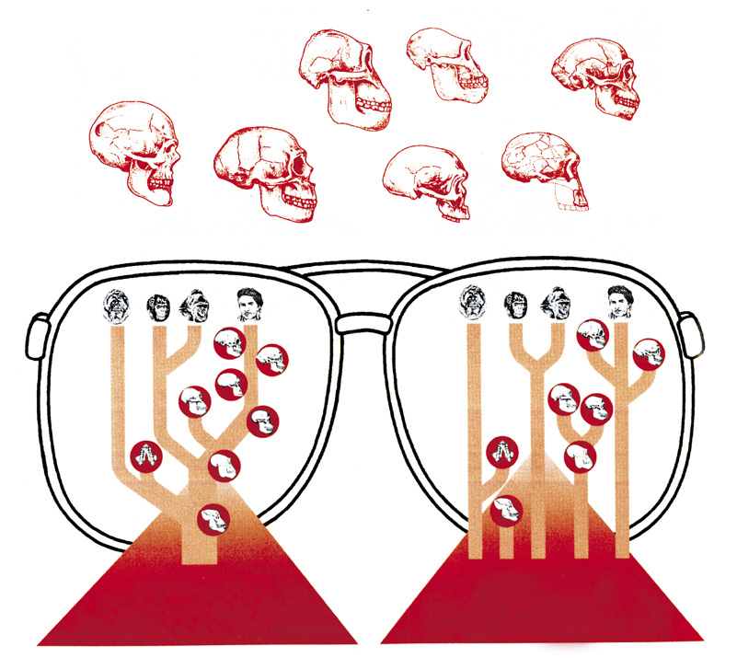
ДАННЫЕ
Какой взгляд согласуется с фактами?
Дерево эволюции
Лес сотворения

Slide 11

Australophithecus
Австралопитек

Slide 12
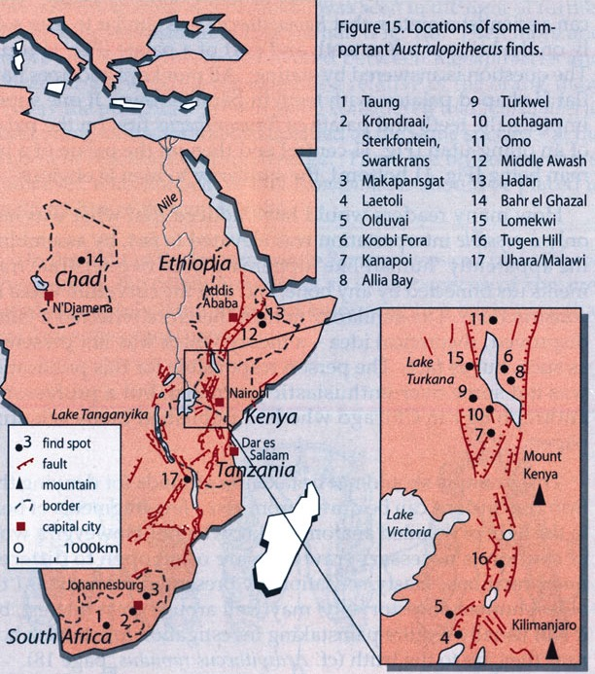
Australopithecines—Kenya map
Notes:
Most of the evidence for australopithecus has been found in east Africa, especially Kenya and Ethiopia

Slide 13
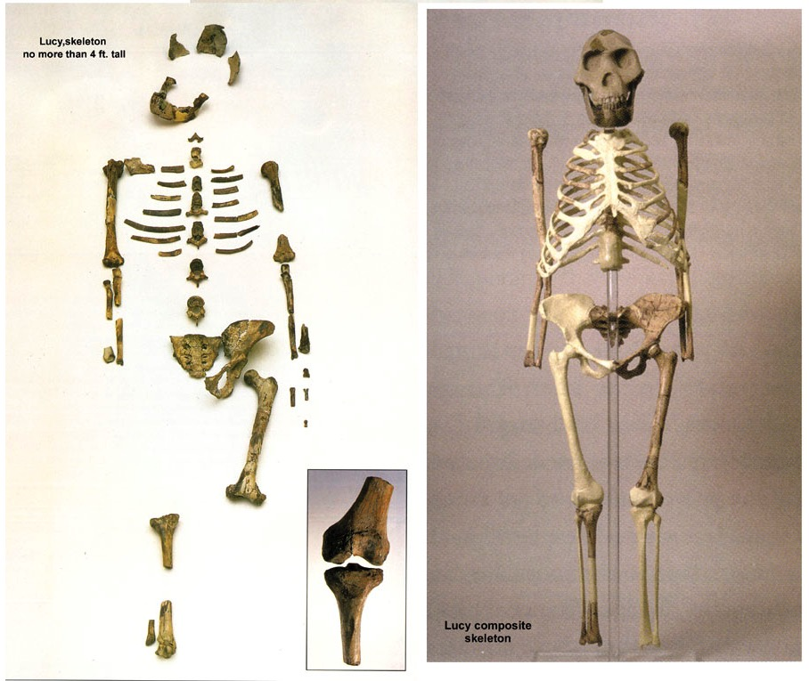
Lucy, partial and full
«Люси», Эфиопия (1974)
Notes:
100s of bone pieces representing 40% of body (Australophithecus afarensis) found by Donald Johanson in 1974 in Hadar Formation of Awash Valley in Ethiopia’s Afar triangle by Donald Johanson. She’s been dated at 3.2 million years old.
Johanson named her “Lucy” because as he came back into camp, the Beatles song “Lucy in the sky with diamonds” was playing.
Research has since shown that Lucy was male not female (David Menton’s video: Lucy: She’s no lady)
More australopithecines have been found and the evolutionist consensus is that they are transitional forms between chimps and humans. But the australopithecine fingers are long and curved like a chimpanzee and the wrist has a locking mechanism like chimpanzees that walk on their knuckles on all fours. The organ of balance is also very chimp-like in the australopithecines. Conclusions can be difficult to draw because these fossils are fragmentary and broken and must be reassembled.

Slide 14
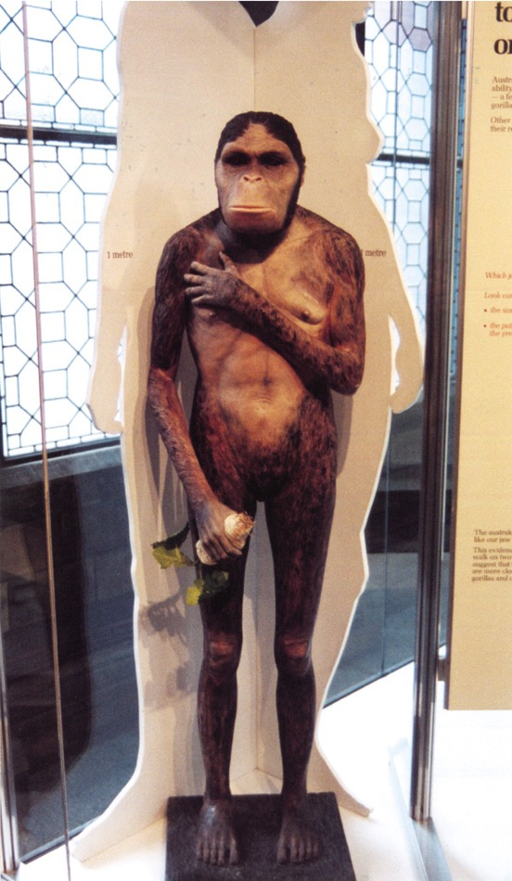
Lucy in the flesh--London
Обратите внимание!
Руки и ступни
Вертикальное положение
Лицо
Правда
Суставы использовались для хождения, как у пигмея, шимпанзе или гориллы
Notes:
PNAS (Proc. Nat. Acad. Sci), vol 104:16 (17 April 2007, pp. 6568-6572: research concludes that Lucy most closely resembles a gorilla or at least the robust australopithecines (no longer considered to be ancestral to man).
Photo by Ken Ham at Natural History Museum in London, 2009
The fossil evidence shows that Lucy (a specimen of Australopithecus afarensis) had very chimp-like body proportions (only 4 feet tall when upright) with long arms and short legs, wrists designed for knucklewalking, long curved hands and feet (with opposing big toes like in apes, not like in humans) for grasping trees, and hip/pelvic shape that indicates that she spent much time in trees, not walking like humans. See critique of the BBC’s Walking with Cavemen, at <www.biblicalcreation.org> and the video by Dr. David Menton (anatomy professor), called “Lucy: She’s no lady!” available from <www.answersingenesis.org>.

Slide 15
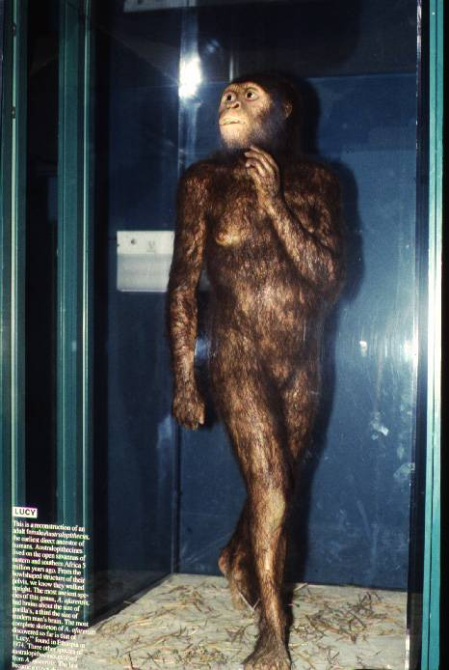
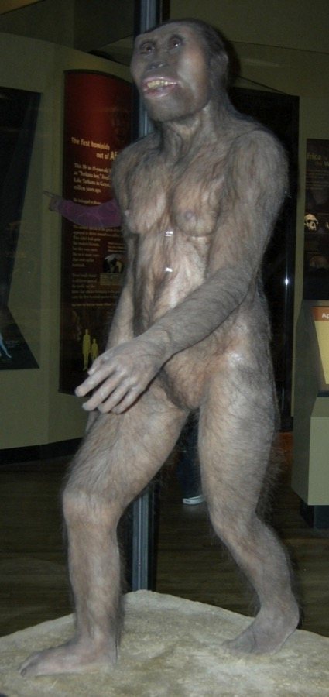
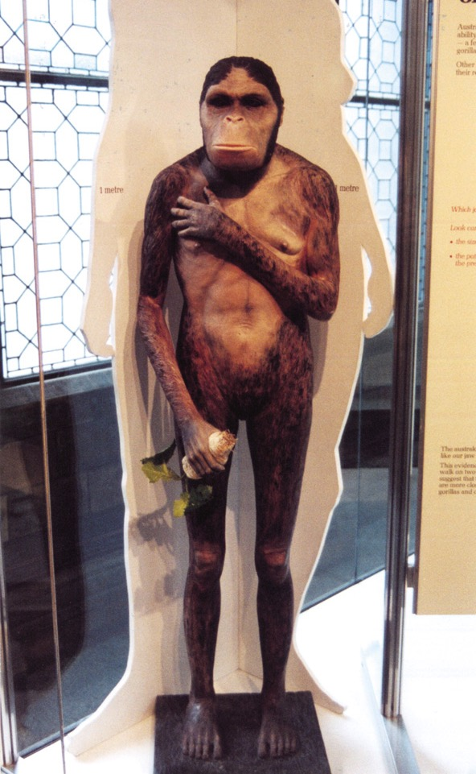
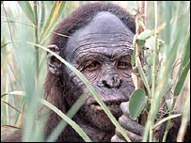
Lucy — London & St. Louis
БиБиСи, 2006
Чикаго FM
Зоопарк Сент-Луи
Лондон МЕИ
Notes:
London photo by Ken Ham from his visit to the Natural History Museum in 2009
St. Louis Zoo’s “Living World” exhibit photo by David Menton (in his DVD, “Lucy: She’s No Lady!”) taken in about 1995 (in the exhibit for at least 20 years from the very beginning in 1985)
Chicago Field Museum’s model (in their “The Evolving Planet” permanent exhibition), photo by Carl Kerby in March 2006 (http://www.answersingenesis.org/docs2006/0313field_trip.asp, 13 Mar 2006, accessed 29 June 2011.
BBC photo: article reporting on Lucy’s bones touring America. The caption under photo in the article: “Lucy's remains were found in 1974 in Hadar, Ethiopia.” See http://news.bbc.co.uk/1/hi/world/americas/6082990.stm, “Lucy’s Ancient Bones to Tour US, 25 Oct. 2006.” She will be on loan from Ethiopia to the Houston Museum of natural Science in Texas for scientific study till 2013. Officials say that money from the tour will be used to improve museums across the country.

Slide 16

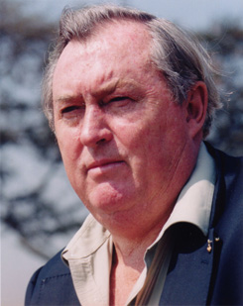
Purple blank
В 1981: «Теперь мы можем с уверенностью сказать, что австралопитеки были прямоходящими».
Ричард Лики (директор, Национальные музеи Кении). Становление человечества. Нью Йорк: E. P. Dutton, 1981. С. 71.
Notes:
Picture from http://www.midland.edu/~events/davidson/leakey.html, downloaded 14 April 2005

Slide 17
Purple blank
Но в 1982 …
«Также, Лики указывает на то, что палеонтологи не знают, были ли австралопитеки прямоходящими. “Никто еще не обнаружил целиком скелет с черепом”, – говорит он».
Анонимный автор. «Лики изменил свое мнение о возрасте человека». New Scientist. Вып. 93 (март 1982). С. 695.

Slide 18
Purple blank
«Мне страшно поверить, что не ранее чем год назад я допустил подобные высказывания», – так сказал Ричард Лики в присутствии образованной аудитории Королевского Института в прошлую пятницу вечером. Он пришел к выводу, что те общепринятые постулаты, которые он недавно поддерживал в своей серии телепередач на БиБиСи под названием “Становление человечества”, скорее всего, неверны в ряде ключевых вопросов».
Анонимный автор. «Лики изменил свое мнение о возрасте человека». New Scientist. Вып. 93 (март 1982). С. 695.
Notes:
The article continues—lecture at Royal Institution in London on Friday
Leakey said he was “probably wrong in a number of crucial areas” in his BBC TV program “The Making of Mankind.”
And what kind of mistakes did he make? (next slide)
Лики 1982 – ошибки палеонтологов №1

Slide 19
Purple blank
«В частности, сейчас он считает, что самый древний предок человека гораздо моложе 15-20 миллионов лет, в отличие от того, что он ранее решительно утверждал на телевидении. Лики говорит, что основополагающий принцип, по которому палеонтологи классифицируют ископаемые останки приматов и людей, является ошибочным, и что ему хотелось бы видеть абсолютно новый метод классификации».
Анонимный автор. «Лики изменил свое мнение о возрасте человека». New Scientist. Вып. 93 (март 1982). С. 695.

Slide 20
Purple blank
1986 год, статья об австралопитеках начинается так:
«Найденный в Кении необыкновенный череп, возраст которого исчисляется 2,5 миллионами лет, опроверг все предыдущие наблюдения о ходе эволюции ранних человекообразных существ. Мы больше не знаем, кто от кого произошел – и, возможно, даже как или когда мы появились...».
Пэт Шипман (палеонтолог, Медицинский Университет Джона Хопкинса). «Загадочная ветвь в родословной». Discover (сентябрь 1986). С. 87.
Notes:
That was Leaky’s view in 1982. But then in 1986 an science article summarized australopithecine research this way.
The new discovery overturned their previous ideas. They don’t know when or how humans came into being.
№23 Шипман 1986 - Эволюция австралопитеков
The skull was KNM-WT 17000 in the National Museums of Kenya. It has the robust characteristics of Australopithecus boisei.
A similar statement to what is on the magazine cover about this find is found on p. 89

Slide 21
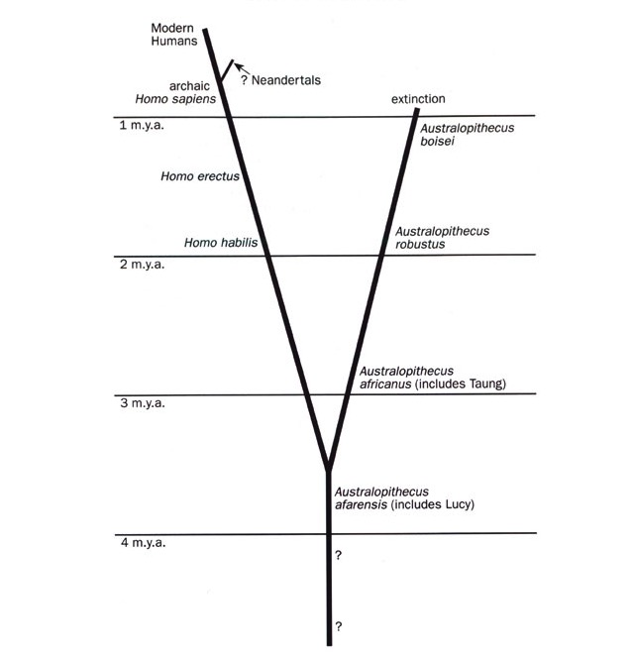
Human evolution chart 1979-86
Теория эволюции человека 1979-1986
(по Джохансону и Уайту)
Notes:
Taken from Marvin Lubenow, Bones of Contention (Grand Rapids: Baker, 1992), p. 54.

Slide 22
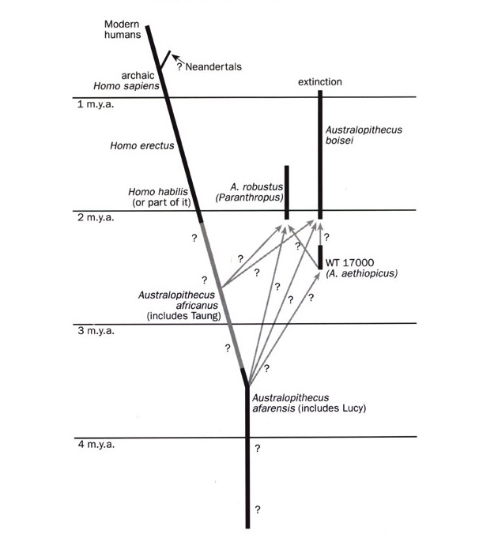
Human evolution chart post-1986
Теория эволюции человека после 1986
(по Джохансону и Уайту)
Notes:
Taken from Marvin Lubenow, Bones of Contention (Grand Rapids: Baker, 1992), p. 55.

Slide 23
Purple blank
Статья заканчивается так:
«Подводя итоги, можно сказать, что необходимо проделать огромную работу. Это новая эра в палеонтологии. То, что мы думали, мы понимаем довольно хорошо, мы не понимаем. … Невозможно привести большего аргумента в опровержение всех усилий, затрат времени и средств, чем этот новый череп. Подобно землетрясению, новый череп превратил наши хорошо выстроенные сооружения в обломки нелепых, необтесанных новых гипотез. Это верный признак научного прогресса».
Шипман (1986). С. 93.
Notes:
The article ends.
The things we thought we understood well, we don’t understand.
Now they have a rubble of awkward new hypotheses.
№26 Шипман 1986 – Эволюция австралопитеков.

Slide 24
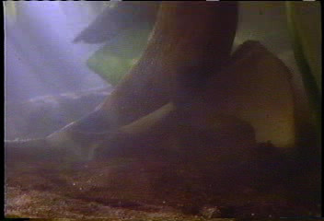
Lovejoy grinding Lucy’s hips
Dr. Owen Lovejoy & Lucy’s Hips
“In Search of Human Origins (Part 1),” NOVA, 1994
Notes:
Dr. Owen Lovejoy, famous anthropology professor at Kent State University in Ohio. The other voice is that of Donald Johanson, who found “Lucy”.
Dr. David Menton (before joining AiG staff he was for 34 years a human anatomy professor at Washington Medical School in St. Louis) comments on this clip:
Lovejoy was totally convinced that Lucy’s kind made the human-like footprints in Laetoli and those prints would not be possible for a creature to make unless it had a human-type pelvis. Therefore before Lovejoy manipulated Lucy’s hipbones he had a massive observer bias.
For Lovejoy to cut along existing cracks and then to fit things together would have been scientifically permissible, but to grind material away is totally unacceptable as a scientist.
This article by cjobrien (evidently an anthropology professor) http://northstatescience.wordpress.com/2011/01/01/correcting-creationists-redux-was-lucy%E2%80%99s-pelvis-reconstruction-a-fraud/ says the clip was from In Search of Human Origins (Part 1) on NOVA in 1994. the author accuses creationists of fraudulently misrepresenting the clip.

Slide 25
Template Suite 1-Content 01360
Неандерталец
Notes:
As a content template, this is best suited for standard content such as outlines, quotations, Scriptures, and maybe illustrations or photos. Presentation Team recommends 48–60 pt. font for headings and 28–40 pt. for body text. Because of eye flow and visual psychology, the top line may be a little closer than all other sides. This also contains a floating AiG logo that can be repositioned or removed as appropriate for the overhead’s content.

Slide 26
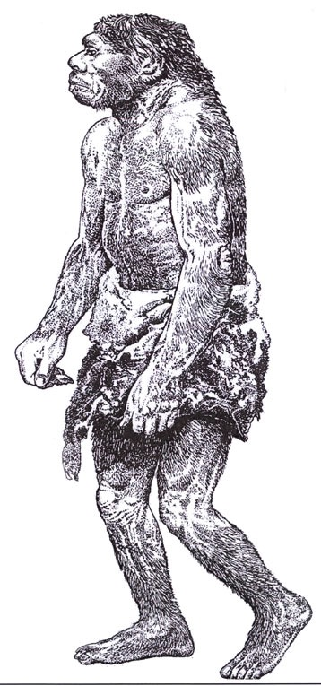
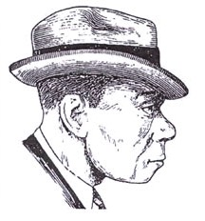
Neanderthals—then (1856) and now (1983)
1983
1856
Notes:
1856 is when the first Neanderthal was found in the Neander Valley near Dusseldorf, Germany. 490 Neanderthal skeletons have been found in Europe and western Asia as of 2006. Initially thought by scientists to be fully human, a man with rickets
1863 TH Huxley called it ancient human but not direct ancestor to modern man
1864 William King (Irish geologist) declared at meeting of BAAS that it was a different species and named it Homo neanderthalensis
1908 three RC priests excavated a nearly complete skeleton near La Chapelle-aux-Saints, France, and gave it to Marcellin Boule, anatomist at Museum d’Histoire Naturelle in Paris to declared it to be a hairy bestial creature with large brain but little intellect, which became the widely accepted view, even today.
The drawing was made by Zdenek Burian, according to Reinhard Junker, Is Man Descended from Adam? (Biblical Creation Society, 2000, translated by Steven Robinson), p. 7, from which the picture was taken. The right picture is from p. 8 of the same book and was done by Haviland in 1983. A similar contrast between the early ape-like and recent, modern-human-like (in a suitcoat and tie even) reconstructions is in Rick Gore, “Neandertals,” National Geographic 189:1 (Jan. 1996), pp. 32-33. The picture of the two in NG is taken from the Neanderthal Museum in Erkrath, Germany.

Slide 27
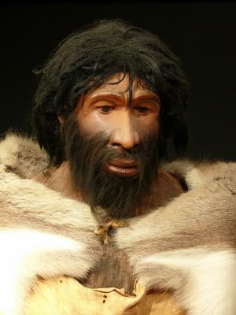
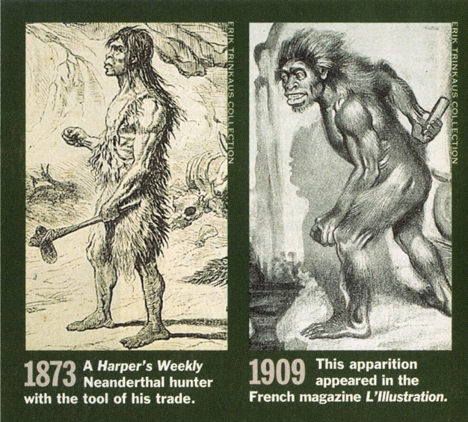
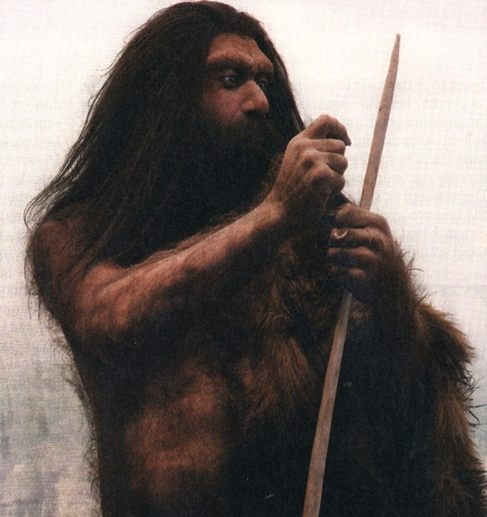
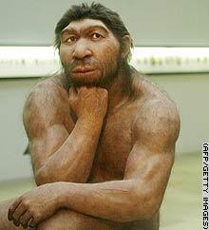
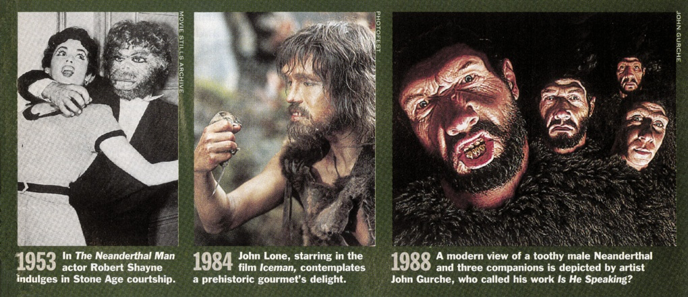
Neanderthal man—changing pictures: TIME magazine
Изменение лица неандертальца
СиэНэН, 2006
Time, Март 1994
Newsweek, Март 2007
ScienceDaily.com Август 2008
Notes:
From TIME, 14 March 1994, pp. 86-87.
CNN picture: http://www.cnn.com/2006/TECH/science/11/15/neanderthal.ap/index.html, “Neanderthal bone gives DNA clues,” 15 Nov. 2006.
The subtitle of the Newsweek picture said, “Neanderthal: In Europe 200,000 to 30,000 years ago, but not our ancestor.” Sharon Begley, “Beyond Stones and Bones,” Newsweek (19 Mar. 2007), p. 58.
Photo 2008: http://www.sciencedaily.com/releases/2008/08/080825203924.htm, accessed 26 Aug 2008. The article said that they made stone tools just as sophisticated as Homo sapiens made—overthrowing an evolutionist belief held to the contrary for over 60 years.

Slide 28
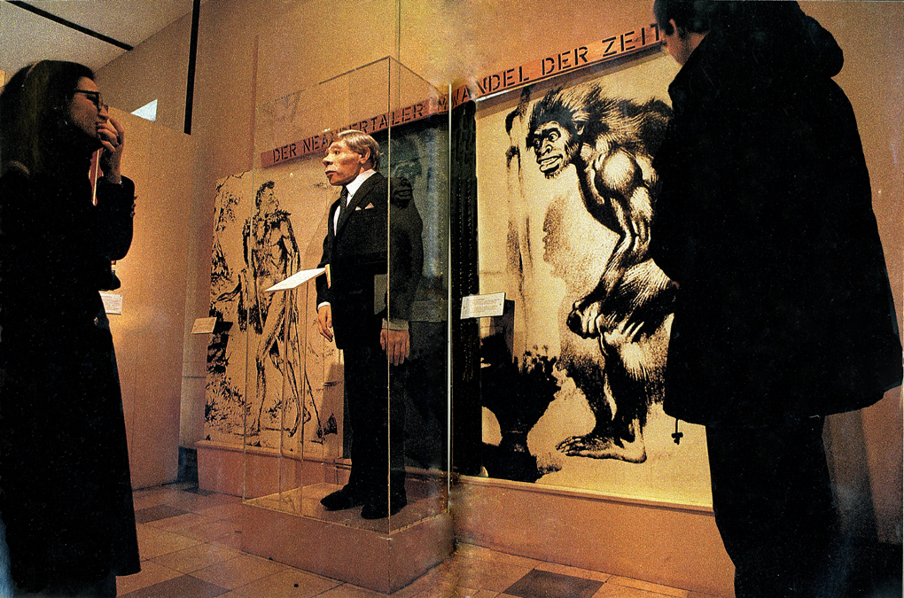
Neanderthals—German display
Неандертальский Музей, Эркрат, Германия.
«В соответствии с духом времени неандерталец изменил звериный образ, присвоенный ему в 19 веке, превратившись в еще одного парня в костюме».
Notes:
Rick Gore, “Neandertals: the Dawn of Humans,” National Geographic, Vol. 189:1 (Jan 1996), pp. 32-33.
In the caption, Gore uses both spellings for this man.

Slide 29
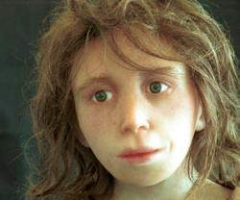
Neanderthal child’s face--2008
Разве она выглядит, как существо ниже человека?
«Реконструкция лица неандертальского ребенка (Фото: Антропологический Институт, Цюрихский Университет)».
Эуэн Колэвей. «Неандертальцы говорят спустя 30000 лет». www.newscientist.com, 15 апреля 2008.
Notes:
Photo and caption: http://www.newscientist.com/channel/being-human/dn13672, accessed 17 April 2008

Slide 30
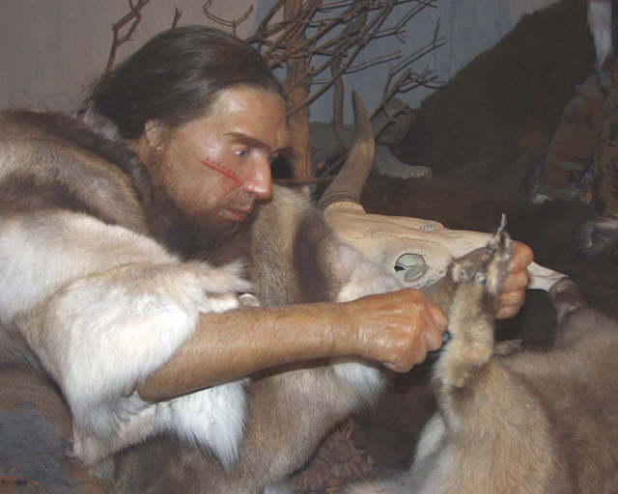
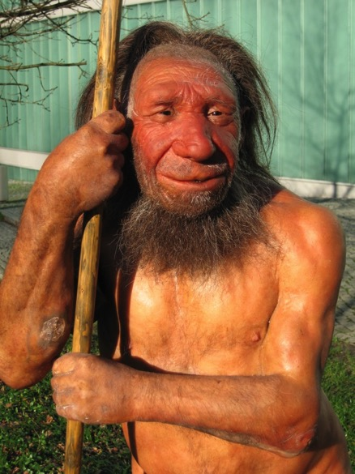
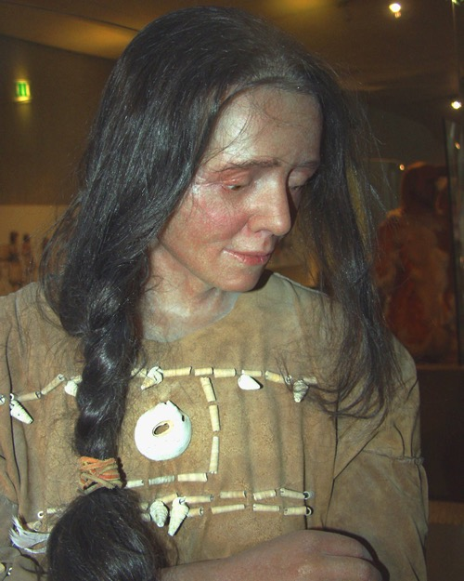
Неандертальский Музей
2010
Notes:
Top: http://commons.wikimedia.org/wiki/File:Neandertaler-im-Museum.jpg (public domain picture from Laura Strobl at AiG).
Left: http://commons.wikimedia.org/wiki/File:Neandertala_homo,_modelo_en_Neand-muzeo.jpg (see copyright on file in cabinet under Neander-homo NM 2010a).
Right: http://commons.wikimedia.org/wiki/File:Cro-Magnon-Frau-Neanderthal.jpg (public domain picture from Laura Strobl at AiG).. Museum calls the lady: Cro-Magnon Neanderthal

Slide 31
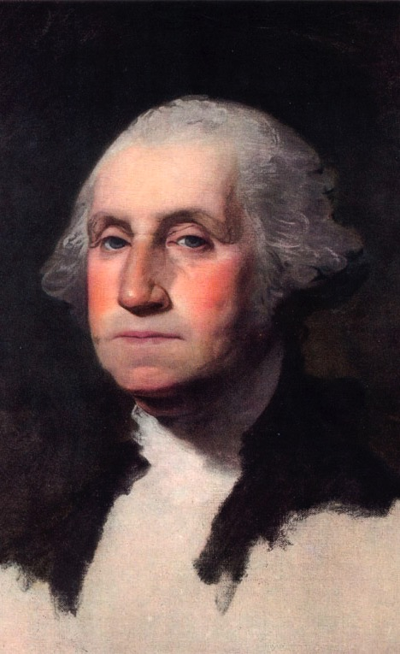
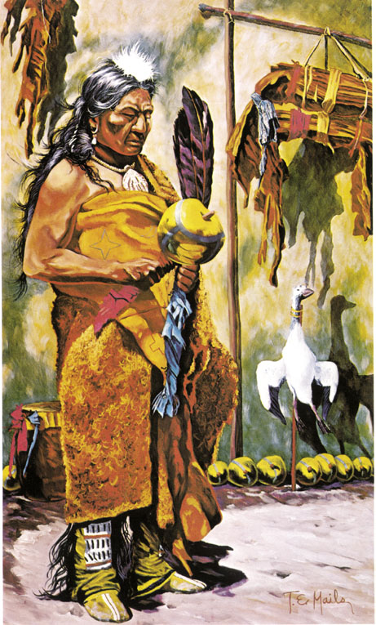
George Washington & Indian

Slide 32
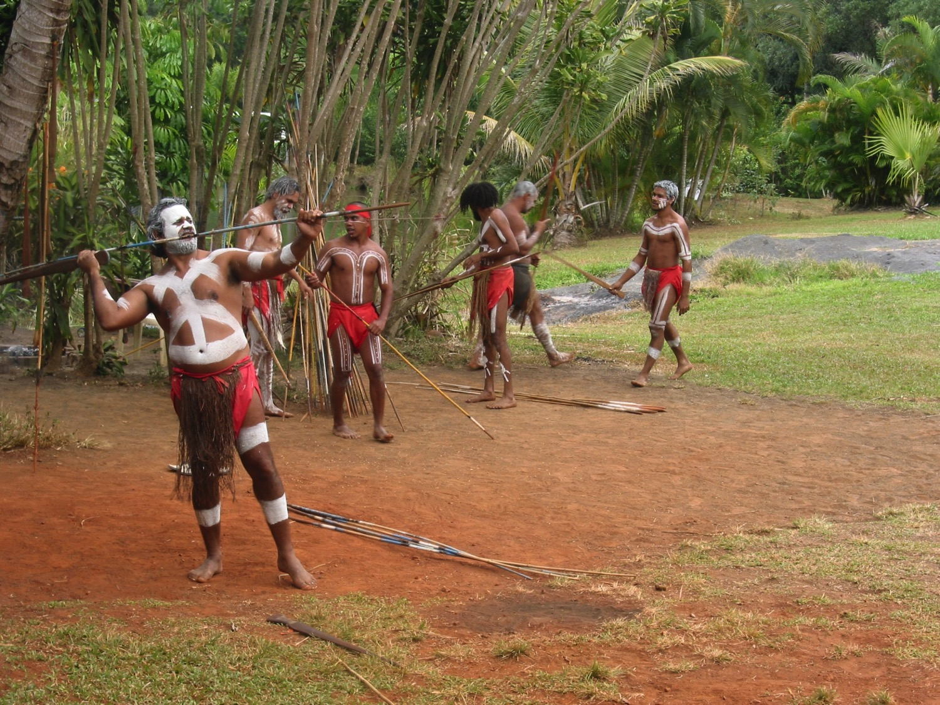
Aborigines - Photo

Slide 33
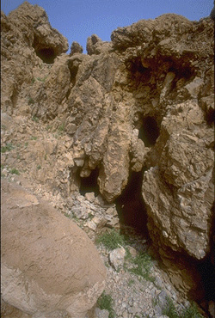
Dead Sea Scroll cave
Пещеры ессеев, где в 1947 году были найдены Свитки Мертвого Моря.
Notes:
Essenes didn’t live in the caves but stored their manuscripts there.

Slide 34

Heb. 11:38 NAS
Евреям 11:38
Те, которых весь мир не был достоин, скитались по пустыням и горам по пещерам и ущельям земли.
Погребены в пещерах: Сарра, Иаков, Лазарь
Жили в пещерах: Лот, Илия, Давид

Slide 35

Osama bin Laden
Усама Бен Ладен

Slide 36
Neanderthals--archeology
Археологические доказательства того, что неандертальцы были на 100% людьми
Изготовляли сложные копья, иглы и инструменты из камня
Пользовались косметикой и украшениями из морских ракушек
Охотились на дельфинов и тюленей
Пользовались огнем и готовили пищу
Изготовляли хижины из шкур животных
Изготовляли флейты из бедренных костей медведя
Заботились о больных и проводили обряды захоронения мертвых
Имели подъязычную кость (в головосом аппарате), «практически идентичную» таковой у современных людей, и имели гены FOXP2, отвечающие за формирование речевых звуков
Notes:
Source of info for above and below: http://www.creationontheweb.com/content/view/4750/, 14 Nov. 2006 article and Kate Wong “Twilight of the Neandertals,” Scientific American (Aug. 2009), pp. 32-37 (in my file cabinet)
CMI article: “Neandertal Genome like ours?” 1 June 2010, http://creation.com/neandertal-genome-like-ours? New genetic evidence confirms that Neandertal genome amazingly similar to modern man. Also, this article says the genomes are 99.5% the same and discusses the seashell jewelry: Jennifer Viegas, “Prehistoric Jewelry Reveals Neanderthal Fashion Sense,” 8 Jan 2010, http://news.discovery.com/archaeology/neanderthal-jewerly-fashion-seashells.html, accessed 22 May 2011. Mention of make-up and jewelry in Christopher Joyce, “Study: Neanderthals Wore Jewelry And Makeup,” 12 Jan 2010, http://www.npr.org/templates/story/story.php?storyId=122466430, accessed 22 May 2011.
CMI article: Neanderthal mitochondrial DNA (mtDNA) shows man is different species?
Considerable debate in the evolutionary community Issues such as postmortem contamination, small sample size, enormous mtDNA diversity in non-human primates, effects of population bottlenecks, and molecular clock inaccuracies render a solution impossible at this time. In 2006, U.S. and German scientists announced plans to reconstruct a draft of the Neanderthal genome over the next two years. But their interpretations of the data will depend on which areas are accurately sequenced and the worldview assumptions of the scientists.
Hyoid bone (has other functions than just speech, as it is found in non-talking animals)—see below for documentation. The larynx is made of cartilage (soft tissue) and has not been found fossilized (as of 2008).
language gene (FOXP2) in Neanderthals: http://www.foxnews.com/story/0,2933,303282,00.html, accessed 12 April 2008, research published 18 Oct. 2007.
Other information on Neanderthal in Marvin Lubenow, Bones of Contention, 2nd ed.
RE. Neanderthal bone flute see: http://www.greenwych.ca/fl-compl.htm and http://www.ukom.gov.si/eng/slovenia/background-information/neanderthal-flute/.
Arensburg, B., A. M. Tillier, et al. (1989). "A Middle Palaeolithic human hyoid bone." Nature 338(6218): pp. 758-60.
Abstract: “The origin of human language, and in particular the question of whether or not Neanderthal man was capable of language/speech, is of major interest to anthropologists but remains an area of great controversy. Despite palaeoneurological evidence to the contrary, many researchers hold to the view that Neanderthals were incapable of language/speech, basing their arguments largely on studies of laryngeal/basicranial morphology. Studies, however, have been hampered by the absence of unambiguous fossil evidence. We now report the discovery of a well-preserved human hyoid bone from Middle Palaeolithic layers of Kebara Cave, Mount Carmel, Israel, dating from about 60,000 years BP. The bone is almost identical in size and shape to the hyoid of present-day populations, suggesting that there has been little or no change in the visceral skeleton (including the hyoid, middle ear ossicles, and inferentially the larynx) during the past 60,000 years of human evolution. We conclude that the morphological basis for human speech capability appears to have been fully developed during the Middle Palaeolithic.”
From http://www.answersingenesis.org/articles/2008/04/19/news-to-note-04192008#three, April 19, 2008
Regarding McCarthy’s computer simulation (based on fossil evidence) that Neanderthals could not make the modern English “e” sound, Washington University anthropologist Erik Trinkaus disputes the finding’s significance: “Ultimately what is important is not the anatomy of the mouth but the neuronal control of it,” Trinkaus says, referencing Neanderthals’ large brains.
Neanderthals also possessed the FOXP2 gene (the so-called “language gene”) that is unique in humans. Humans missing FOXP2 suffer from language and speech disorders.
Ultimately, it is impossible to reproduce with absolute accuracy what Neanderthals would have sounded like, and what vowels they could produce, from mere fossils.
Furthermore, even if Neanderthals were unable to produce a particular vowel, that may not be any more of a sign of communication breakdown than the inability of certain modern humans to pronounce the sounds of various foreign languages. For all we know, Neanderthals may have been able to produce many more sounds than modern humans can.

Slide 37
Template Suite 1-Content 01360
Еще более проблематичные «недостающие звенья»
Notes:
As a content template, this is best suited for standard content such as outlines, quotations, Scriptures, and maybe illustrations or photos. Presentation Team recommends 48–60 pt. font for headings and 28–40 pt. for body text. Because of eye flow and visual psychology, the top line may be a little closer than all other sides. This also contains a floating AiG logo that can be repositioned or removed as appropriate for the overhead’s content.

Slide 38
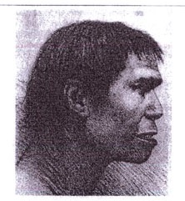
Purple blank
Пилтдаунский Человек, 1912
Доказательства:
фрагмент челюсти
два коренных зуба
фрагмент черепа
Правильное объяснение:
«Об открытии величайшей важности… Была найдена часть тела … самого древнего [500 000 лет] обитателя Англии, если не всей Европы… останки, найденные на данный момент, не оставляют никаких сомнений в том, что они принадлежат… человеку, связывающему нас с нашими далекими предками, приматами».
Illustrated London News, 28 декабря 1912
Notes:
Evidence: piece of jaw, 2 molar teeth, piece of skull
Absolute confidence that it is a missing link.
Over the next 40 years, more than 500 scientific essays were written about the fossils, according to TIME (http://www.time.com/time/specials/packages/article/0,28804,1931133_1931132_1931125,00.html, accessed 27 Oct 2009)

Slide 39
Piltdown Man #2
1953: разоблачение подделки
* Зубы и челюсть — Орангутан, мертвый в течение 50 лет
* Фрагмент черепа — Человек в возрасте 520-720 лет согласно С-14 датированию
* Зубы были отшлифованы, а кости подкрашены

Slide 40
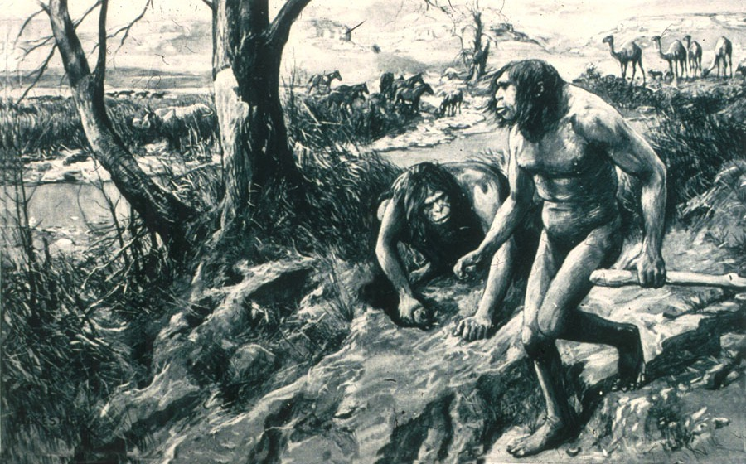
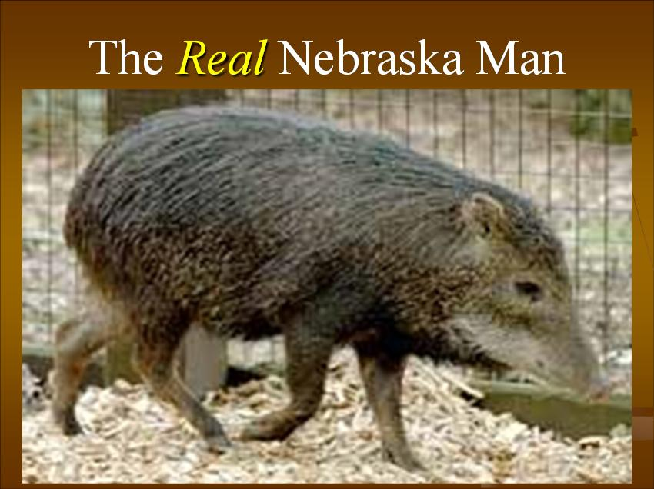
Nebraska Man
Небрасский человек
1922: уверенное заявление – человек-обезьяна
Доказательство – один единственный зуб
Небрасский человек в действительности
1927: иное толкование – вымерший вид свиньи
Notes:
Source: Gary Parker, Creation: Facts of Life (Master Books), p. 152. or Ian Taylor, In the Minds of Men, 231-3.
source of original picture: *******************************
According to this well researched Muslim site http://www.harunyahya.com/refuted8.php#235a
Henry Fairfield Osborn named this tooth “Nebraska Man.” (Hesperophithecus haroldcookii, a form of Pithecanthropus erectus)
In 1927 other parts of skeleton were found and reinterpreted as a tooth from an extinct species of pig (in the genus Prosthennops): William K. Gregory, "Hesperopithecus Apparently Not An Ape Nor A Man," Science, vol. 66:1720 (16 Dec. 1927), pp. 579-581. (article in computer file in pdf form)

Slide 41
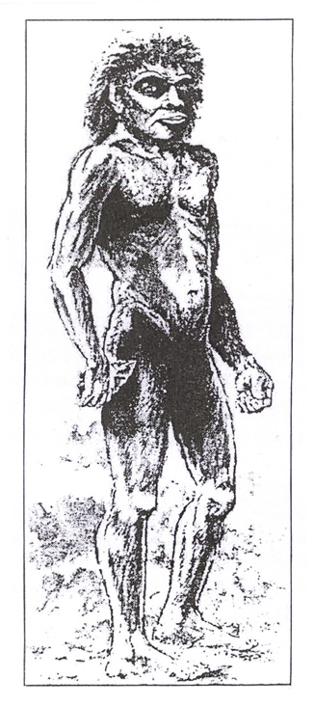
Boxgrove Man
Боксгроувский человек
(Homo heidelbergensis)
Доказательство (1994-95):
Большеберцовая кость—однозначно человеческая
Два зуба—однозначно человеческие, но нет достаточных доказательств, что они принадлежат тому же человеку
Примитивные инструменты из камня—однозначно человеческие орудия
Идентификация?
100% человек времен после Вавилона
«300 000-400 000 лет»
Notes:
Source of picture and info: The Daily Mail (London), 20 June 1995, p. 15.
David Tyler summarizes the research at http://www.biblicalcreation.org.uk/origins_archaeology/bcs063.html:
Evidence found in quarry at Boxgrove, near Chicester in SW England, deposits classed as Middle Pleistocene (creationists would say this is probably post-flood)
Shin found May 1994
Two teeth found separately in late 1995, the first showing dental disease
Various dating methods were used giving dates ranging from 175,000 to 524,000 years. Finally narrowed the dates by using vole evolution data in northern Spain. There is considerable controversy whether this is the oldest European man or not.

Slide 42
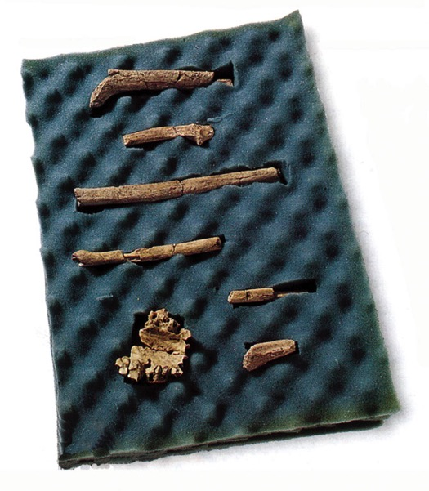
Purple blank
«Сложно найти того, кто смог
бы нарисовать древнего
человекообразного реалистично.
Вот почему художественный
отдел Geographics провел
поиск новых талантов.
Четыре художника получили
слепки останков женской особи
Homo habilis fossils (слева) в
возрасте около 2-х миллионов
лет. Используя эти небольшие
доказательства им нужно было нарисовать скелет человекообразного и полный образ того, кому принадлежали эти кости».
«Закулисная работа». National Geographic (март 2000).
Notes:
From these bits of evidence draw a complete skeleton and what the creature looked like when alive.

Slide 43
Purple blank
«“Каждому художнику было дано
две недели для того, чтобы они
изучили кости, после чего их
отправляли к следующему
человеку”, – говорит координатор
Крис Ханна. “Каждый художник
должен был проводить
исследование абсолютно
самостоятельно. Вот почему их
изображения настолько разные.
Невозможно изобразить ее
одинаковой для всех”.
Палеоантропологи рассмотрели результаты. Заинтересовавшись всеми четырьмя заявками, художественный отдел попросил всех художников нарисовать завершенные варианты с учетом замечаний, данных консультантами».
Notes:
Only 2 weeks to study the bones
Totally independent
No one way to draw her (they were able to determine the sexual gender of this creature! It is amazing what artists can do with a little imagination!

Slide 44
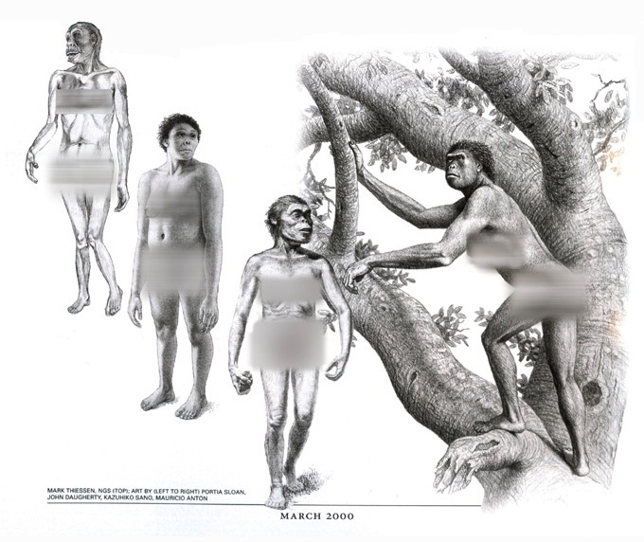
National Geographic—Behind the scences #1—four women

Slide 45
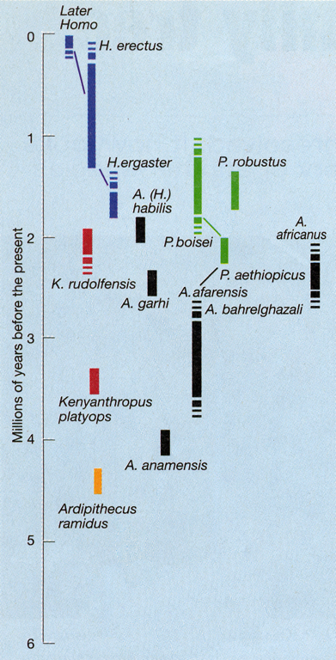
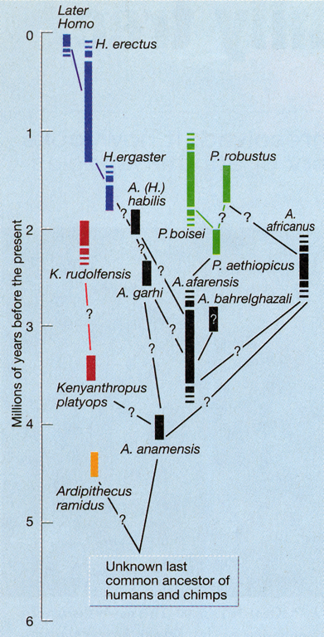
Purple blank
2001
«Еще несколько лет назад эволюционная история нашего вида считалась достаточно упорядоченной.
… Однако в последнее время в эволюционное дерево человека была внесена неразбериха. … Похоже, что это замешательство продолжает усиливаться.”
Даниел И. Либерман. «Другой облик нашего фамильного дерева». Nature. Вып. 410 (22 марта 2001). С. 420.
Notes:
Lieberman is a professor in the Department of Anthropology, The George Washington University, in Wash. DC.

Slide 46
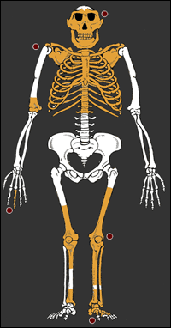
Lucy’s baby—2006 deception
«Ребенок Люси, удивительное
ископаемое”
Человеко-образный обман
Новая обезьяна
Новый человек
Лопатки и шейные позвонки—как у гориллы
Каналы внутреннего уха—как у африканских обезьян
Длинные изогнутые пальцы—как у обезьян, живущих на деревьях
Голосовой аппарат—как у шимпанзе
Характеристики черепа—как у шимпанзе
www.sciam.com, 20 сентября 2006.
Notes:
Picture and details from http://www.sciam.com/article.cfm?chanID=sa003&articleID=00076C1D-62D1-1511-A2D183414B7F0000&pageNumber=1&catID=1, accessed 22 Sept 2006 and on file in computer (see BBC report on file too.
Found in 1999 in sandstone layer near Dikika, Ethiopia, about 4 km from where Lucy was dug up in 1973-74.
The scapulae (shoulder blades) were the first ever found for austropithecines.
The fossil evidence shows curved fingers, but the art work shows them straight like humans. And there doesn’t appear to be any toe bones, but they are drawn like humans too, even though we know from other australopithecine bones that the toes are curved like apes too.

Slide 47
How to make an ape-man?
Как изготовить человекообразного?
1. Несколько человеческих костей + воображение = человекообразное
2. Несколько обезьяньих (?) костей + воображение = человекообразное
3. Несколько человеческих костей + несколько обезьяньих костей + воображение = человекообразное
Notes:
A few human bones
A few ape bones
ape + human bones

Slide 48
Template Suite 1-Content 01360
Что говорит Библия?
Notes:
As a content template, this is best suited for standard content such as outlines, quotations, Scriptures, and maybe illustrations or photos. Presentation Team recommends 48–60 pt. font for headings and 28–40 pt. for body text. Because of eye flow and visual psychology, the top line may be a little closer than all other sides. This also contains a floating AiG logo that can be repositioned or removed as appropriate for the overhead’s content.

Slide 49
Man—supernatural & unique
Человек был сотворен
сверхъестественным образом
и является
уникальным
по сравнению с прочим творением.

Slide 50

Stott 1981—pre-Adamites 1
«Кажется абсолютно возможным согласовать историчность Адама с, по крайней мере, некоторыми (теистическими) эволюционными теориями. Многие библейские христиане так и делают, веря, что эти теории не являются абсолютно несовместимыми.
Доказывать историчность первой пары, которая согрешила через непослушание – это одно;»
Джон Стотт. Цит. по: Коллин Чепмен. Доказательства христианства. Grand Rapids: Eerdmans, 1981. С. 130.
Notes:
Stott died in July 2011.
He says many Christians believe in theistic evolution. But let us remember that truth is not determined by majority vote and the majority is often wrong.
He affirms believe in historical Fall—that’s one thing.

Slide 51
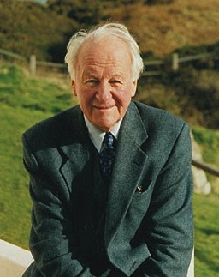
Stott 1981—pre-Adamites 1
«Совершенно другое –
отрицать всю
эволюцию и доказывать
отдельное и особое
сотворение всего,
включая и
человекообразных
существ, и тело Адама».
Джон Стотт. Цит. по: Коллин Чепмен. Доказательства христианства. Grand Rapids: Eerdmans, 1981. С. 130.
Notes:
This great Bible scholar finds it hard to deny evolution, even the evolution of Adam’s body from an ape-man. Why? Because he has been brainwashed by the teaching of evolution.
Picture from http://www.cslewis.org/programs/cruise/2004/speakers.html, downloaded 15 April 2005

Slide 52
Stott 1981—pre-Adamites 2
«Это предположение (ибо это не более, чем предположение) не кажется мне противоречащим Писанию и потому невозможным, что когда Бог сотворил человека по Своему подобию, Он запечатлел Свое подобие на одном из множества “человекообразных”, которые, как кажется, жили в то время».
Стотт (1981). С. 130.
Notes:
“The suggestion (for it is no more than this) does not seem to me to be against Scripture and therefore impossible that when God made man in His own image, what He did was to stamp His own likeness on one of the many ‘hominids’ which appear to have been living at the time.”

Slide 53
Stott 1981—pre-Adamites 2
«Говоря с долей сомнения, как подобает тому, кто не является ученым», Стотт продолжает объяснять, что он склоняется к идее о существовании человекообразных предшественников Адама, которые были анатомически неотличимы от современного человека, но которые не имели образа Божия.
Стотт (1981). С. 130.
Notes:
“Speaking hesitatingly as a non-scientist,” Stott goes on to indicate that he leans toward the idea of pre-Adamite hominids who were anatomically indistinguishable from modern man but who did not bear the image of God.
I wish this great Bible scholar would study Genesis as carefully as he has the other parts of the Bible. He would see his error.
№65 Стод 1981 - предшественники потомков Адама 2

Slide 54
Man—supernatural & unique
Человек был сотворен
сверхъестественным образом
и является
уникальным
по сравнению с прочим творением.
Notes:
54

Slide 55
Gen. 1:27 NAS no ha’adam
Бытие 1:27
И сотворил Бог человека по образу Своему, по образу Божьему сотворил Его; мужчину и женщину сотворил их.
Notes:
All flesh is not the same flesh, but there is one flesh of men, and another flesh of beasts, and another flesh of birds, and another of fish.

Slide 56
1 Cor 15:39 NAS
1 Коринфянам 15:39
Не всякая плоть такая же плоть; но иная плоть у человеков, иная плоть у скотов, иная у рыб, иная у птиц.

Slide 57
Gen. 2:7 NAS
Бытие 2:7
И создал Господь Бог человека из праха земного, и вдунул в лицо его дыхание жизни, и стал человек душою живою.
Notes:
NAS, NIV, NKJV, HCSB: “living being”
KJV “living soul”

Slide 58
Genesis 2:7 diagrams NAS
Библия
Человек + Божье дыхание = Живое существо
nephesh chayyah
(см. Бытие 1:20-21, 24; 9:10)
1 Коринфянам 15:45a
«первый человек, Адам, стал душою живущею»
Теистическая эволюция
X
Живое существо + Божье дыхание = Человек
nephesh chayyah

Slide 59
Gen. 3:19 NAS
Бытие 3:19
В поте лица твоего будешь есть хлеб, доколе не возвратишься в землю, из которой ты взят, ибо прах ты и в прах возвратишься.
Notes:
I’ve got news for your folks, when you die you are not going to become some sub-human living creature. You are literally going to become dust.

Slide 60
Gen. 2:22 NAS
Бытие 2:22
И создал Господь Бог из ребра, взятого у человека, жену, и привел ее к человеку.

Slide 61
Gen 3:20 & 1 Cor 15:45 NAS
Бытие 3:20
И нарек Адам имя жене своей: Ева, ибо она стала матерью всех живущих.
1 Коринфянам 15:45
Так и написано: «Первый человек, Адам, стал душою живущею». …
Notes:
The Bible only speaks of the first heaven and earth and the new ones. The gap theory would mean that there was a first, second and new—so three heavens and earths instead of only two.

Slide 62
Gen. 4
Бытие 4
Каин построил город.
Шесть поколений спустя –
* Некоторые люди были пастухами, живущими в шатрах.
* Другие были одаренными музыкантами, рудокопами и обработчиками металла.

Slide 63
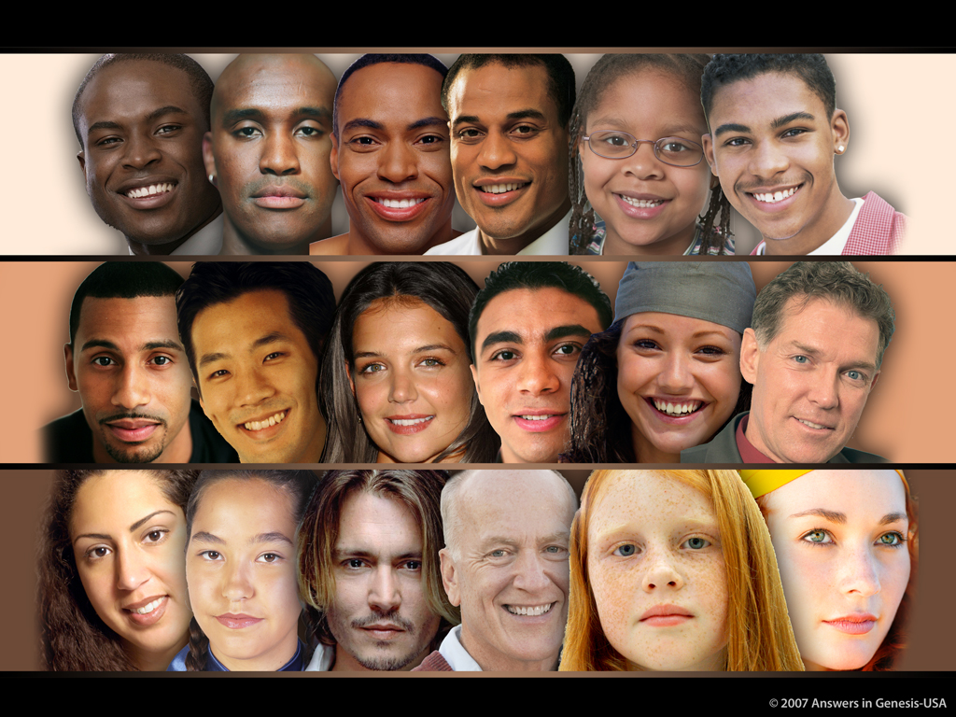
Skin Tones Line-up 03051

Slide 64
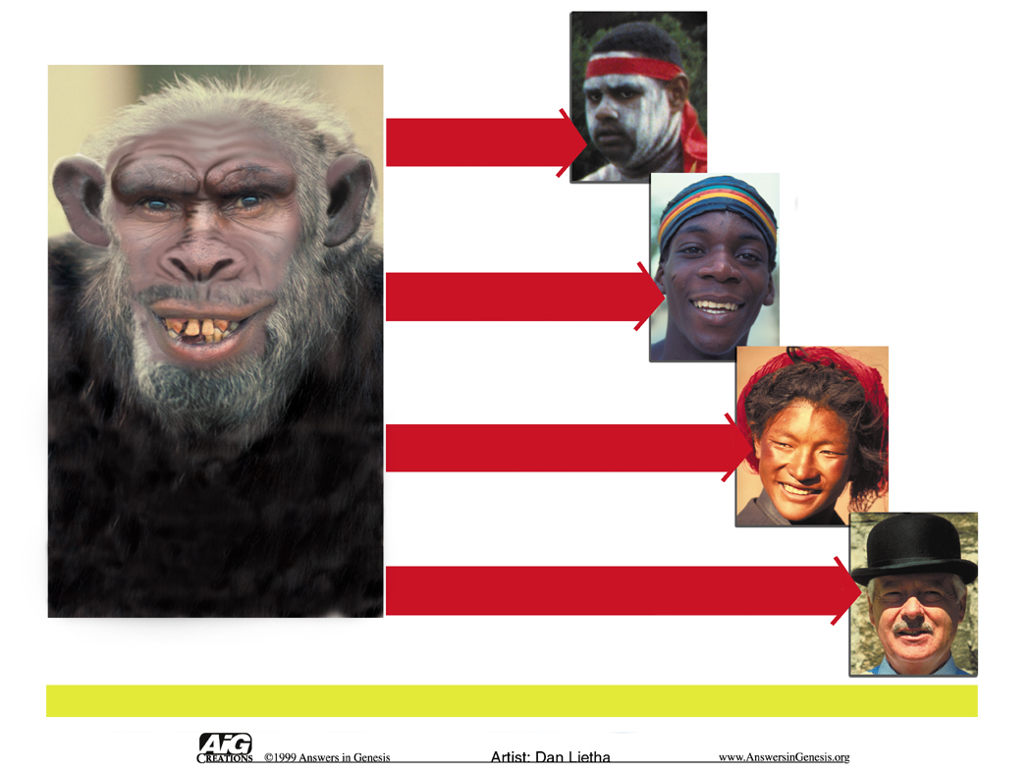
Races--Australoid to Caucasoid
Австралоид
НЕГРОИД
Воображаемый
МОНГОЛОИД
ЭВОЛЮЦИОННЫЙ ПРЕДОК
КАВКАЗОИД
РАСЫ

Slide 65
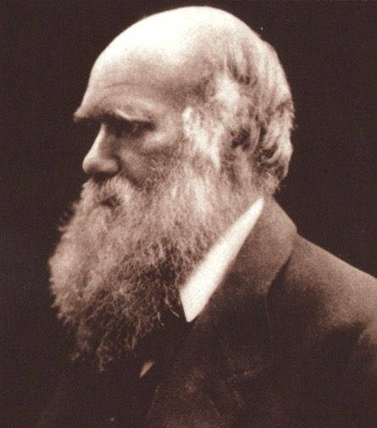
«Когда-то в будущем,
совсем недалеком,
если измерять веками,
цивилизованные
человеческие расы,
скорее всего,
уничтожат и вытеснят
дикие расы в этом
мире. В то же самое время, человекообразные обезьяны ... без сомнения, будут уничтожены».
Чарльз Дарвин. Падение Человека. – 2-е изд. Нью Йорк: A.L. Burt, 1874. С. 178.

Slide 66
«Тогда разрыв между
человеком и его
ближайшими сородичами
будет больше, ибо он
будет разделять человека
в более цивилизованном
государстве, насколько
мы можем надеяться,
даже чем у кавказоидной
расы, и обезьян, таких как
бабуины, по сравнению с тем, что мы видим сейчас, глядя на негра или австралийца [аборигена] и гориллу».
Чарльз Дарвин. Падение Человека. – 2-е изд. Нью Йорк: A.L. Burt, 1874. С. 178.

Slide 67

Purple blank
«Биологические аргументы в пользу расизма, возможно, и встречались в обществе до 1850 года, но их число выросло на порядок вслед за всеобщим принятием эволюционной теории».
Стефен Джей Гоулд. Онтогенез и филогенез. Belknap-Harvard Press, 1977. С. 127-128.
QC 674

Slide 68


National Geographic, 1985
Родословные, 1971
Notes:
Top chart: Kenneth F. Weaver “The Search for our Ancestors,” National Geographic (Nov. 1985), pp. 574-577. Notice the feet, hands, arm length, subtly racist skin color.
Bottom chart: William Howells (Prof. of Anthrop., Harvard), Early Man (New York: Time-Life Books, 1971), pp. 41-45.

Slide 69

Веб-сайт канала Discovery, 11 декабря 2007
Notes:
http://dsc.discovery.com/news/2007/12/11/human-evolution.html, article dated 11 Dec. 2007, accessed 27 July 2008
Notice the arm length and subtly racist skin color change.

Slide 70
Acts 17:24-26 NAS
Деяния 17:24, 26
24 Бог, сотворивший мир и все, что в нем, …
26 От одной крови Он произвел весь род человеческий ...

Slide 71

One Race 02279
Одна «Раса»
Адам и Ева
1 Коринфянам 15:45
Бытие 3:20
Сыновья и дочери
Бытие 5:4
Ной и его сыновья
Бытие 9:17-19
Народы при Вавилонской башне
Бытие 11:8-9
Деяния 17:26
Люди разных национальностей и культур
Notes:
71
Revised: September 2005.

Slide 72
Skin Tones Line-up 03051

Slide 73

МУЖЧИНА
ЖЕНЩИНА
AaBbCc x AaBbCc
Возможная информация в яйцеклетке / сперматозоиде:
A
a
B
b
C
c
Возможная информация у потомков:
Цвет человеческой кожи
AA BB CC
Темный 100%
aa bb cc
Светлый 100%
AA Bb CC
Темный 85%
Aa BB Cc
Темный 70%
Aa Bb Cc
Мулат 50%

Slide 74

АДАМ И ЕВА
ИМЕЛИ ОГРОМНОЕ
ГЕНЕТИЧЕСКОЕ НАСЛЕДИЕ
aabb
Адам и Ева
aaBb
AaBb AaBb
AABb
И МОГЛИ ПРОИЗВЕСТИ БОЛЬШОЕ РАЗНООБРАЗИЕ В ОДНОМ ПОКОЛЕНИИ!
AABB

Slide 75

Notes:
2008: Mother is from Ghana, father from Germany, babies born in Berlin.
“Ryan came first, and everything was as usual, said the hospital’s doctor, Birgit Weber. But when Leo [black baby] was born, I COULDN'T BELIEVE MY EYES.“ … “The doctor said she had been present at some 10,000 births over almost 20 years and had never seen anything quite like this, it has been reported.”
“Two in a Million: Twins Born - One Black, One White,” 17 July 2008, http://www.foxnews.com/story/0,2933,384862,00.html, accessed 18 July 2008.
Don’t know if we have permission to use this picture in a product

Slide 76

Multi-color twins close-up
Multi-color twins close-up
Notes:
2006: Both parents have black fathers and white mothers
Lucy Laing, “Twin Sisters—One Black, One White—Turn Heads in England,” JET, vol. 109:12 (27 March 2006), p. 36.
AiG has permission to use this picture. It is used in the museum.

Slide 77

The Human family

Slide 78

Human variation since Noah
Разнообразие людей
Кавказоид
Негроид
Монголоид
Cro Magnon
Семья Ноя: 8 человек
Homo erectus
Неандерталец
Адам + Ева
Notes:
From Reinhard Junker, Is Man Descended from Adam? (Biblical Creation Society, 2000, translated by Steven Robinson), p. 37.
Neanderthal, Homo erectus and Cro Magnon have the same range of brain size and the same inner ear structure (key for determining that they habitually walked upright) as modern man has. They buried their dead and did artwork like modern man does, too.
Good article (dated 2000) on Homo erectus being equal to modern man is: John Woodmorrape, “How different is the cranial-vault thickness of Homo erectus from modern man?”, <www.answersingenesis.org/home/area/magazines/tj/docs/v14n1_cranium.asp>

Slide 79

Map—post-flood dispersion
Вавилонское рассеяние

Slide 80
ДАННЫЕ
Дерево Эволюции
Лес Сотворения

Slide 81
Template Suite 1-Content 01360
Ну и что?

Slide 82

Purple blank
Представитель Лондонского Зоопарка Полли Уиллс говорит: «Наблюдение за поведением людей в различных ситуациях, посреди прочих животных ... учит членов общества тому, что человек – это просто разновидность приматов».
Notes:
Picture and quote: Assoc. Press, “Crowds go ape over ‘humans’ zoo exhibit,” 26 Aug. 2005, http://www.msnbc.msn.com/id/9087023/, still on line as video clip and article on 2011 May 22.

Slide 83

Adam in Your Past 01127
БОГ ЕСТЬ
АВТОРИТЕТ
БОГ
УСТАНАВЛИВАЕТ
ПРАВИЛА
АДАМ
В ТВОЕМ ПРОШЛОМ

Slide 84

Ape in Your Past 01128
Относительная нравственность
ОБЕЗЬЯНА
В ТВОЕМ ПРОШЛОМ
ЧЕЛОВЕК УСТАНАВЛИВАЕТ ПРАВИЛА
У
У
ААА!

Slide 85
American Atheists—no Adam, no redeemer
«Если не было Адама и Евы, то нет нужды и в спасителе. Это также означает, что Библии нельзя доверять как источнику недвусмысленной, буквальной истины. Она абсолютно недостоверна, потому что она начинается с мифа и продолжает строить на этом основании. Если не было грехопадения человека, то нет нужды в и искупителе».
Американские атеисты. «Ты ЗНАЕШЬ, что это миф: в этот сезон, празднуй РЕЗОН!» https://atheists.org, без даты, доступ: 1 июня 2011.
Notes:
https://atheists.org/atheism/Christmas

Slide 86





Scientist & Bible—layered new
Человек произошел от обезьяны. Поверь мне на слово!
Я сотворил Адама и Еву сверхъестественным образом. Поверь Мне на слово!
БИБЛИЯ
Доктор Джон Стотт

Slide 87

AiG web site #1
Notes:
87

Slide 88

AiG web site #1
www.ScienceAndApologetics.org
Notes:
88

Slide 89

blank
www.origins.org.ua
Notes:
89
www.origins.org.ua

Slide 90
Wood 2002—human evolution is illusion
«Существует широко известное представление об эволюции, которое вы найдете повсюду… Слева на картинке вы увидите примата… Справа – человека… Между ними – последовательность образов, которые становятся все более похожими на человека… Наше развитие от примата к человеку кажется таким плавным и аккуратным. Это такое привлекательное представление, что даже эксперты неохотно отказываются от него. Но это – иллюзия».
Бернард Вуд (профессор в области происхождения человека, Университет Джорджа Вашингтона). «Кто мы?» New Scientist. Вып. 2366 (26 октября 2002). С. 44.
Notes:
“There is a popular image of human evolution that you’ll find all over the place … On the left of the picture there’s an ape … On the right, a man … Between the two is a succession of figures that become ever more like humans … Our progress from ape to human looks so smooth, so tidy. It’s such a beguiling image that even the experts are loath to let it go. But it is an illusion.”
Bernard Wood (prof. of human origins, George Washington Univ.), “Who are we?” New Scientist, 2366 (26 Oct. 2002), p. 44.

Slide 91

Evolution of man—progression: Illusion!
Эволюция человека?
ОБМАН!
ИЛЛЮЗИЯ!

Slide 92
Acts 17:30-31 NAS
Деяния 17:30-31
30 Итак, оставляя времена неведения, Бог ныне повелевает людям всем повсюду покаяться,
31 ибо Он назначил день, в который будет праведно судить вселенную, посредством предопределенного Им Мужа, подав удостоверение всем, воскресив Его из мертвых.

Slide 93
Black blank------------extras

Slide 94
Black blank------------extras
КОНЕЦ

Slide 95
Black blank------------extras

Slide 96

Eye Shape Variations
РАЗНООБРАЗИЕ
формы глаз

Slide 97

Evolutionized Worldview 00826
ЭВОЛЮЦИОНИРОВАННОЕ МИРОВОЗЗРЕНИЕ
Смерть
Убийство
Страдания
Болезнь
Миллионы
лет
Существо-вание человека
ЭТОТ
М И Р
Notes:
97

Slide 98

Частично Библейское
ХРИСТИАНСКОЕ МИРОВОЗЗРЕНИЕ
Совершенство
Суд
Страдания
Спаситель
Согрешение
Смешение
Сотворение
X
X
X
X
ЭТОТ
М И Р
Notes:
98
I explain that when Christians don’t have the first four lenses (either denying them or ignoring some of the truths of Gen. 1-11), they too don’t see (understand) things in the world clearly. They can see come things reasonably clearly (e.g., Jesus died for the sin problem caused by Adam, men are to be the loving heads of their homes and in the church, man is distinct from the animals and made in the image of God), but some things are distorted (e.g. age of the earth, death before the fall) and so they only have a partially Biblical worldview, not a truly Christian worldview.

Slide 99
Purple blank
Код ДНК
«Даже с кодом ДНК у нас нет прямого доступа к процессам эволюции, так что объективная реконструкция исчезнувшего прошлого может быть достигнута лишь благодаря креативному воображению».
Н. А. Такахата. «Взгляд на происхождение и историю человека с точки зрения генетики». Annual Review of Ecology and Systematics. Вып. 26 (1995). С. 343.
Notes:
Takahata is an genetics expert in Japan.
Article saved on my computer under science backup articles.
From Georgia Purdom, “The trouble with sequencing,” http://www.answersingenesis.org/docs2006/1122neandertal.asp, 22 Nov. 2006.
For example, the Science paper says:
We assumed that Neandertals and modern humans evolved from a single ancestral population of 10,000 individuals and the Neandertal population split away from the human ancestral population instantaneously at a time T in the past, with no subsequent gene flow. [emphasis added]
Science article: Noonan, James, et al., “Sequencing and analysis of Neanderthal genomic DNA,” Science, 314 (2006), pp. 1113–1118 (quote on top of 1116). Georgia has this in PDF.

Slide 100
«Обезьяны и люди идентичны на 98%».
КАЗНИТЬ, НЕЛЬЗЯ ПОМИЛОВАТЬ.
КАЗНИТЬНЕЛЬЗЯПОМИЛОВАТЬ
КАЗНИТЬ НЕЛЬЗЯ, ПОМИЛОВАТЬ
Весь вопрос в информации – как она передается, истолковывается и реализуется – а не в сходстве.
Notes:
Actually, research in about 2002 showed only about 95% the same. But also, according to 2003 research (see New Scientist, 15 March 2003, p. 26, for a summary of research published in Genome Research, vol. 13, p. 341), the genetic differences are far more significant that previously thought. And the genetic similarity between man and the 1mm long nematode worm is 75%, but man is not related to a worm

Slide 101
Dolgin 2007—Human genes vs chimp genes
Часто говорят, что разница между геномом человека и геномом шимпанзе – всего лишь 1-2%, т.е. между двумя видами, которые имели общего предка не позднее, чем 5 миллионов лет назад. Но эти проценты относятся к в различию нуклеотидов в общих генах. ... 6,4% из 22 000 специфических человеческих генов не встречаются у шимпанзе, что внезапно делает различие между двумя видами намного больше.
Элай Долджин. «Эволюционный дух сделал нас людьми». Science NOW Daily News, 23 октября 2007.
Notes:
http://sciencenow.sciencemag.org/cgi/content/full/2007/1023/2

Slide 102
Trans-positional mutations in sentences
Дядя Вася пошел охотиться на оленя.
Дядя олень пошел охотиться на Васю.
Генетики распознали буквы и слова генома, но они ничего не знают о грамматике и синтаксисе языка ДНК.
Notes:
The letters and words are identical, but the meaning is opposite because of grammar and syntax.
Geneticists have identified the letters and words of the genome, but know nothing of the grammar and syntax of the DNA language (said Dr. Tom Wood, a geneticist, in his paper at ICC 2003).
So the DNA similarities between apes and man are really meaningless. It is obvious to us all that there are very significant differences between the two and only superficial similarities.

Slide 103
Sentence differences and DNA
Сегодня есть много ученых, которые подвергают сомнению эволюционную парадигму и ее атеистические философские следствия
Сегодня НЕТ многих ученых, которые подвегали бы сомнению эволюционную парадигму и ее атеистические философские следствия.
Эти предложения идентичны на 97%, но они имеют противоположное значение!

Slide 104

Purple blank
«Является ли человек
животным? – это мой
подзаголовок, и ответ в
некотором очевидном
смысле «да». В конце
концов, наше ДНК на 98.8%
сходно с ДНК шимпанзе, и
если это не делает нас
животными, тогда я вообще не знаю, кто мы. Хотя нужно помнить, что наше ДНК также сходно на 50% с ДНК бананов, но это не делает нас наполовину бананами, ни выше пояса, ни ниже него».
Профессор Стив Джонс, 12 января 2002.
Notes:
Color picture: http://www.ucl.ac.uk/biology/academic-staff/jones/jones.htm (Jones, Steve Univ Col London 1) or black and white picture http://www.houghtonmifflinbooks.com/catalog/authordetail.cfm?authorID=8016 (Jones, Steve Univ Col London 2)
"Almost like a Whale": this was Darwin's description of a bear fishing in deep water. It was chosen as a title for his rewritten "Origin of Species" by Steve Jones, Professor of Genetics at University College, London. About Jones book, Jones said the above statement in an interview at the Australian Museum on The Science Show, broadcast on ABC radio, 12 January 2002, and transcribed here: http://www.abc.net.au/rn/science/ss/stories/s456478.htm (accessed 26 March 2006). The interview begins: Jones is a leading evolutionist in Britain (University College, London, I believe)
Robyn Williams: This week a Science Show special: Steve Jones, author of “Almost Like a Whale” at the Australian Museum, talking about Mr Darwin. Steve Jones.
Steve Jones: Thank you for that. 'Is Man another Animal' is my subtitle and the answer in some obvious sense is, yes. After all, we share 98.8% of our DNA with chimpanzees and if that doesn’t make us just another animal then I don’t know what does. It’s worth remember though that we also share about 50% of our DNA with bananas and that doesn’t make us half bananas, either from the waist up or the waist down. So there are limits in what genetics can tell us about what it means to be human, and that’s what I want to explore in the second half of my talk. So the answer - Is Man another Animal – is simultaneously yes, and quite firmly no. However, for most of the talk I’m going to be discussing with you Darwin’s Theory, evolution, what we know about it that perhaps he didn’t, why we regard Darwin with such admiration, indeed such awe as the founder really, not just of evolution but of biology as a science.
This interview is referred to in http://www.answersingenesis.org/creation/v24/i3/humans.asp.

Slide 105
Шимпанзе и человек
Генетические различия
Геном шимпанзе на 12% больше генома человека.
Только 2,4 миллиона оснований были выверены между двумя геномами, делая максимальное сходство лишь в 68-77%.
Во многих частях генома наблюдаются крупные перестановки ДНК, ответственные за еще 10-20% различий.
Доктор Джорджия Пюрдом. «Эволюция: Факт или вымысел?», www.answersingenesis.org, 2 февраля 2006.
Notes:
What they don’t tell us, when they say that Chimps and humans are 94-98% similar.
Dr. Purdom is a cell biologist, with a PhD in molecular genetics from Ohio State University.
See http://www.answersingenesis.org/docs2006/0202Utah.asp.

Slide 106
Шимпанзе и человек
Генетические различия
Шимпанзе имеют 46 хромосом, а люди – 44 хромосомы (не считая половых хромосом у обоих видов).
Ради экономии денег и времени геном шимпанзе был смоделирован с использованием человеческого генома в качестве шаблона (исходя из предубеждения, что человек относится к той же ветви эволюции, что и шимпанзе); в настоящее время неизвестно, были ли части «пазла» генома шимпанзе собраны правильно.
Доктор Джорджия Пюрдом. «Эволюция: Факт или вымысел?», www.answersingenesis.org, 2 февраля 2006.
Notes:
What they don’t tell us, when they say that Chimps and humans are 94-98% similar.
Dr. Purdom is a cell biologist, with a PhD in molecular genetics from Ohio State University.
See http://www.answersingenesis.org/docs2006/0202Utah.asp.

Slide 107

Little girl and chimp--differences
Дети могут
говорить
учиться
думать абстрактно
принимать нравственные решения
творить
Шимпанзе не могут!
Notes:
The letters and words are identical, but the meaning is opposite because of grammar and syntax.
Geneticists have identified the letters and words of the genome, but know nothing of the grammar and syntax of the DNA language (said Dr. Tom Wood, a geneticist, in his paper at ICC 2003).
So the DNA similarities between apes and man are really meaningless. It is obvious to us all that there are very significant differences between the two and only superficial similarities.
Chimp & child photo is mine

Slide 108

World’s population stats #1
Население мира в 2006: 6,5 миллиардов
удвоение ~ каждые 40 лет
Библия: Начните с 1 пары и проводите удвоение каждые 150 лет в течение 4800 лет (40x):
8,6 миллиардов человек (8 600 000 000)
Дата потопа: ~ 4500 лет назад, начните с 3 пар
Библейская хронология имеет смысл!
Notes:
Source: Monty White, “Billions of People in Thousands of Years?,” Answers Magazine, vol. 1:2 (Oct-Dec 2006), p. 82.

Slide 109
World’s population stats #1
Население мира в 2006: 6,5 миллиардов
удвоение ~ каждые 40 лет
Эволюция: настоящие люди на земле существуют, как минимум, 50000 лет
~332 удвоений => 10¹⁰⁰ людей на настоящий момент
X
10,000,000,000,000,000,000, 000,000,000,000,000,000,000,000,000,000,000,000,000,000,000,000,000,000,000,000,000,000,000,000,000,000,000.
Эволюционная хронология не работает!
Notes:
Source: Monty White, “Billions of People in Thousands of Years?,” Answers Magazine, vol. 1:2 (Oct-Dec 2006), p. 82.

Slide 110
Purple blank
1992
«Едва ли найдется другая тема для стольких разногласий, как эволюция человека. Каждая находка останков, каждая новая применяемая методика, каждая догадка – все это высвобождает поток разногласий с бурными нескончаемыми дебатами. …».
Джон Ваймер (археолог, специализирующийся на периоде Палеолитики). «Обновляя прошлое эволюции». New Scientist. Вып. 136 (7 ноября 1992). С. 40.
Notes:
“There can hardly be any other subject so contentious as human evolution. Every fossil discovery, every new scientific technique that is applied, every speculation--all unleash a cascade of disagreements with unresolved and fiercely debated conclusions. …”
John Wymer (archaeologist specializing in the Palaeolithic period), "Refreshing the evolutionary past," New Scientist, Vol. 136 (7 Nov. 1992), p. 40.

Slide 111
Purple blank
«Возможно, самой увлекательной дискуссией является попытка определить когда, где, как и почему мы – люди».
Ваймер (1992). С. 40.
Notes:
“Perhaps the most intriguing discussion is their attempt to define just when, where, how and why we are human.”

Slide 112
Purple blank
Эволюционный судебный процесс
Дейтон, Теннесси, 1925
«Самой древней английской человеческой реликвией является первобытный Пилтдаунский человек».
Профессор Гораций Х. Ньюман
зоолог, Чикагский Университет
Всемирно известный судебный процесс. С. 278.
Notes:
112
This book is the transcript of the Scopes trial.

Slide 113





Piltdown hoax teeth—Werner 1
C. Копия
A. Копия
B. Оригинал
Карл Вернер. Эволюция: Великий эксперимент. Т. 3 (2009)
D. Оригинал
E. Оригинал
© London NHM & Audio Visual Consult. Inc.
Notes:
113
Photos:
A. Museum’s plaster copy of canine tooth. No evidence of tampering
B. Original canine tooth showing that it was filed down exposing the pulp.
C. Museum’s plaster copy of the molars. No evidence of tampering.
D. Original molar teeth showing that they were filed down exposing the pulp.
E. Original molar teeth—side view—obviously filed flat.
Photos used with permission from Dr. Carl Werner, author of Evolution: the Grand Experiment (vol 1 [2007], 2 and 3. Vol 3 [on human evolution] will contain the photos and will be published in 2009 or 2010

Slide 114
Piltdown Man #3
1990-е: Возможные виновники
* Чарльз Досон, первооткрыватель
* Тейяр де Шарден, французский иезуит и палеонтолог
* Некоторые ведущие ученые Британского Общества и Британского Музея
Notes:
114
Dawson died in 1916
Chardin—Catholic priest Teilhard (pronounced “tee-hard”) de Chardin died in 1955.

Slide 115
Summary of defunct ape-men
Вымершие человекообразные
Homo sapiens neanderthalensis — человек
Ramapithecus — вымерший вид орангутана
Eanthropus (Пилтдаунский человек) — подделка
Hesperopithecus (Небрасский человек) — свинья
Australopithecus africanus — вид обезьяны
Australopithecus afarensis — разновидность шимпанзе
Homo habilis — устаревшая категория, никогда не сущствовала?
Homo erectus — некоторые эволюционисты: обычный человек
Pithecanthropus (Явский человек, 1890-е)
Sinanthropus (Пекинский человек, 1920-1930-е)
НЕТ ясных доказательств эволюции человека!
Notes:
115
Homo Habilis—some evolutionists have argued that it is a mixture of australopithecine and Homo erectus fossils, so combining bones from two taxons into one taxon. Others have argued that it is just a variant of australopithecines.
Peking man evidence was all lost in 1941 during WW2. We only have plaster casts remaining

Slide 116
Black blank------------extras
END

Slide 117


Cоздание • BibleStudyDownloads.org
Get this presentation for free!
Notes:
Creation (cr)

