Slide 1
Potopul lui Noe
Spală și șterge milioanele de ani
Dr. Terry Mortenson
Notes:
Editable Text- Use this slide for Translations

Slide 2
Răspunsuri în Geneza
Notes:
We are an evangelistic, apologetics ministry, equipping Christians to understand the Chrsitian worldview, to defend the truth of the Bible, especially in Genesis, and to proclaim the gospel with boldness.

Slide 3
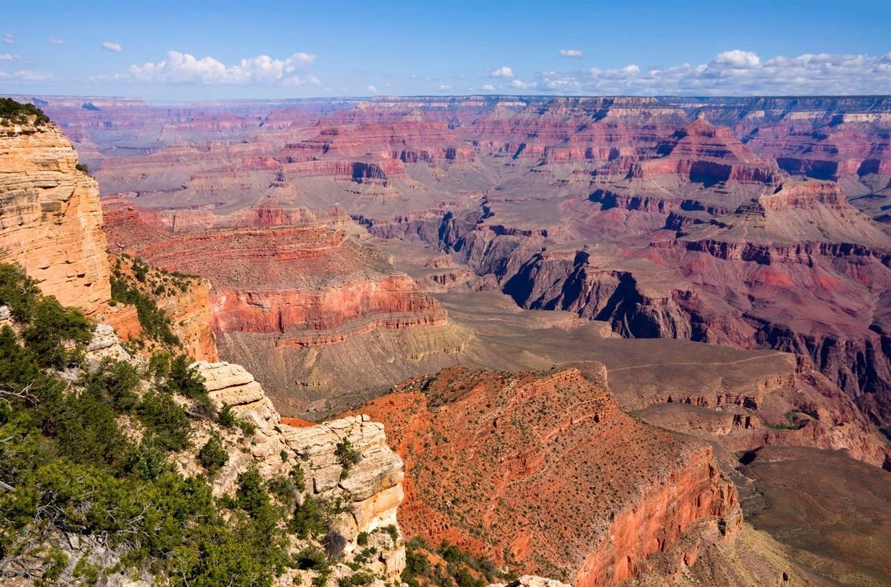
Când și cum s-au format acestea?
Notes:
Photo:121088266_Thinkstock2012_GrandCanyon.jpg
Brandie Downloaded

Slide 4
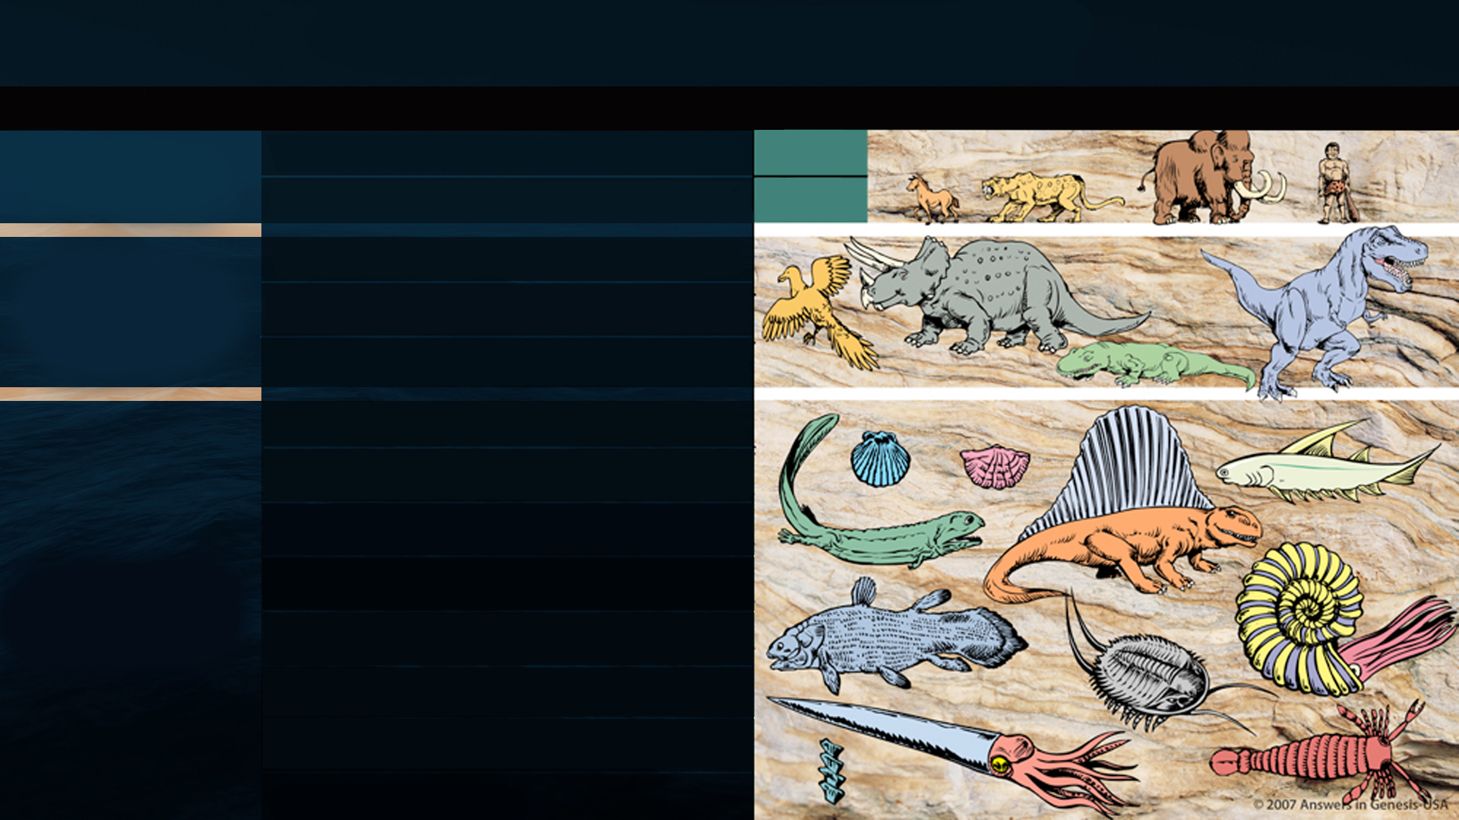
TABLA DE PERIOADE GEOLOGICE
ERA
PERIOADA
EPOCA
SUCCESIUNEA VIEȚII
CENOZOICĂ
viață recentă
CUARTENARĂ
0-1 Milion de ani
3.5 Miliarde de ani
TERȚIARĂ
62 Milioane de ani
MESOZOICĂ
viață medie
CRETACICĂ
72 Milioane de ani
JURASICĂ
46 Milioane de ani
TRIASICĂ
49 Milioane de ani
PERMIANĂ
50 Milioane de ani
PENNSYLVANIAN
30 Milioane de ani
CARBONIFERĂ
MISSISSIPPIAN
35 Milioane de ani
DEVONIANĂ
60 Milioane de ani
SILURIANĂ
20 Milioane de ani
Potrivit cu evoluția
PALEOZOICĂ
viață medie
ORDOVICIANĂ
75 Milioane de ani
CAMBRIANĂ
100 Milioane de ani
PRECAMBRIANĂ

Slide 5
Moreland
Craig
Geisler
Copan
Lennox
Hanegraaff
Koukl
Turek
Notes:
William Lane Craig, JP Moreland, Paul Copan, Norm Geisler
Sean McDowell, John Lennox, Frank Turek, Hank Hanegraaff
BIOLA and SES—schools with largest programs to train future apologists.
EITHER they openly promote the acceptance of millions of years,
OR they support people who are openly advocating millions of years and evolution.

Slide 6
Strobel
Keathley
Dembski
Collins
Zacharias
McDowell
Keller
Grudem
Erickson
Notes:
Ravi Zacharias, William Dembski, Lee Strobel, Ken Keathley, C. John Collins
Tim Keller, Sean McDowell, Wayne Grudem, Millard Erickson
EITHER they openly promote the acceptance of millions of years,
OR they support people who are openly advocating millions of years and evolution.

Slide 7
Patru Ipoteze despre Potop
Catastrofa globală istorică
Catastrofa locală istorică
Inundațiile globale potop liniștit
Mit

Slide 8
SCOPUL
Potopului
Notes:
Editable Text- Use this slide for Translations

Slide 9
Geneza 6:7, 13
7 Şi Domnul a zis: „Am să şterg de pe faţa pământului pe omul pe care l-am făcut, de la om până la vite, până la târâtoare şi până la păsările cerului, căci Îmi pare rău că i-am făcut.”
13 Atunci, Dumnezeu a zis lui Noe: „Sfârşitul oricărei făpturi este hotărât înaintea Mea, fiindcă au umplut pământul de silnicie; iată, am să-i nimicesc împreună cu pământul.”
Notes:
The underlined word is eretz, the same word translated earth in Gen. 1:1 and 2:1 and 2:4. Eretz is used 45 times in the Flood account in Gen. 6:5-9:17. The circled word is adamah, which in modern translations is rendered more accurately as “ground” or “land.” It is used only 9 times in the Flood account. In his rejection of the global Flood, OT scholar Dr. Walter Kaiser said in the Feb. 2006 John Ankerberg debates on creation that eretz is never used in the flood account, but that only adamah is used. He was seriously in error.
NASB

Slide 10
SCOPUL
Arcei
Notes:
Editable Text- Use this slide for Translations

Slide 11
Geneza 7:1–3
1 Domnul a zis lui Noe: „Intră în corabie, tu şi toată casa ta, căci te-am văzut fără prihană înaintea Mea în neamul acesta de oameni. 2 Ia cu tine câte şapte perechi din toate dobitoacele curate, câte o parte bărbătească şi câte o parte femeiască; o pereche din dobitoacele care nu sunt curate, câte o parte bărbătească şi câte o parte femeiască, 3 şi câte şapte perechi, de asemenea, din păsările cerului, câte o parte bărbătească şi câte o parte femeiască, pentru ca să le ţii vie sămânţa pe toată faţa pământului.
Notes:
NASB

Slide 13
ÎNTÂLNIREA CU ARCA
Williamstown, KY
Notes:
About 1.5 times the length and half the width
With the end zones, a football field is 360 feet (Without the end zones, a football field is 300 feet long.)
A football field is 160 feet wide

Slide 14
5000
Notes:
From Roger Patterson:
Working on a lesson on the Ark, I wanted a different comparison for the volume of the Ark. Many younger people might not be familiar with railroad cars, but there would be few who had never seen a semi-trailer. Using the large Ark (510’x85’x51’) we have a rough volume of 2,210,850 ft3. A standard 53’ semi-trailer has a volume of approximately 4,000 ft3 (4013-90 actual). This divides out to about 540–550 trailers of volume. Allowing for loss of volume in the curves, it is safe to say that the volume of the Ark was equivalent to approximately 500 semi-trailers. So, if you would like a new frame of reference for the Ark, you can use 500 semi-trailers.

Slide 15
CARACTERUL
Potopului
Notes:
Editable Text- Use this slide for Translations

Slide 16
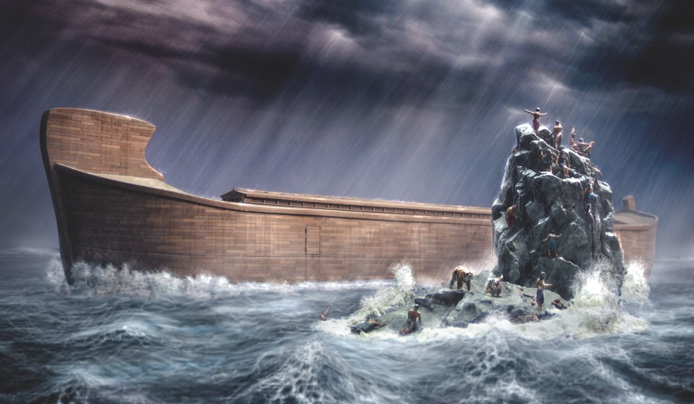

Slide 17
Geneza 7:11
În anul al şase sutelea al vieţii lui Noe, în luna a doua, în ziua a şaptesprezecea a lunii, în ziua aceea, s-au rupt toate izvoarele Adâncului celui mare şi s-au deschis stăvilarele cerurilor.
Notes:
NASB

Slide 18
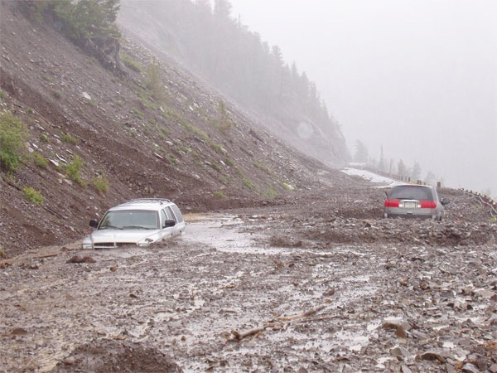
Notes:
Primary source of water was probably not rain but the fountains of great deep, because they are mentioned first in Gen. 7:11 and again in 8:2 when God closed the fountains and stopped the rains.
Mudslide in southern California, 2008: http://edstacy.blogspot.com/, accessed 22 Sept 2008

Slide 19
Geneza 7:11
În anul al şase sutelea al vieţii lui Noe, în luna a doua, în ziua a şaptesprezecea a lunii, în ziua aceea, s-au rupt toate izvoarele Adâncului celui mare şi s-au deschis stăvilarele cerurilor.
Notes:
“great deep” usually refers to ocean in OT. “fountains” implies water under high pressure and implied high temperature.
One expert geophysicist estimates there is 5x-10x as much water in the mantle of the earth (in the crystaline structure) as is on the surface of the earth (see Lou Bergeron, New Scientist Vol 155:2097, pp. 22-26, http://www.newscientist.com/article/mg15520974.900-deep-waters.html. Water is usually released in volcanic eruptions. And we have hot briny vents on the ocean floor today.
“Burst open” = 1 Hebrew verb, used in Num. 16:31 (Korah, Dathan & Abiram), Judg. 15:19 (Samson) and Zech. 14:4 (Jesus on Mt. of Olives). Earthquakes often trigger volcanoes and also tsunamis. Tsunamis caused by seaquakes can travel at speeds up to 500 mph for thousands of miles.
NASB

Slide 20
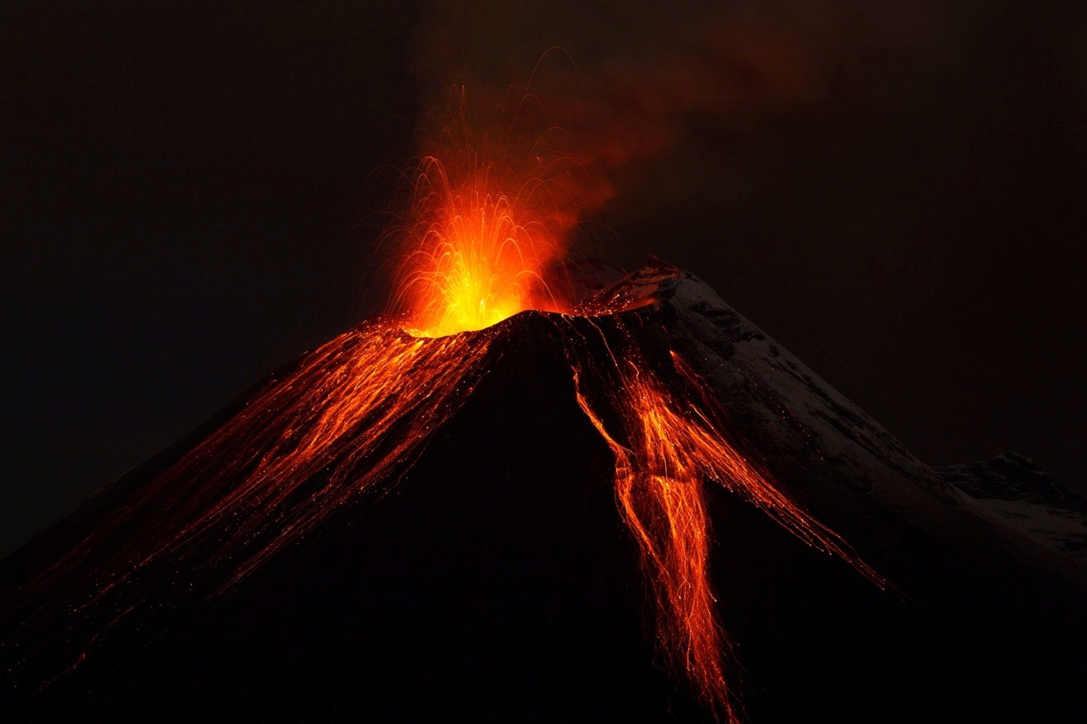
Notes:
135412113_Thinkstock2012_Volcano.jpg
Brandie Downloaded

Slide 21
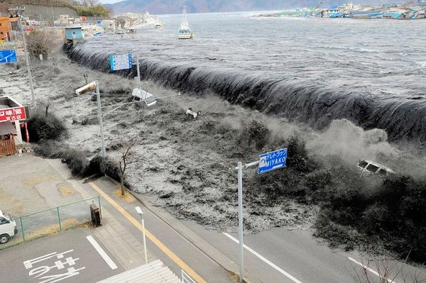
Tsunamiul din Japonia, Martie 2011
Notes:
http://news.nationalgeographic.com/news/2011/03/pictures/110315-nuclear-reactor-japan-tsunami-earthquake-world-photos-meltdown/#/japan-earthquake-tsunami-nuclear-unforgettable-pictures-wave_33291_600x450.jpg, accessed 2011 Mar 26

Slide 22
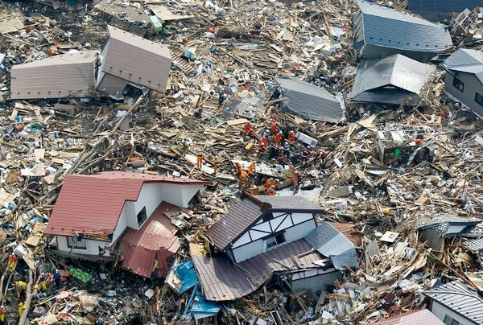
Tsunamiul din Japonia, Martie 2011
Notes:
http://news.nationalgeographic.com/news/2011/03/pictures/110315-nuclear-reactor-japan-tsunami-earthquake-world-photos-meltdown/#/japan-earthquake-tsunami-nuclear-unforgettable-pictures-wave_33291_600x450.jpg, accessed 2011 Mar 26

Slide 23
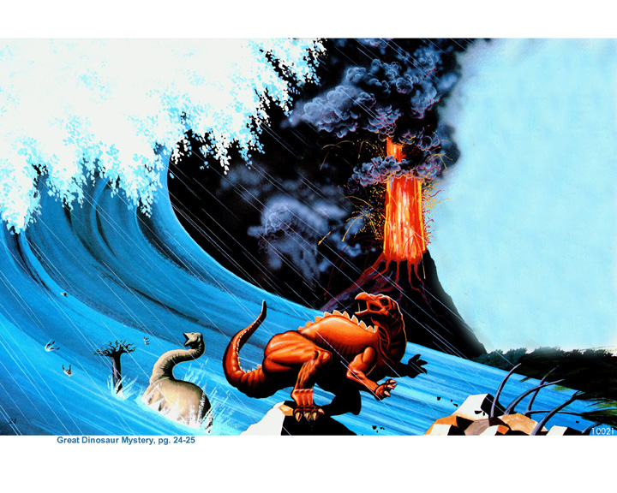
Notes:
From the book, Great Dinosaur Mystery, pp 24-25.

Slide 24
ADÂNCIMEA
Potopului
Notes:
Editable Text- Use this slide for Translations

Slide 25
Genesis 7:19–20
19 Apele au ajuns din ce în ce mai mari şi toţi munţii înalţi, care sunt sub cerul întreg, au fost acoperiţi. 20 Cu cincisprezece coţi s-au înălţat apele deasupra munţilor, care au fost acoperiţi.
Notes:
Where did the water come from? Fountains of the deep==under the ground and ocean floor. Lou Bergeron, “Deep waters,” New Scientist, 2097 (30 Aug. 1997), p. 22, reports that studies suggest that there is at least 10 times as much water in the mantle of the earth (400 km deep) as in all the oceans. Some of this water is brought to the surface in volcanic eruptions today.
Where did all water go? Into late-flood ocean basins and underground reservoirs, as we have today. Present mountains were raised in the latter part of the flood (Ps. 104:6-9 is describing the flood, not the creation of dry land on Day 3, if you study the text carefully). There are marine fossils on the tops of all the high mountains which is part of the evidence that shows that they were once horizontal sediments under the sea that were hardened into stone and later broke and tilted in the process of mountain-building.
NASB

Slide 26
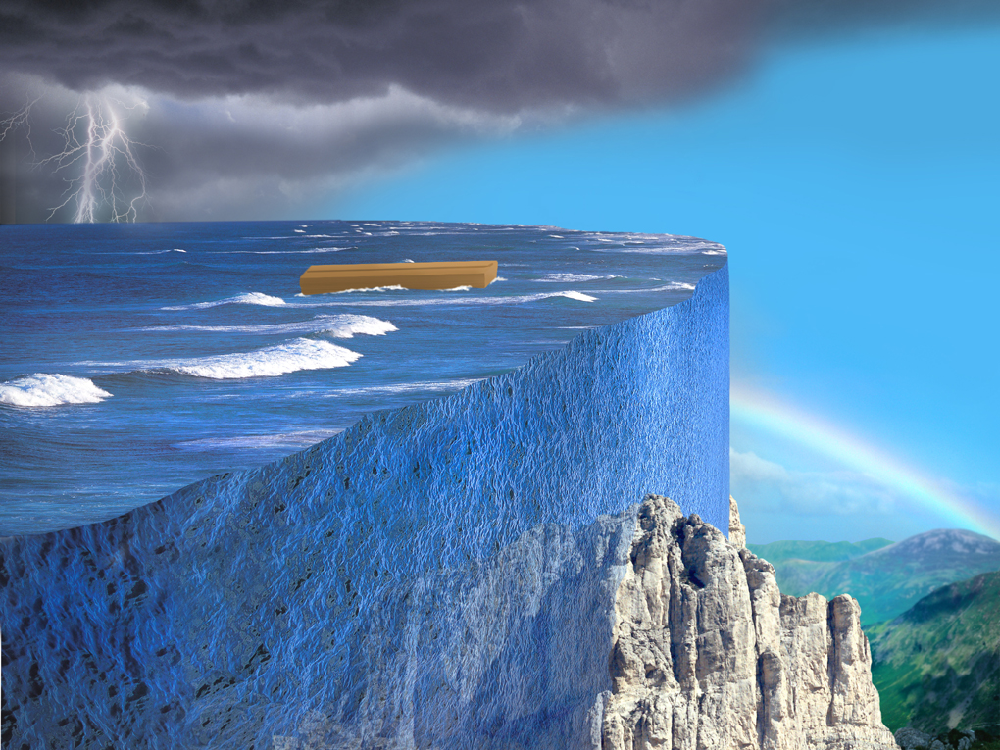

Slide 27
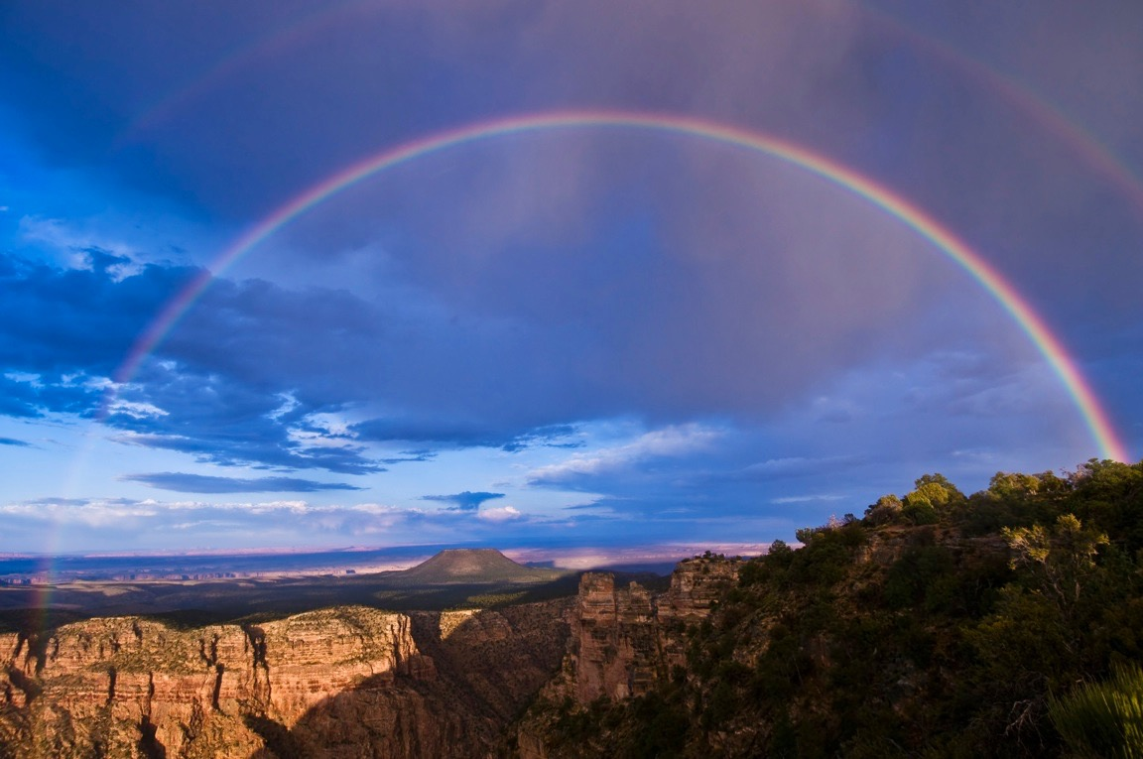
Promisiunea Curcubeului
Notes:
146953200_Thinkstock2012_GrandCanyon_Rainbow.jpg
Downloaded by Brandie

Slide 28
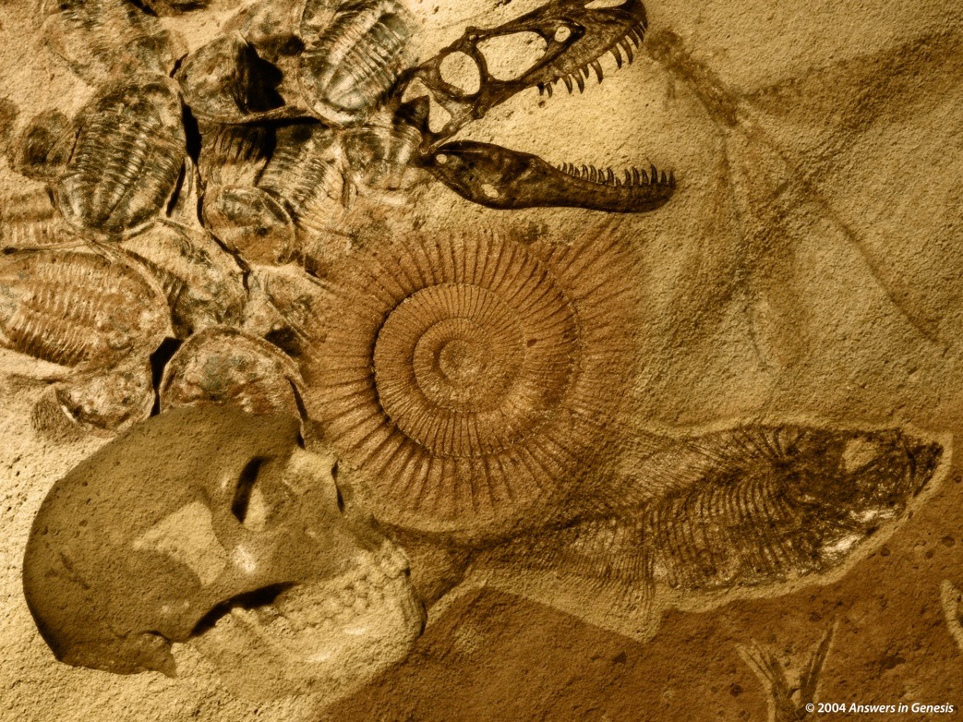
miliarde de vietăți moarte
îngropate în straturi de rocă
depuse de apă
pe întregul pământ

Slide 29
=
Milioane de ani
POTOPUL LUI NOE
MOARTE
DURERI
UCIDERI
BOLI
SPINI
LUPTE
SUFERINȚE
EXTINCȚIE
DATAREA FOSILELOR

Slide 30
CONCEPȚII DE LA ÎNCEPUTUL SECOLULUI AL 19 LEA
CU PRIVIRE LA ISTORIA PĂMÂNTULUI
Conceptul Biblic/Tradițional (Geologi Scripturali)
SSC
P
P
(ca. 6000 ani)
Conceptul Catastrofist (ex., Cuvier, Smith)
ÎS
C
C
C
C
P
(milioane de ani)
Conceptul Uniformitarian (ex., Hutton, Lyell)
ÎS?
P
(milioane de ani)
Notes:
Both old-earth views were based on naturalistic assumptions and a denial of the Word of God.
SSC = Săptămâna supranaturală a creației
P = Potop
ÎS = Început Supranatural
P = Prezent
C = Catastrofă

Slide 31
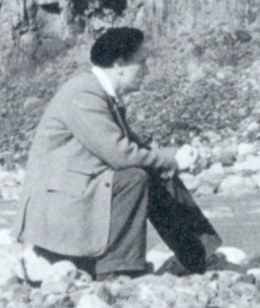
„Scuza mea pentru această lungă și amatoare abatere în istorie este că am incercat să arăt cum cred că geologia a intrat pe mâna unor teoreticieni care au fost
condiționați de situația politico-
socială a vremii mai mult decât
de observațiile făcute pe teren.”
Derek Ager, The Nature of the Stratigraphical Record (London: Macmillan, 1981), pp. 46-47.
Notes:
Derek Ager (1923-1993), Professor and Head of the Geology Dept. at University College of Swansea (Wales) from 1969-1988 and president of the British Geological Association 1988-1990, continued in “retirement” as Emeritus Professor till his death in 1993. In his life he visited over 57 countries to look at rocks and wrote 200 papers and four books, as well as many short articles for New Scientist.
Warning to YEC not to use information from his book: Derek Ager, The New Catastrophism (Cambridge, UK: Cambridge Univ. Press, 1993), p. xi. Ager says (bold in the original): “On that side too were the obviously untenable views of bible-oriented fanatics, obsessed with myths such as Noah’s flood, and of classicists thinking of Nemesis. That is why I think it necessary to include the following ‘disclaimer’: in view of the misuse that my words have been put to in the past, I wish to say that nothing in this book should be taken out of context and thought in any way to support the views of the ‘creationists’ (who I refuse to call ‘scientific’).”
In The Nature of the Stratigraphic Record, p. 20, he says:
“This is heady wine and has intoxicated palaeontologists since the days when they could blame it all on Noah’s flood. In fact, books are still being published by the lunatic fringe with the same explanation. In case this book should be read by some fundamentalist searching for straws to prop up his prejudices, let me state categorically that all my experience (such as it is) has led me to an unqualified acceptance of evolution by natural selection as a sufficient explanation for what I have seen in the fossil record. I find divine creation, or several such creations, a completely unnecessary hypothesis. Nevertheless this is not to deny that there are some very curious features about the fossil record.”

Slide 32
„Cu alte cuvinte, noi am permis să fim îndoctrinați forțat (spălați pe creier) spre a evita orice interpretare a trecutului ce implică extreme și care ar putea fi
etichetată „procese catastrofice.”
Derek Ager, The Nature of the Stratigraphical Record (London: Macmillan, 1981), pp. 46-47.
Notes:
Derek Ager (1923-1993), Professor and Head of the Geology Dept. at University College of Swansea (Wales) from 1969-1988 and president of the British Geological Association 1988-1990, continued in “retirement” as Emeritus Professor till his death in 1993.

Slide 33
Ce lipsește?
Ce a fost inițial?

Slide 34
A.
B.
C.
D.

Slide 35
Nu lipsește nimic!
Așa a fost schițat.

Slide 36
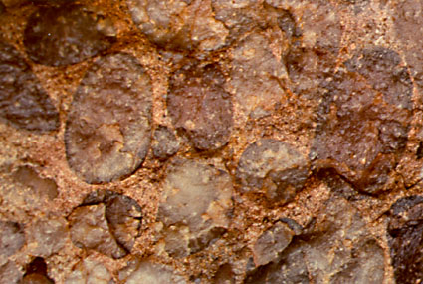
“Aceasta a fost interpretată ca și un conglomerat de bază al unei mări transgresive diacronice. S-a sugerat, având foarte puține fosile ca dovezi, că acest conglomerat are între trei până la cinci zone cu amonit, și prin urmare, până la cinci milioane de ani vechime în timp.
Cu privire la“Piatra Sutton,” un conglomerat etichetat “Jurasicul Timpuriu” în apropierea casei lui Ager din Swansea, Țara Galilor:
Eu însă cred că a fost depozitat în câteva ore sau minute.”
Derek Ager, The New Catastrophism (Cambridge: Cambridge Univ. Press, 1993), p. 120.
Notes:
He then gives his reasons for this conclusion, attributing the deposit to a hurricane or tsunami.
This is near his home, so he was well acquainted with it.
Ager was Emeritus Professor of Geology, University College of Swansea.
Conglomerate is a clastic sedimentary rock that forms from the cementing of rounded cobble and pebble sized rock fragments. Conglomerate is formed by river movement or ocean wave action. The cementing agents that fill the spaces to form the solid rock conglomerate are silica, calcite, or iron oxides.
Notice in the photo above the rounded rock particles in the conglomerate. These rounded particles make conglomerate different from breccia.
Photo: http://www.indiana.edu/~geol105/1425chap5.htm, accessed 22 April 2008
Definition of conglomerate: http://volcano.und.edu/vwdocs/vwlessons/lessons/Slideshow/Serocks/Sedrock2.html, accessed 22 April 2008

Slide 37
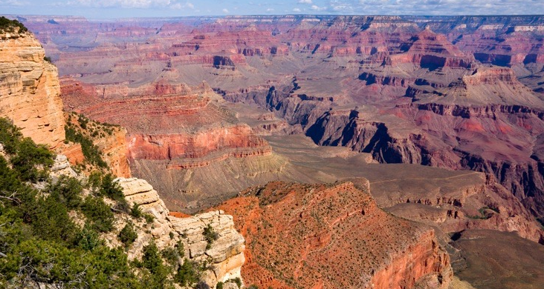
Asumare
Anti-Biblică
Asumare
Biblică
FAPTE
ROCI ȘI FOSILE
Pământ Vechi
Fără Potop Global
Pământ Tânăr
Potop Global
Notes:
147703743_Thinkstock2012_GrandCanyon.jpg
Downloaded by Brandie

Slide 38
De cât timp este nevoie pentru a face fosile?
Notes:
Editable Text- Use this slide for Translations

Slide 39
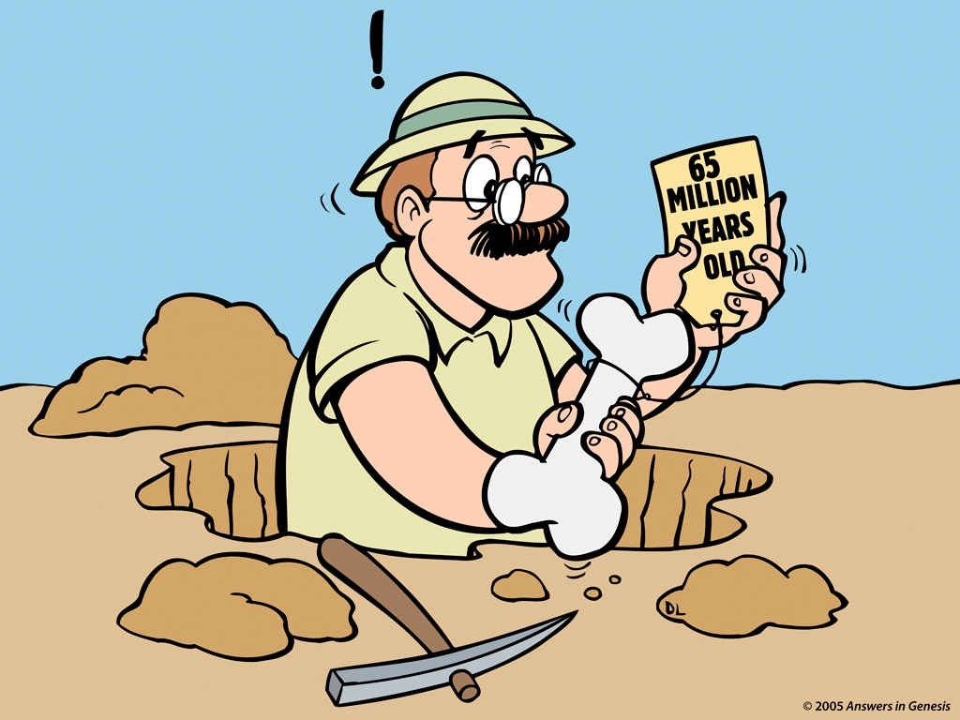
de 65 de milioane de ani?
Notes:
Revised: July 2005.

Slide 40
“Fosilizarea este un proces care poate dura
oricât de la câteva ore la milioane de ani. …
Timpul care îi ia unui os sa devină complet permineralizat este foarte variabil. Dacă apele subterane sunt foarte încarcate cu minerale, procesul poate avea loc foarte rapid. Oasele de acuma care cad în izvoare minerale pot deveni permineralizate într-un interval de doar câteva saptamâni.”
Timpul care îi ia unui os sa devină complet permineralizat este foarte variabil. Dacă apele subterane sunt foarte încarcate cu minerale, procesul poate avea loc foarte rapid. Oasele de acuma care cad în izvoare minerale pot deveni permineralizate într-un interval de doar câteva saptamâni.”
Philip J. Currie & Eva B. Koppelhus, 101 Questions about Dinosaurs (Mineola, NY: Dover Publications, 1996), p. 11.
Notes:
few hours — millions of years
matter of weeks
Groundwater heavily laden with minerals in solution

Slide 41
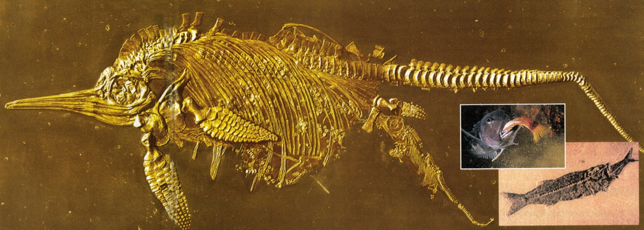
Un Ichthyosaur dând naștere
Un pește mâncând
Notes:
Creation, Vol. 23, No. 1 (Dec. 2000-Feb 2001), pp. 10-11.
Same photo (minus the fish inserts) found in Kenneth R. Miller & Joseph S. Levine, Biology (Boston, MA: Pearson Education, 2010), p. 536-37, which is on my shelf.

Slide 42
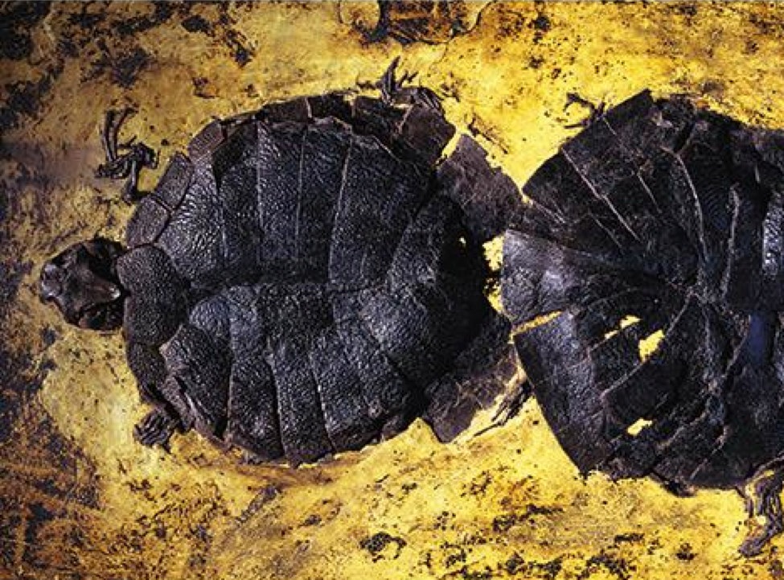
Broaște Țestoase în
reproducere
Groapa Messel, Germania
Notes:
45 mammalian species as well as reptiles, fish, insects, 43 species of birds, and a few amphibians are preserved in Messel Pit. Many of the animals are preserved intact with fur, colored feathers, or dinner in their stomachs, and nine pairs of turtles are preserved mating.
Picture and info from News to Know (AiG), 2014 Jan 4, based on Andrew Currie, Smithsonian Magazine (Jan 2014), http://www.smithsonianmag.com/travel/The-Evolutionary-Secrets-Within-the-Messel-Pit-236238851.html#Tales-Pit-turtles-473.jpg (image from: Jonathan Blair / Corbis)

Slide 43
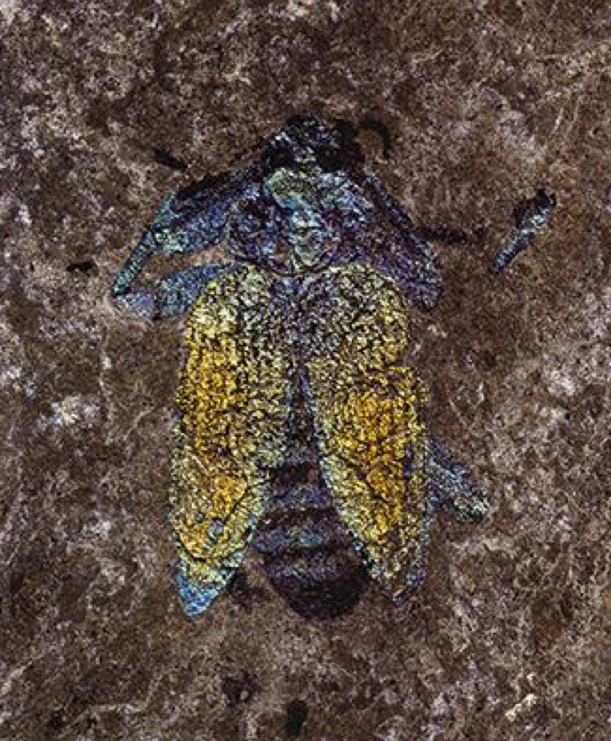
Rădască
O prezervare
incredibilă!
Groapa Messel, Germania
Notes:
45 mammalian species as well as reptiles, fish, insects, 43 species of birds, and a few amphibians are preserved in Messel Pit. Many of the animals are preserved intact with fur, colored feathers, or dinner in their stomachs, and nine pairs of turtles are preserved mating.
Picture and info from News to Know (AiG), 2014 Jan 4., IMAGE from: Berthold Steinhilber, Smithsonian Magazine, http://www.smithsonianmag.com/travel/The-Evolutionary-Secrets-Within-the-Messel-PIt-236238851.html#Tales-Pit-beetle-473.jpg

Slide 44
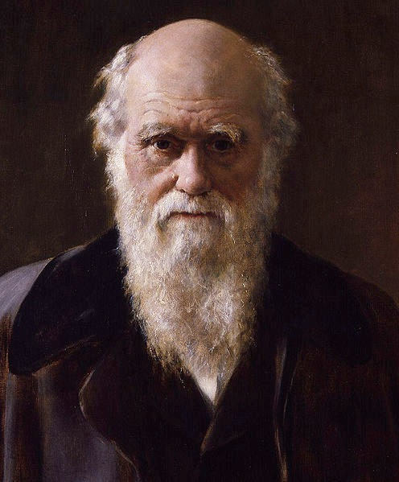
“Nici un organism în intregime moale nu poate fi conservat”
[în evidența fosilelor].
Charles Darwin, On the Origin of Species (London: Penguin Books, 1968 reprint of 1859 first edition), p. 298.
Notes:
photo: Wikimedia.org. This work is based on a work in the public domain. It has been digitally enhanced and/or modified. This derivative work has been (or is hereby) released into the public domain by its author, D. Coetzee. This applies worldwide. In some countries this may not be legally possible; if so, D. Coetzee grants anyone the right to use this work for any purpose, without any conditions, unless such conditions are required by law.

Slide 45
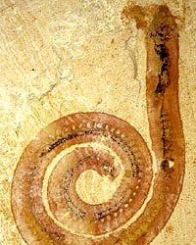
Vierme fosilizat
descoperit în China
Notes:
http://www.abc.net.au/science/articles/2004/10/27/1228791.htm, accessed 12 April 2008. The article stated that the worm was fossilized before bacteria could eat the worm.

Slide 46
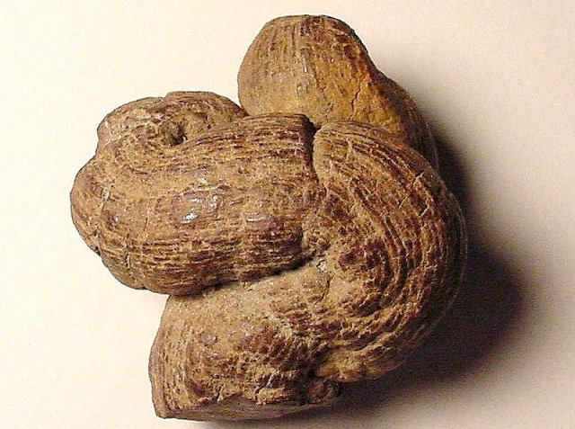
Bălegar fosilizat (Coprolit)
Notes:
“A Coprolite is the fossil that results when human or animal dung is fossilized. They are classified as trace fossils as opposed to body fossils, as they give evidence for the animal's behaviour (in this case, diet) rather than morphology. The name is derived from the Greek words κοπρος (kopros) meaning 'dung' and λιθος (lithos) meaning 'stone'. They were first described by William Buckland in 1829. … Coprolites may range in size from a few millimetres to over 60 centimetres.” Info from: http://en.wikipedia.org/wiki/Coprolite, accessed 12 April 2008
Photo: http://skywalker.cochise.edu/wellerr/fossil/coprolite/coprolite02.htm, accessed 12 April 2008. Site says that the picture is copyright free for non-commercial educational purposes.

Slide 47
Cât timp durează formarea și erodarea pietrelor?
Notes:
How long does it take to form & erode rocks?

Slide 48
“Fără a avea în vedere legile geologiei, noroiul din mlaștini se intărește ca piatra în câțiva ani mai degrabă decât în mii de ani cât durează de obicei. . . .
Eastern Daily Press (Norfolk, UK), 5 Oct. 1994, p. 7
Notes:
“Without any regard to the laws of geology, mud on the marsh is hardening into stone in a few years rather than the thousands it usually takes. . . .

Slide 49
Profesorul Coleman a spus că piatra se formeaza mult mai rapid decât cineva ar crede că e posibil,
o piatră formându-se în șase luni. ... De obicei acestea conțin fosile foarte frumos conservate, unde detaliile țesutului moale al vietății este la fel de bine conservat ca și osul, ca și cum nu a avut timp să putrezească înainte ca piatra să se formeze în jurul ei.”
Eastern Daily Press (Norfolk, UK), 5 Oct. 1994, p. 7.
Notes:
Professor Coleman said the rock was forming faster than anybody had ever believed possible,
with one stone creating itself in just six months. ... They often contain beautifully preserved fossils, where the detail of the soft flesh of the creature is caught as well as the bone, as it had no time to rot before the rock formed around it.”

Slide 50
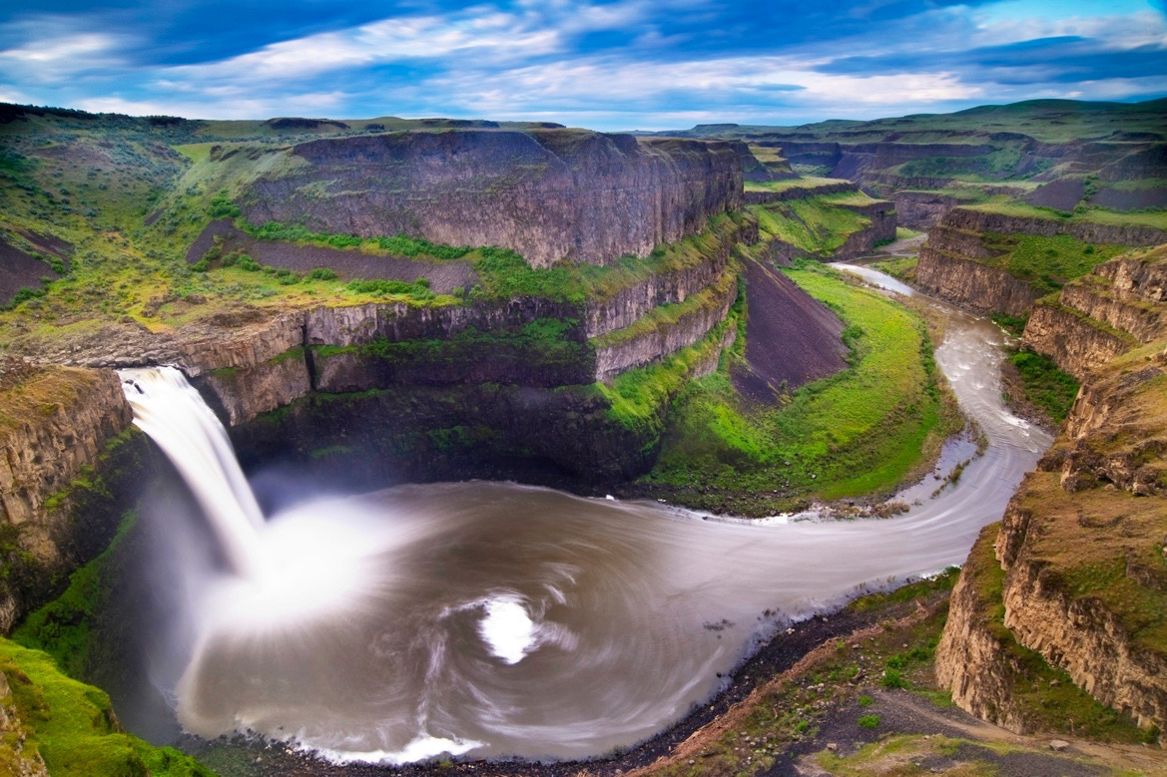
Sculptată de ape în timp de 1–2 zile și nu în milioane de ani.
Cascada Palouse
Scablands, Washingtonul Estic
15,000 mi² (39,000 km²)
Notes:
Originally thought by evolutionary geologists to have formed by stream erosion over millions of years.
Now many evolutionists believe the erosion was the result of 40-100 floods over the course of 1500-3000 years from glacial Lake Missoula to the east.
But other geologists who have carefully investigated the evidence believe most of it was eroded in 1-2 DAYS. It is estimated that 500 cubic miles of water rampaged westward at 60 mph (100 Km/hr) in a torrent flowing with ten times the volume of all the rivers on earth and carrying boulders the size of houses from Montana to Oregon.
See http://www.smithsonianmag.com/smithsonian/issues95/apr95/missoula.html and this report from a NOVA (PBS-TV) report in Mar. 2007: http://www.pbs.org/wgbh/nova/megaflood/scablands.html
Mike Oard (The Missoula Flood Controversy, Creation Research Society, 2004) believes the evidence points to 1 big flood and maybe a few smaller ones, but most of the erosional damage was done by the big one in the post-Flood glacial period.
See also this 2005 report by a YEC geologist teaching in Oregon: http://www.answersingenesis.org/docs2005/0928megaflood.asp, which argues for one major flood and that the basalt layers were deposited under water during the Genesis Flood.
Picture source--http://www.ndsu.nodak.edu/instruct/schwert/geosci/g496_columbia_plateau/g495link.htm
146769637_Thinkstock2012_PalouseFalls_ScablandsWashington.jpg, downloaded by Brandie at AiG

Slide 51
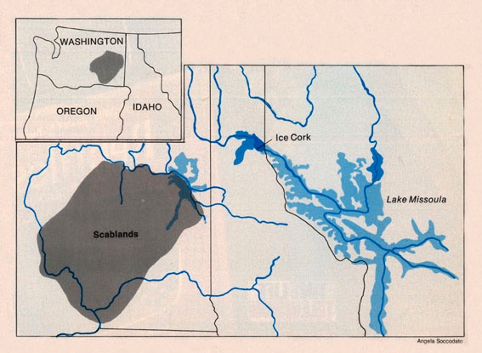
“‘Instituția,’ reprezentată de Societatea Geologică a Statelor Unite, și-a strâns rândurile în opoziție . . . În loc să testeze potopul lui Bretz pe baza meritului propriu, ei l-au respins din principiu general . . .”
Stephen Jay Gould, “The Great Scablands Debate,” Natural History, Vol. 87:7 (Aug./Sept. 1978), pp. 12, 14.
Notes:
“The ‘establishment,’ as represented by the United States Geological Society, closed ranks in opposition. . . . Instead of testing Bretz’s flood on its own merits, they rejected it on general principles . . .”
The evidence for Lake Missoula had been known since the late 1800s, but the uniformitarian geologist, Joseph Pardee, said in his published papers that it had drained slowly. Evidence suggests that he privately believed (even in 1922 before Bretz’s first paper) that the lake had burst producing a catastrophic flood, but the peer pressure of the establishment prevented him from saying so publicly.
Bretz believed that he saw evidence for 7 floods.
Glacial Lake Missoula was perched at 4,200 feet above sea level. When ice dam failed, water hundreds of meters (yards) deep swept across an area twice the size of New Jersey at freeway speed, carving giant channels through the basalt that are now dry “coulees”), depositing gravel-boulder bars over 100 meters (300 feet) high and leaving dried waterfalls that make Niagara Falls look small.

Slide 52
“Bretz a stat împotriva acestei dogme foarte restrictive care niciodată nu a avut logică: concluzia era evidentă de un secol. Charles Lyell, parintele gradualismului geologic, a reușit să înșele toata lumea științifică punând bazele doctrinei schimbării imperceptibile.”
Stephen Jay Gould, “The Great Scablands Debate,” Natural History, Vol. 87:7 (Aug./Sept. 1978), pp. 12, 14.
Notes:
Bretz’s catastrophist theory was proposed in 1923. It was accepted finally by the geological establishment in 1965.

Slide 53
Cuvântul lui Dumnezeu
este Adevărul
Ochelarii biblici
Omul decide
„adevărul”
Milioane
de ani
Milioane
de ani
Ochelarii Evoluționari
Notes:
We all have a philosophy about how evidence should be interpreted. “Oh no, not me!”
Neutrality is a non-neutral position – because it makes a positive assertion.

Slide 54
Sedimentarea Rapidă
Lipsa trăsăturilor de eroziune
Notes:
lack of erosional features

Slide 55
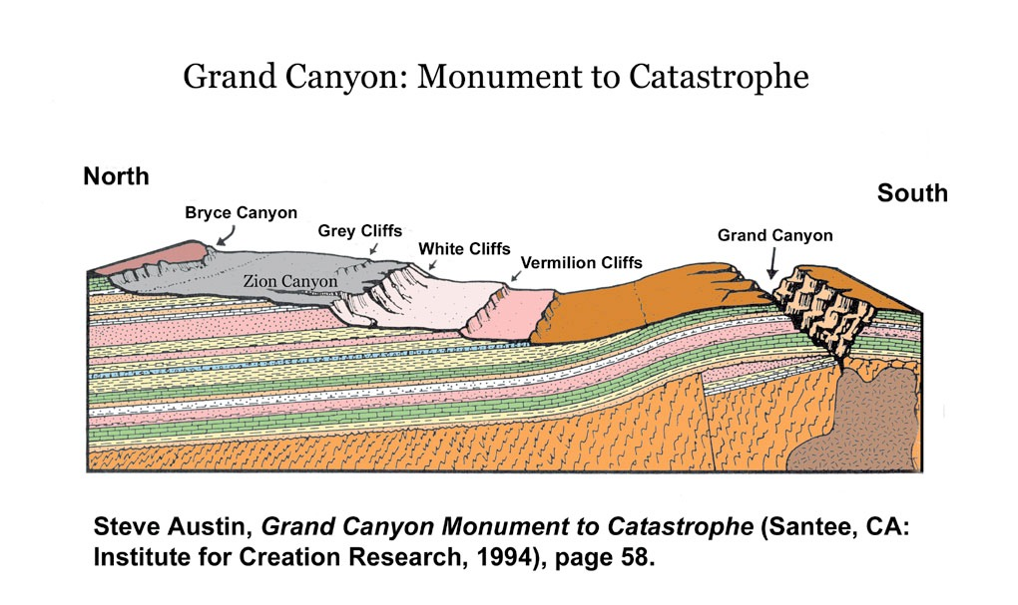
De fapt nici o trăsătură de eroziune între straturi
Trăsături masive de eroziune
300 milioane de ani
}
250 km
Notes:
The strata in the Grand Staircase above the Kaibab Limestone at the top of Grand Canyon represents, according to evolutionists, the Mesozoic and part of the Cenozoic spanning about 250-60 millions years ago.
Picture: Steven A. Austin, ed., Grand Canyon: Monument to Catastrophe (Santee, CA: Institute for Creation Research, 1994), p. 58.

Slide 56
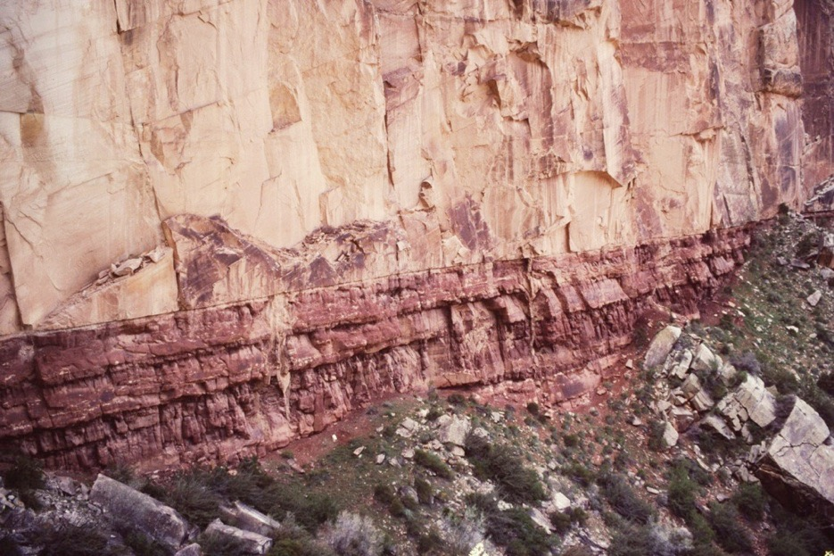
COCONINO Sandstone,
260 mdaîu
HERMIT Shale,
280 mdaîu
marginea Coconino-Hermit
marele canion, sua
Notes:
mdaîu =milioane de ani în urmă

Slide 57
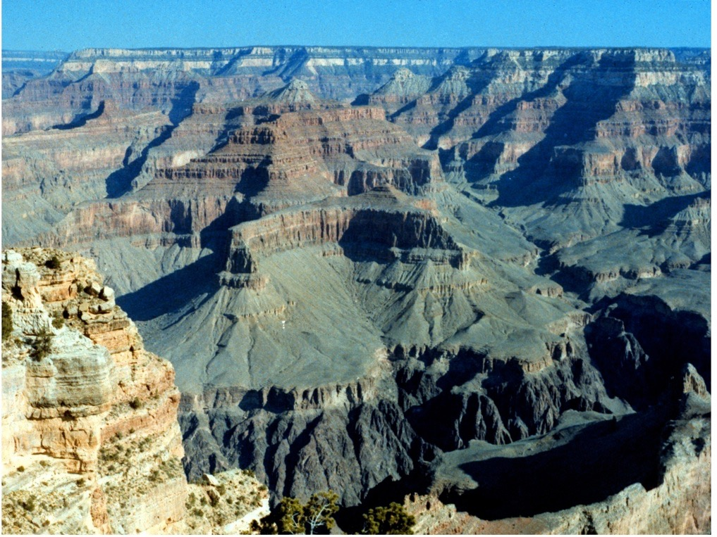
Eroziune: 1.6 Km adâncime ~5 MILIOANE DE ANI
Sedimentare: 300 milioane de ani
Notes:
Evolutionary geologists knowledgeable about Grand Canyon say it was carved in about 1 million years
Conventional reasoning based on current erosion rates say about 15 million.
The layers were deposited, according to evolutionists, over the course of about 300 million years.
Tapeats Sandstone at Great Unconformity (550 mya) to Kaibab Limestone at the top (250 mya).

Slide 58
Ceea ce observăm în mod normal

Slide 59
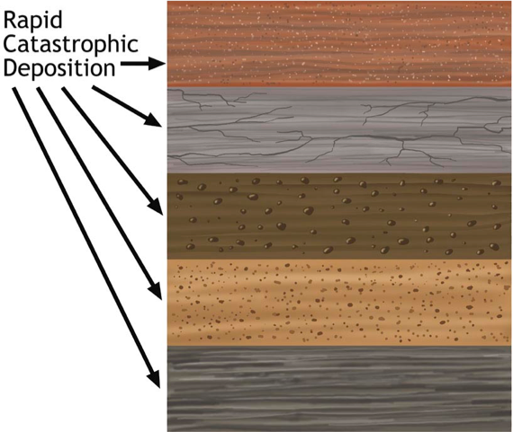
Pământ Vechi Neo-Catastrofism
Depozitări
Catastrofice
Rapide
Trecerea timpului
Trecerea timpului
Trecerea timpului
Trecerea timpului

Slide 60
Sedimentarea Rapidă
Lipsa trăsăturilor de eroziune
Deformarea sedimentelor moi

Slide 61
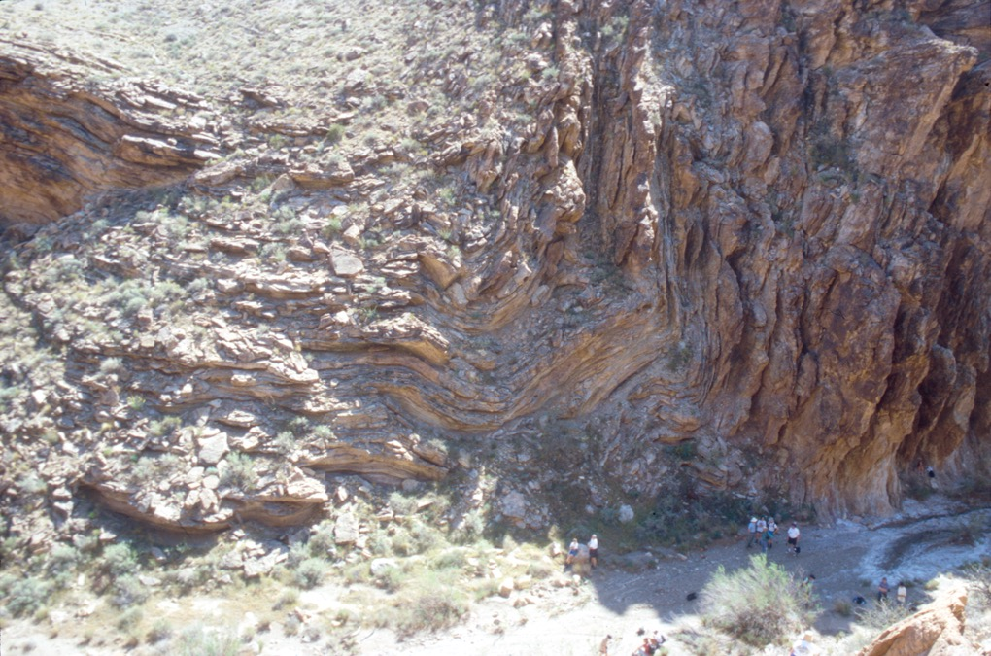
Notes:
Grand Canyon deformation—my slide *** add notes on why these could be rocks bent slowly under pressure after they had hardened, but were deformed while still relatively soft. ??? No elongation of the sand grains? No cracking of the crystals?

Slide 62
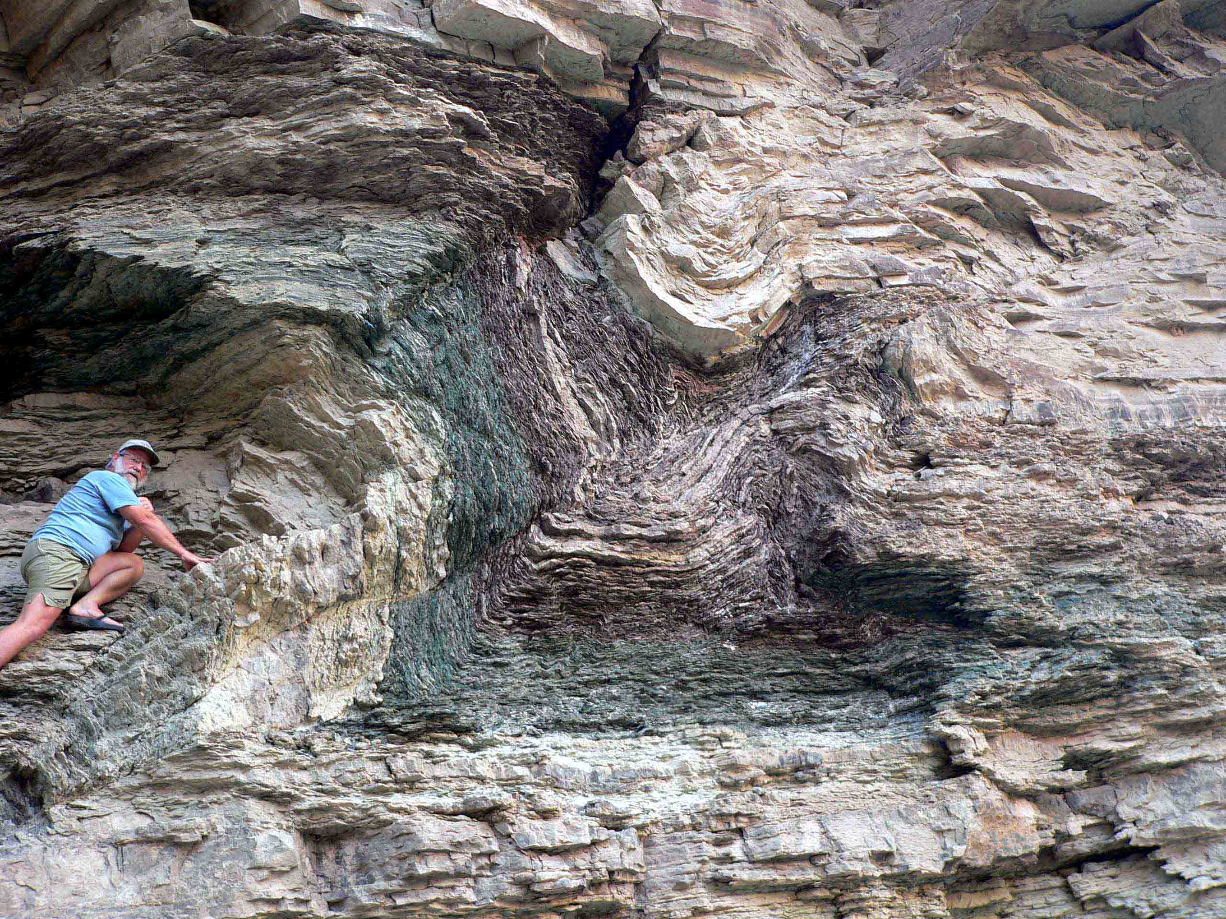
Roca Argiloasă Bright Angel, Marele Canion
Notes:
Folding in the Bright Angel Shale (dated at 530 MYA by conventional geology) that is right at the Whitmore helicopter pad where we fly out of Grand Canyon. Evolutionists tell us that under heat and pressure solid rocks will bend. But in this case the rock gets metamorphosed, which this shale is not. The evidence says this was wet and relatively soft and plastic when it was bent.

Slide 63
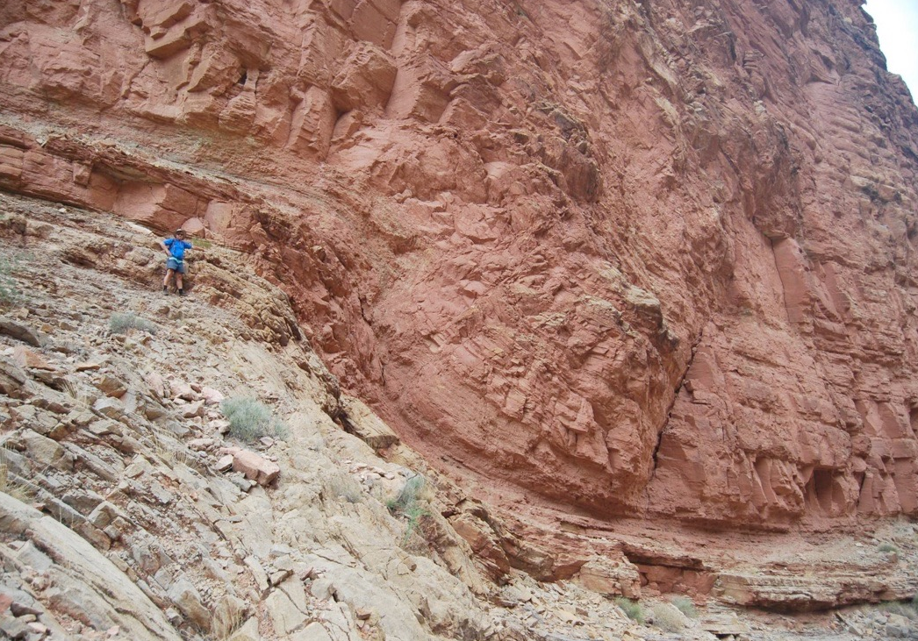
Lipsesc 120 de milioane de ani!
“385 milioane de ani”
“505 milioane de ani”
Notes:
Andrew Snelling in picture, who gave it to me.
Temple Butte Limestone is Devonian, Muav Limestone is middle Cambrian.
Dates from http://3dparks.wr.usgs.gov/coloradoplateau/lexicon/templebutte.htm and http://en.wikipedia.org/wiki/Geology_of_the_Grand_Canyon_area, accessed 2012 Feb 29, has
This fold is right near Matkat Camp, where we usually try to camp on CLTs.

Slide 64
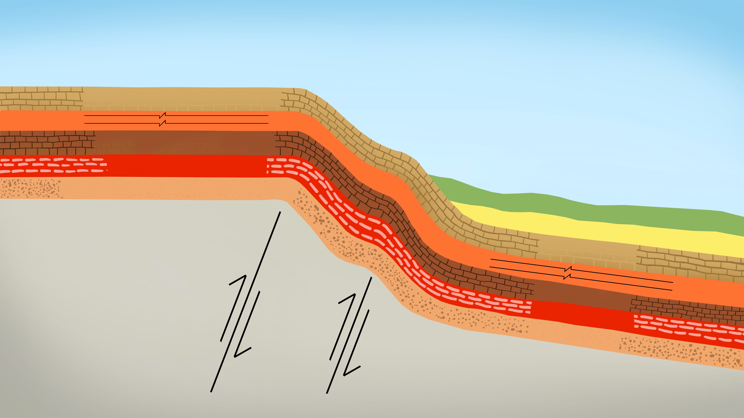
Kaibab Upwarp
Secțiunea geologică tăiată
în Marele Canion
arată tranziția monoclină
și Podișul Kaibab
Calcar Kaibab 250 mdaîu
Calcar Muav
Roca Argiloasă Bright Angel
Gresia Tapeats 520 mdaîu
Șisturi și Graniți
Kaibab
270 mda
Muav
Bright Angel
Tapeats
70 mda
Notes:
Kaibab Upwarp (Podișul Kaibab)
mdaîu =milioane de ani în urmă
mda=milioane de ani
Don’t translate the names of the rock layers or “Kaibab Upwarp"
my = millions of years mya = millions of years ago
70 million years ago is when evolutionists say the upwarp occurred, 180 million years after the Kaibab Limestone formed and 450 million years after the Tapeats Sandstone formed!
North rim (highest point is 8500 ft) is on average 1000 ft higher in elevation than the south rim.
Source: John Morris, The Young Earth (Master Books, 1994), pp. 107-8.

Slide 65
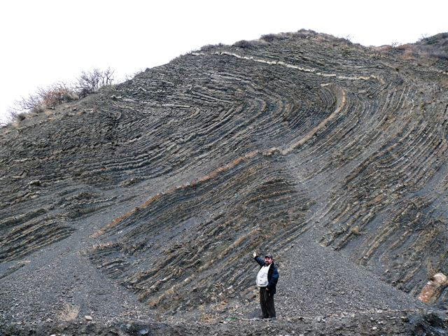
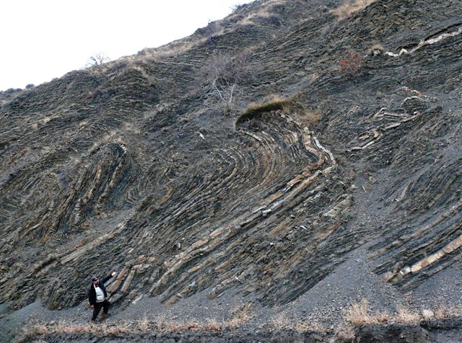
Rocă argiloasă îndoită și straturi de calcar
Crimeea, Ucraina
Notes:
Dr. Sergei Golovin wrote (when he sent me the pictures):
Evolutionists have explained the origin of flysch (a gritstone alternating with shale layers) by multiple catastrophes. A brief single catastrophe deposited each layer of sand which over time turned into a gritstone (light lines on the pictures). But an extended period between two catastrophes left a layer of clay which turned into shale (dark lines on the pictures). Though all the layers were originally horizontal, tectonic pressure bent the segmentary layers. Such inclined and bent flysch is pretty common all over the earth.
Creationist view: Nevertheless the flysch folds we explored are an obvious proof that all those layers were deposited at the same time and the tectonic pressure was applied to them very soon afterwards - they all were still plastic (just clay and sand) or they would cracked otherwise.

Slide 66
Sedimentarea Rapidă
Lipsa trăsăturilor de eroziune
Deformarea sedimentelor moi
Lipsa deranjamentelor de viață (biologice) la suprafață
Notes:
lack of life disturbance at between layers

Slide 67
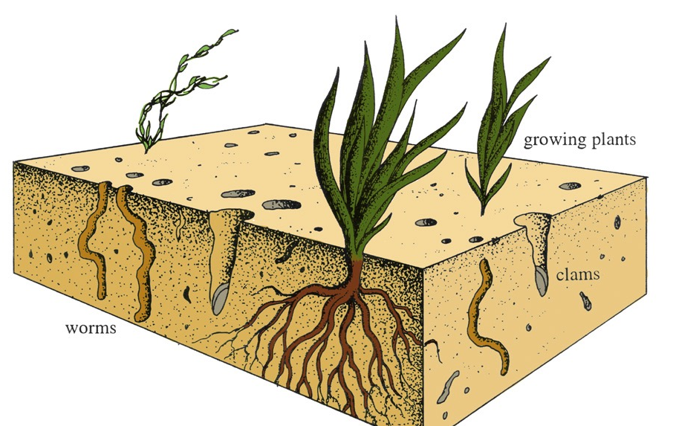
Ecologia vieții de pe fundul oceanului
plante în creștere
viermi
Notes:
John Morris, The Young Earth. This is very rarely seen or where it is, it is reasonable to imagine that the evidence in the particular rock formation could have been caused by animal life in a matter or hours, days or weeks during the alternating periods of calm and violence at this location, rather than being evidence of thousands or millions of years.

Slide 68
Sedimentarea Rapidă
Lipsa trăsăturilor de eroziune
Deformarea sedimentelor moi
Lipsa deranjamentelor de viață (biologice) la suprafață
Urme de valuri, urme de animale și urme de ploaie
Notes:
Ripple marks, animal tracks, raindrop marks

Slide 69
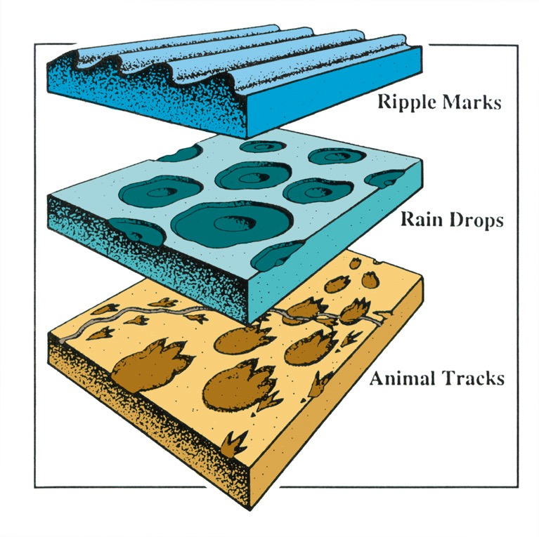
Urme de valuri
Urme de picături
de ploaie
Urme de animale
Notes:
Evidence that animal tracks were made under water, not air (as previously thought), in Grand Canyon, Coconino Sandstone: http://www.answersingenesis.org/home/area/magazines/docs/v15n1_grandcanyon.asp

Slide 70
Sedimentarea Rapidă
Lipsa trăsăturilor de eroziune
Deformarea sedimentelor moi
Lipsa deranjamentelor de viață (biologice) la suprafață
Urme de valuri, urme de animale și urme de ploaie
Fosile polistrate (în mai multe straturi)
Notes:
polystrate fossils

Slide 71
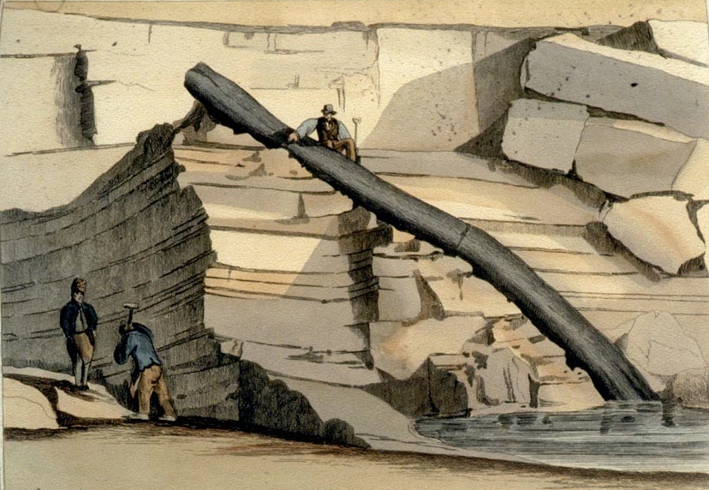
Cariera de piatră Craigleith lângă, Edinburgh, Scoția 1826
Notes:
My slide
This tree was found in 1826 in Craigleith quarry near Edinburgh, Scotland, in a 200-ft thick mass of alternation sandstone and shale.
The in-situ (autochthonous) and transport (allochthonous) theories were much debated from the 1820s to the early 1840s, though even Buckland said in 1840 that he only knew of a few trees that looked in-situ.

Slide 72
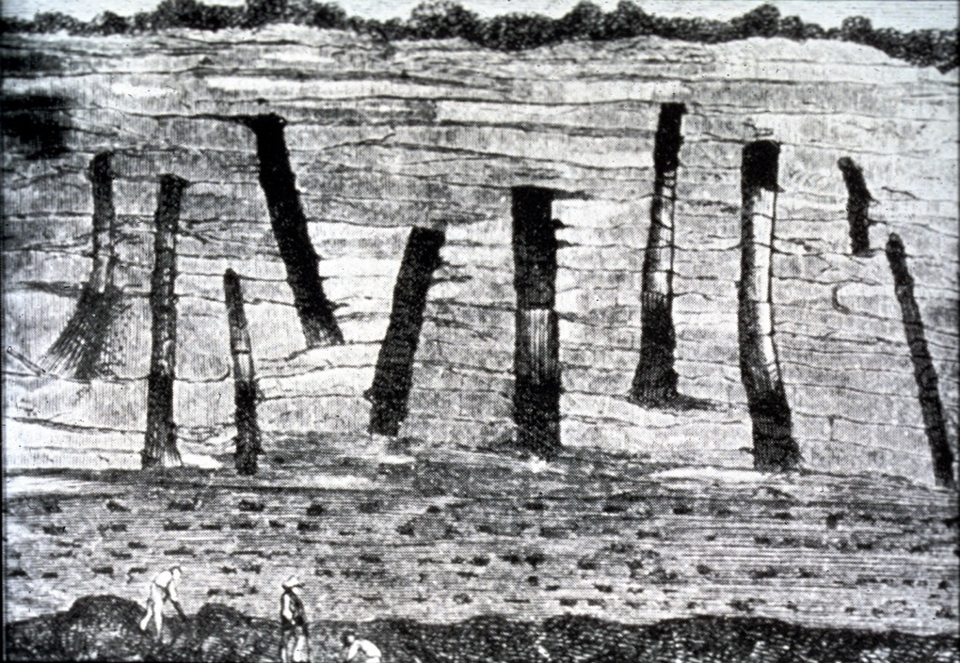
Saint-Etienne, Franța
Notes:
My slide
This is a picture of a cliff near Saint-Etienne, France, in the early 19th century. The drawing must be from about that time.

Slide 73
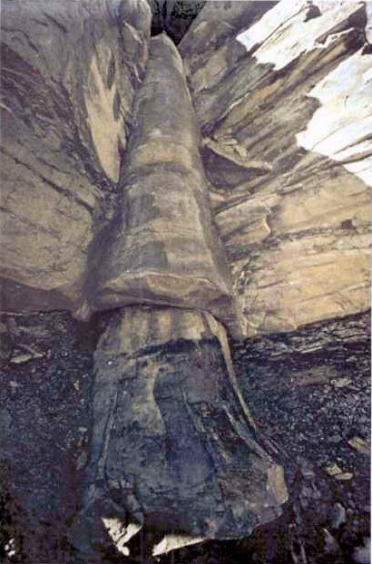
}
Strat de cărbuni
Calcar
Mina Kettle Coal Cookeville, TN, SUA
}
Strat de cărbuni
Photo: D.Patton

Slide 74
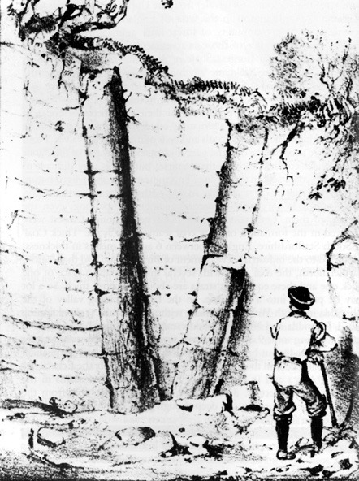
“Este clar că sedimentarea a trebuit să fie foarte rapidă ca să ingroape copacii în picioare înainte de a se putrezi și de a cădea jos.
... noi nu putem să pierdem din vedere concluzia că sedimentarea a fost cânva într-adevăr foarte rapidă și că în alte instanțe au existat pauze lungi în procesul de sedimentare, cu toate că se vede uniform și continuu.”
“În poziție de
creștereș”
Derek Ager, The New Catastrophism (Cambridge: Cambridge U. Press, 1993), pp. 48-49.
Notes:
“Obviously sedimentation had to be very rapid to bury a tree in a standing position before it rotted and fell down. ... we cannot escape the conclusion that sedimentation was at times very rapid indeed and that at other times there were long breaks in sedimentation, though it looks both uniform and continuous.”
Note the text under the picture (both appear on p. 48). Those trees are not in position of growth for they were not buried gradually as they grew and a catastrophe that laid down that much sediment would not leave the trees standing. Furthermore such polystrate trees never have any branches or roots. What kind of trees grow like that?

Slide 75
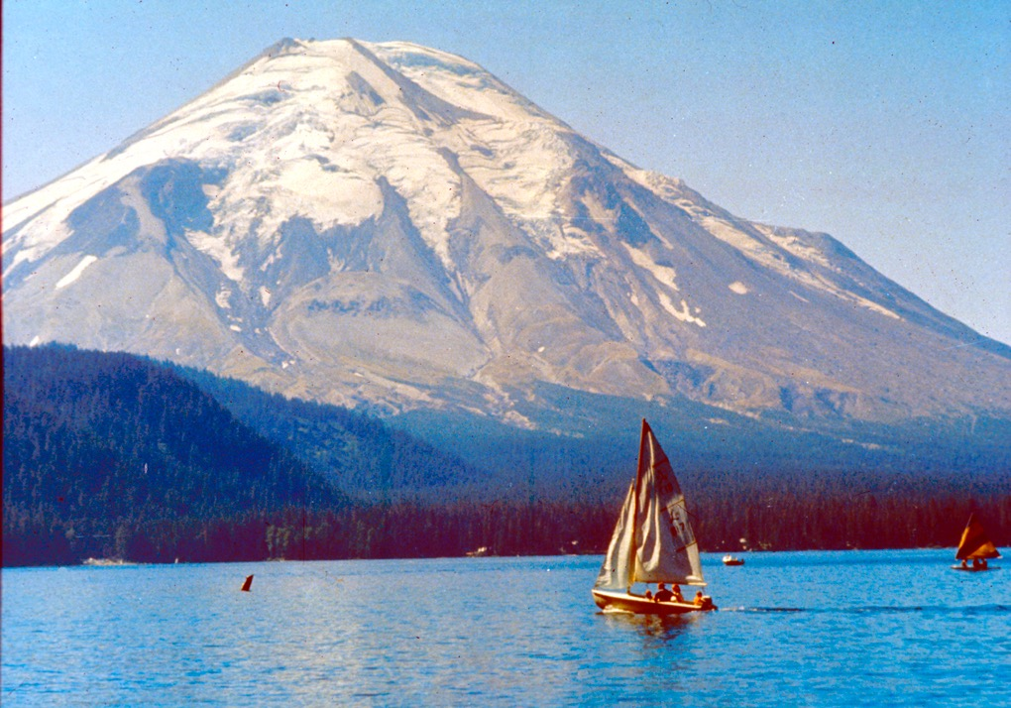
Muntele
Sf. Elena, Statul Washington,
SUA
Mai, 1980

Slide 76
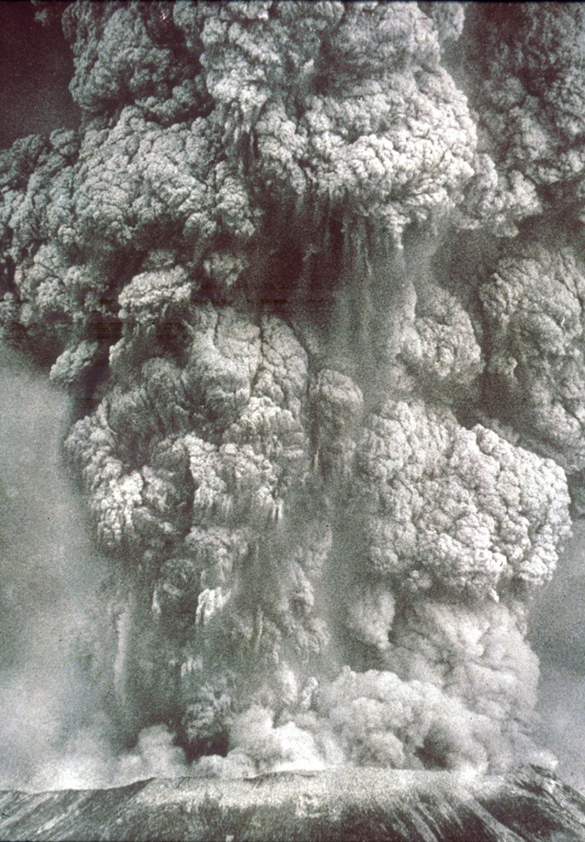
erupție
8:30 am,
18 Mai 1980
Notes:
The initial eruption released energy equivalent to 20 million tons of TNT.
Over the next 9 hours, 440 million tons of TNT (or 1 Hiroshima A-bombs per second for 9 hours) and threw ash 70,000 ft (2 km) into the upper atmosphere

Slide 77
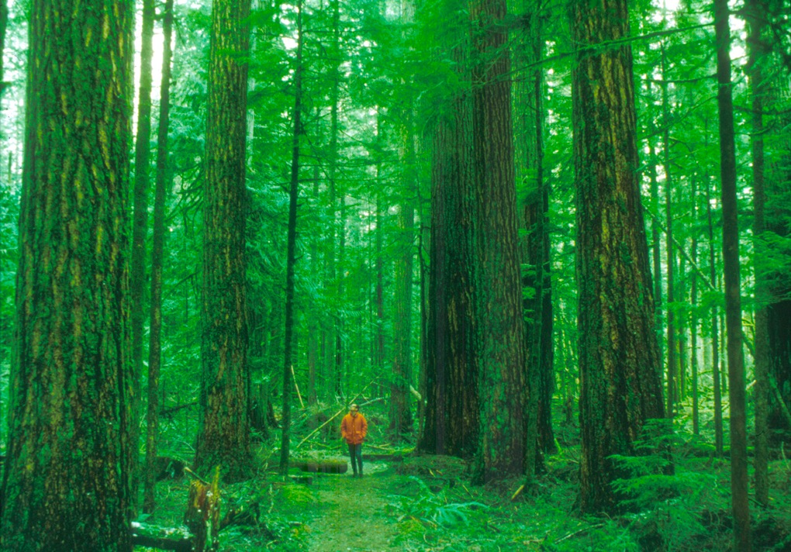
(400 km²)
Notes:
In 6 minutes a virgin forest about 150 mi² (400 km²) was mowed down.

Slide 78
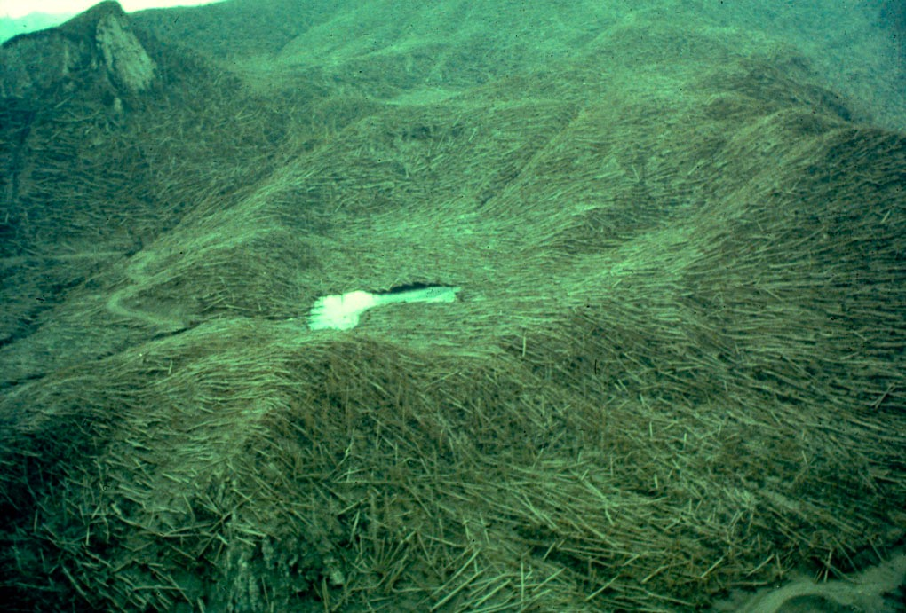
(6 minute)
Notes:
Hurricane wall of steam and ash reduced the trees to toothpicks, enough wood to make 640,000 American-style, three-bedroom houses.

Slide 79
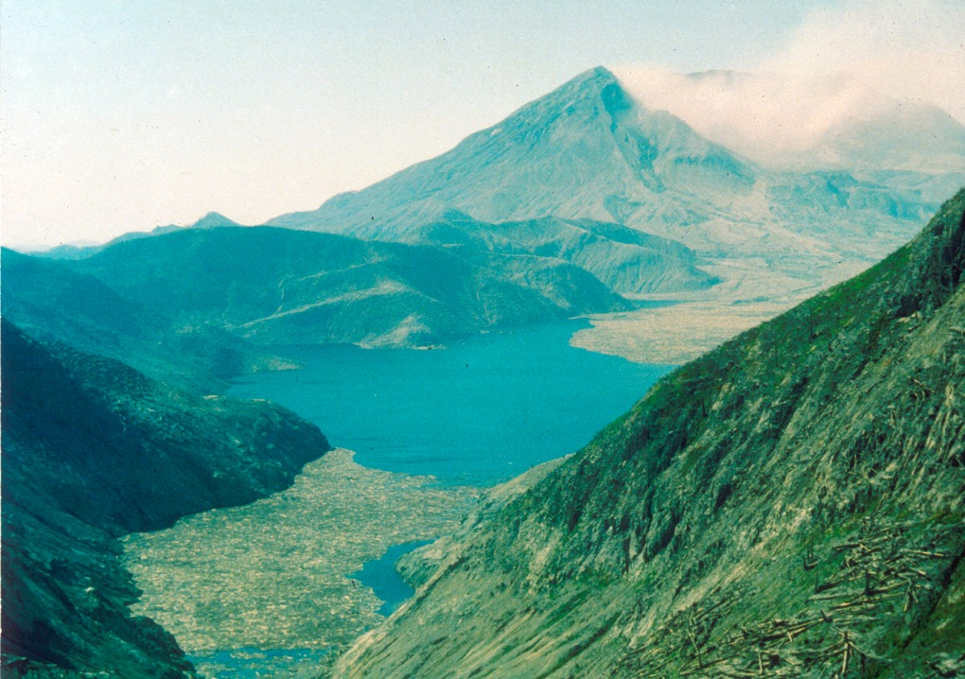
Notes:
Massive landslide went into Spirit Lake (north of the volcano) and up the opposite shore ~800 ft (250 m) in elevation and ripped down about 1 million trees. Most of the trees were floating in a prone position but many were in an upright position. Over the next 10 years about half the logs were deposited on the lake bottom.

Slide 80
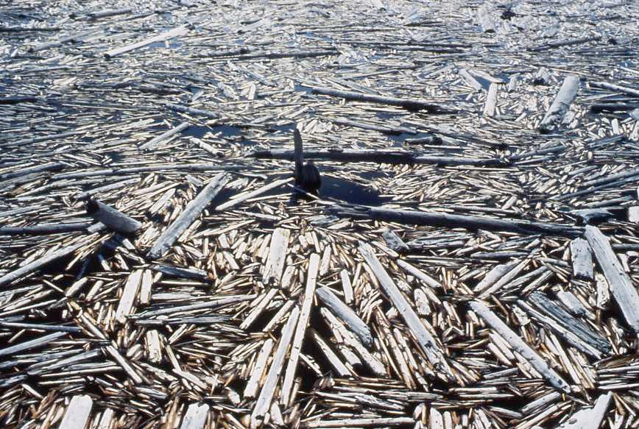
Notes:
Steve Austin slide #55

Slide 81
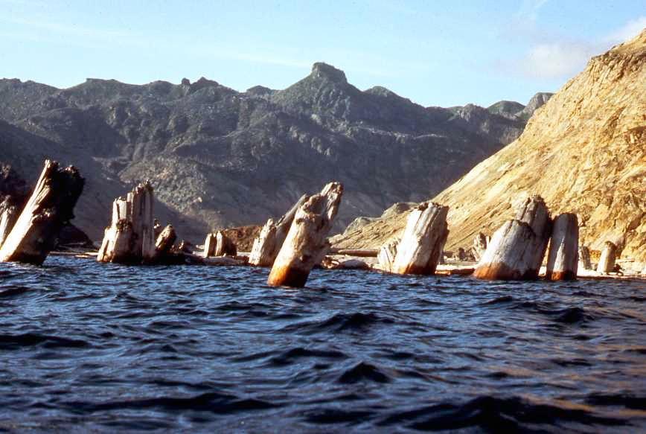
Notes:
Steve Austin slide #56

Slide 82
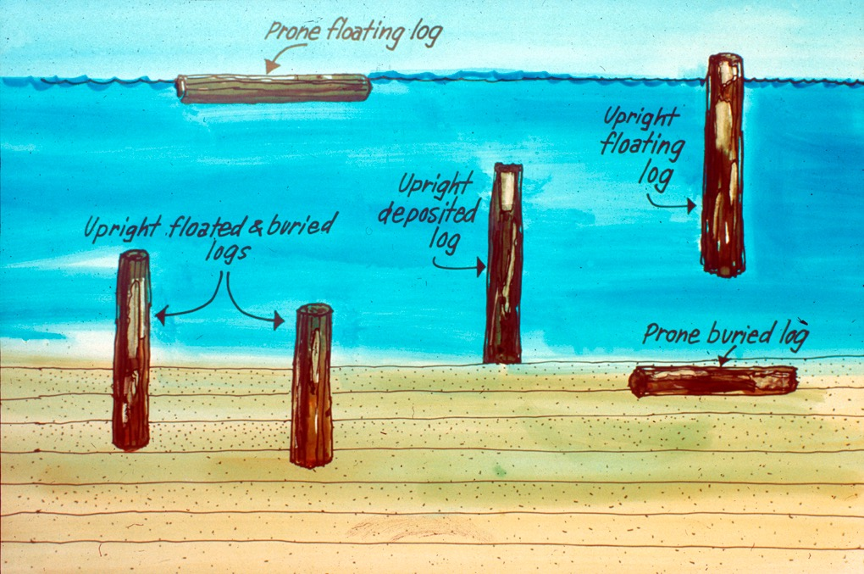
buștean plutitor întins orizontal
buștean
plutitor
vertical
bușteni
plutitori cu
picioarele
îngropate
buștean
depozitat
vertical
buștean
îngropat orizontal
Notes:
Sonar showed that an estimated 20,000-40,000 upright logs were deposited (with many more prone logs) on the lake bottom by 1985 (three years after explosion). They are deposited with the root end down, as if they grew in place.

Slide 83
Sedimentarea Rapidă
Lipsa trăsăturilor de eroziune
Deformarea sedimentelor moi
Lipsa deranjamentelor de viață (biologice) la suprafață
Urme de valuri, urme de animale și urme de ploaie
Fosile polistrate (în mai multe straturi)
Depozite de bazalt masive

Slide 84
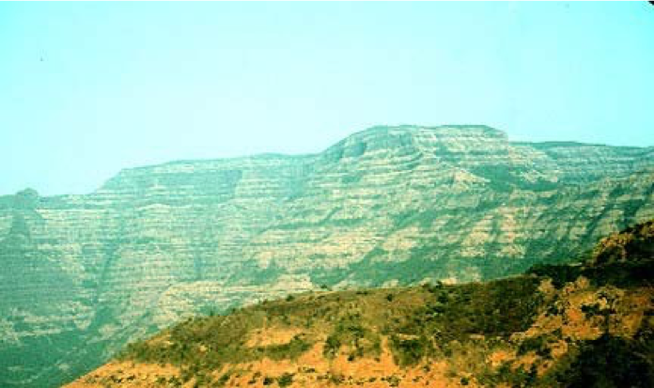
Deccan Traps, India
Grosimea: până la to 2000 m
Suprafața: 500,000 km² (mărimea Franței)
Volumul: 512,000 km³ (cf. Mt. Sf. Elena: 1 km³)
Notes:
Thickness: 6500 ft (2000 m)
Area: 200,000 mi² (size of France, 4/5 size of Texas) (500,000 km²)
Volume: 123,000 mi³ (512,000 km³) (cf. Mt. St. Helens: 0.24 mi³ or 1 km³)
Creationist view: formed during the Flood about the time of the deposition of the Coconino Sandstones in Grand Canyon
Some evolutionists believe this was the cause of the extinction of the dinosaurs (not the Chicxulub asteroid impact in Mexico’s Yucatan Peninsula). See Becky Oskin, “New Dates Tie volcanic Flood to Dinosaur Extinction,” http://www.livescience.com/49097-lava-flows-led-dinosaur-extinction.html, 11 Dec. 2014, accessed 12 Dec. 2014.

Slide 85
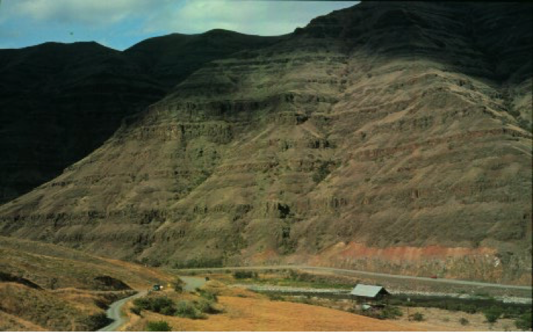
Bazaltul Grande Ronde, Columbia River Basalt Group
Cuprinde porțiuni din cinci state din vest în SUA
GRB acopere 85% din suprafața CRBG: 263,000 km²
Volumul GRB: 149,000 km³
Notes:
The Columbia River Basalt Group is a large igneous province that lies across parts of the Western United States. It is found in the U.S. states of Washington, Oregon, Idaho, Nevada, and California. The Basalt group includes the Steen and Picture Gorge basalt formations.
GRB covers 85% of the CRBG area: 63,000 mi²; GRB Volume: 35,750 mi³
The Grand Ronde Basalt of the Columbia River Basalt Group. Thick stacks of laterally extensive lava flows typify this flood basalt province.
Creationist view: formed in early decades of post-Flood period.
“Almost everything about this volcanic province is impressive. The Columbia River Flood Basalt Province forms a plateau of 164,000 km² between the Cascade Range and the Rocky Mountains. In all, more than 300 individual large (average volume 580 cubic km³!) lava flows cover parts of the states of Idaho, Washington, and Oregon. At some locations, the lava is more than 3,500 m thick. The total volume of the volcanic province is 175,000 cubic km. Eruptions filled the Pasco Basin in the east and then sent flows westward into the Columbia River Gorge. About 85% of the province is made of the Grande Ronde Basalt with a volume of 149,000 cubic km (enough lava to bury all of the continental United States under 12 m of lava!) that erupted over a period of less than one million years. Flows eventually reached the Pacific Ocean, about 300 to 600 km from their fissure vents. The Pomona flow traveled from west-central Idaho to the Pacific (600 km), making it the longest known lava flow on Earth (the major- and trace-element compositions of the flow do not change over its entire length).”
My comment: given this uniform composition, it couldn’t have happened over a million years.
Photo (by Thor Thordarson) and description: http://volcano.und.nodak.edu/vwdocs/volc_images/north_america/crb.html, downloaded 26 Oct 2004

Slide 86
Ce putem spune despre metodele de datare pe baza carbonului și alte metode de datare radioizotropice?
Notes:
What about carbon dating and other radioisotope dating methods?

Slide 87
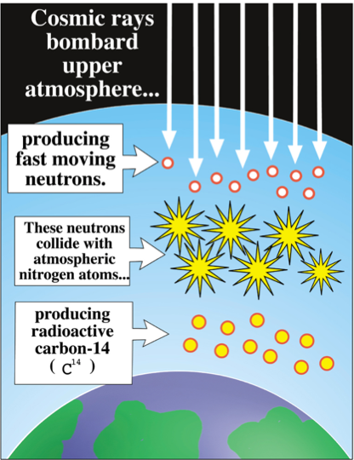
Razele cosmice bombardează atmosfera superioară
Producerea carbonului-14(¹⁴C)
producând o mișcare rapidă a neutronilor
Acești neutroni se ciocnesc cu atomi de nitrogen atmosferic
producând carbon radioactiv
( ¹⁴C )
Notes:
What would have caused pre-Flood or post-flood Ice Age animals and plants to have less C-14 than modern creatures? Possible answer: since the earth’s magnetic field is decaying, it would have been stronger around the time of the Flood, shielding more of the high-energy cosmic rays that convert nitrogen atoms to C-14 in the upper atmosphere.
New evidence of unreliability of C-14 dating: http://www.pnas.org/content/early/2015/07/15/1504467112, 15 July 2015.

Slide 88
¹²C
¹⁴C

Slide 92
La moarte captarea de carbon
SE
OPREȘTE!

Slide 93
¹⁴C în os la momentul morții
Cantitatea de ¹⁴C descrește în timp
Mulți ani mai târziu

Slide 94
ÎN TIMPUL
¹⁴C
VIEȚII
¹⁴C Pierdere prin descompunere
¹⁴C Creștere
MOARTE
¹⁴C
¹⁴C Pierdere prin descompunere
Fără creștere

Slide 95
Carbonul total într-un specimen
¹⁴C (Cantitatea devine mai mică în timp)
Viu
MOMENTUL MORȚII
VECHI
MAI VECHI
VÂRSTĂ
NECUNOSCUTĂ
¹²C
¹²C
¹²C
¹²C
¹²C
¹⁴C
¹⁴C
Radio-carbon
nemăsurabil
¹⁴C
¹⁴C
¹⁴C

Slide 96
„Vârsta” rocilor care conțin diamantele: bazată pe datarea cu K/Ar):
1–2 miliarde de ani
„Vârsta” a 12 diamante bazată pe datarea de C-14: 58,000 de ani
Notes:
crystal structure of diamonds prevents recent contamination with ¹⁴C
Source: www.icr.org/pdf/research/AGUC-14_Poster_Baumgardner.pdf (American Geophysical Union Conf., Dec 2003 poster; five diamonds). While the poster presentation at the AGU conference documents five diamonds dated by 14C, seven more have since been C-dated, according to March 2005 personal communication between Dr. Don Batten (AiG) and Dr. Russ Humphreys (an ICR co-researcher with Dr. Baumgardner).
Photo of Macles diamonds from the Argyle pipe, Western Australia (these are not the ones dated) from: http://volcano.und.nodak.edu/vwdocs/minerals/diamonds.html ‘courtesy of Grand Boxer’.

Slide 97
Evoluționiști:
Eocene 36-57 mdaîu
„Vârsta” C-14”
în toate exemplarele
<70,000 de ani!
Cretaceous 66-144 mdaîu
Pennsylvanian 286-320 mdaîu
Notes:
mdaîu = milioane de ani în urmă
C-14 is found in organic samples throughout the phanerozoic (Cambrian to Quarternary)—all but the youngest organic material shows C-14 evidence of being buried contemporaneously, much less that 250,000 years ago. There is also evidence that some C-14 is primordial—that is, it was not produced by cosmic ray bombardment of nitrogen in the upper atmosphere, but was part of the original creation.

Slide 98
Izotopi Radioactivi
Perioadă de
înjumătățire
Părintele
Fiica
K-40
U-238
Rb-87
1.3 miliarde de ani
4.5 miliarde de ani
49 miliarde de ani
Ar-40
Pb-206
Sr-87
C-14
5730 de ani
N-14

Slide 99
Părintele: Uraniu
Fiica: Plumb
Perioadă de înjumătățire = 4.5 miliarde de ani

Slide 100
Datare Radiometrică
Părintele
Fiica

Slide 101
Presupunerile datării radiometrice
Părinte
?
?
?
?
Fiică
?
Raport
original?
Rata de descompunere?
Adăugat sau scos?

Slide 102
Muntele
Sf. Elena, Statul Washington,
SUA
Mai, 1980

Slide 103
Dom
de
lavă
Notes:
A lava dome started forming soon after the eruption. The first two domes were blown away by subsequent smaller eruptions in 1980. The present dome started forming in late October 1980 and continues growing to this day, though at faster rate than in the first 6 years (see below).
During 17 so-called dome-building eruptions, from 18 October 1980 to 26 October 1986, thick pasty lava oozed out of the volcanic vent like toothpaste from a tube. Dacite lava is too thick to flow very far, so it simply piled up around the vent, forming the mountain-like dome, which now plugs the volcanic orifice.
Mountain rapidly rebuilding in 2005!
Sept 25, 2005 article: http://www.billingsgazette.com/index.php?tl=1&display=rednews/2005/09/25/build/nation/52-st-helens.inc
“Although things could change at any time, scientists are not expecting any big changes at Mount St. Helens in the near future. The new lava dome is growing about six times faster than it did during the six years of dome building between 1980 and 1986. The extrusion rate is about 1.3 to 9.2 cubic yards per second, averaging 3 cubic yards - enough to fill up the back of a pickup truck every second. The new Mount St. Helens dome was about 10 feet below the rim of the crater in July, although it has crumbled a little since then. The growth has been in a series of six big upward thrusts or "whalebacks" as the scientists like to call them because of their shape. At the rate it is growing, Mount St. Helens could regain its conical top within decades.“

Slide 104
Vârsta Radiometrică: 340,000–2.8 milioane de ani
Domul de lavă al
Muntelui Sfânta Elena
demască
miturile datărilor
Dom de lavă
Vârsta reală: mai puțin de 12 ani!!
Notes:
Samples were collected and dated in 1992 from the dome that started forming in late Oct. 1980.
The highly respected lab (Geochron Laboratories of Cambridge, MA) was not told where the samples were collected, only that they were from dacite rock and low levels of argon were expected. The lab dated a “whole rock” sample and 4 different mineral samples.
Photo: Creation Magazine 23:3 (June-Aug. 2001), pp. 23-25. Other examples of erroneous dating from various places in the world are in this article.

Slide 105
Mt. Ngauruhoe, Noua Zeelandă
(5 erupții intre anii: 1949–1975)
Potassiu-Argon: 270,000–3.5 milioane de ani
Vârsta reală a rocilor <50 de ani de la datare!!!
Notes:
Picture: 144276051_Thinkstock2012_MtNgauruhoeNewZealand.jpg Brandie Downloaded It
text below: http://volcano.und.edu/vwdocs/volc_images/img_ngauruhoe.html
Mt. Ngauruhoe is a beautifully shaped volcano on the edge of the Tongariro massif. Ngauruhoe is New Zealand's most active volcano with 61 eruptions since 1839 (most recent eruption in 1977). Photograph of Ngauruhue by W.B. Hamilton, U.S. Geological Survey, November 1965.
My statement summarizes the research by Andrew Snelling, “The cause of anomalous Potassium-Argon ‘ages’ for recent andesite flows at Mt. Ngauruhoe, New Zealand, and the implications for Potassium-Argon ‘dating’,” Proceedings of the Fourth International Conference on Creationism (Pittsburgh: Creation Science Fellowship, 1998), pp. 503-525. Andrew collected the samples and sent them to a top US lab for dating. He did not tell the lab where the samples were collected but suggested that they could be “young,” so as to ensure that the lab took extra care in their analysis. Andrew reports in this paper 24 other published examples of similarly erroneous dates (by millions of years) for rocks that are only a few decades or centuries old. The implication is that the lavas already had the argon in them from the mantle and there is no way to distinguish primordial AR-40 from the AR-40 that results from decay of K-40 after the lava crystalizes.

Slide 106
Roci din Eră
Cunoscută
Roci din Eră
Necunoscută
Metodele de datare nu funcționează
Metodele de datare pretind că funționează

Slide 107
Presupunerile datării radiometrice
Părinte
?
?
?
?
Fiică
?
Raport
original?
Rata de descompunere?
Adăugat sau scos?

Slide 108
Potopul lui Noe!!!
Milioane de ani?
Notes:
Photo:121088266_Thinkstock2012_GrandCanyon.jpg
Brandie Downloaded

Slide 109
Marele Canion SUA
Evidența Potopului
Începutul depozitărilor de la Potop
Notes:
Picture: Steven A. Austin, ed., Grand Canyon: Monument to Catastrophe (Santee, CA: Institute for Creation Research, 1994), p. 58.

Slide 110
TABLA DE PERIOADE GEOLOGICE
ERA
PERIOADA
EPOCA
SUCCESIUNEA VIEȚII
CENOZOICĂ
viață recentă
CUARTENARĂ
0-1 Milion de ani
Depuneri de după Potop
TERȚIARĂ
62 Milioane de ani
MESOZOICĂ
viață medie
CRETACICĂ
72 Milioane de ani
JURASICĂ
46 Milioane de ani
TRIASICĂ
49 Milioane de ani
Depuneri raportate la Potop
PERMIANĂ
50 Milioane de ani
PENNSYLVANIAN
30 Milioane de ani
CARBONIFERĂ
MISSISSIPPIAN
35 Milioane de ani
DEVONIANĂ
60 Milioane de ani
SILURIANĂ
20 Milioane de ani
PALEOZOICĂ
viață medie
ORDOVICIANĂ
75 Milioane de ani
CAMBRIANĂ
100 Milioane de ani
Depuneri înainte de Potop
PRECAMBRIANĂ

Slide 111
MOARTE
DURERE
OMORURI
BOLI
SPINI
LUPTE
SUFERINȚĂ
EXTINCȚIE
POTOPUL LUI NOE
MOARTE
DURERE
OMORURI
BOLI
SPINI
LUPTE
SUFERINȚĂ
EXTINCȚIE
Foarte
bune
MILIOANE DE ANI

Slide 112
Roman1 1:21–22
21 fiindcă, măcar că au cunoscut pe Dumnezeu, nu L-au proslăvit ca Dumnezeu, nici nu I-au mulţumit, ci s-au dedat la gândiri deşarte şi inima lor fără pricepere s-a întunecat.
22 S-au fălit că sunt înţelepţi şi au înnebunit.
Notes:
21 For even though they knew God, they did not honor Him as God, or give thanks, but they became futile in their speculations, and their foolish heart was darkened. 22 Professing to be wise, they became fools.

Slide 113
“Noi am permis să fim îndoctrinați forțat (spălați pe creier)”
Dr. Derek Ager
Notes:
“We have allowed ourselves to be brainwashed.”

Slide 114
“Dintr-o citire superficială a Genezei 1, am avea impresia că întreg procesul de creație a avut loc în 6 zile de 24 ore. Dacă acesta a fost adevărul intenționat de autorul evreu,
acesta pare să meargă împotriva cercetării științifice moderne, care indică faptul că planeta Pământ a fost creată acum câteva miliarde de ani..”
cercetării
Gleason Archer, A Survey of Old Testament Introduction (Chicago, IL: Moody Press, 1994), p. 196.
Notes:
“From a superficial reading of Genesis 1, the impression would seem to be that the entire creative process took place in six twenty-four-hour days. If this was the true intent of the Hebrew author (a questionable deduction, as will be presently shown),
this seems to run counter to modern scientific research, which indicates that the planet Earth was created several billion years ago.”
Creation
He doesn’t start arguing for the day-age view biblically till p. 199 (after erroneously discussing radiometric dating, and giving some weak reasons for rejecting the gap theory and good reasons for rejecting the revelatory day view). He doesn’t even discuss the YEC view and cites no YEC literature. His day-age view is based on 1) Gen 2:4, 2) too much happened on the 6th day for 24 hours, 3) evening and morning doesn’t mean literal days, and 4) the order of Gen 1 fits what geologists say (He asserts that the Sun was created before earth), and 5) a nonsensical dismissal of Ex. 20:11.
In both the 1974 (2nd) and 1994 (3rd) editions, neither in Chapter 14 (on Genesis 1) nor in chapter 15 (on the rest of Genesis) does Archer cite any creationist literature other than The Genesis Flood (1961) in which he refers only to pages 44-48 to show that all (not just part) of humanity died in the Flood. There are no significant changes in these chapters on dealing with creation and the Flood compared to the 1974 edition)
The Flood
In Archer's Encyclopedia of Bible Difficulties (Zondervan, 1982, p. 82-84) he holds to a global flood but completely misses the connection to geology and in his recommended readings inexcusably ignores The Genesis Flood by Whitcomb and Morris and all the other creationist literature between that 1961 book and Archer's 1982 book. In his 1974 and 1994 A Survey of OT Introduction (1974 edition [reprint 1985], pp. 208-217 as well as in 1994, 3rd ed., pp. 213-222) seems to believe in a global flood but is not very clear about it and fails to see that such a view is incompatible with the acceptance of millions of years (because secular geologists deny that there is any evidence for a global Flood 4500 years ago). The text in the two editions are virtually identical on the Flood and he ignores creationist literature in these editions, and though citing The Genesis Flood (TGF) regarding all (not some of) mankind perishing, he completely ignores TGF’s discussion of the globality of the Flood and of geology, dating methods, etc.

Slide 115
BIBLIA NU-I
ADEVĂRATĂ! ACESTE
PIETRE SUNT DE MILIOANE
DE ANI. TREBUIE SĂMĂ
CREZI PENTRU CĂ SUNT
OM DE ȘTIINȚĂ
VOI
ACCEPTA DOAR
MILIOANELE DE ANI
ȘI LE VOI ADĂUGA
LA BIBLIE
STRATURI
DE ROCĂ
MILIOANE
DE ANI
OM DE ȘTIINȚĂ
TEOLOG

Slide 116
Această situație
desigur NU este
de știință!

Slide 117
Cuvântul lui Dumnezeu
este Adevărul
Ochelarii biblici
Omul decide
„adevărul”
Milioane
de ani
Milioane
de ani
Ochelarii Evoluționari

Slide 118
Care este autoritatea noastră finală?
Cuvântul infailibil
al Dumnezeului
celui Sfânt
Opiniile failibile
ale oamenilor păcătoși
sau

Slide 119
Matei 24:37-39
37 Cum s-a întâmplat în zilele lui Noe, aidoma se va întâmpla şi la venirea Fiului omului.
38 În adevăr, cum era în zilele dinainte de potop, când mâncau şi beau, se însurau şi se măritau până în ziua când a intrat Noe în corabie 39 şi n-au ştiut nimic, până când a venit potopul şi i-a luat pe toţi, tot aşa va fi şi la venirea Fiului omului.
Notes:
Also Lk 17:26-29—Jesus mentions Noah and judgment of Flood (from Gen. 1-11) and Lot and judgment of Sodom and Gomorrah and Lot’s wife (Gen. 12-50)—Jesus took both accounts as literal history. In fact, all the accounts that modern man finds so unbelievable (Noah, Lot, Jonah, serpents in the wilderness, etc.) Jesus took as historical fact.

Slide 120
2 Petru 3:3–4
³ Înainte de toate, să ştiţi că în zilele din urmă vor veni batjocoritori plini de batjocuri, care vor trăi după poftele lor, ⁴ şi vor zice: „Unde este făgăduinţa venirii Lui? Căci de când au adormit părinţii noştri, toate rămân aşa cum erau de la începutul zidirii!”

Slide 121
2 Petru 3:5–7
⁵ Căci înadins se fac că nu ştiu că odinioară erau ceruri şi un pământ scos prin Cuvântul lui Dumnezeu din apă şi cu ajutorul apei ⁶ şi că lumea de atunci a pierit tot prin ele, înecată de apă. ⁷ Iar cerurile şi pământul de acum sunt păzite şi păstrate, prin acelaşi Cuvânt, pentru focul din ziua de judecată şi de pieire a oamenilor nelegiuiţi.

Slide 122
The earth is billions of years old & Noah’s Flood never happened.
Take my word
for it!
Eu am creat
totul acum 6000 de ani în urmă și am trimis unPotop global.
Pe Cuvântul
Meu!
Confirmat
de adevărata
știință
Dr. Gleason Archer și alți oameni de știință creștini, care au dat crezare geologilor laici (seculari)
BIBLIA
Notes:
Archer photo: http://davidsonpress.com/images/misc/Archer.jpg, accessed 11 Mar 2010

Slide 123
2 Corinteni 10:4–5
4 Căci armele cu care ne luptăm noi nu sunt supuse firii pământeşti, ci sunt puternice, întărite de Dumnezeu ca să surpe întăriturile. 5 Noi răsturnăm izvodirile minţii şi orice înălţime care se ridică împotriva cunoştinţei lui Dumnezeu, şi orice gând îl facem rob ascultării de Hristos.
Notes:
4 For the weapons of our warfare are not of the flesh, but divinely powerful for the destruction of fortresses.
5 We are destroying speculations and every lofty thing raised up against the knowledge of God, and we are taking every thought captive to the obedience of Christ.
NASB

Slide 125
ACUM MAI UȘOR PE TELEFONUL MOBIL
Răspunsuri biblice
la vârful degetelor tale

Slide 127
Muzeul Creației, Petersburg, KY SUA

Slide 128
Întâlnirea cu Arca, Williamstown, KY USA

Slide 129
Black

Slide 130
Get this presentation for free!
Creația • BibleStudyDownloads.org
Notes:
The Bible…Basically (bb)

