Slide 1
Oameni-Maimuță:
Fapt sau Ficțiune?
DR. TERRY MORTENSON

Slide 2
Răspunsuri în Geneza

Slide 3
Muzeul Creației, Petersburg, KY

Slide 4
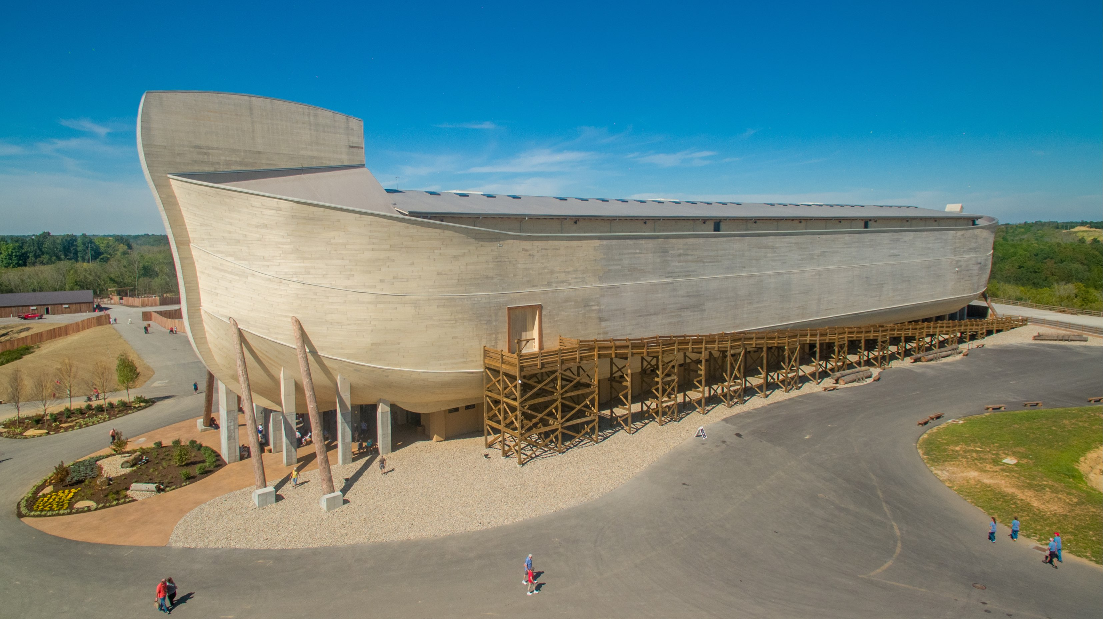

Slide 5
Oameni-Maimuță:
Fapt sau Ficțiune?
DR. TERRY MORTENSON

Slide 6
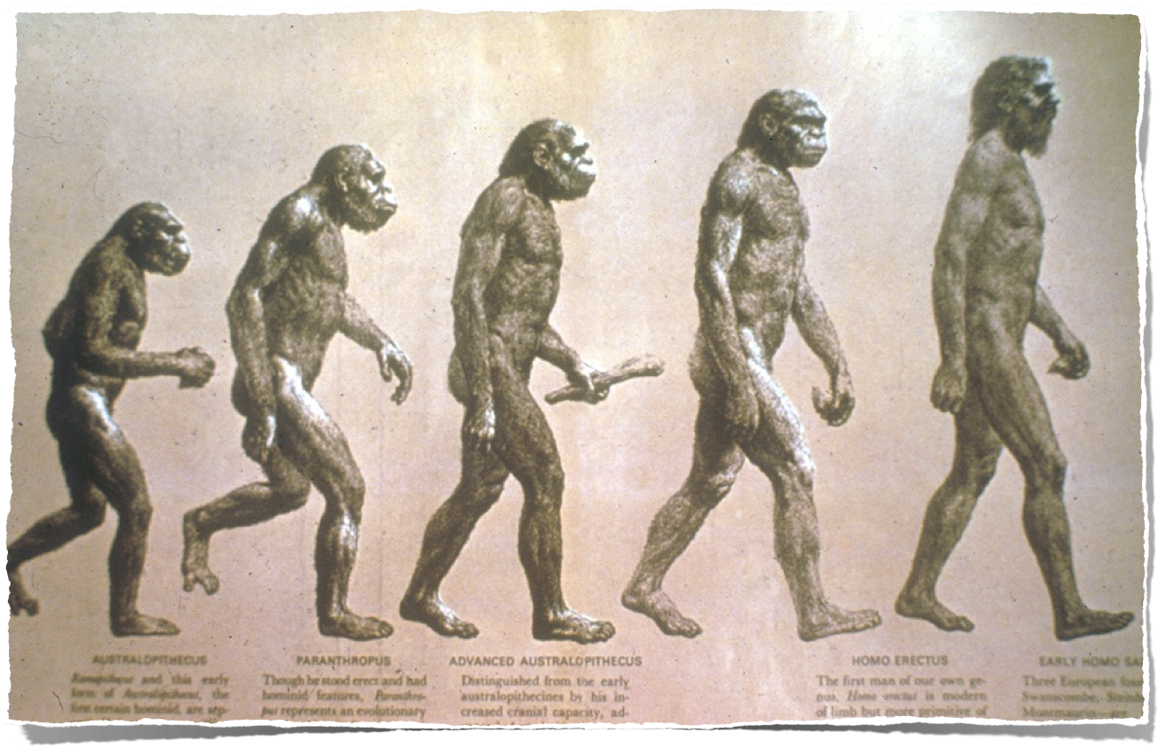
Evoluția Omului?

Slide 7
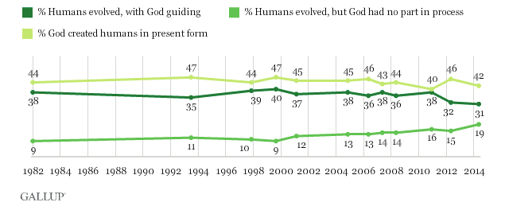
Păreri americane referitoare la originile umane
(Sondaj Gallup, Iunie 2014)
Biblical view -- 42%
Theistic evolution view -- 31%
Atheist view -- 19%
Punct de vedere biblic
Evoluție teistică
Ateistă
50% din americani cred că noi am evoluat din “maimuțe”
Notes:
Frank Newport, “ In U.S., 42% Believe Creationist View of Human Origins: Americans' views related to religiousness, age, education,” 2014 June 2, http://www.gallup.com/poll/170822/believe-creationist-view-human-origins.aspx?utm_source=alert&utm_medium=email&utm_campaign=syndication&utm_content=morelink&utm_term=Religion, accessed 2014 June 4

Slide 8
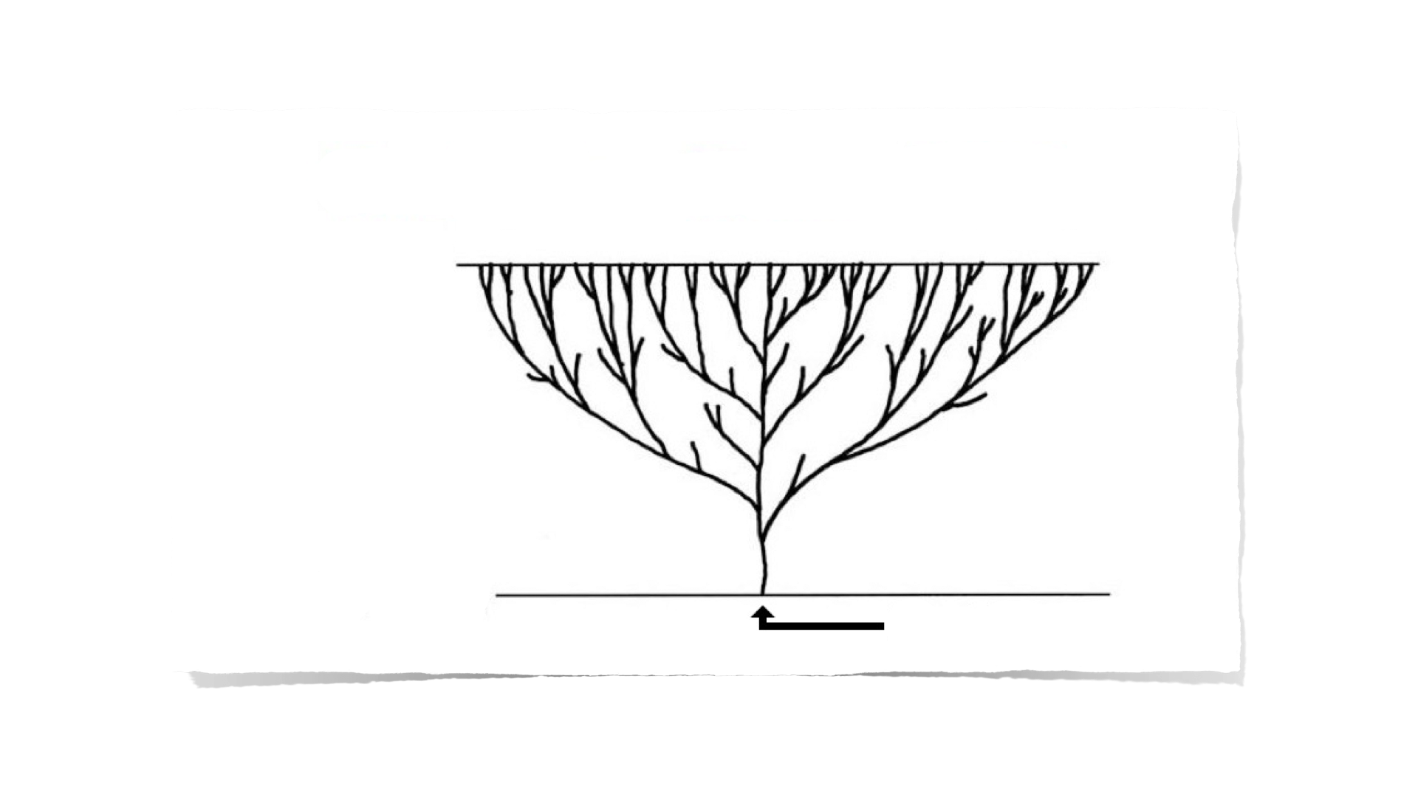
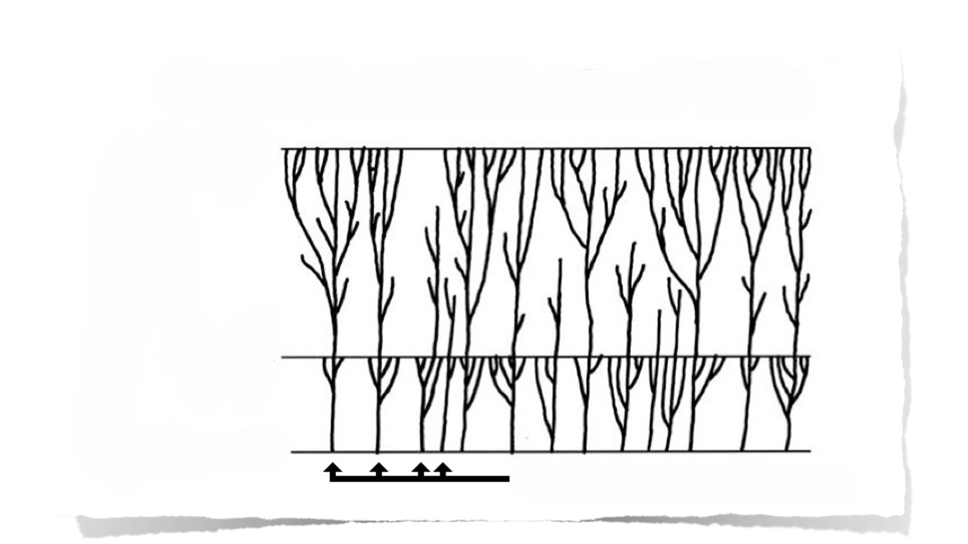
ARBORELE VIEȚII AL EVOLUȚIEI
Prezentul
Milioane de ani
Începutul
Prima celulă vie
PĂDUREA VIEȚII A CREAȚIEI
Prezentul
Mii de ani
Potopul
Creația
Soiurile create original

Slide 9
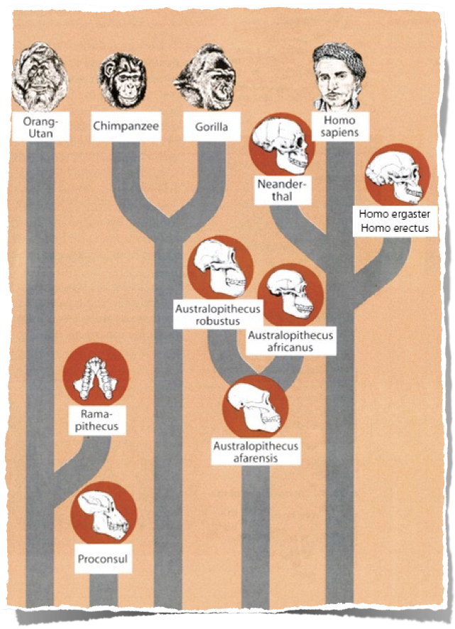
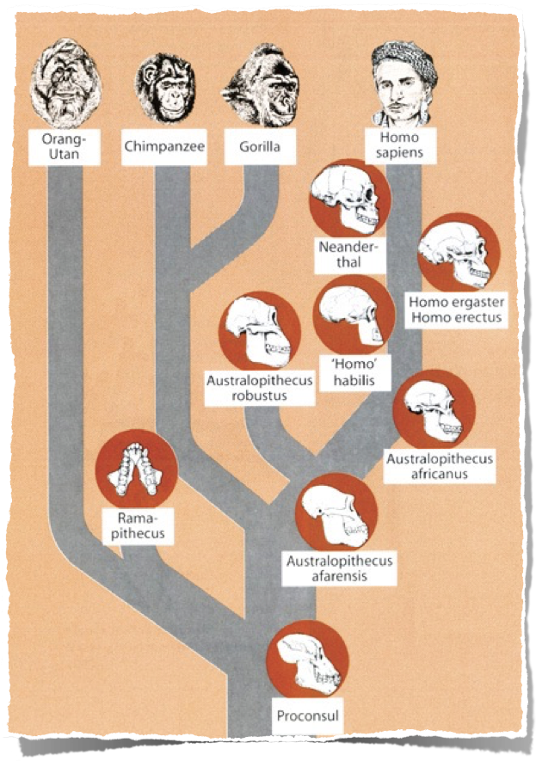
Arborele Evoluției
Pădurea Creației
Notes:
A hominid is any member of the biological family Hominidae (the "great apes"), including the extinct and extant humans, chimpanzees, gorillas, and orangutans. This classification has been revised several times in the last few decades. These various revisions have led to a varied use of the word "hominid": the original meaning of Hominidae referred only to the modern meaning of Hominina, i.e. only humans and their closest relatives. The meaning of the taxon changed gradually, leading to the modern meaning of "hominid," which includes all great apes.
The primatological term hominid is easily confused with a number of very similar words:
A hominoid or ape is a member of the superfamily Hominoidea: extant members are the lesser apes (gibbons) and great apes.
A hominid is a member of the family Hominidae: all of the great apes.
A hominine is a member of the subfamily Homininae: gorillas, chimpanzees, humans (excludes orangutans).
A hominin is a member of the tribe Hominini: chimpanzees and humans.
A hominan is a member of the sub-tribe Hominina: modern humans and their extinct relatives.
A human is a member of Homo sapiens. The word is sometimes also used to refer to any extinct member of the genus Homo or members from other hominan genera.
A humanoid is a vaguely human-shaped entity; the term is typically used in science fiction.
Certain morphological characteristics are still used conventionally to support the idea that hominid should only denote humans and human ancestors, namely bipedalism (walking on two feet) and large brains. These points of departure between human beings and the other great apes are important, but according to genetically based taxonomic classification, are not enough to divide us into separate families. Genetics, rather than morphology, is more widely accepted as the critical standard. Many scientists, including anthropologists, use the term to mean humans and their direct and near-direct bipedal ancestors.
Two charts from Reinhard Junker, Is Man Descended from Adam? (Biblical Creation Society, 2000, translated by Steven Robinson), p. 10-11

Slide 10
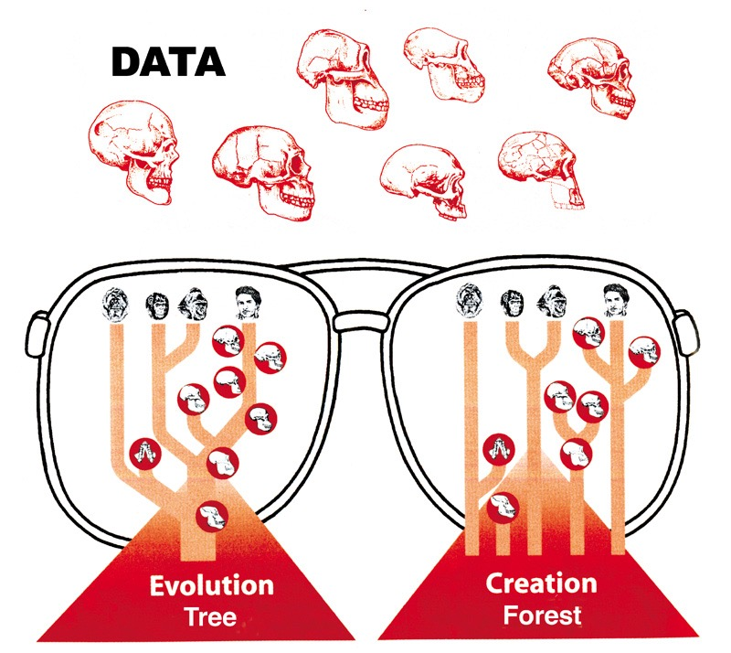
DATE
Care punct de vedere se potriveștecu datele?
Arborele Evoluției
Pădurea Creației
Notes:
As we look at what the evolutionists say and what the Bible says, we will see that the scientific evidence fits with the Bible but it does not at all confirm the evolutionist story.
Chart adapted from Reinhard Junker, Is Man Descended from Adam? (Biblical Creation Society, 2000, translated by Steven Robinson), p. 6.

Slide 11
Australopithecus
“Maimuța Sudică”

Slide 12
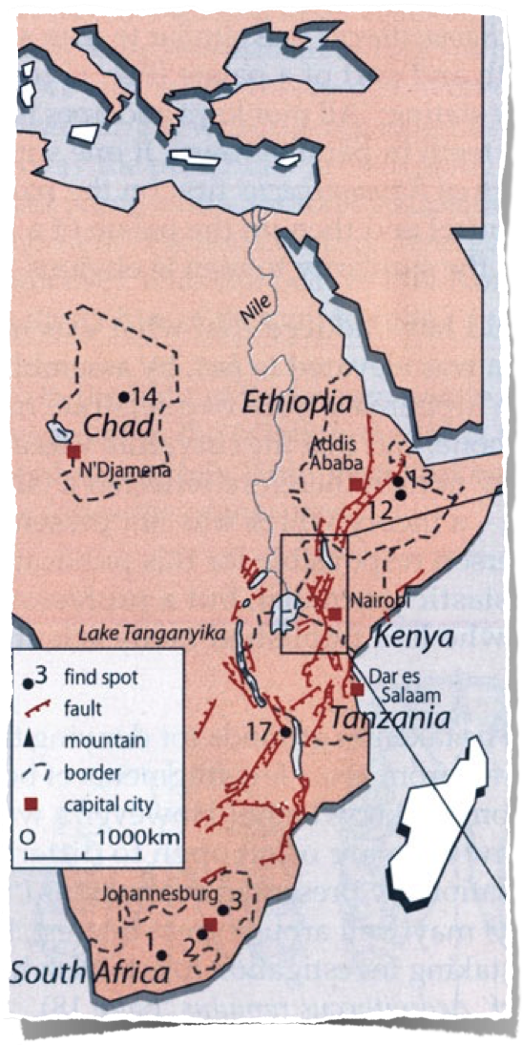
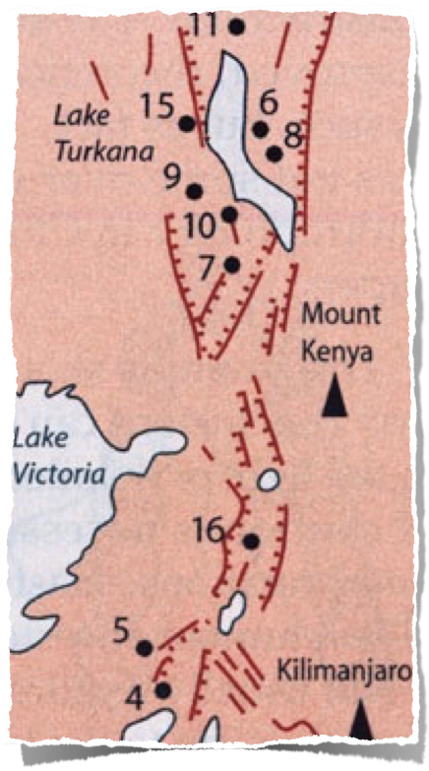
Notes:
Most of the evidence for australopithecus has been found in east Africa, especially Kenya and Ethiopia

Slide 13
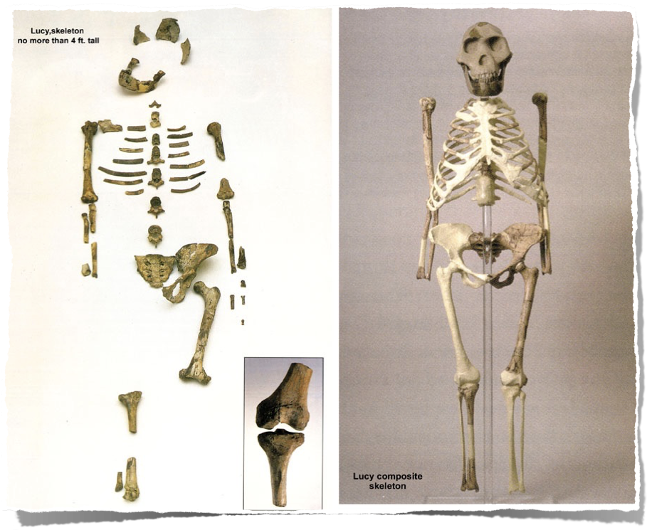
“Lucy” descoperită în Etiopia (1974)
Australopithecus afarensis
Notes:
100s of bone pieces representing 40% of body, say evolutionists. but actually found only 47 of the 207 bones (25%). Estimated height: 3’ 1”
Australopithecus afarensis found by Donald Johanson in 1974 in Hadar Formation of Awash Valley in Ethiopia’s Afar triangle. She’s been dated at 3.2 million years old.
Johanson named her “Lucy” because as he came back into camp, the Beatles song “Lucy in the sky with diamonds” was playing.
Research has since shown that Lucy was male not female (David Menton’s video: Lucy: She’s no lady)
More australopithecines have been found and the evolutionist consensus is that they are transitional forms between chimps and humans. But the australopithecine fingers are long and curved like a chimpanzee and the wrist has a locking mechanism like chimpanzees that walk on their knuckles on all fours. The organ of balance is also very chimp-like in the australopithecines. Conclusions can be difficult to draw because these fossils are fragmentary and broken and must be reassembled.

Slide 14
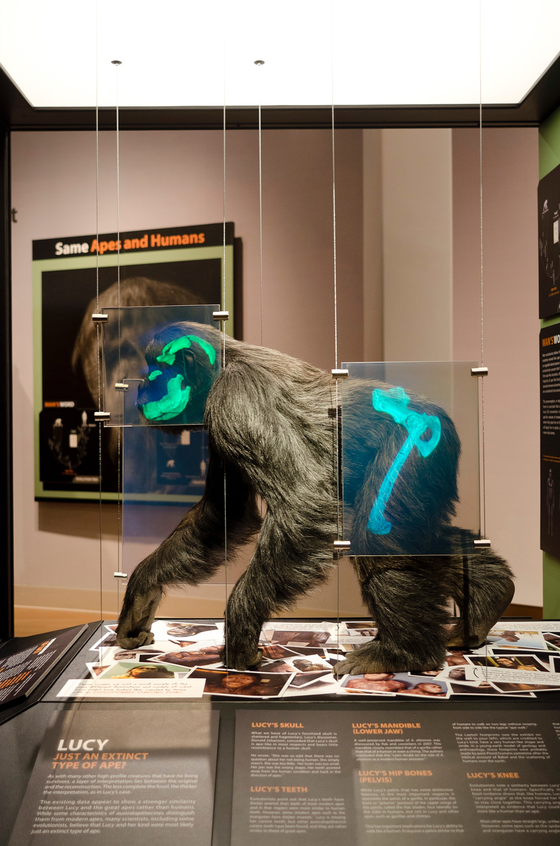
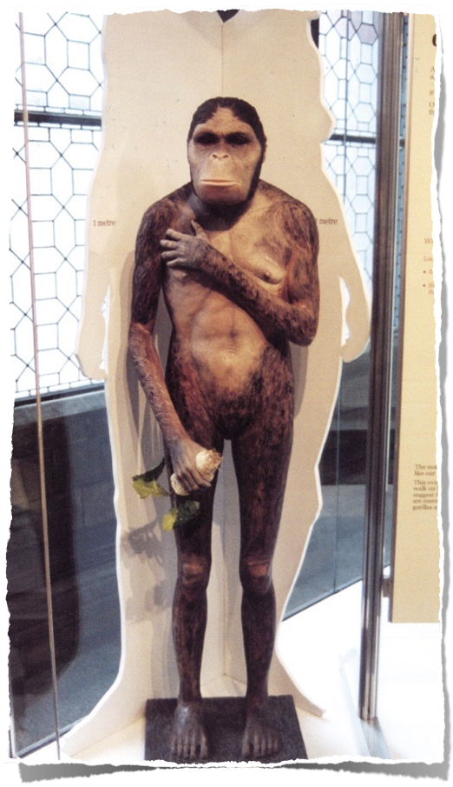
Creation Museum
De notat
Mâini și picioare umane
Postură verticală
Față ca de maimuță
Adevărul
Mers în patru labe (pe nodurile degetelor) similar cu bonobo sau gorila
Notes:
Bonobo (formerly called pigmy or dwarf chimpanzee)
PNAS (Proc. Nat. Acad. Sci), vol 104:16 (17 April 2007, pp. 6568-6572: research concludes that Lucy most closely resembles a gorilla or at least the robust australopithecines (no longer considered to be ancestral to man).
Photo by Ken Ham at Natural History Museum in London, 2009
The fossil evidence shows that Lucy (a specimen of Australopithecus afarensis) had very chimp-like body proportions (only 4 feet tall when upright) with long arms and short legs, wrists designed for knucklewalking, long curved hands and feet (with opposing big toes like in apes, not like in humans) for grasping trees, and hip/pelvic shape that indicates that she spent much time in trees, not walking like humans. See critique of the BBC’s Walking with Cavemen, at <www.biblicalcreation.org> and the video by Dr. David Menton (anatomy professor), called “Lucy: She’s no lady!” available from <www.answersingenesis.org>.

Slide 15
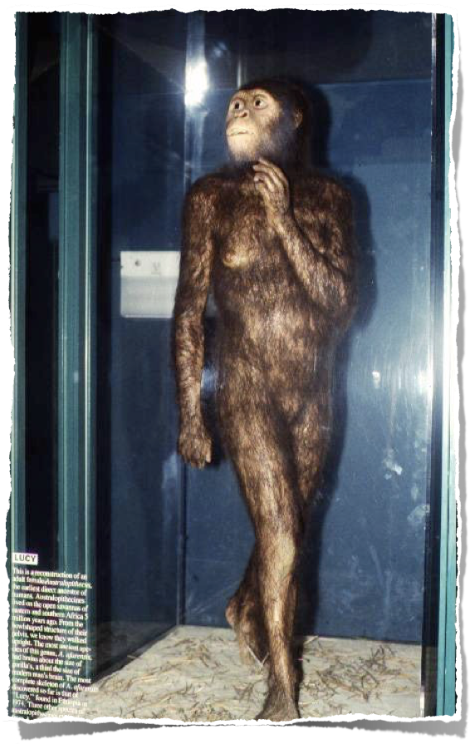
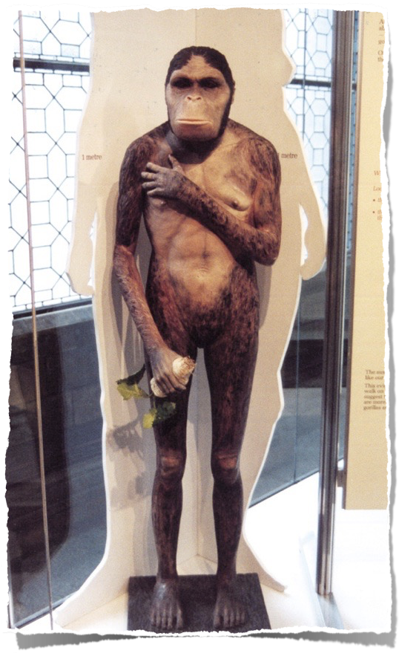
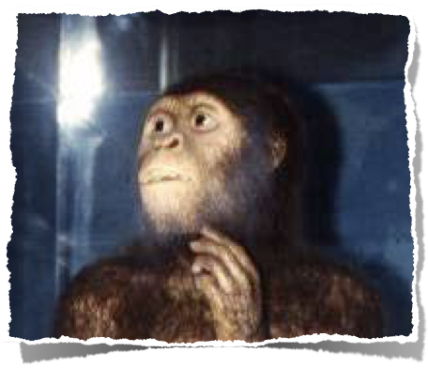
Grădina Zoologică
St. Louis
Muzeul de Istorie Naturală Londra
Notes:
London photo by Ken Ham from his visit to the Natural History Museum in 2009
St. Louis Zoo’s “Living World” exhibit photo by David Menton (in his DVD, “Lucy: She’s No Lady!”) taken in about 1995 (in the exhibit for at least 20 years from the very beginning in 1985)
Chicago Field Museum’s model (in their “The Evolving Planet” permanent exhibition), photo by Carl Kerby in March 2006 (http://www.answersingenesis.org/docs2006/0313field_trip.asp, 13 Mar 2006, accessed 29 June 2011.
BBC photo: article reporting on Lucy’s bones touring America. The caption under photo in the article: “Lucy's remains were found in 1974 in Hadar, Ethiopia.” See http://news.bbc.co.uk/1/hi/world/americas/6082990.stm, “Lucy’s Ancient Bones to Tour US, 25 Oct. 2006.” She will be on loan from Ethiopia to the Houston Museum of natural Science in Texas for scientific study till 2013. Officials say that money from the tour will be used to improve museums across the country.

Slide 16
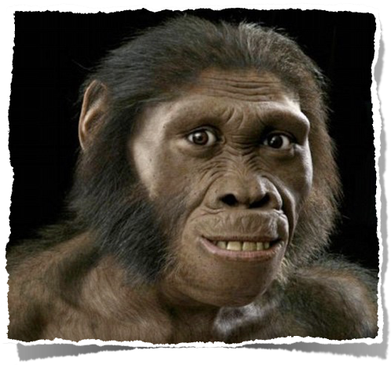
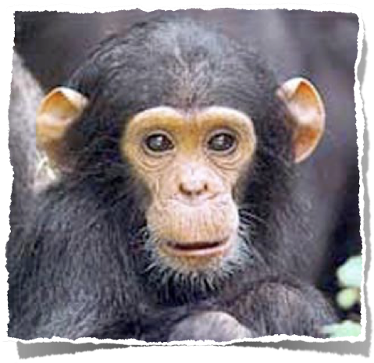
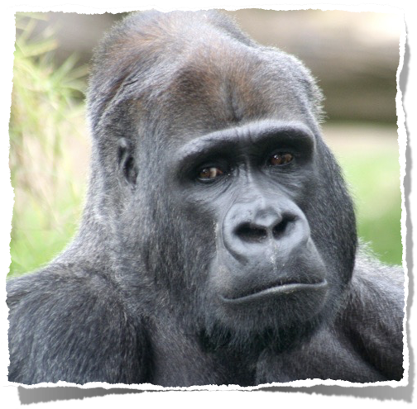
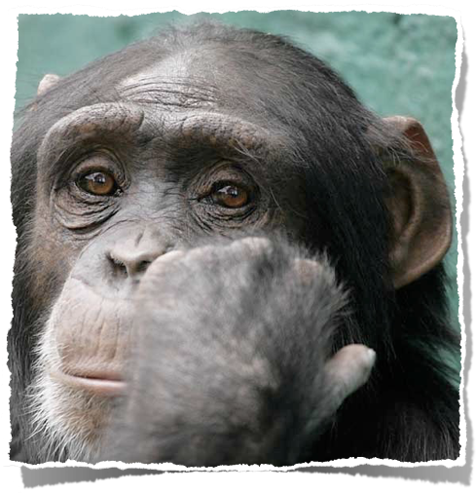
Notes:
Karabo (aka Australopithecus sediba): http://www.dailymail.co.uk/sciencetech/article-2062514/Revealed-The-face-missing-link-ape-man.html, accessed 2011 Dec 28
Chimps are on the right, gorilla on the lower left, Karabo artistic reconstruction on upper left
Article begins:
A curious smile playing on his face, the eyes and mouth are unmistakably human while the cheekbones and jutting brow say wild animal.
Meet Karabo, probably our earliest ancestor and the ‘missing link’ between man and ape – ‘seen’ for the first time thanks to this incredible portrait.
Created by paleo-artist John Gurche, it is based on the remarkably well-preserved skeleton of a boy aged around 13, found in a cave in South Africa. Read more: http://www.dailymail.co.uk/sciencetech/article-2062514/Revealed-The-face-missing-link-ape-man.html#ixzz1hrHWtMN7

Slide 17
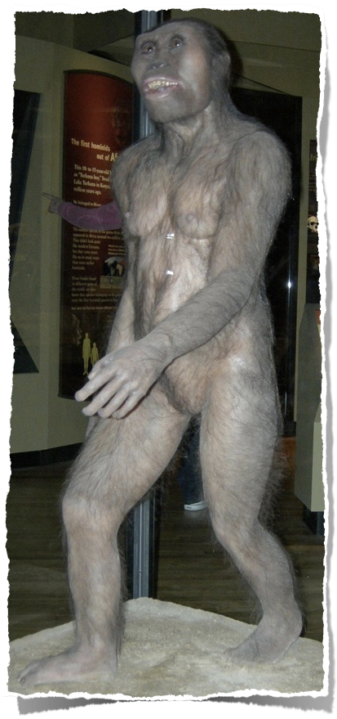
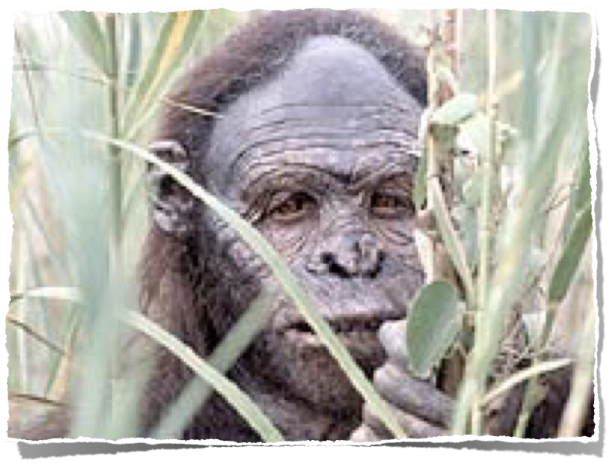
BBC, 2006
Grădina Zoologică St. Louis
Muzeul Câmpului (Field) Chicago
Muzeul de Istorie Naturală Londra
Notes:
London photo by Ken Ham from his visit to the Natural History Museum in 2009
St. Louis Zoo’s “Living World” exhibit photo by David Menton (in his DVD, “Lucy: She’s No Lady!”) taken in about 1995 (in the exhibit for at least 20 years from the very beginning in 1985)
Chicago Field Museum’s model (in their “The Evolving Planet” permanent exhibition), photo by Carl Kerby in March 2006 (http://www.answersingenesis.org/docs2006/0313field_trip.asp, 13 Mar 2006, accessed 29 June 2011.
BBC photo: article reporting on Lucy’s bones touring America. The caption under photo in the article: “Lucy's remains were found in 1974 in Hadar, Ethiopia.” See http://news.bbc.co.uk/1/hi/world/americas/6082990.stm, “Lucy’s Ancient Bones to Tour US, 25 Oct. 2006.” She will be on loan from Ethiopia to the Houston Museum of natural Science in Texas for scientific study till 2013. Officials say that money from the tour will be used to improve museums across the country.

Slide 18
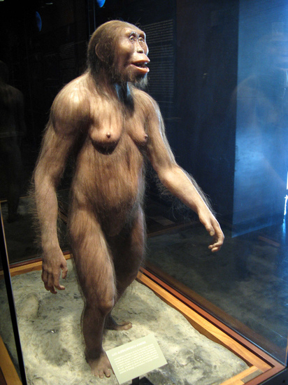
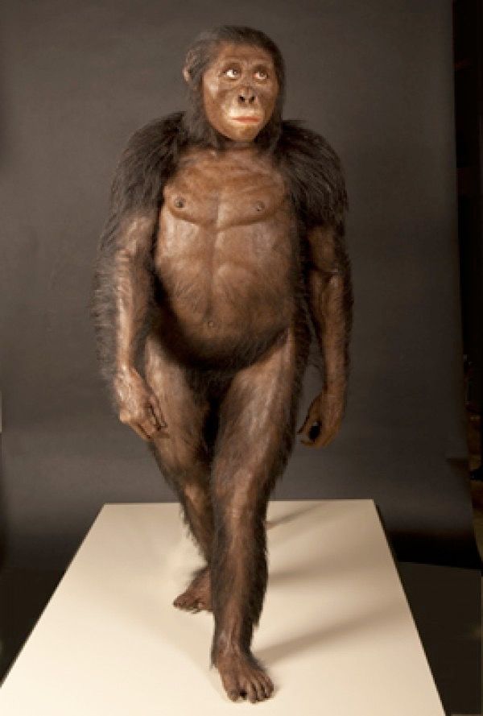
Smithsonian, 2012
Science, 2013
Notes:
Elizabeth Culotta, “ScienceShot: Lucy's Svelte Look,” http://news.sciencemag.org/paleontology/2013/09/scienceshot-lucys-svelte-look, 2013 Sept 23, accessed 2013 Nov 2.
“Did Lucy Walk Too Slow for Her Taller Group Mates?” http://blogs.smithsonianmag.com/hominids/2012/11/did-lucy-walk-too-slow-for-her-taller-group-mates/, 2012 Nov. 5, accessed 2013 Nov 2

Slide 19
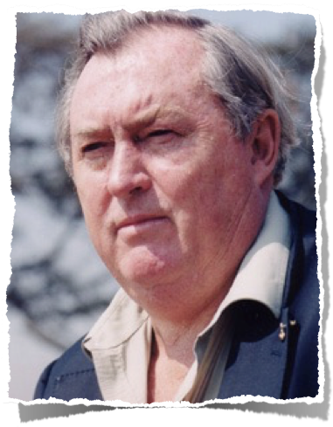
În 1981: “Noi acum putem spune că australopithecinii au mers vertical.”
Richard Leakey (Director, Kenya National Museums), The Making of Mankind (New York: E. P. Dutton, 1981), p. 71.
Notes:
Picture from http://www.midland.edu/~events/davidson/leakey.html, downloaded 14 April 2005

Slide 20
Dar în 1982 . . .
“Și Leakey subliniază că paleontologii nu știu dacă Australopithecul a mers biped. ‘Nimeni nu a descoperit încă un schelet cu tot cu craniu care să certifice teoria,’ spune el.”
Anonymous, “Leakey changes his mind about man’s age,” New Scientist, March 1982, p. 695.

Slide 21
“‘Înclin să cred că numai cu puțin de un an în urmă am facut aceste declarații.’ Așa a spus Richard Leakey, în fața unei audiențe foarte importante într-un discurs în cadrul Institutului Regal vinerea trecută. El a recunoscut că înțelepciunea conventională, pe care a expus-o recent în seria televiziunii BBC Apariția omului, ‘s-a înșelat probabil în câteva aspecte cruciale’.”
Anonymous, “Leakey changes his mind about man’s age,” New Scientist, March 1982, p. 695.
Notes:
Note that his errors were broadcast on BBC for millions to hear, but his recantation was made before an elite audience at the Royal Institution and then quoted in a minor article in New Scientist. But judging from the article he didn’t explicitly recant the error in his book [and no doubt in the BBC-TV series] about australopithecines walking upright.

Slide 22
“În mod special, el consideră că cel mai vechi strămoș al omului ca fiind considerabil mai tânăr decât cei 15-20 milioane de ani pe care i-a declarat pentru televiziune. Leakey spune că etalonul după care paleontologii clasifică fosilele de maimuțe și de oameni este unul înșelător, și că lui i-ar plăcea să vadă o formă de clasificare cu totul nouă.”
1982
Anonymous, “Leakey changes his mind about man’s age,” New Scientist, March 1982, p. 695.

Slide 23
În 1986 un articol despre Australopitheci începe astfel:
“Un craniu extraordinar de 2.5 milioane ani vechime descoperit in Kenya a răsturnat tot ce se știa înainte cu privire la evoluția timpurie a omului. Nu mai putem ști cine a evoluat din cine – probabil că nici cum, sau când am luat ființă.”
Pat Shipman (paleontologist, Johns Hopkins School of Medicine), "Baffling limb on the family tree," Discover, September 1986, cover & p. 89.
Notes:
The skull was KNM-WT 17000 in the National Museums of Kenya. It has the robust characteristics of Australopithecus boisei.
A similar statement to what is on the magazine cover about this find is found on p. 89

Slide 24
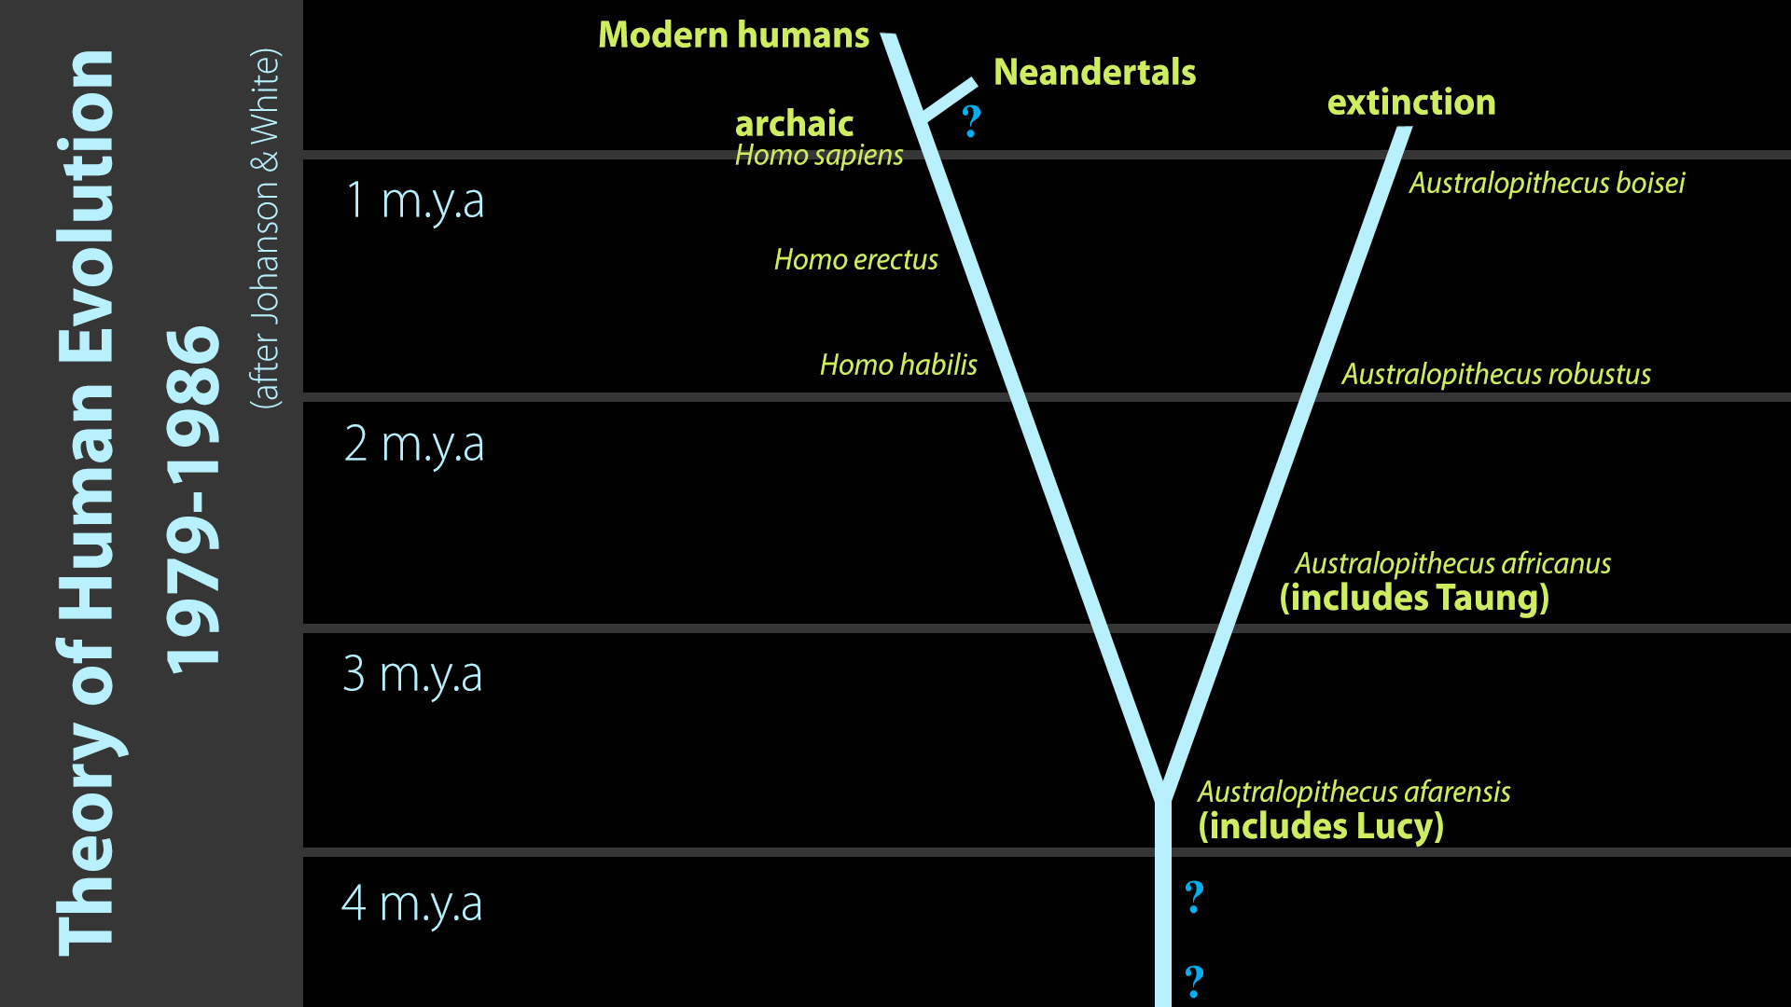
Uman modern
Neanderthali
Extincție
1 milion de ani
Teoria Evoluției Umane
1979-1986
2 milioane de ani
(după Johanson și White)
3 milioane de ani
4 milioane de ani
Notes:
Modified from chart in Marvin Lubenow, Bones of Contention (Grand Rapids: Baker, 1992), p. 54.

Slide 25
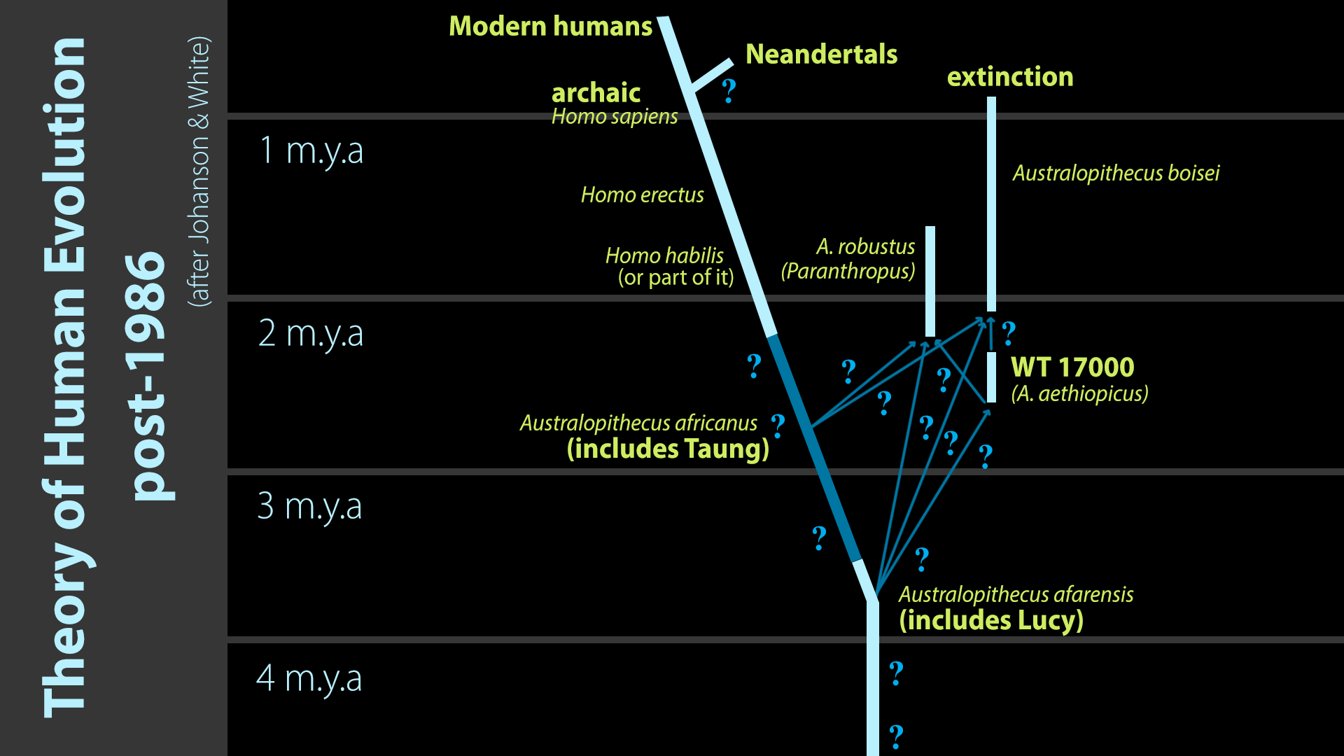
Umani moderni
Neanderthals
Extincție
1 milion de ani
Theory of Human Evolution
1979-1986
2 milioane de ani
(după Johanson și White)
3 milioane de ani
4 milioane de ani
Notes:
Modified from chart in Marvin Lubenow, Bones of Contention (Grand Rapids: Baker, 1992), p. 54.

Slide 26
Articolul se încheie:
“Concluzia principală este că trebuie să muncim foarte mult în acest domeniu. Este o nouă eră în paleontologie. Lucrurile pe care credeam că le-am înteles destul de satisfăcător, de fapt nu le-am înteles. ...
Nu există o dovadă mai bună pentru timpul, costurile și munca de teren depuse decât acest nou craniu. Precum un cutremur, acest nou craniu a redus argumentele noastre de până acum la o nouă și foarte bună ipoteză. Este un semn sigur de progres științific.”
Shipman, September 1986, p. 93.

Slide 27
Dr. Owen Lovejoy & Dr. Donald Johanson
Lovejoy a decis să reconstruiască pelvisul în forma naturală. Nu a vrut să umble cu oasele originale ca să nu le strice, deci a construit unul din ghips.
Acest lucru aa cauzat ca cele două oase să se potrivească atât de bine încât sunt intr-o pozitie imposibilă din punct de vedere anatomic.
Potrivirea perfectă a fost o iluzie care a făcut ca osul șoldului să fie scos înafară ca al unui cimpanzeu. Dar munca nu i-a fost zadarnică.
A fost un lucru delicat. Dar după ce și-a isprăvit pelvisul, toate celelalte s-au potrivit perfect - ca un joc în bucățele tridimensional.
În final, unghiul șoldului nu seamănă de loc cu unul de cimpanzeu, ci mai degrabă seamănă cu unul ca al nostru.
A tăiat bucățile deteriorate și le-a rearanjat așa cum ar fi fost înainte ca Lucy să moară.
Notes:
NOT typewriter animation, just wipe-down boxes
Dr. Owen Lovejoy, famous anthropology professor at Kent State University in Ohio. The other voice is that of Donald Johanson, who found “Lucy”.
Dr. David Menton (before joining AiG staff he was for 34 years a human anatomy professor at Washington Medical School in St. Louis) comments on this clip:
Lovejoy was totally convinced that Lucy’s kind made the human-like footprints in Laetoli and those prints would not be possible for a creature to make unless it had a human-type pelvis. Therefore before Lovejoy manipulated Lucy’s hipbones he had a massive observer bias.
For Lovejoy to cut along existing cracks and then to fit things together would have been scientifically permissible, but to grind material away is totally unacceptable as a scientist.
This article by cjobrien (evidently an anthropology professor) http://northstatescience.wordpress.com/2011/01/01/correcting-creationists-redux-was-lucy%E2%80%99s-pelvis-reconstruction-a-fraud/ says the clip was from In Search of Human Origins (Part 1) on NOVA in 1994. the author accuses creationists of fraudulently misrepresenting the clip.
Textbox 1
This has caused the two bones in fact to fit together so well that they are in an anatomically impossible position.
Acest lucru aa cauzat ca cele două oase să se potrivească atât de bine încât sunt intr-o pozitie imposibilă din punct de vedere anatomic.
Textbox 2
The perfect fit was an illusion that made Lucy’s hip bone seem to flare out like an chimp’s. But all was not lost.
Potrivirea perfectă a fost o iluzie care a făcut ca osul șoldului să fie scos înafară ca al unui cimpanzeu. Dar munca nu i-a fost zadarnică.
Textbox 3
Lovejoy decided he could restore the pelvis to its natural shape. He didn’t want to tamper with the original, so he made a copy in plaster.
Lovejoy a decis să reconstruiască pelvisul în forma naturală. Nu a vrut să umble cu oasele originale ca să nu le strice, deci a construit unul din ghips.
Textbox 4
He cut the damaged pieces out and put them back together the way they were before Lucy died.
A tăiat bucățile deteriorate și le-a rearanjat așa cum ar fi fost înainte ca Lucy să moară.
Textbox 5
It was a tricky job. But after taking the kink out of the pelvis, it all fit together perfectly—like a 3-dimensional zig-saw puzzle.
A fost un lucru delicat. Dar după ce și-a isprăvit pelvisul, toate celelalte s-au potrivit perfect - ca un joc în bucățele tridimensional.
Textbox 6
As a result, the angle of the hip looks nothing like a chimp’s, but a lot like ours.
În final, unghiul șoldului nu seamănă de loc cu unul de cimpanzeu, ci mai degrabă seamănă cu unul ca al nostru.

Slide 28
Grădina Zoologică St. Louis
Muzeul Câmpului (Field) Chicago
Muzeul de Istorie Naturală Londra
Notes:
London photo by Ken Ham from his visit to the Natural History Museum in 2009
St. Louis Zoo’s “Living World” exhibit photo by David Menton (in his DVD, “Lucy: She’s No Lady!”) taken in about 1995 (in the exhibit for at least 20 years from the very beginning in 1985)
Chicago Field Museum’s model (in their “The Evolving Planet” permanent exhibition), photo by Carl Kerby in March 2006 (http://www.answersingenesis.org/docs2006/0313field_trip.asp, 13 Mar 2006, accessed 29 June 2011.
BBC photo: article reporting on Lucy’s bones touring America. The caption under photo in the article: “Lucy's remains were found in 1974 in Hadar, Ethiopia.” See http://news.bbc.co.uk/1/hi/world/americas/6082990.stm, “Lucy’s Ancient Bones to Tour US, 25 Oct. 2006.” She will be on loan from Ethiopia to the Houston Museum of natural Science in Texas for scientific study till 2013. Officials say that money from the tour will be used to improve museums across the country.

Slide 29
Omul de Neanderthal
Notes:
As a content template, this is best suited for standard content such as outlines, quotations, Scriptures, and maybe illustrations or photos. Presentation Team recommends 48–60 pt. font for headings and 28–40 pt. for body text. Because of eye flow and visual psychology, the top line may be a little closer than all other sides. This also contains a floating AiG logo that can be repositioned or removed as appropriate for the overhead’s content.

Slide 30
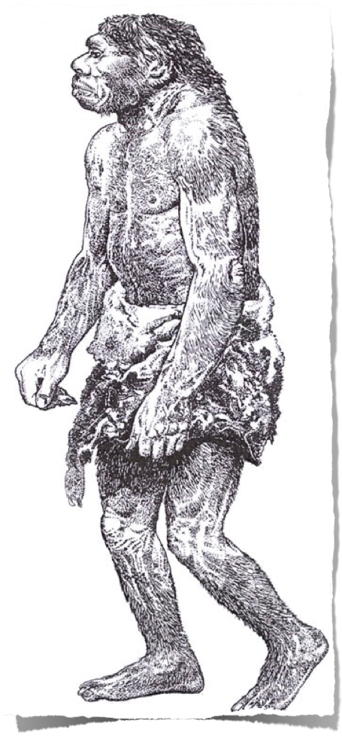
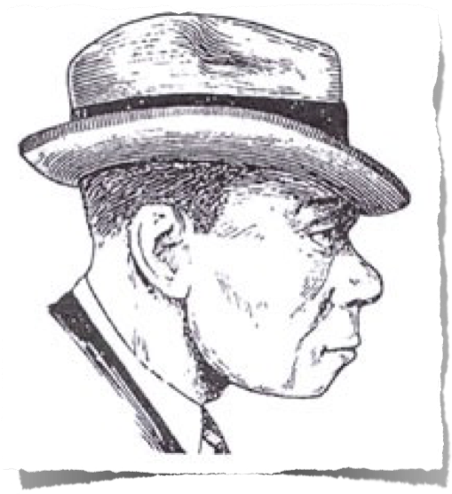
1983
1856
Notes:
1856 is when the first Neanderthal was found in the Neander Valley near Dusseldorf, Germany. 490 Neanderthal skeletons have been found in Europe and western Asia as of 2006. Initially thought by scientists to be fully human, a man with rickets
1863 TH Huxley called it ancient human but not direct ancestor to modern man
1864 William King (Irish geologist) declared at meeting of BAAS that it was a different species and named it Homo neanderthalensis
1908 three RC priests excavated a nearly complete skeleton near La Chapelle-aux-Saints, France, and gave it to Marcellin Boule, anatomist at Museum d’Histoire Naturelle in Paris to declared it to be a hairy bestial creature with large brain but little intellect, which became the widely accepted view, even today.
The drawing was made by Zdenek Burian, according to Reinhard Junker, Is Man Descended from Adam? (Biblical Creation Society, 2000, translated by Steven Robinson), p. 7, from which the picture was taken. The right picture is from p. 8 of the same book and was done by Haviland in 1983. A similar contrast between the early ape-like and recent, modern-human-like (in a suitcoat and tie even) reconstructions is in Rick Gore, “Neandertals,” National Geographic 189:1 (Jan. 1996), pp. 32-33. The picture of the two in NG is taken from the Neanderthal Museum in Erkrath, Germany.

Slide 31
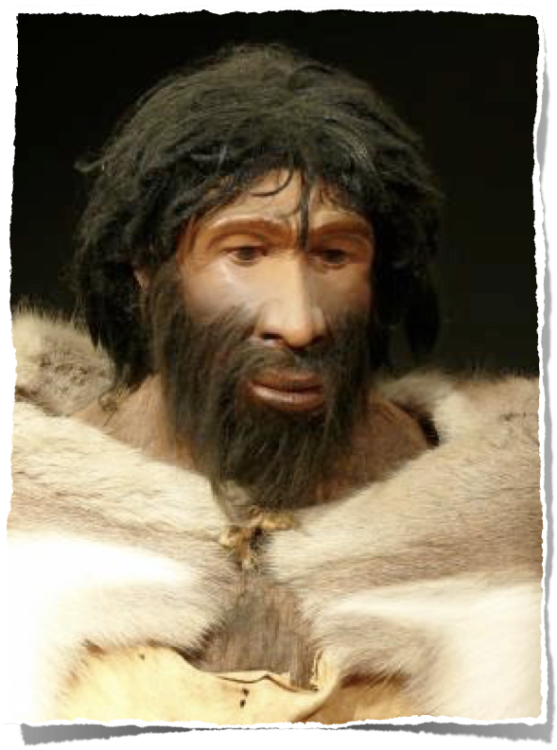
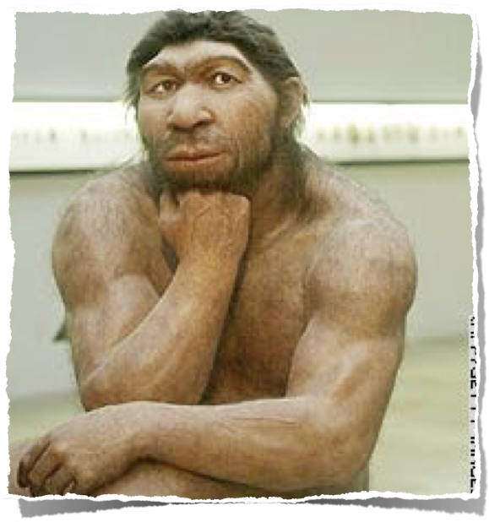
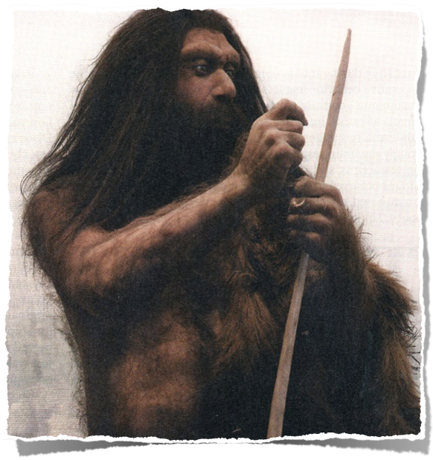
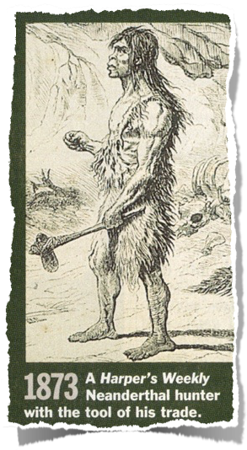
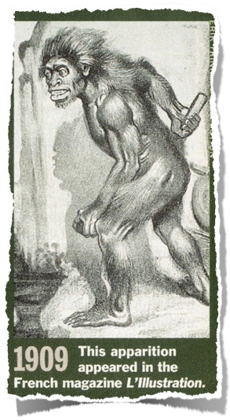
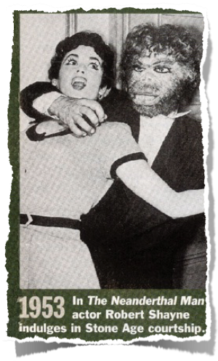
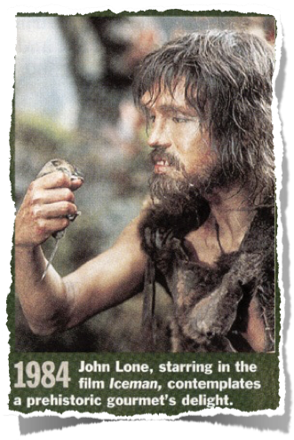
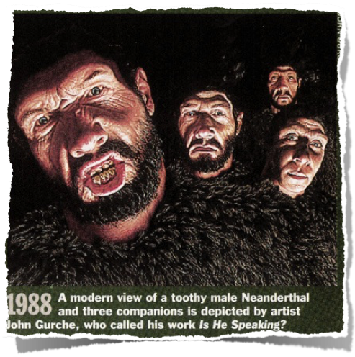
Figurile schimbătoare
ale Omului de Neanderthal
Newsweek,
March 2007
Time,
March 1994
CNN 2006
ScienceDaily.com
August 2008
Notes:
From TIME, 14 March 1994, pp. 86-87.
CNN picture: http://www.cnn.com/2006/TECH/science/11/15/neanderthal.ap/index.html, “Neanderthal bone gives DNA clues,” 15 Nov. 2006.
The subtitle of the Newsweek picture said, “Neanderthal: In Europe 200,000 to 30,000 years ago, but not our ancestor.” Sharon Begley, “Beyond Stones and Bones,” Newsweek (19 Mar. 2007), p. 58.
Photo 2008: http://www.sciencedaily.com/releases/2008/08/080825203924.htm, accessed 26 Aug 2008. The article said that they made stone tools just as sophisticated as Homo sapiens made—overthrowing an evolutionist belief held to the contrary for over 60 years.

Slide 32
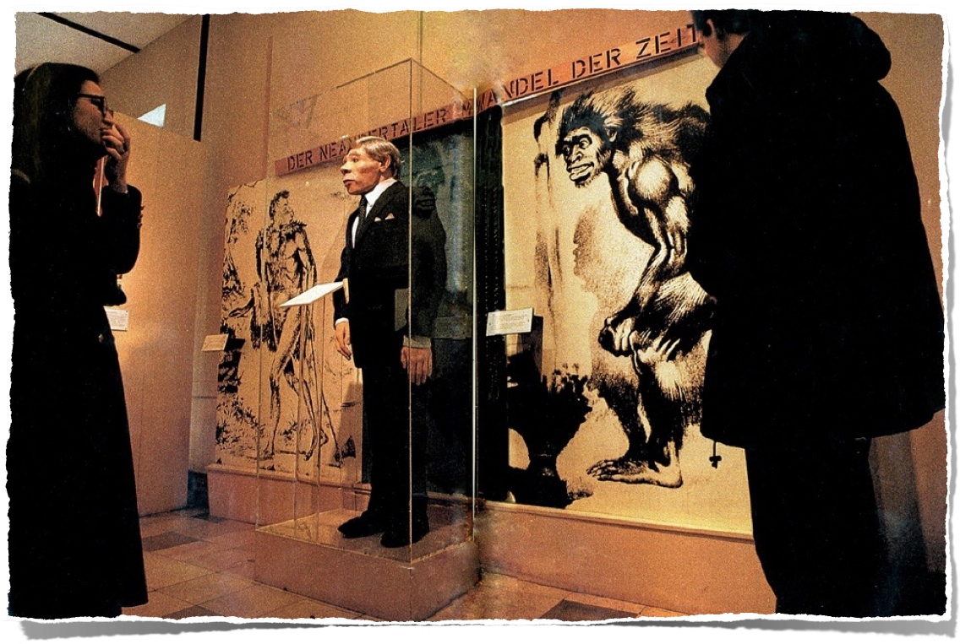
Muzeul
Neanderthal
Erkrath, Germania
“De la bestia din secolul 19, la un tip oarecare în costum, Neanderthalienii s-au adaptat o dată cu vremurile.”
Notes:
Rick Gore, “Neandertals: the Dawn of Humans,” National Geographic, Vol. 189:1 (Jan 1996), pp. 32-33. The quote is Gore’s words in his caption for the picture.
1983 and 1909 versions of the man
In the caption, Gore uses both spellings: “Neanderthal Museum” and “Neandertals” here and elsewhere in the article.
In the caption, Gore uses both spellings for this man.

Slide 33
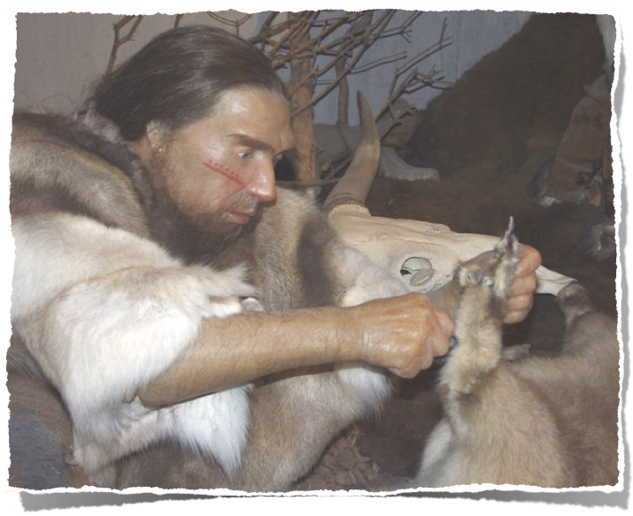
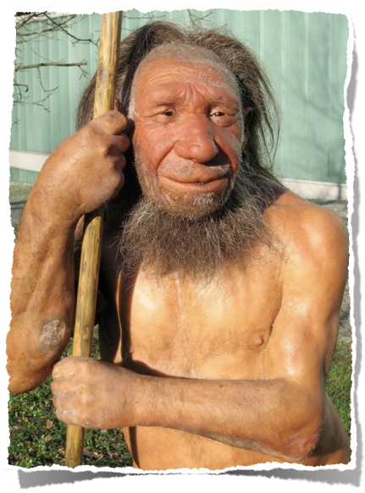
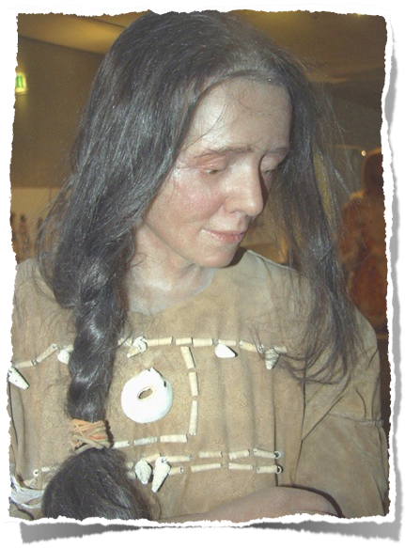
Muzeul Neanderthal
2010
Notes:
Top: http://commons.wikimedia.org/wiki/File:Neandertaler-im-Museum.jpg (public domain picture from Laura Strobl at AiG).
Left: http://commons.wikimedia.org/wiki/File:Neandertala_homo,_modelo_en_Neand-muzeo.jpg (see copyright on file in cabinet under Neander-homo NM 2010a).
Right: http://commons.wikimedia.org/wiki/File:Cro-Magnon-Frau-Neanderthal.jpg (public domain picture from Laura Strobl at AiG).. Museum calls the lady: Cro-Magnon Neanderthal

Slide 34
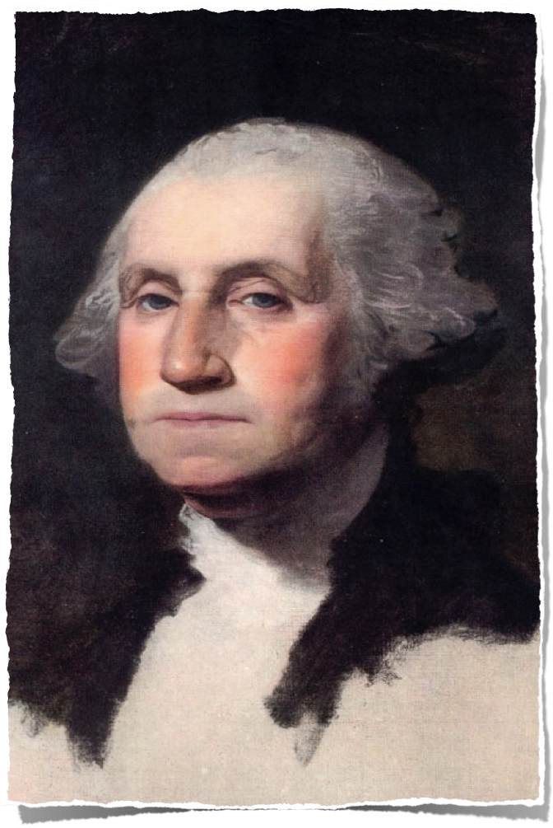
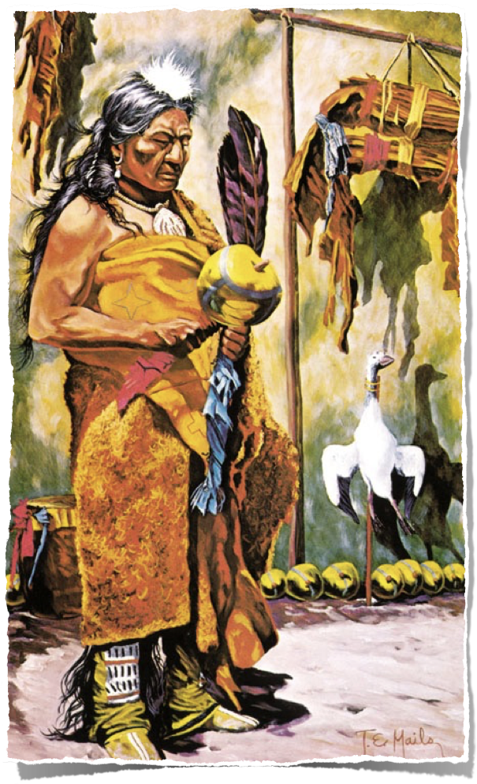

Slide 35
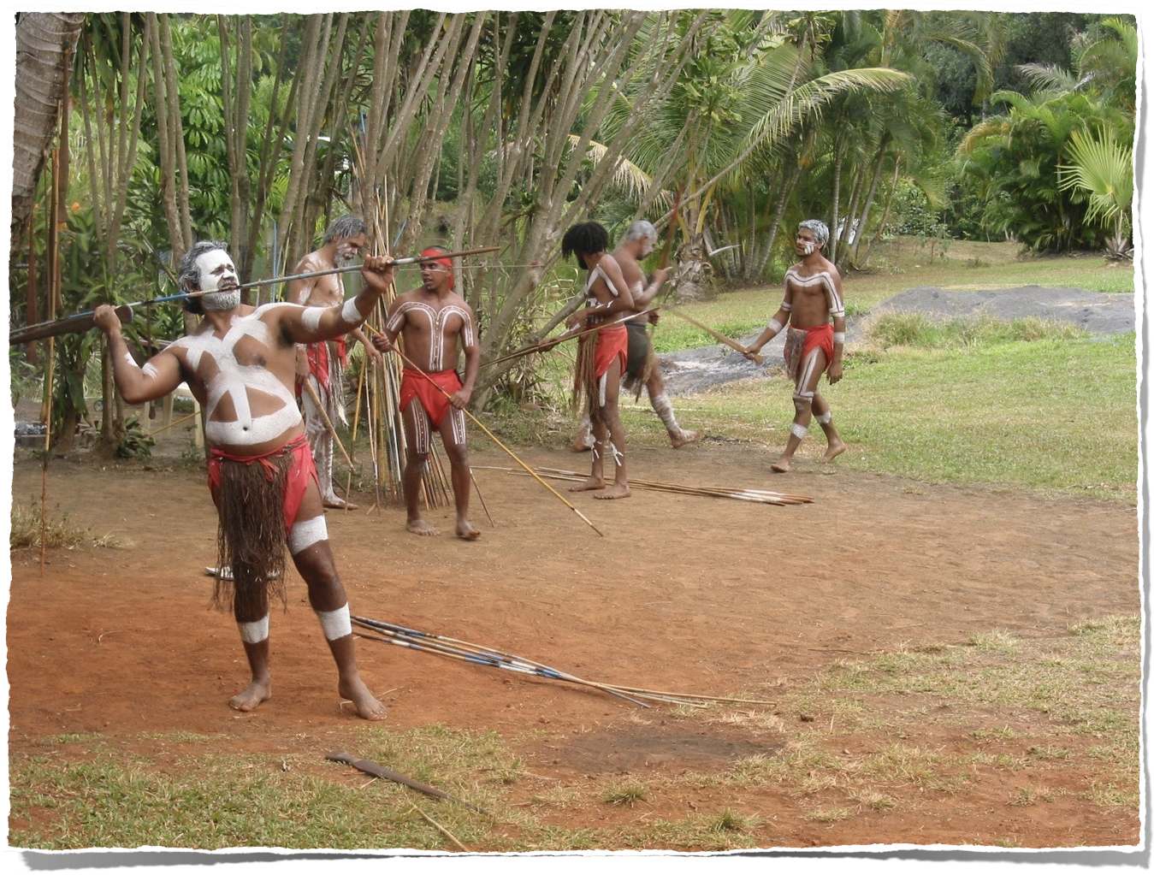

Slide 36
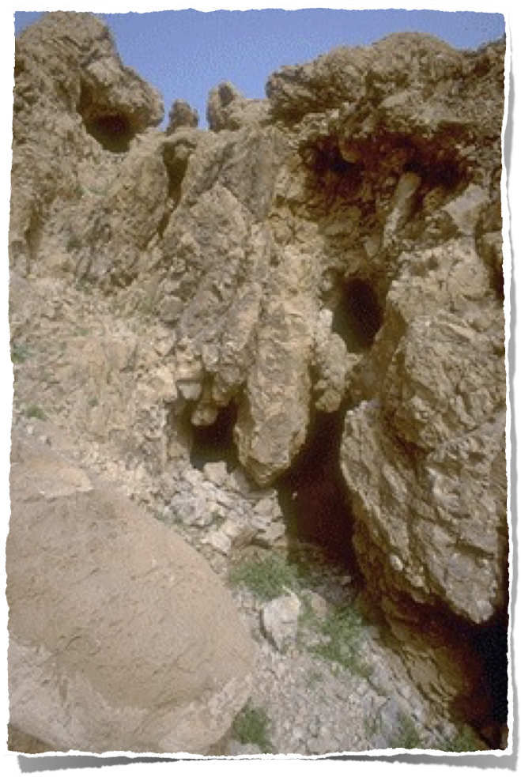
Peșterile Eseniene unde au fost descoperite Manuscrisele de la Marea Moartă
1947
Notes:
Essenes didn’t live in the caves but stored their manuscripts there.
From Dr. Bill Barrick (OT prof, The Master’s Seminary, Mar 25, 2011)
The Essenes did not live in caves. They maintained a geniza (a burial place for old biblical scrolls no longer usable in the synagogue) in the caves and might have maintained a library in one or two of the caves. Scrolls unfit for synagogue use (like the Isaiah scrolls from Cave 1 at Qumran with all of their major omissions, insertions, errors, etc.) were given an honorable burial. Jews still do that with worn out scrolls. They are not destroyed. Burials in that time sometimes involved placing a body in a clay container and setting it in a cave (artificial or natural). Most Jewish burials involved just laying the body on a ledge in the cave. Scrolls, however, would further deteriorate if not placed into a jar and sealed. A few of the caves might have been used to hide scrolls from the Romans, but there is no clear evidence. The best scrolls were sent off to a more distant place out of harm’s way.
The Essenes lived in the wilderness to be separated (like the Hippies in the 60’s) from society. They objected to the traditional Jewish community as much as they did to the Romans. The picture you showed in the slide is Cave 11, where the Psalms scroll was found a few of kilometers from Qumran. The cave (which I have entered myself) was never used for habitation—too little, too narrow. It was used only to house a few scrolls that were probably discarded.

Slide 37
Evrei 11:38
. . . ei, de care lumea nu era vrednică –, au rătăcit prin pustiuri, prin munţi, prin peşteri şi prin crăpăturile pământului.
Sara, Iacov, Lazăr & Isus: Îngropați în peșteri
Lot, Ilie, David: Au trăit în peșteri
Notes:
In fact, Abraham & Sarah, Isaac & Rebekah, and Jacob & Leah were all buried in the same cave (Gen. 49:29-31).
NASB

Slide 38
Osama bin Laden

Slide 39
Dovezi arheologice că
Neanderthalienii au fost 100% umani
Își confecționau unelte din piatră, sulițe și ace
Foloseau machiaj și bijuterii făcute din scoici
Vânau delfini și balene
Controlau focul în scopul gătitului, făceau lipici, etc.
Construiau colibe din piei de animale
Confecționau fluiere din oase (femur) de urs și își ornau capul cu coronițe din pene
Se îngrijeau de cei bolnavi și aveau ceremonii de înmormântare
Construiau și cârmuiau corăbii și bărci
Posedau osul hioid (mărul lui Adam) care era aproape identic cu cel al oamenilor moderni, posedau gena vorbitului, și se puteau încrucișa cu oamenii moderni
Notes:
More evidence that they were fully human (4-min clip and article): http://www.bbc.com/earth/story/20160712-how-human-were-neanderthals, accessed 2016 July 29.
Buried dead with arms crossed
Did surgery--evidence that they amputated (the bone is not jagged but rather rounded on the end--evidence of healing) and they set broken bones (bones clearly broken but set straight and healed): http://www.ncbi.nlm.nih.gov/pubmed/18365508. Also consumed bad-tasting plants with no nutritional value but with medicinal value: http://www.newscientist.com/article/dn22075-neanderthal-dental-tartar-reveals-evidence-of-medicine.html#.UuFdvqEo7oY.
Source of info for above and below:
Neanderthals hunted birds and used feathers for head-dresses: Kate Wong, “Caveman Couture,” Scientific American (Dec. 2012), p. 16.
http://www.creationontheweb.com/content/view/4750/, 14 Nov. 2006 article and Kate Wong “Twilight of the Neandertals,” Scientific American (Aug. 2009), pp. 32-37 (in my file cabinet)
http://www.newscientist.com/article/dn25499-neanderthals-may-have-been-our-intellectual-equals.html#.U2KE9l4Y_Xl, Colin Barras, “Neanderthals may have been our intellectual equals,” 2014 April 30, ccessed 2014 May 1, says “could use fire to chemically transform natural materials into glue.”
CMI article: “Neandertal Genome like ours?” 1 June 2010, http://creation.com/neandertal-genome-like-ours? New genetic evidence confirms that Neandertal genome amazingly similar to modern man. Also, this article says the genomes are 99.5% the same and discusses the seashell jewelry: Jennifer Viegas, “Prehistoric Jewelry Reveals Neanderthal Fashion Sense,” 8 Jan 2010, http://news.discovery.com/archaeology/neanderthal-jewerly-fashion-seashells.html, accessed 22 May 2011. Mention of make-up and jewelry in Christopher Joyce, “Study: Neanderthals Wore Jewelry And Makeup,” 12 Jan 2010, http://www.npr.org/templates/story/story.php?storyId=122466430, accessed 22 May 2011.
CMI article: Neanderthal mitochondrial DNA (mtDNA) shows man is different species?
Considerable debate in the evolutionary community Issues such as postmortem contamination, small sample size, enormous mtDNA diversity in non-human primates, effects of population bottlenecks, and molecular clock inaccuracies render a solution impossible at this time. In 2006, U.S. and German scientists announced plans to reconstruct a draft of the Neanderthal genome over the next two years. But their interpretations of the data will depend on which areas are accurately sequenced and the worldview assumptions of the scientists.
Hyoid bone (has other functions than just speech, as it is found in non-talking animals)—see below for documentation. The larynx is made of cartilage (soft tissue) and has not been found fossilized (as of 2008).
language gene (FOXP2) in Neanderthals: http://www.foxnews.com/story/0,2933,303282,00.html, accessed 12 April 2008, research published 18 Oct. 2007.
Other information on Neanderthal in Marvin Lubenow, Bones of Contention, 2nd ed.
Neanderthals interbred with modern humans: Kate Wong, “Our Inner Neandertal,” Scientific American, special collector’s edition (March 2013), p. 82-83. See also in 2015: https://www.sciencedaily.com/releases/2015/06/150622122718.htm
Neanderthal bone flute see: http://www.greenwych.ca/fl-compl.htm and http://www.ukom.gov.si/eng/slovenia/background-information/neanderthal-flute/.
Arensburg, B., A. M. Tillier, et al. (1989). "A Middle Palaeolithic human hyoid bone." Nature 338(6218): pp. 758-60.
Abstract: “The origin of human language, and in particular the question of whether or not Neanderthal man was capable of language/speech, is of major interest to anthropologists but remains an area of great controversy. Despite palaeoneurological evidence to the contrary, many researchers hold to the view that Neanderthals were incapable of language/speech, basing their arguments largely on studies of laryngeal/basicranial morphology. Studies, however, have been hampered by the absence of unambiguous fossil evidence. We now report the discovery of a well-preserved human hyoid bone from Middle Palaeolithic layers of Kebara Cave, Mount Carmel, Israel, dating from about 60,000 years BP. The bone is almost identical in size and shape to the hyoid of present-day populations, suggesting that there has been little or no change in the visceral skeleton (including the hyoid, middle ear ossicles, and inferentially the larynx) during the past 60,000 years of human evolution. We conclude that the morphological basis for human speech capability appears to have been fully developed during the Middle Palaeolithic.”
From http://www.answersingenesis.org/articles/2008/04/19/news-to-note-04192008#three, April 19, 2008
Regarding McCarthy’s computer simulation (based on fossil evidence) that Neanderthals could not make the modern English “e” sound, Washington University anthropologist Erik Trinkaus disputes the finding’s significance: “Ultimately what is important is not the anatomy of the mouth but the neuronal control of it,” Trinkaus says, referencing Neanderthals’ large brains.
Neanderthals also possessed the FOXP2 gene (the so-called “language gene”) that is unique in humans. Humans missing FOXP2 suffer from language and speech disorders.
Ultimately, it is impossible to reproduce with absolute accuracy what Neanderthals would have sounded like, and what vowels they could produce, from mere fossils.
Furthermore, even if Neanderthals were unable to produce a particular vowel, that may not be any more of a sign of communication breakdown than the inability of certain modern humans to pronounce the sounds of various foreign languages. For all we know, Neanderthals may have been able to produce many more sounds than modern humans can.
Neanderthals actually produced their own pitch. using fire: https://www.sciencedaily.com/releases/2011/03/110314152917.htm

Slide 40
“verigi lipsă”
mai problematice

Slide 41
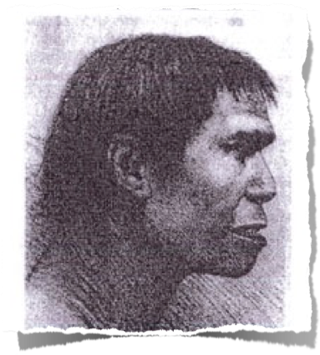
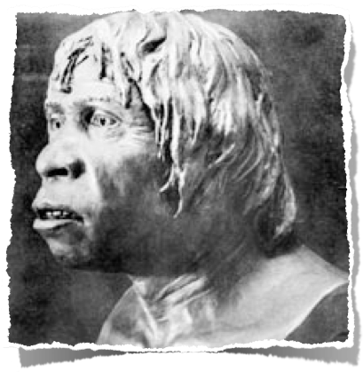
Omul din Piltdown, 1912
Evidența:
o bucată de maxilar
doi molari și un canin
o bucată de craniu
Interpretarea credibilă:
Te 500,000 - 1,000,000 de ani
“fără nici un dubiu posibil acesta reprezintă, ... un om care trebuie considerat că ne oferă o legătură cu strămoșii nostri de departe, maimuțele.”
1953:
Expus ca și un FALS intenționat care a implicat capi ai oamenilor de știintă britanici
“A Discovery of Supreme Importance to All Interested in the History of the Human Race,” Illustrated London News, 28 Dec. 1912, pp. 4–5.
Notes:
Found in a quarry near the village of Piltdown, Sussex, England.
Over the next 40 years, more than 500 scientific essays were written about the fossils, according to Glen Levy, “Piltdown Man”, 16 March 2010, TIME (http://www.time.com/time/specials/packages/article/0,28804,1931133_1931132_1931125,00.html, (also http://content.time.com/time/specials/packages/article/0,28804,1931133_1931132_1931125,00.html), accessed 7 June 2016). TIME’s 30 Nov. 1953 article about the hoax is at http://content.time.com/time/magazine/article/0,9171,823171,00.html, accessed 7 June 2016.
The ape-like painting is another image at that time: see end of http://www.guardian.co.uk/science/2012/feb/05/piltdown-man-archaeologys-greatest-hoax, accessed 2012 Feb 8.
Fuller quote:
“A discovery of supreme importance to all who are interested in the history of the human race was announced at the Geological Society on Wednesday evening (Dec. 18), when Mr. Charles Dawson, of Lewes, and Dr. A. Smith Woodward, the Keeper of the Geological Department of the British Museum, displayed to an eager audience a part of the jaw and a portion of the skull of the most ancient inhabitant of England, if not in Europe. The first of the remains were discovered more than a year ago by Mr. Dawson, in a gravel deposit near Pilt Down Common, close to Uckfield, Sussex. Mr. Dawson, who is a keen student of palæontology, soon made his great find known to Dr. Smith Woodward and the two worked together during the past summer, in a strenuous endeavour to recover, if possible, yet other parts of the skeleton, and especially the rest of the skull. But their efforts have only resulted in obtaining more parts of the skull, and half of the mandible. Nevertheless, the remains thus far recovered leave no possible doubt but that they represent not merely a fossil man, but a man who must be regarded as affording us a link with our remote ancestors, the apes, and hence their surpassing interest.”

Slide 42
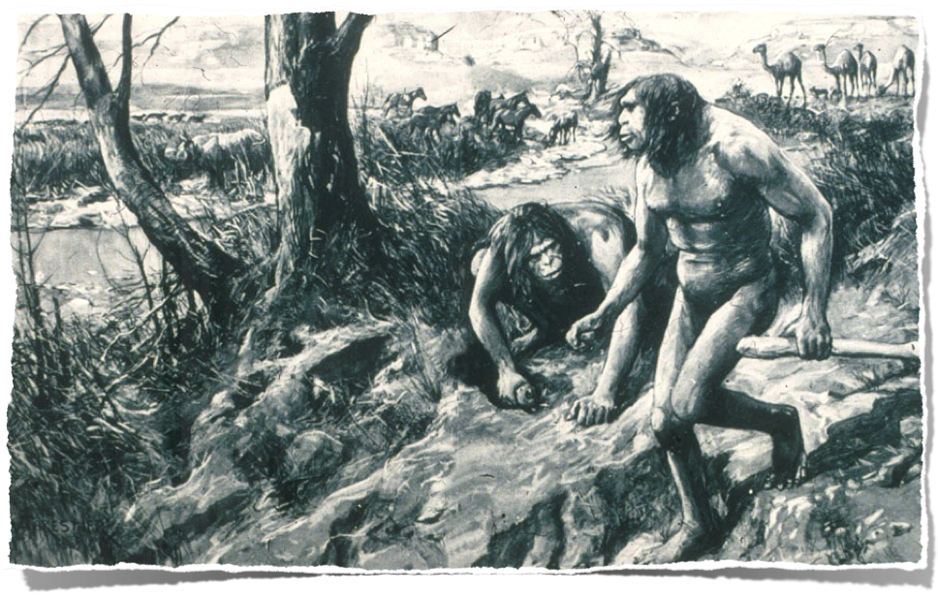
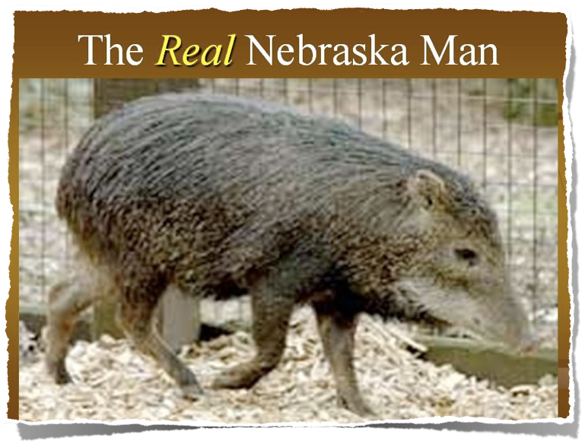
Omul de Nebraska
1922: Interpretare sigură om-maimuță
Evidența un singur dinte
Adevăratul Om de Nebraska
1927: Reînterpretarea o specie exctinctă de porc
Notes:
Source: Gary Parker, Creation: Facts of Life (Master Books), p. 152. or Ian Taylor, In the Minds of Men, 231-3.
source of original picture: *******************************
According to this well researched Muslim site http://www.harunyahya.com/refuted8.php#235a
Henry Fairfield Osborn named this tooth “Nebraska Man.” (Hesperophithecus haroldcookii, a form of Pithecanthropus erectus)
In 1927 other parts of the skeleton were found and reinterpreted as a tooth from an extinct species of pig (in the genus Prosthennops): William K. Gregory, "Hesperopithecus Apparently Not An Ape Nor A Man," Science, vol. 66:1720 (16 Dec. 1927), pp. 579-581. (article in computer file in pdf form)

Slide 43
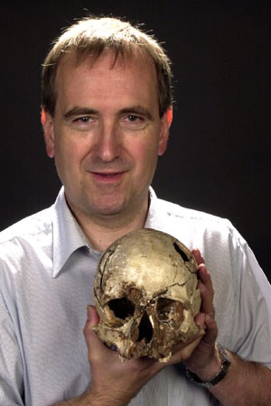
“Studiul originilor umane se pare a fi un câmp în care fiecare descoperire ridică dezbaterea la un mai mare și mai sofisticat nivel de nedumerire . . . Rămânând aproape de tradițiile acestui câmp, argumentele se învârt în jurul întrebărilor cu privire la clasificarea corectă a fosilelor și la relațiile prezumtive dintre speciile umane și pre-umane.”
Chris Stringer, Book review of Origins Reconsidered: In Search Of What Makes Us Human, by Richard Leakey (Doubleday, 1992), Scientific American (May 1993), p. 88 (emphasis mine).
Notes:
Chris Stringer (in 2015 a Research Leader in Human Origins at the Natural History Museum, London), a leading expert in global research.
After mentioning Skulls 1470 and 3733 found by Richard Leakey in Kenya, the Laetoli footprints found by Mary Leakey in Tanzania, and "Lucy" found by Donald Johanson in Ethiopia, Stringer says:

Slide 44
“Este greu ca cineva să poată creiona
o imagine realistică a primilor hominizi.
De aceea revista National Geographic
a pornit în căutarea unui talent.
Patru artiști au primit câteva mulaje
turnate după fosilele femeii-de-două-
milioane-ani Fosile de Homo habilis
(dreapta sus). Din aceste bucățele de
evidență ei trebuiau să schițeze o formă clară în schelet și în carne și oase a hominidului căruia îi aparțineau fragmentele respective.”
“Behind the Scenes,” National Geographic, March 2000

Slide 45
“‘Fiecare artist a avut 2 săptămâni cu mulajele de oase înainte ca acestea să fie trimise mai departe la următorul,’ declară coordonatorul Kris Hannah. ‘Cercetarea depinde absolut de fiecare artist. De aceea fiecare lucrare arată așa de diferit. Nu poate fi un singur mod de realizare a desenului.’
Paleontologii au evaluat rezultatele. Intrigat de cele 4 lucrări diferite, departmentul de artă i-a invitat pe artiști să picteze și să definitiveze versiunile lor deja schițate, pe baza rezultatelor oferite de consultanți.”
“Behind the Scenes,” National Geographic, March 2000

Slide 47
“Behind the Scenes,” National Geographic, March 2000

Slide 48
Gibon
Uman
Cimpanzeu
Gorila
Urangutan
Notes:
https://upload.wikimedia.org/wikipedia/commons/4/49/Ape_skeletons.png, accessed 15 Jan 2016

Slide 50
Cum se face omul-maimuță?
Câteva oase umane + imaginație = omul-maimuță
Câteva (?) oase de maimuță + imaginație = omul-maimuță
Câteva oase de maimuță + Câteva oase umane +
imaginație = omul-maimuță
4. Macină sau șlefuiește oasele de maimuță sau umane +
imaginație = omul-maimuță
Notes:
A few human bones
A few ape bones
ape + human bones
Grind or file the ape bones

Slide 51
Răposatul Om-Maimuță
Neanderthals — complet uman
Eanthropus (Omul de Piltdown) — fals
Hesperopithecus (Omul de Nebraska) — porc
Australopithecines — maimuță
Notes:
Peking Man, Java Man, Hobbit Man, Ida, Homo Habilis, Cro Magnon, Homo naledi, etc.: Fully human, fully ape or imaginary.
Homo Habilis—some evolutionists think: a mixture of australopithecine and Homo erectus fossils (i.e, bones from two taxons). Others: variant of australopithecines.
Peking man evidence was all lost in 1941 during WW2. We only have plaster casts remaining.
Java man, Hobbit man, Ida, etc.
Homo naledi—Dave Menton and Liz Mitchell conclude: ape
https://answersingenesis.org/blogs/ken-ham/2015/09/10/supposed-human-ancestor-found/
https://answersingenesis.org/human-evolution/homo-naledi-new-species-human-ancestor/ (This one is the most analytical.)
https://answersingenesis.org/blogs/ken-ham/2015/09/14/classify-fossil/ (This one looks at the controversy from the perspective of basic principles.)

Slide 52
Nu există
NICI
O EVIDENȚĂ
că omul a evoluat!
Notes:
Peking Man, Java Man, Hobbit Man, Ida, Homo Habilis, Cro Magnon, Homo naledi, etc.: Fully human, fully ape or imaginary.
Homo Habilis—some evolutionists think: a mixture of australopithecine and Homo erectus fossils (i.e, bones from two taxons). Others: variant of australopithecines.
Peking man evidence was all lost in 1941 during WW2. We only have plaster casts remaining.
Java man, Hobbit man, Ida, etc.
Homo naledi—Dave Menton and Liz Mitchell conclude: ape
https://answersingenesis.org/blogs/ken-ham/2015/09/10/supposed-human-ancestor-found/
https://answersingenesis.org/human-evolution/homo-naledi-new-species-human-ancestor/ (This one is the most analytical.)
https://answersingenesis.org/blogs/ken-ham/2015/09/14/classify-fossil/ (This one looks at the controversy from the perspective of basic principles.)

Slide 53
Imaginația
Arta
și
sunt cheile!
Notes:
Peking Man, Java Man, Hobbit Man, Ida, Homo Habilis, Cro Magnon, Homo naledi, etc.: Fully human, fully ape or imaginary.
Homo Habilis—some evolutionists think: a mixture of australopithecine and Homo erectus fossils (i.e, bones from two taxons). Others: variant of australopithecines.
Peking man evidence was all lost in 1941 during WW2. We only have plaster casts remaining.
Java man, Hobbit man, Ida, etc.
Homo naledi—Dave Menton and Liz Mitchell conclude: ape
https://answersingenesis.org/blogs/ken-ham/2015/09/10/supposed-human-ancestor-found/
https://answersingenesis.org/human-evolution/homo-naledi-new-species-human-ancestor/ (This one is the most analytical.)
https://answersingenesis.org/blogs/ken-ham/2015/09/14/classify-fossil/ (This one looks at the controversy from the perspective of basic principles.)

Slide 54
De-a lungul timpului,
Evoluționiștii
devin din ce în ce mai confuzi!
Notes:
Peking Man, Java Man, Hobbit Man, Ida, Homo Habilis, Cro Magnon, Homo naledi, etc.: Fully human, fully ape or imaginary.
Homo Habilis—some evolutionists think: a mixture of australopithecine and Homo erectus fossils (i.e, bones from two taxons). Others: variant of australopithecines.
Peking man evidence was all lost in 1941 during WW2. We only have plaster casts remaining.
Java man, Hobbit man, Ida, etc.
Homo naledi—Dave Menton and Liz Mitchell conclude: ape
https://answersingenesis.org/blogs/ken-ham/2015/09/10/supposed-human-ancestor-found/
https://answersingenesis.org/human-evolution/homo-naledi-new-species-human-ancestor/ (This one is the most analytical.)
https://answersingenesis.org/blogs/ken-ham/2015/09/14/classify-fossil/ (This one looks at the controversy from the perspective of basic principles.)

Slide 55
Ce spune Biblia?

Slide 56
Adam și Eva au fost creați supernatural și au fost unici față de celelalte creaturi.

Slide 57
“Pare perfect posibil să reconciliem istoricitatea lui Adam cu cel puțin o parte (teistă) a teoriei evoluției. Mulți creștini biblici procedează așa, și credem că nu sunt total incompatibili.“
John Stott, quoted in Colin Chapman, The Case for Christianity (Grand Rapids, MI: Eerdmans, 1981), p. 130.
Notes:
Stott died in 2011.
Picture from http://www.cslewis.org/programs/cruise/2004/speakers.html, downloaded 15 April 2005
“It seems perfectly possible to reconcile the historicity of Adam with at least some (theistic) evolutionary theory. Many biblical Christians in fact do so, believing them to be not entirely incompatible. To assert the historicity of an original pair who sinned through disobedience is one thing; it is quite another to deny all evolution and assert the separate and special creation of everything, including both subhuman creatures and Adam’s body. “The suggestion (for it is no more than this) does not seem to me to be against Scripture and therefore impossible that when God made man in His own image, what He did was to stamp His own likeness on one of the many ‘hominids’ which appear to have been living at the time.”
“Speaking hesitatingly as a non-scientist,” Stott goes on to indicate that he leans toward the idea of pre-Adamite hominids who were anatomically indistinguishable from modern man but who did not bear the image of God.
John Stott, quoted in Colin Chapman, The Case for Christianity (Grand Rapids, MI: Eerdmans, 1981), p. 130.

Slide 58
“A afirma istoricitatea unei perechi originale care a păcătuit prin neascultare este un lucru;
este însă altceva să negi toată evoluția și să susții creația specială și separată a lucrurilor, incluzând atât creaturile subumane cât și trupul lui Adam.”
John Stott, quoted in Colin Chapman, The Case for Christianity (Grand Rapids: Eerdmans, 1981), p. 130.
Notes:
Picture from http://www.cslewis.org/programs/cruise/2004/speakers.html, downloaded 15 April 2005

Slide 59
“Sugestia (pentru ca nu poate fi mai mult decât atât)
nu mi se pare a fi în contradicție cu Scriptura și astfel imposibil ca atunci când Dumnezeu a creat omul după chipul Său, să fi marcat imaginea Sa pe unul din cei atât de mulți ‘hominizi’ care par că au trăit în acea vreme.”
John Stott, quoted in Colin Chapman, The Case for Christianity (Grand Rapids: Eerdmans, 1981), p. 130.

Slide 60
“Vorbind cu ezitare ca unul care nu este om de știință” Stott vrea să arate că înclină spre ideea de hominizi pre-Adamici care nu se puteau deosebi, anatomic vorbind, de omul modern, dar care nu purtau chipul lui Dumnezeu.
John Stott, quoted in Colin Chapman, The Case for Christianity (Grand Rapids: Eerdmans, 1981), p. 130.

Slide 61
Adam and Eva au fost creați în mod supranatural și au fost unici față de orice altă creatură.

Slide 62
Geneza 1:27
Dumnezeu a făcut pe om după chipul Său, l-a făcut după chipul lui Dumnezeu; parte bărbătească şi parte femeiască i-a făcut.
Notes:
Man and woman are the only creatures made in the image of God.

Slide 63
Geneza 2:7
Domnul Dumnezeu a făcut pe om din ţărâna pământului, i-a suflat în nări suflare de viaţă, şi omul s-a făcut astfel un suflet viu.
Notes:
NAS, NIV, NKJV, HCSB: “living being”

Slide 64
Biblia
omul + suflare Divină = suflet viu
Ebraică: nephesh chayyah
(și Gen. 1:20-21, 24; 2:19, 9:10)
1 Corinteni 15:45a
De aceea este scris: „Omul dintâi Adam a fost făcut un suflet viu”
GREȘIT!
Evoluția Teistică
creatură vie + suflare Divină = omul
nephesh chayyah

Slide 65
Geneza 3:19
În sudoarea feţei tale să-ţi mănânci pâinea până te vei întoarce în pământ, căci din el ai fost luat, căci ţărână eşti şi în ţărână te vei întoarce.
Notes:
When you die you are not going to become some sub-human living creature. You are literally going to become dust.

Slide 66
Geneza 2:20
Şi omul a pus nume tuturor vitelor, păsărilor cerului şi tuturor fiarelor câmpului, dar, pentru om, nu s-a găsit niciun ajutor care să i se potrivească.
Nu a mai fost alt om cu care Adam să se potrivească.
Notes:
naming animals => Adam saw he is alone

Slide 67
Geneza 2:22
Din coasta pe care o luase din om, Domnul Dumnezeu a făcut o femeie şi a adus-o la om.
Notes:
NASB

Slide 68
Geneza 3:20
Adam a pus nevestei sale numele Eva, căci ea a fost mama tuturor celor vii.
1 Corinteni 15:45
De aceea este scris: „Omul dintâi Adam a fost făcut un suflet viu”.
Notes:
The Bible only speaks of the first heaven and earth and the new ones. The gap theory would mean that there was a first, second and new—so three heavens and earths instead of only two.

Slide 70
Acts 17:24, 26
24 Dumnezeu care a făcut lumea şi tot ce este în ea . . .
26 El a făcut ca toţi oamenii, ieşiţi dintr-unul singur, să locuiască pe toată faţa pământului; …
Notes:
NASB

Slide 71
1
PERSPECTIVA BIBLICĂ
ADAM ȘI EVA
1 Corinteni 15:45
Geneza 3:20
FII ȘI FIICE
Geneza 5:4
NOE ȘI FIII
Geneza 9:17–19
OAMENII LA
TURNUL BABEL
Geneza 11:8–9
Fapte 17:26
OAMENI, CULTURI, GRUPURI DIFERITE

Slide 72
FAPT BIOLOGIC:
TOȚI oamenii aparțin unei singuri “rase”.
Notes:
Experts in the Human Genome Project agreed there is only one human race.
http://en.wikipedia.org/wiki/Human_Genome_Project
The Human Genome Project (HGP) is an international scientific research project with the goal of determining the sequence of chemical base pairs which make up human DNA, and of identifying and mapping all of the genes of the human genome from both a physical and functional standpoint.[1] It remains the world's largest collaborative biological project.[2] The project was proposed and funded by the US government ; planning started in 1984, the project got underway in 1990, and was declared complete in 2003. A parallel project was conducted outside of government by the Celera Corporation, or Celera Genomics, which was formally launched in 1998. Most of the government-sponsored sequencing was performed in universities and research centres in China, France, Germany, Japan, Spain, the United Kingdom, and the United States.[3]
The Human Genome Project originally aimed to map the nucleotides contained in a human haploid reference genome (more than three billion). The "genome" of any given individual is unique; mapping "the human genome" involves sequencing multiple variations of each gene.[4] The project did not study the entire DNA found in human cells; some heterochromatic areas (about 8% of the total genome) remain unsequenced.

Slide 73
STRABUNII DIN EVOLUTIE?

Slide 74
“În viitor, nu un viitor distant dacă îl măsurăm în secole, dar este aproape sigur că rasele civilizate ale omenirii vor extermina și vor înlocui rasele sălbatice de pe tot globul. În același timp, maimuțele antropomorfe . . . fără nici o îndoială vor fi exterminate.”
Charles Darwin, The Descent of Man, 2nd ed. (New York: A.L. Burt, 1874), p. 178.

Slide 75
“Atunci ruptura dintre om și aliații lui cei mai apropiați va deveni mai largă, deoarece va separa omul dintr-o stare mai civilizată, după cum sperăm, chiar un caucazian [om alb] și vreo maimuță atât de inferioară ca și babuinul, în locul celei de acum dintre un negru sau un australian [indigen] și o gorilă.”
Charles Darwin, The Descent of Man, 2nd ed. (New York: A.L. Burt, 1874), p. 178.

Slide 76
“Argumentele biologice pentru rasism au fost destul de obișnuite înainte de 1850 dar ele au crescut la nivele de magnitudine după acceptarea teoriei evoluției.”
Stephen Jay Gould, Ontogeny and Phylogeny (Cambridge, Massachusetts: Belknap-Harvard Press, 1977), pp. 127–128.

Slide 77
National Geographic, 1985
Time-Life Books, 1971
Notes:
Top chart: Kenneth F. Weaver “The Search for our Ancestors,” National Geographic (Nov. 1985), pp. 574-577. Notice the feet, hands, arm length, subtly racist skin color.
Bottom chart: William Howells (Prof. of Anthrop., Harvard), Early Man (New York: Time-Life Books, 1971), pp. 41-45. I have a similar chart to this one in my Photos from F. Clark Howell, Early Man (New York: Time-Life Books,1973).

Slide 78
Discovery Channel web site, 11 Dec. 2007
Notes:
http://dsc.discovery.com/news/2007/12/11/human-evolution.html, article dated 11 Dec. 2007, accessed 27 July 2008
Notice the arm length and subtly racist skin color change.

Slide 79
1
PERSPECTIVA BIBLICĂ
ADAM ȘI EVA
1 Corinteni 15:45
Geneza 3:20
FII ȘI FIICE
Geneza 5:4
NOE ȘI FIII
Geneza 9:17–19
OAMENII LA
TURNUL BABEL
Geneza 11:8–9
Fapte 17:26
OAMENI, CULTURI, GRUPURI DIFERITE

Slide 81
Ce “culoare” a avut
pielea lui Adam și Eva?

Slide 82
aabb
aabb
aabb
aabb
aabb
aabb
Lacking Genetic Variation
AABB
AABB
AABB
AABB
AABB
AABB

Slide 83
aabb
aabb
aabb
aabb
aabb
aabb
AaBb
AaBb
AABB
AABb
aaBb
aabb
AABB
AABB
AABB
AABB
AABB
AABB
AABB
AABB

Slide 84
Variații genetice multiple
AABB
AaBb
AaBb
AABb
aaBb
Adam și Eva
aabb

Slide 85
Notes:
Mother is from Ghana. Father is from Germany.

Slide 86
Multi-color twins close-up
Notes:
Girls born in 2005. Both parents have black fathers and white mothers
Lucy Laing, “Twin Sisters—One Black, One White—Turn Heads in England,” JET, vol. 109:12 (27 March 2006), p. 36.
AiG has permission to use this picture. It is used in the museum.
See also follow story (next slide) at Paul Harris and Lucy Laing, “Closer than ever... The million-to-one black and white twins Kian and Remee turn seven,” The Daily Mail (UK), 30 March 2012. One (Kian) is a brown-eyed “black” and the other (Remee) is a blue-eyed “white.” Their middle-brown parents (f: Remi, m: Kylee) both have “white” mothers and “black” fathers.
http://www.dailymail.co.uk/news/article-2123050/Look-The-black-white-twins-turn-seven.html, accessed 22 April 2014

Slide 87
Gemene
una neagră și una albă?
Gemene
una maro închis și una maro deschis!
Notes:
Here they are at age 7.
Paul Harris and Lucy Laing, “Closer than ever... The million-to-one black and white twins Kian and Remee turn seven,” The Daily Mail (UK), 30 March 2012. One (Kian) is a brown-eyed “black” and the other (Remee) is a blue-eyed “white.” Their middle-brown parents (f: Remi, m: Kylee) both have “white” mothers and “black” fathers.
http://www.dailymail.co.uk/news/article-2123050/Look-The-black-white-twins-turn-seven.html, accessed 22 April 2014

Slide 88
Variații Umane
Caucasian
Negroid
Mongoloid
Cro Magnon
Familia lui Noe
opt oameni
Homo erectus
Neanderthal
Adam și Eva
Notes:
From Reinhard Junker, Is Man Descended from Adam? (Biblical Creation Society, 2000, translated by Steven Robinson), p. 37.
Neanderthal, Homo erectus and Cro Magnon have the same range of brain size and the same inner ear structure (key for determining that they habitually walked upright) as modern man has. They buried their dead and did artwork like modern man does, too.
Good article (dated 2000) on Homo erectus being equal to modern man is: John Woodmorrape, “How different is the cranial-vault thickness of Homo erectus from modern man?”, <www.answersingenesis.org/home/area/magazines/tj/docs/v14n1_cranium.asp>.
Even in the absence of genomic data, it seems reasonable to consider Homo erectus as human beings. Like Neanderthals, Homo erectus left abundant evidence of their ability to use tools, control fire, and bury the dead. Not all variations among humans have survived, but all descended from a literal Adam and Eve. http://www.answersingenesis.org/articles/2011/06/03/feedback-search-for-historical-adam. For more information about Homo erectus see “Homo erectus: A Man for All Seasons” and “Homo erectus: All in the Family” in Bones of Contention by Marvin Lubenow.

Slide 89
DATE
Arborele
Evoluției
Pădurea
Creației
Notes:
As we look at what the evolutionists say and what the Bible says, we will see that the scientific evidence fits with the Bible but it does not at all confirm the evolutionist story.
Chart adapted from Reinhard Junker, Is Man Descended from Adam? (Biblical Creation Society, 2000, translated by Steven Robinson), p. 6.

Slide 90
Și ce contează?
Notes:
As a content template, this is best suited for standard content such as outlines, quotations, Scriptures, and maybe illustrations or photos. Presentation Team recommends 48–60 pt. font for headings and 28–40 pt. for body text. Because of eye flow and visual psychology, the top line may be a little closer than all other sides. This also contains a floating AiG logo that can be repositioned or removed as appropriate for the overhead’s content.

Slide 91
Purtătoarea de cuvânt Polly Wills de la Grădina Zoologică din Londra a afirmat,
“Observând oamenii într-un mediu diferit, în mijlocul altor animale . . . educă membrii publicului că oamenii (umani) sunt doar alte (animale) primate.”
Notes:
Picture and quote: Assoc. Press, “Crowds go ape over ‘humans’ zoo exhibit,” 26 Aug. 2005, http://www.msnbc.msn.com/id/9087023/, still on line as video clip and article on 2011 May 22.

Slide 92
Închis în cușcă
și ținut în pavilionul maimuțelor la Grădina Zoologică Bronx din
New York
din septembrie 1904 până la sfârșitul anului 1906
Notes:
His first wife and kids were brutally murdered by white thugs working for the Belgian government. His second wife died from a poisonous snake bite. Ota Benga (1881-1916), a pygmy in the Belgian Congo (now the Democratic Republic of Congo), was captured and sold into slavery by another tribe. He was later purchased by African explorer Samuel Verner (motivated by evolution theory) who presented Ota to the Bronx Zoo in New York City, where he was caged and displayed with an orangutan in the monkey house in September, 1904.
Black pastors immediately protested and some whites also became concerned. Eventually, he was let out during the day (he was ill-treated by the zoo visitors and even sometimes was hostile back towards them), but had to sleep in the Monkey cage at night. Finally in late 1906 he got out of the zoo and he was cared for by Christians, both black and white, eventually settling in Lynchburg, VA. He became a baptized Christian and attended classes at Virginia Theological Seminary and College for several years. But he quit, went to work in a tobacco factory and 2-3 years later (in 1916) at the age of 35 he committed suicide.

Slide 93
AUTORITATEA
LUI
DUMNEZEU
DUMNEZEU
RÂNDUIEȘTE
REGULILE
ADAM
în trecutul
tău

Slide 94
Moralitate
Relativă
MAIMUȚA
în trecutul
tău
Omul
rânduiește
regulile
Ooh!
Ooh!
Aah!

Slide 95
“Fără Adam și Eva nu avem nevoie de un mântuitor. De asemenea Biblia nu poate a fi crezută ca fiind o sursă de adevăr neambiguu, literal. Este complect lipsită de încredere, deoarece este bazată - din începuturile ei - pe un mit, iar apoi clădește pe această bază. Fără căderea omului nu este nevoie de ispășire și nici de un răscumpărător.”
American Atheists, “You KNOW it’s a Myth: This Season, Celebrate REASON!” https://atheists.org, no date, accessed 1 June 2011.
Notes:
https://atheists.org/atheism/Christmas

Slide 96
În căutarea Istoricului Adam
Anumiți învâțați cred că știința genetică aruncă neîncredere asupra existenței primului bărbat și a primei femei. Alții spun că integritatea credinței o cere.
June 2011
Notes:
Article in file cabinet: Ostling 2011

Slide 97
X
X
X
Notes:
Adam and Eve: AiG Museum
Cross and Tomb: AiG graphic
Birth of Jesus: http://oneyearbible.blogs.com/photos/uncategorized/jesus_manger.jpg, accessed 1 Sept. 2006

Slide 98
DE LA ADAM LA HRISTOS
MATEI:
Din neamul lui Iosif
HRISTOS
LUCA:
Din neamul Mariei

Slide 99
DE LA METAFORĂ LA HRISTOS
MATEI:
Din neamul lui Iosif
HRISTOS
LUCA:
Din neamul Mariei

Slide 100
Isus Hristos
“Ultimul Adam”
1 Cor. 15:45
Şi după cum toţi mor în Adam, tot aşa, toţi vor învia în Hristos.
(1 Corinteni 15:22)
“Primul Adam”
1 Cor. 15:45
Notes:
Absolutely not, it’s a primary doctrine bc it’s foundational to all the other primary doctrines! As I thought about this crucial connection between Adam and the Gospel I thought about Cedarville’s motto

Slide 101
“Există o imagine foarte populară legată de evoluția omului pe care o vei găsi peste tot… În stânga imaginii este o maimuță … În dreapta, un om … Între cei doi este o succesiune de figuri care seamănă mai degrabă cu oamenii … Progresul nostru de la maimuță la om arată atât de lin, atât de ordonat. Este o imagine atât de înșelătoare încât chiar și experții sunt sceptici în a o încuviința.
Dar nu este altceva decât o iluzie.”
Bernard Wood (prof. of human origins, George Washington Univ.), “Who are we?” New Scientist, 2366
(26 Oct. 2002), p. 44.
Notes:
photo (2014): https://www.youtube.com/watch?v=wmWqojkcJ_8, accessed 2015 Nov. 9

Slide 102
Evoluția Omului
ILUZIE
DECEPȚIE
Notes:
iluzie

Slide 103
Acts 17:30-31
”30. Dumnezeu nu ţine seama de vremurile de neştiinţă şi porunceşte, acum, tuturor oamenilor de pretutindeni să se pocăiască,
31. pentru că a rânduit o zi în care va judeca lumea după dreptate, prin Omul pe care L-a rânduit pentru aceasta şi despre care a dat tuturor oamenilor o dovadă netăgăduită prin faptul că L-a înviat din morţi…”

Slide 104
Scientist & Bible—ape-men w/ S, L, D’Souza, Collins & Dembski
Omul a evoluat din maimuță. Pe cuvântul meu!
Eu i-am creat pe Adam și pe Eva supernatural.
Pe Cuvântul Meu!
T. Longman
D. D’Souza
Confirmat de adevărata știință
Francis Collins
C. John Collins
John Walton
John Stott
Notes:
As of 2017
Tremper Longman, OT prof at Westmont College
Dinesh D’Souza, author and film-maker
Francis Collins, Dir. of the Nat. Inst. of Health under Obama, Founder of BioLogos, Former Dir. of the Human Genome Project
C John Collins, OT prof at Covenant Theol. Sem.
John Walton, Wheaton OT prof
John Stott (1921-2011), former Pastor of All Soul’s Church, Langham Place, London

Slide 105
Răspunsuri în Geneza

Slide 106
Cărțile cu Răspunsuri 1, 2, 3 & 4
FREE on-line (English)
rasism
“omul maimuță”
90-7-538_NewAnswersBookSet
Notes:
Answer the 130 most asked questions
First two books available FREE on-line (ANSWERS—ONLINE BOOKS)

Slide 107
Black

Slide 108
Get this presentation for free!
Creația • BibleStudyDownloads.org
Notes:
The Bible…Basically (bb)

