Slide 1
Evoluția versus Creația
Știința versus Credința?
Care-i dreaptă?
Dr. Terry Mortenson

Slide 2

Răspunsuri în Geneza

Slide 3

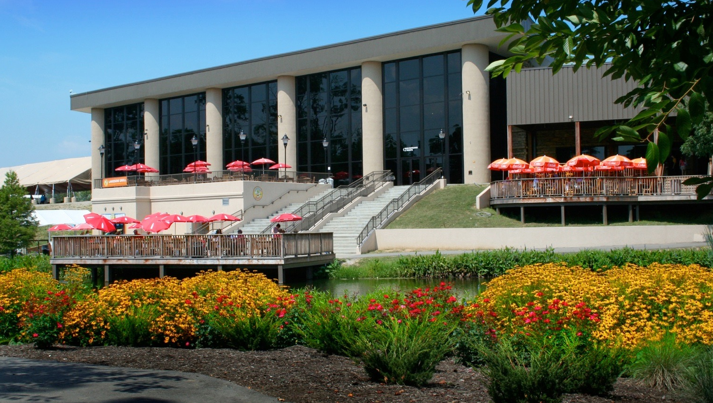
Muzeul Creației, Petersburg, KY

Slide 4

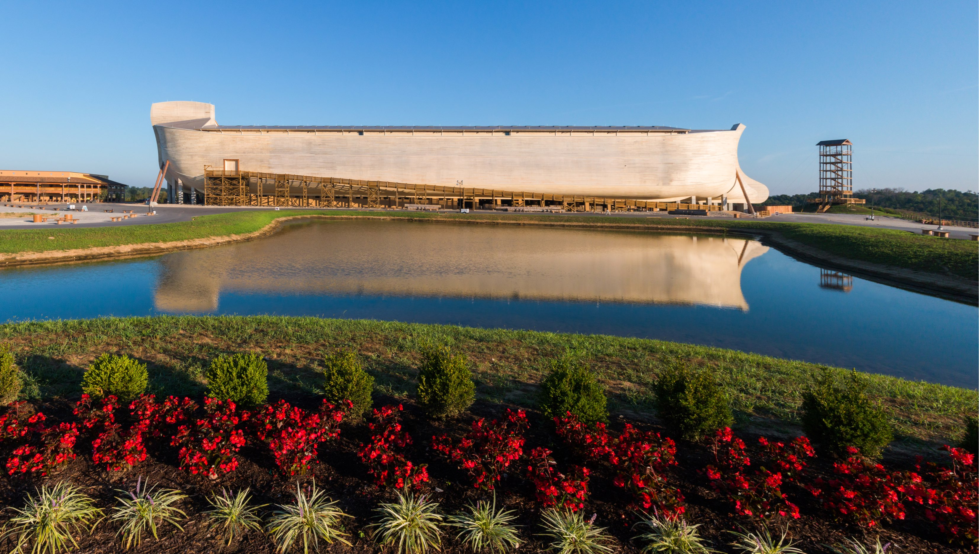
Întâlnirea cu Arca, Williamstown, KY

Slide 5
Evoluția versus Creația
Știința versus Credința?
Care-i dreaptă?
Dr. Terry Mortenson

Slide 6
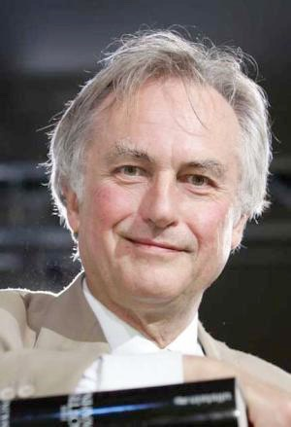
“Este cu o siguranță absolută să poți spune că, dacă întâlnești pe cineva care ține că nu crede în evoluție, acea persoană este ignorantă, proastă sau alienată mintal (sau rău voitor, dar mai degrabă nu aș considera acest lucru).”
Richard Dawkins, “Put Your Money on Evolution” (a review of Donald Johanson and Mailand Edey, Blueprints: solving the mystery of evolution), The New York Times Review of Books (9 April 1989), p. 35.
Notes:
Ignorance, insanity, wickedness of creationists:
http://www.youtube.com/watch?v=C5Is6GLlWAw, accessed 1 May 2013.

Slide 7
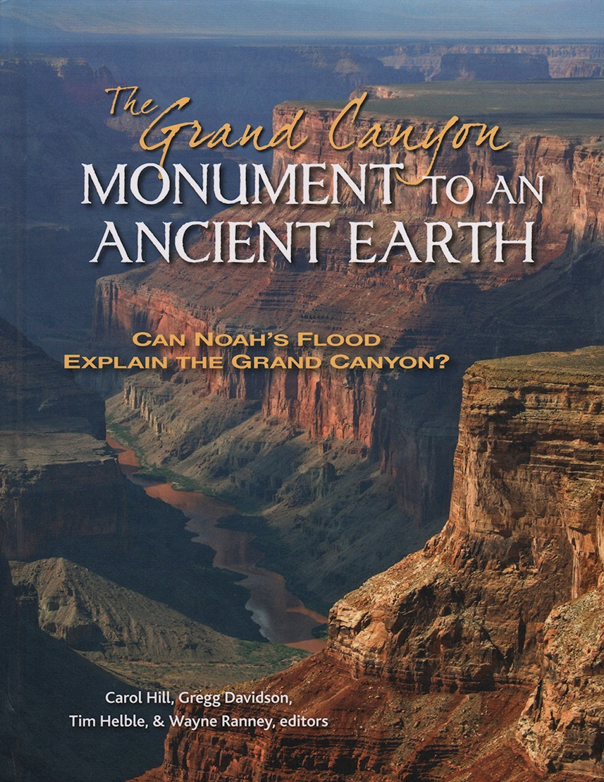
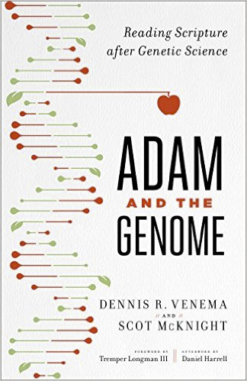
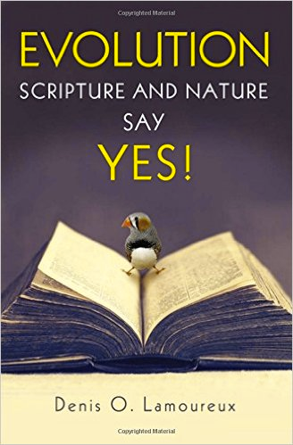
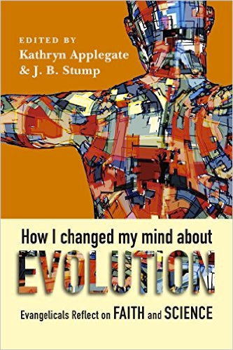
Kregel
Susținerea Evoluției Teistice
Baker
Zondervan
IV Press
Notes:
For sale or review at ETS2016 in San Antonio
Kregel: May 2016
Baker: January 2017.
Zondervan: November 2016
IVPress: June 2016

Slide 8

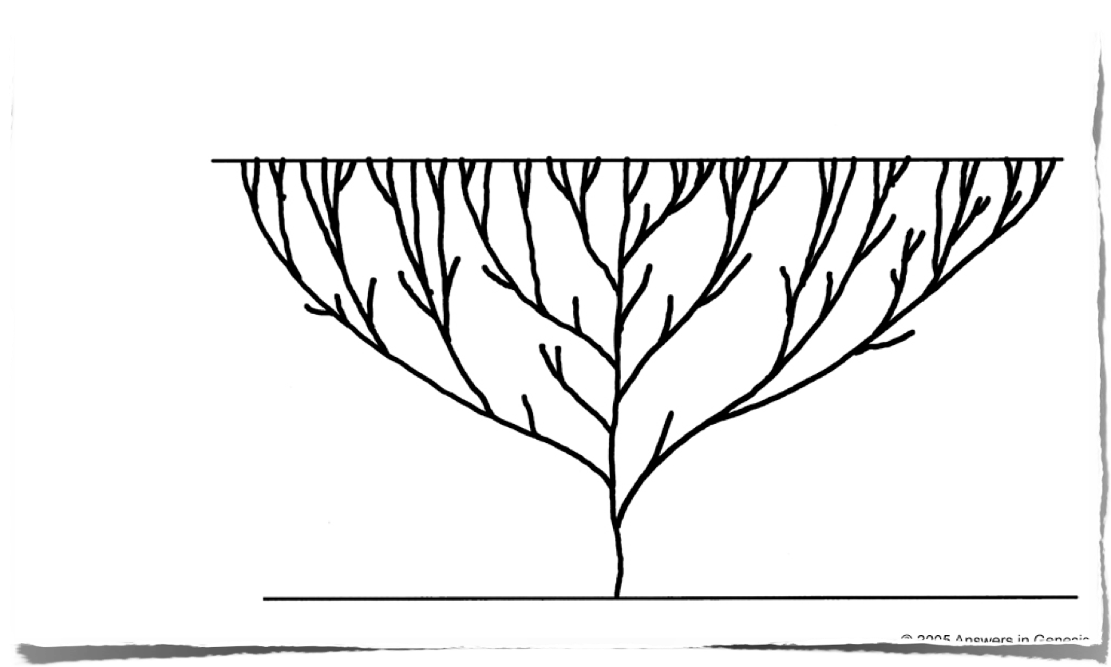

Microb la Microbiolog
„Arborele Vieții” al Evoluției
Prezentul
Milioane de Ani
Începutul
Prima celulă cu viață
Notes:
Evolutionists say that the beginning of life was about 1.9-3.8 billion years ago in the ocean. The trunk of the tree before any branch would actually be much longer than the upper part of the tree as in the evolutionary view it took a very long time (1.4-3.3 bill yrs) to go from single celled to multicelled creatures (about 550 million years ago).

Slide 9
Naturalismul
1) Natura sau materia este tot ce există.
      2) Toate lucrurile pot, și intr-adevăr trebuie să fie explicate prin timp plus șansă plus legile naturii care acționează asupra materiei.
Presupunerile Ateismului

Slide 10
Viziunea Biblică Asupra Lumii
1) Dumnezeu veșnic, bun, atotștiutor, atotputernic, sfânt există și a creeat toate lucrurile.
      2) Biblia, mărturia oculară adevărată și completă a lui Dumnezeu, explică evenimentele cheie din istorie, pentru ca noi să putem interpreta corect evidența de la origine și de la istoria creației (facerii).

Slide 11
Geneza 1:11–12
¹¹ Apoi Dumnezeu a zis: „Să dea pământul verdeaţă, iarbă cu sămânţă, pomi roditori, care să facă rod după soiul lor şi care să aibă în ei sămânţa lor pe pământ.” Şi aşa a fost.
¹² Pământul a dat verdeaţă, iarbă cu sămânţă după soiul ei şi pomi care fac rod şi care îşi au sămânţa în ei, după soiul lor. Dumnezeu a văzut că lucrul acesta era bun.
Notes:
NASB

Slide 12
Geneza 1:21
Dumnezeu a făcut peştii cei mari şi toate vieţuitoarele care se mişcă şi de care mişună apele, după soiurile lor; a făcut şi orice pasăre înaripată după soiul ei. Dumnezeu a văzut că erau bune.
Notes:
NASB

Slide 13
Geneza 1:25
Dumnezeu a făcut fiarele pământului după soiul lor, vitele după soiul lor şi toate târâtoarele pământului după soiul lor. Dumnezeu a văzut că erau bune.
Notes:
NASB

Slide 14
Geneza 1:11–12
¹¹ Apoi Dumnezeu a zis: „Să dea pământul verdeaţă, iarbă cu sămânţă, pomi roditori, care să facă rod după soiul lor şi care să aibă în ei sămânţa lor pe pământ.” Şi aşa a fost.
¹² Pământul a dat verdeaţă, iarbă cu sămânţă după soiul ei şi pomi care fac rod şi care îşi au sămânţa în ei, după soiul lor. Dumnezeu a văzut că lucrul acesta era bun.
Notes:
NASB

Slide 15
Geneza 1:22
22 Dumnezeu le-a binecuvântat şi a zis: „Creşteţi, înmulţiţi-vă şi umpleţi apele mărilor; să se înmulţească şi păsările pe pământ.”
Notes:
NASB

Slide 16
Geneza 1:28
28 Dumnezeu i-a binecuvântat şi Dumnezeu le-a zis: „Creşteţi, înmulţiţi-vă, umpleţi pământul şi supuneţi-l şi stăpâniţi peste peştii mării, peste păsările cerului şi peste orice vieţuitoare care se mişcă pe pământ.”
Notes:
NASB

Slide 17
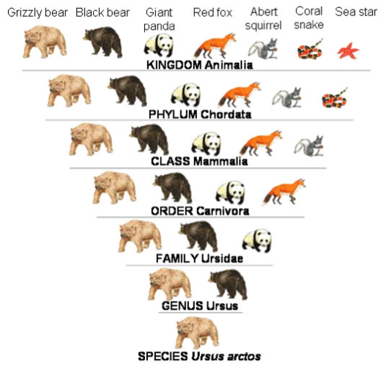
Regn
Încrengătură
Clasă
Ordin
Familie
Gen
Specie
Soi =

Slide 18
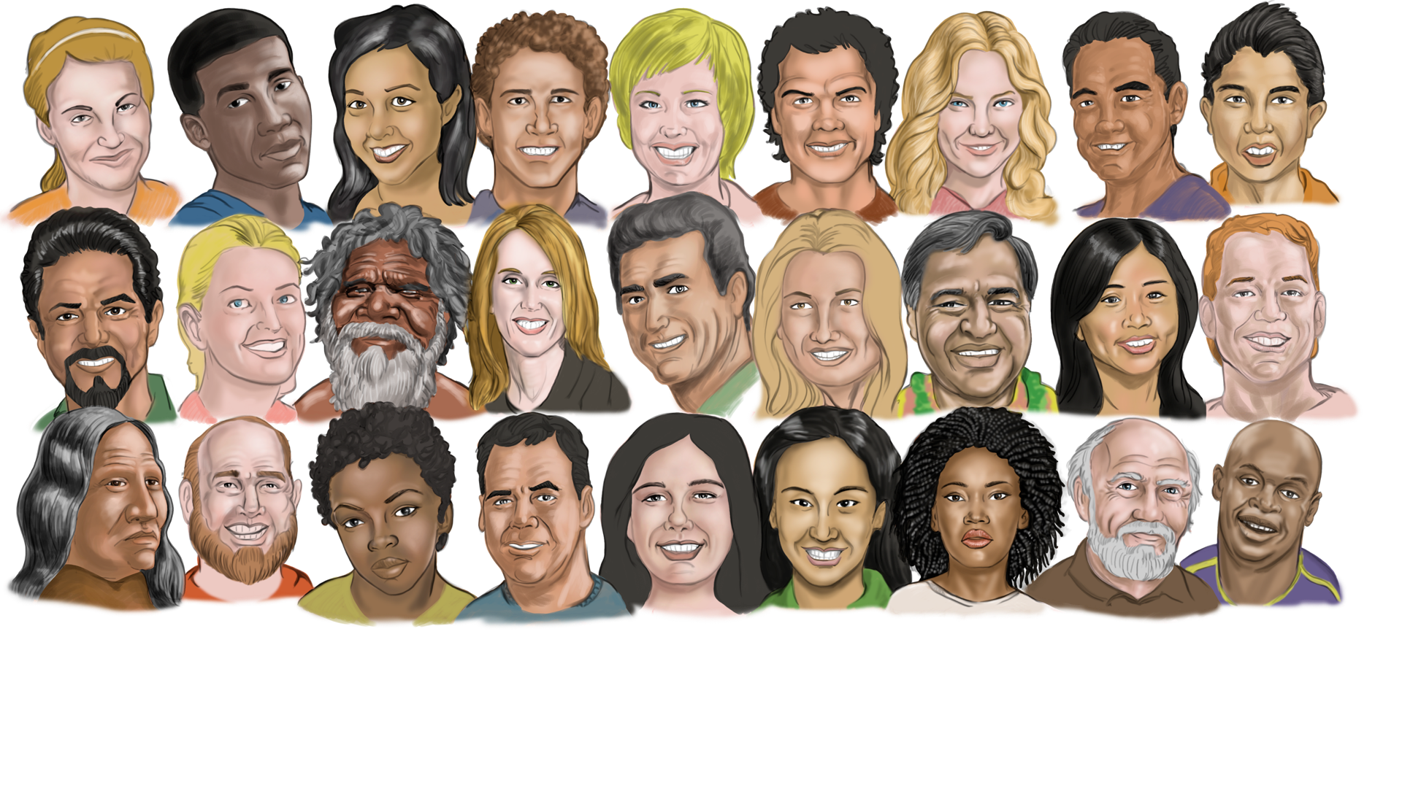

Slide 19
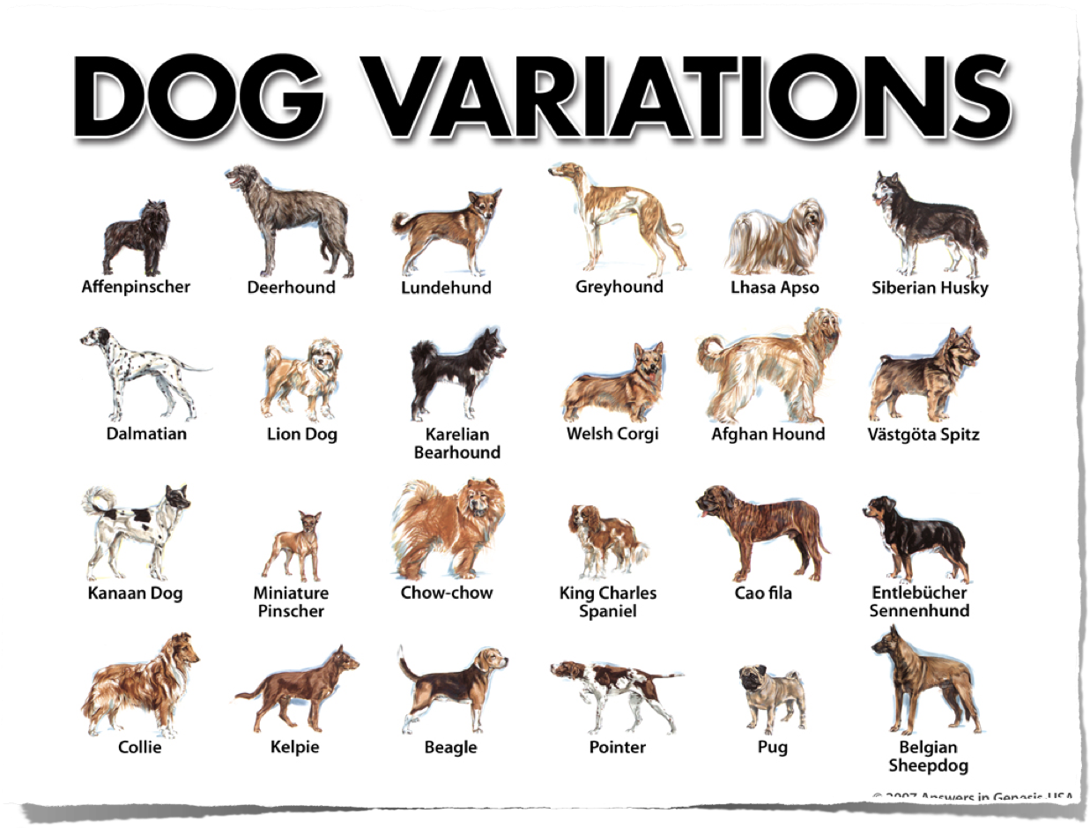
Variații la Câini
Notes:
“DNA mutation explains huge variety in dog sizes: study”, April 5, 2007
A single genetic mutation explains why dogs vary in size from the miniature Chihuahua to massive mastiffs, a range unmatched by any other mammal, according to a study released Thursday.
Researchers have long puzzled over the tremendous variation in size seen in canine breeds, particularly since the species diversified over a relatively short period of time from an evolutionary standpoint.
The new study suggests the riddle can be explained by a combination of a genetic accident that created a small dog and ten thousand years of selective dog-breeding that ensured the rapid dissemination of this particular piece of doggy DNA.
The researchers believe the discovery of the DNA mutation could also help explain why humans vary so much in size.
"The study is a major milestone in canine genetics. We have precisely located the major gene that produces our miniature breeds," said study co-author Paul Jones, a genetics researcher at Mars Inc, the US confectionery and pet food giant which supplied DNA samples used in the study.
All told, an international team of researchers examined the DNA of more than 3,000 dogs from 143 breeds ranging from pocket-sized pooches such as the Chihuahua, Maltese, Pomeranian, pug and Pekinese to the huge Great Dane, St. Bernard and Irish Wolfhound.
They found that all dogs under 20 pounds (9 kilos), and virtually all of the small canines studied, carried minute genetic variations on the gene IGF-1 which codes for a protein hormone called insulin-like growth factor 1.
The IGF-1 gene's hormone helps humans and other mammals grow from birth to adolescence. In small dogs, one or more mutations in the DNA next to the gene suppresses its activity, keeping small dogs from growing larger, the researchers reported in the journal Science.
The investigators found the genetic fingerprint in breeds that are distantly related and found in distant regions, suggesting that this hiccup in doggy DNA probably occurred about 12,000 years ago.
"It's as ancient as small dogs," said Gordon Lark, a biologist at the University of Utah in Salt Lake City who worked on the project.
"Dogs are derived from wolves. Since this is found in all small dogs, it either got into dogs when they were first domesticated or it was a small wolf that dogs descended from."
Over time, and under the management of humans, the species saw a rapid diversification into a multitude of domestic dog breeds. The researchers believe there was a bias toward breeding small dogs because they were easier to maintain in the crowded confines of developing cities and villages, and more easily transportable during trade and migration.
The findings have implications far beyond the canine world, the authors said. "By learning how genes control body size in dogs, we are apt to learn something about how skeletal body size is genetically programmed in humans," said Elaine Ostrander, a senior author of the study and chief of cancer genetics at the National Human Genome Research Institute (NHGRI), which is part of the National Institutes of Health.
"Nearly all of what we learn from studying body structure, behavior and disease susceptibility in dogs helps us understand some aspect of human health and biology."
Web page 2
Researchers at NHGRI led the study with help from colleagues at several US and UK institutions including Cornell University in New York, the University of California, Los Angeles, the University of Southern California in Los Angeles, and the Waltham Centre for Pet Nutrition in Leicestershire, England.
http://news.yahoo.com/s/afp/20070405/sc_afp/ussciencedogs2&printer=1;_ylt=AgwSKUvh, accessed 16 April 2007
Copyright © 2007 Agence France Presse. All rights reserved. The information contained in the AFP News report may not be published, broadcast, rewritten or redistributed without the prior written authority of Agence France Presse.
Original research in:
Nathan B. Sutter, et al, “A Single IGF1 Allele Is a Major Determinant of Small Size in Dogs,” Science, Vol. 316 (6 April 2007, pp. 112-115.

Slide 20
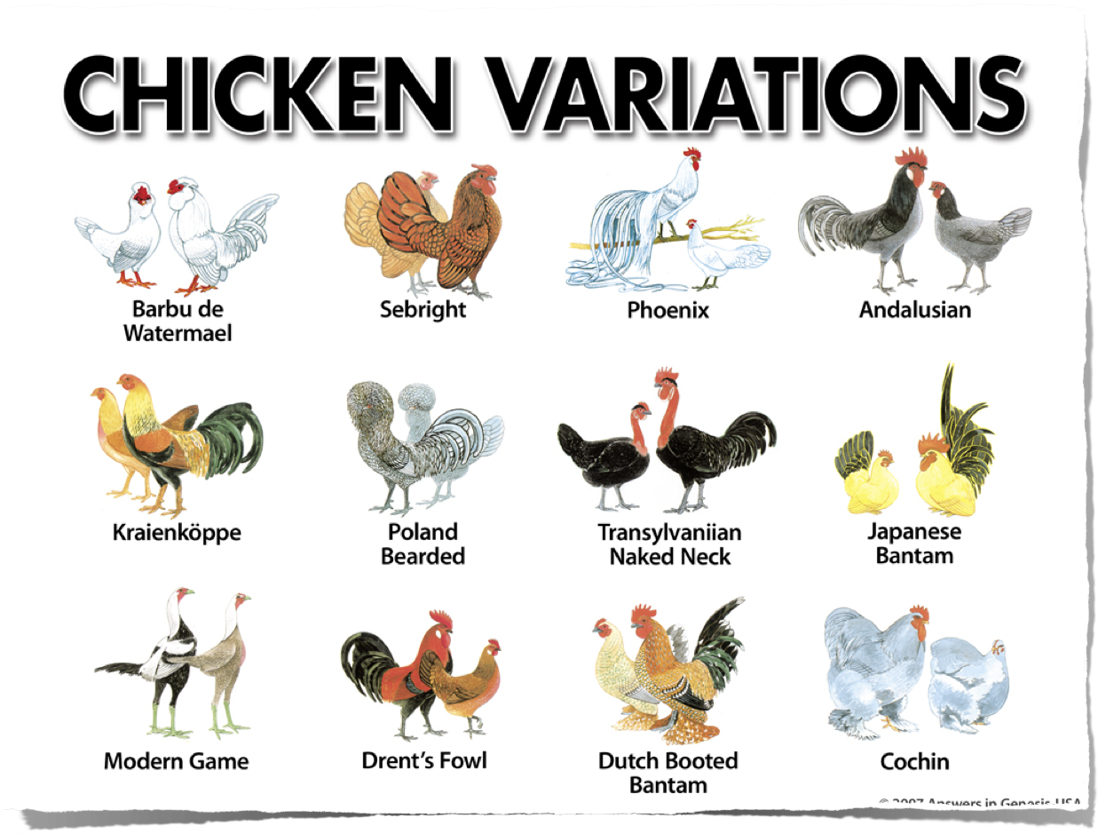
Variații la Cocoși și Găini

Slide 21
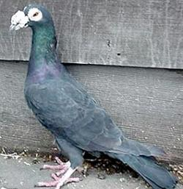
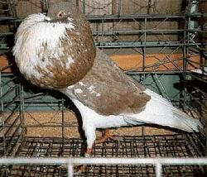
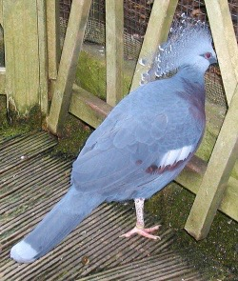
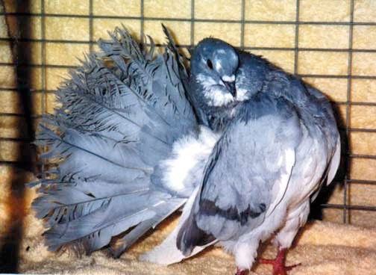
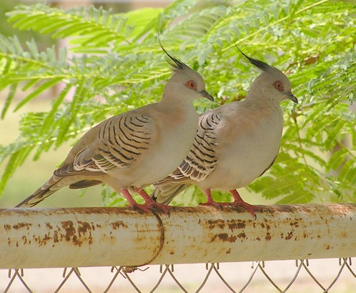
Variații în Soiul de porumbei
Notes:
About 310 species in the family (= kind) Columbidae collectively known as pigeons and doves (names often used interchangeably).
All can interbreed => same kind
Genus Columba (old world pigeons). (see http://en.wikipedia.org/wiki/Columbidae) Rock dove or ferral pigeon is wild type Columba livia. Domesticated pouters, rollers, tumblers, fantails, homers, etc., are descended from the wild type.
After pointing out the remarkable differences in structure and habit between the pouter, fantail, tumbler, and the wild Columba livia, the speaker expressed his entire agreement with Mr. Darwin's conclusion, that all the former domesticated breeds had arisen from the last-named wild stock; and on the following grounds–1. That all interbreed freely with one another. 2. That none of the domesticated breeds presents the slightest approximation to any wild species but C. livia,
Darwin’s publisher encouraged Darwin to publish a book on pigeons rather than O of S. Hooker made the same suggestion.

Slide 22
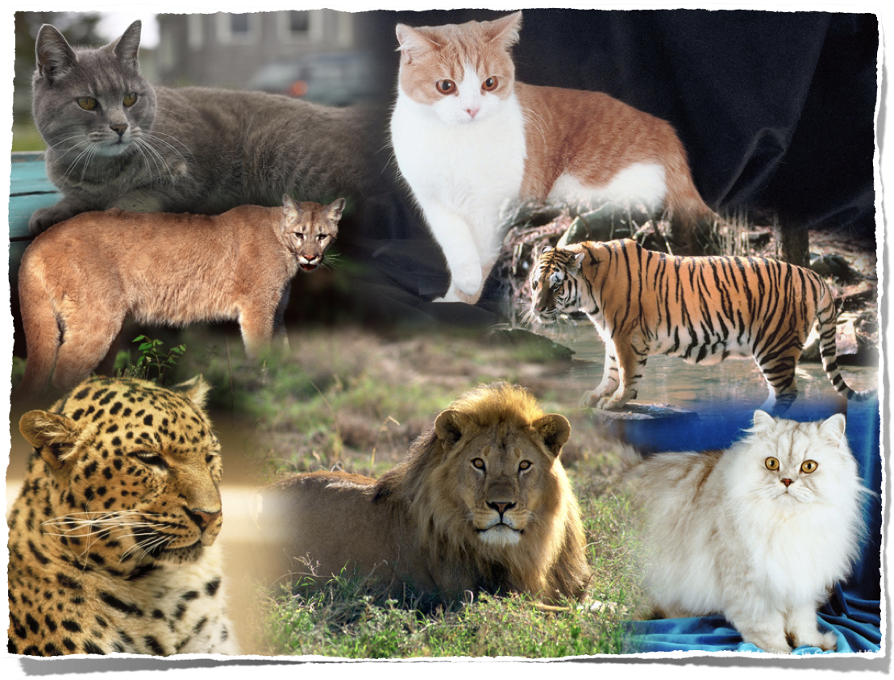

Slide 23
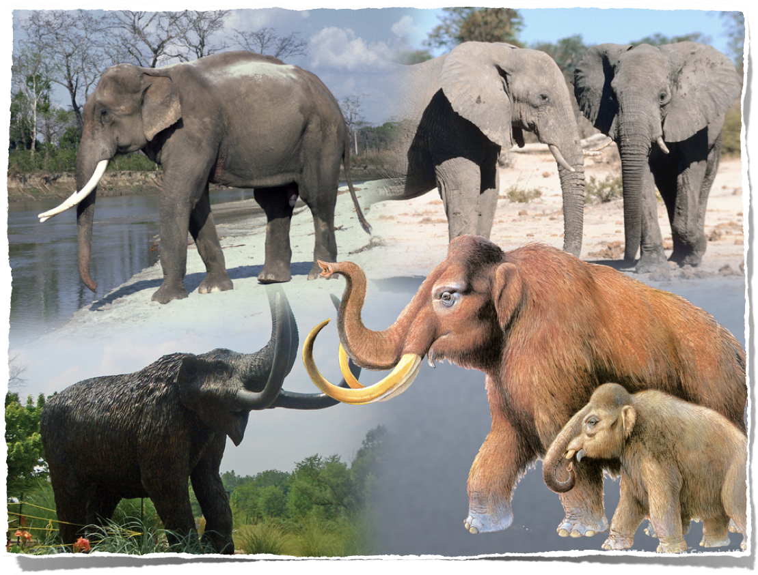

Slide 24
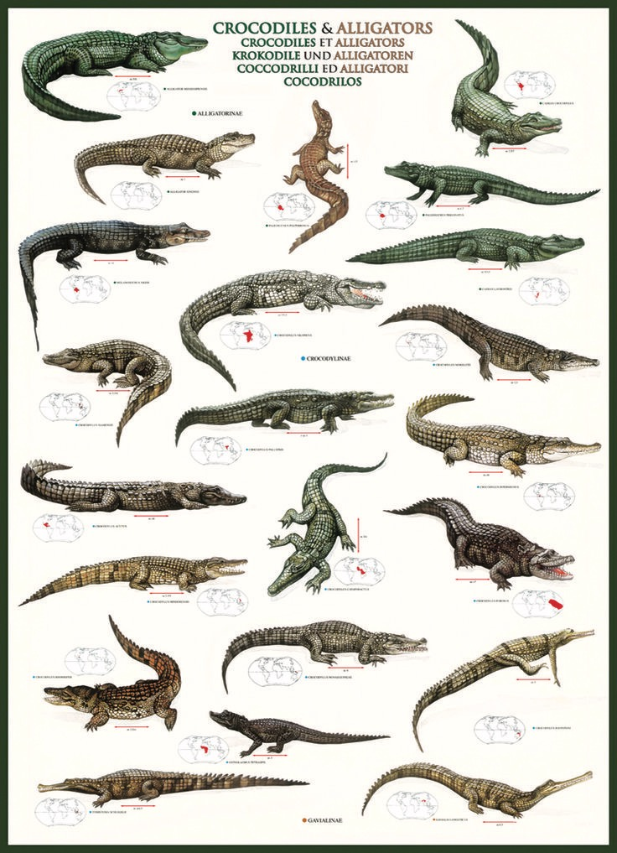

Slide 25
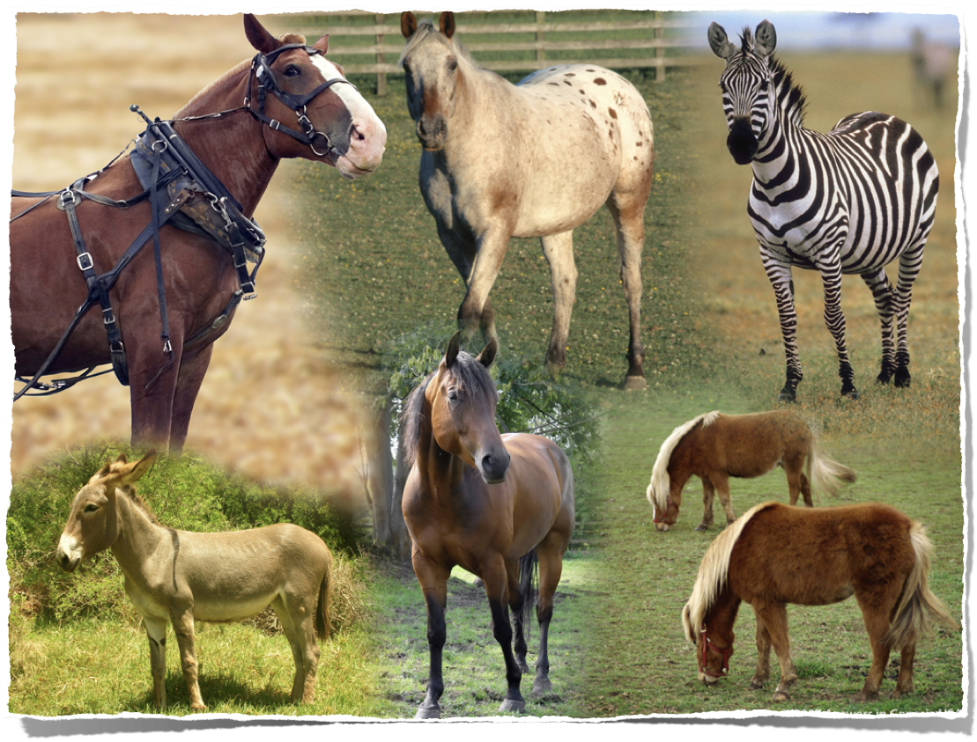

Slide 26
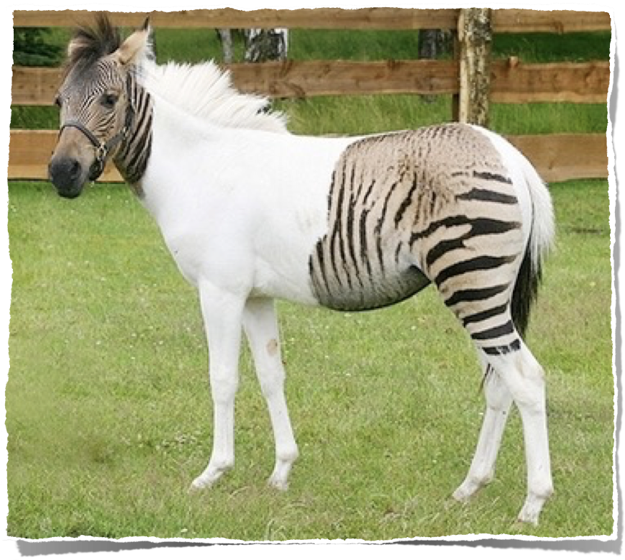
Zebrula (zebră / cal)
Notes:
http://news.yahoo.com/s/afp/20070704/od_afp/germanyanimalzebrula_070704174436, published on 4 July, accessed 5 July 2007
“Safaripark” zoo, near Guetersloh, Germany
Zebrulas have been in existence since the 19th century, this one is particularly unique: its coat is sharply divided between horse and zebra.
It is slightly more than a year old and is a crossbreed between a zebra and a horse. It was born in a horse ranch in Italy.
Her mother is a chapmann-zebra, her father a brown-white horse.

Slide 27
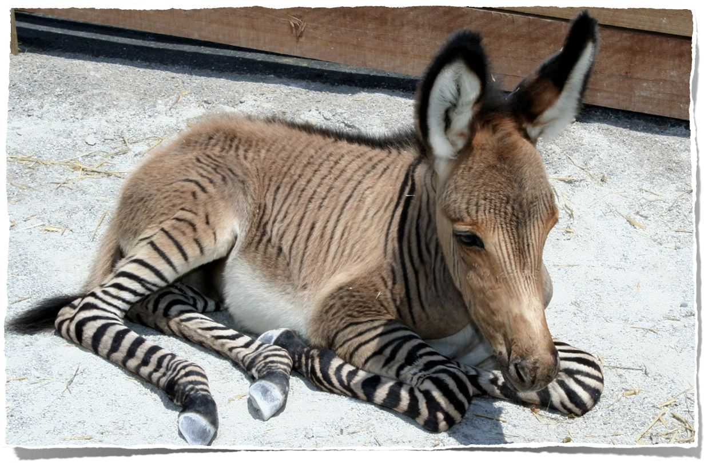
Muzeul Creației: Zonkey (zebră/măgar)
Notes:
Zonkey = ZEBRA + DONKEY

Slide 28
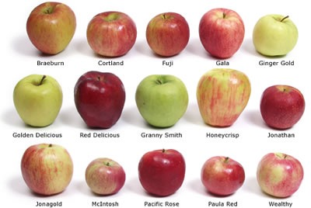
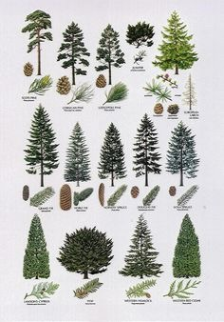
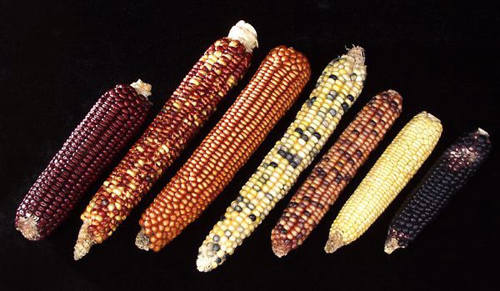
Soiuri de mere
Soiuri de Pini
Soiuri de porumb

Slide 29
Geneza 6:19–20
19 Din tot ce trăieşte, din orice făptură, să iei în corabie câte două din fiecare soi, ca să le ţii vii cu tine: să fie o parte bărbătească şi o parte femeiască. 20 Din păsări după soiul lor, din vite după soiul lor şi din toate târâtoarele de pe pământ după soiul lor, să vină la tine înăuntru câte două din fiecare soi, ca să le ţii cu viaţă.
Notes:
NASB

Slide 30
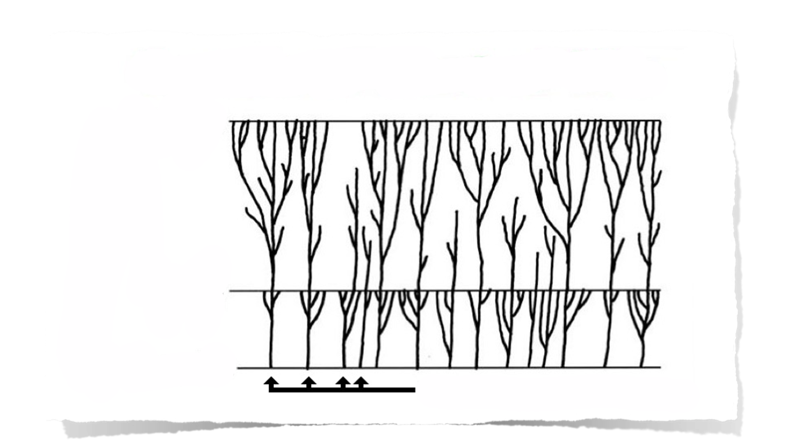
ARBORELE VIEȚII CREAȚIEI
Prezent
Mii de ani
Potop
Creația
Soiuri Create Original
Notes:
For a technical overview of this model see Wayne Frair, “Baraminology—Classification of Created Organisms,” Creation Research Society Quarterly, 37:2 (Sept. 2000), pp. 82-91. Also, on created kinds with latent genetic potential for variation within the kinds, see Todd Charles Wood, “Mediated Design,” ICR Impact #363 (Sept. 2003), available from www.icr.org.
Variation within the created kinds would probably have occurred more quickly after both creation week and the Flood than my picture is capable of showing.

Slide 31
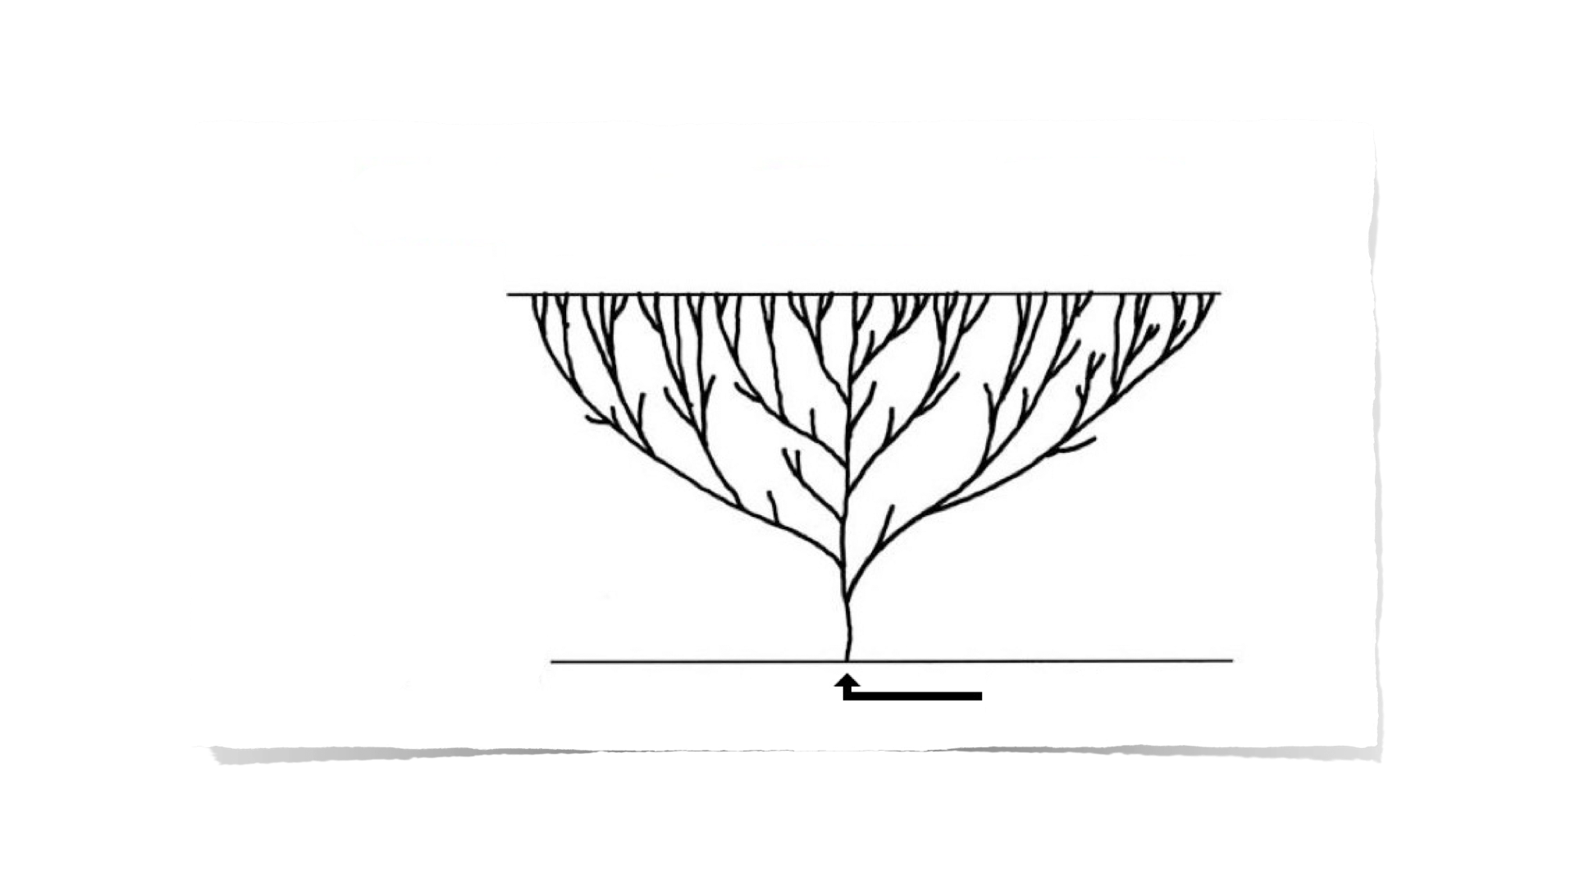
ARBORELE VIEȚII AL EVOLUȚIEI
Prezentul
Milioane de ani
Începutul
Prima celulă vie
PĂDUREA VIEȚII A CREAȚIEI
Prezentul
Mii de ani
Potopul
Creația
Soiurile create original
Notes:
For a technical overview of this model see Wayne Frair, “Baraminology—Classification of Created Organisms,” Creation Research Society Quarterly, 37:2 (Sept. 2000), pp. 82-91. Also, on created kinds with latent genetic potential for variation within the kinds, see Todd Charles Wood, “Mediated Design,” ICR Impact #363 (Sept. 2003), available from www.icr.org.
Variation within the created kinds would probably have occurred more quickly after both creation week and the Flood than my picture is capable of showing.

Slide 32

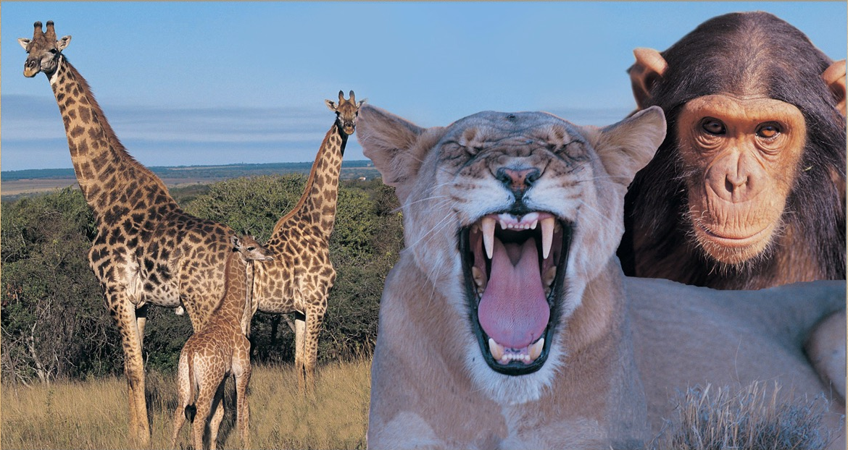
Presupunere
Naturalistică
Presupunere
Biblică
FAPTE (date)
CREATURI VII
Evoluția
Creația

Slide 33
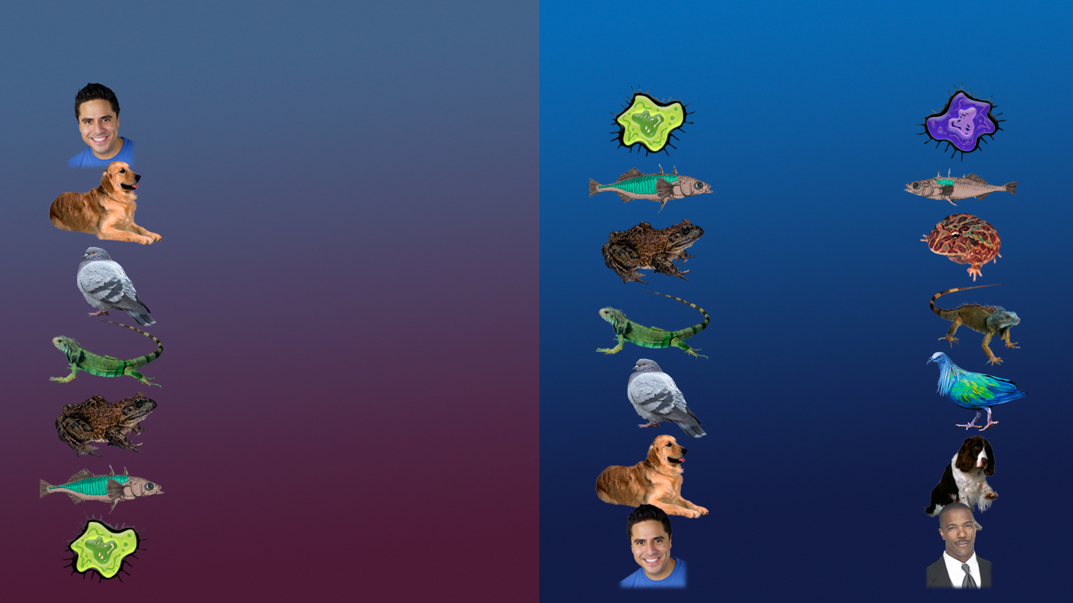
Evoluția
Creația

Slide 34

Evoluția
Creația

Slide 35
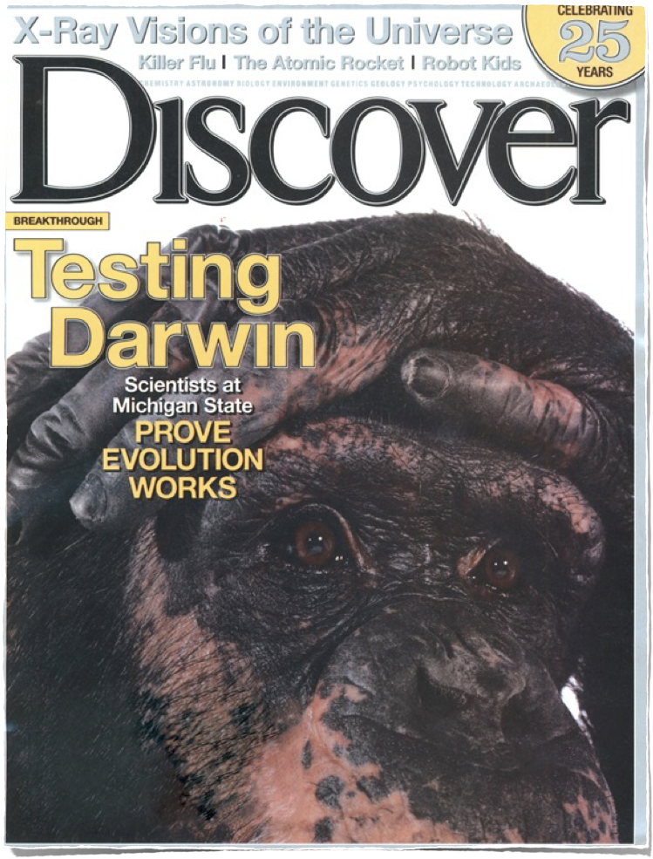
Oamenii de știință de la
Universitatea Michigan State
DOVEDESC CĂ
EVOLUȚIA
FUNCȚIONEAZĂ
2005

Slide 36
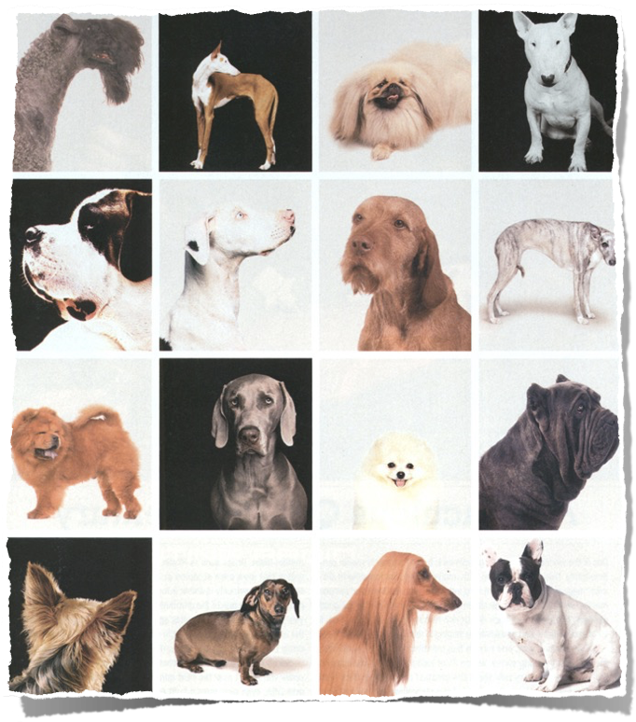
“Darwin a menționat diversitatea câinilor ca și un exemplu al evoluției accelerate.”
Carl Zimmer, “Testing Darwin,” Discover, Feb. 2005, p. 28.

Slide 37
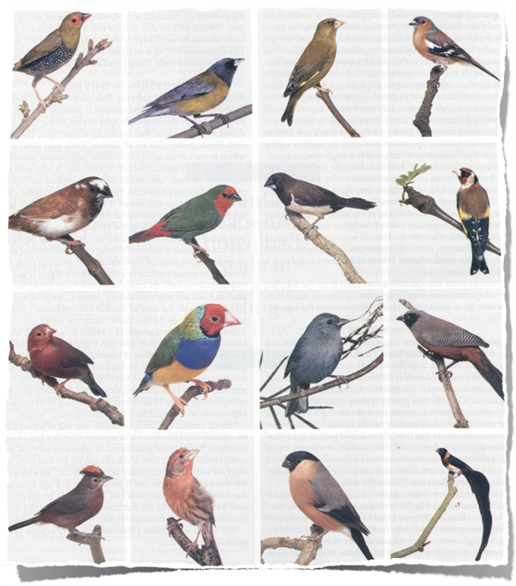

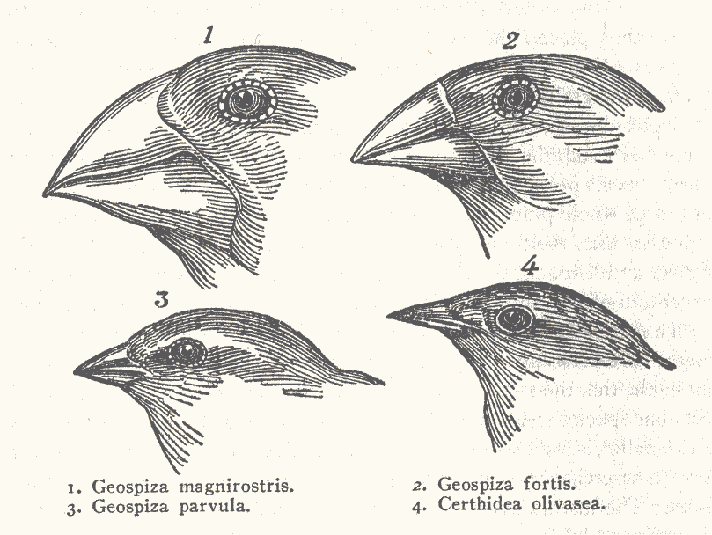
“Cintezoii (sticleții) au jucat un rol central în gândirea lui Darwin cu privire la procesul evoluționar al selecției naturale.”
Carl Zimmer, “Testing Darwin,” Discover, Feb. 2005, p. 34.
Notes:
According to Jonathan Wells (Icons of Evolution, p. 160ff) Darwin collected specimens of 9 of the 13 Finch species (but only identified 6 of them as finches). Except in two cases, he failed to observe any differences in diet. Back in England ornithologist John Gould began to sort out their geographical relationships but much of Darwin’s info was wrong (as seen from the more carefully labeled collections of his shipmates). He had a largely erroneous conception of the feeding habits and geographical distribution of these birds and the finches did NOT impress Darwin as evidence of evolution. It wasn’t until the 1930s that other evolutionists called them “Darwin’s finches” and elevated them to their current prominence. It was Peter and Rosemary Grant in the 1970s who observed carefully the relation of beaks to food and found only oscillation of beak size based on climate/food supplies and no evidence of linear evolution over time. They have also discovered that half of the species can hybridize naturally, so the number of species is reduced. They are clearly all the same kind.
Finches picture scanned from Carl Zimmer, “Testing Darwin,” Discover (Feb. 2005), p. 34.
beaks: http://www.oeb.harvard.edu/faculty/donohue/Finches.html, downloaded 24 Feb. 2006

Slide 38
Evidența fosilelor confirmă
evoluția sau creația?

Slide 39
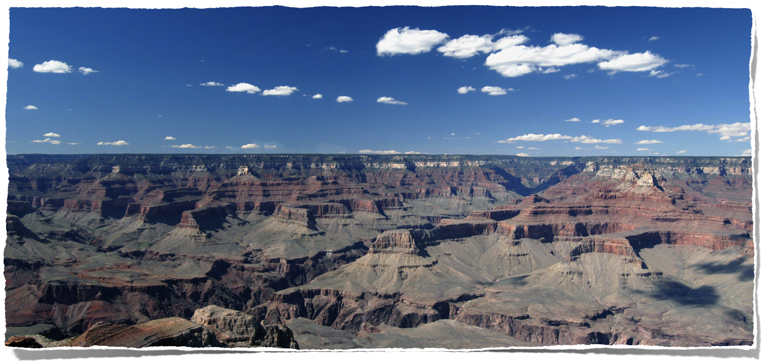
Marele Canion
Notes:
Photo by Tom Vail, used with permission.
Yaki Point wide-angle

Slide 40
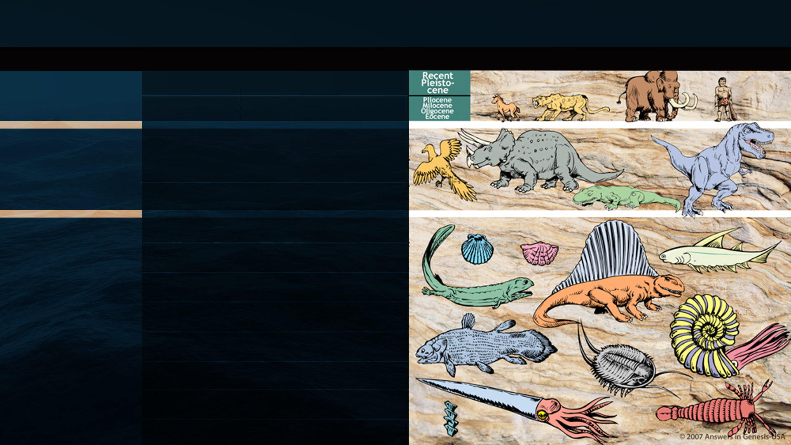
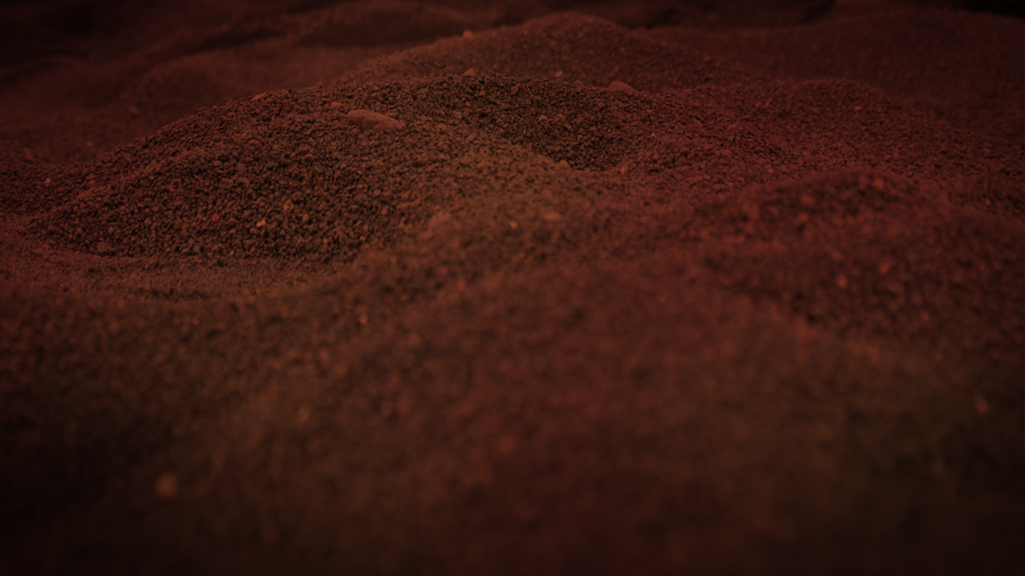
PERIOADELE DE TIMP GEOLOGIC
ERA
PERIOADA
EPOCA
SUCCESIUNEA VIEȚII
CENOZOICĂ
CUATERNAR
0–1 MILIOANE DE ANI
VIAȚA nouă
TERȚIAR
62 MILIOANE DE ANI
CRETACIC
72 MILIOANE DE ANI
MESOZOICĂ
JURASIC
46 MILIOANE DE ANI
VIAȚA de mijloc
TRIASIC
49 MILIOANE DE ANI
PERMIAN
50 MILIOANE DE ANI
PENNSYLVANIAN
30 MILIOANE DE ANI
CARBONIFER
MISSISSIPPIAN
35 MILIOANE DE ANI
PALEOZOICĂ
VIAȚA Antică
DEVONIAN
60 MILIOANE DE ANI
SILURIAN
20 MILIOANE DE ANI
ORDOVICIAN
75 MILIOANE DE ANI
CAMBRIAN
100 MILIOANE DE ANI
PRECAMBRIAN

Slide 41
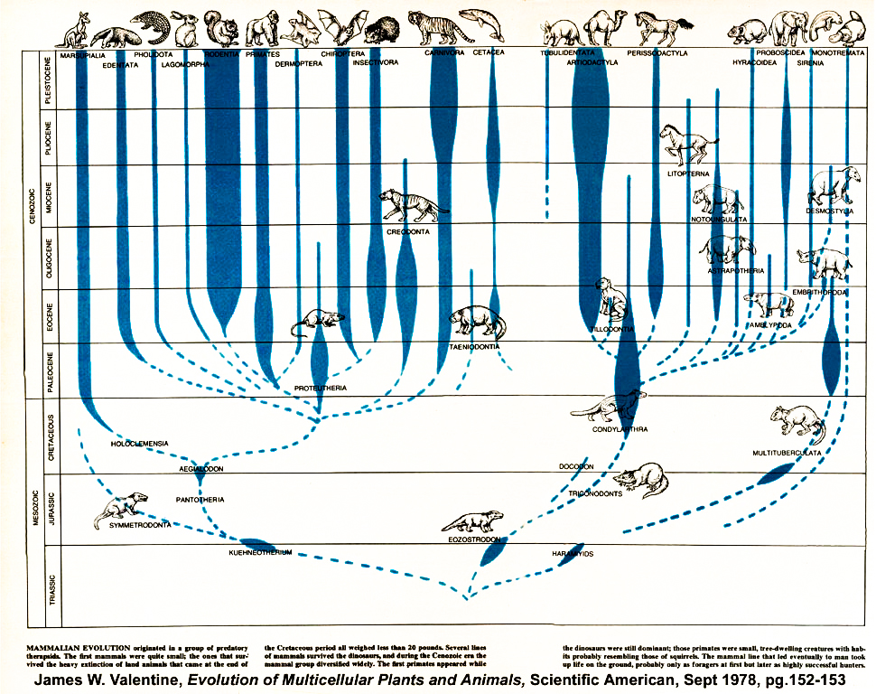
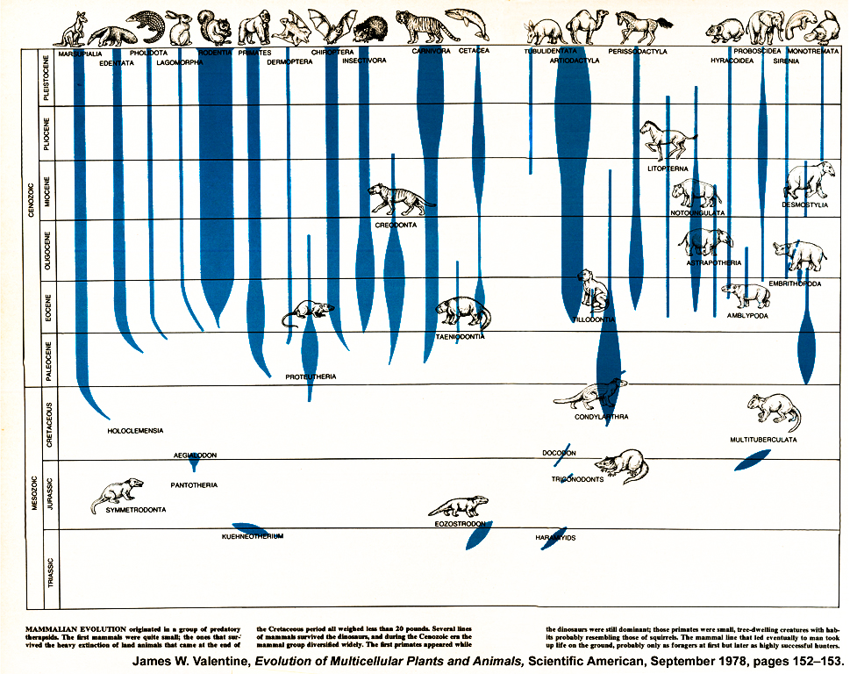
“Evoluția Mamiferelor”
Scientific American, Sept. 1978, pp. 152–153.

Slide 42
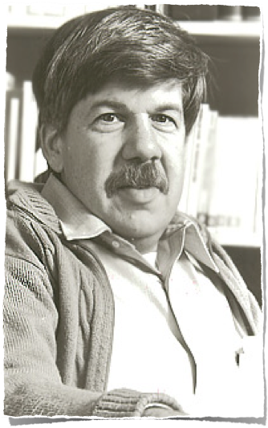
“Raritatea extremă a formelor intermediare din evidența fosilelor persistă ca și un aranjament secret al paleontologiei. Arborii evoluționari care împodobesc manualele noastre conțin informații doar la vârfurile și la nodurile ramurilor lor; restul este deducție, oarecum rezonabilă, nu dovada fosilelor.”
1977
Stephen J. Gould, “Evolution's Erratic Pace,” Natural History 86, no. 5 (May 1977): 14.
Notes:
Professor of Paleontology at Harvard University. Gould died in 2002.
Another evolutionist admission (David Raup):
“Well, we are now about 120 years after Darwin and the knowledge of the fossil record has been greatly expanded. We now have a quarter of a million fossil species but the situation hasn’t changed much. The record of evolution is still surprisingly jerky and, ironically, we have even fewer examples of evolutionary transition than we had in Darwin’s time. By this I mean that some of the classic cases of Darwinian change in the fossil record, such as the evolution of the horse in North America, have had to be discarded or modified as a result of more detailed information—what appeared to be a nice simple progression when relatively few data were available now appears to be much more complex and much less gradualistic. So Darwin’s problem has not been alleviated in the last 120 years and we still have a record which does show change but one that can hardly be looked upon as the most reasonable consequence of natural selection.”
David M. Raup (Prof. of Paleontology, Univ. of Chicago), “Conflicts Between Darwin and Paleontology,” Field Museum of Natural History Bulletin, Vol. 50, No. 1, January 1979, p. 25.

Slide 43
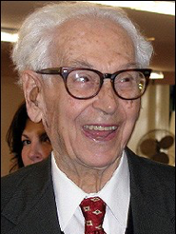
“Având în vedere faptul evoluției, cineva
s-ar aștepta ca fosilele să documenteze schimbarea graduală continuă de la formele ancestrale la descendenți. Dar aceasta nu este găsită de paleontologist.
În schimb, el sau ea găsește goluri în aproape toate seriile filetice. …
Descoperirea seriilor de specii neîntrerupte care se schimbă gradual în specii descendente este foarte rară.”
2001
Ernst Mayr, What Evolution is (New York: Basic Books, 2001), p. 14.
Notes:
Mayr (1904-2005), Harvard zoologist, was called the “Charles Darwin of the 20th century.”
This is after Mayr says that the fossil evidence supports evolution.
Following this quote he explains why we don’t see the “missing links” as he calls them. He gives the same reason Darwin did—”the unimaginable incompleteness of the fossil record.” He then gives an example of a missing link: Archaeopteryx (which he nevertheless calls a “primitive bird”).

Slide 45
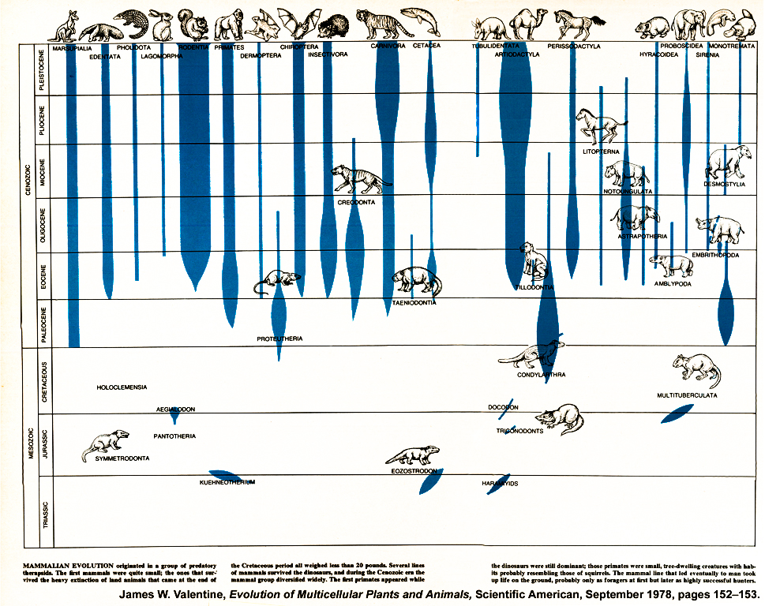

Slide 46
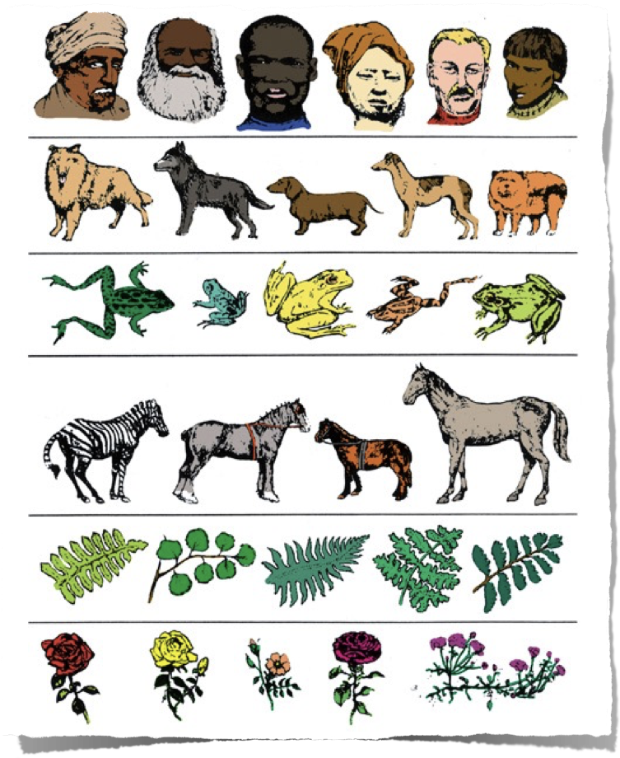
Gould:
Apariția și Staza (stagnarea) Abruptă
Dumnezeu:
Creația „după soiul lor”
(Facerea)
Notes:
Graphic adapted from John Morris, The Young Earth (Master Books), p. 144.
“The history of most fossil species includes two features particularly inconsistent with gradualism:
1. Stasis. Most species exhibit no directional change during their tenure on earth. They appear in the fossil record looking much the same as when they disappear; morphological change is usually limited and directionless.
2. Sudden appearance. In any local area, a species does not arise gradually by the steady transformation of its ancestors, it appears all at once and ‘fully formed’.”
Stephen J. Gould, The Panda’s Thumb (New York: W.W. Norton, 1980), 182.

Slide 47
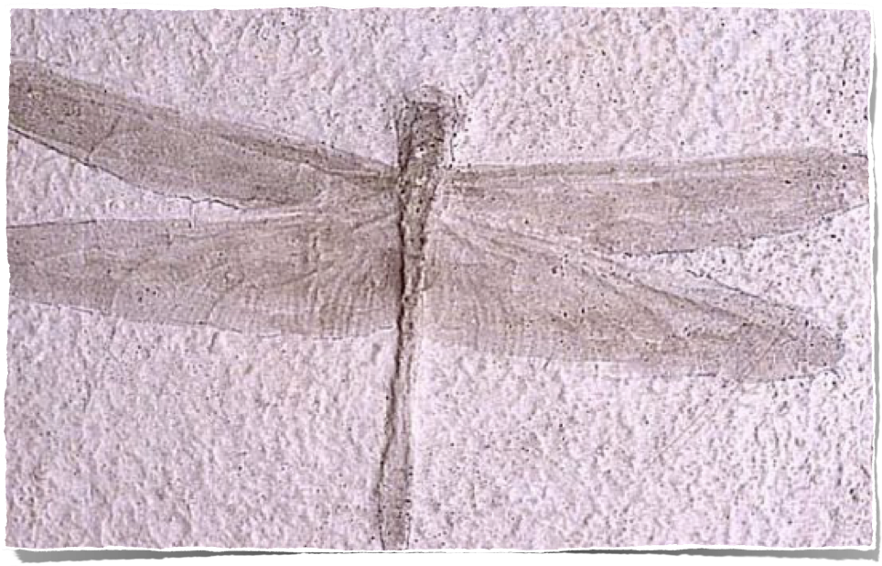
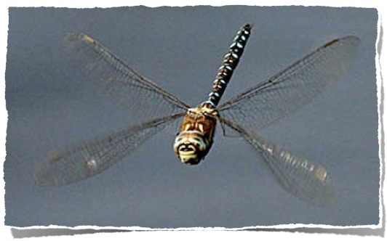
Libelula: „de 200 de milioane de ani”
Atlasul Creației
Notes:
This fossil dragonfly was found in France and is over four times the size of a modern dragonfly (biggest dragonfly ever foundd in fossil record had a wingspan of 30 inches)

Slide 48
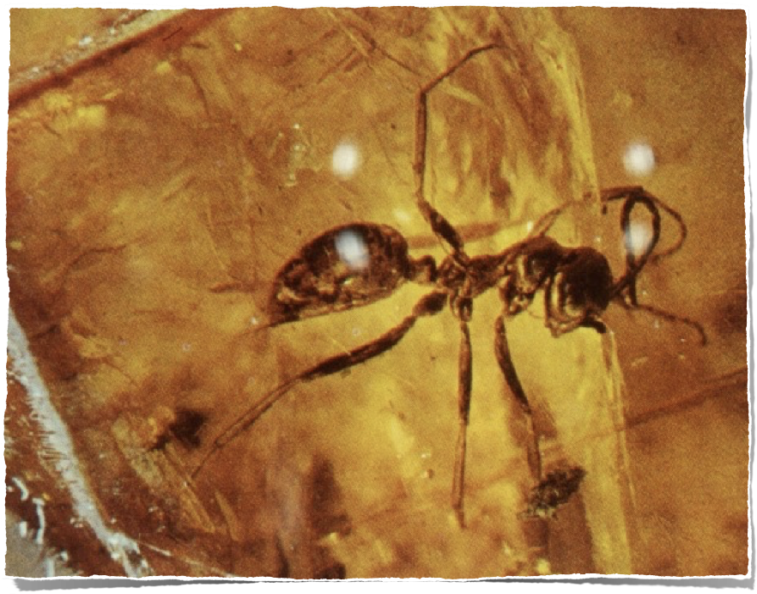
Furnica: „de 135 de milioane de ani”
Notes:
Sphecomyrma, a fossil ant (Cretaceous 135 myo)

Slide 49
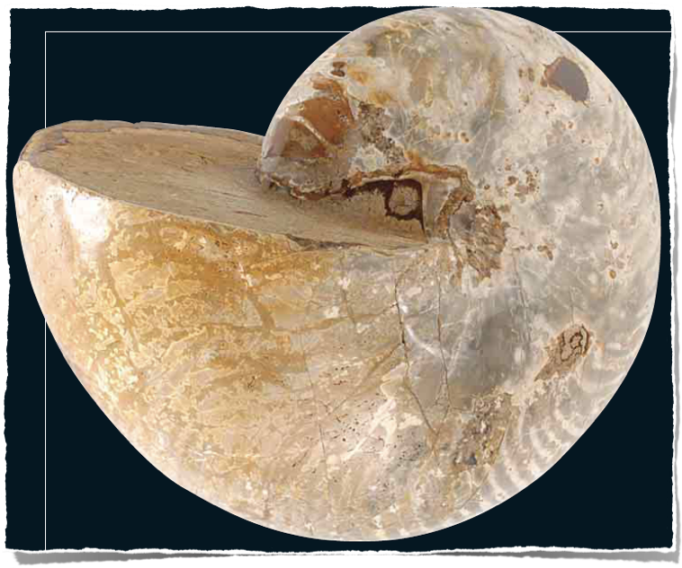
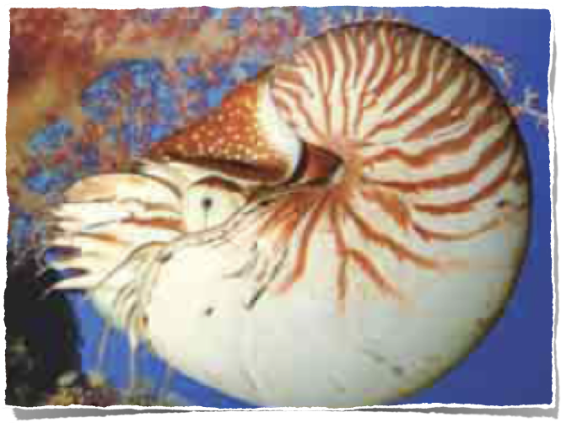
Nautilus: „de 114 milioane de ani”
Atlasul Creației
Notes:
Nautilus from Madagascar, Cretaceous 114 myo

Slide 50
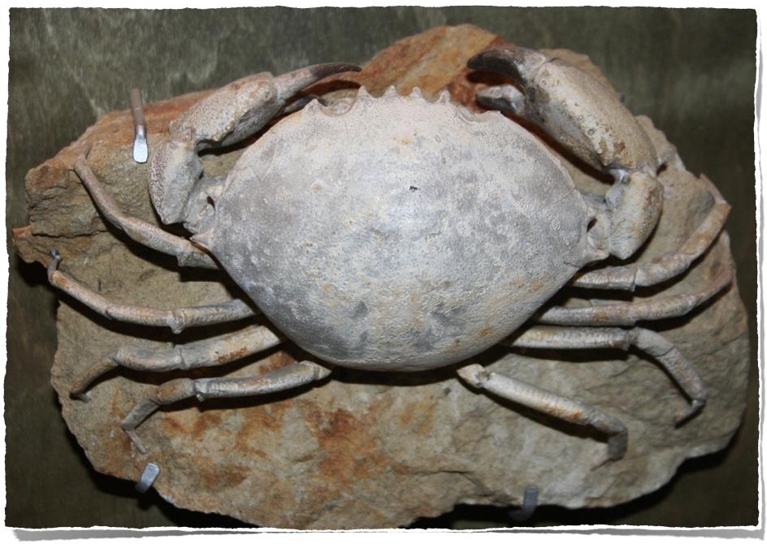
Crabul: „de 50 de milioane de ani”
Muzeul Creației
Notes:
Crab Harpactocarcinus punctulatus. Eocene Monte Baldo Verona Italy

Slide 51

ARBORELE VIEȚII AL EVOLUȚIEI
Prezentul
Milioane de ani
Începutul
Prima celulă vie
PĂDUREA VIEȚII A CREAȚIEI
Prezentul
Mii de ani
Potopul
Creația
Soiurile create original

Slide 52
Oare studiul creaturilor vii confirmă evoluția sau creația?

Slide 53
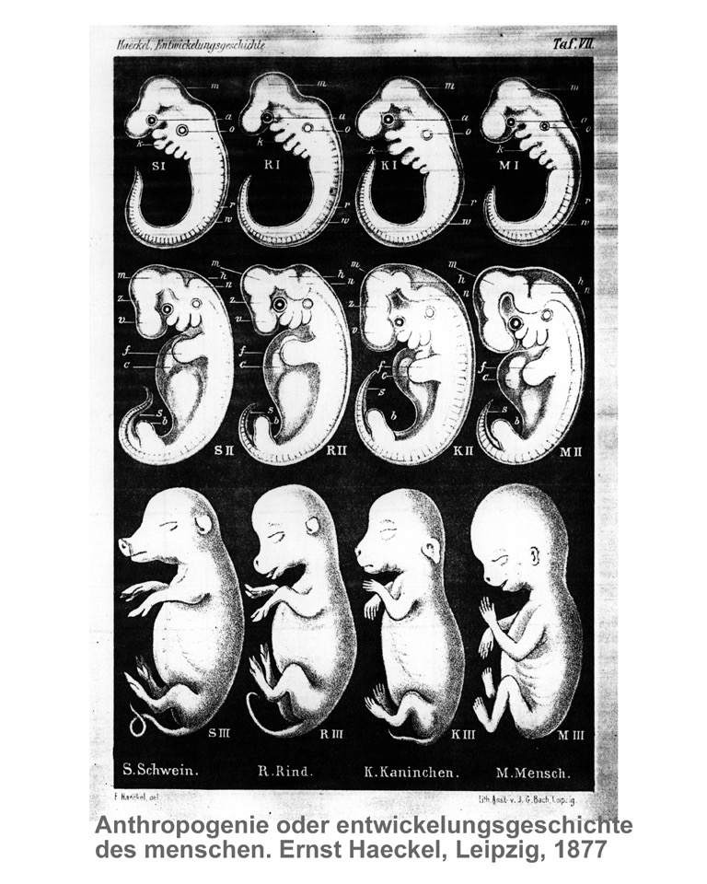
Fraudă!
Porc
Vacă
Iepure
Om
Ernst Haeckel, 1877).
Notes:
Schwein, Rind, Kaninchen, Mensch
Ernst Haeckel (1834-1919), Anthropogenie oder entwickelungsgeschichte des menschen (Leipzig, 1877). The book was on the origin of man and was translated into English in 1904.

Slide 54


Slide 55


„ În stadiul timpuriu de dezvoltare toate embrioanele vertebratelor sunt remarcabil de similare.”
1998

Slide 56


În acest capitol:
“Care este evidența pentru susținerea evoluției?”
Ernst Mayr, What Evolution Is (New York: Basic Books, 2001), p. 28.

Slide 57

Notes:
On a Florida beach

Slide 58

“Nu există nici o lege cunoscută în natură, nici vreun process cunoscut sau vreo secvență de experiențe cunoscută care pot cauza ca informația să origineze de la sine în materie.”
Werner Gitt, In the Beginning Was Information (Bielefeld, Germany: CLV, 1997), p. 107.
Notes:
Gitt is Dir. & Prof. at the German Federal Institute of Physics and Technology, and a YEC.

Slide 59

Produs al timpului, șansei, și al legilor naturii

Slide 60

Rezultat al Inteligenței Creative
APPLE = MĂR

Slide 61

Produs al timpului, șansei, și al legilor naturii

Slide 62

Produs al Inteligenței Creative

Slide 63





Slide 64


Slide 65


ADN
Notes:
DNA is organized into chromosomes (people have 46) upon which many thousands of genes (units of heredity, comprised of nucleotide bases called T, G, C and A) are found. A chromosome is made up of 1 DNA molecule and associated proteins. DNA is a sequence of genes.
UK evolutionist, Richard Dawkins, says that the amount of information in the DNA molecule of every cell of the human body is equivalent to about 3-4 sets of the 20 volumes of Encyclopedia Britannica.
For comparison, the amount of information that could be stored in a pinhead’s volume of DNA is equal to a pile of paperback books (each different in content) 500 times as high as the distance from the earth to the moon. Or, a pinhead of DNA could hold 100 million times more information than a 40 gigabyte hard drive.
Source: Jonathan Sarfati, “DNA: marvellous messages or mostly mess?,” Creation, 25:2 (March-May 2003), pp. 27-28.

Slide 66







A J U T O R
Mărgele pe o sfoară
ADN
Notes:
AJUTOR is Romanian for “help”
Phrase in middle: beads on a rope

Slide 67



ADN-Sistemul Suprem de Depozitare al Informațiilor
Aprox. 155 milioane de molecule de ADN umane pe vârful unui ac de gămălie
X 240
1810 km
Notes:
Werner Gitt said here “Let's look at the amount of information that could be contained in a pinhead volume of DNA. If all this information were written into paperback books, it would make a pile of such books 500 times higher than from here to the moon!” His appendix calculates this with a 160-page, 250,000-letter book.
See his article “Dazzling Design in Miniature” http://www.answersingenesis.org/creation/v20/i1/design.asp.
The volume of a pinhead that is 2mm in diameter is probably about 1.4mm3 (I used the formula for the volume of a sphere [4/3πr3] and multiplied it times one-third [1/3] thus getting an estimated volume for a pinhead [4/9πr3]; I chose one-third because a pinhead looks to be about one-third of a sphere). Now, the average length of a human DNA molecule (all 46 chromosomes plus 2 sex chromosomes) is about 2m (or 2000mm) and the width is about 2.4x10-6mm (or 24 angstroms; http://webphysics.davidson.edu/alumni/jocowan/FinalP/finres.htm), thus it can cover a volume of about 9.0x10-9mm3 (using the volume formula for a cylinder [πr2h] because of the DNA’s helical shape). Which means you could fit about 154,733,972 human DNA molecules in the volume of a pinhead that is 2mm in diameter. Calculation by David Wright in the AiG office.

Slide 68
ADN
Accident Desigur Nu-i!
Acidul DezoxiriboNucleic

Slide 69

Bill Gates
„ADN-ul este ca un program software, dar pe departe mult, mult mai avansat decât orice software pe care l-am creeat noi vreodată.”
Bill Gates, The Road Ahead (Boulder, CO: Blue Pigeon, 1996), p. 228.
Photo: World Economic Forum
Notes:
Photo from Wikipedia
Creative Commons Attribution—Photo:World Economic Forum
http://en.wikipedia.org/wiki/File:BillGates2012.jpg

Slide 70
Întrebări Cheie
1)
Cum a apărut informația ADN a presupusei prime creaturi microscopice vii?

Slide 71

1953 Experiment
Stanley Miller &
Dr. Harold Urey
Notes:
Miller died in 2007 at age 77, still after a career of research on the origin of life with no idea of how the first living cell evolved by chance from non-living matter.
Harold Urey (prof) and Stanley Miller (grad student); 1953 experiment at Univ. of Chicago.
Although secular textbooks continue to show this experiment and state that Miller was successful in creating amino acids necessary for life, the textbooks and media fail to mention that what Miller actually produced was a mixture of left and right-handed amino acids, which is detrimental to life. What Miller produced was actually a soup of potent poisons, not the basic ingredients for producing the first living cell. Since then, similar experiments have also failed to prove this idea.
Also the experiment had a trap to collect what was created because Miller and Urey knew that the same environment that produced them would destroy them (even more easily than they were made), if left in the system. Unfortunately, the primordial oceans had no such trap.
Miller took Urey’s assumption of a reducing atmosphere (no free oxygen), but the deepest rocks of the earth have iron oxides showing that this assumption was wrong.
Miller died in 2007 at age 77, still with no idea of how the first living cell evolved by chance.
http://en.wikipedia.org/wiki/Miller–Urey_experiment, accessed 2013 Mar 5 says:
The experiment used water (H2O), methane (CH4), ammonia (NH3), and hydrogen (H2). The chemicals were all sealed inside a sterile array of glass tubes and flasks connected in a loop, with one flask half-full of liquid water and another flask containing a pair of electrodes. The liquid water was heated to induce evaporation, sparks were fired between the electrodes to simulate lightening through the atmosphere and water vapor, and then the atmosphere was cooled again so that the water could condense and trickle back into the first flask in a continuous cycle.
Within a day, the mixture had turned pink in color, and at the end of two weeks of continuous operation, Miller and Urey observed that as much as 10–15% of the carbon within the system was now in the form of organic compounds. Two percent of the carbon had formed amino acids that are used to make proteins in living cells, with glycine as the most abundant. Sugars were also formed. Nucleic acids were not formed within the reaction. 18% of the methane-molecules become bio-molecules. The rest turns into hydrocarbons like bitumen.
In an interview, Stanley Miller stated: "Just turning on the spark in a basic pre-biotic experiment will yield 11 out of 20 amino acids."
As observed in all subsequent experiments, both left-handed (L) and right-handed (D) optical isomers were created in a racemic mixture. In biological systems, most of the compounds are non-racemic, or homochiral.
The original experiment remains today under the care of Miller and Urey's former student Jeffrey Bada, a professor at UCSD, at the University of California, San Diego, Scripps Institution of Oceanography. The apparatus used to conduct the experiment is on display at the Denver Museum of Nature and Science.
Picture: http://en.wikipedia.org/wiki/File:Miller-Urey_experiment-en.svg, accessed 2013 Mar 5.

Slide 72

„Cum au putut atomii stupizi să-și scrie propriul lor software . . . ?
Nimeni nu știe . . .”
„. . . nu există nici o lege a fizicii cunoscută capabilă de a crea informații din nimic. . .”
Paul Davies, “Life Force,” New Scientist 163, no. 2204 (Sept. 18, 1999), p. 27–30.
Notes:
PHOTO: This work has been released into the public domain by its author, Arizona State University. This applies worldwide.
In some countries this may not be legally possible; if so:
Arizona State University grants anyone the right to use this work for any purpose, without any conditions, unless such conditions are required by law.
http://en.wikipedia.org/wiki/File:Paul_Davies.jpg

Slide 73
Întrebări Cheie
?
1)
Cum a apărut informația ADN a presupusei primei creaturi microscopice vii?
2)
Cum a putut informația ADN-ului din prima creatură cu o singură celulă să se schimbe și să se multiplice în așa fel încât să producă toate plantele și animalele diferite pe care le vedem în evidența fosilelor și care trăiesc astăzi?

Slide 74
Evoluția

Slide 75
Presupusele Mecanisme
ale Evoluției
1)
Selecția Naturală
2)
Mutațiile Întâmplătoare

Slide 76
Selecția naturală este un FAPT.
Dar selecția naturală nu este evoluție.
Și selecția naturală este un proces CONSERVATIV, nu unul creativ.

Slide 77

„Molia sare-și-piper este probabil exemplul cel mai vizual remarcabil și ușor de înțeles referitor la evoluția Darwiniană în acțiune.
[Acest subiect] ar trebui predat. Este, la urma urmei, Dovada Evoluției.”
Dovada Evoluției
Dr. Michael Majerus
PowerPoint slide from his talk at a biology conference in Sweden, Aug. 23, 2007.
Notes:
Michael Majerus (1954-2009, died unexpectedly of cancer) was a geneticist and Professor of Ecology at Cambridge University I have the whole PPT talk and the WORD text of the speech on file. Capitalization in the quote is in the original.
Photo, PPT lecture and WORD notes available from http://www.gen.cam.ac.uk/Research/majerus.htm, accessed 22 Oct. 2007.

Slide 78



AnswersInGenesis.org
Molia Sare-și-Piper
(Biston betularia)
Evidență a selecției naturale, se poate, însă nu e dovadă a evoluției microb-la-microbiolog
Notes:
Photo: Richard C. Lewontin, Adaptation, Scientific American, Sept. 1978, p. 212.
This was actually fraud because dead moths were glued or pinned on trees to provide the fotos. The moths don’t rest on tree trunks during the day but on the underside of the leafy canopy at the top of the tree.

Slide 79


Genul Canis
Notes:
From Robert A. Wallace, Jack L. King, Gerald P. Sanders, Biology: the Science of Life (Glenview, IL: Scott, Foresman & Co., 1986), p. 395. The lines of interbreeding are in the source. The text on that page says: “The interbreeding situation among the eight species of the genus Canis appears to be more one of unwillingness rather than inability. The eight species are similar enough physiologically to be able to produce fertile hybrid offspring.”
Dr. Jean LIghtner (YEC, veterinarian) has found documented evidence of hybrid offspring between foxes and dogs.
DINGOS “New DNA research has found that Australia's iconic wild dog, the dingo, probably descended from a family pet brought to the continent 5,000 years ago. The research unveiled at a New South Wales University conference and reported in Tuesday's press, said the mother of all dingoes might have been a single pregnant female traveling with a group of migrants from what is now Indonesia. ‘All the dingoes have a very similar DNA type,’ said Alan Wilton, a molecular biologist and geneticist at the university. ‘Any variations we find in a population is only a single mutation away from the main type,’ he said.” (30 Sept. 2003, http://animal.discovery.com/news/afp/20030929/dingoes.html)

Slide 80






Soiul de câine
Informație Genetică Pierdută
Lupul
Coiotul
Dingo
Collie
Bulldog
NICI O INFORMAȚIE GENETICĂ NOUĂ
Poodle
Notes:
Grey wolf is common ancestor of all wild and domestic dogs: http://www.nytimes.com/2015/10/20/science/central-asia-could-be-birthplace-of-the-modern-dog.html?WT.mc_id=SmartBriefs-Newsletter&WT.mc_ev=click&_r=1, accessed 21 Oct 2015. It says dogs originated in Central Asia.
“But in the world of dog studies, very little is definitive. The most recent common ancestor of today’s dogs lived in Central Asia, Dr. Boyko said, although he cannot rule out the possibility that some dogs could have been domesticated elsewhere and died out. Or dogs domesticated elsewhere could have gone to Central Asia from somewhere else and then diversified into all the canines alive today, he said.
“Dr. Larson, who was not involved with the study, said he thought the Central Asia finding required further testing. He said he suspected that the origins of modern dogs were ‘extremely messy’ and that no amount of sampling of living populations would be definitive. He said a combination of studies of modern and ancient DNA was necessary.”
Another great article on all wild and domestic dogs being descended from a grey wolf (and on the problems with defining what a species is): https://newrepublic.com/article/124453/whats-species-anyways

Slide 81



Erzsi
Zeke
Notes:
Erzsi’s first litter, 2013
2 yellow, 2 chocolate, 3 black

Slide 82









Cu păr mediu
Cu păr scurt
Cu păr mediu
Cu păr lung
Notes:
S = Short hair
L = Long hair
David Menton’s simplified illustration: hair (fur) length is determined by different alleles for a gene that codes for hair length (Alleles are alternative forms of a single gene)
If they work together as Additive alleles then L+L=L, L+S=M and S+S=S
If they work as Dominant vs Recessive alleles: L would dominate

Slide 83





RECE
FOARTE CALD

Slide 84




Slide 85


SS
SL

Slide 86




Cu păr lung
Cu păr scurt
Cu păr mediu
Cu păr lung

Slide 87
RECE
FOARTE CALD

Slide 88




Slide 89



Slide 90



SL
LL

Slide 91


Cu păr scurt
Cu păr scurt
Cu păr mediu
Cu păr lung

Slide 92
RECE
Cu păr lung
Cu păr mediu
Cu păr mediu
Cu păr scurt
FOARTE CALD

Slide 93
Selecția naturală poate explica
supraviețuirea celui mai puternic,
DAR NU
apariția celui mai puternic,
    care este ADEVĂRATA problemă.

Slide 94
Selecția naturală este metoda proiectată de Dumnezeu de a păstra reprezentanți ai soiurilor originale create intr-o lume căzută.

Slide 95
Oare mutațiile alimentează cu informații noi necesare evoluției?
Notes:
Mutations are any changes in the DNA sequence compared to the ancestral state. They can be caused by:
uncorrected copying errors
harmful mutagens (e.g., UV light)
programmed changes (e.g., within the immune system adaptive mutations are regularly introduced into B cells as part of a normal immune response. There is no scientific reason that something similar cannot happen within reproductive cells to produce adaptive mutations.

Slide 96

Notes:
Totally Naked Rooster

Slide 97

Notes:
Picture by Terry at Alligator Farm, St. Augustine, FL, Oct. 2005
Albinos are produced by a mutation that prevents the production of melanin in the skin, as in normal crocodiles and alligators

Slide 98


Băiat cu 15 degete la mâini și 16 degete la picioare
dailymail.co.uk, 24 Mar 2010
Notes:
“The [Chinese] boy has a condition known as polydactyly, in which one of a variety of genetic disorders - which can be inherited, or are new mutations - gives rise to excess digits.”
Surgery gave him 10 toes and 10 fingers
Quote and photo: “Schoolboy with 31 fingers and toes has surgery to remove his extra digits,” http://www.dailymail.co.uk/news/worldnews/article-1260245/Schoolboy-31-fingers-toes-surgery-remove-extra-digits.html, 24 Mar 2010, accessed 25 Mar 2010.

Slide 99


Notes:
From Francisco J. Ayala, “The Mechanisms of Evolution,” Scientific American, vol. 239:3 (Sept. 1978), p. 60.

Slide 100
Mutațiile sunt UN FENOMEN REAL.
Dar mutațiile aproape întotdeauna reduc informația genetică.
Ele niciodată NU SPORESC informația genetică funcțională.
Notes:
Mutations do not increase genetic information. See https://answersingenesis.org/genetics/mutations/are-mutations-part-of-the-engine-of-evolution/.

Slide 101



Procese naturale oarbe
și fără direcție ?
NICIODATĂ!!!

Slide 102

„Totul arată că mutațiile care au fost studiate la nivel molecular s-au dovedit să reducă informația genetică și nu să o crească.”
Lee Spetner, Not by Chance: Shattering the Modern Theory of Evolution (New York: Judaica Press, 1998), p. 138.
Notes:
On Shannon Information—not undermining our position.
The paper at http://www.ideacenter.org/contentmgr/showdetails.php/id/1376 is a must read. It’s short and it makes very clear the point that ‘Shannon information’ is (almost) irrelevant to biological information or any other meaningful information. This is very important to understand if anyone asks questions about Shannon information in the context of mutations adding genetic information. Dawkins and co., like to talk about Shannon information because it fits with their concepts of random mutations creating it, but Shannon information is almost the opposite of meaningful information (specified complexity).
Werner Gitt's TJ paper http://www.answersingenesis.org/tj/v10/i2/information.asp makes similar points to the ones made in the above paper. In the first part of the paper Werner shows how Shannon 'information' has nothing to do with meaning, or what we mean by 'information' in everyday parlance.
I also highly recommend the two-part series of review papers on information by Alex Williams in TJ, 19:2 (2005), pp. 29-41 and part 3 of the series to be printed in the next TJ for further reading, which clarifies many issues regarding information theory.
I think the only mention of Shannon information on our web site is at http://www.answersingenesis.org/tj/v17/i1/dependence.asp where Royal Truman uses the concept of Shannon information incorrectly:
‘Evolutionary computer models assume there is a continuum in protein sequence space which links minimally functional to highly optimised variants. Many paths are presumed to be available for evolutionary attempts which can lead to ever narrower sets of variants. This trend, if true, would represent an increase in information content in the Shannon sense.’
(This is not ‘in the Shannon sense’, because a random sequence has more Shannon ‘information’ than a non-random sequence).
Dr Don Batten, AiG Australia, 12 Sept 2005 email communication
On 22 Sept 2005 Don wrote again:
It is good that to have a little understanding of this issue if someone asks about information and spouts forth on ‘Shannon information’. I sent something recently about this.
Here is a more technical paper (“Information Theory Demystified” by Scott Uminsky, http://www.ideacenter.org/contentmgr/showdetails.php/id/1236) that makes the point that Shannon ‘information’ is not what we mean normally by information and is not an adequate measure of biological information on the DNA, for example. The Shannon concept might be relevant to the transmission of strings of letters or numbers electronically, but bits of Shannon ‘information’ (or Shannon entropy or uncertainty) do not measure the meaningful content of the message. A random string of letters has the same Shannon information as a meaningful string. However, if the receiver has knowledge of the system, the possible messages can be constrained and this reduces the Shannon information. For example, if you sent an SMS message “Will I c u @ 8?” the expected replies would be yes or no. The limited range of expected responses constrains the information such that it reduces the uncertainty / Shannon entropy or Shannon information greatly of the message received. So, under the circumstance where an intelligent receiver interprets the message (a la Gitt information theory), the random string has more bits of Shannon information (uncertainty / Shannon entropy) than a meaningful string.
The bottom line: a decrease in the bits of Shannon information / entropy / uncertainty will often accompany an increase in meaningful information.
It’s probably best to call it Shannon entropy or Shannon uncertainty, leaving out ‘information’, to minimize confusion.

Slide 103

ADN-ul unei amibe
Noi informații folositoare (genele)
ADN-ul unui cal
Notes:
“Amoebas are puny, stupid blobs, so scientists were surprised to learn that they contain 200 times more DNA than Einstein did.”
http://nautil.us/issue/9/time/evolution-youre-drunk, accessed 4 Feb 2014

Slide 104

H. pylori
(Helicobacteria pylori)
Notes:
Helicobacter pylori, a bacterium in the stomach that can case ulcers and possibly even cancer.
http://en.wikipedia.org/wiki/Helicobacter_pylori, accessed 2014 April 3

Slide 105

Antibiotic
Absorbit prin
peretele
celular
H. pylori
(Helicobacteria pylori)

Slide 106

Antibiotic
Absorbit prin
peretele
celular
H. pylori
produce o enzimă care convertește antibioticul
în otravă
H. pylori
(Helicobacteria pylori)

Slide 107

Antibiotic
Absorbit prin
peretele
celular
H. pylori
produce o enzimă care convertește antibioticul
în otravă
H. pylori
(Helicobacteria pylori)
Otrava omoară bacteria

Slide 108

MUTANTĂ
H. pylori
(Helicobacteria pylori)

Slide 109

Antibiotic
absorbit prin
peretele
celular
MUTANTĂ
H. pylori
(Helicobacteria pylori)

Slide 110
Antibiotic
absorbit prin
peretele
celular
MUTANTĂ
H. pylori
Mutantă
nu are abilitatea
de a produce
enzimă
H. pylori
(Helicobacteria pylori)

Slide 111

Antibiotic
absorbit prin
peretele
celular
MUTANTĂ
H. pylori
Mutantă
nu are abilitatea
de a produce
enzimă
H. pylori
(Helicobacteria pylori)
Fără enzimă
Fără otravă
Fără moarte
A supraviețuit datorită
informației deficitare!

Slide 112

H pylori Dies & Survives
H. pylori
Antibioticul aplicat
Continuă să se reproducă și să producă descendenți care rezistă antibioticelor folosite pentru a o trata
Normal
(produce enzimă)
moarte
HA HA HA!
Mutantă
(nu produce enzimă)
supraviețuiește

Slide 113

Dar ştim că, până în
ziua de azi, toată firea
suspină şi suferă durerile naşterii.
Romani 8:22
PĂCATUL
Notes:
NASB

Slide 114
Mutațiile sunt consecințele menite de Dumnezeu - blestemul Lui asupra creației- din pricina păcatului lui Adam.
Notes:
Mutations do not increase information—further information for those who object to the points made here: Jonathan Sarfati, "Is antibiotic resistance really due to increase in information?" (27 Sept 2003 "Today's Feature"), http://www.answersingenesis.org/home/area/feedback/negative_22October2001.asp

Slide 115


Fără
mutații
FOARTE
BINE!
PREZENT
VIITOR
TRECUT
Adam
FĂRĂ MOARTE
MOARTE
MOARTE
FĂRĂ MOARTE
Mutațiile sunt în creștere
Fără
mutații

Slide 116


Nu există o evidență reală
Arborele Evolutiv al vieții
Prezentul
Milioane de ani
Începutul
Pădurea Creației Vieții
Prezentul
Potrivit cu datele!
Mii de ani
Potopul
Creația

Slide 117
Selecția naturală?
FAPT!
(adevăr)
Mutațiile?
FAPT!
(adevăr)
Selecția Naturală + Mutații = evoluție de la moleculă la om?
MIT!

Slide 118
Cele mai simple forme de viață au apărut oare din întâmplare?
Informația nu provine din materie.
Evoluția de la amiba la om oare a existat în trecut?
Nu există fosile intermediare necontestabile
Selecția naturală + mutația = cu evoluția în ziua de azi ?
Natura nu produce nici o informație nouă.

Slide 119
Problema NU e
micro-evoluția
versus
macro-evoluția.
Problema este
originea și adăugarea informației genetice.
Problema NU e cantitatea de schimbare biologică.

Slide 120

Cluj-Napoca
Alba Iulia

Slide 121

Cluj-Napoca
Alba Iulia
Bucharesti

Slide 122
Informație
Mărită
Tren al Selecției și Mutațiilor Naturale
Viețuitoare
„Teorie”

Slide 123
Informație
Mărită
FAPT!
Viețuitoare
Tren al Selecției și Mutațiilor Naturale
Informație Micșorată

Slide 124

„Nu există o bază rațională pentru a spune că o ființă omenească are drepturi speciale. În cazul în care există un sistem nervos central și abilitatea de a simți durere, foame și sete, un șobolan este un porc care este un câine care este un băiat. Ei toți sunt animale.”
Ingrid Newkirk (founder of People for the Ethical Treatment of Animals), quoted in Washingtonian magazine, Aug. 1, 1986, activistcash.com.
Notes:
picture: http://www.eugeneweekly.com/2005/graphics/021005calendar2.jpg
Quote: http://activistcash.com/biography_quotes.cfm/bid/456

Slide 125


Totul a evoluat
dintr-o celulă,
crede-mă
pe cuvânt!
Eu am creat
SOIURI
distinctive ca să
rămână distinctive.
Pe Cuvântul
Meu!
Confirmed by real science
Confirmat de adevărata știință
SFÂNTA
BIBLIE

Slide 126




Noua Carte a Răspunsurilor 1, 2, 3 & 4
Notes:
Answer the 130 most asked questions

Slide 127






Slide 128

ACUM UȘOR
PE MOBIL
Răspunsuri biblice
la vârfurile degetelor

Slide 129

Răspunsuri
Revistă de Cercetări
„Soiuri” Create

Slide 130
Romani 1:18–19
18 Mânia lui Dumnezeu se descoperă din cer împotriva oricărei necinstiri a lui Dumnezeu şi împotriva oricărei nelegiuiri a oamenilor, care înăbuşă adevărul în nelegiuirea lor. 19 Fiindcă ce se poate cunoaşte despre Dumnezeu le este descoperit în ei, căci le-a fost arătat de Dumnezeu.

Slide 131
Romani 1:20
20 În adevăr, însuşirile nevăzute ale Lui, puterea Lui veşnică şi dumnezeirea Lui, se văd lămurit de la facerea lumii, când te uiţi cu băgare de seamă la ele în lucrurile făcute de El. Aşa că nu se pot dezvinovăţi.

Slide 132
Ioan 3:16
Fiindcă atât de mult a iubit Dumnezeu lumea, că a dat pe singurul Lui Fiu, pentru ca oricine crede în El să nu piară, ci să aibă viaţa veşnică.

Slide 133
Black

Slide 134


Get this presentation for free!
Creația • BibleStudyDownloads.org
Notes:
The Bible…Basically (bb)

