Slide 1
Dr. Terry Mortenson
Wielki Wybuch:
wysadzanie mitu w powietrze

Slide 3
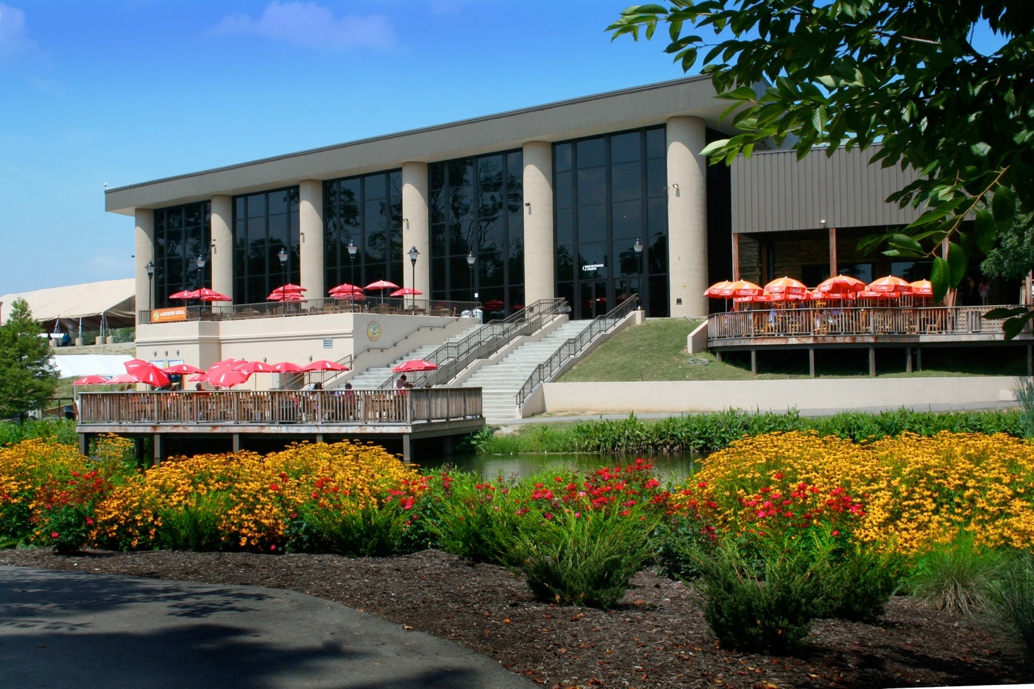
Muzeum Kreacjonizmu w Cincinnati (Ohio)
3

Slide 4
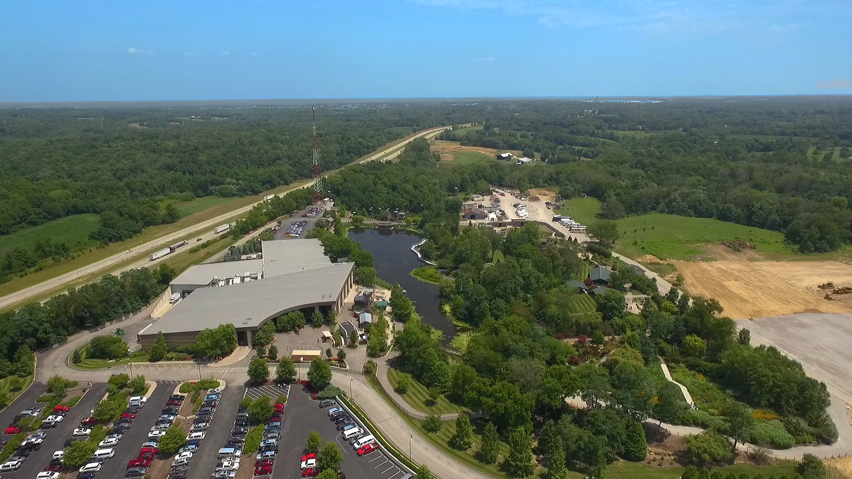
Muzeum Kreacjonizmu w Petersburg (Kentucky)
4
Notes:
1 min, Mar 2017

Slide 5
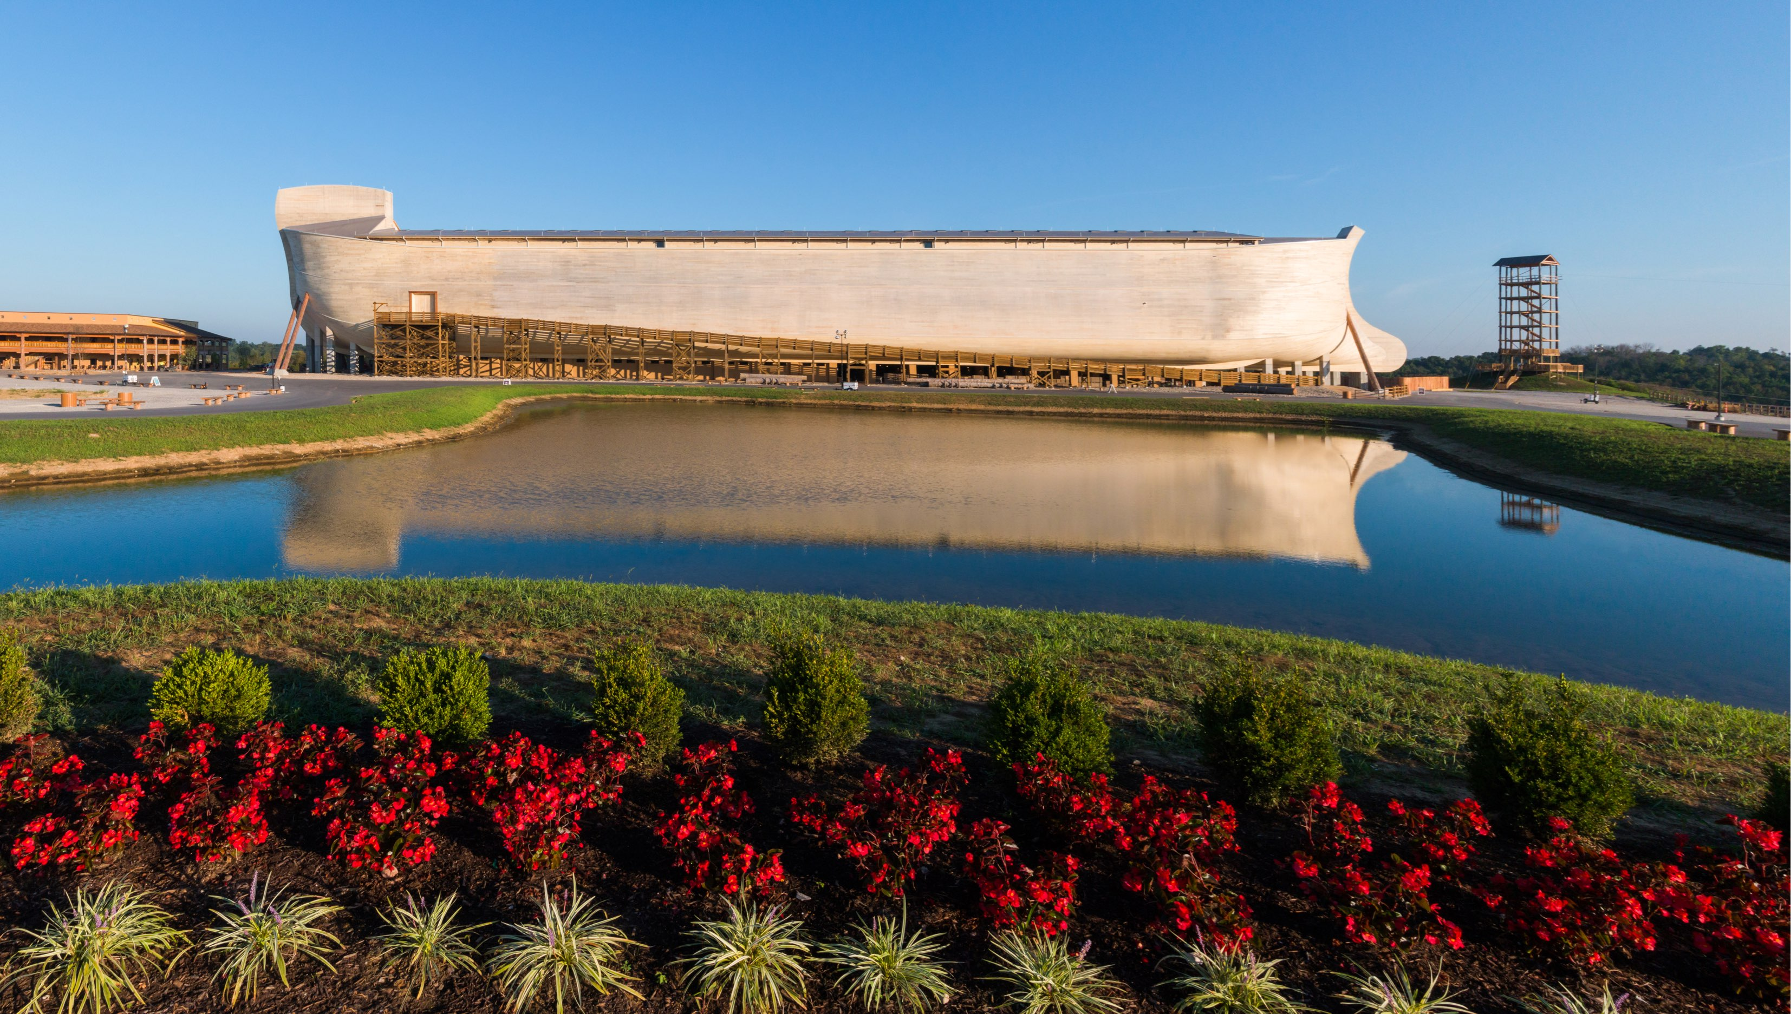
Ark Encounter w Williamstown (Kentucky)

Slide 6
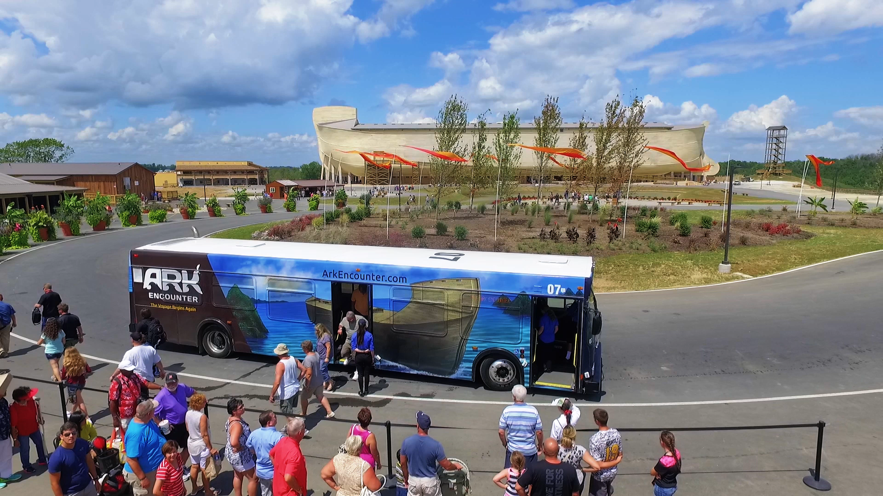
Ark Encounter w Williamstown (Kentucky)
Notes:
1 min
Mar 2017

Slide 7
Dr. Terry Mortenson
Wielki Wybuch:
wysadzanie mitu w powietrze

Slide 8
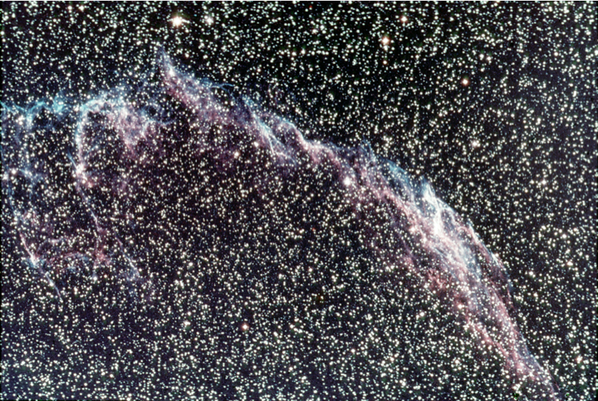
TitleAndActionSafe
Mgławica Włóknista
8
Notes:
Veil Nebula, supernova remnant?

Slide 9
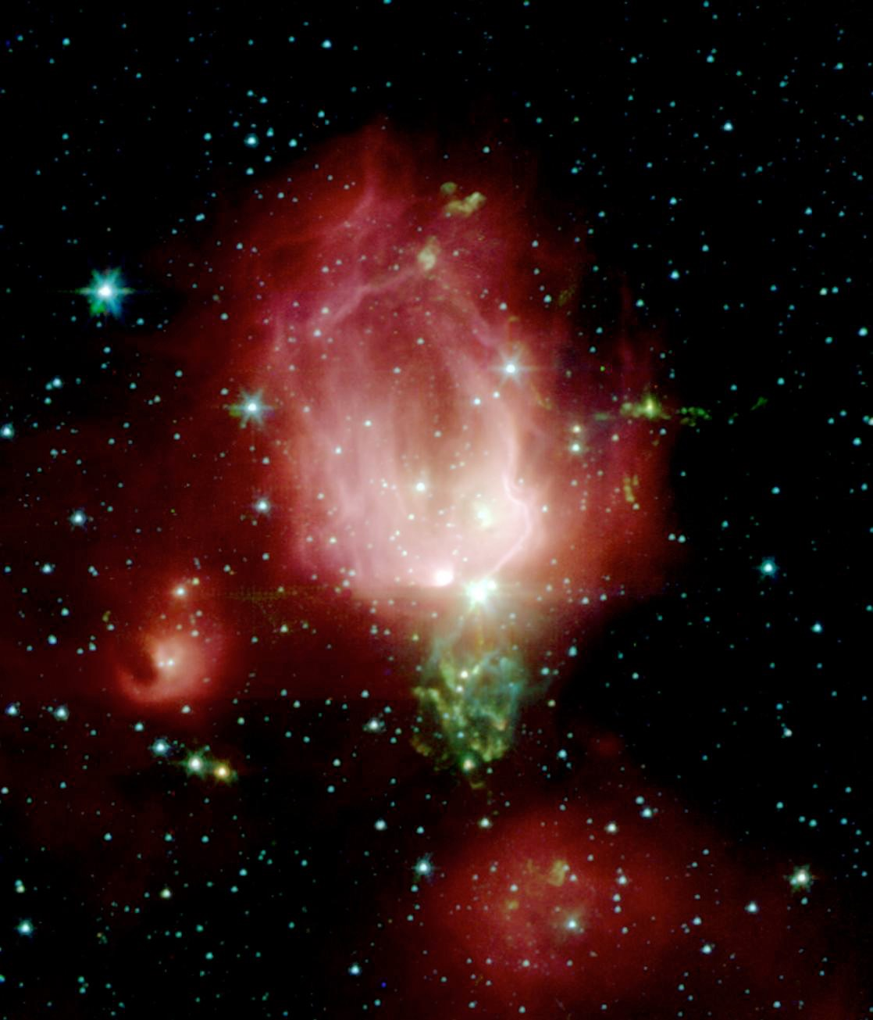
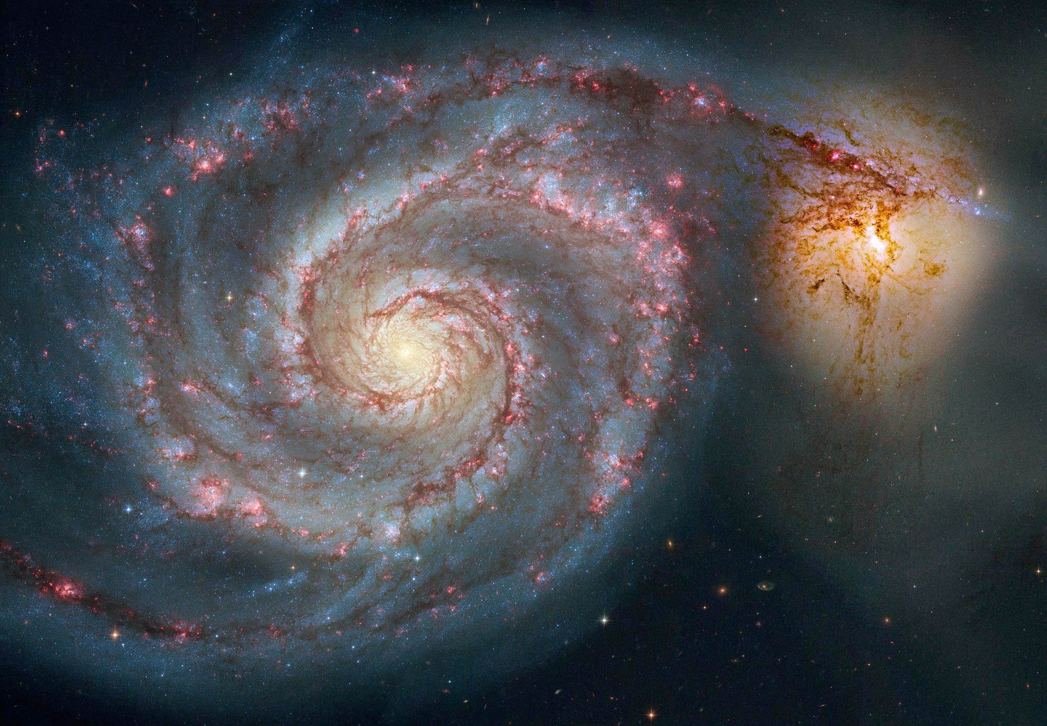
“Mgławica w kształcie róży NGC 7129
Galaktyka Spiralna NGC 5194
9
Notes:
On the left: https://instagram.com/p/2gpC5CoaM1/: rosebud-shaped (and rose-colored) nebulosity known as NGC 7129, Credit: NASA | JPL-Caltec | S.T. Megeath | Harvard-Smithsonian CIA
On the right: https://instagram.com/p/13ycB6IaJx/: spiral galaxy M51 (NGC 5194), Credit: NASA, Hubble Heritage Team, (STScI/AURA), ESA, S. Beckwith (STScI). Additional Processing: Robert Gendler

Slide 10
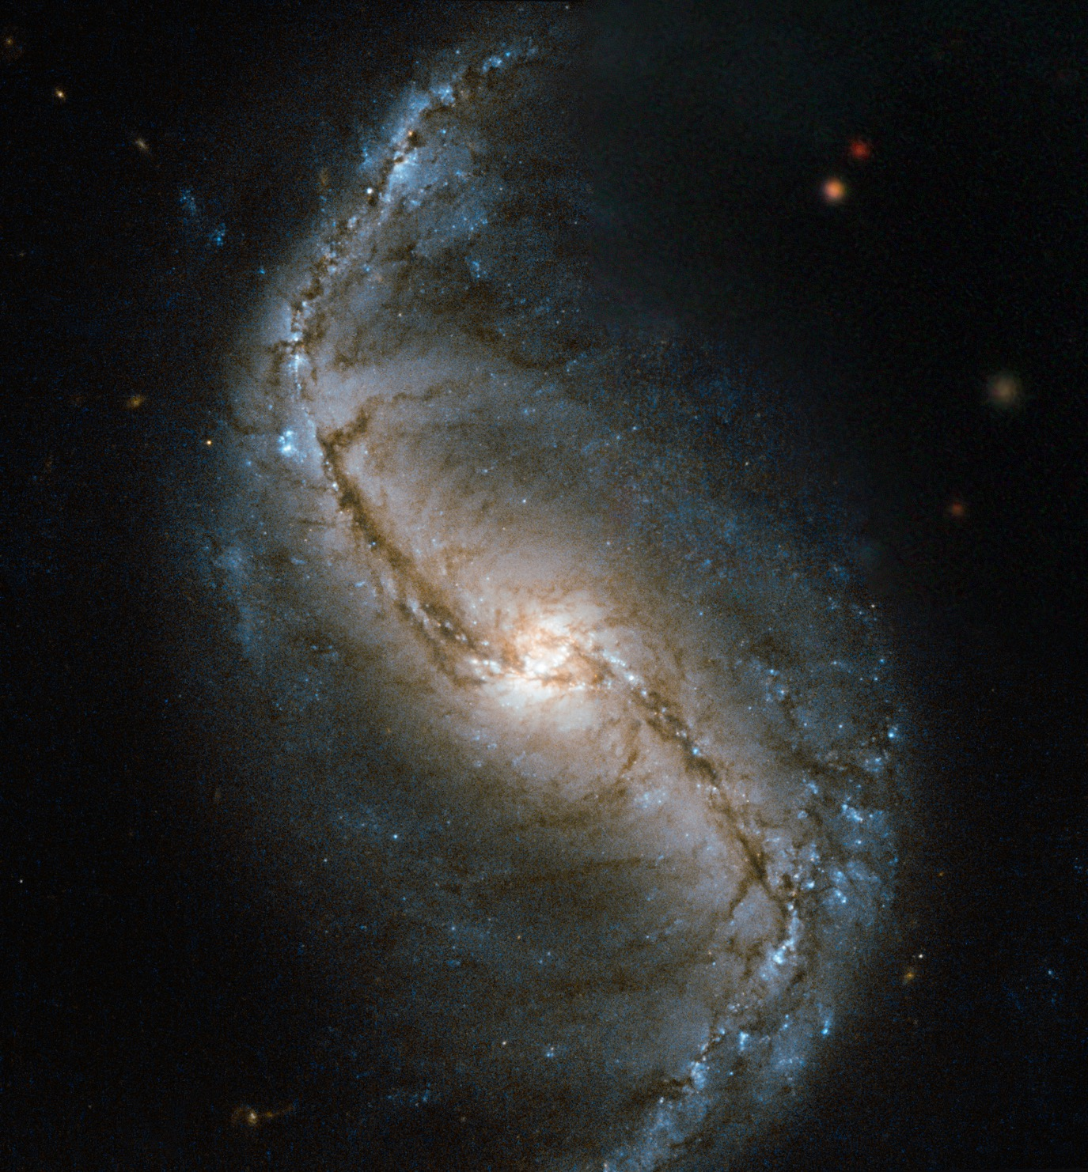
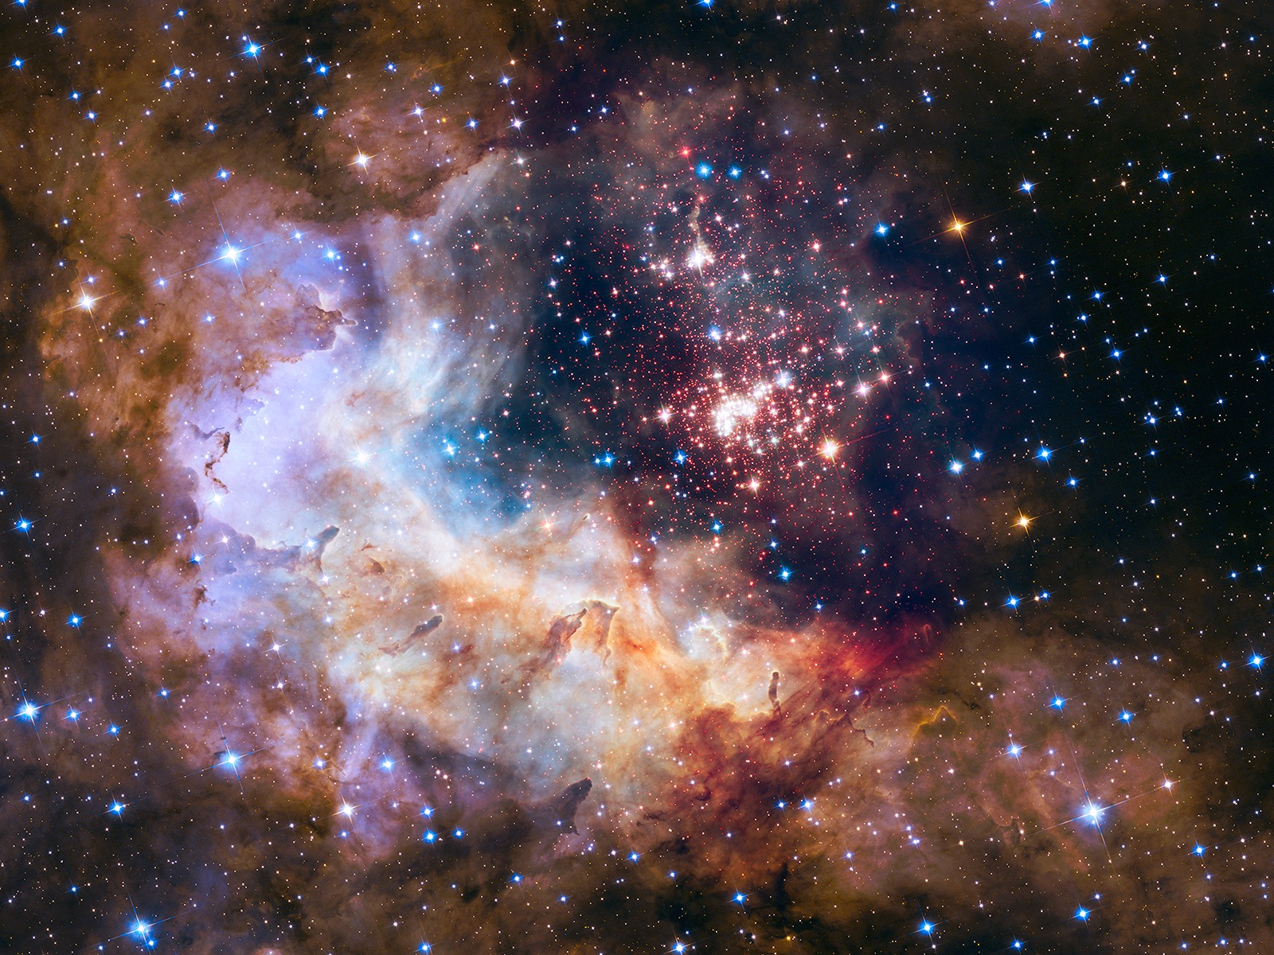
gwiazdozbiór i mgławica
Galaktyka spiralna z poprzeczką NGC 986
10
Notes:
On the left: https://instagram.com/p/vrrNz5IaLY/: NGC 986 — a barred spiral galaxy, Credit: ESA/Hubble & NASA
On the right: https://instagram.com/p/10dDfiIaI0/, Credit: NASA

Slide 11
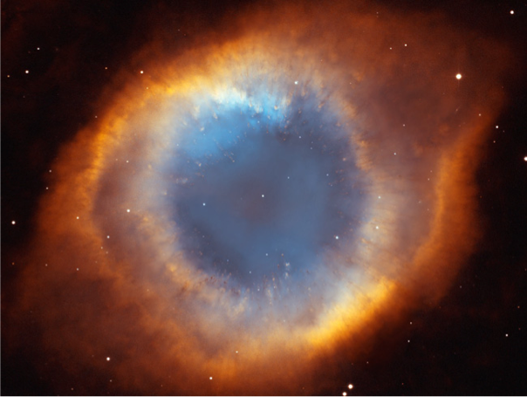
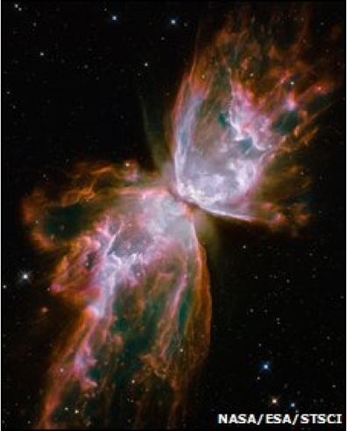
Mgławica Motyl
Mgławica Ślimak
11

Slide 12
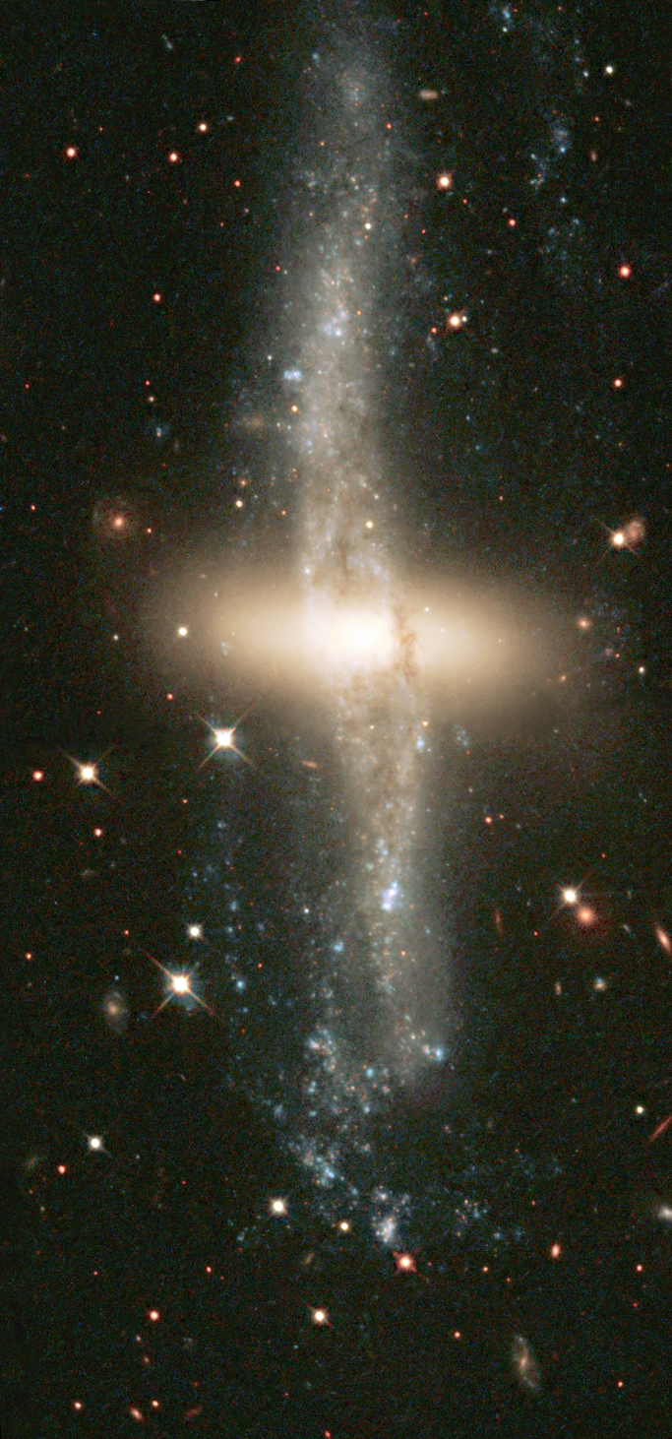
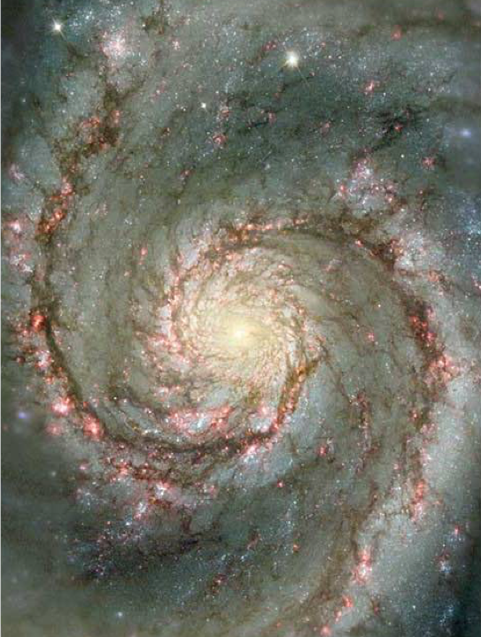
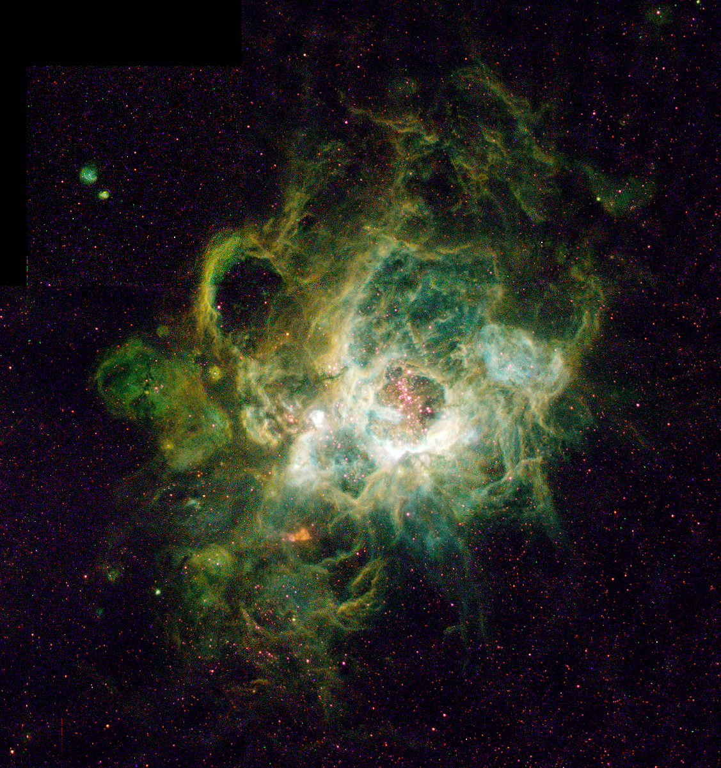
nebula called NGC 604
Mgławica NGC 604
Galaktyka Wir NGC5194
Biegunowa galaktyka pierścieniowa
NGC4650A
12
Notes:
NASA photos, accessed 2015 May 20
On the left: https://www.flickr.com/photos/44494372@N05/9464533971/
"polar-ring" galaxy NGC 4650A. Located about 130 million light-years away, NGC 4650A is one of only 100 known polar-ring galaxies. Their unusual disk-ring structure is not yet understood fully.
In center: http://www.nasa.gov/sites/default/files/images/729779main_hubble_spin_full_full.jpg
At only 30 million light years distant and fully 60 thousand light years across, M51, also known as NGC 5194, is one of the brightest and most picturesque galaxies on the sky.
On the right: https://www.flickr.com/photos/44494372@N05/9460797842/
a vast nebula called NGC 604, which lies in the neighboring spiral galaxy M33, located 2.7 million light-years away in the constellation Triangulum.

Slide 13
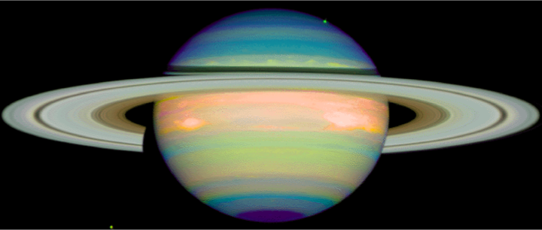
Saturn
13
Notes:
http://nssdc.gsfc.nasa.gov/image/planetary/saturn/hst_saturn_nicmos.jpg
Image credit: Erich Karkoschka (University of Arizona), and NASA

Slide 14
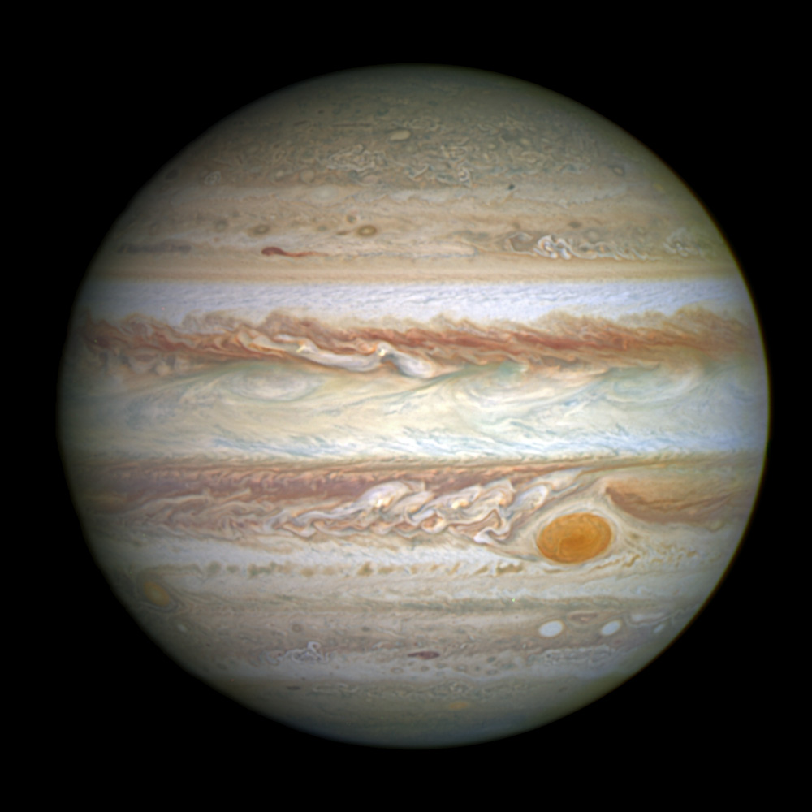
TitleAndActionSafe
Jowisz
(demoted in 2006)
14
Notes:
Credit for Jupiter: NASA, ESA, and A. Simon (Goddard Space Flight Center)

Slide 15
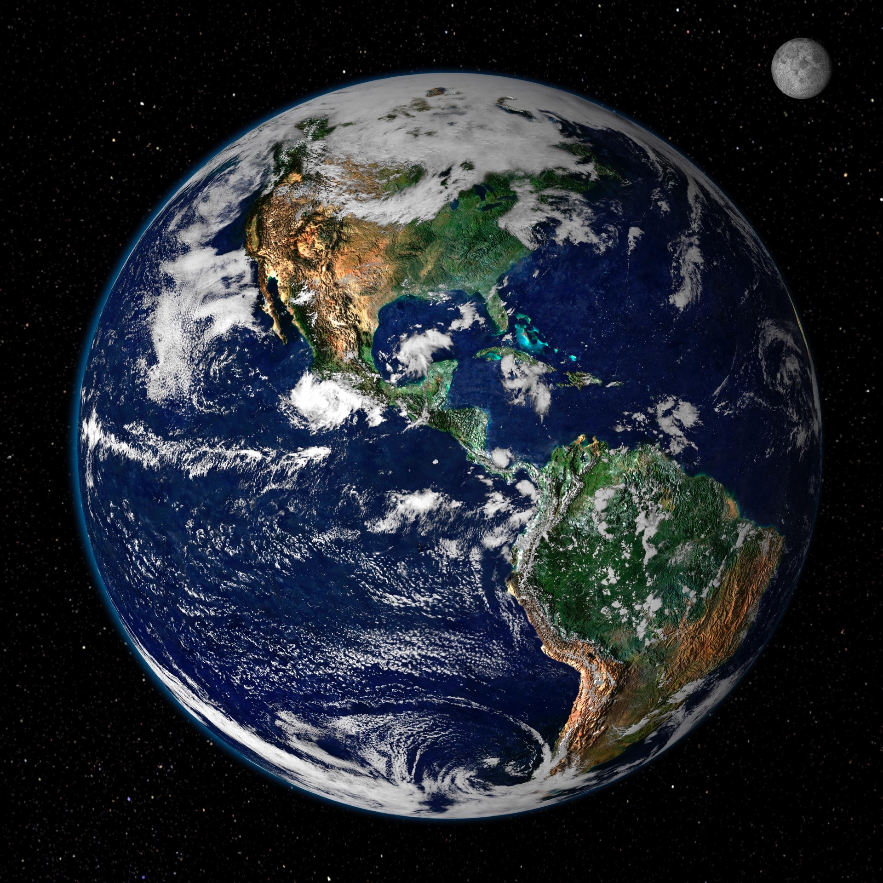
Ziemia
15
Notes:
Credit for Jupiter: NASA, ESA, and A. Simon (Goddard Space Flight Center)

Slide 16
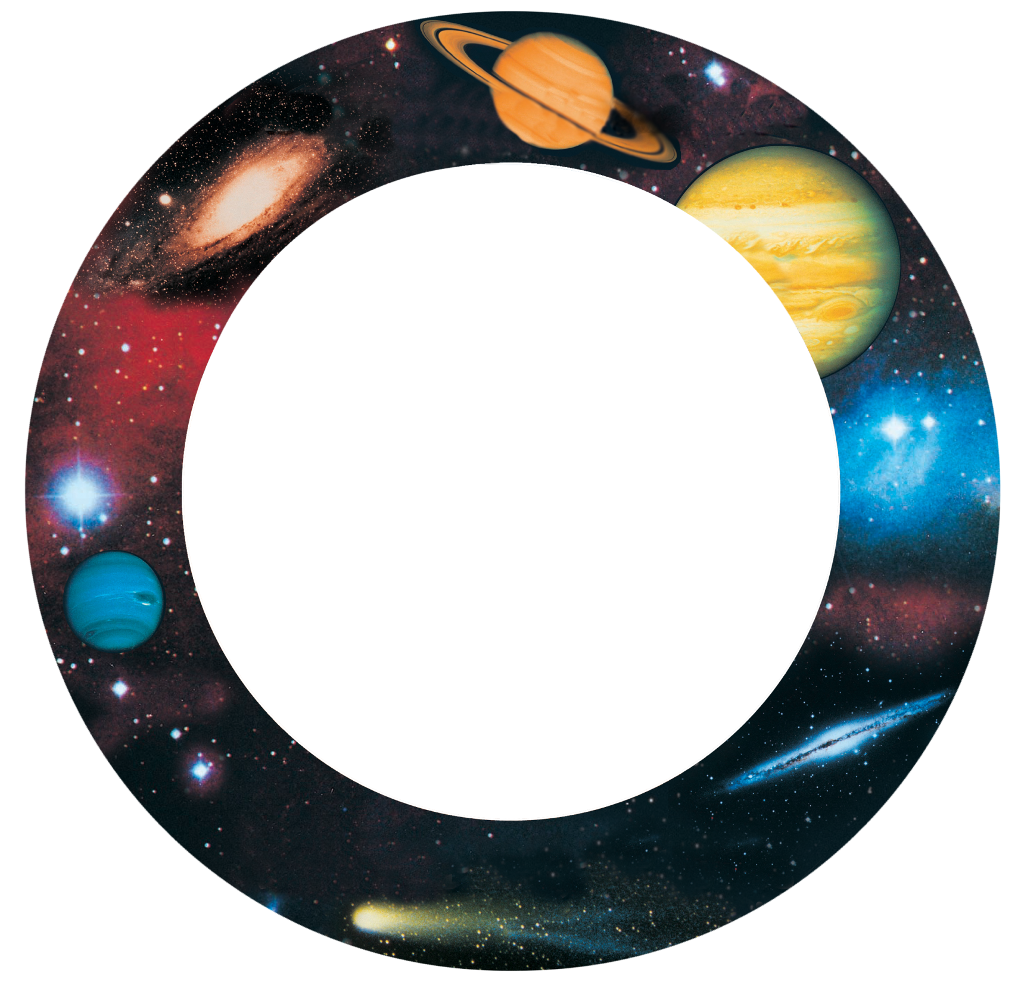
Ewolucja Kosmiczna
Ewolucja
Geologiczna
Ewolucja
Biologiczna
Życie
Ziemia
planety, gwiazdy, galaktyki
16

Slide 17
Światopogląd naturalistyczny
1. Przyroda lub materia to wszystko, co istnieje.
2. Wszystko można wyjaśnić, odwołując się do czasu, ślepego przypadku oraz praw przyrody działających na materię.
Założenia ateizmu

Slide 18
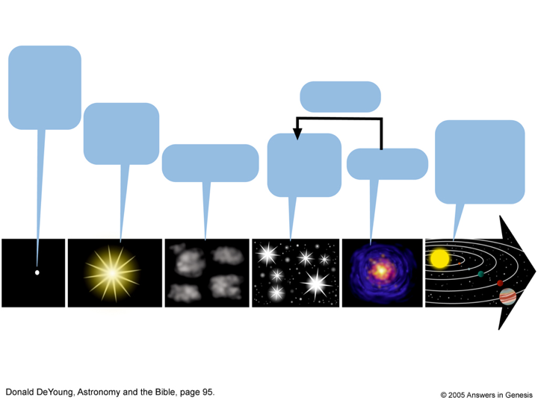
Teoria Wielkiego Wybuchu
“Kosmiczne jajo”
lub Nic
Cykl powrotny
Wielki Wybuch 13,8 mld lat temu
Układ Słoneczny
5 mld lat temu
Chmury
wodoru i helu
Gwiazdy 12-10 mld lat temu
Supernowa
Czas
18
Notes:
The Big Bang developed in the 1920s and 30s (see notes below). Today Big Bangers don’t believe in an original “kernel.” Rather they believe that something popped into existence from nothing and immediately started expanding.
Diagram slightly modified from: Don DeYoung, Astronomy and the Bible (Grand Rapids: Baker 2000), p. 95
Development of big bang theory
(source Danny Faulkner and Wikipedia)
1912 Vesto Slipher measured the first Doppler shift of a "spiral nebula" (spiral nebula is the obsolete term for spiral galaxies), and soon concluded that almost all such nebulae were receding from Earth. He did not grasp the cosmological implications of this fact.
1922 Alexander Friedmann, a Russian cosmologist and mathematician, derived the Friedmann equations from Albert Einstein's equations of general relativity, showing that the universe might be expanding in contrast to the static universe model advocated by Einstein at that time.
1927 Georges Lamaitre (“la-may’-tre”, Belgian Catholic astronomer) proposed that the inferred recession of nebulae was due to the expansion of the universe.
1929 Edwin Hubble published paper on the relation of redshift to expansion
1931 Lamaitre suggested the big bang by supposing that an expanding universe might be traced back in time to an originating single tiny point of immense density and temperature.
1948 Gamow published paper in defense of big bang.
1949 Sir Fred Hoyle (favored the steady state model) coined the term “big bang” in a BBC radio broadcast.
1952 When Hugh Ross (b. 1945) was 7 years old (when he became enamored with astronomy) only a minority of astronomers believed in the big bang. Most held to the Steady State model of eternal expanding universe with new material coming into existence all the time.
1964 Abell’s astronomy textbook mentions the big bang theory as a minor view of the expanding universe. Steady State still more popular because big bang perceived as religious. The cosmic microwave background radiation was discovered.

Slide 19
ŚWIATOPOGLĄD BIBLIJNY
Wieczny, dobry, wszechwiedzący, wszechpotężny, święty Bóg istnieje i to On stworzył wszystko inne.
Biblia, całkowicie wiarygodne Słowo Boga, wyjaśnia kluczowe wydarzenia w historii, więc możemy poprawnie interpretować świadectwa dotyczące powstania świata i historii stworzenia.

Slide 20
Nauka operacyjna czy Nauka o pochodzeniu

Slide 21
NAUKA
EKSPERYMENTALNA
NAUKA
OBSERWACYJNA
Biologia
Chemia
Fizyka
Inżynieria
Medycyna
Notes:
These are examples of operation/experimental/observational science.

Slide 22
Saturn
22
Notes:
http://nssdc.gsfc.nasa.gov/image/planetary/saturn/hst_saturn_nicmos.jpg
Image credit: Erich Karkoschka (University of Arizona), and NASA

Slide 23
NAUKA HISTORYCZNA
NAUKA
O POCHODZENIU
Geologia historyczna
Paleontologia
Archeologia
Kosmologia
Kryminalistyka
Notes:
ORIGIN science is also called HISTORICAL science, and these are examples of that kind of science.

Slide 24
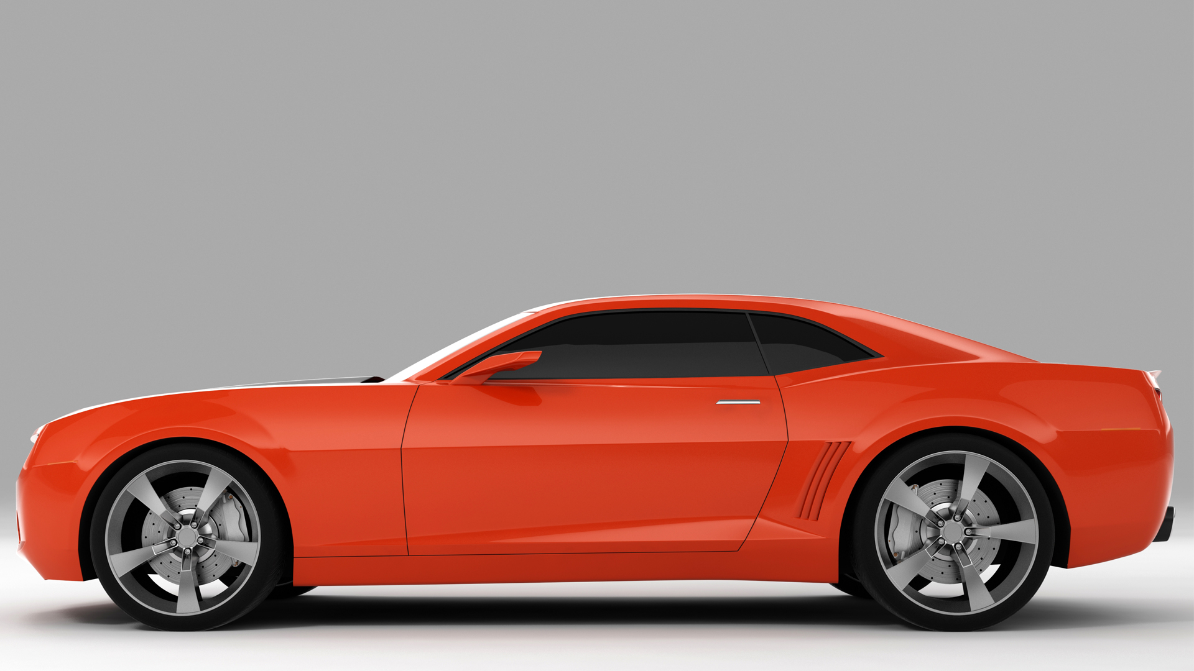
Mechanik samochodowy
(Nauka operacyjna)
Producent Samochodów
(Nauka o pochodzeniu)
Notes:
car mechanic (how the pistons, fuel injector, A/C work)

Slide 25
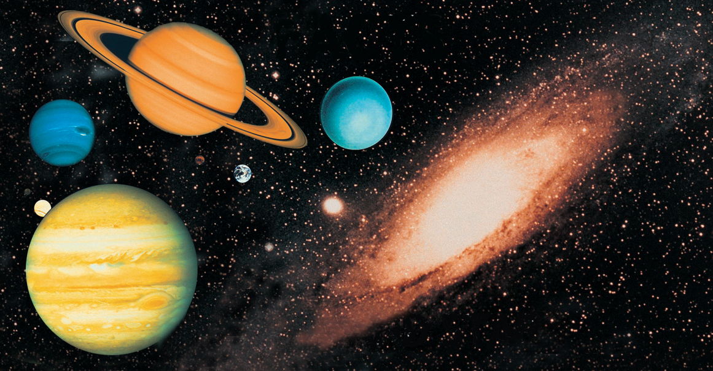
Nauka OPERACYJNA
Nauka O POCHODZENIU
FAKTY
PLANETY I GWIAZDY
25

Slide 26
ZAŁOŻENIE NATURALISTYCZNE
ZAŁOŻENIA BIBLIJNE
FAKTY
PLANETY I GWIAZDY
WIELKI WYBUCH, MILIARDY LAT
ZAPROJEKTOWANY,
MŁODY WSZECHŚWIAT
26

Slide 27
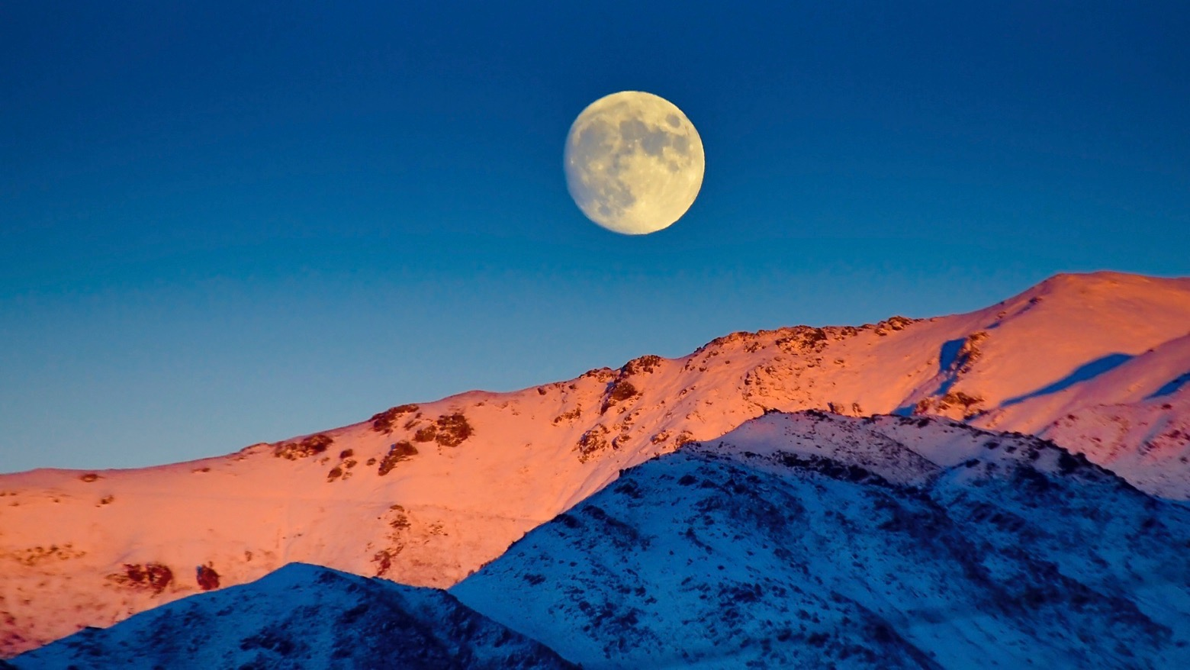
POCHODZENIE KSIĘŻYCA?
Credit:ThinkstockPhotos
Notes:
ThinkstockPhotos-523263969.jpg

Slide 28
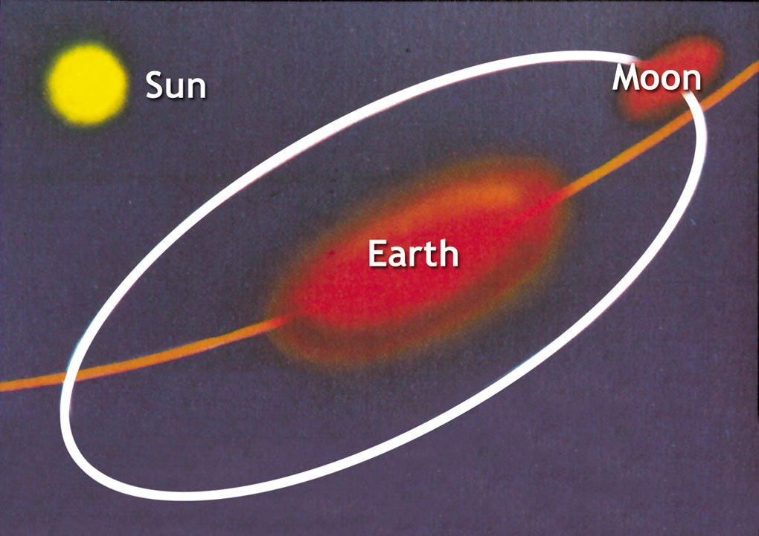
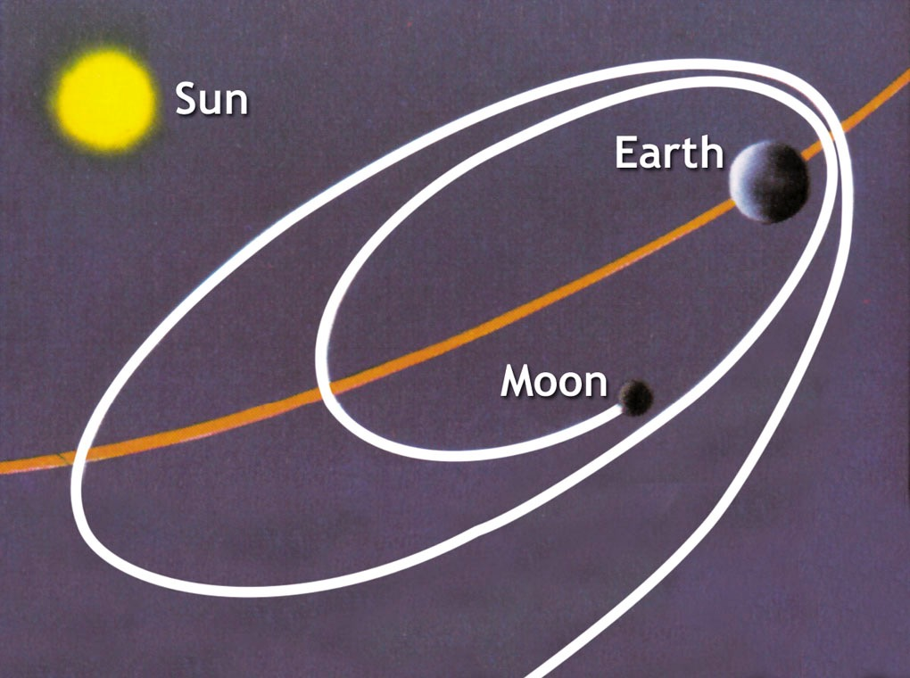
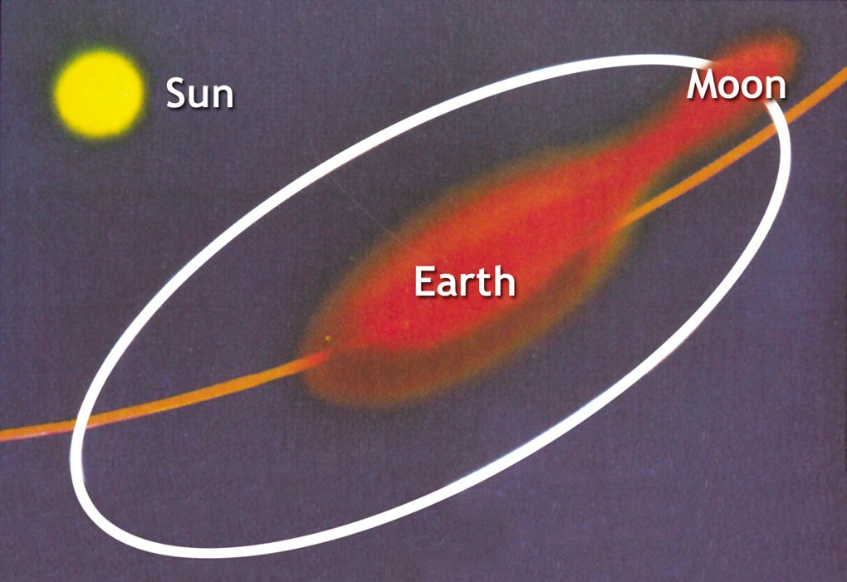
Teoria Siostry
Teoria Żony
Teoria
Córki
28
Notes:
Source of pictures: Peter Adams, Moon, Mars and meteorites (London: British Geological Survey [formerly Institute of Geological Sciences], 1977), p. 28 The theories are explained below by Oard.
The dominant theory today:
According to Robert Roy Britt (Senior Science Writer for Space.com, on 15 Aug 2001 at http://www.space.com/scienceastronomy/solarsystem/moon_making_010815-1.html) (still the dominant theory in 19 Feb 2012: http://www.space.com/14627-moon-quakes-lunar-activity.html), the favored theory (because the others theories have such huge dynamical and geochemical problems) is the single-impact daughter theory—an object the size of Mars slammed into the Earth. The moon was made in 1-100 years. The theory is based totally on computer models, which are based on naturaliistic assumptions.
Another daughter theory that is gaining in popularity is that two large asteroid-type objects collided and eventually the earth and moon formed by accretion of the collision fragments.
The three theories explained by Mike Oard, TJ, 14:1 (2000), 6-7:
SISTER (Condensation (or co-creation) theory — earth and moon formed at about the same time from the same portion of the swarm of planetesimals which supposedly orbited the sun in the early phases of the evolution of the solar system. However, it’s unlikely that the gravitational attraction could have been strong enough, and it doesn’t account for the moon’s low iron content.
WIFE (Capture) theory — the moon was wandering through the solar system, and was captured by Earth’s gravity. But for one approaching body to enter into orbit around another, it would need to lose a lot of energy, which is why spacecraft sent to orbit other planets are designed with retro-rockets. Otherwise the approaching body would have been ‘slingshotted’ rather than captured, a phenomenon the Voyager probes exploited. Finally, even a successful capture would have resulted in an elongated comet-like orbit.
DAUGHTER (Fission) theories One was invented by the astronomer George Darwin (son of Charles). He proposed that the earth spun so fast that a chunk broke off, with the Pacific Ocean as the probable scar (or a modification of the theory that had the earth molten at the time). But this theory is universally discarded today. First, the moon is too chemically different from the earth; second, the earth could never have spun fast enough to throw a moon into orbit; and third, the escaping moon would have been shattered while within the Roche Limit. Another theory was that asteroids and meteors broke off material and that debris got together in orbit to form the moon. It too has fatal theoretical problems.

Slide 29
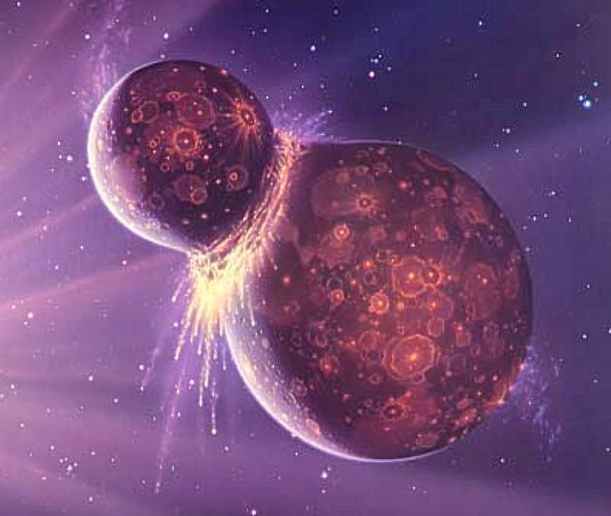
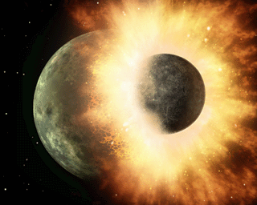
Teoria
Wielkiego Zderzenia
29
Notes:
Mars-size object hit the earth about 4.45 billion years ago. The energy involved was 100 million times greater than the impact believed to have wiped out the dinosaurs. This early giant collision destroyed the incoming object, likely vaporized the upper layers of Earth's mantle, and ejected large amounts of debris into Earth orbit. Our Moon formed from this debris.
Purple photo: http://starchild.gsfc.nasa.gov/docs/StarChild/questions/question38.html, accessed 30 March 2009
Smaller photo: http://en.wikipedia.org/wiki/History_of_the_Earth#mediaviewer/File:Giantimpact.gif, accessed 3 Nov 2014

Slide 30
“W rzeczywistości historia pochodzenia Księżyca jest wciąż uboga w szczegóły. Eksperci nie są zgodni co do tego, czy zderzenie miało miejsce przed, czy po tym, jak Ziemia osiągnęła swój obecny rozmiar”.
2003
Karen Wright, “Skąd wziął się Księżyc?,” Discover, 24:2 (Luty 2003), s. 63.
30

Slide 31
“Oczarowuje obserwatorów od zarania dziejów i dziś wciąż napełnia poetów zadumą, naukowców zaś pytaniami. Skąd wziął się księżyc i jak znalazł się tam, gdzie jest? […] Mam nadzieję, że nowe badania pewnego dnia dostarczą nam ostatecznej odpowiedzi. Jednak wydaje się, że póki co jesteśmy skazani na domysły”.
2012
Bob Yirka, “New research provokes more questions about the origin of the moon,” http://phys.org, 26 March 2012.
31
Notes:
Maybe just refer this in Big Bang talk or use the last quote. Or at least have in my Q&A slides file
http://phys.org/news/2012-03-provokes-moon.html, accessed 12 June 2012.
It’s beguiled watchers since before records were kept, and today still, it fills poets with pensive musings, and scientists with enchanting questions. Where did the moon come from, and how did it get there? The prevailing view is that a planet named Theia entered our solar system and banged into our planet with sufficient force to push some of the molten material from our planet into orbit. Over time, that material coalesced to form the moon. Now, new research from geophysical scientist Junjun Zhang and colleagues, suggests that such thinking might be wrong. In their paper published in Nature Geoscience, they find that in comparing titanium isotopes from both the moon and the Earth, that the match is too close to support the theory that the moon could have been made partly of material from another planet.
Scientists had already found that oxygen isotopes from the Earth’s mantle and the moon were nearly identical, but that wasn’t enough to put a dent in the theory that a collision with Theia had created the moon because oxygen isotopes from the Earth could have mixed with isotopes from the mass of molten material circling the planet after impact. Now, though, because titanium isotopes are not nearly so easily exchanged, it’s difficult to theorize that the same sort of mixing could have occurred.
Most scientists agree that if a planet had smacked into Earth and the moon came about as a result, than the moon ought to be made of some of that other planet as well. Some say the laws of physics suggest it would be somewhere in the neighborhood of forty percent. If that’s the case, why don’t studies of rocks brought back by the Apollo missions show evidence of this other planet?
Some suggest the moon didn’t come about as a result of an impact at all, but from parts of the Earth being flung into orbit due to a faster spin than we now have. Unfortunately, there is no evidence thus far to support the notion that the Earth ever spun that fast. Others suggest that perhaps it wasn’t a planet that struck the Earth but an object made of ice, which would have evaporated leaving no evidence behind that it caused a huge chunk of the Earth to be knocked into orbit.
And some, despite the new evidence, still cling to the belief that it could have been Theia, if Theia were made of nearly the exact same stuff as the Earth, meaning the isotopes would be the same. The odds for that are pretty slim, but not impossible. Hopefully new research will one day provide us with a definitive answer. Until that day though, it seems we will all have to just keep on musing.

Slide 32
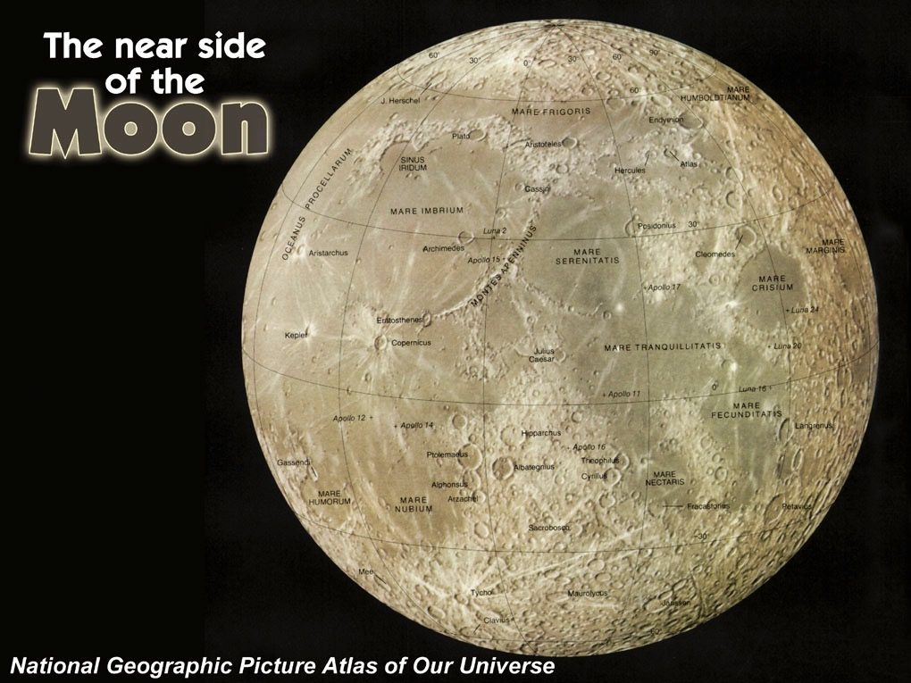
Jasna
strona
KSIĘŻYCA
32

Slide 33
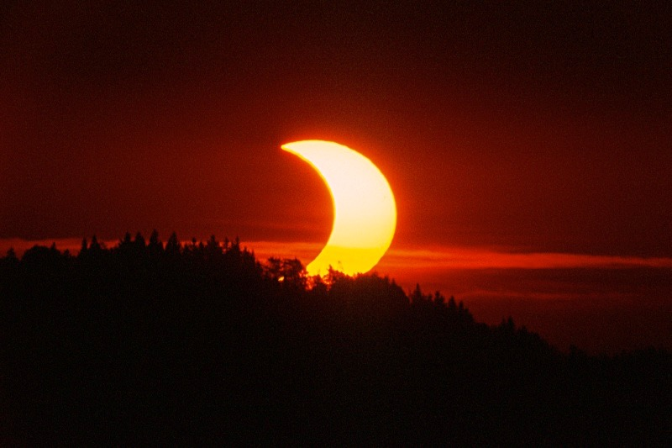
Zaćmienie Słońca
33

Slide 34
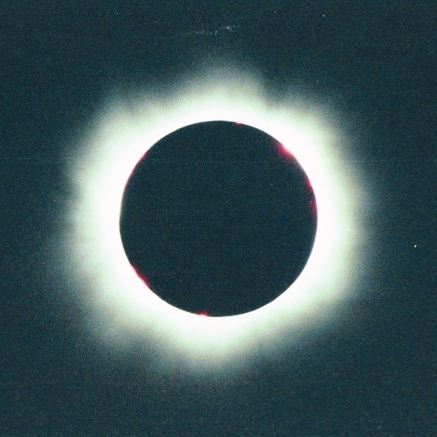
34
Notes:
This happens because the Moon is 400 times smaller than the Sun and 400 times closer to Earth than the Sun is.
(By comparison Sun’s diameter is about 109 times great than the Earth’s diameter so that 1.3 million Earths would fit inside the Sun).
Our Moon is unique in creating solar eclipses.
Out of the 8 planets (including Pluto) and 166 moons in the solar system, no other moon/planet relationship in the Solar System can produce such a perfect and total eclipse.
Partial solar eclipses are common (a few times each year).
Total solar eclipses are rare (somewhere on the earth about 3x per decade and only for a few minutes)—a particular city might witness it only once every 360 years.
From http://members.bellatlantic.net/~vze2vrva/eclipse/hires/img013.jpg, downloaded 31 Jan 2005
If the Moon were in a perfectly circular orbit, a little closer to the Earth, and in the same orbital plane, there would be total solar eclipses every single month. However, the Moon's orbit is inclined (tilted) at more than 5 degrees to Earth's orbit around the Sun so its shadow at new moon usually misses Earth. Earth's orbit is called the ecliptic plane as the Moon's orbit must cross this plane in order for an eclipse (both solar as well as lunar) to occur. In addition, the Moon's actual orbit is elliptical, often taking it far enough away from Earth that its apparent size is not large enough to block the Sun totally. The orbital planes cross each year at a line of nodes resulting in at least two, and up to five, solar eclipses occurring each year; no more than two of which can be total eclipses. However, total solar eclipses are rare at any particular location because totality exists only along a narrow path on Earth's surface traced by the Moon's shadow
Picture: http://aida.astroinfo.org/nies/solar-eclipse-2003-05-31.jpg, downloaded 31 Jan 2005

Slide 35
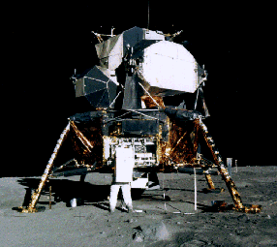
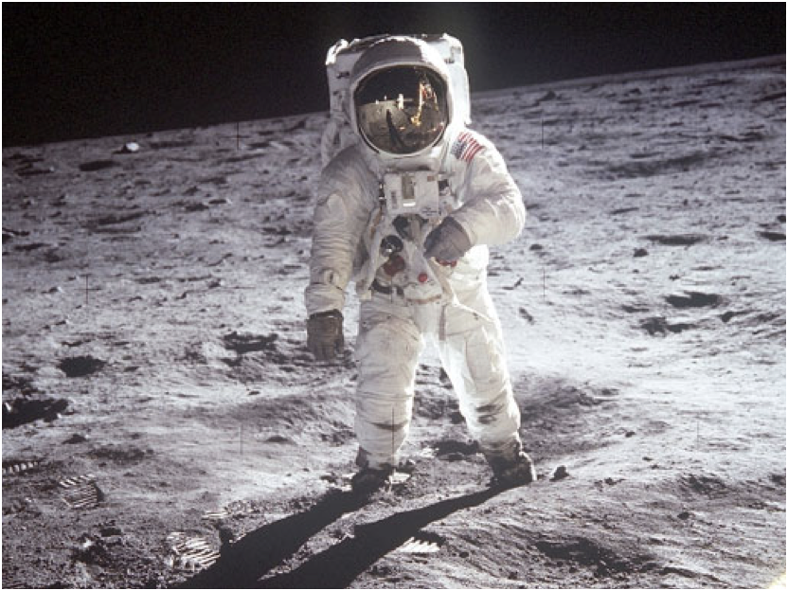
35
Notes:
Neil Armstrong was the first man to walk on the moon: 21 July 1969. Apollo 11 trip.
Picture from http://en.wikipedia.org/wiki/Neil_Armstrong, accessed 21 Aug 2006

Slide 36
Pochodzenie Układu Słonecznego?

Slide 37
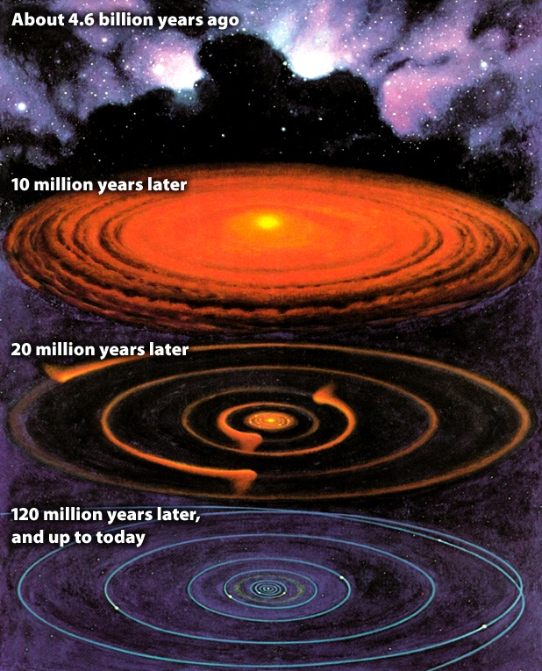
4,6 miliardów lat temu
10 milionów lat temu
20 milionów lat temu
120 milionów lat temu... aż do dziś
37
Notes:
Picture from Roy A. Gallant, National Geographic Picture Atlas of Our Universe (Wash. DC: National Geographic Society, 1986), p. 38. Similar to the diagram in Robert A. Wallace, Jack L. King and Gerald P. Sanders, Biology: the Science of Life (Glenview, IL: Scott, Foresman & Co., 1986), p. 426.

Slide 38
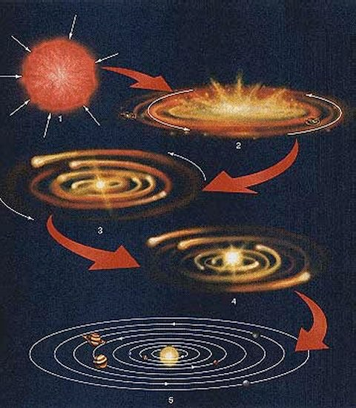
Narodziny Układu Słonecznego?
www.aerospaceweb.org
38
Notes:
http://www.aerospaceweb.org/question/astronomy/q0247.shtml, accessed 28 Feb 2008.

Slide 39
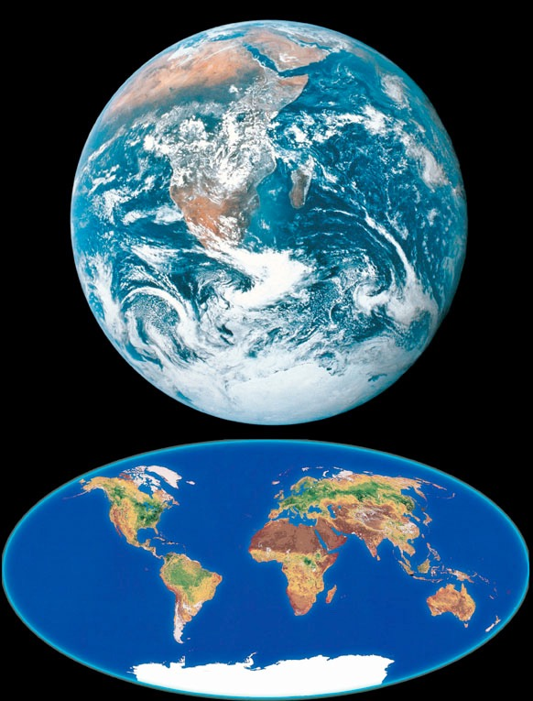
39
Notes:
Earth is 70% covered with water—the only place in the known universe where there is liquid water and we have it in abundance and it is absolutely essential for life as we know it. It has a near-perfect circular orbit around the sun and if it was 5% closer to the sun, its water would boil and turn to steam and if it was 1% farther away from the sun, the oceans would freeze.
Not only is the earth perfectly suited for life, it happens to be located in the best possible location in relation to the other heavenly bodies to enable people on earth to study the rest of the universe (see the DVD “The Privileged Planet”).
Water elsewhere in the universe: Europa (moon of Jupiter) has under a surface layer of ice a global ocean of liquid water 2-3x the amount in our oceans, according to http://apod.nasa.gov/apod/ap120524.html, accessed 2012 May 25.
Regarding our knowledge of the inside of the earth:
“The world’s deepest excavation, a research project on Russia’s Kola Peninsula, has drilled only 7.5 miles into the crust, or less than 0.2 percent of the 3,959 miles to the Earth’s center. Learning about the deep interior from this hole is roughly comparable to learning about Alaska by driving from St. Petersburg, Florida, to Tampa. So geophysicists infer. Seismology, gravitational variation, high-pressure mineral experiments, and chemical analysis of rock samples and meteorites all provide clues. As with all circumstantial evidence, however, interpretations vary.” (bold added)
Source: Anonymous, “What Lies Beneath,” Discover (Aug. 2002), p. 35.

Slide 40
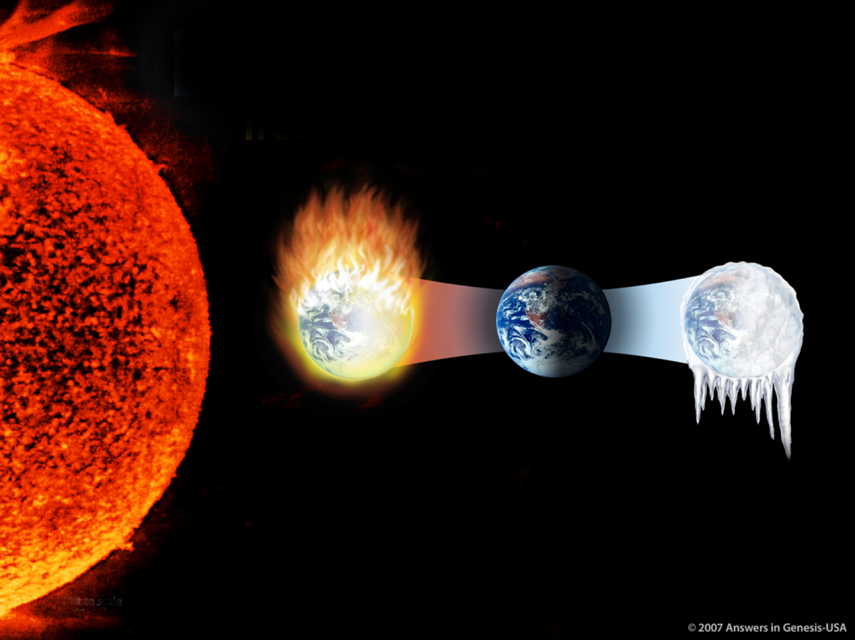
ZIEMIA jest w idealnej odległości
od
SŁOŃCA
Zbyt blisko:
SPŁONIE
Za daleko:
ZAMARZNIE
Not to scale
40

Slide 41
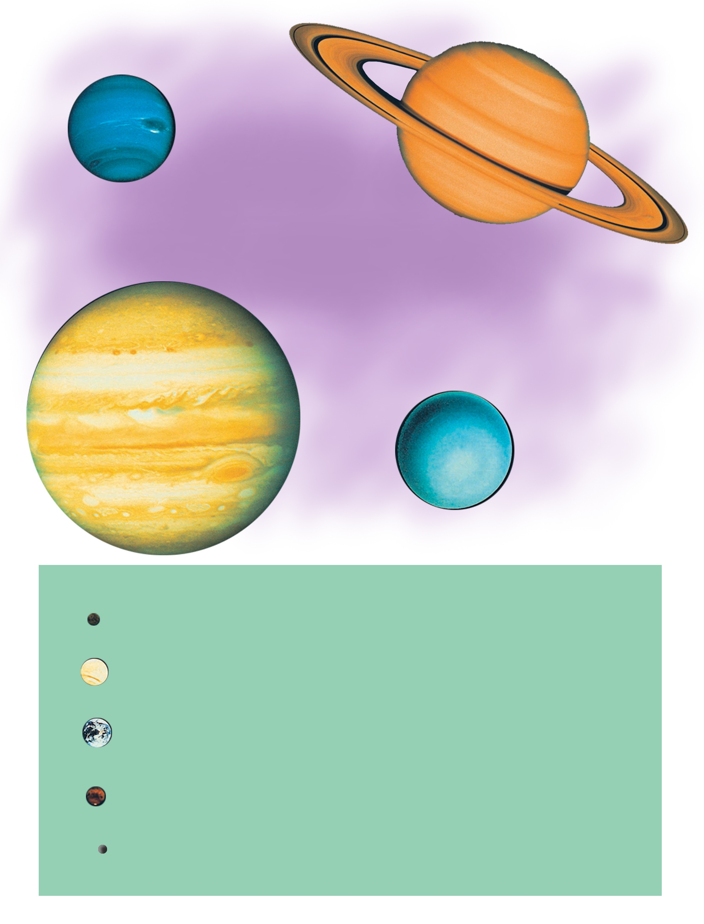
Neptun
Saturn
Gazowe
z płynnym
środkiem
Jowisz
Uran
Merkury
Wenus
Ziemia
Skalne
Mars
Pluton
(zdegradowany w 2006)
41

Slide 42
Słońce
98% helu i wodoru
Merkury Wenus Ziemia
1% helu i wodoru

Slide 43
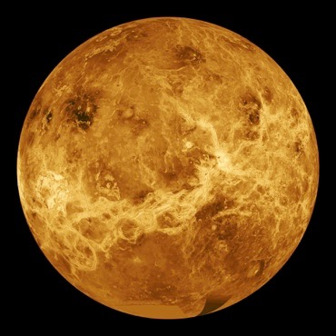
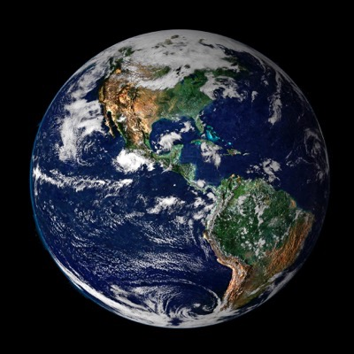
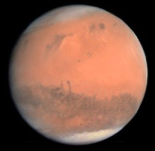
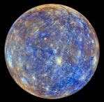
Merkury
Wenus
Ziemia
Mars
Prawie bez atmosfery
Gorąca, gęsta atmosfera
Atmosfera podtrzymująca
życie
Bardzo cienka atmosfera
43
Notes:
Credit for Mercury enhanced color: NASA/Johns Hopkins University Applied Physics Laboratory/Carnegie Institution of Washington
Mercury has almost no atmosphere. The planet's small size means that its gravity is too weak to hold down a normal atmosphere. There is a very thin atmosphere around the planet. Mercury's thin atmosphere is constantly being "blown away" into space by the pressure of sunlight and by the solar wind. Gases are constantly being added to Mercury's atmosphere, too. That's why it still has any atmosphere at all - even though that atmosphere is really, really thin. (http://www.windows2universe.org/mercury/Atmosphere/atmosphere.html, produced by the Nat. Earth Sci. Teachers Assoc.)
Credit for Venus: NASA
The atmosphere of Venus is made up mainly of carbon dioxide, and thick clouds of sulfuric acid completely cover the planet. The atmosphere traps the small amount of energy from the sun that does reach the surface along with the heat the planet itself releases. (http://www.windows2universe.org/venus/atmosphere.html, produced by the Nat. Earth Sci Teachers Assoc)
Credit for Earth: Image created by Reto Stöckli, Nazmi El Saleous, and Marit Jentoft-Nilsen, NASA GSFC, or is it Credit: NASA/NOAA/GOES Project?
Credit for Mars: NASA/JPL/MSSS or is it Credit: ESA?
Mars: The Martian atmospherecontains about 95.3% carbon dioxide (CO2) and 2.7% nitrogen, with the remainder a mixture of other gases. However, it is a very thin atmosphere, roughly 100 times less dense than Earth's atmosphere. (http://coolcosmos.ipac.caltech.edu/ask/79-Does-Mars-have-an-atmosphere-)

Slide 44
Planety mają:
Różne orbity
Różne prędkości obrotowe
Różne nachylenia osi
Różną liczbę pierścieni, księżyców lub obu
Różne atmosfery

Slide 45
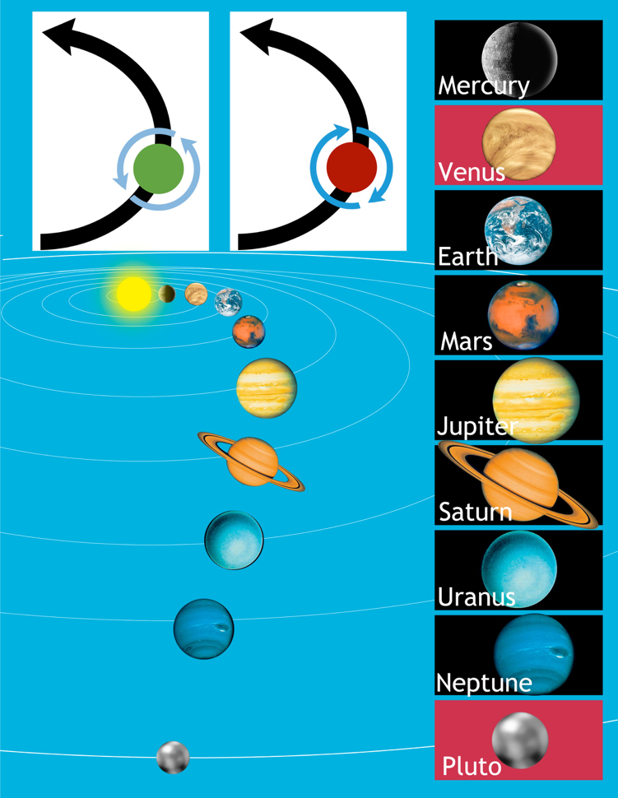
Obieg
wokół
Słońca
Obieg
wokół
Słońca
Merkury
Obrót
planety
Obrót
planety
Wenus
Ziemia
Mars
Jowisz
Saturn
Uran
Neptun
Pluton
45
Notes:
Pluto demoted from being a planet in 2006
According National Geographic (http://news.nationalgeographic.com/news/2006/08/060824-pluto-planet.html, accessed 6 June 2010):
According to the new definition, a full-fledged planet is an object that orbits the sun and is large enough to have become round due to the force of its own gravity. In addition, a planet has to dominate the neighborhood around its orbit.
Pluto has been demoted because it does not dominate its neighborhood. Charon, its large "moon," is only about half the size of Pluto, while all the true planets are far larger than their moons.
In addition, bodies that dominate their neighborhoods, "sweep up" asteroids, comets, and other debris, clearing a path along their orbits. By contrast, Pluto's orbit is somewhat untidy.

Slide 46
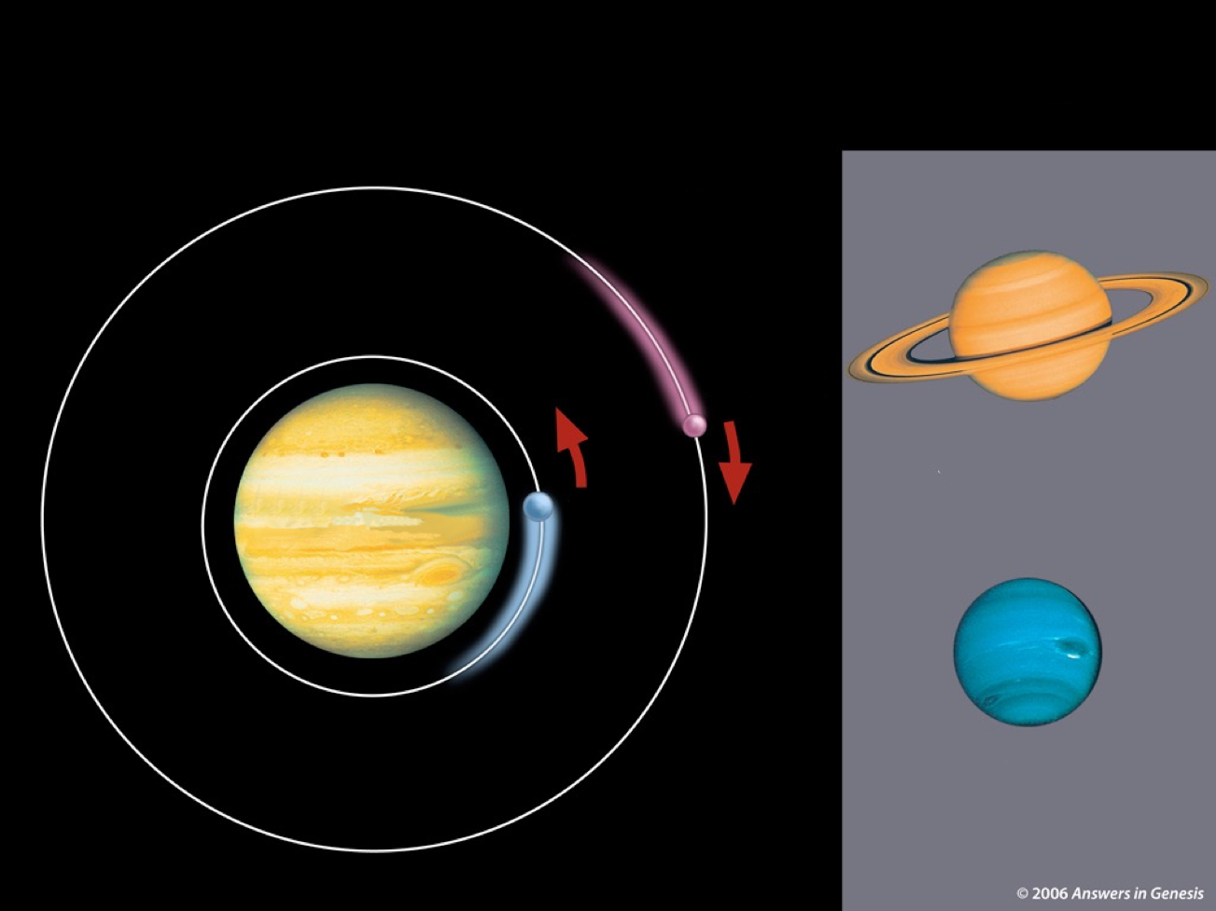
Księżyce krążą w obu kierunkach
Orbity księżyców
Karme
Saturn
Jowisz
Io
Neptun
46

Slide 47
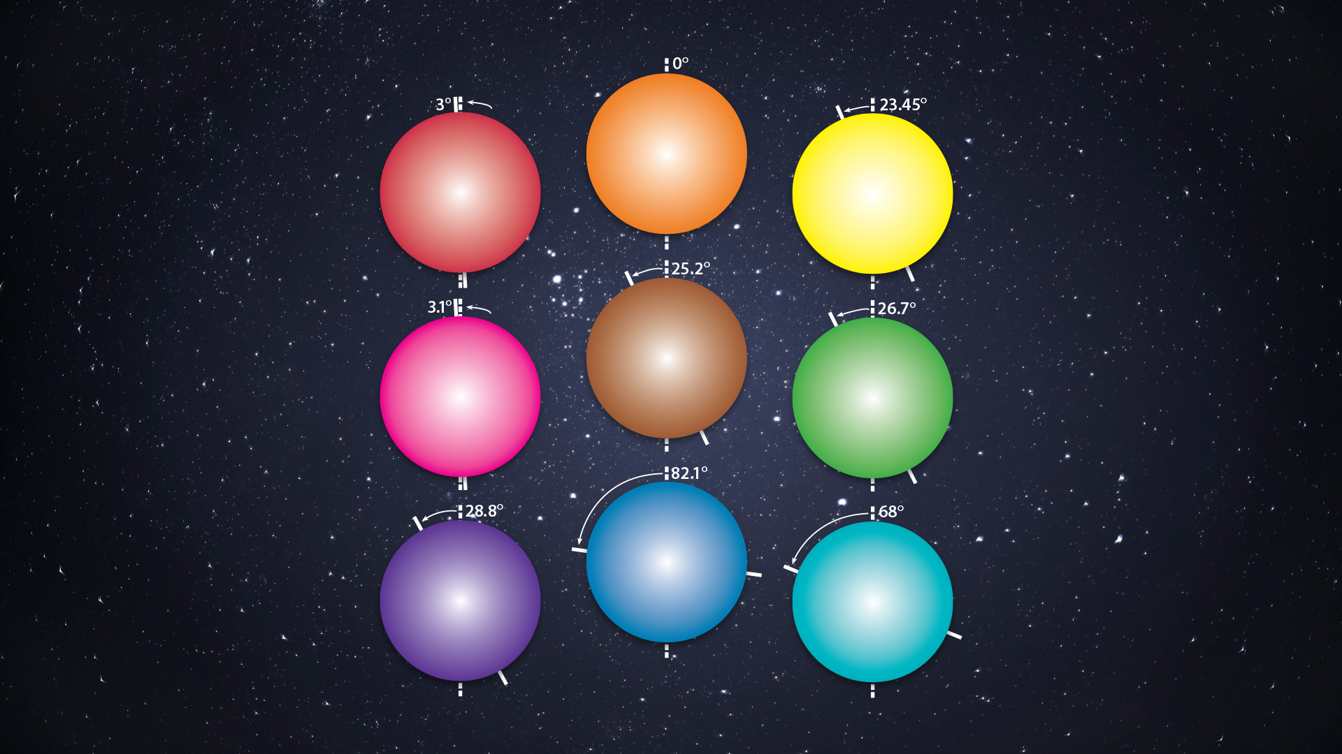
Merkury
Wenus
Ziemia
Mars
Jowisz
Saturn
Uran
Neptun
Pluton
Notes:
Based off of Roy Gallant, Our Universe (Wash. DC: National Geographic Society, 1986), p. 39.

Slide 48
“Nasze pobieżne badania ujawniły strukturę i zawartość Układu Słonecznego, ale sprawa nie jest jeszcze zamknięta. Możemy z powodzeniem interpretować wiele zaobserwowanych cech, takich jak źródła meteorytów. Jednakże bez odpowiedzi pozostaje mnóstwo pytań dotyczących pochodzenia tych cech. Te nierozwiązane kwestie podsuwają niepewne odpowiedzi (Rozdział 7)”.
1987
Michael Zeilik & Elske Smith, Introductory Astronomy & Astrophysics (Philadelphia: Saunders College Publ., 1987), p. 33.
Notes:
But surely we know more now than they did in 1987, right? Next slide
This book was written for undergraduates with a background in math and physics.
Zeilik is from U. of New Mexico and Smith from Virginia Commonwealth U.

Slide 49
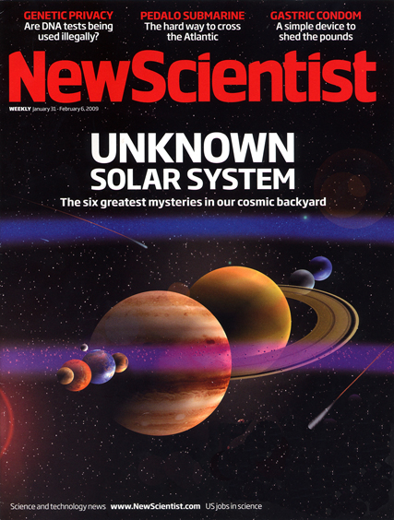
NIEZNANY
UKŁAD SŁONECZNY
Sześć największych tajemnic
z naszego kosmicznego podwórka
31 stycznia 2009
Notes:
Unknown Solar System: The Six greatest mysteries in our cosmic backyard

Slide 50
“6 niewyjaśnionych tajemnic”
Jak powstał Układ Słoneczny?
Dlaczego Słońce i Księżyc są w tym samym rozmiarze na niebie?
Czy istnieje planeta X?
Skąd się wzięły komety?
Czy Układ Słoneczny jest wyjątkowy?
Jak to wszystko się skończy?
Stephen Battersby, “Our Unknown Solar System,” New Scientist 201:2693 (31 Jan. 2009), pp. 29–35.

Slide 51
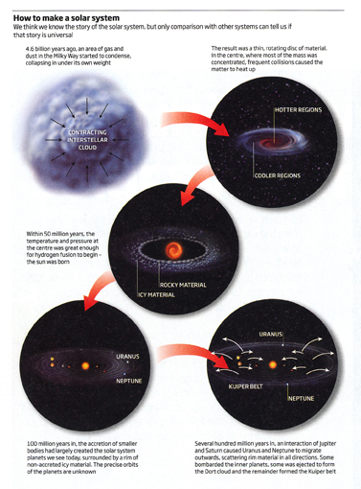
“Wydaje nam się, że znamy historię Układu Słonecznego, ale tylko porównanie z innymi układami może nam powiedzieć, czy ta historia jest uniwersalna”.
Jak zrobić Układ Słoneczny
Ale czy ta historia jest PRAWDZIWA? Nie wiedzą!
2009
Stephen Battersby, “Our Unknown Solar System,” New Scientist 201:2693 (31 Jan. 2009), pp. 29–35.
Notes:
How to make a solar system
We think we know the story of the solar system, but only comparison with other systems can tell us if that story is universal.
We think we know how our car came into existence, but only comparison with other cars (we don’t know how they formed) can tell us if that story about our car’s origin is universal (how all cars came into existence).
Stephen Battersby, “Our Unknown Solar System,” New Scientist 201:2693 (31 Jan. 2009), p. 30.

Slide 52
Nauka OPERACYJNA
Nauka O POCHODZENIU
FAKTY
PLANETY I GWIAZDY
52

Slide 53
Pochodzenie gwiazd
i galaktyk?

Slide 54
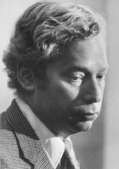
„Wśród najważniejszych reliktów są struktury, które widzimy na niebie: wiele gwiazd zgrupowanych jest w gromady, gromady z kolei wraz z samotnymi gwiazdami, jak nasze słońce, tworzą galaktyki, te zaś łączą się w gromady galaktyk”.
Steven Weinberg, “Origins,” Science, 230:4721 (Oct. 4, 1985), p. 16.
Notes:
This is an article about the big bang and the origin of the universe.
Weinberg is a world-renown astrophysicist. At the time he was Prof. of Science, Dept. of Physics, Univ. of Texas, Austin.

Slide 55
„Drugim wielkim rozczarowaniem astrofizyki jest fakt, że wciąż nie mamy jasności na temat tego, jak te struktury się uformowały. Nie wiemy nawet tego, czy najpierw uformowały się mniejsze struktury, a następnie połączyły w większe, czy raczej to te większe uformowały się wcześniej, a następnie rozpadły na mniejsze kawałki”.
Steven Weinberg, “Origins,” Science, 230:4721 (Oct. 4, 1985), p. 16.
Notes:
The first disappointment he mentioned was that after more than 20 years of discovering the remarkable properties of quasars, scientists “still have NO direct observational confirmation that the quasars actually are powered by black holes—it is just that no one can think of any equally plausible possibilities” (p. 15). Article in my file cabinet.

Slide 56
„Niepokojące jest również to, że wszystkie te oszacowania wieku i składu gwiazd opierają się na skomplikowanych obliczeniach dotyczących tego, co dzieje się w ich wnętrzu, ale jedyne, co obserwujemy, to światło emitowane z ich powierzchni”.
1985
Steven Weinberg, “Origins,” Science, 230:4721 (Oct. 4, 1985), p. 16.
Notes:
Dr. Jason Lisle said in Nov. 2006 that this quote is still accurate with a caveat that they can observe neutrinos coming from the center of the sun and from the explosion of stars.
Dr. Weinberg (PhD Princeton, Nobel Prize in physics, 1979) is Professor and Director of the Theory Research Group at University of Texas, Austin.
Photo source: http://www.nobel.se/physics/laureates/1979/weinberg-autobio.html, downloaded 9 June 2004.

Slide 57
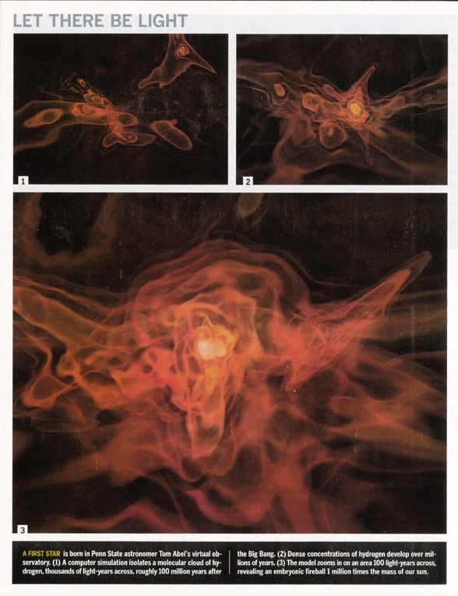
„Rodzi się PIERWSZA GWIAZDA
w wirtualnym obserwatorium astronoma Toma Abla, na Uniwersytecie w Pensylwanii”.
Tim Folger, “The Real Big Bang,” Discover (Dec. 2002), p. 44.
Notes:
There are two text boxes for the quote. “A FIRST STAR is born” is one and the rest of the sentence is the other and is animated.

Slide 58
„Większość masy Wszechświata jest niewidzialna i nikt naprawdę nie wie, czym ona jest [...] Proces formowania się gwiazd spowija tajemnica. Ogólnie mówiąc, gwiazda powstaje, gdy chmura gazu zapada się pod wpływem siły grawitacji. Jednakże, jeśli chmura jest zbyt gorąca, ciśnienie pokona grawitację i zapobiegnie zapadnięciu się chmury. Zatem, aby uformować gwiazdę, chmura gazu musi mieć możliwość schłodzenia się”.
Marcus Chown (astronom), “Let there be light,” New Scientist, 7 Feb. 1998, p. 30.
Notes:
According to http://www.popularscience.co.uk/marcuschown/, Marcus Chown is an award-winning writer and broadcaster. He began his career as a radio astronomer at the California Institute of Technology in Pasadena. Now he is cosmology consultant of the British weekly science magazine New Scientist. Marcus's first popular science book was Afterglow of Creation, which in the UK is the most-read popular science book after Stephen Hawking's A Brief History of Time. Marcus chooses his words carefully. Marcus graduated from the University of London with a first-class degree in physics, and four years later he gained a Master of Science in astrophysics from the California Institute of Technology.

Slide 59
„To nie jest takie proste, jak się wydaje. W dzisiejszym Wszechświecie osiągane jest to, gdy znaczna ilość cząsteczek zderzających się ze sobą wypromieniowuje ciepło. Jednakże, atomy niezbędne do wytworzenia wszystkich oprócz najprostszych cząsteczek—cząsteczek wodoru—muszą powstać wewnątrz gwiazdy. Jest to dylemat typu: jajko czy kura...”
Marcus Chown (astronomer), “Let there be light,” New Scientist, 7 Feb. 1998, p. 30.

Slide 60
„[John] Mather, [NASA Centrum Lotów Kosmicznych imienia Goddarda w Maryland], mówi, ‘Nie mamy żadnych bezpośrednich świadectw dotyczących tego, jak powstały galaktyki, jak powstały pierwsze gwiazdy bez pomocy już wcześniej powstałych gwiazd, jak ewoluowały galaktyki, czy uformowały się ze skupisk mniejszych jednostek, czy w wyniku podzielenia się większych.
Marcus Chown (astronomer), “Let there be light,” New Scientist, 7 Feb. 1998, p. 30.
Notes:
On Oct. 3, 2006, John Mather was named co-winner of the 2006 Nobel Peace Prize for physics (along with George Smoot, both Americans) for their contributions to the success of the Cosmic Background Explorer (COBE) satellite program launched by NASA in 1989. According to Reuters, “Their work took Big Bang theory, which contends the universe began 15 billion years ago as a tiny dot that exploded into today's huge system of stars and planets, out of the realm of mathematical equations and into the world of precise science.” Reuters reported that the Royal Swedish Academy of Sciences (which awards the Nobel prize of 10 million Swedish Crowns (about 1.37 million dollars) said, “the Big Bang scenario for the origin of the universe is the only scenario that predicts the kind of microwave background radiation measured by COBE.” http://today.reuters.com/news/articlenews.aspx?type=domesticNews&storyid=2006-10-03T144526Z_01_L03200407_RTRUKOC_0_US-NOBEL-PHYSICS.xml&src=rss&rpc=22
Of course that wasn’t too precise as evolutionists now say the universe is 13.4 billion years old.

Slide 61
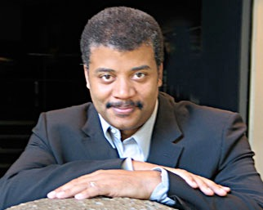
„Gdyby nie to, że wiemy, iż gwiazdy istnieją, czołowi naukowcy przedstawiliby setki przekonujących powodów, dla których nigdy nie mogłoby dojść do powstania gwiazd”.
Neil deGrasse Tyson
Neil deGrasse Tyson, Death by Black Hole and Other Cosmic Quandaries (New York: W.W. Norton & Co., 2007), p. 187.
Notes:
Tyson is an atheist, like his predecessor, Carl Sagan.

Slide 62
Powstanie Wszechświata?

Slide 63
„Zapewne zauważyliście, że pomimo tych wszystkich odważnych słów, nie wyjaśniłem jeszcze pochodzenia Wszechświata. Przyczyną jest oczywiście fakt, że jest to kwestia, co do której naukowcy wciąż nie mają jasnego poglądu[...] Możliwe, że nigdy się tego nie dowiemy, tak jak nigdy być może nie poznamy ostatecznych praw przyrody. Ale o to bym się nie zakładał”.
Steven Weinberg, “Origins,” Science, 230:4721 (Oct. 4, 1985), p. 18.
Notes:
This is in the last paragraph of the article.

Slide 64
„Nie dajcie się ogłupić kosmologom. Oni też nie mają bladego pojęcia [...] ‘Na początku,’ powiedzą: 'nie było nic—nie było czasu, przestrzeni, materii ani energii. Potem nastąpiła kwantowa fluktuacja, z której – Hola!! Tu warto się zatrzymać. Widzicie co oni mówią? Najpierw nie ma nic, a potem jest coś—a zanim się obejrzycie, wyciągną ze swoich kwantowych kapeluszy sto miliardów galaktyk”.
David Darling, “On creating something from nothing,” New Scientist, Vol. 151 (14 Sept. 1996), p. 46.
Notes:
David Darling is a British astronomer, with a Ph.D from the University of Manchester and is the author of several dozen science books. His website is one of the most visited sites on the Internet for information about life and intelligence in the universe. (source: http://www.coasttocoastam.com/guests/548.html)

Slide 65
„Ciemna materia jest jedną z największych tajemnic współczesnej nauki. Chociaż jest niewidzialna, to na podstawie skutków działania jej grawitacji astronomowie doszli do przekonania, że jej masa stanowi co najmniej 90% masy całego Wszechświata. Jednak nie wiedzą oni, czym jest owa ciemna materia ani jak jest rozmieszczona. Dopóki zagadka ciemnej materii nie zostanie rozwiązana, astronomowie nie mogą twierdzić, że posiedli jakieś głębsze zrozumienie Kosmosu”.
David Whitehouse (science editor), “New light on dark matter,” BBC News Online, 9 March 2000.
Notes:
Whitehouse has a PhD in astrophysics from Victoria University in Manchester.
He was a science correspondent (1988-2006) and also served as the Science Editor for BBC News Online.
http://www.desmogblog.com/david-whitehouse, accessed 17 Aug 2013 (he doesn’t believe that global warming is now happening
http://www.davidwhitehouse.com/Academic.html, accessed 17 Aug 2013

Slide 66
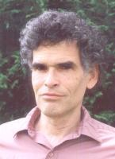
„Teoria wielkiego wybuchu opiera się na coraz większej liczbie hipotetycznych bytów—których nigdy nie obserwowano. Wśród nich najbardziej znaczącymi są: inflacja, ciemna materia i ciemna energia. Bez nich, wystąpiłaby druzgocąca sprzeczność pomiędzy obserwacjami astronomów a przewidywaniami teorii wielkiego wybuchu”.
2009: Podpisane przez 400 naukowców z 50 krajów.
2004: Podpisane przez 34 naukowców z 10 krajów.
Eric Lerner, “Bucking the Big Bang,” New Scientist, 182:2448 (22 May 2004), p. 20.
Notes:
Article at: http://www.newscientist.com/article/mg18224482.900-bucking-the-big-bang.html, last accessed 7 July 2009
As of 2011 April 27 (same as 2009 July 7), the statement also had been signed by over 400 scientists (an additional 218 “scientists and engineers” and 187 “independent researchers”) from over 50 countries and 105 “other” signers. On the web: https://web.archive.org/web/20140401081546/http://cosmologystatement.org/./
Picture from http://www.focusfusion.org/we.html. From this website we learn,
Eric J. Lerner is Executive Director of the Focus Fusion Society and President of Lawrenceville Plasma Physics in Lawrenceville, NJ. He is the author of The Big Bang Never Happened (Random House, 1991, and now in a Vintage paperback edition). He has been an independent researcher in plasma physics since 1979, and has become internationally known for his studies linking cosmic plasma phenomena and laboratory fusion devices, especially the dense plasma focus. He has developed original theories of quasars, large scale structure, the microwave background and the origin of light elements all based on the plasma cosmology approach, which is an alternative to the Big Bang theory. This work has been presented at international conferences and published in the Astrophysical Journal, Astrophysics and Space Sciences and other scientific journals.
In 1986, Lerner outlined a new theory of quasars that did not require black holes, describing quasars as a magnetic self-compression process similar to that occurring in the plasma focus. In effect, the plasmoid in the plasma focus is a tiny scale model of a quasar. In the course of this work, Lerner developed a quantitative theoretical model of the plasma focus which was consistent with all then-available data. The next year, he showed, in proposals to the Department of Energy, how this new theory indicated that the plasma focus could burn advanced fuels, especially hydrogen-boron, and developed the theoretical framework for describing the effect of differing filling gases on the plasma focus.
While the Department of Energy declined to fund this work, Lawrenceville Plasma Physics obtained small grants from NASA's Jet Propulsion Laboratory for space applications. In 1994, Lerner and colleagues at the University of Illinois successfully tested some of the predictions of his theory using a small plasma focus device there.
In 2001, Lerner and colleagues at Texas A&M University successfully achieved ion and electron energies equivalent to two billion degrees K, sufficient to fuse hydrogen-boron fuel. Two years later Lerner demonstrated that the high magnetic fields that can be produced in the plasma focus will greatly reduce the cooling of the plasma by x-rays form the electrons, and thus make achieving net energy production easier.
He is currently preparing for a new set of plasma focus experiments, including using hydrogen boron fuel, as well as continuing research in plasma cosmology.
In addition to research activity, Mr. Lerner has written widely on scientific and technological subjects, publishing over 600 articles in magazines such as IEEE Spectrum, Aerospace America, Discover and IBM Research.

Slide 67
„Otwarta wymiana idei jest tym, czego brakuje na większości mainstreamowych konferencji. Choć, jak powiedziałby Richard Feynman, ‘nauka jest sztuką wątpienia’, to w dzisiejszej kosmologii wątpliwości i odmienne poglądy nie są tolerowane. Młodzi naukowcy uczą się, by raczej milczeć, niż powiedzieć coś negatywnego o standardowym modelu wielkiego wybuchu”.
Eric Lerner, “Bucking the Big Bang,” New Scientist, 182:2448 (22 May 2004), p. 20.
Notes:
Article at: http://www.newscientist.com/article/mg18224482.900-bucking-the-big-bang.html, last accessed 7 July 2009
As of 2011 April 27 (same as 2009 July 7), the statement also had been signed by over 400 scientists (an additional 218 “scientists and engineers” and 187 “independent researchers”) from over 50 countries and 105 “other” signers. On the web: https://web.archive.org/web/20140401081546/http://cosmologystatement.org/./
Picture from http://www.focusfusion.org/we.html. From this website we learn,
Eric J. Lerner is Executive Director of the Focus Fusion Society and President of Lawrenceville Plasma Physics in Lawrenceville, NJ. He is the author of The Big Bang Never Happened (Random House, 1991, and now in a Vintage paperback edition). He has been an independent researcher in plasma physics since 1979, and has become internationally known for his studies linking cosmic plasma phenomena and laboratory fusion devices, especially the dense plasma focus. He has developed original theories of quasars, large scale structure, the microwave background and the origin of light elements all based on the plasma cosmology approach, which is an alternative to the Big Bang theory. This work has been presented at international conferences and published in the Astrophysical Journal, Astrophysics and Space Sciences and other scientific journals.
In 1986, Lerner outlined a new theory of quasars that did not require black holes, describing quasars as a magnetic self-compression process similar to that occurring in the plasma focus. In effect, the plasmoid in the plasma focus is a tiny scale model of a quasar. In the course of this work, Lerner developed a quantitative theoretical model of the plasma focus which was consistent with all then-available data. The next year, he showed, in proposals to the Department of Energy, how this new theory indicated that the plasma focus could burn advanced fuels, especially hydrogen-boron, and developed the theoretical framework for describing the effect of differing filling gases on the plasma focus.
While the Department of Energy declined to fund this work, Lawrenceville Plasma Physics obtained small grants from NASA's Jet Propulsion Laboratory for space applications. In 1994, Lerner and colleagues at the University of Illinois successfully tested some of the predictions of his theory using a small plasma focus device there.
In 2001, Lerner and colleagues at Texas A&M University successfully achieved ion and electron energies equivalent to two billion degrees K, sufficient to fuse hydrogen-boron fuel. Two years later Lerner demonstrated that the high magnetic fields that can be produced in the plasma focus will greatly reduce the cooling of the plasma by x-rays form the electrons, and thus make achieving net energy production easier.
He is currently preparing for a new set of plasma focus experiments, including using hydrogen boron fuel, as well as continuing research in plasma cosmology.
In addition to research activity, Mr. Lerner has written widely on scientific and technological subjects, publishing over 600 articles in magazines such as IEEE Spectrum, Aerospace America, Discover and IBM Research.

Slide 68
„Ci, którzy kwestionują teorię wielkiego wybuchu, obawiają się, że jeśli będą o tym mówić głośno, to stracą fundusze”.
Eric Lerner, “Bucking the Big Bang,” New Scientist, 182:2448 (22 May 2004), p. 20.
Notes:
Article at: http://www.newscientist.com/article/mg18224482.900-bucking-the-big-bang.html, last accessed 7 July 2009
As of 2011 April 27 (same as 2009 July 7), the statement also had been signed by over 400 scientists (an additional 218 “scientists and engineers” and 187 “independent researchers”) from over 50 countries and 105 “other” signers. On the web: https://web.archive.org/web/20140401081546/http://cosmologystatement.org/./
Picture from http://www.focusfusion.org/we.html. From this website we learn,
Eric J. Lerner is Executive Director of the Focus Fusion Society and President of Lawrenceville Plasma Physics in Lawrenceville, NJ. He is the author of The Big Bang Never Happened (Random House, 1991, and now in a Vintage paperback edition). He has been an independent researcher in plasma physics since 1979, and has become internationally known for his studies linking cosmic plasma phenomena and laboratory fusion devices, especially the dense plasma focus. He has developed original theories of quasars, large scale structure, the microwave background and the origin of light elements all based on the plasma cosmology approach, which is an alternative to the Big Bang theory. This work has been presented at international conferences and published in the Astrophysical Journal, Astrophysics and Space Sciences and other scientific journals.
In 1986, Lerner outlined a new theory of quasars that did not require black holes, describing quasars as a magnetic self-compression process similar to that occurring in the plasma focus. In effect, the plasmoid in the plasma focus is a tiny scale model of a quasar. In the course of this work, Lerner developed a quantitative theoretical model of the plasma focus which was consistent with all then-available data. The next year, he showed, in proposals to the Department of Energy, how this new theory indicated that the plasma focus could burn advanced fuels, especially hydrogen-boron, and developed the theoretical framework for describing the effect of differing filling gases on the plasma focus.
While the Department of Energy declined to fund this work, Lawrenceville Plasma Physics obtained small grants from NASA's Jet Propulsion Laboratory for space applications. In 1994, Lerner and colleagues at the University of Illinois successfully tested some of the predictions of his theory using a small plasma focus device there.
In 2001, Lerner and colleagues at Texas A&M University successfully achieved ion and electron energies equivalent to two billion degrees K, sufficient to fuse hydrogen-boron fuel. Two years later Lerner demonstrated that the high magnetic fields that can be produced in the plasma focus will greatly reduce the cooling of the plasma by x-rays form the electrons, and thus make achieving net energy production easier.
He is currently preparing for a new set of plasma focus experiments, including using hydrogen boron fuel, as well as continuing research in plasma cosmology.
In addition to research activity, Mr. Lerner has written widely on scientific and technological subjects, publishing over 600 articles in magazines such as IEEE Spectrum, Aerospace America, Discover and IBM Research.

Slide 69
„To, że teoria Wielkiego Wybuchu przejdzie do historii jako artefakt ludzkiej obsesji na punkcie dogmatycznych twierdzeń, jest absolutnie pewne; i nawet będzie to dla jej własnego dobra, gdyż jest to kolos na glinianych nogach”.
Relacja z konferencji „ Pierwszy Kryzys w Kosmologii” która odbyła się w Portugalii w 2005r:
Hilton Ratcliffe
Hilton Ratcliffe, “The First Crisis in Cosmology Conference,” Progress in Physics Vol. 3 (Dec. 2005): 24.
Notes:
The second such conference was held in 2008 in Port Angeles, WA, USA.
Ratcliffe is a member of both the Astronomical Society of Southern Africa (ASSA) and the Astronomical Society of the Pacific. He became a founding member of the Alternative Cosmology Group (an association of some 700 leading scientists from all corners of the globe developing an alternative to the big-bang theory), which conducted its inaugural international conference in Portugal in 2005 [Eric Lerner is in this group]. He serves as consulting astrophysicist on the steering committee of the Durban Space Science Centre and Planetarium, a project of the Astronomical Society of Southern Africa (Durban Centre). He is best known in formal science as co-discoverer, together with eminent nuclear chemist Oliver Manuel and solar physicist Michael Mozina, of the CNO nuclear fusion cycle on the surface of the sun, nearly 70 years after it was first predicted. See http://www.hiltonratcliffe.com/about/.
John Hartnett’s comment (April 11, 2017 email to me):
Yes, I know Hilton quite well. He is a Christian, amateur astronomer and a nice guy but confused at times in his thinking on origins. I have read and reviewed one of his books, but not the ones you list there. Here is my review for JoC on his book The Virtue of Heresy: http://creation.com/review-hilton-radcliffe-virtue-of-heresy. Note comment by Radcliffe at the bottom of this page: http://creation.com/is-there-evidence-for-expanding-universe.
Terry: in Hartnett’s articles, he says (with quotes) Hilton is a theistic evolutionist. Whether or not he is truly born-again is not yet clear. Two other books by Hilton are: Stephen Hawking Smoked My Socks and The Static Universe: Exploding the Myth of Cosmic Expansion.
One reviewer of the Hawking book wrote (on Amazon.com):
“Basically, I remained fascinated with your thesis from page one to the end of Stephen hawking Smoked My Socks. I expect you and I might well have different perspectives on some specific points - which two people wouldn't? - but the whole notion of faith as you discuss it is, in my view, completely true... Now though I've read the book and, as a practicing Christian, simply cannot see what all the fuss was about. I hope your valid comments re religions and religious faith/belief will not be allowed to detract from the very real accurate message you're conveying re science. In my view (and I may be quoted on this) you've very carefully and accurately exposed possibly the biggest flaw in modern science - a flaw which extends well beyond the bounds of astrophysics and, indeed, physics!” -- theoretical physicist Dr Jeremy Dunning-Davies, University of Wales, Cardiff.

Slide 70
„[...] Prace zaprezentowane na konferencji przez czołowych światowych naukowców pokazały jasno i ponad wszelką wątpliwość, że solidne dane naukowe wskazują no to, iż dominująca teoria o pochodzeniu i przeznaczeniu Wszechświata jest głęboko wadliwa”.
Hilton Ratcliffe
Hilton Ratcliffe, “The First Crisis in Cosmology Conference,” Progress in Physics Vol. 3 (Dec. 2005): 24.
Notes:
Ratcliffe is a member of both the Astronomical Society of Southern Africa (ASSA) and the Astronomical Society of the Pacific. He became a founding member of the Alternative Cosmology Group (ACG — an association of some 700 leading scientists from all corners of the globe developing an alternative to the big-bang theory), which conducted its inaugural international conference in Portugal in 2005. He serves as consulting astrophysicist on the steering committee of the Durban Space Science Centre and Planetarium, a project of the Astronomical Society of Southern Africa (Durban Centre). He is best known in formal science as co-discoverer, together with eminent nuclear chemist Oliver Manuel and solar physicist Michael Mozina, of the CNO nuclear fusion cycle on the surface of the sun, nearly 70 years after it was first predicted.
See http://www.hiltonratcliffe.com/about/.

Slide 71
„Implikacje tego nieszczęsnego konsensusu są w rzeczy samej poważne i z czasem wpłyną zasadniczo nie tylko na kierunek wielu dziedzin naukowych, ale zagrożą też sposobowi, w jaki w ogóle uprawia się naukę”.
Hilton Ratcliffe
Hilton Ratcliffe, “The First Crisis in Cosmology Conference,” Progress in Physics Vol. 3 (Dec. 2005): 24.
Notes:
Ratcliffe is a member of both the Astronomical Society of Southern Africa (ASSA) and the Astronomical Society of the Pacific. He became a founding member of the Alternative Cosmology Group (ACG — an association of some 700 leading scientists from all corners of the globe developing an alternative to the big-bang theory), which conducted its inaugural international conference in Portugal in 2005. He serves as consulting astrophysicist on the steering committee of the Durban Space Science Centre and Planetarium, a project of the Astronomical Society of Southern Africa (Durban Centre). He is best known in formal science as co-discoverer, together with eminent nuclear chemist Oliver Manuel and solar physicist Michael Mozina, of the CNO nuclear fusion cycle on the surface of the sun, nearly 70 years after it was first predicted.
See http://www.hiltonratcliffe.com/about/.

Slide 72
Dlaczego nasze najlepsze wyjaśnienie tego, jak powstał Wszechświat, musi być poprawione—lub zastąpione innym?
Kwiecień 2011
Notes:
Paul J. Steinhardt, “The Inflation Debate,” Scientific American 304:4 (Apr 2011), 36-43, is in this issue.

Slide 73
Czy teoria znajdująca się w sercu współczesnej kosmologii jest głęboko wadliwa?
Paul J. Steinhardt
Albert Einstein Professor in Science & Director of the Princeton Center for Theoretical Science,
Princeton University
Notes:
Steinhardt thinks the inflation theory is deeply flawed and has proposed the “cyclic theory,” which is even more ridiculous: a series of expansions and contractions of multiple universes over trillions of years.
This is the cover page of Paul J. Steinhardt, “The Inflation Debate,” Scientific American 304:4 (Apr 2011), 36-43.
About Steinhardt: http://www.physics.princeton.edu/~steinh/, accessed 27 March 2012

Slide 74
Czas
Wielki Wybuch
Era inflacji
Granica obserwacji bezpośredniej
Obecnie
74

Slide 75
Źródło światła
w laboratorium
Gwiazda
Promień światła
Światło
Kolimator
Kolimator
Spektrometr
Spektrometr
Długość fali
Długość fali
700 650 600 550 500 450 400
700 650 600 550 500 450 400
75
Notes:
You must double-click on the text to be able to translate in both halves of the diagram.
Source: TJ 14:3 p. 47

Slide 76
76

Slide 77
Czas
Wielki Wybuch
Era inflacji
tylko wyobrażenia (nieobserwowalne) oparte na antybiblijnych, naturalistycznych (ateistycznych) założeniach
Granica obserwacji pośredniej
Granica obserwacji bezpośredniej
Obecnie
77

Slide 78
„Dzisiejsza nauka zamknięta jest w paradygmatach. Wszystkie ścieżki zablokowane są błędnymi wierzeniami. Każdy, kto spróbuje opublikować coś w piśmie naukowym, natknie się na mur paradygmatu, a redaktorzy odrzucą jego artykuł”.
Sir Fred Hoyle
J. Horgan, “Profile: Fred Hoyle,” Scientific American 272:3 (1995), pp. 24–25.
Notes:
Sir Fred Hoyle (1915-2001) was an world famous English astronomer and mathematician noted primarily for his contribution to the theory of stellar nucleosynthesis and his often controversial stance on other cosmological and scientific matters—in particular his rejection of the "Big Bang" theory, a term originally coined by him as a jocular, perhaps disparaging, name for the theory which was the main rival to his own. In addition to his work as an astronomer, Hoyle spent most of his working life at the Institute of Astronomy at Cambridge and served as its director for a number of years.

Slide 79
„Naukowcy, zwłaszcza ci z najbardziej prestiżowych instytucji, zwyczajowo tłamszą i ośmieszają odkrycia, które są sprzeczne z ich aktualnymi teoriami i założeniami [...] obecnie astronomowie czują się zmuszeni, aby dopasowywać wyniki obserwacji do teorii, a nie odwrotnie.”
Halton Arp
Halton Arp, Seeing Red: Redshifts, Cosmology and Academic Science (Montreal, CAN: Apeiron, 1998), p. 12.
Notes:
Arp is a world-famous astrophysicist (expert on galaxies and quasars) at the Max Planck Institute in Germany.
Photo: http://www.pozsarko.hu/dla/futurologia/5_ora/56.jpg, accessed 22 Mar 2010.

Slide 80
Pochodzenie – “kosmiczne jajo”? Nieznane!
Coś z niczego? Nonsens!
Pochodzenie Księżyca? Nieznane!
Pochodzenie Układu Słonecznego? Nieznane!
Pochodzenie gwiazd i galaktyk? Nieznane!
Wielki Wybuch?
Niewiarygodny mit!
Notes:
Nothing exploding into something is scientific nonsense--a contradiction to the 1st Law of Thermodynamics, one of the most well attested laws of physics.

Slide 81
Wiek wszechświata?

Slide 82
Ile mam lat?
Jeśli nie masz pojęcia, JAK powstałem,
to najprawdopodobniej nie wiesz też,
KIEDY powstałem.

Slide 83
Kometa
Halleya
Jeden obieg: 76 lat
83
Notes:
“Hal-eez” comet Halley’s next pass (2061). Short-period comets (journey around sun is < 200 years)
Evolutionist explanation: Kuiper Belt (beyond Neptune, source of short-period comets)--too large and different composition from comets
Oort Cloud (way past Pluto, source of long-period comets)--never observed

Slide 84
Comets Faulkner

Slide 85
“Nowe szczegółowe zdjęcia okolic równika Plutona ujawniają ogromną niespodziankę: łańcuch młodych gór”.
85
Notes:
Quote from NASA site below
There appear to be no craters on Pluto, which is a shock to evolutionists as there should be many, if Pluto is 4.5 billion years old.
https://www.nasa.gov/multimedia/imagegallery/iotd.html?id=366735
See Dr. Danny Faulkner’s article: https://answersingenesis.org/astronomy/solar-system/plutos-surface-is-young/, 2015 July 20.

Slide 86
Jeśli galaktyki mają miliardy lat, te ramiona spiralne nie powinny istnieć.
AiG web site: Spiral Faulkner
86
Notes:
Whether they are winding up or unwinding, if the spiral galaxies were really billions of years old, as the evolutionists say, there should be no recognizable spiral arms but instead the galaxies should be amorphous collections of stars and dust. Evolutionists have proposed all kinds of theories to explain the existence of spiral galaxies, but they continue to search for new solutions to the problem because the other explanations just don’t work. Spiral galaxies are perfectly consistent with a 6000-year-old universe.
See Danny Faulkner “Galaxies--Unexplained Spirals,” Answers Magazine 6:1 (Jan-Mar, 2011), p 54-56, http://www.answersingenesis.org/articles/am/v6/n1/galaxies.

Slide 87
The New Answers Book 3
Rozdział 12: Świadectwa na rzecz młodego Wszechświata
Cała książka do pobrania ZA DARMO na stronie internetowej.

Slide 88
Wielki Wybuch “Problem horyzontu”
Ekspansja
„Wielkiego
Wybuchu”
‘BIG BANG’
expansion
Maksymalna
odległość
jaką światło
mogło
przebyć
Na początku rzekomego
wielkiego wybuchu,
punkty A i B startują z
różnymi temperaturami.
Dziś, punkty A i B mają taką samą
temperaturę, ale nie minęło wystarczająco
dużo czasu, aby temperatury odległych punktów
wyrównały się.
88
Notes:
You must double-click on the text to be able to translate in both diagrams.

Slide 89
The New Answers Book 1
Rozdział 19: Czy światło odległych gwiazd dowodzi starego Wszechświata?
Cała książka do pobrania
ZA DARMO ze strony internetowej

Slide 90
A co na to Biblia?

Slide 91
Psalm 33:6, 8–9
6 Słowem Pana uczynione zostały niebiosa, A tchnieniem ust jego całe wojsko ich […]
8 Niech się boi Pana cała ziemia! Niech drżą przed nim wszyscy mieszkańcy świata!
9 Bo on rzekł - i stało się, On rozkazał –
i stanęło.
Notes:
NASB

Slide 92
Psalm 19:1
Niebiosa opowiadają chwałę Boga,
A firmament głosi dzieło rąk jego.
Notes:
NKJV

Slide 93
WIELKI
WÓZ
ORION
93
Notes:
Orion is mentioned in Job 38:31.
Orion photo: http://www.astrosurf.com/sguisard/Pagim/Orion_constellation-HRVB-50mm.html, accessed 2 June 2008
Big Dipper photo: http://my.execpc.com/60/B3/culp/astronomy/Spring/Polar.html, accessed 2 June 2008

Slide 94
Ks. Rodzaju 1:14–15
¹⁴ Potem rzekł Bóg: Niech powstaną światła na sklepieniu niebios, aby oddzielały dzień od nocy i były znakami dla oznaczania pór, dni i lat!
¹⁵ Niech będą światłami na sklepieniu niebios, aby świecić nad ziemią! I tak się stało.
Niech powstaną (10x)
I tak się stało (7x)
I widział Bóg, że to było dobre (7x)
Notes:
NASB

Slide 95
Księga Rodzaju 1:16
I uczynił Bóg dwa wielkie światła: większe światło, aby rządziło dniem, i mniejsze światło, aby rządziło nocą, oraz gwiazdy.
Notes:
NASB
LXX confirms the Hebrew in Gen. 1:16 and Ps. 136:8-9 by using the accusative forms of the definite articles and the nouns.

Slide 96
asah: zrobić lub uczynić
Nigdy nie oznacza „pojawić się” lub „stać widocznym.”
ra’ah: widzieć lub uwidaczniać (być widzianym)
Księga Rodzaju 1:9 „niech się ukaże suchy ląd”
Księga Rodzaju 9:16
„Gdy tedy łuk ukaże się na obłoku . . .”
Psalm 18:11
„Rozpiął wokół siebie jak namiot masy wody, gęste obłoki”.
Notes:
NASB
In Gen. 1:9 the form is tērā’eh which is the reflexive (Niphal), imperfect (yiqtol), 3rd person feminine singular form of rā’āh (“to see”).
In Ps. 18:14 the word “scatters” appears, so God could have said in Gen. 1 that on Day 4 he “scattered the thick clouds so that the heavenly lights could appear.”

Slide 97
Jeśli Bóg nie stworzył Słońca, Księżyca i gwiazd w Dniu 4, to kiedy to zrobił?
Wers 3?
Wers 1?

Slide 98
Księga Rodzaju 1:14–17
14 Potem rzekł Bóg: Niech powstaną światła na sklepieniu niebios, aby oddzielały dzień od nocy; […]
15 Niech będą światłami na sklepieniu niebios, aby świecić nad ziemią! […]
17 I umieścił je Bóg na sklepieniu niebios, aby świeciły nad ziemią […]
Notes:
NASB

Slide 99
Jeśli Bóg nie stworzył Słońca, Księżyca i gwiazd w Dniu 4, to kiedy to zrobił?
Wers 3?
Wers 1?
Przed wersem 1?

Slide 100
Księga Wyjścia 20:11
Gdyż w sześciu dniach uczynił Pan niebo i ziemię, morze i wszystko, co w nich jest, a siódmego dnia odpoczął. Dlatego Pan pobłogosławił dzień sabatu i poświęcił go.
Notes:
NASB

Slide 101
Biblia jasno naucza, że Słońce, Księżyc i gwiazdy zostały wszystkie stworzone w Dniu 4.

Slide 102
Wielki Wybuch
„Płynna”
planeta
Pierwsze Oceany
Gwiazdy
Słońce
13.8 miliardów
lat temu
10-12 miliardów
lat temu
5 miliardów
lat temu
4.5 miliarda
lat temu
3.8 miliardów lat temu
Ziemia pokryta wodą
Suchy ląd i rośliny
Słońce, księżyc i gwiazdy
Dni 1-2
Dzień 3
Dzień 4
102

Slide 103
Przyszłość Wszechświata według
teorii Wielkiego Wybuchu
Wielki
Wybuch
Miliardy lat
Śmierć
cieplna
Przyszłość wszechświata według Biblii
Grzech i Śmierć
6 dniowe
Dzieło
Stworzenia
Nowe
Niebiosa
I Nowa
Ziemia
Tysiące lat
Zniszczenie
Ogniem
Wieczność
Ks. Rodzaju
2 List
Piotra 3
Ks. Objawienia
103
Notes:
The bottom have of the slide is covered by a black box that is animated.
Evolutionist view of future heat death (cold lifeless) universe: http://www.cnn.com/2015/08/10/us/universe-dying/index.html

Slide 104
ZAŁOŻENIA NATURALISTYCZNE
ZAŁOŻENIA BIBLIJNE
FAKTY
PLANETY I GWIAZDY
WIELKI WYBUCH, MILIARDY LAT
ZAPROJEKTOWANY, MŁODY WSZECHŚWIAT
104

Slide 105
Dr. Lawrence Krauss
Arizona State Univ.
październik, 2009
Jedynym sposobem, by mogły one dostać się do twojego ciała, było to, że gwiazdy okazały się tak uprzejme i eksplodowały. Zapomnij więc o Jezusie! To gwiazdy umarły, abyś ty mógł tu dzisiaj być.
Ale zdumiewające jest to, że każdy atom w twoim ciele wziął się z eksplodującej gwiazdy. Atomy
w twojej lewej ręce pochodzą prawdopodobnie
z innej gwiazdy niż te w twojej prawej ręce.
To naprawdę najbardziej poetycka rzecz, jaką wiem o fizyce. Wszyscy jesteście gwiezdnym pyłem. Nie byłoby was, gdyby gwiazdy nie wybuchły, ponieważ pierwiastki
(węgiel, azot, tlen, żelazo—wszystko, co ma znaczenie dla ewolucji) nie zostały stworzone na początku czasu. Zostały stworzone w reaktorach jądrowych gwiazd.
To jest coś, o czym napisałem całą książkę.
Ktoś zapytał mnie wczoraj, dlaczego ją napisałem. Ponieważ jest to najbardziej poetycka rzecz dotycząca wszechświata, jaką znam.
Notes:
The text of this video is in several animated boxes on top of each other. The text in each box is below for you to translation. I can paste the translations into the boxes when I come to Austria.
47 seconds, Dr. Lawrence Krauss, astrophysicist at Arizona State University
Lecture at an Richard Dawkins-led Atheist Alliance Int’l 15th annual conference in Burbank, CA on 21 Oct. 2009
As of Dec 2009 he is Foundation Professor in the School of Earth and Space Exploration and Physics Department, and Inaugural Director of the Origins Initiative at Arizona State University. Formerly professor at Case Western Reserve Univ. in Cleveland.
Krauss walked through the Creation Museum with AiG’s Chief Communications Officer, Mark Looy. Mark actually timed Krauss’s visit. He took a whole 22 minutes to walk through the Museum, most of the time asking Mark Looy questions and occasionally glancing at some of the exhibits. Considering it would take a person nearly one and a half hours to watch the programs in the theaters, including the Planetarium and SFX theatre, take 2 hours to watch all the videos in the various exhibits, and a further two hours to read carefully all the signage—it was obvious Krauss wasn’t the least bit interested in researching the content of the Museum (as one would expect from a real scientist), but only visited presumably to tell people he has seen the Creation Museum—what a farce!
“The Stars Died So That You Could Be Here Today - Lawrence Krauss,” YouTube video, 0:44, from a talk given by Lawrence Krauss in 2009, posted by toesTV, July 31, 2011, https://www.youtube.com/watch?v=rVrr_BbEtJE. Whole lecture is here: http://www.youtube.com/watch?v=7ImvlS8PLIo&feature=related, and the clip is at about 16 min.
Krauss video clip
Textbox 1
This is something I wrote a whole book about. And someone asked yesterday why I wrote that book. Because it is the most poetic thing I know about the universe.
Textbox 2
But the amazing thing is that every atom in your body came from a star that exploded. And the atoms in your left hand probably came from a different star than your right hand.
Textbox 3
It really is the most poetic thing I know about physics. You are all stardust. You could be here if stars had not exploded, because the elements
Textbox 4
(the carbon, nitrogen, oxygen, iron—all the things that matter for evolution) weren’t created at the beginning of time. They were created in the nuclear furnaces of stars.
Textbox 5
And the only way they could get into your body is if the stars were kind enough to explode. So forget Jesus! The stars died so that you could be here today.

Slide 106
Twoim ojcem jest Czerwony Olbrzym
Twoją matką jest gwiazda
Twój dziadek to
Błękitny Super Olbrzym
106
Notes:
These signs mean that you are just an accident.
No, you are a special creation, made in the image of God. Your mother, grandpa and father are human beings, descended from the first man and woman, Adam and Eve.
Sydney (Austraila) Observatory
http://woodagency.wordpress.com/category/our-work/red-giant-sydney-observatory.

Slide 107
Neil deGrasse Tyson
Cosmos: A Spacetime Odyssey (2014), episode 8
"Nasi przodkowie czcili słońce. I nie byli głupi. Dobrze jest czcić słońce i gwiazdy, ponieważ jesteśmy ich dziećmi. Krzem w skałach, tlen w powietrzu, węgiel w naszym DNA, żelazo w naszych drapaczach chmur, srebro w biżuterii—to wszystko powstało w gwiazdach miliardy lat temu. Nasza planeta, nasze społeczeństwo, i my sami jesteśmy gwiezdnym pyłem”.
107
Notes:
34 seconds
Cosmos: A Spacetime Odyssey is a 2014 American science documentary television series.[1] The show is a follow-up to the 1980 television series Cosmos: A Personal Voyage, which was presented by Carl Sagan. This quote:
"Our ancestors worshipped the sun. They were far from foolish. It makes good sense to revere the sun and stars because we are their children. The silicon in the rocks, the oxygen in the air, the carbon in our DNA, the iron in our skyscrapers, the silver in our jewelry—were all made in stars billions of years ago. Our planet, our society, and we ourselves are stardust.”
Cosmos episode 8, called Sisters of the Sun, this clip was at approx 54 minute mark (counting commercials)

Slide 108
“Czym więc jest ludzka egzystencja? Jak to wszystko można podsumować? Okazuje się, że całkiem prosto. Jesteśmy martwymi gwiazdami, które z powrotem spoglądają w niebo”.
“We Are Dead Stars,” YouTube video posted by The Atlantic, May 14, 2014.
108
Notes:
9 sec.
Dr. Michelle L. Thaller is the Assistant Director for Science Communication and Higher Education, Sciences and Exploration Directorate (NASA). She received a BS degree from Harvard in 1992 and a PhD in astrophysics from Georgia State University in 1998. Her research interests have included hot stars, colliding stellar winds, binary star evolution, and evolved stellar companions.
https://www.youtube.com/watch?v=UUo-Q8hhvB0, 0:00
AiG file: Thaller_NASA_Astronomer_WeAreDeadStars.mp4

Slide 109
“Ateizm jest kompletnie bez sensu. Spójrzmy na Układ Słoneczny i zauważmy, że Ziemia znajduje się w takiej odległości od Słońca, która pozwala naszej planecie otrzymywać odpowiednią ilość ciepła i światła. Coś takiego nie zdarzyło się przez przypadek”.
Nadprzyrodzony projekt
Notes:
Sir Isaac Newton, Principia, Book III; cited in; Newton’s Philosophy of Nature: Selections from his writings, H.S. Thayer, ed. (New York: Hafner Library of Classics, 1953), p. 42.

Slide 110
“Ten najpiękniejszy układ słońca, planet i komet mógł powstać jedynie z woli i mocy inteligentnego Bytu”.
Nadprzyrodzony projekt
Sir Isaac Newton
Notes:
Sir Isaac Newton, A Short Scheme of the True Religion, manuscript quoted in Sir David Brewster, Memoirs of the Life, Writings and Discoveries of Sir Isaac Newton (Edinburgh, 1850), cited in Newton’s Philosophy of Nature: Selections from his writings, H.S. Thayer, ed. (New York: Hafner Library of Classics, 1953), p. 65.

Slide 111
Niebiosa opowiadają chwałę Boga.
Psalm 19:1
111

Slide 112
Podręcznik historii Wszechświata!
Biblia

Slide 113
Wielki Wybuch miał miejsce miliardy lat temu.
Daję na to moje słowo!
Stworzyłem Ziemię, zanim stworzyłem Słońce, 6000 lat temu. Daję na to Moje Słowo
Potwierdzone przez prawdziwą naukę
113

Slide 115
Answers Book 1, 2, 3 & 4
Całe pozycje do pobrania
ZA DARMO ze strony internetowej
www.AnswersInGenesis.org
Answers/Online Books.
90-7-538_NewAnswersBookSet
Notes:
Answer the 130 most asked questions

Slide 116
The New Answers Book 1
teoria przerwy
czasowej?
rasy?
teoria „dnia jako epoki”?
globalny Potop?
radiodatowanie?
żona Kaina?
dinozaury?
światło odległych gwiazd?

Slide 117
Answers for Kids Vol. 1, 2, 3, 4, 5 & 6

Slide 118
Muzeum Kreacjonizmu w Cincinnati (Ohio, USA)
118

Slide 119
Ark Encounter, Williamstown, KY

Slide 120
Black

Slide 121
Get this presentation for free!
Stworzenie • BibleStudyDownloads.org
Notes:
The Bible…Basically (bb)

