Slide 1
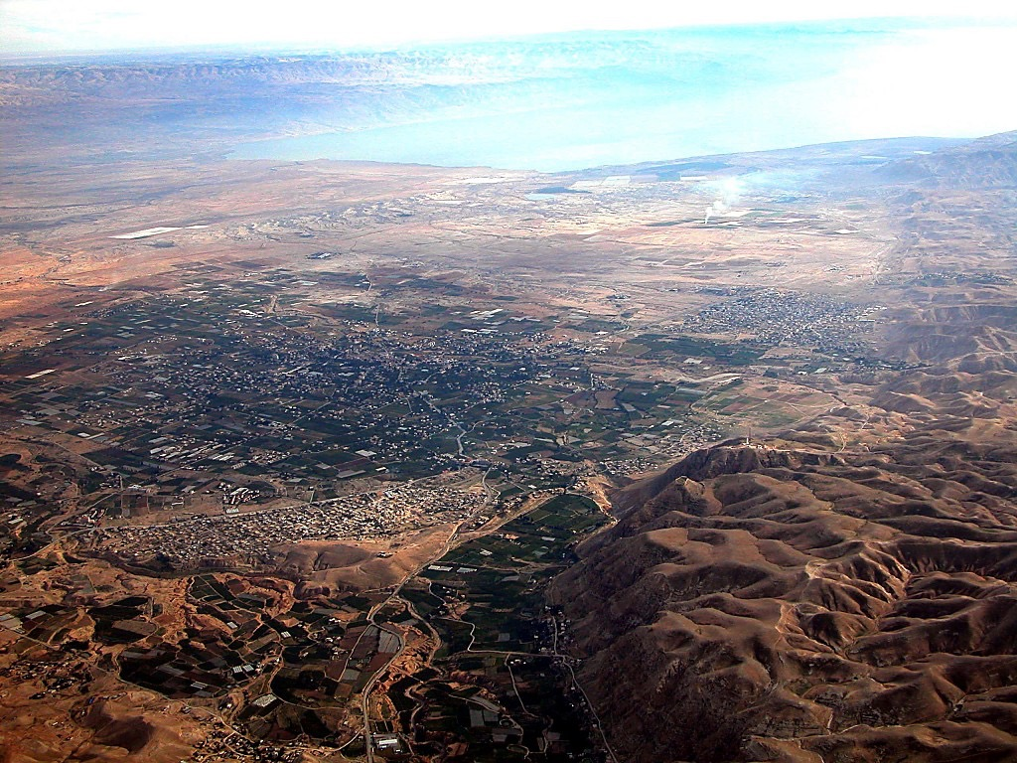
AKITHI ZUGHI
JORDAN GHOKI
Moses-Joshua
ITEHI JERICHO
KHAGHI JERICHO
Jericho Lono...
Jordan Ghoki Kipelau ithulu ani
Notes:
Here is Jericho today. You can easily imagine Joshua's forces crossing the distant river to the east with his thousands upon thousands of armed men ready for the seven years of battle that lay ahead.

Slide 2
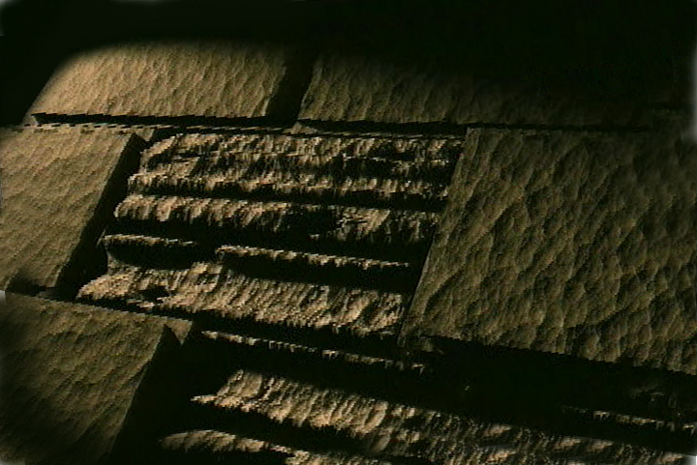
VERSION 9.65
Kuchouyesu… Aboqha
Designed by Dr. John Fryman, Texas, USA • BibleBasically.org Taught by Dr. Rick Griffith, Singapore Bible College All files in many languages for free download at BibleStudyDownloads.org
9.65.01.
©2004 TBBMI
01

Slide 3
KUMSUKUPUJU TSALAPHI:
ABRAHAM-JOSEPH 2000 B.C.
MOSES-JOSHUA 1500 B.C.
01
Notes:
Time-line Date: a change…now about 1500 B.C. We have now moved about 500 years closer in our own historic time. Remember: the dates are heavily rounded!

Slide 4
7
Ipekulu 2:10
PULHOSU
ABRAHAM
ABRAHAM
“Atsaküküghau Lakhiye Küghatha Masa"
ABRAHAM
JOSEPH
ABRAHAM
MOSES
JOSHUA
YEPEKA
KUKAMI KUXU
AKUGHU
YENGUI
JISU
Awulokaku 26-29
02
Notes:
The memory tool…A JUDGE MUST JUDGE…leads to the M of the sentence, which stands for…MOSES. And here is the MOSES folder in the familiar Bible File line up.

Slide 5
7
Ipekulu 8:1
IW TIMI PUWUVE LO
MOSES
ca. 1500 B.C.
Timi Bidi
dolo Aküthüu
ye:
AJMJ
MOSES
40
Awulokaku 26-29
03
1
Notes:
MOSES' file folder appears...as the third in the group of four great people...with a number of items to be added his file folder.
After centuries of Israelite bondage, MOSES moves to center "stage of the action." Repeatedly he approaches the Pharaoh to…
//// "…LET MY PEOPLE GO." And only after MOSES calls down on Egypt a series of devastating plagues does the Pharaoh finally release the Israelites.

Slide 6
7
Ipekulu 12:31
MOSES
ca. 1500 B.C.
IPEKULU!
EXODUS
TIMI BIDI
dolo
“AKUTHUU"
ye:
AJMJ
MOSES
Ipekulu
40
Awulokaku 26-29
04
1
Notes:
Under MOSES' direction those masses of Israelite slaves and their families are permitted to leave Egypt…perhaps as many as two million people according to many scholars and teachers. And that's called the well-known EXODUS.
//// And that's the first item on the Moses file folder

Slide 7
Ipekulu 12:31; 19:2
KUTOKUGHO
KEU
SUCHEDO
MS
N(A)
H
SG
C
ER
B
J
MN
MOSES
DS
Ipekulu
IPEKULU!
E
KB
U
40
MS
PG
RS
Awulokaku 26-29
05
Notes:
That line tracing ancient travel on your map now turns east and then south toward the traditional site of Mount Sinai…right there between the fat rabbit ears on your hand-made map.

Slide 8
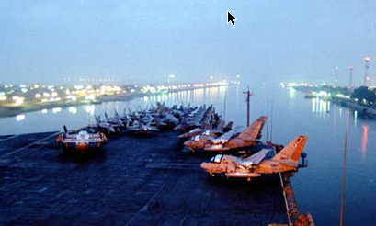
Ipekulu 13:18
KUTOKUGHO
KEU
SUCHEDO
MS
N(A)
H
SG
C
ER
B
J
MN
ISHI TIMI XAKISHE AKEU SUEZ CANAL
MOSES
DS
Ipekulu
E
SUTSUNI ZUGHI:
"YAM SUPH"
40
KB
U
MS
PG
RS
Awulokaku 26-29
06
2
Notes:
Led by MOSES, the Israelites cross what is traditionally called the Red Sea.
/// However, many scholars call it – and, we believe, correctly –
the Sea Of Reeds -- or Yam Suph. It was a body of water on the border between Egypt and the Sinai Peninsula, called in later centuries the Bitter Lakes.
//// That would be the same region through which today's Suez Canal transfers the world's commerce to every corner of the planet.
God allows MOSES to lead the people through those waters on dry land while the Pharaoh's Egyptian forces pursued them. The Egyptians were drowned as the waters returned to their normal levels following the Israelites' crossing.

Slide 9
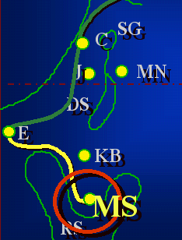
7
Ipekulu 19
MUSE
ca. 1500 B.C.
IPEKULU
SINAI
AJMJ
MOSES
Ipekulu
Sinai
40
Awulokaku 26-29
07
1
Notes:
Safely on the other side, MOSES makes that right-hand turn toward SINAI…leading the Children of Israel southward.
//// Eventually they arrive at MOUNT SINAI, deep in the Sinai Peninsula...there between the rabbit's ears.

Slide 10
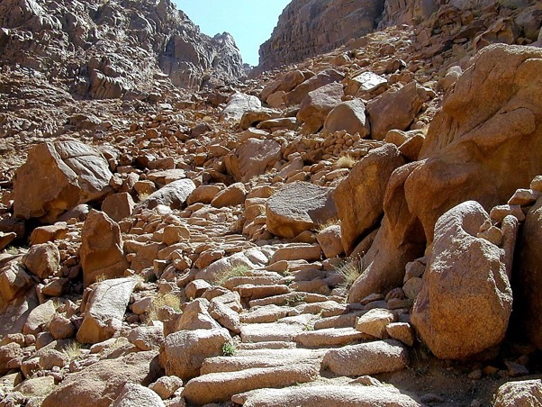
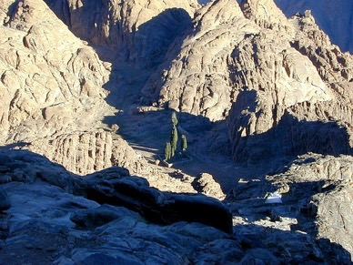
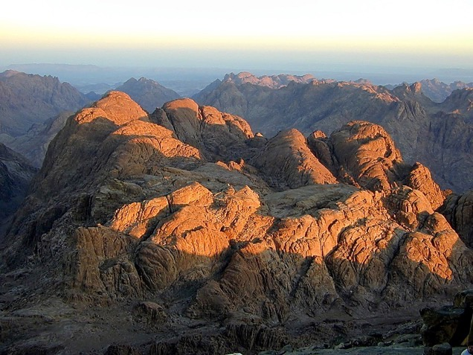
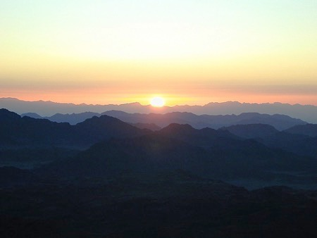
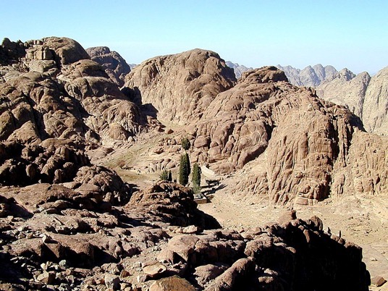
Ipekulu 19:2
MOSES
Ipekulu
Sinai
40
Sinai Naghuto: Ayeza Tsükepi Küghachekeu a-a
Awulokaku 26-29
08
Notes:
This is the traditional site of Mt. Sinai, near today's Monastery of St. Catherine. Regularly modern pilgrims climb to the top of the mountain to watch the Egyptian sunrise. Note the extreme desolation and austere beauty!
Here God spoke to the people through his first prophet, MOSES. Here he gave to them The Law, the Torah, as it's known in Hebrew.

Slide 11
7
Ipekulu 20–31
MOSES
ca. 1500 B.C.
IPEKULU
SINAI
AJMJ
M - C - C
MOSES
Ipekulu
Sinai
M - C - C
40
AMIKUCHO
AQO-AHO
TIQHETINI
Awulokaku 26-29
09
3
Notes:
Here God…Yahweh…issues His Law to MOSES in three sections: M…. C…. C
//// the Moral,
//// the Civil
//// and the Ceremonial….
…the three parts of the Law delivered directly to Moses from the hand of God at the top of Mt. Sinai…TWICE!
Remember that order with these letters on the MOSES folder: M-C-C.

Slide 12
7
Ipekulu 20–31
AYEZA (TORAH)
Alhouno Tsükeu Kighithi
Koküpha Küthü:
MOSES
Ipekulu
Sinai
M - C - C
40
Awulokaku 26-29
10
Notes:
Known in Hebrew as THE TORAH, the Lord's great gift to the Israelites is a godly education in three parts.

Slide 13
7
Ipekulu 20–17
AYEZAH (TORAH)
Alhouno Tsükeu Kighithi
Koküpha Küthü:
AMIKUCHO: Ayezah chighi; Ishi-thoghi
lo pepimhe akeu yeza gholaqo.
MOSES
Ipekulu
Sinai
M - C - C
40
Awulokaku 26-29
11
Notes:
The MORAL part of the Law we know as the Ten Commandments.
Much of our present legal system is based on that great document.

Slide 14
7
Ipekulu 21-24
AYEZAH (TORAH)
Alhouno Tsükeu Kighithi
Koküpha Küthü:
AMIKUCHO: Ayezah Chighi; Ishi-thoghi
lo pepimhe akeu yeza gholaqo.
.
AQO-TIMI: Aqo-aho küxü akitheu lo timi ye lakhino lakhi sasü kishi xüthi xü amasa keno.
MOSES
Ipekulu
Sinai
M - C - C
40
Awulokaku 26-29
12
Notes:
The CIVIL part of the Law spells out – by divine regulation -- how the people are to live with each other both in the future desert wanderings and later when they arrive in the Promised Land requiring a more complicated life-style. At this point, the Israelites don't know that the 40 years of wilderness wandering lie ahead of them. God is preparing them for that time with a set of civil rules that will insure their survival across the difficult years to come.

Slide 15
7
Ipekulu 25-31
AYEZAH (TORAH)
Alhou no Tsükeu Kighithi
Koküpha Küthü:
AMIKUCHO: Ayezah Chighi; Ishi-thoghi
lo pepimhe akeu yeza gholaqo.
AQO-TIMI: Aqo-aho küxü akitheu lo lakhi
no lakhi sasü kishi xuthi anikeu.
TIQHETINI: Aqo-aho lo kishi Alhou
müllathi masakeno.
MOSES
Ipekulu
Sinai
M - C - C
40
Awulokaku 26-29
13
Notes:
In the CEREMONIAL part of the Law God instructs His people how to go about worshiping him in the new desert Tabernacle and later in the great Temple to be built in Jerusalem. The complex rituals required in the new form of worship also prefigure future relationships between men and the coming Messiah. We'll find out much more about The Law as this study moves forward.

Slide 16
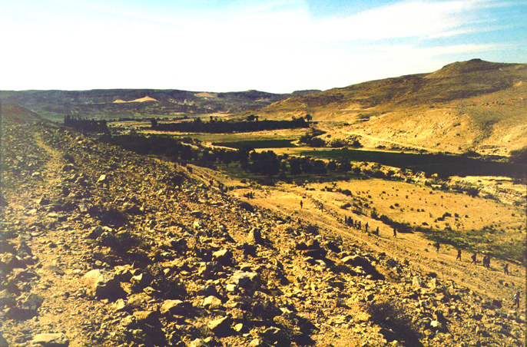
Akikihi 20:13
KUTOKUGHO
KEU
SUCHEDO
MS
N(A)
H
SG
C
ER
B
J
MN
Ttehi Egypt lo Kadesh Barnea lo Oasis akeu-a
MOSES
DS
IPEKULU
Sinai
E
M - C - C
KB
U
40
MS
PG
RS
Awulokaku 26-29
14
2
Notes:
After God gives them the new Law, MOSES organizes the tribes,
//// leading them northward toward a resting place at KADESH BARNEA,
//// a welcomed oasis -- as it appears here in today's Egyptian desert not far from its border with Israel. At Kadesh Barnea they establish a camp, awaiting God's next direction for their northward movement -- back toward the Land of Abraham -- through the harsh wilderness of the Negeb and the Sinai.

Slide 17
7
Akikihi 32:8; Zakiniu 1:19
MOSES
ca. 1500 B.C.
IPEKULU
SINAI
AJMJ
M - C - C
KADESH BARNEA
MOSES
IPEKULU
Sinai
M - C - C
Kadesh Barnea
40
Awulokaku 26-29
15
Notes:
So, KADESH BARNEA appears on the MOSES file folder. Finally, the people are on their way back into the Promised Land of their forefathers, The Land of ABRAHAM, ISAAC, and JACOB.

Slide 18
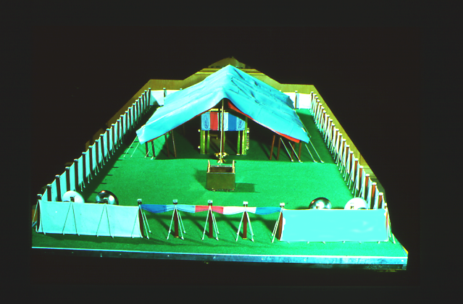
7
Akikihi 13
MOSES YE SUTSASULI ITHINISHI A!
MOSES no alagha züqhukishimi kukütsü.
MOSES
Ipekulu
Sinai
M - C - C
Kadesh Barnea
40
Timi Küghünamo keu a lo Aphiki
Awulokaku 26-29
16
2
Notes:
While at KADESH BARNEA, all the tribes of Israel camped out IN AN ORDERED FORMATION around the tabernacle -- that remarkable worship center that had been built in the desert…all according to God's specific directions in the CEREMONIAL part of the LAW given at Sinai.
//// Now…Moses needs new information! Any good leader must have dependable intelligence or information about the tasks ahead.
//// God sends a command to MOSES….to assign a representative from each of the 12 tribes...to go out and explore the land of Canaan.

Slide 19
7
Akikihi 13; Zakiniu 1:19-23
INIJUKEPU AKHOTO KHAMI…
“Ayeghi ye kiutoi kea?
Timi khunoqo akea?
Aghoki eno Azüpuki?
Naghuto eno Aghasa?
MOSES
Ipekulu
Sinai
M - C - C
Kadesh Barnea
Aghüma yeghi keo?
40
Achuqupu akema?
Awulokaku 26-29
17
6
Notes:
Here are some of the basic questions for which Moses needed dependable answers…
//// What is that land like?
//// What of the people?
//// Are there rivers and springs?
//// Hills? Forests?
//// Are there fertile farmlands?
//// Is there food available immediately?

Slide 20
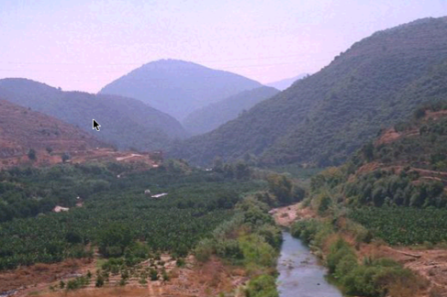
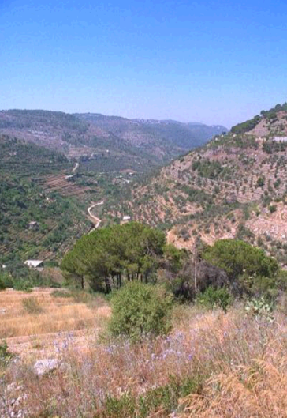
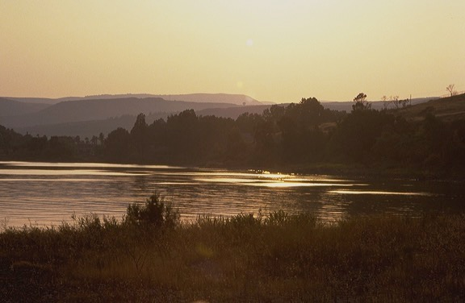
Akikihi 13
KUTOKUGHO
KEU
SUCHEDO
MS
N(A)
H
AHU-U LONO ISHIDOLO APEU LEBANON…
SG
C
ER
THEKUJUMI PUWUKEU LAGHI
B
J
MN
MOSES
DS
Ipekulu
Sinai
E
M - C - C
Kadesh Barnea
KB
U
40
MS
PG
RS
Awulokaku 26-29
18
Notes:
He instructs the men to go over into Canaan to "spy out the land." They travel northward as far as today's southern Lebanon. Along their route, the spies discover a fertile and beautiful land, filled with enormous potential for nation building.

Slide 21
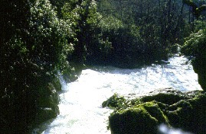
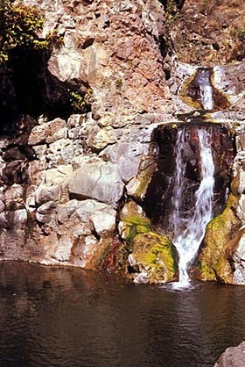
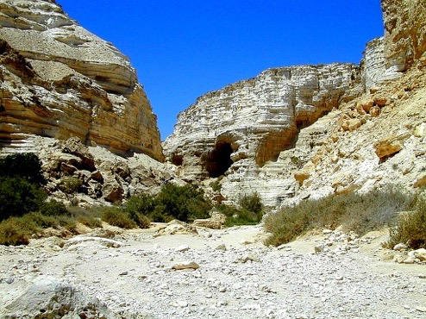
Akikihi 13
KUTOKUGHO
KEU
SUCHEDO
MS
N(A)
H
…TILENO IDEWO APEU KADESH BARNEA.
SG
C
ER
PUKUJUMI LAGHIQO
B
J
MN
MOSES
DS
Ipekulu
Sinai
E
M - C - C
Kadesh Barnea
KB
U
40
MS
RS
Awulokaku 26-29
19
Notes:
As they turn back southward -- on the return journey -- they see even more evidence of the challenges that lie ahead. Why? Because the land is heavily populated by small tribes and kingdoms -- the Canaanites and other tribal groups and clans. The Israelites must be dealt with as they prepare to enter the Land -- and to subdue it under God's direct command.

Slide 22
Akikihi 13:26-14:9
KUTOKUGHO
KEU
SUCHEDO
HILEHI KIU SHOLUKENO:
MS
PUKUJUMI 12 DOLO 2 NO PIKEU
10 PUKUJUMI: AKICHIU NO PIKEU
AKICHIZU ENO AKUNGO YEGHI!
SUBOSUGHIMI NO NGO AKEU-A!
EGYPT LO IDEWOVELO!
2 PUKUJUMI: AGHULOMI NO PIKEU
AKICHUZU ENO AKUNGO YEGHI!
SUBOSUGHIMI no NGOA KEU-A!
ALHOU YE NIGHOLO ANI!
N(A)
H
SG
C
ER
B
J
MN
MOSES
DS
Ipekulu
Sinai
E
M - C - C
Kadesh Barnea
KB
U
40
MS
PG
TIGHENGUNO..NINGU WUNI!!!!!
RS
Awulokaku 26-29
20
12
Notes:
Here's the situation…
//// The twelve spies return to report their findings to MOSES at KADESH BARNEA. They have two sharply differing reports following their mission.
//// There is a majority opinion: ten spies or scouts report
//// having found The Land filled with "milk and honey."
//// But it is also filled with a population of enormous strength...giants in the land, they say...such that, in their sight, the children of Israel are but mere grasshoppers. These 10 spies do not believe they can go in and subdue The Land as God has instructed — and live to tell about it.
//// Their advice: turn back to Egypt and be done with all these plans for conquest.
//// However, two remaining scouts -- their names are JOSHUA and CALEB -- give a minority report: the facts of the case are indeed true, they say.
//// Land of milk and honey!
//// Giants in the land...all true.
//// But, yet, they declare, God is with us. The Land can be subdued!
//// SO LET'S GET ON WITH IT!
//// There you have it...two reports...two opinions...
But do the people believe God for His protection and provision?
No, they do not.
//// The people throw their support behind the spies with the MAJORITY REPORT! They are too fearful and, therefore, are in disobedience to God's specific plan and promise.

Slide 23
Akikihi 14:20
KUTOKUGHO
KEU
SUCHEDO
HILE KIU SHOLU KENO:
MS
PUKUJUMI 12 DOLO 2 NO PIKEU
10 PUKUJUMI: AKICHIU NO PIKEU
AKICHIZU ENO AKUNGO YEGHI!
SUBOSUGHIMI NO NGO AKEU-A!
EGYPT LO IDEWOVELO!
2 PUKUJUMI: AGHULOMI NO PIKEU
AKICHUZU ENO AKUNGO YEGHI!
SUBOSUGHIMI no NGOA KEU-A!
ALHOU YE NIGHOLO ANI!
N(A)
H
WUNIYEAKEU XACHILEVE
SG
C
ER
B
J
MN
MOSES
DS
Ipekulu
Sinai
E
M - C - C
Kadesh Barnea
KB
U
40
MS
PG
SO...LET'S GO!!!!!
RS
Awulokaku 26-29
21
Notes:
In response, MOSES does not give the command to enter Canaan and subdue it. THE TRIP INTO THE LAND WAS CANCELLED! FOR THE TIME BEING.

Slide 24
7
Akikihi 32:13
MOSES
ca. 1500 B.C.
IPEKULU
SINAI
AJMJ
M - C - C
KADESH BARNEA
40
MOSES
Ipekulu
Sinai
M - C - C
Kadesh Barnea
40
40
Awulokaku 26-29
22
Notes:
Here we add the number 40 to the Moses folder.
As a result of their disobedience and their lack of belief, God sends the Israelites into the desert wilderness to wander for 40 years —

Slide 25
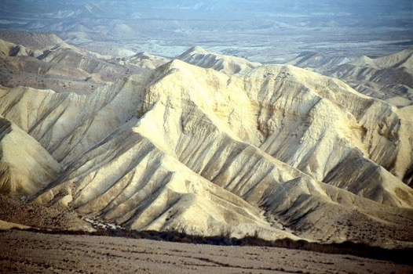
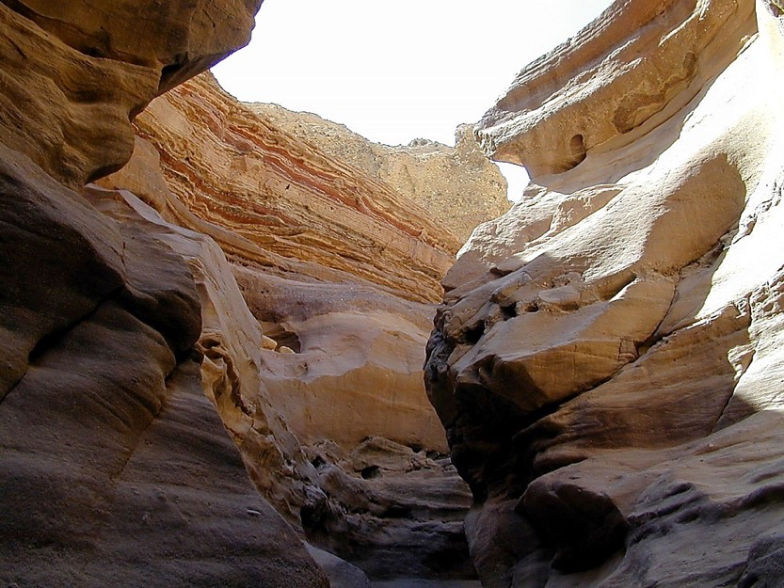
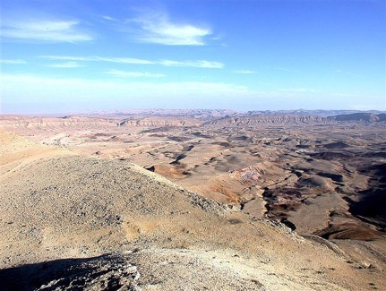
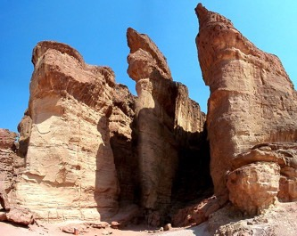
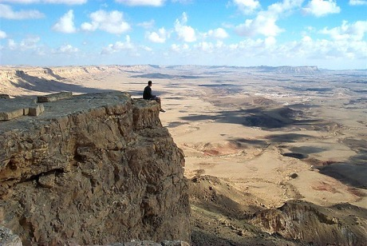
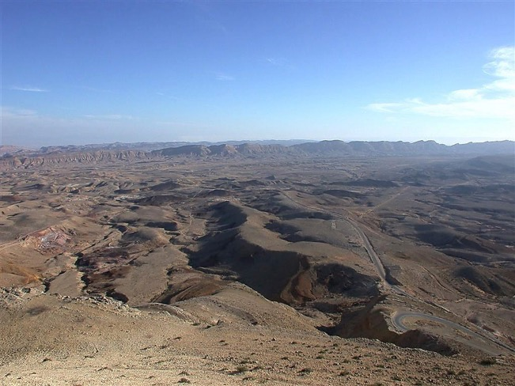
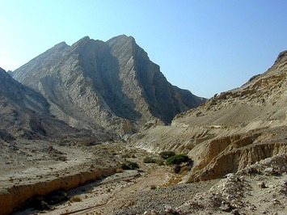
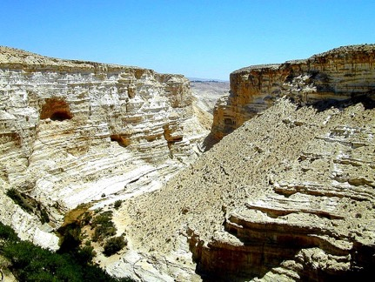
Akikihi 32:13
DRESSING
THE
STAGE
NOYE AMPE 40 PIANIKEA? HIPA-A LO?
MOSES
Ipekulu
Sinai
M - C - C
Kadesh Barnea
40
40
Awulokaku 26-29
23
1
Notes:
…until every grumbling, disobedient Israelite above the age of 20 years dies off. Everyone in that "disbelieving generation" – everyone, that is, except JOSHUA, Caleb, -- the two spies of the "minority report" -- MOSES and their families.
//// The people said…DO YOU MEAN…40 YEARS OUT HERE? That's right…40 long years! And all because of their lack of faith in God's provision and His long-range plan. And don't forget that through those 40 years, many NEW Israelites would be born to the people during that long desert trek.

Slide 26
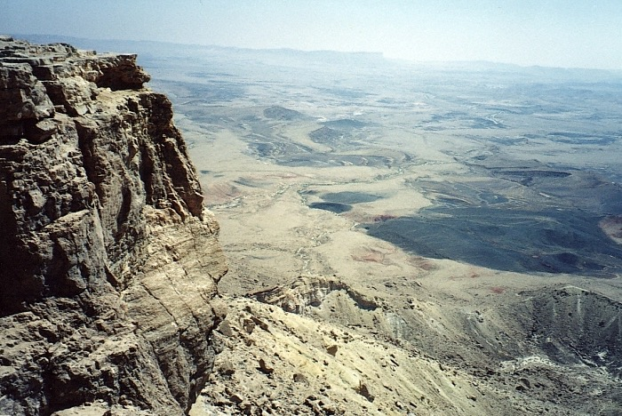
Akikihi 32:13
KUTOKUGHO
KEU
SUCHEDO
KUSHIYE?
AGHOLUMOKEA!
13
35
34
24
33
30
9
28
25
8
31
5
26
29
27
40
32
4
6
3
10
23
22
39
7
2
21
16
15
20
19
38
18
14
17
11
1
36
12
37
PULUMOKEA!
MOSES
Ipekulu
Sinai
M - C - C
Kadesh Barnea
40
40
YENGUIKEU-A LO ITSUCHEKE
Awulokaku 26-29
24
3
Notes:
And that's a crucial point to remember about the wilderness wanderings…
//// WHY were the Israelites sentenced to 40 years of wandering in the desert wilderness?
//// Disobedience and unbelief! Disobedience to God's direction and unbelief in his ability to protect them and safely deliver them into the land promised to old Abraham.
//// [THIS NUMBER SEQUENCE REQUIRES SOME 20 SECONDS TO PLAY THROUGH.] Just think of it. After those 40 long years of wandering in the desert near the Dead Sea – year after year after trying year. Of course, during those years, Moses the great deliverer of Israel, was nearing the end of his 120 years of life.

Slide 27
Zakiniu 32: 48-49
KUTOKUGHO
KEU
SUCHEDO
MS
N(A)
H
SG
C
ER
MN
B
J
MN
MOSES
DS
Ipekulu
Sinai
E
M - C - C
KB
Kadesh Barnea
U
40
40
MS
PG
RS
Awulokaku 26-29
25
Notes:
So they spent 40 years wandering between KADESH BARNEA and, finally, MOUNT NEBO. But because of Moses own earlier disobedience, even he is not destined to enter that Promised Land himself. Mark that route of wandering on your map.

Slide 28
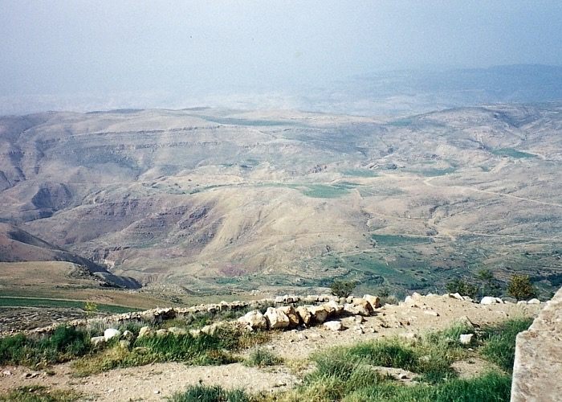
Zakiniu 34:1
MOSES
Ipekulu
Sinai
M - C - C
Kadesh Barnea
40
40
Pishipuwo “Ashoqhi Yeghi“ ithulu ani Nebo Naghuto lono
Awulokaku 26-29
26
1
Notes:
At the end of the 40 years in the wilderness, Moses brings the people to the region of Mt. Nebo. Moses was able to view the Promised Land from an area near here on that mountaintop. Were we to stand by Moses on top of Nebo, this is what he would have seen…but would never be allowed to enter.
//// God instructs MOSES that the time has come for the Israelites to go into the land of Canaan, to subdue it, and to claim it as their own rightful inheritance.

Slide 30
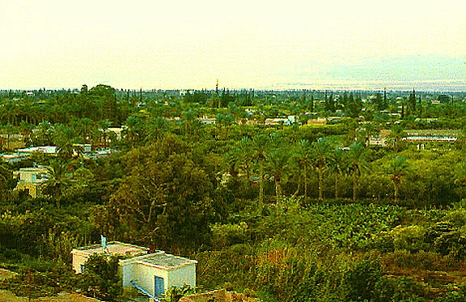
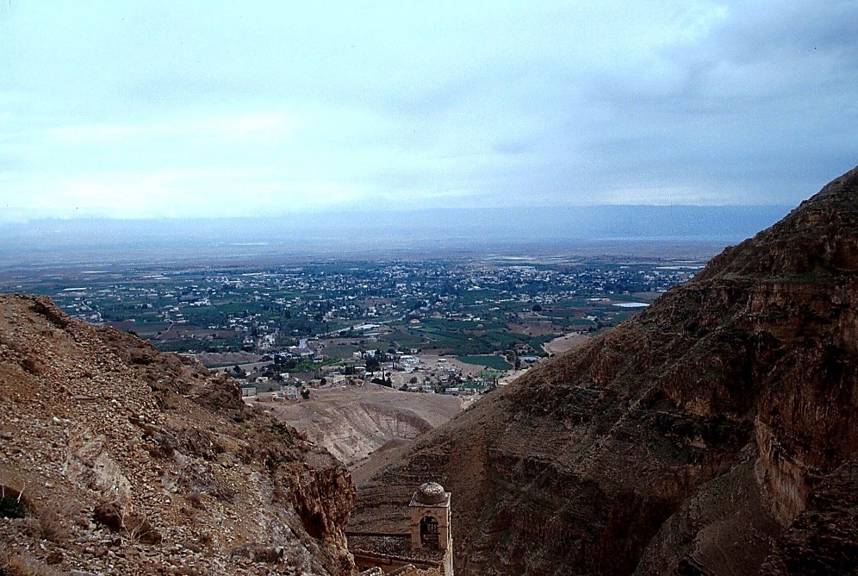
Zakiniu 34:1
Nebo Naghuto veche Jordan
MOSES
Exodus
Sinai
M - C - C
Kadesh Barnea
40
40
From Jericho...
Looking Across the Jordan River Toward Mt. Nebo
Awulokaku 26-29
27
1
Notes:
While over in Jericho, west of Mt. Nebo, that huge Jericho oasis would have looked then much as it does today...except for the modern buildings…a land rich with water…
////…date palms and fertile soil. Here we can see the approximate location of Mount Nebo to the east beyond the Jordan River.

Slide 31
7
MOSES
ca. 1500 B.C.
IPEKULU
SINAI
AJMJ
M - C - C
KADESH BARNEA
40
MOSES
LC
Ipekulu
5 AKUKUTSU
Sinai
M - C - C
Kadesh Barnea
40
40
Alhou shepe 5
Deut. 30:1-10
AYEGHI PULOSHOQHI
ZAKINIU: AYEZAH AKINIU!
Panongu ye Kishi Xumasa kea!
PANONGUYE KHUNOQO KEA!
KHIUNO PANONGU LHOU KEA?
Panonguw Pakutakeu Ghakhu Mheghi!
AKITHEW ENO TIQHELI KITHE
Awulokaku 26-29
28
8
Notes:
And then…just before Moses dies, he delivers a series of 5 SERMONS near Mt. Nebo. He reminds the Israelites of their Law and the unusual heritage of their people. He speaks to
//// a new and younger generation,
//// instructing them about their God,
//// about who they are,
//// their unique national heritage,
//// and how they should live as they move into their Promised Land.
//// These 5 SERMONS make up the book of Deuteronomy -- which means "Second Law". At the end of his teaching…
//// MOSES issues the great LAND COVENANT…that eternal promise to Abraham's descendants for all time. That land inheritance forms the core of world conflict to this very day!
//// Note the "LC" scroll at the end of the MOSES file folder – standing for the LAND COVENANT. At Deut. 30: 1-10, Scripture describes God's unconditional promise to Israel: the Land is to be her inheritance in perpetuity. Thus this promise amplifies or further explains the "Land" portion of the ABRAHAMIC COVENANT between God and Abraham.

Slide 32
7
Zakiniu 30
ASHOQHI YEGHI (PALISTANMI)
⁵ Tishianguno nongu pu-asuno khile achekeno tipau yeghi itaghi amheghi shi pighiluve nani.. Pa no nopuasu nguno alau shi nongu pelo kinikulu shilu eno timi kumzapa shilupe nanike.
MOSES
Ipekulu
⁶ Ampeu Alhou no nongu eno nopolo kughukomi lau aghokulu mulo tsunanike tishianguno nongu mulo kuchopu pesu Pa qhuivulai nani eno ayeghi tipaulo xü acheuve nani. (NIV).
Sinai
M - C - C
Kadesh Barnea
40
40
Alhou shepe 5
Awulokaku 26-29
29
2
Notes:
Verses 5 and 6 are the very heart of that Land Covenant from Deuteronomy 30:
5 "He will bring you to
//// the land that belonged to your fathers, and you will take possession of it. He will make you more prosperous and numerous than your fathers.
//// 6 The Lord your God will circumcise your hearts and the hearts of your descendants so that you may love him with all your heart and with all your soul and live."

Slide 33
Abraham lau Puloshoqhi
(“Ku Keu")
Bothubo 12:1-3
MOSES
AYEGHI
APITI
KUKUMGHA
Ipekulu
Sinai
M - C - C
Kadesh Barnea
Ayeghi
40
40
Alhou shepe 5
Zakiniu
30:1-10
30
Notes:
And with this covenant -- this further promise from God – we see an amplification of that first part of the Abrahamic Covenant -- the promise of a LAND. As Israel's future unfolds, the SEED and BLESSING portions of the Abrahamic will also be amplified in yet more promises to God's special Old Testament people…but each one related to that original Abrahamic contract or covenant. Soon after Moses delivers his five sermons or discourses…he dies and is carried by God to a burial site unknown to any man to this day.

Slide 34
7
Bothubo 1- Zakiniu 34
PULHOKUSU
YEPEKA
1st kipitimi & totimi
1st Sin
P
1st Tsavipe
1st Akibo
KUKAMI KUXU
(1000 B.C.)
1st Ghikiqhi
Azukucho/Milisu
Aqokighe
ABRAHAM
AQO-AHO 3
P 7 Y J
The CALL
AC
L - S - B
I - I
J - E
12
AKUGHU
7 = 4 + 3
JOSEPH
MOSES
TIMI 4
Aqü-axe
Ipekulu
430
Sinai
M - C - C
MOSES
(500 B.C.)
Kadesh Barnea
Y
YENGUYI
40
40
Ipekulu
S
Alhou shepe 5
Sinai
M - C - C
Kadesh Barnea
JISU
40
40
LC
Alhou shepe 5
J
JOSHUA
31
Notes:
So now...we've finished CREATION and moved through three of the great people: ABRAHAM – with the original Abrahamic Promises – then JOSEPH and MOSES, developing the amplified Land Covenant.
Remember that we're not concerned with detail…only a stable skeletal framework of the entire Bible based on its chronological story line. The file folders and their individual component items begin to form that skeletal mental framework on which all OTHER Biblical details have a firm location…a place…a mental map…around which to fit your Biblical thinking!

Slide 35
7
Josh. 1:1
AJMJ
Timi
4 BIDI
Dolo
ABIDIU
ye:
?
32
Notes:
Now we've come at the last File Folder of the four Great People...
the last in the AJMJ series. Do you recall this next and final name?

Slide 36
7
Josh. 1:1
AJMJ
Timi
4 BIDI
dolo
ABIDIU
ye:
"JOSHUA"
33
Notes:
His name is... "JOSHUA"

Slide 37
Josh. 1:1
KUMSUKUPUJU TSALAPHI:
ABRAHAM-JOSEPH 2000 B.C.
MOSES-JOSHUA 1500 B.C.
34
Notes:
Let's maintain the timeline in the 1500 B.C. era. Once again, that's close enough for our purposes in this study.

Slide 38
7
Josh. 1:1
PULHOKUSU
ABRAHAM
ABRAHAM
ABRAHAM
JOSEPH
"Atsaküküghau Lakhiye
Küghatha Masa"
ABRAHAM
MOSES
JOSHUA
YEPEKA
KUKAMI KUXU
AKUGHU
YENGUI
JISU
Awulokaku 29-31
35
Notes:
A JUDGE MUST JUDGE…the final "J"…here is Joshua's file folder in The Bible File sequence.

Slide 39
7
Josh. 1:1
JOSHUA
AJMJ
JOSHUA
Awulokaku 29-31
36
Notes:
So…the great Israeli general, JOSHUA succeeds MOSES in leadership. Recall that JOSHUA was one of the two faithful spies who gave that minority report to MOSES 40 years earlier ... after the 12 spies' inspection trip through Canaan.

Slide 40
Josh. 1:4
KUTOKUGHO
KEU
SUCHEDO
MS
JOSHUA LAU ALHOU
SHOQHI:
N(A)
H
ASAYELI
LONO
LEBANON…
SG
C
ER
B
J
MN
JOSHUA
DS
E
KB
U
EUPHRATi LONO “AZUGHI AKIJEU KUTO"
MS
PG
RS
Awulokaku 29-31
37
2
Notes:
God made a further promise to Joshua.
//// He would give him all the land from the southern desert to Lebanon...and …
//// from the Euphrates River to the Mediterranean Sea, known as the Great Sea in ancient times. But that promise meant that Joshua and the Chosen People must first conquer it!

Slide 41
Josh. 1:11
KUTOKUGHO
KEU
SUCHEDO
MS
N(A)
AYEGHI
H
"JOSHUA…
TILE ILONO
AYEGHI
PUKHA LULO!"
SG
C
ER
B
J
MN
JOSHUA
DS
E
KB
U
MS
PG
RS
Awulokaku 29-31
38
Notes:
Joshua was instructed to "go in and to possess the Land."

Slide 42
Josh. 1:11
KUTOKUGHO
KEU
SUCHEDO
MS
N(A)
AYEGHI
H
SG
NEBO NAGHUTO
LONO JOSHUA‘W GHUSHIMI YE
JORDAN GHOKI
PUTHASU WUMASA
C
ER
B
J
MN
JOSHUA
DS
Jericho/Ai
E
KB
U
MS
PG
RS
Awulokaku 29-31
39
Notes:
That means that from Mt. Nebo's region, Joshua's armies must cross the Jordan River, and then subdue the Canaanites who dwelled throughout the Promised Land – from the North to the South.

Slide 43
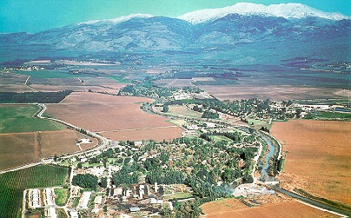
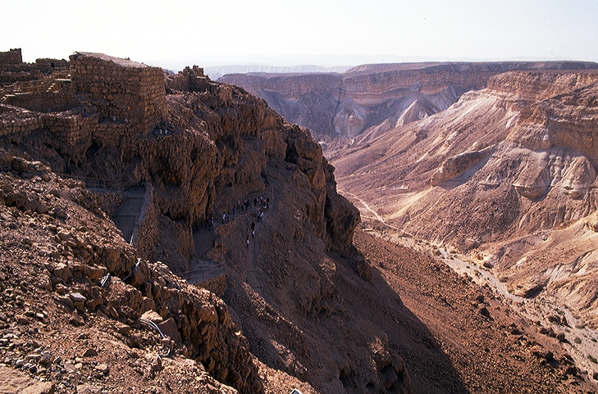
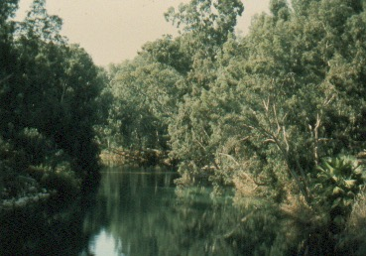
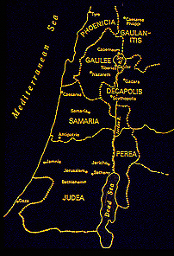
Josh. 1:16
Joshua no Wumasa-akeu Yeghiqha..
JOSHUA
Jericho/Ai
Awulokaku 29-31
40
4
Notes:
So, from the highlands near Mt. Nebo, General Joshua marshaled his forces…
//// … and prepared for the challenges that lay ahead! He leads the Israelites across the Jordan River near today's ancient city of Jericho.
//// Once again, God holds back a flood of water…this time, not the Sea of Reeds, but the Jordan River…allowing the people, once again, to cross on dry land -- just as he had done for MOSES during the great Exodus from Egypt.
//// The Israelites then enter the land of Canaan, today's Israel, ...from the fertile valleys and plentiful water resources in the north...
//// …to the desolate wilderness with great thirst in the south.
They are finally on their way to reclaim their Promised Land...from the North to the South...all the Land unconditionally promised to ABRAHAM centuries earlier in THE ABRAHAMIC COVENANT.

Slide 44
7
Josh. 6-8
JOSHUA
JERICHO / AI
AJMJ
JOSHUA
Jericho/Ai
Awulokaku 29-31
41
Notes:
At first, they conquer two principal cities, JERICHO, followed by a difficult campaign against the city of AI.

Slide 45
AKITHI ZUGHI
JORDAN GHOKI
ITEHI JERICHO
JOSHUA
Jericho/Ai
KHAGHI JERICHO
Jericho Lono...
Jordan Ghoki Kipelau ithulu ani
Awulokaku 26-29
42
Notes:
Here is Jericho today. You can easily imagine Joshua's forces crossing the distant river to the east with his thousands upon thousands of armed men ready for the seven years of battle that lay ahead.

Slide 46
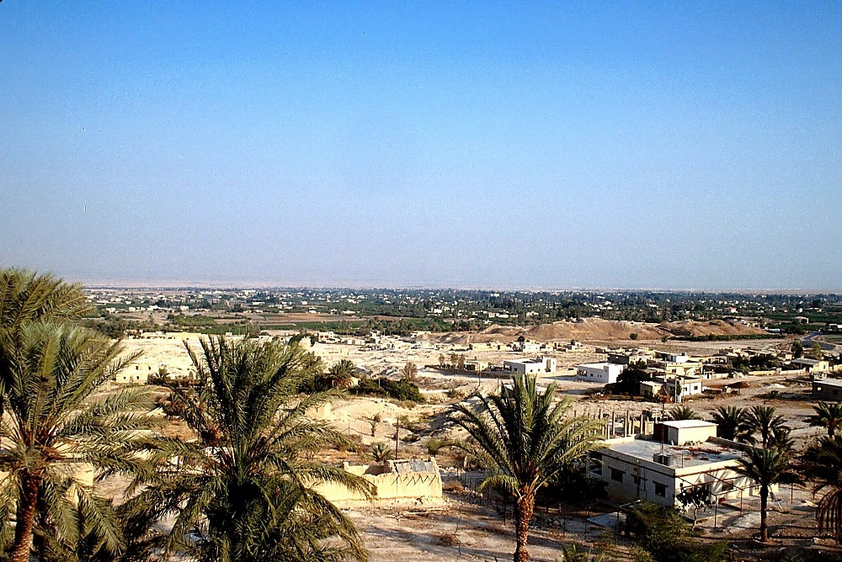
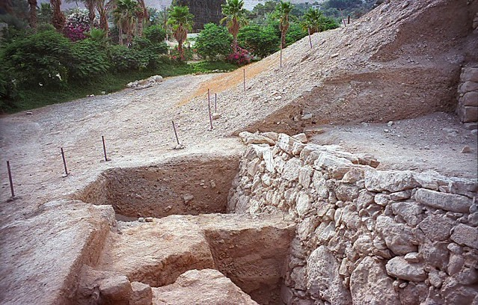
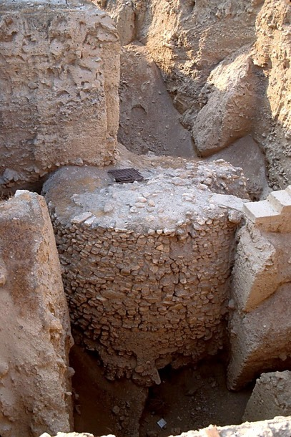
JOSHUA
Jericho/Ai
Jericho: Khaghi Lo Achekeu
Awulokaku 29-31
43
Notes:
The sandy hills in the middle of this picture show the remains of the ancient city of Jericho -- as they stand today. It's possible that some ancient watchmen observed Joshua's forces from this Neolithic watchtower as they neared the city, eventually to bring down these actual walls of Jericho…uncovered here in past excavations…

Slide 47
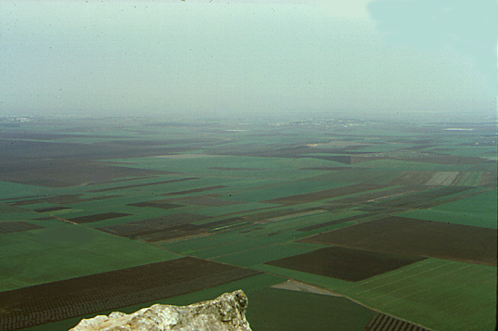
7
Josh. 17:16
Tabor Naghuto lono Jezreel Khilaqa
JOSHUA
Jericho/Ai
Hiye Akichizü eno akungo-a ke!
Awulokaku 29-31
44
Notes:
And so, for seven years Joshua's armies ranged up and down the land. Here is the famed Valley of Jezreel seen from the top of Mount Tabor deep in today's region of Galilee in northern Israel. THIS IS TRULY THE MILK AND THE HONEY!

Slide 48
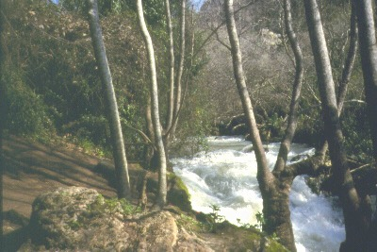
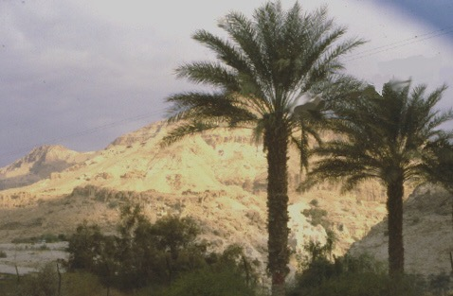
…Ahu-u Dan lono...
Ampe
Tsuni
Kutolo
Aloqhi
Aghushive…
JOSHUA
Jericho/Ai
…Apeu Beersheba kutolo...
Awulokaku 29-31
45
2
Notes:
Across those seven years of hard-fought battles North to South,
Joshua's forces had to contend with enormous physical contrasts and challenges….
//// the lands of the north….well watered and fruitful….while in the south, a place of desolation and loneliness.
//// From Dan in the North to Beersheba in the south.
In spite of all their efforts, though, Joshua's armies do not completely rid the land OF ALL THE Canaanites as God had instructed. This failure to completely obey God's directive later proves to be a great mistake in the future development of Israel's national life.

Slide 49
7
Josh. 14:5
JOSHUA
JERICHO / AI
AYEGHI KIJEVE
AJMJ
JOSHUA
Jericho/Ai
Ayeghi Kijheve
Awulokaku 29-31
46
Notes:
The Israelites have many military successes. Then…at the end of seven years of JOSHUA's military campaigns the LAND is finally subdued…and DIVIDED among the 12 tribes of Israel named for Jacob's 12 sons.

Slide 50
7
Josh. 13:1-21; 13:43
Azüghi Kije
ASHER
NAPHTALI
ZEBULON
Galilee
züghi
Alimi amqo pütüta shelo ngolukhave, Abraham tsuni ipipüa keu yeghi kithe lo xünikeu kutolukhave.
Mt. Tabor
Mt. Carmel
ISSACHAR
JOSEF
NULIQO
KANAN YEGHI
Ye
KIJEVE Ke!
Mt. Gilboa
MANASSEH
MANASSEH
JOSHUA
EPHRAIM
Jericho/Ai
DAN
Ayeghi kijeve
BENJAMIN
GAD
JUDAH
Hebron
LEVI: Aphughi khilehi; panonuno ngoni keno Achineki jukuto kughoi ni!
Dead Sea
REUBEN
SIMEON
Awulokaku 29-31
47
13
Notes:
And…dividing that land among the tribes was no easy task. As it was accomplished…
//// …each tribal unit or clan then settled down, ready to learn to live in the new land of Abraham's inheritance. As to the land assignments, there were…
//// ASHER
//// ZEBULON
//// NAPHTALI
//// ISSACHAR
//// THE SONS OF JOSEPH BECAME TWO TRIBES…EPHRAIM AND MANASSEH. NOTE THAT MANASSEH'S INHERITANCE WAS ON BOTH SIDES OF THE JORDAN RIVER.
There was
//// GAD
//// DAN
//// REUBEN
//// SIMEON
//// JUDAH and
//// BENJAMIN.
//// As for the tribe of LEVI...no land inheritance was made...they were given only towns to live in with pasturelands for their flocks and herds. The Levites were the priests of the tabernacle and...as Scripture says..."...the offerings made by fire to the Lord...are their inheritance, as he promised them."

Slide 51
7
Judg. 17:6
Azüghi
Kije
ASHER
NAPHTALI
ZEBULON
"Milakhikhi no pütüta nhethi lono kiu achipi kepi ithulu keno ti shike."
ISSACHAR
MANASSEH
MANASSEH
JOSHUA
EPHRAIM
Jericho/Ai
DAN
Ayeghi kijheve
BENJAMIN
GAD
LEVI: Aphughi khilehi; panonuno ngoni keno Achineki jukuto kughoi
JUDAH
REUBEN
SIMEON
Awulokaku 29-31
48
Notes:
But note also the Scripture says that at that time "each man did that which was right in his own eyes." And that very important phrase leads directly to Israel's future difficulties in their new life in The Promised Land.

Slide 52
KUMSUKUPUJU TSALAPHI:
ABRAHAM-JOSEPH 2000 B.C.
MOSES-JOSHUA 1500 B.C.
JOSHUA
Jericho/Ai
Ayeghi Kijheve
49
Notes:
Keep in mind the approximate dates for these lives and related events. The dates are easy to remember in broad groups of roughly 500 years for each major period:
ABRAHAM & JOSEPH: around 2000 B.C.
MOSES & JOSHUA: around 1500 B.C.

Slide 53
7
Bothubo 1 – Josh. 24
PULHOKUSU
YEPEKA
1st Kipti & Totimi
1st Axine
P
1st Tsavipe
1st Akibo
KUKAMI KUXU
(1000 B.C.)
1st Hekiqhi
Azucho/Milisu
Aqokighe
ABRAHAM
(2000 B.C.)
AQO-AHO 3
Kulukeu
AC
P 7 Y J
AC
L - S - B
I - I
J - E
12
AKUGHU
7 = 4 + 3
JOSEPH
JOSHUA
Aqü-axe
Jericho/Ai
430
Land Divided
TIMI 4
MOSES
(1500 B.C.)
(500 B.C.)
Y
YENGUI
Ipekulu
S
Sinai
M - C - C
Kadesh Barnea
JISU
40
40
LC
5 Sermons
LC
J
JOSHUA
Jericho/Ai
Ayeghi kijeve
50
2
Notes:
Now we have finished half of your Bible File -- that basic architectural and dramatic layout of God's Word. We've completed
//// the CREATION file, followed by the group of Four People:
//// ABRAHAM, JOSEPH, MOSES and JOSHUA…together with the Abrahamic Covenant and its first sub covenant…the Land Covenant during the time of Moses.

Slide 54
Kuchouyesu… Aboqha • BibleStudyDownloads.org
Hipau pesü Kümsa lono tsülo!
Notes:
The Bible…Basically (bb)

Slide 55
©2005 TBBMI
9.7.03c.
51

