Slide 1
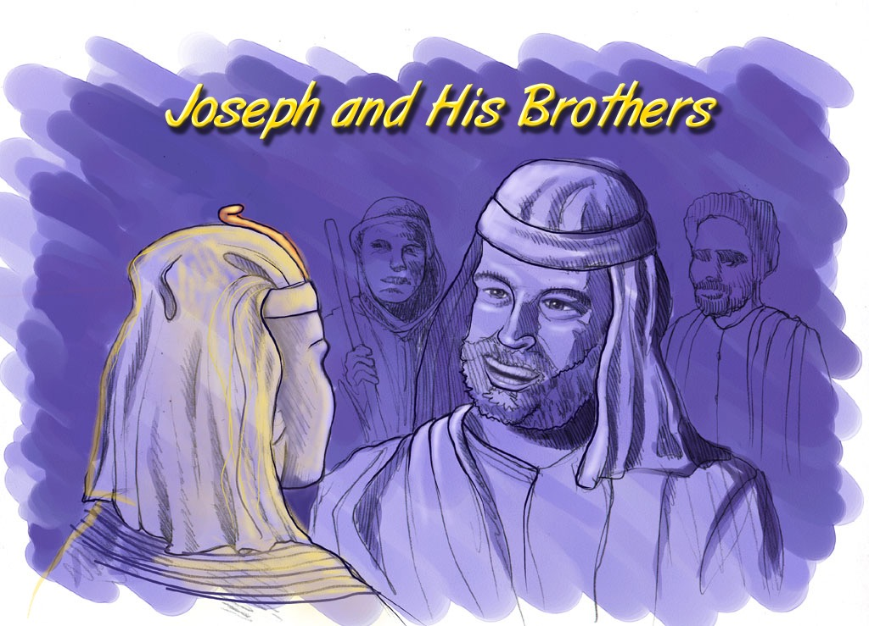
Abraham-Josef
Joseph and His Athikuzumiqo
Notes:
Through a series of dramatic events -- told about in great detail in the latter chapters of Genesis – the brothers learn that their sibling, JOSEPH, is now the governor of Egypt

Slide 2

VERSION 9.65
Kuchouyesu… Aboqha
Designed by Dr. John Fryman, Texas, USA • BibleBasically.org
Taught by Dr. Rick Griffith, Singapore Bible College
All files in many languages for free download at BibleStudyDownloads.org
9.65.01.
©2004 TBBMI
01

Slide 3
Bothubo 11:26 lono 25:8 kuto
KUMSUKUPUJU TSALAPHI:
ABRAHAM-JOSEPH 2000 B.C.
TSALAPHIQO KUMTSU AMIPE 500
LONO KIHIKIKE
Awulokaku apa 19-24
01
1
Notes:
Now…let's begin a biblical timeline. Abraham's date on the timeline: about 2000 B.C. By the way, throughout our study…
//// …most dates will be presented in large, rounded groupings in 500 -year increments.
More precise dating is not needed in this particular study. All dates can be sharpened as your own interests direct.
2135-1960 BC Abraham's lifespan

Slide 4
7
“Xakuthami
Lakhiye
Xakutha
Tsumasa"
PULHOKUSU
ABRAHAM
ABRAHAM
ABRAHAM
JOSEF
ABRAHAM
MUSE
JOSHUA
YEPEHA
KUKAMI KUXU
AKUGHU
TIMI 4
dolo
ATUGHIU
YENGUYI
JISU
Awulokaku apa 19-24
02
Notes:
The memory tool, A JUDGE MUST JUDGE, brings to mind ABRAHAM…the FIRST OF THE FOUR GREAT PEOPLE...right after the CREATION file folder. Here is ABRAHAM'S folder in the Bible File line up.

Slide 5
Bothubo 12:4
AKHACGE
KUTOPE
QHI
MS
6
N(A)
H
HOKHÜKEU GHUMA-A
SG
C
ER
B
J
MN
DS
Hukuthu shikeu Choküsü...
E
U
KB
MS
PG
RS
Awulokaku apa. 19-24
03
1
Notes:
In Chapter 12 of Genesis, this "Quick Chronology" of Abraham's life] begins – at ancient Ur of the Chaldees – the "U" on your map of the Ancient Near East. That's the place in Scripture where the Author comes to a quick narrowing of the earlier Biblical perspective.
//// And its setting is in the rich Fertile Crescent of the Middle East,
The stage of this great drama stretches from the Euphrates Valley all the way over to the Mediterranean Sea…
and in between we find some very familiar place names.

Slide 6
AKHACGE
KUTOPE
QHI
A-a 10
MS
6
4
N(A)
H
IRAQ
IRAN
KUWAIT
SAUDI ARABIA
SYRIA
ISRAIL
TURKEY
EGYPT
SG
GALILI ZUGHI
C
ER
B
KANAAN
J
MN
DS
NILE GHOKI
AMTI ZUGHI
E
EGYPT
U
KB
SINAI ZUDOYEGHI..
MS
PG
RS
Awulokaku apa. 19-24
04
14
Notes:
You've already identified some of them on your map that we called "Dressing the Stage."
There lie
//// Canaan…today's state of Israel, and the West Bank, Palestine,
//// the Sea of Galilee,
//// and the Dead or Salt Sea…as Scriptures calls it.
//// Also there is Egypt and
//// the great Nile River.
//// The Sinai Peninsula appears, a region in the headlines of recent world events.
But in our world, our own time, we also find
//// Iraq
//// Iran
//// Kuwait
//// Saudi Arabia
//// Syria
//// Modern Israel and the West Bank
//// Turkey and
//// Today's Egypt

Slide 7
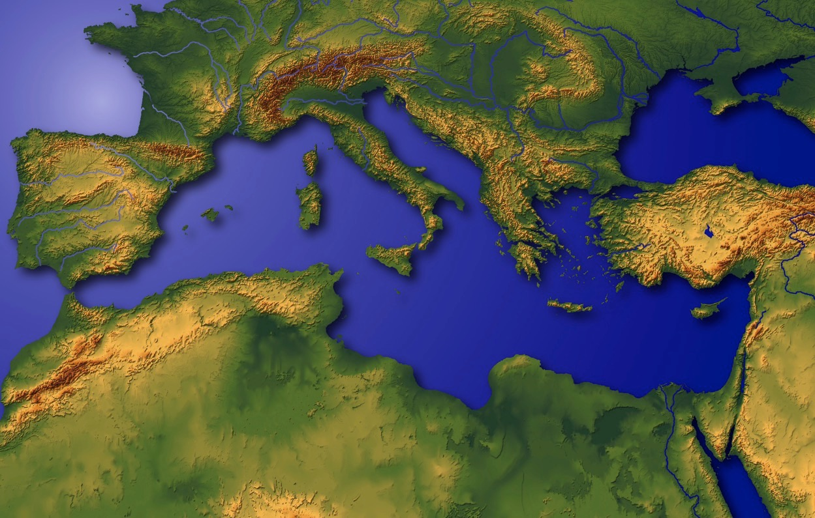
“Ayeghi Pola"
Awulokaku apa. 19-24
05
1
Notes:
This region has been called the very NAVEL OF THE EARTH.
Through this great hinge of history, time and again, great world
powers of the past -- time and again -- have marched in conquest,
//// with Canaan/Palestine/Israel being pulled and stretched by enormous international and internal pressures.

Slide 8
Bothubo 11:28
AKHACGE
KUTOPE
QHI
MS
N(A)
H
SG
C
ER
B
J
MN
DS
E
KB
U
MS
CHALDEES LO UR: KHAGI LO MESOPOTOMIAMI-W MHESHOMHEGHI-A:
ABRAHAM KUNGOA
PG
RS
Awulokaku apa. 19-24
06
1
Notes:
So the story of ABRAHAM begins at the head of the Persian Gulf, in that ancient city -- Ur of the Chaldees.
//// Abraham and his family lived in this early cultural center in the Mesopotamian Basin.
This is the "U" on map we named "Dressing the Stage."
Follow along by tracing on your own map as the story begins to unfold.

Slide 9
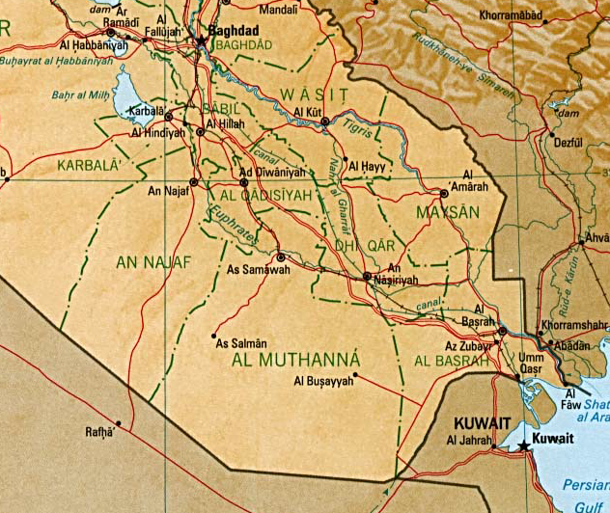
7
BABYLON
UR
KUMSULULO! Persiami-w Gulf Ghüshi Iraq lo Aghüshikeu
Awulokaku apa. 19-24
07
6
Notes:
Here is the map of this region in today's world. Remember that this was the stage of the earlier Persian Gulf War of the 1990s…
and more recently the War in Iraq that toppled Saddam Hussein.
//// There is the familiar Tigris River…
//// …and the Euphrates…
//// …today's city of Baghdad…
//// …Kuwait stands at the head of the Persian Gulf…
//// …to the north…the location of ancient Babylon…
//// …and the beginning point of our story…the ancient city of UR.

Slide 10
7
Mesopotamia Bokhu
SUMERIANMINO PHUPHE…
YEHKEU ENO AKHOHI
ABOTHULO…
AYEZHA
KUSUGHU
YEPUYESU
AHILAKUKUGHU
KHAGHILOMI APHUGHI AQO
Awulokaku apa. 19-24
07a
4
Notes:
Here in this Middle Eastern land – bordering the Persian Gulf --
were some of the earliest beginnings of mankind's discovery of an intellectual life.
//// In this triangular shaped valley,
//// called the Mesopotamian Basin,
//// the ancient Sumerians presented us the gifts of writing and the wheel. And here we see
//// the beginnings of basic concepts of civilization…of law…of medicine… of astronomy and architecture.
//// Archaeologists have also found evidence of some of the very earliest urban centers…
the communities and the cities that, through time, have led directly to the civilization and cultures we know today.

Slide 11
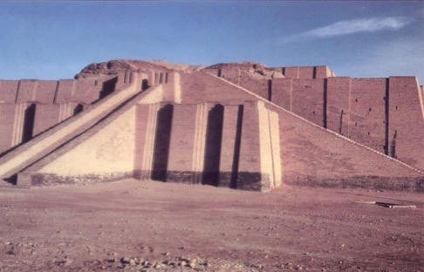
Bothubo 10:10; 11:28
Chalices lo khaghi Ur Yeghilo pakutakeu-A lakhi “Ziggurat” ipikeu
Handbookapa. 19-24
08
Notes:
This kind of temple tower, or ziggurat, was common in that region in Abraham's day in Ur of the Chaldees. In 2000 B.C., Ur was a great city, an international center of learning, culture, commerce and idolatrous spiritual darkness. But think about this: what kind of technology -- literally, brain power -- was required to construct a building of such size and complexity of design? Those thoughts hint at the kind of life, times and talent of those ancient civilizations!

Slide 12
Bothubo. 11:31
ABRAHAM KIBOLOMI:
• TERAH (APU)
•ABRAHAM (ABRAM)
• SARAH (PANIPU, SARAI)
• LOT (ABRAHAM TIKISHIU)
Awulokaku apa. 19-24
09
5
Notes:
//// The Biblical narrative tells us about a man named ABRAHAM, living with his family in ancient Ur of the Chaldees.
//// In the family was his aging father…Terah.
//// Terah's son named Abram, later to be renamed by God, ABRAHAM, as his future place in history is made clear.
//// ABRAHAM'S wife's name was Sarah (originally named Sarai)...
//// Also in the family group was ABRAHAM's nephew, Lot

Slide 13

7
ABRAHAM
ABRAHAM
ca. 2000 B.C.
TIMI 4
dolo
ATUGHIU
ye:
ABRAHAM
AJMJ
Bothubo 12 eno tipathiu
Awulokaku apa 19-24
10
3
Notes:
So we begin with ABRAHAM's file folder.
Note also a special feature about the visuals you are watching...
//// From this point and on through the chronology there will be a small file folder image floating in most slide frames. They will help guide your thinking as the great story line unfolds. You'll always know where we are as the BILE FILE folders build out and fill up.
//// Abraham's story opens in Genesis 12 and forward...
//// Time frame: about 2000 B.C...the first of the four Great People.
It is through this one man, ABRAHAM, that God begins a new program
to provide for His creation the way back to that original intimate relationship that existed in the beginning. Through ABRAHAM unfolds all the rest of the Bible, until we see in the book of Revelation, once again, the broad view of the world and the universe.

Slide 14
7
Bothubo 12: 1-3
ABRAHAM
ABRAHAM
ca. 2000 B.C.
KULUKEU
TIMI 4
dolo
ATUGHIU
ye:
ABRAHAM
KULUKEU
AJMJ
Bothubo 12 eno tipathiu
Awulokaku apa 19-24
11
Notes:
The great story begins in the 12th Chapter of Genesis where ABRAHAM receives God's CALL, telling him to leave Ur and go toward a land that will be shown to him in due time.

Slide 15
7
Bothubo 12: 1-3
ABRAHAM
ABRAHAM
ca. 2000 B.C.
KULUKEU
AC
AJMJ
BOTHUBO 12:1-3
ABRAHAM
KULUKEU
ALHOU-W KIHIKHUTHA KUHAKEU SHOQHI ABRAHAM LAU!
Awulokaku apa 19-24
12
Notes:
This is the most crucial Biblical event in the life of the old patriarch and also the beginning point in the revelation of God's new Program with Man. On your work sheet, it's represented by the letters AC inside the image of a scroll. AC is to remind us of the great ABRAHAMIC COVENANT -- provided for us in our own Bibles at Genesis 12...verses 1-3. It is an UNCONDITIONAL covenant promise!

Slide 16
Kihikutha kuhakeu kiqiye
7
ABRAHAM
ABRAHAM
ca. 2000 B.C.
KULUKEU
AC
L - S - B
AJMJ
BOTHUBO 12:1-3
AYEGHI
APITI
ABRAHAM
KULUKEU
L - S - B
KUKUMUGHA
KIHIKUTHA KUHAKEU SHOQI ATHIU YE SHIKUPUVE!
Awulokaku apa 19-24
13
Notes:
Now…on ABRAHAM'S file folder, add the letters...L...S...B...standing for the words: LAND...SEED...AND BLESSING. Here is the significance of those words. Right there in the book of Genesis, 12th Chapter, verses 1-3, God makes THAT UNCONDITIONAL COVENANT PROMISE to Abraham…later to become an actual legal contract in the culture of that day!

Slide 17
7
Bothubo 12
Amped no Abraham vilo pi,
“Oghakhu, owtimi, opuno tsukeu thime kumtsu qhivelo eno ino opiye niye akeu yeghi lo wuvelo.”
1
“Ino no peso ashiaye kije kughulho tsuni; eno ino no kumghatsu nani;
Ino oje pesu kije shitsuni,
eno okumghatsuni.
2
ABRAHAM
KULUKEU
Ino khunono okumgha tsu keno panno kumghatsuni, eno khuno oghushoni keno Ino pa ghushoni;
eno ayghilomi ye ovechewuno kumghalu nani."
L - S - B
3
Awulokaku apa 19-24
14
3
Notes:
In Genesis 12, verses 1-3 present God's three-part promise to Abraham. Here it is:
//// The Lord had said to Abram,
"Leave your country, your people and your father's household, and go to THE LAND I will show you.
//// "I will make you into A GREAT NATION
and I will bless you;
I will make your name great,
and you will be a blessing.
//// I will bless those who bless you,
and whoever curses you I will curse;
and ALL PEOPLES ON EARTH
WILL BE BLESSED THROUGH YOU."

Slide 18
7
Bothubo 12
Amped no Abraham vilo pi,
“Oghakhu, owtimi, opuno tsukeu thime kumtsu qhivelo eno ino opiye niye akeu yeghi lo wuvelo.”
1
AYEGHI
APITI
"Ino no peso ashiaye kije kughulho tsuni; eno ino no kumghatsu nani;
Ino oje pesu kije shitsuni,
eno okumghatsuni.
2
ABRAHAM
KULUKEU
Ino khunono okumgha tsu keno panno kumghatsuni, eno khuno oghushoni keno Ino pa ghushoni;
eno ayghilomi ye ovechewuno kumghalu nani."
L - S - B
3
KUKUMUGHA
Awulokaku apa 19-24
15
3
Notes:
The order of those covenant promises is an important key to Biblical order itself:
//// First is the promise of a LAND…then…
//// a SEED
//// followed by a BLESSING, represented by "L-S-B" on the ABRAHAM file folder.

Slide 19

Abraham lau ashoqhi shikeu
("Kulukeu")
Bothubo 12:1-3
ABRAHAM
AYEGHI
APITI
KUKUMUGHA
KULUKEU
L - S - B
12:1
12:2
12:3
"L-S-B"
Awulokaku apa 19-24
16
3
Notes:
Now study this plan of organization…the down-to-earth meaning of those three promises…the L-S-B on ABRAHAM's folder…
//// First…PROMISE #1: GENESIS 12:1...A LAND — real estate, a geographic inheritance that most Jewish people respect politically to this present day.
//// PROMISE #2: GENESIS 12:2...A SEED — a long line of descendants...especially interesting because at the time the Promise is given, ABRAHAM and SARAH are approaching old age and yet they have never had children.
//// The final PROMISE, Number 3: GENESIS 12:3...A BLESSING promised to Abraham personally and to his descendants. Furthermore, God promises that, through His blessing to ABRAHAM, all the families of the earth will be blessed…NOT JUST ABRAHAM'S descendants! Notice that wording! It's important to an understanding of GRACE!

Slide 20
Abraham lau ashoqhi shikeu
("Kulukeu")
Bothubo 12:1-3
THIME KUTHU KUPASUPE AKEU!
ABRAHAM
AYEGHI
APITI
KUKUMUGHA
KULUKEU
L - S - B
• PIQHIKEU
• ALHOKUPUJU
• KIHIKUTHAKUHA
17
3
Notes:
Now...to the basic outline of the promise...L-S-B-...for LAND, SEED, and BLESSING...we can also add these basic concepts...three additional ideas that describe the characteristics of that Abrahamic Promise...
//// First…that great promise was -- and is -- LITERAL in that the words mean exactly what they say.
//// It is also ETERNAL, an unending arrangement, guaranteed by the maker of the contract, God Himself. And finally...
//// It is UNCONDITIONAL...indicating that no matter what Abraham or his descendants might do in the future, God would, in time…REPEAT: IN TIME…fulfill every element of His promises.
As we move farther through this story, we'll come to see how the entire Bible is built on that set of unconditional and foundational promises.... soon to become a legal contract between God and his friend, Abraham.

Slide 21
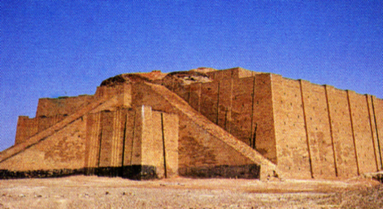
Bothubo 11:31
AKHACGE
KUTOPE
QHI
PANONGU YE PULUBENO WUVE!
MS
N(A)
H
SG
C
R
B
J
MN
ABRAHAM
DS
KUKUKEU
L - S - B
E
KB
U
MS
PG
RS
Awulokaku apa. 19-24
18
2
Notes:
After Abraham receives God's Promises…the entire family leaves Ur of the Chaldees to follow the Lord's direction.
//// They move toward the northwest with all their flocks and their possessions -- probably a large congregation of people, animals and tents. Biblical evidence shows ABRAHAM's family was probably wealthy. Again, if you have the map, add to it the map tracing that you see here in bright yellow. The main point here is this:
//// ABRAHAM and his family LEFT IN FAITH! They are moving toward a land that God will show them in due time. But as they leave Ur of the Chaldees they DO NOT know their destination. Their obedience is a profound demonstration of their faith in God's provision and His total protection as they head out into the unknown under Abraham's leadership.

Slide 22
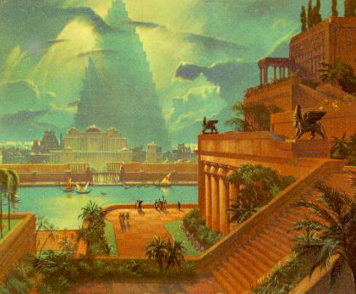
Bothubo 11:31-32
AKHACGE
KUTOPE
QHI
MS
N(A)
H
SG
C
ER
B
J
MN
ABRAHAM
DS
KULUKEU
L - S - B
E
KB
U
Babylon Phughi Kuloghi
MS
PG
RS
Awulokaku apa 19-24
19
Notes:
It is entirely possible that they passed through the region of ancient Babylon, upriver from Ur...that city to which you'll learn that Abraham's descendants – the Jews -- would be held as prisoners in the centuries to follow.

Slide 23
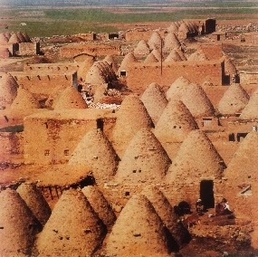
Bothubo 11:31-32
AKHACGE
KUTOPE
QHI
MS
N(A)
H
APU, ASU TERAH, HARAN LONO THIVE.
SG
C
ER
B
J
MN
ABRAHAM
DS
KULUKEU
L - S - B
E
KB
U
Harran lo “Akhi-ghu” phughi ishi ye (Turkey) api ani
MS
PG
RS
Awulokaku apa 19-24
20
1
Notes:
They continue northwestward, finally arriving at ancient Haran…
… still in existence today in modern Turkey.
//// While settled temporarily in Haran, ABRAHAM's father, Terah, dies.

Slide 24
Bothubo 12:5
AKHACGE
KUTOPE
QHI
MS
N(A)
H
SG
C
ER
B
J
MN
ABRAHAM
DS
KULUKEU
L - S - B
E
KB
U
MS
PG
RS
Awulokaku apa 19-24
21
Notes:
Once again, God speaks to ABRAHAM, instructing him to now leave Haran and to move onward toward The Land He had promised to show him. That land is to be Canaan, or the land we call Israel today.

Slide 25
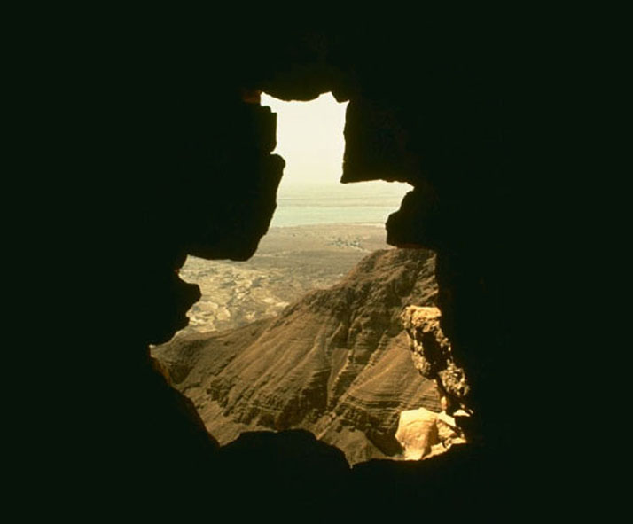
7
Abraham no ayeghi tile ilokelo…
Paya ampe 75 shia…
Panipu, Sarah, no 65 shia.
Eno tis hike ghi atianuli ithukulupu shike!
ABRAHAM
KULUKEU
L - S - B
Awulokaku apa 19-24
22
4
Notes:
Now the great stage is set!
//// When he enters The Land,
//// ABRAHAM is already 75 years old and
//// his wife, Sarah, is 65.
//// And yet, God has promised them children? What?
Was God teasing the old couple? Children promised at that age?

Slide 26
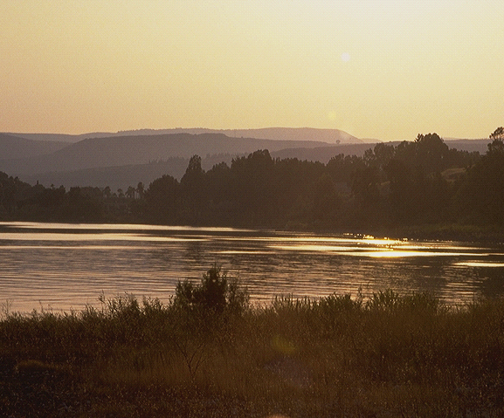
7
Bothubo 15:6
ABRAHAM NO ALHOU SHOQHI PULUBEKE: AYEGHI LAKHI, APITI LAKHI, ENO KUKUMGHA LAKHI!
AYEGHI
APITI,
KUKUMUGHA
Bothubo 15:6!
Alhou no Abraham kupulu ye amikucho
kepi ikhiluve ke!
Mülalei pülübekeu!
ABRAHAM
KULUKEU
L - S - B
Awulokaku apa 19-24
23
3
Notes:
Yes…ABRAHAM continues to believe God's promise of a LAND, a SEED, and a BLESSING!
//// His simple unquestioning belief is told to us in Genesis 15:6...
//// …where God counts that BELIEF as righteousness on ABRAHAM's part.
//// Just simple belief! This is the first step in the new program of redemption God will introduce to the earth through His old friend.

Slide 27
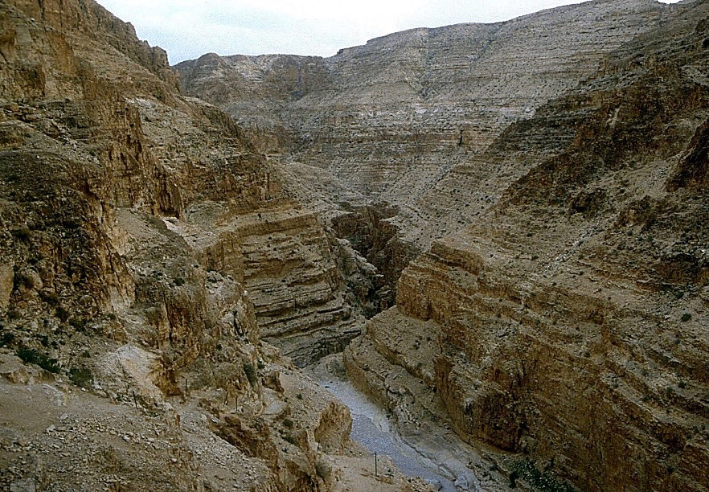
7
Bothubo 16:1-4
ABRAHAM NO ALHOU PULU!
Tishinamu: Abraham eno Sarah pamaye kutuukumla shike.
"Abraham… Hagar lau wu!"
(Sarah-w aqeliu)
ABRAHAM
KULUKEU
L - S - B
Awulokaku apa 19-24
24
3
Notes:
//// Abraham truly believes that God will accomplish what He has promised. And the years pass.
//// In spite of God's clear promise…ABRAHAM and Sarah become impatient as they wait for the children God had promised would be coming. In her impatience,
//// Sarah suggests that ABRAHAM go in to her Egyptian servant girl, Hagar, hoping that through that union the promised child might be born. That was not unusual in the culture of their day.

Slide 28
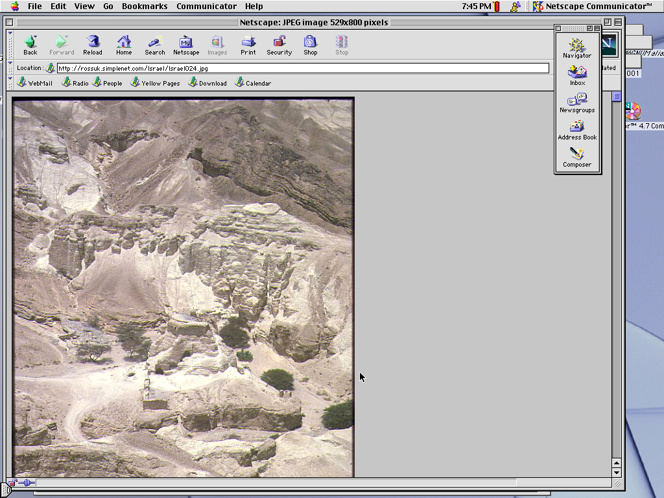
7
Bothubo 16:11-12; 17:20-21
Tisci kehu…Abraham ye Hagar vechewo anga lakhi papu shive.
Paje ye: ISHMAEL.
(ISHMAEL YE ASHOQHI SHIPUAKEU NU KUMOE).
ABRAHAM
KUKUKEU
L - S - B
Awulokaku apa 19-24
25
3
Notes:
//// Indeed, in time...ABRAHAM does father a son through Hagar.
//// The boy is named ISHMAEL.
//// But, God says, the infant is not the intended son of His covenant Promise to Abraham's descendants.

Slide 29
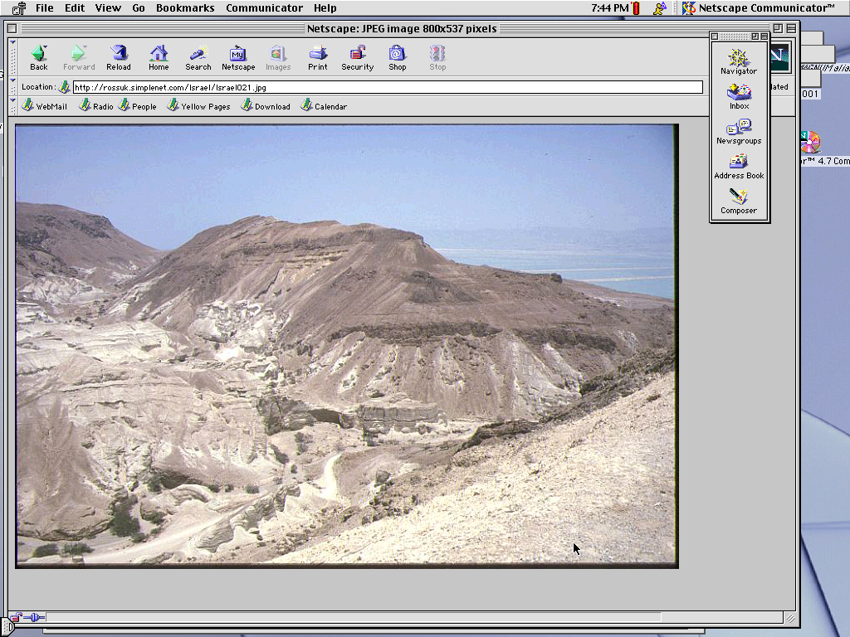
7
Bothubo 17:19
Abraham no ampe 85 shiakelo…Sarah ye ampe 75 shiake.
Ampe 15 thiu…
SARAH vechewo ABRAHAM ye anu lakhi ithulu.
AJE: "ISAK"
ABRAHAM
KULUKEU
L - S - B
Awulokaku apa 19-24
26
4
Notes:
//// By now, ABRAHAM is 85; Sarah, 75.
//// After another 15 years...
//// …the son of God's promise to ABRAHAM is finally born...through Sarah.
//// He is named ISAAC, a word that traces its meaning to the Hebrew root term indicating laughter. Yes, ABRAHAM thinks it hilarious that he and Sarah are to become parents at such advanced ages.

Slide 30
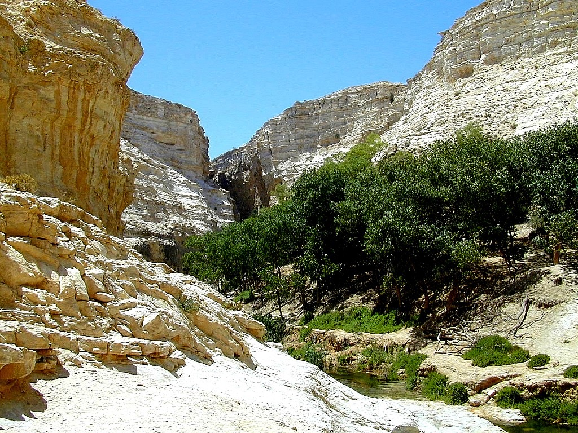
7
Bothubo 17:21
Isak ye ado kusholono laju khe akeu nu ke …
… pa vechewo Abraham lau Alhou shoqhi shikupu wovenikeu…
ABRAHAM
KUKUKEU
L - S - B
…ISAK VECHEWO AKIBO IKOWOKEU !
Awulokaku apa 19-24
27
2
Notes:
ISAAC is indeed the long-awaited son…
//// …through whom God's promise to ABRAHAM is to be passed down…
//// …through HIS family line.

Slide 31
7
Bothubo 17
ABRAHAM
ABRAHAM
ca. 2000 B.C.
KULUKEU
AC
L - S - B
AJMJ
I - I
BOTHUBO 12:1-3
ABRAHAM
KULUKEU
L - S - B
I - I
ISHMAEL eno ISAK
Awulokaku apa 19-24
28
Notes:
So…the letters I and I appear on ABRAHAM's file folder. From these two sons of Abraham….ISHMAEL and ISAAC...
right here at this crucial historic point…the terrible Jewish-Arab conflict of our own time begins some 4,000 years ago...around 2000 B.C.

Slide 32
7
ABRAHAM
ABRAHAM
ca. 2000 B.C.
The CALL
AC
L - S - B
AJMJ
Bothubo 12:1-3
I - I
ABRAHAM
KULUKEU
L - S - B
I - I
ISHMAEL VECHEWO
ARAB SHIYE IKOWOVE
ISAK VECHEWO
ISRAIL SHIYE IKOWOVE
Awulokaku apa 19-24
29
2
Notes:
Because...
//// …ISHMAEL is recognized today as the father of the Arab nations…through ABRAHAM…
//// while ISAAC, of course, is revered as one of the founding patriarchs of the Jews…also through ABRAHAM!

Slide 33
7
ABRAHAM
ABRAHAM
ca. 2000 B.C.
The CALL
AC
L - S - B
AJMJ
Bothubo 12:1-3
I - I
ABRAHAM
KULUKEU
L - S - B
I - I
ISHMAEL VECHEWO
ARAB SHIYE IKOWOVE
ISAK VECHEWO
ISRAIL SHIYE IKOWOVE
Awulokaku apa 19-24
30
Notes:
There is enormous conflict between the two half-brothers and their mothers. And as we watch or read today's news, we see that that age-old turmoil begun in ABRAHAM's tent 4,000 years ago continues today! Both the Jews and the Arabs claim ABRAHAM as the beginning point of their respective peoples!

Slide 34
7
Bothubo 22:2; 2 Yek. 3:1
ANU KHIPAU?
“Alhou no pi, ‘Onu lakhi akeu, Isaac, khiu nono kimye chenikeno, pa sass Moriah lo wulo. Tishino naghuto lakhi ino kichetsunike, tileno pitikumlla keu gho shighi ghiqhipe imullave lo’” Bothubo 22:2
ABRAHAM
KULUKEU
L - S - B
I - I
NIV hekupho kiqilo: Ibrimi tsa kiqilo, "Isak" khiu nono kimye cheni keno, ipi akeu kiqi ye, nono kimye chekeu, onu lakhi likhi akeu , tipau kiqi ye, Isak ye “Alhou no ashoqhi shipuakeu” nu lakhike"
2 Yek. 3:1 Akiyeh-uno achineki shinikeu-a shuphetsu[Ishiye a-a tipau pesu Atu kuboho Julho ipi ani].
Awulokaku apa 19-24
31
3
Notes:
The question then arises: how do we know WHICH SON was REALLY the inheritor of the Abrahamic promises? Look at Genesis 22:2…
//// "The God said, "Take your son, your only son, Isaac, whom you love, and go to the region of Moriah. Sacrifice him there as a burnt offering, on one of the mountains I will tell you about."
//// Look at this study note from the NIV translation: "In the Hebrew text, "Isaac" follows the clause "whom you love," in order to heighten the effect: "your son, your only son, whom you love – Isaac." Isaac was the only "son of the Promise."
//// Here also, you'll find in Second Chronicles 3:1 that God identifies Moriah with the Temple mount, which, today, is the site of the Moslem Dome of the Rock." Much more on that location a little later.

Slide 35
7
Bothubo 17:20-21
ANU KHIPAU?
"Eno Ismael ghenguye ino asutsa chiluvae, Ike ino pa kumghatsuni, pa pelo atianuli kutomo ithulupe eno ino pa kumghatsunani. Paye kijemi chighikini papu shilupe eno papelo ashiaye kije shitsunani. Ikemu iw puloshoqhi ye Isak lau qhinani, toku hipa ghuloki lono Sara no pa pununani."
Bothubo 17:20-21 (NKJV)
ABRAHAM
KULUKEU
L - S - B
I - I
Ikemu iw puloshoqhi ye Isak
lau qhinani
Awulokaku apa 19-24
32
2
Notes:
But Ishmael was not forgotten…not at all!
//// Genesis 17: 20-21…"And as for Ishmael, I have heard you. Behold I have blessed him, and will make him fruitful, and will multiply him exceedingly. He shall beget twelve princes, and I will make him a great nation.
//// But My covenant I will establish with Isaac, whom Sarah shall bear to you at this set time next year."

Slide 36
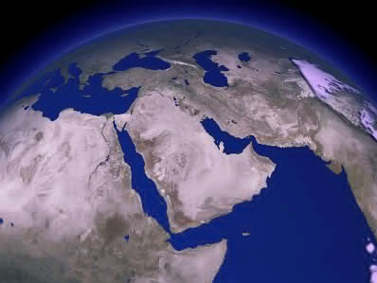
ISHI AGHOQO KIMIGHIJU LO…
ISAK
ABRAHAM
ISHMAEL
KULUKEU
L - S - B
I - I
KIUSHIYE KUMZAPU KIYEQUVE KYA ?
Awulokaku apa 19-24
33
3
Notes:
It's interesting to compare those gifts today…
//// Generally speaking…here are the lands populated today by the descendants of Ishmael…the lands of the Middle East.
//// But then…compare that with the descendants of Isaac in the Middle East…right there in tiny Israel.
//// Why the enormous difference?

Slide 37
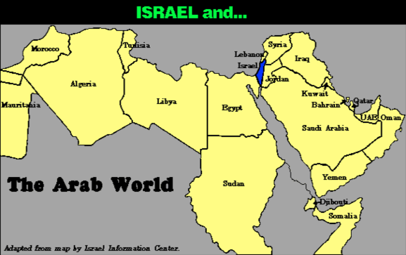
7
AYEGHIQHA KIMIGHIJU KEU…
Israil eno…
ABRAHAM
KULUKEU
L - S - B
Arab Yeghiqa
I - I
Awulokaku apa 19-24
34
Notes:
Practically speaking…just compare the geography…today's Israel versus the rest of the Arab world!

Slide 38
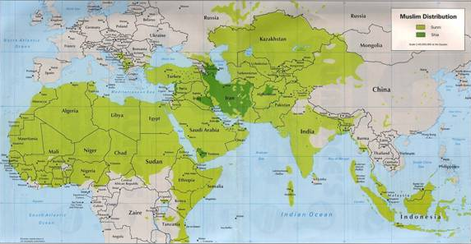
7
AYEGHIQHA KIMIGHIJU KEU…
ABRAHAM
KULUKEU
L - S - B
I - I
MOHAMMED ENO ISAK!
Awulokaku apa 19-24
35
Notes:
But there is something else at work here. Compare the Middle Eastern influence of Ishmael's descendant, Mohammed, founder of Islam…with that of Isaac, the great Israelite patriarch, and the brother of Ishmael!

Slide 39
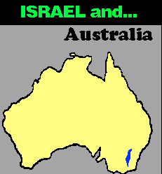
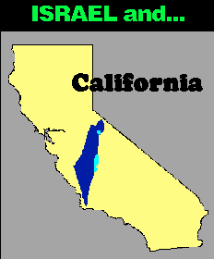
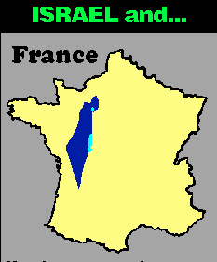
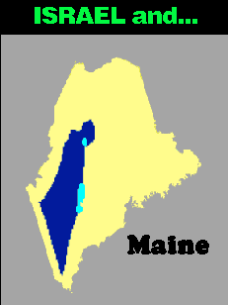


7
AYEGHIQHA KIMIGHIJU KEU…
ISRAIL eno…
ISRAIL eno…
ISRAIL eno…
Australia
France
California
ISRAIL eno…
ISRAIL eno…
Singapore
ABRAHAM
The CALL
L - S - B
I - I
Maine
Map shisupia keulo Israel no atsulaju
Awulokaku apa 19-24
4
9.65.03b.
36
Notes:
In today's geopolitical world…compare the size of tiny Israel with
Australia…
//// Israel with France…
//// Israel and the United States' state of Maine…or
//// Israel and California.
//// The width of Singapore and Israel are about the same.

Slide 40
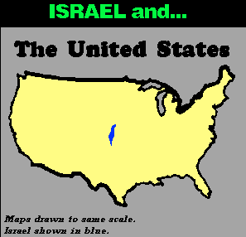
7
ISRAIL eno…
UNITED STATES
ABRAHAM
KULUKEU
L - S - B
I - I
HIYE ACHIPI IPILU NANIMA?
Awulokaku apa 19-24
37
Notes:
And finally…even when Israel is compared to the entire United States…from the north to the south…from east to west: when it comes to size alone, there is enormous disparity between Isaac and Ishmael! Why is this so? How can we explain it?

Slide 41
7
"…Ismaelmi ye ayeghi eno kuakini Israemi nguno alaushi tsuke. Ishi tiqheli lo amizu kuakini tsa piamoe, ikemu xughili tsalo hiye kuchiuke. Eno aghungu xakulupu ye alhokuthu lono panongu ghenguno khaqhi puatsuake.
ABRAHAM
KULUKEU
L - S - B
I - I
Hal Lindsay no Jihad ghili yekeu, The Everlasting Hatred,The Roots of Jihad: (2002) kaku apa 65
Awulokaku apa 19-24
38
Notes:
Look at this passage from Hal Lindsay's 2002 book, The Everlasting Hatred: The Roots of Jihad:
"…the Ishmaelites were given more land and ultimately more wealth than Israelites. This was true in their past history, not to mention the vast oil wealth of modern times. And spiritual salvation has always been open to the Ishmaelites."
[Continue to the next part of the passage below.]

Slide 42
7
"…Ismaelmi ye ayeghi eno küakini Israemi nguno alaushi tsuke. Ishi tiqheli lo amizü küakini tsa piamoe, ikemu xüghili tsalo hiye kuchiuke. Eno aghungu xakulupu ye alhokuthu lono panongu ghenguno khaqhi puatsuake.
Ikemu Alhou-w puloshoqhi Aghungu xakulupu ghili ye, Isak eno pakughuko lau likhi khaqhitsuke. Aphimpi kukumgha shoqhi pesu Isak tsukeu ye ayeghiqha pelo Alhou ghungu kumla ye palauno ighikeu ithipeniye ke." [Atsa akhoto]
ABRAHAM
KULUKEU
L - S - B
I - I
Hal Lindsay no Jihad ghili yekeu, The Everlasting Hatred,The Roots of Jihad: (2002) kaku apa 65
Awulokaku apa 19-24
39
Notes:
"But God's covenant, which concerned His spiritual purposes, was only for Isaac and his descendants. The physical blessings promised to Isaac were to facilitate God's spiritual call for the nation that would come from him."

Slide 43
7
LEBANON
Mediterranean Sea
ISAK LAGHA KUGHUKO
SYRIA
Sea of Galilee
IRAQ
Haifa
Nazareth
Netanya
JORDAN
Tel Aviv-Jaffa
AMMAN
JERUSALEM
Jericho
Gaza
Hebron
Dead Sea
ABRAHAM
Beersheba
KULUKEU
ISRAEL
L - S - B
I - I
ISHMAEL LAGHA KUGHUKO
EGYPT
SAUDI ARABIA
Eilat
Al' Aqaba
Gulf of Aqaba
ISHI ISRAEL YEGHIQHA LO ISHMAEL eno ISAK
Awulokaku apa 19-24
40
2
Notes:
And inside the ancient Land right now…
//// Here, the descendants of Isaac
//// and the descendants of Ishmael continue today -- that endless conflict begun in Abraham's tent in ancient Palestine or Canaan – or Israel -- so long ago. Jewish Israel is engulfed by the descendants of Ishmael in surrounding countries on all sides! The implications of that circumstance in our own day are enormous.

Slide 44
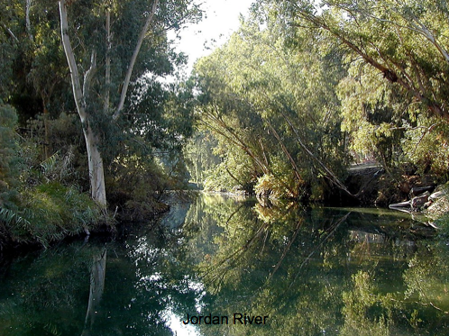
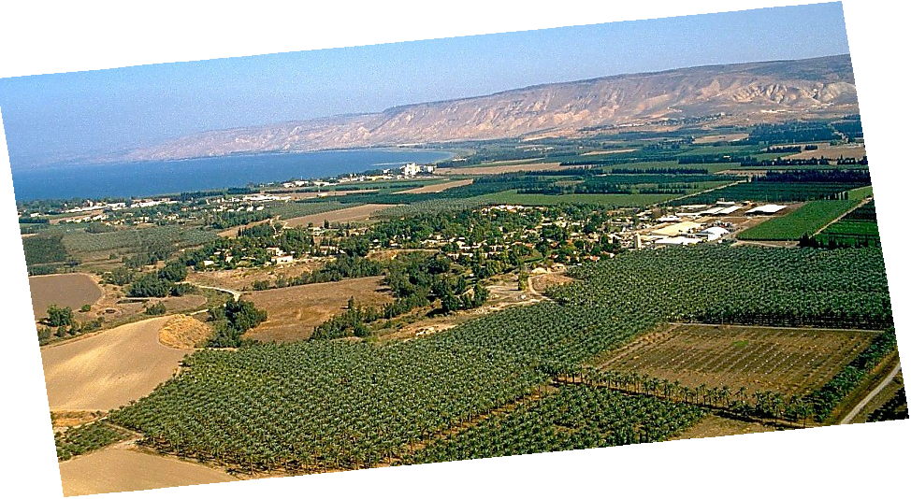
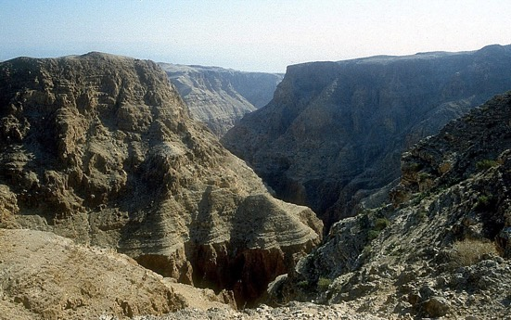
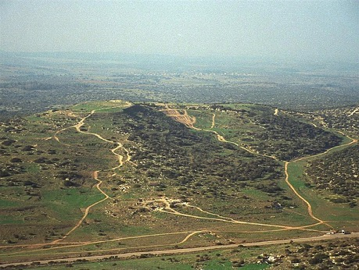
Bothubo 13:10-11; Ipekulu 3:8
A PORTION OF ABRAHAM'S PROMISE,,,
ABRAHAM
The CALL
L - S - B
I - I
THE MARVELOUS BEAUTY OF CANAAN…
THE LAND OF HIS ANCIENT INHERITANCE!
Israel Müta lo Jordan Ghoki
Awulokaku apa 19-24
41
1
© 2006 TBBMI
9.65.03b.
Notes:
And here is that Land today…but only a portion of God's promise to Abraham…this lush location along Israel's Jordan River.
//// the Land of his promised inheritance! From the fertile north to the desolate south…"milk and honey" are only the start of the blessings of this special piece of earth's real estate.

Slide 45
7
Ipekulu 2:24
ABRAHAM
ABRAHAM
ca. 2000 B.C.
KULUKEU
AC
L - S - B
AJMJ
I - I
BOTHUBO 12:1-3
J - E
12
ABRAHAM
KULUKEU
L - S - B
I - I
J - E
Jacob ye Ashoqhi nu!
12
ASHOQHI PEKUPUKEU!
Awulokaku ape 19-24
42
7
Notes:
The story now begins to move much faster. ISAAC, ABRAHAM's son through Sarah, IS the Son of God's promise.
//// ISAAC then has two sons: JACOB and ESAU (J and E on the ABRAHAM File Folder). JACOB is the son through whom the unconditional Promise now passes on.
//// Jacob, in turn has 12 sons (the number 12 on the Abraham folder).
//// So, then...the Line of the Promise...is
//// Abraham
//// Isaac
//// Jacob and
//// the 12 sons of Jacob.

Slide 46
7
Bothubo 35:23-26; Bothubo 34:1
ABRAHAM
ABRAHAM
ca. 2000 B.C.
KULUKEU
AC
L - S - B
AJMJ
I - I
Gen. 12:1-3
J - E
12
12
ABRAHAM
1
10
KULUKEU
L - S - B
I - I
6
J - E
8
12
4
5
13
7
11
3
9
2
Awulokaku apa 19-24
43
Notes:
Here is a graphic representation of those 12 sons of JACOB, born to him and his four wives across the long years of his life. You'll see there was also a 13th child… one daughter. From those 12 sons of old Jacob emerge the 12 tribes of Israel.

Slide 47
7
Bothubo 35:24
ABRAHAM
ABRAHAM
ca. 2000 B.C.
KULUKEU
AC
L - S - B
AJMJ
I - I
BOTHUBO 12:1-3
J - E
12
ABRAHAM
KULUKEU
L - S - B
I - I
J - E
12
11
Awulokaku apa 19-24
44
Notes:
But notice one particular son of Jacob – number eleven, one of his youngest -- and probably the most remembered of all his children. This son's story is familiar to almost everyone:

Slide 48
7
Bothubo 35:24
ABRAHAM
ABRAHAM
ca. 2000 B.C.
KULUKEU
AC
L - S - B
AJMJ
I - I
BOTHUBO12:1-3
J - E
12
ABRAHAM
KULUKEU
L - S - B
I - I
J - E
12
JOSEF!
11
Awulokaku apa 19-24
45
Notes:
His name is JOSEPH. This great man of legendary character –– his name known throughout the ages -- bridges us over to the next of the four biblical personalities in this mental map of the biblical storyline:

Slide 49

7
Bothubo 1 lono 25 kuto
PULHOKUSU
YEPEHA
1st Kipitimi & Totimi
1st Axine
C
1st Tsavipe
1st Akibo
KUKAMI KUXU
(1000 B.C.)
1st Ghikiqhi
Azukucho/Milisu
Aqokighe
(2000 B.C.)
ABRAHAM
(2000 B.C.)
AQO-AHO 3
C 7 S J
KULUKEU
AC
L - S - B
I - I
J - E
12
AKUGHU
7 = 4 + 3
JOSEF
ABRAHAM
KULUKEU
TIMI 4
L - S - B
I - I
MUSE
(1500 B.C.)
(500 B.C.)
J - E
S
YENGUYI
12
S
JISU
J
JOSHUA
46
2
Notes:
Now we've completed the second folder in the Bible File collection:
//// first is CREATION,
//// followed by ABRAHAM, the first of the four great names.

Slide 50
7
AJMJ
TIMI 4
lo
AKINIU
ye:
?
47
Notes:
Time now to move forward to the second in the group of four great Old Testament characters…the Bible File Folder Number 3.
From "A Judge Must Judge" we know that his name begins with the letter J. Which is…

Slide 51
7
Bothubo 30:24
AJMJ
TIMI 4
lo
AKINIU
ye:
"JOSEF"
48
Notes:
Joseph. Probably no Biblical character is more famous, more legendary than this one man who -- through his character and his integrity before God -- changed all of human history.

Slide 52
7
Bothubo 30:24
KUMSUKUPUJU TSALAPHI:
ABRAHAM-JOSEF 2000 B.C.
49
Notes:
And the timeline…let's keep it generally in that early 2000 B.C. range. It's unnecessary to be more specific at this point. So don't feel burdened to remember a long lists of ancient dates. The dates presented in THE BIBLE…BASICALLY are only broad anchor points to help keep events in correct order. You can sharpen them later.

Slide 53
7
Bothubo 30:24 lono Bothubo 50:26 kuto
PULHOKUSU
ABRAHAM
ABRAHAM
"Xaküthami
ye Xakütha tsumasa"
ABRAHAM
JOSEF
ABRAHAM
MUSE
JOSHUA
YEPEHA
KUKAMI KUXU
AKUGHU
YENGUYI
JISU
Awulokaku apa 24-25
50
Notes:
And here is Joseph's folder in the Bible File lineup.
"A JUDGE MUST JUDGE"…the first "J" which brings to mind: JOSEPH.

Slide 54
7
JOSEF
ABRAHAM
TIMI 4
lo
AKINIU
ye:
JOSEF
AJMJ
Awulokaku apa 24-25
51
Notes:
JOSEPH's folder appears ready for two significant events to be filled in. The young man is well loved by his father, JACOB — so deeply and obviously, in fact…

Slide 55
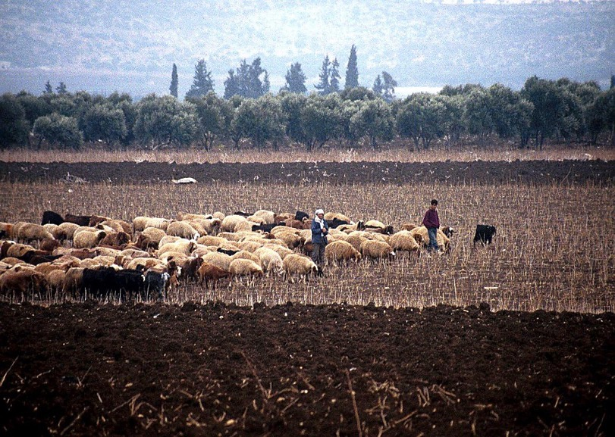
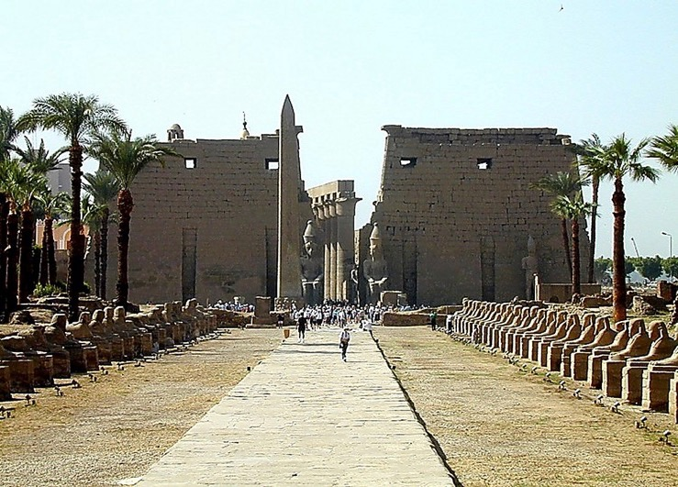
Bothubo 37:16-18
Façade of Luxor Achine, Egypt
JOSEF
Bherikhemi Dothan yeghi lo, Israel
Awulokaku apa 24-25
52
1
Notes:
…that it arouses the envy of most of his shepherd brothers. Tending flocks at that time in the fields near today's Dothan in northern Israel…
//// the brothers plot against JOSEPH, selling him into slavery to a passing caravan on its way to Egypt.

Slide 56
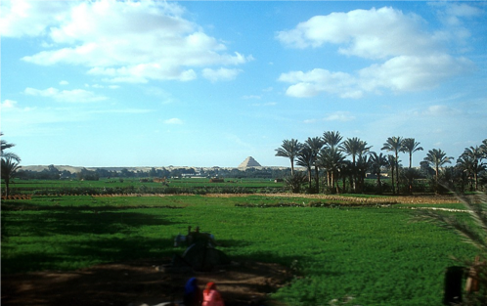
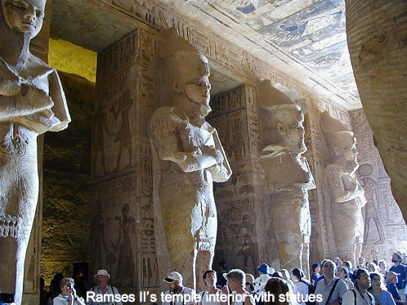
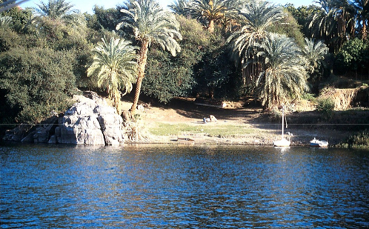
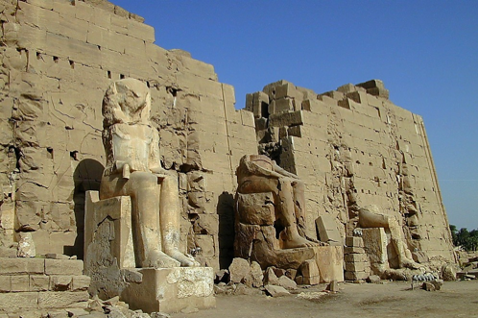
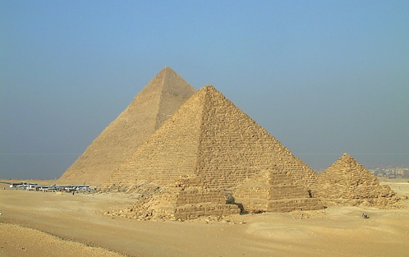
Bothubo 37:28
JOSEF
Awulokaku apa 24-25
53
Notes:
Once in Egypt…among the fabulous wealth and wonders of that advanced civilization…and after several difficult personal trials…JOSEPH is soon discovered to be a brilliant young man with enormous administrative ability. He learns quickly while remaining faithful and obedient to God's authority and leading in his life.

Slide 57
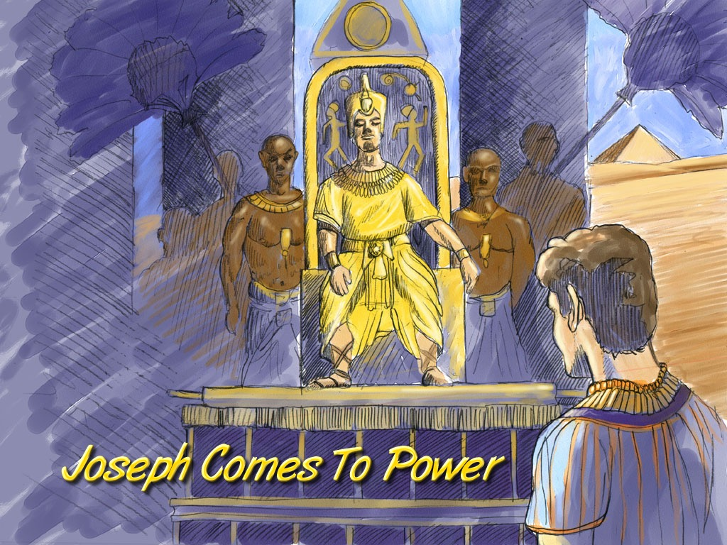
Bothubo 41:41-46
JOSEF
Joseph Comes To Power
Josef no akuka ighiluve
Awulokaku apa 24-25
54
Notes:
In time JOSEPH rises in Egyptian civil authority. He becomes governor of all of Egypt, second only to the Pharaoh himself.

Slide 58
Bothubo 42:2
AKHACGE
KUTOPE
QHI
MS
N(A)
PUQÜMIYE!
H
SG
C
ER
B
J
MN
JOSEF
DS
E
KB
U
NIBONILEI!
MS
PG
RS
Awulokaku apa 24-25
55
1
Notes:
At this same time, back in Canaan, famine strikes The Land.
//// In order to survive the crisis, JOSEPH's father, old JACOB (now called Israel), sends some of the brothers to Egypt to buy grain. FAMINE IN THE NORTH…PLENTY TO THE SOUTH. (On your map, add the tracing line from Canaan down to Egypt.)

Slide 59
Bothubo 42:7
Josef eno pathikuzumiqo
JOSEF
Joseph and His Athikuzumiqo
Awulokaku apa 24-25
56
Notes:
Through a series of dramatic events -- told about in great detail in the latter chapters of Genesis – the brothers learn that their sibling, JOSEPH, is now the governor of Egypt

Slide 60
Bothubo 46:3-7
AKHACGE
KUTOPE
QHI
MS
N(A)
H
SG
C
ER
AKIBO PASU…
AKIBO HUNO AGHAKHU SHIVENANI !
B
J
MN
JOSEF
DS
E
KB
U
MS
PG
RS
Awulokaku apa 24-25
57
Notes:
The family follows and decides to settle in Egypt permanently. And there...as a family of Hebrews…they begin to multiply into a nation, to be known through later history as the Israelites.

Slide 61
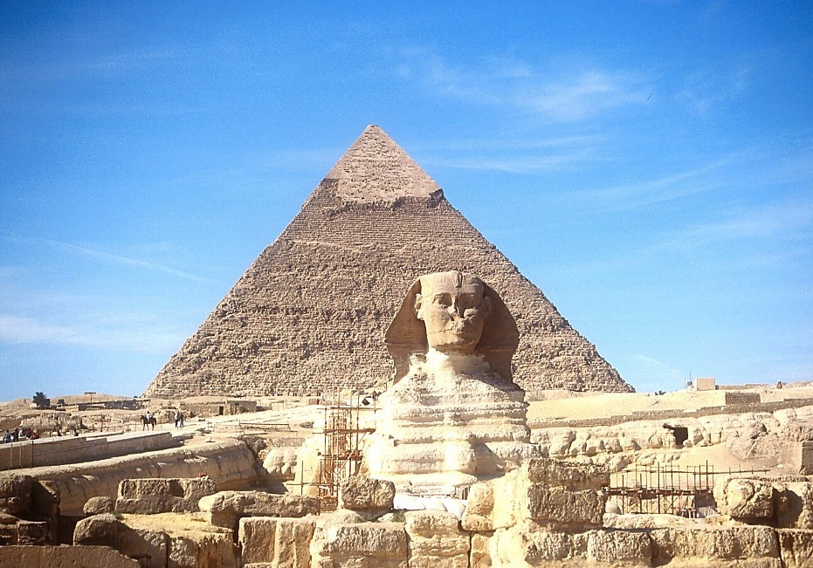
7
JOSEF
Sphinx eno Pyramid akiqheu
Awulokaku apa 24-25
58
Notes:
For a while, they remain in good favor with the Egyptian people and the government administration. After all, they are the family of their respected Governor! Perhaps they even saw the great structures of the Sphinx and the pyramids of Egypt even as they remain for us to marvel at today.

Slide 62
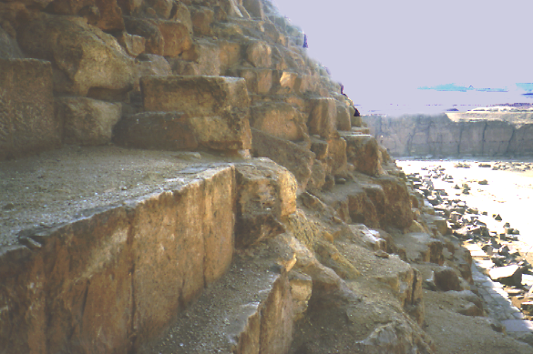
7
JOSEF
Pyramid akiqheu lo atu chuluchekiu-a
Awulokaku apa 24-25
59
Notes:
We can climb the side of the Great Pyramid today and wonder: are these the quarries where Joseph's family later slaved through the centuries? Maybe so. Some evidence points in that direction.

Slide 63
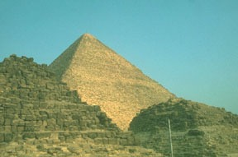
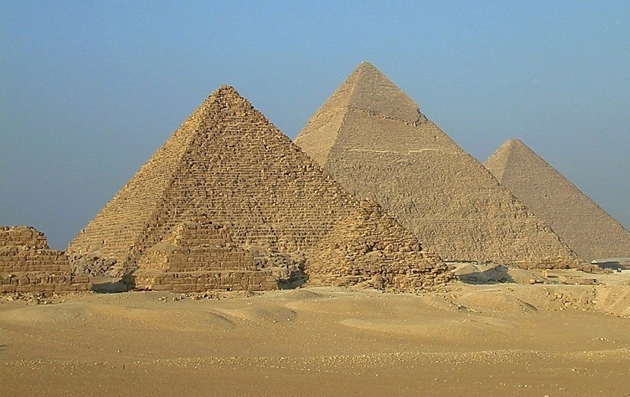
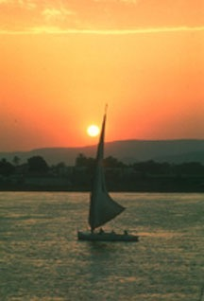
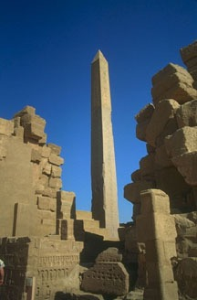
7
ISRAILIMI NO ITHULU…
JOSEF
…EGYPTMI-W MHESHOMHEGHI.
Awulokaku apa 24-25
60
Notes:
As time passed and Joseph died, these ancient wonders would have seen the throne of Egypt undergo changes of attitude and a loss of respect for the alien Hebrews -- or the Israelites, the old family of Joseph.

Slide 64
Bothubo 8:8-10
JOSEF
ABRAHAM
AQEMI
The SECOND
of the
4 PEOPLE
is:
AJMJ
Notes:
After his death, Joseph's long service to Egypt is soon forgotten.
//// While at the same time, as a population, the Israelites are multiplying rapidly – lots and lots of children –
[NOTE: SEVEN SETS OF "CHILDREN-DOTS" APPEAR]
– soon becoming an enormous social problem and a serious national threat to their Egyptian overlords. So…to take care of that problem…
//// the Israelites, Joseph's national descendants, become SLAVES to the Egyptians.
//// Israelites are in Egypt for some 430 years. Much of that time is lived out under the terrible bondage of Egyptian slave masters.

Slide 65

7
Bothubo 1:1 lono Ipekulu 1:6 kuto
PULHOKUSU
YEPEHA
1st Kipitimi & Totimi
1st Axine
C
1st Tsavipe
1st Akibo
KUKAMI KUXU
(1000 B.C.)
1st Ghikiqhi
Azukucho/Milisu
Aqokighe
(2000 B.C.)
ABRAHAM
(2000 B.C.)
AQO-AHO 3
C 7 S J
KULUKEU
AC
L - S - B
I - I
J - E
12
AKUGHU
7 = 4 + 3
JOSEF
JOSEF
AQEMI
Aqemi
430
430
TIMI 4
MUSE
(1500 B.C.)
(500 B.C.)
S
YENGUYI
S
JISU
J
JOSHUA
Awulokaku apa 24-25
62
Notes:
Now…THE BIBLE FILE...is filled in to include
CREATION, ABRAHAM, and JOSEPH…

Slide 66
7
AJMJ
TIMI 4
lo
AKUTHIU
ye:
?
63
Notes:
…which brings us now to the third person in the Group of Four great Biblical personalities.
This great person – THE LARGE CAPITAL M – will be…

Slide 67
7
Ipekulu 2:10
AJMJ
TIMI 4
lo
AKUTHIU
ye:
"MUSE"
64
Notes:
...MOSES.
In His time, God raises up the most famous of all the Old Testament characters, MOSES, known as The Great Deliverer…
to take the people out of their Egyptian bondage and on toward the land of Abraham's promised inheritance.

Slide 68


Kuchouyesu… Aboqha • BibleStudyDownloads.org
Hipau kümsa lono pesü küsaje lo!
Notes:
The Bible…Basically (bb)

Slide 69
65
©2006 TBBMI
9.65.03b.

