Slide 1
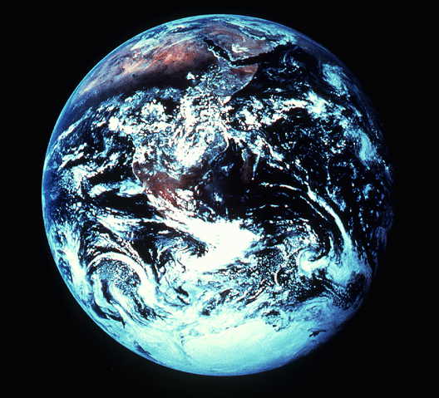
“Lhosukeu"
©2006 TBBMI
Notes:
So…as we enter the CREATION BIBLE FILE…at Genesis 1:1…
//// …we are "In the Beginning…" those three small words that ring up a curtain of unfathomable depth and meaning for the unfolding Plan of the Ages.

Slide 2
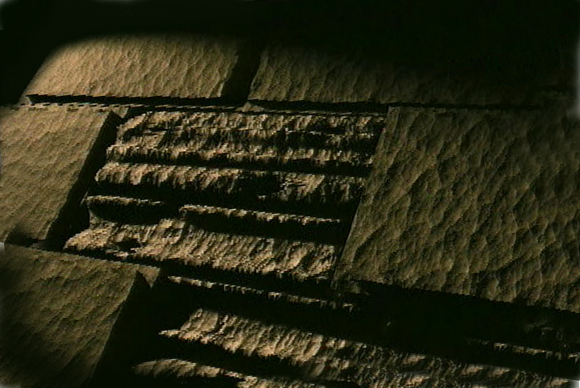
VERSION 9.65
Kuchouyesu… Aboqha
Designed by Dr. John Fryman, Texas, USA • BibleBasically.org Taught by Dr. Rick Griffith, Singapore Bible College All files in many languages for free download at BibleStudyDownloads.org
9.65.01.
©2004 TBBMI
01

Slide 3
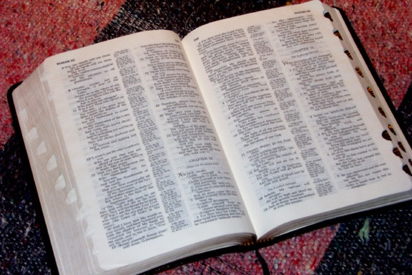
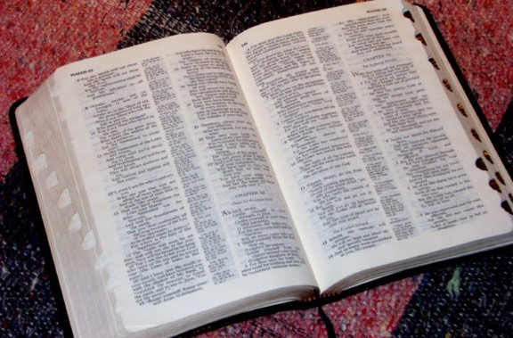
(Hile KIU Shivekeno Ithuluani.)
BIBLE… W ABOQHA
®
KOKUPHA KUTHU
OW KILEKITHI: “AGHULOKI PHUKIPHE"
©2006 TBBMI
9.65.03a.
02
Notes:
Part Three…and here we get to the heart of the matter…the very story core of Scripture. We call it THE QUICK CHRONOLOGY. This is the 'WHAT HAPPENED" of the great Biblical drama…in the briefest possible detail.

Slide 4
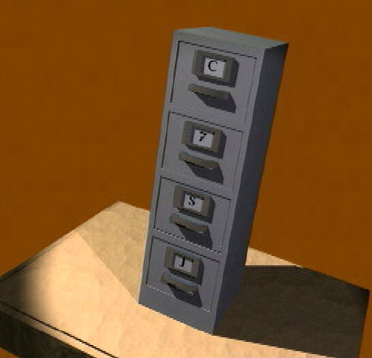
-
P
7
Y
J
03
1
Notes:
First…a quick review…the 7 with a dash through the stem…
//// …surrounded by the C, the S, and the J.

Slide 5
7
PI IDEGHI PIAKEU...
P 7 Y J
=
4 3
04
1
Notes:
Just a reminder…the 7 in the upper left corner of the frame…almost always there as a mental help… //// …the 7 breaks into the 4 and the 3.

Slide 6
7
PI IDEGHI PIAKEU
P 7 Y J
P 4 3 Y J
05
Notes:
…which leads to C 4 3 S J…

Slide 7
7
PI IDEGHI PIAKEU...
P 7 Y J
P 4 3 Y J
PULHOKUSU
4 TIMI
3 AQO-AHO
YENGUYI
JISU
06
Notes:
….bringing us to the five ideas of
CREATION…4 PEOPLE…3 SOCIETIES…SILENCE…JESUS.

Slide 8
7
PULHOSU
ABRAHAM
JOSEF
MUSE
JOSHUA
YEPEHA
KUKAMI KUXU
AKUGHU
YENGUYI
JISU
07
Notes:
And finally…the ten file folders of THE BIBLE FILE.
Say them with me: CREATION, ABRAHAM, JOSEPH, MOSES, JOSHUA, ANARCHY, ROYALTY, CAPTIVITY, SILENCE and JESUS.

Slide 9
AKHACGE
KUTOPE
QHI
10 A_AJELI
MS
PULHOKUSU
6 4
ABRAHAM
N (A)
H
JOSEF
MUSE
AYEGHI
SG
C
JOSHUA
YEPEHA
MN
B
J
KUKAMI KUXU
AKUGHU
"THE STAGE
OF THE
ACTION!"
D S
YENGUYI
U
E
JISU
KB
RS
MS
PG
08
1
Notes:
So now...with your own map of the Ancient Near East in your mind – THE STAGE OF THE ACTION -- and
//// THE BIBLE FILE FOLDERS outlined in their order...what's next?

Slide 10
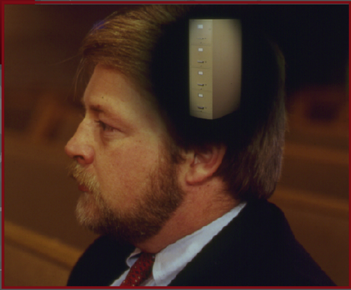
7
PULHOKUSU
ABRAHAM
ABRAHAM
ABRAHAM
JOSEF
ABRAHAM
MUSE
JOSHUA
YEPEHA
KUKAMI KUXU
AKUGHU
YENGUYI
JISU
•Kumsu kupuju yeghijutho mula!
•Ninguye Chixechilei ithi amoe...
•Ajutho kijeqo likhi.
•Bible aqhalo akhotoqo.
09
4
Notes:
//// Remember, first, that we're building a mental map. We use the ten Bible Files as basic building blocks for what eventually can become a very large intellectual or mental structure! However, we are only building AN OUTLINE MAP of the Author's enormous literary work.
//// We're learning no small details!
//// We will be dealing only with the big picture...
//// …only the Bible's general outline. And that's the great value of THE BIBLE…BASICALLY.
You'll finally begin learning generally WHAT is WHERE in God's great love letter to His Creation.

Slide 11
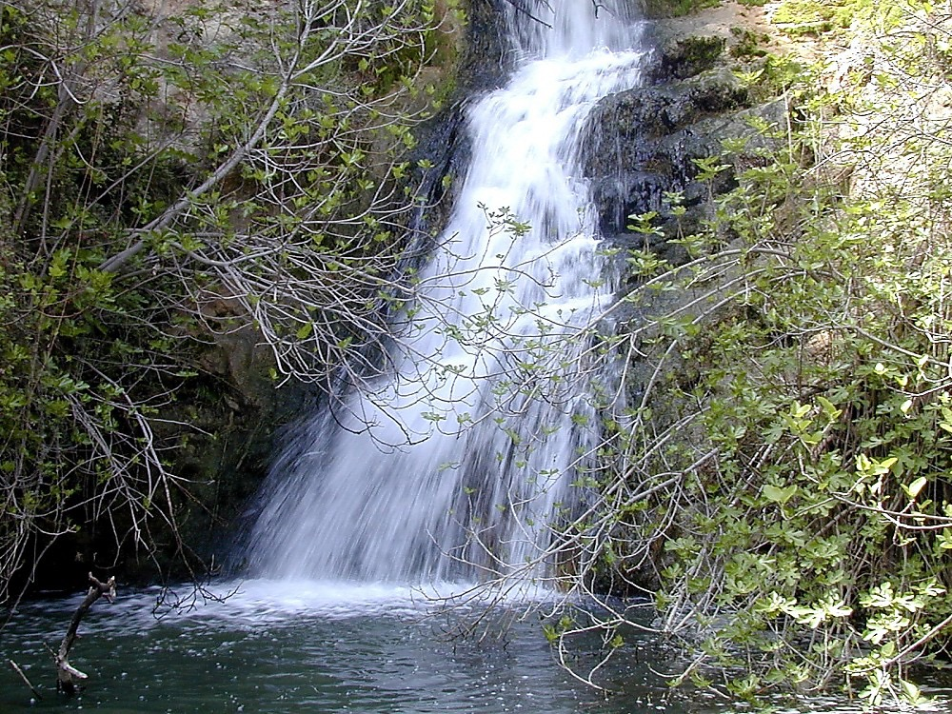
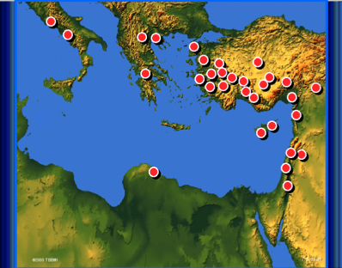
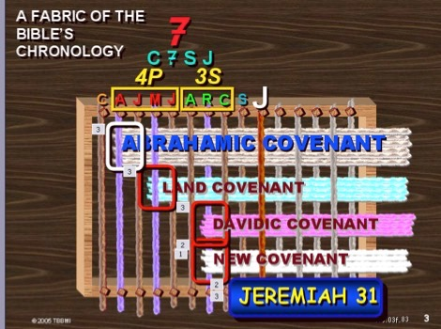
10
Notes:
Based on the ten labeled Bible Files – with lots of visuals…lots of graphic assistance…we are now going to learn Scripture's basic chronology, its foundational story and time line. Keep in mind our main concern: learning only the most outstanding biblical milestone events, along with some of the most well known biblical characters. Many events and characters that you might expect to find will not be mentioned. But their places are reserved among those that are. And all this done while learning a mental tool to keep it all in order.
[blue "woven" fabric graphic is the last one]
_______________
Note to Translators: Slides 3A.10 and 5A.04 are identical and preview slides that should be translated in the other presentations. Note that each graphic listed below shows where to find it in the other presentations. Only the “Help” graphic in the upper left corner and the blue OT map in the lower right corner are translated by the time you start to translate presentation 3A, so take a screenshot of these slides at 01.19 (Presentation 01, slide 19) and 02.79 and substitute the English ones here. For example, the HELP! Graphic is at Animation > Picture 13 > Effect Options > In From Screen Center > Timing > After Previous. Put the translated version of this graphic over it and then delete the English version.
Later, once all the presentations are translated, screen shots of these various slides should be added here.
Here is where to find the 11 graphics:
Picture 8 Map with Red Dots at 08.49
Picture 3 Sea of Galilee at 3F.15
Picture 5 Jesus file Folder at 3F.57
Picture 7 The Synoptics Blue Quadrants at 08.21
Picture 2 Solomon’s Temple at 3D.30.
Picture 14 Blue OT Map at 02.79.
Picture 9 Light Blue OT Historical Books Structure at 07.37
Picture 10 Open Bible Blue OT & NT at 06.16
Picture 11 Abrahamic Covenant Eternal—Literal—Unconditional at 5B.13.
Picture 13 HELP! at 01.19
Picture 18 Fabric of the Bible’s Chronology with Covenants & Jeremiah 31 at 3F.83 and 08.83

Slide 12
PULHOKUSU
ABRAHAM
ABRAHAM
ABRAHAM
JOSEF
ABRAHAM
MUSE
JOSHUA
YEPEHA
AYEKIPE
AKUGHU
YENGUYI
JISU
11
Notes:
Then as we move through The Quick Chronology -- based on THE BIBLE FILE -- you'll be able to tie in each part –
each event and character --with one of those ten key words now placed on ten mental BIBLE FILE folders —
in the chronological order you learned them.

Slide 13
7
PULHOKUSU
ABRAHAM
ABRAHAM
ABRAHAM
JOSEF
ABRAHAM
MUSE
JOSHUA
YEPEHA
KUKAMI KUXU
AKUGHU
YENGUYI
JISU
12
Notes:
The first of which will be the CREATION file. This is the beginning of your chronological thinking.

Slide 14
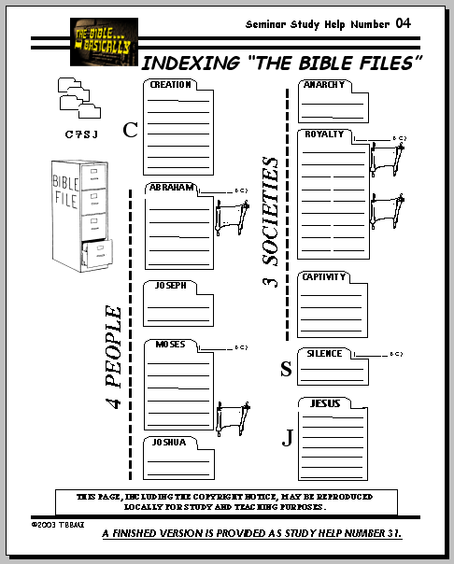
7
Bothubo 1 long 11 kuto
PULHOKUSU
ABRAHAM
ABRAHAM
ABRAHAM
JOSEF
PULHOKUSU
ABRAHAM
MUSE
JOSHUA
YEPEHA
KUKAMI KUXU
AKUGHU
YENGUYI
JISU
PHUKUJU KUKUPHU #04
13
1
Notes:
If you have the worksheet from the student handbook entitled INDEXING THE BIBLE FILE – STUDY HELP NUMBER 4 -- keep it handy as we work through the next section. All the Bible Files are located there as you work through them. It will help you to embed THE QUICK CHRONOLOGY mentally as we move forward…beginning with the CREATION file.
//// Now let's move on to expand The Bible Files, always filling them with more details, building on what has gone before, while still maintaining that high, outline view of the overall story line of Scripture.

Slide 15
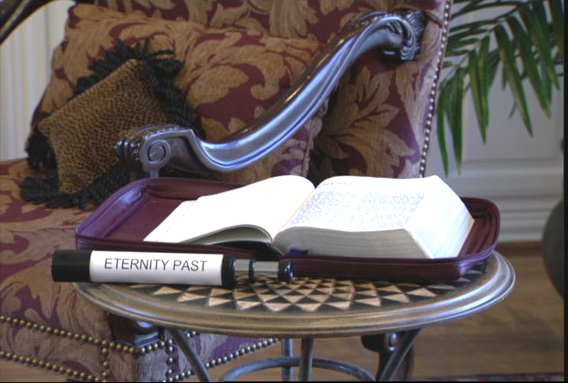
7
BOTHU. 1–11: LHOKUTA ABOTHU
LHOKUTA ABOTHU
Awulokaku apa 17-19
14
1
Notes:
In the CREATION FILE, with great speed, we are swept through the first eleven chapters of the book of Genesis. We see the universe in its broadest dimensions of time and space…and then…
//// We view the earliest events in the opening chapters through that telescope into Eternity Past... In both early Genesis here and Revelation later on we see a telescoped view of enormous spans of time. [God breaks through eternity past by creating the earth.]

Slide 16
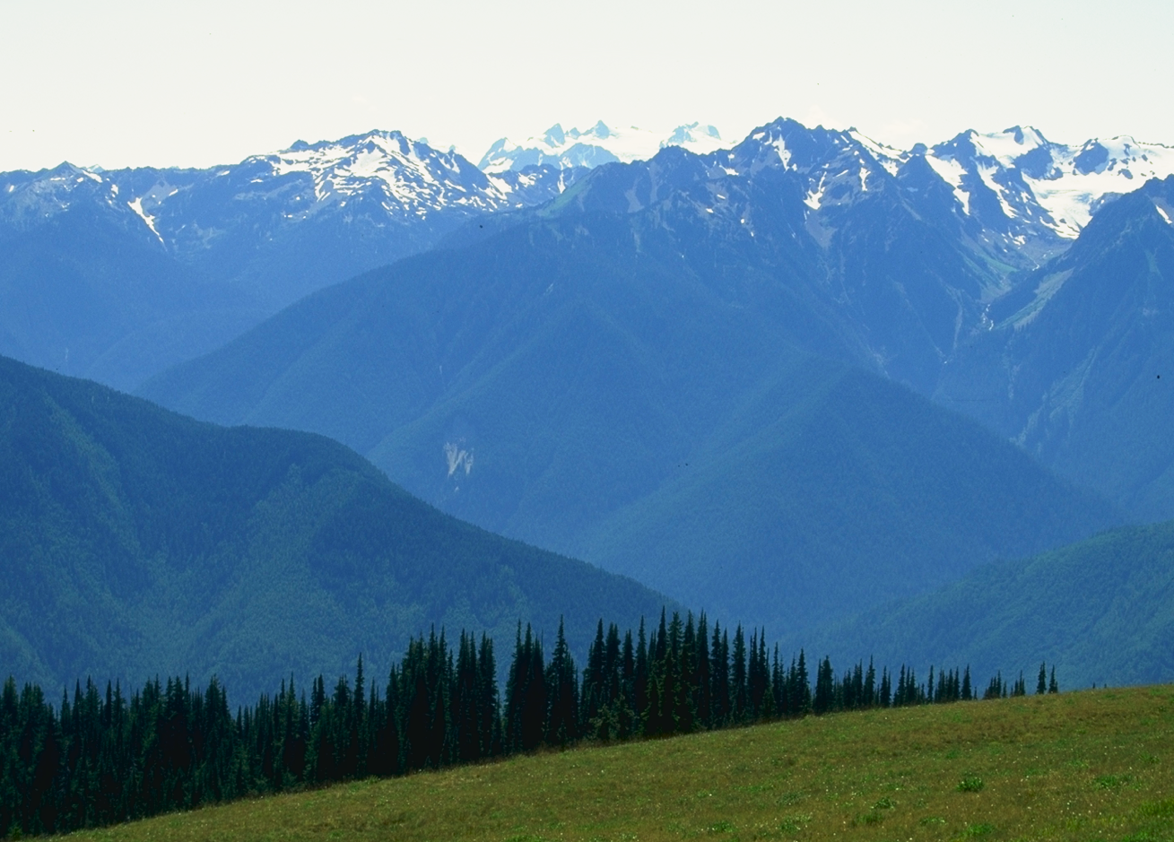
ABOTHU LHOKUTA ITHUKULU...
Awulokaku apa 17-19
15
Notes:
Through this telescope into Eternity Past, the effect is quite similar to viewing mountain ranges from a great distance.
We can see the peaks lined up one after another into the far distance.

Slide 17
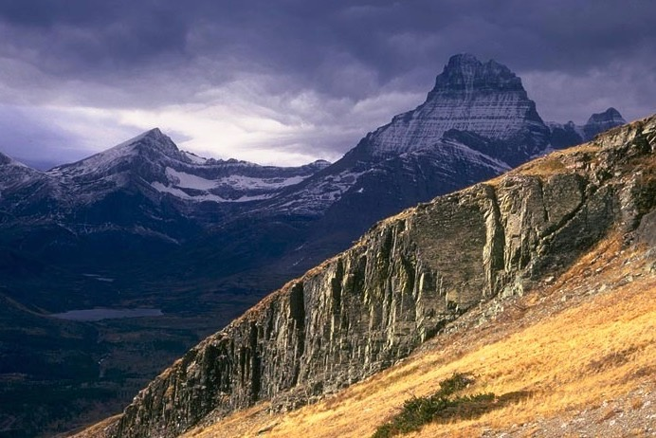
ABOTHU LHOKUTA ITHUKULU...
Awulokaku apa 17-19
16
1
Notes:
It is obvious that a great deal of land lies between the peaks.
//// But only when we get into the valleys between the peaks can we clearly see that the valleys are there…
and to estimate the distances that lie across the valleys between the mountain peaks.

Slide 18
Bothubo 1:1
“inahu...
abothu lono"
8.0.03a.
17
1
©2006 TBBMI
Notes:
So…as we enter the CREATION BIBLE FILE…at Genesis 1:1…
//// …we are "In the Beginning…" those three small words that ring up a curtain of unfathomable depth and meaning for the unfolding Plan of the Ages.

Slide 19
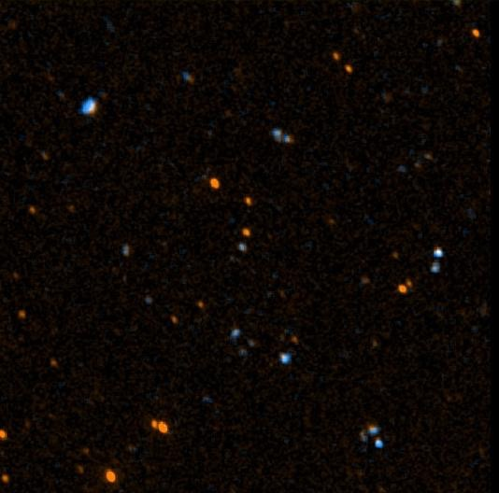
Johan 17:5
“Apuo! Ayeghiqha lhophe mphilo ino ogholo achekeu jekipi hu pesü itehino ogholono ijepipi tsülo."
©2006 TBBMI
8.0.03a.
18
Notes:
In the earliest phases of Genesis we are beamed backward as it were to a time before the world was. Jesus Himself spoke of that time. We know it to be so because He asked the Father – in John 17 -- to glorify him "with the glory which I had with you before the world was." [John 17:5]

Slide 20
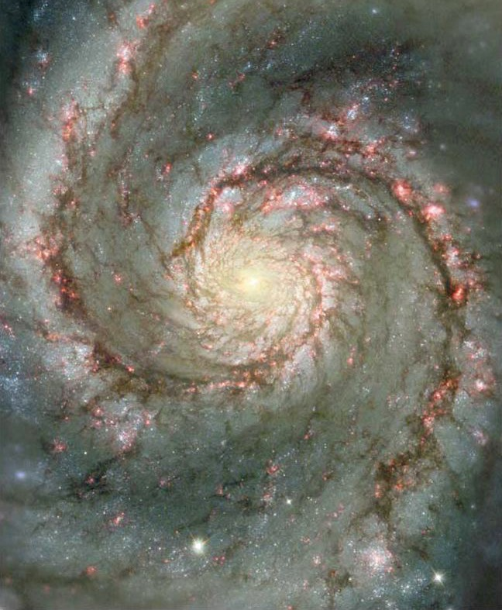
Johan 17:5
"Apuo, ayeghiqha lhophe mphilo ino ogholo achekeu jekipihu pesu itehino ogholo ijepipi tsulo."
©2006 TBBMI
8.0.03a.
19
Notes:
In the earliest phases of Genesis we are beamed backward as it were to a time before the world was. Jesus Himself spoke of that time. We know it to be so because He asked the Father – in John 17 -- to glorify him "with the glory which I had with you before the world was." [John 17:5]
[AUTO ADVANCE]

Slide 21
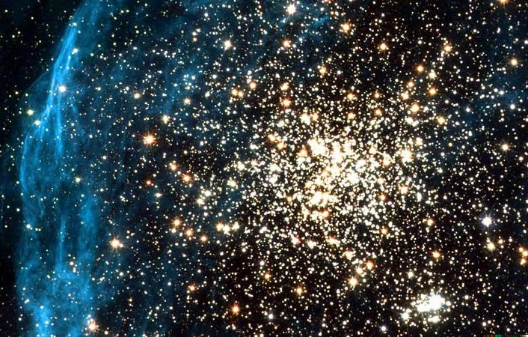
Johan 17:5
"Apuo, ayeghiqha lhophe mphilo ino ogholo achekeu jekipihu pesu itehino ogholo ijepipi tsulo"
©2006 TBBMI
8.0.03a.
20
Notes:
In the earliest phases of Genesis we are beamed backward as it were to a time before the world was. Jesus Himself spoke of that time. We know it to be so because He asked the Father – in John 17 -- to glorify him "with the glory which I had with you before the world was." [John 17:5]
[AUTO ADVANCE]

Slide 22
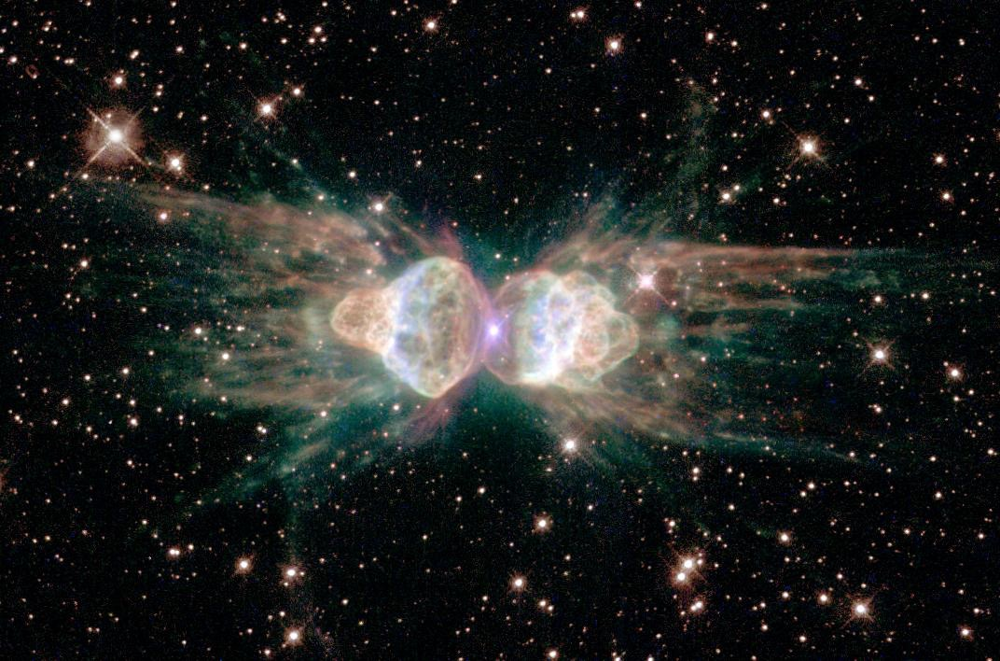
John 17:5
“Apuo! ayeghiqha lhophe mphilo ino ogholo achekeu jekipi hu pesü itehino ogholo ije pipitsülo."
©2006 TBBMI
8.0.03a.
21
Notes:
In the earliest phases of Genesis we are beamed backward as it were to a time before the world was. Jesus Himself spoke of that time. We know it to be so because He asked the Father – in John 17 -- to glorify him "with the glory which I had with you before the world was." [John 17:5]
[AUTO ADVANCE]

Slide 23
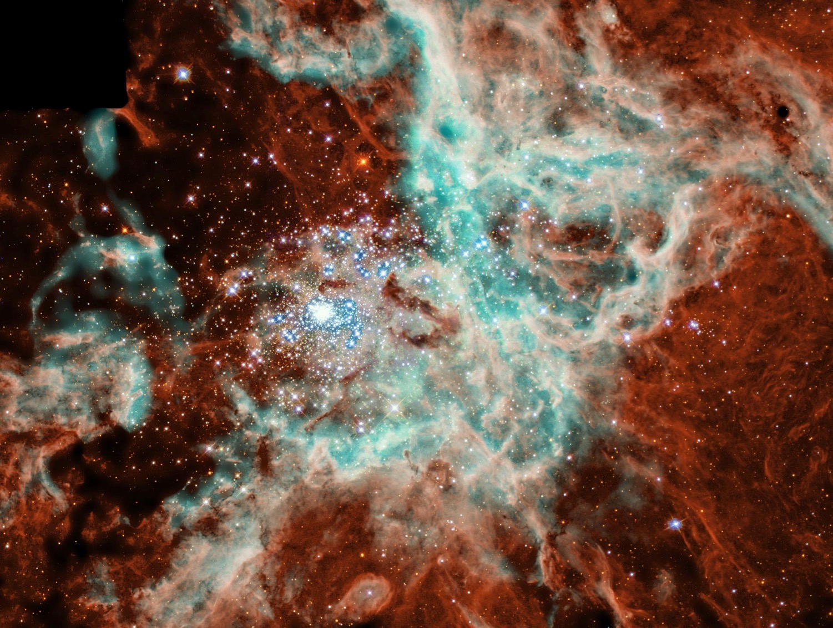
Johan 17:5
“Apuo! Ayeghiqha lhophe mphilo ino ogholo achekeu jekipi hu pesü itehino ogholo ije pipitsülo."
©2006 TBBMI
8.0.03a.
22
Notes:
In the earliest phases of Genesis we are beamed backward as it were to a time before the world was. Jesus Himself spoke of that time. We know it to be so because He asked the Father – in John 17 -- to glorify him "with the glory which I had with you before the world was." [John 17:5]
[LAST SLIDE IN AUTO SEQUENCE]

Slide 24
Job 38:4-18
“Ino ayeghi boqha qha akelo noye khile akea?"
CREATION
©2006 TBBMI
8.0.03a.
23
Notes:
And…should men get overwhelmed by their own earthly pride of accomplishment and conceit on this planet, the Creator set them straight when he asked Job the simple question… "Where were you when I laid the earth's foundations?"

Slide 25
Bothubo 1–11
Bothu. 3:15:…“pano okütsu kubotsü eno nono pa phitsü mighitaü nanil."
NIV kiqiloye: “Totimi xuthi lono ipeghikeu huno apighi kütsü kubotsu nani; tiye Khristo no satan shou toluve keu shikuputsü—— tokulu tiye küpülümi kümtsü no küsaje luke (Rom. 16:20)."
PULHOSU
Ado kumtsu Abraham zuu
CREATION
1st KIPTI &TOTIMI
(Kupukulai)
1st AXINE
(alimji tomula)
ABRAHAM
PULHOKUSU
1st TSAVIPE
AJELI 7
(Xakuluu)
1st AKIBO
(Kutsalakulu)
1st GHIKIQHI
(Akumou xine)
AZUKUCHO/MILISU
(Pgm #1: Noah)
AQOKIGHE
(Pgm #2: Babel)
Awulokaku apa 42-45
24
10
Notes:
SO…As we open up the first file folder, CREATION, Genesis 1-11…the BIBLE FILE FOLDER image has spaces
//// ….provided for seven items.
//// All time prior to 2000 BC—call it pre-Abraham—is included in the first eleven Genesis chapters. […] The entire story of CREATION and the course of the universe and this planet up through the development of the first known civilizations are contained in Genesis, chapters 1 through 11. But in spite of the brevity of those first eleven Genesis chapters, they are priceless words that teach us many important "first things."
Beginning now with A LIST OF FIRST THINGS…
//// The FIRST MAN and WOMAN
Man appears on earth in a perfect form and is placed in the sinless environment of God's created perfection.
//// The FIRST SIN
Man is given a test of his gift of free will. He is tempted by Satan and falls from his created state of perfection into a sinful condition, having "missed the mark" for which he was created. A distance or gulf is created between the Creator and his created!
//// The FIRST GOSPEL
The Creator provides the first announcement that He will send a Redeemer to provide for man a way back to that original state of created perfection, innocence and holiness.
//// It's important to note Genesis 3:15: "…he will crush your head, and you will strike his heel." In a footnote in the NIV Study Bible is this statement: "The offspring of the woman would eventually crush the serpent's head; a promise fulfilled in Christ's victory over Satan…a victory in which all believers will share."
//// The FIRST FAMILY
Adam and Eve have children. They provide the basis for future development of a race of men which must contend with satanic efforts to keep them from a restored relationship with the loving Father and Creator.
//// The FIRST MURDER
Sin is committed in its most abusive and abject form, man's destruction of God's ultimate gift, life itself.
And then we have two items of ancient history in those first eleven chapters. These are contained in two programs of God's action among men.
//// The GREAT FLOOD and RAINBOW
First program: God determines to wipe out His Creation turned desperately sinful…and to begin it again. All mankind perishes except eight people who, under the leadership of righteous Noah, remain true to the Father, Who provides His rainbow promise as the waters recede. And then…
//// The TOWER OF BABEL
Second program: Man attempts to climb to an elevation equal to God Himself. God intervenes with a confusion of earthly languages in order to disperse the races.

Slide 26
Akughukhou loye: PULHOKUSU ipi akeuye Alhou no timi lhophe eno pano ikiqivekeu xüghili piani. Tile akeu ye Apu w lhoküta kukughu pephenikeu tiye timi pelo atüghi lo toi axine kuhakeu küxü xüno punukhoi eno pa sasü kütshukime pesü apenikeu ke. “Idewonikeu xülhe tipau ye Bible xülhe lo atsakiviu akhotou shikumto tsü skeu tsa lakhike." John Walvoord
Awulokaku apa 17-19
©2006 TBBMI
8.0.03a.
25
Notes:
So, then, Genesis 1 to 11...In summary: the CREATION file is the story of God's creation of Man and his subsequent fall. It contains the declaration of the Father's eternal plan for Man's return to that original sinless state of close and intimate relationship with Him. As John Walvoord has written: "The story of that return is the substance of the Bible story, the very core of the Gospel."

Slide 27
7
Bothubo 1 lono 11 kuto
PULHOKUSU
KUKAMI KUHAKEDO
1st kipitimi & totimi
1st Sin
C
1st Tsavipe
1st Akibo
KUKAMI KUXU
(1000 B.C.)
1st Ghikiqhi
Azukucho/Milisu
Aqokighe
ABRAHAM
(2000 B.C.)
AQO-AHO 3
C 7 S J
AKUGHU
7 = 4 + 3
JOSEF
TIMI 4
MUSE
(1500 B.C.)
(500 B.C.)
S
S
YENGUYI
JISU
J
JOSHUA
Awulokaku apa 17-19
26
Notes:
The CREATION folder is now complete. Think of these first eleven chapters of Genesis as a record of titanic human events squeezed into a few pages --- presented in only limited words…but with spiritual impact and instruction beyond our comprehension! The first Bible File folder is now complete.

Slide 28
Kuchouyesu… Aboqha • BibleStudyDownloads.org
Hipau kümsa lono pesü küsaje lo!
Notes:
The Bible…Basically (bb)

Slide 29
©2006 TBBMI
8.0.03a.
27

