Slide 1

VERSION 9.65
BIBLE… Aboqha
Designed by Dr. John Fryman, Texas, USA • BibleBasically.org
Taught by Dr. Rick Griffith, Singapore Bible College
All files in many languages for free download at BibleStudyDownloads.org
©2004 TBBMI
9.65.01.
01
Notes:
Slides still needing translation as some English remains: 2, 3, 4, 6, 69, 70

Slide 2

YOUR ATTENTION PLEASE… KINDLY SILENCE ALL CELL PHONES, BEEPERS AND OTHER COMMUNICATION DEVICES DURING THE TEACHING SESSIONS. YOUR FRIENDS IN THE CLASSES WILL THANK YOU!
9.65.01.
02
1
Notes:
Same as text above

Slide 3
The Bible…Basically Ministries Int'l
Committee of Reference
Dr. John Hannah
Distinguished Professor of Historical Theology
Research Professor, Historical Theology
Dallas Theological Seminary
Dallas, Texas
Dr. Rick Griffith
D.Min. Director
Assoc. Professor in Biblical Studies
Singapore Bible College
Republic of Singapore
Dr. Mark Bailey
President
Dallas Theological Seminary
Dallas, Texas
John Maisel Kurt Nelson
President Exec. Vice President
East/West Ministries
Dallas, Texas
©
Dr. William R. Bright
Late Founder
Campus Crusade for Christ
Orlando, Florida
Vasily Dimitrievski
Director for Russia
Global Missions Fellowship (e3)
Penza, Russia
Rev. Douglas Valenzuela
Senior Pastor, Conservative Baptist Missions
Chiesa Battista Evangelica di Casoria
Naples, Italy
Dr. Ted Kitchens
Senior Pastor
Christ Chapel Bible Church
Ft. Worth, Texas
Karyn Granger
Director of Bible Studies
Southwest Christian Schools
Ft. Worth, Texas
Dr. Kenneth Horton
Senior Pastor
McKinney Memorial Bible Church
Ft. Worth, Texas
©2006 TBBMI
9.65.01.
03
Notes:
This seminar has been approved by many respectable leaders in the western world.

Slide 4
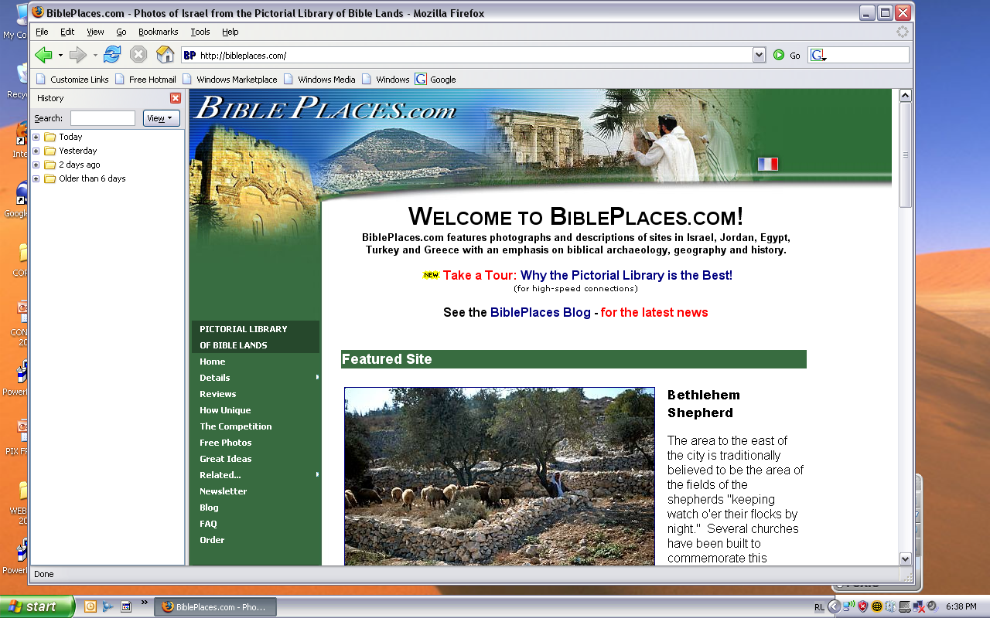
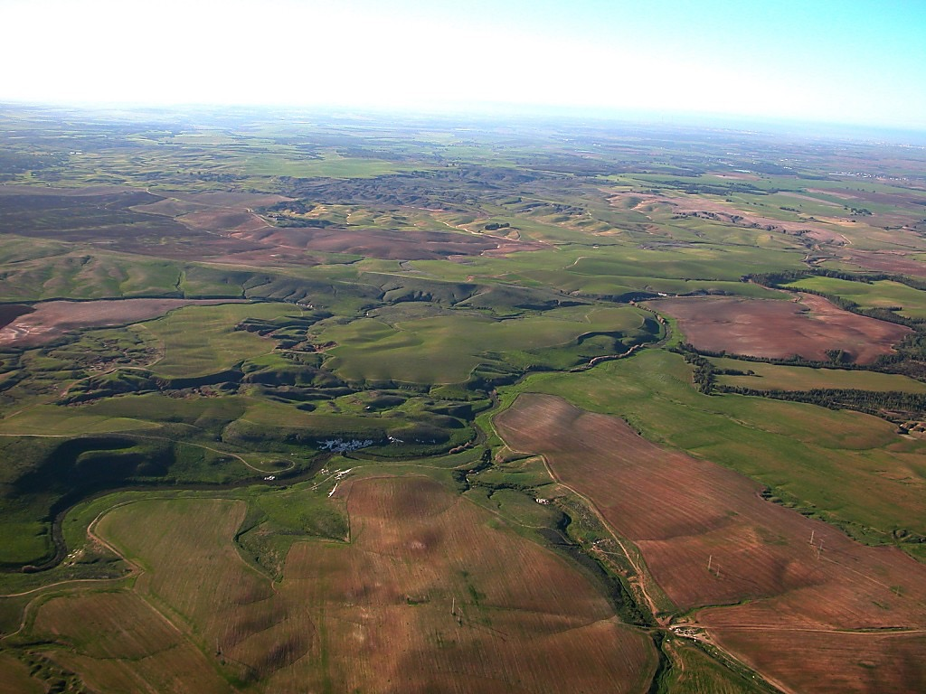
Bible Yeghiqha Juthoqo
Our ministry is deeply indebted to Todd Bolen, creator of the Pictorial Library of Bible Lands, for his generous permission to use photo resources throughout THE BIBLE…BASICALLY®. TBB users are urged to visit BiblePlaces.com and explore the thousands of photo resources available: from the Holy Land, throughout the Aegean and Mediterranean Basin to Southern Europe where the Christian faith took root. BiblePlaces.com offers teachers and visual producers an incomparable array of high-resolution digital photographic resources. Please visit! Thanks, Todd!
9.65.01.
04
Notes:
This presentation has been granted use of almost 150 pictures from the BiblePlaces.com website. We thank Todd Bolen for his support!

Slide 5
VERSION 9.65
BAIBEL… Aboqha
Designed by Dr. John Fryman, Texas, USA • BibleBasically.org
Taught by Dr. Rick Griffith, Singapore Bible College
All files in many languages for free download at BibleStudyDownloads.org
©2004 TBBMI
9.65.01.
01

Slide 6
The Bible…Basically Project was conceived, developed
and produced by John E. Fryman, Ph.D.
Copyright © 2006 The Bible…Basically Ministries Intl. Inc., Ft. Worth, Texas
All rights reserved. This work is protected under the copyright laws of the United States of America. No part or section may be reproduced in any form without permission in writing from the author or copyright owner, except in the case of brief quotations embodied in critical articles or reviews.
Those sections for which permission is specifically provided in the text may be reproduced locally as student need requires.
The ministry is indebted to Dr. Todd Bolen, The Master's College, Jerusalem, Israel, and Pictorial Library of Bible Lands (BiblePlaces.com) for permission
to use extensive photo resources throughout this production. Photography of Kadesh-Barnea is used with permission of Dr. Leen Ritmeyer, Hawthornedene, Australia. Should the copyrighted material of others be noted without our knowledge or proper attribution, the ministry requests an immediate notice. The specified content attribution will be properly adjusted. Every effort was used to avoid unauthorized use of text and graphics.
Teachers, media operators and/or other facilitators may not alter any PowerPoint slide, animation effect, or order of presentation in any way, in any language edition, or in any computerized application from any image storage facility, transmission, digital or Internet technique except by permission of the producers.
Produced in the United States of America. International Rights Reserved.
©2006 TBBMI
9.65.01.
06
Notes:
At the end of the seminar, we plan to give each of you a CD of this PPT so you can teach it to your own people. However, as this copyright page notes, we ask you not to change any of the content.

Slide 7
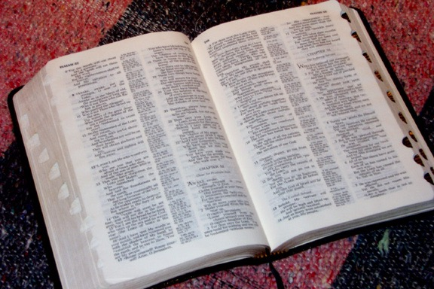

(Akimiji: BIBLE akükümsü lono ithini!)
BIBLE
ABOQHA
®
Koküpha Lakhi
BIBLE Khaqhi nikeu"
©2006 TBBMI
9.65.01.
07
Notes:
Our goal during this seminar is to mentally manage the Bible.

Slide 8
Ningu Kumtsu kukumusu kuqano akumla hipau huthuni!
?
KHILENO HUTHUKEA…
Christomi no Puluchekeu
Christomi Kupulughola
Kuchoyesu boqha kaku qo:
Phukutho keu kakubo kumtsu
Timiquo kakubo kumtsu
Luthu kakubo kumtsu
University kakubo kumtsu
Ayeghiqha kumtsu
Atsa zheli kumtsu
Kuchyesu boqha kukumusu
Kupulumi eno pulumokemi ayeqalo akemi
08
15
©2006 TBBMI
9.65.01.
Notes:
Our lonely planet floats in space while men on its surface struggle – sometimes in vain – to understand it! They ask the questions for which Christians have the valid answers. But too many of the questioners either will not listen…or else have never heard. Believers know very well that the answers have been given between the covers of God's Word…His Bible.
//// So with that fact in mind…let's launch this seminar with one massive thought!
//// What is the source of
//// every Christian doctrine,
//// Every Christian belief system,
//// In every Biblically based book in
//// Every seminary library,
//// Every public library,
//// Every personal library,
//// Every University library,
//// In every country in the world,
//// In almost every language,
//// And…besides all that…
//// The source of every biblically based thought of
//// every believer and nonbeliever across our planet?
//// (DIZ QUESTION MARK)

Slide 9
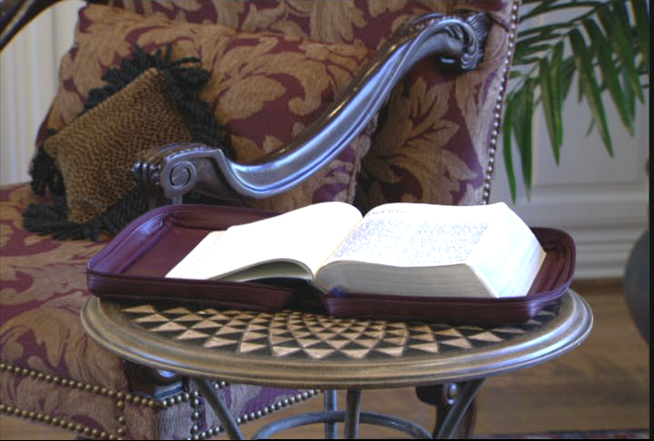
Ningu küpülü boqha Kaku
Handbook pg. 6
2
09
Notes:
The answer? This book: Because Christian belief is built on personal faith in this Book... However…that faith is also built upon solid fact! The Word of God is an organized record of the facts of the faith.
//// We can call it: the BASIC DOCUMENT OF OUR FAITH!
However, around the world, well-grounded research and experience shows that -- for MOST people -- the facts and historical progression of scriptural storyline are a great and lasting mystery.
//// And a housekeeping note to begin: at the lower right-hand corner of many slides you'll see a reference to locations in the TBB student handbook for your personal reference.

Slide 10
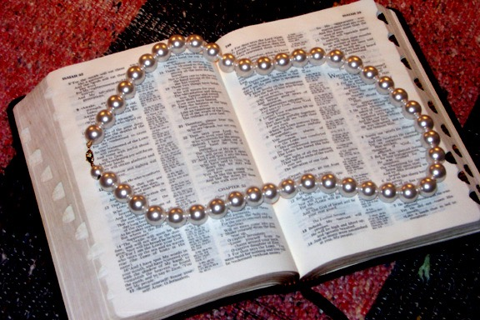
Liw kaku loye “Bible ye kiu kea!"
Dr. Henrietta Mears wrote…
Handbook pg. 6
10
Notes:
One of the great Bible teachers of the 20th Century, Henrietta Mears....wrote about this idea in her book, "What The Bible Is All About." She said…

Slide 11
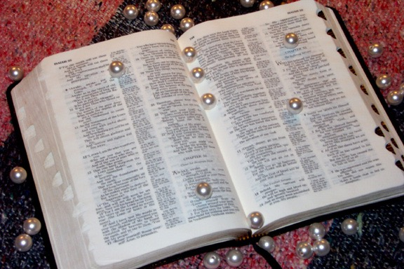
…akighi itava… Bible xulhe kikithi ye shipüsaveno avehu izü eno kӫbanguva!
Handbook pg. 6
12
Notes:
…the bead string is broken. The organized progression of the Biblical storyline is disorganized and confused. Each fine gem is separate…disorganized…just strewn about all around. It is impossible to appreciate the beauty of that complete necklace of lovely pearls.

Slide 12
Timi kutomow Bible kighithi ye akughupuchi pilipüa ketoi
Ikemu phiakemiqo muloye…
Handbook pg. 6
11
Notes:
SAME
Most people's Bible knowledge is like a string of fine pearls…but in many readers' minds…

Slide 13
Handbook pg. 6
13
Notes:
How can we restring the lovely pearls? In the same way…how can we reassemble the pieces of SCRIPTURE, bringing them together so that, just like the pearls, each piece is in its proper place...one leading to another…each gem or biblical fact placed in ITS proper relationship…as each relates to every other one in that grand panorama of biblical revelation…stretching across 4,000 years?
Only with an organized, mentally accessible knowledge base of Scripture can we begin to comprehend …

Slide 14
Akimthe yesü kutho
Akiqhi pühave
Aghungu kimithe kukuphu avehupushi ani
14
2
Notes:
…the depth of Scripture
//// the nuances of its meaning…and
//// the deeper leadings or instructions from the Holy Spirit…Who stands ready to teach us through every page of His Word.
Can that kind of comprehensive, coherent knowledge of Scripture be accomplished? Answer: Yes...it can be done...both swiftly and efficiently.

Slide 15
?
?
?
Alhou u xakulu kupughu
Abraham & Khagi Israel
Nimpeu Jisu Christo ighi
Akukuhou huthukeu
?
?
?
?
?
?
15
5
Notes:
In this one book, we are told how to see…
//// The glorious wholeness of God's Plan of Redemption recorded for us in words we can understand…framed by…
//// …the drama of old Abraham and ancient Israel…beginning in the Middle East some 4,000 years ago…
//// ….culminating in the appearance and gospel ministry of the Lord Jesus Christ…
//// …and the birth of the Church. Our part of the story is to understand the movement of the Gospel message of Jesus Christ …progressing right down to our own time.
//// But, sad to say, for the vast majority of people, this is often unfamiliar territory. In fact, for many, it's a downright intellectually fearful place.

Slide 16
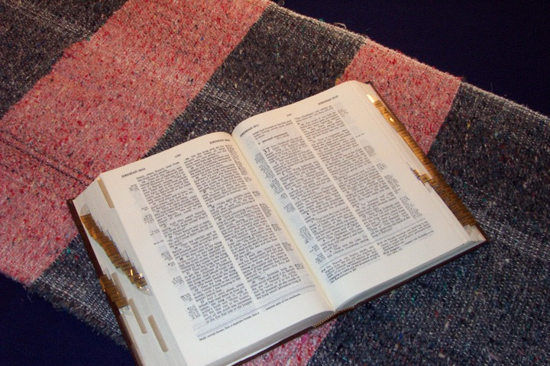
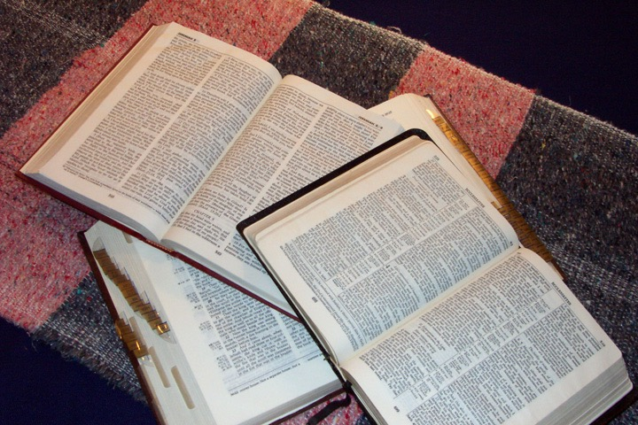
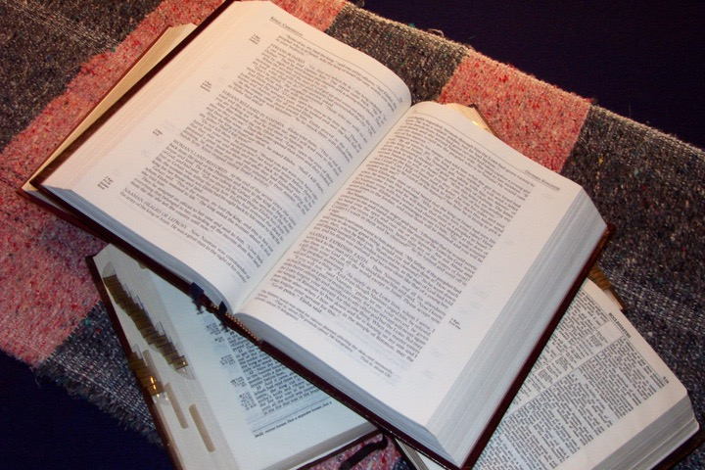
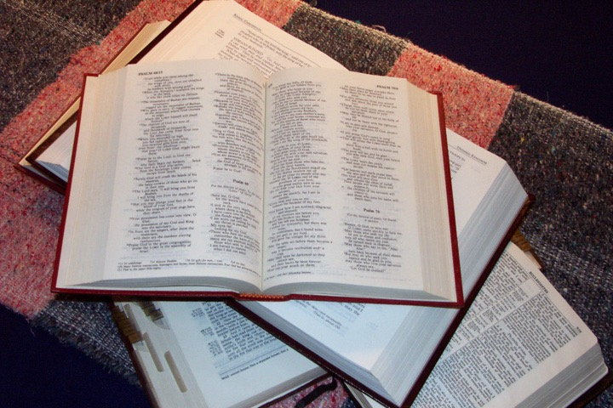
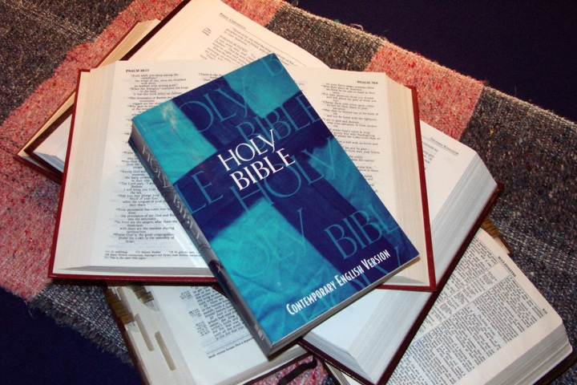
  Bible jeli
  hipaqo julo!
16
Notes:
Just look at all these Bibles! All the versions…all the translations…
the special editions for special groups of Bible readers…ALL AROUND THE WORLD!

Slide 17
Avehu izükeu lakhi!
• Qhetonhe kishekulu
• Agilisüqe aqhe shou
• 750,000 Atsaqo
• 1,200 Akihedo
• 31,000 Azhoqo
• Hesa khamla atsa
pekikde
17
7
Notes:
And that's where the problem begins. For many people…believers included…
//// the Bible is a huge and unruly puzzle.
//// It has thousands of details...
//// hundreds of characters...
//// three/quarters of a million words...many exotic and unfamiliar...
//// 1,200 chapters...
//// 31,000 verses...
//// and those countless versions and translations...in unnumbered languages all across the planet...
Taken together, this situation produces an enormous problem for readers more accustomed to today's quick-in, quick-out approach to reading and to literature and entertainment in our age of high technology.

Slide 18

Khuno kiu mula kea?
Khuno kiu pikea?
Kakuqo
Kiu kea?
Timiqo
Atsalaqo
Kiu kutsukime momu khiu lau kea?
18
7
Notes:
Here are some typical worries...
//// what about all those books...
//// all those people, all 3,000 of them...
//// all the dates...
//// and who said what...
//// why did they do what they did...
//// who did what...
//// and what relates to whom or what?

Slide 19
kuphulo!
Khuno kiu mula kea?
Khono kiu pikea?
Kakuqo
Kiu kea?
Timiqo
Atsalaqo
Kiu kutsukime momu khiu lau kea?
19
Notes:
Here are some typical worries...
//// what about all those books...
//// all those people, all 3,000 of them...
//// all the dates...
//// and who said what...
//// why did they do what they did...
//// who did what...
//// and what relates to whom or what?

Slide 20

Akukuphu!
Niye lunishiamo ke!!!
Tighenguno! Akheu
Pelono shivepeni
20
Notes:
And many of them go one step farther...they say, I JUST CAN'T TAKE IT! SO...I'LL JUST LET THE PASTOR DO IT…Or whoever the Biblical expert in their world might be at the time.

Slide 21
Kiumu
mulomo?
21
Notes:
And then again...WHO CARES?
[Often we end up apathetic]

Slide 22
Kiu
kena?
22
Notes:
And the next question might be...SO WHAT? [But why do we need an overview of Scripture?]

Slide 23
“ Niküpülüye kuchou lo ngomo keloye, kümtsü kichileu shivenani"
Aghungu küxü lo thu u nikeu yezah
23
4
Notes:
One answer comes from a great Christian writer...hear the words of Miles Stanford:
"Unless our faith is established on
//// facts, it is no more than
//// conjecture,
//// superstition and
//// presumption."

Slide 24
Shikalunikeu ghola…
“Ninguno ithi akeu nguno alau pülümo,
Eno ninguno pülü akeu nguno akiqheu lo xümo."
Albert Mohler, President
The Southern Baptist Seminary Louisville, KY
24
3
Notes:
And think about this anchor point of study…
//// Dr. Albert Mohler, president of The Southern Baptist Seminary in Louisville, Kentucky, wrote this…
//// "We will not believe more than we know…
//// …and we will not live higher than our beliefs. The many fronts of Christian compromise in this generation can be directly traced to biblical illiteracy in the pews and the absence of biblical preaching and teaching in our homes and churches…This generation must get deadly serious about the problem of biblical illiteracy, or a frighteningly large number of Christians will go on thinking that Sodom and Gomorrah lived happily ever after."

Slide 25

Tighenguno… Ningu hileno
wuni!
(Ado lakhi mu pevemo.
Kümtsü avehupu!)
25
1
Notes:
Which brings us to the study that lies ahead. We are about to embark on a Biblical voyage named: THE BIBLE…BASICALLY. It's a quick tour through ALL of Scripture, leaving you well equipped to THINK BIBLICALLY and to help others acquire that same skill!
You will have a new set of mental tools that can reshape your view of God's Word and his message for your life and the lives of others around you…both believers and those still searching for life's answers!
So here we go…and try to attend every session or class because each new idea steadily builds on those that have gone before!

Slide 26
Bible no …akükümsü boqa
Ithilu nani
®
!
26
Notes:
TBB is new way of thinking Biblically!
CHANGED FROM THE ORIGINALS (TQC)
Old: We'll first learn THE QUICK CHRONOLOGY of the Biblical story line…that will lead you directly into a new way of thinking Biblically!

Slide 27
Bible…Boqha
®
Bible shika luni keu!
27
Notes:
You'll be learning to mentally manage your Bible!
CHANGED FROM THE ORIGINALS (TQC)

Slide 28


Bible…Boqhaye
®
Akhoto lakhi: Hile nono kütami shika lukepu ani!
P 7 Y J
Alhou shepe shinikeu dokivi!!!
28
1
Notes:
And there's an important subtext going on here also: you will be learning something that you can teach to others!
//// And what an opening for witnessing to others around YOU!
So, here we go…
CHANGED FROM THE ORIGINALS (TQC)

Slide 29
Bible…Boqhaye
®
Khaqhi keu
“Ow Bible pekikithi"
29
Notes:
…with first things first…Let's begin by opening up "Your Bible File."
CHANGED FROM THE ORIGINALS (TQC)

Slide 30
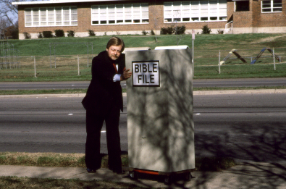
Bible kikithi
30
Notes:
I'd like to introduce you to our friend, Mike. Mike is about to go into church. He's entering the building with a "Bible File" of information already in his head...well…somewhat!

Slide 31
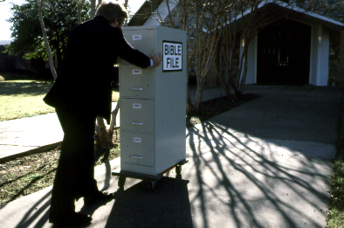
Bible
pekikithi
31
Notes:
There he is…walking up the sidewalk right into church with his mental Bible File...

Slide 32
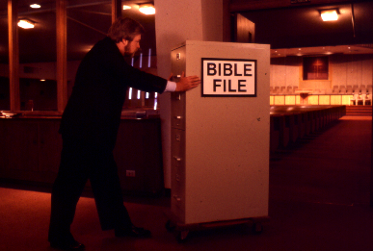
BIBLE
FILE
Bible
pekikithi
32
Notes:
... And Mike goes straight into the building, pushing that File Cabinet in his head right into the sanctuary or worship center.

Slide 33
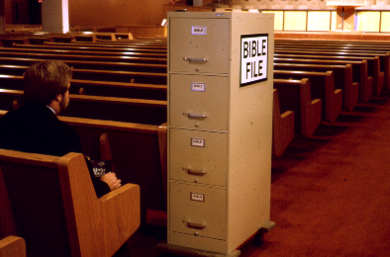
Bible pekikithi
33
Notes:
Mike sits himself down ready for the preacher or the teacher to begin. And Mike is getting ready to open his Biblical file cabinet…

Slide 34
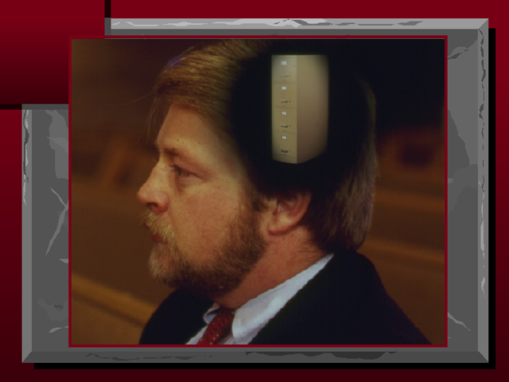
34
Notes:
…up there in his head! …….Well, there he sits... his Bible file all primed to plug into whatever the pastor or teacher is about to say.

Slide 35
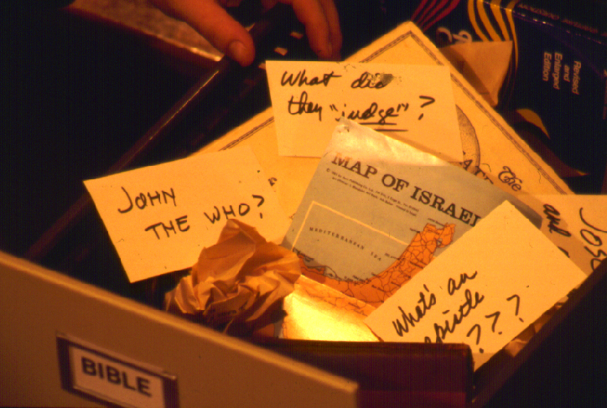
?
Khileno asütsa kuchou eno kumokeu hipaqo shikithe kepu huthulunani kea?
?
?
?
35
5
Notes:
When he opens up his mental Bible File…figuratively speaking of course…it is a mess!
//// John the Who? Baptist? Methodist? Catholic? Maybe Jewish? What's that all about?
//// And what in the world did they judge? Who were those judges anyway? Who elected them in the first place?
//// And ANY map of Israel...now that's a place of Biblical confusion! You mean to tell me, Mike says, that that is the very same place as today's Israel, the one in the newspapers and on TV?
//// And the "Epistles?"....truly, research shows that many people think that an EPISTLE was the wife of an APOSTLE! Yes, some really do think that!
//// So...where do you begin to sort out all that information...and a great deal of MISinformation?

Slide 36
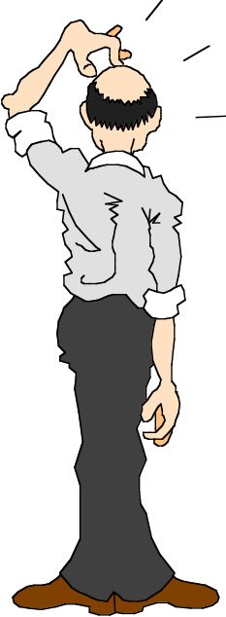
Niye kiu mu ithiamo!
Niye khileno huthu nanikea?
36
Notes:
Most folks will say, "I have absolutely no idea!"
…So..."Where do I begin?"

Slide 37
7
Handbook pg. 8-14
37
Notes:
Let's start with the number 7. But look closely and you'll see that dash through the stem of the 7.

Slide 38
7
7
Handbook pg. 8-14
1
38
Notes:
And that's important! The dashed line will remind you of something. In just a minute you'll divide that number 7 into two others: 4 and 3.
//// Also, as the visuals move along, many of them will have that 7 with a dashed line through its stem up in the right hand corner of each frame….a handy, continuing reminder of the mental tools we are learning to use.

Slide 39
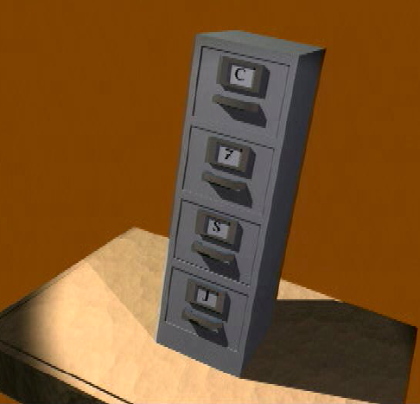
Ow
Bible
7
P
7
Y
J
Handbook pg. 8-14
39
Notes:
Now let's think again about a filing cabinet. This will be YOUR BIBLE FILE! Here is a look ahead to where we are going in this study.

Slide 40
Ow Bible
7
C
7
S
J
Handbook pg. 8-14
40

Slide 41
10 Chighi qo
7
1
2
3
4
5
6
7
7
8
S
9
10
J
Handbook pg. 8-14
41
Notes:
As a starting point, begin thinking about 10 file folders in a filing cabinet.
You are going to organize your own Bible File into a collection of these ten mental file folders.
Very soon you'll be applying labels to each of those 10 file folders. So…now to begin…and…

Slide 42
Ow Bible khaqhi nikeu"
7
P
7
J
7
Y
J
7
P
7
J
7
P
7
Y
J
7
7
Y
Y
Handbook pg. 8-14
4
42
Notes:
We begin right here...with the single number…. 7.
That's our mental anchor point. Simply the number 7 with that all-important dash through the stem.
//// Next step...surround that number with three alphabet letters. Set them firmly in place in your mind:
C 7 S J
Repeat the letter group aloud several times as you embed it in your mind... Because this is the very core of the Bible's organization and time-line flow:
//// "C 7 S J....
//// C 7 S J....
//// C 7 S J...etc."

Slide 43
“Ow Bible khaqhi nikeu"
7
7
= 4+3
Handbook pg. 8-14
2
43
Notes:
Now...about that European style '7'.
//// You'll remember that it has a dash through its stem... That's an important reminder — a mind clue. Keep it mentally handy. That small dash divides the length of the 7's stem into two parts. So, ask yourself the question: "What two numbers does 7 easily split into?"
//// One possible answer…and the right one…is: 4 and 3.

Slide 44
P 4 3 Y J
7
Ou Bible
Khaqhi keu"
P 4 3 Y J
P 4 3 Y J
Handbook pg. 8-14
1
44
Notes:
So, in the C 7 S J formula, by changing the 7 to a 4 and a 3, we have
C 4 3 S J.
As before, repeat that changed sequence aloud several times to help it hold tightly in your mind for easy recall.
//// C 4 3 S J.

Slide 45
5 Atsa boqhaqo:
7
P = Pulhoküsü
4 = Timiqo
3 = Aqo aho
Y = Yenguyi
J = Jisu
Handbook pg. 8-14
5
45
Notes:
Now, based on C 4 3 S J, we enlarge that idea into five key words or phrases. They will become the foundation of your mental Bible File. Here they are…say them aloud…
//// C = CREATION
//// 4 = 4 PEOPLE
//// 3 = 3 SOCIETIES
//// S = SILENCE
//// J = JESUS.
And that's an organizational plan for the entire Bible! Those five words and phrases create an abbreviated outline map of the entire Bible's basic design.

Slide 46
Atsathi akhoto 5:
7
P = Pulhoküsü
4 = Timiqo
3 = Aqo aho
Y = Yengui
J = Jisu
Handbook pg. 8-14
6
46
Notes:
Once again...aloud…
//// C = CREATION
//// 4 = 4 PEOPLE
//// 3 = 3 SOCIETIES
//// S = SILENCE
//// J = JESUS.
We will now go back through the phrases, expanding them still farther.
//// CREATION,
of course, remains at the top of the list naturally…because the Bible story itself begins right there.

Slide 47
Atsathi akhoto 5:
7
P = Pulhoküsü
4 = Timiqo
3 = Aqo aho
S = Yenguyi
J = Jisu
Handbook pg. 8-14
47
Notes:
We then take the next phrase from the list:
4 PEOPLE.

Slide 48
Timi 4 qo:
7
ABRAHAM
JOSEPH
MOSES
JOSHUA
Handbook pg. 8-14
5
48
Notes:
Let's break apart "4 PEOPLE" into 4 specific people, in this order:
//// ABRAHAM
//// JOSEPH
//// MOSES
//// JOSHUA
It's helpful to remember the word order by repeating several times the first-letter order of the words:
//// "A-J-M-J ... A-J-M-J ... etc."

Slide 49
7
Atsa
Küküghami ye Kügha masa!
Handbook pg. 8-14
49
Notes:
How can you remember the order of those letters and the names?
This simple sentence..."A JUDGE MUST JUDGE." The first letters of each word: AJMJ and then you have it.

Slide 50
Timi 4 qo:
7
A BRAHAM
A
J OSEPH
Atsa Küküghami
M OSES
ye
J OSHUA
Kügha masa
Handbook pg. 8-14
8
50
Notes:
Just remember to repeat the four names aloud to yourself several times until you feel the rhythm of the words:
//// "ABRAHAM,
//// JOSEPH,
//// MOSES and
//// JOSHUA."
And here again is that mental tool…
//// A
//// JUDGE
//// MUST
//// JUDGE.

Slide 51
7
PULHOKUSU
ABRAHAM
JOSEPH
MOSES
JOSHUA
Handbook pg. 8-14
5
51
Notes:
So, from the top of the list we now can say:
//// CREATION
//// ABRAHAM
//// JOSEPH
//// MOSES
//// JOSHUA
This step completes the main FOUR PEOPLE of your new Bible File. Of course, there are dozens of other Biblical characters, but these are the only ones we are using to build the Bible File right now. Repeat the four names aloud several times until they are firmly set mentally.

Slide 52
Atsathi akhoto 5:
7
P = Pulhoküsü
4 = Timiqo
3 = Aqo aho
Y = Yenguyi
J = JISU
Handbook pg. 8-14
52
Notes:
The next phrase of that beginning list is:
3 SOCIETIES.

Slide 53
A R C
7
Handbook pg. 8-14
2
53
Notes:
Another memory tool now…what do you call
//// that red section of the perimeter of a circle?
//// It's called an "arc," spelled A-R-C. Those letters, then, remind you of the first letters of 3 KINDS OF SOCIETIES.

Slide 54
3 Aqo aho qo:
7
Yepeka
Kukami Kuxu
Akughu
Handbook pg. 8-14
6
54
Notes:
The three societies are…
//// ANARCHY
//// ROYALTY
//// CAPTIVITY.
As before, please repeat that word order several times.
ANARCHY, ROYALTY, CAPTIVITY...
ANARCHY, ROYALTY, CAPTIVITY.
And the mental tool here:
//// A
//// R
//// C.

Slide 55
OT Review
7
Pulhoküsü
ABRAHAM
JOSEPH
MOSES
JOSHUA
Yepeka
Kukami Kuxu
Akughu
Handbook pg. 8-14
55
Notes:
Now we add the 3 SOCIETIES group to the others, and we have:
CREATION
ABRAHAM
JOSEPH
MOSES
JOSHUA
ANARCHY
ROYALTY
CAPTIVITY

Slide 56
To Review…
7
7
Jukithe keu...
P 7 YJ
P 4 3 Y J
Handbook pg. 8-14
3
56
Notes:
To review the entire sequence so far…
Beginning with the single number
//// 7....
leading to…
//// C 7 S J...
which becomes...
//// C 4 3 S J.
These numbers and letters are then used to develop a mental list of TEN WORDS that will form a dependable mental outline of the entirety of Scripture.

Slide 57
The Basics
7
Pulhoküsü
4 Timiqo
3 Aqo ahoqo
Yengui
JISU
Handbook pg. 8-14
57
Notes:
C 4 3 S J is then expanded into:
CREATION
4 PEOPLE
3 SOCIETIES
SILENCE
JESUS.

Slide 58
The Last Two Folders
7
Pulhoküsü
ABRAHAM
JOSEPH
MOSES
JOSHUA
Yepeka
Kukami kudu
Akughu
Yenguyi
JISU
Handbook pg. 8-14
2
58
Notes:
Then further expanded into:
CREATION
ABRAHAM
JOSEPH
MOSES
JOSHUA
ANARCHY
ROYALTY
CAPTIVITY.
Finally, now, we add: //// SILENCEand//// JESUS.

Slide 59
Ow Akithe Kükümsü “Bible Kikithi”
PULHOKUSU
PULHOSU
ABRAHAM
ABRAHAM
ABRAHAM
ABRAHAM
JOSEPH
ABRAHAM
MOSES
JOSEPH
JOSHUA
YEPEKA
MOSES
KUKAMI KUXU
AKUGHU
JOSHUA
YENGUYI
JISU
YEPEKA
KUKAMI KUXU
AKUGHU
YENGUYI
JISU
Handbook pg. 8-14
59
11
Notes:
Now it's time mentally to apply those ten words as labels to ten mental folders in your new Bible File –
//// right up there in your head. That mental picture might look something like this. And there they are...
//// CREATION//// ABRAHAM//// JOSEPH//// MOSES//// JOSHUA//// ANARCHY//// ROYALTY//// CAPTIVITY//// SILENCE…and…//// JESUS.
Now it's organized in a neat and orderly package in your mind --- ready for recall and use as you need it. Now just a few more
examples to drive home the point...

Slide 60
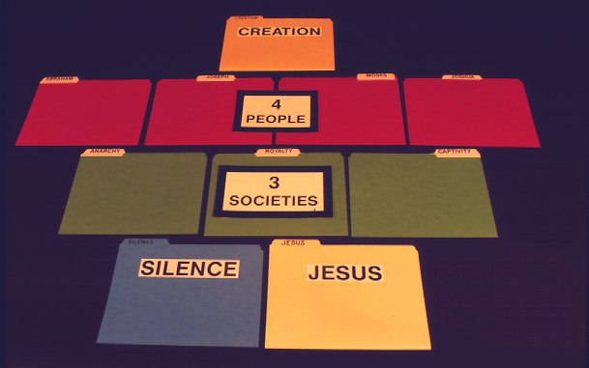
7
PULHOKUSU
Manuel pg. 8-14
60

Slide 61
7
PULHOKUSU
4
Timiqo
Manuel pg. 8-14
61

Slide 62
7
PULHOKUSU
4
Timiqo
3
Aqo aho
Manuel pg. 8-14
62

Slide 63
7
PULHOKUSU
4
Timiqo
3
Aqo aho
YENGUYI
JISU
Manuel pg. 8-14
63

Slide 64
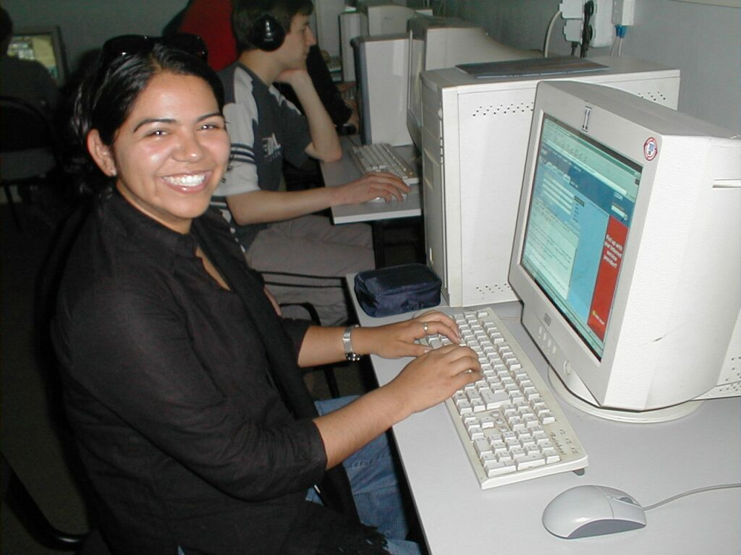
7
Ayeghiqa kiliva!
Handbook pg. 8-14
64
Notes:
Here is yet another way to think of your Bible File. Like many of us, this young woman spends hours every day at her computer.

Slide 65




7
PULHOKUSU
ABRAHAM
ABRAHAM
ABRAHAM
JOSEPH
ABRAHAM
MOSES
JOSHUA
Mishika kuha
Akuka
Akughumi
Inaqhoi
JISU
65
Notes:
So...instead of thinking just of file folders as heavy folded paper, think about them as computer files on a floppy disk or on a computer hard drive.

Slide 66
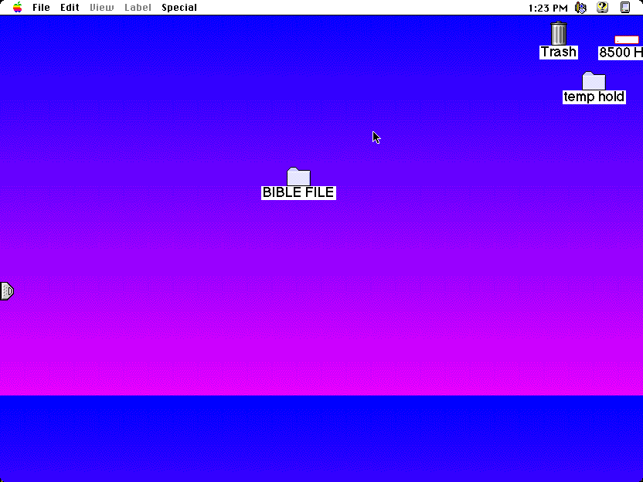
Bible
66
Notes:
Imagine this as the main screen of your own computer monitor – with a data folder you created named, naturally, Bible File. Double click on that imaginary folder….

Slide 67
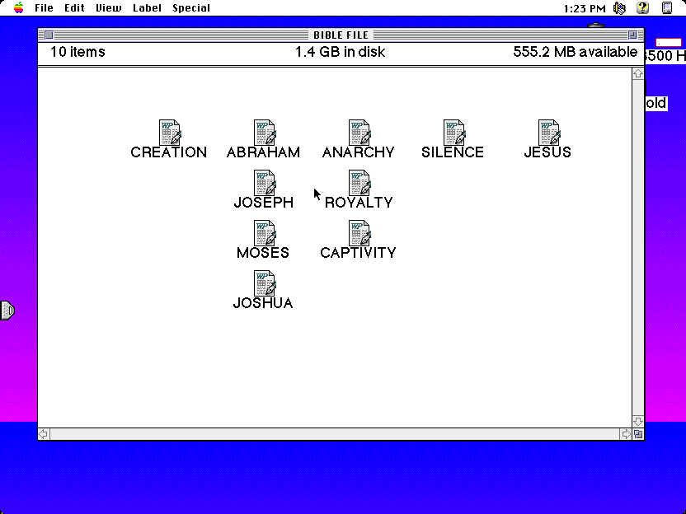
C 7 S J
C
PULHOKUSU
ABRAHAM
YEPEKA kuha
Yenguyi
JISU
4
Timiqo
JOSEPH
KUKAMI KUXU
3
Aqo aho
MOSES
Akughu
JOSEPH
68
Notes:
And, with some computer graphics, you might even add the basic building plan over those folders. The now a familiar mental tool... C 7 S J And its 4 PEOPLE and 3 SOCIETIES.

Slide 68
C
Pulhokusu
ABRAHAM
Yepeka kuha
Yenguyi
JISU
JOSEPH
Kukami Kuxu
MOSES
Akughu
JOSHUA
67
10
Notes:
…and you would get this...the ten sub-files, all as folders, named, in
order…and say them along with me…
//// CREATION
//// ABRAHAM
//// JOSEPH
//// MOSES
//// JOSHUA
//// ANARCHY
//// ROYALTY
//// CAPTIVITY
//// SILENCE
//// JESUS.

Slide 69
Ow akükümsü Bible!
PULHOKUSU
ABRAHAM
JOSEPH
STURDY
MOSES
JOSHUA
YEPEKA
COMPREHENSIVE
KUKAMI KUXU
AKUGHU
YENGUYI
JISU
COHERENT
69
4
Notes:
So there you have the basic building blocks of a complete biblical filing system…in your head…the basic building plan of the Bible…how THE BASIC DOCUMENT OF THE FAITH is organized.
//// It's your personal Mental Bible File!
From this point on, we will construct a
//// sturdy,
//// comprehensive,
//// and coherent mental map of God's Word…each step of its progress built on this reliable basic mental mapping idea.

Slide 70
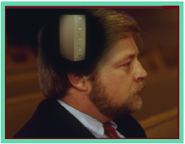
Itehiye noye Bible ghili kumsu aghinani…
•Bible khaqhinikeu kukumsu"…
C 7 S J
1. Kiushivekea !
Inijukeu küthü Khochilelo
2. Kiu shiye shive kea !
3. Bible no oküxü shikithe keu
70
4
Notes:
O.K. Now we're on our way. By this time…you have that idea called THE BIBLE FILE…and the mental key to open it…C 7 S J. The way is clear now for building a new and organized approach to thinking about your entire Bible, everything in its place.
//// We'll be able to answer three fundamental questions:
//// WHAT happened…
//// WHY it happened…and finally…
//// HOW the WHAT and the WHY influence the shape and content of Scripture…the organization of the book itself.

Slide 71
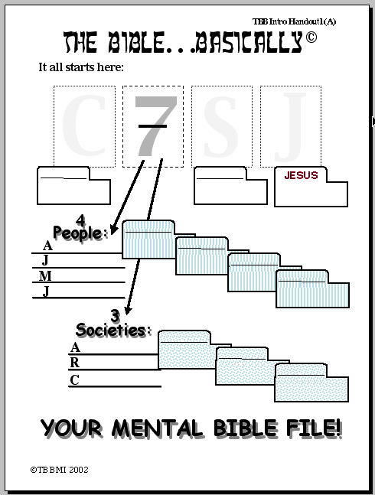
Bible boqha
It all starts here:
P
7
Y
J
Pulhosu
Yenguyi
Jesus
4 Timiqo:
{
ABRAHAM
BRAHAM
JOSEPH
A
OSEPH
MOSES
J
OSES
JOSHUA
M
OSHUA
J
{
3 Aqo Aho
Shika kukuphu #01
Yepka
Yepeka
kuha
A
Kukami kuxu
Kukami kuxu
R
Akughu
C
Akughu
Bible kükümsü!
©2006 TBBMI
9.65.01.
71
20
Notes:
Now look at Study Help Number One in the student handbook. That sheet will help you to embed in your thinking how to keep these tools on the front of your mind…while also learning how to teach others.
//// Beginning with a large C…
//// for CREATION then…
//// the Number 7…the dashed line is already there…7 standing for the four people and then the three societies. So…first…the FOUR
PEOPLE…
//// who are ABRAHAM…
//// then added to his File Folder…
//// JOSEPH…
//// onto the JOSEPH folder
//// MOSES…
//// his Folder…and finally…
//// JOSHUA…
//// finishing out the FOUR GREAT PEOPLE and their file Folders in the Bible File. Then on to the THREE SOCIETIES…
//// beginning with ANARCHY…
//// and its folder…
//// ROYALTY…
//// and the folder…
//// finishing with CAPTIVITY…
//// and its folder.
Now we'll finish it out…
//// S for
//// SILENCE…and
//// the culmination of all our thinking…J for JESUS.

Slide 72
02
Bible boqha
Bible khaqhinikeu ghola
P 7 Y J
"P" Puthugho:
Pulhokusu
7 = 4+3 hephope:
4 timiqo& 3 aqo aho
Timi bidi qo:
ABRAHAM JOSEPH MOSES
JOSHUA
Aqo aho kuthu:
Yepeka
Kukami kuxu
Akughu
PULHOKUSU
ABRAHAM
"P" Puthugho:
JESUS
Yenguyi
JOSEPH
"J" :
...
JISU
MOSES
Tighenguno atsathi chighi lo puthughoani
JOSHUA
YEPEKA
KUKAMI KUXU
AKUGHU
YENGUYI
JISU
©2006 TBBMI
9.65.01.
72
9
Notes:
And here is STUDY HELP NUMBER 2….this is the one you can use for your own review-- or to hold in your hand while you teach THE BIBLE FILE idea to others.
//// First the key to open the file:
//// C 7 S J…
//// The letter C stands for CREATION.
//// 7 equals 4 plus 3…for the four people and the three societies.
//// FOUR PEOPLE…ABRAHAM, JOSEPH, MOSES, JOSHUA.
//// THREE SOCIETIES…ANARCHY, ROYALTY, CAPTIVITY.
//// The letter S standing for SILENCE
//// The letter J representing JESUS.
//// FINALLY the TEN WORDS. And there are your ten file folders in your new Bible File. Repeat them one last time:
CREATION, ABRAHAM, JOSEPH, MOSES, JOSHUA, ANARCHY, ROYALTY, CAPTIVITY, SILENCE, and JESUS.

Slide 73
7
73
Notes:
And it all begins right here...the number 7 with that now familiar dash through its stem. Now you know the value of that simple mental tool. It is truly A GATEWAY IDEA!

Slide 74
Bible…Boqha
®
Khaqhinikeu ghola
“Ow Bible Kikithi"
74
Notes:
Now it's time to move forward toward expanding this "key to opening up Your Bible File" -- for what we will call THE QUICK CHRONOLOGY. Through the next hours of THE BIBLE… BASICALLY training, here is what you'll learn…

Slide 75
Noye itehiye ithiva… Noye hile no khilau wunikea
•Alokeu kivi “Bible "
•Akukumsu “Bible "…C 7 S J
•Akukumsu zhulho Kuchoyesu nlo ahkoto qo
•Kuchoyesu “kughakiche" akimichi: “Itheno kughaphelu"
•Abrahamic boqha kivi lono Jisu kumla kughutha kuphulu
• Bible ghiliye “Kughakiche vecheo ke"
•Aqau eno akitheu Bible lo atsathi.
 
75
8
Notes:
//// We've introduced the THE BIBLE FILE idea and…
//// The mental key to open that file…Then…
//// You'll learn to make a mental map of the Ancient Near East…that's next.
//// Then the so-called STORY CORE of Scripture, titled THE QUICK CHRONOLOGY…That's the WHAT HAPPENED question to be answered.
//// Then we'll explore the ABRAHAMIC FOUNDATIONS of the Great Plan…the WHY of Scripture…
//// leading to an understanding of the Bible's basic architectural layout…
//// ending with a brief look at the Old and New Testament Books and their general themes or ideas behind them.
//// And through it all, it will become obvious– from start to finish – that SOMETHING IS HAPPENING HERE; GREAT EVENTS ARE TRANSPIRING. God was busy at work then and continues right up to this present moment!
Now it's time to move on into a very valuable experience!
you'll learn to make your own map of the Ancient Near East…AND RIGHT OUT OF YOUR OWN HEAD!

Slide 76
VERSION 9.65
Bible… Aboqha
Designed by Dr. John Fryman, Texas, USA • BibleBasically.org
Taught by Dr. Rick Griffith, Singapore Bible College
All files in many languages for free download at BibleStudyDownloads.org
©2004 TBBMI
9.65.01.
01

Slide 77
77
©2006 TBBMI
9.65.01.

Slide 78
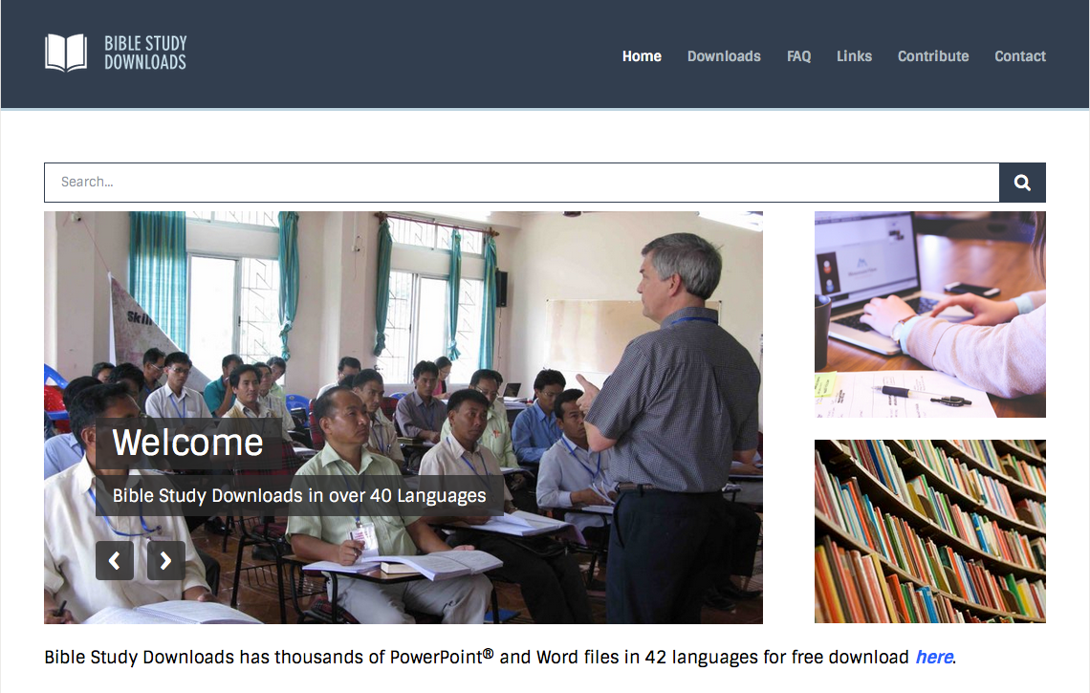

Kuchouyesu… Aboqha • BibleStudyDownloads.org
Hipau kümsa lono pesü küsaje lo!
Notes:
The Bible…Basically (bb)

