Slide 1
Broken & Spilled Out
Performed By Steve Green
Tff]l8Psf] / kf]lvPsf]
:6Le lu|gsf] k|:t''tL

Slide 2
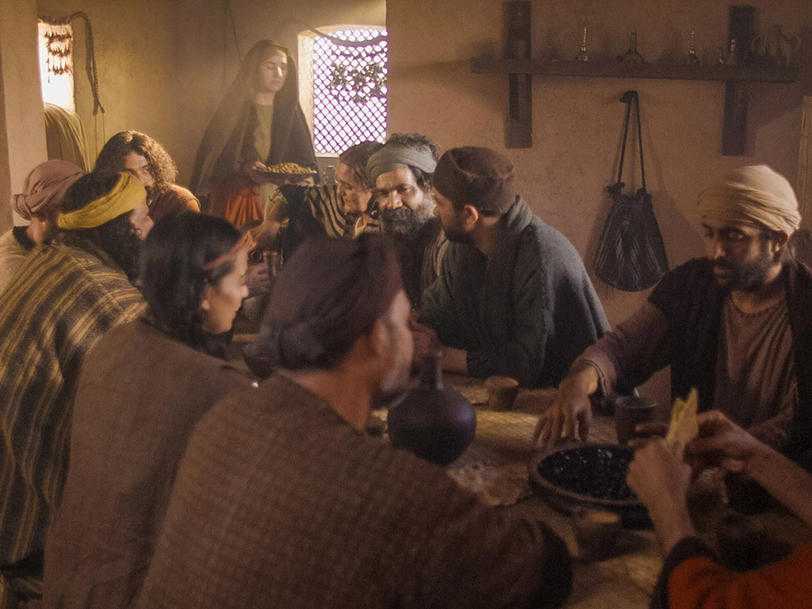
Notes:
Music background 1 of 2

Slide 3
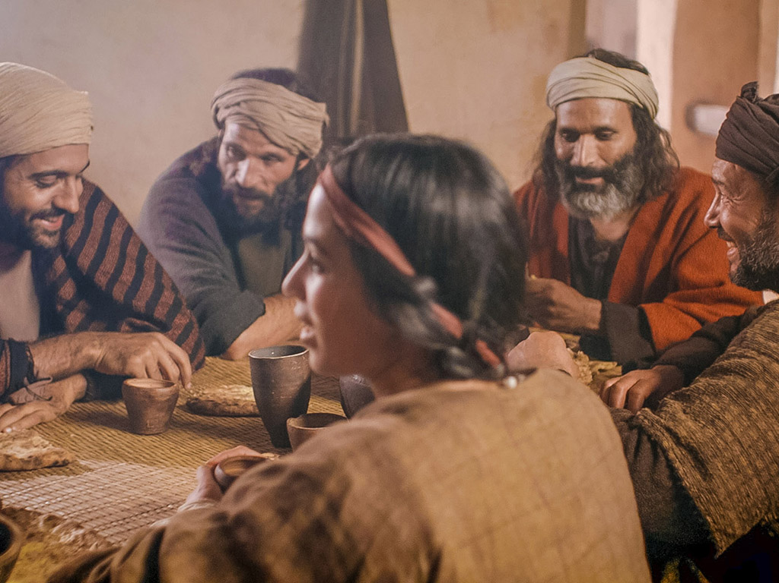
Notes:
Music background 1 of 2

Slide 4
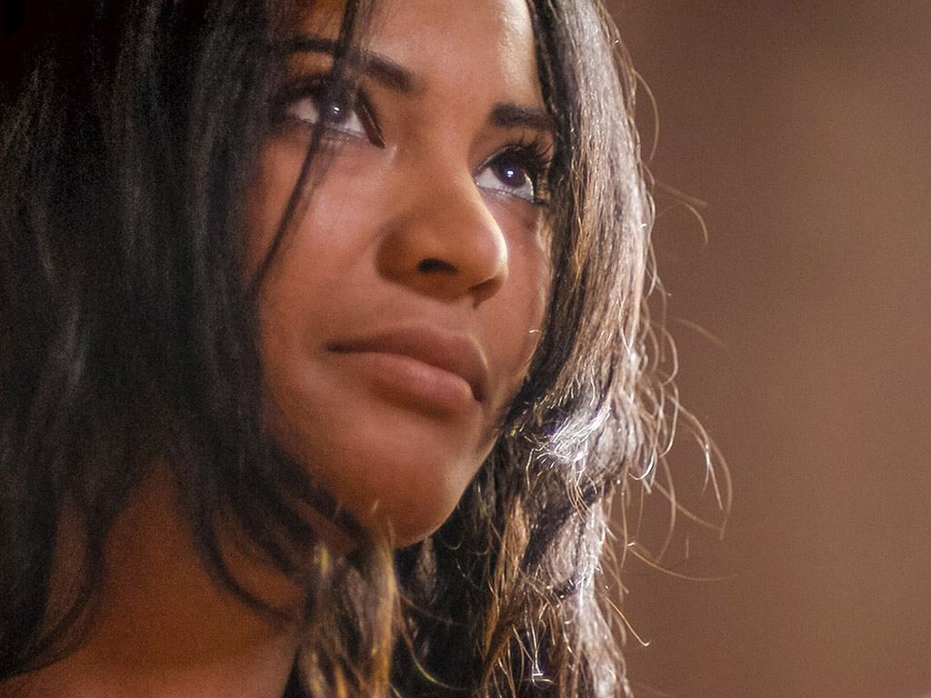
One day a plain village woman, driven by love for her Lord
Pslbg Pp6L ;fwf/0f dlxnf
k/d]Zj/sf] lglDt pgsf] k|]dsf] sf/0f

Slide 5
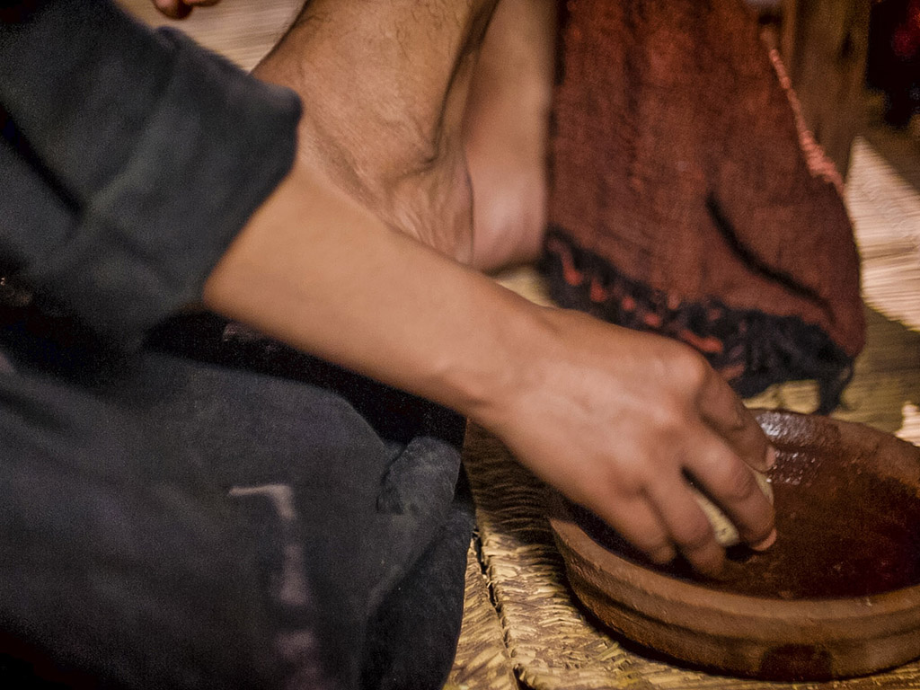
Recklessly poured out a valuable essence, disregarding the scorn
c?af6sf] ckx]ngfnfO{ a]jf:tf ul/
Psbd} d"Nojfg cQ/, pxfFdfly vGofOlbOg\

Slide 6
And once it was broken and spilled out A fragrance filled all the room.
km]l/ PskN6 cQ/ kf]lvof]
o;sf] ;'uGwn] ;Dk"0f{ sf]7f el/of]

Slide 7
Like a prisoner released from his shackles Like a spirit set free from the tomb
s}bL cfˆgf] aGwgaf6 d'Qm eP em}+
lrxfgaf6 cfTdf d'Qm eP em}+

Slide 8
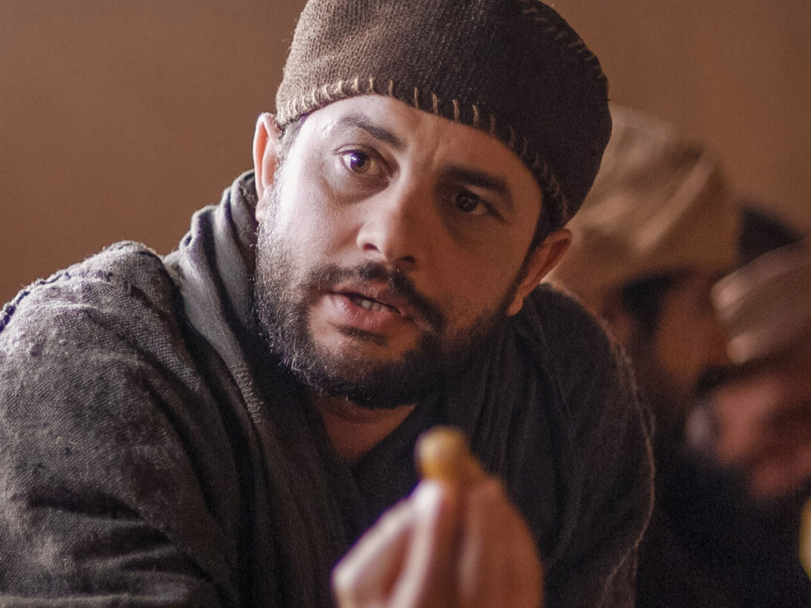
Broken and spilled out, just for love of you, Jesus
tf]l8Psf] / kf]lvPsf]
tkfO{sf] lglDt d]/f] k|]dsf] sf/0f, o]z"

Slide 9
Life's most precious treasure, lavished on Thee
d]/f] Psbd} d"Nojfg wg
;a} d tkfO{nfO{ lbGb5'

Slide 10
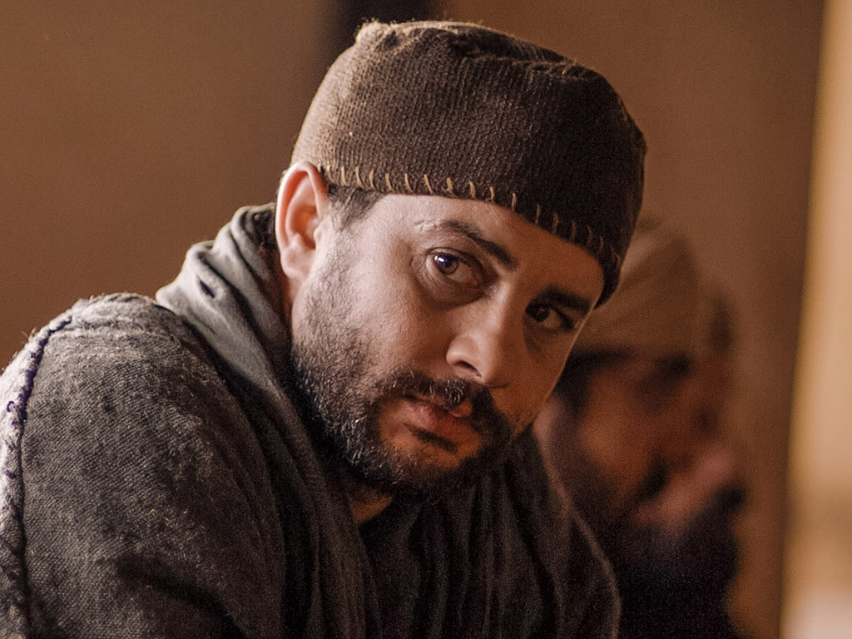
Broken and spilled out, and poured at Your feet
Tf]l8Psf] / kf]lvPsf]
d tkfO{sf] kfpFdf vGofpF5'

Slide 11
In sweet abandon let me be spilled out and used up for Thee
Pp6f ld7f] ;dk{0ftfdf
dnfO{ kf]lvg lbg'xf];\
/ tkfO{sf] lglDt k|of]u x'g lbg'xf];\ .

Slide 12
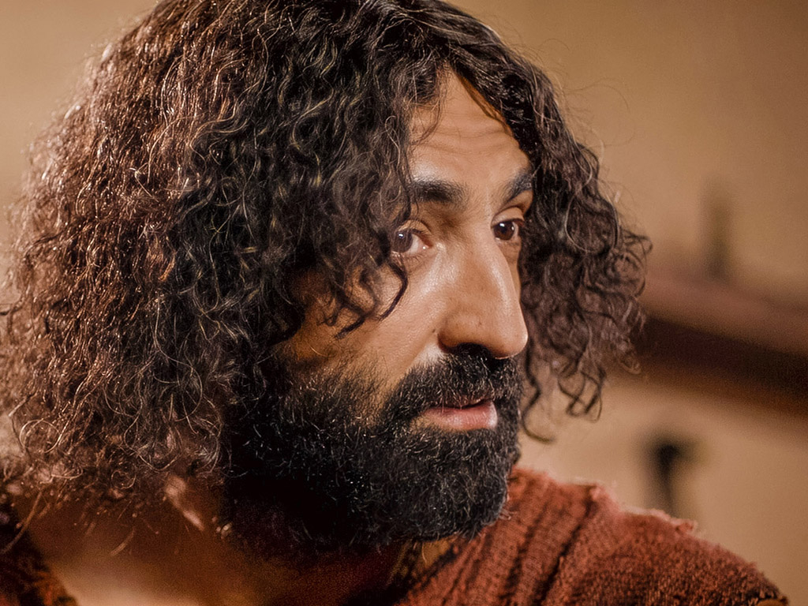
Lord, You were God's precious treasure, His loved and His own perfect Son
o]z", tkfO{ k/d]Zj/sf] d"Nojfg\ wg
pxfFsf] k|]d / pxfFsf] cfˆgf] l;4 5f]/f]

Slide 13
Sent here to show me the love of the Father, just for love it was done
dnfO{ b]vfpg oxfF k7fpFg'xf];\
Pp6f lktfsf] k|]d
sf/0f pxfFn] dnfO{ k|]d ug{'x'G5

Slide 14
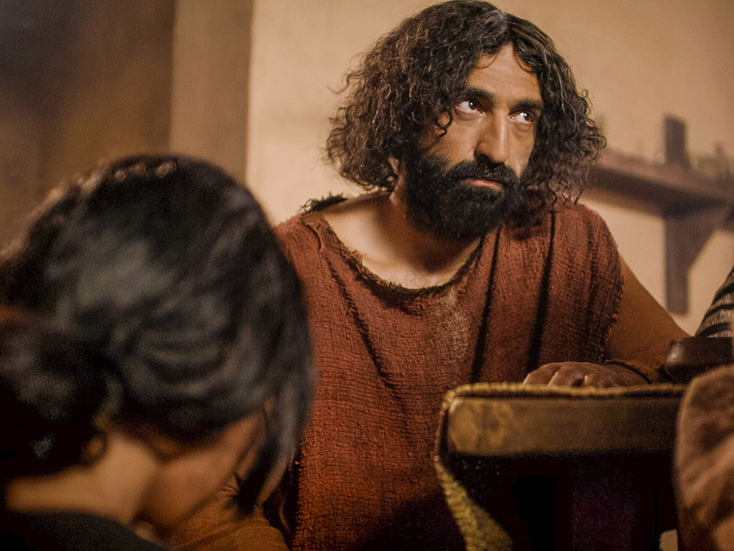
And though You were perfect and holy You gave up Yourself willingly
tkfO{ l;4 / kljq x'g'ePtfklg
tkfO{n] cfkm}nfO{ cfˆgf] OR5f;lxt lbg'eof

Slide 15
You spared no expense for my pardon You were used up and wasted for me
tkfO{n] ;a}s'/f TofUg'eof] tfls d}n] Ifdf kfpm
tkfO{ d]/f] sf/0f k|of]u ul/g'eof] / lslrg'eof]

Slide 16
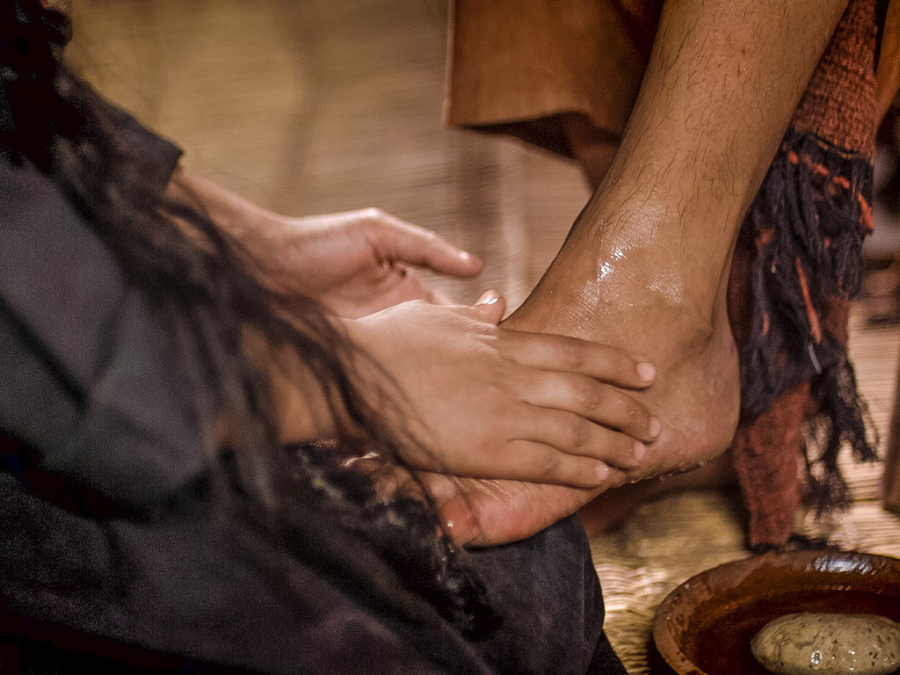
Broken and spilled out Just for love of me, Jesus––
o]z", tkfO{ tf]l8g'ePsf] lyof] / kf]lvg'eof]
dk|ltsf] tkfO{sf] k]|dsf] sf/0f

Slide 17
God's most precious treasure lavished on me
k/d]Zj/sf] ;a}eGbf d"Nojfg wg
d]/f] lglDt ;a} lbOof]

Slide 18
Broken and spilled out and poured at my feet.
tkfO{ tf]l8g'ePsf] lyof] / kf]lvg'eof]
/ d]/f] kfpFdf vGofOg'eof]

Slide 19
In sweet abandon, Lord, You were spilled out and used up for me
Pp6f ld7f ;dk{0ftfdf
k|e', tkfO{ d]/f] sf/0f kf]lvg'eof] / lslrg'eof] .

Slide 20
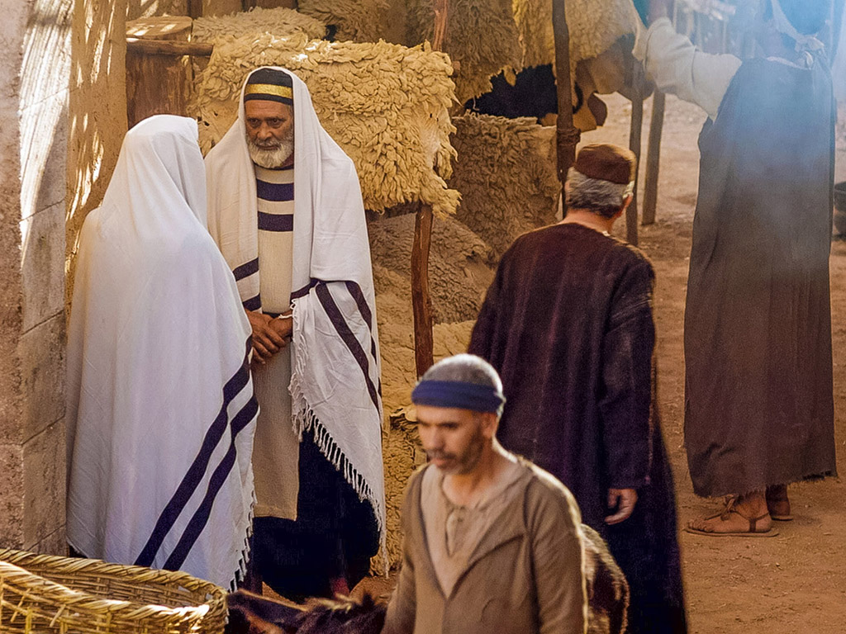
In sweet abandon, let me be spilled out and used up for Thee
Pp6f ld7f] ;dk{0ftfdf
dnfO{ kf]lvg /
tkfO{sf] lglDt k|of]u x'g lbg'xf];\ .

