Slide 1
afOan cfwf/e[\t ;]jfsfO{sf] k|:t[\lt • kmf]y{ jf]y{, 6f/;;\

Slide 2
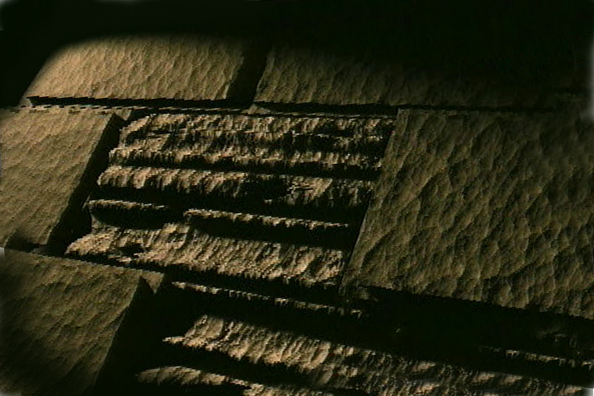
afOan===
cfwf/e[\t
©2006 TBBMI
A Presentation of The Bible…Basically Ministries International Inc. Fort Worth, Texas
www.biblebasically.com
01
©2004 TBBMI
8.0.02.

Slide 3
w]/} glhssf] ldtL:
ca|fxfd - o]z[\km @))) B.C.
df]zf - oxf]z !%)) B.C.
01
Notes:
Time-line Date: a change…now about 1500 B.C. We have now moved about 500 years closer in our own historic time. Remember: the dates are heavily rounded!

Slide 4
पृष्ठ
&
प्रस्थान @:!)
pTktL
ABRAHAM
ca|fxfd
“Ps
Gofstf{n]
Gofof
ug[\{ k5{ ”
ABRAHAM
o]z[\km
ABRAHAM
df]zf
oxf]z[\
c/fhstf
co]df]o
/fhkl/jf/
bf;Tj
z[\Gg]tf
o]z[\
पुस्तिका पृष्ठ !(-@$
02
1

Slide 5
&
प्रस्थान *:!
df]zf
ca. !%)) B.C.
मेरा मानिसहरूलाई जान देऊ !
"$ dflg;x?"
dWo t];|f]
rflx+ :
co]df]o
df]zf
40
पुस्तिका पृष्ठ @^-@(
03
1
Notes:
MOSES' file folder appears...as the third in the group of four great people...with a number of items to be added his file folder.
After centuries of Israelite bondage, MOSES moves to center "stage of the action." Repeatedly he approaches the Pharaoh to…
//// "…LET MY PEOPLE GO." And only after MOSES calls down on Egypt a series of devastating plagues does the Pharaoh finally release the Israelites.

Slide 6
&
प्रस्थान !@:#!
df]zf
ca. !%)) B.C.
प्रस्थान !
प्रस्थान
"$ dflg;x?"
dWo t];|f]
rflx+ :
co]df]o
df]zf
प्रस्थान
40
पुस्तिका पृष्ठ @^-@(
04
1
Notes:
Under MOSES' direction those masses of Israelite slaves and their families are permitted to leave Egypt…perhaps as many as two million people according to many scholars and teachers. And that's called the well-known EXODUS.
//// And that's the first item on the Moses file folder

Slide 7
d+rnfO
l;+3f/g[\
प्रस्थान !@:#!; !(:@
e[\ ;
lg(c)
x
Uff ;
s
O gbL
lg k
a
o]
प्रस्थान !
df]zf
d[ ;
प्रस्थान
O{
p
40
sf af
40
l; k
Kff 3f
Nff ;
पुस्तिका पृष्ठ @^-@(
05
Notes:
That line tracing ancient travel on your map now turns east and then south toward the traditional site of Mount Sinai (सीनै पर्वतमा)…right there between the fat rabbit ears on your hand-made map.

Slide 8
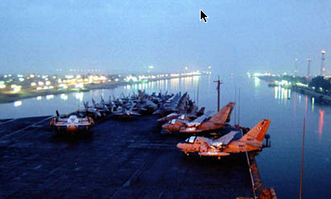
d+rnfO
l;+3f/g[\
प्रस्थान !#:!*
e[\ ;
lg(c)
x
Uff ;
s
O gbL
lg k
a
o]
cfhsf] ;'Oh Sofgn ofqf ubf
df]zf
d[ ;
प्रस्थान
O{
gs{6sf] ;d'b:
"ofd ;'k"
sf af
p
40
40
l; k
Kff 3f
Nff ;
पुस्तिका पृष्ठ @^-@(
05
Notes:
That line tracing ancient travel on your map now turns east and then south toward the traditional site of Mount Sinai (सीनै पर्वतमा)…right there between the fat rabbit ears on your hand-made map.

Slide 9
&
प्रस्थान !(
df]zf
ca. !%)) B.C.
प्रस्थान
सीनै
co]df]o
df]zf
प्रस्थान
सीनै
40
पुस्तिका पृष्ठ @^-@(
07
1
Notes:
Safely on the other side, MOSES makes that right-hand turn toward SINAI…leading the Children of Israel southward.
//// Eventually they arrive at MOUNT SINAI, deep in the Sinai Peninsula...there between the rabbit's ears.

Slide 10
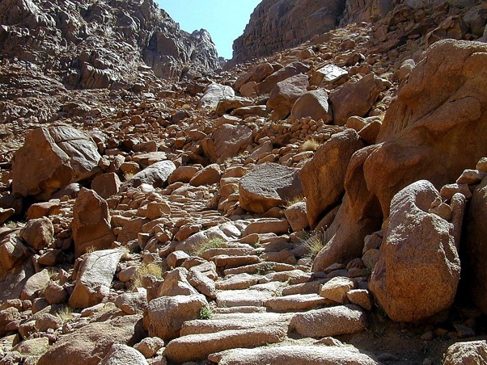
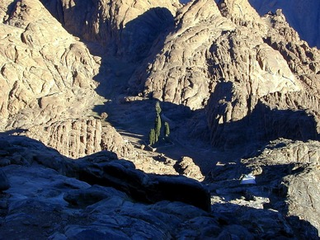
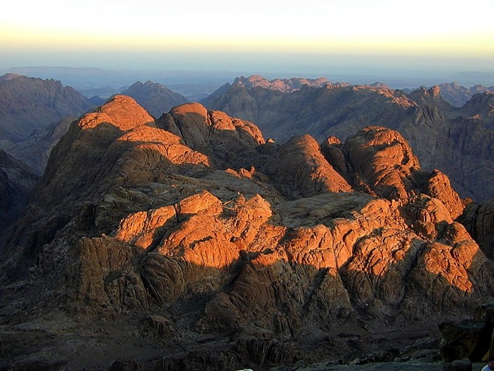
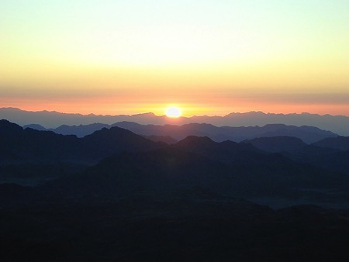
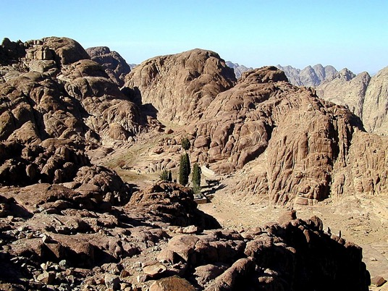
प्रस्थान !(:@
df]zf
प्रस्थान
सीनै
40
40
सीनै पर्वतमा: Joj:yf lbgsf] nflu k/Dk/fut If]q
पुस्तिका पृष्ठ @^-@(
08
Notes:
This is the traditional site of Mt. Sinai, near today's Monastery of St. Catherine. Regularly modern pilgrims climb to the top of the mountain to watch the Egyptian sunrise. Note the extreme desolation and austere beauty!
Here God spoke to the people through his first prophet, MOSES. Here he gave to them The Law, the Torah, as it's known in Hebrew.

Slide 11
&
प्रस्थान @) – #!
df]zf
ca. !%)) B.C.
प्रस्थान
सीनै
co]df]o
g} - g - cf}
df]zf
प्रस्थान
g} - g - cf}
g}lts
40
gful/s
cf}krfl/s
पुस्तिका पृष्ठ @^-@(
09
3
Notes:
Here God…Yahweh…issues His Law to MOSES in three sections: M…. C…. C
//// the Moral,
//// the Civil
//// and the Ceremonial….
…the three parts of the Law delivered directly to Moses from the hand of God at the top of Mt. Sinai…TWICE!
Remember that order with these letters on the MOSES folder: M-C-C.

Slide 12
&
प्रस्थान @) – #!
Joj:yf -tf]/fx_
O{Zjl/o lzIff tLg efudf :
df]zf
प्रस्थान
सीनै
g} - g - cf}
40
पुस्तिका पृष्ठ @^-@(
10
Notes:
Known in Hebrew as THE TORAH, the Lord's great gift to the Israelites is a godly education in three parts.

Slide 13
&
प्रस्थान @) – !&
Joj:yf -tf]/fx_
O{Zjl/o lzIff tLg efudf :
g}lts: दश आज्ञाहरू ; xfd|f] xfnsf] sfg"gL k4ltsf] nflu cfwf/ .
df]zf
प्रस्थान
सीनै
g} - g - cf}
40
पुस्तिका पृष्ठ @^-@(
11
Notes:
The MORAL part of the Law we know as the Ten Commandments.
Much of our present legal system is based on that great document.

Slide 14
&
प्रस्थान @! – @$
Joj:yf -tf]/fx_
O{Zjl/o lzIff tLg efudf :
g}lts: दश आज्ञाहरू ; xfd|f] xfnsf] sfg"gL k4ltsf] nflu cfwf/ .
gful/s: gofF ;fdflhs 9fFrfdf dflg;x¿ Ps csf{df s;/L lhpg' kb{5 .
df]zf
प्रस्थान
सीनै
g} - g - cf}
40
पुस्तिका पृष्ठ @^-@(
12
Notes:
The CIVIL part of the Law spells out – by divine regulation -- how the people are to live with each other both in the future desert wanderings and later when they arrive in the Promised Land requiring a more complicated life-style. At this point, the Israelites don't know that the 40 years of wilderness wandering lie ahead of them. God is preparing them for that time with a set of civil rules that will insure their survival across the difficult years to come.

Slide 15
&
प्रस्थान @% – #!
Joj:yf -tf]/fx_
O{Zjl/o lzIff tLg efudf :
g}lts: दश आज्ञाहरू ; xfd|f] xfnsf] sfg"gL k4ltsf] nflu cfwf/ .
gful/s: gofF ;fdflhs 9fFrfdf dflg;x¿ Ps csf{df s;/L lhpg' kb{5 .
cf}krfl/s: gofF ;fdflhs 9fFrfdf s;/L k/d]Zj/nfO{ cf/fwgf ug{ ;lsG5 .
df]zf
प्रस्थान
सीनै
g} - g - cf}
40
पुस्तिका पृष्ठ @^-@(
13
Notes:
In the CEREMONIAL part of the Law God instructs His people how to go about worshiping him in the new desert Tabernacle and later in the great Temple to be built in Jerusalem. The complex rituals required in the new form of worship also prefigure future relationships between men and the coming Messiah. We'll find out much more about The Law as this study moves forward.

Slide 16
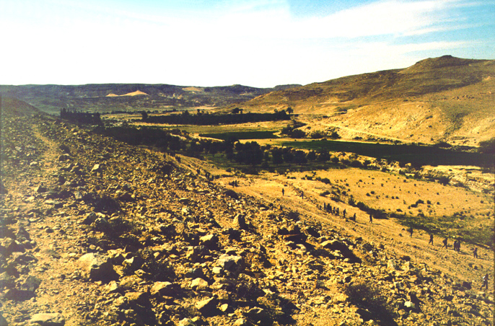
d+rnfO
l;+3f/g[\
गन्ती @) – !#
e[\ ;
lg(c)
x
Uff ;
s
O gbL
sfb]z afg]{ cfw'lgs ld>df d?Bfg
lg k
a
o]
“
df]zf
d[ ;
प्रस्थान
सीनै
g} - g - cf}
sf af
p
40
40
l; k
Kff 3f
Nff ;
पुस्तिका पृष्ठ @^-@(
14
2
Notes:
After God gives them the new Law, MOSES organizes the tribes, //// leading them northward toward a resting place at KADESH BARNEA,
//// a welcomed oasis -- as it appears here in today's Egyptian desert not far from its border with Israel. At Kadesh Barnea they establish a camp, awaiting God's next direction for their northward movement -- back toward the Land of Abraham -- through the harsh wilderness of the Negeb and the Sinai.

Slide 17
&
गन्ती @):*; व्यवस्था !:!(
df]zf
ca. !%)) B.C.
प्रस्थान
सीनै
co]df]o
g} - g - cf}
कादेश बर्ने
df]zf
प्रस्थान
सीनै
g} - g - cf}
कादेश बर्ने
40
पुस्तिका पृष्ठ @^-@(
15
Notes:
So, KADESH BARNEA appears on the MOSES file folder. Finally, the people are on their way back into the Promised Land of their forefathers, The Land of ABRAHAM, ISAAC, and JACOB.

Slide 18
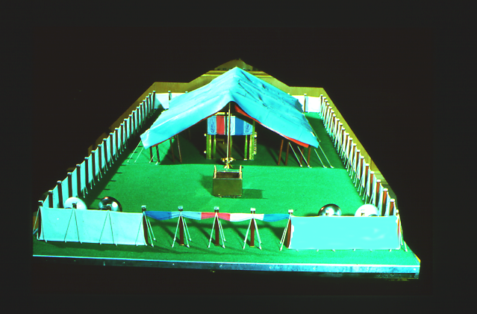
&
गन्ती @#
df]zfnfO{ gofF hfgsf/L rflxG5 !
df]zfn] x/]s s'nsf nflu k|ltlglwlgx¿ af]nfpF5g\ .
df]zf
प्रस्थान
सीनै
g} - g - cf}
कादेश बर्ने
40
phf8 :yfgdf kljq af;:yfg
पुस्तिका पृष्ठ @^-@(
16
2
Notes:
While at KADESH BARNEA, all the tribes of Israel camped out IN AN ORDERED FORMATION around the tabernacle -- that remarkable worship center that had been built in the desert…all according to God's specific directions in the CEREMONIAL part of the LAW given at Sinai.
//// Now…Moses needs new information! Any good leader must have dependable intelligence or information about the tasks ahead.
//// God sends a command to MOSES….to assign a representative from each of the 12 tribes...to go out and explore the land of Canaan.

Slide 19
&
गन्ती !#; व्यवस्था ! :!(–@#
s]lx cfwf/e"t k|Zgx¿ …
Tof] "b]z" s:tf] 5 ?
Dfflg;x¿ sf] x'g\ ?
Vff]nf / d"nx¿ ?
kxf8 / jgx¿ ?
df]zf
प्रस्थान
सीनै
g} - g - cf}
pAhgL of]Uo hdLg ?
कादेश बर्ने
40
s] ToxfF vfgf pknAw 5 ?
पुस्तिका पृष्ठ @^-@(
17
6
Notes:
Here are some of the basic questions for which Moses needed dependable answers…
//// What is that land like?
//// What of the people?
//// Are there rivers and springs?
//// Hills? Forests?
//// Are there fertile farmlands?
//// Is there food available immediately?

Slide 20
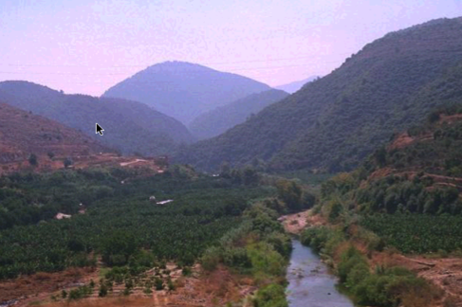
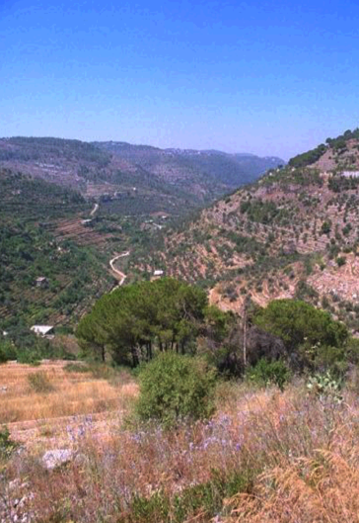
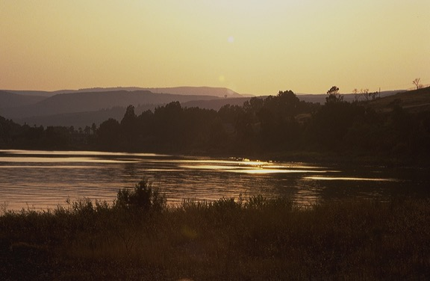
d+rnfO
l;+3f/g[\
गन्ती !#
e[\ ;
lg(c)
x
xfnsf] blIf0fL n]agfglt/sf] pQ/tkm{ ofqf ug{'xf];\ …
hf;';x¿sf] dfu{
Uff ;
s
ER
a
o]
lg k
df]zf
d[ ;
प्रस्थान
सीनै
O
g} - g - cf}
sf af
p
कादेश बर्ने
40
l; k
Kff 3f
Nff ;
पुस्तिका पृष्ठ @^-@(
18
Notes:
He instructs the men to go over into Canaan to "spy out the land." They travel northward as far as today's southern Lebanon. Along their route, the spies discover a fertile and beautiful land, filled with enormous potential for nation building.

Slide 21
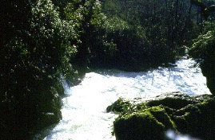
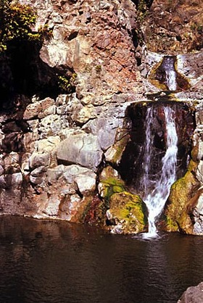
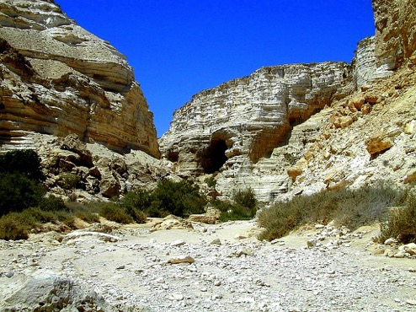
गन्ती !#
d+rnfO
l;+3f/g[\
e[\ ;
lg(c)
… To;kl5 …sfb]z afg]{Ú lt/sf] kmsf{Osf] blIf0ftkm{ ofqf ug{'xf];\ .
x
Uff ;
hf;';x¿sf] dfu{
s
ER
a
o]
lg k
df]zf
d[ ;
प्रस्थान
सीनै
O
g} - g - cf}
sf af
p
कादेश बर्ने
40
l; k
Kff 3f
Nff ;
पुस्तिका पृष्ठ @^-@(
19
Notes:
As they turn back southward -- on the return journey -- they see even more evidence of the challenges that lie ahead. Why? Because the land is heavily populated by small tribes and kingdoms -- the Canaanites and other tribal groups and clans. The Israelites must be dealt with as they prepare to enter the Land -- and to subdue it under God's direct command.

Slide 22
d+rnfO
l;+3f/g[\
गन्ती !#:@^–!$:(
cj:yf oxfF 5 :
e[\ ;
Affx| hgf : hf;';x¿M b'O{ j6f k|ltj]bgx¿
bz hgf : hf;';x¿M ax'dt ljrf/
b"w / dxsf] b]z !
b]zdf /fIf;x¿ !
ld>df kms]{/ hfpm !
b'O{ hgf : hf;';x¿M अल्पसंख्यक ljrf/
b"w / dxsf] b]z !
b]zdf /fIf;x¿ !
k/d]Zj/ xfdL;Fu x'g'x'G5 !
lg(c)
x
Uff ;
s
ER
a
o]
lg k
df]zf
d[ ;
प्रस्थान
सीनै
O
g} - g - cf}
sf af
p
कादेश बर्ने
40
l; k
To;}n]... hfcf}+ !!!!!
Kff 3f
Nff ;
पुस्तिका पृष्ठ @^-@(
20
12
Notes:
Here's the situation…
//// The twelve spies return to report their findings to MOSES at KADESH BARNEA. They have two sharply differing reports following their mission.
//// There is a majority opinion: ten spies or scouts report
//// having found The Land filled with "milk and honey."
//// But it is also filled with a population of enormous strength...giants in the land, they say...such that, in their sight, the children of Israel are but mere grasshoppers. These 10 spies do not believe they can go in and subdue The Land as God has instructed — and live to tell about it.
//// Their advice: turn back to Egypt and be done with all these plans for conquest.
//// However, two remaining scouts -- their names are JOSHUA and CALEB -- give a minority report: the facts of the case are indeed true, they say.
//// Land of milk and honey!
//// Giants in the land...all true.
//// But, yet, they declare, God is with us. The Land can be subdued!
//// SO LET'S GET ON WITH IT!
//// There you have it...two reports...two opinions...
But do the people believe God for His protection and provision?
No, they do not.
//// The people throw their support behind the spies with the MAJORITY REPORT! They are too fearful and, therefore, are in disobedience to God's specific plan and promise.

Slide 23
d+rnfO
l;+3f/g[\
गन्ती !$–@)
ofqf /2 eof !
cj:yf oxfF 5:
MS
Affx| hgf : hf;';x¿M b'O{ j6f k|ltj]bgx¿
bz hgf : hf;';x¿M ax'dt ljrf/
b"w / dxsf] b]z !
b]zdf /fIf;x¿ !
ld>df kms]{/ hfpm !
b'O{ hgf : hf;';x¿M अल्पसंख्यक ljrf/
b"w / dxsf] b]z !
b]zdf /fIf;x¿ !
k/d]Zj/ xfdL;Fu x'g'x'G5 !
N(A)
H
SG
C
ER
B
J
MN
df]zf
DS
प्रस्थान
सीनै
g} - g - cf}
E
कादेश बर्ने
U
40
KB
MS
PG
SO...LET'S GO!!!!!
RS
पुस्तिका पृष्ठ @^-@(
21
Notes:
In response, MOSES does not give the command to enter Canaan and subdue it. THE TRIP INTO THE LAND WAS CANCELLED! FOR THE TIME BEING.

Slide 24
&
गन्ती #@:!#
df]zf
ca. 1500 B.C.
प्रस्थान
सीनै
co]df]o
g} - g - cf}
कादेश बर्ने
$)
df]zf
प्रस्थान
सीनै
g} - g - cf}
कादेश बर्ने
$)
40
पुस्तिका पृष्ठ @^-@(
22
Notes:
Here we add the number 40 to the Moses folder.
As a result of their disobedience and their lack of belief, God sends the Israelites into the desert wilderness to wander for 40 years —

Slide 25
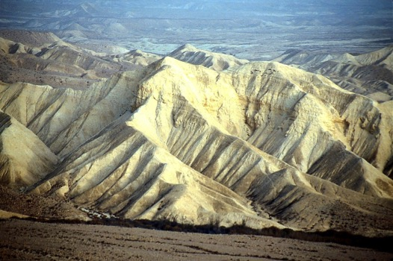
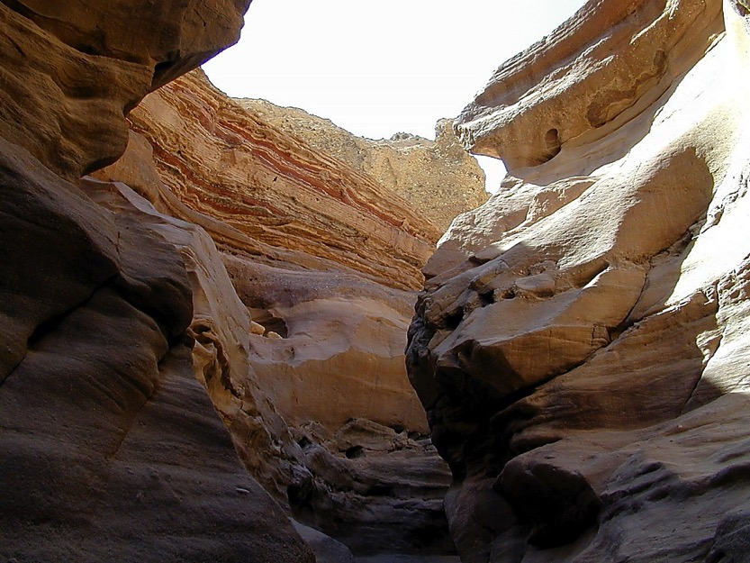
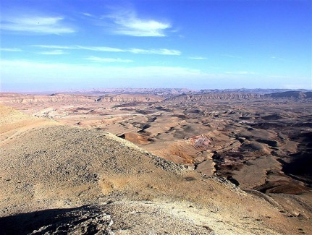
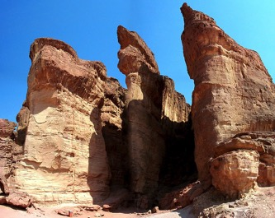
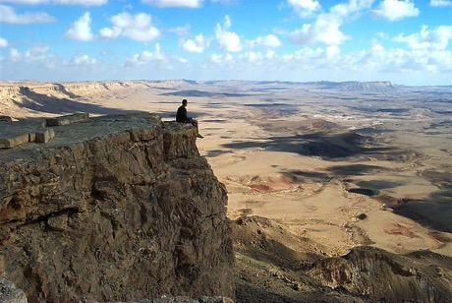
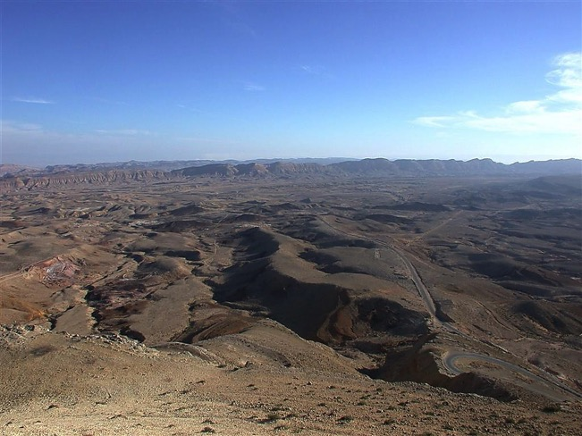
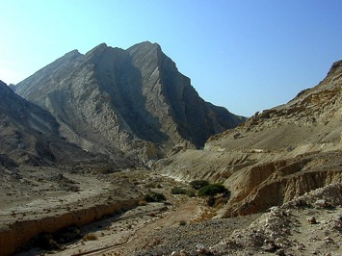
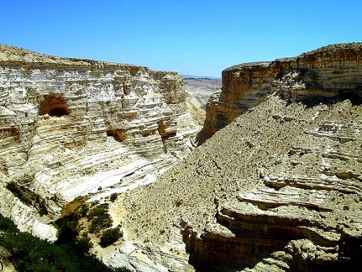
गन्ती #@:!#
d+rnfO
l;+3f/g[\
tkfO{sf] cy… $) jif{ ?
oxfF cem ?
tkfO{sf] cy…
$) jif{ ?
oxfF cem ?
tkfO{sf] cy… $) jif{ ?
oxfF cem ?
df]zf
प्रस्थान
सीनै
g} - g - cf}
कादेश बर्ने
$)
40
पुस्तिका पृष्ठ @^-@(
23
1
Notes:
…until every grumbling, disobedient Israelite above the age of 20 years dies off. Everyone in that "disbelieving generation" – everyone, that is, except JOSHUA, Caleb, -- the two spies of the "minority report" -- MOSES and their families.
//// The people said…DO YOU MEAN…40 YEARS OUT HERE? That's right…40 long years! And all because of their lack of faith in God's provision and His long-range plan. And don't forget that through those 40 years, many NEW Israelites would be born to the people during that long desert trek.

Slide 26
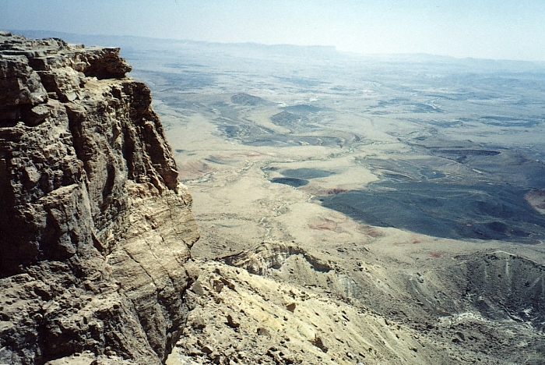
d+rnfO
l;+3f/g[\
गन्ती #@:!#
किन?
अनाज्ञाकारिता !
#!
#*
#%
#^
#&
#@
#$
#)
@*
##
#(
@!
!(
!*
!)
@#
@(
!^
(
!@
@%
@^
$)
^
!#
!!
@)
*
@$
!$
!%
%
@@
@&
!
!&
#
@
अविश्वास !
$
&
df]zf
प्रस्थान
सीनै
g} - g - cf}
कादेश बर्ने
$)
40
phf8 :yfgdf 3'ld/xg'
पुस्तिका पृष्ठ @^-@(
24
3
Notes:
And that's a crucial point to remember about the wilderness wanderings…
//// WHY were the Israelites sentenced to 40 years of wandering in the desert wilderness?
//// Disobedience and unbelief! Disobedience to God's direction and unbelief in his ability to protect them and safely deliver them into the land promised to old Abraham.
//// [THIS NUMBER SEQUENCE REQUIRES SOME 20 SECONDS TO PLAY THROUGH.] Just think of it. After those 40 long years of wandering in the desert near the Dead Sea – year after year after trying year. Of course, during those years, Moses the great deliverer of Israel, was nearing the end of his 120 years of life.

Slide 27
d+rnfO
l;+3f/g[\
प्रस्थान #@:$*–$(
e[\ ;
lg(c)
x
Uff ;
s
lg k
O gbL
lg k
a
o]
df]zf
d[ ;
प्रस्थान
सीनै
g} - g - cf}
कादेश बर्ने
p
$)
sf af
40
l; k
Kff 3f
Nff ;
पुस्तिका पृष्ठ @^-@(
25
Notes:
So they spent 40 years wandering between KADESH BARNEA and, finally, MOUNT NEBO. But because of Moses own earlier disobedience, even he is not destined to enter that Promised Land himself. Mark that route of wandering on your map.

Slide 28
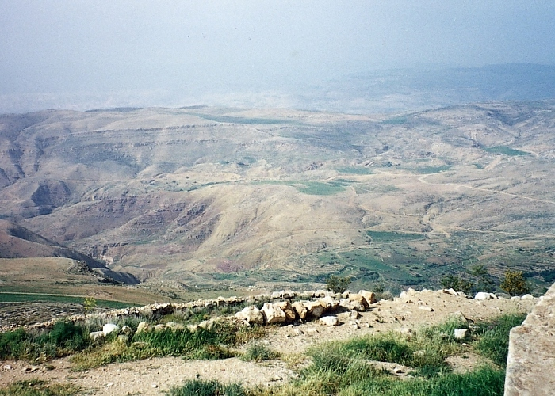
प्रस्थान #$:!
df]zf
प्रस्थान
सीनै
g} - g - cf}
कादेश बर्ने
$)
40
g]af] kj{tsf] 6'Kkfaf6 "k|lt1fsf] b]z" x]g{'
पुस्तिका पृष्ठ @^-@(
26
1
Notes:
At the end of the 40 years in the wilderness, Moses brings the people to the region of Mt. Nebo. Moses was able to view the Promised Land from an area near here on that mountaintop. Were we to stand by Moses on top of Nebo, this is what he would have seen…but would never be allowed to enter.
//// God instructs MOSES that the time has come for the Israelites to go into the land of Canaan, to subdue it, and to claim it as their own rightful inheritance.

Slide 29
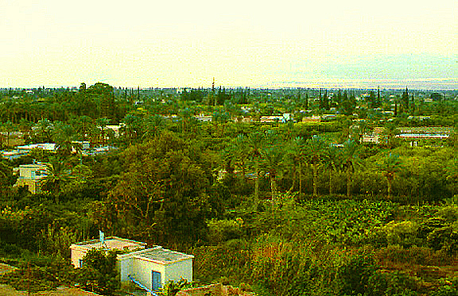
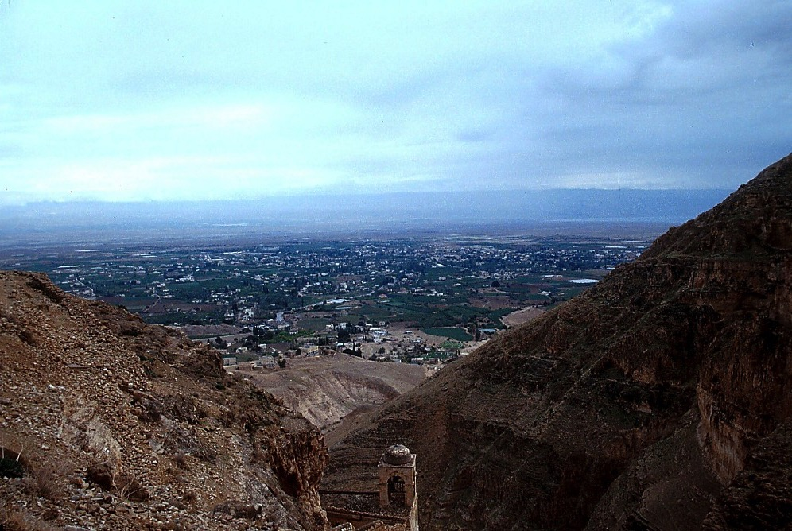
प्रस्थान #$:!
g]af] kj{taf6 ob{g
df]zf
प्रस्थान
सीनै
g} - g - cf}
कादेश बर्ने
$)
40
ol/xf]af6...
ob{g gbLnfO{ kf/ u/]/ g]af] kj{tlt/ x]b}{
पुस्तिका पृष्ठ @^-@(
27
1
Notes:
While over in Jericho, west of Mt. Nebo, that huge Jericho oasis would have looked then much as it does today...except for the modern buildings…a land rich with water…
////…date palms and fertile soil. Here we can see the approximate location of Mount Nebo to the east beyond the Jordan River.

Slide 30
&
df]zf
ca. !%)) B.C.
प्रस्थान
सीनै
co]df]o
g} - g - cf}
कादेश बर्ने
$)
df]zf
e[ lj
प्रस्थान
% jrgx¿
सीनै
g} - g - cf}
कादेश बर्ने
$)
40
% jrgx¿
प्रस्थान #):! -!)
व्यवस्था: bf];|f] Joj:yf !
ltgLx¿ sf] x'g !
gofF / o'jf k':tfx¿nfO
ltgLx¿sf] cl4lto /fli6«o hGdl;4 clwsf/ !
ltgLx¿ s;/L hLpg'k5 !
ltgLx¿sf] k/d]Zj/ sf] xf ?
e[\dLsf] s/f/sf] ljifo
पुस्तिका पृष्ठ @^-@(
28
8
Notes:
And then…just before Moses dies, he delivers a series of 5 SERMONS near Mt. Nebo. He reminds the Israelites of their Law and the unusual heritage of their people. He speaks to
//// a new and younger generation,
//// instructing them about their God,
//// about who they are,
//// their unique national heritage,
//// and how they should live as they move into their Promised Land.
//// These 5 SERMONS make up the book of Deuteronomy -- which means "Second Law". At the end of his teaching…
//// MOSES issues the great LAND COVENANT…that eternal promise to Abraham's descendants for all time. That land inheritance forms the core of world conflict to this very day!
//// Note the "LC" scroll at the end of the MOSES file folder – standing for the LAND COVENANT. At Deut. 30: 1-10, Scripture describes God's unconditional promise to Israel: the Land is to be her inheritance in perpetuity. Thus this promise amplifies or further explains the "Land" portion of the ABRAHAMIC COVENANT between God and Abraham.

Slide 31
&
प्रस्थान #)
e[\dL (प्यालेस्टिनियन) k|lt1f
⁵ जुन भूमि तिमीहरूका पिता-पुर्खाहरूको थियो त्यो फेरि तिमीहरूकै हुनेछ। परमप्रभु तिमीहरूको निम्ति असल हुनुहुनेछ र तिमीहरूको पिता-पुर्खाहरूसँग भएको भन्दा धेरै परमप्रभुले तिमीहरूलाई दिनु हुनेछ। अरू जातिमाभन्दा तिमीहरूको जन संख्या धेरै हुनेछ।
df]zf
प्रस्थान
सीनै
g} - g - cf}
⁶अनि परमप्रभु तिमीहरूका परमेश्वरले तिमीहरू र तिमीहरूका सन्तानलाई उहाँका आज्ञाहरू पालन गर्नु इच्छुक बनाउनु हुनेछ। तब तिमीहरूका सम्पूर्ण हृदय र सारा प्राणले परमप्रभुलाई प्रेम गर्नेछौ र बाँच्नेछौ।
कादेश बर्ने
$)
40
% jrgx¿
पुस्तिका पृष्ठ @^-@(
29
2
Notes:
Verses 5 and 6 are the very heart of that Land Covenant from Deuteronomy 30:
5 "He will bring you to
//// the land that belonged to your fathers, and you will take possession of it. He will make you more prosperous and numerous than your fathers.
//// 6 The Lord your God will circumcise your hearts and the hearts of your descendants so that you may love him with all your heart and with all your soul and live."

Slide 32
ca|fxflds s/f/
(“af]nfj6”)
pTktL !@:!-#
df]zf
e[\dL
;Gtfg
cflzif
प्रस्थान
सीनै
g} - g - cf}
कादेश बर्ने
$)
e[\dL प्रस्थान #):! -!)
40
% jrgx¿
पुस्तिका पृष्ठ @^-@(
16
3

Slide 33
&
pTk. ! - प्रस्थान #$
CREATION
pTktL
ANARCHY
c/fhstf
1st Man & Woman
k|yd k[\?if / dlxnf
1st Sin
p
klxnf] kfk
1st Gospel
klxnf] ;[\;dfrf/
1st Family
klxnf] kl/jf/
ROYALTY
(!))) B.C.)
1st Murder
/fhfstf{
klxnf] xTof
Flood/Rainbow
hnk|no / OGb|0fL
Tower
3//f
ca|\fxfd
ABRAHAM
# hftLx?
Aff]nfj6
c a
The CALL
e[\ - ; - cf
p & z[\ o]
L - S - B
O -O
I - I
of - P
J - E
!@
12
CAPTIVITY
bf;Tj
& = $ + #
o;[\km
df]zf
Bf;Tj
प्रस्थान
$ dflg;x?
$))
सीनै
g} - g - cf}
df]zf
कादेश बर्ने
(%)) B.C.)
$)
SILENCE
40
प्रस्थान
z
S
z[\Gg]tf
% jrgx¿
सीनै
g} - g - cf}
कादेश बर्ने
$)
JESUS
40
o]z[\
% jrgx¿
e[ lj
o
oxf];
31
Notes:
So now...we've finished CREATION and moved through three of the great people: ABRAHAM – with the original Abrahamic Promises – then JOSEPH and MOSES, developing the amplified Land Covenant.
Remember that we're not concerned with detail…only a stable skeletal framework of the entire Bible based on its chronological story line. The file folders and their individual component items begin to form that skeletal mental framework on which all OTHER Biblical details have a firm location…a place…a mental map…around which to fit your Biblical thinking!

Slide 34
&
यहोशू !:!
co]df]o
"$ dflg;x?"
dWo rf}yf]
rflx+ :
?
32
Notes:
Now we've come at the last File Folder of the four Great People...
the last in the AJMJ series. Do you recall this next and final name?

Slide 35
&
यहोशू !:!
co]df]o
"$ dflg;x?"
dWo rf}yf]
rflx+ :
"यहोशू "
33
Notes:
His name is... "JOSHUA"

Slide 36
यहोशू !:!
w]/} glhssf] ldtL:
ca|fxfd - o]z[\km @))) B.C.
df]zf - oxf]z !%)) B.C.
34
Notes:
Let's maintain the timeline in the 1500 B.C. era. Once again, that's close enough for our purposes in this study.

Slide 37
&
यहोशू !:!
pTktL
ABRAHAM
ca|fxfd
ABRAHAM
o];[\km
“Ps
Gostf{n]
Gofof
ug[\{k5{ ”
ABRAHAM
df];f
oxf];[\
c/fhtf
/fhstf{
bf;Tj
z[\Gg]tf
o]z[\
पुस्तिका पृष्ठ @(-#!
35
Notes:
A JUDGE MUST JUDGE…the final "J"…here is Joshua's file folder in The Bible File sequence.

Slide 38
&
यहोशू !:!
यहोशू
co]df]o
यहोशू
पुस्तिका पृष्ठ @(-#!
36
Notes:
So…the great Israeli general, JOSHUA succeeds MOSES in leadership. Recall that JOSHUA was one of the two faithful spies who gave that minority report to MOSES 40 years earlier ... after the 12 spies' inspection trip through Canaan.

Slide 39
यहोशू !:$
d+rnfO
l;+3f/g[\
oxf]z"nfO{ k/d]Zj/sf] k|lt1f:
e[\ ;
lg(c)
x
phf8 :yfgb]lv n]agfg;Dd…
Uff ;
s
ER
a
o]
lg k
यहोशू
d[ ;
O
sf af
p
40
... o'k|]l6;b]lv “dxf;fu/” ;Dd -d]l86]l/og dxf;fu/_
l; k
Kff 3f
Nff ;
पुस्तिका पृष्ठ @(-#!
37
2
Notes:
God made a further promise to Joshua.
//// He would give him all the land from the southern desert to Lebanon...and …
//// from the Euphrates River to the Mediterranean Sea, known as the Great Sea in ancient times. But that promise meant that Joshua and the Chosen People must first conquer it!

Slide 40
d+rnfO
l;+3f/g[\
यहोशू !:!!
e[\ ;
lg(c)
x
e[\dL
"यहोशू …
leq hfpm / e[\dLnfO{ आफ्नै agfpm !"
Uff ;
s
ER
a
o]
lg k
Jयहोशू
यहोशू
d[ ;
O
sf af
p
40
40
l; k
Kff 3f
Nff ;
पुस्तिका पृष्ठ @(-#!
38
Notes:
Joshua was instructed to "go in and to possess the Land.“

Slide 41
d+rnfO
l;+3f/g[\
यहोशू !:!!
e[\ ;
lg(c)
x
e[\dL
g]af] kj{taf6 …
ob{g gbL tg{ oxf]z"sf] hf]8
Uff ;
s
ER
a
o]
lg k
Jयहोशू
यहोशू
d[ ;
O
sf af
p
40
40
l; k
Kff 3f
Nff ;
पुस्तिका पृष्ठ @(-#!
38
Notes:
Joshua was instructed to "go in and to possess the Land."

Slide 42
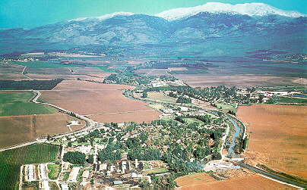
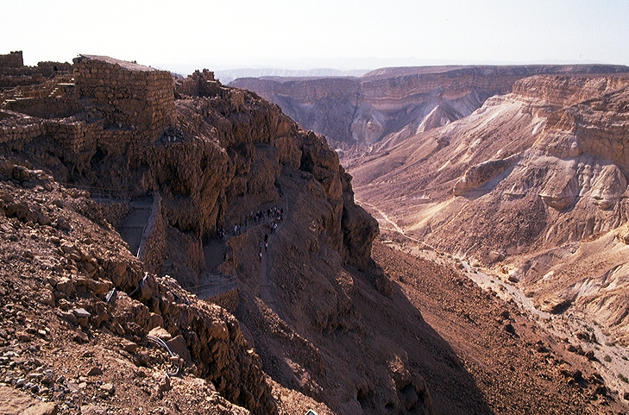
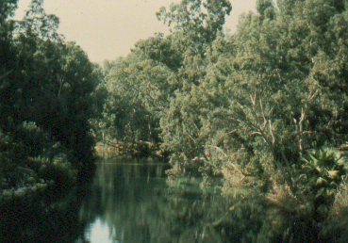
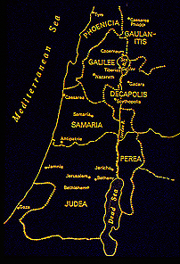
यहोशू !:!^
oxf]z"sf] euf}lns r'gf}ltx¿...
यहोशू
यरीहो / ऐ
पुस्तिका पृष्ठ @(-#!
40
4
Notes:
So, from the highlands near Mt. Nebo, General Joshua marshaled his forces…
//// … and prepared for the challenges that lay ahead! He leads the Israelites across the Jordan River near today's ancient city of Jericho.
//// Once again, God holds back a flood of water…this time, not the Sea of Reeds, but the Jordan River…allowing the people, once again, to cross on dry land -- just as he had done for MOSES during the great Exodus from Egypt.
//// The Israelites then enter the land of Canaan, today's Israel, ...from the fertile valleys and plentiful water resources in the north...
//// …to the desolate wilderness with great thirst in the south.
They are finally on their way to reclaim their Promised Land...from the North to the South...all the Land unconditionally promised to ABRAHAM centuries earlier in THE ABRAHAMIC COVENANT.

Slide 43
&
यहोशू ^-*
यहोशू
यरीहो / ऐ
co]df]o
यहोशू
यरीहो / ऐ
पुस्तिका पृष्ठ @(-#!
41
Notes:
At first, they conquer two principal cities, JERICHO, followed by a difficult campaign against the city of AI.

Slide 44
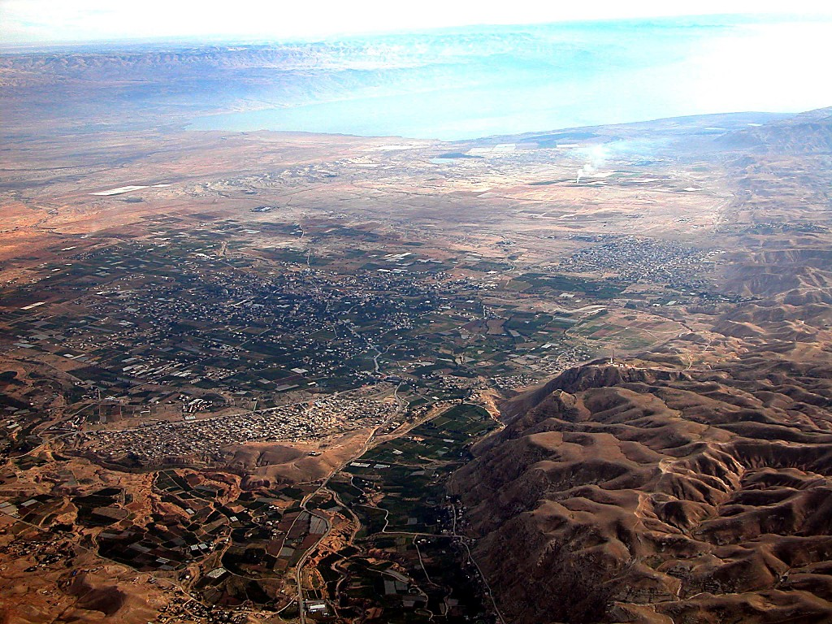
खाराको समुद्र
ob{g gbL
cfw'lgs यरीहो
यहोशू
यरीहो / ऐ
k|flrg यरीहो
यरीहोb]lv...
ob{g gbLsf] kf/ k"j{lt/ x]bf{
पुस्तिका पृष्ठ @^-@(
42
Notes:
Here is Jericho today. You can easily imagine Joshua's forces crossing the distant river to the east with his thousands upon thousands of armed men ready for the seven years of battle that lay ahead.

Slide 45
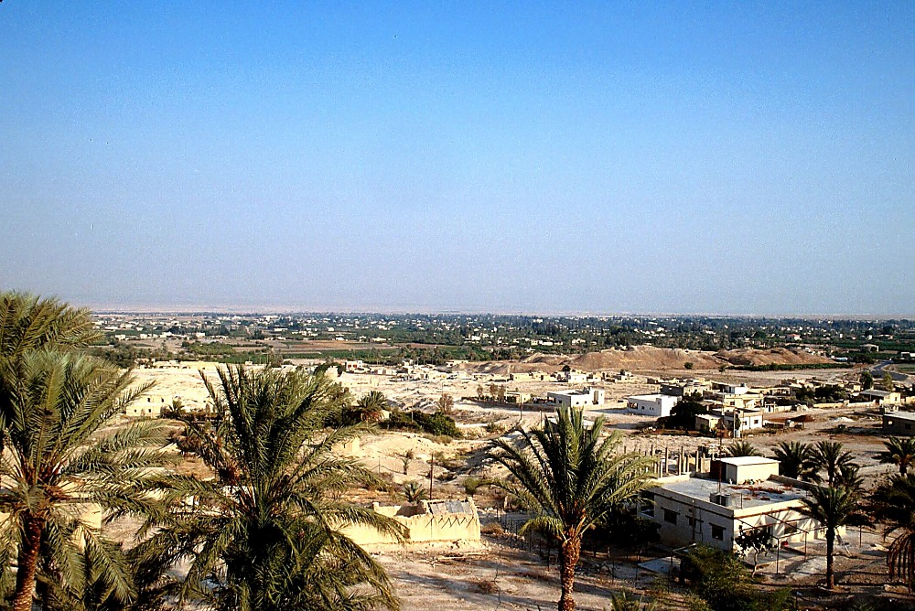
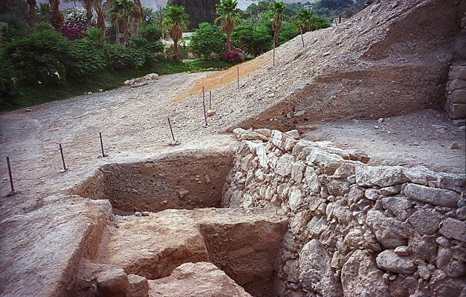
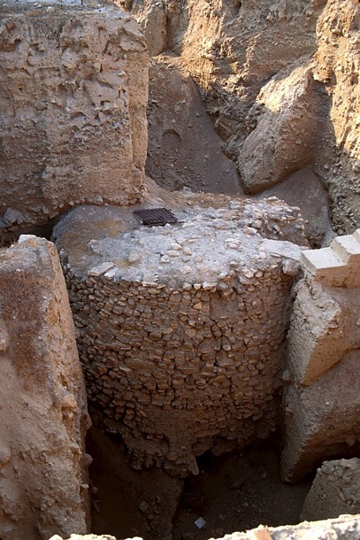
यहोशू
यरीहो / ऐ
यरीहो: k|flrg /xG5
पुस्तिका पृष्ठ @(-#!
43
Notes:
The sandy hills in the middle of this picture show the remains of the ancient city of Jericho -- as they stand today. It's possible that some ancient watchmen observed Joshua's forces from this Neolithic watchtower as they neared the city, eventually to bring down these actual walls of Jericho…uncovered here in past excavations…

Slide 46
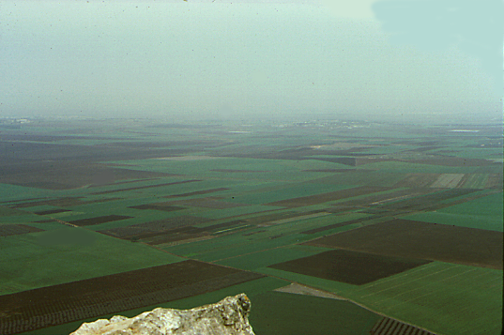
यहोशू !&:!^
7
taf]/ kj{taf6 Oh|]n pkTosf
यहोशू
यरीहो / ऐ
of] b"w / dx xf !
पुस्तिका पृष्ठ @(-#!
44
Notes:
And so, for seven years Joshua's armies ranged up and down the land. Here is the famed Valley of Jezreel seen from the top of Mount Tabor deep in today's region of Galilee in northern Israel. THIS IS TRULY THE MILK AND THE HONEY!

Slide 47
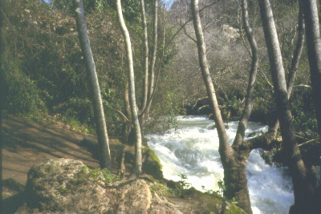
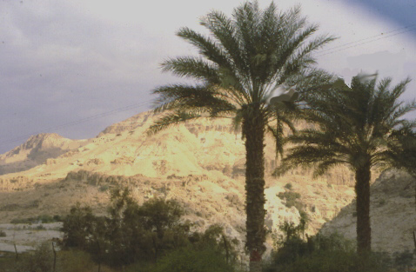
…pQ/df bfg…
;ft jif{sf] sl7g o'4kl5 …
यहोशू
यरीहो / ऐ
…blIf0fdf a]z]{af…
पुस्तिका पृष्ठ @(-#!
45
2
Notes:
Across those seven years of hard-fought battles North to South,
Joshua's forces had to contend with enormous physical contrasts and challenges….
//// the lands of the north….well watered and fruitful….while in the south, a place of desolation and loneliness.
//// From Dan in the North to Beersheba in the south.
In spite of all their efforts, though, Joshua's armies do not completely rid the land OF ALL THE Canaanites as God had instructed. This failure to completely obey God's directive later proves to be a great mistake in the future development of Israel's national life.

Slide 48
&
यहोशू !$: %
यहोशू
यरीहो / ऐ
b]zsf] ljefhg eof]
co]df]o
यहोशू
यरीहो / ऐ
b]zsf] ljefhg eof]
पुस्तिका पृष्ठ @(-#!
46
Notes:
The Israelites have many military successes. Then…at the end of seven years of JOSHUA's military campaigns the LAND is finally subdued…and DIVIDED among the 12 tribes of Israel named for Jacob's 12 sons.

Slide 49
&
यहोशू !#-@!; !#-$#
dxf;fu/
आशेर
नप्ताली
जबूलून
गालील समुद्र
sgfg b]zsf] ljefhg eof !
x/]s s'n a;f]af; u/kl5, ca|fxfdsf] pQ/flwsf/sf] gofF b]zdf a:g l;Sgsf] nflu tof/ 5g\ .
ताबोर पर्वत
कर्मेल डाँडा
इस्साखार
यूसुफका छोराहरू
गिल्बो पर्वत
मनश्शे
मनश्शे
यहोशू
एप्रैम
यरीहो / ऐ
b]zsf] ljefhg eof]
दान
बिन्यामीन
गाद
यहूदा
हेब्रोन
लेवी : zx/x¿df dfq a:g ­ ltgLx¿n] kljq af;:yfgsf] jf:tf ug{' kYof]{!
खाराको समुद्र
रूबेन
शिमोन
पुस्तिका पृष्ठ @(-#!
47
13
Notes:
And…dividing that land among the tribes was no easy task. As it was accomplished…
//// …each tribal unit or clan then settled down, ready to learn to live in the new land of Abraham's inheritance. As to the land assignments, there were…
//// ASHER
//// ZEBULON
//// NAPHTALI
//// ISSACHAR
//// THE SONS OF JOSEPH BECAME TWO TRIBES…EPHRAIM AND MANASSEH. NOTE THAT MANASSEH'S INHERITANCE WAS ON BOTH SIDES OF THE JORDAN RIVER.
There was
//// GAD
//// DAN
//// REUBEN
//// SIMEON
//// JUDAH and
//// BENJAMIN.
//// As for the tribe of LEVI...no land inheritance was made...they were given only towns to live in with pasturelands for their flocks and herds. The Levites were the priests of the tabernacle and...as Scripture says..."...the offerings made by fire to the Lord...are their inheritance, as he promised them."

Slide 50
&
यहोशू !#-@!; !#-$#
dxf;fu/
आशेर
नप्ताली
जबूलून
"यसर्थ हरेकले त्यही गर्थे जो उसले सही सम्झन्थ्यो"
इस्साखार
मनश्शे
मनश्शे
यहोशू
एप्रैम
यरीहो / ऐ
b]zsf] ljefhg eof]
दान
बिन्यामीन
गाद
यहूदा
लेवी : zx/x¿df dfq a:g ­ ltgLx¿n] kljq af;:yfgsf] jf:tf ug{' kYof]{!
रूबेन
शिमोन
पुस्तिका पृष्ठ @(-#!
47
13
Notes:
And…dividing that land among the tribes was no easy task. As it was accomplished…
//// …each tribal unit or clan then settled down, ready to learn to live in the new land of Abraham's inheritance. As to the land assignments, there were…
//// ASHER
//// ZEBULON
//// NAPHTALI
//// ISSACHAR
//// THE SONS OF JOSEPH BECAME TWO TRIBES…EPHRAIM AND MANASSEH. NOTE THAT MANASSEH'S INHERITANCE WAS ON BOTH SIDES OF THE JORDAN RIVER.
There was
//// GAD
//// DAN
//// REUBEN
//// SIMEON
//// JUDAH and
//// BENJAMIN.
//// As for the tribe of LEVI...no land inheritance was made...they were given only towns to live in with pasturelands for their flocks and herds. The Levites were the priests of the tabernacle and...as Scripture says..."...the offerings made by fire to the Lord...are their inheritance, as he promised them."

Slide 51
w]/} glhssf] ldtL:
ca|fxfd - o]z[\km @))) B.C.
df]zf - oxf]z !%)) B.C.
यहोशू
यरीहो / ऐ
b]zsf] ljefhg eof]
49
Notes:
Keep in mind the approximate dates for these lives and related events. The dates are easy to remember in broad groups of roughly 500 years for each major period:
ABRAHAM & JOSEPH: around 2000 B.C.
MOSES & JOSHUA: around 1500 B.C.

Slide 52
&
pTk. ! - प्रस्थान #$
CREATION
pTktL
ANARCHY
c/fhstf
1st Man & Woman
k|yd k[\?if / dlxnf
1st Sin
p
klxnf] kfk
1st Gospel
klxnf] ;[\;dfrf/
1st Family
klxnf] kl/jf/
ROYALTY
(!))) B.C.)
1st Murder
/fhfstf{
klxnf] xTof
Flood/Rainbow
hnk|no / OGb|0fL
Tower
3//f
ca|\fxfd
ABRAHAM
# hftLx?
Aff]nfj6
c a
The CALL
e[\ - ; - cf
p & z[\ o]
L - S - B
O -O
I - I
of - P
J - E
!@
12
CAPTIVITY
bf;Tj
& = $ + #
o;[\km
Bf;Tj
$ dflg;x?
यहोशू
$))
यरीहो / ऐ
df]zf
b]zsf] ljefhg eof]
SILENCE
(%)) B.C.)
प्रस्थान
z
S
z[\Gg]tf
सीनै
g} - g - cf}
कादेश बर्ने
$)
JESUS
40
o]z[\
% jrgx¿
e[ lj
o
यहोशू
यरीहो / ऐ
b]zsf] ljefhg eof]
31
Notes:
So now...we've finished CREATION and moved through three of the great people: ABRAHAM – with the original Abrahamic Promises – then JOSEPH and MOSES, developing the amplified Land Covenant.
Remember that we're not concerned with detail…only a stable skeletal framework of the entire Bible based on its chronological story line. The file folders and their individual component items begin to form that skeletal mental framework on which all OTHER Biblical details have a firm location…a place…a mental map…around which to fit your Biblical thinking!

Slide 53
of] k|:t[tL tkfO{sf] nflu lk|mdf pknAw 5 .
8f= l/Ss lu|lkmyaf6 ljt/0f • BibleStudyDownloads.org
Notes:
The Bible…Basically (bb)

Slide 54
9.7.03c.
©2005 TBBMI
51

