Slide 1
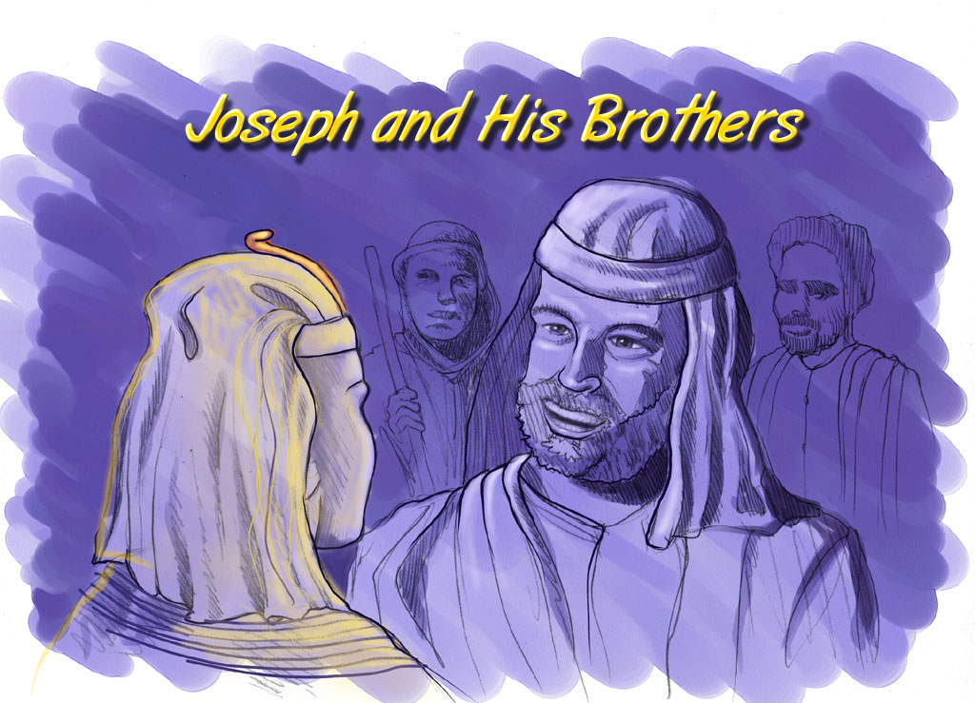
ca|fxfd - o]z[\km
Joseph and His Brothers

Slide 2
w]/} glhssf] ldtL:
ca|fxfd - o]z[\km @))) B.C.
;a} ldtLx? %)) aif{sf] a[4L b/df 5g .
Handbook pg. 19-24
01
1

Slide 3
pTk. #&:@ - pTk. %):@^
&
“Ps
Gofstf{n]
Gofof
ug[\{ k5{ ”
pTktL
ABRAHAM
ca|fxfd
ABRAHAM
o]z[\km
ABRAHAM
df]zf
oxf]z[\
c/fhstf
/fhkl/jf/
bf;Tj
$ dflg;x?df ;a} eGbf klxnf] .
z[\Gg]tf
o]z[\
Handbook pg. 19-24
02
1

Slide 4
pTk. !%:!*
dGrsf] l;+uf/
e[\ ;
^
lg=(c)
x
Fdlnnf] a[4LtfTds cw{rGb|
Uff ;f
s
O=g=
a]
o]
gL k
d[ ;
;[\?jft laGb[\ ...
O{
p
sf af]
l; k
Kff 3f
Nff ;
Handbook pg. 19-24
03
1

Slide 5
pTk. !%:!*
dGrsf] l;+uf/
!) :yfgx?
e[\ ;
^
$
lg(c)
x
O{/fs
O{/fg
s[\a]t
;fplb c/a
l;l/of
Oh|fPn
6ls{
OlhK6
Uff ;
Ufflnnsf] ;d[\Gb|
s
o g
a]
o]
lg k
sgfg
d[ ;
lgn gbL
g[\gsf] ;fuf/
O{
O{lhK6
sf af]
p
l;of]gsf] pklbk ..
l; k
k 3f
Nff ;
Handbook pg. 19-24
04
14

Slide 6
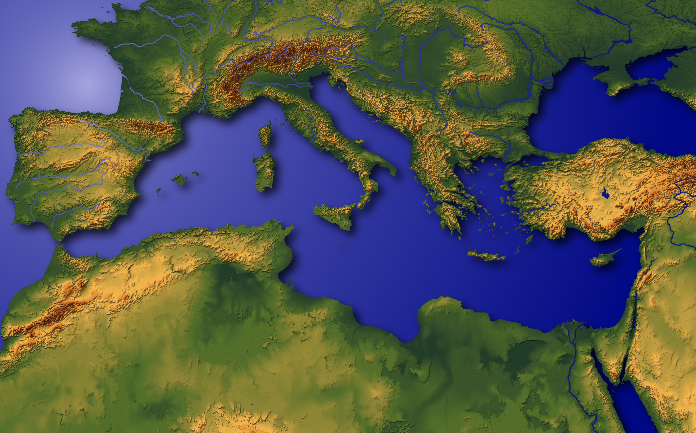
“ hldgsf] gfle ”
Handbook pg. 19-24
05

Slide 7
pTk. !!:@*
dGrsf] l;+uf/
e[\ ;
lg(c)
x
Uff ;
s
O gbL
a]
o]
lg k
d[ ;
O{
sf af]
p
rfN8L;sf] p/ : d];f]kf]6fldozL k|lrg ;f+:s[tsf] s]Gb| xf], / ca|fxfdsf] 3/ .
l; k
Kff 3f
Nff ;
Handbook pg. 19-24
06
1

Slide 8
&
a]lanf]g
p/
ofbug[\{ xf]; ! kf/l;ofg 3f+l6sf] o[\4 / O{/fsdf o[\4 .
Handbook pg. 19-24
07
6

Slide 9
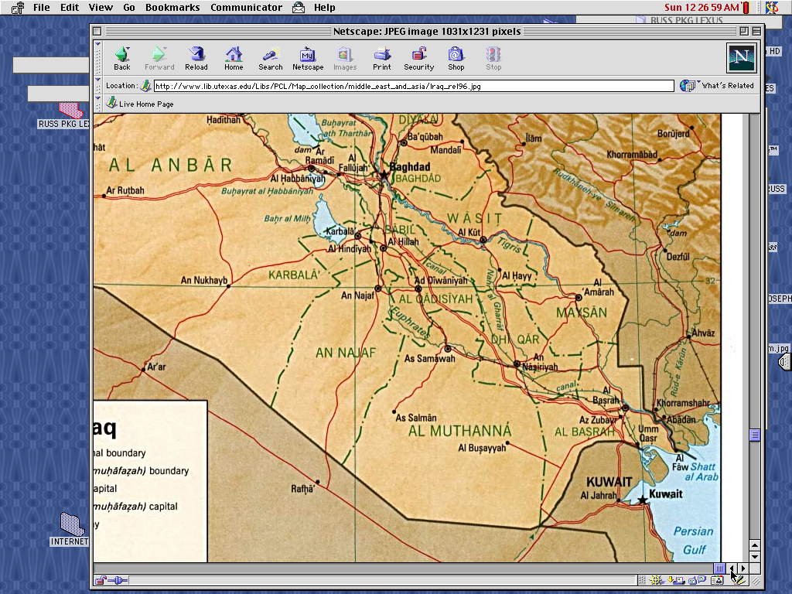
&
The Mesopotamian Basin
SUMERIAN INVENTIONS…
WRITING AND THE WHEEL
BEGINNINGS…
LAW
MEDICINE
ASTRONOMY
ARCHITECTURE
EARLIEST URBAN CENTERS
Handbook pg. 19-24
07a
4
Notes:
Here in this Middle Eastern land – bordering the Persian Gulf --
were some of the earliest beginnings of mankind’s discovery of an intellectual life.
//// In this triangular shaped valley,
//// called the Mesopotamian Basin,
//// the ancient Sumerians presented us the gifts of writing and the wheel. And here we see
//// the beginnings of basic concepts of civilization…of law…of medicine… of astronomy and architecture.
//// Archaeologists have also found evidence of some of the very earliest urban centers…
the communities and the cities that, through time, have led directly to the civilization and cultures we know today.

Slide 10
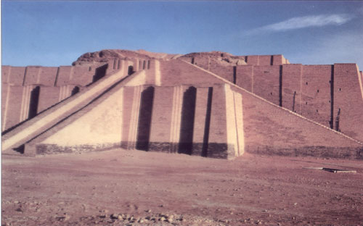
pTk !):!); !!:@*, #!
Ps k/fdk/fut “w/f/f dlGb/” k|flrg rflN8;sf] p/ / cfhfsf] O{/fsdf kb{5 .
Handbook pg. 19-24
08

Slide 11
pTk. !!:#!
ca|fxfdsf] kl/jf/:
• t]/x ( lktf )
•ca|fxfd (ca|fd )
• ;f/fO{ (p;sf] :jf:gL , ;f/} )
• nf]t (ca|fxfdsf] elthf )
Handbook pg. 19-24
09
5

Slide 12

ca|fxfd
ABRAHAM
ca. @))) B.C.
klxnf] AoStL
$ dflg;x?df
Rflx+:
ca|fxfd
co]df]o
pTktL !@ / To; kl5sf v08x? .
Handbook pg. 19-24
10
3

Slide 13
pTk. !@: !-#
ABRAHAM
ca. 2000 B.C.
ca|fxfd
jf]nfj6
klxnf] AoStL
$ dflg;x?df
Rflx+ :
ca|fxfd
Jf]nfj6
co]df]o
pTktL !@ / To; kl5sf v08x? .
Handbook pg. 19-24
11

Slide 14
pTk. !@: !-#
ca|fxfd
ABRAHAM
ca. 2000 B.C.
jf]nfj6
co]df]o
pTk . !@: !-#
ca|fxfd
Jf]nfj6
k/d]Zj/sf] ;t{ljgfsf] k|lt1f ca|fxfdnfO{ !
Handbook pg. 19-24
12

Slide 15
&
ca|fxfd
ABRAHAM
ca. 2000 B.C.
jf]nfj6
c j
e[\ - ; - c
co]df]o
pTk . !@: !-#
e[\ld
;Gtfg
ca|fxfd
jfnfj6
e[\ - ; - cf
cflzif
;t{ljgfsf] k|lt1f kl5 Ps ljl3jt\ s/f/ aGof] !
Handbook pg. 19-24
13

Slide 16
&
pTktL !@
k/d]Zjn] ca|fxfdnfO{ eGg[\eof] ,
“t]/f] b]z / t]/f s[\6[\Da tyf t]/f lktfsf] 3/af6 lg:s]/ h[\g b]z d tnfO{ lbG5[\ ToxfF hf .
!
“d tFaf6 Pp6f 7[\nf] hflt
ug]{5[\ , / tFnfO{ cflzif lbg]5[\ .
d t]/f] gfp k|l;4 u/fpg]5[\ ,
tF cflzifsf] d[\n x[\g]5;\ .
@
ca|fxfd
Aff]nfj6
e[\ - ;- c
tFnfO{ cflzif lbg]nfO{ d cflzif lbg]5[\ ,
/ tFnfO{ ;/fk lbg]x?nfO{ ;/fk lbg]5[\ .
tF4f/f g} k[YjLsf ;a} s[\nn] cflzif kfpg]5g\ .”
#
Handbook pg. 19-24
14
3

Slide 17
&
pTktL !@
k/d]Zjn] ca|fxfdnfO{ eGg[\eof] , “t]/f] b]z / t]/f s[\6[\Da tyf t]/f lktfsf] 3/af6 lg:s]/ h[\g b]z d tnfO{ lbG5[\ ToxfF hf .
!
e[\dL
“d tFaf6 Pp6f 7[\nf] hflt
ug]{5[\ , / tFnfO{ cflzif lbg]5[\ .
d t]/f] gfp k|l;4 u/fpg]5[\ ,
tF cflzifsf] d[\n x[\g]5;\ .
@
;Gtfg
ca|fxfd
Aff]nfj6
e[\ - ;- c
tFnfO{ cflzif lbg]nfO{ d cflzif lbg]5[\ ,
/ tFnfO{ ;/fk lbg]x?nfO{ ;/fk lbg]5[\ .
tF4f/f g} k[YjLsf ;a} s[\nn] cflzif kfpg]5g\ .”
#
cflzif
Handbook pg. 19-24
15
3

Slide 18

ca|fxflds s/f/
(“af]nfj6”)
pTktL !@: !-#
ca|fxfd
e[\dL
;Gtfg
cflzif
Aff]nfj6
e[\ - ; - c
!@:!
!@:@
!@:#
“e[\-;-c ”
Handbook pg. 19-24
16
3

Slide 19
ca|fxflds s/f/
(“af]nfj6”)
pTktL !@ : ! -#
tLg k|d[\v u[\0fx?-rl/qx?_ !
ca|fxfd
e[\dL
;Gtfg
cflzif
Af]nfj6
e[\ - ; - cf
• zflAbs
• cgGt
• ljgf;t{
17
3

Slide 20
pTk. !@:$
dGrsf] l;+uf/
e[\ ;
ljZjf;df
ltgLx? uP .
lg(c)
x
Uff ;
s
o[\ g
a]
o
lg k
ca|fxfd
d[ ;
Aff]nfj6
O{
sf] af]
p
l; k
Kff 3f
Nff ;
Handbook pg. 19-24
18
2

Slide 21
pTk. !!:#!
dGrsf] l;+uf/
e[\ ;
lg(c)
x
Uff ;
s
o[\ g
a]
o
lg k
ca|fxfd
d[ ;
Aff]naj6
O{
sf af]
p
a]lanf]gsf] 7[\nf] zx/
l; k
k 3f
Nff ;
Handbook pg. 19-24
19

Slide 22
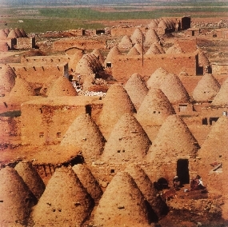
pTk. !!:#!-#@
dGrsf] l;+uf/
e[\ ;
lg(c)
x
ca|fxfdsf lktf, a[4 t]/x, x/fgdf db{5g\ .
Uff ;
s
o[\ g
a]
o
lg k
ca|fxfd
d[ ;
Aff]nfj6
O{
sf af]
p
l; k
k 3f
x/fgsf] “ laxfe ” zx/ cfhsf] 6sL{df kb{5 .
l; k
Handbook pg. 19-24
20
1

Slide 23
pTk. !@:%
dGrsf] l;+uf/
e[\ ;
lg(c)
x
Uff ;
s
o[\ g
a]
o
lg k
ca|fxfd
d[ ;
Aff]nfj6
O
sf af]
p
l; k
k 3f
l; k
Handbook pg. 19-24
21

Slide 24
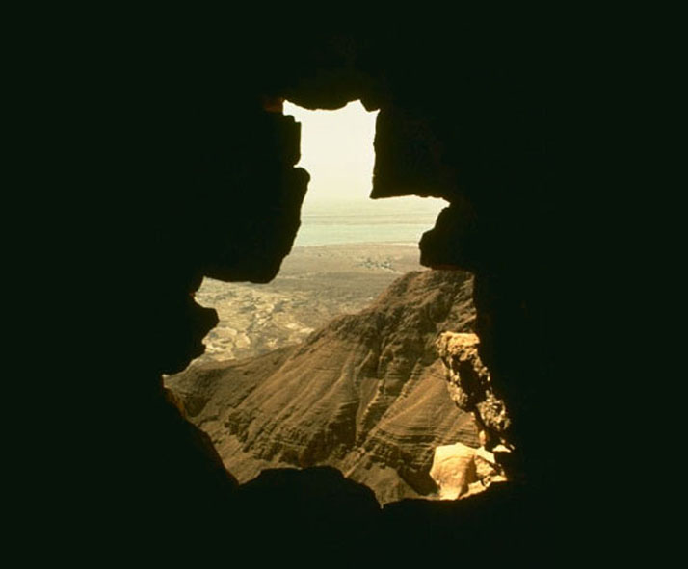
&
ha ca|fxfd To; e[\dLdf k|j]z ub{5g\ …
pgL &% aif{sf lyP …
pxfFsf] >LdtL, ;f/}, ^% aif{sf lyOg\ .
/ o; ;do;Dd} pgLx?nfO{ ;Gtfgsf] k|lt1f ul/Psf] lyof] !
ca|fxfd
Aff]nfj6
e[\ - ; - cf
Handbook pg. 19-24
22
4

Slide 25
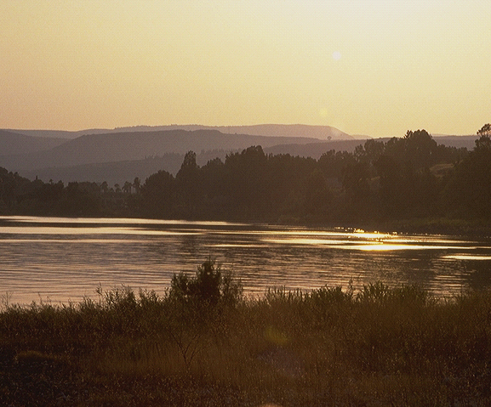
pTk. !%:^
&
ca|fxfdn] k/d]Zj/sf] k|lt1fnfO{ ljZjf; ub{5g\ :
_{e[\dL , ;Gtfg , / cflzif !}
_{e[\dL}
_{;Gtfg ,}
_{cflzif}
pTktL !%:^ !
ca|fxfdsf] ;DaGwdf k/d]Zj/n] p;sf] ljZjf;nfO{ wfld{Stfsf] ?kdf lng[\x[\G5 !
s]an ;fdfGo ljZjf; !
ca|fxfd
Aff]nfj6
e[\ - ; - cf
Handbook pg. 19-24
23
3

Slide 26
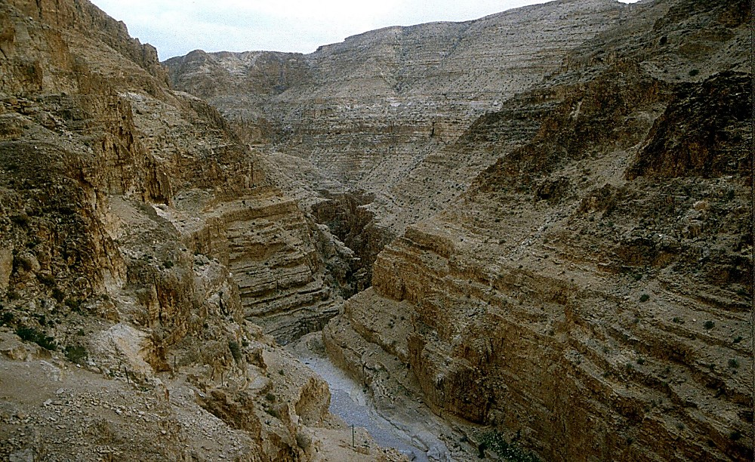
pTk. !^:!-$
&
ca|fxfdn] k/d]Zj/nfO{ ljZjf; ub{5 !
To;f] eP/ klg :
ca|fxfd / ;f/} cwL/ eP .
“ ca|fxfd … xfuf/sf]df uP !”
( ;f/}sf] cfkmg} gf]sf/fgLsf]df )
ABRAHAM
The CALL
L - S - B
Handbook pg. 19-24
24
3

Slide 27
pTk. !^:!!-!@; !&:@)-@!
&
To; ;dodf… ca|fxfd xfuf/ af6sf] Ps 5f]/fsf afa[\ aGb5g\ .
p;sf] gfd: O:dfPn xf] .
(O:dfPn rflx+ k|lt1fsf] 5f]/f xf]O{gg\ .)
ca|fxfd
Aff]nfj6
e[\ - ;- cf
Handbook pg. 19-24
25
3

Slide 28
pTk. !&:!(
&
clxn] ca|fxfd *% aif{sf 5g\ . ;fy} ;f/} rflx+ &% aif{ eO{;s]sL lyO{g .
ca csf]{ !% aif{ kl5 …
ca|fxfdsf] nflu Pp6f 5f]/f ;f/f 4f/f hlGdof] . h;sf] gfd Ozfs xf] .
ca|fxfd
Aff]nfj6
e[\ - ; - cf
Handbook pg. 19-24
26
4

Slide 29
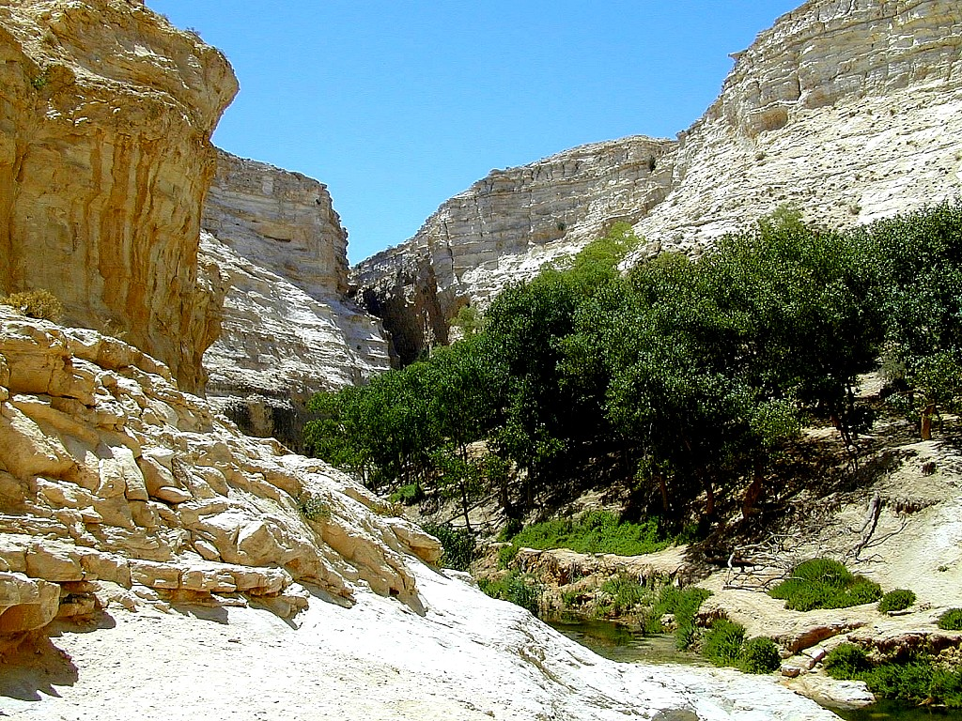
pTk. !&:@!
&
O{zfs ;fFlrg} nfdf] ;do ;Dd k|ltIff ul/Psf 5f]/f x[\g\\ …
… h; 4f/f k/d]Zj/n] ca|fxfdnfO{ ug[\{ ePsf] k|lt1f x/]s k[\:tf ;Dd x:tfGt/0f ug[\{ kg]{ 5 …
ca|fxfd
Aff]nfj6
e[\ - ;- cf
… O{zfssf] a+z 4f/f !
Handbook pg. 19-24
27
2

Slide 30
pTk. !&
&
ca|fxfd
ABRAHAM
ca. 2000 B.C.
af]nfj6
c j
e[\ - ; - cf
cof]df]o
O{ – O{
pTk. !@: !-#
ca|fxfd
Aff]nfj6
e[\ - ; - cf
O{ -O{
O{:dfPn / O{zfs
Handbook pg. 19-24
28

Slide 31
&
ca|fxfd
ABRAHAM
ca. 2000 B.C.
c a
The CALL
c j
L - S - B
pTk. !@:!-#
cof]df]o
O{ – O{
ca|fxfd
Aff]nfj6
e[\ - ; - cf
O{ - O{
O{:dfPn 4f/f c/fljog
hftLsf] z[\? eof] .
O{zfs 4f/f ox[\bL
hftLsf] z[\?jft eof] .
Handbook pg. 19-24
29
2

Slide 32
&
ca|fxfd
ABRAHAM
ca. 2000 B.C.
c a
The CALL
c j
L - S - B
cof]df]o
pTk. !@:!-#
O{ – O{
ca|fxfd
Aff]nfj6
e[\ - ;- cf
O{ – O{
O{:dfPn 4f/f c/fljog
hftLsf] z[\? eof] .
O{zfs 4f/f ox[\bL
hftLsf] z[\?jft eof] .
Handbook pg. 19-24
30

Slide 33
pTk. @@:@; @ O{lt. #:!
&
s[\g ;Gtfg ?
“pxfFn] eGg[\ eof] , “ t]/f] 5f]/f], cyf{t\ t}n] dfof u/]sf] t]/f] Pp6} 5f]/f] O;xfsnfO{ lnP/ df]l/ofsf] b]zdf uO{ d}n] tFnfO{ b]vfPsf] 8fF8fdf To;nfO{ xf]danL u/\ . ” pTktL @@:@
NIV afOansf] k|lts[of ,“ lxa|[\ afOandf, ‘O;xfs’ gfd;Fu Ps afSofF; hf]l8Psf] 5 , “h;nfO{ t}n} dfofF u5{;\” :ki6 kfg{sf nflu elgPsf] 5 , “t]/f] 5f]/f, t]/f] Pp6} dfq 5f]/f, h;nfO{ tF 3]/} dfofF u5{;\ == “O;xfs”. O;xfs rflxF Psdfq “k|lt1fsf ;Gtfg x[\g\” .
ca|fxfd
Aff]nfj6
e[\ - ;- cf
O{ - O{
@ Oltxf; # :! n]vsn] of] efunfO{ kj{tsf] dlGb/sf] ?kdf lrgfPsf 5g\ , -hf] cfh ‘8f]d ckm b /s’ eGg] :yfgdf kb{5 ._
Handbook pg. 19-24
31
3

Slide 34
pTk. !&:@)-@!
&
s[\g ;Gtfg ?
“ clg O:dfPnsf] ljifodf rflx d}n] t]/f] laGtL ;[\g]+ . x]/, d To;nfO{ cflzif lbg]5[\ , / d To;nfO{ kmNbf] km[\Nbf] t[\NofP/ k|z:t u/L To;sf] j[lb ug]{5[\ . afX zf;ssf] Tof] lktf x[\g]5 , / d To;af6 Pp6f 7[\nf] hftL pTkGg u/fpg]5[\ . t/ d]/f] s/f/ t d O;xfs;Fu} :yflkt ug]{5[\ ,h;nfO{ ;f/}n] cfpFbf] ;fn oFxL ;dodf tFaf6 hGdfpg]5 .”
pTk !&:@)-@! (NKJV)
ca|fxfd
Aff]nf6
e[\ - ;- cf
O{ -O{
t/ d]/f] s/f/ rfFlx d
O;xfsdf g} :yflkt ug]{ 5[\ .
Handbook pg. 19-24
32
2

Slide 35
&
pkfxf/ t[\nfgf ug[\{xf];, cfh …
O;xfs
ca|fxfd
Aff]nfj6
e[\ - ; - cf
O{ -O{
O:dfPn
lsg otL w]/} 7\[nf] leGgtf ?
Handbook pg. 19-24
33
3

Slide 36
&
ef}ulns t[\ngf u/f}+ …
o;|fPn /===
ca|fxfd
Aff]nfj6
e[\ - ;- cf
c/jLog ;+;f/
O{ – O{
Handbook pg. 19-24
34

Slide 37
&
ef}ulns t[\ngf u/f}+ …
ca|fxfd
af]nfj6
e[\ - ; - cf
I - I
dxdb\ / O;xfssf] lardf !
Handbook pg. 19-24
35

Slide 38
&
ef}ulns t[\ngf u/f}+ …
o;|fPn /===
o;|fPn /===
ci6lnof
km|fG;
o;|fPn /===
o;|fPn /===
Solnkmf]lg{of
ca|fxfd
Aff]nfj6
e[\- ; - cf
O{ -O{
d}g]
Handbook pg. 19-24
36
3

Slide 39
&
o;|fPn /===
;+o[\St /fHo
ca|fxfd
Aff]nfj6
e[\ - ; - cf
O{ –O{
s] of] /fd|f] b]lvG5 t ?
Handbook pg. 19-24
37

Slide 40
&
“… O;|fonLx?nfO{ eGbf O:dfO{nLx?nfO{ w]/} hldg / wg ;DktLx? lbOPsf] lyof] . of] ;To xf] lsgsL ltgLx?sf] P]ltxf;df of] b]Vg ;lsG5 , at{dfg ;dosf] t]n ;DktLnfO{ glnbf+ klg pgLx? w]/} wgL lyP . cgL cflTds p2f/ pgLx?sf] nfuL ;w}+ v[\Nnf ul/Psf] 5 . ”
ca|fcfd
Aff]nfj6
e[\ - ;- cf
O{- O{
xn lng8;] , “The Everlasting Hatred: The Roots of Jihad,” 2002, Pg 65
Handbook pg. 19-24
38

Slide 41
&
“… O;|fonLx?nfO{ eGbf O:dfO{nLx?nfO{ w]/} hldg / wg ;DktLx? lbOPsf] lyof] . of] ;To xf] lsgsL ltgLx?sf] P]ltxf;df of] b]Vg ;lsG5 , at{dfg ;dosf] t]n ;DktLnfO{ glnbf+ klg pgLx? w]/} wgL lyP . cgL cflTds p2f/ pgLx?sf] nfuL ;w}+ v[\Nnf ul/Psf] 5 . ”
t/ k/d]Zj/sf] s/f/, hf] rflxF pxfFsf] cflTds p2]Zosf] nfuL xf] , Tof] rflXF s]an O;xfs / p;sf ;Gtfgx?sf]nfuL lyof] . O;xfsnfO{ ul/Psf] k|lt1fsf] ;Gtfgx? g} k|zf/0fsf >f]tx? x[\g\ h;x? 4f/f x[\g cfpg] /fi6|\sf] nfuL k/d]Zj/sf] cflTdsL af]nfj6 lbOPsf] lyof] . ” [a9L hf]8 lbP/ AoVof ul/Psf]]
ca|fxfd
Aff]nfj6
e[\ - ;- cf
I - I
xn lng8;] , “The Everlasting Hatred: The Roots of Jihad,” 2002, Pg 65
Handbook pg. 19-24
39

Slide 42
&
n]ag[\g\
O;xfssf ;Gtfgx?
e[\dWo;ful/o ;d[\Gb|
SYRIA
O/fs
X}kmf
uflnnsf] ;fuf/
Gffh/fy
hf]8{g
g]6g\of
cDdfg
t]n Plkmkm=hkmf
o]?znd
h]l/sf]
Gaza
Hebron
d[t;fuf/
ca|fxfd
Aff]nf6
la/;]jf
e[\ - ;- cf
O;|fPn
O - O
O:dfPnsf ;Gtfgx?
OlhK6
;fplb c/ljof
Onf6
cn cufx
cufxsf] 3fF6L
cfhsf] O;|fPndf O:dfon / O;xfs .
Handbook pg. 19-24
2
40

Slide 43
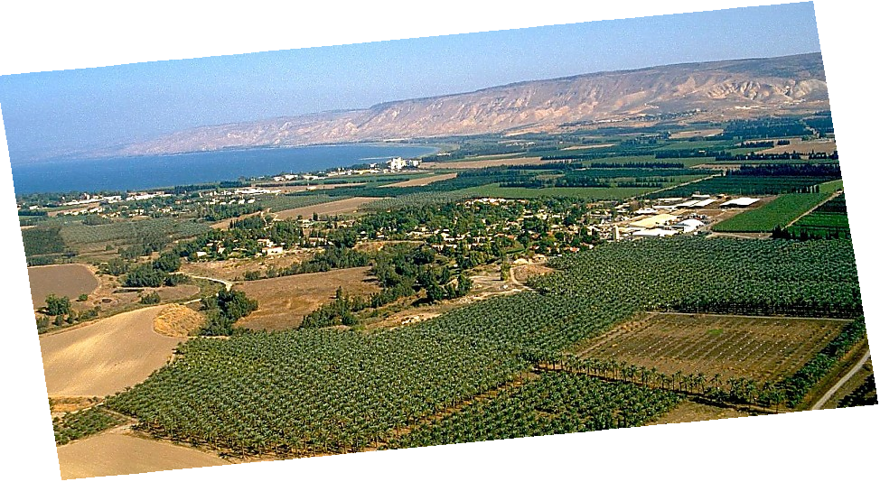
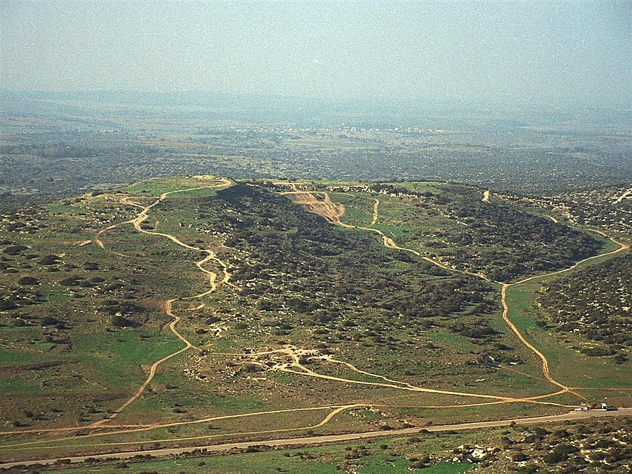
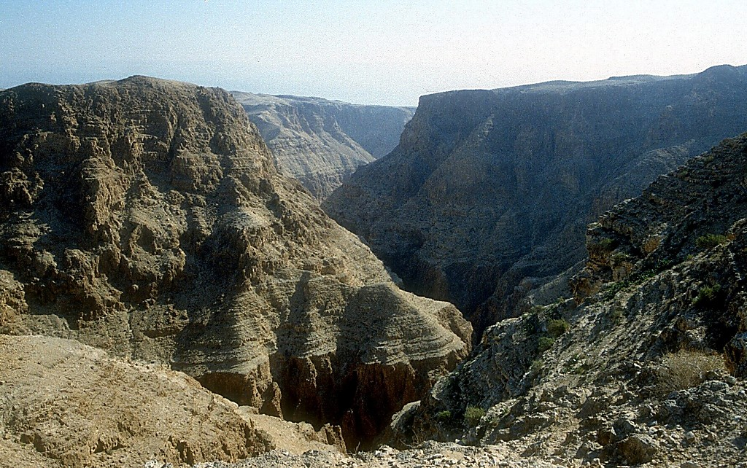
pTk. !#:!)-!!; oxf];[\. !&:!^
ca|fxfdsf] k|lt1fsf] Ps efu ,,,
ca|fxfd
Aff]nfj6
e[\- ; - cf
dxfg ;[\Gb/tfsf] sgfg…pxfFsf]
k[\/VofpnL ;DktL hUuf !
The Jordan River in Central Israel
Handbook pg. 19-24
41

Slide 44
k|:tf. @:@$
&
ca|fxfd
ABRAHAM
ca. 2000 B.C.
Aff]nfj6
c j
e[\ -;- cf
co]df]o
pTk. !@:!-#
O{ – O{
of- P
!@
ca|fxfd
Aff]nfj6
e[\ - ;- cf
O- O
of - P
ofs[\a rflxF k|lt1fsf 5f]/f x[\g\ !
!@
k|lt1fsf] jz+jfnL !
Handbook pg. 19-24
42
7

Slide 45
pTk. #%:@#-@^; pTk. #$:!
&
ca|fxfd
ABRAHAM
ca. 2000 B.C.
Aff]nfj6
c j
e[\ -;- cf
co]df]o
pTk. !@:!-#
O – O
of- P
!@
!@
!)
ca|fxfd
!
Aff]nfj6
e[\-;-cf
O- O
of - P
^
*
!@
$
%
!#
&
!!
3
(
@
Handbook pg. 19-24
43

Slide 46
pTk. #%:@$
&
ca|fxfd
ABRAHAM
ca. 2000 B.C.
Aff]nfj6
c j
e[\ -;- cf
co]df]o
O – O
pTk. !@:!-#
of- P
!@
!@
!)
ca|fxfd
!
Aff]nfj6
e[\-;-cf
O- O
of - P
^
*
!@
$
%
&
!!
#
(
@
Handbook pg. 19-24
44

Slide 47
pTk. #%:@$
&
ca|fxfd
ABRAHAM
ca. 2000 B.C.
Aff]nfj6
c j
e[\ -;- cf
co]df]o
O – O
pTk. !@:!-#
of- P
!@
ca|fxfd
Aff]nfj6
e[\-;-cf
O- O
of - P
!@
o];[\km !
!!
Handbook pg. 19-24
45

Slide 48
pTk. !-#%
&
pTktL
c/fhstf
k|yd k[\?if / dlxnf
p
klxnf] kfk
klxnf] ;[\;dfrf/
klxnf] kl/jf/
/fhfstf{
(1000 B.C.)
klxnf] xTof
hnk|no / OGb|0fL
3//f
(2000 B.C.)
ca|\fxfd
(2000 B.C.)
# hftLx?
Aff]nfj6
c a
p 7 z[\ o]
e[\ - ; - cf
O -O
of - P
!@
bf;Tj
& = $ + #
o;[\km
ca|fxfd
Aff]nfj6
$ dflg;x?
e[\ - ; - cf
O -O
(1500 B.C.)
of -P
Dff]zf
z[\
z[\Gg]tf
(500 B.C.)
!@
S
o]z[\
o]
oxf];[\
46
2

Slide 49
&
co]df]o
$ dflg;x? dWo
bf];|f rflxF :
?
47

Slide 50
&
co]df]o
$ dflg;x? dWo
bf];|f rflxF :
“o];[\km”
48

Slide 51
&
glhssf] ;[\xfpFbf] ldtL :
ca|fxfd-o];[\km @))) B.C.
49

Slide 52
pTk. #&:@ - pTk. %):@^
&
pTktL
ABRAHAM
“Ps
Gostf{n]
Gofof
ug[\{k5{ ”
ca|fxfd
ABRAHAM
o];[\km
ABRAHAM
df];f
oxf];[\
c/fhtf
/fhstf{
bf;Tj
z[\Gg]tf
o]z[\
Handbook pg. 24-25
1
50

Slide 53
&
o];[\km
ABRAHAM
$ dflg;x? dWo
bf];|f rflxF :
o];[\km
co]df]o
Handbook pg. 24-25
51

Slide 54
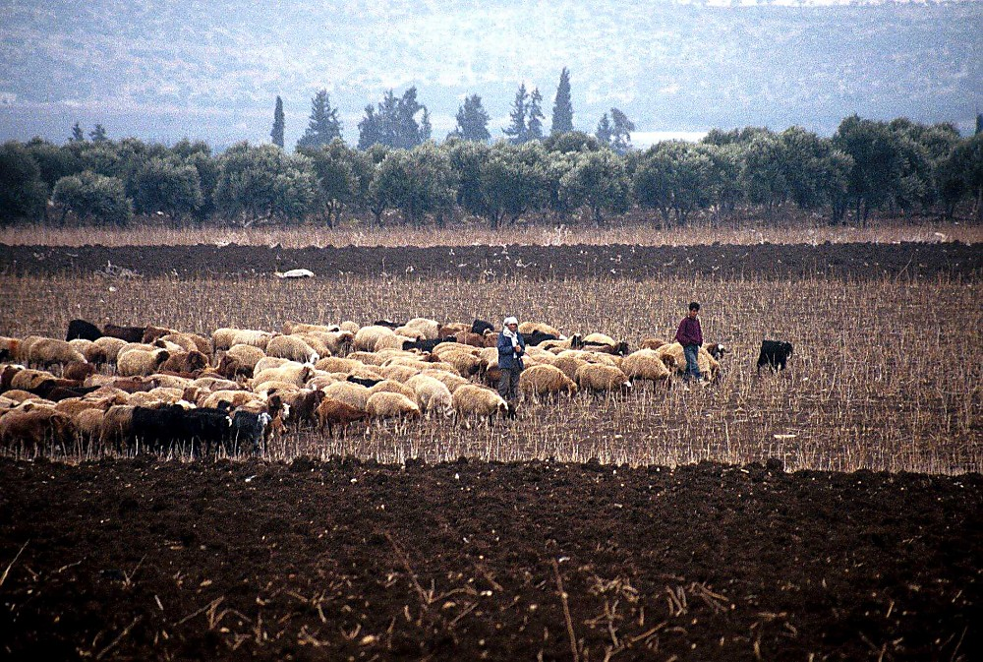
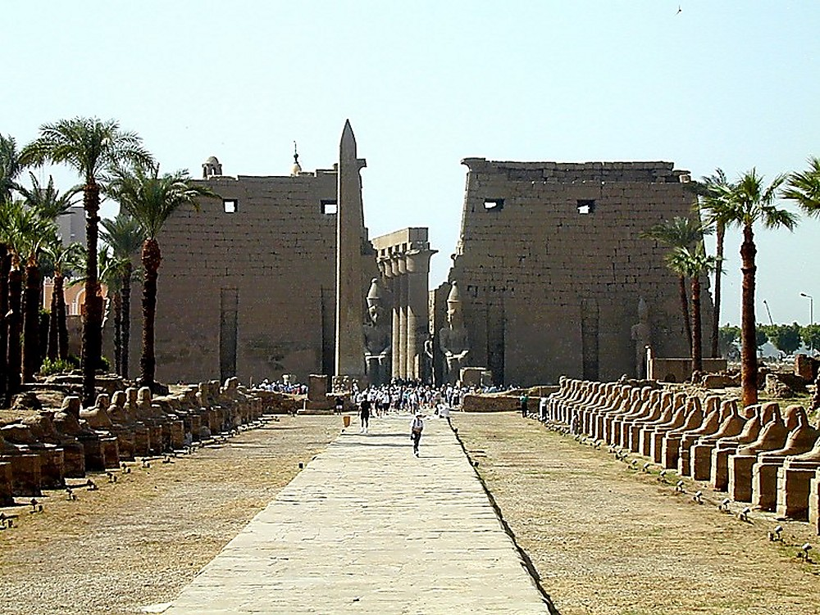
pTk.#&-$!
O{lhK6df ePsf] kmfh]8sf] nS;f] dlGb/ .
o];[\km
O{;|fondf ePsf] 8f]yfgsf] e]8f / uf]7fnfx?sf] d}bfg .
Handbook pg. 24-25
1
52

Slide 55
pTk. #&-$!
o];[\km
Handbook pg. 24-25
53

Slide 56
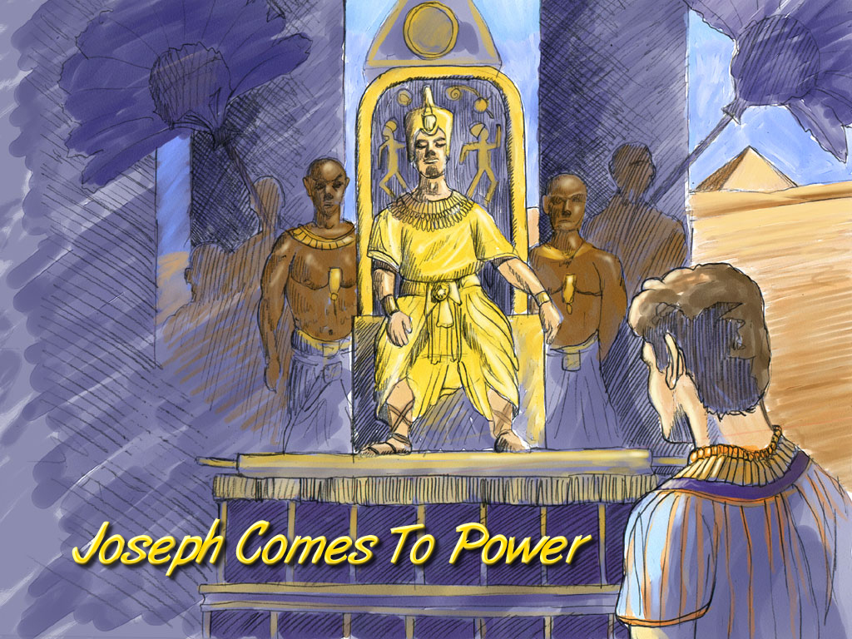
pTk. $!:$!-$$
o];[\km
o];[\kmn] /fi6|\sf] clVyof/ k|fKt ub{5 .
Joseph Comes To Power
Handbook pg. 24-25
54

Slide 57
pTk. $@:@
drFsf] l;+uf/
e[\;
lg(c)
clgsfn !
x
Uff ;
s
o g
a]
o
lg k
o];[\km
d[ ;
O{
sf af]
p
;xsfn !
l; k
kf 3fF
nf ;
Handbook pg. 24-25
1
55

Slide 58
pTk. #&-$!
o];[\km / p;sf efOx?
o];[\km
Joseph and His Brothers
Handbook pg. 24-25
56

Slide 59
pTk. $^: #-&
drFsf] l;+uf/
e[\ ;
lg(o)
x
kl/jf/n] k5fof] …
kl/jf/ ca Pp6f /fi6|\ aGg]5 .
Uff ;
s
o[\ g
a]
J
lg k
o];[\km
d[ ;
O{
sf a
p
l; k
Kff 3fF6L
nf ;
Handbook pg. 24-25
57

Slide 60
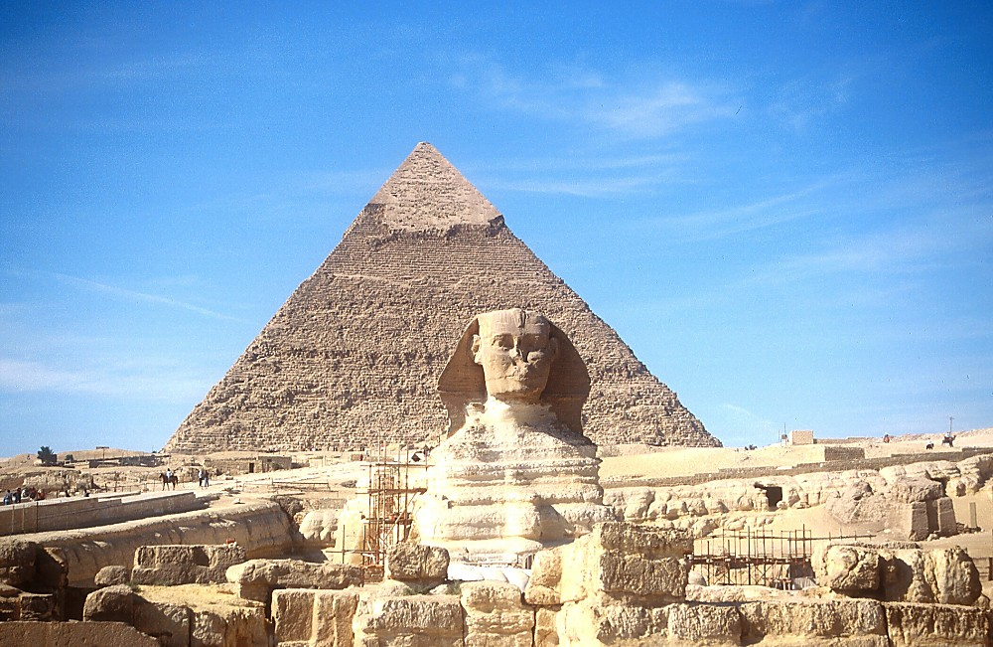
&
o];[\km
d[\tL{ / la/f6 ;dflwsf] dlGb/
Handbook pg. 24-25
58

Slide 61
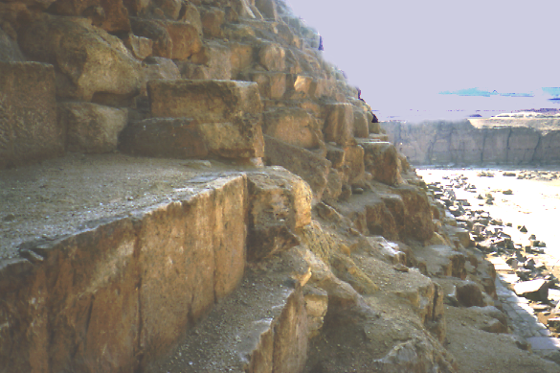
o];[\km
la/f6 ;dflwsf] dlGb/ e]l6Psf] 9[\uf+vfgL .
Handbook pg. 24-25
59

Slide 62
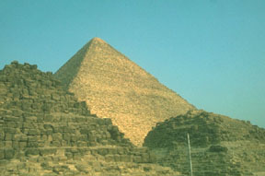
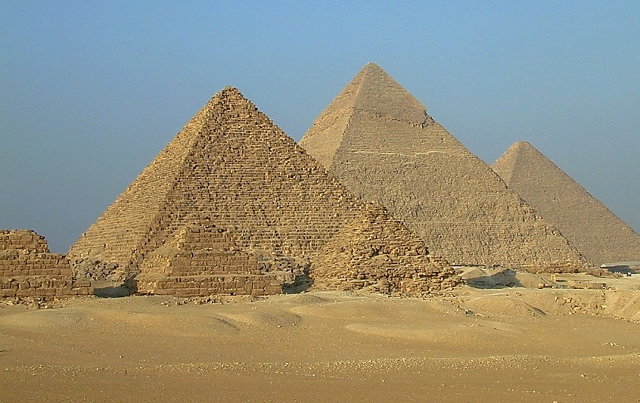
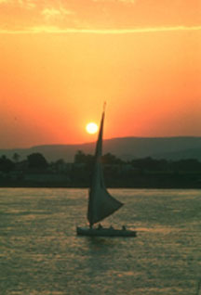
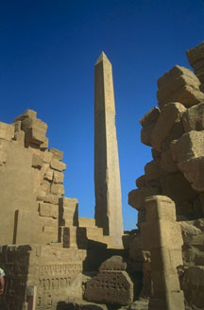
&
O;|fonLx?n] b]v] …
o];[\km
…ld;|b]zdf ePsf k|flrg cl2tLo cfZr{osf s[\/fx? .
Handbook pg. 24-25
60

Slide 63
k|:yfg. !@:$)-$!; unf. #:!&
o];[\km
ABRAHAM
bf;Tj
$ dflg;x?df
bf];|f] rflx+:
codf]o

Slide 64
pTk. !:! – k|:yfg. !:^
&
pTktL
c/fhstf
klxnf] k[\?if / :qL
klxnf] kfk
p
klxnf] ;[\;dfrf/
Klxnf] kl/jf/
(1000 B.C.)
klxnf] xTof
/fhfstf{
hnK|no / OGb|0fL
w//f
(2000 B.C.)
ca|fxfd
(2000 B.C.)
# ;fd[\bfoL
Aff]nfj6
c a
;& z[\ o]
e[\ - ;-cf
O -O
o] - O
!@
bf;Tj
o];[\km
o];[\km
& = $+#
Bf;Tj
bf;Tj
$#)
$#)
$ dflg;x?
Dff]zf
(1500 B.C.)
(500 B.C.)
z[\
S
Z[\Gg]tf
o]z[\
o]
oxf];[\
Handbook pg. 24-25
62

Slide 65
&
co]df]o
$ dflg;x? dWo t];|f] rflx+ :
?
63

Slide 66
&
co]df]o
$dflg;x? dWo t];|f] rflx+ :
“df]zf ”
64

Slide 67
65
©2004 TBBMI
8.0.03b.

Slide 68


8f= l/Ss lu|lkmyaf6 ljt/0f • BibleStudyDownloads.org
of] k|:t[tL tkfO{sf] nflu lk|mdf pknAw 5 .
Notes:
The Bible…Basically (bb)

