Slide 1
“सृष्टि[सम्पादन गर्ने]”

Slide 2



afOan======
cfwf/e[\t
afOan======
cfwf/e[\t
afOan cfwf/e[\t ;]jfsfO{sf] k|:t[\lt
kmf]y{ jf]y{, 6f/;;\
A Presentation of The Bible…Basically Ministries International Inc. Fort Worth, Texas
BibleBasically.org
BibleBasically.org
01
8.0.03a.
8.0.01.
©2004 TBBMI
04
©2004 TBBMI

Slide 3


(s] ePsf] lyof] Tof] oxf+ 5 . )
afOan…cfwf/e[\t
®
Effu tLg
tkfO{sf] kl/ro : “5l/tf] ldtL s|df cWoog” sf nfuL .
02
©2004 TBBMI
8.0.03a.

Slide 4
&
P& z[\ o]
&
p
Z[\f
o]
03
1

Slide 5
&
s]an k[\g :d/0fsf] nflu dfq ...
P & z[\ o]
=
$#
04
1

Slide 6
&
s]an k[\g :d/0fsf] nflu dfq ...
p & z[\ o]
p $# z[\ o]
05

Slide 7
&
s]an k[\g :d/0fsf] nflu dfq ...
p & z[\ o]
p $# z[\ o]
pTktL
rf/ dflg; hftL
tLg ;d[\bfoLx?
z[\Gg]tf
o]z[\
06

Slide 8
&
pTktL
ca|fxfd
o]]z[\km
Df]fzf
oxf]z[\
c/fhstf{
/fhkl/jf/
bf;Tj
z[\Gotf
o]z[\
07

Slide 9
dGrnfO{ l;+uf/g[\
!) :yfgx?
e[\=;=
^ $
pTktL
lg (c)
ca|fxfd
x
o]z[\km
df]zf
e[\ld
uf=;f=
s
o]xf]z[\
c/fhstf
lg=k=
a]=
o]
/fhkl/jf/
“ ls|ofsf] cj:yf !”
bf;Tj
d[ ;
z[\Gg]tf
p
O{
o]z[\
sf af
nf ;
l; k
k= 3f=
08

Slide 10
&
pTktL
ca|fxfd
o]z[\km
df]zf
o]xf]z[\
c/fhstf
/fhkl/jf/
bf;Tj
z[\Gg]tf
o]z[\
•xfdLx? Ps dl:tis lrq lgdf{0f ub}{ 5f} !
•xfdLx?n] lj:t[t cWwog ul//x]sf 5}gf}...
•s]an dxTjk[\0f{ s[\/fx?nfO{ dfq.
•afOansf] ;fdGo ?k/]vf.
09
4

Slide 11
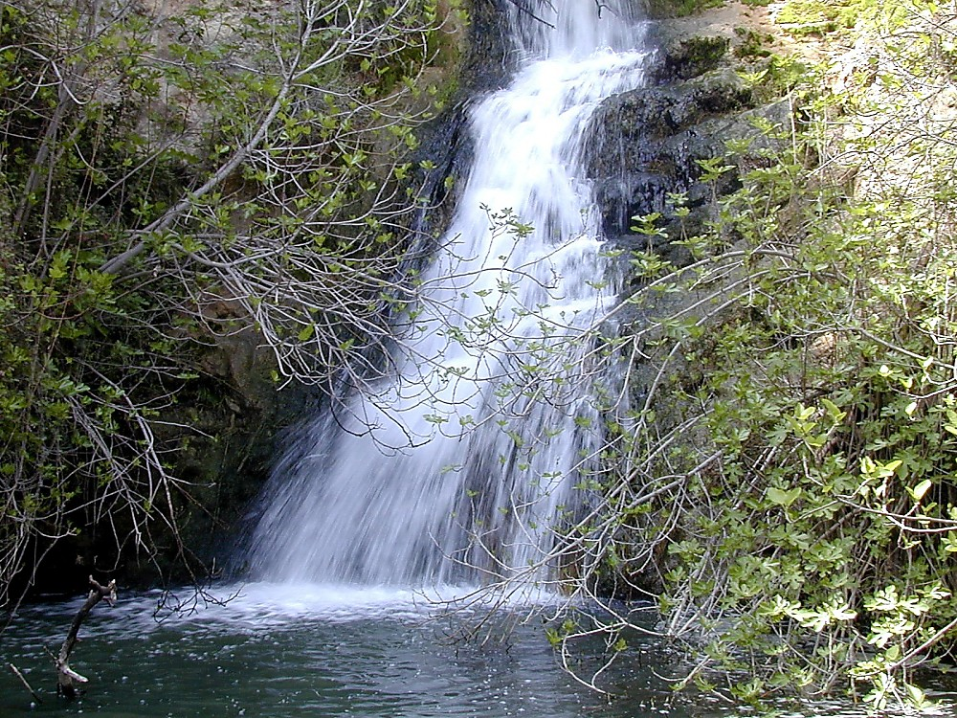
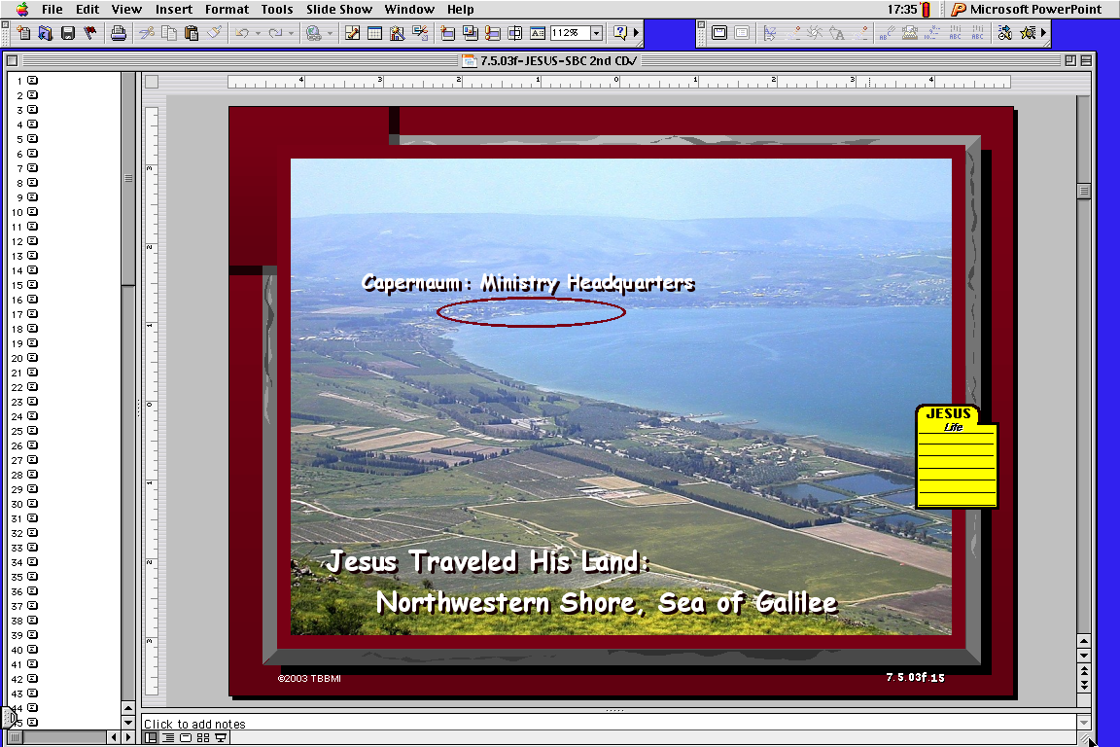
10

Slide 12
pTktL
o]z[\km
df]zf
o]xf]z[\
c/fhstf
/fhkl/jf/
bf;Tj
z[\Gg]tf
o]z[\
11

Slide 13
&
pTktL
ca|fxfd
o]z[\km
df]zf
o]xf]z[\
c/fhstf
/fhkl/jf/
bf;Tj
z[\Gg]tf
o]z[\
12

Slide 14
pTktL !-!!
&
pTktL
pTktL
ABRAHAM
ca|fxfd
ABRAHAM
o]z[\km
ABRAHAM
df]zf
# ;fd[\bfoL
o]xf]z[\
c/fhstf
/fhkl/jf/
bf;Tj
z[\Gg]tf
$
Df
lg;x?
o]z[\
cWwog ;xof]lu #04
13
1

Slide 15
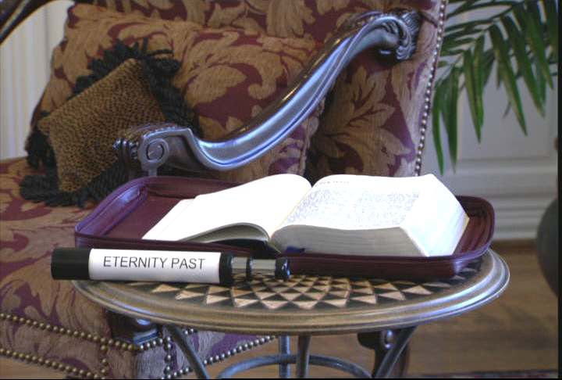
7
pTktL !-!!: cgGt e[\t
cgGt e[\t
Handbook pg. 17-19
14
1

Slide 16
cgGt e[\tnfO{ x]g]{ Ps “b[\/ljg”...
Handbook pg. 17-19
15

Slide 17
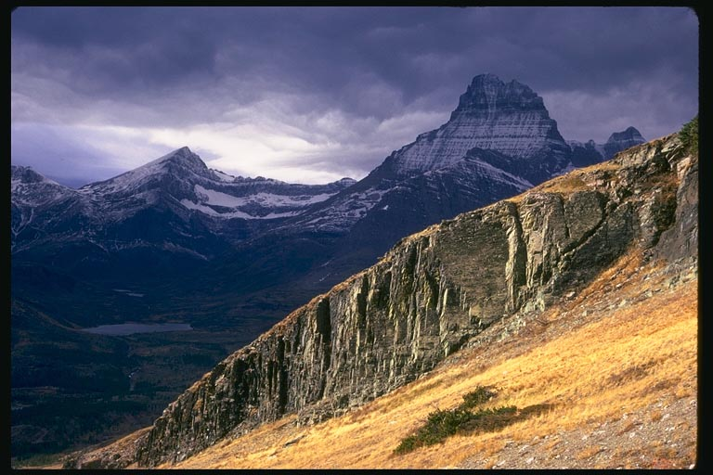
cgGt e[\tnfO{ x]g]{ Ps “b[\/ljg”...
Handbook pg. 17-19
16
1

Slide 18
pTk. !:!
“cflbdf...”
17
1
©2004 TBBMI
8.0.03a.

Slide 19
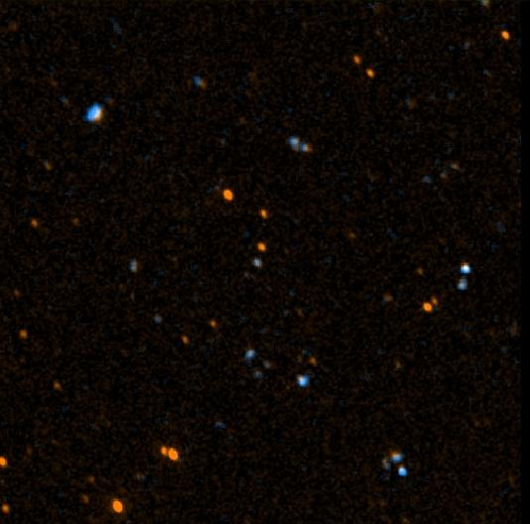
o[\xGgf !&:%
“ca x] lktf, ;+;f/sf] ;[li6 x[\g cl3 tkfO{sf] ;Dd[\v d]/f h[\g dlxdf lyof], To;}n] cfkm\gf] pkl:yltdf dnfO{ dlxldt kfg[\{xf];\ . ”
18
©2004 TBBMI
8.0.03a.

Slide 20
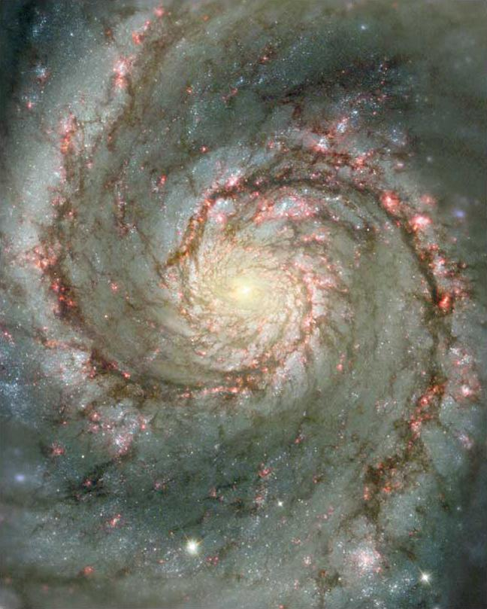
o[\xGgf !&:%
“ca x] lktf, ;+;f/sf] ;[li6 x[\g cl3 tkfO{sf] ;Dd[\v d]/f h[\g dlxdf lyof], To;}n] cfkm\gf] pkl:yltdf dnfO{ dlxldt kfg[\{xf];\ . ”
19
©2004 TBBMI
8.0.03a.

Slide 21
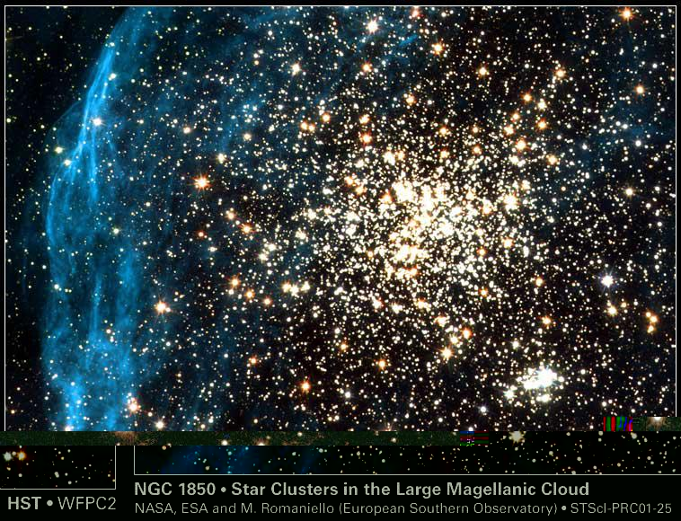
o[\xGgf !&:%
“ca x] lktf, ;+;f/sf] ;[li6 x[\g cl3 tkfO{sf] ;Dd[\v d]/f h[\g dlxdf lyof], To;}n] cfkm\gf] pkl:yltdf dnfO{ dlxldt kfg[\{xf];\ . ”
20
©2004 TBBMI
8.0.03a.

Slide 22
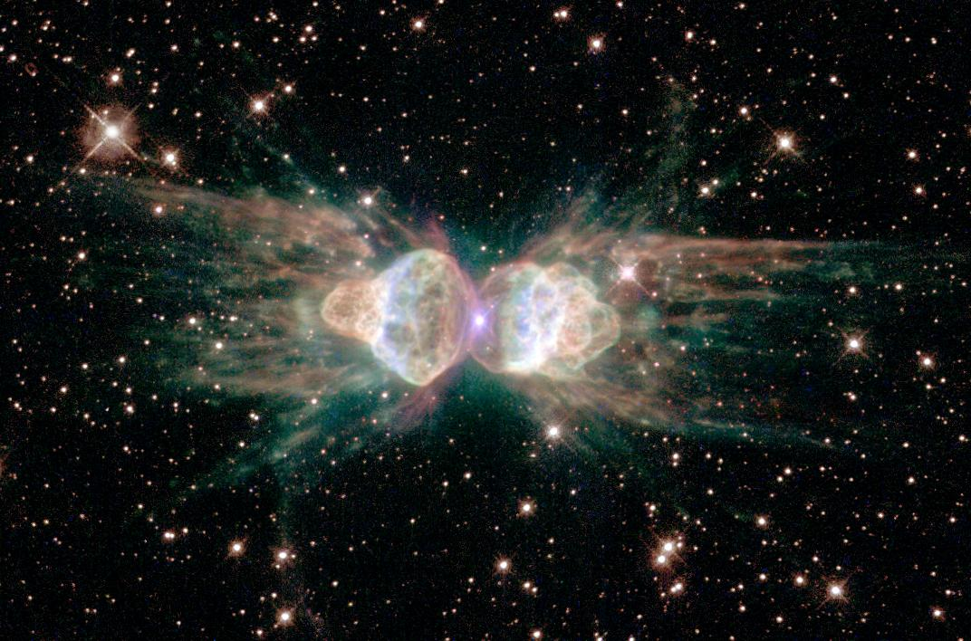
o[\xGgf !&:%
“ca x] lktf, ;+;f/sf] ;[li6 x[\g cl3 tkfO{sf] ;Dd[\v d]/f h[\g dlxdf lyof], To;}n] cfkm\gf] pkl:yltdf dnfO{ dlxldt kfg[\{xf];\ . ”
21
©2004 TBBMI
8.0.03a.

Slide 23
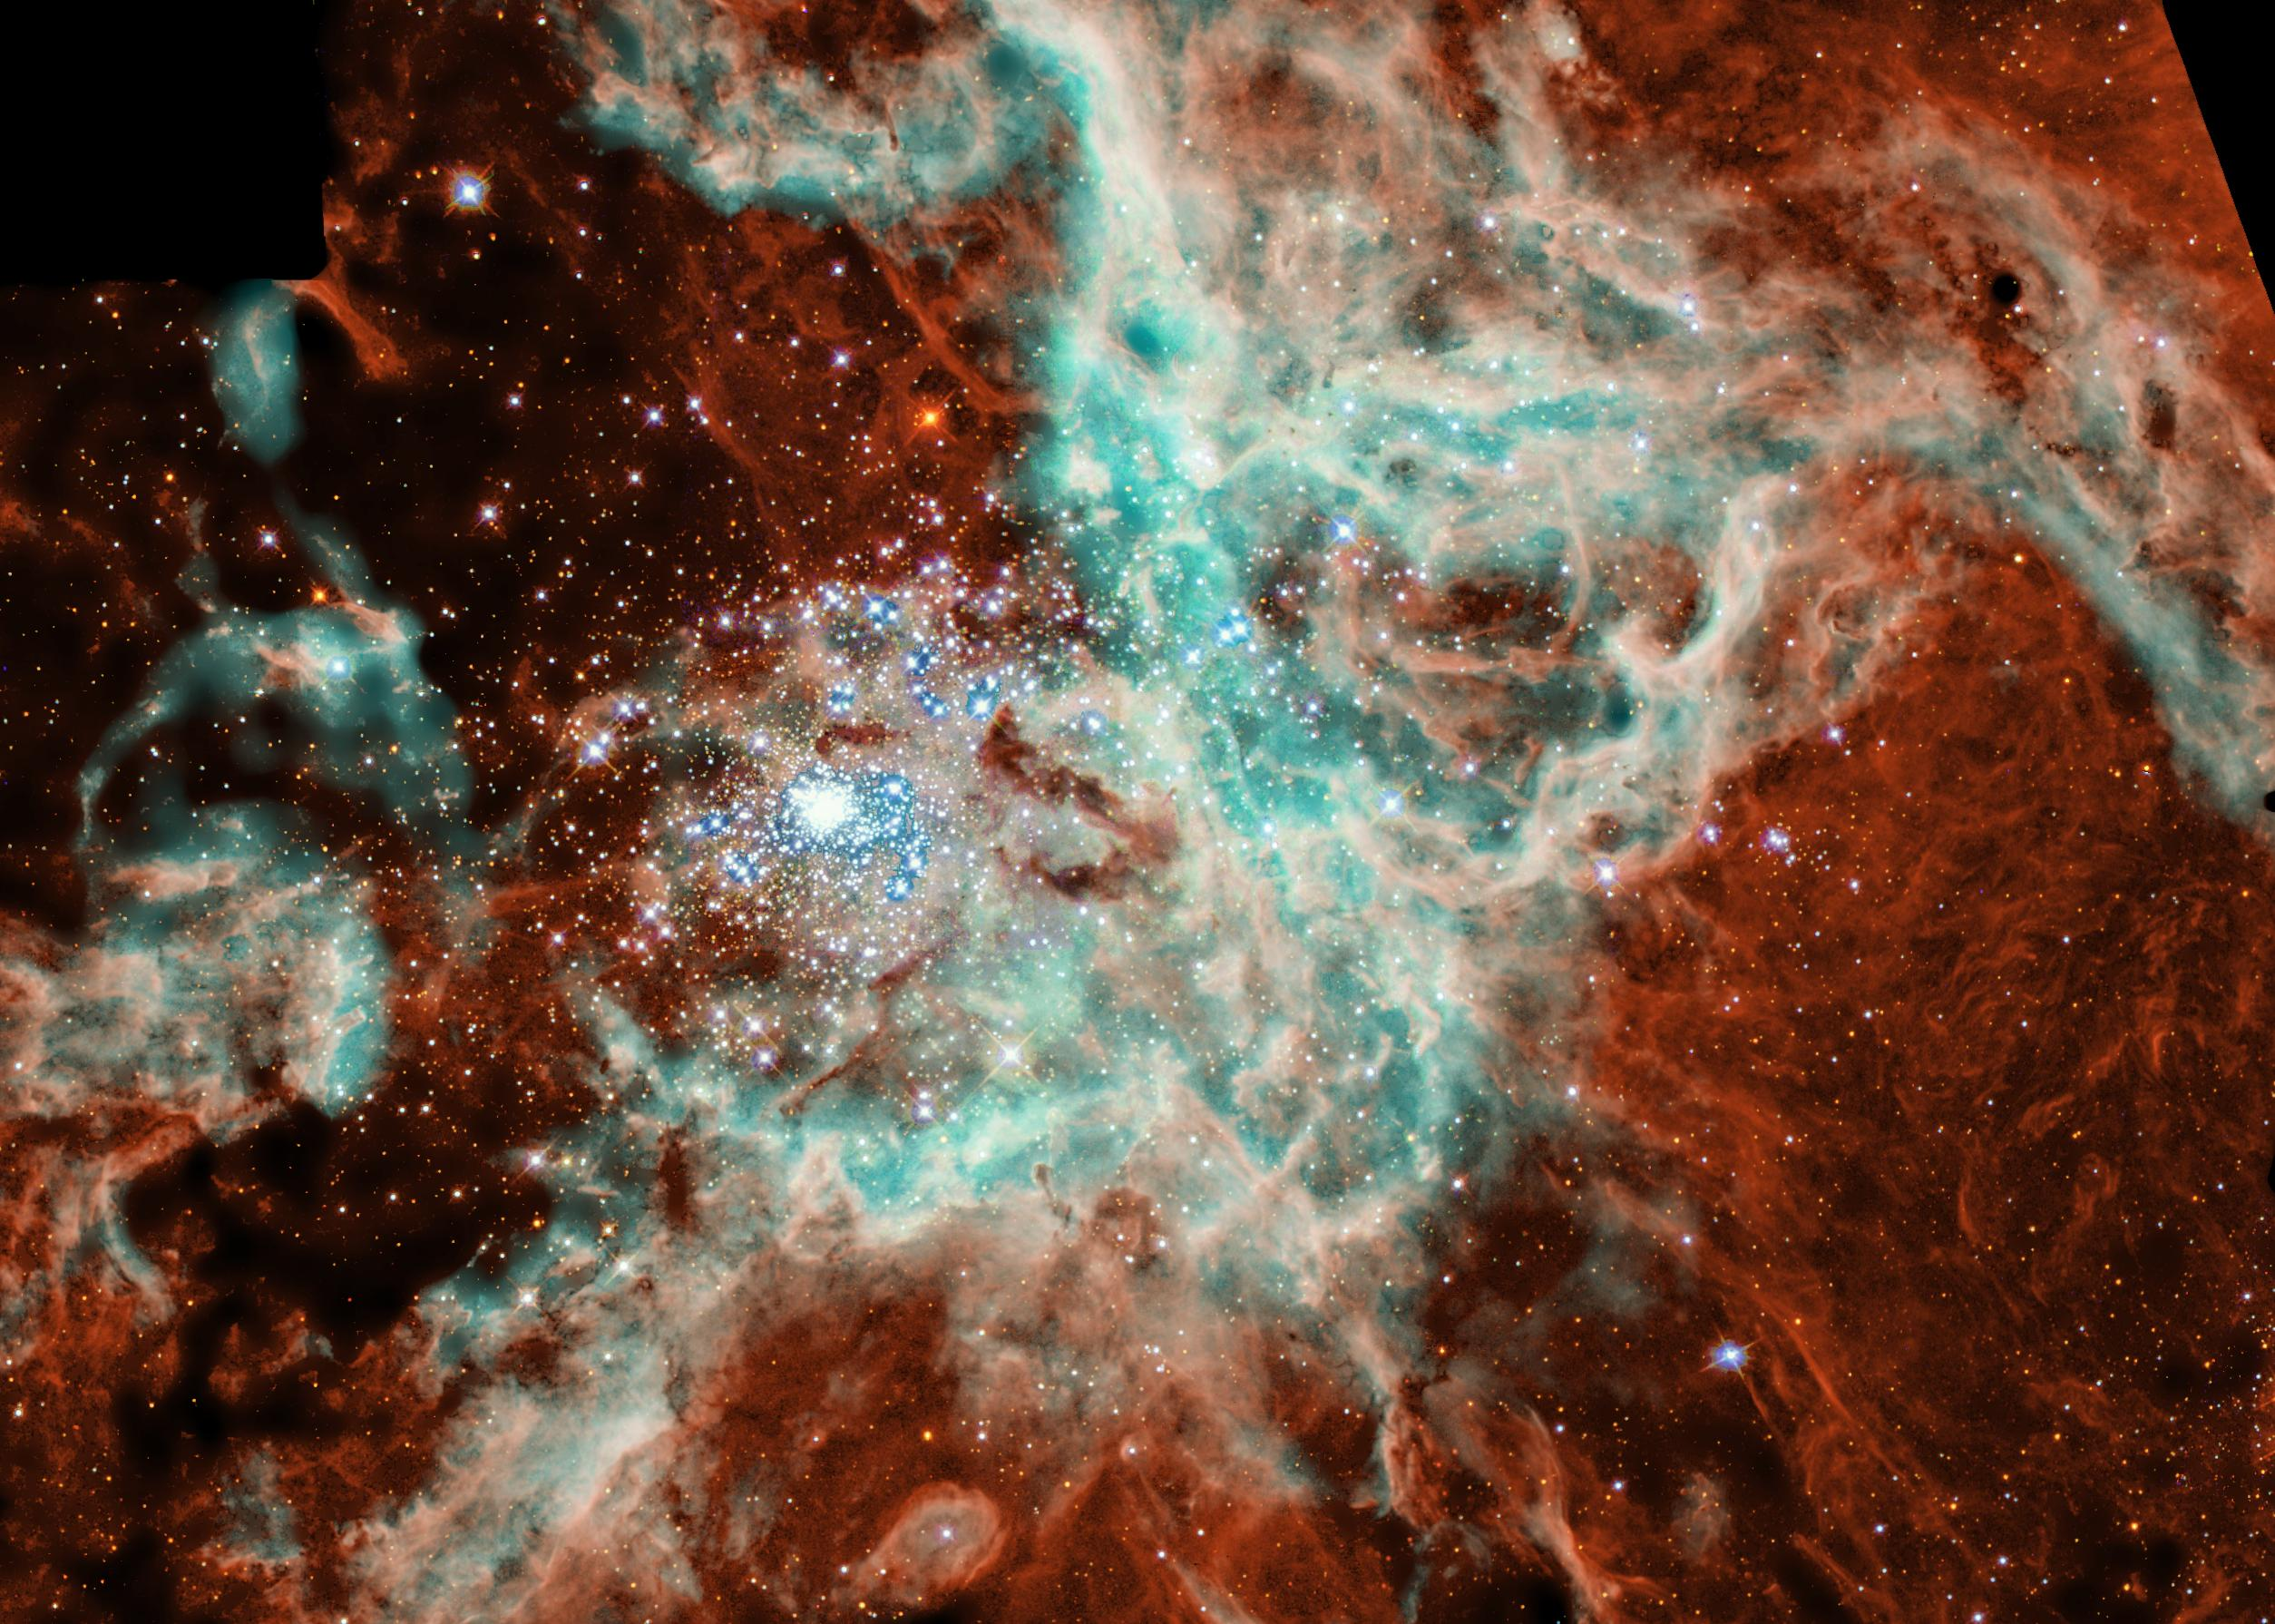
o[\xGgf !&:%
“ca x] lktf, ;+;f/sf] ;[li6 x[\g cl3 tkfO{sf] ;Dd[\v d]/f h[\g dlxdf lyof], To;}n] cfkm\gf] pkl:yltdf dnfO{ dlxldt kfg[\{xf];\ . ”
22
©2004 TBBMI
8.0.03a.

Slide 24
co[\a #*:$-!*
CREATION
“k[YjLsf] hu d}n] a;fNbf t+ sxf+ lyO;\ ?”
23
1
©2004 TBBMI
8.0.03a.

Slide 25
pTktL . ! -!!
pTk= #:!%:…”To;n] t]/f] lz/ s[\RRofpg]5, / t}+n] To;sf] s[\s[\{Rrf] 8:g]5;\ . ”
NIV footnote: “:qLsf] ;Gtfgn] jf:tjd} ;k{sf] lz/ s[\RRofpg]5 ; ;}tfg dflysf] v|Li6sf] ljhodf g} of] k|lt1f k[\/f x[\G5 – Tof] ljhodf ;a} ljZjf;Lx? /xg]5g (/f]ld !^:@)).
pTktL
;a} ;dox? ca|fxfd k[\j{sf x[\g .
CREATION
k|yd k[\?if / :qL
( l;4tf )
klxnf] kfk
( dfk laGb[\df gk[\Ug[\ )
pTktL
ABRAHAM
& a:t[\x?
klxnf] ;[\;drf/
( 5[\6sf/f )
klxnf] kl/jf/
( ljafb, ts{ )
klxnf] xTof
( a:t[\ut kfk )
hnk|no/OGb|0fL
(sfo{s\d #!: gf]cf)
w/f/f
(sfo{s\d #@: afa]n)
Handbook pg. 42-45
24
10

Slide 26
;f/+z: pTktL vftf k/d]Zj/sf] ;[i6L dflg; / p;sf] ktgsf] syf xf] . o;n] pxf+;usf] dflg;sf] wlgi6 / glhssf] ;DaGw tyf l;4 kfk/lxtsf] cj:yfdf dflg;nfO{ lkm{tf u/fpg] k/d]Zj/sf] cgGtsf] of]hgfsf] 3f]if0ffnfO{ atfpb5 . “of] lkmtf{ x[\g] syf rflx afOansf] ;Dk[\0f{ syf xf], / of] jf:tljs ;[\;dfrf/ klg xf] . ” hf]xg jflno[\/8
Handbook pg. 17-19
25
©2004 TBBMI
8.0.03a.

Slide 27

pTk. !-!!
&
;[i6L
c/fhstf
Klxnf] k[\?if / :qL
;[
Klxnf] kfk
Klxnf] ;[\;dfrf/
Klxnf] kl/jf/
(1000 B.C.)
Klxnf] xtof
/fhkl/jf/
hnk|no / OGb|0fL
w/f/f
ca|fxfd
(2000 B.C.)
# ;fd[\bfoLx?
;& z[\ o]
bf;Tj
& = $+#
o]z[\km
$ dflg;x?
Dff]zf
(1500 B.C.)
(500 B.C.)
z[\
S
Zf[\Gg]tf
o]z[\
o]
oxf]z[\
Handbook pg. 17-19
26

Slide 28
©2004 TBBMI
8.0.03a.
27

Slide 29


8f= l/Ss lu|lkmyaf6 ljt/0f • BibleStudyDownloads.org
of] k|:t[tL tkfO{sf] nflu lk|mdf pknAw 5 .
Notes:
The Bible…Basically (bb)

