Slide 1


afOan======
cfwf/e[\t
A Presentation of The Bible…Basically Ministries International Inc. Fort Worth, Texas
www.biblebasically.com
01
©2004 TBBMI
8.0.02.

Slide 2


( h] ePtf klg, Tof] 7fpF sxfF k5{ ?)
afOan … cfwf/e[\t
®
efu b[\O{
d+rnfO{ l;+3f/b} : afOalno k|flrg ef}ulns gSzf lgdf{0f .
02
©2004 TBBMI
8.0.02.

Slide 3
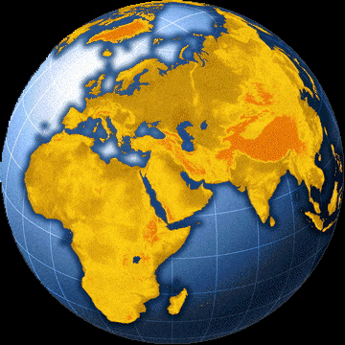
?
afOanLo 36gfsf] e[\dWo;ful/o cj:yf .
03
4

Slide 4
e[\dWo;fu/Lo ;d[\Gb|{
n]afgf]g\
l;l/of
X}kmf
uflnnsf] lemn
O/fs
Gfh/y
g]tfgef
t]nclk hkf
cdfg
o]?zn]d
h]l/sf]
Uffhf
X]a|f]g
d[[t ;fuf/
la/z]jf
O{;|fon
hf]8{g
OlhK6
;fx[\lb c/a
O{nf6
cncsfF
cSsfafsf] 3f+l6
04
1

Slide 5
e[\=;=
lg
x
uf ;
s
o[\ g
a]
o]
g] k
d[ ;
O{
sf af]
p
gSzfsf sf/0fx? !
l; k
Kff 3
Nff ;
Handbook pg. 15-16
05
1

Slide 6
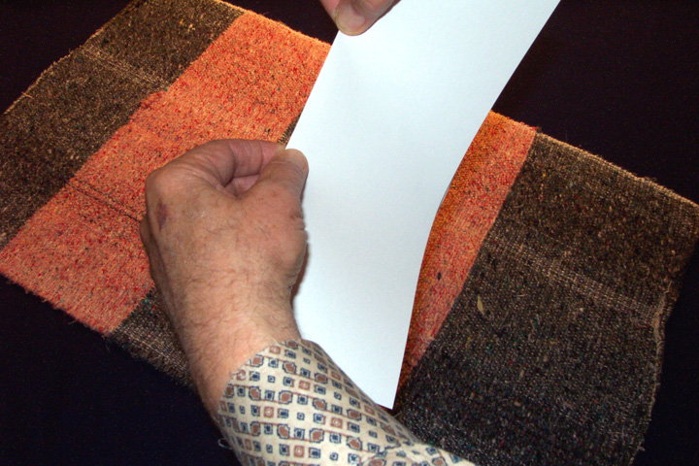
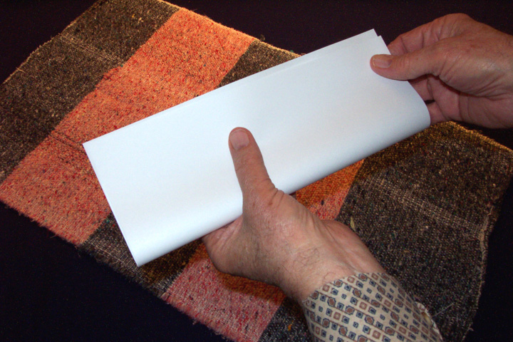
cWoog ;xof]uL #03a; (cltl/St vfln k[i6 #03b)
Ps kGgf sfuh lng[\xf];\ ,
t]/;f] u/L ,
nDafO{ af6 Ps kN6 k6fpg[\;\ ,
Handbook pg. 15-16
06

Slide 7
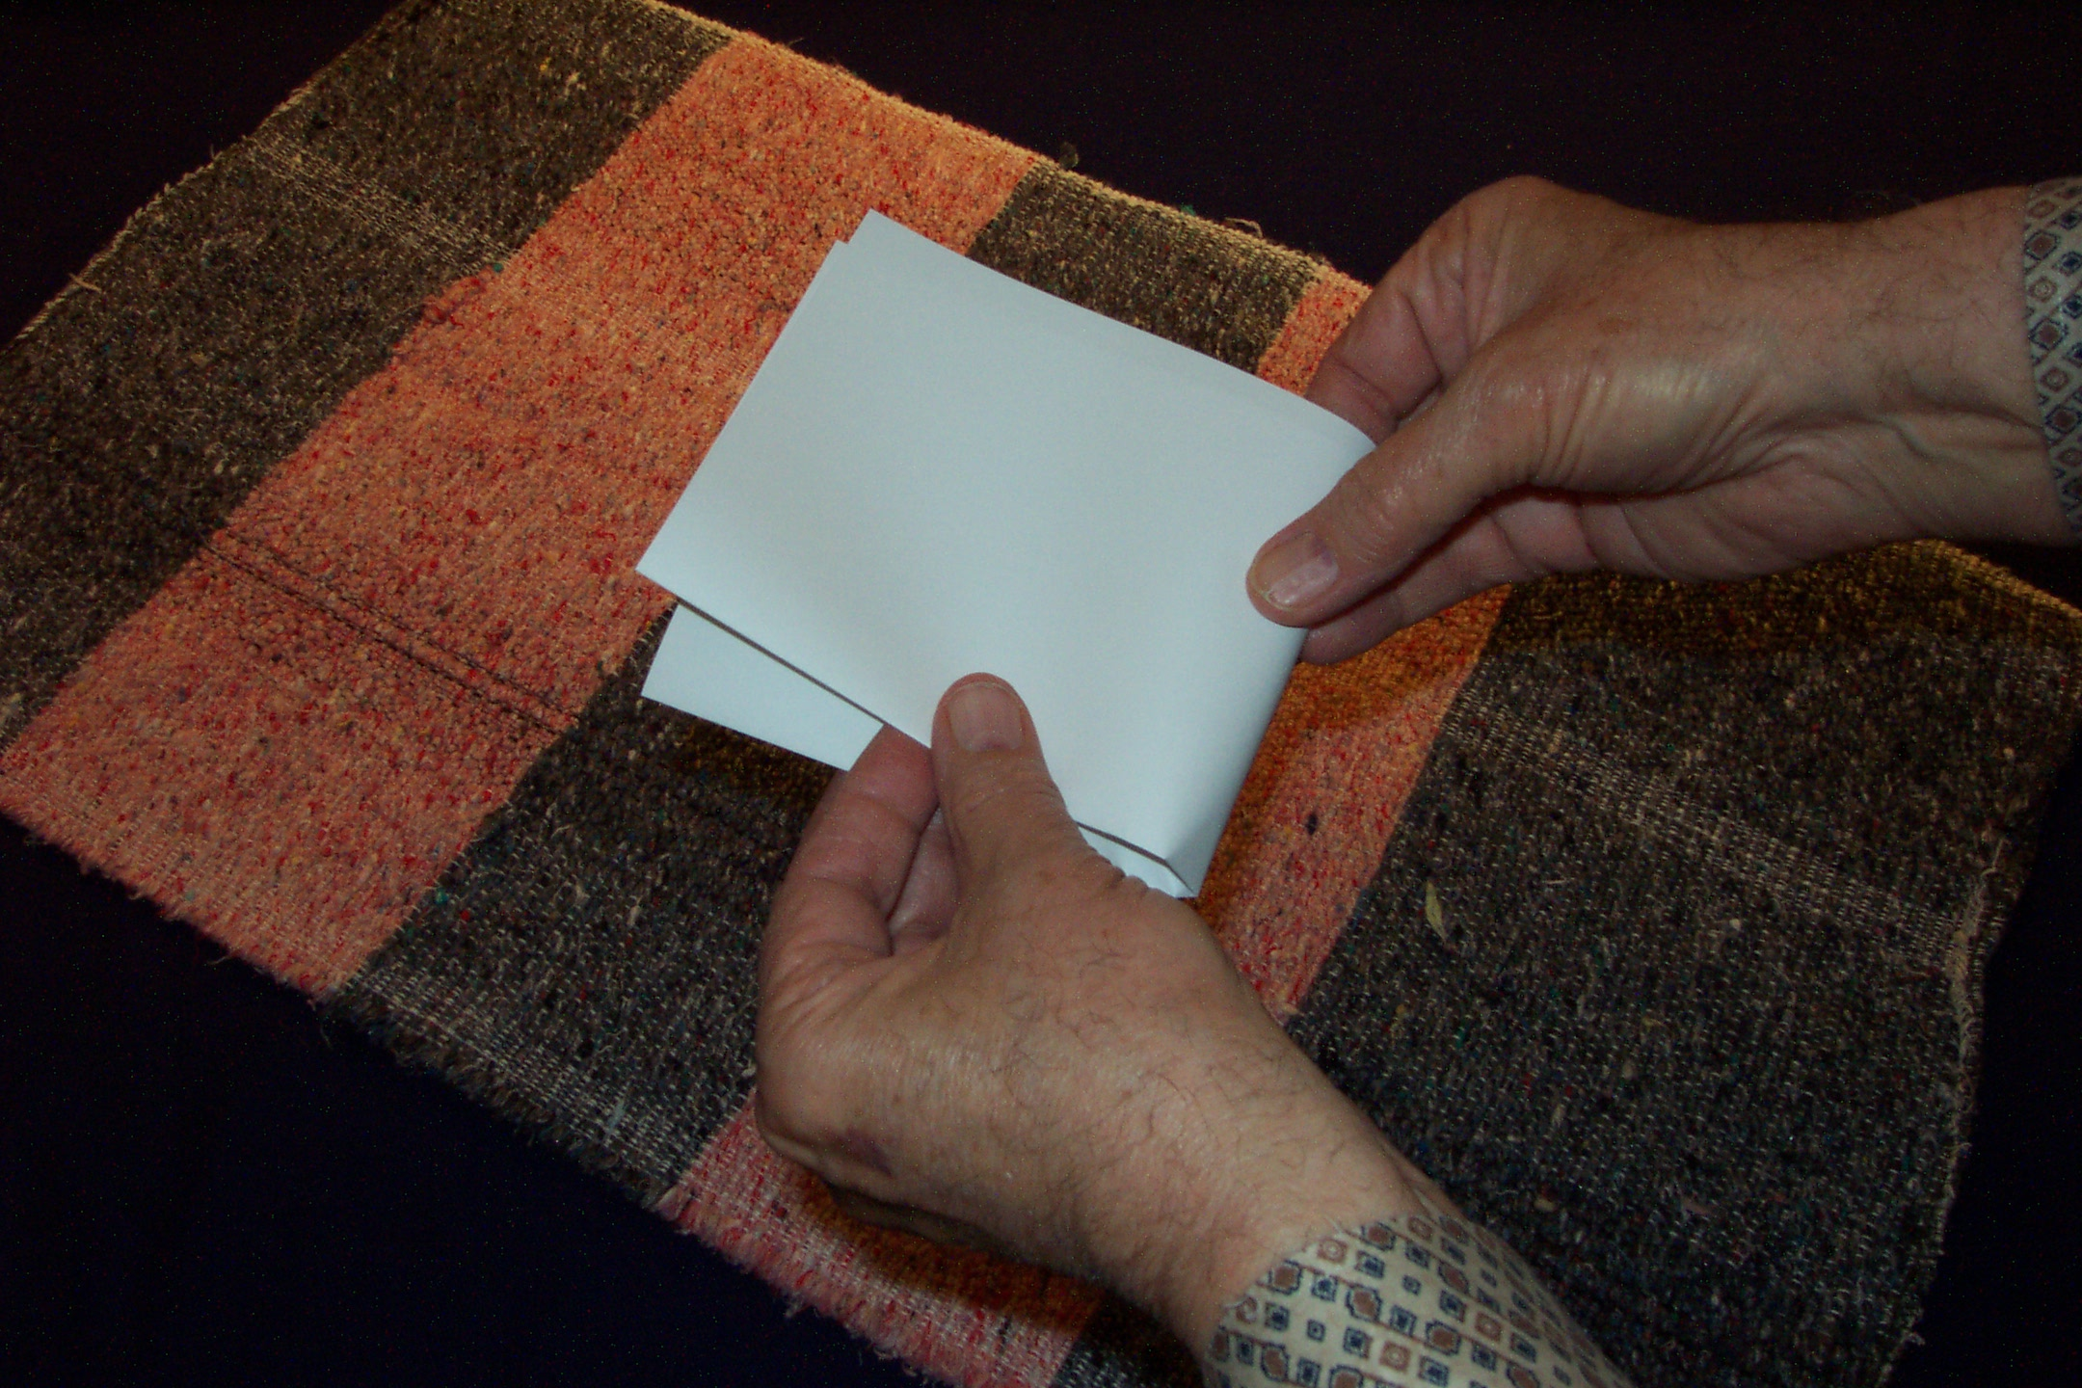
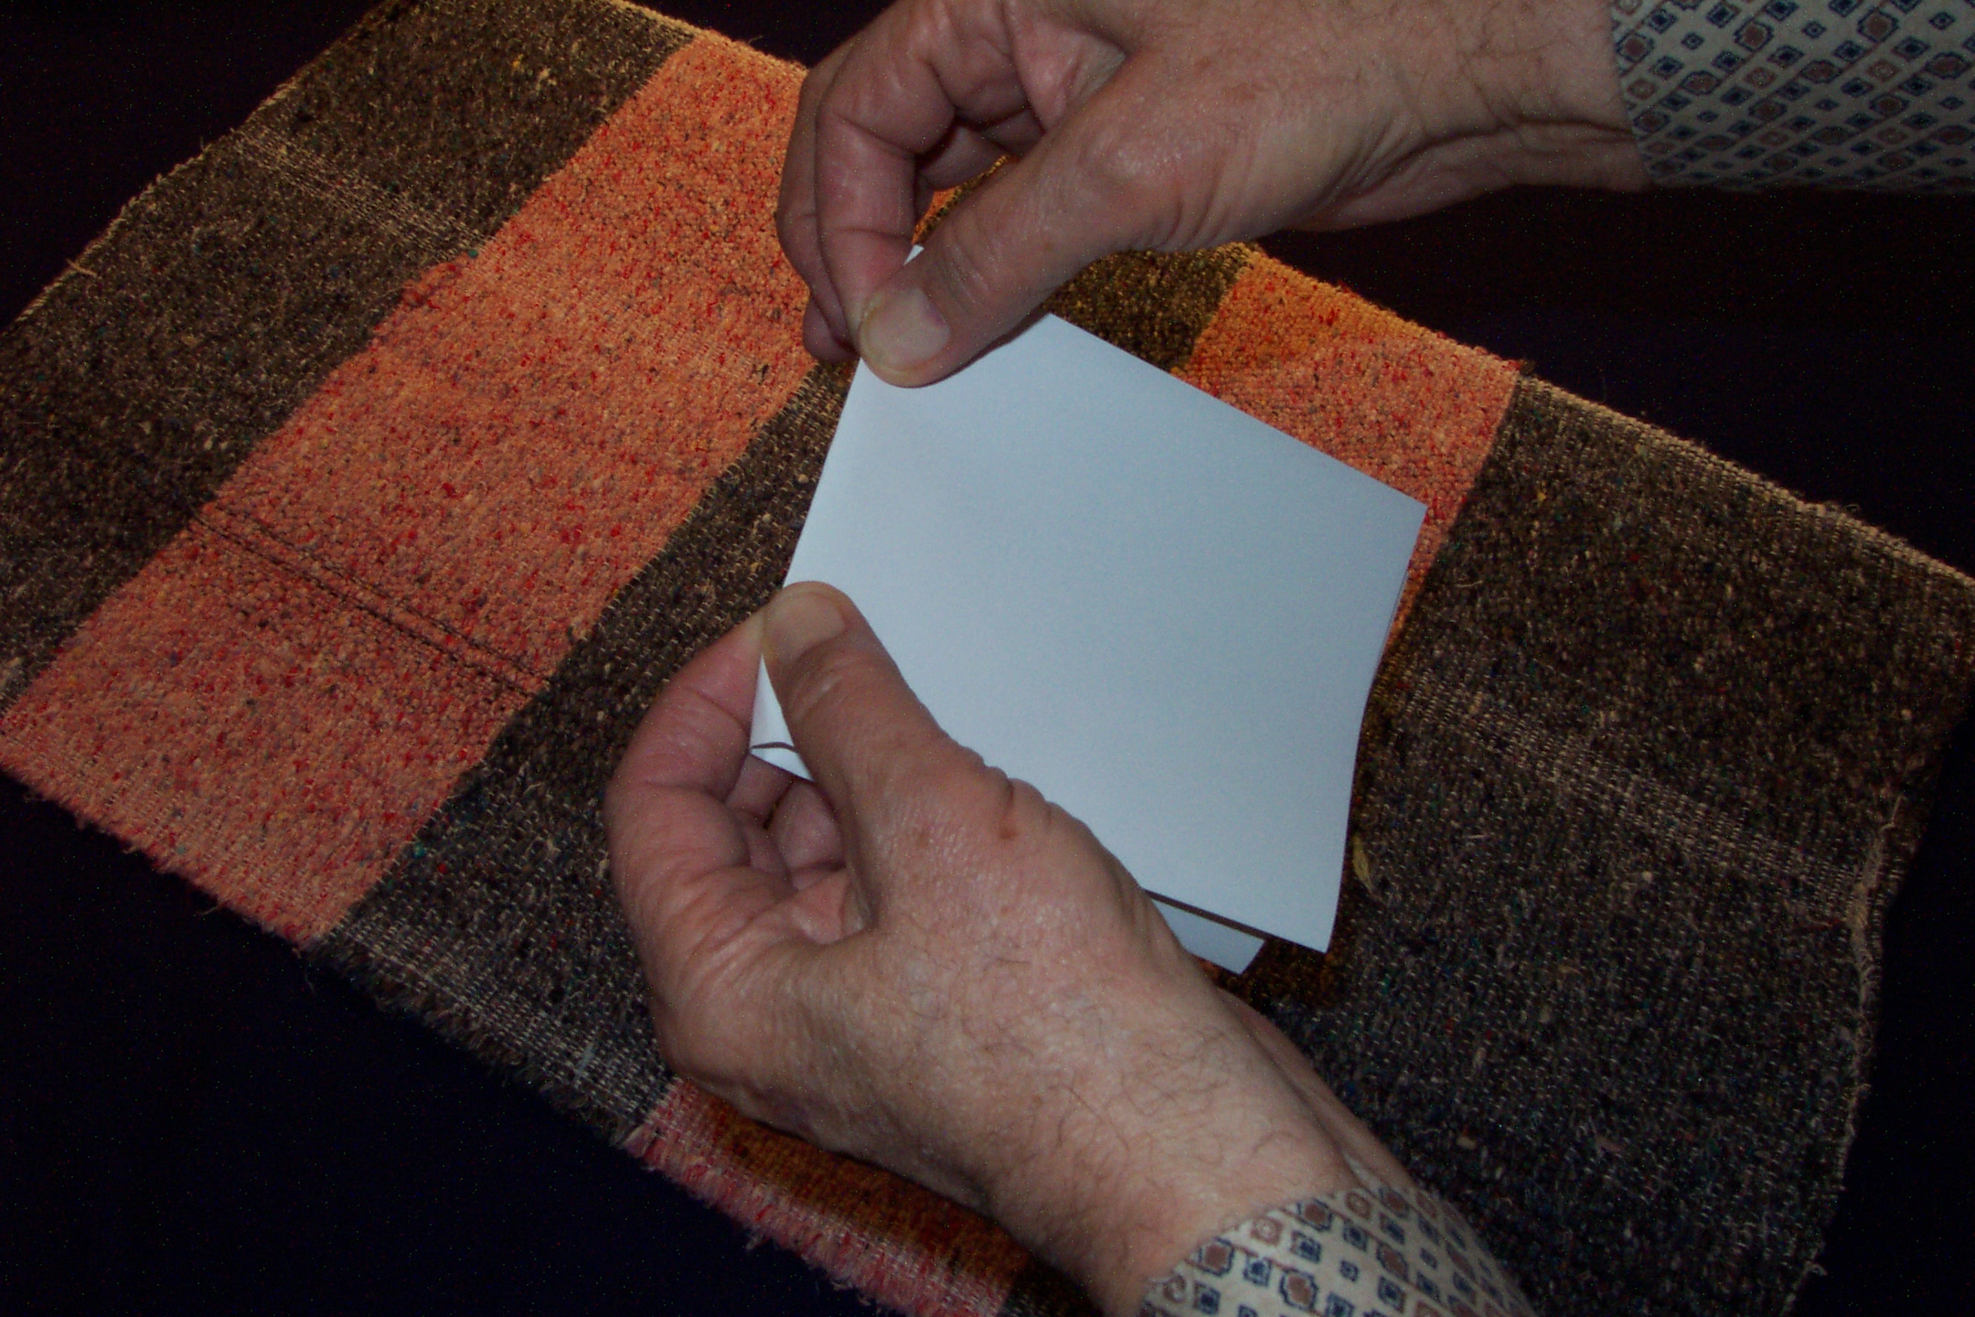
km]l/ o;nfO{ Ps kN6 k6fpg[\;\ …
…b[\O j6f lsgf/ /]vfx? agfpg[\ xf];\ .
Handbook pg. 15-16
07

Slide 8
Handbook pg. 15-16
08
3

Slide 9
k|yd\: ^ kflgsf efux?
bf];|f]: !) 7fpFx?
t];|f]: ;DalGwt\ leGgtf
Handbook pg. 15-16
09
2

Slide 10
Handbook pg. 15-16
10
1

Slide 11
Handbook pg. 15-16
11

Slide 12
:yfgsf] gfdx? k|of]u gug[\{; ...
s]an k|of]u ug[\{;\
Gffdx?sf] klxnf cIf/...
;Dk[\0f{ zAbx? g n]Vg[\;\ .
Handbook pg. 15-16
12

Slide 13
e[\=;=
Handbook pg. 15-16
13

Slide 14
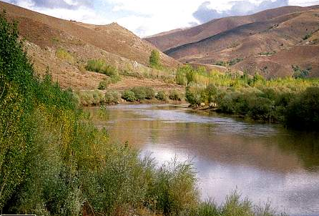
e[\=;=
o[\= g=
Handbook pg. 15-16
14

Slide 15

e[\=;=
o[\= g=
k=3f=
Handbook pg. 15-16
15

Slide 16
e[\=;=
e[\dWo;fufl/o ;d[\Gb|
o[\= g=
o[\km/6L; gbL
k=3f=
k/;Log 3fF6L
Handbook pg. 15-16
16
2

Slide 17
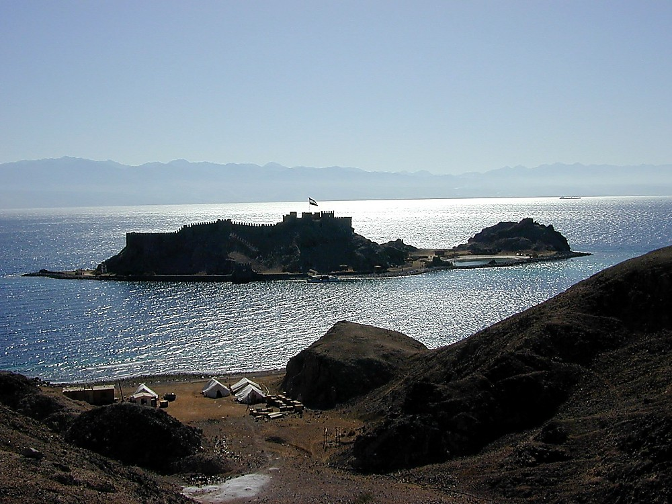
e[\=;=
ER
k=3f=
Handbook pg. 15-16
17

Slide 18
e[\=;=
ER
Nffn ;d[\Gb|
k=3f=
Nff=;=
Handbook pg. 15-16
18

Slide 19
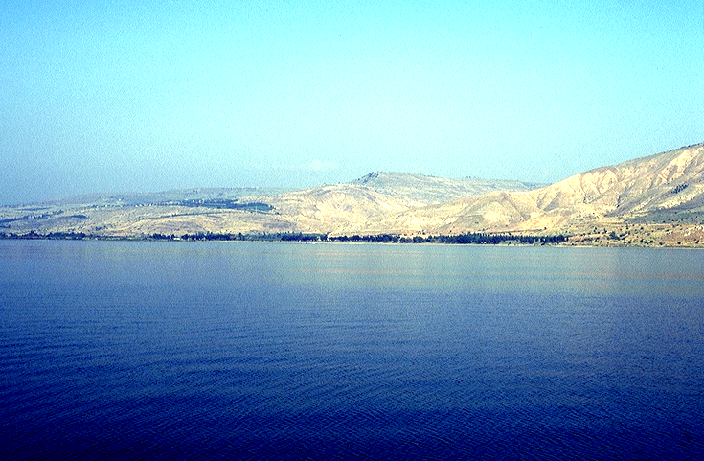
e[\=;=
ER
k=3f=
Nff=;=
Handbook pg. 15-16
19

Slide 20
e[\=;=
ER
k=3f=
Nff=;=
Handbook pg. 15-16
20

Slide 21
e[\=;=
Uff=;=
uflnnsf] ;d[\Gb|
ER
k=3f=
Nff=;=
Handbook pg. 15-16
21

Slide 22
e[\=;=
Uff=;=
Ufflnn\sf] ;d[\Gb|
ER
d[=;=
d[t ;fuf/
k=3f=
Nff=;=
Handbook pg. 15-16
22

Slide 23
e[\=;=
Uff=;=
o[\=g=
d[=;=
ob{g glb
k=3f=
Nff=;=
Handbook pg. 15-16
23

Slide 24
^
e[\=;=
Uff=;=
o[\=g=
d[=;=
k=3f=
Kfflgsf efux?
Nff=;=
Handbook pg. 15-16
24
7

Slide 25

e[\=;=
Uff=;=
o[\=g=
“e[\ld ”
d[=;=
k=3f=
Nff=;=
Handbook pg. 15-16
27

Slide 26
!) :yfgx?
e[\=;=
!)
Uff=;=
o[\=g=
d[=;=
hldgsf efux?
k=3f=
Nff=;=
Handbook pg. 15-16
26
1

Slide 27
!) :yfgx?
e[\=;=
$
Uff=;=
o[\=g=
d[=;=
k=3f=
Nff=;=
Handbook pg. 15-16
27

Slide 28
!) :yfgx?
e[\=;=
^
$
Uff=;=
o[\=g=
afOanLo
“ 36gfx?sf] cj:yf ”
d[=;=
k=3f=
Nff=;=
Handbook pg. 15-16
28

Slide 29
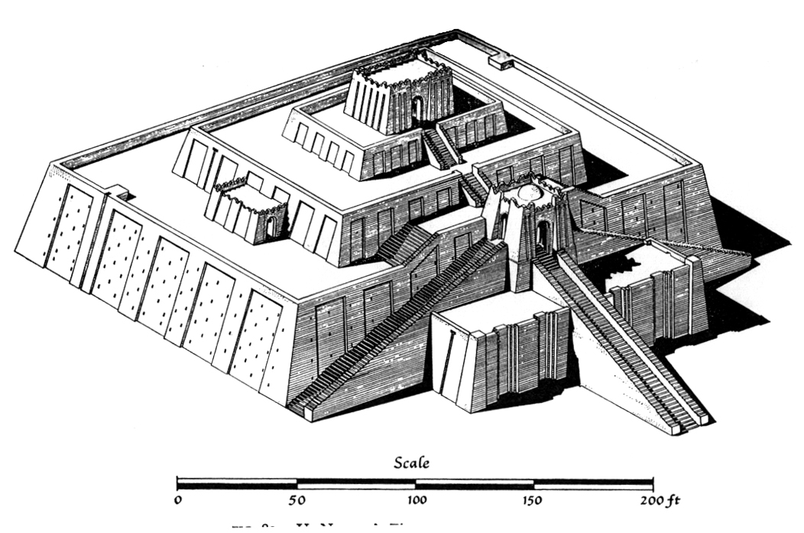
!) :yfgx?
e[\=;=
^
$
Uff=;=
o[\=g=
d[=;=
p
k=3f=
RS
rfn8Lhsf] p/
Handbook pg. 15-16
29

Slide 30

!) :yfgx?
e[\=;=
^
$
Uff=;=
o[\=g=
a]
d[=;=
p
a]lanf]g
k=3f=
RS
Handbook pg. 15-16
30

Slide 31

!) :yfgx?
e[\=;=
^
$
x
uf=;=
o[\=g=
a
d[=;=
p
x/fg
( x/fg, 6sL{ )
k=3f=
RS
Handbook pg. 15-16
31

Slide 32
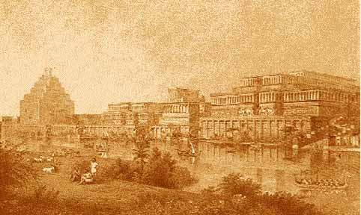
!) :yfgx?
e[\=;=
^
$
lg (c)
x
uf=;=
o[\=g=
a]=
d[=;=
p
lggj] (c;l/of)
d;[\n ,O/fs
k=3f=
RS
Handbook pg. 15-16
32

Slide 33
!) :yfgx?
e[\=;=
^
$
g=(c)
x
Uff=;=
o[\=g=
a]=
d[=;=
p
k=3f=
nf=;=
Handbook pg. 15-16
33

Slide 34
!) :yfgx?
e[\=;=
^
$
g (c)
x
at{jfg sgfg
s
uf=;=
o[\=g=
B
d[=;=
p
k=3f=
nf=;=
Handbook pg. 15-16
34
1

Slide 35
!) :yfgx?
e[\=;=
^
$
g(c)
x
uf=;=
C
o[\=g=
o]?z]nd
o]
a]
d[=;=
p
k=3f=
nf=;=
Handbook pg. 15-16
35

Slide 36
!) :yfgx?
e[\=;=
^
$
g(c)
x
uf=;=
s
o[\=g=
a]=
o]
g]=k=
g]af]sf] kj{t
d[=;=
p
k=3f=
nf=;=
Handbook pg. 15-16
36

Slide 37

!) :yfgx?
e[\=;=
^
$
lg(c)
H
sfb]z- aflg{of
uf=;=
s
o[\=g=
a]=
o]
gL=k=
d[=;=
sf=a=
p
k=3f=
nf=;=
Handbook pg. 15-16
37

Slide 38
!) :yfgx?
e[\=;=
^
$
lg=(c)
OlhK6
x
SG
s
ER
a]=
o]
MN
d[=;=
O=
sf=a=
p
k=3f=
nf=;=
Handbook pg. 15-16
38

Slide 39
!) :yfgx?
e[\=;=
^
$
lg(c)
x
l;of]gsf] ka{t
uf=;=
s
o[\=g=
a]=
o]
lg=k=
d[=;=
O
sf a
p
l;=k=
k=3f=
nf=;=
Handbook pg. 15-16
39

Slide 40
!) :yfgx?
e[\=;=
^
$
lg(c)
!) hldgsf efux?
x
uf=;=
s
o[\=g=
a]
o]
lg=k=
d[=;=
O
sf=a=
p
l;=k=
k=3f=
nf=;=
Handbook pg. 15-16
40
2

Slide 41
Gofostf{ @):!
!) :yfgx?
e[\=;=
^
$
lg(c)
x
” bfg b]lv
a]/l;jf
;Dd ”
e[\efu
uf=;=
s
o[\=g=
a]
o]
lg=k=
d[=;=
O
sf=a=
p
l;=k=
k=3f=
nf=;=
Handbook pg. 15-16
41
3

Slide 42
e[\dWo;fufl/o ;d[\Gb|
lggj] (c;l/of)
Xf/fg
Ufflnnsf] ;d[\Gb|
o[\lkm{l6; glb
sgfg
g]af] ka{t
a]lanf]g
o]?zn]d
36gfsf]
d+r !
d[t ;fuf/
OlhK6
sfb]z af/gL
p/
l;of]g ka{t
Kf/l;ofg 3fFl6
Nffn ;d[\Gb|
Handbook pg. 15-16
42

Slide 43
ca …lz3| k[\glj{rf/sf
nflu ...
Handbook pg. 15-16
43

Slide 44
Handbook pg. 15-16
44

Slide 45
Handbook pg. 15-16
45

Slide 46
Handbook pg. 15-16
46

Slide 47
Handbook pg. 15-16
47

Slide 48
e[\=;=
Handbook pg. 15-16
48

Slide 49
e[\=;=
o[\=g=
Handbook pg. 15-16
49

Slide 50
e[\=;=
o[\=g=
k=3f=
Handbook pg. 15-16
50

Slide 51
( e[\dWo;fufl/o ;d[\Gb| )
e[\=;=
o[\=g=
( o[\km/6L; gbL )
k=3f=
( k/;Log 3fF6L )
Handbook pg. 15-16
51

Slide 52
e[\=;=
o[\=g=
k=3f=
Handbook pg. 15-16
52

Slide 53
e[\=;=
o[\=g=
k=3f=
nf=;=
Handbook pg. 15-16
53

Slide 54
e[\=;=
o[\=g=
k=3f=
nf=;=
Handbook pg. 15-16
54

Slide 55
e[\=;=
o[\=g=
k=3f=
nf=;=
Handbook pg. 15-16
55

Slide 56
e[\=;=
o[\=g=
k=3f=
nf=;=
Handbook pg. 15-16
56

Slide 57
e[\=;=
uf=;=
o[\=g=
k=3f=
nf=;=
Handbook pg. 15-16
57

Slide 58
e[\=;=
uf=;=
o[\=g=
d[=;=
k=3f=
nf=;=
Handbook pg. 15-16
58

Slide 59
e[\=;=
uf=;=
o[\=g=
ob{g glb
d[=;=
k=3f=
nf=;=
Handbook pg. 15-16
59
1

Slide 60
!) :yfgx?
e[\=;=
uf=;=
o[\=g=
d[=;=
k=3f=
nf=;=
Handbook pg. 15-16
60

Slide 61
!) :yfgx?
e[\=;=
$
uf=;=
o[\=g=
d[=;=
k=3f=
nf=;=
Handbook pg. 15-16
61

Slide 62
!) :yfgx?
e[\=;=
^
$
uf=;=
o[\=g=
d[=;=
k=3f=
nf=;=
Handbook pg. 15-16
62

Slide 63
!) :yfgx?
e[\=;=
^
$
uf=;=
o[\=g=
d[=;=
p
k=3f=
nf=;=
Handbook pg. 15-16
63

Slide 64
!) :yfgx?
e[\=;=
^
$
uf=;=
o[\=g=
a]
d[=;=
p
k=3f=
nf=;=
Handbook pg. 15-16
64

Slide 65
!) :yfgx?
e[\=;=
^
$
x
uf=;=
o[\=;=
a]
d[=;=
p
k=3f=
nf=;=
Handbook pg. 15-16
65

Slide 66
!) :yfgx?
e[\=;=
^
$
lg(c)
x
uf=;=
o[\=g=
a]
d[=;=
p
k=3f=
nf=;=
Handbook pg. 15-16
66

Slide 67
!) :yfgx?
e[\=;=
6
4
lg(c)
x
uf=;=
o[\=g=
a]
d[=;=
p
k=3f=
nf=;=
Handbook pg. 15-16
67

Slide 68
!) :yfgx?
e[\=;=
^
$
lg c
x
s
uf=;=
o[\=g=
a]
d[=;=
p
k=3f=
nf=;=
Handbook pg. 15-16
68

Slide 69
!) :yfgx?
e[\=;=
^
$
lg . c
x
uf=;=
s
o[\=g
a]
of]
d[=;=
p
k=3f=
nf=;=
Handbook pg. 15-16
69

Slide 70
!) :yfgx?
e[\=;=
^
$
lg(c)
x
uf=;=
s
o[\=g
lg k
a]
of]
d[=;=
p
k=3f
nf=;=
Handbook pg. 15-16
70

Slide 71
!) :yfgx?
e[\=;=
^
$
lg, c
x
uf=;=
s
o[\=g
a]
of]
lg=k=
d[=;=
sf=a=
p
k=3f
nf=;=
Handbook pg. 15-16
71

Slide 72
!) :yfgx?
e[\=;=
^
$
lg, c
x
uf=;=
s
o[\=g
a]
of]
lg=k=
d[=;=
O
sf=a=
p
k=3f
nf=;=
Handbook pg. 15-16
72

Slide 73
!) :yfgx?
e[\=;=
^
$
lg, c
x
uf=;=
s
o[\=g
a]
of]
lg=k=
d[=;=
O
sf=a=
p
l;=k=
k=3f
nf=;=
Handbook pg. 15-16
73

Slide 74
!) :yfgx?
e[\=;=
^
$
lg(c)
x
uf=;=
s
o[\=g=
a]
o]
lg=k=
d[=;=
O
sf=a=
p
l;=k=
k=3f=
nf=;=
Handbook pg. 15-16
74
1

Slide 75
!) :yfgx?
e[\=;=
^
$
lg(c)
x
e[\dL
uf=;=
s
o[\=g=
a]
o]
lg=k=
” bfg
b]lv
a]/l;jf ;Dd ”
d[=;=
O
sf=a=
p
l;=k=
k=3f=
Gofostf{ @):!
nf=;=
Handbook pg. 15-16
75

Slide 76
e[\dWo;ful/o ;d[\Gb|
lggj] (c;l/of)
Xf/fg
uflnnsf] ;d[\Gb|
o[\km/l6; gbL
sgfg
d]af] ka{t
a]lanf]g
36gfsf]
d+r !
o]?zn]d
d[t ;fuf/
OlhK6
sfb]z af/lg
p/
l;of]g ka{t
Kf/l;og 3fF6L
Nffn ;d[\Gb|
Handbook pg. 15-16
42

Slide 77
ca oL ;a}sf] sf/0f rfxL ...
Handbook pg. 15-16
77

Slide 78
pQ/sf] dlnnf] e[\ld b]lv blIf0fsf] phf8 :yfg ;Dd …
Handbook pg. 15-16
78

Slide 79
e[\=;=
lg(c)
x
uf=;=
s
o[\=g=
a]
o]
lg=k=
d[=;=
…tkfO{n] tkfO{sf] dl:tis cfFvfdf o; dxfg afOanLo 36gfx?sf] gf6lso d+rg ug{ “d+r t}of/” ug[\{ x[\g]5 !
O
sf=a=
p
l;=k=
k=3f=
nf=;=
Handbook pg. 15-16
79
1

Slide 80
e[\=;=
pTktL
ca|fxfd
o];[\km
lg(c)
x
Df]zf
uf=;=
s
o[\=g=
oxf]z[\
a]
o]
lg=k=
c/fhstf{
/fhkl/jf/
d[=;=
bf;Tj
O
z[\Gotf
o]z[\
sf=a=
p
l;=k=
k=3f=
nf=;=
Handbook pg. 15-16
80

Slide 81
ca tkfO{sf] kfnf] … tkfO{sf] dl:tis af6 afOanLo k|flrg gSzf agfpg[\ xf];\ !
gSzfx? k[\/f ul/Psf 5g\ cWoog ;xof]lu ##)
Handbook pg. 15-16
81

Slide 82
5f]6f] sfns|ddf
©
“ca, tkfO{n] of] 7fpF sfxfF k5{ hGg[\ x[\g]5 !”
“h] ePtfklg, Tof] :yfg sxfF k5{?”
Handbook pg. 15-16
1
82

Slide 83

ca b]lv, afOan …cfwf/e[\t, tkfO{sf] dl:tisdf 5 …
•of] rf+lx “afOan vftf”
• “afOan vftf” vf]Ng] d[\Vo a[\Fbf … p= &= z[\= o]=
• dl:tis gSzf afOansf] d[\Vo d[\Vo 36gfx?nfO{ ;d]6]/ t}of/ ul/Psf] 5 .
•afOansf] “syf” : “ 5f]6s/L sfns|ddf ”
1
83

Slide 84
afOan======
cfwf/e[\t
A Presentation of The Bible…Basically Ministries International Inc. Fort Worth, Texas
www.biblebasically.com
84
©2004 TBBMI
8.0.02.

Slide 85
85
©2004 TBBMI
8.0.02.

Slide 86


8f= l/Ss lu|lkmyaf6 ljt/0f • BibleStudyDownloads.org
of] k|:t[tL tkfO{sf] nflu lk|mdf pknAw 5 .
Notes:
The Bible…Basically (bb)

