Slide 1


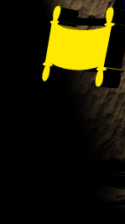
afOan======
cfwf/e[\t
afOan======
cfwf/e[\t
afOan cfwf/e[\t ;]jfsfO{sf] k|:t[\lt
kmf]y{ jf]y{, 6f/;;\
A Presentation of The Bible…Basically Ministries International Inc. Fort Worth, Texas
www.biblebasically.org
8f= l/Ss lu|lkmyaf6 ljt/0f • BibleStudyDownloads.org
8.0.01.
©2004 TBBMI
04

Slide 2
s[kof Wofg lbg[\xf];===
k|lzIf0f ;do el/ kmf]g / cGo s[\g} klg ;+rf/sf ;fwfgx? aGb ug{[\xf];\ . sIffdf tkfO{sf ;flyx?n] tkfO{nfO{ wGoafb lbg]5g\ .
8.0.01.
01.
1

Slide 3
©
afOan===cfwf/e[\t ;]jfsfO{
;dLltsf ;b:ofx?
8f= hf]g\ xGgfx .
Distinguished Professor of Historical Theology
Dallas Theological Seminary
Dallas, Texas
8f= l/Ss lu|lkmy
DMin Director
Assoc. Professor in Biblical Studies
Singapore Bible College
Republic of Singapore
8f= ljlnod cf/= a|fO6
Late Founder
Campus Crusade for Christ
Orlando, Florida
Hf]g dfO;]n s/6 g]N;g
President Exec. Vice President
East/West Ministries
Dallas, Texas
/]e= 8Un; e]n]gh[\nf
Senior Pastor, Conservative Baptist Missions
Chiesa Battista Evangelica di Casoria
Naples, Italy
Jfl;ln l8ld6L{e:sL
Director for Russia
Global Missions Fellowship
Penza, Russia
8f= 8]la8 j{r
Former President
Tyndale Theological Seminary
Amsterdam, The Netherlands
8f= ljlnod 6f]nf/
Distinguished Professor of Biblical Backgrounds
Southwestern Baptist Theological Seminary
Ft. Worth, Texas
sf/]g u|fGh/
Director of Bible Studies
Southwest Christian Schools
Ft. Worth, Texas
8f= s]g]y x/6g
Senior Pastor
McKinney Memorial Bible Church
Ft. Worth, Texas
8.0.01.
©2004 TBBMI
02

Slide 4
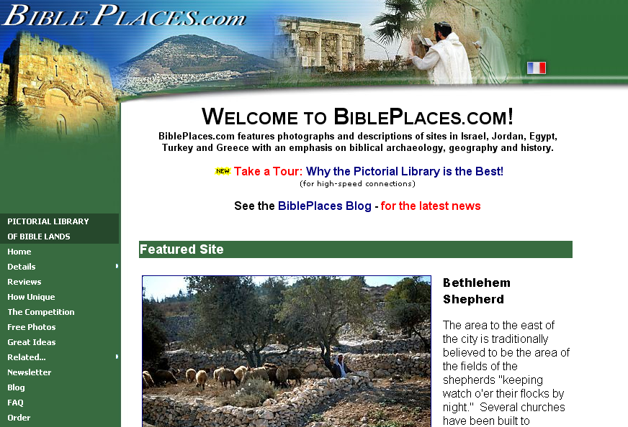
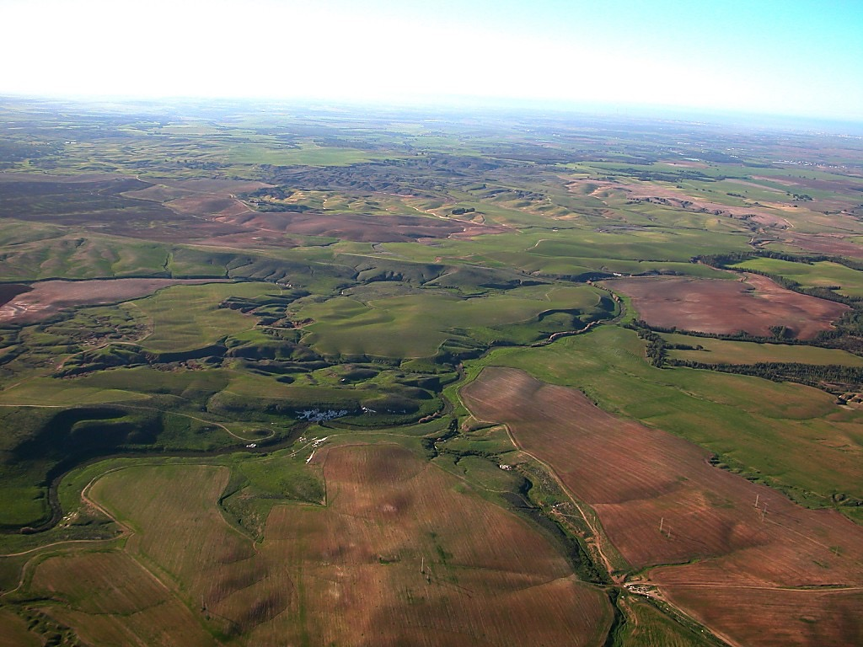
The Pictorial Library of Bible Lands
Our ministry is deeply indebted to Todd Bolen, creator of the Pictorial Library of Bible Lands, for his generous permission to use photo resources throughout THE BIBLE…BASICALLY®. TBB users are urged to visit BiblePlaces.com and explore the thousands of photo resources available: from the Holy Land, throughout the Aegean and Mediterranean Basin to Southern Europe where the Christian faith took root. BiblePlaces.com offers teachers and visual producers an incomparable array of high-resolution digital photographic resources. Please visit! Thanks, Todd!
Notes:
This presentation has been granted use of almost 150 pictures from the BiblePlaces.com website. We thank Todd Bolen for his support!

Slide 5
afOan cfwf/e[\t sfo{s|d hf]xg O{= km|]dfg, lk=Pr=l8= 4f/f /rLt, lgdf{0fLt, / pTkflbt xf] .
Copyright © 2004 The Bible…Basically Ministries Intl. Inc., Ft. Worth, Texas
©;j{flwsf/ n]vsdf lglot 5 . of] s[lt ;o[\St /fHo cd]l/sfsf] k|sfzg sfg[\g cGt/ut ;[\/lIft 5 . s[\g} klg ljz]if sf/0f ljgf cf+lzs jf k[\0f{ n]vssf] cg[\dlt ljgf k|sfzg ug{ kfO{g] 5}g .
lt efux? hf] ljz]if?kdf cg[\dlt lbO{Psf v08x? 5g\ lawfly{xsf] clgjfo{tf cg[\;f/ k|sfzg ug{ ;lsg]5 .
d+qfno 8f= 6f]8 an]g, df:6/ sn]h, h]?;]nd, O;|fon / lkS6f]l/on n}a/L ckm afOan n]i8 h;n] o; k|]sfzgdf t:jL/z? /fVg cg[\dlt lbg[\eOsf]df cfef/ AoSt ub{5f} . sfb]z af/g]sf] t:jL/z? /fVg cg[\dftL xfldn] 8f= nL l/6dfo/sf] cg[\dtL c:6nLofaf6 kfof}+ . cGo k|lt k|sfzg / To;k|sf/sf ;fdfu|Lx? Xfd|f] hfgsf/L / 1fg ljgf ug{ / ug[\{k/]df d+qfnon] ;[\rgf hfl/ ug]{5 .
cfjZos kl/jt{gx? ul/g]5g\ . Tl:j/ / n]v v08df ulNtx? ;Sbf] x6fpg] k|of; ul/Psf]5 .
lzIfs, ;+rf/stf{, / k|lzIfsn] s[\g} klg tl:j/, k|:t[\tL jf efiff jf tf}8tl/sf, ;+:s/0f cyjf s[\g} klg sDk[\6/ k|fljlwss[\/fx? pTkfbssf] cg[\dtL ljgf ug{ kfOg] 5}g .
of] s[lt ;o[\St /fHo cd]l/sfsf] k|sfzg sfg[\g cGt/ut ;[\/lIft 5 .
8.0.01.
©2004 TBBMI
03

Slide 6
afOan======
cfwf/e[\t
afOan======
cfwf/e[\t
afOan cfwf/e[\t ;]jfsfO{sf] k|:t[\lt
kmf]y{ jf]y{, 6f/;;\
A Presentation of The Bible…Basically Ministries International Inc. Fort Worth, Texas
www.biblebasically.org
8.0.01.
©2004 TBBMI
04
©2004 TBBMI
8.0.01.
04

Slide 7


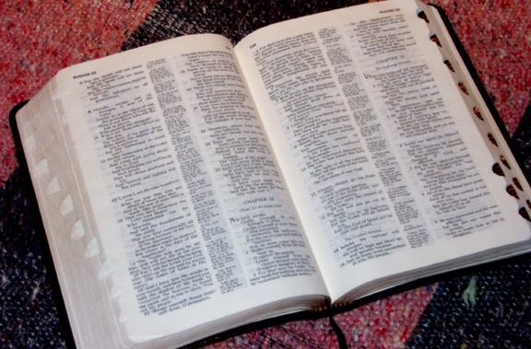
laifo, afOannfO{ dl:tisdf Aojl:yt\ ug{[\ .
®
afOan===cfwf/e[\t
Effu Ps
;[\?jft\ / cu|ufld
“afOan hLjg”
©2004 TBBMI
8.0.01.
05

Slide 8

?
o;sf] ;|f]t s] xf] …
x/]s OzfO l;2fGtx?
cfpg[\;\ o;
k|lzIf0fnfO{ Ps ulDe/ larf/;+u} cufl8 n}hfp .
OzfO laZjf;sf k2tLx?
k|Tos afOan cfwfl/t k[\:tsx?
x/]s OzfO k[\:tsfnodf
x/]s ;dflhs k[\:tsfnox?df
x/]s AolStut k[\:tsfnox?df
x/]s ljZjAoflk k[\:tsfnox?df
;+;f/sf x/]s b]zx?df
k|of, ;a} efiffx?df
tyf
afOan cfwfl/t ;a} larf/x?
x/]s laZjfl; tyf claZjfl; hf] csf]{ cGtl/Iffdf uPsf 5g\ .
8.0.01.
15
©2004 TBBMI
06

Slide 9
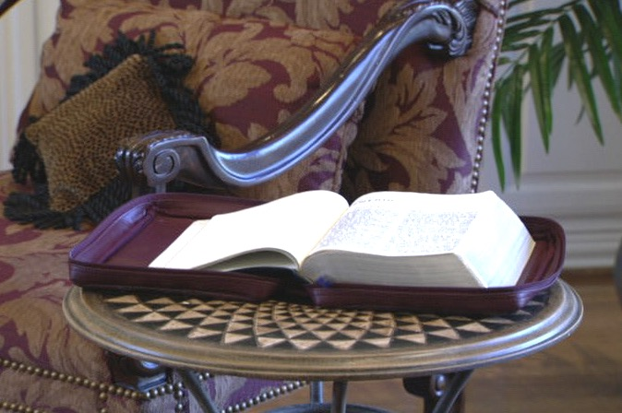
Xfd|f] laZjf;sf]
cfwf/e[\t b:tfj]h .
Handbook pg. 6
07
2

Slide 10

pgsf] k[\:tsdf,
“afOan ;Dk[\0f{?kdf s] xf] <”
8f= x]G/LP6f ldP/; n]lV5g\ ====.
Handbook pg. 6
08

Slide 11
w]/} dfl;x?sf nflu afOan 1fg,
Ps ;[\Gb/ df]lt h:t} xf] .
t/ k9\g]x?sf nflu eg] dl:tis dfq xf] ===
Handbook pg. 6
09

Slide 12

…;fFrf] efFlrPsf] 5====
Jojfl:yt\ k|ultlzn aOanLo ;[\lgof]lht syf cJojfl:yt\ / cGof]lnt agfO{Psf] 5 .
Handbook pg. 6
10

Slide 13
Handbook pg. 6
11

Slide 14
Wfd{zf:qsf] ulx/fO{
o;sf] cy{sf] laleGgtf
klaq cfTdfsf] ulx/f] cu[\jfO{kg
12
2

Slide 15
?
?
?
p2f/sf] lglDt k/d]Zj/sf] of]hgf
ca|fxfd tyf k|flrg O{;|fPn
k|e[\ o]z[\ lv|i6sf] k|s6
d08nLsf] hGd
?
?
?
?
?
?
13
5

Slide 16





  oL ;a} afOanx? k9\g[\xf];\ .
14

Slide 17
/ ToxLF af6 ;d:ofsf] ;[\?jft ePsf] 5 .
of] g} Pp6f dxfg cGof}ntf xf] .
• xhf/f} AofVofx?
• ;of}+ kfqfx?
• &,%),))) zAbx?
• !,@)) cWofox?
• #!,))) kbx?
• cgulGt leGg afOanx?
/ pNyfx?
15
7

Slide 18
s:n] s] u/\of] ?
s:n] s] eGof] ?
k[\:tsx?
lsg ?
Dflg;
ldtLx?
s;;Fu s:sf] s] ;DaGw 5 ?
16
7

Slide 19
;xfotf
s:n] s] u/\of] ?
s:n] s] eGof] ?
k[\:tsx?
lsg ?
Dflg;
ldtLx?
s;;Fu s:sf] s] ;DaGw 5 ?
17

Slide 20
;xfotf u/ !
Df o;nfO{ ug{ ;lSbg !!!
To;}n] ...d
of] kf:6/nfO{ g} ug{ lbg]5[\ !
18

Slide 21
s;n]
jf:tf u5{ ?
19

Slide 22
To;f]
eP s] ?
20

Slide 23
“ha ;Dd xfd|f] laZjf; ;Totfdf lgdf0f{ x[\b}g, ta ;Dd of] cg[\dfg , wf/0ff / cGwlaZjf; eGbf s]xL km/s x[\b}g . .”
- ldn]; :6fGkmf]{8
cflTds pGgtLsf l;2fGtx?
21
4

Slide 24
cWoogsf] uxg laGb[\ …
“xfdLnfO{ yfxfePsf] eGbf al9 xfdL laZjf; ug]{ 5}gf} ,
/ xfdL xfd|f] laZjf;x? eGbf dfly eP/ lhpg] 5}gf} .”
cnj6{ df]xn/
;efktL
The Southern Baptist Seminary Louisville, KY
22
3

Slide 25
afOan======
cfwf/e[\t
afOan======
cfwf/e[\t
afOan cfwf/e[\t ;]jfsfO{sf] k|:t[\lt
kmf]y{ jf]y{, 6f/;;\
A Presentation of The Bible…Basically Ministries International Inc. Fort Worth, Texas
www.biblebasically.org
8.0.01.
©2004 TBBMI
04

Slide 26
afOan…cfwf/e[\t
®
Ps larf/ ug]{ tl/sf xf] !
24
Notes:
CHANGED FROM THE ORIGINALS (TQC)

Slide 27
afOan…cfwf/e[\t
®
tkfO{n] l;Sg[\ x[\g]5 ls , afOannfO{
dlit:sdf s;/L Aojl:yt ug]{!
25
Notes:
CHANGED FROM THE ORIGINALS (TQC)

Slide 28
afOan…cfwf/e[\t
®
Ps dxTjk[\0f{ v08 : oxfF s]xL s[\/fx?5g\ hf] tkfO{n] c?x?nfO{ lzIf0f ug{ ;Sg[\ x[\G5 !
p & z[\ o]
ujfxLsf] nflu ;[\?jft !!!
26
1
Notes:
CHANGED FROM THE ORIGINALS (TQC)

Slide 29
afOan…cfwf/e[\t
®
Vff]Ng[\xf];\
“tkfO{sf] afOan vf]Ng[\;\ ”
27
Notes:
CHANGED FROM THE ORIGINALS (TQC)

Slide 30
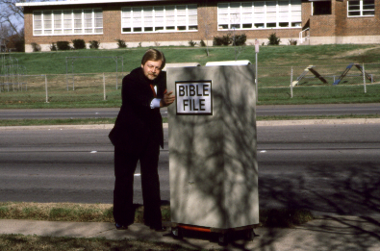
afOan vftf
28

Slide 31
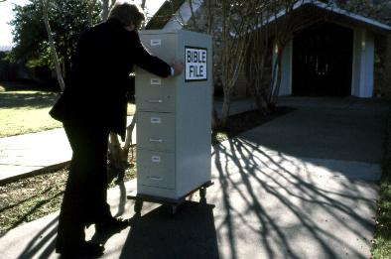
afOan vftf
29

Slide 32
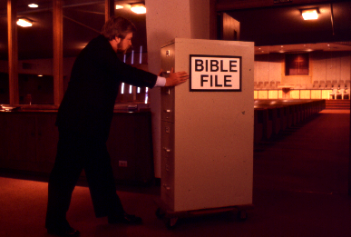
afOan vftf
30

Slide 33
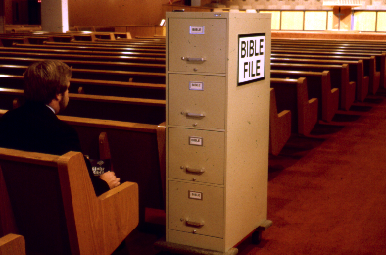
afOan vftf
31

Slide 34
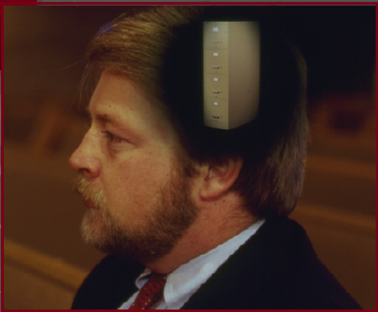
32

Slide 35
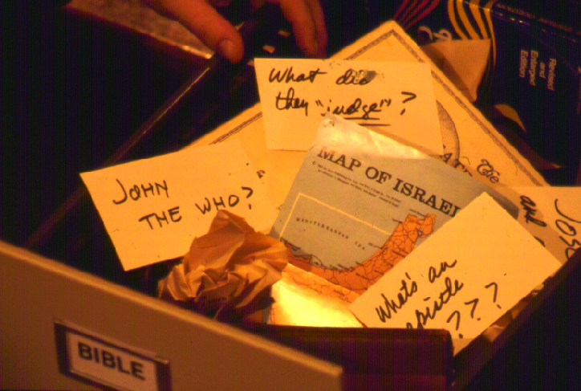
?
To;f] eP …tkfO{ lo ;a} hfgsfl/….tyf unt hfgsfl/nfO{ sxfF /fVg[\ x[\G5?
?
?
?
33
5

Slide 36
lgZrog} dnfO{ s]xL yfxf 5}g !
sxfF af6 d ;[\? u/f}+ ?
34

Slide 37
&
Handbook pg. 8-14
35

Slide 38
&
&
Handbook pg. 8-14
36
1

Slide 39

&
tkfO{sf]
afOan hLjg
Handbook pg. 8-14
37

Slide 40
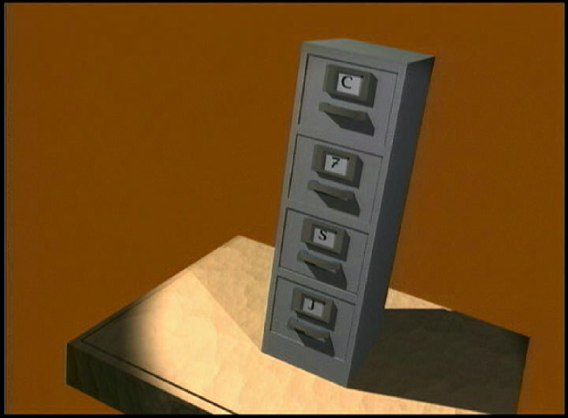
7
File Cabinet Movie w/ narration
38

Slide 41
&
!
@
#
$
%
^
&
*
(
!)
Handbook pg. 8-14
39

Slide 42
Vff]Ng[\ xf];
“tkfO{sf] afOan vftf ”
&
p& z[\ o]
p& z[\ o]
p& z[\ o]
p& z[\ o]
&
Handbook pg. 8-14
40
4

Slide 43
Vff]Ng[\ xf];
“tkfO{sf] afOan vftf ”
&
&
= $+#
Handbook pg. 8-14
41
2

Slide 44
&
Vff]Ng[\ xf];
“tkfO{sf] afOan vftf ”
p $ # z[\ o]
Handbook pg. 8-14
42
1

Slide 45
%d[\Vo zAbx? :
&
p = pTktL
$ = dflg;x?
# = ;d[\bflo, hflt
z[\ = z[\Gotf
o] = o]z[\
Handbook pg. 8-14
43
5

Slide 46
%d[\Vo zAbx? :
&
p = pTktL
$ = dflg;x?
# = hfltx?, ;fd[\bfoL
z[\ = z[\Gotf
o] = o]z[\
Handbook pg. 8-14
44
6

Slide 47
%d[\Vo zAbx? :
&
p = pTktL
$ = dflg;
# = hfltx?, ;fd[\bfoL
z[\ = z[\Gotf
o] = o]z[\
Handbook pg. 8-14
45

Slide 48
$ dflg;x? :
&
c a|fxfd\
of] ;]km
df] zf
o xf]z[\
Handbook pg. 8-14
46
5

Slide 49
&
c
of] Gofostf{n]
df] ug}{ k5{
o Gofo!
Handbook pg. 8-14
47

Slide 50
$ AolStTjx? x[\g =====
&
c a|fxfd\
c
of] ;]km
Gofostf{n]
df] zf
ug}{ k5{
o xf]z[\
Gofo
Handbook pg. 8-14
48
8

Slide 51
&
pTktL
c a|fxfd
of] ;[\km
df] zf
o xf]z[\\
Handbook pg. 8-14
49
5

Slide 52
% d[\Vo zAbx? ======
&
p = pTktL
$ = dflg;
# = hfltx?
z[\ = z[\Gotf
o] = o]z[\
Handbook pg. 8-14
50

Slide 53
&
c /f bf
Handbook pg. 8-14
51
2

Slide 54
# ;d[\bfoLx?======
&
c /fhstf{
/f hkl/jf/
bf ;Tj
Handbook pg. 8-14
52
6

Slide 55
pTktL ca|xfd of];[\km df]zf oxf]z[\ c/fhstf{
/fhkl/jf/ bf;Tj
&
Handbook pg. 8-14
53

Slide 56
&
&
k[\g bf]/\of} ...
p & z[\ o]
p $ # z[\ o]
Handbook pg. 8-14
54
3

Slide 57
pTktL
$ dflg;
# ;fd[\bflox? z[\Gotf o]z[\
&
Handbook pg. 8-14
55

Slide 58
&
pTktL
ca|fxfd
of];[\km
df]zf
oxf]z[\
c/fhstf{
/fhkl/jf/
bf;Tj
z[\Gotf
o]z[\
Handbook pg. 8-14
56
2

Slide 59
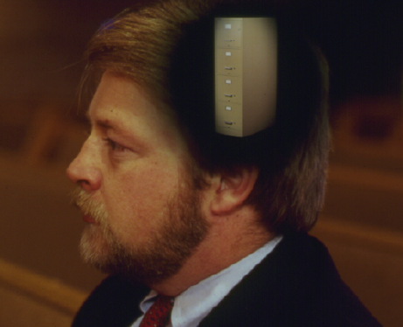
tkfO{sf] dfgl;s “afOan vftf”
pTktL
ca|fxfd
of];[\km
df]zf
oxf]z[\
c/fhstf{
/fhkl/jf/
bf;Tj
z[\Gotf
o]z[\
Handbook pg. 8-14
57
11

Slide 60
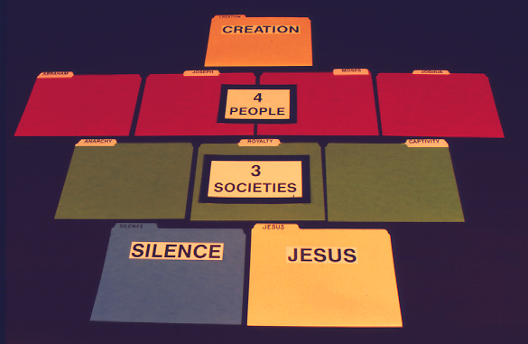
&
pTktL
Handbook pg. 8-14
58

Slide 61
pTktL
$ dflg;
Handbook pg. 8-14
59

Slide 62
pTktL
$ dflg;
# ;d[\\bfoL
Handbook pg. 8-14
60

Slide 63
pTktL
$ dflg;
# ;d[\\bfoL
z[\Gotf
o]z[\
Handbook pg. 8-14
61

Slide 64

&
of];+;f/ ;fr}+ kl/jt{g ePsf] 5 .
Handbook pg. 8-14
62

Slide 65




&
pTktL
CREATION
ABRAHAM
ABRAHAM
ca|fxfd
ABRAHAM
ABRAHAM
ABRAHAM
o;[\km
JOSEPH
ABRAHAM
ABRAHAM
df]zf
MOSES
oxf]z[\
JOSHUA
c/fhstf{
ANARCHY
/fhkl/jf/
ROYALTY
bf;Tj
CAPTIVITY
z[\Gotf
SILENCE
o]z[\
JESUS
63

Slide 66

afOan vftf
64

Slide 67

pTktL
ca|fxfd
c/fhstf{
z[\Gotf
o]z[\
o;[\km
/fhkl/jf/
df]zf
bf;Tj
oxf]z[\
65
10

Slide 68
p & z[\ o]
{
}
pTktL
ca|fxfd
c/fhstf{
z[\Gotf
o]z[\
$
dflg;
o;[\km
/fhkl/jf/
#
hfltx?
df]zf
bf;Tj
oxf]z[\
66
10

Slide 69
pTktL
tkfO{sf] dl:tis afOan vftf !
ca|fxfd
of];[\km
cWoog
df]zf
oxf]z[\
c/fhstf{
lj:t[t
/fhkl/jf/
bf;Tj
z[\Gotf
;[\;+ut
o]z[\
67
4

Slide 70

ca b]lv afOan ..cfwf/e[\t, tkfO{sf] ljj]sdf 5 …
•ts{ rflx+ “afOan vftf ”
•vf]Ngsf] nflu d[\Vo a[\bf+ “ afOan vftf ”… p & z[\ o]
!. s] eof] !
pTt/ lbg[\ kg]{ tLg k|Zgx?
@. lsg o:tf] eof] !
#. k|efjx?, wd{zf:qsf] cfsf/ / ljifo
68
4

Slide 71
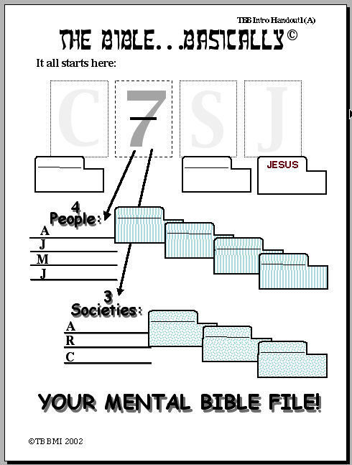
afOan …cfwf/e[\t
p
&
z[\
o]
pTktL
Z[\Gotf
o]z[\
{
$ dflg;
ca|fxfd
ca|fxfd
o;[\km
o;[\km
Df]zf
Df]zf
oxf]z[\
oxf]z[\
{
# ;d[\\bfoL
c/fhstf{
cWoog ;xof]uL #0!
c/fhstf{
/fhkl/jf/
/fhkl/jf/
bf;Tj
bf;Tj
tkfO{sf] dl:tis afOan vftf
©2004 TBBMI
8.0.01.
20
69

Slide 72
02
afOan …cfwf/e[\t
Now…try your hand at opening your mental Bible File,
either by yourself or by drilling or quizzing someone else.
The key to opening your Bible file is:
C 7 S J
The letter “C” stands for:
CREATION
7 = 4+3 breaks out into:
4 PEOPLE & 3 SOCIETIES
The FOUR PEOPLE are:
ABRAHAM JOSEPH MOSES
JOSHUA
Then…call out the group,
leaving out one. Answer is ?
cWoog ;xof]uL #0@
The THREE SOCIETIES are:
ANARCHY ROYALTY CAPTIVITY
Also…call out the group,
leaving out one. Answer is ?
pTktL
ca|fxfd
The letter “S” stands for:
SILENCE
JESUS
of];[\km
The letter “J” stands for:
JESUS
...
df]zf
Therefore, the ten words… and your ten file folder labels… are:
oxf]z[\
c/fhstf{
/fhkl/jf/
bf;Tj
YOUR MENTAL BIBLE FILE!
z[\Gotf
o]z[\
©2006 TBBMI
9.65.01.
9
70
Notes:
And here is STUDY HELP NUMBER 2….this is the one you can use for your own review-- or to hold in your hand while you teach THE BIBLE FILE idea to others.
//// First the key to open the file:
//// C 7 S J…
//// The letter C stands for CREATION.
//// 7 equals 4 plus 3…for the four people and the three societies.
//// FOUR PEOPLE…ABRAHAM, JOSEPH, MOSES, JOSHUA.
//// THREE SOCIETIES…ANARCHY, ROYALTY, CAPTIVITY.
//// The letter S standing for SILENCE
//// The letter J representing JESUS.
//// FINALLY the TEN WORDS. And there are your ten file folders in your new Bible File. Repeat them one last time:
CREATION, ABRAHAM, JOSEPH, MOSES, JOSHUA, ANARCHY, ROYALTY, CAPTIVITY, SILENCE, and JESUS.

Slide 73
&
71

Slide 74
afOan …cfwf/e[\t
®
d[\Vo vf]Ng[\kg]{
“tkfO{sf] afOan vftf”
72

Slide 75
clxn] oxfF tkfO{x?n] yfxf ug[\{ eof] … xfdL stf ulx/x]sf 5f} …
•klxnf] s[\/f “afOan vftf”
• “afOan vftf” vftf vf]Ng] d[\Vo a[\bf+ … p & z[\ o]
• dfgl;s gSzf hf] afOanLo d[\Vo 36gfx?df cfwfl/t 5g\ .
•afOansf “syf” x? : “ ;+lIfKtdf sfns|dfg[\;f/ ”
•ca|fxfd cfwfl/t wd{zf:qsf] v08n] k|e[\ o]z[\ v|Li6sf] ;]jfsfO{df k|ToIf cu[\jfO{ ub{5 .
• afOansf] :j?k lgdf0f{sf] cfwf/ “syf” x? x[\g\ .
•k[\/fgf] / gofF s/f/ k[\:tsx? tyf laifox? .
 
73
7

Slide 76
afOan======
cfwf/e[\t
afOan======
cfwf/e[\t
A Presentation of The Bible…Basically Ministries International Inc. Fort Worth, Texas
A Presentation of The Bible…Basically Ministries International Inc. Fort Worth, Texas
www.biblebasically.org
www.biblebasically.org
8.0.01.
©2004 TBBMI
04
8.0.01.
©2004 TBBMI
74

Slide 77
8.0.01.
©2004 TBBMI
75

Slide 78


8f= l/Ss lu|lkmyaf6 ljt/0f • BibleStudyDownloads.org
of] k|:t[tL tkfO{sf] nflu lk|mdf pknAw 5 .
Notes:
The Bible…Basically (bb)

