Slide 1
Tuipam pheikakhãi khumkakhui
31
Kathãda varetuili pheisin sãlaga khumkhuira?
Dr. Rick Griffith • Singapore Bible College • BibleStudyDownloads.org

Slide 2
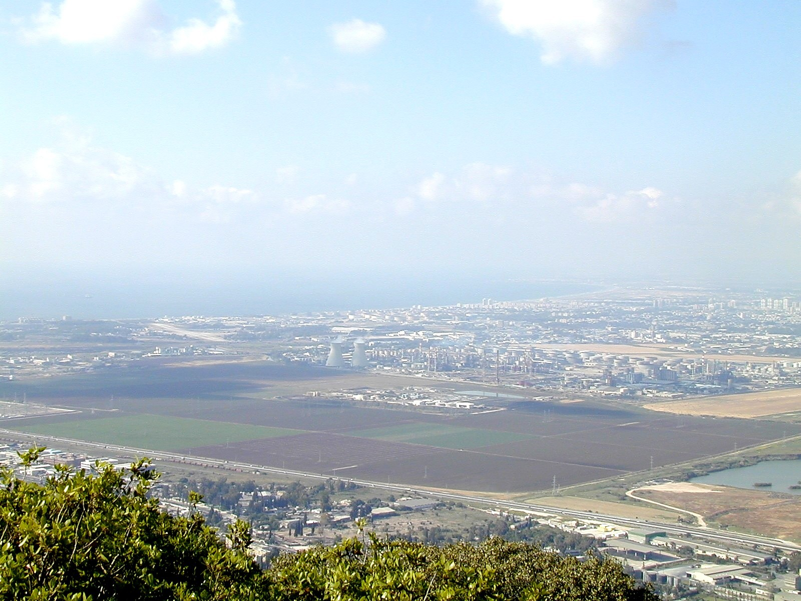
Varetui hãshokkhavãi khangarãnwui aponghi akhasi yanghamkhuisa . . .
Hi anã 251 li chitheihaidalei
Chieina anã 27-28 li khumkakhuiwui apong kha mihaidalei

Slide 3
Pao hāshokkhavai khangarãnli kazang
27-28, 251
Ramesh Richard wui lairik, khangaran wui tuiyar Maningkha paoharkashok tui eina kakhui
TUIPAM
PAOKAPHÃ
5 Khanganābingwui ningkachāng
Kuingatok
4 Phakashok khangahān kathum
khangashun
3.2 Khamataiya tuipam
KHT
Malung
KHP
6 Khamataiya pao
7 Paokaphawui akhum
8 Khamathing
9 Houkaphok/ kakup
3.1 Tuipam meikakhai akhum
Ma-ong
Ãrakui
Ma-ong
2 Tuiza khamanā
Khamachuk
Ãphi
Hākashok
10 MSS &
Hākashok
1 Tuiza kakapang
Mayak kacharbing hina kachitheiva 10 Haddon Robinson wui kathara tui harkashok eina pheikar kakhui 10 (lairik, 105)sss
Notes:
Cover steps 1-3 on page 27

Slide 4
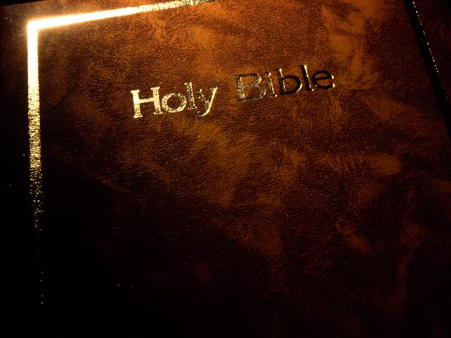
1. Tuipam kapā kala khamachuk
27
a. Phangāthang mangāli tuipam kapanghaolu; Akhasi matuikhavai tuipam kashangshang makhuialu.
b. Tuipam chi pheikhailu, (pālu, machuklu kala manālu) kala nana kaphaningchi kapikhuilu.

Slide 5
1. Tuipam kapā kala khamachuk
27
b. Tuipam kathāda pheikhaira...
1) Seiha sakhuilu, khani kathumsi pālu, kala mibingna ngahānkhamarao, ngahānkapai ningli rākazang katonga kapikhuilu (mamalāi khavāi). Kala chi ngahānkālu.
2) Shebshitui einala khani kathum pālu kala tuiyār khangatei leilā yangkhuilu.
3) Greek/Hebrew pātheikha ngaheoyanglu kala khamataiya tuiyārbing manālu.

Slide 6
1. Tuipam kapā kala khamachuk
27
4) Masavākapai leiharakha Commentaries li ngasanlu (Iva pheikar 5 wui thili sanaowa).
a) Greek / Hebrew commentaries ngasanlu (pāthei akha!).
b) Expositor's Bible Commentary hi khamathā kala mashālakkahai akhana.
c) Pao hākashokwui Commentary yanglu (Stott, Wiersbe, Boice, Criswell, Swindoll, etc.).

Slide 7
Matthew 18:15-20 hi sāyangsa
27
b. Tuipam kathada pheikhaira...
1) Seiha sakhuilu, khani kathumsi pālu, kala mibingna ngahānkhamarao, ngahānkapai ningli rākazang katonga kapikhuilu (mamalāi khavāi). Kala chi ngahānkālu.
2) Shebshitui einala khani kathum pālu kala tuiyār khangatei leilā yangkhuilu.
3) Greek/Hebrew pātheikha ngaheoyanglu kala khamataiya tuiyārbing manālu.

Slide 8
Matthew 18:15-20 (Tangkhul)
34a-b
Tuipam hili khi khangahān leili?
Nachinana nawui tungli khayon sahaiakha, ali valaga nanimang ngasopamlaga awui khayon chi hangmilu, ana mayaakha nana nachinali yuikhuihaira. Ana nali mahengsang- akha mi akha khani ngasophungda valu, Chithaakha tui maram kachiva hilaka kaji kathara lairikli kapi kahai thada mi khani kathumwui shakhi chieina khuipaira. Kha ana athumlila mahensangakha saikora churchli hangchitheilu; kala ana churchlila mahengsangakha nathumwui mangali a hi kameoli kaphaninga kala khasina kakhuia kathana da khuilu. Ina nathumli kachangkhat eina kahangna, kachikathali nathumna okathuili khalap kahahai chi kazingramlila khalapra, kala nathumna okathuili khamayaya chi kazingramlila mayara. Ina nathumli hangluishit kajina, nathumwui ngachaili mi khanina okathuili mayangarokta kachikatha poakha kapopo chi kachingramli khaleiya ishavana mira. Kihkhalajila mi khani kathumna iwui mingli kakazip chili I zangda lei.
Notes:
two main teachings on restoring Christians in sin

Slide 9


Matthew's Relational Pillars
Matthew wui khangasik pākra
5:23-24
Na hi:
Kasā-apā
Khili:
Katongali
Notes:
Have you ever had a problem with another believer? (If you say “no,” then I wonder which planet you have been living on!) Are you in fellowship with every Christian that you know now—your family members, your work colleagues, your neighbors and friends? If you're not in harmony, what should you do?

Slide 10
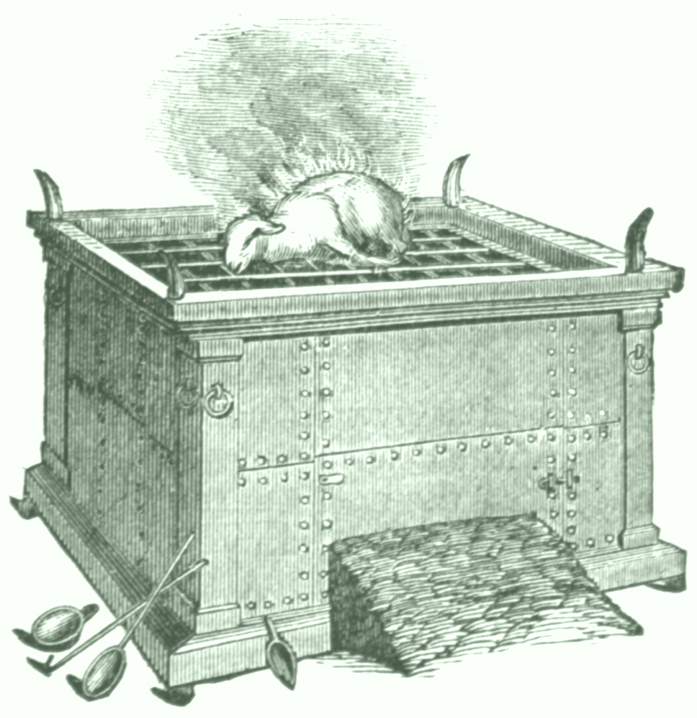

Matthew 5:23-24

Slide 11
Matthew 5:23-24
?
“Chiwuivang eina nana hanphutpamli nawui kachikat chikatkida leilakha nachinana nali makhamaya leili da phaningungakha nawui chikat khavai chi hanphut mangali haisalu, hanunglaga rimeithuida nachinali mashitkhuifalu. Chiwui thili ralaga rachikatnaolu.”

Slide 12
Matthew's Relational Pillars
Matthew wui khangasik pākra
5:23-24
18:15-17
Na hi:
Kasā-apā
Sajakahaipā
Khili:
Katongali
Moreili

Slide 13



Kathāda morei sādakhalei ichinā akhali huikhuira?
Tuipam hiwui khangahān khare (vv. 15-17)
34d
Notes:
Fill in your bulletin outline

Slide 14
Matthew 18
34a
Ningrin
Kachiwui āman kashak
ākha
1
1
Nao ākha (1-9)
1
Yao ākha
(10-14)
1
Morei kaphungnao ākha
(15-20)
1
Leiman kazangnao ākha
(21-35)
Notes:
Context: The value of one child (1-9), one sheep (10-14), one sinner (15-20), one debtor (21-35).
15-20 at the heart (advance slide to read)

Slide 15
Matthew 18:15-20 (Tangkhul)
Nachinana nawui tungli khayon sahaiakha, ali valaga nanimang ngasopamlaga awui khayon chi hangmilu, ana mayaakha nana nachinali yuikhuihaira. Ana nali mahengsang- akha mi akha khani ngasophungda valu, Chithaakha tui maram kachiva hilaka kaji kathara lairikli kapi kahai thada mi khani kathumwui shakhi chieina khuipaira. Kha ana athumlila mahensangakha saikora churchli hangchitheilu; kala ana churchlila mahengsangakha nathumwui mangali a hi kameoli kaphaninga kala khasina kakhuia kathana da khuilu. Ina nathumli kachangkhat eina kahangna, kachikathali nathumna okathuili khalap kahahai chi kazingramlila khalapra, kala nathumna okathuili khamayaya chi kazingramlila mayara. Ina nathumli hangluishit kajina, nathumwui ngachaili mi khanina okathuili mayangarokta kachikatha poakha kapopo chi kachingramli khaleiya ishavana mira. Kihkhalajila mi khani kathumna iwui mingli kakazip chili I zangda lei.
Kathāda huikhuira
15-17
Khiwuivang huikhuira
18-20
Notes:
two main teachings on restoring Christians in sin

Slide 16

Tuizā 15-17 wui tuira
34c
I. Tātungkahai mi ākhali Church na huikhui khavai āpong chiva kashap eina tangda khalattawui alungli kupsangkhuiki kachina (15-17).

Slide 17
Ithumwui ningrin:
Ithumwui ningrin:
Huikakhui !

Slide 18

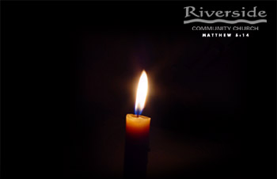
Restore People in Sin
Mibingli moreiwui eina huikhuilu
“Ivānaongarā, kachikathana khalang ot kasa theiakha maglarinli kathukbing nathumna ali khaninm eina huikhuiphalungra.”
Galatianao 6:1
Restore People in Sin

Slide 19
Varena huikakhuiwui pheikar 4…
34d
4
3
2
1
…pheikar kachida mi chungmeimamandali theingasakra

Slide 20

Huikahuiwui Pheikar khare
Namāngna vāhānglu
34d
M
M
M
M
M
M
M
M
M
M
M
M
M
M
M
M
T
M
M
M
M
M
M
M
M
M
M
M
T = Tātungkahaipā
M = Mipha

Slide 21
Matthew's Relational Pillars
Matthew wui khangasik pākra
5:23-24
18:15-17
Na hi:
Kasā-apā
Sājakahaipā
Khili:
Katongali
Moreili

Slide 22
Matthew's Relational Pillars
Matthew wui khangasik pākra
5:23-24
18:15-17
Na hi:
Kasā-apā
Sājakahaipā
Khili:
Katongali
Moreili
Khipāna:
Na!
Na!

Slide 23

Na masā vālāklu
34d
Email
SMS
Chithi
Phone
Eina maningla

Slide 24


Khiwuivāng ithumna mangashungthu?
34d
Makathei
Ningkhamaong
Maikashi
Khangachee
Hāngkaphanep
Makathar
Yāruishang khavāt

Slide 25
Huikakhuiwui Pheikar khare
Namāngna vāhānglu
34d
M
M
M
M
M
M
M
M
M
M
M
M
M
M
M
M
T
M
M
M
M
M
M
M
M
M
M
M
T = Tātungkahaipā
M = Mipha

Slide 26
Huikakhuiwui pheikar kakhane ākha-khani ngayurvālu
34d
M
M
M
M
M
M
M
M
M
M
M
M
M
M
M
M
T
M
M
M
M
M
M
M
M
M
M
M
T = Tātungkahaipā
M = Mipha

Slide 27

Pheikar kakhaneli ngahānpāi
Khipālongli thānvāpaira?
Khisāda ākha-khani?

Slide 28
Khalatlui. 19:15
Mithitkuikai nilala, khayon ot nilala, kaphenwui vang shakhi akhamangwui tui makhuipai mana; khani kathumna shakhi sakha bichar sapaira.

Slide 29
Huikakhuiwui pheikar kakatheum church katongali theingasakhaolu
34d
M
M
M
M
M
M
M
M
M
M
M
M
M
M
M
M
T
M
M
M
M
M
M
M
M
M
M
M
T = Tātungkahaipā
M = Mipha

Slide 30
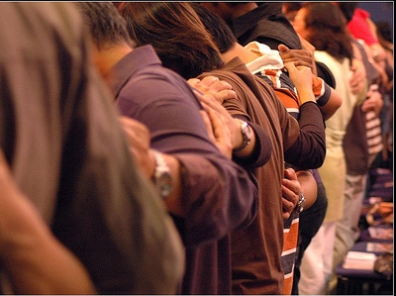
Khiwuivāng church hupvali?

Slide 31
Huikakhuiwui pheikar khamate
Mashitkasangnao thāda khuihaolu
34d
M
M
M
M
M
M
M
M
M
M
M
M
M
M
M
M
T
M
M
M
M
M
M
M
M
M
M
M
T = Tātungkahaipā
M = Mipha
T

Slide 32

Sins Worthy of Discipline
Kathāda masāmara?
AYARLI KHUISHOKHAOLU !

Slide 33

Hāngmachinkapai morei
Kathāda hāngmachinra?
34d
Ali vareshinei machiluimara.
Ali paokhamathā tamchitheimilu.
Prohowui phāchizātli sharuk makhuimara.
Church miphawui eina khuishokhaora.
Mashitkasngbing
“Hikathā mili phasā shimankhavai chipeeli horsangmira” (1 Cor. 5:5).
Maphazārummalu (1 Cor. 5:11).
Churchli marāngasakalu?
Zakshikhamei

Slide 34
Tuizā 15-17 wui tuira
34c
I. Tātungkahai mi ākhali Church na huikhui khavai āpong chiva kashap eina tangda khalattawui alungli kupsangkhuiki kachina (15-17)

Slide 35
Varena huikakhuiwui pheikār 4…
34d
4
3
2
1
…pheikar kachida mi chungmeimamandali theingasakra

Slide 36

Kakhane khangahān tuizā 18-20 li ngahānkāmidalei:
Khiwuivang tātungkahaibingli mathāda huikhuikikachido?
34d

Slide 37

Tuizā 18-20 wui tuira
34d
II. Church hina Varewui sārān-pangshap wui amathunna!

Slide 38

Khisāda hāngmachinra?
Ithumna huikhuikhavai kasāli…
34d
Avāwui mathum sāda ot sai.
(18-19)

Slide 39
A Better Translation…
NAU na mathāmeida khalattalei…
Tangkhul “Ina nathumli kachangkhat eina kahangna, kachikathali nathumna okathuili khalap kahahai chi kazingramlila khalapra, kala nathumna okathuili khamayaya chi kazingramlila mayara.”
NAU “Truly I say to you, whatever you bind on earth shall have been bound in heaven; and whatever you loose on earth shall have been loosed in heaven.”

Slide 40

Matthew 18:19
" Ina nathumli hangluishit kajina, nathumwui ngachaili mi khanina okathuili mayangarokta kachikatha poakha kapopo chi kachingramli khaleiya ishavana mira. " (NIV).

Slide 41
Khisāda hāngmachinra?
Ithumna huikhuikhavai kasāli…
34d
Avāwui mathum sāda ot sai.
(18-19)
Christawui mangali sarān-pangshap kasana
(20)

Slide 42
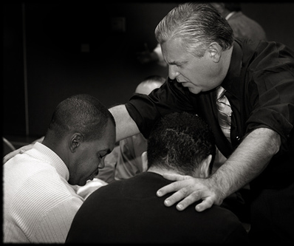
Matthew 18:20
" Kihkhalajila mi khani kathumna iwui mingli kakazip chili I zangda lei" (Tangkhul).

Slide 43

Khamataiya tuipam:
34d
Ithumna tātungkahaibingli mathālak eina huikhuira, khiwuivangkhala jiakha ithum Varewui mathun eina kasāna.

Slide 44

Ithumna laala pheikhaipai
6
"A Mighty Fortress" kachi laa hiwui khamataiya tuipam phashoklu.
page 6

Slide 45
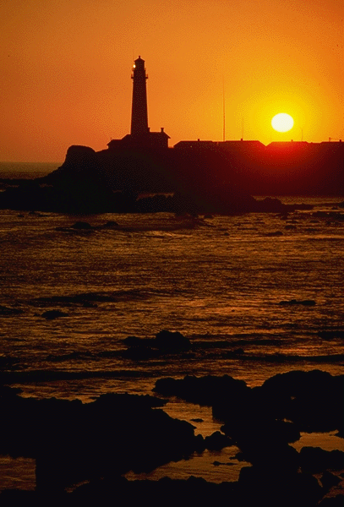
Verse 1
31
Vare hi ithumwui kapanga raipan na,
Makhangapatta ngavei na;
Tara kaphongli A ithumwui ngachonme
Okthuiwui kachot kachāng thārān
Khikhalajila ithumwui kazamma yangshāt
China ithumli ngahomchingdalei
Awui sakathuk kala pangshap leilaka,
Sakashi yangshatna shaksālaga,
Okathuili ali khangashung malei.

Slide 46
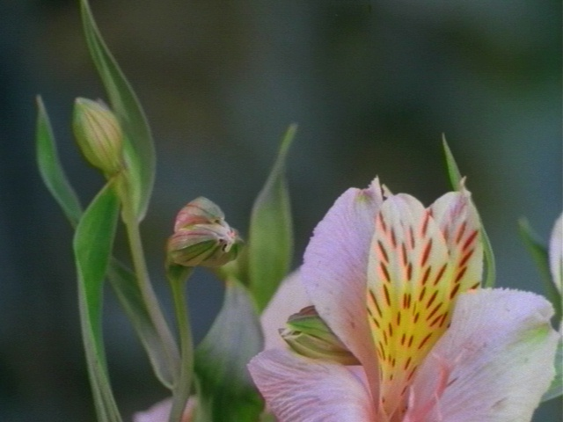
Verse 2
31
Ithum khalattawui kashapli chihanlā,
Ithumwui hotkhanā aremana,
Khamashungapā ithumwui maning,
Varena kapangkhuikahaipā,
Khipanei da phaningkhala?
Jesu Christana, A chi
Proho Sabaoth kachina A ming,
Thot thotli chithashon,
kala Ana raichi yuira.

Slide 47
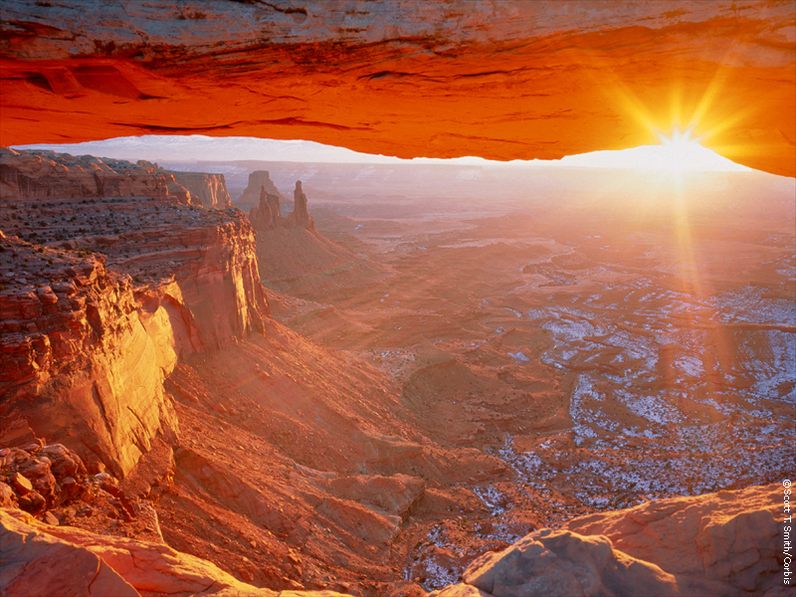
Verse 3
31
Okathuihi makaphā chipeena pemhaida,
Ithumli machitkhavai sālala,
Mangacheemara, Vare ithumli sohaida
Awui khamashung na mungra ithumli.
Tangkhamangwui wungnao na rimlala,
Kakathir awuivang maningma,
Awui khamchitva khāngshapa,
Kachiva yanglo, Ava shimanphunghaora:
Tuikhur akhana ali kongluingasakra.

Slide 48
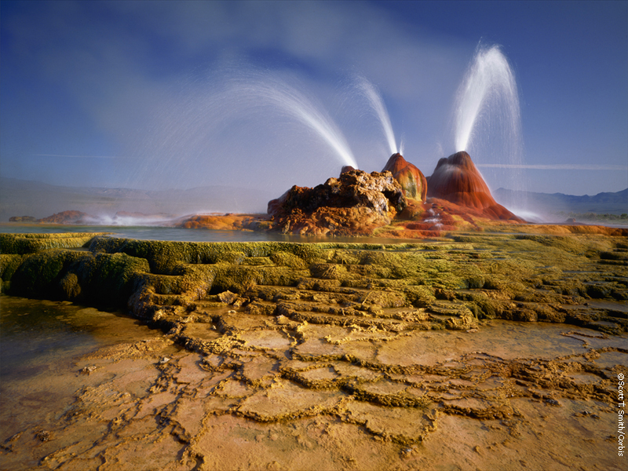
Verse 4
31
Tui china okathui pangshap li chongmei
Maningshimana chili ngashikda;
Mangla kala lemmet chiva ithumwuina
Awui mangā eina ithum zangda.
Thongthāng ot kala kakahao thuihranu,
Shimānkapai mirin hila zangda,
Phasā hiva athumna khuihaipai;
Varewui khamashung chiya leishonra:
Awui wungram katang mavaima!

Slide 49
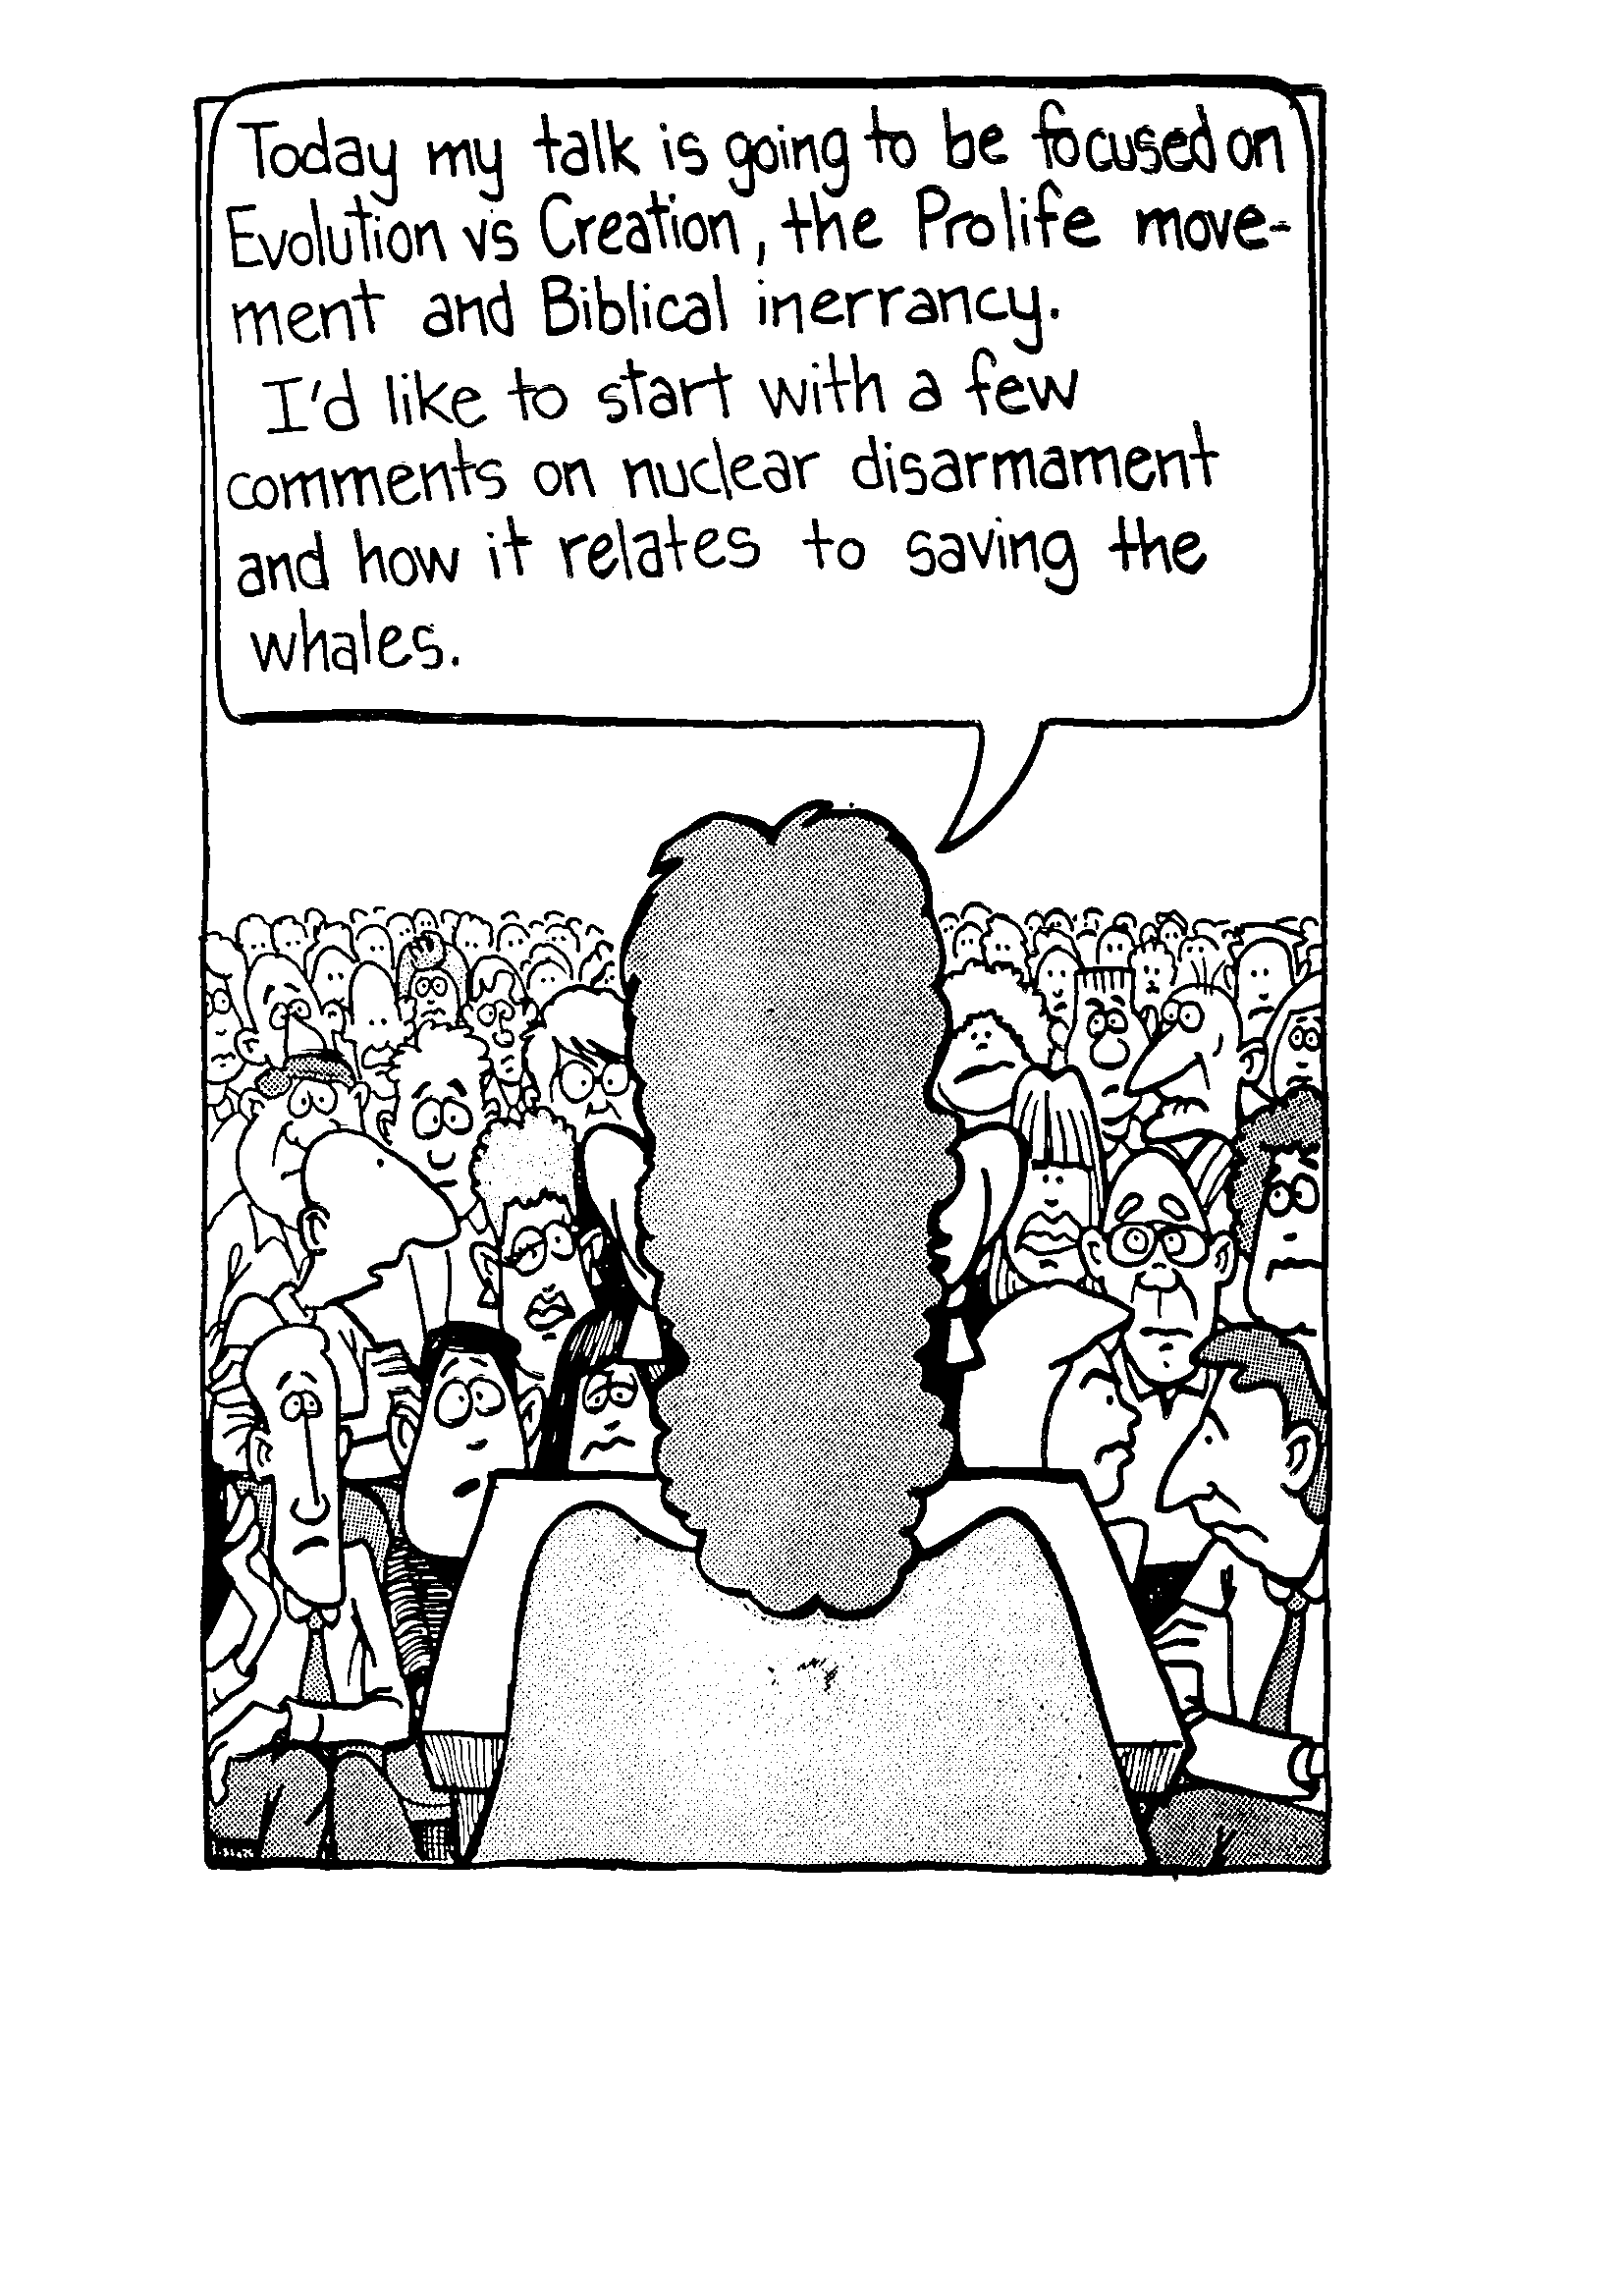
Rinshit eina khamatui phai!
Aja ina matuikikachi tuipamna okathui Varena kasemkā akhalatta kharākhala kala mirinwui ponghili biblewui kasak khi lei kachina. Nuclear mashichinkhavai kachi hina ngayiwui khaili kathada ungashik kachi teomeikha hanglaga houphokngai.

Slide 50

What do you do for a living?
Nava khi salaga ringdo?
Ot sai.

Slide 51
Could you be more vague?
Kateokha mashāmeipairala?
Rinshit hailu!

Slide 52
Pao hashokkhavai khangarãnli kazang
27-28, 251
Ramesh Richard's lairik, Preparing Expository Sermons eina kakhui
TUIPAM
PAOKAPHÃ
5 Khanganābingwui ningkachang
Kuingatok
4 Phakashok khangahan kathum
khangashun
3.2 Khamataiya tuipam
KHT
Malung
KHP
6 Khamataiya pao
7 Paokaphawui akhum
8 Khamathing
9 Houkaphok/ kakup
3.1 Tuipam meikakhai akhum
Ma-ong
Ãrakui
Ma-ong
2 Tuiza khamanā
Khamachuk
Ãphi
Hākashok
10 MSS &
Hākashok
1 Tuiza kakapang
Kazarbing hina 10 Haddon Robinson wui Biblical Preaching eina kakhui pheikar 10 (lairik, 105)
Notes:
Cover steps 1-3 on page 27

Slide 53
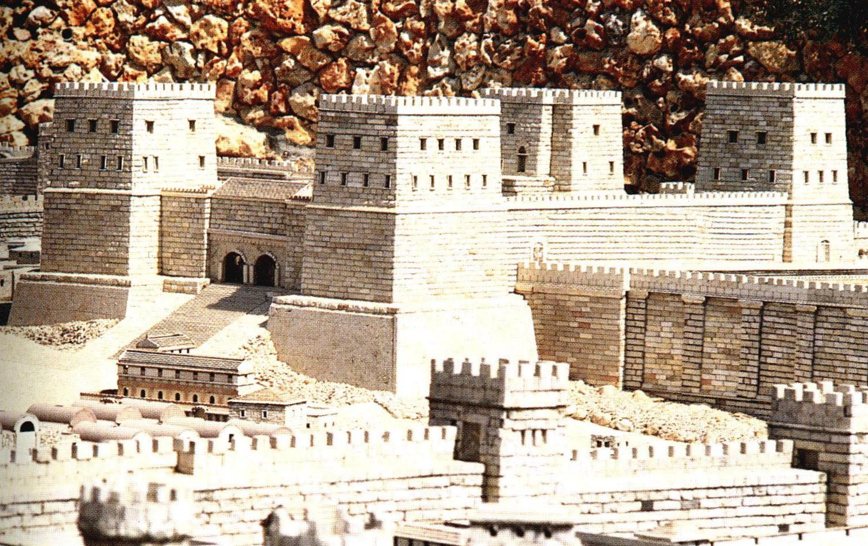
Exegetical Outlining
31
"A Mighty Fortress“ wui tuipong eina hangkhavā kathāda samphang
(khalatta kasā #2 p. 6)?

Slide 54
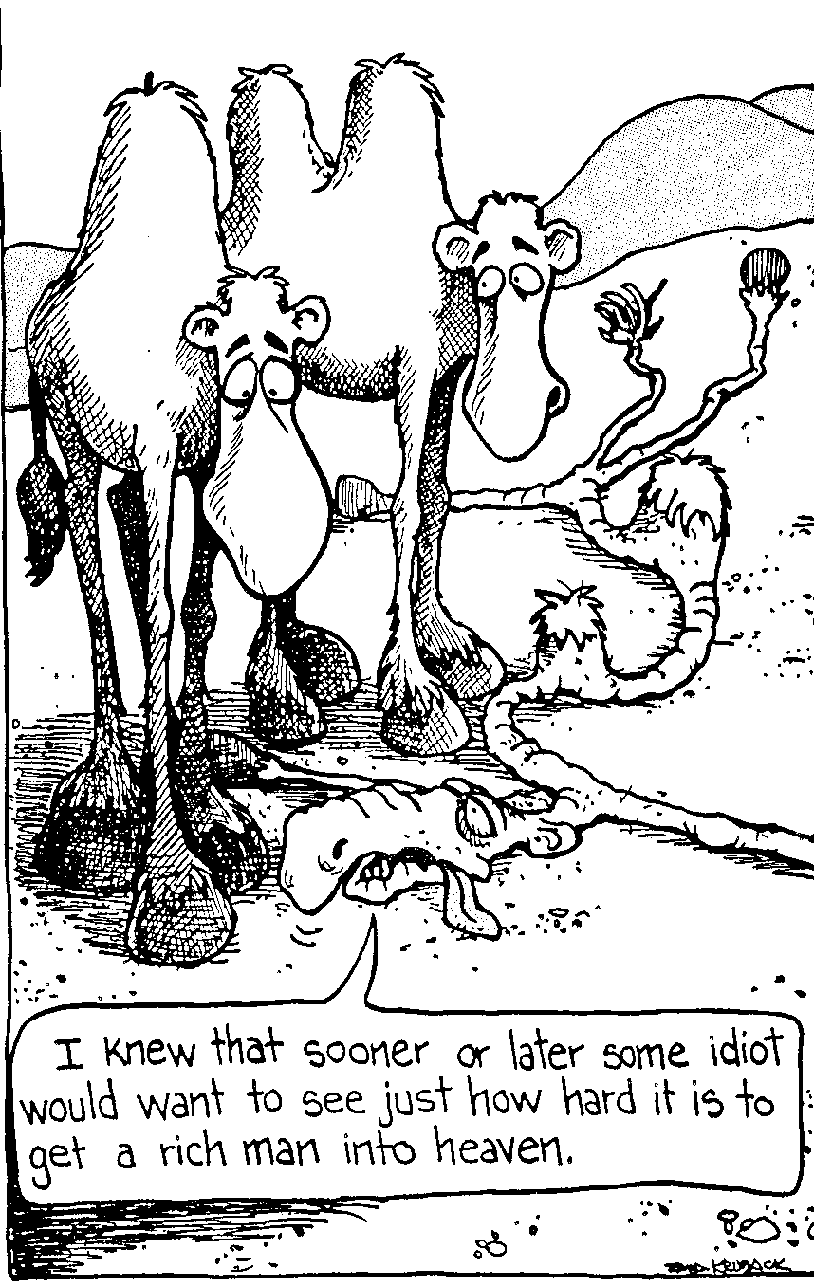
Khamathā arā pheikar eina tuipamwui khamashung kakhalat samphangra
Thangkhava thāda mangkhama kaikhana kashāngnaona kazingram kazanghi kayākha saklākkhala sāyanglakra kachi ina theiwo.

Slide 55
Tuipam pheikakhai khumkakhuiwui arā-pheikār kathum (angayung)
31
Tui kasakbing kala chanzambing paikhamei tui eina ngacheikhuili.
Chamsada, Varehi “Kapanga raipan” na kachiwui kakhalat khikhala?

Slide 56
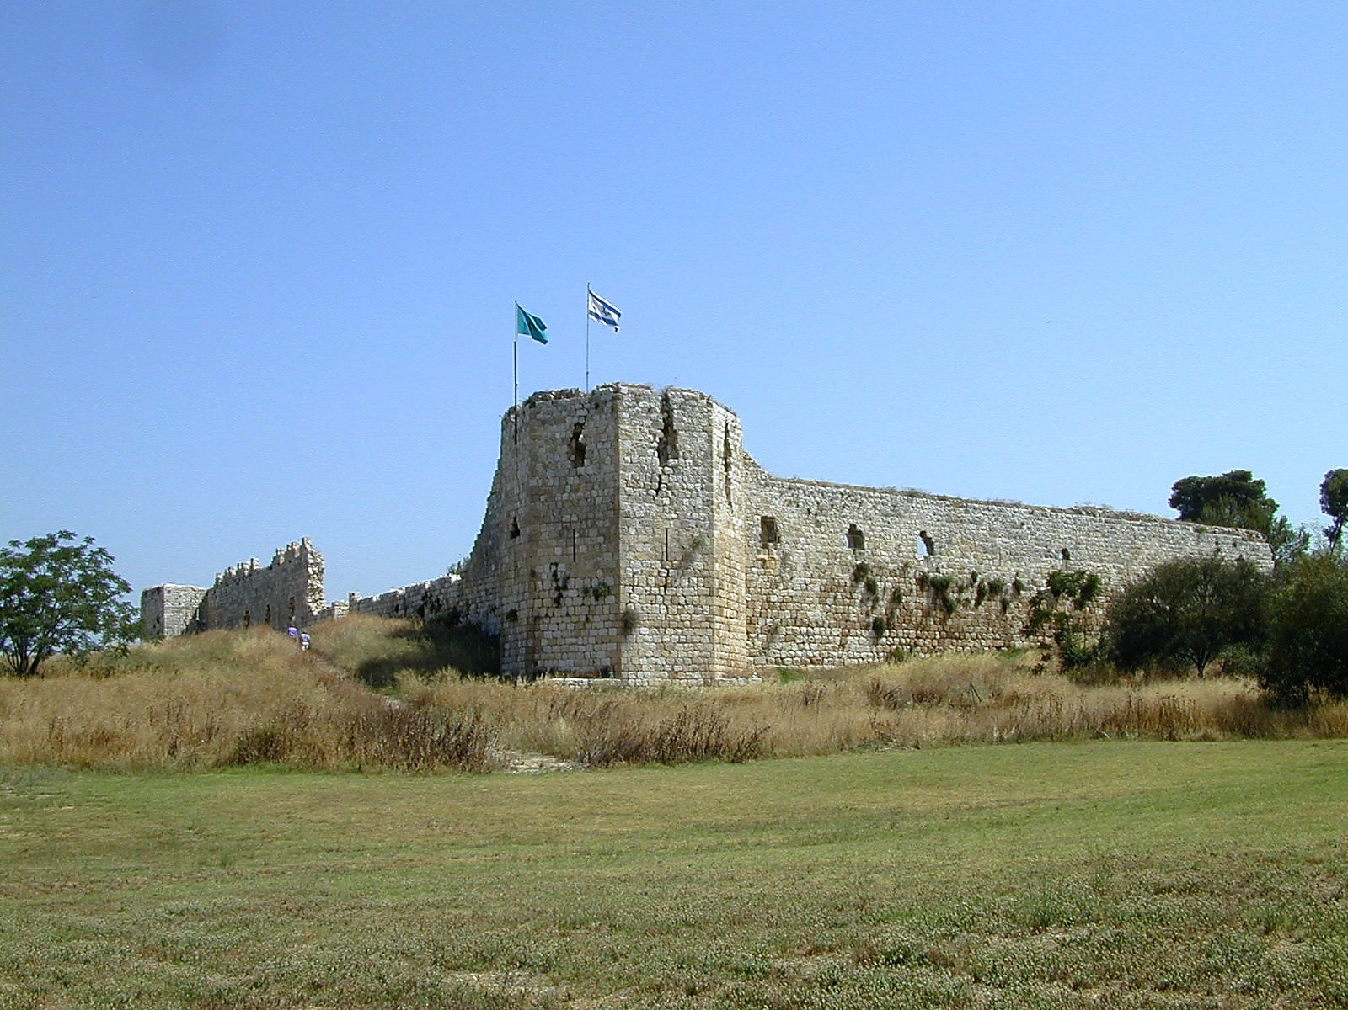
Aphek Turkish wui raipan

Slide 57
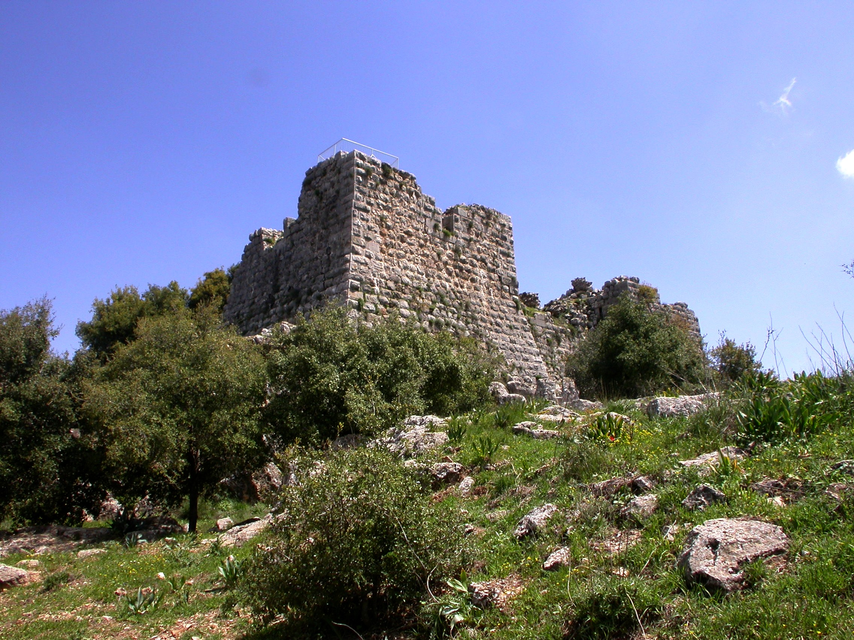
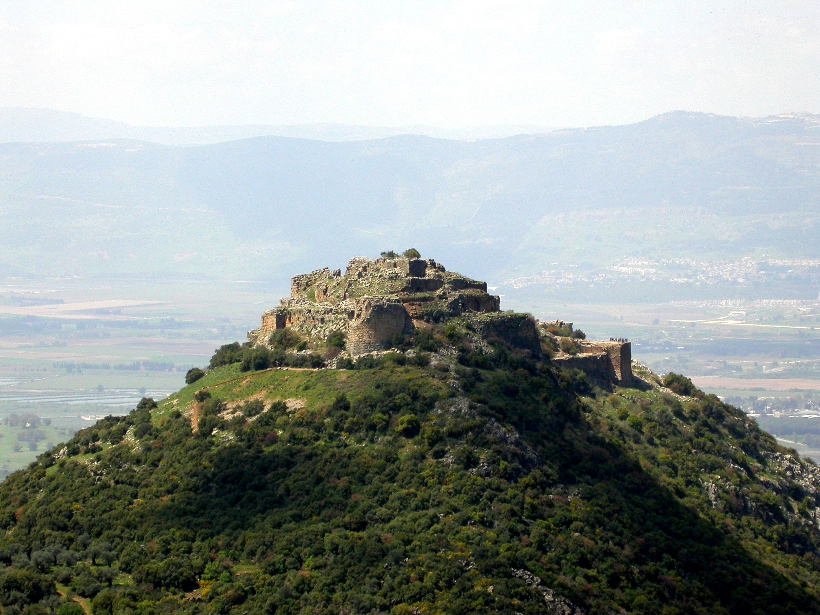
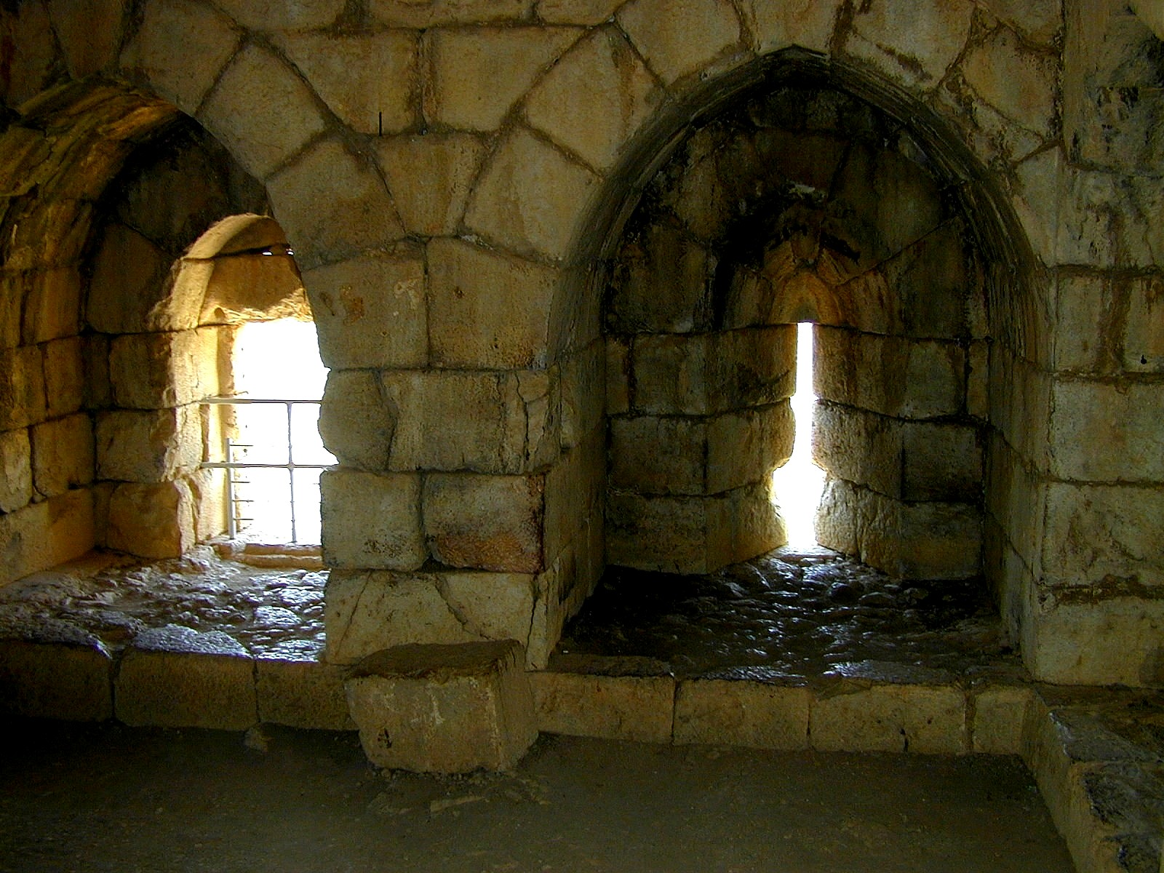
Nimrod wui raipan

Slide 58
Verse 1
31
Vare hi ithumwui kapanga raipan na,
Makhangapatta ngavei na;
Tara kaphongli A ithumwui ngachonme na
Okthuiwui kachot kachāng thārān
=
Vare ithumwui kasak atamli makhangapatta ngayinkhame kala ngachonme na

Slide 59
Verse 1
31
Khikhalajila ithumwui kazamma yangshāt
China ithumli ngahomchingdalei
Awui sakathuk kala pangshap leilaka,
Sakashi yangshatna shaksālaga,
Okathuili ali khangashung malei.
=
Mikumo khipānakha chipeewui mareimarā, pangshap kala yangshātli mangashungma.

Slide 60
Tuipam pheikakhai khumkakhuiwui arā-pheikār kathum (angayung)
31
A. Tui kasakbing kala chanzambing paikhamei tui eina ngacheikhuili.
B. Ngaraikacha tuipam kala ningpam bing akha sada khumkhuilu.
C. Khamataiya bing chi kapishoklu kala hina akhum teokhamei sada ungzangasaklu.

Slide 61
Verse 1
31
Vare ithumwui kasak atamli makhangapatta ngayinkhame kala ngachonme na
+
Mikumo khipānakha chipeewui mareimarā, pangshap kala yangshātli mangashungma.
=
Chipeewui pangshapli ngashungkhavai Vare ithumwui makhangapatta ngayinkhavaina (1).

Slide 62
vv. 1-2 la khamataiya tuigui phakhuida -
31
Chipeewui pangshapli ngashungkhavai Vare ithumwui makhangapatta ngayinkhavaina (1).
+
Varena ithumwui raiyui pangshap sada Christali kapangkhui (2)
=
I. Christawui mangā eina Varena ithumli chipeeli yuingasakka (1-2).

Slide 63
Nawui khamataiya tuiguili…
Khalatta sākhayang #2 wui chāng
31
Vare: 7 shi (-7%)
Chipee/pangshap: 10 shi (-10%)
Christa/Proho: 7 shi (-7%)
Khayui: 11 shi (-11%)
Tui/Khamashung: 4 shi (-4%)
Shitkashang/kachihan: 2 shi (-2%)
Hibinghi mazangakha (- 40%)
(Vareshi/ithum kachila 17 shi!)
Notes:
"Help/Evil" instead of "Victory/Triumph" (-5%); Full credit also for "Savior" & "salvation" & "defender"
"Trouble/Trials/etc." instead of "Satan" (-5%); Full credit also for "darkness" & "enemies"
"Faith/Trust/Depend" also accepts for full credit "not fear"
Mentioning "Mighty" (-2%) or "Fortress" (-2%)

Slide 64
Verse 1
31
Vare hi ithumwui kapanga raipan na,
Makhangapatta ngavei na;
Tara kaphongli A ithumwui ngachonme
Okthuiwui kachot kachāng thārān
Khikhalajila ithumwui kazamma yangshāt
China ithumli ngahomchingdalei
Awui sakathuk kala pangshap leilaka,
Sakashi yangshatna shaksālaga,
Okathuili ali khangashung malei.

Slide 65
Verse 2
31
Ithum khalattawui kashapli chihanlā,
Ithumwui hotkhanā aremana,
Khamashungapā ithumwui maning,
Varena kapangkhuikahaipā,
Khipanei da phaningkhala?
Jesu Christana, A chi
Proho Sabaoth kachina A ming,
Thot thotli chithashon,
kala Ana raichi yuira.

Slide 66
Verse 3
31
Okathuihi makaphā chipeena pemhaida,
Ithumli machitkhavai sālala,
Mangacheemara, Vare ithumli sohaida
Awui khamashung na mungra ithumli.
Tangkhamangwui wungnao na rimlala,
Kakathir awuivang maningma,
Awui khamchitva khāngshapa,
Kachiva yanglo, Ava shimanphunghaora:
Tuikhur akhana ali kongluingasakra.

Slide 67
Verse 4
31
Tui china okathui pangshap li chongmei
Maningshimana chili ngashikda;
Mangla kala lemmet chiva ithumwuina
Awui mangā eina ithum zangda.
Thongthāng ot kala kakahao thuihranu,
Shimānkapai mirin hila zangda,
Phasā hiva athumna khuihaipai;
Varewui khamashung chiya leishonra:
Awui wungram katang mavaima!

Slide 68
Nawui khamataiya tuiguili…
Khalatta sākhayang #2 wui chāng
31
Vare: 7 shi (-7%)
Chipee/pangshap: 10 shi (-10%)
Christa/Proho: 7 shi (-7%)
Khayui: 11 shi (-11%)
Tui/Khamashung: 4 shi (-4%)
Shitkashang/kachihan: 2 shi (-2%)
Hibinghi mazangakha (- 40%)
(Vareshi/ithum kachila 17 shi!)
Notes:
"Help/Evil" instead of "Victory/Triumph" (-5%); Full credit also for "Savior" & "salvation" & "defender"
"Trouble/Trials/etc." instead of "Satan" (-5%); Full credit also for "darkness" & "enemies"
"Faith/Trust/Depend" also accepts for full credit "not fear"
Mentioning "Mighty" (-2%) or "Fortress" (-2%)

Slide 69


Pao harkashokwui ara • BibleStudyDownloads.org
Hiwuili zangdakhaleihi tamkachitheiwui aponglinai. Kachisat binghi kalemeina samphangpaira
Notes:
Preaching (pr)
Homiletics

Slide 70
Black

