Slide 1
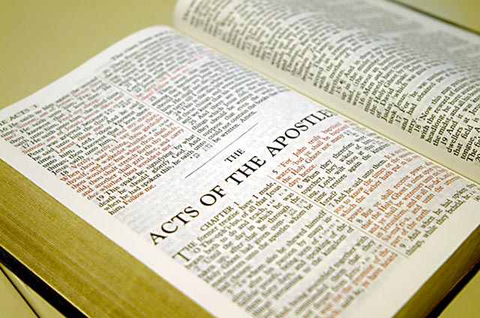
Yārui mangāli Varewui Tui kapā
Mibingna shākhui khavai kathāda ākhon chuilak eina Varetui pāra!
Dr. Rick Griffith • Singapore Bible College • BibleStudyDownloads.org

Slide 2
Nawui tamkachitheili mataimeikap kaja apam…
9
…chiya hiva Varewui tuinada yaruina nganā kakhui china.

Slide 3
Kathāda Varewui tui tāzak tāram eina pāra?
9
Ithumna kashoi khavāt kala tuikupbing kaikha yangarumsa…

Slide 4
A. Ātam kachungkhali Varewui tui kapā china ngathorshong wui tuipongli khikha mangasik mana.
9
Chiwui vāng eina khani chi ngasik ngasaklu!

Slide 5
B. Ithumna pāda khalei lairik āpam mathāda mahāng thuda mibing kachili zatda khalei khala da ngahān ngaroka .
9
Chiwui vāng eina mikaikha haokaphokli makashā bingwui vāng eina kathum shida nana pāda khalei lairik chi hāngluishitlu.

Slide 6
C. Mibingna pākhavai tuipam chi maphākhuirang lakha eina ithumna pāphok haowa.
9
Chiwui vāng eina mapāphokla yaruina lairik herkāda khalei akhon chi mangasām rang lakha eina tangda ngarailu.

Slide 7
D. Ithumna phāptāmei khavai shokahai khararchān mahāngmi mana (chānsam sada, Otsak 14:21 pākhavai shokahai khararchān mahāng mana).
9
Chiwui vāng eina nana pāki kachi tuipam chi mahāngrang lakha einala shokahai khararchān dārkār kasā chi hānglu.

Slide 8
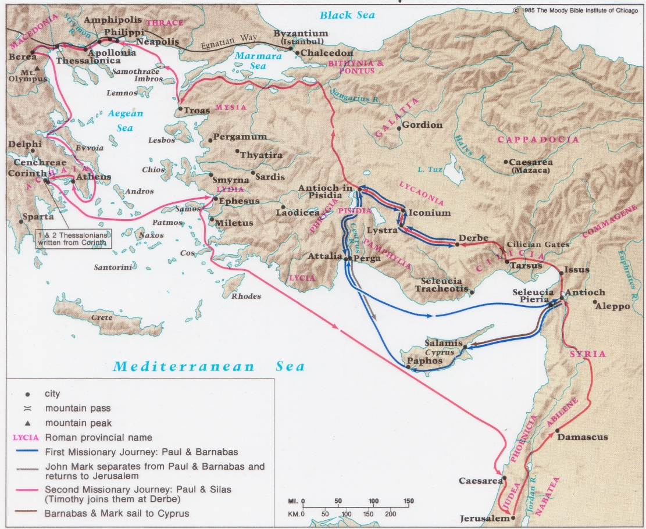
Paul & Barnabas wui
Remeikap kaja Pao hākashokwui Shongzā(Acts 13–14)

Slide 9
E. Mathāda makhangarān wui vāng kasaka tuizābing chi hāngui kahai ngavāya.
9
Chiwui vāng eina miwui āmingbing mashungrik eina matui khavai Mirinwui Lairik (The Book of Life) kachi lairik chili yangkhuilu (pp. 226-244)

Slide 10
F. Kapā ātamli makhaning tuiyarli kachang khamei thāda khuikahai (Gal 2:20 li ‘mikahai’ chili ākhon kakhayet; Exo 20:3 li ‘ili’ kachili kakhayet)
9
Chiwuivang eina tuiyār kachipāli ākhon yitrakhala kachi sāyanglu kala ākhon pangda palui palui chilo kala ningphunla salu.

Slide 11
G. Akhon mashoror eina kapā.
9
Chiwui vang eina thākmei kashi kala nemmei-chuimei kashida matuilo. Naoshinao bingwui mangāli pāchitheilo – āthumna nali ngatartei eina hāngmira!

Slide 12
H. “Iva theihaira” kachi ningphanin khalei mibingli tamkachithei hi saklāk-ka.
9
Nawui church li lairik mathālāk eina kapā mi phangā li hi tamchitheiyanglo.

Slide 13
I. Ithumwui zatkhanā “Varena Awui Tui kapā hili sokhami mataisangmiranu” kachi eina ungkup chingra da phaninga.
9
Ithumna Bible munlak eina pā-ākha, ithumna tuichi mahānglala Varena somilākra.

Slide 14
Vare Tui kapa
9
A. Khararchān: Maiyālāk eina kazang (Mark 11:1-11)
Phongkhami: Kazingramwui Pamkhong (Revelation 4:1-11)
Chapchāt: Khangachon kapo (Psalm 70)

Slide 15
Pao harkashokwui ara • BibleStudyDownloads.org
Hiwuili zangdakhaleihi tamkachitheiwui aponglinai. Kachisat binghi kalemeina samphangpaira
Notes:
Preaching (pr)
Homiletics

Slide 16
Black

