Slide 1
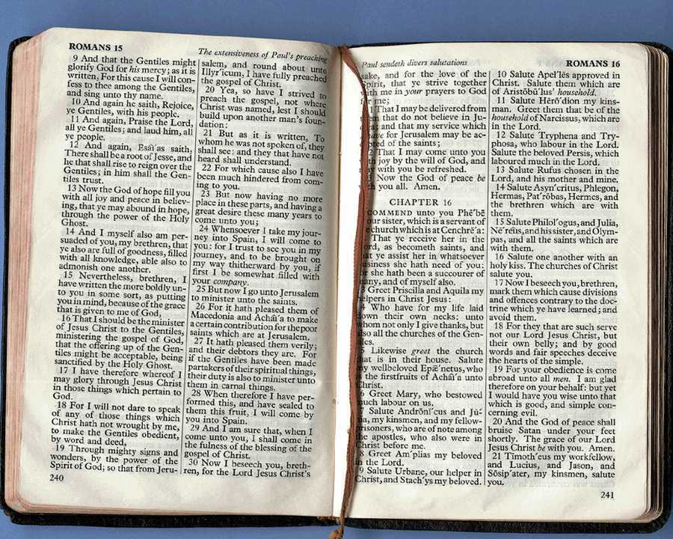
Pao harkashokwui ara: Tuipam pheikhaida pao hakashokwui arā
Dr. Rick Griffith • Singapore Bible College • BibleStudyDownloads.org
Notes:
Welcome & thanks

Slide 2
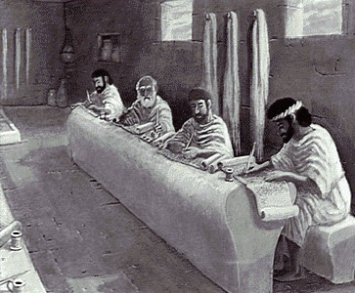
Tuipam pheikakhai: kathada kala khiwuivang

Slide 3
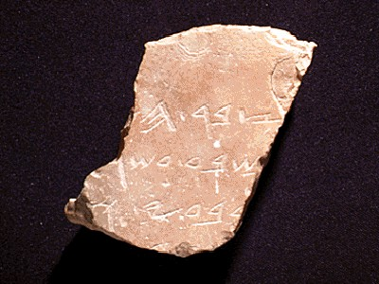
Kathada tuipam pheikhailaga pao hashokra?
1
Kakhalat
“Tuikhum pheikhailaga paohakashok hina khanganābing
wui vang khamashung kala shichin kapai pao ngasāngasaka"
Walter Liefeld, NT Exposition, 6

Slide 4
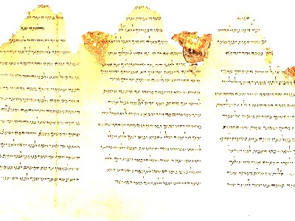
Kakhalat mathameida…
1
“Tuipam pheikhailaga khamatuihi biblewui kakhalatchi vaokashokna; otsot khararchan, grammar kala kakapi ara tamkazaklaga, tuipamchi kali-khipali-katharan kachi athishurda phaptakhuilaga, kala rikapda mangla kadharna khamatuipali sazamilaga, khanganabingwui mirin/shongzalila kannakapai ngasa khangasakna“
(Robinson, 20, paohakashokwui seminarli kahang)

Slide 5
Tuipam pheikakhaiwui machakbing
1
Biblewui tuipam akha tamkachithei
Liefeld, 6-7
Notes:
E.g., 1 Cor 13:1-7
Reference to other Scriptures is subordinate to the exposition of the main passage

Slide 6
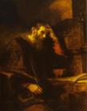
Tuipam pheikakhaiwui machakbing
1
Kakapi pāwui kharin makaila
=
Liefeld, 6-7
Notes:
Neh 8:8
Luke 4:16-22 on Isa. 61:1-2
The text is not a box of candy from which one selects his favorite treats. It is the Word of God, which has come to us to be master, not servant.
For example, preaching leadership principles from Nehemiah 1—2 misreads authorial intent.
You can preach a biblical message from the wrong verse!
In other words, you can be held by a great theology so that you preach truth, but it may not be the message of the particular passage before you.

Slide 7
Tuipam pheikakhaiwui machakbing
1
Ngasik khangasak
Hakkhamei kakhalat
Tuikhumwui kakhalat
Liefeld, 6-7
Notes:
True exposition expounds the one, central idea of the text called the Big Idea (homiletical idea or main idea or synthetic statement). Real exposition is not a series of exegetical comments, unrelated truths, or a cute outline that gives a survey of a passage

Slide 8
Tuipam pheikakhaiwui machakbing
1
Tuimatuichi kachivak vadalei
I. Hakkhamei kakhalatli jangasaklu
II. Hakkhamei kakhalatli jangasaklu
III. Hakkhamei kakhalatli jangasaklu
Hakkhamei kakhalatchi milu
Tuikhumwui kakhalat
Liefeld, 6-7
Notes:
brings the hearers towards the same point made by the author. The message does not simply state the main idea over and over without some design that brings the listeners along in truth

Slide 9
Tuipam pheikakhaiwui machakbing
1
Mirinli kathada shichinra
Khanganāpawui darkar…
Phap katā
Wuklungli sakaja
Ot kasa
Tuikhumwui kakhalat
Liefeld, 6-7
Notes:
It relates biblical truth to the listener's life in line with the original purpose, meaning, or function of the text.
Application must first be applied to the preacher's life to be effective exposition
----- Meeting Notes (7/5/12 10:55) -----
Preaching without application is like making a car but forgetting to put the tyres on! It is "where the rubber meets the road" in this sense, for the sermon will go nowhere without application.

Slide 10
Machakbing kasha eina
1
Notes:
Summary: So then, what is expository preaching and what is it not?

Slide 11
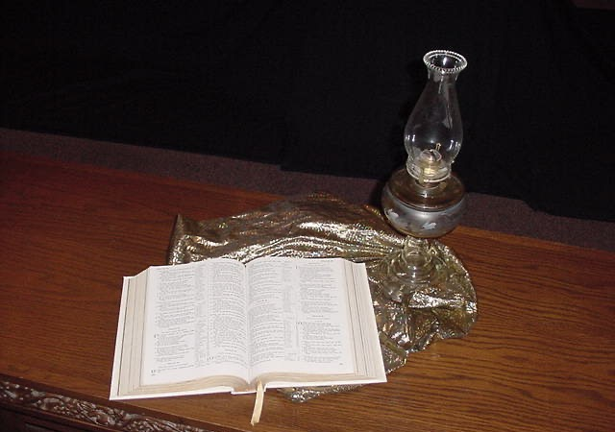
Tuipam pheikhaida pao hakashok khiwuivang darkar sahao?
2

Slide 12
A. Tuipam pheikakhai hi khangui makhalei tuipamli pheisin saya kala Varewui ningkachang chitheimi
2
Khalattawui mirinvang
Shimkhurvang
Otkasawui vang
Varewui tui katamvang
Notes:
The more we preach from Scripture, the less false teaching we will have.
We have only ONE inerrant book! Why preach other things?

Slide 13
B. Tuipam pheikakhai hina mangla kadharna kapangkakhui atam/apam chili varetui tammi
2
Khalattawui jukhanāmangli varewui tui sikachinwui eina makanmi
Makhamashung tuiru mashichin phapha ngasakmana
Notes:
God's Word is much more effective than the best of man's sermons to affect people's will and meet their needs.
"The type of preaching that best carries the force of divine authority is expository preaching" (Robinson, 19).

Slide 14
C. Tuipam pheikakhai hili sashap kala pangshap lei
2
Notes:
Isaiah 55:10-11
----- Meeting Notes (7/5/12 11:23) -----
As water comes from God and blesses the earth, so God's Word comes from him and blesses his people.

Slide 15
D. Tuipam pheikakhaihina khanganabingli Bible shāngasaka
2
Kasan kachon
Kasak kaza
Naongara
Notes:
By teaching his people how to get answers from Scripture itself, the pastor frees himself up from always being the authority.
Expository sermons remind people that the final authority is the Bible—not the preacher!

Slide 16
KHISADA VAREWUITUI DARKAR SANAHAO?
Kathara tui saikora Varena kasatkhami tuina. Chieina tamkachithei, hangkhamachin, mashung khangasak kala khamashung khangarongli rakkhavai wuivang kannai. Chiwuivang eina Vareli otram khangatha chili khamatha ot sakhavai, sari khangavai thada kashung ngasaklu
2 Timothy 3:16-17 (NIV)

Slide 17
VARETUIWUI ATHEI MATI
2
Hangkhamachin
Correcting
Tamkachithei
Khamashung khangarongli kharāk
2 Timothy 3:16-17
Notes:
If you preach sequentially through the Bible, you will have the divine balance in these four areas:
Teaching tells people how to walk God's road
Rebuking tells them when they get off the path
Correcting shows how to get back to the right way
Training in righteousness is the result of the cycle of teaching, rebuking and correcting over and over.

Slide 18
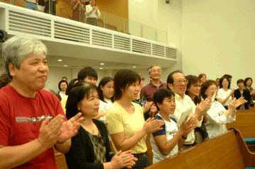
E. Tuipam pheikakhai hina manglawui kachangkhat darkar chi mi
2
Notes:
Good expository preaching does not impress the congregation; it feeds them.

Slide 19
F. Tuipam pheikakhai hina Varetui nguida tamkachithei maleingasakmana
2
Atam/apam
Atam/apam
Tuipam
Atam/apam
Atam/apam
Notes:
"Spiritualizing" (drawing a spiritual lesson while ignoring the actual meaning of a passage) is more difficult to fall into when one preaches from a single text than when the pulpit hits at verses all over the Bible.

Slide 20
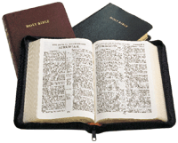
G. Tuipam pheikakahai hina lairik peida wui eina paohashokphamei
2
2015 chanpao
2013 chanpao
hapta 1
hapta 4
hapta 2
hapta 5
2008 chanpao
hapta 3
hapta 6
2009 chanpao
Tuipam pheikakhai
Paohakashok ara khangatei
2011 chanpao
2012 chanpao
Galatianao
Galatianao
2010 chanpao
2014 chanpao
2017 chanpao
hapta 7
hapta 10
2016 chanpao
hapta 8
hapta 11
hapta 9
hapta 12
Notes:
In a 10 year period, topical preaching might at best hit a third of the text in these two pages.
Systematic exposition provides a vehicle for people to get to know the big picture of each biblical book and cover every passage.

Slide 21
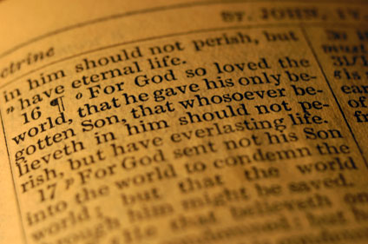
H. Tuipam pheikakhai hina khi maramli matuishikhanada jukhamajuwui atamchi ngatangkhuimi
2
“Vare, aja haptahili khi maramli paohashokrado?"

Slide 22
I. Tuipam pheikakhai hina shitkasang eina matui ngasaka
2
Khanganang
Khami
Phasawui khamathangli kathar

Slide 23
J. Tuipam pheikakhai hina supkhuiphaphalaga khamatuiwui nguikapaichili matatung ngasak mana
2
Khi nguikapai?

Slide 24
Supkhuiphaphalaga khamatuiwui nguikapai
2

Slide 25
Pao harkashokwui ara • BibleStudyDownloads.org
Hiwuili zangdakhaleihi tamkachitheiwui aponglinai. Kachisat binghi kalemeina samphangpaira
Notes:
Preaching (pr)
Homiletics

Slide 26
Black

