Slide 1
Katamli Ngachonkhavai
Katamnaowui Lairik eina kakhui Ngarumkasang
Mashing 1 eina thuida 36 kâshungdawui ngahânkâ khami
THE BIBLE…BASICALLY MINISTRIES INT'L INC.
KRISTAwui âsâkai katongali Biblewui wortam mayâsang khangasak
Ft. Worth, Texas www.biblebasically.org
52
Notes:
Print new 21 (SH14), 23 (Genealogy SH16)

Slide 2
KATAMNAOLI KACHITHEI:
KATAMLI NGACHON KHAVAI LAIRIK HI POWERPOINT EINA TAMKACHITHEILI SHICHINPAI KHAVAI NAMKASHOKNA
KHAYEIRUM HILI KATAMLI NGACHON KVAI KALA SHICHINPAI KHAVAI KHINA CHÂMEITHUIRA KAJI POWERPOINT SLIDES BING HILI CHITHEIMI HAIDALEI.
NAMSHOKLUISHIT LAGA SHIKACHIN THARAN LAIRIK NAMKASHOK WUI KHAMAYA ZANGRÂN CHI LAIRIK ÂNÂ KACHIDA ZANGPHALUNGRA.
KATAMLI KHANGACHON 09/09a
KALA 26/26a
ÂNÂ BINGHI KHANUK-EINA-KHANUK NAPLAGA SHICHIN KHAVAINA.
53

Slide 3
Katamli Khangachon Ngarumkasang
Khayeirum hili Katamli Ngachon khavai âtan âkha hi hina.
Lairik ânâ kathar chungmeidala mishokra; laga shurmamânda kamasai KATONGA chi chipuisangda ngahânkâmi khavai katomdalei. Tamkakhuiwui âthei hi kachangkhat Khayeirum hiwui kala nana râkhangarumwui mapungkaphâ kala kânkhanâ âtâzan ngasâra.
Râkhami wui vang ningshilak haira! Ithumwui Varena nathumwui ot hili somilakra da Awui Tuina tamchithei. Na hiwui eina kashok tharan, Varewui mangatam kapai Tui hiwui âman kasak kala khamashung hi nawui ningli mathingmeikhârda tipsangkhuira kaji chihânchaowa.
Pao hâkashok khutlai âkha ngasâda, nali “Nana khi shitsang do? Ili hangmilu khiwuivang do!” da khangahân katongali Varewui tui hi mapung phâmeida kala mashungmeida hângmishap haora.
THE BIBLE…BASICALLY MINISTRIES INT'L INC.
KRISTAwui âsâkai katongali Biblewui wortam mayâsang khangasak
Ft. Worth, Texas www.biblebasically.org
54

Slide 4
LAIRIK HILI KAZANG
ÂKHUM AKHA
01 O7VJ Katam-nâ: “Hili haophoksera.”
02 O7VJ Ningphun ngahân
03 Biblewui thâk maron maron shak-kasâ: Khamasai
04 “Bible Files” bing Kazipkasang: Khamasai
05 “Vari Kahai Atam:” Malachi eina Matthew wui âmatakli
06 “Vari Kahai Atam:” Haklak kahai khamataiya ungkashung
07 Thingrong Âphângli khangaruiya Jishuwui Shongzâ
08 Biblewui Thotinchân kala Khararchânpong chonsâ ningli rakkasang
09 Yangkhali Kathei Thotrinchân Flash Card Âtan
10 “MOREI” kaji Maramli
11 Varewui Tekhamateiya Amingbing
12 Ngacheiung-ngacheivâ sâkapai Tuiyur Mati
13 Achalakha Tuingashitwui Khangashikbing
14 Genesisli Abrahamli Ngashitkahai: Khamasai
15 Moseswui Tuingashit: Hunakhawuivang Khangaran
16 Jishu Khristawui Mi-un
17 Jishu Khrista Kaphara kala Awui mirinli shok-kapai otshot
18 Hârkahaiya Bible: Khamasai
19 Kachama Tuingashitwui Lairikbing Semkakâ: Khamasai
20 Kadhara Tuingashitwui Lairikbing Khorkakâ: Khamasai
21 Proho Jishu KRISTAwui Sâzangkahai Âzak
22 Johnwui Paokaphâ: Hâshok kahai
23 Sâkhangathabingwui Otsak: Akhum Kathum sada
24 Paul: Âwui Shongzâ Khangashân: Khamasai
Paulwui Khamataiya Mashun Tuipam Khani
26 “Chithibing” wui Khamataiya Tuikuibing (26ali ngasoda)
Phongkhami: Khamataiya Apong Phangâ
Biblewui Ningrin Kharupkakhui: Jishu KRISTA
29 Kupsangkahaibing Kachithei
30 Thâk maron maron semkakâ: Kupsangkahai
31 Bible File Kazipkasang: Kupsangkahai
32 Haokaphokli Abrahamli Ngashitkahai: Kupsangkahai
33 Hârkahaiya Bible: Kupsangkahai
34 Kachama Tuingashitwui Lairikbing Semkakâ: Kupsangkahai
35 Kachama Tuingashitwui Lairikbing Khorkakâ: Kupsangkahai
36 Paul: Awui Kharamkazat Yangkhakakhui: Kupsangkahai
ÂKHUM KHANI
ÂKHUM KATHUM
ÂKHUM MATI
ÂKHUM PHANGÂ
ÂKHUM THARUK
ÂKHUM SHINI
ÂKHUM CHISHAT
KUPSANGKAHAI KHANGACHON BINGWUI ÂKHUM
55

Slide 5
01
Hili haophoksera…
J
O
7
J
O
7
V
V
OKATHUI KASEM
VARI KAHAI
Jishu
Mi 4:
ABRAHAM
A
ABRAHAM
JOSEPH
J
JOSEPH
MOSES
M
MOSES
JOSHUA
J
JOSHUA
Mishang 3:
R
ROTKHAMARAT
ROTKHAMARAT
WUNGNAO
W
WUNGNAO
C
NARKAHAI
NARKAHAI
NAWUI NINGWUI BIBLE FILE!

Slide 6
02
Âra… nawui ningwui Bible File chi shokhavai, nakhalatta sâyangpai maningkha mili ningphun ngahân sâlaga shokhavai salu.
Nawui Bible File shokhavai châpi chiva:
O 7 V J
Mayek “O” eina haokaphok tui chi:
OKATHUI KASEM
7 = 4+3 ngayarkhai akha:
MI 4 KALA MISHANG 3
MI MATI chiya:
ABRAHAM
JOSEPH
MOSES
JOSHUA
Thâkha…âkha lemhai laga, yâruili hoshoklu. Ngahânkakâna ?
MISHANG KATHUM chiya:
ROTKHAMARAT WUNGNAO NARKAHAI
Thâkha…âkha lemhai laga, yâruili hoshoklu. Ngahânkakâna ?
OKATHUI KASEM
Mayek “V” eina haokaphok tui chi:
VARI KAHAI
ABRAHAM
JOSEPH
Mayek“J” eina haokaphok tui chi:
JISHU
MOSES
Chithâkha, tuikhur tharâ … kala nawui file tharâ wui ming… chiya:
JOSHUA
NAWUI NINGWUI BIBLE FILE!
ROTKHAMARAT
WUNGNAO
NARKAHAI
VARI KAHAI
JISHU

Slide 7
03a
BIBLEWUI THÂK MARON MARON SEMKAKÂ
(Khayeirumli map yek-khavai lairik ânâ hi khamasai eina haikhamina.)
MN
N(A)
H
C
GN
B
J
NK
EK
E
DN
U
KB
PG
SK
OT MANGÂ
“
RN
WUI VANG
NGARÂNKAPHOK”

Slide 8
03b
BIBLEWUI THÂK MARON MARON SEMKAKÂ
(Khayeirumli map yek-khavai lairik ânâ hi khamasai eina haikhamina.)
MN
N(A)
H
C
GN
B
J
NK
EK
E
DN
U
KB
PG
SK
OT MANGÂ
“
RN
WUI VANG
NGARÂNKAPHOK”

Slide 9

04
“”BIBLE FILES” BING KAZIP SÂKASANG
OKATHUI KASEM
(Abraham wui mangâli)
ROTKHAMARAT
Mayarnao & Shanao khare
Wungva Wungvâ
Morei khare
350
O
Paokaphâ khare
O
7
V J
Shimkhur khare
WUNGNAO
(1000 B.C.)
Mi sâthat khare
S - D - S
_{DT}
Tara kaphong/
changjingawut
••• KAKAI •••
Dolân
Âto Âze
MISHANG 3
ABRAHAM
(2000 B.C.)
Israel Judah
ÂWUI KAHO
_{AT}
10 2
_{KT}
N - Â - S
MARÂNBING
I - I
20-J 20-R
200 350
J - E
Assyria Babylon
12
JOSEPH
NARKAHAI
ZINGKUM 70
RAOPAM
Hankhaung âpong 3
430
Zingkum 100/50,000
Z - E - N
MI 4
MOSES
(1500 B.C.)
VARI KAHAI
SHONGZA
V
Greekwui Alex
(500 B.C.)
Sinai
Romanwui Zatkhanâ
A - Y - P
Kadesh Barnea
Jishu
40
_{NT}
Mirin
TAMKACHITHEI 5
J
Krush
JOSHUA
Church
Paokaphâ
Jericho/Ai
Otsak
Ngalei Ngayarkahai
Chithibing
Phongkhami
LAIRIK ÂNÂ PÂ HI, LAIRIK NAMKASHOK WUI MASHUN ZANGDA, NAMSHOKLUISHIT LAGA KATAM KALA TAMKACHITHEI WUI VANG SHICHIN PAIRA.

Slide 10
05
Vari Kahai Âtam
MALACHI EINA MATTHEW WUI ÂMATAKLI
Alexander kum ____...li thihaowa...300s B.C. tamli
33
Âwui keinung chi âwui ____________ matina ngayar haowa.
SHIPAI AKHAVA
GREECE:
ASIA MINOR:
Cassander
Lysimachus
SYRIA:
Seleucidwui Khamungbing
_______
SELEUCUS
MEDITERRANEAN NGAYI
“”Okathuiwui ____________ Kaji âpam!”
PALESTINE
MACHANMEITHUI
EGYPT
______
PTOLEMY
Ptolemaicwui Pharaohbing
KALA… ____________ âtamli:
ROMEWUI
________________________________ wui âtam:
SHORKÂRWUI KHAMUNG
KHUTLAI SHIKACHIN...TARA-
TRIGONOMETRY SEMKASHOK
TARA EINA KAZAT PUNG
ROSETTA KAJI NGALUNGLI KAKAPI
ALEXANDRIA : COLLEGE LINGKAKÂ
ROMAN BANKWUI ZATKHANÂ
SHIM KASEM ÂSAK-ÂVÂT KADHAR
TARA/KHAMAKHAO ZATKHAVAI; CHEK
LEIHLON KHAVAIWUI SEMKAKÂ
KEINUNG KUIMAREIDA SHONGFA
ZINGKUMKHALI 365 THANGSHÂNKAPHOK
PAX ROMANA KAJI CHINGRI KAHAIVANG
PALESTINELI ROMENA MUNGKAHAI
PHAOLÂK KAHAIYA ALEXANDER
ARISTOTLE: ALEXANDERWUI OJÂ
ARISTOTLE: LAA KASEMA
CHINAWUI KAHAKA PHALÂNG
CHINALI MARI SHIKACHIN
ALEXANDRIA: GREEK TAMKHAVAI APAM
EUCLID: GEOMETRYWUI OT SÂKAHAI
ROMANWUI PHEISÂ KHARE CORINTH LEIH KASÂWUI KHAMATAI ÂPAM ONKAHAI
EGYPTLI KHALEI JEHUDIWUI LEIH SÂKHAVAI ÂPAM
GREEKWUI ZATKHANÂ EINA KEINUNGBING GREEKWUI KHARING-KHARAK

Slide 11
06
“Vari Kahai” Âtam
MALACHI EINA MATTHEW WUI ÂMATAKLI
HAKLÂK KAHAI KHAMATAIYA MATI UNGKASHUNG:
VARETUI:
1. _______ _______ (Kachama Tuingashit) kapikup haowa.
2. Kachama Tuingashit hi ________ tui eina khalatshoka. (Septuagint kaji hi -- Lairikli ”LXX” da samphangra)
HEBREW CANON
GREEK
OKATHUI OTSHOT:
3. _________ ________ ___________ na Greekwui kasâ-khavâ âwui keinung peida ngayaomiya.
4. Palestine hi ________ na munghaowa: atam hitharan chuilak kahai _________ kala makaphawui _______ kahai chi okathuli khuiraya. (Pax Romana kachi china)
PHAOLAK KAHAIYA ALEXANDER
ROMANS
ÂKAP-ÂKÂ
CHINGRI
…CHITHADA SADA HIBING HINA ABRAHAMLI VARIVARANA NGASHIT KAHAI CHI UNGSHUNG KHAVAI KHUIRÂ KHAMINA… MESSIAH OKATHUILI KHARÂ, PROHO Jishu KRISTA!

Slide 12
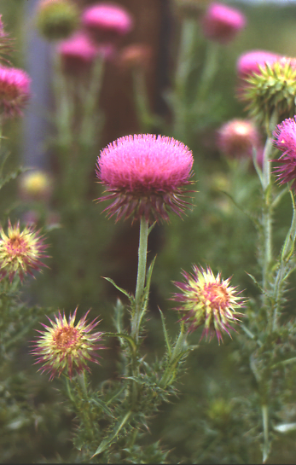
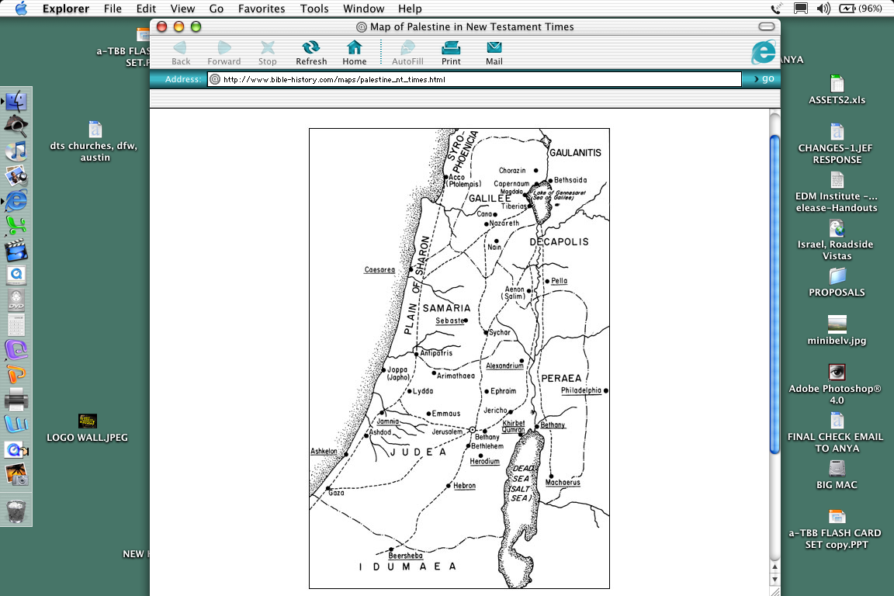
07
Jishuwui “Kashat Shongzâ” Khangakhui
GALILEE LI HAKMAHÂLAK EINA OTRAM KHANGATHA _____________
3
CAPERNAUM
CAPERNAUM
GALILEE
4
2
_________ OTRAM KHANGATHA
______________ KHAMAKÂN
SAMARIA
PEREANLI
SAMARITAN
5
1
KHANAOWA ____________ OTRAM KHANGATHA
PROHONA OTRAM NGATHA KHARE HI ____________
'
JERUSALEMLI
'
JERUSALEM
'
JERUSALEM
JUDEA

Slide 13
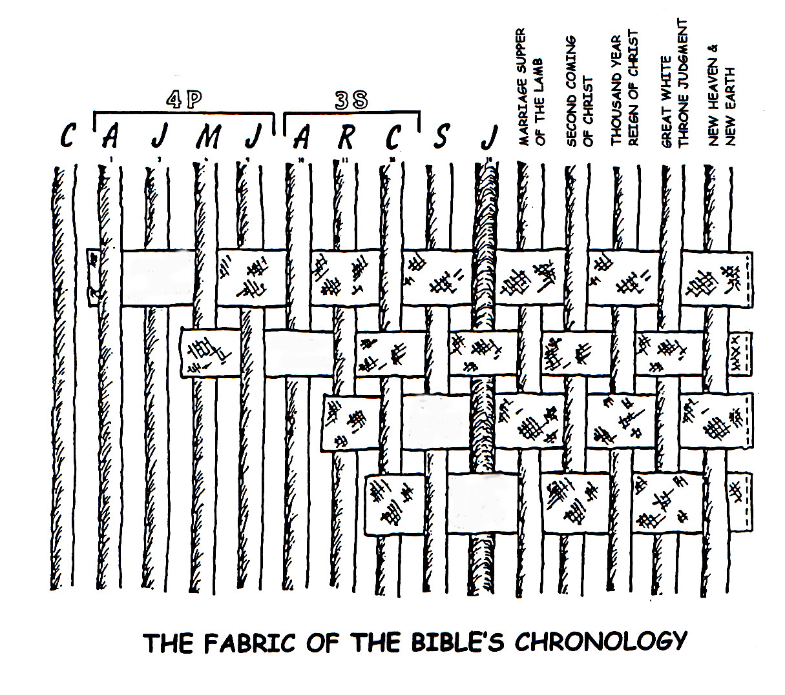
08
Biblewui Thotrinchân kala khararchân chonsâ thada ningli rak-kasang
O 7 V J
YAONAOWUI SHAKKAZA ZATKHANG
HAKKHAMAHA KACHARA WUNGPAMKHONGWUI BICHAR
KRISTANA OKATHUILI ZINGKUM THINGKHA KHAMUNG
KADHARA KAZINGRAM KALA KADHARA OKATHUI
M 4
M 3
Jishu KRISTAWUI RAKAKHANE
O
R
W
N
V
ABRA-HAMWUI TUINGASHIT
NGALEI TUINGASHIT
DAVIDWUI TUINGASHIT
KADHAR TUINGASHIT
Abrahamli tuingashit sâkahai chi ungshungmamânda,Biblewui khararchânpong la mataikamamân:
• Haokaphok Kapikasang 12 kala 15 wui Abrahamli Kaho kala Tuingashit,
• Khalatlui Kapikasang 30 wui Ngalei (Palestinian) Tuingashit,
• 2 Sam. 7 wui Davidwui Tuingashit kala
• Jeremiah 31 wui Kadhar Tuingashit.

Slide 14
09
YKT FLASH CARDS
Lairik ânâ hi mangâ-kala-khanukli kapi kahaina. Kazik eina chukhaida khalei pâreng chili chichâpvâlu, lairik ânâ teokhamei semshok khavai kala chibing china Bible File âvavali khimamei zangkhala kachi chitheira.
_________
_____ B.C.
_____ B.C.
_____ B.C.
TARIK ATAM
TARIK ATAM
TARIK ATAM
TARIK ATAM
TARIK ATAM
____ B.C.
MOSES
OKATHUI KASEM
ABRAHAM
JOSEPH
JOSHUA
The Bible…Basically
The Bible…Basically
The Bible…Basically
The Bible…Basically
The Bible…Basically
®
®
®
®
®
_____ B.C.
_____ B.C.
_____ B.C.
_____ B.C.
TARIK ATAM
TARIK ATAM
TARIK ATAM
TARIK ATAM
TARIK ATAM
_______
_______
WUNGNAO
Jishu
ROTKHAMARAT
NARKAHAI
VARI KAHAI
The Bible…Basically
The Bible…Basically
The Bible…Basically
The Bible…Basically
The Bible…Basically
®
®
®
®
®
KHANGAHÂN VÂK

Slide 15
09
YKT FLASH CARDS
Lairik ânâ hi mangâ-kala-khanukli kapi kahaina. Lâk khavâk kazik eina chukhaida khalei pâreng chili chichâpvâlu, lairik ânâ teokhamei semshok khavai kala chibing china Bible File âvavali khimamei zangkhala kachi chitheira.
TARIK ATAM
TARIK ATAM
TARIK ATAM
TARIK ATAM
TARIK ATAM
1500 B.C.
1500 B.C.
2000 B.C.
2000 B.C.
MOSES
ABRAHAM WUI MAMÂNGLI
Shongza
AT
OKATHUI KASEM
Sinai
Mayarnao & Shanao khare
JOSHUA
A - Y - P
JOSEPH
ABRAHAM
Morei Khare
Jericho/Ai
Kadesh Barnea
Raopam
Awui KAHO
Paokapha Khare
Ngalei Ngayarkahai
40
430
N - Â - S
Shimkhur Khare
Tamkachithei 5
I - I
Mi Sâkathat Khare
J - E
Tara kaphong/
Changjingawut
NT
12
Dolân
TARIK ATAM
500 B.C.
500 B.C.
1000 B.C.
TARIK ATAM
TARIK ATAM
TARIK ATAM
1000 B.C.
CENTURY KHARE
TARIK ATAM
DT
KT
Jishu
WUNGNAO
Mirin
S - D - S
Krush
NARKAHAI
••• KAKAI•••
ROTKHAMARAT
Church
VARI KAHAI
Zingkum 70
Âto Âze
Wungva-Wungvâ
Paokaphâ
Greekpâ Alex
Hankhaung âpong 3
Israel Judah
350
Otsak
Romanwui Zatkhanâ
Zingkum 100/50,000
10 2
Chithibing
Z - E - N
MARÂNBING
Phongkhami
20-J 20-R
200 350
Assyria Babylon
NGAHÂNKAKÂ VÂK

Slide 16
10
Bibleli Phongkhamiwui “Âmeikong” (khamataiya):
Varewui Makhangapat Tuingashitwui Rânyei
“_______” kaji Maramli…
MOREI
Hebrew kala Greek khaninili: “MOREI” kaji hi: âcham âram kakai, khayon, chonkhamakân, makaphâ makhayâ, khalâng, kala makaphâ.
Kha chili lângmeida…
“MOREI” =
KHARIN CHI MAKAZA
“…mi saikora morei sâserhaoda Varewui tekhamatei chili makâshungrarmana.”” Romnao 3:23

Slide 17
11
VAREWUI ______________ __________ !
TEKHAMATEIYA AMINGBING
AVÂ…NGANINGKHAME…SASHAP PANGSHAPA…ALPHA…AMEN…ACHALAKHAWUI MI…THAONEOMI KAHAIYA…PANGMON KHAREI…PROHOWUI PANGTHEI…KHARINGAWUI AKHAVA…SHITKASANG HAOPHOKPAM…HAOKAPHOK KALA AKATANGA…AKHAMANG KAJA SOKHAMI KHAMUNGA…APHANG…KHARINGAWUI KHAMUI…VAREWUI KHAMUI…MAKHAM KAHAIYA…KAHORA ZINGTHANWO…YAOKAHOMA…KAPANGKHUI KAHAIYA…KRISTA…VAREWUI KRISTA…PROHOWUI KRISTA…KRISTA, KHARINGA VAREWUI NAOMAYARA…RINGPHA KHANGASAKA…RAIMI AKHAVA…ISRAELLI MAKAN KHAME…KACHUIYA MEI…PAKRA AKHOKA…MACHINME…KAZING NGALEI KASA…HUIKHAME….YUR SAIKORAWUI NINGKACHANG…KHAMONG…EL SHADDAI…KATANG MAKHAVAI VARE…KATANG MAKHAVAI AVÂ…VAREWUI AZAK TAKAMHAI…NINGKATONG KALA KHAMASHUNG…NINGTONGDA SAKHI SAKHAME…ÂVÂ…VARENA SEMKAHAI KATONGALI NAOCHIZAI KHARE…. SAMPHANGKHARE ATHEI…SHIMPHUNG…KHASHINA KHALOKBING KALA MOREI KAPHUNGBINGWUI NGASOTNAO…NIMSHIMRI KAHAI KHON…VAREWUI LEMMET…PROHOWUI TEKHAMATEI…VARIVARA…SASHAP PANGSHAPA VARE…SAIKORAWUI VARE…ILI KATHEI VARE…KAPHA YAOKAHOMA…PANGMON KHAREI…SASHAPA YAOKAHOMA…CHIZAKHAME…PHASAWUI AKUI…CHURCHWUI AKUI…SAIKORAWUI SHIMLUIKAT…KATANG MAKHAVAI PANGMON KHAREI…THANRKHAMATHENGA…ISRAELWUI THANGKHAMATHENGA…MANGLA KATHARA…KACHIHAN…PANGSHAK KHALEIYA HUIKHAME… I CHI INA…VAREWUI AMAHÂ…AKHALATTAWUI AMAHÂ…IMMANUEL…JEHOVAH…
JISHU…
JISHU KRISTA ITHUMWUI PROHO…BICHAR SAME…AWUNGA…KATANG MAKHAVAIYA AWUNGA…AWUNGABINGWUI AWUNGA…THOTTHOTWUI AWUNGA…VAREWUI YAONAO…KHANAOWA ADAM…AIN KHAME…KATHANA…KHARINGA…OKATHUIWUI KAHOR…KHALANG KATHA…TAMPAKWUI TIMRAWON…JUDAH SHANGNAOWUI KAZINGKHA…KHARINGA LUNGGUI…KHARINGA TARA…PROHO…SASHAPA PROHO VARE…PROHO JISHU KRISTA…SAIKORAWUI PROHO…TEKHAMATEIYA PROHO…PROHOBINGWUI PROHO…ITHUMLI NGARONGKHANGASAKA PROHO…LEIKASHI…WUKKAKHANGA MI…AMEI… NGASHIKME…LUMASHAN KATHA VARE …NAZARENE…DAVIDWUI NAOTUN…OMEGA…NAOHO NAOTONG…ITHUMLI MAKANKHAME YAONAO…ITHUMWUI CHINGRI KAHAI…HAM KASA…
VAREWUI PANGSHAP…CHINGRI KAHAI WUNGNAO…MARAN…SAMATHA KHAME…RABONNI [OJA]…VAREWUI TEKHAMATEIWUI KAHAN…HUIKHAME…SHARKHAWUI MEI…RINGKHALUIYA KALA KHARINGA…KHANGARONGA…LUNGHAR…DAVIDWUI ANGAYUNG…SHARONWUI WON…VAREWUI THEMSAKLI KHAMUNGA…OKATHUI WUNGNAOTUNGLI KHAMUNGA…ISRAELLI KHAMUNGA…NGATANGKHAME… ISRAELWUI EINA KHANTHING…ATHA…RAO…NAMANGLALI HOMKHAME KALA YANGKHAME…CHANGVEI…DAVIDWUI NAOMAYARA…VAREWUI NAOMAYARA…JACOBWUI EINA KASHOK SIRA…LUNGGUI…KHANGARONGWUI NAO…OJA…KHAMASHUNGA KAHOR…KHAMASHUNGA DRAKATHEIRONG…VAREWUI THANGKHAMEI… MATAKKHAK KAHAI MACHINME…TUI…VAREWUI TUI.
Mary Foxwell Loeks,
The Glorious Names of God,
Baker, 1986
ITHUMWUI KHARINCHI ZAKA MAZADO?

Slide 18
12
Varewui Makhangapat Tuingashitwui Ranyei: Bibleli Phongkhamiwui Ameikong (Khamataiya)
Kachama kala Kadhara Tuingashitli ngacheiung-ngacheivâ sâkapai tuiyur kaikhawui kakhalat hi phaningyangsa:
KACHAMA TUINGASHIT
KADHARA TUINGASHIT
____
NING
___________
KHANGASHIT
___________
___________
CONTRACT
TUINGASHIT

Slide 19
13
ACHÂLAKHA TUINGASHITWUI KHANGASHIKBING…MAKHANGACHEI KHAVAI NGANAIMAMÂN KAHAI!
APANGWUI
__________TUINGASHIT: Aruihonwui handshake kasâli khangarui; pangmayâ khani mitkhangarok; hunakhawui vang.
_____________TUINGASHIT: Athumwui alungli pheihop ngathakhangarok; hiwui khutamva pheihop chi âkhavâpâli mahanmiranglakha eina tangda tuingashit chi leira.
PHEIHOPWUI
___________TUINGASHIT: Athumna âmankasaka machi hi chonsâkhaonaoli phungzata. Mayâkhangarok wui âlungli, âkhana âkhawui chonsâkhaoli machi kateoteo masiksang ngaroka, hiwui khutamva machi âpâ chi ngarakzakda âkhavâpâli mahanmiranglakha eina tangda tuingshit chi makaila leira.
MACHIWUI
___________TUINGASHIT: Tuingashit kakaipâ chili sâ li sâkathat tâkam eina: kathiwui tandi mira. Sâ kathiwui khutam hina theikhangasakva, mathiranglakha eina tangda tuingashit hi zatnâra.
ASHEEWUI
Apong: J. Dwight Pentecost, Thy Kingdom Come

Slide 20
14
HAOKAPHOKLI ABRAHAMLI NGASHITKAHAI: Bibleli Phongkhamiwui Ameikong (Khamataiya)
Abrahamli _______ Hao. 12:1-3
ABRAHAMWUI TUINGASHIT
__________ Hao. 15:9-18
KAHO
TUINGASHIT
Abrahamwui Tuingashit hili Farorkhami Tuirabing
KATANG MAKHAVAI
TAZAK KAHAI
MAKHANGAPAT
Hao. 13:15
Hao. 13:14-16
Hao. 15:9-18
__________
NGALEI
ATHA
SOKHAMI
Hao. 12:2
Hao. 12:3
Hao. 12:1
Gen. ___:___
NGALEI
DAVIDWUI
KADHAR
Tuingashit
Tuingashit
Tuingashit
Khalatlui 30:1-10
2 Sam. 7:14-16
Jer. 31:31-34
Kakhalat mataisang khangasak Tuingashitbing
KUPSANG KAHAI, KATAMLI KHANGACHON MASING 32 LI MIHAIDALEI.

Slide 21

15
Varena Mosesli ngasoda Ngakheikhang kahai Khangarân:
“ _______________TUINGASHIT””
MOSESWUI
A-Y-P
Hunnakhawui, Sâphalungki kachi, Kashok-shok
NINGKHAMI THARȂ
KAPIKASANG 20: __________________
_{“Ningkhami Tharâ”}
Âcham-Âram
Ngalung Khare – Vareli Sâkhangayi (Tuiza 1-12)
_{Proho Nawui Vare}
_{Kateili Varenada phaningshâra}
Kameoli kala Ngaraikachâ akhali shâr sashâra
_{Vare kateili makhorumpai mana}
Prohowui Ming Kathar eina haira
Sabbath Zimiksho kathar eina mayonphalungra
_{Tharukthang mang ot kasa}
_{Sabbath Zimiksholi khangasam}
Ngalung Kakhane – Mili Sâkhangayi (Tuiza 13-17)
_{Ava avâli khayashilu}
_{Sakashâr:}
_{Mi Sakathat}
_{Phokapha}
_{Khali kasha}
_{Kakapik}
_{Mili kala otli kakahao}
KAPIKASANG 21-24: _________________ AINBING
_{Ichichawui mashun}
_{Lanwui mashun}
Ningtongda ringkhavai sakhangayi
KAPIKASANG 25-31: _____________________ AINBING
Ningkhami Oko, Table kala Thaomeishong
_{Chi semkaka}
Pithraiwui Hanphutpam kala Kayang
_{Chiwui Pangmonbing}
_{Pangmonbingli tharkachikat}
Hanphutpamwui nganamkapha kala khokharumabing
Otram khangathabing kala Sabbath
Yâruirin
YÂRUIRINWUI
TABERNACLEWUI
Shâr

Slide 22
16
ADAMWUI EINA THUIDA KRISTA
JISHU KRISTAWUI MI-UN
ADAM -- EVE
CAIN ABEL SETH
ENOSH
CAINAN
MAHALALEEL
JARED
ENOCH
METHUSELAH
LAMECH
NOAH
SHEM (HAM & JAPHETH)
ARPHAXAD
CAINAN
SHELAH
HEBER
PELEG
REU
SERUG
NAHOR
TERAH
ABRAHAM (SARAH)
ISAAC (REBEKAH)
JACOB
JOSEPH
Matthew 1:1-17
• ____________,
_________THARÂ
• Abrahamwui eina Mangashong
Davidwui Naomayâra,
Josephwui manga eina
• Jehudili mik rak-khangasak
• Ainwui Tharâ
MARY
Luke 3:23-38
• _____________ THARÂ
• Adamwuili Han-unglaga
Marywui manga eina,
Thot-thot eina
• Mary Khalattawui kala awui eina
kashok Mi-un,
• Davidwui shimkhurwui Athâ
(2 Sam. 7: 12, 13; Romnao 1:3)
ASHEEWUI
WUNGNAO
AINWUI
(ZILPAH)
(LEAH)
(RACHEL)
(BILHAH)
[ GAD, ASHER]
[REUBEN, SIMEON, LEVI, ISSACHAR, JUDAH, ZEBULUN]
[JOSEPH, BENJAMIN]
[DAN, NAPHTALI]
NATHAN
MATTATHA
MENNA
MELEA
ELIAKIM
JONAM
JOSEPH
JUDAH
SIMEON
LEVI
MATTHAT
JORIM
ELIEZER
JOSHUA
ER
ELMADAM
COSAM
ADDI
MELCHI
NERI
SHEALTIEL
ZERUBBABEL
PEREZ
HEZRON
RAM
ADMIN
AMMINNADAB
NAHSHON
SALMON
BOAZ
OBED
JESSE
SOLOMON
REHOBOAM
ABIJAH
ASA
JEHOSHAPHAT
JORAM
UZZIAH
JOTHAM
AHAZ
HEZEKIAH
MANASSEH
AMON
JOSIAH
JECONIAH
AWUI THARA KHONSHIKAHAI;
(JER. 22: 24-30LI YANGLU);
ASHEEWUI THARA HILI NGASAMHAOwA; KHA AINWUI THARAVA LEIFAYA.
SHEALTIEL
ZERUBBABEL
RHESA
JOANAN
JODA
JOSECH
SEMEIN
MATTATHIAS
MAATH
NAGGAI
HESLI
NAHUM
AMOS
MATTATHIAS
JOSEPH
JANNAI
MELCHI
LEVI
MATTHAT
ELI
JOSEPH (Arihâ)
MARY
DAVID
KALA
BATHSHEBA
ABIUD
ELIAKIM
AZOR
ZADOK
ACHIM
ELIUD
ELEAZAR
MATTHAN
JACOB
JOSEPH
ASHEEWUI THARÂ
Jishu
AINWUI THARÂ
KRISTA (CHRISTOS: “THAO NEOMI KAHAIPÂ”) – VAREWUI NAOMAYÂRA

Slide 23
17
THADA KASHUIRAK PHARÂ KAHAILA?
JISHU KRISTAWUI KAPHARÂ KALA MIRINWUI TEKMATEILAK KAHAI MASHOK KHAMARAO KASHOK CHI PHANINGYANGSA*
KACHAMA TUINGASHITLI: MESSIAH KHARÂWUI MARAMLI 300 SHIDA KAPI KAHAI KATONGA CHI JISHU KRISTAWUI KAPHARÂ, AWUI MIRIN KALA ALI SHAOKATHAT CHILI UNGSHUNGSER KAHAINA. CHI KAHÂNG EINA NGASODA…
PHONGKHAMI 8 MÂNG MI AKHAWUI MIRINLI ARUI RASHUNGDA KAYAKHA SHIDA UNGSHUNGHAIRA MARAO?
NGAHANKAKÂ:100 QUADRILLION (10 ¹⁷) WUI EINA AKHAMANG
_{1:100,000,000,000,000,000}
PHONGKHAMI 48 (300 WUI EINA ) ARUI RASHUNGDA MI AKHAWUI MIRINLI UNGKASHUNG KAYAKHA SHOKMARAO KHALA:
_{NGAHÂNKAKÂ: 10}¹⁵⁷ _{wui ngachaili akhamâng}
1:10,000,000,000,000,000,000,000,000,000,000,000,000,000, 000,000,000,000,000,000,000,000,000,000,000,000,000,000, 000,000,000,000,000,000,000,000,000,000,000,000,000,000, 000, 000,000,000,000,000,000,000,000,000,000,000
ASHEEWUI THARÂ (MARY)
JISHU
KRISTA
(CHRISTOS: “THAO NEOMI KAHAIPÂ)
VAREWUI NAOMAYÂRA
AINWUI THARÂ (JOSEPH)
*Apong: Josh McDowell, Evidence That Demands A Verdict, 1972, p. 175;
Peter Stoner, Science Speaks, Moody Press, 1963.

Slide 24
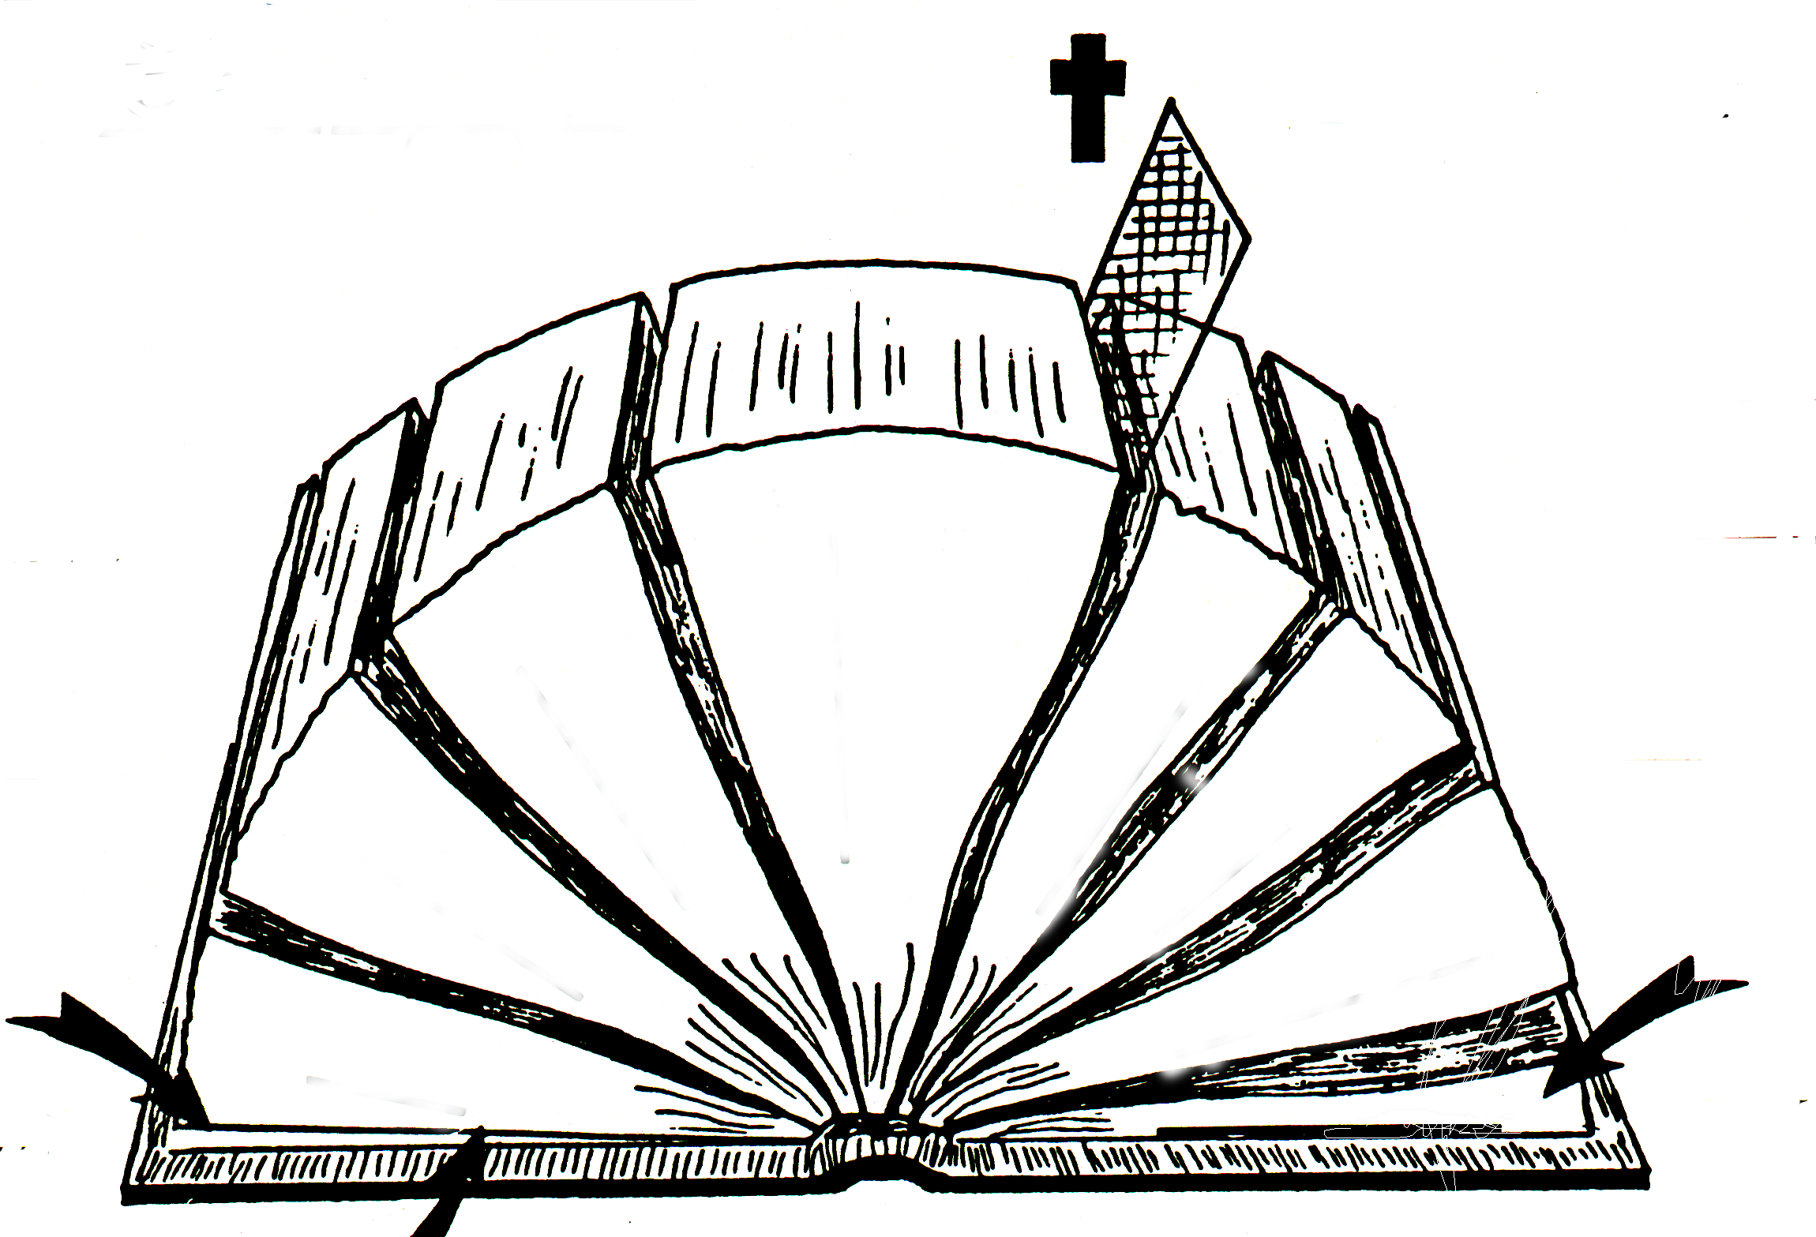
18
HÂRKAHAIYA BIBLE
_{Zingkum 1600}
A
_{Kapimebing 40}
B
D(KT)
_{“Kachama” Tuingashit}
D(KT)
_{“Kadhara” Tuingashit}
C
TUIKUI ÂKHA:
_{Varewui Tekhamatei}
E(KT)
_{Lairik “39”}
E(KT)
_{Lairik “27”}
F(KT)
_{Hebrew}
F(KT)
_{Greek}
4
/
3
5
/
G(KT)
_{Ain}
_{PAOKAPHÂ}
G(KT)
_{Lukhamashan}
_{MARÂNKHAMI}
6
_{Ungkashung}
_{Khangashit}
2
_{OTSAK}
_{LAASEM}
7
_{THOTCHÂNBING}
_{CHITHIBING}
1
_{AIN}
8
_{HISTORIES}
_{PHONGKHAMI}
H(KT)
_{Telescope}
_{Telescopes}
H(KT)
_{Telescope}
J
2
1
_{Kânthui Kahai Katang Makhavai}
_{Microscope}
_{Microscope}
_{Rârâda khalei Katang Makhavai}
I(KT)
KACHAMA KALA KADHARA TUINGASHITWUI NGARAIKACHÂ ÂYANBING:
AIN (1) kala PAO KAPHÂ (5)
na thotrinchân khuikashok,
THOTRINCHÂNBING (2) kala OTSAK (6);
ngashan reikasang kachithei;
Lairik kachungkha khuikashok;
LAASEM (3) kala CHITHIBING (7),
ithumwui Bibleli ngakheikhang kahai khani shokhangasak,
MARÂNKHAMI (4) kala PHONGKHAMI (8).

Slide 25
Khayeirum Katamli Khangachon Masing
19
O 7 V J
“LAIRIKBING SEMKAKÂ:”
KACHAMA TUINGASHIT PARENG CHINGKAKÂ
O
OKATHUI KASEM
1.
Nganaimeikapkaje âtam
pâreng: 2000 B.C. wui mangâli
Shimkhur Morei Tara kaphong Dolân
Haokaphok
AT
ABRAHAM
circa:
2.
Nganaimeikapkaje âtam pâreng: 2000 B.C.
N-Â-S Isaac Jacob Naomayâra 12
2.
Abra- ham
Job
KHANGATEI LAIRIK KATONGA CHI WUNGNAO ÂTAMWUI EINA NA
JOSEPH
1/2 David 1 Moses
3.
7.
Nganaimeikapkaje âtam pâreng: 2000 B.C.
Raopam 430
Laa
MI 4
ÂIN (5)
LAASEM (5)
Shongzâ
7.
Solomonna Thangkhamei wui pongli
MOSES
Chân.
4.
Nganaimeikapkaje âtam pâreng: 1500 B.C.
Sinai A-Y-P Kadesh Zingkum 40 Tamkachithei 5
Pangmonshi
Solomonna Mirinwui pongli
7.
Mishan
Has.
Khalatlui
NT
7.
Solomonna Shimkapânwui pongli
Sol.
JOSHUA
MARANBINGWUI KHANGANONG CHI KHALÂ KAKHUI:
5.
Nganaimeikapkaje âtam pâreng: 1500 B.C.
Jericho/Ai Ngalei Ngayarkahai
Joshua
ISRAELLI (WUNGRAM ÂTO)
_{A}
Amos
gato ngarâli
_{H}
Wungva-Wungvâ
Hosea
uimida
ROTKHAMARÂT
Jonah (Nineveh)
_{J}
6.
Nganaimeikapkaje âtam
pâreng: 1000 B.C.
Wungva-Wungvâ Zingkum 350
Ruth
amitheilu
JUDAHLI (AWUI SUIKATÂ LI)
*
_{I}
na
Isaiah
_{J}
1 Samuel
ishuli
(S)
Joel
_{M}
MISHANG 3
THOTCHÂNBING (12)
WUNGNAO
ahorhailakla
7.
Nganaimeikapkaje âtam pâreng: 1000 B.C.
S-D-S KAKAI
2 Samuel
DT
Micah
_{O}
Ato Shang 10 Israel 20-J 200 Assyria
Aze Shang 2 Judah 20-R 350 Babylon
(D)
}
Obadiah (Edom)
kthuira
1 Wungnao
(S)
*
_{J}
JUDAHLI (ROTKHAMARATLI)
ishuna
2 Wungnao
KT
(MR)
*
Jeremiah
_{L}
MARÂNMI KAHAIBING (17)
“NGAKAI”
KAHAI
WUI THILI
MARANBINGNA
ZINGKUM
SHÂMATIWUI
ALUNGLI
KAGAPINA”
Chapchat Laa
eishida
1 Thotrn.
_{H}
( )
Habakkuk
oda leilakha
2 Thotrn.
Nahum (Nineveh)
_{N}
NARKAHAI
athum
8.
Nganaimeikapkaje âtam pâreng: 500 B.C.
Zingkum 70 Shang 2 Zingkum 100 Mi 50,000 Z-E-N
Ezra
_{Z}
Nehemiah
Zephaniah
anunglu
*
Esther
JUDAHLI (NARKAHAILI)
_{E}
Ezekiel
nochwui shim
V
*
_{D}
VARI KAHAI
Daniel
harkachikat
9.
Nganaimeikapkaje âtam
pâreng: 500 B.C.
Greekwui Alex Romanwui Zatkhanâ
©2006 John Fryman
JUDAHLI (HANKHAUNGLI)
_{H}
Haggai
angkhamachinli
J
Jishu
KADHARA TUINGASHIT PAO KAPHÂ…OTSAK…CHITHIBING…PHONGKHAMI
_{Z}
10.
Zechariah
akshida
Nganaimeikapkaje âtam pâreng: Khare Century A.D.
Mirin Krush Church
_{M}
Malachi
akhuihaialu
KUPSANG KAHAI, KATAMLI KHANGACHON MASING 34 LI MIHAIDALEI.

Slide 26
20
KADHARA TUINGASHIT WUI LAIRIKBING SEMKAKÂ
Kadhara Tuingashit hina “Jishuwui File” eina thuida”…Pao Kapha kala Church wui thotrinchan hili zingkum 100 shakhawui hangkhamina. Achalakhava, Kadhara Tuingashit hi matailak kahai tuikhur mati sada khaihai….
(4)
(1)
(21)
(1)
_{Khamashung}
_{Churchwui}
_{Churchwui}
_{Rarada khalei}
_____________ kala ___________
____________ ____________
____________ ____________
____________ ____________
_{Varewui maram}
_{Thotrinchân}
_{Kazang- kashok}
_{Katang makhavai}
PAOKAPHÃ:
Matthew*
Mark*
Luke*
John
--------*Synoptic:
__________
__________
SÃKHANGATHA
BINGWUI
OTSAK
CHITHI
BING
Paulna kagapi chithibing:
Romnao
1 Corinthianao
2 Corinthianao
Galatianao
Ephesianao
Philippianao
Colossianao
1 Thessalonicanao
2 Thessalonicanao
1 Timothy
2 Timothy
Titus
Philemon
Khangateiwui Chithibing:
Hebrews
James
1 Peter
2 Peter
1 John
2 John
3 John
Jude
PHONGKHAMI
_{Romnaoli kapi kahai}
_____
_{Kaikha 2 Cor li zanga}
_{Gentiles}
“_________
_________
_________
_________”
_{“Yangkha-}
_{Eina}
_{Pangmon}
_{Ngarum”}
_{Chungmei}
Church Lansingme wui Kakhanang ______ ___________ _________.”
Athum Khon makashok Tithes
Khamibing
“Paul wui katang PHilemonli”
Aja ngayâ Jerusalemwui Tvli azingwui _______ nao matina kumei ngareora
James,
Peter,
John, kala
Jude
Hebrew
KUPSANG KAHAI, KATAMLI KHANGACHON MASING 35 LI MIHAIDALEI.

Slide 27

21
PROHO JISHU KRISTAWUI KUPKAHAI AMA
Paokaphâ kapimebing: athumwui rinsit kahai mibingli kakapi… Jishu KRISTA hithai kaji ichichâwui hângkachithei ârâ…kala Paokaphâ chi kakapiwui ningrin…kakapi atam.
_{40s}
₆₄₋₆₈
_{_________A.D.}
_{_________A.D.}
1
_{Matthew}
2
_{Mark}
_{Jehudinaoli}
_{Romnaoli}
_____________ _____________ _____________
______________ ______________
______________
_{Awungana da}
_{Raona da}
_{Âna khi Hâng}
_{Âna khi Sâ}
_{Synoptic:}
_{“Yangkhangarum”}
3
_{Luke}
4
_{John}
_{Greeknaobingli}
_{Churchli}
______________ ______________ ______________
______________ ______________ ______________
_{Vare/Mikumona da}
_{Varena da}
_{Âna khi Phung}
_{Âna khi Phaning}
₅₇₋₅₉
₆₉
_{_________A.D.}
_{_________A.D.}

Slide 28
22
JOHNWUI PAOKAPHÂ: SYNOPTICS (YANGKHANGARUM) WUI EINA Â KATHADA NGAKHEIKHANGHAO KHALA?
4
JOHN
ITHUMNA JOHNWUI HAOKAPHOK TUIZABING CHILI YANGSA
AKHUM ÂKHA …
CHURCHLI
______________ ______________ ______________
VARENA DA
ANA KHI PHANING
JISHU KRISTAWUI
_______________ ___________ ______ !
Hakmahâlak kahai Khamashung Tharuk
• Jishu: Leihairakasâ (Tuiza 1)
• Jishu: Ngakheikhang kahai Vare (Tuiza 1)
• Jishu: A chi chichinga (Tuiza 1)
• Jishu: Katangmavaila Ringkhangarum (Tuiza 2)
• Jishu: Âpug-Âpaka Kasema (Tuiza 3)
• Jishu: Kahor kala Mirinwui Ângayung (Tuiza 4, 5, 9)

Slide 29
23
SÂKHANGATHABINGWUI OTSAK: ÂKHUM KATHUM SADA
1
2
3
4
5
6
7
Jishuna Kakaso kala Kazingram kâthuikahai
Pentecost: Churchwui Kapharâ Zimiksho
Phei Katekli Raikhami
Remeithui kaji Rekkakharek
Ananias kala Sapphira
Remeithui kaji Deaconbing
Stephen kala Shitkasangwui vang Kathi
_{Jerusalem}
Akhum 1
____________ LI Kapikasang 1-7
8
9
10
11
12
Philip kala Ahonga
Damascus Shongfali Saulna Vareli khuikasang
Peter kala Cornelius
Peterna Gentilenaoli pao hâkashokwui maramli kaphayet
Herodna Vareshibingli Rekkakharek
_{Palestine}
____________ LI KALA ____________ LI Kapikasang 8-12
Akhum 2
_{Syria}
13
14
15
16
17
18
19
20
21
22
23
24
25
26
27
28
PAO KAZAT SHONGZÂ KHARE
“
JERUSALEM KAZIP (COUNCIL)
PAO KAZAT SHONGZÂ KAKHANE
“
“
PAO KAZAT SHONGZÂ KAKATHUMA
“
Paul: Jerusalemli
Paul: Mi Kachungkhawui Mangâli Kaphayet
Paul: Sanhedrinwui Mangâli Kaphayet
Paul: Felixwui Mangâli Kaphayet
Paul: Festuswui Mangâli Kaphayet
Paul: Awunga Agrippawui Mangâli
ROMELI HUIKHAVÂ: Marikhong Kakai
Paul: Rome
_{Okathui}
_____________ ÂCHIKUN VÂSHUNGDA Kapikasang 13-28
Akhum 3

Slide 30
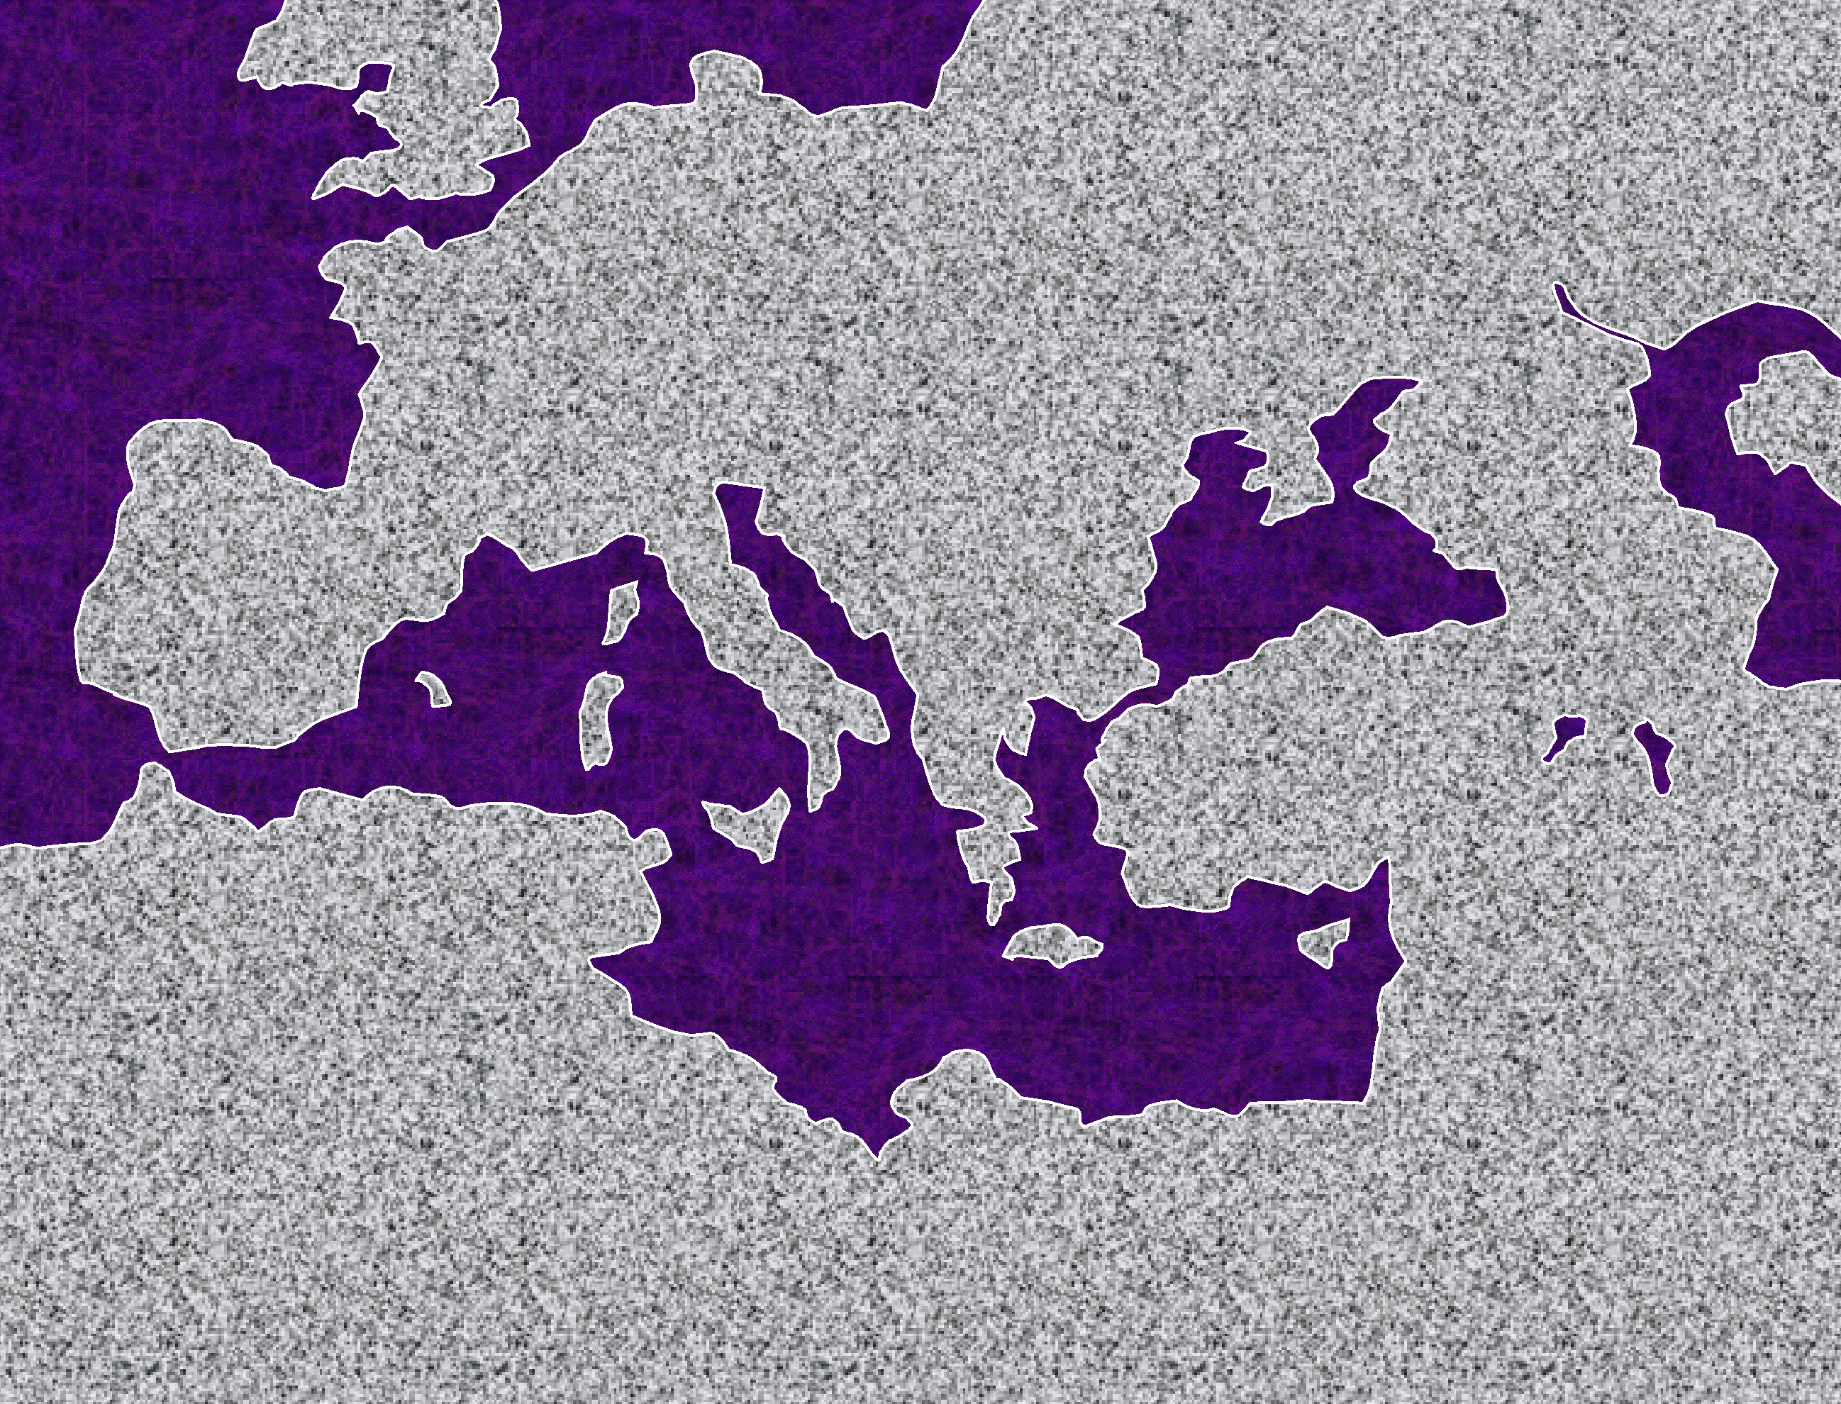


24
Paul: Awui Kharamkazat Yangkhakakhui
EUROPE
1.“Sayangkakhui”
Otsak 13-14
_{Meoma}
#1
Khamataibing: ________li khokharum; matakhak kahai ot kasâ; Paulli ________________; otmangâ kasak; church haokaphok.
•ROME
ASIA
_{Ngalung eina kaher}
GREECE
•
•PISIDIAN ANTIOCH
ATHENS/CORINTH•
•SYRIAN ANTIOCH
EPHESUS
•JERUSALEM
Tuipam Kupsangkahaina: __________ na ______ maningmana!
AFRICA
ARABIA
_{Lukhamashan}
_{Ain}
EUROPE
Otsak 15-18
Otsak 15 Jerusalem Kazip
•ROME
ASIA
GREECE
•PISIDIAN ANTIOCH
_{Europe}
ATHENS/CORINTH•
2. “_________ vâk khavâ”
#2
EPHESUS
•SYRIAN ANTIOCH
Khamataiya: church kachungkha haophoka; _____________ li khava, kala Athensli; Mars Hill; ______________ li kasângkha kapam.
•JERUSALEM
_{Macedonia}
AFRICA
ARABIA
_{Corinth}
_{Asia}
EUROPE
Otsak 18-21
3. “____vâk khavâ”
#3
•ROME
_{Ephesus}
ASIA
Khamataiya: _____________ wui churchli âtam sharakha kapam; yaronnao akha kathi eina ringkhangasak; chithi kakapi; _________________ li Ephesiawui ot kasâbing khangama.
GREECE
•PISIDIAN ANTIOCH
_{amphitheatre}
ATHENS/CORINTH•
•SYRIAN ANTIOCH
EPHESUS
•JERUSALEM
AFRICA
ARABIA
EUROPE
_{Rome}
_{UNGKAPHAT}
Otsak 21-28
4. “_____ li __________!”
#4
•ROME
ASIA
_{Rome}
GREECE
Khamataiya: Phatop kazang, _________ li chihokhavâ; phatop shimli kala____________ li vareshi mankakâ; khamataiya kala khanaowa chithi; “kaphâ rai ngararhaira, shitkasang eina yuihaira!”
•PISIDIAN ANTIOCH
_{Caesar}
ATHENS/CORINTH•
•SYRIAN ANTIOCH
EPHESUS
•JERUSALEM
AFRICA
ARABIA
KUPSANG KAHAI, KATAMLI KHANGACHON MASING 36 LI MIHAIDALEI.

Slide 31
25
PAULWUI KHAMATAIYA MASHUN TUIPAM KHANI Vareshirinwui Khamataiya Shimphung/Ângayung
_{Mashungkhami}
________________ -- moreili narkahaiwui eina khalâkhami…kala __________________
_{Mashungkhangasak}
_{Âkhashimâng}
(_________________ KASHOK OTSHOT!)
Hao. 15:6 Abramna Proholi shitsanga; kala chiwui vang ali khamashung khangarongana da shankhui.
Rom 5:16-18 Varewui lemmet eina mi akhawui moreiwui athei chi ngateiya. Mi akhawui moreiwui vang eina “Khayon” kaho chi theikhui ngasaka, kala morei kachungkha sakahaiwui thili lemmet china mashungkhami khuirai. Mi akhawui moreiwui vang kathina mungsai kha Jishu Kristana sami kahai athei china kayakha hakmeikhala! Varewui makhavata lukhamashan kala khamashung-khangarongwui lemmet samkaphanga athumna Jishu Kristawui manga eina kharing samphangra.
_{Tharkhami}
______________ -- katharkhamashung sâkhavai khaishokahai.
_{Savâshumki kachi}
(MARON MARON RARSANGMAMANDA ___________________,)
1 Cor 1:2 Corinthli khalei Varewui church, Varewui kathara mi sakhavai hokhui kahaibing saikora, KRISTA Jishuli khangarumwui vang Varewui mi sakahaibing kala apam kachivali Proho Jishu KRISTAli athumwui kala ithumwui Prohonada kokharuma mi saikorali kakapi chithina.
2 Cor 5:17 Chiwui vang eina kachikathana KRISTAli zangakha a midhar onhaira; kachama ot thuihaida yanglu; kadhara rakahaina.
Rom 5: 1-4 Ara shitkasangwui manga eina ithumli mashungmihaoda ithumwui Proho Jishu KRISTAwui manga eina Vareli mashit ngasakhaira. Shitkasangwui manga eina arui ithumna Varewui lukhamashan lungli ringda khalei hi mazapyangdalei kala Varewui tekhamatei chi ithum samphangngarumra kajiwui kachihanwui vang mathanna. Chili langda ithumna kachotkachanglila ringphai, khikhala jila ithumna thei kaja kachotkachang eina khangkathei shoka, khangkathei eina Varewui kapen, Varewui kapen eina kachihan shoka.

Slide 32
26
“Chithibing”” wui Khamataiya Tuiguibing
KHARE : PAULNA KAKAPI CHITHIBING
ROMNAO
1 COR
2 COR
GALATIA-NAO
EPHESIA-NAO
PHILIPPIA-NAO
COLOSSIA-NAO
_{SHITKA-}
_{SANG}
CHURCHLI VARESHINAOWUI ÂCHAM ÂRAM
_{LUKHAMA-}
_{SHAN}
__________
__________EINA THARKHA-MI
PAULWUI SÂKHA-NGATHA KÂKA-SHUNG
__________
__________WUI PANGSHAP
SHITKA-SANG BINGWUI APONG
Jishu KRISTA ITHUMWUI MATHÂN-KHAVAINA
Jishu KRISTA: MAKHA-NGAPATA
1:17
1:2
12:9
3:2
1:3
4:4
2:10
1 THESS
2 THESS
1 TIMOTHY
2 TIMOTHY
TITUS
PHILEMON
HEBREW-NAO
KHANAOWA ZIMIKSHOLI RASHOKKI KAJIBING
RARADA KHALEI PROHO WUI ZIMIKSHO
CHURHWUI TAZAK KAHAI KASHOK KAZANG
PAOKAPHA KHANGÂK; PAO HÂSHOKLU
_{KATHÂN-NA}
KRISTA WUI LUNGLI KATEILI KHUISANGKHAMI
JISHU KRISTA: _________ _________
________
_________
__________SAKIKAJIBING
_{MAKHAVATA}
_{CHUIKHAMA-}
_{TAIYA}
1:10
1:6
2:8
1:13
2:1-2
v.17
1:4
JAMES
1 PETER
2 PETER
1 JOHN
2 JOHN
3 JOHN
JUDE
_{THANGKA-}
_{CHIDAWUI}
_{MIRINLI}
CHURCHLI NGWUIDA TAMKACHITHEIBING
NGATANGMI HAIRA NGWUIDA TAMKACHI-THEILI NGASHARLU
KRISTA-WUI NINGKHAMI LUNGLI KAZAT
SHITKA-SANGWUI VANG KHANGA-NING
_________
__________
__________SHITKASANG
VARESHI-WUI MIRIN KALA SÂRÂN
JOHN SÂKHANGA-THAWUI KASHAP
2:26
2:7
2:1
5:13
v. 3
vv. 4, 11
vv. 20-21
KAKHANE: “KATEIBINGNA KAKAPI CHITHI

Slide 33
26a
“Chithibing” wui khamataiya Tuiguibing
Paulwui Chithibing wui eina
TITUS 2:1-2
Kha tamkachithei khamatha chili khangaruma chi nana chishutphalungra. Khararnaobingli ngarakzakhai khavai, ningka khavai, khalatta ngarinthei khavai, shitkasang, leikashi kala kakhangli nganingtit khavai tamchitheilu.
ROMNAO 1:17
Kaja, Varivarana mikumoli kathada mashungmikhala kaji hi pao khamathana phongmi: hi khare eina thuilaga khanao eina tangda shitkasang manga einana. Hithada kapihaida lei, “Shitkasangwui manga eina mashungmi kahai a china ringra.
1 CORINTHIANAO 1:2
Corinthli khalei Varewui church, Varewui kathara mi sakhavai hokhui kahaibing saikora, KRISTA Jishuli khangarumwui vang Varewui mi sakahaibing kala apam kachivali Proho Jishu KRISTAli athumwui kala ithumwui Prohonada kokharuma mi saikorali kakapi chithina.
PHILEMON 17-18
Chiwui vang eina ili nawui ot sakhangaruma akhana da phaningakha ili nana samphangkhuiki kaji thada ali samphangkhuimilu. Nali khayon sahaisalala kala leiman zangsalala chi ina runra..
2 CORINTHIANAO 12:9
Kha ana ili hãnga, “Iwui lukhamashan chi nawui vang shapa, kaja khangazan tharan iwui pangshap chi kashung ngasaka.” Chiwui vang eina iwui khangazanwui vang mataimeida mathanda langsomeira, chithaakha KRISTAwui pangshap chi iwuili leimichingra.
“Kateibingna kakapi Chithi” wui eina
Hebrews 1:4
Varena Anaomayarali khami aming china kazingraobing-wui amingli reikhamei thada athumli Anaomayara reimeida sakahaina.
GALATIANAO 3:2 Hi hanglu: Varewui mangla hi ain khamayon einaka, paokapha shalaga shitkasang eina samkaphangkhala?
James 2:26 Mangla mazangakha phasamang kathina, otsak mazangakha shitkasangmang kathina.
EPHESIANAO 1:3
Ithumwui Proho Jishu KRISTAwuili kazangwui vang Varena kazingramli ithumwui tungli manglawui sokhami kachungkha heirormihaira.
1 Peter 2:7
Li shitkasangbingwui vanga kapi kahai hithada: “Makannamana, da shim kasaana horkahai ngalung chi phameikap kaje akhoka ngasahaowa.”
PHILIPPIANAO 4:4
Atam kachida Proholi ringkhangarumwui vang mathanchinglu. Ina hangluishitli; mathanlu!
2 PETER 2:1
Chieina nathum khalatta makapha-makhaya chi haorhaolu. Makapikluialu, mapharekalu, mayuishialu kala kaphor tui mamatuialu.
COLOSSIANAO 2:10
Chieina ali ngashikta okthuikharum lungli nathumli kakashunga mirin chi mihaira.
1 JOHN 5:13
Varewui Naomayarali makashiman kharing lei kaji theikhavai ina hi kakapina.
1 THESSALONICANAO 1:10
Ithumli raki kaji malungkhavat chiwui eina kanshokkhame, kathiwui eina Varena ringkhangasaka Anaomayara Jishuwui pongli athumna ngazeksera.
2 JOHN v.3
Âvava Varivara kala Âvavawui Naomayara Jishu KRISTAwui eina khara lukhamshan, phaningkhami kala chingri kahai china ithumli khamashung kala leikashi eina ngasomira.
2 THESSALONICANAO 1:6
Varena phavaira kaji chi ana sara, nathumli rekakharekbing chili ana rekharekra.
3 JOHN vs 4:11
Inaongara khamashung eina okthuida lei kaji paoli langmeida ringphakhamei maleiluimana…Leikase ngasotnao, makapha mashaalu, kha kapha shakhuilu. Kapha kasa chi Varewuina, kha makapha ot kasapa chi Vareli matheimana.
1 TIMOTHY 2:8
Chiwui vang eina mayarnaona kakhararla, malungkhavatla maleila apam kachivali pang khangkada seiha samingasakngai.
2 TIMOTHY 1:13
Nawui vang shurpai khavai ngayoyan thada ina tamchithei kahai khamashung tui chi singtitlu, kala KRISTA Jishuwuili khalei shitkasang kala leikashi chili leichinglu.
JUDE: vs. 20-21
Kha leikashebingli, kathara shitkasang chili reisang khavai salu, kala Mangla Katharawui pangshap eina ngasoda seiha salu.

Slide 34
27
SÂKHANGATHA JOHNNA:
Katang Makhavai Rârâda Khalei chi Yangkhakakhui
PHONGKHAMI
CHITHIBING MAHORWUI BICHAR TALLAWUI BICHAR TENGKOTWUI BICHAR MATHUI KAHAI CHURCH KRISTAWUI LATKHARÂ
_{SHAKKAZÂ}
_{ZÂTKHÂNG}
_{YAONAOWUI _____________}
____________
_{PHO. 19:1-10}
_{JISHU KRISTAWUI ____________}
_{PHO. 19:11-16}
_{RÂKAKHANE}
PHONGKHAMILI KHAMATAIYA ÂPONG PHANGÂ: KAPIKASANG 19, 20, 21
_{KRISTANA ___________ _________}
_{PHO. 20:4-6}
_{OKATHUILI}
_{KHAMUNG}
HAKKHAMAHÂ __________ _____________ WUI BICHÂR PHO. 20:11-15.
_{KACHARA}
_{WUNGPAMKHONG}
AEGEAN NGAYILI KHALEI PATMOS ISLANDWUI EINA A.D. 95 MAIKHALI KAKAPI
_{KAZINGRAM}
KADHARA _____________ KALA KADHARA __________
_{PHO. 21:1-8}
_{OKATHUI}

Slide 35
28
Biblewui Thotrinchân Chonsâ
Biblewui Tekhamatei Khararchân Parengwui Ningrin Kharupkakhui
O 7 V J
HAKKHAMAHA KACHARA WUNGPAMKHONGWUI BICHAR
YAONAOWUI SHAKKAZA ZATKHANG
KRISTANA OKATHUILI ZINGKUM THINGKHA KHAMUNG
KADHARA KAZINGRAM KALA KADHARA OKATHUI
M 4
M 3
Jishu KRISTAWUI RAKAKHANE
O
R
W
N
V
JISHU
KRISTA
ABRA-HAMIC COVENANT
ABRA-HAMWUI TUINGASHIT
LAND COVENANT
NGALEI TUINGASHIT
DAVIDWUI TUINGASHIT
DAVIDIC COVENANT
NEW COVENANT
KADHAR TUINGASHIT
Abrahamli tuingashit sâkahai chi ungshungmamânda,Biblewui khararchânpongla mataikâmamân:
• Haokaphok Kapikasang 12 kala 15 wui Abrahamli Kaho kala Tuingashit,
• Khalatlui Kapikasang 30 wui Ngalei (Palestinian) Tuingashit,
• 2 Sam. 7 wui Davidwui Tuingashit kala
• Jeremiah 31 wui Kadhar Tuingashit.

Slide 36
29
Mangâshongwui lairik ânâbinghi Khayeirumli tammamânlaga, katamnaona chipuisangki kaji chi kupsangkahai “tharzari” eina chithei khamina. Kha, Khayeirumli tammahungda leilakhava khamasai bingchi chipuisangmamân khavai katomdalei; china ithumwui tamkakhui hi mapung phâmeingasakra.

Slide 37
30
BIBLEWUI THÂK MARON MARON SEMKAKÂ
N(A)
MN
H
C
GN
J
NK
ER
B
E
DN
KB
U
SK
“OT MANGÂ
WUI VANG
NGARÂNKAPHOK”
RN
PG
“KHARARCHÂN” CHILI ÂPONG MATAIKASANG
N(A)
MN
H
C
GN
ER
J
NK
B
DN
E
U
KB
“OT MANGÂ
WUI VANG
NGARÂNKAPHOK”
SK
PG
RN

Slide 38
31
“BIBLE FILES” BING KAZIPKASANG”
OKATHUI KASEM
(Abrahamwui mangâli)
ROTKHAMARAT
Mayarnao kala
Shanao khare
Wungva Wungvâ
Morei khare
350
O
Paokaphâ khare
O
7
V J
Shimkhur khare
WUNGNAO
(1000 B.C.)
Mi sâthat khare
S - D - S
_{DT}
Tara kaphong/
changjingawut
••• KAKAI •••
Dolân
Âto Âze
N
ABRAHAM
(2000 B.C.)
Israel Judah
ÂWUI KAHO
_{AT}
10 2
_{KT}
N - Â - S
MARÂNBING
I - I
20-J 20-R
200 350
MISHANG 3
J - E
Assyria Babylon
12
JOSEPH
NARKAHAI
ZINGKUM 70
RAOPAM
Hankhaung âpong 3
430
Zingkum 100/50,000
Z - E - N
MOSES
(1500 B.C.)
VARI KAHAI
SHONGZA
V
Greekwui Alex
(500 B.C.)
MI 4
Sinai
Romanwui Zatkhanâ
A - Y - P
Kadesh Barnea
Jishu
40
_{NT}
Mirin
TAMKACHITHEI 5
J
Krush
JOSHUA
Church
Paokaphâ
Jericho/Ai
Otsak
Ngalei Ngayarkahai
Chithibing
Phongkhami
LAIRIK ÂNÂ PÂ HI, LAIRIK NAMKASHOK WUI MASHUN ZANGDA, NAMSHOKLUISHIT LAGA KATAMWUI KALA TAMKACHITHEI WUI VANG SHICHIN PAIRA.

Slide 39
32
HAOKAPHOKLI ABRAHAMLI NGASHITKAHAI: Bibleli Phongkhamiwui Ameikong (khamataiya)
Abrahamli _______ Hao. 12:1-3
ABRAHAMWUI TUINGASHIT
__________ Hao. 15:9-18
KAHO
TUINGASHIT
Abrahamwui Tuingashit hili Farorkhami Tuirabing
KATANG MAKHAVAI
TAZAK KAHAI
MAKHANGAPAT
Hao. 13:15
Hao. 13:14-16
Hao. 15:9-18
NGALEI
ATHA
SOKHAMI
__________
Hao. 12:1
Hao. 12:2
Hao. 12:3
Gen. ___:___
NGALEI
DAVIDWUI
KADHAR
Tuingashit
Tuingashit
Tuingashit
Khalatlui. 30:1-10
2 Sam. 7:14-16
Jer. 31:31-34
Kakhalat mataisang khangasak Tuingashitbing

Slide 40
33
HARKAHAIYA” BIBLE
A
_{Zingkum 1600}
B
_{Kapimebing 40}
D(KT)
_{“Kachama” Tuingashit}
D(NT)
_{“Kadhara” Tuingashit}
C
TUIKUI AKHA:
_{Lairik “39”}
_{Varewui Tekhamatei}
_{Lairik “27”}
E(KT)
E(NT)
F(KT)
_{Hebrew}
F(NT)
_{Greek}
4
/
3
5
/
G(KT)
_{Ain}
_{PAOKAPHÂ}
G(NT)
_{Lukhamashan}
_{MARÂNKHAMI}
6
_{Ungkashung}
_{Khangashit}
2
_{OTSAK}
_{LAASEM}
7
_{THOTCHÂNBING}
_{CHITHIBING}
1
_{AIN}
8
_{HISTORIES}
_{PHONGKHAMI}
H(OT)
_{Telescope}
_{Telescopes}
H(NT)
_{Telescope}
J
2
1
_{Kânthui Kahai Katang Makhavai}
I(OT)
_{Microscope}
_{Microscope}
_{Rârâda khalei Katang Makhavai}
KACHAMA KALA KADHARA TUINGASHITWUI NGARAIKACHÂ ÂYANBING:
AIN (1) kala PAOKAPHÂ (5)
na thotrinchân khuikashok,
THOTRINCHÂNBING (2) kala OTSAK (6);
ngashan reikasang kachithei;
Lairik kachungkha khuikashok;
LAASEM (3) kala CHITHIBING (7),
ithumwui Bibleli ngakheikhang kahai khani shokhangasak,
MARÂNKHAMI (4) kala PHONGKHAMI (8).

Slide 41
Khayeirum Katamli Khangachon Masing
34
O 7 V J
“LAIRIKBING SEMKAKȂ:”
KACHAMA TUINGASHIT PARENG EINA KHANGASUN
O
OKATHUI KASEM
1.
Shimkhur Morei Tara kaphong Dolân
Nganaimeikapkaje âtam
Pâreng: 2000 B.C. wui mangali
Haokaphok
AT
ABRAHAM
circa:
2.
Nganaimeikapkaje âtam pâreng: 2000 B.C.
N-A-S Isaac Jacob Naomayara 12
2.
Abra- ham
Job
KHANGATEI LAIRIK KATONGA CHI WUNGNAO ÂTAMWUI EINA NA
JOSEPH
1/2 David 1 Moses
3.
7.
Nganaimeikapkaje âtam pâreng: 2000 B.C.
Raopam 430
Laa
MI 4
AIN (5)
LAASEM (5)
Shongzâ
7.
Solomonna Thangkhamei wui pongli
MOSES
Chan.
4.
Nganaimeikapkaje âtam pâreng: 1500 B.C.
Sinai A-Y-P Kadesh Zingkum 40 Tamkachithei 5
Pangmonshi
Solomonna Mirinwui pongli
7.
Mishan
Has.
Khalatlui
NT
7.
Solomonna Shimkapânwui pongli
Sol.
JOSHUA
5.
Nganaimeikapkaje âtam pâreng: 1500 B.C.
Joshua
MARANBINGWUI KHANGANONG CHI KHALÂ KAKHUI:
Jericho/Ai Ngalei Ngayarkahai
ISRAELLI (WUNGRAM ÂTO)
_{A}
Amos
gato ngarâli
_{H}
Wungva-Wungvâ
Hosea
uimida
ROTKHAMARAT
Jonah (Nineveh)
_{J}
6.
Nganaimeikapkaje âtam
pâreng: 1000 B.C.
Wungva-Wungvâ Zingkum 350
Ruth
amitheilu
JUDAHLI (AWUI SUIKATÂ LI)
*
_{I}
na
Isaiah
_{J}
1 Samuel
esuli
(S)
Joel
_{M}
MISHANG 3
THOTRINCHAN (12)
WUNGNAO
ahorhailakla
7.
Nganaimeikapkaje âtam pâreng: 1000 B.C.
S-D-S KAKAI
2 Samuel
DT
Micah
_{O}
Ato Shang 10 Israel 20-J 200 Assyria
Aze Shang 2 Judah 20-R 350 Babylon
(D)
}
Obadiah (Edom)
kthuira
1 Wungnao
(S)
*
_{J}
JUDAHLI (ROTKHAMARATLI)
esuna
(MR)
*
KT
2 Wungnao
Jeremiah
_{L}
MARÂNMI KAHIBING (17)
“NGAKAI”
KAHAI
WUI THILI
MARANBINGNA
ZINGKUM
SHÂMATIWUI
ALUNGLI
KAGAPINA”
Chapchat Laa
eishida
1 Thotrn.
_{H}
( )
Habakkuk
oda leilakha
2 Thotrn.
Nahum (Nineveh)
_{N}
NARKAHAI
athum
8.
Nganaimeikapkaje âtam pâreng: 500 B.C.
Zingkum 70 Shang 2 Zingkum100 Mi 50,000 Z-E-N
Ezra
_{Z}
Nehemiah
Zephaniah
anunglu
*
Esther
JUDAHLI (NARKAHAILI)
_{E}
Ezekiel
nochwui shim
V
*
_{D}
VARI KAHAI
Daniel
harkachikat
9.
Nganaimeikapkaje âtam
pâreng: 500 B.C.
Greekwui Alex RomanwuiZatkhanâ
©2004 John Fryman
JUDAHLI (HANKHAUNGLI)
_{H}
Haggai
angkhamichinli
J
Jishu
KADHARA TUINGASHIT
PAOKAPHA…OTSAK…CHITHIBING…PHONGKHAMI
_{Z}
10.
Zechariah
akshida
Nganaimeikapkaje âtam pâreng: KhareCentury A.D.
Life Krush Church
_{M}
Malachi
akhuihaialu
KATAMLI KHANGACHON MASING19LI ÂNÂ HILI NGARAIKACHÂ KHAMASAI NGARANMIHAIDA LEI.

Slide 42
35
KADHARA TUINGASHIT WUI LAIRIKBING
Kadhara Tuingashit hina “Jishuwui File” eina thuida”…Pao Kapha kala Church wui thotrinchan hili zingkum 100 shakhawui hangkhamina. Achalakhava, Kadhara Tuingashit hi matailak kahai tuikhur mati sada khaihai….
(4)
(1)
(21)
(1)
_{Khamashung}
_{Churchwui}
_{Churchwui}
_{Rarada khalei}
_____________ kala ___________
____________ ____________
____________ ____________
____________ ____________
_{Varewui maram}
_{Thotrinchân}
_{Kazang- kashok}
_{Katang makhavai}
PAOKAPHÃ:
Matthew*
Mark*
Luke*
John
--------*Synoptic:
__________
__________
SÃKHANGATHA
BINGWUI
OTSAK
CHITHI
BING
Paulna kagapi chithibing:
Romnao
1 Corinthianao
2 Corinthianao
Galatianao
Ephesianao
Philippianao
Colossianao
1 Thessalonicanao
2 Thessalonicanao
1 Timothy
2 Timothy
Titus
Philemon
Khangateiwui Chithibing:
Hebrews
James
1 Peter
2 Peter
1 John
2 John
3 John
Jude
PHONGKHAMI
_{Romnao}
________
₂ _{cor raktheilaka}
_____
_{Gentiles}
“_________
_________
_________
_________”
_{“Yangkha-}
_{Eina}
_{Pangmon}
_{Ngarum”}
_{Chungmei}
_{Thada Tip-Tit haolu}
______ _______ _______
_{Phungkhangarum Chithi}
“________________________”
Aja ngayâ Jerusalemwui Tvli azingwui _______ nao matina kumei ngareora
James,
Peter,
John, kala
Jude
Hebrew
KUPSANG KAHAI, KATAMLI KHANGACHON MASING 35 LI MIHAIDALEI.

Slide 43
36
Paul: Awui Kharamkazat Yangkhakakhui
EUROPE
#1.“Sayangkakhui”
Otsak 13-14
Khamataiya: Meomali khokharum; matakhak kahai ot kasâ; Paulli ngalung eina kaher; ot mangâ kasak; church haokaphok.
•ROME
ASIA
GREECE
•
•PISIDIAN ANTIOCH
#1
ATHENS/CORINTH•
•SYRIAN ANTIOCH
Tuipam Kupsangkahaina: LUKHAMASHAN na AIN maningmana!
EPHESUS
•JERUSALEM
AFRICA
ARABIA
EUROPE
Otsak 15-18
Acts 15 Jerusalem Kazip
•ROME
ASIA
GREECE
•PISIDIAN ANTIOCH
2. “Europe vak Khava”
ATHENS/CORINTH•
#2
EPHESUS
•SYRIAN ANTIOCH
Khamataiya: church kachungkha haophoka; Macedoniali khavâ, Athensli; Mars Hill; Corinthli kasângkha kapam.
#2
AFRICA
ARABIA
EUROPE
Otsak 18-21
3. “Asia vak Khava”
•ROME
ASIA
Khamataiya: Ephesusli atam sharakha kapam; yaronnao akhali kathi eina ringkhangasak; khamataiya chithi kakapi; amphitheatreli Ephesiawui otkasabing khangama.
GREECE
•PISIDIAN ANTIOCH
#3
ATHENS/CORINTH•
•SYRIAN ANTIOCH
EPHESUS
4
AFRICA
ARABIA
EUROPE
Otsak 21-28
4. “Romeli UNGKAPHAT!”
•ROME
ASIA
Khamataiya: Phatop kazang, Romeli chihokhavâ; phatop shimli kala Caesarli vareshi mankakâ; Khamataiya kala khanaowa chithi; “kapha rai ngararhaira, shitkasang eina yuihaira!”
GREECE
•PISIDIAN ANTIOCH
ATHENS/CORINTH•
•SYRIAN ANTIOCH
#4
EPHESUS
AFRICA
ARABIA

Slide 44

The Bible…Basically Ministries International Inc.
v: 817-346-4750 c: 817-300-6492 www.biblebasically.org johnfryman@sbcglobal.net
KHA HÂNGMILU…
Bible…Ngashankakhui tamkhamili nana khaphâ-kashi theikakhui kala tamkakhui chi ishiwui ministryli kha hângmilu. Nana nawui kaphaning hângkhami mangâ eina ishiwui ministrywui ot kasâli kachungkha mataikasang ngasâra. Nawui âming mamilala mayai. Kha, nana mingaikha nawui aming, address kala email azingli kapimilu; rârâda khalei âtamli ishi ministrywui otmangâ nali pao mipaimei khavai.
Chungmeida kapingaiakha khanukvâk kapimilu
Khayeirum hiwui âtam shikachin hi
( ) sangnâhaowa ( ) ngarakzak hai ( ) kha sângmeipai ( ) sângmeikhârda sâpai
(azingwui hi machipuilala mayai)
Aming:_________________________________________________
Apam:_________________________________________________
_______________________________________________________
_______________________________________________________
Email Address:__________________________________________
KATONGA KHA NAMSHOKMISERLU!
Kristawui âsâkai katongali Biblewui wortam mayâsang khangasak

Slide 45
The Bible…Basically Ministries International Inc.
v: 817-346-4750 c: 817-300-6492 www.biblebasically.org johnfryman@sbcglobal.net
NANA TUIKHUR ÂKHAMÂNG HÂNGKHAMINA KACHUNGKHA NGACHONRA!
BIBLE…NGASHANKAKHUIWUI KHAYEIRUM PROGRAM HIWUI MARAMLI NANA MINISTRY KHANGATEIWUI MIBINGLI MANINGAKHA CHURCHESBINGLI HÂNGMARONMISIJA ISHIWUI MINISTRYLI KACHUNGKHA KHANGACHON NGASÂRA. CHIEINA ISHINA ÂTHUMWUI ÂPAMLI KHAYEIRUM HI VÂRUNGKAPAI MINISTRIESBINGWUI MARAMLI KHA HÂNGMILU.
LONGNAOWUI AMING:_________________________________________
APAM : ______________________________________________________
SAMPHANGKAPAI MIPA: _______________________________________
NAWUI ÂMING SHICHINPAIRALÂ?____________________
LONGNAOWUI AMING:_________________________________________
APAM : ______________________________________________________
SAMPHANGKAPAI MIPA: _______________________________________
NAWUI ÂMING SHICHINPAIRALÂ?____________________
LONGNAOWUI AMING:_________________________________________
APAM : ______________________________________________________
SAMPHANGKAPAI MIPA: _______________________________________
NAWUI ÂMING SHICHINPAIRALÂ?____________________
LONGNAOWUI AMING:_________________________________________
APAM : ______________________________________________________
SAMPHANGKAPAI MIPA: _______________________________________
NAWUI ÂMING SHICHINPAIRALÂ?____________________
Aming :________________________________________________
Apam:_________________________________________________
Email Address:__________________________________________
KATONGA KHA NAMSHOKMISERLU!
Kristawui âsâkai katongali Biblewui wortam mayâsang khangasak

