Slide 1
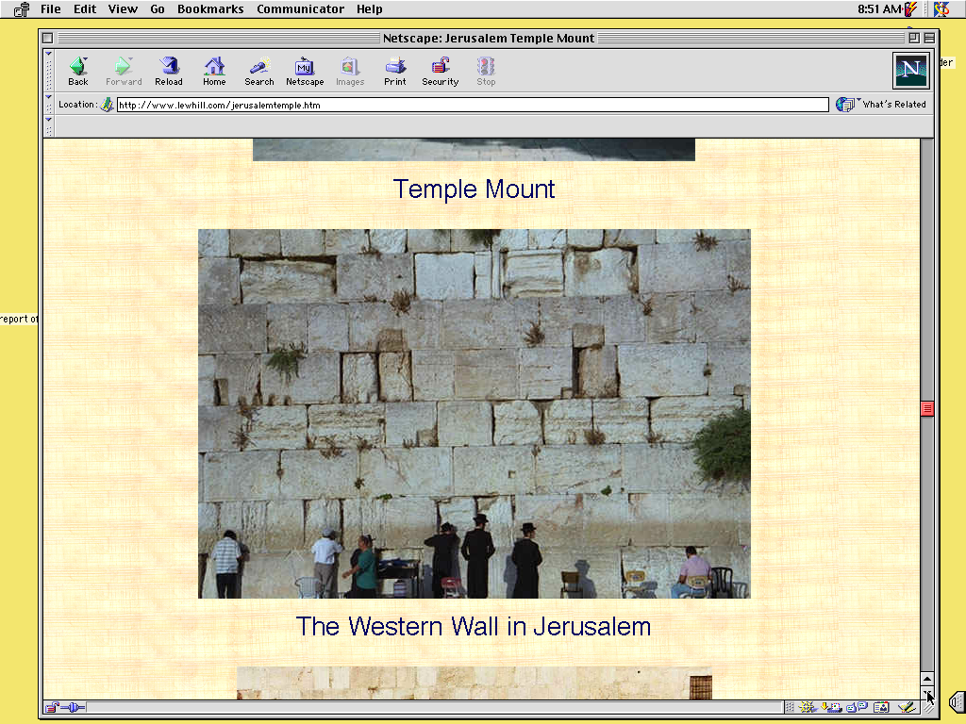
Biblewui
Ameikong
2
9.65.05a.
1
©2006 TBBMI
04
Notes:
The answer is, yes. The ideas ARE there. And we call them, our BIBLICAL BEDROCK...because in that deepest stratum of biblical meaning, revelation and understanding...
//// ….that's where it all begins.

Slide 2
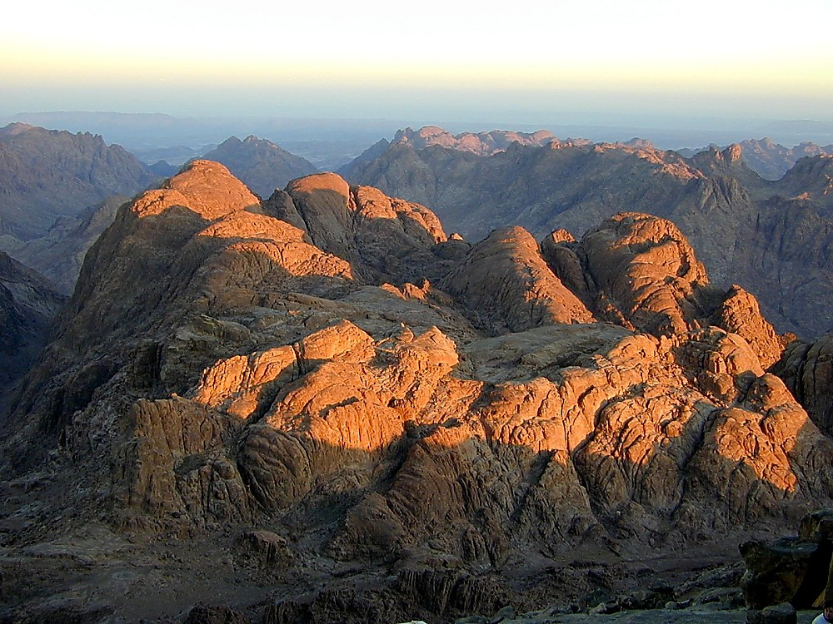
VARENA MOSESLI NGASODA NGAKHEIKHANG KAHAI KHANGARAN
I
II
III
IV
V
VI
VII
VIII
IX
X
KACHAMA TUINGASHITWUI EINA
SHONGZA LAIRIK:
KATAMLI KHANGACHON #15
“MOSESWUI TUINGASHIT”
KHANGARAN HI KATHA?
9.65.05B.
©2006 TBBMI
01
Notes:
We’ll be using Study Help #15 for this
//// look at The MOSAIC COVENANT or MOSAIC LAW in the book of Exodus.
//// What about this arrangement? We must consider it in order to have the complete picture.

Slide 3
I
II
III
IV
V
VI
VII
VIII
IX
X
MOSES
SHONGZA
SINAI
A - Y - P
A - Y - P
“A-Y-P”
KADESH BARNEA
40
Acham-aram
Yarui Ain
Phanit-phanao
TAMKACHITHEI 5
02
1
Notes:
In the MOSES Bible File, remember the item M-C-C?
//// M-C-C: standing for MORAL...CIVIL...CEREMONIAL parts of the new Law. Many scholars and teachers have organized the Mosaic Law into those main parts…as God dictated Moses—twice, by the way – atop Mt. Sinai.

Slide 4
KHARARCHAN CHI PHANINGLU!
I
II
III
IV
V
VI
VII
VIII
IX
X
•EGYPTLI KHANAR: KUM 400
•YARUIRIN KALA ZATKHANA MAVAKASHUNG
•VAREWUI MARAMLI: NGATHUMTIT KAHAI?
CHIEINA…
• ISRAELNAONA VARELI… KALA ATHUM THEINGAROK KHAVAI APONG CHI MOSESWUI TUINGASHIT CHINA PHEIKAR KHAMATAIYA AKHA SADA KHUIRAMIYA!
03
4
©2006 TBBMI
9.65.05B.
Notes:
Remember also the context for these Laws.
//// The Israelites had been in Egyptian bondage for four long centuries...hard labor...
//// poor or very little cultural and civic development...probably deeply lacking in experience in relating to each other in a civilized society...having no time for development of higher levels of interpersonal relationships..
//// And certainly, little direction on how to maintain a growing relationship with their Creator God. ..the God of Abraham, Isaac, and Jacob. It had become a mystery…perhaps only a distant memory.
//// So…the Mosaic Law then becomes a major step in the development of the Israelites as they mature in their relationship to God while learning to behave among themselves as the Chosen People.
SO YOU SEE…THERE IS ALWAYS A CONTEXTUAL REASON FOR EVERY BIBLICAL EVENT OR INSTRUCTION.

Slide 5
I
II
III
IV
V
VI
VII
VIII
IX
X
Ngakheikhang kahai:
Moseswui Tuingashitli
HAOKAPHOK
kala
VAKATANG leiya!
04
1
Notes:
But there is one most important distinction between the Abrahamic and the Mosaic arrangements. And here it is…
//// ….the MOSAIC COVENANT had a beginning --- as did the Abrahamic, of course --- but THE MOSAIC also had an END. As of this moment, the Abrahamic Contract is still running while the Mosaic ended at Calvary…as we will shortly see!

Slide 6
MOSESWUI
“MOSESWUI TUINGASHIT”
I
II
III
IV
V
VI
VII
VIII
IX
X
“A”
SHONGZA KAPIKASANG 20:
MOSESWUI AIN
“Ningkhami Thara”
ACHAM ARAM
Ngalung Khare –
Vareli Sakhangayi (Tuiza 1-12)
Proho Nawui Vare
Kateili Varenada Phaningshara
Kameoli kala Ngaraikacha akhali shar
sashara
Vare kateili makhorum paimana
Prohowui Ming Kathar
Sabbath zimiksho tharda khamayon
Tharukthang ot kasa
Sabbath thang khangasam...
05
12
Notes:
Here’s a quick tour of the parts of the Mosaic Covenant from
//// the 20th Chapter of Exodus, sometimes called the Decalogue…
//// containing the familiar TEN COMMANDMENTS...
//// Beginning with M...for the MORAL parts of the Mosaic Covenant...THE LAW...or, in Hebrew, the Torah.
The MORAL part of the law is traditionally divided into two TABLES...
//// …the first table being the Israelites' duties to God...Exodus 20, verses 1-12:
//// Briefly, Moses is given directions for proper respect to "the Lord your God."..
//// that there should be no other gods before him...
//// no idols or likenesses of him.
//// no worship of other gods...
//// attention to the sanctity of the Lord's name...
//// keeping the Sabbath Day holy...
//// working only six days...
//// and resting on the Sabbath. This is the FIRST TABLE...man’s duties to God alone

Slide 7
“MOSESWUI TUINGASHIT”
I
II
III
IV
V
VI
VII
VIII
IX
X
“A”
SHONGZA KAPIKASANG 20:
MOSESWUI AIN
“Ningkhami Thara”
ACHAM ARAM
Ngalung Khare –
Vareli Sakhangayi (Tuiza 1-12)
Ngalung Kakhane –
Mili Sakhangayi (Tuiza 13-17)
Ava Avali Khayashi Khangayi
Sakashar:
Mi Sakathat
Phokapha
Khali
Kakapik
Mili kala Otli kakahao...
06
7
Notes:
Then verses 13-17 – The Second Table -- are directed to duties to Man.
//// Such as honoring our parents...
//// and the several forbidden acts...
//// murder...
//// adultery...
//// stealing...
//// lying...
//// and coveting the persons and things belonging to others

Slide 8
“MOSESWUI TUINGASHIT”
I
II
III
IV
V
VI
VII
VIII
IX
X
SHONGZA KAPIKASANG 20:
MOSESWUI AIN
“A”
“Ningkhami Thara”
Ngalung Khare –
Vareli Sakhangayi (Tuiza 1-12)
Ngalung Kakhane –
Mili Sakhangayi (Tuiza 13-17)
“Y”
KAPIKASANG 21-24:
YARUIWUI AIN
YARUI RIN
Ichichawui mashun
Lanwui mashun
Ningtongda ringkhavai sakhangayi...
07
4
Notes:
Now the FIRST “C” of the M-C-C idea...the CIVIL part of the Mosaic Law...these are the so-called Social ordinances….
//// CHAPTERS 21 THROUGH 24....in other words....how to get along with one another...out in the desert, later in their settlements...because the wilderness wanderings are lying just ahead in Israel's dramatic future. Here we find the Lord’s fundamental directions regarding
//// personal rights...
//// property rights...and
//// basic ideas for personal integrity. The Social Ordinances.

Slide 9
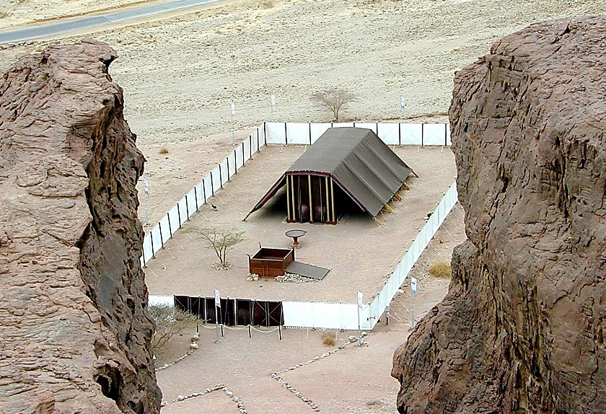
“MOSESWUI TUINGASHIT”
I
II
III
IV
V
VI
VII
VIII
IX
X
SHONGZA KAPIKASANG 20:
MOSESWUI AIN
“A”
“Ningkhami Thara”
Ningkhami oko, Table kala Thaomeishong
Ngalung Khare –
Vareli Sakhangayi (Tuiza 1-12)
Khamataiya Ainbing
Chi semkhavai kahangbing
Pithraiwui Hanphut kala Kayang
Ngalung Kakhane –
Mili Sakhangayi (Tuiza 13-17)
Khokharumwui kasa-khava
Chiwui Pangmonbing
Pangmon bingli tharkachikat
“Y”
Kharing-kharakwui chizakhami
KAPIKASANG 21-24:
YARUIWUI AINBING
Nganamkapha Hanphut kala Khokharuma-bing
Ot kasabing kala Sabbath...
“P”
KAPIKASANG 25-31:
TABERNACLEWUI AINBING
PHANIT PHANAO
08
11
Notes:
And the FINAL “C” of M-C-C...this one representing the CEREMONIAL part of the Law.
//// Chapters 25-31: called the Tabernacle Ordinances…that ancient worship center shown here in a modern model out in today’s Israeli desert…built according to the Old Testament directions. And again we must remember that these new regulations were being provided for a people just coming out of four centuries of debilitating slavery and a culturally stunted growth.
//// These SPECIAL ORDINANCES were given to turn the people directly to the worship of their God while providing them
//// with A SYSTEM OF WORSHIP in the new Tabernacle, along with the new
//// GUIDELINES FOR LIVING among themselves, alone, and in the conditions of the desert wilderness.
//// Which included…the Tabernacle’s Ark, Table and Candlestick
//// Directions for its General Construction,
//// The Bronze Altar and the Court,
//// Its Priesthood for its ritual services,
//// Consecration of the Priesthood,
//// The Altar of Incense and the Worshippers, and
//// The Workmen in relation to the Sabbath.

Slide 10
I
II
III
IV
V
VI
VII
VIII
IX
X
“MOSESWUI TUINGASHIT” YANGKHANGARUM:
“A”
KAPIKASANG 20:
NINGKHAMI THARA
“Y”
KAPIKASANG 21-24:
YARUIWUI AINBING
“P”
KAPIKASANG 25-31:
TABERNACLEWUI AINBING
09
3
Notes:
So...the Mosaic Covenant, summed up…in its three distinct parts…
//// THE DECALOGUE…M…the MORAL PART…
//// THE SOCIAL ORDINANCES…C…the CIVIL PART…and
//// THE TABERNACLE ORDINANCES…another C…the CEREMONIAL PART…all given to Moses by the Lord…and then to the people...in all of their complexities and far-reaching implications -- even into our own day.

Slide 11
Moseswui Tuingashitwui Maramli:
1. Ngaran-ngayei makapong.
2. Kahang nganakhamang sokhami khara.
3. Jesu Christawui otram khangatha eina tangda ain chiwui kankhana chi vatang haowa. Chili Ungkup haowa.
4.Okathuili Mangla Kathara Chihora kahaiwui thili,
4.Okathuili Mangla Kathara Chihora kahaiwui thili, Ain chi shitkasangbing kachivawui wuklung kala mirinwui akhum akha ngasa haowa!
9.65.05B.
4
©2006 TBBMI
10
Notes:
So…what were some of those implications of the Mosaic Covenant?
At least…these four…
//// the Mosaic Covenant was a TEMPORARY arrangement. It had a beginning and it had an end.
//// It was a CONDITIONAL agreement. You do THIS, God will do THAT. And then…some 1500 years later…in Jerusalem…on Calvary…
//// ….it had served its purpose at the conclusion of Jesus Christ’s ministry. It ended there. Finally…
//// After the Holy Spirit was introduced into the earth – following the Lord’s Ascension -- the Mosaic Law became an internalized part of the life and heart of each believer. Jeremiah had foretold that enormous change in man’s heart when He announced the New Covenant.
Jesus himself attested to his place in the history of the Law…

Slide 12
MATTHEW 5:17
Jesuna hanga:
“Ain eina marantui chi shiman ngasakkida I kharana da maphaningalu; Chi shiman ngasakkida khara maningla kha chi ungshung ngasak khavai I kharana.”
Chi shiman ngasakkida khara maningla kha chi ungshung ngasak khavai I kharana.”
11
1
Notes:
In Matthew 5:17, he said..."Do not think that I have some to abolish the Law or the Prophets.
//// I HAVE NOT COME TO ABOLISH THEM BUT TO FULFILL THEM." Remember in the JESUS FILE, where we mentioned the implications of the Cross? This statement is at the core of that enormous event…a profound shift in man’s relationship to his Creator through the new Gospel ministry of the Messiah.

Slide 13
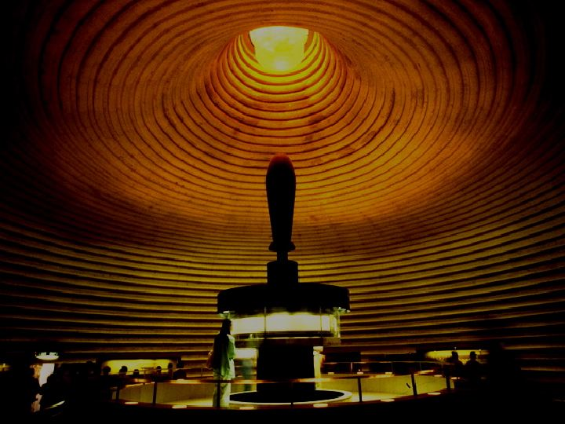
Abrahamli Kaho Hao 12:1-3
ABRAHAMWUI TUINGASHIT
Tuingashit Hao 15:9-18
Tuingashitwui Aphangbing
KATAMLI KHANGACHON #14
Varetui Phab Takhavaiwui “Angayung”
12
©2006 TBBMI
9.65.05B.
Notes:
Now…using Study Help #14…let's return to dig a little deeper into that backbone of Biblical revelation…THE ABRAHAMIC COVENANT. We’ll develop the so-called amplified sub-covenants of God’s UNCONDITIONAL COVENANTAL PROGRAM with man …

Slide 14
Abrahamli Kaho Hao 12:1-3
ABRAHAMWUI TUINGASHIT
Tuingashit Hao 15:9-18
KATANG MAKHAVAI
TAZAK KAHAI
MAKHANGAPAT
Hao 13:15
Hao 13:14-16
Hao 15:9-18
NGALEI
ATHA
SOKHAMI
Hao 12:1
Hao 12:2
Hao 12:3
Varetui Phab Takhavaiwui “Angayung”
13
©2006 TBBMI
9.65.05B.
Notes:
…the LAND, SEED AND BLESSING aspects of the Abrahamic arrangements….and their qualities as:
//// ETERNAL, LITERAL, and UNCONDITIONAL.

Slide 15
NGALEIWUI
TUINGASHIT
Abrahamli Kaho Hao 12:1-3
ABRAHAMWUI TUINGASHIT
Tuingashit Hao 15:9-18
KATANG MAKHAVAI
TAZAK KAHAI
MAKHANGAPAT
Hao 13:15
Hao 13:14-16
Hao 15:9-18
NGALEI
SEED
SOKHAMI
Gen 12:1
Hao 12:2
Hao 12:3
Tuingashitwui Aphangbing
Ngalei
Khal 30: 1-10
Varetui Phab Takhavai “Angayung”
14
©2006 TBBMI
9.65.05B.
Notes:
Beginning with the Land Covenant...sometimes called by its earlier name, the Palestinian...
//// This is the first amplification of the Abrahamic Covenant…the land portion.

Slide 16
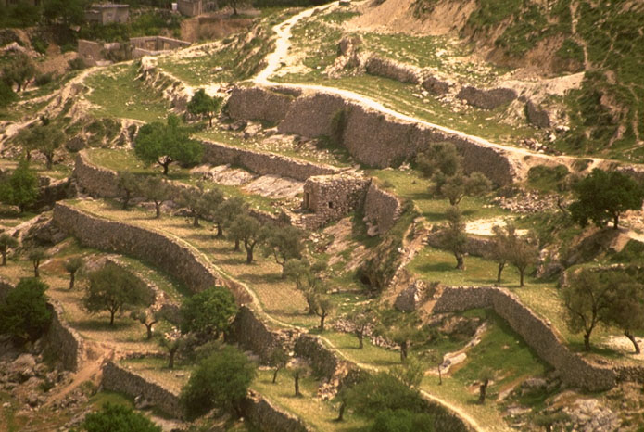
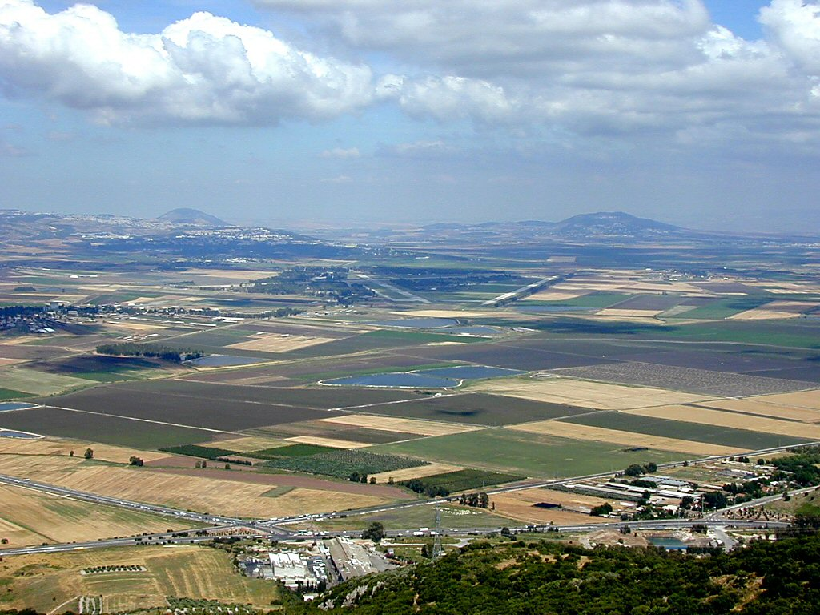
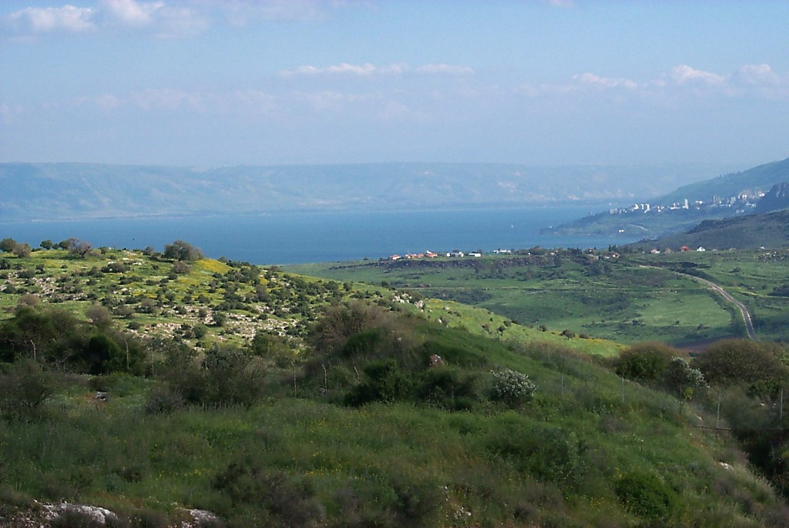
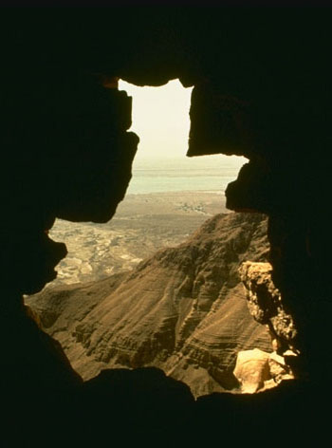
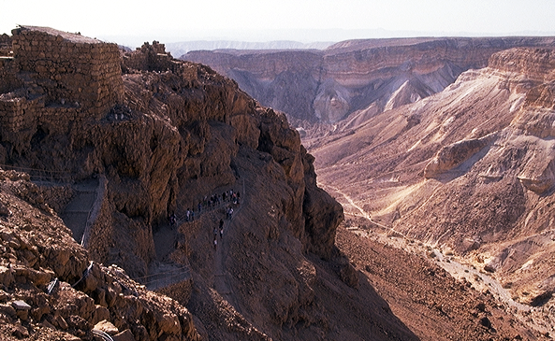
ABRAHAMWUI SHIMLUIKAT NGALEIBING
15
Notes:
First…take a look at the Land of Abraham’s inheritance…remember that this was…and is…real acreage…real land…real lakes…farm fields…orchards…deserts and canyons. A place of great beauty and enormous wealth potential…

Slide 17
Khalatlui 30
NGALEIWUI TUINGASHITBING
⁵ Kala nawo ngarana pamkasa pam chili somlui khavai nathumli khuiungluida nawo ngarali chungmeida okthuiluira.
⁶ Nathumwuila, nao ngarawuila, ara-azawuila Prohona ning tharmihaida, ning yang tongtingda ali leishira, kala Israel malinglui shitra. (Kathara Bible)
16
2
Notes:
THE LAND PROMISE is recounted by Moses in Scripture at Deuteronomy 30, verses 1-10. In the heart of those ten verses lie these two:
//// ⁵ He will bring you to the land that belonged to your fathers, and you will take possession of it. He will make you more prosperous and numerous than your fathers.
//// ⁶ The Lord your God will circumcise your hearts and the hearts of your descendants so that you may love him with all your heart and with all your soul, and live.

Slide 18
KHAMATHA KALA KATUMA NGALEI
17
Notes:
The words of that promise, made here to Moses, reflect God's earlier promises to Abraham, stating clearly that, in some distant day, both Israel AND Judah will return to their land to live in peace with their neighbors…a land of enormous beauty and material prosperity.

Slide 19
DAVIDWUI
TUINGASHIT
Abrahamli Kaho Hao 12:1-3
Tuingashit Hao 15:9-18
ABRAHAMWUI TUINGASHIT
KATANG MAKHAVAI
TAZAK KAHAI
MAKHANGAPAT
Hao 13:15
Hao 13:14-16
Hao 15:9-18
NGALEI
ATHA
SOKHAMI
Hao 12:1
Hao 12:2
Hao 12:3
Tuingashitwui Aphangbing
Ngalei
Davidwui
Khal 30:1-10
2 Sam 7:4-16
Vare Tui Phab Takhavai “Angayung”
18
©2006 TBBMI
9.65.05B.
Notes:
Now...the Davidic Covenant...
//// ….an amplification of the SEED portion of the Abrahamic...
2 Samuel 7, verses 4-16.

Slide 20
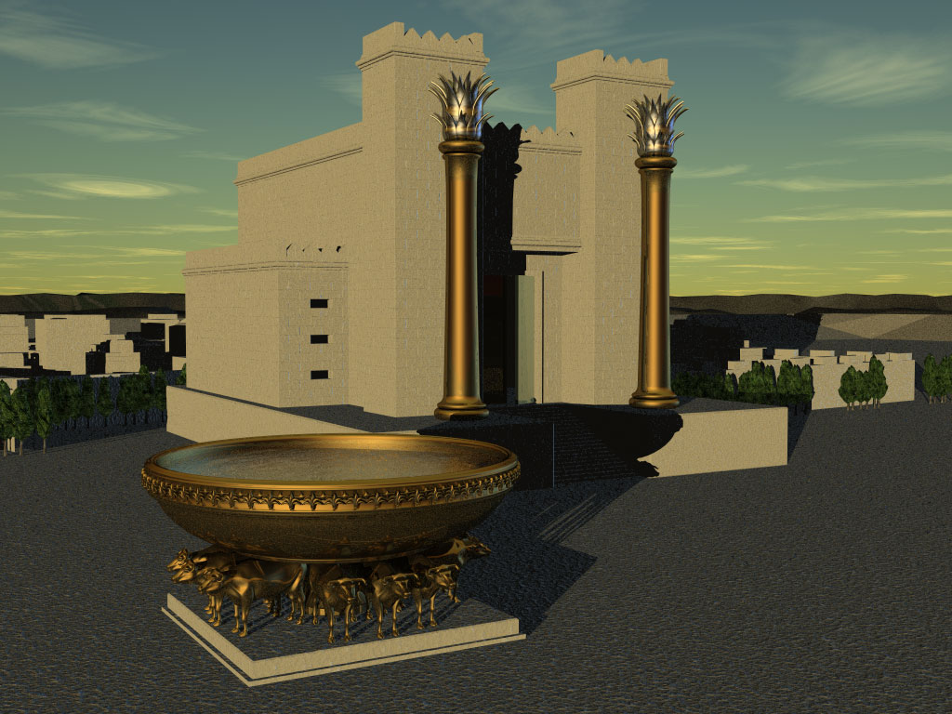
DAVIDWUI TUINGASHIT
UNGSHUNG PHALUNGKI KACHI KATHUM
2 Samuel 7
¹⁶ Nawui shimkhurla kala wungramla iwui mangali leiching ngasakra; nawui wungpamkhong mangatha mara.
leiching
mangatha mara
19
6
©2006 TBBMI
9.65.05B.
Notes:
Again...at the heart of that scripture…
//// is the great Davidic Covenant and its three guarantees…
/// It has this statement: 2 Samuel 7:16…to David through his household prophet Nathan…God says, “Your house and your kingdom will endure forever before me; your throne will be established forever.”.
To clarify:...
//// Your HOUSE.. or your lineage or family line...and your
//// KINGDOM...meaning actual real estate over which to govern...
//// and your THRONE...meaning a governmental administration...will be established…
//// …forever. Not just until the end of modern history, but forever...into eternity. So this verse then becomes a key idea in understanding Biblical eschatology or a study of The End Times.

Slide 21
Chitha-akha, khalatta ngahanlu: Davidwui wungpamkhongli khipana pamngayi khala?
Chitha-akha, khalatta ngahanlu: Davidwui wungpamkhongli khipana pamngayi khala?
20
©2006 TBBMI
9.65.05B.
Notes:
So, then, the question must be asked…AFTER King David’s day…1000 B.C….who is qualified to sit on that Davidic throne?

Slide 22
DAVIDWUI WUNGNAO-RIN
Jesu Christawui Wungnao Mi-un
KATAMLI KHANGACHON #16
21
1
©2006 TBBMI
9.65.05B.
Notes:
Which…then… leads directly to the question of the DAVIDIC DYNASTY. With Study Help #16 we’ll find some answers. Because throughout the New Testament, we find…over and over again…
//// references to Jesus as the Son of David…a bloodline product of the Davidic dynasty…or THE ROYAL GENEALOGY OF JESUS CHRIST!

Slide 23
DAVIDWUI THARA: Jesu Christawui Wungnao Mi-un*
*SHALAK EINA SEMKAHAI
22
1
Notes:
What about the genealogy of the Lord Jesus Christ, out of that line of David, according to Scripture? What do the scriptures have to say about all that? We are given a long and complex genealogy...
/// so this one will be vastly abbreviated.

Slide 24
DAVIDWUI THARA: Jesu Christawui Wungnao Mi-un*
ADAM EVE
Varetuili Kapikahai:
Haokaphok 3:20
*SHALAK EINA SEMKAHAI
23
Notes:
We begin with Adam and Eve, first recounted in Genesis 3:20...

Slide 25
DAVIDWUI THARA: Jesu Christawui Wungnao Mi-un*
ADAM EVE
Varetuili Kapikahai:
Haokaphok 4:1-2; 4:8
CAIN ABEL
* SHALAK EINA SEMKAHAI
24
1
Notes:
From their union came the brothers Cain and Abel.
//// And we know that Cain slew Abel because of Cain's jealousy of the gifts Abel made in sacrifice to the Lord. As a replacement for that murdered brother who was more favored by God, another son was born to Adam and Eve...

Slide 26
DAVIDWUI THARA: Jesu Christawui Wungnao Mi-un *
ADAM EVE
Varetuili Kapikahai:
Haokaphok 4:25
CAIN ABEL SETH
* SHALAK EINA SEMKAHAI
25
Notes:
He was Seth, the beginning of a godly line of men. AND RIGHT HERE is where the royal genealogy of Jesus Christ gets underway.

Slide 27
DAVIDWUI THARA: Jesu Christawui Wungnao Mi-un *
ADAM EVE
Varetuili Kapikahai:
Haokaphok 5:29
CAIN ABEL SETH
NOAH
* SHALAK EINA SEMKAHAI
26
Notes:
From Seth...followed Noah. By the way...dotted lines represent an abbreviation of all the Biblical names that actually occur during the long lines of descent. Scripture tells us the names of each one.

Slide 28
DAVIDWUI THARA: Jesu Christawui Wungnao Mi-un *
ADAM EVE
Varetuili Kapikahai:
Haokaphok 11:26
CAIN ABEL SETH
NOAH
ABRAHAM
* SHALAK EINA SEMKAHAI
27
Notes:
Eventually through this line...we arrive at Abraham.

Slide 29
DAVIDWUI THARA: Jesu Christawui Wungnao Mi-un *
ADAM EVE
Varetuili Kapikahai:
Matthew 1:2-6
CAIN ABEL SETH
NOAH
ABRAHAM (Sarah)
* SHALAK EINA SEMKAHAI
DAVID
28
Notes:
And from Abraham, a thousand years later, appears David..

Slide 30
DAVIDWUI THARA: Jesu Christawui Wungnao Mi-un *
ADAM EVE
Varetuili Kapikahai:
2 Samuel 12:24
CAIN ABEL SETH
NOAH
ABRAHAM
* SHALAK EINA SEMKAHAI
DAVID BATHSHEBA
29
Notes:
And...among other of David's several wives...appears Bathsheba.

Slide 31
DAVIDWUI THARA: Jesu Christawui Wungnao Mi-un *
ADAM EVE
Varetuili Kapikahai:
2 Samuel 5:14
CAIN ABEL SETH
NOAH
ABRAHAM
* SHALAK EINA SEMKAHAI
DAVID BATHSHEBA
NATHAN SOLOMON
30
Notes:
Among the children of David and Bathsheba are these two sons: Nathan and Solomon. And here the line splits. Note that. It's a crucial place.

Slide 32
DAVIDWUI THARA: Jesu Christawui Wungnao Mi-un *
ADAM EVE
Varetuili Kapikahai:
Luke 3:23 Kala Khangateila
CAIN ABEL SETH
NOAH
ABRAHAM
* SHALAK EINA SEMKAHAI
DAVID BATHSHEBA
NATHAN SOLOMON
LUKE 3:23 (Khangateila Yanglu)
MARY
31
Notes:
From the line of son Nathan, eventually appears Mary, the mother of Jesus.

Slide 33
DAVIDWUI THARA: Jesu Christawui Wungnao Mi-un *
LUKE 3:23 (khangateila yanglu)
Luke 3:23: “Jesuna awui ot sakaphok chitharan, awui zingkum thumra shakha kahairasai. Ava mina kaphaning thada, Heliwui naomayara Josephwui naona.” (Tangkhul Bible)
“Lukena Marywui thara pa-khaungna. Khalatkhame tarakkha na, [kachungana…] Lukena Marywui mi-un kapana kachi hi mayaya, china a hi Davidwui tharali zanga kachi hangchithei. Chiwui vang eina Jesu hi Messiah sakapai hi Josephwui manga (Kharara akhawui shimluikat ain athishurda) eina mang maningla Marywui manga einala sakapaina.”
Louis Barbieri, The Bible Knowledge Commentary, eds. John Walvoord & Roy Zuck (Victor Books, 1983), 212.
32
1
Notes:
Luke wrote about this in his Gospel. In his third chapter, verse 23: “Now Jesus himself was about 30 years old when He began His ministry. He was the son, SO IT WAS THOUGHT, of Joseph.”
//// This further explanation from two eminent Bible scholars: “Luke was tracing the line of Mary. Many interpreters [among varied other positions…] argue that Luke was giving the genealogy of Mary, showing that she also was in the line of David and that therefore Jesus was qualified as the Messiah, not only through Joseph (since he was the oldest legal heir) but also through Mary.”

Slide 34
DAVIDWUI THARA: Jesu Christawui Wungnao Mi-un *
ADAM EVE
Varetuili Kapikahai:
Matthew 1:16
CAIN ABEL SETH
NOAH
ABRAHAM
* SHALAK EINA SEMKAHAI
DAVID BATHSHEBA
NATHAN SOLOMON
MARY JOSEPH
33
Notes:
And from Solomon’s side...the line of descent leads directly to Joseph, Jesus' FOSTER-father. And then the climactic event of the ages...from Joseph and Mary, through the intervention of the Holy Spirit in Mary’s womb…

Slide 35
DAVIDWUI THARA: Jesu Christawui Wungnao Mi-un *
ADAM EVE
Varetuili Kapikahai:
Matthew 1:16
CAIN ABEL SETH
NOAH
ABRAHAM
* SHALAK EINA SEMKAHAI
DAVID BATHSHEBA
NATHAN SOLOMON
MARY JOSEPH
JESU CHRISTA
34
Notes:
…the Lord Jesus Christ enters the earth. And, you might say, “well…we all know that. What is the importance of such an emphasis on it?” Answer: earthly kingship presents two requirements...

Slide 36
DAVIDWUI THARA: Jesu Christawui Wungnao Mi-un *
ADAM EVE
CAIN ABEL SETH
NOAH
ABRAHAM
DAVID BATHSHEBA
NATHAN SOLOMON
PHASAWUI THARA
AINWUI THARA
SHIMKHURWUI Mashun
Luke 3:23-38
AINWUI Mashun
Matt 1:1-17
MARY JOSEPH
JESU CHRISTA
35
3
Notes:
FIRST…a family qualification by right of a bloodline succession.
//// SECOND…there must also be a legal qualification by right of traditional succession.
//// The family right and blood line through Mary – the mother of Jesus – as it is laid out in Luke's gospel, third chapter, verses 23-38,
//// While the legal line of Jesus’ father – Joseph -- appears in detail in Matthew’s Gospel, chapter 1, verses 1-17.
Much has been written all about this...far more than can be described here. So you are encouraged to dig into these ideas. They are rich with meaning, significance and credibility toward establishing the Lord’s place in the great Plan of the Ages.

Slide 37
DAVIDWUI THARA: Jesu Christawui Wungnao Mi-un *
ADAM EVE
CAIN ABEL SETH
NOAH
ABRAHAM
DAVID BATHSHEBA
NATHAN SOLOMON
SHIMKHURWUI Mashun
Luke 3:23-38
AINWUI Mashun
Matt 1:1-17
PHASAWUI
MASHUN
MARY JOSEPH
JESU CHRISTA
36
Notes:
So...to sum up...
Mary, Jesus’ birth mother, supplies his bloodline directly back to the throne of David...and beyond.

Slide 38
DAVIDWUI THARA: Jesu Christawui Wungnao Mi-un *
ADAM EVE
CAIN ABEL SETH
NOAH
ABRAHAM
DAVID BATHSHEBA
NATHAN SOLOMON
SHIMKHURWUI Mashun
Luke 3:23-38
AINWUI Mashun
Matt 1:1-17
PHASAWUI
MASHUN
AINWUI
MASHUN
MARY JOSEPH
JESU CHRISTA
37
Notes:
...and Joseph…as the foster-father and a descendant of King Solomon… has the right of legal succession to bestow upon his foster son, Jesus. A remarkable evidence of the credibility and reliability of the Scriptural record.

Slide 39
Criswell, W. A.
Danker, Frederick
Ellis, E. Earle
Fitzmeyer, Joseph
Godet, F. A.
Hendricksen, William
Hoehner, Harold
Ironside, F. A.
Marshall, I. Howard
McGee, J. Vernon
Morgan, G. Campbell
MacArthur, John
Scofield, C. I.
Swindoll, Charles
Unger, Merrill
Walvoord, John
Zuck, Roy
Jesuswui Mi-unwui maramli kakapi mibing kateokha chitheili:
38
©2006 TBBMI
9.65.05B.
Notes:
Here is a list of only a few of the dozens of authors who have written extensively on the genealogy of Jesus Christ as it is presented in the Gospels of Matthew and Luke. There are many, many more than these!

Slide 40
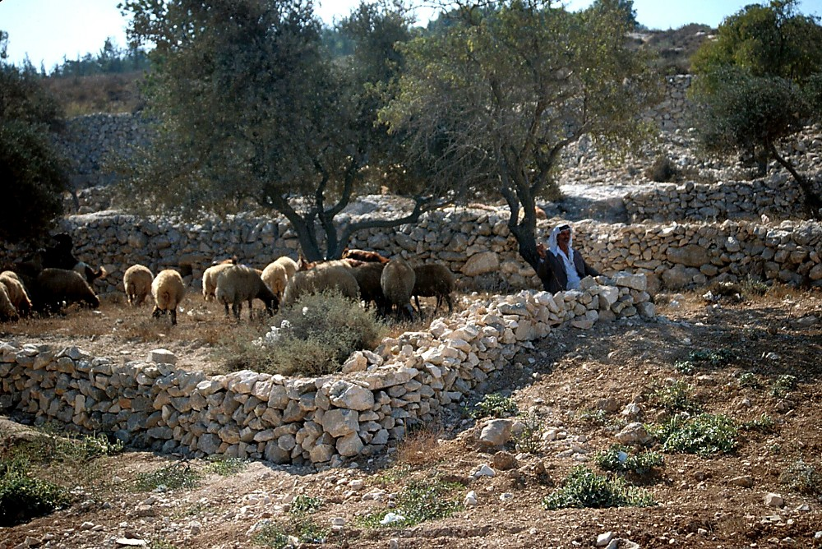
JESU CHRISTAWUI KAPHARA KALA AWUI MIRINWUI TEKMATEILAK KAHAI MASHOK KHAMARAO NA MAMACHUK YANG HAIRA?
THADA PHARA KAHAILA?
KATAMLI KHANGACHON #17
39
2
©2006 TBBMI
9.65.05B.
Notes:
With Study Help #17 in hand…place yourself here in a rocky field outside Bethlehem where a shepherd tends his flock –– as it has been for thousands of years on this same land…just outside that ancient little town where Jesus was born. From here you could have seen and heard the angelic announcement of his miraculous birth! Which leads to another another question…
//// Have you ever considered the astonishing statistical probabilities of the birth and life of Jesus Christ?
//// Was it just an accident of birth?

Slide 41
JESU CHRISTAWUI KAPHARA KALA AWUI MIRINWUI TEKMATEILAK KAHAI MASHOK KHAMARAO NA MAMACHUK YANG HAIRA?
*
THADA PHARA KAHAILA?
KACHAMA TUINGASHITLI: MESSIAH KHARAWUI MARAMLI 300 SHIDA KAPIKAHAI KATONGA CHI JESU CHRISTAWUI KAPHARA, AWUI MIRIN KALA ALI SHAOKATHAT CHILI UNGSHUNG SERKAHAINA…
KATAMLI KHANGACHON #17
*Lairik: Josh MacDowell, Evidence That Demands A Verdict, 1972, page 175; Peter Stoner, Science Speaks, Moody Press, 1963.
40
Notes:
In the Old Testament…more than 300 references to a coming Messiah were fulfilled upon the birth, life and crucifixion of Jesus Christ. So then, with that said, according to established scientific techniques of probability and statistics.

Slide 42
CHITHAHAOKIDA…
PHONGKHAMI 8 MANG MI AKHAWUI MIRINLI ARUI RASHUNGDA KAYAKHA SHOK MARAOKHALA?
_{NGAHANKASA:}
_{100 QUADRILLION (10} ¹⁷_{) WUI}
_{EINA AKHAMANG}
_{1:100,000,000,000,000,000}
*Lairik: Josh MacDowell, Evidence That Demands A Verdict, 1972, page 175; Peter Stoner, Science Speaks, Moody Press, 1963.
41
2
Notes:
What, then, are the chances of only EIGHT predictions being fulfilled in the life of any one individual between then and now?
//// The answer: one chance in 100 quadrillion…or…10 to the 17th!
//// and here is what that number looks like typed out!
If you think that is incredible…here comes another one.

Slide 43
CHUNGMEIDA CHAKYANGSA…
PHONGKHAMI 48 (300 WUI EINA) ARUI RASHUNGDA MI AKHAWUI MIRINLI UNGKASHUNG KAYAKHA SHOKMARAO KHALA:
_{NGAHANKASA: 10}¹⁵⁷ wui ngachaili akhamang
1:10,000,000,000,000,000,000,000,000,000,000,000,000,000, 000,000,000,000,000,000,000,000,000,000,000,000,000,000, 000,000,000,000,000,000,000,000,000,000,000,000,000,000, 000,000,000,000,000,000,000,000,000,000,000,000
*Lairik: Josh MacDowell, Evidence That Demands A Verdict, 1972, page 175; Peter Stoner, Science Speaks, Moody Press, 1963.
42
3
Notes:
Another measure of scientific probability…
//// Then…with just 48 of the 300 predictions being fulfilled in the life of any one individual between then and now:
//// The answer: one chance in 10 to the 157th!
//// Typed out…here you are!
Before your very eyes…statistical probabilities produced by a world-renowned scientist…according to established scientific procedures of statistics and probability.

Slide 44
DAVIDWUI THARA: Jesu Christawui Wungnao Mi-un *
KATAMLI KHANGACHON #16
MARY
JOSEPH
Luke 3:23-38
Matt 1:1-17
• PHASAWUI THARA
• Adamli hankhaung
Marywui manga eina,
Thot-thot eina
• Khalattawui Mi-un,
Marywui manga eina
• Davidwui shimwui thara
(2 Sam 7:12, 13; Rom 1:3)
• WUNGNAO,
AINWUI THARA
• Abrahamwui eina haokaphok
Davidwui nao,
Josephwui manga eina
• Ainwui Thara
• Jehudi bingli mik rak-khangasak
Jesu Christawui Wungnao Pharat
43
16
Notes:
Now…with all this said, let’s summarize the ROYAL GENEALOGY OF JESUS CHRIST…along with Study Help 16…
//// ….Mary…produced the bloodline for the Messiah.
//// ….This Lucan genealogy traces the Lord’s bloodline
backward to Adam.
//// ….through Mary.
//// ….it’s the lineal descent.
//// ….It’s a personal genealogy…
//// ….through Mary.
//// ….A seed of the House of David…
//// ….All of it recounted in 2 Samuel and Romans.
Meanwhile…from Joseph’s side…
//// ….This is the Royal
//// ….Legal line.
//// ….Moving forward from Abraham…
//// ….As a son of David…
//// ….through Joseph…
//// ….the Legal Line…
//// ….As a revelation to the Jew…
//// ….both lines of descent then producing….THE ROYAL BIRTH …INTO THE EARTH…OF THE LORD JESUS CHRIST.

Slide 45
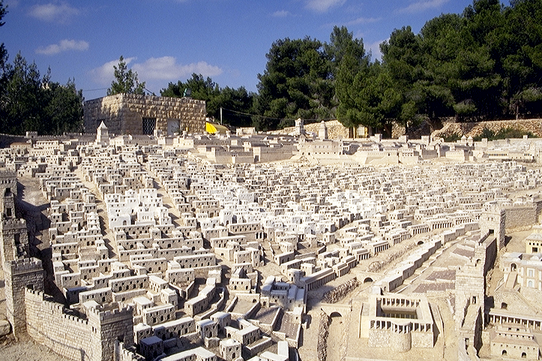
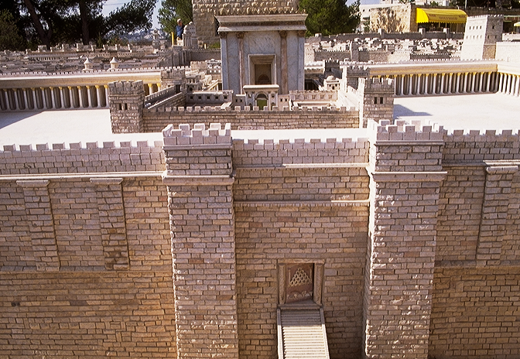
JESUWUI ATAMLI JERUSALEM HITHA SAYA
JESU ATAMLI HERODNA KASEM VARESHIM ZINGSHO-KHAMONG
44
1
Notes:
Taken together, we can see that when Jesus entered
the City of Jerusalem on Palm Sunday he was approaching…the eastern entrance to the great Herodian Temple with the apparent purpose –– so the people thought –– of actually claiming the Throne of David as his own.

Slide 46
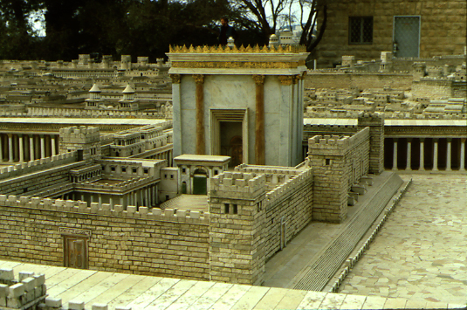
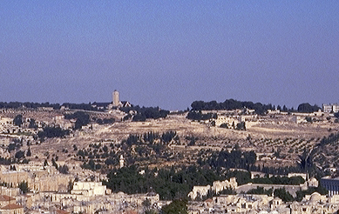
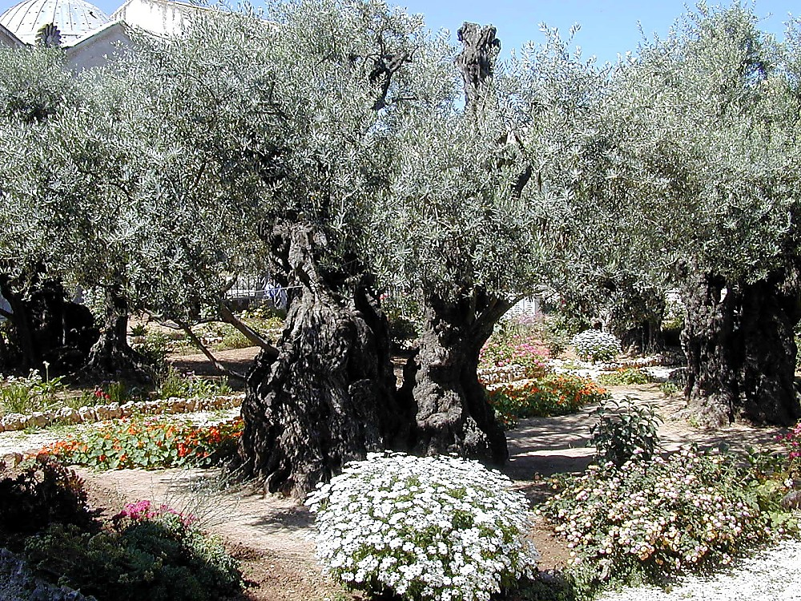
HEROD AWUNGANA KASEM “VARESHIM KAKHANE”
OLIVE KAPHUNG
GETHSEMANE YAMGUILI KHALEI OLIVE THINGRONG
45
2
Notes:
It all happened here… in the massive armed precincts of Herod’s great Temple on the same site as Solomon’s earlier Temple and before that, the mountaintop where Abraham was instructed to sacrifice Isaac 2000 years earlier…
….and on the Mount of Olives…in the outskirts of the ancient city of Jerusalem…
…and the Lord’s agony in the Gethsemane garden.

Slide 47
Abrahamli Kaho Hao 12:1-3
Tuingashit Hao 15:9-18
ABRAHAMWUI TUINGASHIT
KADHAR
TUINGASHIT
KATANG MAKHAVAI
TAZAK KAHAI
MAKHANGAPAT
Hao 13:15
Hao 13:14-16
Hao 15:9-18
NGALEI
Atha
SOKHAMI
Hao 12:1
Hao 12:2
Hao 12:3
Tuingashitwui Aphangbing
Land
Davidwui
Kadhar
Khal 30:1-10
2 Sam 7:4-16
Jer 31:31-34
Varetui Phab Takhavai “Angayung”
46
1
©2006 TBBMI
9.65.05B.
Notes:
The appearance of the Lord in Israel 2000 years ago leads directly to the last of the amplified subcontracts of the Abrahamic Covenant. This last one is...the NEW COVENANT...
//// ….a further expansion on the message and implications of that BLESSING part of the Abrahamic. We find it in Jeremiah 31:31-34.

Slide 48
Jeremiah 31
KADHAR TUINGASHIT
WUNGNAO
(1000 B.C.)
Jeremiah atamwui sipkasa…
S - D - S
••• KAKAI •••
Atung Azing
Israel
Judah
10 2
MARANBING
19-J 20-R
“Judahwui Kachot-kachang”
200 350
Assyria Babylon
47
2
Notes:
We’ll become more familiar with Jeremiah further on. But for now…Jeremiah is the Bible’s central figure in delivering the New Covenant announcement…a new arrangement just over the prophet’s historical horizon from his Old Testament time!
//// Think about the prophet’s severe circumstances at the time he was writing…They are right there in the ROYALTY FILE FOLDER. Jeremiah appeared in the time of THE PROPHETS.
The United Kingdom had split apart. Jerusalem was soon to be destroyed by the approaching Babylonians. In spite of those terrible times, Jeremiah pronounced a message of incomparable brilliance and optimism…a piece of “good news” that would echo through the coming centuries...awaiting only the appearance of Messiah to fulfill his vision.
//// …Yes…Jeremiah’s circumstances were severe…JUDAH WAS IN CRISIS!

Slide 49
Jeremiah 31
KADHAR TUINGASHIT
³¹ “Yanglu, Judahwui shimkhurli [Azingwui Wungram] kala Israelwui shimkhurli [Atungwui Wungram] ina khangashit kadhar akha sakhavai atam rarali,” da prohona hanga.
(Tangkhul Bible)
48
4
Notes:
Here are those amazing words from Jeremiah 31... This is THE NEW COVENANT announcement! Pay close attention to every word!
//// Calling out verse 31 specifically..."The time is coming," declares the Lord, "when I will make a NEW COVENANT with the house of Israel”…the Northern Kingdom… “and with the house of Judah”…the Southern Kingdom.
//// A new covenant…
//// with Israel…the Northern Kingdom, now dispersed…
//// and with Judah…the Southern Kingdom…a nation to go into captivity but with a promised return to the Land of Abraham’s inheritance.

Slide 50
Jeremiah 31
KADHAR TUINGASHIT
³² Hiya khare kachang eina athumwui awo ngarabingli Egyptwui eina pang eina tharakashok chikathawui tuingashit katha maningmana, kachiya athumna tuingashit sakhaihaowa, ina gahara ngasayi chilala,” da Prohona hanga.
(Tangkhul Bible)
49
Notes:
"It will not be like the covenant I made with their forefathers when I took them by the hand to lead them out of Egypt, because they broke my covenant though I was a husband to them, " declares the Lord.”

Slide 51
Jeremiah 31
KADHAR TUINGASHIT
³³ “Kha hiwui thili Israelpashili khangashit saki kachi chiya hithara da Prohona hanga:
“Iwui ain hi athumwui ningli sangmira, kala athumwui wuklungli kapisangmira, kala I athumwui Vare sara, athum iwui mi sara.”
(Tangkhul Bible)
50
1
Notes:
This is the covenant I will make with the house of Israel after that time, declares the Lord.
//// [THIS PHRASE IS TYPED OUT ON SCREEN FOR EMPHASIS.] "I will put my law in their minds and write it on their hearts. I will be their God and they will be my people." Notice that this newly announced Covenant will be with BOTH HOUSES OF THE DIVIDED KINGDOM...BOTH JUDAH AND ISRAEL.
[John Walvoord, Roy Zuck; The Bible Knowledge Commentary – Old Testament Edition; Victor Books, 1985; page 1171

Slide 52
Kadhara Tuingashitli Pao Kachishot
¹⁹Chiwui thili ana khamui khuida ningkashi michang kahai eina serkhailaga athumli hanga, “Hi iwui phasana, nathumwui vang mikahaina. Ili phaningungda hi sachinglu.”
Luke 22:19-20
²⁰ Kharewui takam eina shaikup kahai chitharan tengkot chi athumli mida hanga, “Nathumwui vang tengkot hili heisangmi kahai hi iwui ashee eina kapi kahai kadhara tuingashitna.
(Tangkhul Bible)
51
4
Notes:
Now move over to the New Testament...for the announcement at that time…
//// …The 22nd chapter of Luke...verses 19-20. At that final supper with his friends…Jesus
//// ..."took bread, gave thanks and broke it, and gave it to them, saying, “This is my body given for you; do this in remembrance of me.”
//// ²⁰In the same way, after the supper he took the cup, saying, “This is the …
//// …new covenant in my blood, which is poured out for you.”

Slide 53
Kadhara Tuingashitli Pao Kachishot
Matthew 26:26-28
²⁶ Athum phazamahunglakha Jesuna khamui khuisingda ningkashiwui seiha sahailaga khamui chi serkhaida athuli mida hanga, “Khuilu, shailu, hi iwui phasana.”
²⁷Chiwui thili ana tengkot singkhuida Vareli ningkashi mihailaga athumli mida hanga, “Nathum zaikora hiwui eina manglu,
²⁸khikhalajila hi Varewui tuingashit eina mahor namkahai iwui asheena.
52
4
Notes:
And then again...in the 26th chapter of Matthew...verses 26-28:
//// ²⁶While they were eating, Jesus took bread, gave thanks and broke it, and gave it to his disciples, saying, “Take and eat; this is my body.”
//// ²⁷Then he took the cup, gave thanks and offered it to them, saying, “Drink from it, all of you.
//// ²⁸This is my blood of the covenant, which is poured out for many for the forgiveness of sins.
//// Again…the Lord said clearly…MY BLOOD OF THE COVENANT!

Slide 54
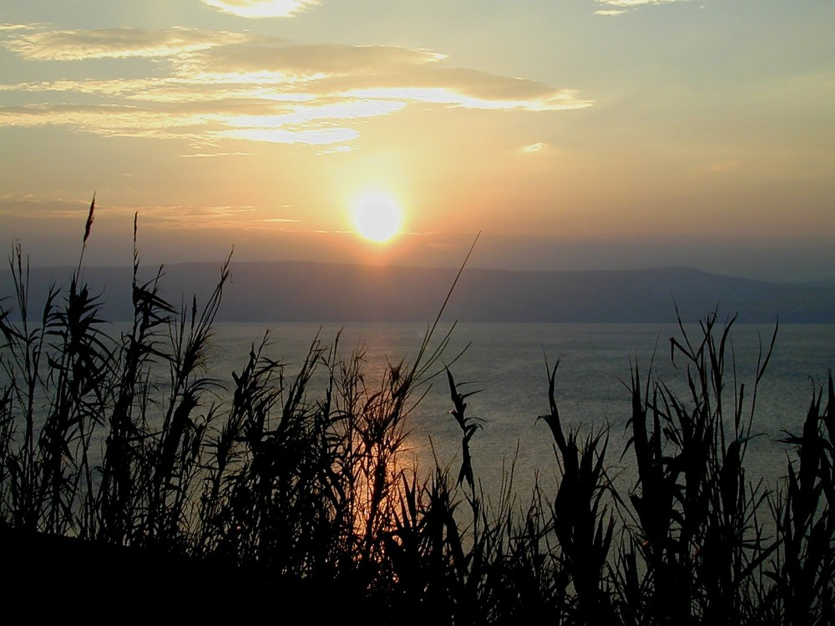
Sunset from Kursi
HI KHI SHOKDA KHALEI?
WHAT IS HAPPENING HERE?
NGAHANKAKA: KASEMA KALA MIKUMOWUI ALUNGLI KATHUKA KHANGACHEI KHARA!
53
1
©2006 TBBMI
9.65.05B.
Notes:
WHAT IS HAPPENING HERE? Jeremiah was announcing…and Jesus is establishing…
//// …the arrival of a profound change in the relationship between the Creator and His Created! Meaning…in a very practical sense.

Slide 55
“SAPHALUNGRA” kachi Kachama Tuingashitwui Ningphanin kankathui……
54
©2006 TBBMI
9.65.05B.
Notes:
The ancient HAVE-TO mentality of the Old Testament and THE LAW had given way…

Slide 56
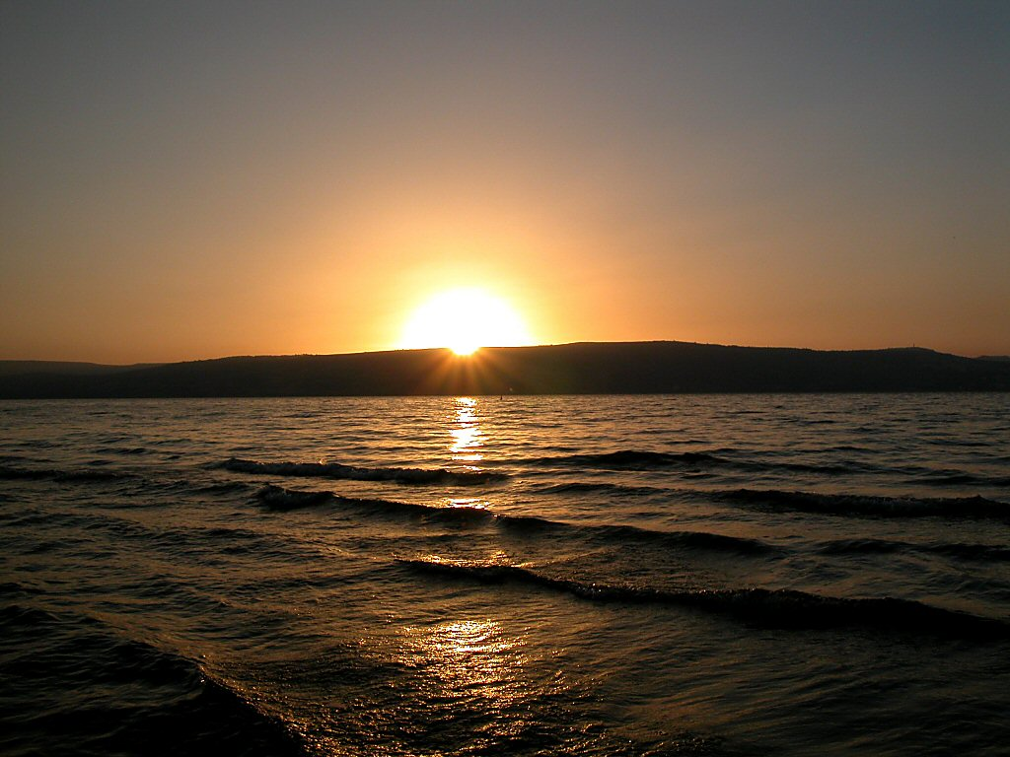
Sunset over Sea of Galilee
“SAPHALUNGRA” kachi Kachama Tuingashitwui Ningphanin kankathui……
…kala “SANGAIYA” kachi Kadhara Tuingashitwui Ningphanin leikahai.
Kathada? Mangla Katharana wuklungli ot kasawui vang – Messiahwui pao kaphali shitkasanga katongali ngachonkhami rakashung!
55
1
©2006 TBBMI
9.65.05B.
Notes:
The ancient HAVE-TO mentality of the Old Testament and THE LAW had given way. …to the WANT-TO mentality of the New Testament and the Gospel! A profound change, indeed. From the “HAVE-TO” OF LEGALISM – “Do this, do that” according to the strict Mosaic Regulations -- TO THE “WANT-TO” OF THE GENTLE INDWELLING HOLY SPIRIT!
//// How? Because of the internalized urgings of the Holy Spirit… ….to be available to every believer and living in every believer’s heart...to be available with the coming of the Messiah and His inauguration of the New Covenant. An approach to God no longer based on human performance on the outside…as in the time of The Law. But now…INSIDE THE HEART OF EVERY BELIEVER!…the time of THE NEW COVENANT!

Slide 57
Sunset over Sea of Galilee
AIN
KANTHUIHAI LAGA
LUKHAMASHAN
KHARA
56
©2006 TBBMI
9.65.05B.
Notes:
Summed up:
LAW HAD GIVEN WAY TO GRACE!
A time of enormous spiritual change had arrived. That change was destined to cause schism and friction – indeed, an explosion – in the Jewish community to which the Lord would be appearing…as the New Testament records tell us! It’s effect on world history would be profound!

Slide 58
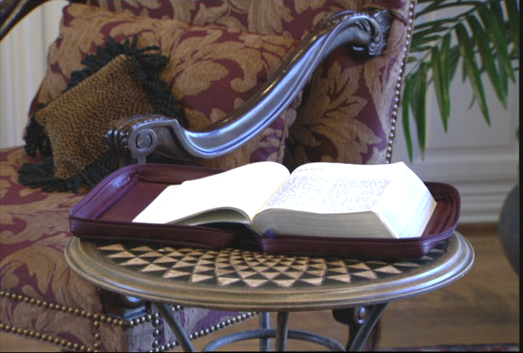
BIBLEWUI KHARARCHAN KATHEIWUI KANKHANA ARA ITHUMNA PHAB TAHAIRA…
OKATHUI KASEM
ABRAHAM
JOSEPH
MOSES
JOSHUA
ROTKHAMARAT
NGATANGKHAMIWUI HAK-KHAMAHA KHANGASHAN SAMPHANGA!
WUNGNAO
NARKAHAI
VARI KAHAI
JESU
57
Notes:
Now we can understand the importance of the Biblical story line toward grasping THE GRAND PANORAMA OF REDEMPTION! Here also we can see in hindsight the foundation of the Church coming into view.

Slide 59
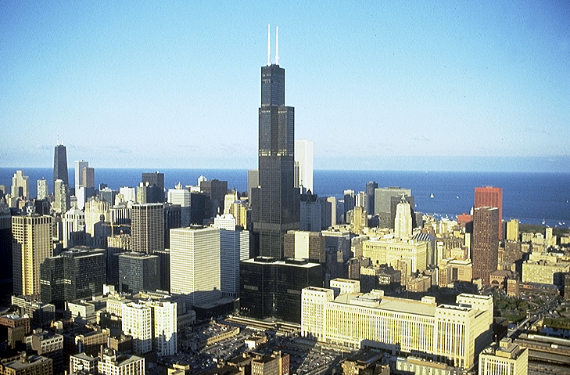


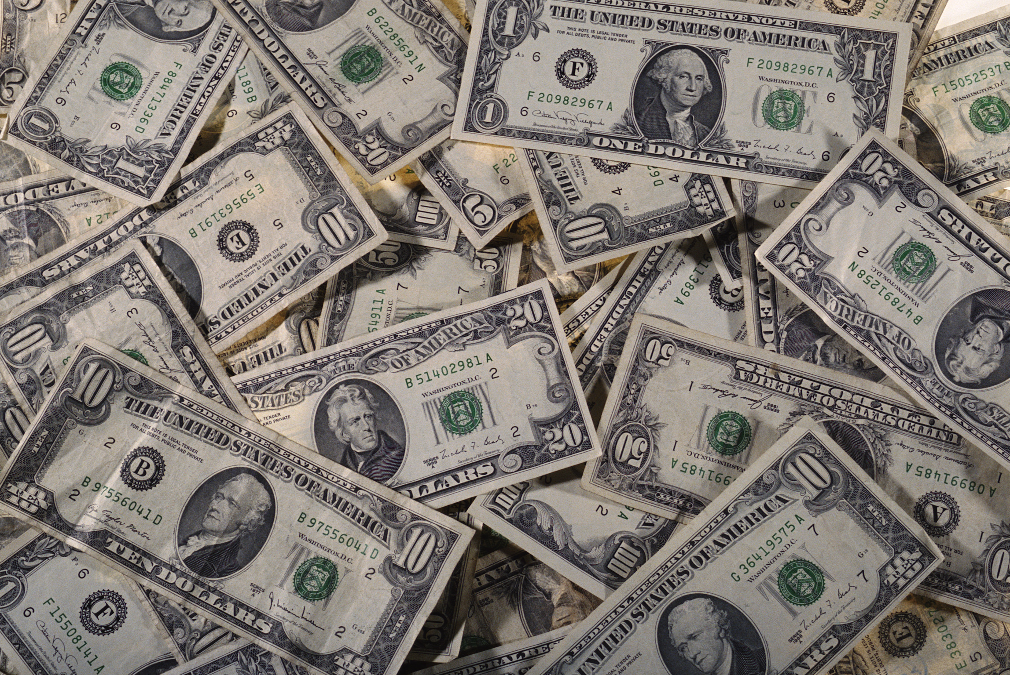


KHANGAHAN: OKATHUI REIKASANG ATAM HILI, JESUNA ASHEE TAKHAMIWUI KANKHANA KHIKHALA?
58
Notes:
Now...one final question...in our world of high technology, satellites and computers, the Internet…for many the concept of a blood sacrifice or the meaning or necessity of Jesus’ blood sacrifice is downright disturbing. What about that? To clear up this issue…let’s turn again to God’s Word.

Slide 60
“ASHEE” Chiwui Kakhalat hi Yangsa…
Hebrewnao 9: 15-22
¹⁵ Hiwui vang eina Christana kadhara tuingashitwui ngashikmena. Varena ngashitkahai katang makhavai sokhami — chi ana hokhui kahaibingli samphang ngasaka, kacha khare tuingashit chiwui eina ningkhan khavai thikhamina.
59
2
Notes:
Hebrews 9 tells us...
¹⁵For this reason Christ is the mediator of
//// a new covenant, that those who are called may receive
//// the promised eternal inheritance — now that he has died as a ransom to set them free from the sins committed under the first covenant.

Slide 61
¹⁶Hangthi kahai leiakha kahanga mipa chi thihaira kachi theikhui phalungra.
“ASHEE” Chiwui Kakhalat hi Yangsa…
Hebrewnao 9: 15-22
¹⁷Hangkathi kaho hiya kahangapa chi mathiranglakhava kankhana maleimana, kha thikahaiwui thili khuisangpai kajina.
60
1
Notes:
¹⁶In the case of a will, it is necessary to prove the death of the one who made it,
//// ¹⁷because a will is in force only when somebody has died; it never takes effect while the one who made it is living.

Slide 62
“ASHEE” Chiwui Kakhalat hi Yangsa…
Hebrewnao 9: 15-22
¹⁸Chiwui vang khare tuingashit chi ashee kata maleiakha kankhana maleimana.
61
Notes:
¹⁸This is why even the first covenant was not put into effect without blood.

Slide 63
¹⁹Kharena, ainli kapikahai ningkhami saikora chi Mosesna mi saikorali hangchithei hailaga seishee eina meshee tara manatlaga hungrisi kahai saha eina hyssop kaho thingna chi khuilaga lairik eina mibing khaninili ikrorda
“ASHEE” Chiwui Kakhalat hi Yangsa…
Hebrewnao 9: 15-22
62
Notes:
¹⁹When Moses had proclaimed every commandment of the law to all the people, he took the blood of calves, together with water, scarlet wool and branches of hyssop, and sprinkled the scroll and all the people.

Slide 64
“ASHEE” Chiwui Kakhalat hi Yangsa… Hebrewnao 9: 15-22
²⁰ hanga, “Hi nathumna mayon khavai Varena kaso kahai tuingashit chi mahor namkhami asheena.”
²⁰ hanga, “Hi nathumna mayon khavai Varena kaso kahai tuingashit chi mahor namkhami asheena.”
63
1
Notes:
²⁰ He said, “This is the blood of the covenant, which God has commanded you to keep.”

Slide 65
“ASHEE” Chiwui Kakhalat hi Yangsa…
Hebrewnao 9: 15-22
²¹Chi takam eina Mosesnala kachonshimlila kala khokharuli shikachina ot saikoralila ashee ikrorra.
64
Notes:
²¹In the same way, he sprinkled with the blood both the tabernacle and everything used in its ceremonies.

Slide 66
“ASHEE” Chiwui Kakhalat hi Yangsa…
Hebrewnao 9: 15-22
²²kachangkhata ainwui athishurda ot saikora ashee eina tharmi ngasak papama; kala ashee takhami maningla morei mapheomipaimana.
65
Notes:
²²In fact, the law requires that nearly everything be cleansed with blood.

Slide 67
“ASHEE” Chiwui Kakhalat hi Yangsa…
Hebrewnao 9: 15-22
²²kachangkhata ainwui athishurda ot saikora ashee eina tharmi ngasakpapama; kala ashee takhami maningla morei mapheomipaimana.
ashee takhami maningla
66
1
Notes:
and without the shedding of blood there is no forgiveness.
So...finally...we come to understand that without
//// the shedding of blood...which represents the Creator's most precious gift to Man outside of His own son...the gift of life itself which resides in human blood.

Slide 68
“ASHEE” Chiwui Kakhalat hi Yangsa…
Hebrewnao 9: 15-22
Kachikat chi maningla morei mapheomipaimana.
Ithumwui Prohona Calvaryli thimida, kathi khamasali yuikhuida, ithumwui khanaowa kachikat ngasamiya
ITHUMWUI MAHUT SADA!
67
Notes:
Without that sacrifice there is no forgiveness. Our Lord provided that ultimate sacrifice when he went to Calvary and became victorious over death itself…IN OUR BEHALF!

Slide 69
KATAMLI KHANGACHON #14 & #32
Abrahamli Kaho Hao 12:1-3
Tuingashit Hao: 15:9-18
ABRAHAMWUI TUINGASHIT
KATANG MAKHAVAI
TAZAK KAHAI
MAKHANGAPAT
Hao 13:15
Hao 13:14-16
Hao 15:9-18
NGALEI
ATHA
SOKHAMI
Hao 12:1
Hao 12:2
Hao 12:3
Tuingashitwui Aphangbing
Ngalei
Davidwui
Kadhar
Khal 30:1-10
2 Sam 7:4-16
Jer 31:31-34
Varetui Phab Takhavai “Angayung”
68
5
©2006 TBBMI
9.65.05B.
Notes:
So..with Study Helps 14 and 32 in hand…the Abrahamic Covenant can be seen now in its full grandeur...
//// …a Call to Abraham in Genesis 12…followed by…
//// …the making or “cutting” of the Covenant itself... in Genesis 15...
//// proclaiming its LAND, SEED AND BLESSING aspects....
//// …and seen to be ETERNAL IN ITS DURATION...LITERAL IN ITS MEANING...AND UNCONDITIONAL IN ITS APPLICATION...with each of the three parts amplified through later centuries
//// …in the form of the Land Covenant of Deuteronomy given through Moses...the Davidic Covenant of Second Samuel...and finalized in the New Covenant in the writings of Jeremiah.
//// THIS IS THE FULL IMPACT OF THE ABRAHAMIC COVENANT…THE VERY BACKBONE OF BIBLICAL REVELATION.

Slide 70



RA RAK-KHAVAI CHI PHANINGLU!
BIBLE THOTRINCHANWUI CHONSA
KATAMLI KHANGACHON #08
69
© 2006 TBBMI
9.65.05B.
Notes:
One final time let’s set up and thread that loom of Biblical chronology as shown in Study Help #8…

Slide 71
RA RAK-KHAVAI CHI PHANINGLU!
BIBLE THOTRINCHANWUI CHONSA
70
© 2006 TBBMI
9.65.05B.
Notes:
…15 threads on the loom... each vertical thread representing an event in the chronology and…

Slide 72
BIBLE THOTRINCHANWUI CHONSA
7
KACHARRA WUNGPAMKHONGWUI
BICHAR
OKATHULI CHRISTANA KHAMUNG
4M
3M
YAONAOWUI SHAKAZA
ZATKHANG
KAZINGRAM KADHAR,
OKATHUI KADHAR
CHRISTANA LATKHARA
J
O
A
J
M
J
R
W
N
V
71
© 2006 TBBMI
9.65.05B.
Notes:
…according to many...the progressive events of earth’s history reach far out into the future until the end of time itself...

Slide 73
BIBLE THOTRINCHANWUI CHONSA
7
CHURCH
KACHARA WUNGPAMKHONGWUI
BICHAR
OKATHUILI CHRISTANA KHAMUNG
4M
3M
YAONAOWUI SHAKAZA
ZATKHANG
KAZINGRAM KADHAR,
OKATHUI KADHAR
CHRISTANA LATKHARA
J
O
A
J
M
J
R
W
N
V
ABRAHAMWUI TUINGASHIT
NGALEI TUINGASHIT
DAVIDWUI TUINGASHIT
KADHAR TUINGASHIT
72
6
© 2006 TBBMI
9.65.05B.
Notes:
...and then on our loom are horizontal bands...those wide, strong bands representing:
//// THE ABRAHAMIC COVENANT...
//// THE LAND COVENANT…
//// THE DAVIDIC COVENANT...
//// AND THE NEW COVENANT.
//// And here between the time of the JESUS thread and the final five threads on the loom is our time frame of the Church…this is us…at work right now moving forward our part of the Kingdom of God
//// And after that time…there will be the final five threads to deal with…

Slide 74
BIBLE THOTRINCHANWUI CHONSA
7
KACHARA WUNGPAMKHONGWUI
BICHAR
OKATHUILI CHRISTANA KHAMUNG
4M
3M
YAONAOWUI SHAKAZA
ZATKHANG
KAZINGRAM KADHAR
OKATHUI KADHAR
CHRISTANA LATKHARA
J
YAONAOWUI SHAKAZA ZATKHANG
O
A
J
M
J
R
W
N
V
CHRISTANA LATKHARA
ABRAHAMWUI TUINGASHIT
OKATHUILI CHRISTANA KHAMUNG
NGALEI TUINGASHIT
KACHARA WUNGPAMKHONGWUI BICHAR
DAVIDWUI TUINGASHIT
KAZINGRAM KADHAR & OKATHUI KADHAR
KADHAR TUINGASHIT
73
4
© 2006 TBBMI
9.65.05B.
Notes:
Five great landmarks of The Revelation…THE MARRIAGE SUPPER OF THE LAMB.
//// ….THE SECOND COMING OF CHRIST…
//// …THE EARTHLY REIGN OF CHRIST…
//// …THE GREAT WHITE THRONE JUDGMENT…
//// … and THE NEW HEAVEN AND THE NEW EARTH.

Slide 75
BIBLE THOTRINCHANWUI CHONSA
7
KACHARA WUNGPAMKHONGWUI
BICHAR
OKATHUILI CHRISTANA KHAMUNG
4M
3M
YAONAOWUI SHAKAZA
ZATKHANG
KAZINGRAM KADHAR,
OKATHUI KADHAR
CHRISTANA LATKHARA
J
O
A
J
M
J
R
W
N
V
ABRAHAMWUI TUINGASHIT
NGALEI TUINGASHIT
DAVIDWUI TUINGASHIT
KADHAR TUINGASHIT
74
© 2006 TBBMI
9.65.05B.
Notes:
And at the end of all time…the unconditional ABRAHAMIC COVENANT and its three sub-contracts or covenants with men are – in effect – sewn together. We are given very little information about the world and its existence after that time. Hints, of course. But the message there: concentrate on what the Lord wants us to do right now; don’t spend a lot of time on the hereafter! There is enough work to do in the here and the now.

Slide 76
CHIEINA, ARA HI NGAHANSA:
Aruihon kakashunga, themlak kahai atam hili, kum 4000 kakahai athishurda, Varena awui ngasota Abraham aniwui lungli mayangarok kahai kapikahai lairik chi ithumna sakda khuingayila? (Hao. 12 & 15)
(Mamalai-alu: Bible mashunglak eina khalat kahai tarakkha chili katonga hi samphangra!)
MHA…MASHOILAKLA…khikhala jila…
Varena Abrahamwui nao ISAACLI latluida Hao. 26li hanga.
Hao. 35li JACOBLI ngashitluiya.
Kala Hao. 48li JOSEPHLI hangpapama.
Shongza 6li MOSESLI, kala Joshua 1 JOSHUALI.
Naomeithuida… kanameikapkaji…hi katonga ungshung khavai Messiah kharana!
75
8
©2006 TBBMI
9.65.05B.
Notes:
Here, then, is a question:
//// In this sophisticated twenty-first century, should we honor that 4,000 year old legal, documented agreement between God and his friend, Abraham?
//// (Remember: it is found in every accurate Bible translation version or edition throughout the world.)
//// Yes…absolutely…because…
//// God repeated it to Abraham’s son, Isaac in Genesis 26.
//// It was restated to Jacob in Genesis 35.
//// Again to Joseph in Genesis 48.
//// To Moses in Exodus 6…and to Joshua in Joshua 1.
//// Finally…most important…the Messiah arrived in fulfillment of it.

Slide 77
Hi hangser kahaiwui thili:
Makhangapata, tazak kahai ngashitmi kahai binghi nawui Bibleli kapisang haokida…ithumna khikha sangayiya... Apong akha eina jilala!
76
1
Notes:
With all this said…
//// …Because these UNCONDITIONAL, LITERAL Promises are right there in your Bible…we MUST deal with them…somehow!

Slide 78
“Ithumwui shitkasanghi
masemka akha, kaji, kaji kala
kaji eina ngaraichaya”
Miles Stanford
Principles of Spiritual Growth
mashunli,
mashunli,
phaningphapha
phaningphapha
ngacheephapha
ngacheephapha
chukmajaphapha
chukmajaphapha
77
4
Notes:
As Miles Stanford said earlier…“Unless our faith is established on
//// …facts, it is no more than…
//// …conjecture….
//// …superstition and…
//// …presumption.”
He had it absolutely right! All of our work and study in THE BIBLE…BASICALLY is aimed squarely toward establishing many of the irrefutable basic facts of our faith just as they appear in the pages of its BASIC DOCUMENT.

Slide 79
Akha kapangkhuilu:
1. Makanamana da phaninglu.
2. KACHAMA Tuingashitna da malaihaolu.
3. Okathuili naoda khi rashoknikhala da phaning kazaklaga phab takhui khavai salu.
78
3
Notes:
So once again we have some choices that must be made.
//// …First…We can ignore these ancient promises as IRRELEVANT. Or…
//// …Second…We can forget about them because, after all, they are in the OLD TESTAMENT! Or…
//// …Third…We can intelligently explore their meaning and implications in terms of the future of this planet.

Slide 80
Akha kapangkhuilu:
1. Makanamana da phaninglu.
2. KACHAMA Tuingashitna da malaihaolu.
3. Okathuili naoda khi rashoknikhala da phaning kazaklaga phab takhui khavai salu.
Kha nana #3 kapangakha, …na hi sangayiya
4. Nawui naodawui mirin kala Jesu Christa naniwui khangashik chiwui maramli kathada tuitak khuingayi khala.
79
1
Notes:
But if you choose Number Three, then…you must deal with…
//// …Number Four…Decide what they mean for YOUR future and YOUR relationship to Jesus Christ.

Slide 81
Saklak kahai, Khalatta ngahan khangayi:
Vare Tui hi mamashung?
Nana kayakkha ngahanka salala ngahankhangayi katei leisa shonmara.
80
2
Notes:
HERE THEN IS THE CRUCIAL, PERSONAL QUESTION…
//// …Is God’s Word true or not?
//// …And no matter what your answer, a new question logically follows…and it is most the crucial of any possible question.

Slide 82
Jesu hipa hili khi sashi khala?
81
Notes:
WHAT DO WE DO WITH THIS Jesus?

Slide 83
“Ina hili kahang hiya mibingna mangmalak eina awui maramli kahang chi mahang khavai kasana:
‘Jesu hi mashun khaleiya kathema oja akhana kaji ina mayaya, kha a Varena kaji I mamayamana.’
Hikatha tui hi mahang-lak-ki kachina.
Icham kahai mi akhana, Jesuna hang kahai tuibing chi hangni kaja, a kathema mashun khalei oja akha maning mara.
A hi pakahai mi akha laka—ning mapeikhana akhana kahang eina ngaraichaya—maningakha, a hi meifawui Chipeena..
Na akha kapangkhui phalungra.
Mipa hi Varewui nao akhana; maningakha pajao kahai mina, maningakha zakshikhamei akha daleira.”
C.S. Lewis, Mere Christianity, pp. 40-41
82
7
Notes:
Hear this from that stupendous enormous Christian intellect of C.S. Lewis where he wrote…
//// …“I am trying here to prevent anyone saying the really foolish thing that people often say about Him – Jesus -- : they say
//// …”I’m ready to accept Jesus as a great moral teacher, but I don’t accept His claim to be God.’
//// …That is the one thing we must not say.
//// …A man who was merely a man and said the sort of things Jesus said would not be a great moral teacher.
//// …He would either be a lunatic—on a level with the man who says he is a poached egg—or else he would be the Devil of Hell.
//// …You must make your choice.
//// …Either this man was, and is, the Son of God; or else a madman or something worse.”

Slide 84
Chieina akhashida ngathingluiga: NA Jesu hipa hili khi saura khala?
83
Notes:
So…once again…comes the question: WHAT DO YOU DO WITH THIS JESUS? It is the single most crucial decision to be made in the life of any one human being.

Slide 85
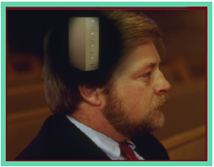
Bible Ngashankakhui maramli nawui ningli ara hibing hi leira…
•“Bible File” Kachiwui Maramli Kathei
• “Bible File”…O 7 V J shokhavai Ningwui sho
• Biblewui khamataiya otshotbing Ningwui Map thada khalei
• Biblewui “KHARARCHAN” khamataiya: “Otshot paida theikhavai”
• Bibleli kapikahai Abrahamwuili Pheisinsada Proho
Jesu Christawui otram khangathali chizavaya
84
1
Notes:
All right…take a deep breath! We’ve made a lot of progress…by now you have in mind
//// ….THE BIBLE FILE idea…
//// ….the key to open your file…
//// ….ability to make your own map of the Middle East…
//// ….you have THE QUICK CHRONOLOGY story line, the very core of Scripture…and now
////…the Abrahamic Foundations of Scripture that lead us directly from the Old Testament into the New Testament ministry of the Lord Jesus Christ.
//// Now – more than ever before –– we’re in a position to bring together the varied parts of the Bible, itself…the actual book…how it is structured and organized, based on the THE BIBLE FILE ideas of chronology and the Abrahamic Foundations of Scripture.
//// Now we can explore how the book itself is arranged…logically and progressively.

Slide 86

Tangkhul (India)
Bible…
Ngashankakhui
Bible…Ngashankakhuina Ministries International Inc. pashina semkashok Fort Worth, Texas
www.biblebasically.com
9.65.05B.
©2004 TBBMI
85

Slide 87
81
©2006 TBBMI
9.65.05B.
86

