Slide 1
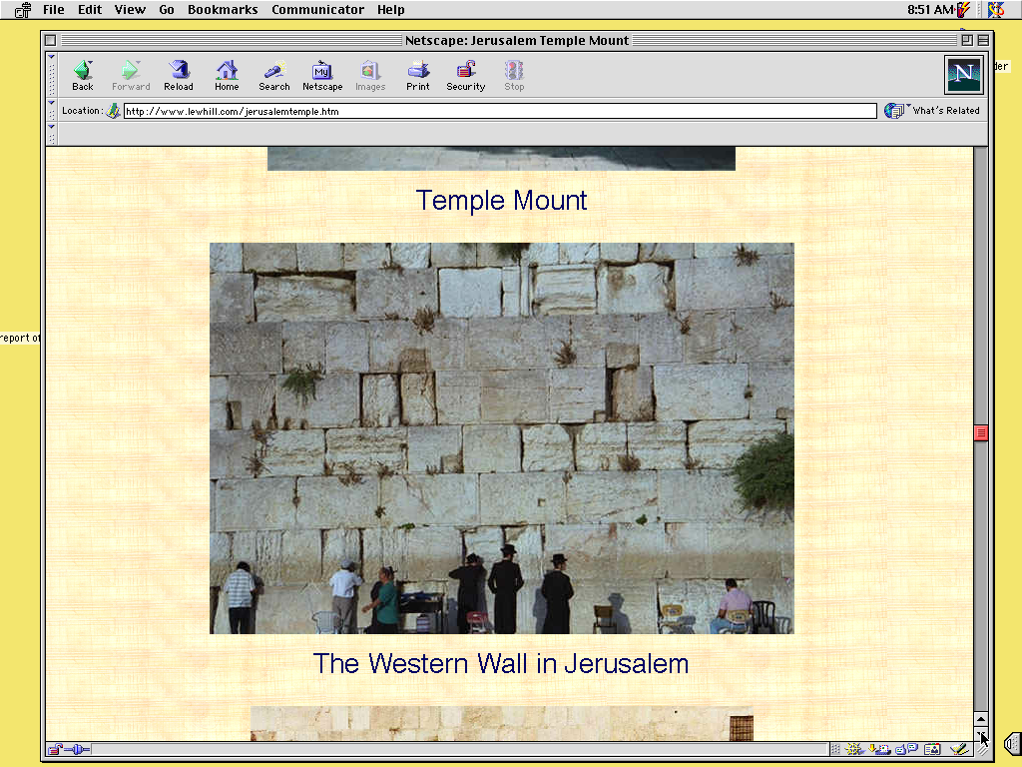
Biblewui
Ameikong
1
9.65.05a.
1
©2006 TBBMI
04
Notes:
The answer is, yes. The ideas ARE there. And we call them, our BIBLICAL BEDROCK...because in that deepest stratum of biblical meaning, revelation and understanding...
//// ….that's where it all begins.

Slide 2


Bible…
Ngashankakhui
Bible… Ngashankakhui Ministries International Inc. pashina semkashok
Fort Worth, Texas
www.biblebasically.com
©2006 TBBMI
9.65.05a.01

Slide 3
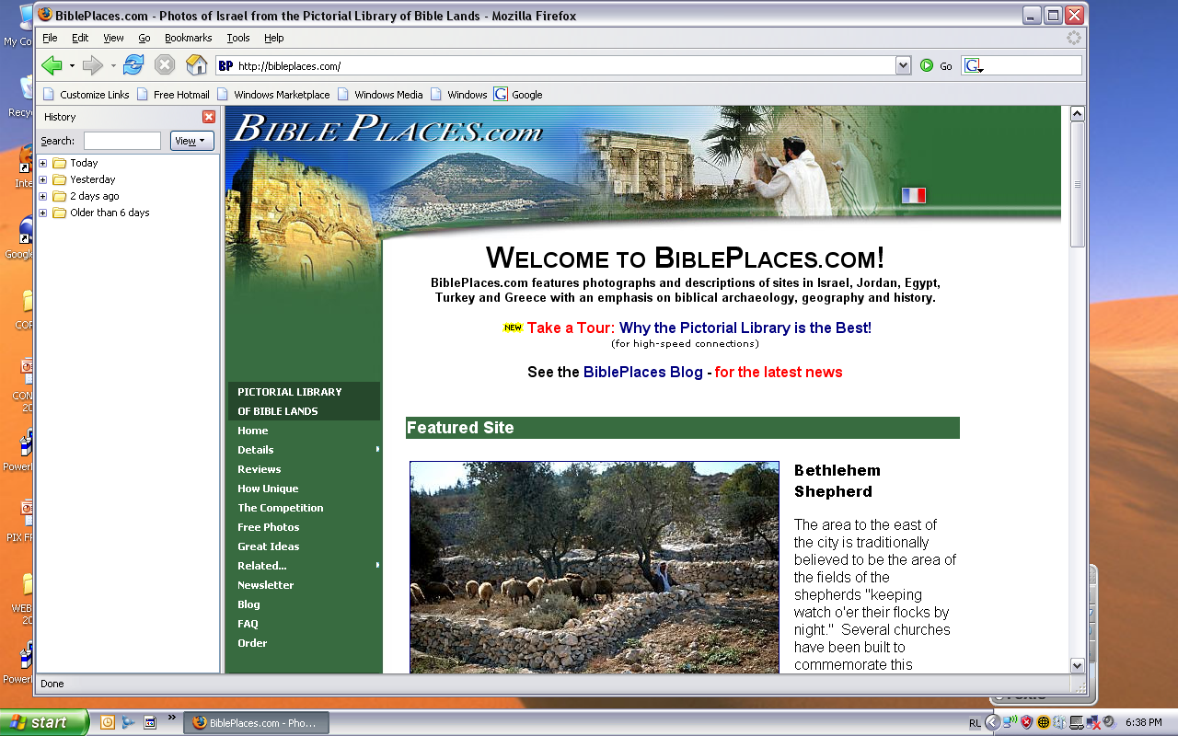
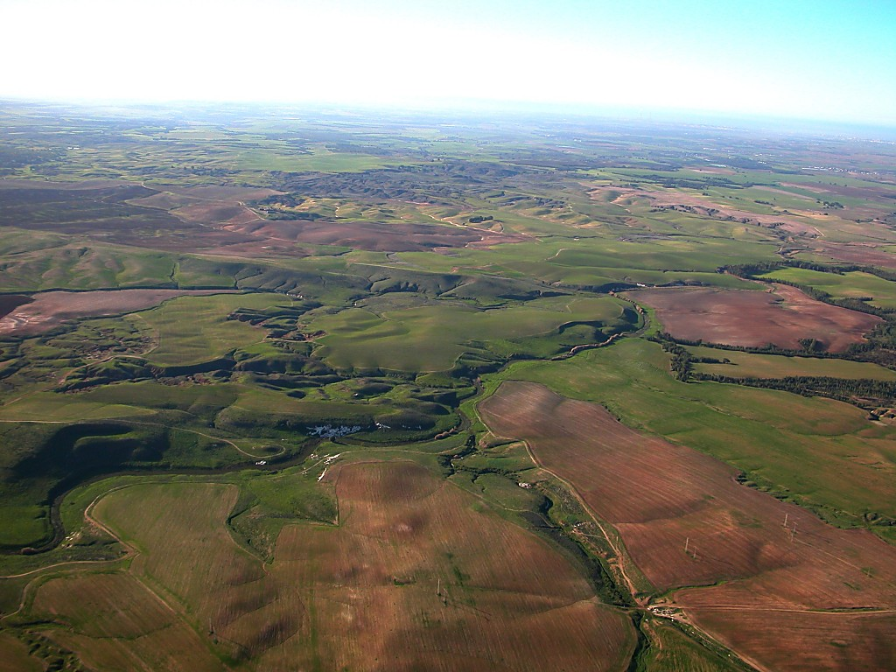
The Pictorial Library of Bible Lands
Our ministry is deeply indebted to Todd Bolen, creator of the Pictorial Library of Bible Lands, for his generous permission to use photo resources throughout THE BIBLE…BASICALLY®. TBB users are urged to visit BiblePlaces.com and explore the thousands of photo resources available: from the Holy Land, throughout the Aegean and Mediterranean Basin to Southern Europe where the Christian faith took root. BiblePlaces.com offers teachers and visual producers an incomparable array of high-resolution digital photographic resources. Please visit! Thanks, Todd!

Slide 4


(“Khiwuivang?” kachi chitheili)
BIBLE NGASHANKAKHUI
®
AKHUM KAPHANGA
BIBLEWUI AMEIKONG
9.65.05a.
©2006 TBBMI
02
Notes:
SEGMENT TITLE: BIBLICAL BEDROCK (A)
In THE QUICK CHRONOLOGY we found THE WHAT of what happened in the great Biblical panorama. Now it’s time to discover THE WHY of those world-shaping events.

Slide 5
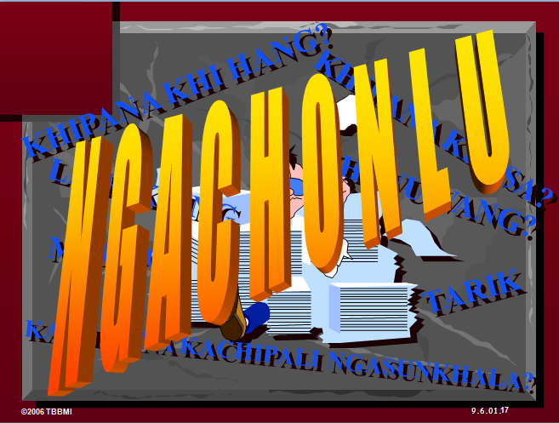
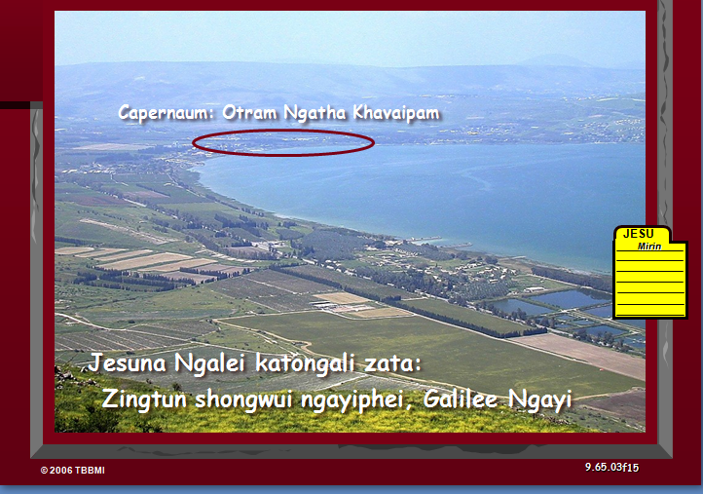
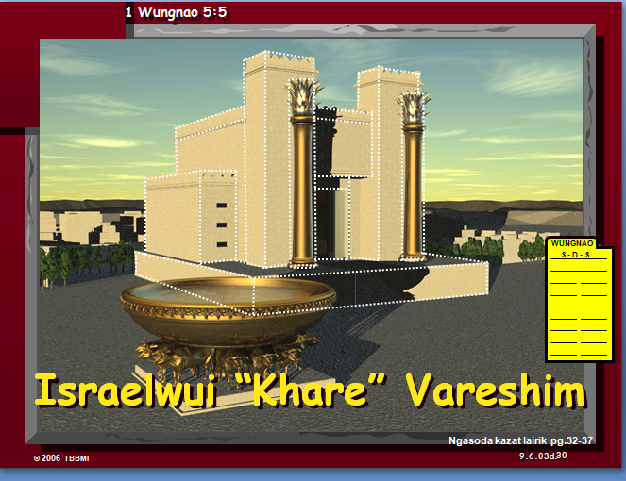
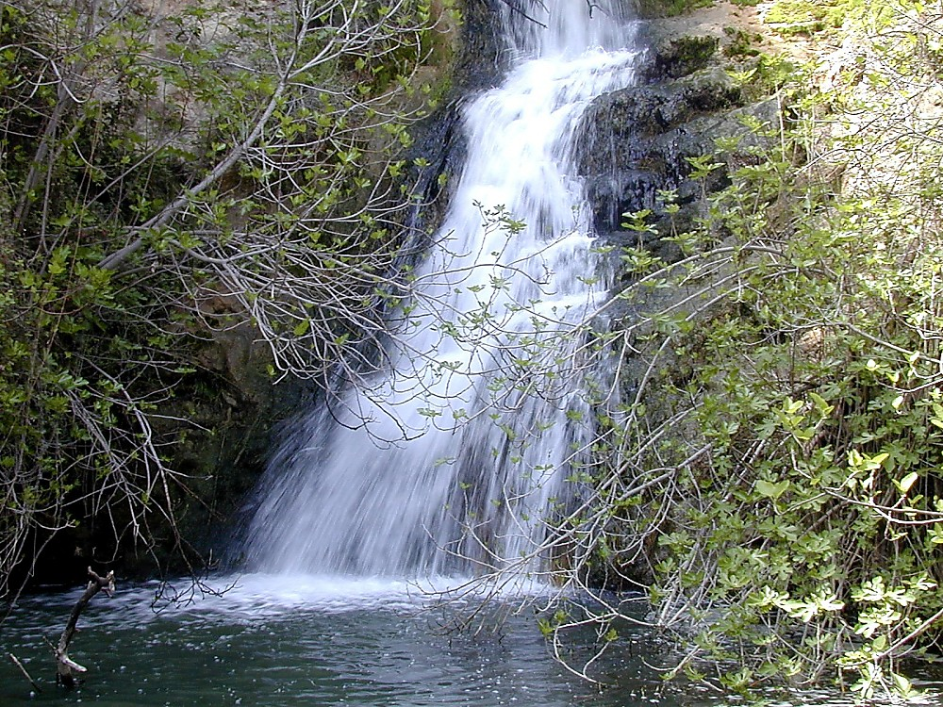
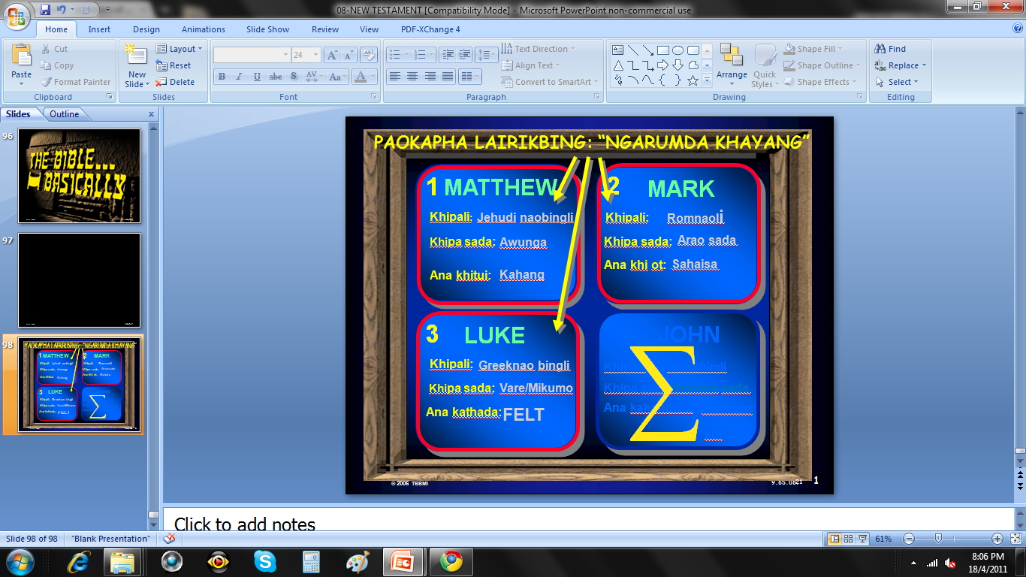
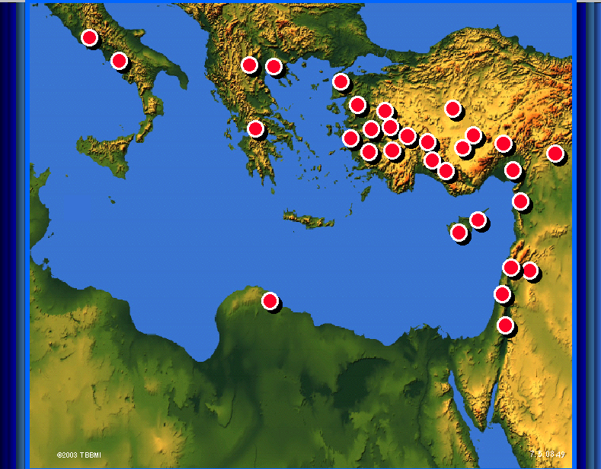
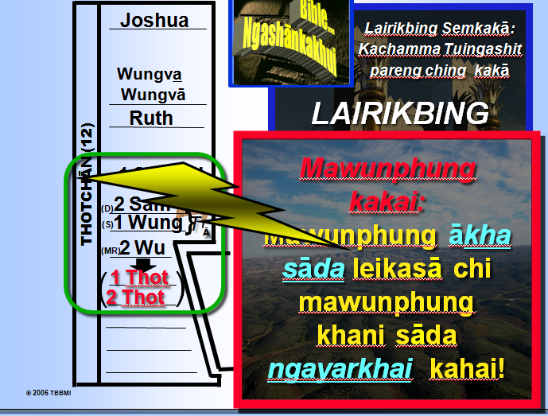
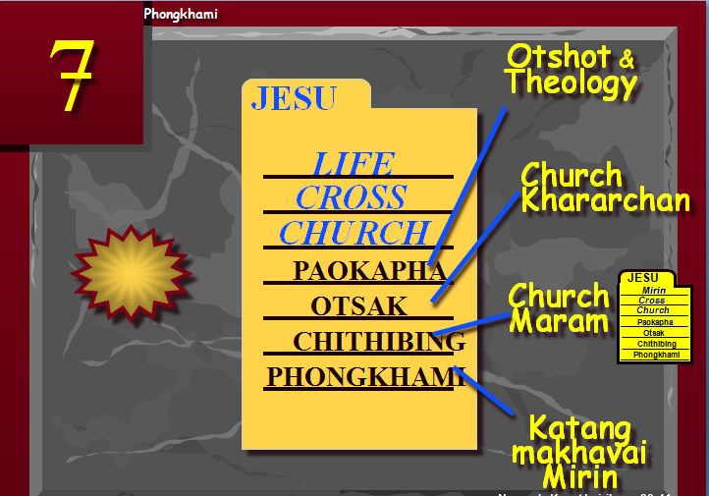
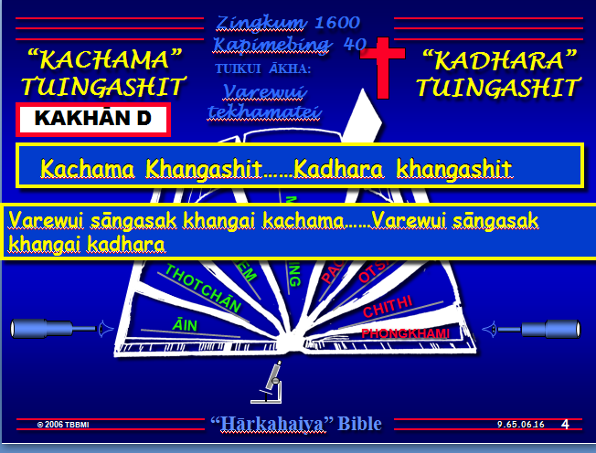
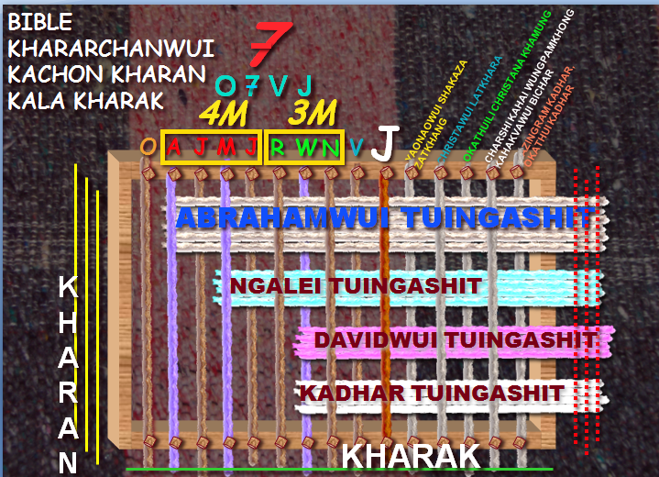
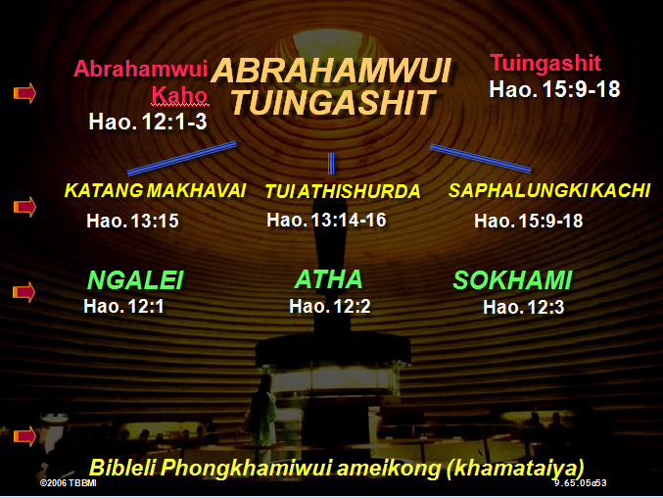
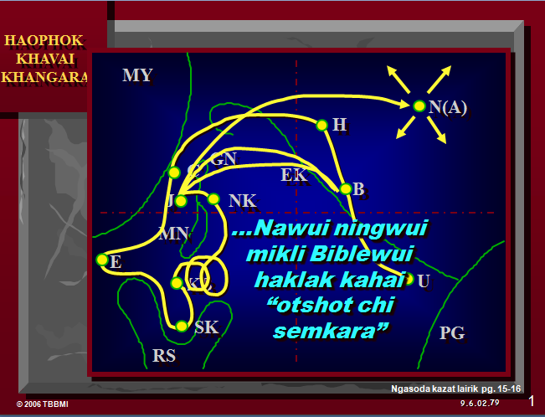
03
©2006 TBBMI
9.65.05a.
Notes:
[AUTO SLIDE MONTAGE-BLUE GRAPHIC LOWER LEFT IS THE LAST]
In everything we’ve encountered so far in THE BIBLE...BASICALLY, we have covered enormous epochs of time, a storyline of incredible dimension, presented to us in a collection of books that are unparalleled in divine authorship, human impact, and spiritual instruction.
So the question is this: what holds all this together? Are there concepts or basic ideas that run straight through the progress of each event and the presentation of each new revelation in God's unfolding program for Man?

Slide 6
Biblewui
Ameikong
KATONGA HI
KALI
HAOPHOK?
9.65.05a.
1
©2006 TBBMI
04
Notes:
The answer is, yes. The ideas ARE there. And we call them, our BIBLICAL BEDROCK...because in that deepest stratum of biblical meaning, revelation and understanding...
//// ….that's where it all begins.

Slide 7



KAZAIRA EINA RĀNDALEIDA PHANINGHAOLU...
BIBLE THOTRINCHANWUI MARAM
KATAMLI KHANGACHON #08
9.65.05a.
© 2006 TBBMI
05
Notes:
Remember that imaginary loom we built and threaded in the JESUS FILE? On Study Help #8 we called it "The Fabric of the Bible's Chronology.

Slide 8
BIBLE THOTRINCHANWUI MARAM
7
4M
3M
J
O
A
J
M
J
R
W
N
V
SĀKAKĀ TUIZĀ THARĀ BINGCHI!
9.65.05a.
1
© 2006 TBBMI
06
Notes:
We prepared the loom with ten threads representing the C7SJ ideas…
//// …followed by those ten organizing words of THE BIBLE FILE.

Slide 9
BIBLE THOTRINCHANWUI MARAM
7
4M
3M
J
O
A
J
M
J
R
W
N
V
OKATHUI KASEM
ABRAHAM
MOSES
JOSHUA
ROTKHAMARAT
WUNGNAO
NARKAHAI
VARI KAHAI
JESU
9.65.05a.
© 2006 TBBMI
07
Notes:
…CREATION, ABRAHAM, JOSEPH, MOSES, JOSHUA, ANARCHY, ROYALTY, CAPTIVITY, SILENCE, and Jesus.

Slide 10
BIBLE THOTRINCHANWUI MARAM
7
4M
3M
J
O
A
J
M
J
R
W
N
V
OKATHUI KASEM
ABRAHAM
JOSEPH
KHANGACHANG ATAM
MOSES
JOSHUA
ROTKHAMARAT
WUNGNAO
NARKAHAI
VARI KAHAI
JESU
9.65.05a.
© 2006 TBBMI
08
Notes:
Then we added five additional threads to represent the main events of the troubling END-TIMES scenario. The vast majority of the Body of Christ agrees – at least -- on these five future events. They are…

Slide 11
BIBLE THOTRINCHANWUI MARAM
7
CHARSHI KAHAI WUNGPAMKHONG KAHAKVAWUI BICHAR
KADHARA KAZINGRAM KALA OKATHUI
CHRISTANA OKATHUILI KHAMUNG
4M
3M
YAONAOWUI SAKAZA ZATKHANG
J
CHRISTAWUI LATKHARA
O
A
J
M
J
R
W
N
V
OKATHUI KASEM
ABRAHAM
JOSEPH
KHANGACHANG ATAM
MOSES
JOSHUA
ROTKHAMARAT
WUNGNAO
NARKAHAI
VARI KAHAI
JESU
9.65.05a.
4
© 2006 TBBMI
09
Notes:
the marriage supper of the Lamb…
//// the second coming of Christ
//// his thousand-year reign on earth…the Millennium…
//// followed by the Great White Throne Judgment,
//// culminating in that event that climaxes them all… the New Heaven and the New Earth.

Slide 12
BIBLE THOTRINCHANWUI MARAM
7
KADHARA KAZINGRAM KALA OKATHUI
CHARSHI KAHAI WUNGPAMKHONG KAHAKVAWUI BICHAR
4M
3M
YAONAOWUI SAKAZA ZATKHANG
CHRISTANA OKATHUILI KHAMUNG
J
CHRISTAWUI LATKHARA
O
A
J
M
J
R
W
N
V
ABRAHAMWUI TUINGASHIT
NGALEI TUINGASHIT
DAVIDWUI TUINGASHIT
KADHAR TUINGASHIT
9.65.05a..
5
© 2006 TBBMI
10
Notes:
Now…bring back to mind those strong bands of the covenants that we wove into that fabric of the Bible's chronology...Those covenants…unconditional promises from God…we believe are continuing to run at this very time. Those strong bands of the Old Testament promises are, in order,
//// THE ABRAHAMIC COVENANT...Genesis 12 and 15…
//// THE LAND COVENANT...Deuteronomy 30
//// THE DAVIDIC COVENANT…2 Samuel 7…and
//// the great NEW COVENANT…Jeremiah 31.
Taken together, all these grand events bring to a
//// close earth’s history and the climax of all those glorious promises – and their complete fulfillment – made from God to old Abraham so long ago.

Slide 13
BIBLELI PHONGKHAMIWUI AMEIKONG (KHAMATAIYA)
Varena saphalungkikachi
Tuingashitwui ranyei
11
Notes:
SO...to further explore all this...let's get into THE BACKBONE OF BIBLICAL REVELATION...GOD'S UNCONDITIONAL COVENANTAL PROGRAM.

Slide 14
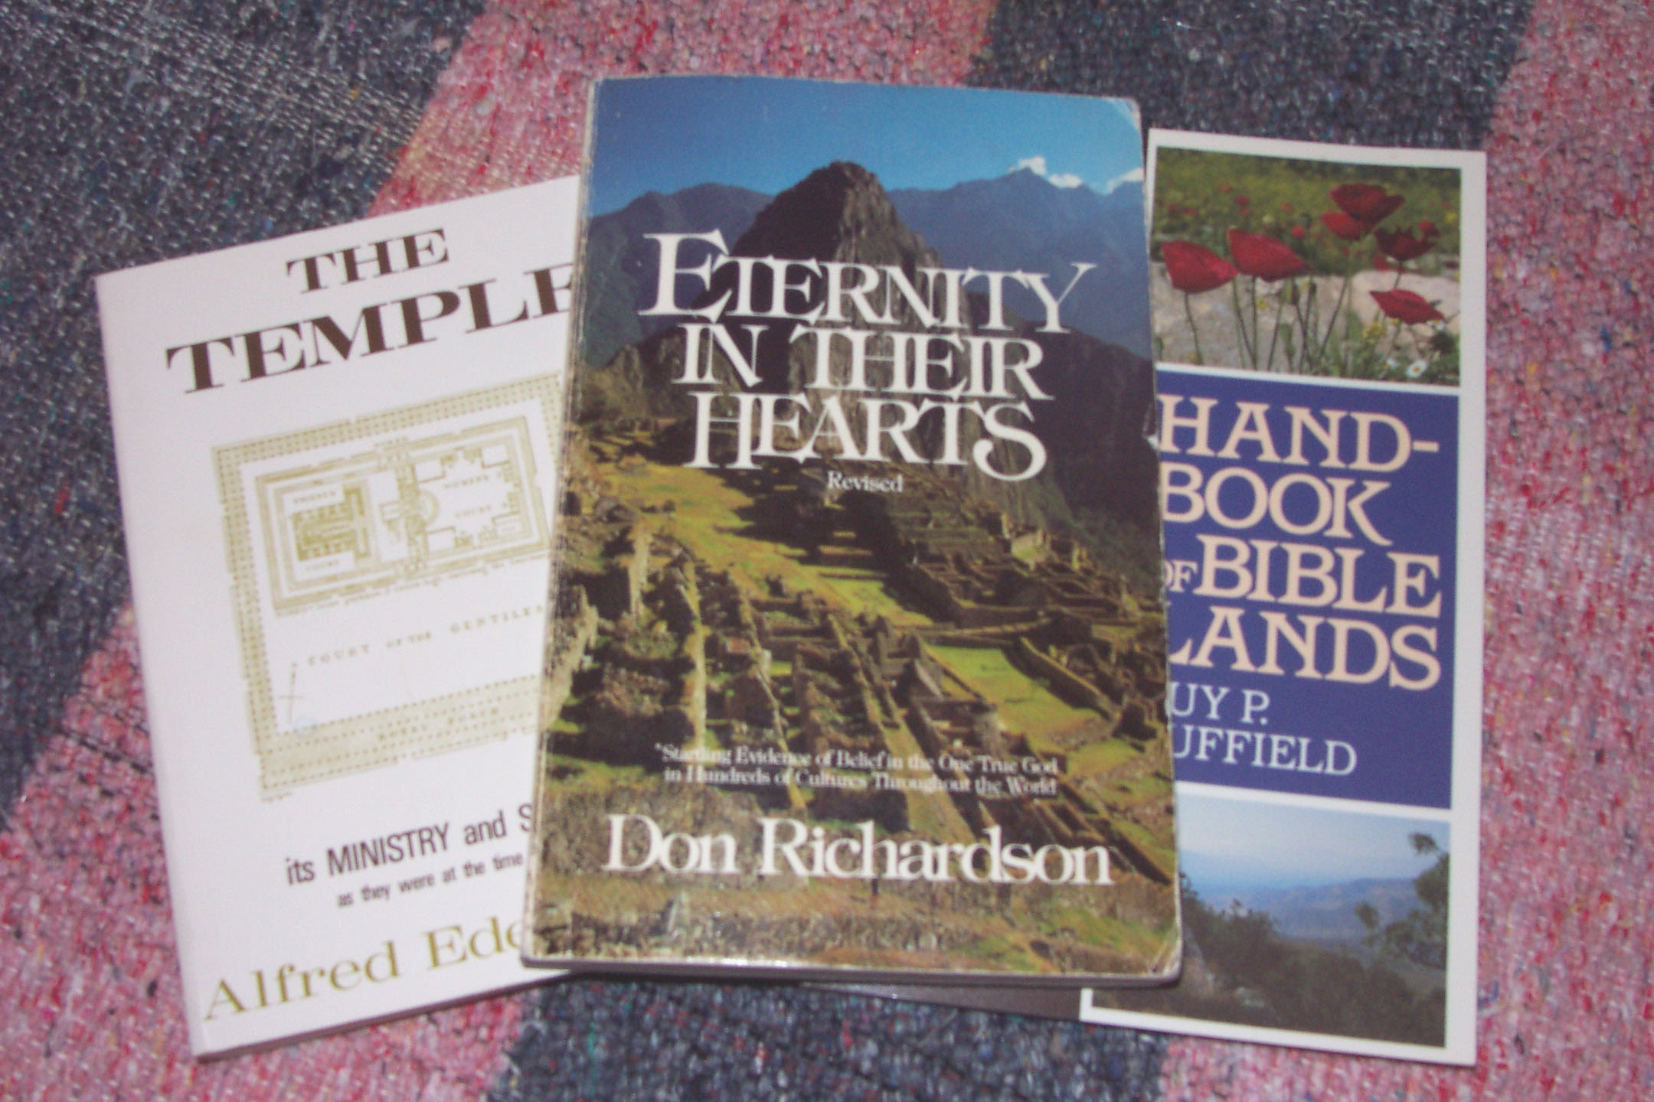
Bibleli Phongkhamiwui ameikong (khamataiya):
Varena saphalungkikachi Tuingashitwui ranyei
Don Richardson, Eternity in their Hearts
12
Notes:
Here's another good quote to think about...it's by Christian author Don Richardson, a writer of wide and long experience on the mission field...a missionary who is also an expert linguist. Don Richardson wrote...in his book ETERNITY IN THEIR HEARTS…

Slide 15
Bibleli Phongkhamiwui ameikong (khamataiya):
Varena saphalungkikachi Tuingashitwui ranyei
Kala tamkachitheilila kachangkhat eina ameikong mazangmara. Hina vareshibingli athumna samphang kahai sokhami chi, athumwui miyur mangli maningla, kha okathuili leida khalei mikumo katongali, masomi maronla ngachang zatngasak haowa. (Pg. 163)
Abrahamwui tuingashit...hina Biblewui ameikong kathana – Bibleli phongkhamiwui khamataiyachina. Khamataiya phongkhamihi mazangla tamkachitheichiya ameikong makazang kathana.
Don Richardson, Eternity in their Hearts
13
2
Notes:
“The Abrahamic Covenant...is the very backbone of the Bible – the spinal column of special revelation. Teaching which does not acknowledge that spinal column will inevitably have a certain spinelessness about it.
//// It will – quite literally – lack backbone. And it will tend to leave Christians less motivated than they would otherwise be to …
//// …pass on the blessing they have received, not merely to their own kind of people, but to all people on earth.”

Slide 16
Bibleli Phongkhamiwui ameikong (khamataiya):
Varena saphalungkikachi Tuingashitwui ranyei
“Morei” Kachi Maramli …
Hebrew kala Greek li:
Acham aram kakai
Khayon
Chonkhamakan
Makapha makhaya
Khalang
Makapha...
KATAMLI KHANGACHON #10
14
8
Notes:
Now let's put some parts of a Biblical puzzle together. There will be several pieces to work with. Begin with Study Help #10.
//// Starting with some ideas about that common little English word, SIN.
//// In both the Hebrew of the Old Testament and the Greek of the New...both words which, in English, are translated SIN ... actually have much wider meanings…such as…
//// MISBEHAVIOR...
//// INIQUITY...
//// TRANSGRESSION...
//// WICKEDNESS...
//// TRESPASS...
//// and EVIL...
Each of those words in their original languages means all these different kinds of negative behavior. As you can see, the word SIN is really an ineffective single word when we consider all the wider ORIGINAL meanings for which the only English word in translation is: SIN.

Slide 17
Bibleli Phongkhamiwui ameikong (khamataiya):
Varena saphalungkikachi Tuingashitwui ranyei
KHA! NA HITHADA PHANINGDA LEIRA…
“Morei” kachi maramli
Hebrew kala Greek li:
…KHARIN CHI KACHILI LEILI?
“kharin chi makaza.”
15
2
Notes:
But there is also a phrase common to both the Hebrew and the Greek
for the word that in English is translated as SIN.
//// the phrase is...TO MISS THE MARK…even as an archer might miss the mark of the target's bull's eye.
//// But you are probably thinking…where or what in the world…in the biblical sense...is that kind of mark?

Slide 18
Bibleli Phongkhamiwui ameikong (khamataiya):
Varena saphalungkikachi Tuingashitwui ranyei
“Morei” Kachi Maramli…
Hebrew kala Greek li: “kharin chi makaza.”
KĀKASHUNGA URUM CHI…BIBLELI YANGLU!
“Chiwuivāng eina kazingli khaleiya nathumwui avāna kākashung chithāda nathumla kāshungphalungra.” Matt. 5:48
16
1
Notes:
Well…for that plumb line of perfection…we go straight to Scripture. And there we discover God's own mark or expectation for perfect human behavior.
//// Jesus Himself said, “Be perfect, therefore, as your heavenly Father is perfect.” [Matthew 5:48]

Slide 19
TEKHAMATEIYA VAREWUI AMINGBING!
ABBA…NGANINGKHAME…SASHAP PANGSHAPA…ALPHA…AMEN…ACHALAKHAWUI MI…
THAO NEOMIKAHAIYA…PANGMON KHAREI…PROHOWUI PANGTHEI…
KHARINGAWUI AKHAVA…SHITKASANG HAOKAPHOKPAM…HAOKAPHOK KALA AKATANGA…
AKHAMANGKAJE SOKHAME KHAMUNGA…APHANG…KHARINGAWUI KHAMUI…VAREWUI KHAMUI… MAKHAM KAHAIYA…KAHORA ZINGTHANWO…YAOKAHOMA…VAREWUI KAPANGKAKHUIYA…CHRISTA…VAREWUI CHRISTA…PROHO CHRISTA…CHRISTA, KHARINGA VAREWUI NAO… RINGPHA KHANGASAKA…RAIMI AKHAVA…ISRAELLI MAKAN KHAME…KACHUIYA MEI…PAKRA AKHOKA…MACHINME… KAZING NGALEI KASA…HUIKAME….YUR SAIKORAWUI NINGKACHANG…KHAMONG…EL SHADDAI…KATANG MAKHAVAI VARE… KATANG MAKHAVAI AVĀVA…VAREWUI AZAK TAKAMHAI…NINGKATONG KALA KHAMASHUNG…NINGTONGDA SAKHI SAKHAME…AVAVA…VARENA SEMKAHAI KATONGALI HAKHAMEI NAOCHIZAI….RIMEIKAPTA KASHOK… SHIMPHUNG…KHAJANA KHALOKABING KALA MOREI KAPHUNGBINGWUI NGASOTNAO…NIMSHIMRI KAHAI KHON…VAREWUI LEMMET…PROHOWUI TEKHAMATEI…VARIVARA…SASHAP PANGSHAPA VARE…SAIKORAWUI VARE…THEISER KAJE VARE…KAPHA YAOKAHOMA…PANGMON KHAREI…KAHAKA YAOKAHOMA… CHITHEI KHAME…PHASAWUI AKUI…CHURCHWUI AKUI…SAIKORAWUI SHIMLUIKAT…KATANG MAKHAVAI PANGMON KHAREI…KATHARA PA…ISRAELWUI KATHARA PA…MANGLA KATHARA…KACHIHANA…PANGSHAP KHALEIYA HUIKHAME…I CHI INA…VAREWUI AMAHA…AKHALATAWUI AMAHA…VARENA ITHUMLI NGASOMI…JEHOVAH…JESU…JESU CHRISTA ITHUMWUI PROHO…BICHAR SAME…WUNGNAO…KATANG MAKHAVAI WUNGNAO…WUNGNAOWUI WUNGNAO…THOTHOTWUI AWUNGA…VAREWUI YAONAO…KHANAOVA ADAM…AIN KHAME…KATHANA…KHARINGA…OKATHUIWUI KAHOR…KHALANG THADA…TAMPAKWUI TIMRAWON…JUDAH SHANGNAOWUI KAZINGKHA…KHARINGA LUNGGUI…KHARINGA TARA…PROHO…SASHAPA PROHO VARE…PROHO JESU CHRISTA…SAIKORAWUI PROHO…TEKHAMATEIYA PROHO…PROHOBINGWUI PROHO…ITHUMLI NGARONG KHANGASAKA PROHO…LEIKASHI…WUKKAKHANANGA MI…AMEI…NGASHIKME…LUMASHAN KATHA VARE…NAZARENE…DAVIDWUI NAOTUN…OMEGA…NAOHONAOTONG…ITHUMLI MAKANKHAMI WUI YANAO…ITHUMWUI CHINGRI KAHAI…HAM KASAA…VAREWUI PANGSHAP…CHINGRI KAHAI WUNGNAO… MARAN…SAKHAMATHAA…OJA [TAMKACHITHEIPA]…VAREWUI TEKHAMATEIWUI KAHAN…HUIKHAME…SHARKHAWUI MEI…RINGKHALUIYA KALA KHARINGA…KHANGARONGA…LUNGHAR… DAVIDWUI ANGAYUNG…SHARONWUI WON…VAREWUI THEMSAKLI KHAMUNGA…OKATHUIWUNGNAO TUNGLI KHAMUNGA… ISRAELLI KHAMUNGA…NGATANGKHAME…ISRAELWUI EINA KHANTHING…ATHA…RAO…NAMANGLALI HOMKHAME KALA YANGKHAME…CHANGVEI… DAVIDWUI NAO…VAREWUI NAO…JACOBWUI EINA SIRA…LUNGGUI…KHANGARONGWUI NAO… OJA…KHAMASHUNGA KAHOR…KHAMASHUNG..DRAKHARONG…VAREWUI THANGKHAMEI…MATAKHAK KAHAI MACHINME…TUI…VAREWUI TUI.
JESU
PROHO CHRISTA
PROHO CHRISTA
PROHO CHRISTA
KATAMLI KHANGACHON #11
Mary Foxwell Loeks, Tekhamateiya Varewui Amingbing
ITHUM KHARINCHI ZAKA-MAZAMAKHALA?
17
8
Notes:
With Study Help # 11…how exactly would you ever know the dimensions of “perfection?” For that…just look at the names of God right there in the Bible…names, terms and phrases that He uses in reference to Himself. That list gives us a good idea of the quality of the behavior and spiritual behavior expected of us. And, of course, among those dozens of the biblical names for God…are these…
//// ….ALMIGHTY…
//// ….COMFORTER…
//// ….FAITHFUL AND TRUE…
//// ….LAMB OF GOD…
//// ….RIGHTEOUS ONE…
//// ….TRUTH…
//// ….AND THAT NAME ABOVE ALL NAMES……CHRIST THE LORD…JESUS Himself!
These are some of the dimensions of expectation…to which none of us can compare. Then the question remains…
//// DO WE…OR DO WE NOT…MISS THE MARK? THAT’S why we need a Savior…Jesus Christ the Lord.

Slide 20
Bibleli Phongkhamiwui ameikong (khamataiya):
Varena saphalungkikachi Tuingashitwui ranyei
“Morei” kachi Maramli…
Chiyakha kachuiya kharinchi khipana kashungshaprakhala?
Paulna Romnao 3:23li hithada kapihaidalei
18
1
Notes:
Another question then: WHO can measure up to such criteria? How do we live life on this planet and NOT miss that mark?
//// We have an answer to that. Paul summed it up clearly in Romans.

Slide 21
"...KHIKHALA CHILA KATONGA MOREI
PHUNGHAIDA VAREWUI TEKHAMATEI
MAKASHUNG RARMANA."
19
Notes:
"FOR ALL HAVE SINNED AND FALL SHORT OF THE GLORY OF GOD." AGAIN…ALL HAVE SINNED!

Slide 22
Bibleli Phongkhamiwui ameikong (khamataiya):
Varena saphalungkikachi Tuingashitwui ranyei
KACHAMA
KADHARA
CONTRACT
CONTRACT
TUINGASHIT
KHANGASHIT
NING
TUINGASHIT
KHANGASHIT
NING
NING
KHANGASHIT
KHANGASHIT
KATAMLI KHANGACHON #12
CONTRACT
TUINGASHIT
20
19
Notes:
Now comes another puzzle piece...Study Help #12…this one is a matter of some interchangeable words. Beginning with
//// WILL.....then
//// CONTRACT...followed by
//// TESTAMENT...and finally
//// COVENANT.
Each of these terms has a legal idea behind its meaning.
In fact,
//// CONTRACT and TESTAMENT are interchangeable...as are
//// TESTAMENT and WILL...then
//// WILL and CONTRACT...and finally...each one...
//// CONTRACT,
//// TESTAMENT and
//// WILL…is an interchangeable term with
//// COVENANT.
So there is an enormous amount of contractual and legal nuance brought together in these four terms. In other words, according to the dictionary, we could call the parts of our Bible...God’s OLD
//// ….WILL…
//// ….COVENANT...or
//// ….CONTRACT…
In the same way…we could refer to God’s New
//// ….WILL
//// ….COVENANT or
//// ….CONTRACT
Interchangeable terms that give enormous insight into the depth and breadth of God’s legal arrangements with his Creation. With all these possibilities…it was the decision of earlier translators to use the older inclusive term TESTAMENT…giving us
//// OLD TESTAMENT and
//// NEW TESTAMENT.
Then...with the idea of Biblical covenants and contracts in mind...think about this…

Slide 23
Bibleli Phongkhamiwui ameikong (khamataiya):
Varena saphalungkikachi Tuingashitwui ranyei
ACHALAKHAWUI
TUINGASHITBING
KALA
CONTRACTS
21
Notes:
…the social or financial situations in those ancient times where covenants and contracts were a prominent part of civil discourse. As an example of ancient covenants, this situation…

Slide 24
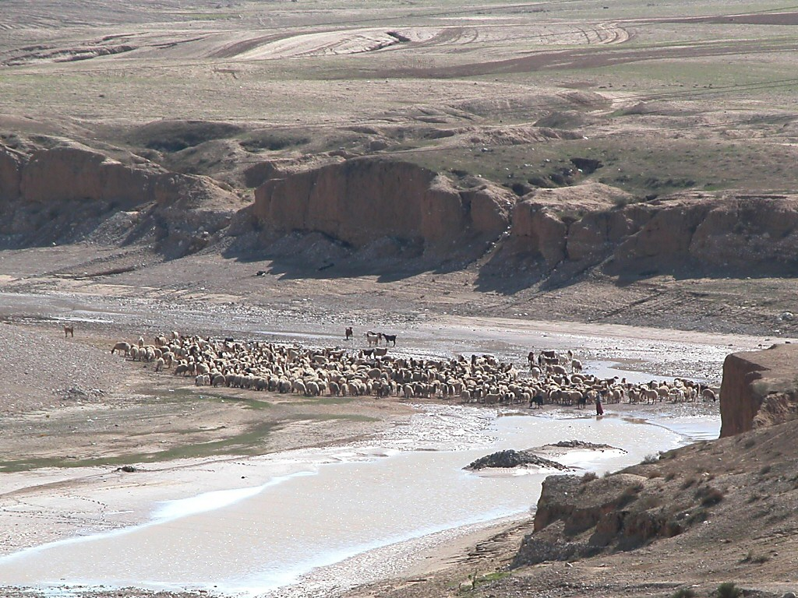
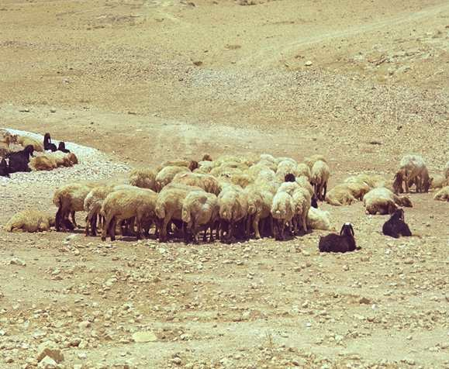
Bibleli Phongkhamiwui ameikong (khamataiya):
Varena saphalungkikachi Tuingashitwui ranyei
ACHALAKHAWUI TUINGASHITBING
KATAMLI KHANGACHON #13
22
1
Notes:
…with Study Help 13 in hand…suppose you own a herd of sheep…but you need additional land on which to graze that herd.
//// On the other hand, your friend owns a very large range of land and is quite willing to make some of it available to fill your needs.
How do you make that arrangement?
In Biblical times…in one of four ways...such as…

Slide 25
Ezra 10:19; Ezek. 17:18
Bibleli Phongkhamiwui ameikong (khamataiya):
Varena saphalungkikachi Tuingashitwui ranyei
ACHALAKHAWUI TUINGASHITBING
• APANG
23
Notes:
The ancient HAND COVENANT…simply shaking hands…a basic gesture of understanding between people -- coming right on down to our own time.

Slide 26
Ruth 4:8
Bibleli Phongkhamiwui ameikong (khamataiya):
Varena saphalungkikachi Tuingashitwui ranyei
ACHALAKHAWUI TUINGASHITBING
• APANG
• PHEIHOP
24
Notes:
With slightly more symbolic permanence…though temporary…the SHOE COVENANT. As a symbol of the agreement, each party exchanges a sandal, which will be retained by each...just as long as the agreement is in effect. To cancel it all, we simply give back each other's sandal, and the agreement is concluded. Things return to their original condition.

Slide 27
Pang. 2:13; Mish. 18:19; 2 Thot. 13:5
Bibleli Phongkhamiwui ameikong (khamataiya):
Varena saphalungkikachi Tuingashitwui ranyei
ACHALAKHAWUI TUINGASHITBING
• APANG
• PHEIHOP
• MACHI
• ASHEE
25
2
Notes:
Then…the SALT COVENANT…still another form of contract, this one requiring yet more commitment than the shoe covenant, though not by much. Each party to the agreement exchanged an amount of precious salt from a side condiment pouch many people carried. The idea here being that once the agreement was ended…the return of all the salt would be very difficult although, in theory, possible. And also, salt was used in ancient times as a way of ratifying an agreement. Sometimes the pouches were just exchanged between the parties. So, this contract could be nullified with some ease.
//// But now, we come to the most important and far-reaching ancient covenant or contract agreement of them all. This one we call a BLOOD COVENANT.
The Blood Covenant worked like this:
//// each of the parties to an agreement selects an animal, or animals, depending upon one’s personal wealth.

Slide 28

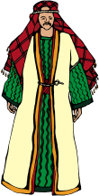



Hao. 15
Bibleli phongkhamiwui ameikong (khamataiya):
Varena saphalungkikachi tuingashitwui ranyei
ACHALAKHAWUI TUINGASHITBING
Abrahamli ngashitkhami chitharan Varena sakikaji ot chiwuivang shakhi sai. Ali hakhameiya maleithuda khangashit kasa chitharan a khalattawui mingli mingzai (Heb. 6:13). Hiwui kakhalatva tuingashitchi Varewui shongmāng eina kasāna. Chiwuivangeina ungshungphalungkikachi tuingashitna.”
Walvoord/Zuck, The Bible Knowledge Commentary
“ASHEEWUI TUINGASHIT”: MATHIRANGLAKHA EINA TANGDA ZATNARA!
X
• ASHEE
26
3
Notes:
The animals are slaughtered and the carcasses spread about on the ground with a passage between them,
//// …and then side-by-side, the parties walk together between the animal pieces. Significant? Yes…because blood has been spilled in behalf of the arrangement.
//// That BLOOD COVENANT then is utterly binding until the death of one of the parties! In other words, there is no abrogating a blood covenant. Why this emphasis? Here’s a glimpse of that climactic scene in Genesis between Abraham and God:
//// “[God] came down and made…or literally CUT…a formal treaty with Abraham (the Abrahamic Covenant.) Since God could “swear” (confirm a covenant) by none greater, ‘He swore by Himself’ (Heb. 6:13). In other words this was a unilateral covenant. So its promises are absolutely sure.

Slide 29



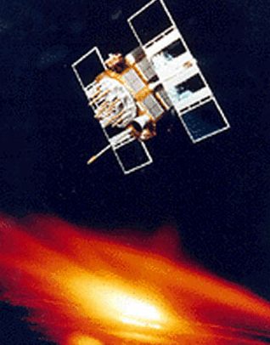
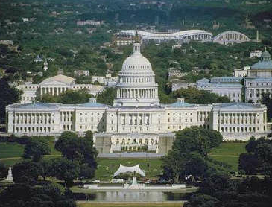


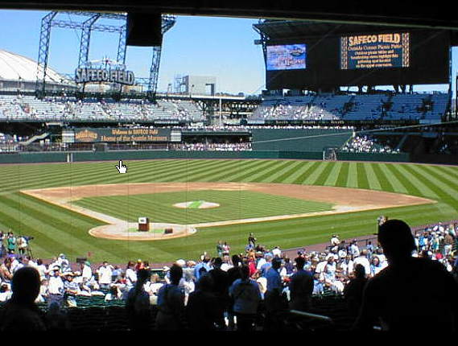
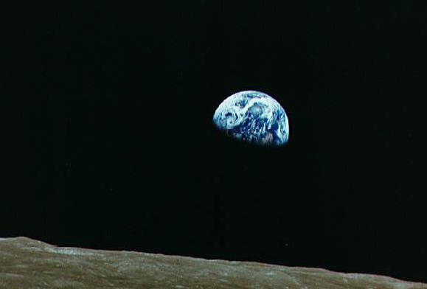
OT KATONGAHI KHINA VAMKHUI KHALA?
27
1
Notes:
Now the last puzzle piece...
Here is a series of sights and events that are common to life in the United States at this time in the world’s history.
….And the majesty of the U.S. capitol building in Washington D.C.
With all of these varied aspects of our contemporary life...
//// ….there is a question here: is there one common concept that holds all this together? Is there an underlying idea or fundamental principle that brings all this – in this instance, the United States of America – together in what we could call –– in this case –– nationhood?

Slide 30
AMERICAWUI RIYA
Americali kharing-kharakwui ameikong
28
Notes:
We could suggest that the U.S. Constitution be considered as the very BACKBONE of American life. It is a legal document...not a divine instrument, of course. However, through the centuries that single written document has held the United States and its way of life together…through war and through peace...the good times and the very bad…a document of common understanding among all American people.

Slide 31
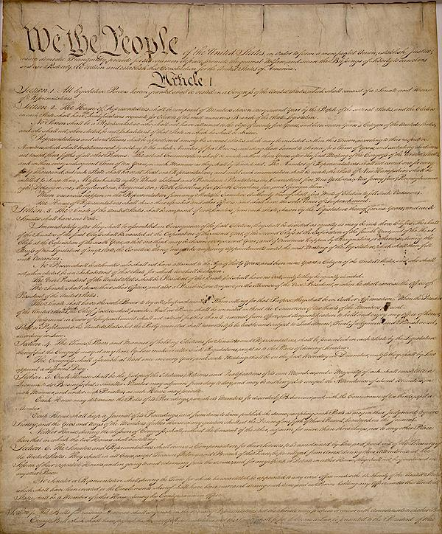
YARUI KALA SHORKAR NGACHAMDA RINGPAIKHAVAI AINWUI LAIRIK!
AMERICAWUI RIYAN
Americali kharing-kharakwui ameikong
29
1
Notes:
//// A LEGAL DOCUMENT OF UNDERSTANDING BETWEEN MEN AND THEIR GOVERNMENTS.

Slide 32
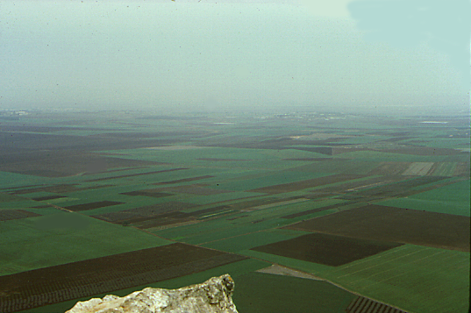
KAHO
KADESH BARNEA
S - D - S
PAOKAPHA
40
SINAI
CHITHI
JERICHO
NGAKAI KAHAI NGALEI
430
SHONGZA
VARESHIM
ZINGKUM 70
ISRAEL
MARANBING
J - E
OTSAK
RAOPAM
WUNGVA-WUNGVA
JUDAH
350
L - S - B
I - I
PHONGKHAMI
SHANG 12
M - C - C
Z - E - N
TAMKACHITHEI 5
SHONGFA 3...
9.65.05a.
© 2006 TBBMI
30
Notes:
Now think about all of these Biblical concepts, these ideas, the people, the events...all of them major parts of THE BIBLE…BASICALLY and THE QUICK CHRONOLOGY … the Bible's time and story lines we have moved through earlier…[DISSOLVING DIRECTLY INTO…]

Slide 33
KAHO
KADESH BARNEA
S - D - S
PAOKAPHA
40
CHITHIBING
SINAI
KALA...
JERICHO
NGALEI NGAKAI KAHAI
430
PROHO JESU CHRISTAWUI OTRAM KHANGATHA
VARESHIM
SHONGZA
ZINGKUM 70
ISRAEL
MARANBING
J - E
OTSAK
RAOPAM
JUDGES
JUDAH
350
L - S - B
I - I
PHONGKHAMI
SHANG 12
M - C - C
Z - E - N
TAMKACHITHEI 5
SHONGFA 3...
9.65.05a.
© 2006 TBBMI
31
Notes:
…including and culminating in the ministry of the Lord Jesus Christ! Now comes another question…

Slide 34
KAHO
KADESH BARNEA
S - D - S
KALA...
PAOKAPHA
40
SINAI
CHITHIBING
PROHO JESU CHRISTAWUI OTRAM KHANGATHA
JERICHO
NGAKAI KAHAI NGALEI
430
SHONGZA
VARESHIM
ZINGKUM 70
ISRAEL
MARANBING
J - E
RAOPAM
OTSAK
WUNGVA WUNGVĀ
JUDAH
350
L - S - B
I - I
PHONGKHAMI
SHANG 12
OTSHOTBING KATONGA HI KHANGASIK LEINGAROKLA?
M - C - C
Z - E - N
TAMKACHITHEI 5
SHONGFA 3...
9.65.05a.
© 2006 TBBMI
32
Notes:
Is there here, also, a connection, a combining principle, or perhaps even A LEGAL DOCUMENT that would account for the Biblical events unfolding exactly as they did across the pages of Scripture? Of course, there is!

Slide 35
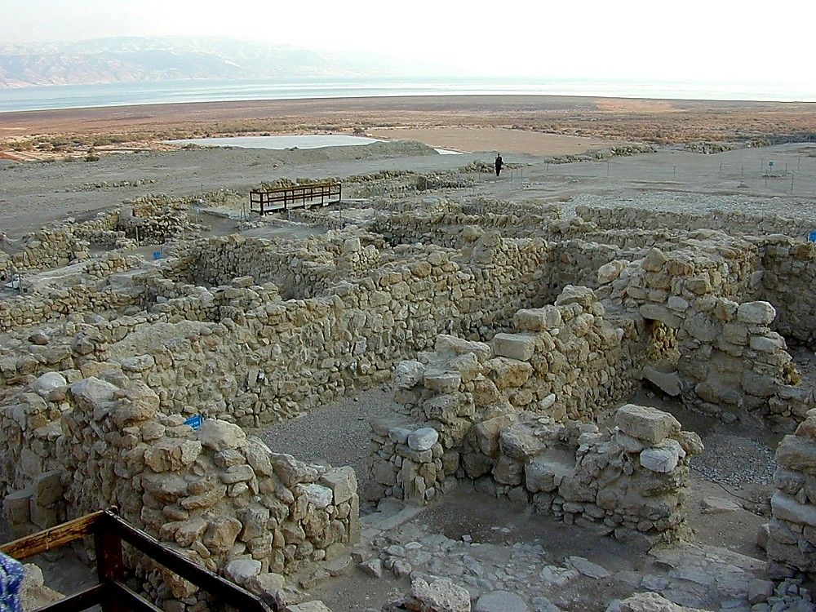
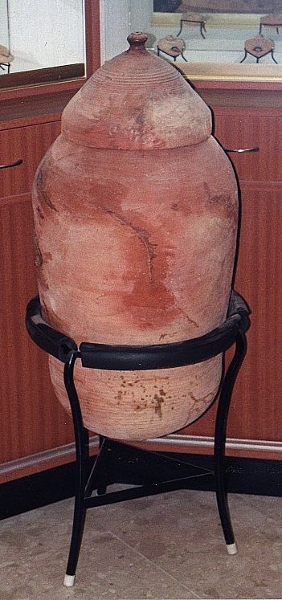
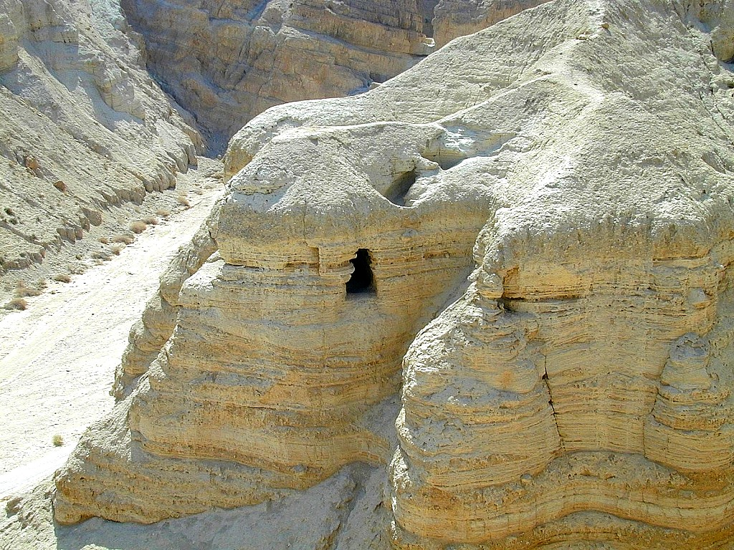
KATHI NGAYIWUI LAIRIK AKHALUI KHANGATHUM APAM
ACHALAKHAWUI QUMRAN RAMCHO KAHAI, KATHI NGAYIWUI YIREIPHEILI KAPĀNNA ESSENCE ASHANGVA
33
2
Notes:
But first…let’s make a framework in which to talk about all this. These are the ancient ruins of Qumran, a community of Essenes – a sect of extremely pious Jews – who lived apart on the shores of the Dead Sea not far from Jerusalem. Some scholars believe that John the Baptist was a member of this community.
//// The Essenes were known to have hand-copied the ancient Jewish scriptures. As Palestine was collapsing under the Romans, the Essenes spirited their precious copies of the Scriptures out of the community…hiding them across a dry streambed in a group of caves…
//// …preserving them in ceramic jars like this. And they stayed right there –– in the caves –– undisturbed until 1947 when they were discovered by a shepherd boy searching for his wandering sheep.

Slide 36
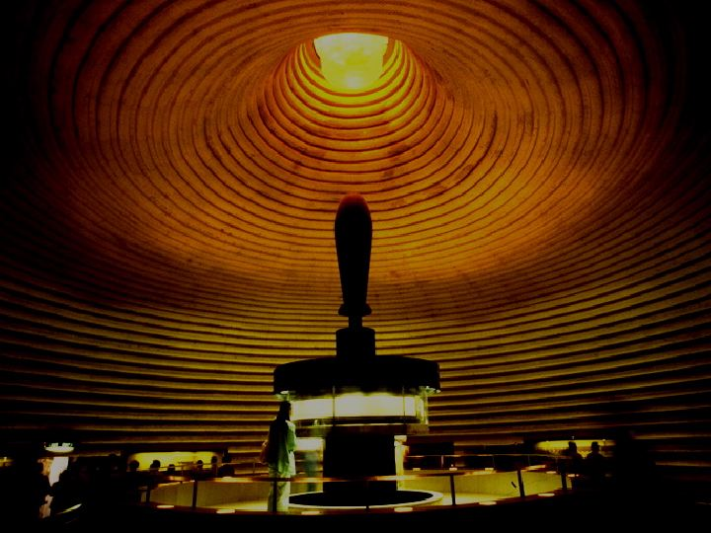
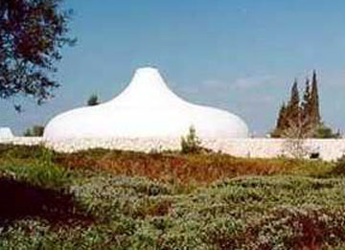
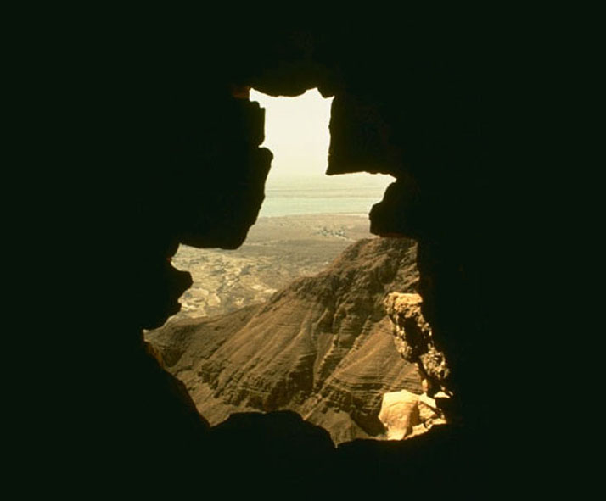
The Shrine of the Book, Israel Yurwui Museum, Jerusalem, Israel
9.65.05a.
2
©2006 TBBMI
34
Notes:
Today, some of those ancient scrolls are preserved and displayed to the public in Jerusalem’s…
//// …famed Shrine of the Book at Israel’s National Museum.
//// So…from the caves…to the museum and to scroll researchers around the world…an enormous treasure of Essene writings has survived….held by many to be the most significant archeological discovery of the Twentieth Century.

Slide 37
The Shrine of the Book, Israel Yurwui Museum, Jerusalem, Israel
The Shrine of the Book wui alungshong
9.65.05a.
©2006 TBBMI
35
Notes:
Then…with this background inside Jerusalem’s Shrine of the Book, let’s explore the place of the Biblical legal understandings and promises between God and man…just as they have come down to us IN WRITING and preserved in the pages of Scripture in your own Bible.

Slide 38
ABRAHAMWUI
TUINGASHIT
KATAMLI KHANGACHON #14
9.65.05a.
1
©2006 TBBMI
36
Notes:
The arrows on the side of the screen will guide us through Study Help #14…
//// ….as we develop…first… THE ABRAHAMIC COVENANT.

Slide 39
ABRAHAMWUI
TUINGASHIT
Bibleli Phongkhamiwui ameikong (khamataiya):
Varena saphalungkikachi Tuingashitwui ranyei Hili haophoka.
9.65.05a.
©2006 TBBMI
37
Notes:
This is Richardson’s “VERY BACKBONE OF BIBLICAL REVELATION.” GOD’S UNCONDITIONAL COVENANTAL PROGRAM BEGINS RIGHT HERE!
That great ABRAHAMIC COVENANT....God's unconditional covenantal program of the ages was announced in two parts..

Slide 40
ABRAHAMWUI
KAHO Hao. 12:1-3
TUINGASHIT
Hao. 15:9-18
ABRAHAMWUI
TUINGASHIT
Bibleli Phongkhamiwui ameikong (khamataiya):
Varena saphalungkikachi Tuingashitwui ranyei Hili haophoka.
9.65.05a.
2
©2006 TBBMI
38
Notes:
Guided on the Study Help by the arrows to the left…
The Abrahamic Promises originate in two different locations in Genesis...
//// First…Abraham received his famous CALL –– with its three promises –– in Genesis 12:1-3. Remember the time frame: about 2000 B.C.
//// Later on in Genesis 15:9-18, the actual Covenant is presented …in the form of a BLOOD COVENANT…as we described earlier…. followed by God –– in effect –– signing the actual COVENANT or contract between Himself and Abraham.
So then…what ARE the features of that ancient promise.

Slide 41
Haokaphok 12: 1-3
ABRAHAMWUI TUINGASHITBING
¹ Chi eina Prohona Abramli hanga,
“Naramwui eina, shangwui eina kala navā wui shim eina zatta Ina chitheiki kachi ngalei chili vālu.
NGALEI
²“Kala Ina nali kahaka yur akha sāngasakta
nali sokhamila somira,
nawui ming reingasakta,
sokhame mi ākha sāngasakra.
ATHA
ABRAHAM
KAHO
N – A - S
³ Nali kasobingli Inala sora,
nali khonkashe mi chili Inala khonshira;
kala okathui shimkhur hupta
nawui manga eina sokhami ngasāra.”
I - I
J - E
12
SOKHAMI
39
8
Notes:
Read along with this Covenant between God and Abraham as we touched on it much earlier...remember from Genesis 12: 1-3?
//// ….the L-S-B on the ABRAHAM File Folder. The verses read…
//// ¹ “ The Lord had said to Abram,
“Leave your country, your people and your father’s household, and go to the land I will show you.
//// THIS IS THE PROMISE OF A LAND FOR THE ABRAHAM’S DESCENDANTS.
//// ²“I will make you into a great nation
and I will bless you;
I will make your name great,
and you will be a blessing.
//// THIS IS THE PROMISE OF A SEED, OR GREAT LINE OF DESCENDANTS, TO COME FROM HIM.
//// ³ I will bless those who bless you,
and whoever curses you I will curse;
and all peoples on earth
will be blessed through you.”
//// THIS IS THE BLESSING, THAT PART OF THE PROMISE THAT EXTENDS FAR BEYOND ABRAHAM’S LINE…OUT TO EVERY PERSON ON EARTH FROM THEN UNTIL THIS VERY DAY!
//// The significant points of that promise are these... L…S…B… presenting to Abraham
A LAND...A SEED......AND A BLESSING!

Slide 42
Abrahamli kaho Hao. 12:1-3
ABRAHAMWUI TUINGASHIT
Tuingashit Hao. 15:9-18
NGALEI
ATHA
SOKHAMI
Hao. 12:1
Hao. 12:2
Hao. 12:3
Bibleli Phongkhamiwui ameikong (khamataiya)
9.65.05a.
2
©2006 TBBMI
40
Notes:
So…in outline…The LAND provision is stated in Genesis 12:1...
//// The SEED aspect laid out in Genesis 12:2...
//// And that world-girdling BLESSING provision in Genesis 12:3.

Slide 43
Haokaphok 12: 1-3
ABRAHAMWUI TUINGASHITBING
¹ “ Chieina Prohona Abramli hanga, “Naramwui eina, shangwui eina kala navāwui shim eina zatta Ina chitheiki kaji ngalei chili vālu”.
²“Kala Ina nali kahaka yur ākha sāngasakta nali sokhamila somira, nawui ming reingasakta, sokhame mi ākha sāngasakra.
³ Nali kasobingli Inala sora, nali khonkashe chili Inala khonshira kala okathui shimkhur hupta nawui mangā eina sokhami ngasāra.”
Aruila tuizābing hili ākhashida yangsa…
41
Notes:
Now take another quick look at those astonishing verses one more time. Two questions arise...

Slide 44
Haokaphok 12: 1-3
ABRAHAMWUI TUINGASHITBING
¹ “ Chieina Prohona Abramli hānga,
“Naramwui eina, shangwui eina kala navāwui shim eina zatta Ina chitheiki kaji ngalei chili vālu”.
2Kala Ina nali kahaka yur sāngasakta nali sokhamila somira, nawui ming reingasakta, sokhame mi akha sāngasakra.
³ Nali kasobingli Inala sora, nali khonkashe chili Inala khonshira kala okathui shimkhur hupta nawui mangā eina sokhami ngasāra.”
Tuibing hiwui kakhalat ngarakzak eina phapta daleila ithum?
42
Notes:
FIRST… do we take them at their absolute face value…exactly what they say or mean?

Slide 45
Haokaphok 12: 1-3
ABRAHAMWUI TUINGASHITBING
¹ “ Chieina Prohona Abramli hānga,
“Naramwui eina, shangwui eina kala navāwui shim eina zatta Ina chitheiki kaji ngalei chili vālu.
²“Kala Ina nali kahaka yur
ākha sāngasakta nali sokhamila somira, nawui ming reingasakta, sokhame ākha sāngasakra.
³ Nali kasobingli Inala sora, nali khonkashe chili Inala khonshira kala okathui shimkhur hupta nawui mangā eina sokhami ngasāra.”
43
Notes:
We are told plainly enough…God is promising Abraham and his descendants A LAND OF THEIR OWN…A GREAT NATION OF INDIVIDUALS…AND, THROUGH HIM, AN EVENTUAL BLESSING TO ALL FAMILIES OF THE EARTH!

Slide 46
Haokaphok 12: 1-3
ABRAHAMWUI TUINGASHIT
¹ “ Chieina Prohona Abramli hānga,
“Naramwui eina, shangwui eina kala navāwui shim eina zatta Ina chitheiki kaji ngalei chili vālu.
²“Kala Ina nali kahaka yur ākha sāngasakta nali sokhamila somira, nawui ming reingasakta, sokhame mi akha sāngasakra.
³ Inali kasobingli Inala sora, nali khonkashe chili Inala khonshira kala okathui shimkhur hupta nawui mangā eina sokhami ngasāra.”
Tuizabinghi Abrahamwui atamli khamashung thada aruila mashungdaleila?
Maningthurakha… Biblewuitui kachimamei mamashungthurada khuishokhaorakhala?
44
1
Notes:
Are these words as valid today as they were in Abraham’s time
…some 4,000 years ago when first revealed to the patriarch?
Of course, that's for you to answer…from your heart and from your intellect! Our response to that question has deep implications for our faith in the infallibility of God’s Word…because…
//// Otherwise…IF NOT…what other parts of the biblical record would you put aside as no longer valid…or adjust to your more comfortable preferences?

Slide 47
Haokaphok 12: 1-3
ABRAHAMWUI TUINGASHITBING
¹ “ Chieina Prohona Abramli hānga,
“Naramwui eina, shangwui eina kala navāwui shim eina zatta Ina chitheiki kaji ngalei chili vālu.”
2 Kala Ina nali kahaka yur akha sāngasakta nali sokhamila somira, nawui ming reingasakta, sokhame mi akha sāngasakra.
³ Nali kasobingli Inala sora, nali khonkashe chili Inala khonshira kala okathui shimkhur hupta nawui mangā eina sokhami ngasāra.” (NIV)
MAH!
O.K., CHITHAKHA, KACHIKATHANA KHAMASHUNGDO?
45
1
Notes:
A second question then follows: is there anything else at work here? Indeed…
//// Emphatically YES!

Slide 48
Abrahamwui Kaho Hao. 12:1-3
ABRAHAMWUI TUINGASHIT
Tuingashit Hao. 15:9-18
KATANG MAKHAVAI
Hao. 13:15
NGALEI
ATHA
SOKHAMI
Hao. 12:1
Hao. 12:2
Hao. 12:3
Bibleli Phongkhamiwui ameikong (khamataiya)
9.65.05a.
©2006 TBBMI
46
Notes:
The scholars, the linguists and the teachers tell us that these words are ETERNAL in their application...an example is Genesis 13:15. Are these words in effect even as you read them here?

Slide 49
KATANG MAKHAVAI...Haokaphok 13:15
¹⁵kaja nana kathei ram saikora hi Ina nali kala nawui naotunbingli
katang mavaila mira.
47
1
Notes:
God said..."All the land that you see I will give to you and your offspring FOREVER."
…Not a year...or a thousand years...but FOREVER…an unmistakable meaning in the Hebrew original.

Slide 50
Abrahamwui Kaho Hao. 12:1-3
ABRAHAMWUI TUINGASHIT
Tuingaashit Hao. 15:9-18
KATANG MAKHAVAI
TUI ATHISHURDA
Hao. 13:15
Hao. 13:14-16
NGALEI
ATHA
SOKHAMI
Hao 12:1
Hao. 12:2
Hao. 12:3
Bibleli Phongkhamiwui ameikong (khamataiya)
9.65.05a.
©2006 TBBMI
48
Notes:
Following ETERNAL…then…the covenant promises are LITERAL. They mean exactly what they say.

Slide 51
TUI ATHISHURDA...Haokaphok 13:14-17
¹⁴Lotna pakthui kahaiwui thili Prohona Abramli hanga, “Nana pamda khalei chiwui eina atungshongla, azingshongla zingsho kala zingtun kapei yanglu.
49
Notes:
Look at the larger context of that FOREVER verse…Genesis 13: 14-17.
"The LORD said to Abram after Lot has parted from him, "lift up your eyes from where you are and look north and south, east and west.”

Slide 52
¹⁵Akaja nana kathei ram saikorahi Ina nali kala nawui naotunbingli katang mavaila mira.
TUI ATHISHURDA...Haokaphok 13:14-17
50
Notes:
All the land that you see I will give to you and your offspring forever.

Slide 53
¹⁶Nawui ara-azā okathuiwui chifa yakha ngasa ngasakra; chieina mina chifa shankhuishapakha nawui ara-azāla shānkhui shapra.
TUI ATHISHURDA...Haokaphok 13:14-17
51
Notes:
I will make your offspring like the dust of the earth, so that if anyone could count the dust, then your offspring could be counted.

Slide 54
¹⁷Ngakarthuida ngalei chiwui asān-aret peida zatlu,
Ina hi nali mira.”
TUI ATHISHURDA...Haokaphok 13:14-17
52
1
Notes:
Go, walk through the length and breadth of the land, for
I AM GIVING IT TO YOU.

Slide 55
Abrahamwui Kaho Hao. 12:1-3
ABRAHAMWUI TUINGASHIT
Tuingashit Hao. 15:9-18
KATANG MAKHAVAI
TUI ATHISHURDA
SAPHALUNGKI KACHI
Hao. 13:15
Hao. 13:14-16
Hao. 15:9-18
NGALEI
ATHA
SOKHAMI
Hao. 12:1
Hao. 12:2
Hao. 12:3
Bibleli Phongkhamiwui ameikong (khamataiya)
9.65.05a.
©2006 TBBMI
53
Notes:
Underlying every word of this additional information on the contract is the fact that God is giving the land – making the promises -- to Abraham and his descendants with no strings attached. In other words...it is an UNCONDITIONAL COVENANT arrangement. What does that imply… UNCONDITIONAL?

Slide 56
TUI-KASĀ ARĀ KHANI...
CONDITION KHAVAI MAYĀKHANGAROK...
“INA HI SĀMIRA…
NANA CHI SĀAKHA.”
CONDITION MAKHAVAI MAYĀKHANGAROK...
“INA HI SĀPHALUNGRA…
NANA CHI SĀLAPAI- MASĀSALAPAI .”
54
5
Notes:
Think of these two crucial formulas:
//// A CONDITIONAL agreement would be...
//// "I will do THIS...if you will do THAT."
It’s an agreement requiring mutual action on both sides of a bargain or agreement.
//// However, for an UNCONDITIONAL agreement to be arranged,
the formula must be…
//// "I will do this or that NO MATTER WHAT YOU MIGHT DO in the meantime."
It’s an agreement between two parties with one side of the agreement carrying out its end of the deal with absolutely nothing required – no action whatever -- on the part of the other.
//// THAT was and is the very heart and soul of the Abrahamic Covenant, Contract, Testament, or...in this case, God’s Will.

Slide 57
SAPHALUNGKI KACHI... Haokaphok 15:9-18*
¹⁷Zimik tunhaida khangayā chitharān meikhutwui ham kala meiwon kakā zārmai akha shokta ngakāi kahai sākhumbing chiwui ngachāili kānkhava thei.
*Hi asheewui tuingashitwui otsakna
55
2
Notes:
Now…for an event closer look…we’ll read Genesis 15: 9-18:
//// It’s the scene of that blood covenant agreement between God and Abraham. Here are two verses at the climax of the scene of signing the blood covenant –- a recognized legal contract in the culture of that day:
//// “When the sun had set and darkness had fallen, a smoking firepot with a blazing torch appeared and passed between the pieces.

Slide 58
SAPHALUNGKI KACHI...Haokaphok 15:9-18*
¹⁸Chithang Prohona Abramli tuingashit akha sāda hānga, “Nawui naotunbingli Egyptwui kong eina thuilaga kahaka Euphrates kong vāshungda Ina khamina.”
56
Notes:
“On that day the Lord made a covenant with Abram and said, "To your descendants I give this land, from the river of Egypt to the great river, the Euphrates."

Slide 59
Kharewuithada, “Abrahamwui tuingashit” chiya Vare kala akhalattawui shongmang eina awui ngasota Abrahamli asheewui tuingashit khamina.
Hebrewnao 6
¹³Abrahamli ngashitkhami chithāran Varena sākikaji ot chiwuivang shākhi sāi. Ali hakkhameiya maleithuda khangashit kasā chitharān a khalattawui mingli mingzai.
9.65.05a.
2
©2006 TBBMI
57
Notes:
We defined it earlier…THE ABRAHAMIC COVENANT then was a unilateral blood-covenant-based contractual promise between God and himself toward his friend, Abraham.
//// Over in the New Testament this is made clear…Hebrews 6: 13 tells us….
//// “When God made his promise to Abraham, since there was no one greater for him to swear by, he swore by himself…”

Slide 60
^{Chieina...}
Tuingashitbing chiya
katang mavaimara,
tui athishurda kachangkhat shokphalungra, kala saphalungki kachina.
katang mavaimara,
tui athishurda kachangkhat shokphalungra,
saphalungki kachina.
9.65.05a.
4
©2006 TBBMI
58
Notes:
So then...regarding these arrangements that God made with Abraham...
//// The promises are
//// ETERNAL in their duration...
//// LITERAL in the meaning...
//// and UNCONDITIONAL in their fulfillment.

Slide 61
Naomeikapda…phakhamataiya!
Ana Proholi shitsanga; kala chiwuivang ali khamashung khangaronga da shānkhui.
Haokaphok 15:6
59
3
Notes:
Finally…a capstone to all that is revealed. It’s there for us in a sentence of startling simplicity…at Genesis 15:6…we mentioned it in the ABRAHAM FILE FOLDER…
//// ABRAM BELIEVED THE LORD AND HE...[GOD]...CREDITED TO HIM AS RIGHTEOUSNESS.
Which gives us the powerful lesson: simple unquestioning belief in God's direction and provision is the proper definition for
//// righteousness in His sight. And it's presented to us clearly in words that we can easily understand...which makes
//// Genesis 15:6 one of the Old Testament’s anchor points of basic evangelical
theology.

Slide 62
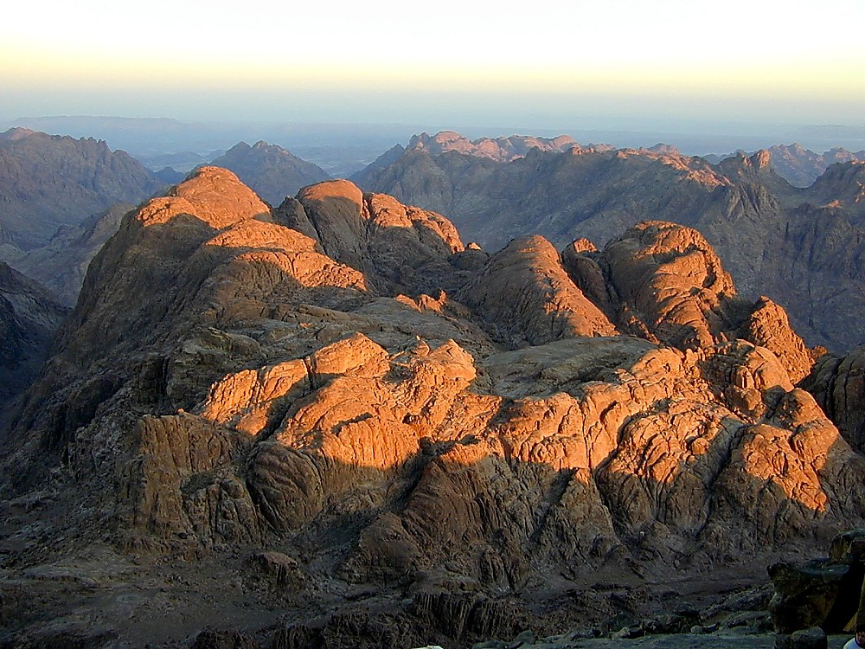
VARENA MOSESLI NGASODA NGAKHEIKHANG KAHAI KHANGARAN
I
II
III
IV
V
VI
VII
VIII
IX
X
KACHAMA TUINGASHIT EINA
SHONGZA LAIRIK:
“MOSESWUI TUINGASHIT”
KHANGARAN HI KATHA?
9.65.05a.
3
©2006 TBBMI
60
Notes:
Now we must journey onto a side road for just a moment.
//// There is another covenant in the Old Testament that you may have thought about already. We must consider it briefly.
//// However, its circumstances and its elements are very different from those in the Abrahamic promises. . IT’S GOD’S SPECIAL ARRANGEMENT WITH MOSES! This covenant is placed in the book of Exodus in the Old Testament…
//// and is called THE MOSAIC COVENANT. However…THE MOSAIC is NOT a part of that Abrahamic contract. What about THIS arrangement?

Slide 63
I
II
III
IV
V
VI
VII
VIII
IX
X
KATAMLI KHANGACHON #15
61
Notes:
In our next session we will work through THE MOSAIC COVENANT with Study Help #15.

Slide 64
62
©2006 TBBMI
9.65.05a.

