Slide 1
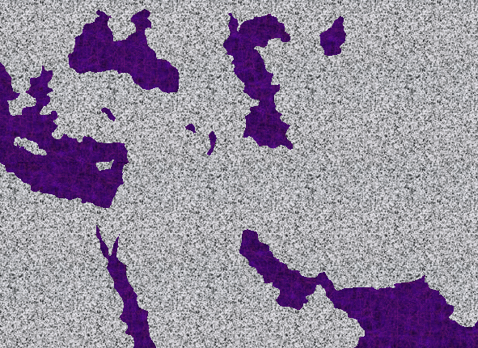
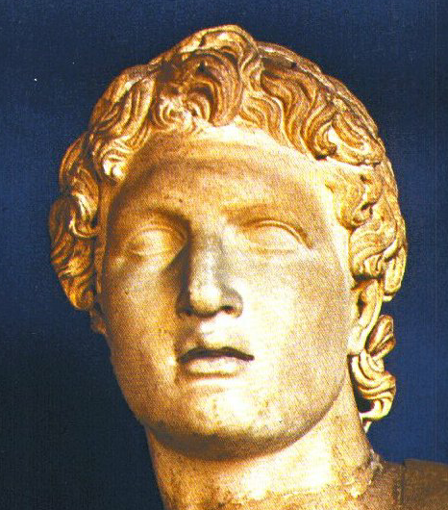
KASHAIKHA
SILENCE
ca. 500 B.C.
KACHAMMA KALA TUINGASHIT KHANI CHIWUI ALUNGLI OTSHOT KASHOK PAMBING.
Alexanderwui Keinung Ngaleibing
OT S NT
ASIA
MEDITERRANEAN NGAYI
ARABIA
AFRICA
Notes:
To this day, the works and accomplishments of Alexander the Great fascinate historians on every continent.
//// Looking at the stage of action between the Testaments – with Study Help #5 –– you realize that this one individual played a central role by preparing the Mediterranean world for the arrival of the Lord Jesus Christ…and for the rest of the planet’s history.

Slide 2


Haokaphok - Esther
7
OKATHUI KASEM
ROTKHAMARAT
1st Mayarnao & Shanao
Wungva-Wungva
1st Morei
350
O
1st Paokapha
350
1st Shimkhur
(1000 B.C.)
1st Sakathat
WUNGNAO
(1000 B.C.)
DT
Tara Kaphong/Changimahut
S - D - S
DT
Tolan
••• KAKAI •••
Atung Azing
(2000 B.C.)
ABRAHAM
(2000 B.C.)
Israel
Judah
10 2
3 MISHANG
KT
Awui KAHO
AT
KT
O 7 V J
AT
MARANBING
N - A - S
20-J 20-R
I - I
200 350
J - E
Assyria Babylon
12
NARKAHAI
7 = 4 + 3
JOSEPH
Kum 700
Rao Kasa
Khaung 3
4 MIKUMO
430
Kum 100 / 50,000
Z - E - N
(1500 B.C.)
MOSES
(1500 B.C.)
(500 B.C.)
Shongza
V
S
VARIKAHAI
Sinai
A - Y - P
Kadesh Barnea
JESU
40
40
NT
Tamkachithei 5
NT
J
JOSHUA
Jericho/Ai
Ngalei Khangayar
01
2
Notes:
//// BIBLE FILEwui …Ithumna OKATHUI KASEM kachil file sem haira…MIKUMO MATI….MISHANG KATHUM…HIBING HI BIBLELI KAZANG VAREWUI TUINGASHIT MATI EINA NGASUNKHUISERA…ara ithum Biblewui khararchan eina ayar shong zat thui haora, kha chiwui otshot bing china Kachamma Tuingashit eina Kathara Tuingashit anili ngasun khuingasakra.
//// Chili ithumna Vari Kahai da kahona.

Slide 3
HAIRAPKAHAI TARIK:
ABRAHAM-JOSEPH 2000 B.C.
MOSES-JOSHUA 1500 B.C.
ROTKHAMARAT-WUNGNAO 1000 B.C.
NARKAHAI-VARI KAHAI 500 B.C.
02
Notes:
Otshot hi 500 B.C. wui atamli shokda khaleina. Rarada khalei otshot shok kahai chi chitheimiga. Mamalai haialu, Okathuli Varena ngaranping kahaina Huikhamiali chihorakhavai…kha zingkhum tarakkha leifaya. Otshot shokda khalei bing china shongfa semmirala? Mha…mathalak eina semmiya! Rakashok chi yanglu.

Slide 4
7
V
O 7 J
(KT) Zingkum 400wui maramli (KT)
Ngasoda Kazat Lairik pg. 38-39
03
2
Notes:
Atam hili VARI KAHAI da kahona…V chi O 7 V kala J.
//// Kachamma eina Kathara Tuingashit alungli zingkum 400 shikha leiya, kha matailak kahaiya khangatei leiya.
//// Ithumwuili leidakhalei Bibleli khangatei Varena Lairik khami maleimana hiwui atamli. Bible kakapi khangatei maleilui mana. Kathara Tuingashitli Matthew Lairikchina vahaokaphok ngasaluiya.
Maran Danielna theivabing hai kasana. Kha, Lairik kagapi maramliva, Biblewui Lairik kagapiliya, VARI KAHAI atam hili ithumli Lairik mikahai maleiluimana.

Slide 5
Malachiwui eina thuilaga Matthew eina tangda
KACHAMMA TUINGASHIT
OKATHUI KASEM
ABRAHAM
ABRAHAM
ABRAHAM
JOSEPH
ABRAHAM
MOSES
JOSHUA
ROTKHAMARAT
WUNGNAO
NARKAHAI
VARI KAHAI
JESU
KADHARA TUINGASHIT
Ngasoda Kazat Lairik pg. 38-39
©2006 TBBMI
04
2
Notes:
Nawui Bible Fileli VARI KAHAI kachili khimamei zangkhala kachichi hibing hina. Kha hi mamalai haialu...Tuingashit khani hiwui alungli ithumna phokkahai VARI KAHAI chisalala, okathuili otshot shokda khalei hiya vari kahai maning mama.
//// Bible File kachi hi Kachamma Tuingashit eina…
//// ….Kathara Tuingashit ani matakli hai kahaina…JESU kachiwuili.

Slide 6
7
VARI KAHAI
ca. 500 B.C.
GREEKWUI ALEX
KT V KT
VARI KAHAI
Greekwui Alex
Ngasoda Kazat Lairik pg. 38-39
05
1
Notes:
VARI KAHAI kachiwui atamhi…500 B.C maikhali haophoka.… chili khararchan khani leiya, Biblewui kala Okathuwui otshot…. Chiwui otshot chi mahorkapaina kachiva chiona ithumli Biblehi mathalak eina phap tangasaka.
//// GREEKWUI ALEX eina haophoksa – maramhi kashakha leilakha mihaora.

Slide 7
7
VARI KAHAI
Greekwui Alex
Phaolak kahaiya Alexander
Ngasoda Kazat Lairik pg. 38-39
06
Notes:
PHAOLAK KAHAIYA ALEXANDERLI kahangna…Greekwui shipai phaomeityhui kachipa china okathui ngacheimiya.

Slide 8
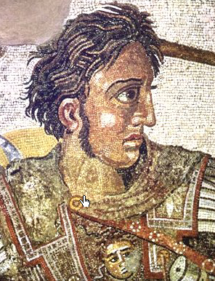
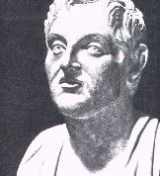
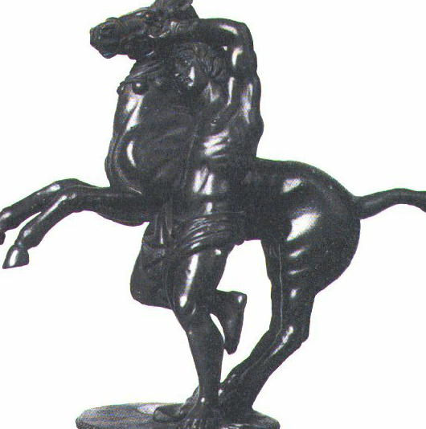
Phaolak kahaiya Alexander
Alexanderna Bucephalasli kharak
VARI KAHAI
Greekwui Alex
Alexwui Oja Aristotle
Ngasoda Kazat Lairik pg. 38-39
07
Notes:
Alexanderwui maramli kachithei: Aristotlena Alexanderli tamchitheiya, kala awui sigui Bucephalusli ngasoda rai tarakkha ana yuikhuiya.

Slide 9
MACEDONIA: ALEXANDER’S BIRTHPLACE
MACEDONIA: ALEXANDERWUI KAPHARA PAM
SILENCE
ca. 500 B.C.
OT S NT
ASIA
MEDITERRANEAN NGAYI
PALESTINE
VARIKAHAI
GREEKWUI ALEX
“HELLENISM”… GREEKWUI ZATKHANA & “GREEK TUI”
ARABIA
Achalakhawui Philippi
AFRICA
Ngasoda Kazat Lairik pg. 38-39
08
5
Notes:
ALEXANDER hi Macedoniali pharaya…Jesu Christa mapharanglakha kum 400 mamangli…
//// …Achalkhawui Philippi kachi chili, Awunga Philipwui naona. Alexanderna okathuili tarakkha khangachei khuira miya. Awui raimi bingna chiwui atamli khalei kachunga apam ngarar khui kahaina.
//// A kum 33li kathi tharan, Alexanderna Europe kala Asiawui ngalei kachunga ngarar khui haowa…Africa Atungwui eina haophoklaga aruihonwui Turkey apam eina tangda, kala aruihonwui Greece Atung eina haophoklaga India vashungda. Kachngkhat pandam kharar hikatha tarakkha maleimana.
//// Kala Alexanderwui rai khangararwui alungli khamataiya hi teolak kahaiya Cannali khalei Israel hina, Romanwui atamli Palestine chihaowa. Abrahamna shimluikat ungkaka pam chili Alexanderna tarakkha khangachei khuramiya.
//// A khavava apamli, Alexanderna Greekwui zatkhana ngayaozata. Awui otshot zaikorawui lunli matailak kahaina khikhala chiyakha…Alexanderna ngararkhui kahai apam bing chili Greekwui zatkhana haimiya…
//// …Paokapha hakashok eina yangsa chiakha: Greek Tui...yarui na khamatui, Koine (KOIN-AY) Greek da hoya.

Slide 10
Otsak 17:16-34
VARI KAHAI
ca. 500 B.C.
GREEKWUI ALEX
Greekbingwui kathem mamalai hai-alu.
VARI KAHAI
GREEKWUI ALEX
Paulva mamalai mana!
Ngasoda Kazat Lairik pg. 38-39
09
1
Notes:
Chiwui vang eina GREEKWUI ALEX da ithumwui Bible Fileli sangkahaina. Pao hakashoka Paulna Miditerraneanwui apam bingli pao hangzat kapai chi Greek Tui hi ngaran haikasa eina kharana.
//// Ithumwui atam hila mamalai haiasa: Greekwui Kathem hi mamailai lakalu. Paulva mamalai mana. Otsakwui Lairik chi pa-akha nana theira Paulna athumli kayakkha khayashi khala kachichi…tangkhamang mangla lungli okthui salala.

Slide 11
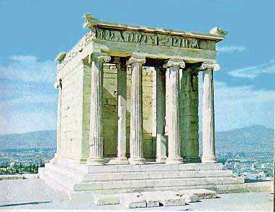
Otsak 17:16-34; Otsak 18
7
VARI KAHAI
ca. 500 B.C.
ALEX THE GREEK
Corinth
VARI KAHAI
GREEKWUI ALEX
Athens: Acropolis apam &
Athena Nikeli khalei khorum khavai shim
Ngasoda Kazat Lairik pg. 38-39
10
Notes:
Greek Tui hi apam katongali khangayao mang maningla…mamalai haialu, Greekwui zatkhanala ngayaova miser kahaina...Greekwui shim kasem kala chikathatha… chamsada: Athenian Acropolis kachi chi kala Nike kachi khorum khavai shim. Achalakhawui Corinth kachi chila…Paulva chili okthuiya…Aruila leida leiya!

Slide 12
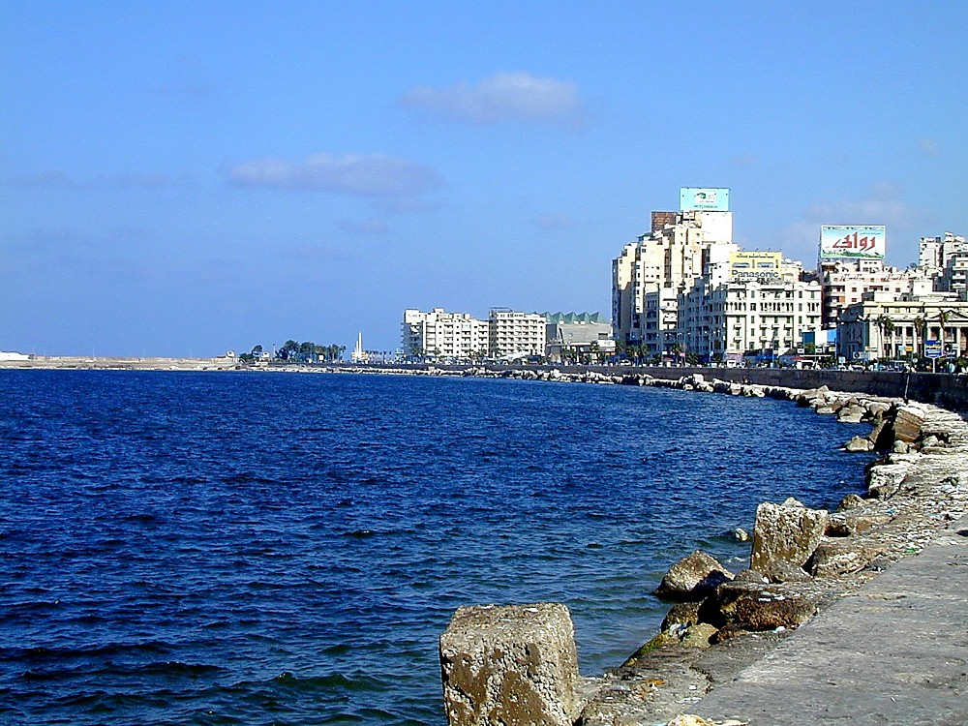
SILENCE
ca. 500 B.C.
Alexanderwui Keinung Ngaleibing
OT S NT
ASIA
MEDITERRANEAN NGAYI
VARI KAHAI
GREEKWUI ALEX
Egyptian Alexandria
ARABIA
AFRICA
Ngasoda Kazat Lairik pg. 38-39
11
2
Notes:
Alexanderwui ngarar khui kahai apam bingli, ana keinung tarakkha semkaya, kala awui khaya samphang khavai awui ming eina hoya.
//// Nilewui ngayiphaeili khalei Egyptwui Alexandria chiya akhaliya.
//// Aruihonwui Alexandria hi leifaya. Mediterraneanwui ngayi pheili khalei keinung hili, Alexanderna phaolak kahai tamkhavai semkamiya.

Slide 13
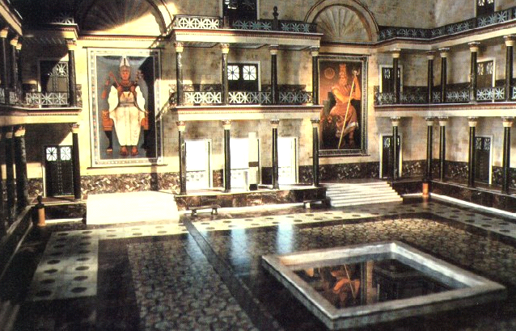
VARI KAHAI
GREEKWUI ALEX
Alexandriali khalei kahaka library
Ngasoda Kazat Lairik pg. 38-39
12
Notes:
Alexandriali khalei library hi achalakhawui kapi kahai athishgurda okathuiwui theikakhui kala chiwui atam rashungda leikhangayi katonga chi chili khaleina. 272 A.D. li kalakashi kahaka akha rashoka, library chi meina chita miser haowa...Greekwui kathemthem bingna kapiser kahai chi zanglaga. Lac phanga kashung naikha shikha lairik kapikahai chuita kahaina, mashankhara kashimana.

Slide 14
LAIRIK #05
SILENCE
ca. 500 B.C.
KACHAMMA KALA TUINGASHIT KHANI CHIWUI ALUNGLI OTSHOT KASHOK PAMBING.
Alexanderwui Keinung Ngaleibing
OT S NT
ASIA
MEDITERRANEAN NGAYI
VARI KAHAI
GREEKWUI ALEX
ARABIA
AFRICA
Ngasoda kazat Lairik pg. 38-39
13
1
Notes:
To this day, the works and accomplishments of Alexander the Great fascinate historians on every continent.
//// Looking at the stage of action between the Testaments – with Study Help #5 –– you realize that this one individual played a central role by preparing the Mediterranean world for the arrival of the Lord Jesus Christ…and for the rest of the planet’s history.

Slide 15
7
Alexander kum...33li... thihaowa 300s BC tamli.
Awui keinung ngayar haowa akhava matina.
GREECE:
ASIA MINOR:
Cassander
Lysimachus
SYRIA:
Seleucus
VARI KAHAI
GREEKWUI ALEX
MEDITERRANEAN NGAYI
LAIRIK #05
EGYPT
Ptolemy
Ngasoda Kazat Lairik pg. 38-39
14
9
Notes:
Alexander kum 33li thi haowa. Hi 300s B.C. atamlina
//// Ana kapi kahai chili awui shipai akhava matili ngayar mirada kapihai...
Mediterranean Ngayi ngalemli khalei zingsho shongwui ngaleibing hi…
//// Greece,
//// Asia Minor,
//// Syria, kala
//// Egypt...
Mediterranean Ngayili leikasa Alexanderna mungsalaga awui shipai akhava bingna mungthui kahaina
//// General Cassanderna Greece kachi pam hi samphanga…
//// Asia Minor hi General Lysimachusna khuiya…
//// Syria hi General Seleucusna samphanga...
//// kala Egypt hi General Ptolemyna samphanga.

Slide 16
7
Alexander kum 33li...thiya...300s BC atamli.
Awui keinung hi shipai akhava matina ngayar-a.
GREECE:
ASIA MINOR:
Casander
Lysimachus
Seleucidwui Atambing
SYRIA:
‘Okathuiwui khamatai apam”
Seleucus
VARI KAHAI
GREEKWUI ALEX
MEDITERRANEAN SEA
PALESTINE
EGYPT
Ptolemaicwui Pharaohbing
Ptolemy
Ngasoda Kazat Lairik pg. 38-39
15
2
Notes:
Kala chiwui alung chili, Palestine kaho pam chili teolak kahai keinung Israel, kum tarakkha rotkhamarat apam – kala naodala chithada hopapamra.
Achalakha atamli apam hili okathuiwui haitong da kahona…Okathuili kakhanuk otsak kashok apamna! Hibinghi hili haophoka:
//// Makapha Syriawui Selucid Awunga bing kala
//// Egyptwui Ptolemaic Pharaoh bing…phaolak kahai Awungva Cleopatra hieina kharana. A hi Greeknao na!
Jehudi bingwui vang keinung khani hina tarakkha hapkhano-a…otshot matailak kahai shok rarada khaleina.

Slide 17
7
APOCRYPHALI KAZANG LAIRIK 15
Protestantbing: Lairikbing hi Varewui eina khara maning mana.
Roman Catholicna 7 mang 1546li maya-a.
1546li
1546li
1546li
(KT) Kum 400 Shikha (KT)
Ngasoda Kazat Lairik pg. 38-39
16
3
Notes:
Kachamma Tuingashit kala Kathara Tuingashit alungli khalei kum 400li otshot kashok lungli hibinghi zanga …
//// …Apocrypha kaho chiwui Larik 15 rashoka. Lairik bing hina chiwui atamwui khararchan thei ngasaka…
//// …Protestant bingna Lairik 15 hi Bibleli masang mana …Varewui tui na makhui mana… Varewui eina kharanada makhui MANA.
//// Roman Catholic bingla Lairik shini mang, shini mang mashunga da athumwui Lairikli sanga…kala chi A.D. century 16 atam mangli kasangna.

Slide 18
7
APOCRYPHALI KAZANG LAIRIK 15 BING CHI
khare Esdras
Kakhane Esdras
Tobit
Judith
Esther Lairikli khangarum bing
Solomonwui Thangkhami Lairik
Ecclesiasticus, Jesu, Sirachwui Nao kala awui
thangkhamei tuibing
Baruch
Jeremiahwui Chithi
Azariahwui Seiha kala
Yaron Kathumwui Laa
Susanna
Bell kala Dragon
Mannassehwui Seiha
Khare Maccabees
Kakhane Maccabees...
VARI KAHAI
GREEKWUI ALEX
Ngasoda Kazat Lairik pg. 38-39
17
1
Notes:
Apocryphal Lairik bingwui aming bing chi hina…Katonga ngarum laga 15na. Chiwui chili Lairik khani hi kannaya: Khare kala Kakhane Maccabees…ani chiwui eina akha…
//// …Khare Maccabees Lairik hina VARI KAHAI atmwui khamatai otshot bing kapi kahai zanga…

Slide 19
7
APOCRYPHALI KAZANG LAIRIK 15
First Esdras
Second Esdras
Tobit
Judith
The Additions to the Book of Esther
The Wisdom of Solomon
Ecclesiasticus, or the Wisdom of Jesus the Son of Sirach
Baruch
The Letter of Jeremiah
The Prayer of Azariah and
The Song of the Three Young Men
Susanna
Bell and the Dragon
The Prayer of Mannasseh
First Maccabees
Second Maccabees...
Hiwui Atamwui vang Achalakha kapikahai Lairik Khani…
VARI KAHAI
Khare Maccabees
GREEKWUI ALEX
Josephusna kapikahai Lairik
Ngasoda Kazat Lairik pg. 38-39
18
Notes:
Chieina…VARI KAHAI atam hiwui maramli achalakha kapikahai Lairik khani lei, chiya: Khare Maccabees…kala…Josephusna kapikahai Lairik. Ngarumlaga, khani Lairik china ithumwui Huikhamiya maphara ranglakha okathui hi kathada leisa khala kachi thei ngasaka.

Slide 20
7
KATAMLI KHANGACHON #05
ALEXANDER AWUNGAWUI ATAM:
ARISTOTLE: ALEXANDERWUI OJA
ARISTOTLE: LAA KASEMA
CHINAWUI KAHAKA PHAKLANG
CHINALI MARI KASING
ALEXANDRIA: GREEK TAMKHAVAI APAM
EUCLID: GEOMETRYWUI OT SAKAHAI
KHARE ROMAN PHEISA
CORINTH: LEI KASAWUI KHAMATAI PAM
EGYPTLI KHALEI JEHUDIWUI LEI APAM
GREEKWUI ZATKHANA & KEINUNG
GREEK-KHARING KHARAK
GREEK TUI
VARI KAHAI
GREEKWUI ALEX
Romanwui Zatkhana
Ngasoda Kazat Lairik pg. 38-39
19
12
Notes:
Kaphaoa Greekwui Alexander atamli shokda khalei otshot aruila chitheida khaleina...
//// ARISTOTLE hi ALEXANDERWUI OJANA
//// ARISTOTLENA laa semkashokna
//// CHINAWUI KAHAKA PHAKLANG semkaya
//// CHINALI MARI SINGA
//// ALEXANDRIA HI GREEKWUI KHAMATAIYA KATAM PAMNA
//// EUCLID: Ana GEOMETRYwui LAIRIK KAPIYA
//// KARE ROMEWUI PHEISA HILI HAOKAPHOKNA
//// CORINTH hi LEILON KHAVAIWUI KHAMATAIYA NGASA HAOWA
//// JEWISHBINGWUI LEI SAKHAVAI APAM EGYPTLI HAOPHOK HAOWA
Kala ...
//// GREEKWUI ZATKHANA kala CHIWUI KEINUNG
Khangateili ngarumlaga
//// GREEKWUI KHARING-KHARAK…kala mataimeithui kachiya…
//// GREEK TUI hi tarakkhana matuiya.

Slide 21
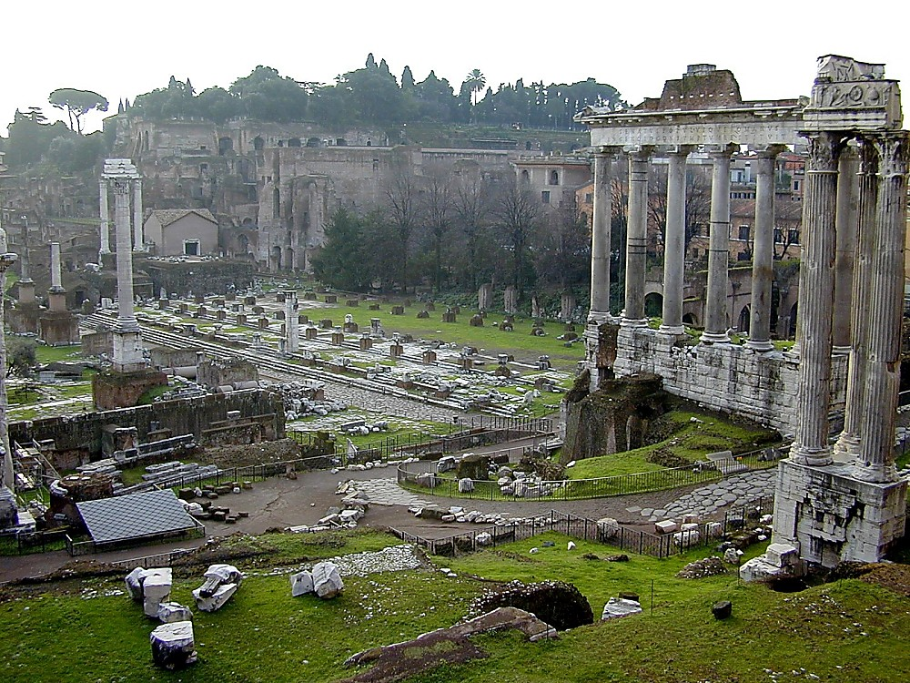
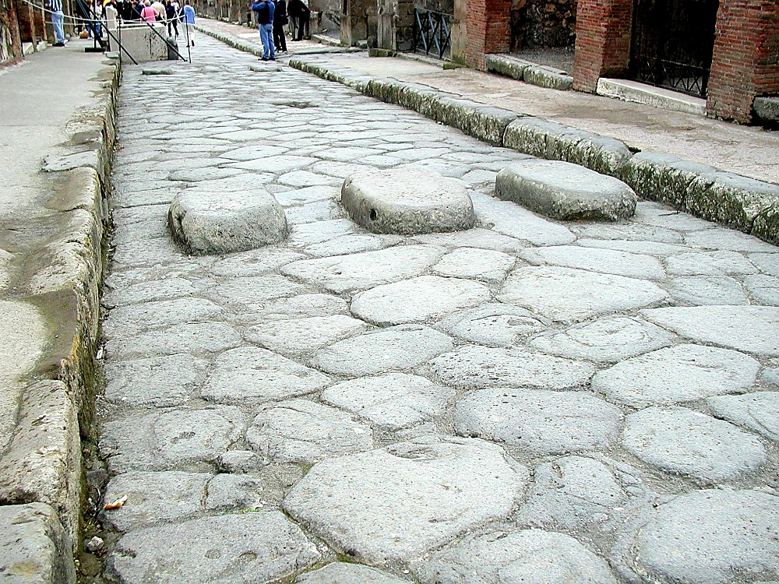
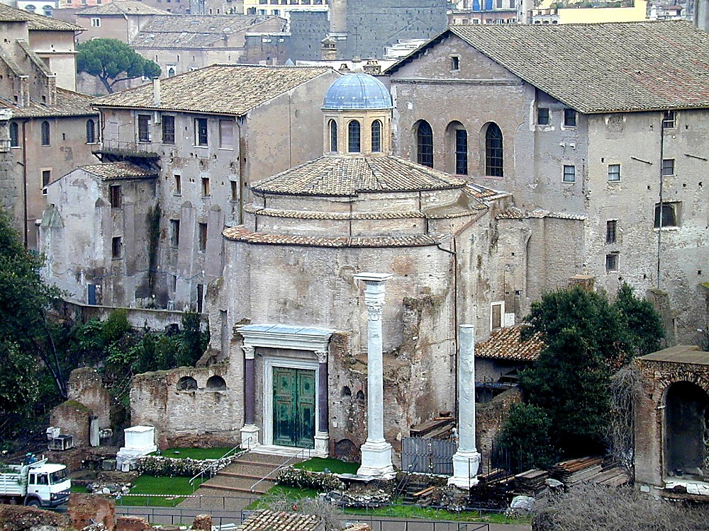
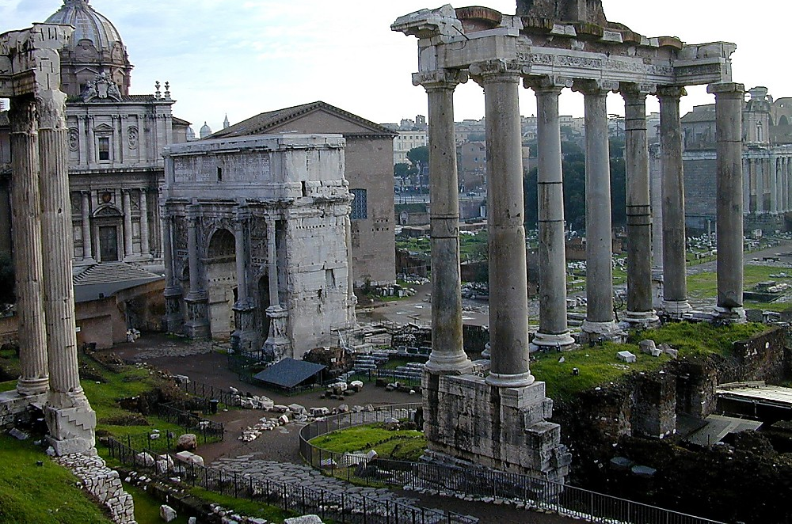
Otsak 28: 11-16
VARI KAHAI
ca. 500 B.C.
GREEKWUI ALEX
ROMANWUI ZATKHANA
Yarui & Shipaiwui Zatkhana
Ain
Pao Mikhangarokwui
Khaung-Khava
Bank kala Kashina
Pax Romana...
VARI KAHAI
GREEKWUI ALEX
Romanwui Zatkhana
Ngasoda Kazat Lairik pg. 38-39
20
6
Notes:
Bible Fileli leifaya VARI KAHAI atam…500 B.C maikhali…..ALEXANDER kanthui kahaiwui thili…ROMAN KEINUNG hi okathuili ROMANWUI ZATKHANA eina razang haowa
//// yarui kala shipaiwui zatkhana,
//// ain,
//// pao mikhangarok,
//// khaung khava,
//// bank maramli kala kashina kashan. Kala kayakkha zakshi salala,
//// Romewui phaolak kahaiya Pax Romana kachi chi, Romewui chingri kahai maramlina, okathui achikun mati peida chingri kahai khamung okathuina mazapkhuia, chi atam eina tangda chithada laei kasana…Zakshilak salala!

Slide 22
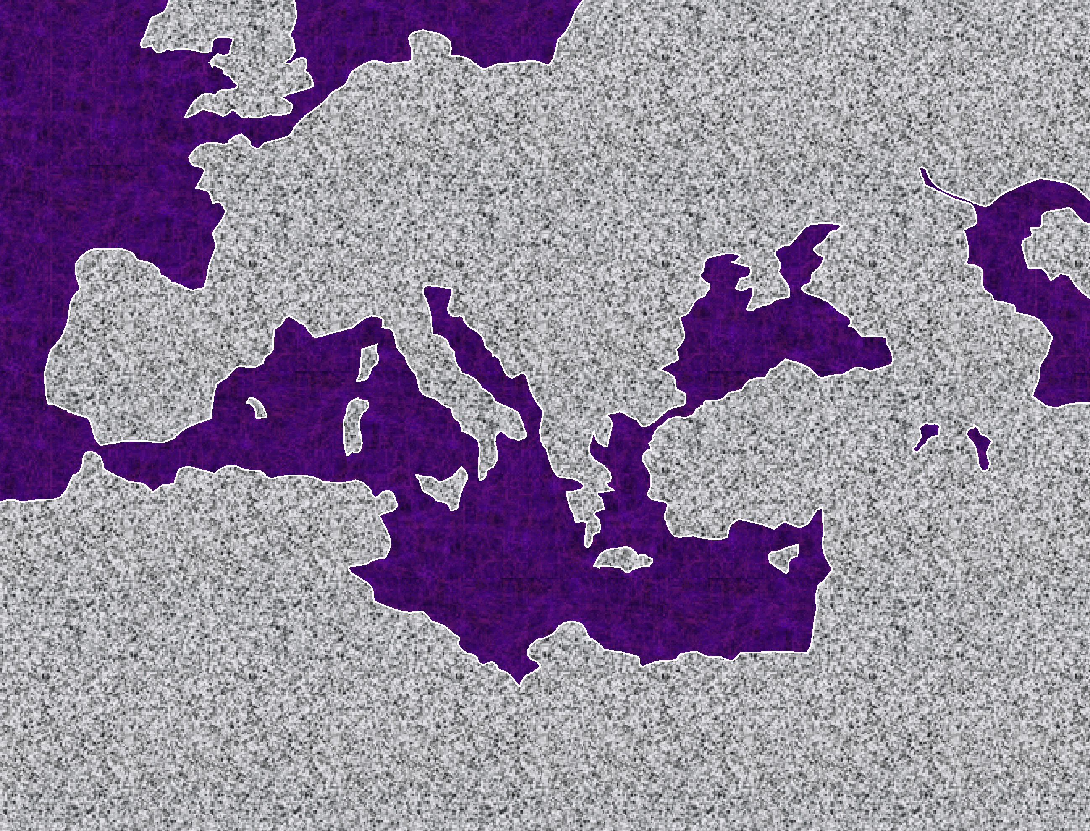

ATLANTIC SHAMADRU
EUROPE
ASIA
ROMAN KEINUNG
Vari Kahai
Greekwui Alex
Romanwui Zatkhana
MEDITERRANEAN NGAYI
PALESTINE
ARABIA
AFRICA
Ngasoda Kazat Lairik pg. 38-39
21
2
Notes:
Roman Keinung hi Englandwui eina haophoklaga Arabia Atungshong eina tangda vashunga, kala
//// Africa Atungshong eina haophoklaga aruihonwui Russia azingshong eina tanga. Rome keinung eina sigui khuilaga thaklag eina zat akha achikun akaha vashung kida hapta mati zangra.
//// Kali keinung hiwui alungli, zingsho kala azingshongwuili khalei rotkhamarat apam chileiya, Palestine da kaho pamna.

Slide 23
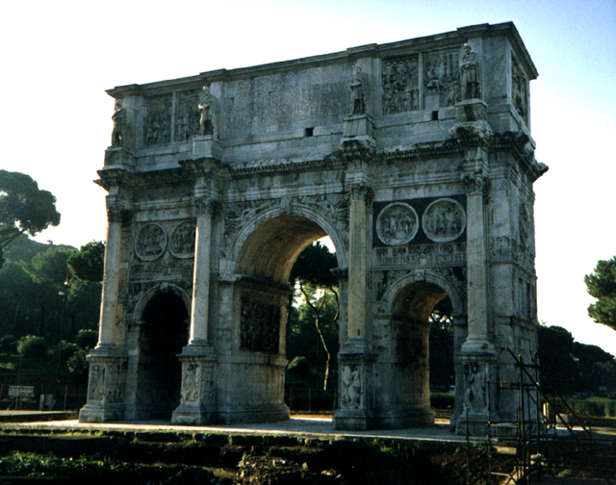
Vari Kahai
Greekwui Alex
Romanwui Zatkhana
Rome: Constantineli Khalei
Ngasoda Kazat Lairik pg. 38-39
22
Notes:
Romewui kathembing kala shipai akhava bingna ngararkhui kahai kala shim katha saka kahai hi ithumna yanglaga matak-khak haiya. Romewui Vareshi Awunga Khare Constatine atamli semkahai Constantineli khalei colossal Arch kachichi arui eina tangdala Romewui Colosieum ngalemli leiya, kala aruila mathalak eina leifaya.

Slide 24
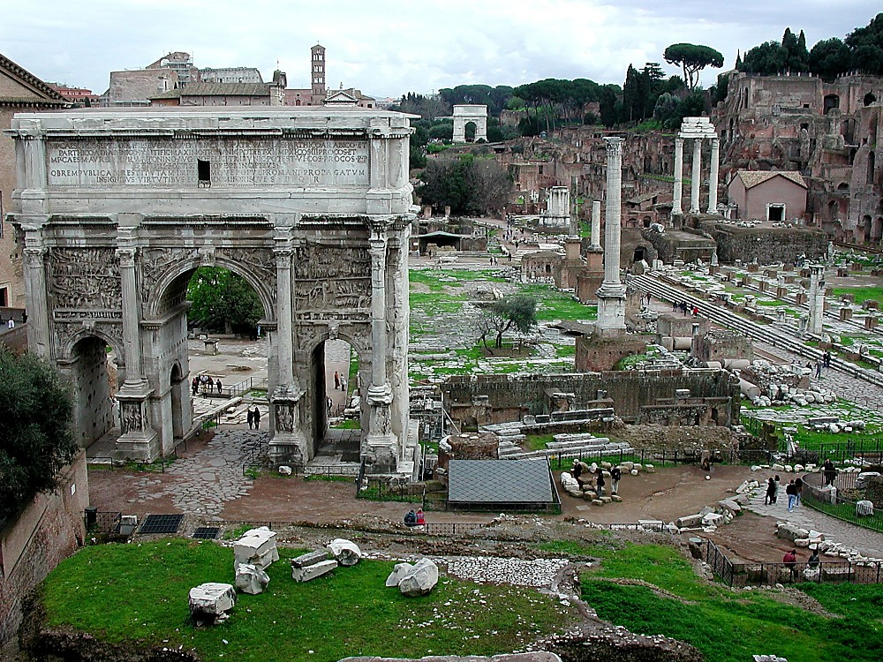
Caesarli Sakathat
Vari Kahai
Greekwui Alex
Romanwui Zatkhana
Rome: Forum Kachi Shongfa
Ngasoda Kazat Lairik pg. 38-39
23
1
Notes:
Romewui Forum kachi hinala ithumli Romewui hak-khamaha kala kayakkha manga vahai sakhala kachi ithumli theikhui ngasaka.
//// Julius Caesarli sakathat pam chi Forum Romanumda hoya kala teolak eina nana theivara.

Slide 25
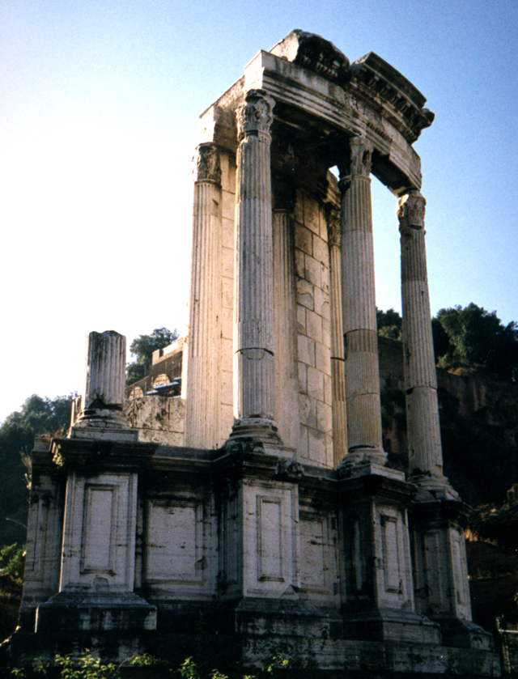
7
Vari Kahai
Greekwui Alex
Romanwui Zatkhana
Rome: Romanwui Pangthem
Ngasoda Kazat Lairik pg. 38-39
24
Notes:
Kum 2000wui thilila Romewui kathembingna semka kahai arui eina tangdala nganingda khalei china khi chithei khala chilaga Romewui kathem kala thangkhamei. Chgina khi chiza khala chiakha okathui hi ara apong tarakkhali manga vangasak haira.

Slide 26
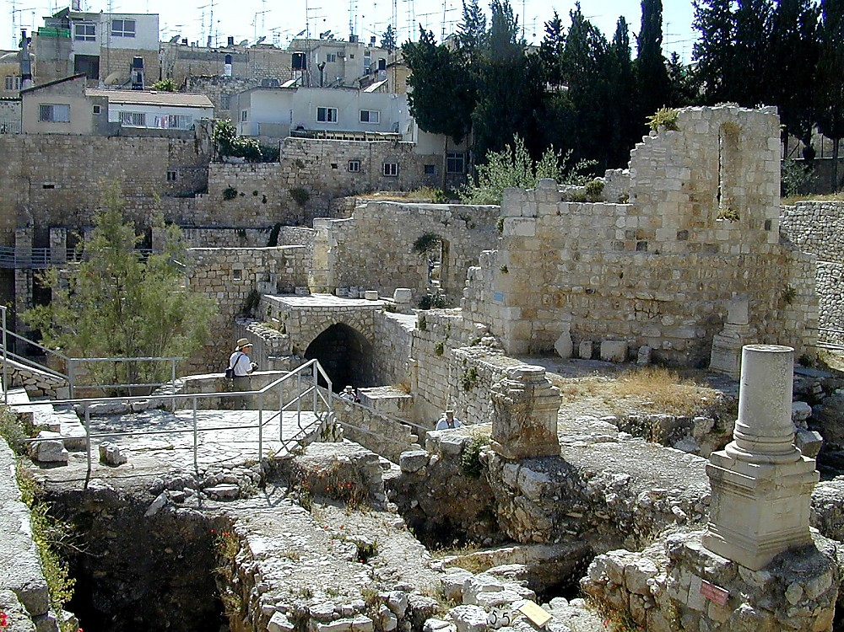
John 5:2
Vari Kahai
Greekwui Alex
Romanwui Zatkhana
Jerusalem: Bethesdawui Pukhri
Ngasoda Kazat Lairik pg. 38-39
25
Notes:
Mediterranean kala Europewui okathui he ROMEWUI kasa khavana tarakkha ngachei mida leiya, awui keinung zanglaga. Jerusalemlila, Bethesdawui pukhri chi phashok haira – Romena kasemna – Paokapha Johnli kapisang kahai Bethesdawui pukhri kharachan chi mathamei kharda phab tangasaka [John 5:2).

Slide 27
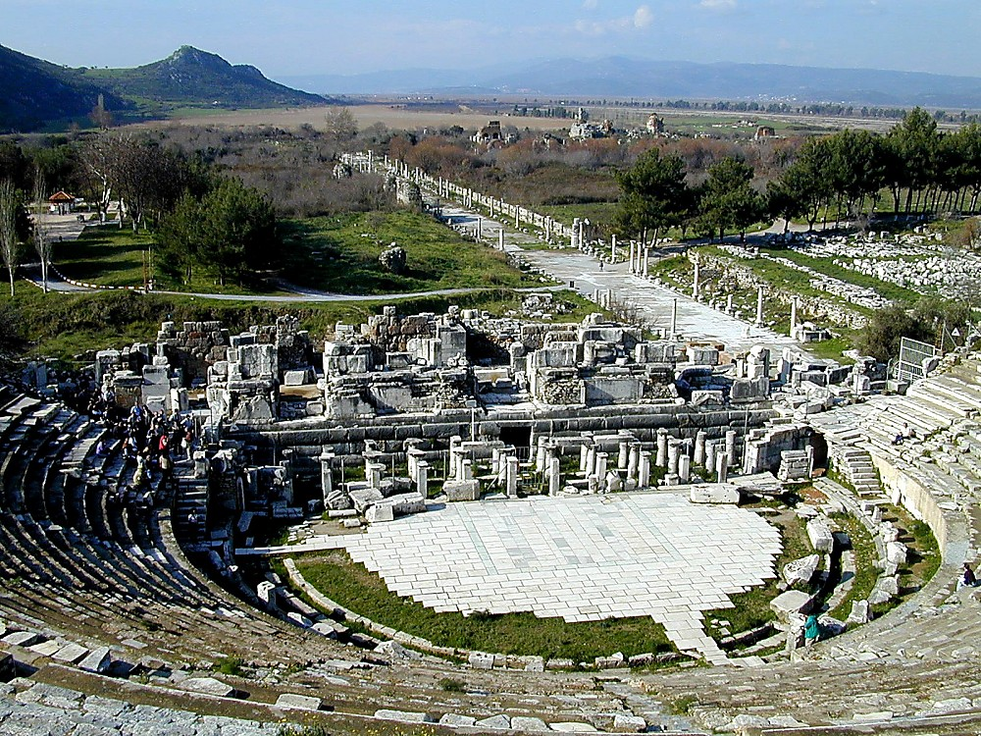
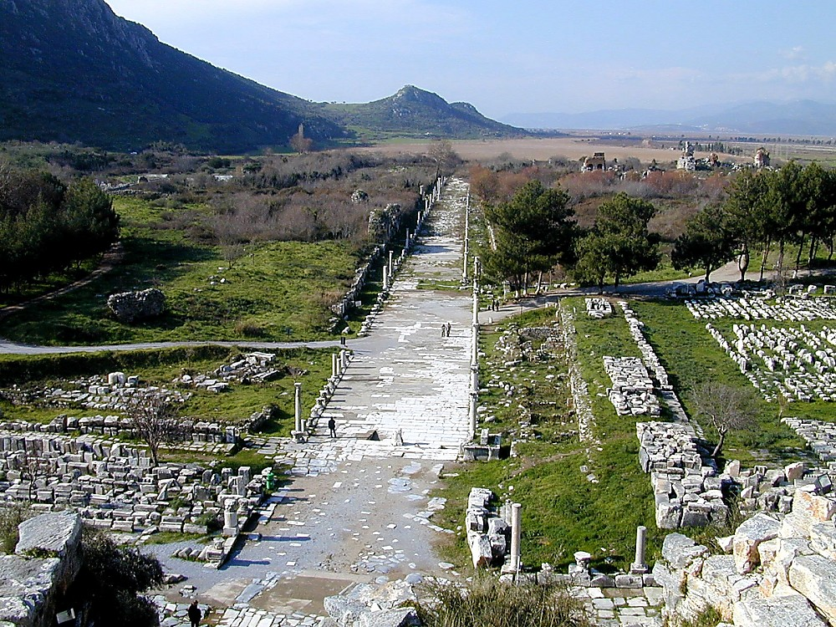
Otsak 19: 23-41
Vari Kahai
Greekwui Alex
Romanwui Zatkhana
Ephesus: (Paulwui) Amphitheater
Ngasoda Kazat Lairik pg. 38-39
26
1
Notes:
Ephesus kaho talak kahai pam chili, aruihon Turkey kaho pam chili, amphitheater kachichi aruila leifaya. Paulna Diana kameowui maramli makhamaya otshot chi hili kashokna.
//// Paulna chiwui eina kongphei chili zat katana Ara, ngalei kala situi na pemhaira.

Slide 28
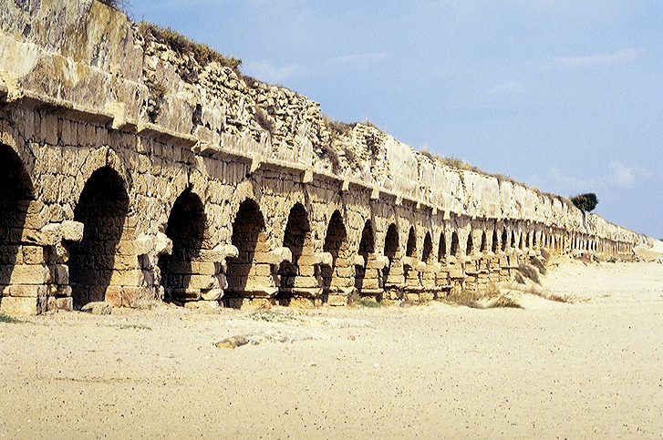
Otsak 18:22
Vari Kahai
Greekwui Alex
Romanwui Zatkhana
Caesarea Maritima, Israel: Romewui Tara Shongfa
Ngasoda Kazat Lairik pg. 38-39
27
Notes:
Mediterraneanwui ngayi pheili, mile 22 tara longzat khavai Romena semka kahai he tekmateilak kahaina. Kaphungwui eina Caesarea kaho keinung chili Romewui engineer bingna tara khuira khavai chithei da khalei ama chi kasemna. Hi Romewui Aungawui ming eina kasemna.

Slide 29
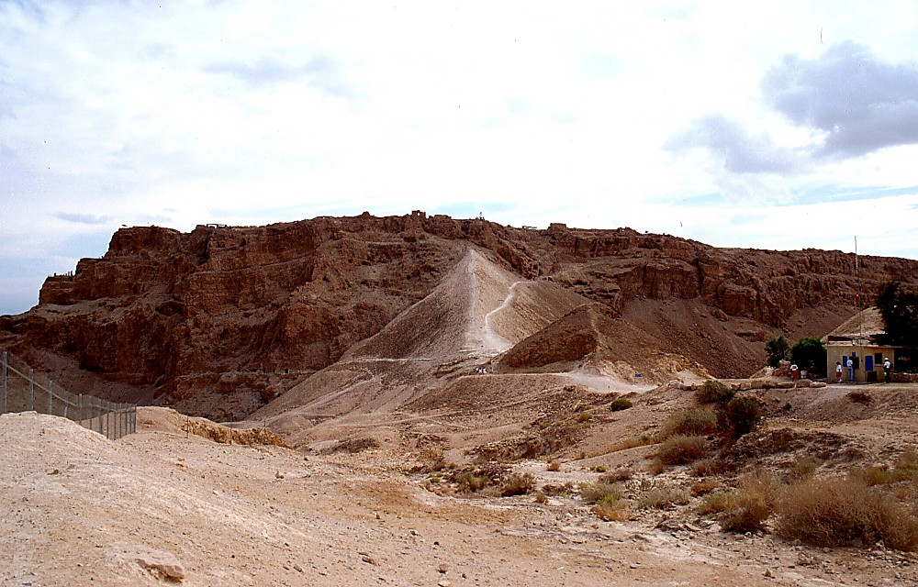
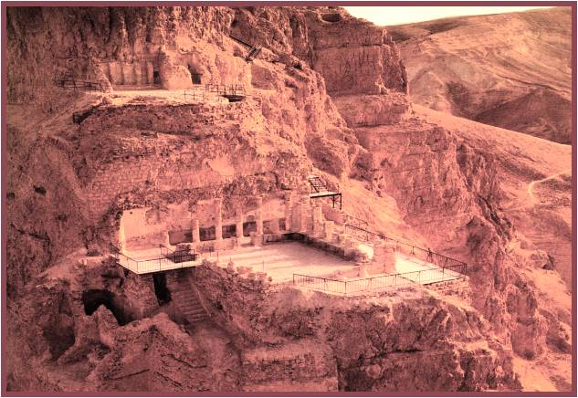
Matt 2:1
VARI KAHAI
Greekwui Alex
Romewui Ngarar Khavai Kuinamlaga Khalei
Romanwui Zatkhana
Ama Kakhuiwui Ningkashi: Massada Ltd. Publishers Givatayim, Israel
Herod Awunga:
Awui Mungkhavai Apam Masada, Israel
28
Notes:
Kala hi...Kaphaoa Herodna Masada apam, Kathi Ngayili ngashanvalaga khalei, mathalak eina kala ngaziplak eina semkahai lungkui kaphung tungli -- Jerusalemwui khangarara bing china apam hieina kum 3wui vang Romewui shipai bingli ngasunga. Kha 73 A.D.li Israelnao 900 athm khalatda sathat ngarok haowa Romewui pangli mathisang mara chiaokida kala athumwui rao masamara da lei kahaiwui vangna Aruihon eina tangdala, Israelwui shipai bing hi shipai katam kuphaida haophok haora chiakha apam hili tuingashit khuiya....Kala chili athumna tui hi hanga, “Mashokngasaklui lak mara!”

Slide 30
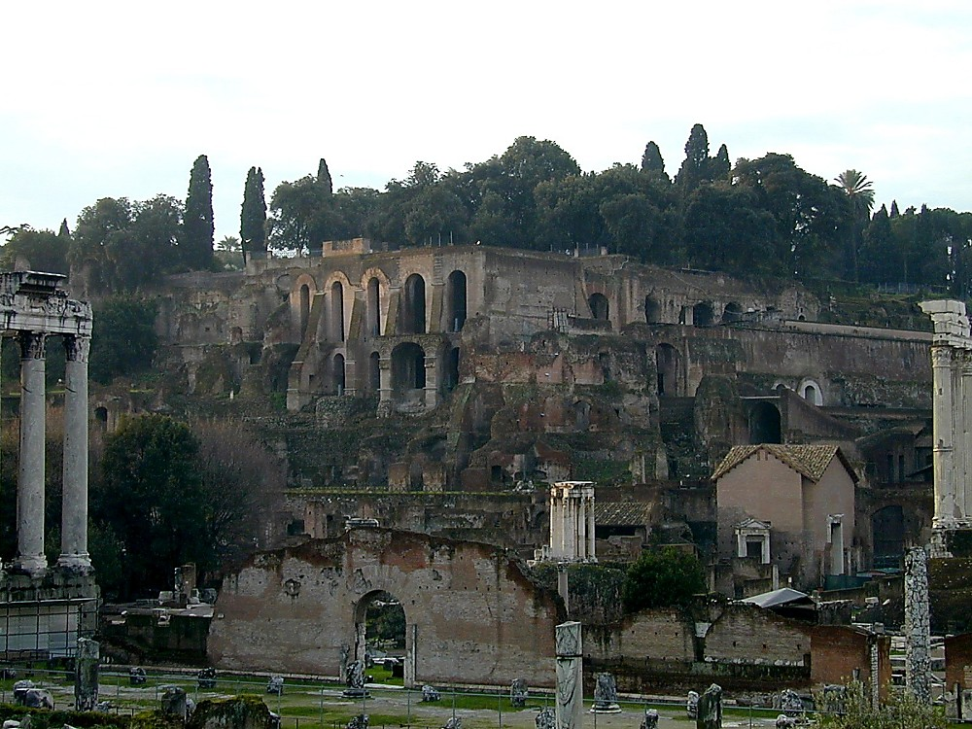
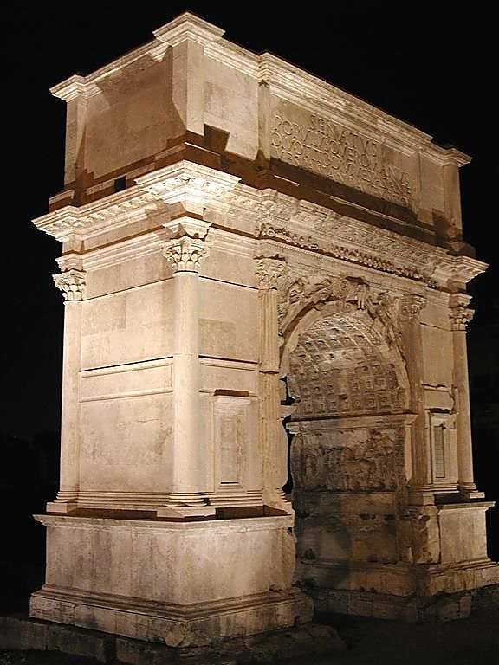
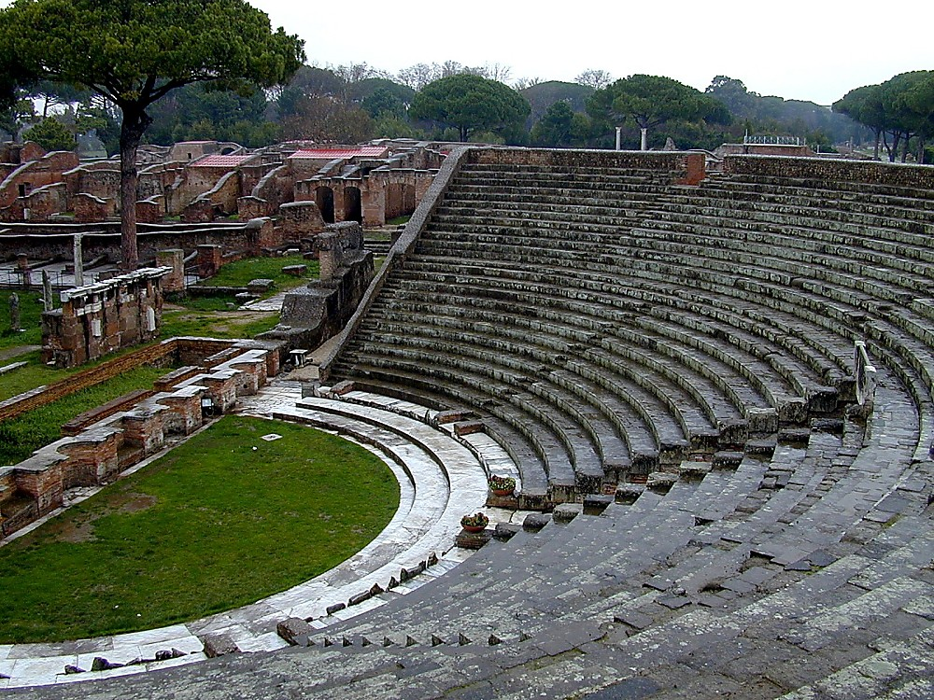
KATAMLI KHANGACHON #05
7
KALA…
ROMEWUI ATAMLI:
SHORKARWUI KHAMUNG
KARI GEAR KASING & TARA KASHIREI
TRIGONOMETRY SEMKASHOK
TARA EINA KAZAT PUNG
ROSETTA KACHI NGALUNGLI KAKAPI
ALEXANDRIA: COLLEGE SEMKAKA
ROMEWUI BANK MA-ONG
SHIM KASEM ARA KATHAR
TARA/KHAMAKHAO ZATKHAVAI; CHEK
LEILON KHAVAIWUI SEMKAKA
KEINUNG PEIDA SHONGFA (53K MIS)
365-THANG CALENDAR HAOKAPHOK
LATIN TUI KEINUNG PEIDA KASING
RAI KASAWUI THEMSAK
PAX ROMANA KACHI CHINGRI KAHAIVANG
ROMENA- KHAMUNG PALESTINE APAM
KAPHAO-A ALEXANDERWUI ATAM:
ARISTOTLE: ALEXANDERWUI OJA
ARISTOTLE: LAA KASEM
CHINAWUI KAHAKA PHAKLANG
CHINALI MARI KASING
ALEXANDRIA: GREEK TAMKHAVAI KHAMATAIYA PAM
EUCLID: GEOMETRY PHAKASHOK
ROMEWUI KHARE PHEISA
CORINTH HI LEILON PAM KHANGASA
JEWISHWUI LEI KASA PAM EGYPTLI
GREEKWUI KASAKHAVA & KEINUNG
GREEKWUI KHARING-KHARAK
GREEK TUI
Ngasoda Kazat Lairik pg. 38-39
29
16
Notes:
Katamli Khangachon #5, Romena khamung atamli kathada leisa khara chiakha chithei kahai bing chi yanglu… hibing hi VARI KAHAI atamli shokser kahai otshotna. Otshot bing hina okathui hi khangachei thik khuiramiya...
//// ROME SHORKARWUI KATHEM KALA KHAMUNG
//// KARI GEAR SING KAPHOK...TARA KASHIREI KASEM
//// TRIGONOMETRY SEMKASHOK
//// TARAEINA KAZAT PUNG
//// ROSETTA KACHI NGALUNGLI KAGAPI
//// ALEXANDRIALI COLLEGE SEMKAKA
//// ROMEWUI BANK MA-ONG
//// SHIM KASEM ARA KATHAR
//// TARA & KHAMAKHAO LONGZAT KHAVAI…CHECK EINA SEMPHOKA
//// LEILON KHAVAIWUI SEMKAKA
//// KEINUNG PEIDA SHONGFA
//// KUM AKHALI 365-ZIMIKSHOWUI CALENDAR SINGKAPHOK
//// LATIN TUI KEINUNG PEIDA KASING
//// RAI KASAWUI THEMSAK
//// PAX ROMANA kachi chi khuiraya hibing hina, kala leiching kachiya
Caesarwui kashat…
//// PALESTINE KAHO ROMENA KHAMUNG KEINUNGNAO CHI

Slide 31
7
KALA…
ROMEWUI ATAMLI:
SHORKAR KHAMUNG
KARI GEAR KASING & TARA KASHIREI
TRIGONOMETRY SEMKASHOK
TARA EINA KAZAT PUNG
ROSETTA KACHI NGALUNGLI KAGAPI
ALEXANDRIA: COLLEGE SEMKAKA
ROMEWUI BANK MA-ONG
SHIM KASEM ARA KATHAR
TARA/KHAMAKHAO ZATKHAVAI; CHECK
LEILON KHAVAWUI SEMKAKA
KEINUNG PEIDA SHONGFA (53K MIS)
365-THANG CALENDAR HAOKAPHOK
LATIN TUI KEINUNG PEIDA KASING
RAI KASA THEMSAK
PAX ROMANA KACHI CHINGRI KAHAIVANG
ROMANNA-KHAMUNG PALESTINE APAM
ALEXANDER AWUNGAWUI ATAM:
ARISTOTLE: ALEXANDERWUI OJA
ARISTOTLE: LAA KASEM
CHINAWUI PHAKLANG KAHAKA
CHINALI MARI KASING
ALEXANDRIA: GREEKWUI KHAMATAIYA KATAM PAM
EUCLID: GEOMETRY PHAKASHOK
ROMEWUI KHARE PHEISA
CORINTH LEILON PAM KHANGASA
JEWISHWUI LEIPAM EGYPTLI KHALEI
GREEKWUI KASA-KHAVA & KEINUNG
GREEK-KHARING-KHARAK
GREEK TUI
Ngasoda Kazat Lairik pg. 38-39
30
Notes:
Ara…Greecena manga vangasak kahai chi Romewui shorkar khamatha kala rai khangarar khamatha chili ngashikda hailu. Kanini chi pandamda kashokwui atam athishurda yangakha…shok khangayi bing hi rashoka!

Slide 32
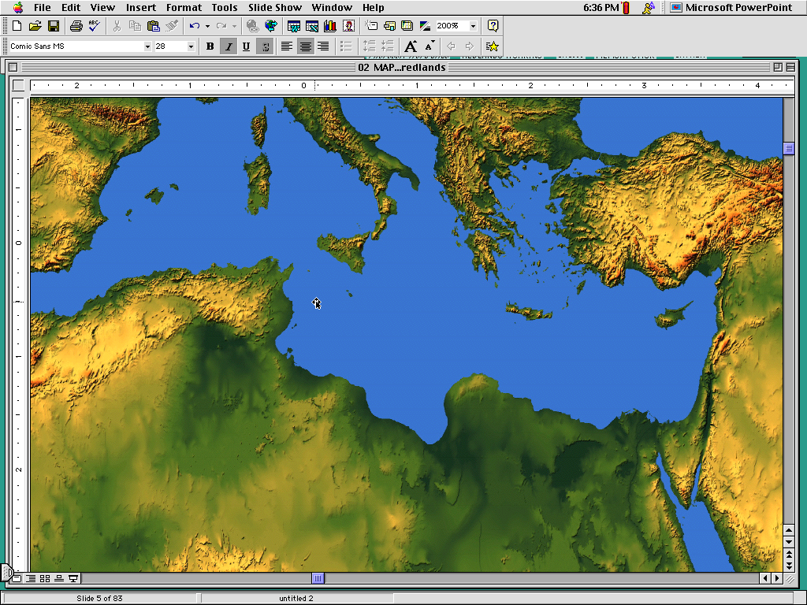
OKATHUI HI NGACHEI CHAO HAIRA!
Ngasoda Kazat Lairik pg. 38-39
03
4
9.65.02.
© 2006 TBBMI
31
Notes:
Kachamma Tuingashit kupkasang eina kum 400 zatkhava hi okathui kachangkhat tarakkha ngachei haira!

Slide 33
KATAMLI KHANGACHON #06
7
“Vari Kahai” Atam
MALACHI KALA MATTHEWWUI MARAKLI
HAKLAK KAHAI MATI MANGA KHAVA:
VARETUI:
OKTHUI OTSHOT:
Hebrew
Canon
Alexander
kachi
Kaphaoa
1. ______ ______ (Kachamma Tuingashit) kapi kup haowa.
3. ___________ _____ ________ Greekwui kasa-khava awui keinung vapeida ngayaomiya.
VARI KAHAI
Greekwui Alex
Romanwui Zatkhana
Romena
2. Kachamma Tuingashit he tuiyur akha eina khalata: _____.
4. Palestine hi khipana mung? ________: chulak kahai _________ kala makapha _______ kahai chi okathuili khuraiya (Pax Romana kachi china).
Greek
themsak
(Septuagint Kachi hi -- “LXX” Lairik chi samphanga)
chingri
…HIBING HINA KUPKASANG ATAM KHUI KHARANA ABRAHAMLI VARENA NGASHIT KAHAI CHI… MESSIAH OKATHUILI KHARA, PROHO JESU CHRISTA!
32
5
Notes:
KATAMLI KHANGACHON #6 –– Kachamma Tuingashitwui Malachi eina Kathara Tuingashitwui Matthew matakli –– ithumna matailak kahaiya ayur mati tamklhuiya Abrahamwui ngashitkhami pheikar eina haophoklaga Christa khara eina tangda…Varetuiwui eina khani, kala Okthui otshotwui eina khani…
//// Khare, Jehudi bingna Hebrew Canon kachihi kupsanghaowa…Kachamma Tuingashitli kazang lairik bingli kahangna…VARI KAHAI atamli kashokna.
//// Kakhane, Hebrew tui eina kapi kahai Kachamma Tuingashit hi Greek Tuili khalatshok haowa, china Bible Tui kakhalat katongawui khamataiya ngasahaowa arui rashungda. Chili SEPTUAGINT da hoya, Romewui kashan mayek eina chili “LXX” dala hoya. Lairik hi acalakhawui Alexandria kachi pamli Bible kathemthem bing 70na khalat kahai Biblena.
//// Kakathumali kala okthui otshot athishurda, KAPHAO-A ALEXANDERNA Greekwui kasa-khava kala Greek Tui hi ngayao miya, Mediterranean ngayipheiwui pam bingli kala kata apam shongla.
//// Khamateli kala khanaowa sada, Israel hi ROMANNA munghaowa kala chiwui atamli THEMSAK hi matailak eina leikasana, kha makhamatha CHINGRI KAHAI tandi eina hai khavai saya keinung achikun mati vapeida.
//// Katonga hi ngarum laga, Abrahamli Varena ngashit kahai chi ungshung khavai ngaranbing haowa, Proho Jesus Christawui khara ngaranbing haowa!

Slide 34
Haokaphok – Esther; kala Malachi eina tangda
7
OKATHUI KASEM
ROTKHAMARAT
1st Mayarnao & Shanao
Wungva-Wungva
1st Morei
350
O
1st Paokapha
350
1st Shimkhur
(1000 B.C.)
1st Sakathat
WUNGNAO
(1000 B.C.)
DT
Tara Kaphong/Changimahut
S - D - S
DT
Tolan
••• KAKAI •••
Atung Azing
(2000 B.C.)
ABRAHAM
(2000 B.C.)
Israel
Judah
10 2
3 MISHANG
KT
Awui KAHO
AT
KT
O 7 V J
AT
MARANBING
N - A - S
20-J 20-R
I - I
200 350
J - E
Assyria Babylon
12
NARKAHAI
7 = 4 + 3
JOSEPH
Kum 700
Rao Kasa
Khaung 3
4 MIKUMO
430
Kum 100 / 50,000
Z - E - N
(1500 B.C.)
MOSES
(1500 B.C.)
(500 B.C.)
Shongza
V
S
VARIKAHAI
Sinai
A - Y - P
Kadesh Barnea
JESU
40
40
NT
Tamkachithei 5
NT
J
JOSHUA
Jericho/Ai
Ngalei Khangayar
33
3
Notes:
Ithu hi ara hili rakup sang haira…ithumna tamlaga phashoklaga hili rashung hair
OKATHUI KASEM…MIKUMO MATI…MISHANG KATHUM…
//// …hibing hi Varetuili kazanga khamataya TUINGASHIT MATIna haingaruma, ABRAHAMWUI TUINGASHIT kala khangatei khangashit kathum chi hieina phang kashokna…Ngaleiwui, Davidwui, kala Kathara Tuingashit.
//// Kala KAPAHOA ALEXANDER na aramwui kasa-khavali khangachei khuikhara kala ROMEWUI zatkhana chi tamkachithei….
//// …ara atam chi semhaira khanaoiwa Bible File thara khalei chi khuishok khavai kala rarada khalei AKHAPA CHI ---Messiah kaho…Awui vang eina khararchan katonga hi mathalak eina hai kahaina Kachamma Tuingashit kala Kathara Tuingashitli.

Slide 35
34
©2006 TBBMI
9.65.03e.

