Slide 1
W
R N
“LONGNAO KATHUM”

Slide 2

Wungva-Wungva - Esther
OKATHUI KASEM
ROTKHAMARAT
1st Mayarnao & Shanao
1st Morei
O
1st Pao Kapha
1st Shimkhur
WUNGNAO
(1000 B.C.)
1st Sakathat
Tara kaphong/changimahut
Tolan shim
ABRAHAM
(2000 B.C.)
3 MISHANG
O 7 V J
Awui KAHO
AT
N - A - S
I - I
J - E
12
NARKAHAI
7 = 4 + 3
JOSEPH
Rao kasa
4 MIKUMO
430
MOSES
(1500 B.C.)
(500 B.C.)
Shongza
V
S
VARI KAHAI
Sinai
A - Y - P
Kadesh Barnea
JESU
40
40
NT
Tamkachithei 5
J
JOSHUA
Jericho/Ai
Ngalei khangayar
01
3

Slide 3
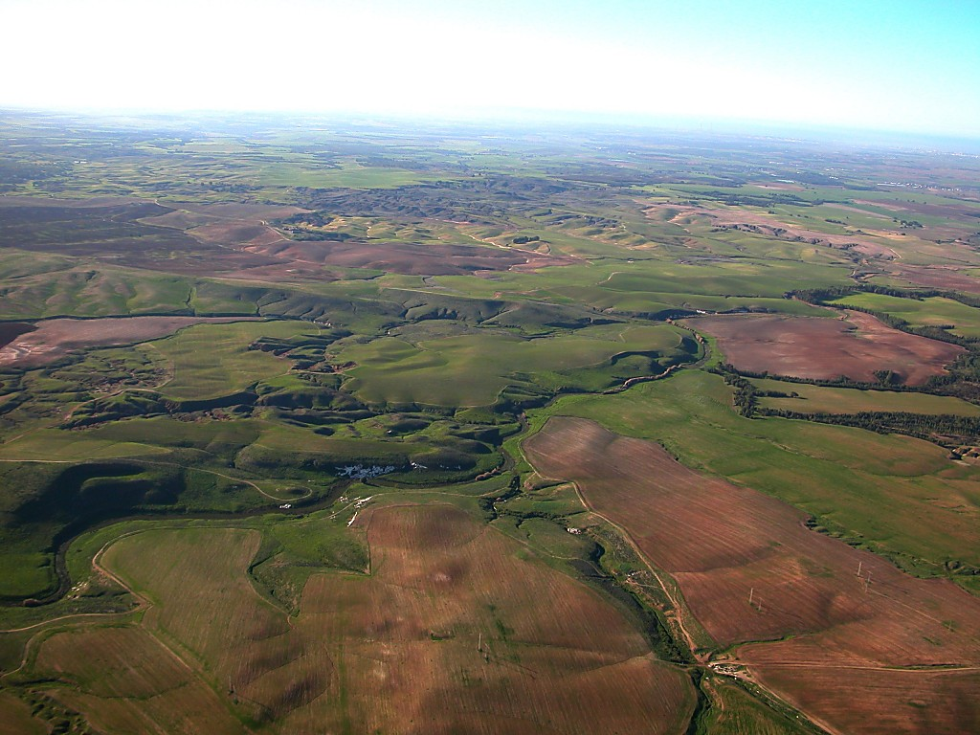
Josh. 14:5; 24:29; Wuv. 17:6
7
Otshot apam ngachei haira...
Ngalei yuikhui haira.
Ngalei ngayar haira.
Joshua kathi.
Yurwui kahaka kathana maleiluimana!
02
4

Slide 4
?
Khangahan akha:
Chitharan NAWUI kaphaningli khi shok-khala….
03

Slide 5
Josh. 14:21
Mediterranean Yirei
ASHER
NAPHTALI
ZEBULON
Galileewui Ngayi
Tabor Kaphung
Carmel Kaphung
ISSACHAR
“Kachichawui mashun ning eina sakhangai sasai.”
Gilboa Kaphung
MANASSEH
MANASSEH
JOSHUA
EPHRAIM
Jericho/Ai
Ngalei khangayar
DAN
BENJAMIN
GAD
JUDAH
Hebron
Machi Ngayi
REUBEN
LEVI: Pan khavai pambing leimaya.
SIMEON..
04

Slide 6
Wuv. 17:6
ASHER
NAPHTALI
Mediterranean Yirei
ZEBULON
Galileewui Ngayi
Tabor Kaphung
ROTKHAMARAT!
Carmel Kaphung
“Kachichawui mashun ning eina sakhangai sasai.”
ISSACHAR
Gilboa Kaphung
MANASSEH
MANASSEH
JOSHUA
EPHRAIM
Jericho/Ai
Ngalei khangayar
DAN
BENJAMIN
GAD
JUDAH
Hebron
Machi Ngayi
REUBEN
SIMEON
LEVI: Pan khavai pambing leimaya.
Ngasoda kazat lairik pg.31-32
05

Slide 7
Wungva-Wungva & Ruth
R W N
OKATHUI KASEM
ABRAHAM
ABRAHAM
ABRAHAM
JOSEPH
ABRAHAM
MOSES
JOSHUA
ROTKHAMARAT
WUNGNAO
NARKAHAI
VARI KAHAI
JESU
Ngasoda kazat lairik pg.31-32
06
9.6.03d.

Slide 8
Wuv. 17:6
ROTKHAMARAT
MISHANG
KATHUM
Chiwui eina
KHAREPA
chi:
ROTKHAMARAT
350
Chiwui atamli yur katongawui tungli khamung maleisamana.
R W N
Ngasoda kazat lairik pg.31-32
07

Slide 9
Wuv. 2:16-19
ROTKHAMARAT
WUNGVA-WUNGVA
ROTKHAMARAT
Wungva-Wungva
350
YURNA VARELI KHAMALAI ATAM!
Ngasoda kazat lairik pg.31-32
08
1

Slide 10
Wuv. 2:16-19
Othniel
Ehud
Shamgar
Deborah & Barak
Jair
Abimelech
Tola
Gideon
Jephthah
Ibzan
Elon
Abdon
Samson
Eli
Samuel
ROTKHAMARAT
Deborah & Barak
WUNGVA-WUNGVA
Nana kathada shankhala kachiwui tungli lei… 13 eina 15 WUNGVA-WUNGVA SHAKHA ACHALAKHAWUI ISRAELLI LEIKASANA
Gideon
ROTKHAMARAT
Wungva-Wungva
350
Samson
Ngasoda kazat lairik pg.31-32
09
1

Slide 11
1 Sam. 7:15
KHA ISRAELWUI
WUNGVA-WUNGVAWUI
NGACHAILI...
KHANAOWA KALA HAKMEIKAP,
KACHI “NGASUNKAKHUI ACHAM-ARAM KHAMATHA,” PACHI...
SAMUEL
ROTKHAMARAT
Wungva-Wungva
350
Ngasoda kazat lairik pg.31-32
©2006 TBBMI
10

Slide 12
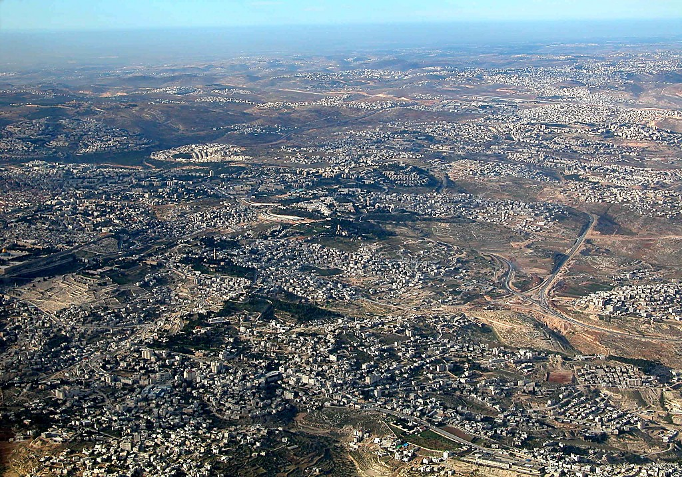
East Jerusalem and Mt of Olives aerial from s
1 Sam. 7:15
1 Sam. 8:4-22
7
Nebi Samwil (Ramahwui ngalemli)
BUT OF THE
MANY JUDGES
OF
ISRAEL...
Samuel: Maran kala Wungvanao; Awui Shim kala Kaphara Apam Jerusalemwui Atungshong
Temple Mount
THE LAST AND GREATEST,
THE “HINGE CHARACTER,” WAS...
SAMUEL
1 Sam. 8:4-19
ANARCHY
Olive Kaphung
Judges
Bethany
350
Dome of the Rock
Jericholi vakhavai shongfa
Ngasoda kazat lairik pg.31-32
11
1
©2006 TBBMI
9.6.03d.

Slide 13
ROTKHAMARAT
WUNGVA-WUNGVA
350
“ITHUM AWUNGA NINGCHANGA”
ROTKHAMARAT
Wungva-Wungva
350
350
“NA KACHANGKHAT EINA CHI SANGAILA?”
Ngasoda kazat lairik pg.31-32
12
2

Slide 14
1 Sam. 9:17
OF THE
13 JUDGES
OF
ISRAEL...
DEBORAH
GIDEON
THE LAST AND GREATEST,
THE “HINGE CHARACTER,” WAS...
ROTKHAMARAT
WUNGNAO
SAMUEL
Ngasoda kazat lairik pg.31-32
13
1

Slide 15
W
R N
“WUNGNAO”
14
2

Slide 16
Haokaphok eina thuilaga 1 Samuel 8:22 eina tangda
OKATHUI KASEM
ROTKHAMARAT
1st Mayarnao & Shanao
Wungva-Wungva
1st Morei
350
O
1st Pao Kapha
350
1st Shimkhur
WUNGNAO
(1000 B.C.)
1st Sakathat
Tara kaphong/changimahut
Tolan shim
ABRAHAM
(2000 B.C.)
3 MISHANG
O 7 V J
Awui KAHO
AT
N - A - S
I - I
J - E
12
NARKAHAI
7 = 4 + 3
JOSEPH
ROTKHAMARAT
Rao Kasa
Wungva-Wungva
4 MIKUMO
350
430
350
MOSES
(1500 B.C.)
(500 B.C.)
Shongza
V
S
VARI KAHAI
Sinai
A - Y - P
Kadesh Barnea
JESU
40
40
NT
Tamkachithei 5
J
JOSHUA
Jericho/Ai
Ngalei khangayar
15
4

Slide 17
HAIRAP KAHAI TARIK KHAMI:
ABRAHAM-JOSEPH 2000 B.C.
MOSES-JOSHUA 1500 B.C.
ROTKHAMARAT-WUNGNAO 1000 B.C.
16

Slide 18
1 Sam. 9:1 wui eina 2 Kings 25:21 eina tangda
R W N
OKATHUI KASEM
ABRAHAM
ABRAHAM
ABRAHAM
JOSEPH
ABRAHAM
MOSES
JOSHUA
ROTKHAMARAT
WUNGNAO
NARKAHAI
VARI KAHAI
JESU
Ngasoda kazat lairik pg.32-37
17
©2006 TBBMI
9.6.03d.

Slide 19
HAOPHOK
KHAVAI
KHANGARAN
MY
N(A)
H
GN
KHOKHA KASA Okathuili Israel hi lan kala khamungli pangshap khaleia akha ngasa haowa!
C
EK
B
J
NK
MN
E
KB
U
SK
PG
RS
Ngasoda kazat lairik pg.32-37
18
1

Slide 20
1 Sam. 9:1
WUNGNAO
ca. 1000 B.C.
MISHANG
KATHUM
Chiwui eina
KAKHANEPA
chi:
WUNGNAO
R W N
Ngasoda kazat lairik pg.32-37
19
1

Slide 21
1 Sam. 15:1; 2 Sam. 2:4; 1 Wungnao 1:39
WUNGNAO
ca. 1000 B.C.
S - D - S
SAUL
R W N
DAVID
WUNGNAO
S - D - S
SOLOMON
Ngasoda kazat lairik pg.32-37
20
4

Slide 22
1 Sam. 16:13-14
WUNGNAO
ca. 1000 B.C.
S - D - S
Saul Awunga: Narkahai mi!
Saulwui mahut shinkhavai Samuel thao neokhavai zathao-a: Bethlehemli khalei Davidli.
Saul Awunga: Narkahai mi!
Saulwui mahut shinkhavai Samuel thao neokhavai zathao-a: Bethlehemli khalei Davidli.
A R C
WUNGNAO
S - D - S
Ngasoda kazat lairik pg.32-37
21

Slide 23
1 Sam. 16:1
WUNGNAO
ca. 1000 B.C.
S - D - S
R W N
WUNGNAO
S - D - S
Bethlehemwui ayar lui akhali David Yao homkazatli Samuelna samphanga.
Ngasoda kazat lairik pg.32-37
22
1

Slide 24
WUNGNAO
ca. 1000 B.C.
Davidwui Tuingashit
S - D - S
DT
2 Sam 7:4-16
1 Thot 17:3-15
R W N
WUNGNAO
S - D - S
Ngasoda kazat lairik pg.32-37
23
1

Slide 25
DAVIDWUI TUINGASHIT
UNGSHUNG PHALUNGKI KACHI APONG KATHUM
2 Samuel 7
¹⁶ Nawui shimkhurla, wungramla iwui mangali leiching ngasakra, nawui wungpamkhong mangatha mara.
shimkhurla
wungramla
leiching
WUNGNAO
S - D - S
wungpamkhong
mangatha mara
Ngasoda kazat lairik pg.32-37
24
5

Slide 26

Abrahamwui Tuingashit
(“Awui Kaho”)
Haokaphok 12: 1-3
NGALEI
ATHA
SOKHAMI
Ngalei
Davidwui
Khalatlui
30:1-10
2 Samuel
7:4 -16
Ngasoda kazat lairik pg.32-37
25

Slide 27
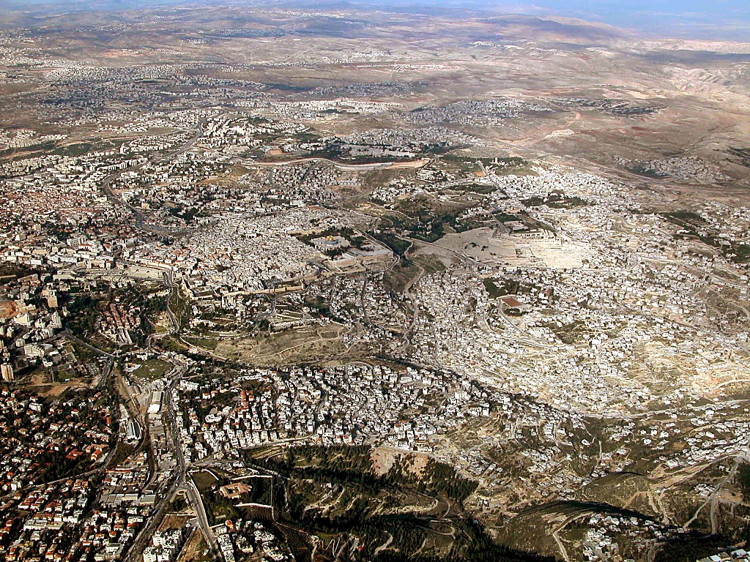
Jerusalem area aerial from south
2 Sam. 24:18-24; 2 Thot. 3:1
Jerusalem: Temple Mount chili azingshong eina Yangkashang
26
1
©2006 TBBMI
9.6.03d.

Slide 28
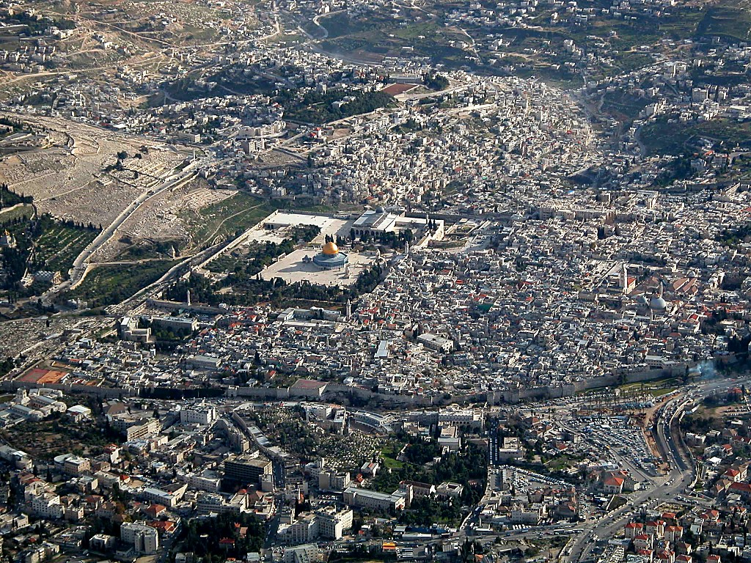
Old City aerial from north
2 Sam. 24:18-24; 2 Chron. 3:1
Temple Mount kachi pam chi: Okathuina ningkasang Jerusalemwui khamataiya pam
9.6.03d.
27
©2006 TBBMI

Slide 29
2 Sam. 24:18-24; 2 Thot. 3:1
Achalakhawui Ranpum pam
Araunahwui ranpumli (luili)…
Davidna lokhui haowa…
Prohowui Shim KHARE semka khavai!
Moriah Kaphung tungli!
28
5
©2006 TBBMI
9.6.03d.

Slide 30

1 Wungnao 5:5
WUNGNAO
S - D - S
David Awungana ngaran-a.
Kha…awui nao Solomonna semki kachina!
Ngasoda kazat lairik pg.32-37
29
1

Slide 31
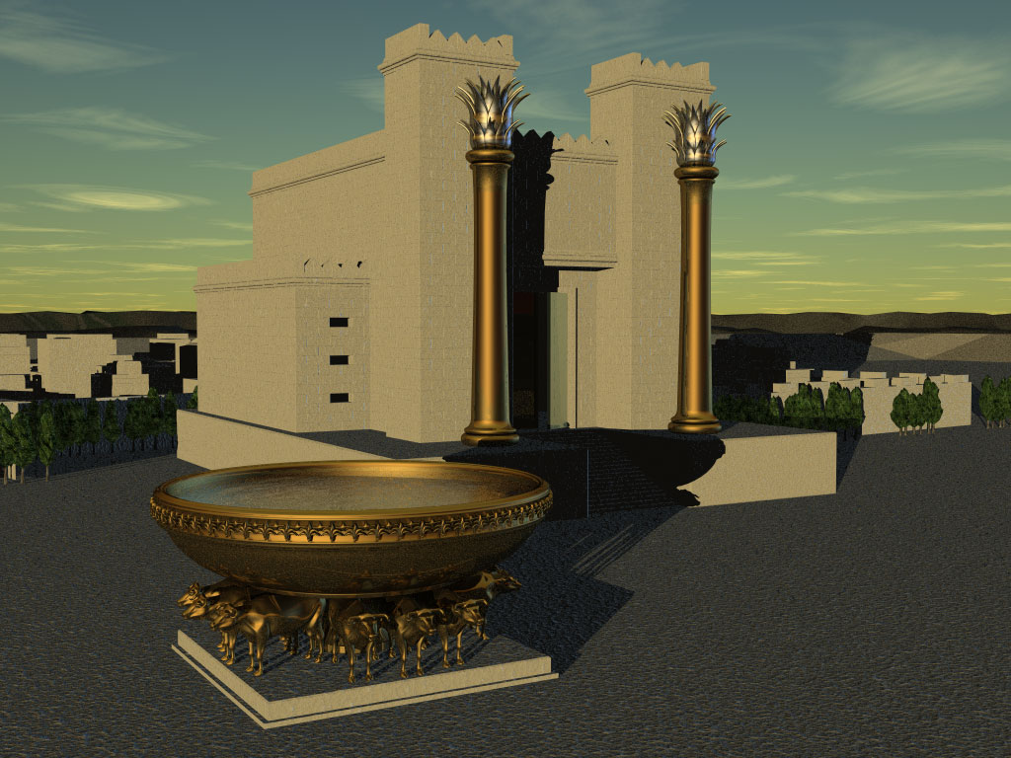
1 Wungnao 5:5
WUNGNAO
S - D - S
Israelwui “Khare” Vareshim
Ngasoda kazat lairik pg.32-37
30

Slide 32
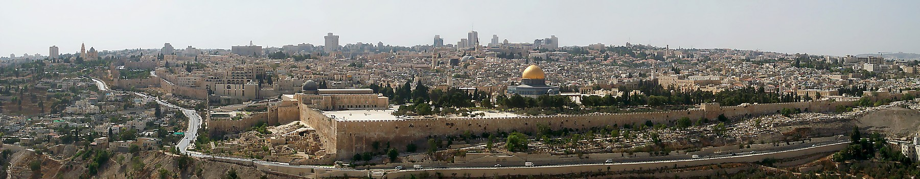
1 Wungnao 6:14-38
Aruihon Jerusalemwui Temple Mount
Abrahamna Isaacli chikat khavai kasa apam…
Moriah Kaphung… Zion Kaphung
ACHALAKHA KATHADA SEMKHALA?
LIGHTWUI AKAP BINGLA MALEISA MANA!
COMPUTERLA MALEISA MANA!
WUNGNAO
S - D - S
SCALELA MALEISA MANA!
PANG-OT MANG LEISAYA!
Ngasoda kazat lairik pg.32-37
31
6

Slide 33
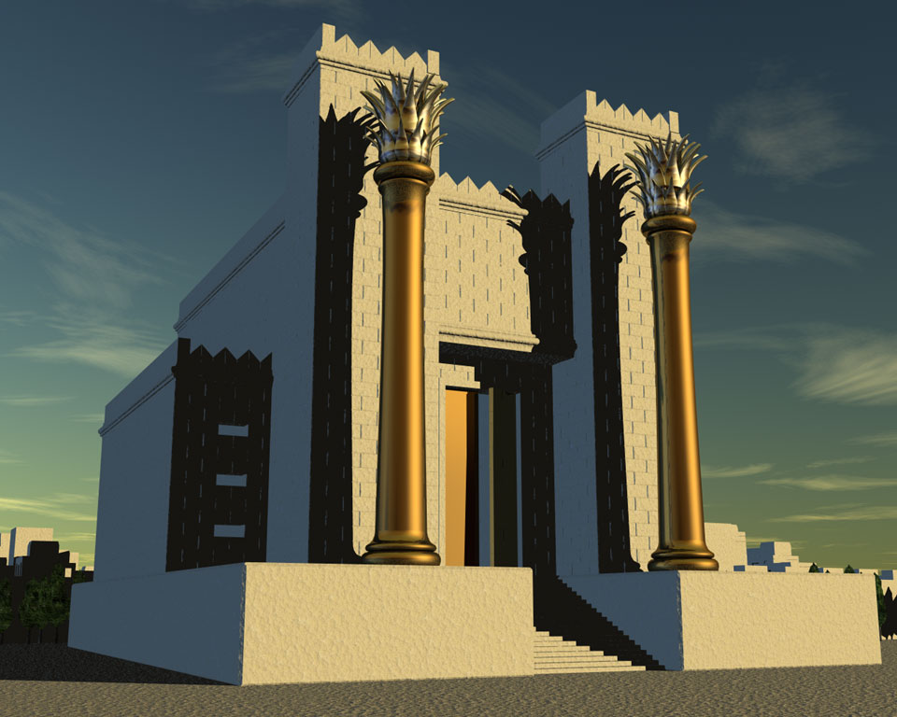
1 Wungnao 6:14-38
Aruihon Jerusalemwui Temple Mount
Abrahamna Isaacli chikat khavai kasa apam…
Moriah Kaphung… Zion Kaphung
Tekmateilak kahai shim binghi kasem!
Zingsho shongwui “Wailing Wall” kachi chi
Herodwui “Kakhane” Vareshim Jesuwui atamli leikasa
Solomon-na kasem “Khare” Vareshim
Aruihon Islamwui ‘Dome of the Rock’
Ngasoda kazat lairik pg.32-37
32
6

Slide 34
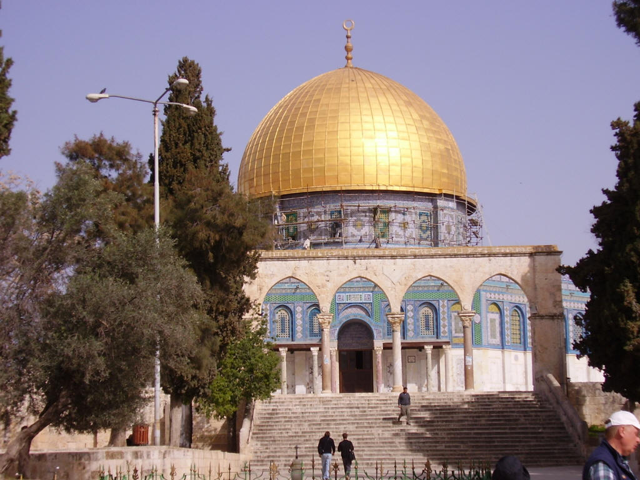
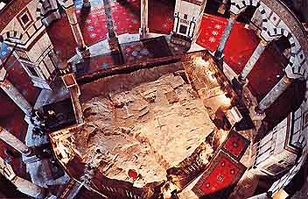
Aruihon Jerusalemwui Temple Mount
Dome of the Rockwui alungli
Temple Mount kachi tungli Dome of the Rock
Ngasoda kazat lairik pg.32-37
32a
1

Slide 35
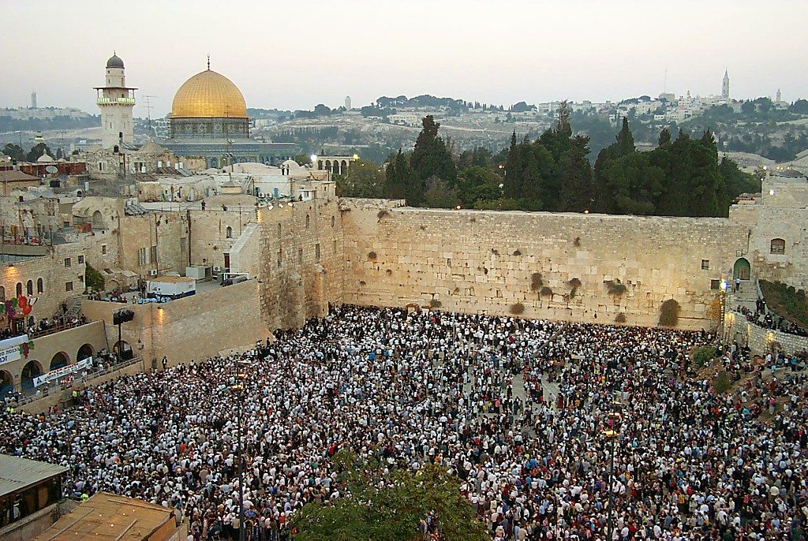
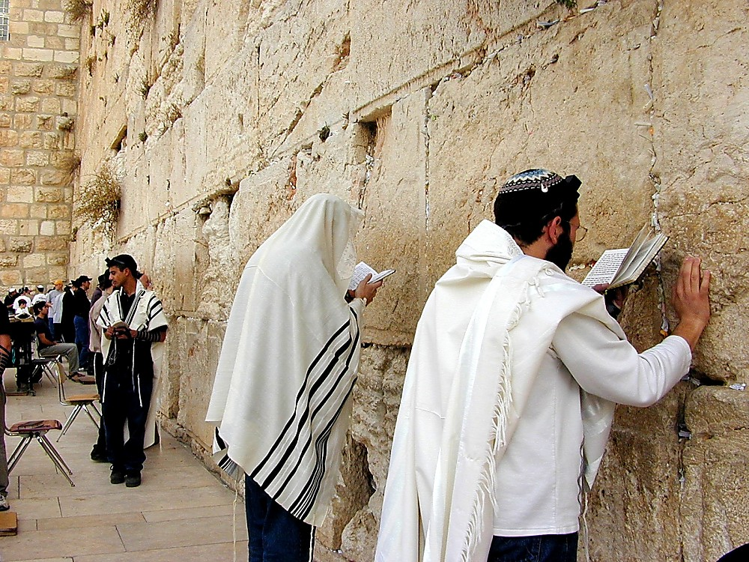
1 Wungnao 6:14-38
Wailing Wall kachi chili seiha kasa
WUNGNAO
S - D - S
Temple Mountwui Zingsho shongwui phaklang
Ngasoda kazat lairik pg.32-37
33
1

Slide 36
1 Wungnao 6:14-38; Matt 21:12-17
TEMPLE MOUNT KACHIWUI KHAMATAIYA KANKHANA BING!
• Manglarin
• Vare-rin
• Yur-rin
• Ngalei pam
WUNGNAO
S - D - S
• Khanaowa Atam
Ngasoda kazat lairik pg.32-37
34
6

Slide 37
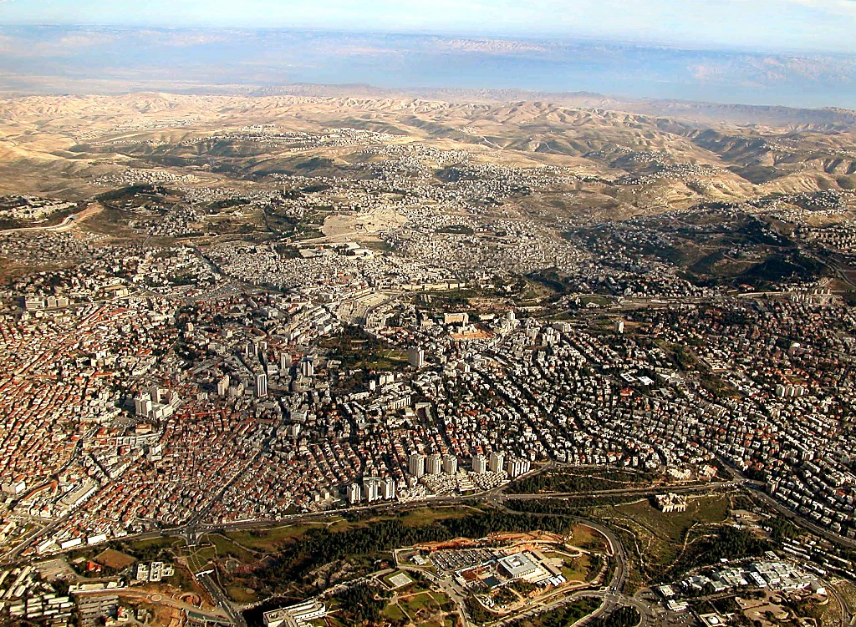
1 Wungnao 6:14-38; Matt 21:12-17
Temple Mount aruihonwui Jerusalemli khalei: Okathuiwui khamataiya otshot apam
Ngasoda kazat lairik pg.32-37
35

Slide 38
WUNGNAO
ca. 1000 B.C.
S - D - S
DT
2 Sam 7: 4-16
1 Thot 17:3-15
R W N
WUNGNAO
S - D - S
SOLOMON: KAPHANING HAKLAKA!
MARAM KAHAK: AMAN RUNRAN HAIRA.
Ngasoda kazat lairik pg.32-37
36
6

Slide 39
1 Wungnao 9, 10, 11
WUNGNAO
ca. 1000 B.C.
S - D - S
DT
Shim kasem!
Khashina kachung!
Lupa kankahai!
Meomali khokharum!
2 Sam 7: 4-16
1 Thot 17:3-15
R W N
WUNGNAO
S - D - S
Ngasoda kazat lairik pg.32-37
37
4

Slide 40
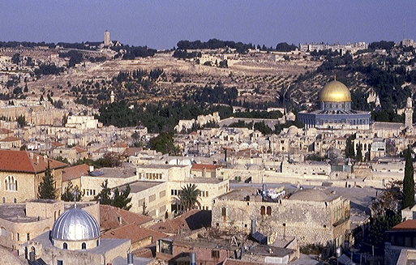
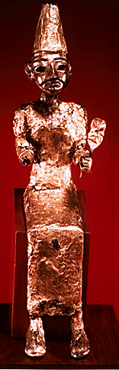

1 Wungnao 11:4-13
ROYALTY
Olive Kaphung
ca. 1000 B.C.
S - D - S
DC
2 Sam 7: 4-16
1 Thot 17:3-15
A R C
Temple Mount
WUNGNAO
S - D - S
MEOMALI KHOKHARUM!
Ngasoda kazat lairik pg.32-37
38
4

Slide 41
1 Wungnao 12:25 wui eina 14:31 eina tangda
ROYALTY
ca. 1000 B.C.
S - D - S
DT
<<<< KAKAI >>>>
ATUNG AZING
2 Sam 7: 4-16
1 Thot 17:3-15
R W N
ISRAEL JUDAH
10 2
WUNGNAO
S - D - S
••• KAKAI •••
Atung Azing
Israel
Judah
10 2
Ngasoda kazat lairik pg.32-37
39
3

Slide 42
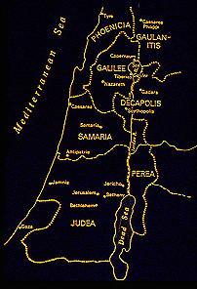
1 Wungnao 12:25 eina thuilaga 14:31 eina tangda
ATUNGSHONGWUI KEINUNG:
ISRAEL
Y i r e i
SHANG 10
SAMARIA
WUNGNAO
S - D - S
••• KAKAI •••
JERUSALEM
Atung Azing
SHANG 2
Israel
Judah
10 2
AZINGSHONGWUI KEINUNG:
JUDAH
Ngasoda kazat lairik pg.32-37
40
1

Slide 43
1 Wungnao 17-22; Isaiahwui eina thuilaga Malachi eina tangda
WUNGNAO
ca. 1000 B.C.
S - D - S
DT
<<<< KAKAI >>>>
ATUNG AZING
2 Sam 7: 4-16
1 Thot 17:3-15
R W N
ISRAEL JUDAH
10 2
WUNGNAO
MARANBING
S - D - S
••• KAKAI•••
Atung Azing
Israel
Judah
10 2
MARANBING
Ngasoda kazat lairik pg.32-37
41

Slide 44
Isaiahwui ena thuilaga Malachi eina tangda
MALACHI
MICAH
WUNGNAO
ca. 1000 B.C.
EZEKIEL
S - D - S
ZEPHANIAH
DANIEL
<<<< KAKAI >>>>
ZECHARIAH
ATUNG AZING
JEREMIAH
ISRAEL JUDAH
AMOS
HABAKKUK
JOEL
10 2
MARANBING
WUNGNAO
S - D - S
HAGGAI
••• KAKAI •••
Atung Azing
OBADIAH
Israel
Judah
ELISHA
10 2
MARANBING
ELIJAH
ISAIAH
HOSEA
NAHUM
JONAH…
Ngasoda kazat lairik pg.32-37
42

Slide 45
WUNGNAO
ca. 1000 B.C.
S - D - S
DT
<<<< KAKAI >>>>
ATUNG AZING
2 Sam 7: 4-16
1 Thot 17:3-15
R W N
ISRAEL JUDAH
10 2
KT
WUNGNAO
MARANBING
Kadhar Tuingashit
S - D - S
••• KAKAI •••
Atung Azing
Israel
Judah
10 2
Jer 31: 31-33
MARANBING
Ngasoda kazat lairik pg.32-37
43

Slide 46
Jeremiah 31
KADHAR TUINGASHIT
Judahwui shimkhurli
kala Israelwui shimkhurli
³¹ ‘Yanglu, Judahwui shimkhurli
kala Israelwui shimkhurli ina
khangashit kadhar akha sakhavai
atam rarali,’ da Prohona hanga.
WUNGNAO
S - D - S
••• KAKAI •••
Atung Azing
Israel
Judah
10 2
MARANBING
MESSIAH NGASHIT KAHAINA!
Ngasoda kazat lairik pg.32-37
44
3

Slide 47
Abrahamwui Tuingashit
(“Awui Kaho”)
Haokaphok 12: 1-3
WUNGNAO
NGALEI
SOKHAMI
S - D - S
NGALEI
ATHA
SOKHAMI
ATHA
••• KAKAI •••
Atung Azing
Israel
Judah
Ngalei
Davidwui
Kadhar
10 2
MARANBING
Khalatlui
30:1-10
2 Samuel
7:4 -16
Jeremiah
31:31-33
Handbook pg. 32-37
45
5

Slide 48
1 Wungnao 12 wui eina thuilaga 2 Kings 24 eina tangda
WUNGNAO
ca. 1000 B.C.
S - D - S
DT
<<<< KAKAI >>>>
ATUNG AZING
2 Sam 7: 4-16
1 Thot 17:3-15
R W N
ISRAEL JUDAH
10 2
KT
WUNGNAO
MARANBING
S - D - S
••• KAKAI •••
Atung Azing
20-J 20-R
Israel
Judah
10 2
Azing: Rehoboam
MARANBING
Atung: Jeroboam
20-J 20-R
AWUNGA KHAMATHA MALEI MANA
AWUNGA KHAMATHA KHALEI
Ngasoda kazat lairik pg.32-37
46
2

Slide 49
2 Wungnao 17:6
WUNGNAO
ca. 1000 B.C.
S - D - S
DT
<<<< KAKAI >>>>
ATUNG AZING
2 Sam 7: 4-16
1 Thot 17:3-15
R W N
ISRAEL JUDAH
10 2
KT
WUNGNAO
MARANBING
S - D - S
••• KAKAI•••
Atung Azing
20-J 20-R
Israel
Judah
Jer 31: 31-33
10 2
200
MARANBING
20-J 20-R
200
ASSYRIA
Assyria
Ngasoda kazat lairik pg.32-37
47

Slide 50
HAOPHOK
KHAVAI
KHANGARAN
2 Wungnao 17:6
MY
N(A)
H
GN
C
EK
B
J
NK
WUNGNAO
MN
S - D - S
••• KAKAI •••
E
Atung Azing
ATUNGSHONGWUI KEINUNG:
ISRAEL (722 B.C.)
JEHUDINAO CHAIYANG KAHAI
Israel
Judah
KB
U
10 2
MARANBING
20-J 20-R
200
Assyria
MS
PG
RS
Ngasoda kazat lairik pg.32-37
48
1

Slide 51
HAOPHOK
KHAVAI
KHANGARAN
MY
Kha chithalala… AZINGSHONGWUI Keinungva?
N(A)
H
GN
C
EK
B
J
NK
WUNGNAO
MN
S - D - S
BABYLONNA ASSYRIALI YUIKHUI HAOWA!
••• KAKAI •••
E
Atung Azing
Israel
Judah
KB
U
10 2
MARANBING
20-J 20-R
200
Assyria
SK
PG
RS
Ngasoda kazat lairik pg.32-37
49
2

Slide 52
2 Wungnao 25
WUNGNAO
ca. 1000 B.C.
S - D - S
DT
<<<< KAKAI >>>>
ATUNG AZING
2 Sam 7: 4-16
1 Thot 17:3-15
R W N
ISRAEL JUDAH
10 2
KT
WUNGNAO
MARANBING
S - D - S
••• KAKAI •••
Atung Azing
20-J 20-R
Israel
Judah
Jer 31: 31-33
10 2
200
350
MARANBING
20-J 20-R
350
200
ASSYRIA
BABYLON
Assyria
Babylon
Ngasoda kazat lairik pg.32-37
50

Slide 53
HAOPHOK
KHAVAI
KHANGARAN
2 Wungnao 25: 1-21
MY
N(A)
H
GN
C
EK
B
J
NK
ROYALTY
MN
S - D - S
••• KAKAI •••
E
Atung Azing
Israel
Judah
KB
U
10 2
AZINGSHONGWUI KEINUNG:
JUDAH (586 B.C.)
BABYLONNA TUKTHUI KAHAI
MARANBING
20-J 20-R
350
200
Assyria
Babylon
SK
PG
RS
Ngasoda kazat lairik pg.32-37
51
2

Slide 54
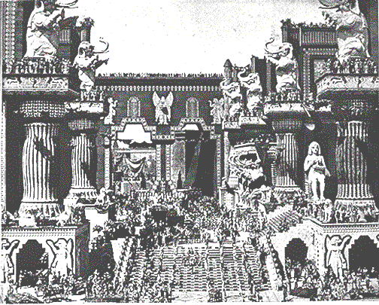
2 Wungnao 25: 1-21
WUNGNAO
S - D - S
••• KAKAI •••
Atung Azing
Israel
Judah
10 2
MARANBING
20-J 20-R
350
200
Assyria
Babylon
Achalakhawui Babylon Keinung
“Intolerance” kachi amawui eina kakhuina
Ngasoda kazat lairik pg.32-37
52

Slide 55
Haokaphokwui eina thuilaga Nehemiah eina tangda
OKATHUI KASEM
ROTKHAMARAT
1st Mayarnao & Shanao
Wungva-Wungva
1st Morei
350
O
1st Pao Kapha
350
1st Shimkhur
(1000 B.C.)
1st Sakathat
WUNGNAO
(1000 B.C.)
Tara kaphong/changimahut
S - D - S
DT
Tolan Shim
••• KAKAI •••
3 MISHANG
Atung Azing
(2000 B.C.)
ABRAHAM
(2000 B.C.)
Judah
Israel
Awui KAHAO
AT
10 2
O 7 S J
N - A - S
MARANBING
I - I
20-J 20-R
KT
J - E
200 350
Assyria Babylon
12
NARKAHAI
7 = 4 + 3
JOSEPH
WUNGNAO
Rao kasa
S - D - S
4 MIKUMO
••• KAKAI •••
430
Atung Azing
MOSES
(1500 B.C.)
Israel
Judah
V
VARI KAHAI
(500 B.C.)
10 2
Shongza
S
MARANBING
Sinai
20-J 20-R
350
A - Y - P
200
Kadesh Barnea
JESU
Assyria
Babylon
40
40
NT
Tamkachithei 5
J
JOSHUA
Jericho/Ai
Ngalei Khangayar
53

Slide 56
N
R W
“NARKAHAI”
Ngasoda kazat lairik pg.37-38
54
1

Slide 57
2 Wungnao 25:21 wui eina thuilaga Ezra 1:3 eina tangda
R W N
OKATHUI KASEM
ABRAHAM
ABRAHAM
ABRAHAM
JOSEPH
ABRAHAM
MOSES
JOSHUA
ROTKHAMARAT
WUNGNAO
NARKAHAI
VARI KAHAI
JESU
Ngasoda kazat lairik pg.37-38
55
©2006 TBBMI
9.6.03d.

Slide 58
HAIRAP KAHAI TARIK KHAMI:
ABRAHAM-JOSEPH 2000 B.C.
MOSES-JOSHUA 1500 B.C.
ROTKHAMARAT-WUNGNAO 1000 B.C.
NARKAHAI-VARI KAHAI 500 B.C.
56

Slide 59
HAOPHOK
KHAVAI
KHANGARAN
Isaiah 9:6-7
Yangluishitsa…
MY
N(A)
H
GN
C
EK
B
J
NK
MN
JUDAHLI NGAKMIYA!
E
KHIWUIVANG?
KB
U
SK
Kaja: Messiah hi Judahwui shangnao eina rara kachi maran hairasaya.
PG
RS
Ngasoda kazat lairik pg.37-38
57
8

Slide 60
2 Wungnao 25:21
NARKAHAI
MISHANG
KATHUM
Chiwui eina
KAKATHUMA
pachi:
NARKAHAI
R W N
Ngasoda kazat lairik pg.37-38
58

Slide 61
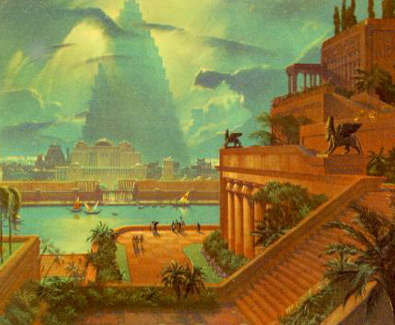
Daniel 1
Achalakha Babylon kaho Keinung
NARKAHAI
Euphrates Kong
Babylonwui Hanging Gardens
Ngasoda kazat lairik pg.37-38
59

Slide 62
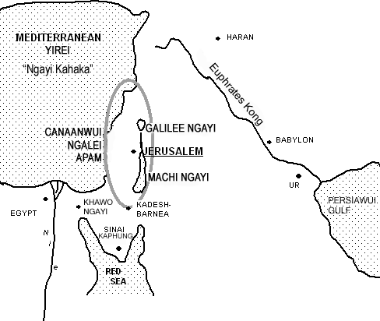
NARKAHAI
OTSHOT KASHOK APAM
Ngasoda kazat lairik pg.37-38
60

Slide 63
Jer. 29:10; Ezra 3:8; Neh. 2:5-6
NARKAHAI
KUM 70
KHAUNG 3
R W N
NARKAHAI
Kum 70
Khaung 3
“JEHUDIWUI”
“JEWS”
“SYNAGOGUE”
“SYNAGOGUE”
Ngasoda kazat lairik pg.37-38
61
3

Slide 64
HANKHA-UNG 3 SHIDA
R W N
NARKAHAI
Kum 70
Khaung 3
OTSHOT KASHOK APAM
Ngasoda kazat lairik pg.37-38
62

Slide 65
Ezra 1 eina 2
NARKAHAI
ZINGKUM 70
KHAUNG 3
R W N
KUM 100 / 50,000
NARKAHAI
Kum 70
Khaung 3
Kum 100 / 50,000
Ngasoda kazat lairik pg.37-38
63

Slide 66
Ezra 1:4
50,000 HANUNGA!
KHA TARAKKHA MAUNGMANA HANKHAUNG BINGLI LAN EINA NGACHON KHAVAI.
NARKAHAI
Kum 70
Khaung 3
Kum 100 / 50,000
Ngasoda kazat lairik pg.37-38
64
1

Slide 67
Jer. 29; Ezra 3; Neh. 2
ZERUBBABEL
NARKAHAI
EZRA
KUM 70
KHAUNG 3
R W N
KUM 100 / 50,000
Z - E - N
NARKAHAI
NEHEMIAH
Kum 70
Khaung 3
Kum 100 / 50,000
Z - E - N
Ngasoda kazat lairik pg.37-38
65
4

Slide 68
Neh. 3
ZERUBBABEL…Vareshim semphok khavai hanunga.
ZERUBBABEL
NARKAHAI
Z-E-N
KUM 70
EZRA
EZRA…Prohowui ain tamchithei khavai hanunga.
KHAUNG 3
KUM 100 / 50,000
PANGMON KATHANA KATHUM
Z - E - N
NARKAHAI
NEHEMIAH
Kum 70
NEHEMIAH…Kachama Tuingashitwui kathana akha sada phakho eina veikhur semka khavai hanunga .
Khaung 3
Kum 100 / 50,000
Z - E - N
Ngasoda kazat lairik pg.37-38
66
3

Slide 69
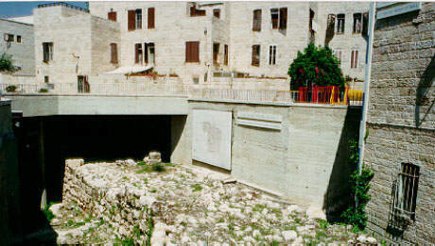
Neh. 3:8
Jerusalem: Nehemiahwui Phakho
NARKAHAI
Kum 70
Khaung 3
Kum 100 / 50,000
Z - E - N
Ngasoda kazat lairik pg.37-38
67

Slide 70
HAOPHOK
KHAVAI
KHANGARAN
MY
ISRAEL
N(A)
H
JUDAH
GN
C
EK
B
J
NK
NARKAHAI
MN
Kum 70
Kachama Tuingashit ungkakupli Israel chaoyang haowa; Judah hanung haowa.
Khaung 3
E
100 Years / 50,000
Kum 100 / 50,000
U
Z - E - N
KB
Messiah ngashit kahaina “atam ungkashung chitharan.”
Messiah ngashit kahaina “atam ungkashung chitharan.”
Messiah ngashit kahaina “atam ungkashung chitharan.”
SK
PG
RS
Ngasoda kazat lairik pg.37-38
68
3

Slide 71
Haokaphokwui eina thuilaga Esther eina tangda
OKATHUI KASEM
ROTKHAMARAT
1st Mayarnao & Shanao
Wungva-Wungva
1st Morei
350
O
1st Pao Kapha
350
1st Shimkhur
(1000 B.C.)
1st Sakathat
WUNGNAO
(1000 B.C.)
Tara kaphong/changimahut
S - D - S
DT
Tolan Shim
••• KAKAI •••
Atung Azing
(2000 B.C.)
ABRAHAM
(2000 B.C.)
Judah
Israel
10 2
3 MISHANG
O 7 S J
Awui KAHO
AT
MARANBING
N - A - S
20-J 20-R
I - I
200 350
KT
J - E
Assyria Babylon
12
NARKAHAI
7 = 4 + 3
JOSEPH
Kum 70
NARKAHAI
Rao Kasa
Khaung 3
Kum 70
4 MIKUMO
430
Kum 100 / 50,000
Khaung 3
Z - E - N
100 Years / 50,000
(1500 B.C.)
Kum 100 / 50,000
MOSES
(500 B.C.)
Z - E - N
Shongza
V
S
VARI KAHAI
Sinai
A - Y - P
Kadesh Barnea
JESU
40
40
NT
Tamkachithei 5
J
JOSHUA
Jericho/Ai
Ngalei Khangayar
69
1

Slide 72
70
9.6.03d.

