Slide 1
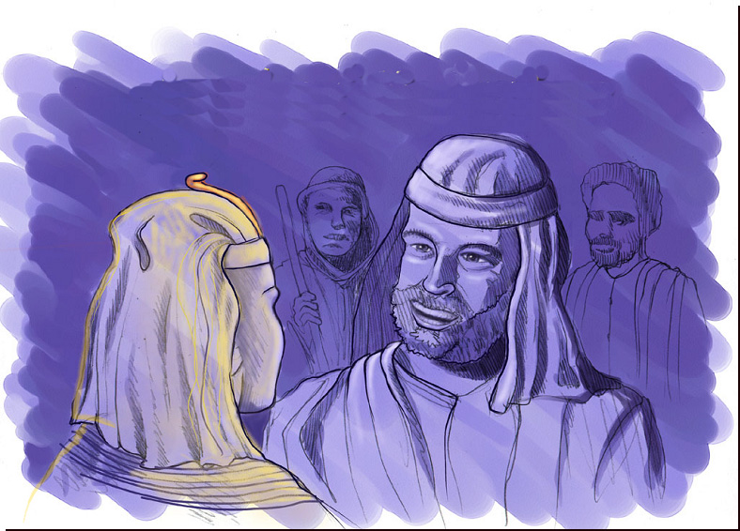
ABRAHAM-JOSEPH
Notes:
Kumei katha otshot tarâkha shok laga – meisâ eina Haokaphokwui akuplamshongli hângchithei haidalei – âchinâ ngarâ bingna kathei samphanga chiya athumwui agato, JOSEPH, hi ara Egypt wui ram-mungana.

Slide 2
Hao. 11:26wui eina thuilaga 25:8 eina tangda
HAIRAPKAHAI TARIK KHAMI:
ABRAHAM-JOSEPH 2000 B.C.
TARIK KATONGA HI ZINGKUM 500WUILI NGACHAMKHUI KAHAINA .
Ngasoda kazat lairik pg.19-24
01
1
Notes:
Ara…Biblewui atam athishurda haophoksa. Abrahamwui tarik hi: 2000 B.C shakhana. Ithumwui katam peichaoda…
//// …tarik chungkhameiva haklâk eina, zingkum 500 eina mataisang mamânra.
Ngarakzak kahai tarik kachithei chi katam hiwui kharin maningmana. Ngarakzak kahai tarikbing chi theingaikha nakhalattÂli hotkhanâ eina vaira.
2135-1960 BC hi Abrahamna okthuiya.

Slide 3
7
“Aja JISHU
Mirin JISHU”
OKATHUI KASEM
ABRAHAM
ABRAHAM
ABRAHAM
JOSEPH
ABRAHAM
MOSES
JOSHUA
ROTKHAMARAT
WUNGNAO
NARKAHAI
MI 4 chiwui eina KHAREPA
chi
VARI KAHAI
JISHU
Ngasoda kazat lairik pg.19-24
02
Notes:
Ningwui akap, ALI JAHEI MILU JO, china Abrahamli phaningung ngasak-ka…MI MATIWUI KHAREPA…OKATHUI KASEMWUI lairik sangkhavai lairikkom. Hili Biblewui khararchangli Abrahamwui larik sangkhavai akong leihaira.

Slide 4
Hao. 12:4
HAOPHOK
KHAVAI
KHANGARAN
MN
6
N(A)
H
Ngalei katum apam
GN
C
EK
B
J
NK
MN
Haokaphok apam chi...
E
U
KB
SK
PG
RS
Ngasoda kazat lairik pg.19-24
1
03
Notes:
Haokaphok kapikasag 12li, ‘Thakâk eina Theikapai Thotchan’ chi haophok-ka – achâlakhÂli Chaldean bingwui keinungli – nali mapli “U” da kapisang kahai chi.
Bible apam chiwui chi eina kapimena Bible khararchan chi mashameida theikhavai apam chili ngaheowa.
//// Kala apam chi ngalei tumlâk kahai apam kachâng thada ngakaida khalei Middle Eastwui apam chili shok-ka,
Kumei hiwui haokaphok hi Euphrateswui ashât eina haophokda Mediterranean Ngayi vashunga…
Kala apam chiwui ngachaili ithumna shaching kachi apam kha leiya.

Slide 5
HAOPHOK
KHAVAI
KHANGARAN
10 APAM
MN
6
4
N(A)
H
IRAQ
IRAN
KUWAIT
SAUDI ARABIA
SYRIA
ISRAEL
TURKEY
EGYPT
GN
C
EK
GALILEEWUI NGAYI
B
CANAAN
J
NK
MN
NILE KONG
KATHI NGAYI
E
EGYPT
U
KB
SINAIWUI NGALEI..
SK
PG
RS
Ngasoda kazat lairik pg.19-24
14
04
Notes:
nali map “Haophok Khavai Khangaran” kachili nana kha theihaira.
Leida khalei apambing chi
//// Canaan…aruihon atamwui Israel, and Zingtun Kongpei, Palestine,
//// Galilee Ngayi,
//// kala Kathi maningkha Machi Ngayi da… Bibleli kapisang kahai.
//// kala chili Egyptla leidalei
//// kala kahak-ka Nile Kong.
//// Sinaiwui lui-wuk, aruihon okathuili shokda khalei khabarli zangching kachi.
Kha ithumwui okthotli, thotli, apam hibing hila leidalei
//// Iraq
//// Iran
//// Kuwait
//// Saudi Arabia
//// Syria
//// Aruihonwui Israel kala Zingtushongwui Kongphei
//// Turkey kala
//// Aruihon thotwui Egypt

Slide 6
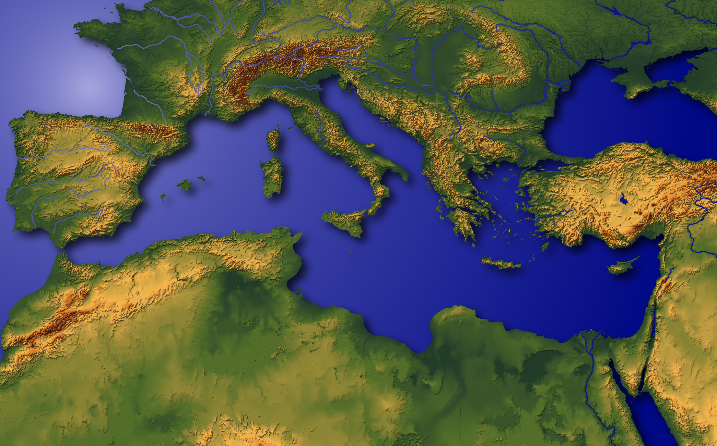
“Okathuiwui Haidong”
Ngasoda kazat lairik pg.19-24
05
1
Notes:
Apam hi OKATHUIWUI HAIDONG da hoya.
Thotchan-pam hi eina, latlui-latluida, hakmahâlâk kahai okathuiwui
Thuikahai atamli pangshap kashok -- latlui-latluida -- apam yuikhui khavai zatta.
//// Canaan/Palestine/Israel bingli khuishok hailga okathui hupvana kala alungshong athum khalatta shirenda.

Slide 7
Hao. 11:28
HAOPHOK
KHAVAI
KHANGARAN
MN
N(A)
H
GN
C
EK
B
J
NK
MN
E
KB
U
SK
CHALDEESWUI UR: ACHALAKHA MESOPOTAMIA ATAMWUI KHAMATAIYA APAM; ABRAHAMWUI SHIM
PG
RS
Ngasoda kazat lairik pg.19-24
06
1
Notes:
Chithada sada ABRAHAMWUI khararchanhi Persian Gulf wui akuishong, achâlakhÂli Chaldeeswui keinung – Urli haophok-ka.
//// Abraham kala Âli shimkhur hi achâlakha Mesopotamianwui kong ngalemli khalei ngashanwui phaolak kahai apamli okthuisai.
Hi nali map “Haophok Khavai Khangaran” li “U” da ithumna kapikahai china.
Khararchan chi zattâ mamân kachi eina nali Map chi ngaheolu.

Slide 8
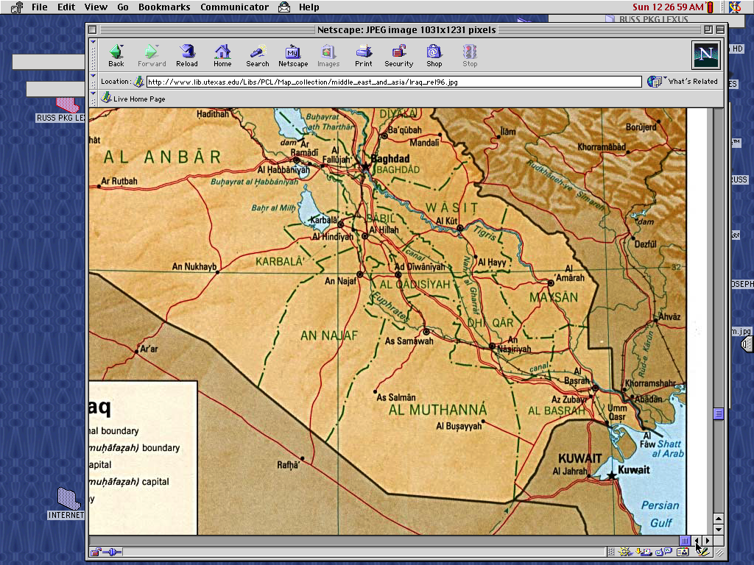
7
BABYLON
UR
PHANINGUNGLU! Persian Gulfwui Rai chi Iraqli Rai kasa Chi
Ngasoda kazat lairik pg.19-24
07
6
Notes:
Apam chiwui map hi aruihon thotli hithada lei. Phaningunglu kachia apam hi khareli 1990wui atamli Persian Gulfwui Rai chi hilina…
kala naoda Iraqli khangarar-ra Rai Saddam Husseinli wungpam wui eina khuikatâ chi hilina.
//// chili Tigris Kong leidalei…
//// …kala Euphrates…
//// …aruihon thotwui keinung Baghdad…
//// …Kuwait chi Persian Gulfwui akuishong leiya…
//// …aungshong…achâlakhÂli keinung Babylong…
//// …kala ithumwui khararchan haokaphok apam… achâlakhÂli keining UR.

Slide 9
7
MesopotamiÂli Pambing
SUMERIAN-NA PHAKASHOK…
KAKAPI KALA GARI PHEI
HAOKAPHOK…
AIN
ARI
KAZINGRAM KALA SIRAWUI MARAMLI
SHIM KASEMWUI MARAMLI
HAOKAPHOK KEINUNG PAMBING
Ngasoda kazat lairik pg.19-24
07a
4
Notes:
Zingshoshong apam alungthungli – Persian Gulfwui tharili ngashikta—
okathuili rikapta thangmeilâk eina pânkasa mibingwui mirin chi phashok-ka
//// chithek kathum eina chithei kahai apamli,
//// Mesopotamianwui Lui-wuk
//// Achâlakha Sumerian bingna ithumli kakapi kala kângpheiwui lemmet kaho hi miya. Kala hili ithumna thei
//// reikasangwui haophok tha-thar ata…ainwui…ari-araiwui…sirâ-kachâng kala shimsak wui maram
//// khararchan phakazatta bingna achâlakha reisanglâk eina pânkasÂli ngashan phâkhuiya…
apam chili pânkhangaruma bing kala keinungbing wui mangâ eina aruihon ithumwui reikasang kala zatnâda khalei ngashanbing chi chiwui eina khashokla leidalei.

Slide 10
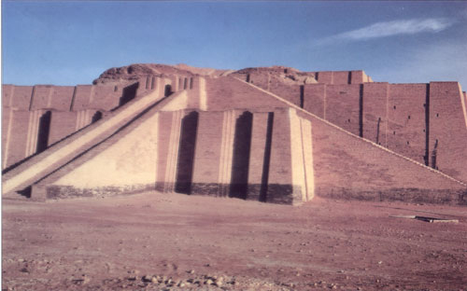
Hao 10:10; 11:28
Achalakha Urwui Chaldeesli khalei “Ziggurat” kachi hi aruihonwui Iraqli khaleina
Ngasoda kazat lairik pg.19-24
08
Notes:
Hikatha khorumkhavai dolan, maningkha ziggurat da kaho hi Abrahamwui atamli Chaldeanbingwui ngalei Ur kaho apam chili phaolâk eina leisai. 2000 B.C atamli Ur hi haklâk kahai keinung ngasasaya kala apam chi katam kasha, ngashan, leikhalon kala manglârin tangmanglâk eina leikasâ apamna. Kha hi machuk yanglo: kachi katha akap-akai – kuingatok– chikatha saklâk kahai shimchi darkâr sakhala? Chikatha khamachuk china achâlakha chiwui thotli okthuikasâ bingwui kathem thangkhamei chitheiya!

Slide 11
Hao. 11:31
ABRAHAMWUI SHIMKHUR:
• TERAH (AVAVA)
•ABRAHAM (ABRAM)
• SARAH (APREIVA, SARAI)
• LOT (ABRAHAMWUI AGATOWUI NAO)
Ngasoda kazat lairik pg.19-24
09
5
Notes:
//// Biblewui khararchan china ithumli ABRAHAM kaho mi akha, kala Âli shimkhur achâlakha Chaldean bingwui ngalei Urli pânkasÂli maram hangchitheiya.
//// Shimkhur chili sârlâk kahai avâ-va akhala leisaya… Terah.
//// Terahwui naomayara Abram, naoda Varena ABRAHAM da aming ngacheimihaowa, hi naoda thotchanli Âli apam shenglâk eina chitheimihai.
//// ABRAHAMWUI apareivÂli aming Sarah hoya (kachangkhatliva Sarai)…
//// Shimkhur chili ABRAHAMWUI agatowui nao, Lotla zangsaya.

Slide 12


7
ABRAHAM
ABRAHAM
ca. 2000 B.C.
MI 4 chiwui eina KHAREPA
chi:
ABRAHAM
AJMJ
Haokaphok 12 kala chiwui thili
Ngasoda kazat lairik pg.19-24
10
3
Notes:
ABRAHAMWUI lairik sangkhavai lairik-kom chieina haophoksa.
Nana yangda khalei amabing hili matailak kahaibing chi munmeida yanglo…
//// Hi eina haophokda khari-khanao athishurda zatkhavali lairik sangkhavai akhong akha arâng kachida leisâra. Chibing china nali juk-khamajali khararchan chi zattâ mamân kachieina ngachonra. BIBLE LAIRIK-KOM chi chipuisang mamăn kachi eina ithum kali zatlikhala kachi nana theira.
//// Abrahamwui khararchan hi Haokaphok 12 eina haophokda mangăshong kapisanghai…
//// Zingkum atamna: 2000 B.C shakha… Kahak-ka Mi matiwui ngachaili rimeithui kachi.
Mi akha, ABRAHAMWUI mangâ eina Varena ngaran-ngayei kadhar haophok-ka
Âli themsâkbingli kharewui morei makhalei atamwui thâda ngashiklâk eina pânkasa chili hanunglui khavai shongfa semmiya. ABRAHAMWUI mangâ eina Biblewui khararchan katongachi maron-maron eina rashunga, Phongkhami lairikli okathui kala apuk-apakvachi mashâlak eina matheiranglaga.

Slide 13
7
Hao. 12: 1-3
ABRAHAM
ABRAHAM
ca. 2000 B.C.
Âli KAHO
MI 4 chiwui eina KHAREPA
chi:
ABRAHAM
Âli KAHO
AJMJ
Haokaphok 12 kala chiwui eina
Ngasoda kazat lairik pg.19-24
11
Notes:
Hakmahâlâk kahai kharachan chi 12wui Kapikasang ABRAHAMLI KAHO eina haophok-ka, Ur ngalei chiholaga matheirang kachi ngalei akhali kha naoda atam ungkatâ tharan chitheimiki kachi, chili zathaoluda hânga.

Slide 14
7
Hao. 12: 1-3
ABRAHAM
ABRAHAM
ca. 2000 B.C.
Âli KAHO
AT
AJMJ
Hao. 12: 1-3
ABRAHAM
Âli KAHO
VARENA SAMILÂK-KI KACHI KHANGASHIT ABRAHAMLI KHAMI!
Ngasoda kazat lairik pg.19-24
12
Notes:
Otshot hi khare avâ ngarâbingwui thotli matailâk kahaiya kala Varena mikumowui vang ngaran-ngayei kadhar phongkachithei atam ngasâya. Nawui katamli ngachonkhavai anâ chili, mayek AT china chitheimihaidalei. AT china ithumli hakmahâlâk kahai ABRAHAMWUI TUINGASHIT phaningung ngasakka -- tihumwui Bibleli Haokaphok kapikasang 12…tuizâ 1-3li mihaiya. Hi SAMILÂK-KI KACHI khangashit tuingashitna!

Slide 15
7
ABRAHAM
ABRAHAM
ca. 2000 B.C.
Âli KAHO
AT
N - A - S
AJMJ
Hao. 12: 1-3
NGALEI
ATHA
ABRAHAM
Âli KAHO
N - A - S
SOKHAMI
VARENA SAMILÂK-KI KACHI KHANGASHIT CHI KHA LEILAGA TUINGASHIT AIN SEMKAHAI!
Ngasoda kazat lairik pg.19-24
13
Notes:
Ara… ABRAHAMWUI lairik sangkhavai lairik-komli, mayek… N…A…S…da ngarumsanglu: NGALAEI…ATHA… KALA SOKHAMI. Tuiyar bingwui kakhalatva hithaya. Haokaphok kapikasang 12, tuizâ 1-3li, Varena SAMILÂK-KI KACHI KHANGASHIT TUINGASHIT chi Abrahamli saya…kha leilaga tuingashit chi atam chitharanwui ain ngasâhaowa!

Slide 16
7
Haokaphok 12
Chieina Prohona Abramli hanga,
“Naramwui eina, kala shangnaowui eina kala navÂli shim eina zatta Ina chitheiki kachi apam (ngalei) chili valu.
1
“Ina nali kahaka yur akha sangasakta
sokhamila somira;
nali ming reingasakta,
sokhame mi akha sangasakra.
2
ABRAHAM
Âli KAHO
Nali kasobingli inala sora,
kala nali khonkashe mi chili inala khonshira;
kala okathui miyur huptali
nawui mangâ eina somira.”
N - A - S
3
Ngasoda kazat lairik pg.19-24
3
14
Notes:
Haokaphok 12, tuizâ 1-3li Varena khangashit akai kathum Abrahamli saya. Chi hina:
//// Chieina Prohona Abramli hanga,
“Naramwui eina, kala shangnaowui eina kala navÂli shim eina zatta Ina chitheiki kachi apam (ngalei) chili valu.
//// “Ina nali kahaka yur akha sangasakta
sokhamila somira;
nali ming reingasakta,
sokhame mi akha sangasakra.
//// Nali kasobingli inala sora,
kala nali khonkashe mi chili inala khonshira;
kala OKATHUI MIYUR HUPTALI
NAWUI MANGÂ EINA SOMIRA.”

Slide 17
7
Haokaphok 12
Chieina Prohona Abramli hanga,
“Naramwui eina, kala shangnaowui eina kala navÂli shim eina zatta Ina chitheiki kachi apam (ngalei) chili valu.
1
NGALEI
“Ina nali kahaka yur akha sangasakta
sokhamila somira;
nali ming reingasakta,
sokhame mi akha sangasakra.
2
ATHA
ABRAHAM
Âli KAHO
Nali kasobingli inala sora,
kala nali khonkashe mi chili inala khonshira;
kala okathui shimkhur hupta nali
vang eina sokhami ngasara.”
N - A - S
3
SOKHAMI
Ngasoda kazat lairik pg.19-24
3
15
Notes:
Khangashit tuingashit chiwui khare-khanao chi Biblewui khare-khanao sada kapikahailila kan-naya:
//// Khare china NGALEIWUI tuingashitna…laga…
//// ATHA
//// Chiwui thili SOKHAMI, hi “N,A,S” mayekna theingasak-ka ABRAHAMWUI lairik sangkhavai lairik-komli.

Slide 18

Abrahamwui Tuingashit
(“Âli Kaho”)
Haokaphok 12: 1-3
ABRAHAM
NGALEI
ATHA
SOKHAMI
Âli KAHO
N - A - S
12:1
12:2
12:3
“N-A-S”
Ngasoda kazat lairik pg.19-24
16
3
Notes:
Ara kathada kapihaili khala kaji chi tamsa… ngararik-tazak-kahai tuingashit kathum hiwui kakhalat… N-A-S ABRAHAMWUI lairik sangkhavai akhongli…
//// Khare sâda…TUINGASHIT #1: HAOKAPHOK 12:1… NGALEI AKHA – shimpam, Jehudi miyurbingwui ngashan akha sada ngalei hi shimluikat sâda samkaphang kala aruihon rashungda athumna zatkhanâ chi khayâshiya.
//// TUINGASHIT #2: GENESIS 12:2…ATHA – sânglâk kahai thârâ…matailak kahai akhava tuingashit hi khami tharan, ABRAHAM eina SARAHva sârphok hairasaya kali âni nao maleirangsaya.
//// Khanaowa TUINGASHIT, mashing 3: HAOKAPHOK 12:3…SOKHAMI AKHA Abraham kala awui thârâ bingli tuingashit sakahai. Aruila, Varena ngashitta kachiva, ABRAHAMLI sokhami mangâ eina, okathui shimkhur katonga sokhami samphangra…ABRAHAMWUI THÂRÂ bing mâng maningmana! Tuiyar chi phaningunglu, hi LUKHAMASHAN-LEIKASHI phabkatâli kanâya!

Slide 19
Abrahamwui Tuingashit
(“Âli Kaho”)
Haokaphok 12: 1-3
Mataimeithui kachi kathum kazang!
ABRAHAM
NGALEI
ATHA
SOKHAMI
Âli KAHO
N - A - S
• Kachangkhat okathuili kashok
• KATANG MAKHAVAI
• SAPHALUNGKI KACHI
17
3
Notes:
Ara…tuingashit wui mataimeithui kachi…N-A-S… NGALEIWUI VANG, ATHAWUI VANG kala SOKHAMI… hibinghili ithumna matailak kahai tui kathum ngarumsangsa… tui kathum hina Abrahmli Tuingashit sakahai hi meikhaimiya…
//// Khare sada… kahak-ka tuingashit chi -- kala chi – HORZAK-KAHAI kachiva tuibing china ngarakzak kahai kakhalat chi hangmiya.
//// Kala KATANG MAKHAVAILA, kupkahai makhangava khangaran, ain kasemmapâ china kasâ, Vare Âmashâ. Kala khanaowali…
//// Chiya SÂMILÂK-KI KACHINA… naoda Abraham kala awui thârâ bingna khi-khikha sâsalala, Varena, atamwui alungli…HANLUIDA: ATAMWUI ALUNGLI… Âwui ngashit kahai peichaoda ungshung ngasakra.
Khararchan hi tâmamân kachi eina, ithumna theira kachiya Bible peichaoda hi sâmilâk-ki kachi kala angayung kathâ tuingashit chili semkâya… thaklâk eina Vare kala Âwui ngasotta Abraham aniwui ngachaili ain onhaora.

Slide 20
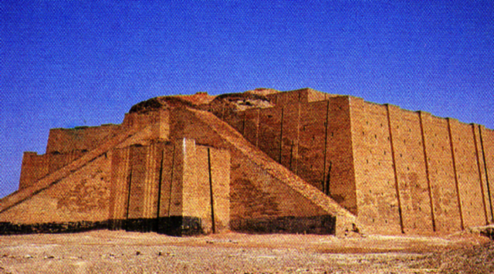
Hao. 11:31
SHITKASANG
EINA
ATHUMNA
ZATHAOWA!
HAOPHOK
KHAVAI
KHANGARAN
MN
N(A)
H
GN
C
EK
B
J
NK
ABRAHAM
MN
Âli KAHO
N - A - S
E
KB
U
SK
PG
RS
Ngasoda kazat lairik pg.19-24
18
2
Notes:
Abrahamna Varewui ngashitkhami samphang kahai thili… awui shimkhur katonga Chaldean bingwui ngalei Ur kaho apam chi nothahai laga Prohona chizakhami athishurda vahaowa.
//// Athumnaz ato-zingtunshong shakei kala khalei-lei khuiphungda vahaowa…mishang tarâkha, sayur-vayur kala tampur shim. Biblena chitheiya kachiya ABRAHAMWUI shimkhur hi shânglâk saya. Aruila, map chi singda leikha, map chili zatta khalei chi theikhavai yaingâng maju eina khânlu. Matailâk kahai kharin pava:
//// ABRAHAM kala âwui shimkhur hi SHITKASANG EINA ZATHAOWA! Athumhi Varena chitheimiki kachi ramshong zatta khaleina. Kha athumna Chaldeanwui ngalei Ur chi nothahai laga kazat hi athum atâzan matheimana. Athumn Abrahamwui kathan chili kahâng nganâda matheirang kachi apamli vakhavai kazat hi Vareli shitkasang kala awui ngarân khami kala ngâk-khamili shitkasang wui matailâk kahai chansam sakhavaina.

Slide 21
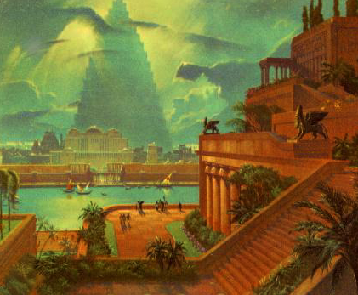
Hao. 11:31-32
HAOPHOK
KHAVAI
KHANGARAN
MN
N(A)
H
GN
C
EK
B
J
NK
ABRAHAM
MN
Âli KAHO
N - A - S
E
KB
U
Kahaka Babylonwui Keinung
SK
PG
RS
Ngasoda kazat lairik pg.19-24
19
Notes:
Athumhi achâlakhawui keinung Babylon chi makân maraowa, Urwui kong atungshong… keinung hiwui maram naoda nana tamra kachiva Abrahamwui naotunbing -- Jehudibing -- hi naoda zingkum shâ-shâwui thili apam hili narpamra.

Slide 22
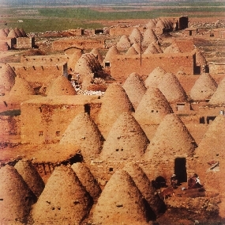
Hao. 11:31-32
HAOPHOK
KHAVAI
KHANGARAN
MN
N(A)
H
AVAVA, ARAR TERAH, HARANLI THIHAOWA.
GN
C
EK
B
J
NK
ABRAHAM
MN
Âli KAHO
N - A - S
E
KB
U
SK
PG
Aruihon Harranwui (Turkey) “Kuihang” Keinung
RS
Ngasoda kazat lairik pg.19-24
20
1
Notes:
Athumna ato-zingtunshong zatshum-ma, naolak eina achâlkhawui Haran chili vazanga…
… apam hi aruihon thotlila Turkey kaho apam chili leidaleifaya.
//// Hun-nakha wuivang Haran li pamdaleilakha, ABRAHAMWUI ava, Terah, chili thihaowa.

Slide 23
Hao. 12:5
HAOPHOK
KHAVAI
KHANGARAN
MN
N(A)
H
GN
C
EK
B
J
NK
ABRAHAM
MN
Âli KAHO
N - A - S
E
KB
U
SK
PG
RS
Ngasoda kazat lairik pg.19-24
21
Notes:
Aruila akhashida, Varena ABRAHAMLI matuiya, Haran apam chi chiho laga Âna Ngashitmi Kahairam chi chithei khavai zathaolu da hangmiya. Ngalei chi Canaan ngaleina, aruihon ithumna Israel da kathei china.

Slide 24
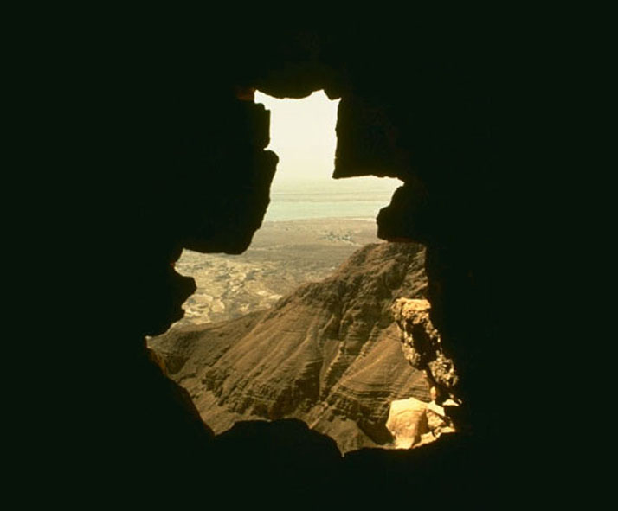
7
Abrahamna Ngalei chili kazang tharan…
A zingkum 75 kahairasai…
Apreiva Sarahna 65.
Chithalala…nao ngashitmi kahaina!
ABRAHAM
Âli KAHO
N - A - S
Ngasoda kazat lairik pg.19-24
22
4
Notes:
Ara haophok khavai kahak-ka khangaran chi kuphaira!
//// Âna Ngalei chi vakazang tharan,
//// aperiva Sarah, hi 65.
//// Laga, Varena nao mirada ngashitmi-e? Khido?
Varena kasâr-ra parei-gahar chili chipat khanganaola? Hikatha zingkumli nao mirada ngashit dava?

Slide 25
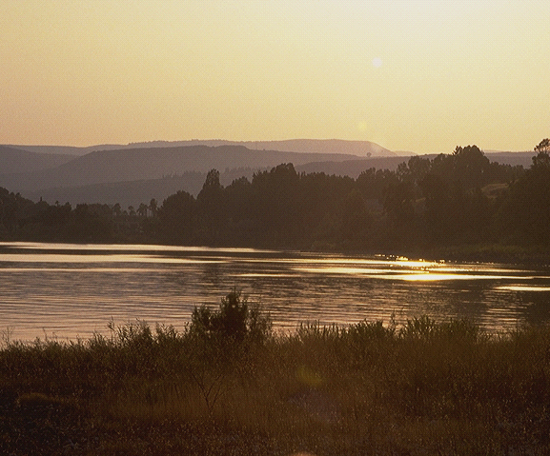
7
Hao. 15:6
ABRAHAMNA VAREWUI KHANGASHITLI SHITSANGA: NGALEI, ATHA, KALA SOKHAMI!
_{NGALEI}
_{ATHA,}
_{SOKHAMI}
Haokaphok 15:6!
Abrahamwui shitkasangli Varena khamashung khangarong eina shankhui!
Thada shampat kahai shitkasang!
ABRAHAM
Âli KAHO
N - A - S
Ngasoda kazat lairik pg.19-24
23
3
Notes:
Mah… ABRAHAMNA Varewui ngashit khami NGALEI, ATHA kala SOKHAMILI shitsangchinga!
//// Âwui mangakaikâlâk kachi shitkasang chi Haokaphok 15:6li kapisang haiya…
//// …Varena ABRAHAMWUI SHITKASANG chi khamashungana da shânkhuiya.
//// Thada icham-cham kahai shitkasangna! Hina Varewui okathuihi Âwui kacham ngasotnaowui mangâ eina ngatangkhui khavai ngaran-ngayei kadharwui pheikâr kharena

Slide 26
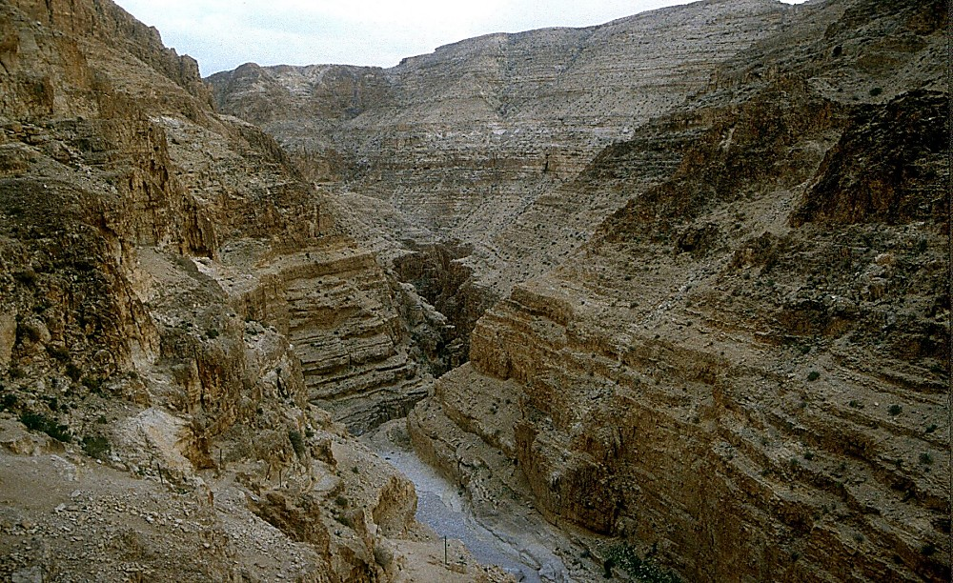
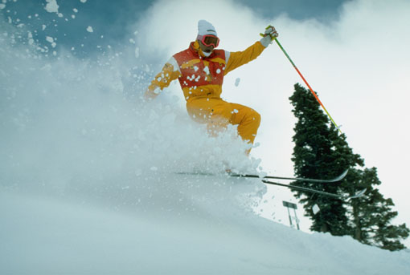
7
Hao. 16:1-4
ABRAHAMNA VARELI SHITSANGA!
Chithasalala: Abraham eina Sarah mahonrar thuwa.
“Abraham…Hagarli zang-ngasopilu!” (Sarahwui raoshanao)
ABRAHAM
Âli KAHO
N - A - S
Ngasoda kazat lairik pg.19-24
24
3
Notes:
//// Abrahamna Varena ngashitmi kahai chi ungshunglâkrada shitsanga. Kala zingkumva mit-mit zatma-mân na.
//// Varena shenglâk ngashitmi haisalala… ABRAHAM eina Sarahna nao chi mangarairar thuwa. Sarahwui mangarai khararli,
//// Ana ABRAHAMLI âwui Egyptwui rao-shanao, Hagar li, phasâ ngarumkhavai valu da hanga kachiva awui kachihanli Varena ngashitmi kahai naochi âwui rao-shanao ani khangarum eina pharâlapai. Chikatha chi chiwui atamwui ngashan li zatnâ saya.

Slide 27
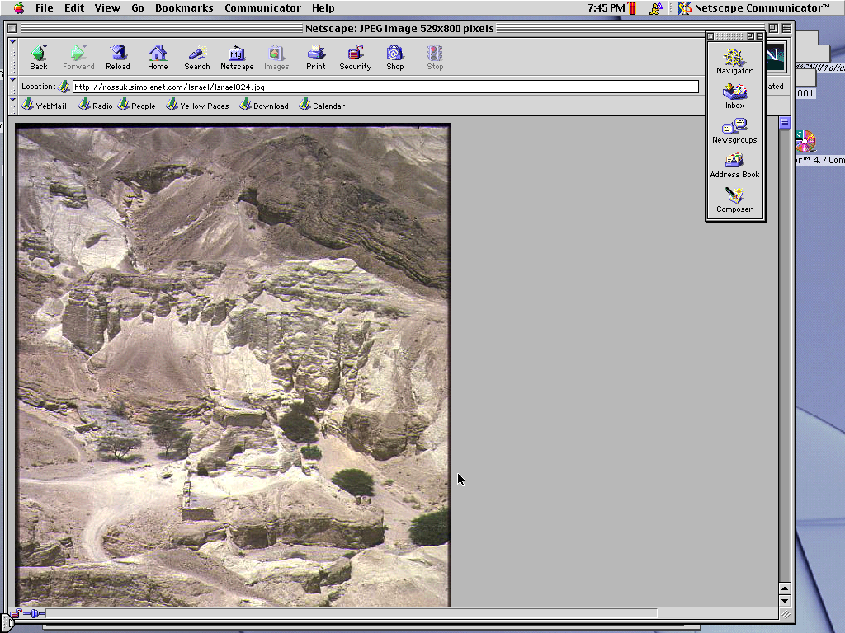
7
Hao. 16:11-12; 17:20-21
Atam ungshung-uda…Abrahamna Hagarwui eina nao akha samphanga.
Âli mingna: ISHMAEL.
(ISHMAEL HI NGASHIT KAHAIWUI NAO MANINGMANA).
ABRAHAM
Âli KAHO
N - A - S
Ngasoda kazat lairik pg.19-24
25
3
Notes:
//// Chithada sada, atam ungshung-uda…ABRAHAMNA Hagarwui mangâ eina nao mayara akha samphanga.
//// Nao mayarnao chili ISHMAEL da phokmiya.
//// Kha, Varena hanga, naoshinaopâ chi Abrahamli kala âwui thârâli Âna Ngashitmi kahai nao chi maningmana.

Slide 28
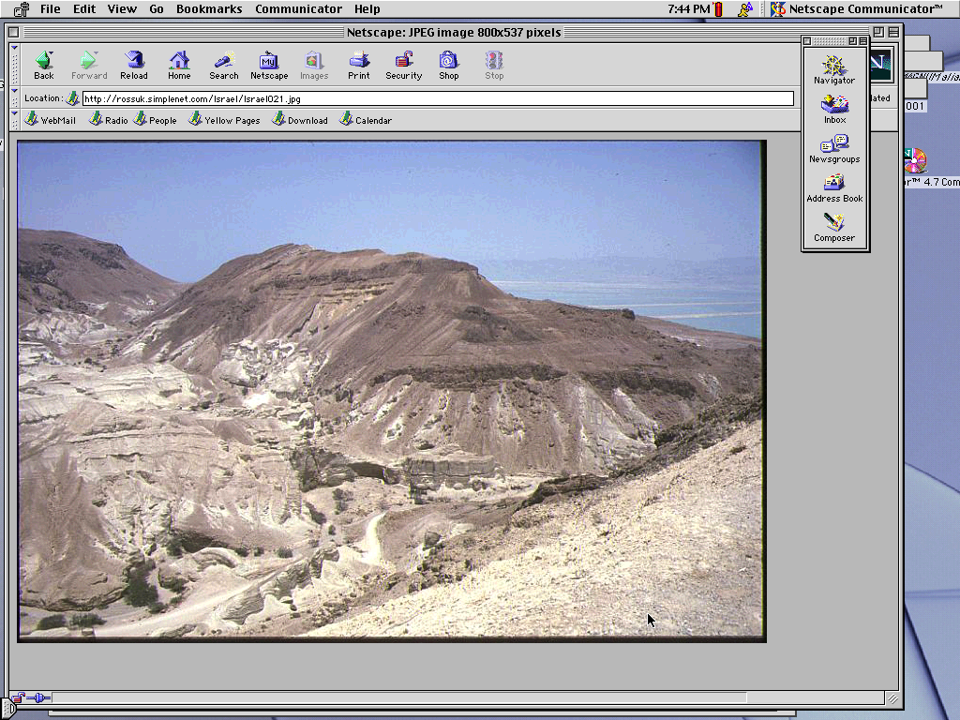
7
Hao. 17:19
Ara…Abraham kum 85 kahaira…Sarahna 75.
Zingkum 15wui thili…
ABRAHAM eina SARAHwui nao akha pharaya.
MINGNA: “ISAAC”
ABRAHAM
Âli KAHO
N - A - S
Ngasoda kazat lairik pg.19-24
26
4
Notes:
//// Atam hithara, ABRAHAM hi 85; Sarah, 75.
//// Zingkum 15wui thili…\
//// …Varena ABRAHAMLI ngashitmi kahai chi naolâk eina pharâhaowa…Sarahwui mangâ eina.
//// Nao chiwui aming ISAAC, Hebrew tuiwui kakhalatva khamana. Mah, ABRAHAMNA hiya Sarah anina hikatha zingkum hili avâ-va khangasâ hi manangaiya da phaninga.

Slide 29
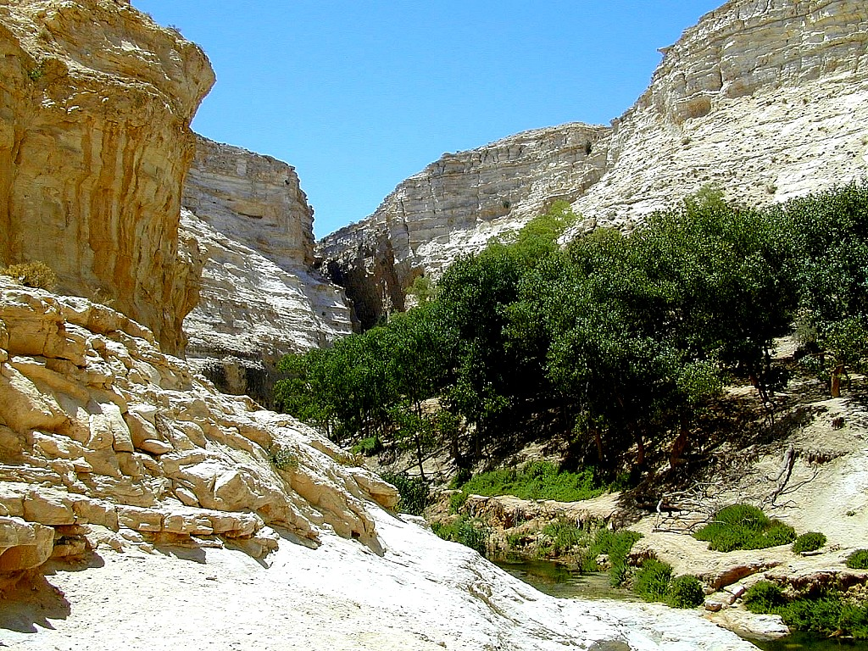
7
Hao. 17:21
Isaac hi kasangkha honkahaiwui naona…
… Varena Abrahamli ngashit kahai thara (atha) wui sokhami hi Âli eina zatvaki kachina…
ABRAHAM
Âli KAHO
N - A - S
… ISAACWUI THARA EINA!
Ngasoda kazat lairik pg.19-24
27
2
Notes:
ISAAC hi kachangkhatwui sânglâk eina ngarai kahai nao mayar-ra china…
//// …âwui mangâ eina Varena ABRAHAMLI ngashitmi kahai chisin maronna…
//// …ÂWUI shimkhurwui eina.

Slide 30
7
Hao. 17
ABRAHAM
ABRAHAM
ca. 2000 B.C.
Âli KAHO
AT
N - A - S
AJMJ
I - I
Hao. 12: 1-3
ABRAHAM
Âli KAHO
N - A - S
I - I
ISHMAEL & ISAAC
Ngasoda kazat lairik pg.19-24
28
Notes:
Chithada sâda… mayekbing I kala I hi ABRAHAMWUI lairik sangkhavai lairik-komli leihaira. Abrahamwui naomayara khani hiwui eina…ISHMAEL kala ISAAC…
matailâk kahai thotchanwui atam hili…ngachee-ngachamlâk kahai aruihonwui Jehudi-Arabwui nganang khangarok hi zingkum 4,000 li haophok-ka… 2000 BC maikhali

Slide 31
7
ABRAHAM
ABRAHAM
ca. 2000 B.C.
The CALL
AT
L - S - B
AJMJ
Hao. 12: 1-3
I - I
ABRAHAM
Âli KAHO
N - A - S
I - I
ISHMAEL WUI EINA
ARABNAO KHARA
ISAAC WUI EINA
JEHUDINAO KHARA
Ngasoda kazat lairik pg.19-24
29
2
Notes:
Maram-ma…
//// …ISHMAEL hi aruihon Arab ngaleiwui avâna da theiya…hi ABRAHAMWUI mangâ eina na…
//// kala ISAAC, mah, hi Jehudibingwui avâna da khayâshiya… chila ABRAHAMWUI mangâ eina na!

Slide 32
7
ABRAHAM
ABRAHAM
ca. 2000 B.C.
The CALL
AT
L - S - B
AJMJ
Hao. 12: 1-3
I - I
ABRAHAM
Âli KAHO
N - A - S
I - I
ISHMAEL WUI EINA
ARABNAO KHARA
ISAAC WUI EINA
JEHUDINAO KHARA
Ngasoda kazat lairik pg.19-24
30
Notes:
Chinaoni kala ava-va ngachaili zakshilâk kahai nganang khangarok leiya. Aruihon ithumna khabar yang maningkha pâ-akha, ithumna thei kachiya achâlakhawui nganang khangarokchi ABRAHAMWUI tampur shim eina haophok-ka kala arui rashungda nganang ngarokda leifaya! Jehudi eina Arab miyur bing hi ABRAHAM hi athumwui avâ-vana da ngapai ngarokda khaleina!

Slide 33
7
Hao. 22:2; 2 Thot. 3:1
NAO KACHIPÂ?
“Akha mang kache kala nana leikashe nanao Isaacli Moriah ngaleili, ina chitheiki kachi kaphung akhali thanvada rik-kata hanphut apha haolu,” da Varena hanga. Haokaphok 22:2
ABRAHAM
Âli KAHO
N - A - S
I - I
NIVwui pakhavai ngarumkasangli hithada kapihai: Hebrew tuili, “Isaac” kachiwui thili tuibing hi kapiya “nana leikashe,” mathameida zakhavai: “nali nao, akha mang kache, nana leikashe -- Isaac.” “Ngashit kahaiwui nao” hi Isaac mang-a.
2 Thot. 3:1 Kakapepa hina apam chi Khorum khavai shimna da chitheiya [Aruihonwui Dome of the Rock kachi chi].
Ngasoda kazat lairik pg.19-24
31
3
Notes:
Thakha ithumna bichar saya kachiya: NAO KACHIPÂ CHI KACHANGKHAT Abrahamli ngashitmi kahai shimluikat kakhuipâ china da theipairakhala? Haokaphok 22:2 li yanlu…
//// “Akha mang kache kala nana leikashe nanao Isaacli Moriah ngaleili, ina chitheiki kachi kaphung akhali thanvada rik-kata hanphut apha haolu,” da Varena hanga.
//// NIVwui pakhavai ngarumkasangli hithada kapihai: Hebrew tuili, “Isaac” kachiwui thili tuibing hi kapiya “nana leikashe,” mathameida zakhavai: “nali nao, akha mang kache, nana leikashe -- Isaac.” “Ngashit kahaiwui nao” hi Isaac mang-a.
//// Hilila nana samphangra II Thotrinchan 3:1li Varena Moriah hi Khorum khavai kaphungda khuiya, aruihon, thotli, apam chi “Moslem Dome of the Rock” china. Apam chiwui maramli kupmeida khaleilaga tamra.

Slide 34
7
Hao. 17:20-21
NAO KACHIPÂ?
“Ishmaelwui vangla, ina nali shamihaira; yanglu, ina ali somida athei matheira kala kachungkha mataisangmira; â wungnao tharada khaniwui avâ-va sara, kala yur kahaka akha sangasakra. Kha Iwui tuingashitva Isaacwui mangâ eina sara, Sarahna nali nao chi zingkuma hitharan pharâra.”
Hao 17:20-21
ABRAHAM
Âli KAHO
N - A - S
Kha Iwui tuingashitva Isaacwui mangâ eina sara,
I - I
Ngasoda kazat lairik pg.19-24
32
2
Notes:
Kha Ishmael lila… mamalailâk mana!
//// Haokaphok 17:20-21…”Ishmaelwui vangla, ina nali shamihaira; yanglu, ina ali somida athei matheira kala kachungkha mataisangmira; â wungnao tharada khaniwui avâ-va sara, kala yur kahaka akha sangasakra.
//// Kha Iwui tuingashitva Isaacwui mangâ eina sara, Sarahna nali nao chi zingkuma hitharan pharâra.”

Slide 35
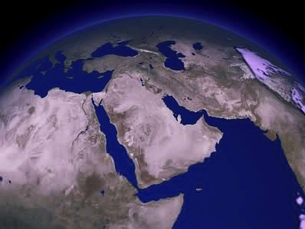
AJA ANIWUI SOKHAMI CHI NGAHEO YANGLU…
ISAAC
ABRAHAM
ISHMAEL
Âli KAHO
N - A - S
I - I
KHIWUI VANG EINA HIYAK-KHA NGATEIHAO?
Ngasoda kazat lairik pg.19-24
33
3
Notes:
Chikatha lemmet chi aruihon ithumna ngaheokhayang hi kannâya…
//// Thada khamatuiliva…Ishmaelwui thârâna pân kahai ngalei…Middle Eastwui Arab ngalei.
//// Kha thalala… Middle Eastli pânda khalei Isaacwui thârâli ngaheo yanglu… kateowa Israel chili
//// Khiwui vang chiyakha hakda ngateihao?

Slide 36
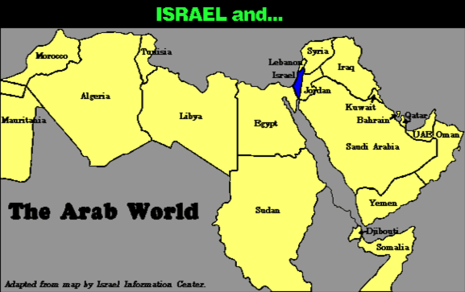
7
NGALEI PAMBING NGAHEO YANGSA…
kala…
ABRAHAM
Âli KAHO
N - A - S
Arabwui okathui
I - I
Israelwui Pao mikashok pamwui eina map hi kakhuina
Ngasoda kazat lairik pg.19-24
34
Notes:
Shenglâk eina hanglu chiakha…ngalei chiwui maram chi ngaheolu… aruihon thotwui Israel kala Arabwui okathui!

Slide 37
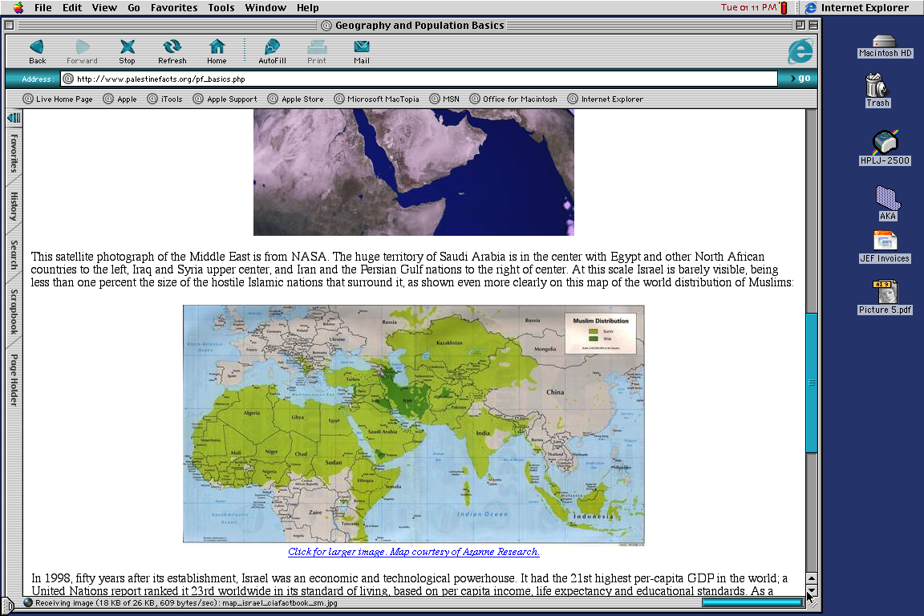

7
NGALEI PAMBING NGAHEO YANGSA…
ABRAHAM
Âli KAHO
N - A - S
I - I
MOHAMMED KALA ISAAC!
Ngasoda kazat lairik pg.19-24
35
Notes:
Khangatei maram akhala leifaya. Ithumna ngaheoyangsa Middle Eastshong Ishmaelwui thârâ, Mohammed, Islamwui khuikashok-kana kasing apam…eina Isaac, Israel naobingwui avâ, kala Ishmael wui agato!

Slide 38
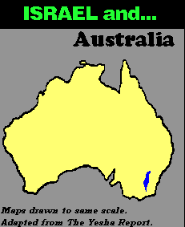
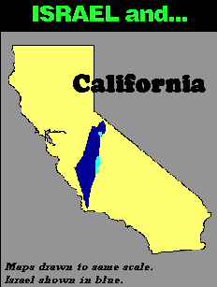
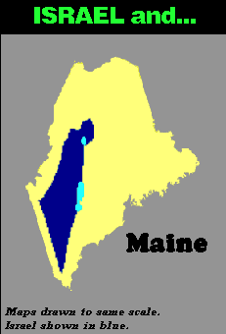
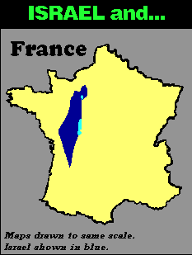
7
NGALEI PAMBING NGAHEO YANGSA…
kala…
kala…
kala…
kala…
ABRAHAM
Âli KAHO
Map hi tamlaga yek kahaina.
Israel hi khaMNing machu eina chitheili.
N - A - S
I - I
Map hi tamlaga yek kahaina.
Israel hi khaMNing machu eina chitheili.
Map hi tamlaga yek kahaina.
Israel hi khaMNing machu eina chitheili.
Map hi tamlaga yek kahaina.
Israel hi khaMNing machu eina chitheili.
Ngasoda kazat lairik pg.19-24
36
3
Notes:
Aruihon thotwui okathui ngaleiwui maramli…kateowa Israel ngalei chi
Australia ngaheolu…
//// Israel hi Franceli…
//// Israel kala United Stateswui Maine kaho ngalei…maningkha
//// Israel eina California.
//// Singapore eina Israelwui kapâk chi ngaraichaya.

Slide 39
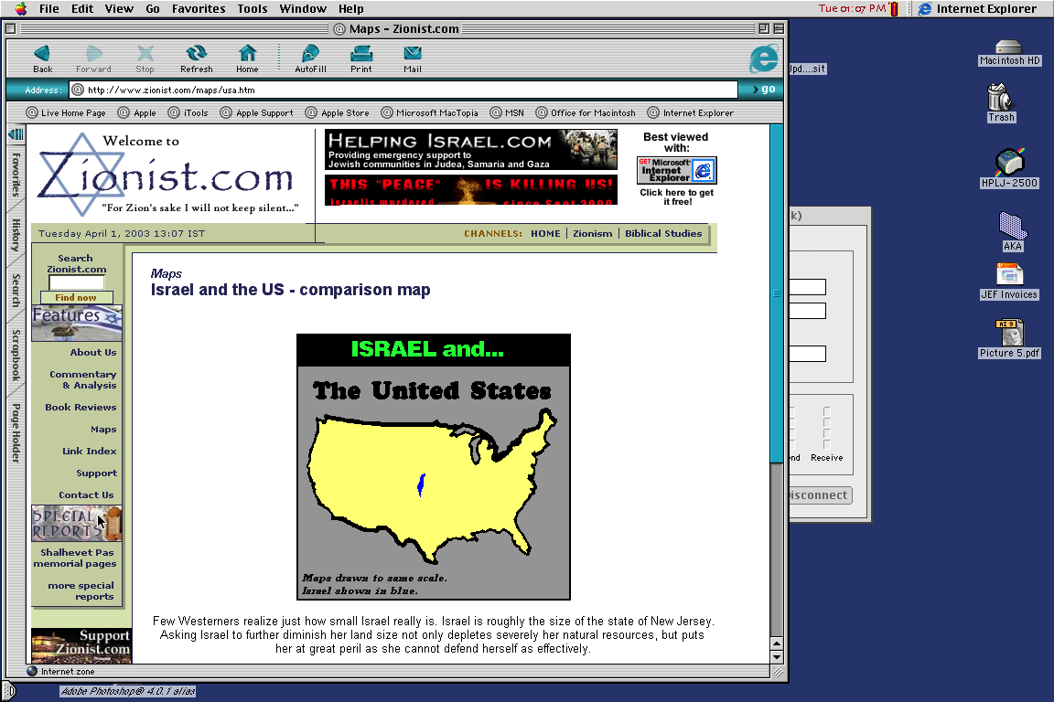
7
kala…
AMERICAWUI APAM
ABRAHAM
Âli KAHO
N - A - S
I - I
APAM PANKATAM HI YANG-NGAILA?
Ngasoda kazat lairik pg.19-24
37
Notes:
Kala naolak eina…Israel hi United States katongali tamyang salala… ato eina haophokda aze tashungda… zingsho eina thuida zingtun vashungda: kahak-kateo maram khangazek tharan, Isaac eina Ishmaelwui ngachaili haklâk kahai mangaraikacha kachi leiya! Hi katha kahai?

Slide 40
7
“…Ishmaelwui yurli ngaleila kala lanla chungmei kharda miya Israelnaoli yangakha. Khararchan hi mashunga kala chiwui tungli aruihon thaola tarakkha samphanga. ManglÂli huikhami hi Ishmaelnaoli khamong aruila shomishon-a.
ABRAHAM
Âli KAHO
N - A - S
I - I
Hal Lindsey, “Katangmakhavai Yangkashi: Jihadwui Angayung,” 2002, Pg 65
Ngasoda kazat lairik pg.19-24
38
Notes:
Hal Lindsayna 2002li kakapi lairik The Everlasting Hatred: The Roots of Jihadwui tuiyârkha chili yanglu:
“…Ishmaelwui yurli ngaleila kala lanla chungmei kharda miya Israelnaoli yangakha. Khararchan hi mashunga kala chiwui tungli aruihon thaola tarakkha samphanga. ManglÂli huikhami hi Ishmaelnaoli khamong aruila shomishon-a.
[khamathang tuiyârkha akhumwui vang zatvalu]

Slide 41
7
“…Ishmaelwui yurli ngaleila kala lanla chungmei kharda miya Israelnaoli yangakha. Khararchan hi mashunga kala chiwui tungli aruihon thaola tarakkha samphanga. ManglÂli huikhami hi Ishmaelnaoli khamong aruila shomishon-a.
Kha Varewui tuingashit, Âli manglÂli ningrinbingva, Isaac kala Âli thara bingwui vangna. Isaacli ngashit kahai mik eina theikapai bingchi Varewui manglÂli kaho Isaacwui eina yurli hokhui khavai vang mikahaina” [Machu ngateikahai chi khangarumna]
ABRAHAM
Âli KAHO
N - A - S
I - I
Hal Lindsey, “Katangmakhavai Yangkashi: Jihadwui Angayungna,” 2002, Pg 65
Ngasoda kazat lairik pg.19-24
39
Notes:
“Kha Varewui tuingashit, Âli manglÂli ningrinbingva, Isaac kala Âli thara bingwui vangna. Isaacli ngashit kahai mik eina theikapai bingchi Varewui manglÂli kaho Isaacwui eina yurli hokhui khavai vang mikahaina”

Slide 42
7
LEBANON
ISAACWUI NAOTUNBING
Mediterranean Yirei
SYRIA
Galilee Ngayi
IRAQ
Haifa
Nazareth
Netanya
JORDAN
Tel Aviv-Jaffa
AMMAN
JERUSALEM
Jericho
Gaza
Hebron
Machi Ngayi
ABRAHAM
Beersheba
Âli KAHO
ISRAEL
N - A - S
I - I
ISHMAELWUI NAOTUNBING
EGYPT
SAUDI ARABIA
Eilat
Al’ Aqaba
AqabÂli Gulf
ARUIHONWUI ISRAELLI ISHMAEL & ISAAC
ARUIHONWUI ISRAELLI ISHMAEL & ISAAC
Ngasoda kazat lairik pg.19-24
40
2
Notes:
Kala achâlakhawui ngaleilung chili arui-arui…
//// Hili, Isaacwui thârâ
//// kala Ishmaelwui thârâ arui rashungda -- kupkahai makhangava nganang khangarok Abrahamwui tampur shim achâlakha Palestine maningkha Canaan – maningkha Israel -- li haokaphok. Jehudi Israelnao bing hi Ishmaelwui thârâna apam kuimareida pamphin haiya! Chiwui sakaza chi aruihon ithumwui thotli haklâk eina leiya.

Slide 43
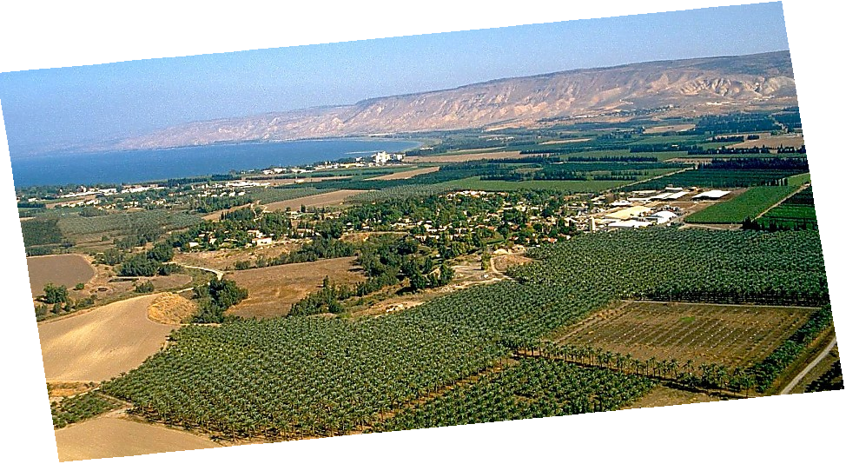
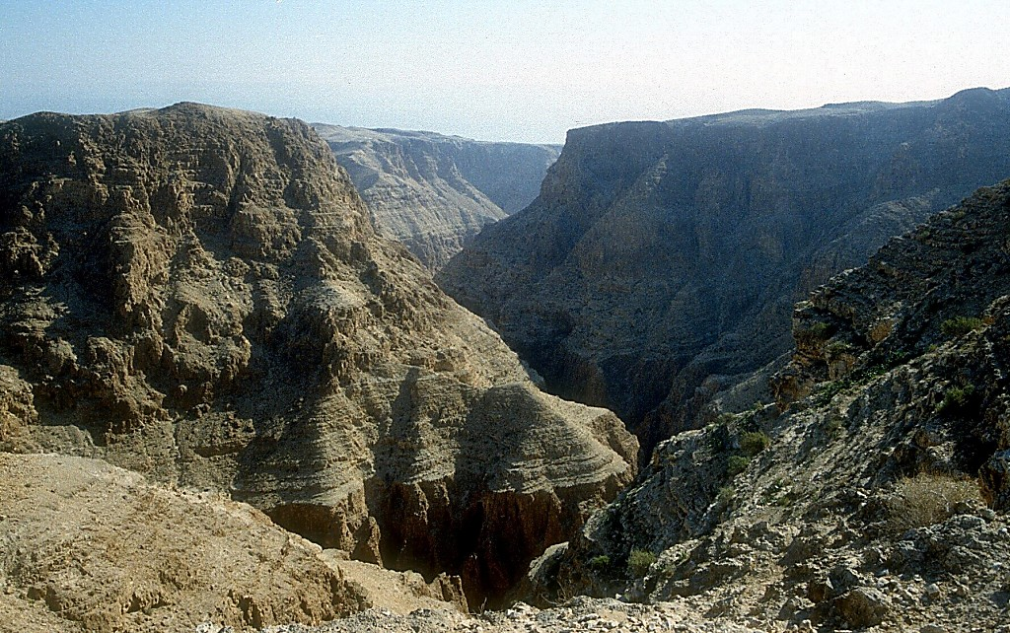
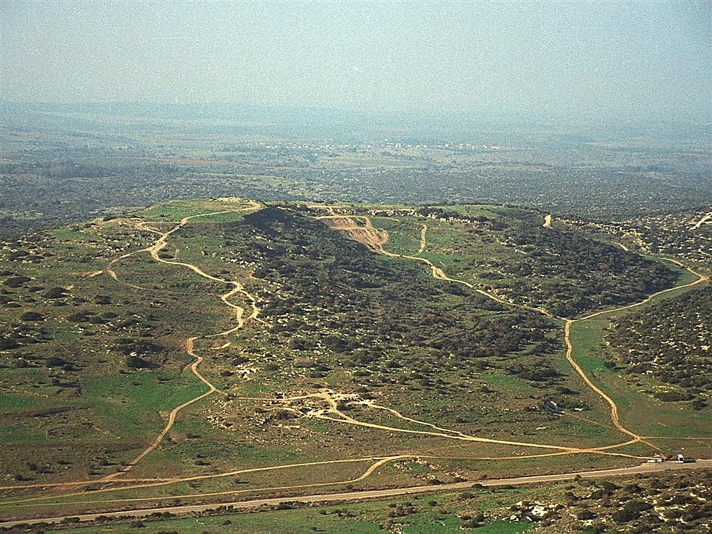
Hao. 13:10-11; Sho. 3:8
A PORTION OF ABRAHAM’S PROMISE,,,
ABRAHAM
The CALL
L - S - B
I - I
THE MARVELOUS BEAUTY OF CANAAN…THE LAND OF HIS ANCIENT INHERITANCE!
Israel lungli longkazat Jordan kong
Ngasoda kazat lairik pg.19-24
41
1
© 2006 TBBMI
9.6.03b.
Notes:
Achâlakhawui ngalei chi aruihon hithada lei… kha Varena Abrahamli ngashitmi kahai chiwui eina akai akhamânga… tumlâk kahaiya ngalei hi Israelwui Jordan Kongli leiya.
//// âli Shimluikat sâkhavai Ngashitmi kahaiya Ngalei! Tumlâk kahai ato eina haophokda rampho kahai aze tashungda…”seina eina khuira” khani hi mângna mathalâk kahai ngalei hiwui sokhami haokaphokna.

Slide 44
7
Sho. 2:24
ABRAHAM
ABRAHAM
ca. 2000 B.C.
Âli KAHO
AT
N - A - S
AJMJ
I - I
Hao. 12: 1-3
J - E
12
ABRAHAM
Âli KAHO
N - A - S
I - I
J - E
12
Ngashit kahaiwui Nao hi Jacobna!
NGASHIT KAHAIWUI THÂRÂNA!
Ngasoda kazat lairik pg.19-24
42
7
Notes:
Ara khararchan hi thâkmei kharda zattalei. ISSAC, ABRAHAMWUI nao Sarah wui mangâ eina, HI Varena ngashitmi kahai Naomayar-ra china.
//// ISAAC nao mayarnao khani leiya: JACOB kala ESAU (J kala E da Abrahamwui lairik sangkhavai lairik-kom chili yanglu). JACOBWUI mangâ eina sâmilak-ki kachi Tuingashit chi chisin maronna.
//// Jacob nao mayarnao 12 leiya (Abrahamwui lairik sangkhavai lairik-kom li mashing 12 leidalei)
//// Chithada sada…Ngashitmi kahaiwui mitun bing chi…
//// Abraham
//// Isaac
//// Jacob kala
//// Jacobwui nao mayarnao 12

Slide 45
7
Hao. 35:23-26; Hao. 34:1
ABRAHAM
ABRAHAM
ca. 2000 B.C.
Âli KAHO
AT
N - A - S
AJMJ
I - I
Hao. 12: 1-3
J - E
12
12
ABRAHAM
1
10
Âli KAHO
N - A - S
I - I
6
J - E
8
12
4
5
13
7
11
3
9
2
Ngasoda kazat lairik pg.19-24
43
Notes:
JACOBWUI nao mayar-ra bing 12 hi ama eina hithada chitheidalei, â kala âpareiva matili wuili okpeilâk eina okathuili pharaya. Nana theira nao 13 tharâda kakathumala leisâya… naongalâva akha. Kasâra Jacobwui nao mayar-ra 12 wui eina Israelwui shang 12 hi shok-ka.

Slide 46
7
Hao. 35:24
ABRAHAM
ABRAHAM
ca. 2000 B.C.
Âli KAHO
AT
N - A - S
AJMJ
I - I
Hao. 12: 1-3
J - E
12
ABRAHAM
Âli KAHO
N - A - S
I - I
J - E
12
11
Ngasoda kazat lairik pg.19-24
44
Notes:
Kha Jacobwui nao mayar-ra akhali rinsit eina theilu – mashing tharâda akhali kazangpâ, nganuimeikap kachi ngachaili -- kala naongarâwui ngachaili phaningungpai meithui kachi. Nao mayar-ra hipawui khararchan hi mi saikorana theiya:

Slide 47
7
Hao. 35:24
ABRAHAM
ABRAHAM
ca. 2000 B.C.
Âli KAHO
AT
N - A - S
AJMJ
I - I
Hao. 12: 1-3
J - E
12
ABRAHAM
Âli KAHO
N - A - S
I - I
J - E
12
JOSEPH!
11
Ngasoda kazat lairik pg.19-24
45
Notes:
Âwui aming hi JOSEPH. Phaolâk kahai mi akha – âwui aming hi thot kachida theiya –- kala Bible khararchanwui ningwui mapli âna mi matili ngasunra:

Slide 48
7
Hao. 1 wui eina thuilaga 25 eina tangda
OKATHUI KASEM
ROTKHAMARAT
1st Mayarnao & Shanao
1st Morei
O
1st Pao Kapha
1st Shimkhur
WUNGNAO
(1000 B.C.)
1st Sakathat
Tara Kaphong/Changimahut
Tolan Shim
(2000 B.C.)
ABRAHAM
(2000 B.C.)
O 7 V J
Âli KAHO
AT
N - A - S
I - I
3 MISHANG
J - E
12
NARKAHAI
7 = 4 + 3
JOSEPH
ABRAHAM
4 MIKUMO
Âli KAHO
N - A - S
I - I
MOSES
(1500 B.C.)
(500 B.C.)
J - E
V
S
VARI KAHAI
12
JISHU
J
JOSHUA
46
2
Notes:
Ara ithumn Biblewui lairik sangkhavai akhong kakhane chi peihaira:
//// khare chi OKATHUI KASEM
//// chiwui thili ABRAHAM, kahak-ka mi matiwui aming ngachaili rimeithuikachi.

Slide 49
7
AJMJ
MI 4 chiwui eina
KAKHANEPA
chi:
?
47
Notes:
Kachama Tuingashitli haklâk kahai mi matiwui kakhane ashang chi tamkhavai ngaran-usa…Bible Lairik sangkhavai Lairik-kom Mashing 3.
“Âli Jahei Milu Jo” kachiwui eina ithumna theiya kachiya âwui aming hi mayek J eina haophok-ka. Âhi…

Slide 50
7
Hao 30:24
AJMJ
MI 4 chiwui eina
KAKHANEPA
chi:
“JOSEPH”
48
Notes:
Joseph. Biblewui asak-avat ngachaili mipâ hili phaokhamei, theimikhamei khipâkha maleimana -- âwui ajei-arei kala Varewui mangâli ningkathar -- eina mikumowui thotchan ngacheiya.

Slide 51
7
Hao 30:24
HAIRAP KAHAI TARIK KHAMI:
ABRAHAM-JOSEPH 2000 B.C.
49
Notes:
Atamna… kharewui atam 2000 B.C wui châng chili haisa. Arui rashungdava ngarak-zak kahai tarik kathei darkâr masaranga. Chiwui vang eina achâlakhawui tarik kasâng bing chi phungkhavai hotkhanâli machotlu. BIBLE NGASHANKAKHUI hili tarik chithei kahai bing hiya kashok-kazang hi khare-khanao athishurda theipaimeikhavai hairap kahai tarik khamina. Nana naoda ngarakzak meida theipaiya.

Slide 52
7
Hao. 30:24 wui eina thuilaga Hao. 50:26 eina tangda
OKATHUI KASEM
“Ali
JAHEI
Milu
Jo”
ABRAHAM
ABRAHAM
ABRAHAM
JOSEPH
ABRAHAM
MOSES
JOSHUA
ROTKHAMARAT
WUNGNAO
NARKAHAI
VARI KAHAI
JISHU
Ngasoda kazat lairik pg.24-25
50
Notes:
Kala hili Josephwui Bible lairik sangkhavai akhong leidalei.
“ÂLI JAHEI MILU JO”…. Khare “J” hina ningli phaningung ngasak-ka: JOSEPH.

Slide 53
7
JOSEPH
ABRAHAM
MI 4 chiwui eina
KAKHANEPA
chi:
JOSEPH
AJMJ
Ngasoda kazat lairik pg.24-25
51
Notes:
JOSEPHWUI lairik sangkhavai akong hi matailâk kahai otshot khaniwui vang ngaran haira. Nganuizao kahai yaronpâ hi âshâvâ, JACOB na leishilâk-ka -- thuklâk eina kala phongsharlâk eina, kachangkhat…

Slide 54
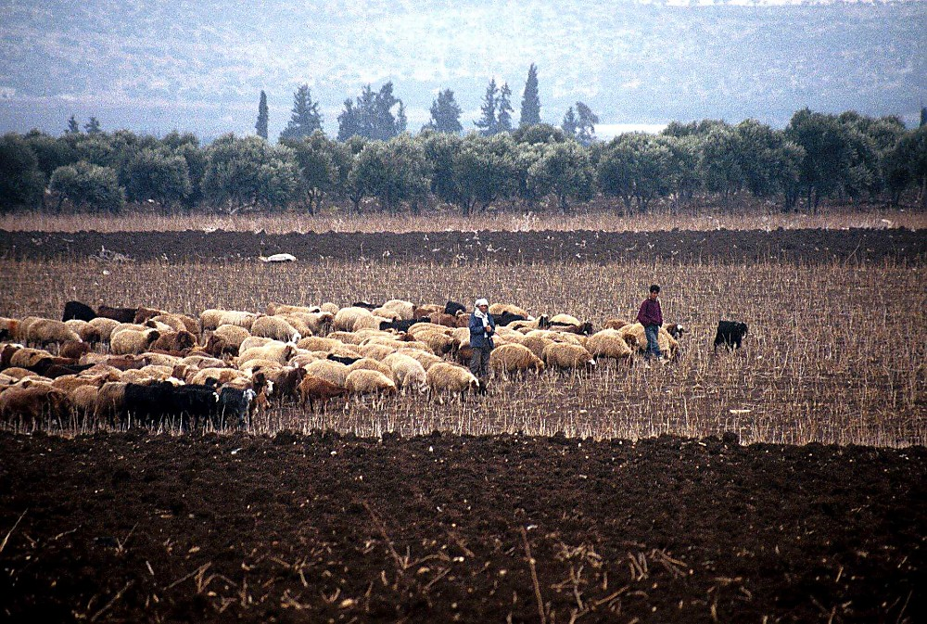
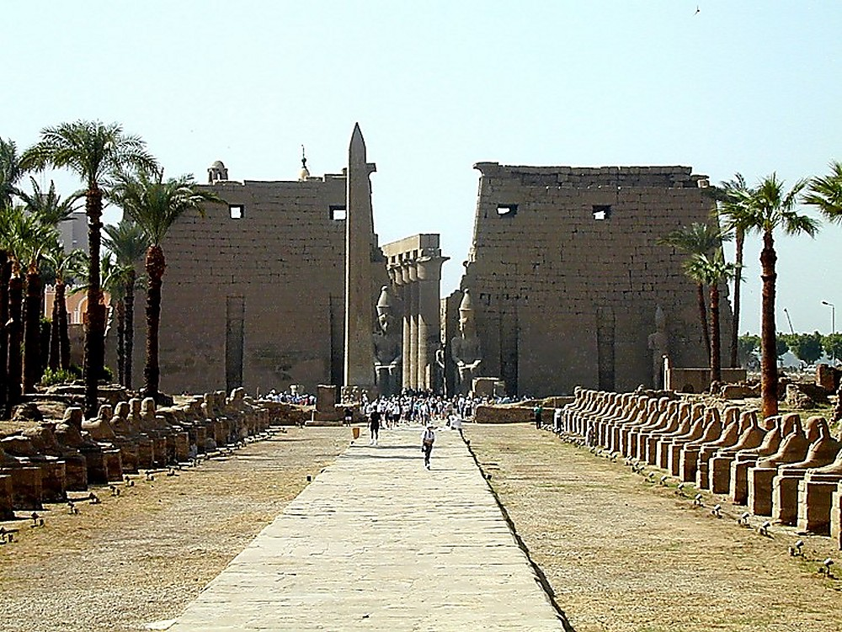
Hao. 37:16-18
Egyptli khalei Luxor kachiwui kameoshim
JOSEPH
Israelli, Dotham kachi apamli Yaokahombing luili yao homkazat
Ngasoda kazat lairik pg.24-25
52
1
Notes:
…china amei ngarâ bingli yuishi ngasak-ka. Chiwui atam chitharan aruihon atamli Dothan da Israel atoshong khalei luipamli yao hom-ma…
//// ama ngarâ bingna JOSEPHLI hâtkhavai ngarn-na, Egyptli vâkhavai ramkazatta bingli rao sakhavai yorsang haowa.

Slide 55
Hao. 37:28
JOSEPH
Ngasoda kazat lairik pg.24-25
53
Notes:
Egyptli vakazang eina…sina-lupa lan kala matak-khak kahai atam chithranwui reikasang…kala chotlâk kahai kachot kachângwui thili… JOSEPH hi thangmeilâk kahai kala khamungwui thangmet leilâk kahaiya mayarnao akhana kachi chi theihaowa. Âna thâklâk eina tamkhui-shakhuiya kala Varewui thankhami chiza khami chili kahâng nganada okthuiya.

Slide 56
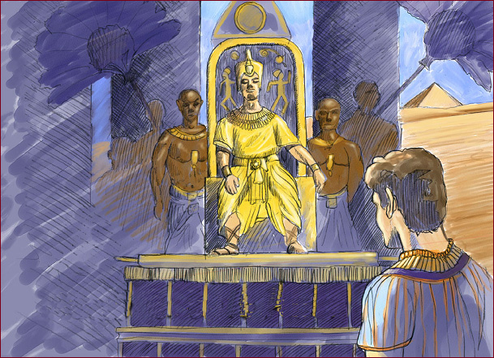
Hao. 41:41-46
JOSEPH
Joseph wungpamkhongli kapamhaowa
Ngasoda kazat lairik pg.24-25
54
Notes:
Atamwui lungli JOSEPH hi yaruipânli pangshap shokmamân haowa. Âhi Egypt ngaleiwui ram-munga akha ngasâhaowa, âwui atungli hak-khamei hi Pharao manga.

Slide 57
Hao. 42:2
HAOPHOK
KHAVAI
KHANGARAN
MN
N(A)
ZAT KATANG!
H
GN
C
EK
B
J
NK
JOSEPH
MN
E
KB
U
TARAKKHA KHALEI!
SK
PG
RS
Ngasoda kazat lairik pg.24-25
55
1
Notes:
Atam chitharan, Canaanli, Ngalei chili chamrei raya.
//// Kasak-ka atam chili ringkhavai, JOSHEPHWUI avâ, kasâr-ra JACOB (ara Israel da hokahai), chinao ngarâ kaikha sâm lokhavai Egyptli chihovaya. ATOSHONGLI CHÂMREI… AZESHONGLI SORKHANGASAI. (Nawui mapli, majut kapai akhân chi Canaan wui eina haophok laga Egypt tashungda khântâ haolu.)

Slide 58
Hao. 42:7
Joseph kala Âli meinaongara
JOSEPH
Ngasoda kazat lairik pg.24-25
56
Notes:
Kumei katha otshot tarâkha shok laga – meisâ eina Haokaphokwui akuplamshongli hângchithei haidalei – âchinâ ngarâ bingna kathei samphanga chiya athumwui agato, JOSEPH, hi ara Egypt wui ram-mungana.

Slide 59
Hao. 46:3-7
HAOPHOK
KHAVAI
KHANGARAN
MN
N(A)
H
GN
C
EK
B
J
SHIMKHURLA SHURVA HAOWA…
SHIMKHUR HI YUR AKHA NGASARA!
NK
JOSEPH
MN
E
KB
U
SK
PG
RS
Ngasoda kazat lairik pg.24-25
57
Notes:
Shimkhur china thishur-raya kala Egyptli pamchang-pam khavai tuitak khui haowa. Kala chili…Hebrewnao bingwui shimkhur akha ngasada…athumwui yur akha sakhavai mayâsanga, thotchan peichaoda Israelnao bingda theiya.

Slide 60
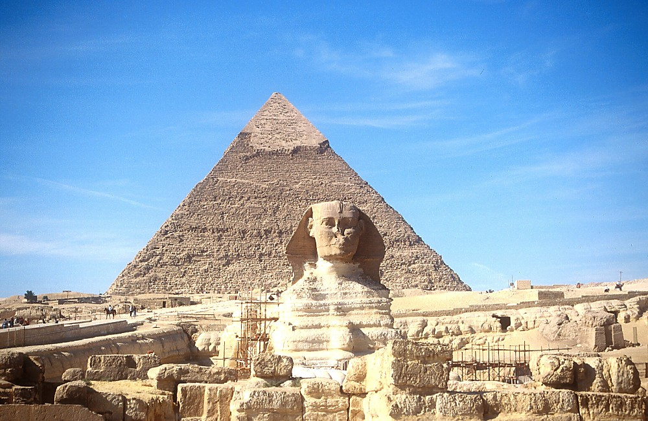
7
JOSEPH
Sphinx kala Phaolak kahai Pyramid kachi chi
Ngasoda kazat lairik pg.24-25
58
Notes:
Atam kashakhawui vang, athum hi Egyptnao bingli kala shorkârli mashitri eina okthuiya. Khiwui vang khala chiakha, athum hi ram-munga akhawui shimkhurna! Athum hi aruihon ithumna matak-khak kahai Sphinx kala pyramids kaho hila theidaleira.

Slide 61
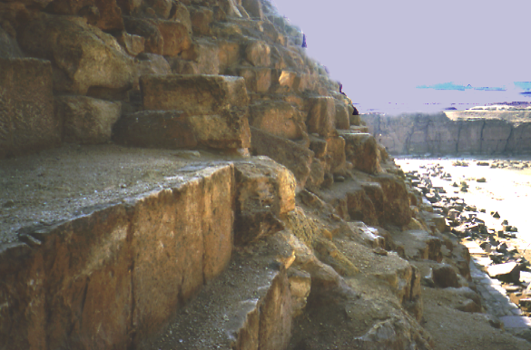
7
JOSEPH
Pyramidwui lungkui semka kahai pamchi
Ngasoda kazat lairik pg.24-25
59
Notes:
Ithumna Kahak-ka Pyramid kaho chiwui thâkli yak-kâ laga phaninga: lung-gui bing hi Josephwui shimkhur ngarâna naoda zingkum shâ-shâwui thili rao ngasada semka-kâ chila? Chilapaiya. Kachikatha otshotna chithada shakhi saya.

Slide 62
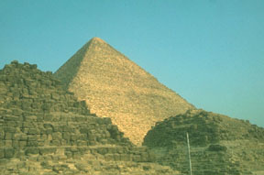
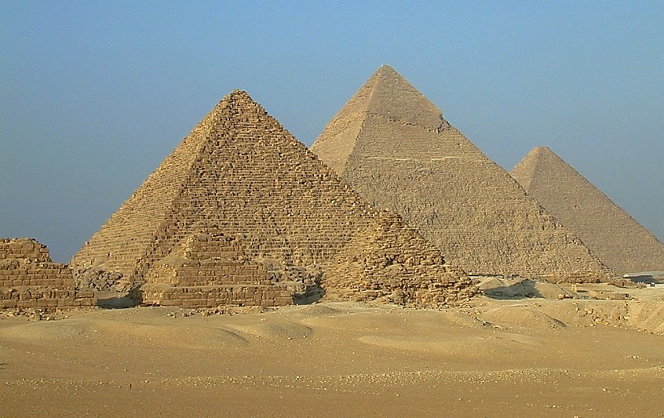
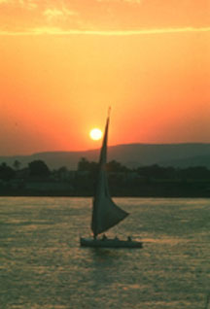
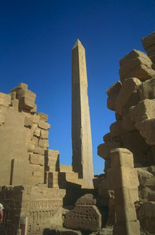
7
ISRAELNAONA THEIYA…
JOSEPH
…EGYPTWUI TEK-KHAMATEI CHI.
Ngasoda kazat lairik pg.24-25
60
Notes:
Atam kanma-mân-uda Joseph thihaowa, achâlakhawui tek-khamatei chi Egyptwui wung-pamkhong kala miyur bingwui asak-avat khangachei kala Hebrew naobingli -- maningkha Israel naobing, Jospehwui shimkhurli kayâkashi suikatâ katheila samphang daleira.

Slide 63
Sho. 8:8-10
JOSEPH
ABRAHAM
RAO KASA
AJMJ
Notes:
Â thikahai thili, Josephwui sânglâk eina Egyptli otram khangatha chi malai haowa.
//// Atam chitharan, mishânla, Israel nao binghi thaklâk eina mataisanga – nao tarâkha pharaya –
[KACHITHEI: “NAO NGARAWUI DOTS” AKHUM SHINI SHOKRA]
/// Israel nao bing, Josephwui thârâ binghi Egypt nao bingwui RAO ngasathui haowa.
//// Israel naobing hi Egypli zingkum 430 shakha leiya. Zingkum sangkhamei atam chitharanva Egypt miyur bingwui rao akhavâwui azingli chot-changlâk eina okthuiya.

Slide 64
7
Hao. 1:1 eina thuilaga Sho. 1:6 eina tangda
OKATHUI KASEM
ROTKHAMARAT
1st Mayarnao & Shanao
1st Morei
O
1st Pao Kapha
1st Shimkhur
WUNGNAO
(1000 B.C.)
1st Sakathat
Tara Kaphong/Changimahut
Tolan Shim
(2000 B.C.)
ABRAHAM
(2000 B.C.)
O 7 V J
Âli KAHO
AT
N - A - S
I - I
3 MISHANG
J - E
12
NARKAHAI
7 = 4 + 3
JOSEPH
JOSEPH
Rao kasa
Rao kasa
4 MIKUMO
430
430
MOSES
(1500 B.C.)
(500 B.C.)
V
S
VARI KAHAI
JISHU
J
JOSHUA
Ngasoda kazat lairik pg.24-25
62
Notes:
Ara… BIBLE LAIRIK-KOM…hi chipuisang haora
OKATHUI KASEM, ABRAHAM, kala JOSEPH…

Slide 65
7
AJMJ
MI 4 chiwui eina
KAKATHUMA
chi:
?
63
Notes:
…hina ithumli ara Biblewui kahak-ka mi Matiwui li Ashang kakathumali tângasak haira.
Kahak-ka mi – MAYEK KAHAK-KA M – hinava...

Slide 66
7
Sho. 2:10
AJMJ
MI 4 chiwui eina
KAKATHUMA
chi:
“MOSES”
64
Notes:
…MOSES.
Awui atamli, Varena Kachama Tuingashitli phaomeithui kachi mi shok ngasak-ka, MOSES, kahak-ka Ngatangkhamei dala theiya…
mibing chili Egyptli narkapamwui eina khuishok lagaAbrahamli ngashitmi kahai shimluikat chili vakhavai.

Slide 67
65
©2006 TBBMI
9.6.03b.

