Slide 1

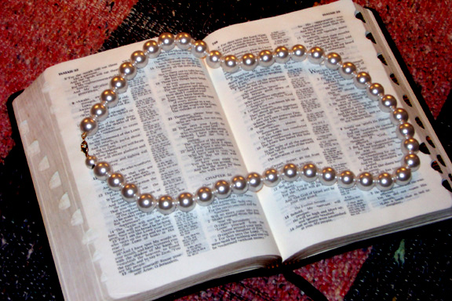
ITHUMNA HENRIETTA WUI CHA RUIKAKHUI THADA ATAM TARAKHA ZANGHAIRA...
Akatang
Notes:
We've spent a lot of time restringing Henrietta's pearls…
to bring together a clear view of THE BASIC DOCUMENT OF OUR FAITH…
THE BIBLE. We have brought together a limited number of people,
a limited number of locations and details,
all of it bound together with the idea of A STORY based on A PROMISE…
so we might bring the pearls of this beautiful necklace of Scripture together –
and all in a high-level view of organization and purpose. And now the collection of gems is complete.

Slide 2

Bible…
Ngashankakhui
Bible…Ngashankakhui Otsin International Inc. Fort Worth, Texas
wui tamkachithei
8.0.01.
©2004 TBBMI
04

Slide 3
Aruiva
‘kathahao?’
01
1
Notes:
//// NOW COMES THE BIG SO WHAT!

Slide 4
Ithumna munlak eina matailak kahaibing chi pheihaira…
02
Notes:
We have closely explored a fundamental idea…

Slide 5
“Ithumwui shitkasang hi akajangli pheisin masarang laga va, shitkasang chi khalatkhui phâphâ kachi, shitsang phâphâ kachi kala phab eina kazat ngasahaora”
Miles Stanford
Principles of Spiritual Growth
akajangli
khalatkhui
phâphâ kachi
shitsang phâphâ
kachi
phab eina kazat
03
4
Notes:
Unless our faith is established on
//// …facts, it is no more than…
//// …conjecture,
//// ...superstition and
//// …presumption.

Slide 6
ITHUMNA HENRIETTA WUI CHA RUIKAKHUI THADA ATAM TARAKHA ZANGHAIRA...
ITHUMWUI SHITKASANGWUI KHAMATAIYA LAIRIK
04
Notes:
We've spent a lot of time restringing Henrietta's pearls…
to bring together a clear view of THE BASIC DOCUMENT OF OUR FAITH…
THE BIBLE. We have brought together a limited number of people,
a limited number of locations and details,
all of it bound together with the idea of A STORY based on A PROMISE…
so we might bring the pearls of this beautiful necklace of Scripture together –
and all in a high-level view of organization and purpose. And now the collection of gems is complete.

Slide 7
  Ara athum rakazip kahai wuivang…
ITHUMWUIVANG SAKLAK KAHAI KHANGAHAN KHANI LEIYA.
05
Notes:
Now that they have come together…
We are left with two crucial questions…

Slide 8
Khangahan Khare:
Varewui Tuili zatrashum kahai wui thili…
Khrista nani khangashik chili na kali leili?
©2005 TBBMI
9.65.09.
2
06
Notes:
Question Number One:
//// After this journey through the Word of God…
//// Where are you in relation to OUR LORD JESUS CHRIST?

Slide 9
Prohowui pangli na ning nganungkhung eina pam lapaiya.
KHA NA CHI THEISHING KAKHUI MALEIRAR AKHA…
©2005 TBBMI
07
1
9.65.09.
Notes:
You may already be safe in the arms of your Lord…your eternal future secure!
//// But if you are not certain…

Slide 10
ICHAM-CHAM EINA HORSANGCHAO DA SEIHA KASA HINA KATANG MAKHAVAI MIRINWUI NGAVEI NGASAPAIYA…
©2005 TBBMI
9.65.09.
08
Notes:
A simple prayer of relinquishment can become your gateway to life eternal.
Will you pray that simple prayer with me?

Slide 11
“Proho Jishu, nana ili Bible hi Krushli nana iwui mahut eina khi samihirakhala kachi hangchithei khavai miya.
09
©2005 TBBMI
9.65.09.
Notes:
“Lord Jesus, you gave this Bible to me to tell me of your work on the Cross in my behalf.

Slide 12
“Proho Jishu, nana ili Bible hi Krushli nana iwui mahut eina khi samihirakhala kachi hangchithei khavai miya. Ara ina iwui khangazan kala makathuk katonga hangphat laga rarali.
10
©2005 TBBMI
9.65.09.
Notes:
I come to you now fully confessing my entire shortcomings, all my failures.

Slide 13
“Proho Jishu, nana ili Bible hi Krushli nana iwui mahut eina khi samihirakhala kachi hangchithei khavai miya. Ara ina iwui khangazan kala makathuk katonga hangphat laga rarali. I mapung kapha mi ngasahaira.
11
©2005 TBBMI
9.65.09.
Notes:
I am incomplete .

Slide 14
“Proho Jishu, nana ili Bible hi Krushli nana iwui mahut eina khi samihirakhala kachi hangchithei khavai miya. Ara ina iwui khangazan kala makathuk katonga hangphat laga rarali. I mapung kapha mi ngasahaira. I morei kaphunga mi ngasasaya.
12
©2005 TBBMI
9.65.09.
Notes:
I am a sinner who has missed the mark.

Slide 15
“Proho Jishu, nana ili Bible hi Krushli nana iwui mahut eina khi samihirakhala kachi hangchithei khavai miya. Ara ina iwui khangazan kala makathuk katonga hangphat laga rarali. I mapung kapha mi ngasahaira. I morei kaphunga mi ngasasaya. I nawui pheokhami, chizakhami chanradalei– arui kala khanao eina tangda.
13
©2005 TBBMI
9.65.09.
Notes:
I am seeking your forgiveness, your direction – now and eternally.

Slide 16
“Proho Jishu, nana ili Bible hi Krushli nana iwui mahut eina khi samihirakhala kachi hangchithei khavai miya. Ara ina iwui khangazan kala makathuk katonga hangphat laga rarali. I mapung kapha mi ngasahaira. I morei kaphunga mi ngasasaya. I nawui pheokhami, chizakhami chanradalei– arui kala khanao eina tangda. Arui atam hitharan ina nawuili rada nawui huikhami hi khuiga.
14
©2005 TBBMI
9.65.09.
Notes:
At this moment I reach up to you and grab hold of your salvation.

Slide 17
“Proho Jishu, nana ili Bible hi Krushli nana iwui mahut eina khi samihirakhala kachi hangchithei khavai miya. Ara ina iwui khangazan kala makathuk katonga hangphat laga rarali. I mapung kapha mi ngasahaira. I morei kaphunga mi ngasasaya. I nawui pheokhami, chizakhami chanradalei– arui kala khanao eina tangda. Arui atam hitharan ina nawuili rada nawui huikhami hi khuiga. Iwui mirinli razangmilu. Chipem milu. Chizamilu.
15
©2005 TBBMI
9.65.09.
Notes:
Come into my life. Fill it. Direct it.

Slide 18
“Proho Jishu, nana ili Bible hi Krushli nana iwui mahut eina khi samihirakhala kachi hangchithei khavai miya. Ara ina iwui khangazan kala makathuk katonga hangphat laga rarali. I mapung kapha mi ngasahaira. I morei kaphunga mi ngasasaya. I nawui pheokhami, chizakhami chanradalei– arui kala khanao eina tangda. Arui atam hitharan ina nawuili rada nawui huikhami hi khuiga. Iwui mirinli razangmilu. Chipem milu. Chizamilu. Nana ili kathada ringasakngai khala kachi chi nawui eina tamkhui ngasak miluishitlu.
16
©2005 TBBMI
9.65.09.
Notes:
Help me to learn all over again how to live as You would have me to live.

Slide 19
“Proho Jishu, nana ili Bible hi Krushli nana iwui mahut eina khi samihirakhala kachi hangchithei khavai miya. Ara ina iwui khangazan kala makathuk katonga hangphat laga rarali. I mapung kapha mi ngasahaira. I morei kaphunga mi ngasasaya. I nawui pheokhami, chizakhami chanradalei– arui kala khanao eina tangda. Arui atam hitharan ina nawuili rada nawui huikhami hi khuiga. Iwui mirinli razangmilu. Chipem milu. Chizamilu. Nana ili kathada ringasakngai khala kachi chi nawui eina tamkhui ngasak miluishitlu.
Ili shim thanung milu.
17
©2005 TBBMI
9.65.09.
Notes:
Bring me home.

Slide 20
“Proho Jishu, nana ili Bible hi Krushli nana iwui mahut eina khi samihirakhala kachi hangchithei khavai miya. Ara ina iwui khangazan kala makathuk katonga hangphat laga rarali. I mapung kapha mi ngasahaira. I morei kaphunga mi ngasasaya. I nawui pheokhami, chizakhami chanradalei– arui kala khanao eina tangda. Arui atam hitharan ina nawuili rada nawui huikhami hi khuiga. Iwui mirinli razangmilu. Chipem milu. Chizamilu. Nana ili kathada ringasakngai khala kachi chi nawui eina tamkhui ngasak miluishitlu.
Ili shim thanung milu. Hak-khamaha nawui mingli ina seiha hi kasana.
18
©2005 TBBMI
9.65.09.
Notes:
I pray this in your incomparable Name.

Slide 21
“Proho Jishu, nana ili Bible hi Krushli nana iwui mahut eina khi samihirakhala kachi hangchithei khavai miya. Ara ina iwui khangazan kala makathuk katonga hangphat laga rarali. I mapung kapha mi ngasahaira. I morei kaphunga mi ngasasaya. I nawui pheokhami, chizakhami chanradalei– arui kala khanao eina tangda. Arui atam hitharan ina nawuili rada nawui huikhami hi khuiga. Iwui mirinli razangmilu. Chipem milu. Chizamilu. Nana ili kathada ringasakngai khala kachi chi nawui eina tamkhui ngasak miluishitlu.
Ili shim thanung milu. Hak-khamaha nawui mingli ina seiha hi kasana. Iwuivang nana samikahai zaikora chiwuivang ningshiya. Amen”
19
©2005 TBBMI
9.65.09.
Notes:
Thank you for all you have done for me. Amen.”

Slide 22
“Proho Jishu, nana ili Bible hi Krushli nana iwui mahut eina khi samihirakhala kachi hangchithei khavai miya. Ara ina iwui khangazan kala makathuk katonga hangphat laga rarali. I mapung kapha mi ngasahaira. I morei kaphunga mi ngasasaya. I nawui pheokhami, chizakhami chanradalei arui kala khanao eina tangda. Arui atam hitharan ina nawuili rada nawui huikhami hi khuiga. Iwui mirinli razangmilu. Chipem milu. Chizamilu. Nana ili kathada ringasakngai khala kachi chi nawui eina tamkhui ngasak miluishitlu.
Ili shim thanung milu. Hak-khamaha nawui mingli ina seiha hi kasana. Iwuivang nana samikahai zaikora chiwuivang ningshiya. Amen”
SHIMLI UNGLU!
20
©2005 TBBMI
9.65.09.
Notes:
Your life may very well be changed from this moment on! AND WELCOME HOME!

Slide 23
Nana seiha chi ningzanglak eina, khuimi phalungra da kala razang milaklu da sa-akha, nawui huikhami mashimanlui mara.
Manglâ Kathara chi ara nawui wuklungli pamhaida nawui huikhami hi Mashimanluimara.
NALI MASHUNGMI HAIRA!
ARAVA.. NAWUI MANGLÂRIN RARKASANG
NAWUI THARKHANGASAK…
JISHU KHRISTAWUI LUNGLI HAOPHOHAIRA
21
3
©2005 TBBMI
9.65.09.
Notes:
If you prayed that prayer with sincerity, conviction and invitation, your salvation is assured! Our Bible promises that!
//// The Holy Spirit now resides in your heart and your eternal life is ALSO assured.
//// YOU HAVE BEEN JUSTIFIED!
//// And now…your spiritual growth…YOUR SANCTIFICATION…in Jesus Christ has just begun.

Slide 24
KHANGAHAN KAKHANE:
Varewui Tuili zatrashum kahai wui thili…
BIBLE HILI HANGKAHAI TUI EINA NAWUI KHANGASHIK KALI LELI?
22
2
Notes:
Now we come to Question Number Two:
//// After this journey through the Word of God…
//// Where are you in your relationship to this book and its message?

Slide 25
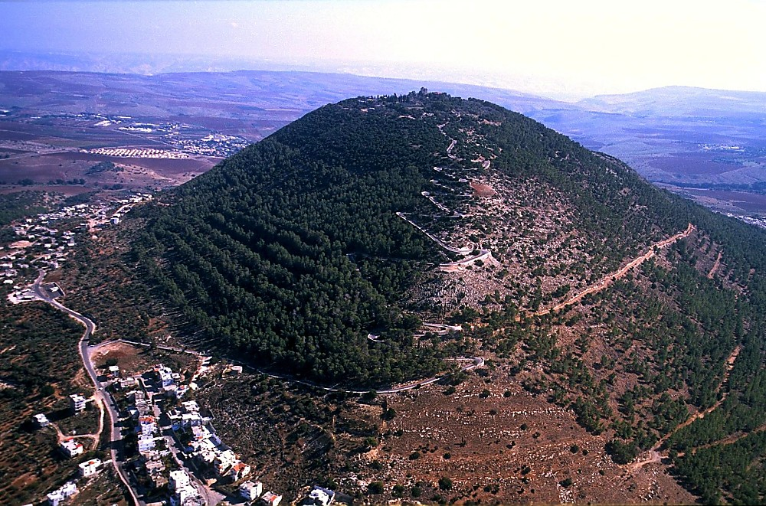
Mt Tabor aerial from northwest
“Chiwui thili sakhangatha tharâda akha china Khristana hangkahai takam eina Galilee wui kaphungli vahaowa.”
Matt. 28:16 (NIV)
Tabor Kaphung Galilee, Ato Israel
JISHU KHRISTA WUI KAKASO:
“All authority in heaven and on earth has been given to "Kazingramlila kala okathuilila pangshap katonga ili mihaira. Chiwuivang eina vada yurjat hupvali sakhangatha sangasaklo, Avava kala Anaomayara kala Mangla Kathara wui ming singda rahikmilu, kala iwui tamkachitheibing chi
mayon ngasaklu. Kala yanglu, Ina nathumli khanao eina tangda ngasomichingra."Matt 28:18b-20 (NIV)
Chiwuivang eina vada yurjat hupvali sakhangatha
kala iwui tamkachitheibing chi
mayon ngasaklu
23
5
©2005 TBBMI
9.65.09.
Notes:
Our Lord Himself was very clear on this point…Matthew's Gospel tells us…
//// ”Then the eleven disciples went to Galilee, to the mountain where Jesus had told them to go.” That mountain could well have been this one…Mount Tabor…
//// The Lord then issued THE GREAT COMMISSION to the disciples first and then…by extension…to every believer for all time to come:
//// He said…“All authority in heaven and on earth has been given to me.
//// Therefore go and make disciples of all nations, baptizing them in the name of the Father and of the Son and of the Holy Spirit, and
//// ….teaching them to obey everything I have commanded you. And surely I am with you always, to the very end of the age.”

Slide 26
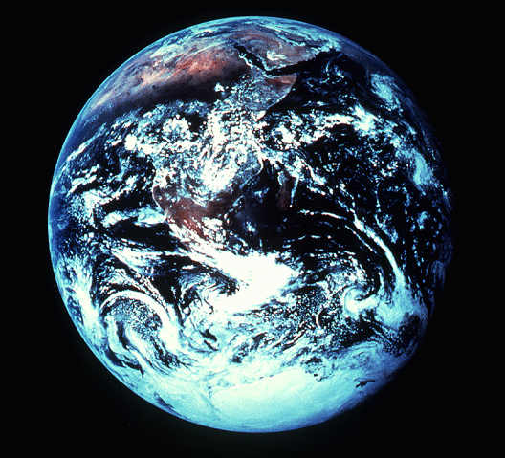
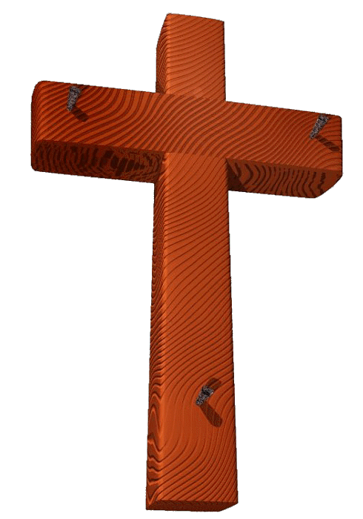
NA SHITKASANGA MI AKHA
Peterna ithumli 1 Peter 3:15 khi sara kala kathada sara kachi chi ngarakzak eina hangmihai dalei!
24
1
©2005 TBBMI
9.65.09.
Notes:
But if already you are a believer…
//// Peter tells us in his first letter, chapter 3, verse 15…exactly what we are to do and how to do it. He gently commands us in this way…

Slide 27
1 Peter 3:15 (NIV)
“Kha nawui wuklungna Khrista hi Prohona da thei akha. Mi kateili nana kachihan khalei wui shakhi mishap khavai atam kachida ngaranlo. Kha nimsor eina kala khayashida salu.”
25
©2005 TBBMI
9.65.09.
Notes:
[auto advance through #36]
“But in your hearts set apart Christ as Lord. Always be prepared to give an answer to everyone who asks you to give the reason for the hope that you have. But with gentleness and respect.”

Slide 28
1 Peter 3:15 (NIV)
“Kha nawui wuklungna Khrista hi Prohona da thei akha. Mi kateili nana kachihan khalei wui shakhi mishap khavai atam kachida ngaranlo. Kha nimsor eina kala khayashida salu.”
26
©2005 TBBMI
9.65.09.
Notes:
auto-advance during reading…

Slide 29
1 Peter 3:15 (NIV)
“Kha nawui wuklungna Khrista hi Prohona da thei akha. Mi kateili nana kachihan khalei wui shakhi mishap khavai atam kachida ngaranlo. Kha nimsor eina kala khayashida salu.”
27
©2005 TBBMI
9.65.09.
Notes:
auto-advance during reading…

Slide 30
1 Peter 3:15 (NIV)
“Kha nawui wuklungna Khrista hi Prohona da thei akha. Mi kateili nana kachihan khalei wui shakhi mishap khavai atam kachida ngaranlo. Kha nimsor eina kala khayashida salu.”
28
©2005 TBBMI
9.65.09.
Notes:
auto-advance during reading…

Slide 31
1 Peter 3:15 (NIV)
“Kha nawui wuklungna Khrista hi Prohona da thei akha. Mi kateili nana kachihan khalei wui shakhi mishap khavai atam kachida ngaranlo. Kha nimsor eina kala khayashida salu.”
29
©2005 TBBMI
9.65.09.
Notes:
auto-advance during reading…

Slide 32
1 Peter 3:15 (NIV)
“Kha nawui wuklungna Khrista hi Prohona da thei akha. Mi kateili nana kachihan khalei wui shakhi mishap khavai atam kachida ngaranlo. Kha nimsor eina kala khayashida salu.”
30
©2005 TBBMI
9.65.09.
Notes:
auto-advance during reading…

Slide 33
1 Peter 3:15 (NIV)
“Kha nawui wuklungna Khrista hi Prohona da thei akha. Mi kateili nana kachihan khalei wui shakhi mishap khavai atam kachida ngaranlo. Kha nimsor eina kala khayashida salu.”
31
©2005 TBBMI
9.65.09.
Notes:
auto-advance during reading…

Slide 34
1 Peter 3:15 (NIV)
“Kha nawui wuklungna Khrista hi Prohona da thei akha. Mi kateili nana kachihan khalei wui shakhi mishap khavai atam kachida ngaranlo. Kha nimsor eina kala khayashida salu.”
32
©2005 TBBMI
9.65.09.
Notes:
auto-advance during reading…

Slide 35
1 Peter 3:15 (NIV)
“Kha nawui wuklungna Khrista hi Prohona da thei akha. Mi kateili nana kachihan khalei wui shakhi mishap khavai atam kachida ngaranlo. Kha nimsor eina kala khayashida salu.”
33
©2005 TBBMI
9.65.09.
Notes:
auto-advance during reading…

Slide 36
1 Peter 3:15 (NIV)
“Kha nawui wuklungna Khrista hi Prohona da thei akha. Mi kateili nana kachihan khalei wui shakhi mishap khavai atam kachida ngaranlo. Kha nimsor eina kala khayashida salu.”
34
©2005 TBBMI
9.65.09.
Notes:
auto-advance during reading…

Slide 37
1 Peter 3:15 (NIV)
“Kha nawui wuklungna Khrista hi Prohona da thei akha. Mi kateili nana kachihan khalei wui shakhi mishap khavai atam kachida ngaranlo. Kha nimsor eina kala khayashida salu.”
35
©2005 TBBMI
9.65.09.
Notes:
auto-advance during reading…

Slide 38
1 Peter 3:15 (NIV)
“Kha nawui wuklungna Khrista hi Prohona da thei akha. Mi kateili nana kachihan khalei wui shakhi mishap khavai atam kachida ngaranlo. Kha nimsor eina kala khayashida salu.”
36
©2005 TBBMI
9.65.09.
Notes:
“BUT WITH GENTLENESS AND RESPECT.”
BECAUSE…

Slide 39
Okathuina ngaraidalei.
37
©2005 TBBMI
9.65.09.
Notes:
The world is waiting.

Slide 40
Ningsangda nganâ khami wuivang ningshiya!
The Bible…Basically
Ministries International Inc.
Fort Worth, Texas
John E. Fryman, (Ph.D) na phaninglaga kala machuk laga phakashokna.
Amabing hiwuivang hangda khalei athumli ningshiya: Todd Bolen, Jerusalem, Israel;
BiblePlaces.Com; Holyland Hotel, Jerusalem, Israel; kala Dr. Leen Ritmeyer, Hawthornedene,
Australia
©2005 TBBMI
38

Slide 41
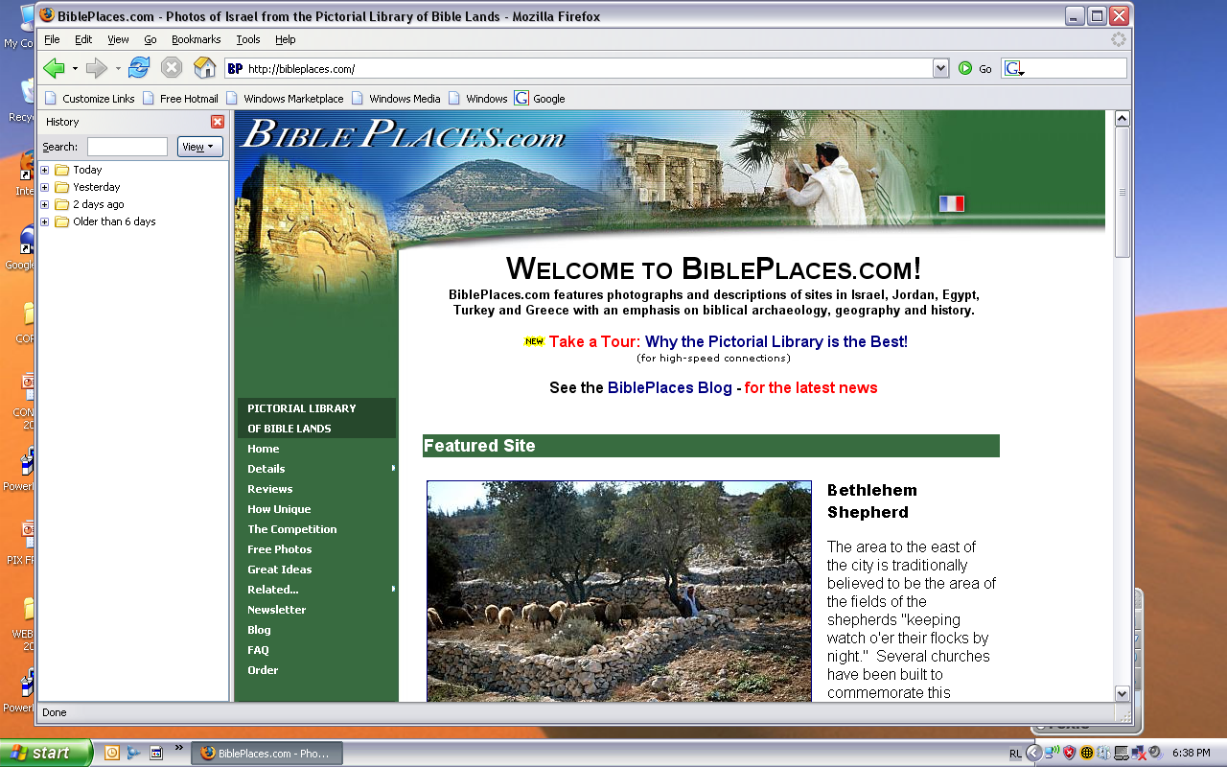
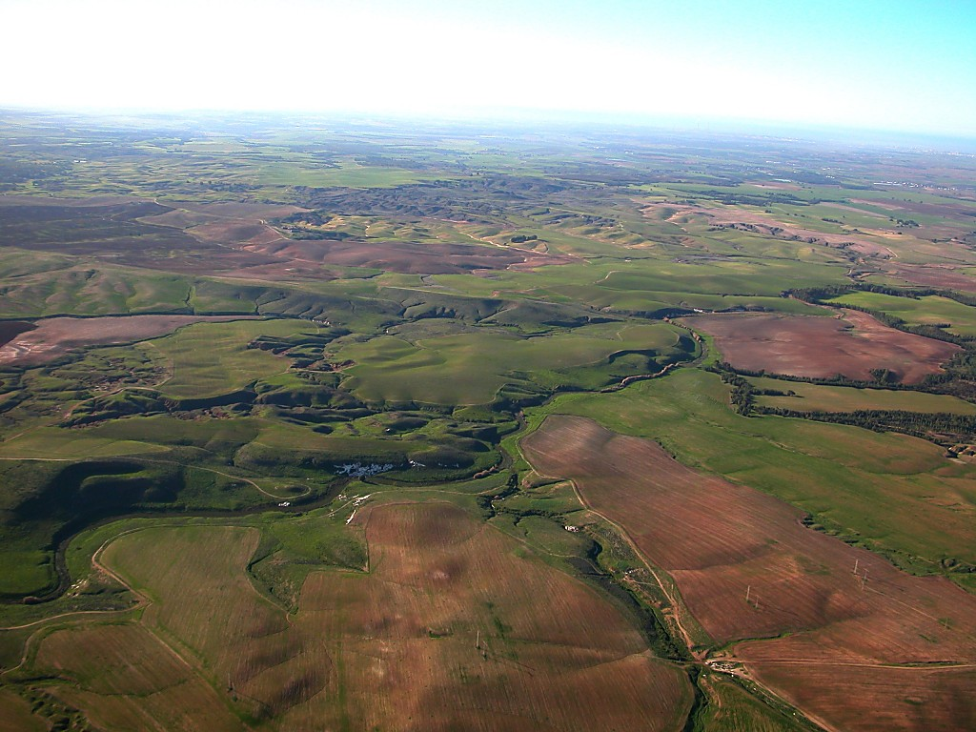
The Pictorial Library of Bible Lands
Bibleli kazanga ngaleibingwui ‘ama-shim’ (pictorial library) phashok khame Todd Bolen li amabing hi sichin khangasak wuivang ishi ministryna ningkashi midalei.THE BIBLE…BASICALLY®. TBB sikachina bingna www.BiblePlaces.com li zanglaga yangakha Kathara Ngalei, Aegean kala Mediterranea wui kongphei eina thuilaga Europe wui Aze- Vareshi haophok khavaiwui angayung apambing hiwui ama tarakha samphangra. BiblePlace.com na chishutmebing kala ama khanambing sichin kapai ama shenglak kahai tarakha leiya. Lumashanda website chili yangmilu.
Todd li Ningshiya.
Notes:
Once again, we are indebted to BiblePlaces.com for the many images used. We encourage you to consult this website for 7000 images.

Slide 42
NALI ningshiya ithumwui ministry…
Bible…
Ngashankakhui
Bible…Ngashankakhuina Ministries International Inc.
pashina semkashok • Fort Worth, Texas
9.65.09.
©2004 TBBMI
39
Notes:
Our thanks to you from the ministry of THE BIBLE…BASICALLY.
[DIZ TO…]

Slide 43
40
©2005 TBBMI
9.65.09.
Notes:
Thanks for your kind attention. [from the TBB Ministry]

Slide 44


Bible Ngashȃnkakhui • BibleStudyDownloads.org
Hiwuili zangdakhaleihi tamkachitheiwui aponglinai. Kachisat binghi kalemeina samphangpaira
Notes:
The Bible…Basically (bb)

