Slide 1
“Hārkahaiya”
BIBLE
ĀKHUM
kala
ĀKAI
Ngarānkazak kahai……..Phāsang reisang mamān........ Ātam makhavai
A Ministry of ScriptureTechnologies International
©2006 TBBMI
Notes:
We call this section, THE OPENED BIBLE….because…
//// We are going to explore its parts and its pieces.
And by now, you are probably beginning to develop your own mental Bible File.
So…the ideas presented next will further show you that the
//// Word of God is an organized, progressive structure, timeless in its spiritual value…containing an incomparable collection of literature on which you can place your complete faith and confidence -- in its writers, its message of salvation, and its proven spiritual directions for every human life on our planet.

Slide 2
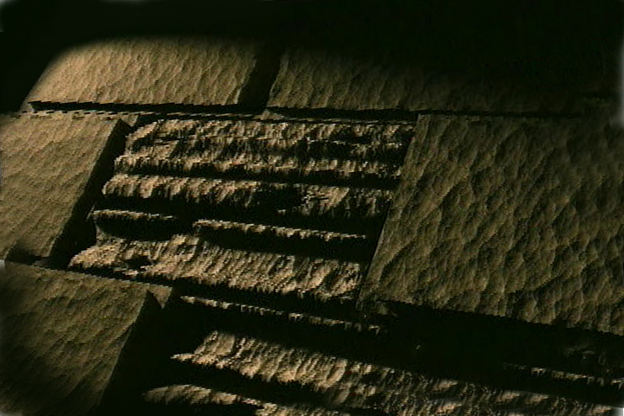
Bible…
Ngashānkakhui
Bible…Ngāshankakhui Ministries International Inc. pāshina semkashok, Fort Worth, Texas
www.biblebasically.com
9.65.06.
©2006 TBBMI
01

Slide 3
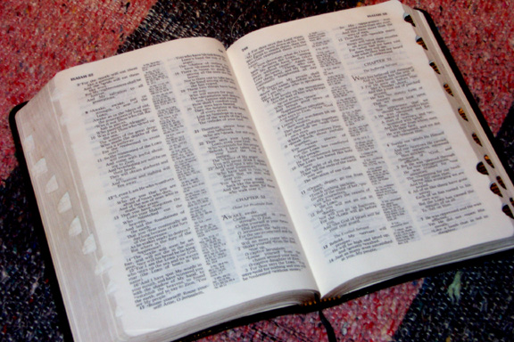
(Ma, hi ngarān kazak kahaiya lairikna)
BIBLE… NGASHĀNKAKHUI
®
Ākhum katharuka
“HĀRKAHAIYA BIBLE”
9.65.06.
©2006 TBBMI
02
Notes:
YES…IT IS AN ORGANIZED BOOK! So let's take a big step forward in this expanding view of -- as we said – “the basic document of our faith.” This is Part SIX of THE BIBLE...BASICALLY, the part we call The OPENED Bible.

Slide 4
ĀRA…
Ithumna ngayarkhai haosa...
9.65.06.
©2006 TBBMI
03
Notes:
We're going to slice and dice the Word-- as a published book, just as we know books today -- developing some of its distinct parts and divisions.
Today’s Bibles are very different from the Scriptures of our ancient ancestors. But the eternal message is the same, all across the millennia.

Slide 5
“ Hārkahaiya”
BIBLE
ĀKHUM
kala
ĀKAI
Ngarānkazak kahai……..Phāsang reisang mamān........ Ātam makhavai
A Ministry of ScriptureTechnologies International
9.65.06.
2
©2006 TBBMI
04
Notes:
We call this section, THE OPENED BIBLE….because…
//// We are going to explore its parts and its pieces.
And by now, you are probably beginning to develop your own mental Bible File.
So…the ideas presented next will further show you that the
//// Word of God is an organized, progressive structure, timeless in its spiritual value…containing an incomparable collection of literature on which you can place your complete faith and confidence -- in its writers, its message of salvation, and its proven spiritual directions for every human life on our planet.

Slide 6
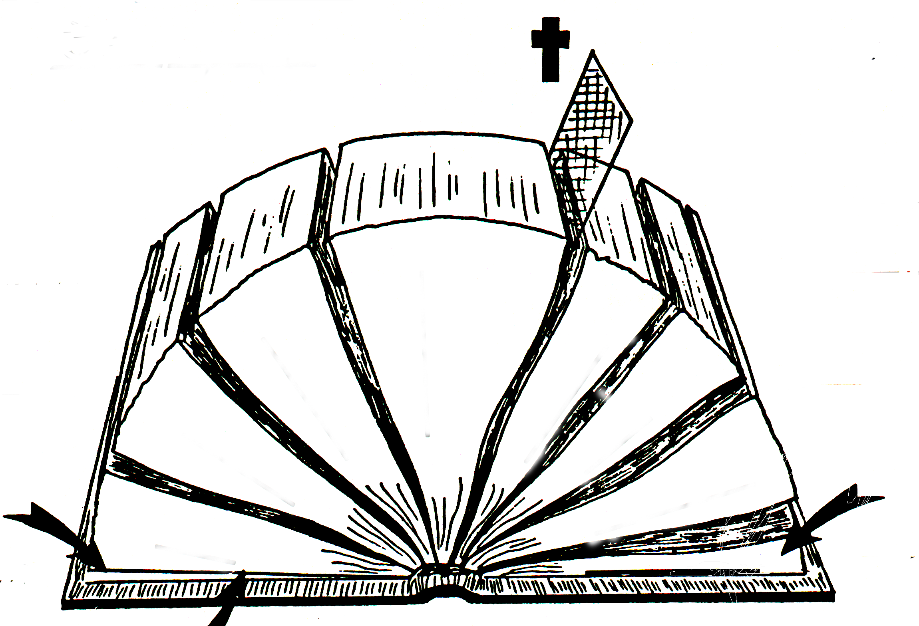
A
B
“ ”
“ ”
D(OT)
C
TUIKUI AKHA:
D(NT)
E(OT)
“ ”
E(NT)
“ ”
F(OT)
F(NT)
4
3
5
/
/
G(OT)
6
G(NT)
2
KATAM KHANGACHON #18
7
1
8
H(OT)
2
1
H(NT)
I(OT)
J
“Hārkahaiya” Bible
06-06
©2006 TBBMI
©2006 TBBMI
06-
9.65.06.
05
©TBBBI
Notes:
With Study Help #18… called the OPENED BIBLE,…you’ll be able to fill it in as we work forward. Stop to study it a moment and you'll find a number of blank lines and letters. They will guide you through this next section. Ready? Let's begin.

Slide 7
CHAMKHAMEIYA
KHARARCHĀN
DHARKHAMEIYA
KHARARCHĀN
4
3
5
6
2
4
4
7
1
8
06
5
Notes:
We start by spreading open the pages of the Bible in this sketch,
separating it out into eight sections...
//// with a division marker right in the middle...
//// …with four sections on one side and four on the other. And of course, it is probably obvious to you
//// …that a division marker lies at the intersection of these two major Biblical sections. It identifies the most significant event in the history of our planet – the Cross of Calvary and the sacrifice of Our Lord.
//// The four sections to the left of the marker make up what we’ll call, for now, THE OLDER STORY…
//// those to the right, THE NEWER STORY.

Slide 8
CHAMKHAMEIYA KHARARCHĀN
DHARKHAMEIYA KHARARCHĀN
4
3
5
6
2
7
1
8
07
Notes:
Now we'll number each of the sections in order...from SECTION ONE on the left, across and over to SECTION EIGHT on the right.

Slide 9
CHAMKHAMEIYA
KHARARCHĀN
DHARKHAMEIYA
KHARARCHĀN
4
3
5
6
2
7
1
8
08
4
Notes:
We’ll uncover some interesting parallels between the varied sections of the Book. We will, for instance, link together sections
//// 1 and 5,
//// 2 and 6,
//// 3 and 7, and
//// 4 and 8.

Slide 10
CHAMKHAMEIYA
KHARARCHĀN
DHARKHAMEIYA
KHARARCHĀN
4
3
5
PAOKAPHĀS
6
2
7
1
ĀIN
8
Āma kala lairik eina kazip kaphok
09
3
Notes:
Look first at sections 1 and section 5. Think about them as serving a parallel purpose in term of the Bible’s story line development. If you are using the Study Help #18 sheet, you can fill in each location as we go.
//// Across the centuries these two sections of Scripture have come to be known as THE LAW in the Old Testament
//// and THE GOSPELS in the New. Think about these two sections, linked here by a blue line as fulfilling somewhat parallel functions in the organization of the Bible. Because, it’s from these beginning sections of the Old and the New that
//// all the events of the rest of each testament unfold...as we'll see right now. OK...
HERE WE HAVE “THE BEGINNING DOCUMENTATION” for each part of your Bible. Following these beginning documents…the Law in the Old and the Gospels in the New. Let’s unpack the other sections.

Slide 11
CHAMKHAMEIYA
KHARARCHĀN
DHARKHAMEIYA KHARARCHĀN
4
Khimameina surdalei? Kapi kahai eina!
Khimameina surdalei? Kapi kahai eina!
3
5
PAOKAPHĀ
6
2
OTSAK
7
THOTCHĀN
1
ĀIN
8
10
4
Notes:
Here are the next linked parallel sections, 2 and 6.
These sections we call HISTORY in the Old and
//// the ACTS in the New. In other words,
//// these two biblical sections reveal the result of circumstances set up in that beginning documentation...sections 1 and 5. So, then, if we have Law and Histories in the Old, and Gospels and Acts in the New…
//// …what follows next? Inevitably, a body of writings develops out of every significant historical epoch and its unique culture.

Slide 12
CHAMKHAMEIYA
KHARARCHĀN
DHARKHAMEIYA
KHARARCHĀN
4
3
5
PAOKAPHĀ
6
2
LĀĀSEM
OTSAK
7
THOTCHĀN
1
CHITHI
ĀIN
8
11
3
Notes:
So…here we’ll link together sections 3 in the Old and 7 in the New.
//// These are traditionally called POETRY in the Old
//// and THE EPISTLES in the New.
//// In both cases, the resulting writings were produced in response to circumstances recounted in the earlier two sections of each testament…with some prophetic characteristics

Slide 13
CHAMKHAMEIYA
KHARARCHĀN
DHARKHAMEIYA
KHARARCHĀN
4
3
5
6
PAOKAPHĀ
2
MARĀNBING
LĀĀSEM
OTSAK
7
THOTCHĀN
CHITHI
1
ĀIN
8
PHONGKHAMI
12
2
Notes:
And finally...sections 4 and 8...the parts of our Bible that, as a type of literature, are virtually unknown in other religious documents outside the Judeo-Christian tradition.
//// These sections are THE PROPHETS in the Old Testament and
//// the Book of REVELATION in the New. We will expand a little on all of this as we move along.

Slide 14
CHAMKHAMEIYA
KHARARCHĀN
DHARKHAMEIYA
KHARARCHĀN
4
3
5
PAOKAPHĀ
6
2
MARĀNBING
LĀĀSEM
OTSAK
7
THOTCHĀN
CHITHI
1
ĀIN
8
PHONGKHAMI
13
4
Notes:
Some new ideas may be coming into focus now. From this high level view, “the foundational document of our faith” is organized very clearly in a general progression of subjects that makes sense and shows order…when we look at it in this way.
//// In each section we have the beginning documentation...
//// …out of which falls a history of resulting events...
//// …which in turn produces a body of preserved writing...
//// …culminating in two sections of prophetical writing that look far beyond our times toward an outworking of titanic future events.

Slide 15
KAKHĀN A & B
zingkum 1600
kapimebing 40
MICHAM MĀNG
SIPAI
KATHĀNBING
LEIKHALONBING
LĀĀSEM KAKAPIYABING
4
PĀNGMONBING
3
5
ĀWUNGA-BING
6
2
PAOKAPHĀ
THINGRONG SĀKHAMATHĀBING
MARĀNBING
LĀĀSEM
OTSAK
BANK WUI ĀKHAVĀBING
7
THOTCHĀN
CHITHI
1
ĀIN
8
PHONGKHAMI
14
4
Notes:
But there are many other factors that help clarify some of the primary characteristics of the Bible. If you are using the Study Help #18, you'll find corresponding letters and numbers to keep your progress organized as we move through the visuals to come.
//// [Study Help sheet disappears] … Beginning with LINE A…
//// Your Bible was written across an enormous span of time, by earthly measurement...1600 years.
//// And throughout all that time...LINE B...it was compiled from a series of works of some 40 AUTHORS, people from all kinds of backgrounds....
//// [following is an auto-advance through this list]
…kings, a poor fig tree pruner, bankers, poets, priests, military leaders and just everyday folks with special messages from God to the people of their day...and to the people of our own time

Slide 16
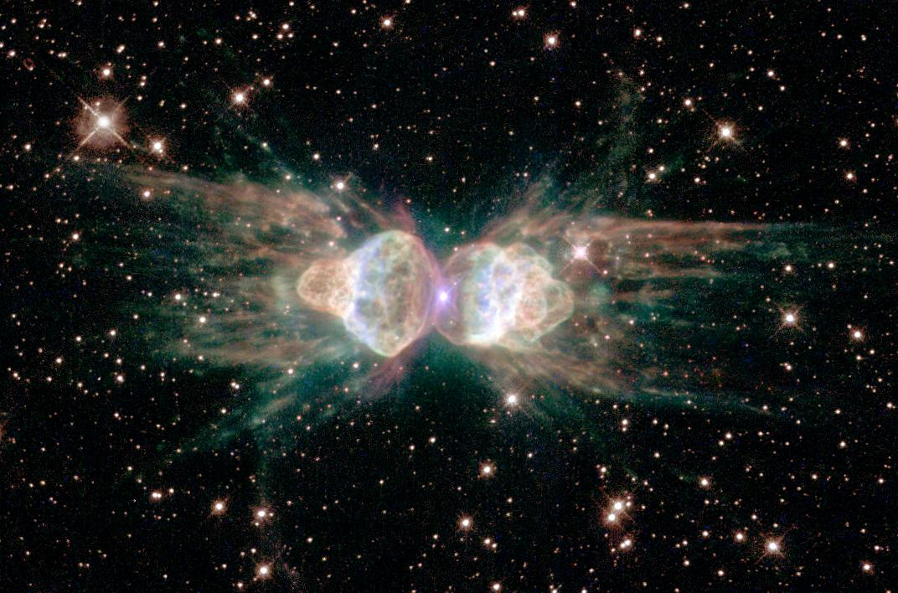
Zingkum 1600
kapimebing 40
KAKHĀN C
TUIKUI ĀKHA:
Varewui tekhamatei
Varewui
tekhamatei
4
3
5
6
2
PAOKAPHĀ
MARĀNBING
OTSAK
LĀĀSEM
7
THOTCHĀN
1
CHITHIBING
ĀIN
8
PHONGKHAMI
2
9.65.06.
2
© 2006 TBBMI
15
Notes:
And through every book, on every page, there is communicated
//// only one great theme...LINE C...THE GLORY OF GOD.
//// Why this theme? Because without our basic recognition of God's glory we are bypassing the most foundational unifying theme of every action of our Christian lives. How can we be most effective in evangelism, for example, unless, first of all, we celebrate the Glory of Him for whom we are carrying out the evangelism effort in the first place?

Slide 17
Zingkum 1600
Kapimebing 40
“KACHAMA”
TUINGASHIT
“KADHARA”
TUINGASHIT
TUIKUI ĀKHA:
Varewui tekhamatei
KAKHĀN D
Kachama Khangashit……Kadhara khangashit
Kachama Khangashit……Kadhara khangashit
Varewui sāngasak khangai kachama……Varewui sāngasak khangai kadhara
Varewui sāngasak khangai kachama……Varewui sāngasak khangai kadhara
PAOKAPHĀ
MARĀNBING
OTSAK
LĀĀSEM
THOTCHĀN
CHITHI
ĀIN
PHONGKHAMI
16
4
Notes:
LINE D on both sides....lists the most basic divisions of the Book, the ones familiar to most everyone. Now the Study Guide divides to include…
//// …on the left side, THE OLD TESTAMENT,
//// …on the right, THE NEW TESTAMENT.
Recalling the study of the covenants, we can now see that those words could just as well have been…
//// OLD CONTRACT and NEW CONTRACT ... or
//// GOD’S OLD WILL and GOD’S NEW WILL.

Slide 18
Zngkum 1600
Kapimebing 40
“KACHAMA”
Tuingashit
“KADHARA”
Tuingashit
TUIKUI ĀKHA:
Varewui tekhamatei
KAKHĀN E
Lairik “39”
Larik “27”
3 x 9 = 27
3 x 9 = 27
PAOKAPHĀ
MARĀNBING
OTSAK
LĀĀSEM
THOTCHĀN
CHITHI
ĀIN
PHONGKHAMI
17
3
Notes:
How large are those groups of Books of each testament?
By the way, some of them are really only rather short letters.
//// LINE E...39 BOOKS in the Old Testament...and
//// 27 BOOKS in the New. And here's a helpful idea to jog your memory....
//// ….from the number 39 on the left... multiply 3 times 9 and you have 27. So 39 leads you straight to 27. Easy to remember that way.

Slide 19
Zingkum 1600
Kapimebing 40
“Kachama”
Tuingashit
“Kadhara”
Tuingashit
TUIKUI ĀKHA:
Varewui
tekhamatei
“39” Lairik
“27” Lairik
Hebrew
KAKHĀN F
Greek
PAOKAPHĀ
MARĀNBING
OTSAK
LĀĀSEM
THOTCHĀN
CHITHI
ĀIN
PHONGKHAMI
18
2
Notes:
Now what about languages? This brings us to LINE F.
//// In the original manuscript writings, The Old Testament was composed almost entirely in Hebrew, the ancient language of the Jews.
//// But on the New Testament side, those documents were originated almost entirely in the common learned language of that day – which was Greek. Here and there in both Testaments we occasionally see phrases and short sentences from other languages of the Ancient Near East, but not often.

Slide 20
zingkum 1600
“Kachama”
Tuingashit
Kapimebing 40
“Kadhara”
Tuingashit
TUIKUI ĀKHA:
Varewui tekhamatei
Lairik “39”
Lairik “27”
Hebrew
Greek
Āin/
KAKHĀN G
PAOKAPHĀ
Lukhamashan/
Ngashitkahai
MARĀNBING
OTSAK
ungkashung
LĀĀSEM
THOTCHĀN
CHITHI
ĀIN
PHONGKHAMIN
19
4
Notes:
But are there some other ways to slice and dice the Book? For instance…If you had to bring it all down to one or two words that describe each of the Testaments, what word or words would you choose?
Here are some suggestions.
//// First, LINE G ON BOTH SIDES.... the Old Testament reflects a time of LAW,
//// while the New Testament, a time of GRACE, a profound difference in man's progressive relationship to God.
//// Another idea, some would say that the Old Testament was a time of PROMISE,
//// while the New, a time of FULFILLMENT.
In each of these linked ideas, you can see a reflection of the covenant promises we just studied…together with their historic program across many, many centuries!

Slide 21
Zingkum 1600
kapimebing 40
“KACHAMMA”
Tuingashit
TUIKUI ĀKHA:
“KADHARA”
Tuingashit
Varewui tekhamatei
Lairik “39”
Lairik“27”
Hebrew
Greek
Āin/
PAOKAPHĀ
Lukhamashan/
Ngashitkahai
MARĀNBING
Ungkashung
LĀĀSEM
OTSAK
THOTCHĀN
CHITHI
ĀIN
PHONGKHAMI
20
Notes:
Now we see two telescopes, pointing in opposite directions...one placed near the beginning of the Bible, at the book of Genesis...another near the end, at the book of The Revelation...

Slide 22
1600 zingkum
40 kapimebing
“KACHAMA”
Tuingashit
“KADHARA”
Tuingashit
TUIKUI ĀKHA:
Varewui tekhamatei
“39” Lairik
“27” Lairik
Hebrew
Greek
Āin/
PAOKAPHĀ
Lukhamashan/
Ngashitkahai
MARĀNBING
Ungkashung
LĀĀSEM
OTSAK
Telescope
THOTCHĀN
CHITHI
Telescope
ĀIN
KAKHĀN H
PHONGKHAMI
Kānthui kahai
Katang makhavai
Rārāda khalei katang makhavai
21
3
Notes:
...bringing us to LINE H...in the Old Testament, showing a TELESCOPE
//// that looks distantly into ETERNITY PAST.
While on the New Testament side,
//// another TELESCOPE,
//// this one gazing far out into ETERNITY FUTURE.
Remember that this telescope idea applies only to the extreme ends of the Book. Think of them as bookends for the entire collection of Scripture.

Slide 23
Zingkum 1600
Kapimebing 40
“KACHAMA”
Tuingashit
“KADHARA”
Tuingashit
TUIKUI ĀKHA:
Varewui tekhamatei
Lairik“39”
Lairik “27”
Hebrew
Greek
ABRAHAM
Āin/
ABRAHAM
PAOKAPHĀ
Lukhamashan/
Ngashitkahai
MARĀNBING
Ungkashung
LĀĀSEM
OTSAK
HAOKAPHOK 12!!!
Telescope
THOTCHĀN
CHITHI
Telescope
ĀIN
PHONGKHAMI
Kānthui kahai katang makhavai
Rārāda khalei katang makhavai
Microscope
KAKHĀN I
9.65.06.
5
22
Notes:
Line I…Now, in your thinking, change from TWO TELESCOPES to
//// only ONE MICROSCOPE… on the Old Testament side. This is a major point of change in the direction of the Biblical story line.
//// During the time of the LAW… at the 12th CHAPTER OF GENESIS…the Bible abruptly moves from recounting events far away in eternity past...suddenly focusing down to one man, his family, and their remarkable lives as they followed God in full faith and belief.
//// The man is Abraham. We pick up his amazing story at Genesis 12…remember Land…Seed…Blessing? We remember that this man lived out his life and ministry during the earliest years of recorded history. He is no fiction of ancient tribal lore.
//// So…here at the MICROSCOPE we can adjust our biblical view from the wide angle of eternity past…down to the very narrow and specific view of that one man – under a Biblical microscope: Abraham.
//// It was his life, his passions and his complete belief in God’s direction, that become the foundation for the Bible’s great story---through all 66 books, and continuing to work out and evolve in on our own lives down to this very moment.

Slide 24
Zingkum 1600
Kapimebing 40
“KACHAMA”
Tuingashit
“KADHARA”
Tuingashit
TUIKUI ĀKHA:
Varewui tekhamatei
Lairik “39”
Lairik “27”
Hebrew
Greek
ĀIN/
Lukhamashan/
PAOKAPHĀ
Ngashitkahai
MARĀNBING
Ungkashung
LĀĀSEM
OTSAK
Telescope
THOTCHĀN
CHITHI
Telescope
ĀIN
PHONGKHAMI
Kānthui kahai katang makhavai
KAKHĀN J
Rārāda khalei katang makhavai
2 Telescopes
1 Microscope
Microscope
23
Notes:
So…it’s yet another way to label things.....the two lines in the box labeled J. The Bible can be viewed as a collection of works organized under the headings of 2 TELESCOPES and 1 MICROSCOPE. Emphasis on the life of Abraham – the great man in the lens of the microscope –– is a central anchor in learning to “mentally manage the Bible.”

Slide 25
Zingkum 1600
Kapimebing 40
“KACHAMA”
Tuingashit
“KADHARA”
Tuingashit
TUIKUI ĀKHA:
Varewui tekhamatei
Lairik “39”
Lairik “27”
Hebrew
Greek
ĀIN/
Lukhamashan/
PAOKAPHĀ
Ngashitkahai
MARĀNBING
Ungkashung
LĀĀSEM
OTSAK
Telescope
THOTCHĀN
CHITHI
Telescope
ĀIN
PHONGKHAMI
Kānthui kahai katang makhavai
Rārāda khalei katang makhavai
2 Telescopes
1 Microscope
Microscope
24
1
Notes:
Remember the focus as we quickly review this “Opened Bible” idea.
//// The Cross of Jesus Christ is THE FOCAL POINT that brings all these fundamental facts together. You can clearly recognize the fact now that God's Word – with its historic chronological timeline…

Slide 26
KAHO
1600 years
KADESH BARNEA
Zingkum 1600
1600 years
KADESH BARNEA
S - D - S
KAHO
40 authors
“OLD”
Testament
Kapimebing 40
“NEW”
Testament
S - D - S
Paokaphābing
40 authors
40
“Kachama”
Tuingashit
ONE THEME:
“Kadhara”
Tuingashit
“OLD”
Testament
SINAI
“NEW”
Testament
Chithibing
Paokaphābing
the glory of God
40
TUIKUI ĀKHA:
ONE THEME:
Chithibing
SINAI
the glory of God
JERICHO
Varewui
tekhamatei
Otshot katonga hina… Proho Jesu Christa wui otram khangathali thānvai
Ngalei ngakai kahai
JERICHO
Ngalei ngakai kahai
“27” Books
“39” Books
430
Vareshim
Shongzā
“39” Books
“27” Books
Lairik “27”
Lairik “39”
430
Zingkum 70
Hebrew
Shongzā
Vareshim
Greek
ISRAEL
Zingkum 70
Marānbing
Hebrew
Greek
Hebrew
GOSPELS
Greek
J - E
Marānbing
Law/
ISRAEL
Grace/
Otsak
Raopam
PROPHECIES
Promise
Wungva
Wungvā
GOSPELS
Fulfillment
J - E
Law/
Grace/
ĀIN/
Otsak
ACTS
Lukhamashan/
WRITINGS
PAOKAPHĀ
Raopam
Promise
Wungva
Wungvā
PROPHECIES
JUDAH
HISTORIES
350
Fulfillment
L - S - B
Ngashitkahai
KAPIKAHAI BING
ACTS
Ungkashung
Telescope
MARĀNBING
EPISTLES
Telescope
WRITINGS
OTSAK
I - I
JUDAH
Phongkhami
LAW
350
SHANG 12
HISTORIES
REVELATION
Eternity Past
Telescope
THOTCHĀN
EPISTLES
Telescope
L - S - B
Telescope
I - I
CHITHIBING
Eternity Future
Phongkhami
LAW
Telescope
M - C - C
Z - E - N
Shang 12
2 Telescopes
1 Microscope
ĀIN
REVELATION
Microscope
Eternity Past
Eternity Future
TAMKACHITHEI 5
PHONGKHAMI
M - C - C
Rārāda khalei katang makhavai
Kānthui
Kahai katang makhavai
2 Telescopes
1 Microscope
Z - E - N
Shongfa 3...
06-27
Microscope
2 Telescopes
1 Microscope
TAMKACHITHEI 5
Shongfa 3...
Microscope
06-27
9.65.06.
1
©2006 TBBMI
25
Notes:
…is an organized collection of logical and credible writings!
From Abraham’s remarkable life ….beckoned by those covenant promises…. leading to every event of the biblical timeline….
//// Culminating in the ministry of the Lord Jesus Christ and development of the early church and its spread throughout the world! A remarkable document of completeness, coherence and promise to our souls!
Now…quickly…let’s review just where we have been in this Opened Bible.

Slide 27
1600 years
1600 years
1600 years
KADESH BARNEA
KAHO
KADESH BARNEA
KAHO
S - D - S
S - D - S
“Kachama”
Tuingashit
40 authors
40 authors
40 authors
“OLD”
Testament
“NEW”
Testament
“OLD”
Testament
“NEW”
Testament
“NEW”
Testament
40
Paokaphabing
40
Paokapha
ONE THEME:
ONE THEME:
ONE THEME:
Chithibing
SINAI
EPISTLES
SINAI
the glory of God
the glory of God
the glory of God
Kachama kala Kadhara tuingashit wui otsak ngarai kachābing… ĀIN(1) kala Paokaphā (5) wui eina thotrinchān__________, THOTRINCHĀN (2) kala OTSAK(6), _________ reikasang kachithei, LĀĀSEM (3) chili lāngda CHITHI (7), ___________ shok khangasak, ithumwui Bibleli ngakheikhang kahai khani kaja _______________ (4) kala _____________ (8) chi mazangla.
JERICHO
JERICHO
Ngalei ngayar kahai
LAND DIVIDED
“39” Books
“27” Books
“27” Books
“39” Books
“27” Books
“39” Books
430
430
SHONGZA
Vareshim
EXODUS
Vareshim
70 YEARS
Zingkum 70
rākashok
Hebrew
Greek
Hebrew
Greek
Hebrew
Greek
PROPHETS
ISRAEL
PROPHETS
ISRAEL
GOSPELS
GOSPELS
GOSPELS
J - E
J - E
Grace/
Law/
Grace/
Law/
Grace/
Law/
ngashan
RAOPAM
ACTS
SLAVERY
OTSAK
PROPHECIES
Promise
PROPHECIES
Fulfillment
Promise
Fulfillment
Ngashitkahai
PROPHECIES
lairik
Fulfillment
Wungva
Wungva
ACTS
ACTS
WRITINGS
ACTS
WRITINGS
WRITINGS
JUDAH
JUDGES
JUDAH
350
350
L - S - B
HISTORIES
L - S - B
HISTORIES
Telescope
HISTORIES
EPISTLES
Telescope
Telescope
EPISTLES
Telescope
EPISTLES
Telescope
I - I
Telescope
I - I
LAW
SHANG 12
LAW
12 TRIBES
PHONGKHAMI
LAW
PHONGKHAMI
REVELATION
REVELATION
REVELATION
Eternity Past
Eternity Future
Eternity Past
Eternity Past
Eternity Future
Eternity Future
M - C - C
M - C - C
Z - E - N
MARĀNBING
Z - E - N
2 Telescopes
1 Microscope
2 Telescopes
1 Microscope
2 Telescopes
1 Microscope
PHONGKHAMI
Microscope
Microscope
Microscope
5 SERMONS
5 SERMONS
KATAM KHANGACHON #18
Shongzā 3 ...
3 TREKS...
06-27
06-27
06-27
9.65.06.
5
©2006 TBBMI
26

Slide 28
zingkum 1600
Kapimebing 40
“KACHAMA”
Tuingashit
“KADHARA”
Tuingashit
TUIKUI ĀKHA:
Varewui tekhamatei
Lairik “39”
Lairik “27”
Hebrew
Greek
ĀIN/
PAOKAPHĀ
Lukhamashan/
Ngashitkahai
MARĀNBING
Ungkashung
LĀĀSEM
OTSAK
Telescope
THOTCHĀN
CHITHI
Telescope
ĀIN
PHONGKHAMI
Kānthui kahai katang makhavai
Rārāda khalei katang makhavai
2 Telescopes
1 Microscope
Microscope
KATAM KHANGACHON #33
27
Notes:
Now one last time, using Study Help #33 as your guide, here are the factors at play in THE OPENED BIBLE. Scripture developed over some sixteen hundred years from the pens of some 40 different authors from a wide spectrum of background and human experience…

Slide 29
Zingkum 1600
Kapimebing 40
“KACHAMA”
Tuingashit
“KADHARA”
Tuingashit
TUIKUI ĀKHA:
Varewui tekhamatei
Lairik “39”
Lairik “27”
Hebrew
Greek
ĀIN/
PAOKAPHĀ
Lukhamashan/
Ngashitkahai
MARĀNBING
Ungkashung
LĀĀSEM
OTSAK
Telescope
THOTCHAN
CHITHI
Telescope
ĀIN
PHONGKHAMI
Kānthui kahai katang makhavai
Rārāda khalei katang makhavai
2 Telescopes
1 Microscope
Microscope
28
Notes:
Clearly recognizing one central theme that plays through every page of its drama, history and teaching….the Glory of God…

Slide 30
Zingkum 1600
“KACHAMA”
Tuingashit
Kapimebing 40
“KADHARA”
Tuingashit
TUIKUI ĀKHA:
Varewui tekhamatei
Lairik “39”
Lairik “27”
Hebrew
Greek
ĀIN/
PAOKAPHĀ
Lukhamashan/
Ngashitkahai
MARĀNBING
Ungkashung
LĀĀSEM
OTSAK
Telescope
THOTCHĀN
CHITHI
Telescope
ĀIN
PHONGKAMI
Kānthui kahai katang makhavai
Rārāda khalei katang makhavai
2 Telescopes
1 Microscope
Microscope
29
Notes:
Divided into two large sections, which have come to be called through the centuries…the Old Testament and the New Testament.

Slide 31
Zingkum 1600
Kapimebing 40
“KACHAMA”
Tuingashit
“KADHARA”
Tuingashit
TUIKUI ĀKHA:
Vareui tekhamatei
Lairik “39”
Lairik “27”
Hebrew
Greek
ĀIN/
PAOKAPHĀ
Lukhamashan/
Ngashitkahai
MARĀNBING
Ungkashung
LĀĀSEM
OTSAK
Telescope
THOTCHĀN
CHITHI
Telescope
ĀIN
PHONGKHAMI
Kānthui kahai katang makhavai
Rārāda khalei katang makhavai
2 Telescopes
1 Microscope
Microscope
30
Notes:
Organized into 39 books in the Old and 27 books in the New Testament.

Slide 32
Zingkum 1600
Kapimebing 40
“KACHAMA”
Tuingashit
“KADHARA”
Tuingashit
TUIKUI AKHA:
Varewui tekhamatei
Lairik “39”
Lairik “27”
Hebrew
Greek
AIN/
PAOKAPHA
Lukhamashan/
Ngashitkahai
MARANBING
Ungkashung
LAASEM
OTSAK
Telescope
THOTCHAN
CHITHI
Telescope
AIN
PHONGKHAMI
Kānthui kahai katang makhavai
Rārāda khalei katang makhavai
2 Telescopes
1 Microscope
Microscope
31
Notes:
Written in Hebrew…for the Old…and mostly Greek…for the New.

Slide 33
Zingkum 1600
Kapimebing 40
“KACHAMA”
Tuingashit
“KADHARA”
Tuingashit
TUIKUI ĀKHA:
Varewui tekhamatei
Lairik “39”
Lairik “27”
Hebrew
Greek
Āin/
PAOKAPHĀ
Lukhamashan/
Ngashitkahai
MARĀNBING
Ungkashung
LĀĀSEM
OTSAK
Telescope
THOTCHĀN
CHITHI
Telescope
ĀIN
PHONGKHAMI
Kānthui kahai katang makhavai
Rārāda khalei katang makhavai
2 Telescopes
1 Microscope
Microscope
32
Notes:
Two bottom-line ideas stretching across its pages…Law in the Old versus Grace in the New…and also…in the thinking of many.

Slide 34
Zingkum 1600
“KACHAMA”
Tuingashit
Kapimebing 40
“KADHARA”
Tuingashit
TUIKUI ĀKHA:
Varewui tekhamatei
Lairik “39”
Lairik “27”
Hebrew
Greek
Āin/
PAOKAPHĀ
Lukhamashan/
Ngashitkahai
MARĀNBING
Ungkashhung
LĀĀSEM
OTSAK
Telescope
THOTCHĀN
CHITHI
Telescope
ĀIN
PHONGKHAMI
Kānthui kahai katang makhavai
Rārāda khalei katang makhavai
2 Telescopes
1 Microscope
Microscope
33
Notes:
Promise in the Old…fulfillment in the New.

Slide 35
Zingkum 1600
Kapimebing 40
“KACHAMA”
Tuingashit
“KADHARA”
Tuingashit
TUIKUI AKHA:
Varewui tekhamatei
Lairik “39”
Lairik “27”
Hebrew
Greek
Ain/
PAOKAPHA
Lukhamashan/
Ngashitkahai
MARANBING
Ungkashung
LAASEM
OTSAK
Telescope
THOTCHAN
CHITHI
Telescope
AIN
PHONGKHAMI
Kānthui kahai katang makhavai
Rārāda khalei katang makhavai
2 Telescopes
1 Microscope
Microscope
34
Notes:
Then we view the entire Bible as opening and closing with two long-range telescopes…in the Old Testament, a telescope gazing into the most distant past of the earth and the universe…Eternity Past….while in the New…a telescope looking forward into Eternity Future.

Slide 36
Zingkum 1600
Kapimebing 40
“KACHAMA”
Tuingashit
“KADHARA”
Tuingashit
TUIKUI ĀKHA:
Varewui tekhamatei
Lairik “39”
Lairik “27”
Hebrew
Greek
Āin/
PAOKAPHĀ
Lukhamashan/
Ngashitkahai
MARĀNBING
Ungkashung
LĀĀSEM
OTSAK
Telescope
THOTCHĀN
CHITHI
Telescope
ĀIN
PHONGKHAMI
Kānthui kahai katang makhavai
Rārāda khalei katang makhavai
2 Telescopes
1 Microscope
Microscope
35
Notes:
Then from the immensity of viewing through those distant telescopes,
the view quickly refocuses on one man, Abraham, seen through a Biblical microscope...all the rest of Scripture resulting from God’s work in his friend’s righteous life…

Slide 37
Zingkum 1600
Kapimebing 40
“KACHAMA”
Tuingashit
“KADHARA”
Tuingashit
TUIKUI ĀKHA:
Varewui tekhamatei
Lairik “39”
Lairik “27”
ABRAHAM
Hebrew
ABRAHAM
Greek
Āin/
PAOKAHĀ
Lukhamashan/
Ngashitkahai
MARĀNBING
Ungkashung
HAOKAPHOK 12!!!
OTSAK
LĀĀSEM
Telescope
THOTCHĀN
CHITHI
Telescope
ĀIN
PHONGKHAMI
Kānthui kahai katang makhavai
Rārāda khalei katang makhavai
2 Telescopes
1 Microscope
Microscope
©2006 TBBMI
9.65.06.
36
Notes:
Early Genesis…that wide angle view quickly sharpens down to a fine point, discovering the life of one man, Abraham…then expanding through him to reveal the great Plan of Redemption, presenting the appearance of the Messiah and His Gospel, then working through all Christians at this present time, encompassing all the earth.

Slide 38
Zingkum 1600
“KACHAMA”
Tuingashit
Kapimebing 40
“KADHARA”
Tuingashit
TUIKUI ĀKHA:
Varewui tekhamatei
Lairik “39”
Lairik “27”
Hebrew
Greek
Āin/
PAOKAPHĀ
Lukhamashan/
Ngashitkahai
MARĀNBING
Ungkashung
LĀĀSEM
OTSAK
Telescope
THOTCHĀN
CHITHI
Telescope
ĀIN
PHONGKHAMI
Kānthui kahai katang makhavai
Rārāda khalei katang makhavai
2 Telescopes
1 Microscope
Microscope
37
Notes:
Seen finally as…two telescopes…and one microscope…as a tool in which to view the overall structure of the Scriptures.

Slide 39
“HĀRKAHAIYA”
BIBLE
NAWUI BIBLE…
NGAYARKHAI KAHAI...
ĀKHUM
kala
ĀKAI
Ngarān kazak kahai...Phāsang reisang mamān... Ātam makhavai
A Ministry of ScriptureTechnologies International
9.65.06.
©2006 TBBMI
38
Notes:
And that’s your Bible…sliced and diced and put back together in a way…

Slide 40
“HĀRKAHAIYA”
BIBLE
ĀKHUM
kala
ĀKAI
Ngarān kazak kahai...Phāsang reisang mamān... Ātam makhavai
A Ministry of ScriptureTechnologies International
39
©2006 TBBMI
9.65.06.
Notes:
…that clearly illustrates organization and progression of its great and timeless central theme…

Slide 41
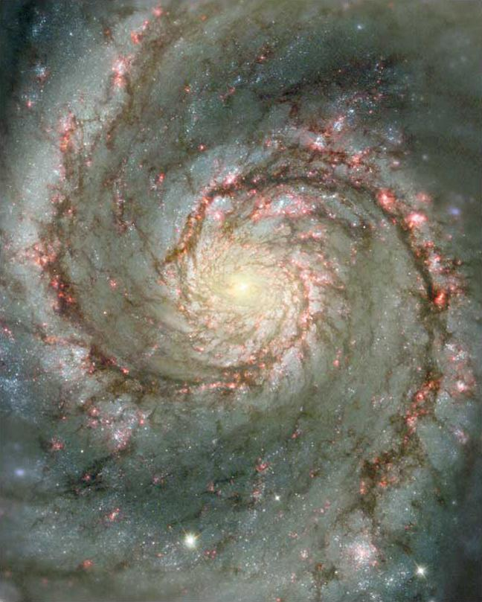
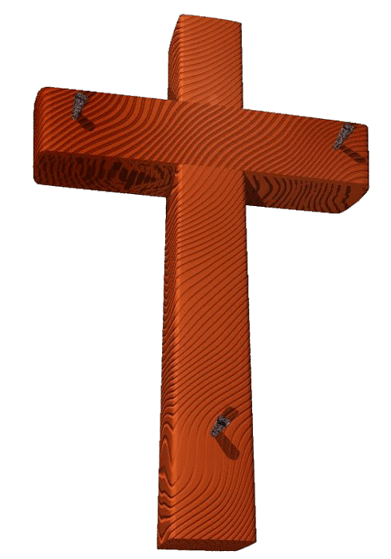
Varewui tekhamatei
06-31
©2006 TBBMI
9.65.06.
1
40
Notes:
THE GLORY OF GOD. ITS ONE MESSAGE SURMOUNTING ALL THE OTHERS! Delivering to us the glorious message of the Cross and the Savior’s gift of eternal life to all men who ask it of Him.

Slide 42
Bible…Ngashānkakhui Ministries International Inc. pāshina semkashok, Fort Worth, Texas
www.biblebasically.com
41

Slide 43
*
©2006 TBBMI
42
9.65.06.

