Slide 1
Mediterranean Yirei
LEBANON
SYRIA
Haifa
Galilee
Ngayi
IRAQ
Nazareth
Ning_eina
Netanya
Tel Aviv-Jaffa
AMMAN
JERUSALEM
Jericho
Gaza
Hebron
Machi
Ngayi
Beersheba
ISRAEL
JORDAN
EGYPT
SAUDI ARABIA
Eilat
Aqabawui Gulf
Al’ Aqaba
Notes:
Nganaida eina yang akha nana aruihon atam wui Mediterranean kongphei wui zingshoshong akatangali theira… Kadhara Ngalei… politics kala ngashan wui eina zakshilâk eina ngakai kahai
//// … Jehudi kala Arab mitun alungli… maram kachungkha wuivang eina ngakaikahai ithumna BIBLE NGASHANKAKHUI hi zatva mamân kachi eina kathei samphangra.

Slide 2

Bible…
Ngashankakhui
Bible…Ngashankakhui Otsin International Inc. Fort Worth, Texas
wui tamkachithei
8.0.01.
©2004 TBBMI
04

Slide 3


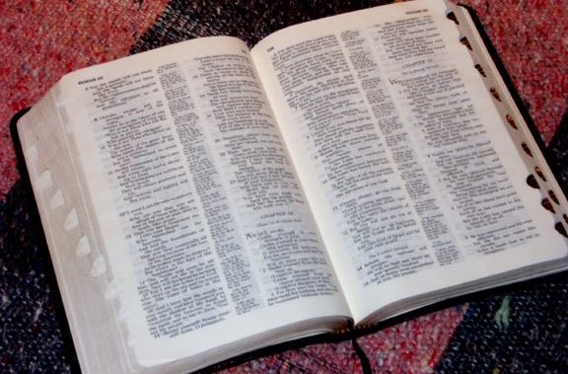
(Apam chi kali leida?)
BIBLE… NGASHANKAKHUI
®
AKHUM KAKHANE
HAOPHOK KHAVAI KHANGARAN: ACHALAKHA ISRAEL NGALEMLI LEIKASA APAM BINGWUI MAP KASEM
9.6.01.
©2006 TBBMI
02
Notes:
Varewui Tui kakatamli… ithumna ngahân-na… “Apam chi kali leido?”
Chiwuivang eina, BIBLE LAIRIK-KOM semkakâ li khamathanga sâda… achalakha Israel ngalemli leikasâ apam bingwui map semra.
Akhum hiwui kakatamli, Bibleli shok-kahai katongawui “Haophok khavai Khangaran” mingthon da nana hopaira.

Slide 4
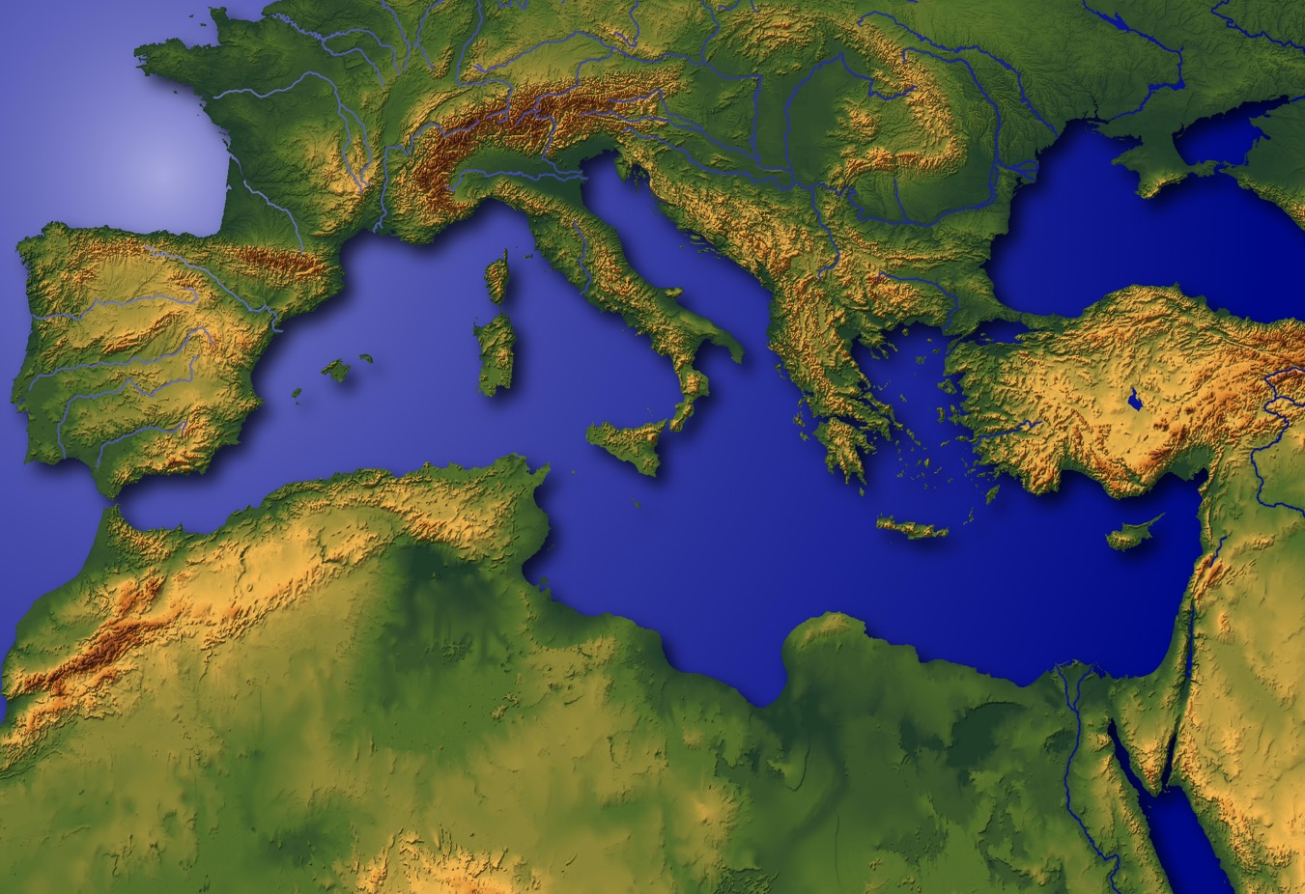
HAOPHOK
KHAVAI
KHANGARAN
?
Mediterraneanli kashok Biblewui Khararchan
4
9.6.02.
4
03
© 2006 TBBMI
03
Notes:
Chieina… ITHUMNA HAOPHOK KHAVAI NGARAN-USA!
Ithum hili leiya…ngachakyâng eina Varewui khamasaili ngaphong kazatta… mathâlâk kahai kha rotkhamaratla rotmaratlak kahai okathui… Hakmahalak kahai kharachan chi ithumna THAKDA THEIKAPAI THOTCHAN li pheingarumra
//// Matailak kahai khangahânva.… Okathui hili, kachikatha apamli, chikatha khararchan chi shok-khala? Varewui Tui katamli… KALI, KHI kachangkhat shok kachi kathei hi darkâr salak-ka…matailak eina naningli kahai!
//// Chichang chili… ithumna aruihon Middle East da kaho apamwui achitheknaoli…
//// …hakmahâlâk kahai khararchan chi sashok-ka, achâlakha wui apam chili matak-khak kala tekmateilak kahai khararchan…
//// …kachungana thotchan wui matailak kahai apamda kathei… hi Mediterraniali Bibleli shok-kahai khararchan wui akai akhana.

Slide 5
Mediterranean Yirei
LEBANON
SYRIA
Haifa
Galilee
Ngayi
IRAQ
Nazareth
Netanya
Tel Aviv-Jaffa
AMMAN
JERUSALEM
Jericho
Gaza
Hebron
Machi
Ngayi
Beersheba
ISRAEL
JORDAN
EGYPT
SAUDI ARABIA
Eilat
Aqabawui Gulf
Al’ Aqaba
04
1
Notes:
Nganaida eina yang akha nana aruihon atam wui Mediterranean kongphei wui zingshoshong akatangali theira… Kadhara Ngalei… politics kala ngashan wui eina zakshilâk eina ngakai kahai
//// … Jehudi kala Arab mitun alungli… maram kachungkha wuivang eina ngakaikahai ithumna BIBLE NGASHANKAKHUI hi zatva mamân kachi eina kathei samphangra.

Slide 6
MY
N(A)
H
GN
C
EK
B
J
NK
MN
E
KB
U
MAPWUI KANKHANA!
SK
PG
RS
Handbook pg. 15-16
1
05
Notes:
Ara… katonga hiwui marama. Achâlakha Israeli ngalemli leikasâ ngaleibing wui map ichichâ khalattana semkhuira kala nawui map chi sichinlaga Bibleli shok-kahai khararchan chi yang ngarumra… maron-maron eina
//// ...Hithada… maron-maron eina matailak kahai khararchan bing chi

Slide 7
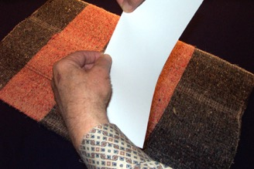
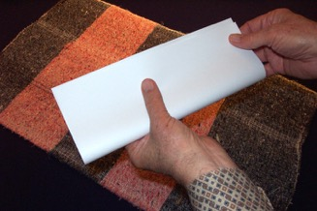
KATAMLI KHANGACHON #03a; (lairik kadhar akha #03b)
LAIRIK
AKHA
PANGLI
SINGLU
NGATARTEIDA,
ASAN SHONG EINA TIPZANGLU, AKHASHIDA
Ngasoda kazat lairik pg. 15-16
06
Notes:
Katamli Khangachon 3A kala 3B katamnaowui katamli ngachon khavai larikli khikhala makapirang kachi anâ map hi semkhavai mihaidalei.
Chieina chikatha anâ akha larik chiwui eina khuishoklu…
ngatarteida asân shong eina tipzanlu, akhashida…

Slide 8
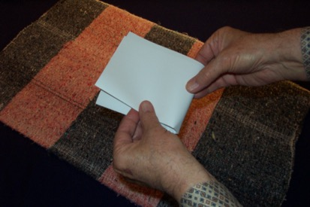
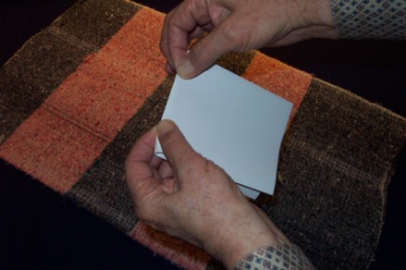
AKHASHIDA TIPLUISHITLU…
…AKHÂN SAMPHANGKH-AVAI KATIP
Ngasoda kazat lairik pg. 15-16
07
Notes:
Akhashida tipluishitlu, chithakha lairik ana chi akhân khani leihaora… akhana ngarongrik eina… akhana ngatartei eina… nawui maple Ato-Aze kala Zingsho-Zingtun theikhavai. Nawui mangâli ngatarteida…maningkha asân wui athishurda haitalu.

Slide 9
Ngasoda kazat lairik pg. 15-16
3
08
Notes:
Lairik chi asânwui athishurda haita hailaga, nawui map kathar semkhavai ngaranlu… haophok khavai… Middle East shongli shok-kahai Bible wui khararchan.
//// Mangashong zat khavâ eina yaingâng maju wui kakhân chi theikhavai sâlu.
//// Chikatha yaingâng maju wui kakhân chi nawui maple nana sangra. Kakhân kathar katonga chi yaingâng maju eina chithei mira…
//// Nana reda khan kahai bingchi zikma-man ra, hili maju khamatek wui thada

Slide 10
KHARE: 6 TARA PAMBING
KAKHANE: 10 NGALEI PAMBING
KAKATHUM: KATÂWUI CHÂNG
Ngasoda kazat lairik pg. 15-16
2
09
Notes:
Ara ithum kali zatli khala kachi nana theihaira… rimeithuida yireipung THARUK Bibleli kapi kahai chi phashoksa…
//// kala kakhane sada… matatimeithui kachiya ngalei 10 wui apambing chi phashokra.
Hi saklâk eina ngalei wui maramli katam mangasâ mara, chiwuivang mangacheelu.
Kala kakathuma… phaningunglu
//// that the locations and distances are ONLY RELATIVE…ONLY APPROXIMATE. Apambing kala katâhi PHAB…KALA CHÂNG eina kahâng na. Kha ngarakzak machisâlala mashungkapai châng eina khuilaga ningli ngalei kala tara wui map Bibleli kazang chi semra.

Slide 11
Handbook pg. 15-16
1
10
Notes:
Nawui lairikli… latluida, lairik chi ngatarteid eina singlaga… uishongwui amareili haklak eina ngumrik-si kahai khânlu, yaingâ maju eina chithei kahai hithada…
//// yâshong azingshong wui amareilila tâkam eina khânlu.
Yaingâng maju eina chithei kahai thada horzakda sâlu.
Apambingchi kathâlâk khala kachi chi nana theimamanra.

Slide 12
Handbook pg. 15-16
11
Notes:
Mathangli, yaohomthing wui thâda yâshong azingli khan kahai wui alungthung eina haophokda. Uishong kaza nanai khânlu.

Slide 13
Apamwui aming masinglu...
Kha haokaphokwui
KHARE MMAYEK MANG CHI...SINGLU.
TUIKHUR KATONGA MASINGLU!
Ngasoda kazat lairik pg. 15-16
12
Notes:
Apamwui aming masinglu...
Kha haokaphokwui khare mayek mang chi...Singlu. Tuipâ katonga masinglu!
Hina nali mapli kapikahai mayekbing china tuipâbing katonga chi phaningung ngasakra. hithada

Slide 14
MN
Ngasoda kazat lairik pg. 15-16
13
Notes:
Uishongwui atungli ngumrisik eina khânkahai chiwui alungli MN da kapisanglu…
Kala aruihon yirei chiwui ama chi chitheida khalei hina.
//// Uishongwui atungli Bible tuipam mihaida khalei chi yanglu, yireihi achâlakha wui tamli Hak-khamahâ Ngayi da theisaya. Bible ngashân khayang wui khayeirum hi zat-tâ maman kachi eina khangatatei apam bingwui Bible tuipam bingli maron-maron eina chitheimi rasara.

Slide 15
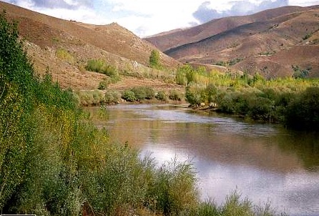
MN
EK
Ngasoda kazat lairik pg. 15-16
14
Notes:
...khamathangli… yaohomthing wui alung maikhali EK da kapisanglu…

Slide 16
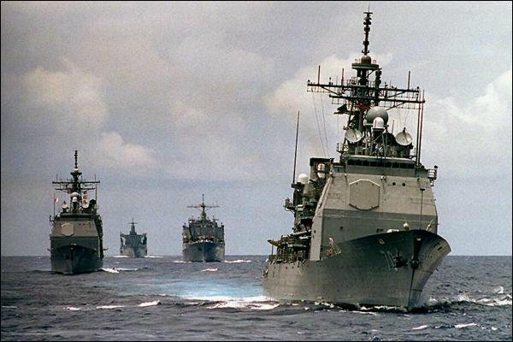
MN
MEDITERRANEAN YIREI
EK
EUPHRATES KONG
PG
PERSIAWUI GULF
Ngasoda kazat lairik pg. 15-16
2
16
Notes:
… kala naomeithuida, azingshonli khânkahai chili PG da kapisanglu

Slide 17
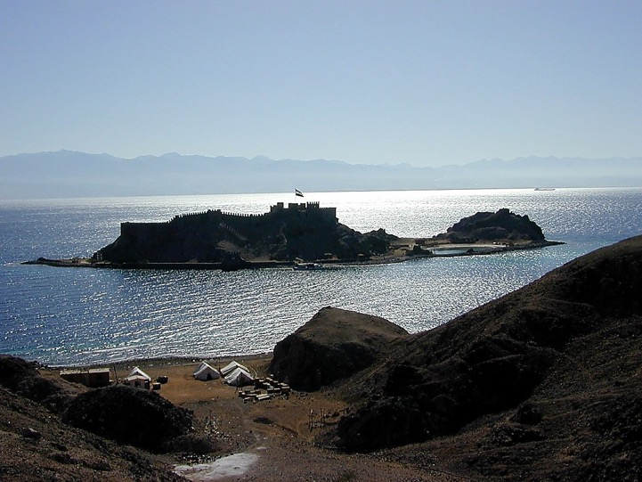
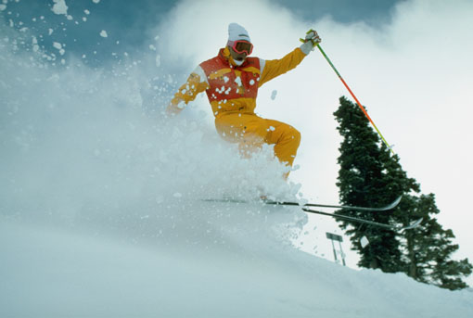
MN
ER
PG
Ngasoda kazat lairik pg. 15-16
17
Notes:
Uishong atungli mikahi mayek bing china MEDITERRANEAN NGAYI kachina. Aruila tuikhur peida makapila mayekbing mang shichinlu.
//// EUPHRATES KONG yaohomthing wui atungvak… kala
//// PERSIAN GULF yâshong azingshongli
Arava, ngayi apam kathum chi phashok haira… kahtum vatfaya: nawui mapwui ui azingshong eina hoaphokra

Slide 18
MY
ER
RED SEA
PG
RS
Ngasoda kazat lairik pg. 15-16
18
Notes:
…kala thebâwui khanâ thâda yeksanglu

Slide 19
MY
EK
PG
Ngasoda kazat lairik pg. 15-16
15
Notes:
Khanâwui alungchili, kala taratungli, RS da kapisanglu hina RED SEA kachina.
Aruihon RED SEA wui ama chitheili.

Slide 20
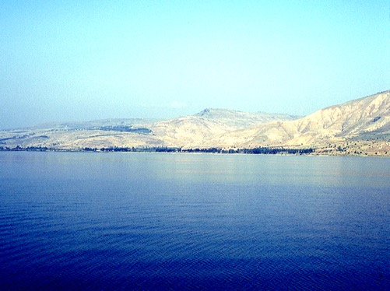
MN
ER
PG
RS
Ngasoda kazat lairik pg. 15-16
19
Notes:
Khamathangli yaohomthing azingchang chili shanglu. Har-ra thada khani yeklu, akhana teomei ngasaklu…

Slide 21
MY
ER
PG
RS
Ngasoda kazat lairik pg. 15-16
20
Notes:
… khani chi… ngasunlu.

Slide 22
MY
GN
GALILEE NGAYI
ER
PG
RS
Ngasoda kazat lairik pg. 15-16
21
Notes:
Near the smaller oval...mark it with SG, for THE SEA OF GALILEE.
Teokhamei ngalemli… GN da kapilu, hina GALILEE NGAYI na.

Slide 23
MY
GN
GALILEE NGAYI
ER
MN
KATHI NGAYI
PG
RS
Ngasoda kazat lairik pg. 15-16
22
Notes:
Hak-khameili, KN da kapisanglu, hina KATHI NGAYI na.

Slide 24
MY
GN
ER
MN
JORDAN KONG
PG
RS
Ngasoda kazat lairik pg. 15-16
23
Notes:
Yeksang maman kachi eina mapchi ngazirut eina theihaora, chiwuivang eina kong hipa hi mayeklu… har-ra thada khani yek-kahai… Galilee Ngayi eina Kathi Ngayi… ngasunda khalei kakhânchi phaolâk kahai kala mathalak kahai JORDAN KONG na. Chi nana phaningungra… Ithumwui Proho hiwui tarabing hili rahik-ka.

Slide 25
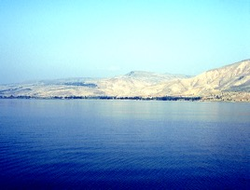

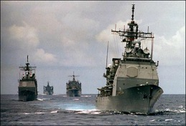

6
MY
GN
EK
MN
TARA PAMBING
PG
RS
Ngasoda kazat lairik pg. 15-16
7
24
Notes:
Ara ithumna ngayi tharuk kala kong akha phashok haira, athum ava-va hi Bible khararchan haophok khavai kan-nâlâk-ka. Ithumna
//// MEDITERRANEAN NGAYI,
//// EUPHRATES KONG
//// PERSIAN GULF
//// RED SEA (NGAYI)
//// KATHI NGAYI
//// GALILEE NGAYI, JORDAN KONG na ngasunlaga
//// Nawui mapli ngayi 6 leihairara.

Slide 26
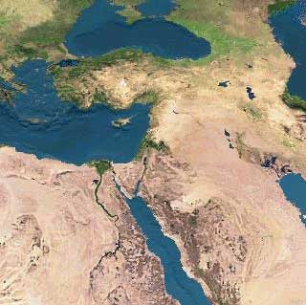
MS
SG
ER
“THE LAND”
DS
PG
RS
Ngasoda kazat lairik pg. 15-16
25
1
Notes:
Ara ngaleishong mai ngarei-usa… ngalei hili Biblewui khararchan kashok.
//// Biblena kahang ngalei hiwui asan-aret hâklâk-ka kala Middle Eastern shong vapeichaowa da kapisang haiya.

Slide 27
10
10 APAM
MY
GN
EK
MN
Ngalei Apambing
PG
RS
Ngasoda kazat lairik pg. 15-16
26
1
Notes:
Ithumna 10 mang phashokra -- 10 mang -- apambing ngaleili … ava-va chi Biblewui THÂLÂK EINA THEIKAPAI THOTCHANli matailâk kahai apambing na.
//// Zattâ-usei. Nawui map atungshong, alungthunglyi, ato-aze da theikhavai akhânli, hi kapisanglu, 10 APAM.

Slide 28
10 APAM
MY
4
GN
EK
MN
PG
RS
Ngasoda kazat lairik pg. 15-16
27
Notes:
“10 apam” da yâshongwui ato-aze khânkahaili kapikahaiwui azingli, mashing 4 hi kapisanglu kala malâtheira wui akui thada zingshoshong chizavâlu…chiva… yâshong chizavâlu.
NGUMRIK EINA MASHINGLI KUIMAREIDA KHANKAHAI CHI NALI NARAKZAK KAHAI APAM CHITHEI KHAVAI MAYA.

Slide 29
10 APAM
MY
6
4
GN
EK
MN
Bibleli “Kashok otshot bing”
PG
RS
Ngasoda kazat lairik pg. 15-16
28
Notes:
Laga uishongli, mashing 6 chi malâtheirawui akui uishong chizavâlaga kapisanglo. Arava, ithum Bibleli “Shok-kahai Khararchan”wui apambing chi phashok khavai ngarânkup haira.

Slide 30
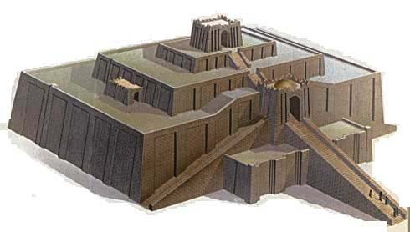
10 APAM
MY
6
4
SG
ER
DS
U
PG
CHALDEANWUI UR
RS
Ngasoda kazat lairik pg. 15-16
29
Notes:
Nawui lairikli zingshoshong eina hoaphoklaga, Euphrates kong khamor tashungda, kongchi Persian Gulf takhangasunli… mayek haklâk eina, “U” KALA DOT HI APAM HORZAK KACHI CHITHEI KHAVAI kapisanglu… achâlakha konung akhawui amingna, Chaldeanswui konung UR… khorum khavai shimtungli juilâk eina sakakâli phaolâk saya. Aruila latluida phaningung ngasakngaiya kachiva tuipâbingwui mayek khare chiming chi sichinlu…hina nali tuikhur peida phaningung ngasakra. Hikathahi kasâ eina phaning khaunghi mataisang ngasak-ka.

Slide 31
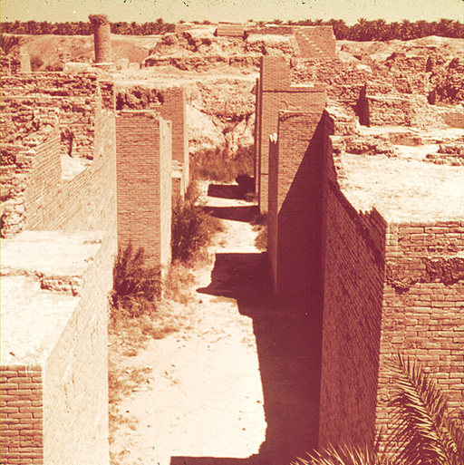
10 APAM
MY
6
4
GN
EK
B
DS
U
BABYLON
PG
RS
Ngasoda kazat lairik pg. 15-16
30
Notes:
Chithada sada, U na URwui vang…arava kong atungshong shanghaora, Persian Gulfwui eina tangkhai shakha shangda. Mayek haklâk eina B da kapilu… haklâk kahai dot akha eina ngasoda… achâlakhawui konung Babylonwuivang, konungchi okathui apam huptawui eina razanglaga zatyur peida pânsaya.

Slide 32
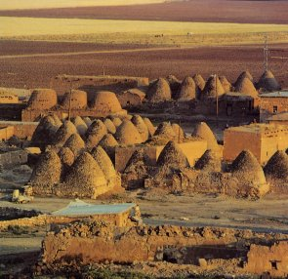
10 APAM
MY
6
4
H
GN
EK
B
DS
U
HARAN
(HARRAN,TURKEY)
PG
RS
Ngasoda kazat lairik pg. 15-16
31
Notes:
Mathangli… mashâlâk kahai apamli akhali, kongwui zingshoshong, mayek halâk eina Hda kapilu, hina achâlakhawui konung Haran chithei khavai, konunghi aruihon thotlila leidaleifaya.

Slide 33
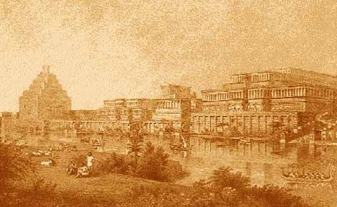
10 APAM
MY
6
4
N(A)
H
GN
EK
B
DS
NINEVEH (ASSYRIA) MOSUL, IRAQ
U
PG
RS
Ngasoda kazat lairik pg. 15-16
32
Notes:
Kala naomeithuida, ato-azeda theikhui khavai tipkahaiwui zingshoshongli, akatangali, mayek haklâk eina N da kapilu kala achizunli A kapisanglu. Mayek khani hina achâlakhawui Assyria wungramwui konung chitheiya. Aruihon thotli Iraqwui keinung Mosul kaho apam hi chimaikhali leiya.

Slide 34
10 APAM
MY
6
4
N(A)
H
GN
EK
B
MN
U
PG
RS
Ngasoda kazat lairik pg. 15-16
33
Notes:
Apam mati phakhuihaira… CHALCEDONWUI UR… BABYLON… HARAN…kala ASSYRIAli khalei NINEVEH.

Slide 35
10 APAM
MY
6
4
N(A)
H
ARUIHONWUI CANAAN
C
GN
ER
B
MN
U
PG
RS
Ngasoda kazat lairik pg. 15-16
34
1
Notes:
Zingshoshongli khalei apam mati phashokhaira, ara zingtunshongli apam tharuk leida khalei chi phashok-usa
//// Jordan Kong kala Mediterranean Ngayi alungthunli mayek C kakapi eina haophoksa. Mayek hina CANAAN ngalei hupva wuivang nganingra, ngalei chi achâlakhawui Israelda mahoranglakha, naodawui thotchanli, Palestine, kala aruihon atamli, Israel kala Palestineda khani-ni eina kathei.

Slide 36
10 APAM
MY
6
4
N(A)
H
GN
C
JERUSALEM
ER
J
B
MN
U
PG
RS
Ngasoda kazat lairik pg. 15-16
35
Notes:
Kathi Ngayi atungshong shangkatang ngalemli, Jordan Kongwui zingtunshongli, mayek haklâk eina J, Jerusalem keinung wuivang… okathuiwui thotchanli hakmahâ-meithui kachi kala khonzârmeithui kachi keinung ngasaya.

Slide 37
10 APAM
MY
6
4
N(A)
H
GN
C
EK
NK
B
J
NEBO KAPHUNG
MN
U
PG
RS
Ngasoda kazat lairik pg. 15-16
36
Notes:
Arava Jordan chi makânlu, Kathi Ngayiwui ngalemli…mayek khani NK hi kapisanglu, Nebo Kaphung chitheikhavai. Apam hiwui kankhanâhi ithumna Thâlâk eina Theikapai Thotchan katam tharan theinaora.

Slide 38
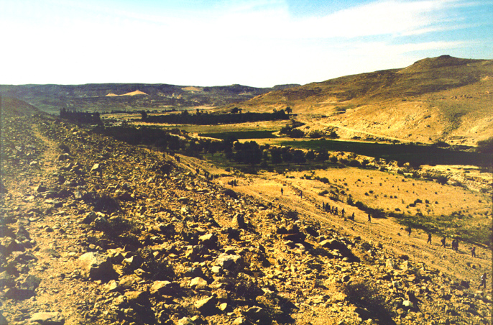
10 APAM
MY
6
4
N(A)
H
KADESH BARNEA
GN
C
ER
B
J
NK
MN
KB
U
PG
RS
Ngasoda kazat lairik pg. 15-16
37
Notes:
Laga… Kathi Ngayi takatang shong, thebâwui khanâ angachaili, KBda kapilu…achâlakha siwukli tara khalei apam akha KADESH BARNEA, apam chi aruihon namkakhui ama na.

Slide 39
10 APAM
MY
6
4
N(A)
H
EGYPT: Giza Tampak
SG
C
ER
B
J
MN
MN
E
KB
U
PG
RS
Ngasoda kazat lairik pg. 15-16
38
Notes:
Apam khani leifaya…UISHONG thebâwui khanâ atungshongli, mayek haklâk eina Eda kapisanglu, EGYPT wungramwuivang…matak-khak kahai shok-kahai khararchanbing kupkahai makhangavâ ngalei chi aruihon thotlila phaningkha ngak-ngasak-ka. Kala naomeithuida…

Slide 40
10 APAM
MY
6
4
N(A)
H
GN
SINAI KAPHUNG
C
ER
B
J
NK
MN
E
KB
U
SK
PG
RS
Ngasoda kazat lairik pg. 15-16
39
Notes:
…thebâwui khanâ khani angachaili KHANGATEI SKda kapisanglu, hina SINAI KAPHUNG chithei khavaina. Ara, map katongachi, naningli leihaira…

Slide 41
10 APAM
MY
6
4
N(A)
H
GN
C
EK
10 Ngalei Apambing
B
J
NK
MN
E
KB
U
SK
PG
RS
Ngasoda kazat lairik pg. 15-16
40
2
Notes:
Mapwui zingtunshong 6 leidakhalei chi…
//// kala zingshoshong 4 leida khaleihi… apamhibingwui khangashik chitheikhavaina
//// Biblewui matailâk kahai ngalei tharâ.

Slide 42
Wungva-Wungva 20:1; 2 Sam 17:11; 1 Wungnao 4:25
10 APAM
MY
6
4
N(A)
H
“DAN EINA
HAOPHOKLAGA
BEERSHEBA
EINA TANGDA”
APAM CHI
GN
C
EK
B
J
NK
MN
E
KB
U
SK
PG
RS
Ngasoda kazat lairik pg. 15-16
41
3
Notes:
Khanaowa ngarumkasang. Bible peichaoda, “Ngalei” hi latlui-latluida samphangshon-na…
//// Wungva-Wungva 20:1. Uishongwui atungli Bible tuipam chitheimi kahai hina ngaleibinghi Bibleli sikachin kakhalat athishurda khamina. Takam eina, uishong atungli khangatei ngaleibingwui Bibleli sikachin kakhalat athishurda chitheimira. Amali chitheimi kahai thada, NGALEIDA Canaan ngayipheishong kapisanglu…
//// …NGALEIda kapikahai chiwui eina pareng khani kakhân…akha china Euphrates Kongwui kakhui atungchangli… kala khangatei pareng akha china, azingshong Kathi Ngayi eina thebâwui khanâ ngachaili.
//// apamhi “Danwui eina Beersheba”da zatnâya.

Slide 43
MY
N(A)
H
GN
C
EK
B
J
NK
“SHOK KAHAI
OTSHOT
WUI APAM”
MN
E
KB
U
SK
PG
RS
Ngasoda kazat lairik pg. 15-16
42
Notes:
Arava map hi kuphaira. Ithumna ungtameikap kachi “Bibleli shok kahai otshot” bing chi theikapai eina yekhaira…Bibleli matak-khak kahai shok kahai khararchan bingwui horzak kahai apambing.

Slide 44
Ara…
Ithumna tamkahai chi YANGLUISA...
Ngasoda kazat lairik pg. 15-16
43
Notes:
Arui rashung tamkahibing chi hanluida yangsa…apam chi ngarakzak eina kali leido?

Slide 45
Ngasoda kazat lairik pg. 15-16
44
Notes:
Khikhala makapirang kachi lairik anâ akha khuilu…khanishida tiplu, katipwui akhân khani leira…ATO/AZE…ZINGSHO/ZINGTUN.

Slide 46
Ngasoda kazat lairik pg. 15-16
45
Notes:
Uishong chithek atungli, kachang ngakai kahai thada haklâk eina kapilu.

Slide 47
Ngasoda kazat lairik pg. 15-16
46
Notes:
…takam eina yâshong azinglila yeklu.

Slide 48
Ngasoda kazat lairik pg. 15-16
47
Notes:
Yaohomthing wui thâda yâshong azingli khân kahaiwui alungthung eina haophokda. Uishong kaza nanai khânlu. Apamwui aming masinglu... Kha haokaphokwui khare mayek mang chi...Singlu. Tuipâ katonga masinglu. Hina nali mapli kapikahai mayekbing china tuipâbing katonga chi phaningung ngasakra. Hithada

Slide 49
MN
Ngasoda kazat lairik pg. 15-16
48
Notes:
MN da uishong atung kachang thada ngakaida yek-kahai chili kapisanglu.

Slide 50
MN
EK
Ngasoda kazat lairik pg. 15-16
49
Notes:
…yaohomthing katha alungthungmaikhali EK da kapisanglu.

Slide 51
MN
EK
PG
Ngasoda kazat lairik pg. 15-16
50
Notes:
… kala azingshonli khânkahai chili PG da kapisanglu

Slide 52
MN
(MEDITERRANEAN NGAYI)
EK
(EUPHRATES KONG)
PG
(PERSIAWUI GULF)
Ngasoda kazat lairik pg. 15-16
51
Notes:
Mayek ava-vabing hina MEDITERRANEAN NGAYI…EUPHRATES KONG..kala PERSIAN GULF chithei khavaina.

Slide 53
MN
EK
PG
Ngasoda kazat lairik pg. 15-16
52
Notes:
Uishong azingwui achithekli, thebâwui khanâ chi yeklu.

Slide 54
MY
EK
PG
RS
Ngasoda kazat lairik pg. 15-16
53
Notes:
Khanâwui alungli, RS da yeklu china RED SEA kachina.

Slide 55
MY
EK
PG
RS
Ngasoda kazat lairik pg. 15-16
54
Notes:
Khamathangli yaohomthing azingchang chili shanglu. Har-ra thada khani yeklu

Slide 56
MY
EK
PG
RS
Ngasoda kazat lairik pg. 15-16
55
Notes:
…teokhameipâ…

Slide 57
MY
EK
PG
RS
Ngasoda kazat lairik pg. 15-16
56
Notes:
…hak-khameipâwui atungli… kakhân akha khanichi ngasunlaga…

Slide 58
MY
GN
EK
PG
RS
Ngasoda kazat lairik pg. 15-16
57
Notes:
Kateowa ngalemli…GN, GALILEE NGAYI

Slide 59
MY
GN
EK
KN
PG
RS
Ngasoda kazat lairik pg. 15-16
58
Notes:
Hak-khameipali, KNda KATHI NGAYIda theikhavai.

Slide 60
MY
GN
EK
JORDAN KONG
KN
PG
RS
Ngasoda kazat lairik pg. 15-16
59
1
Notes:
Akhân kasha china… phaolâk kahai JORDAN KONG
//// …tarapam tharuk kala kong akha… MEDITERRANEAN NGAYI, EUPHRATES KONG, PERSIAN GULF, RED SEA (NGAYI), KATHI NGAYI, GALILEE NGAYI, JORDAN KONG na ngasunlaga.

Slide 61
10 APAM
MY
GN
EK
MN
PG
RS
Ngasoda kazat lairik pg. 15-16
60
Notes:
“10 apam” da yâshongwui ato-aze khânkahaili kapikahaili.

Slide 62
10 APAM
MY
4
GN
EK
MN
PG
RS
Ngasoda kazat lairik pg. 15-16
61
Notes:
Chiwui azingli mashing 4 kapikahai kala malâtheira wui akui thada zingshoshong chizavâda…chiva… yâshong chizavâlu.

Slide 63
10 APAM
MY
6
4
GN
EK
MN
PG
RS
Ngasoda kazat lairik pg. 15-16
62
Notes:
Uishongli, mashing 6 malâtheira akui eina chiza mikahai.

Slide 64
10 APAM
MY
6
4
GN
EK
MN
U
PG
RS
Ngasoda kazat lairik pg. 15-16
63
Notes:
Ato-azeda khânkhai chiwui zingshoshongli, Euphrates Kongwui khamorli, “U”…Chaldeanswui vang. Phaningunglu, tuipâbingwui mayek kharemangchi sichinlu.

Slide 65
10 APAM
MY
6
4
GN
EK
B
MN
U
PG
RS
Ngasoda kazat lairik pg. 15-16
64
Notes:
Kong atungshong shanglu, Persian Gulfwui eina tangkhai shakha shanglaga…B, achâlakhawui keinung Babylongwui vang.

Slide 66
10 APAM
MY
6
4
H
GN
EK
B
MN
U
PG
RS
Ngasoda kazat lairik pg. 15-16
65
Notes:
Ara, situiwuikli shok-usa, kongchiwui eina zingshoshong, H, achâlakhawui keinung Haranwui vang.

Slide 67
10 APAM
MY
6
4
N(A)
H
GN
EK
B
MN
U
PG
RS
Ngasoda kazat lairik pg. 15-16
66
Notes:
Ato-azeda theikhui khavai tipkahaiwui zingshoshongli, akatangali, mayek haklâk eina N da kapilu kala achizunli A kapisanglu. Mayek khani hina achâlakhawui Assyria wungramwui konung.

Slide 68
10 APAM
MY
6
4
N(A)
H
GN
EK
B
MN
U
PG
RS
Ngasoda kazat lairik pg. 15-16
67
Notes:
Akhânwui eina zingshoshong apam mati ara phakhuihaira…

Slide 69
10 APAM
MY
6
4
N(A)
H
C
GN
EK
B
MN
U
PG
RS
Ngasoda kazat lairik pg. 15-16
68
Notes:
Ara zingtunshongli va-usa. Jordan Kong ngalemli mayek C kakapi eina haophoksa. Mayek hina CANAAN ngalei hupva wuivang nganingra.

Slide 70
10 APAM
MY
6
4
N(A)
H
GN
C
EK
J
B
MN
U
PG
RS
Ngasoda kazat lairik pg. 15-16
69
Notes:
Kathi Ngayi atungshong shangkatang ngalemli, Jordan Kongwui zingtunshongli, mayek haklâk eina J, Jerusalem keinung wuivang.

Slide 71
10 APAM
MY
6
4
N(A)
H
GN
C
EK
NK
B
J
MN
U
PG
RS
Ngasoda kazat lairik pg. 15-16
70
Notes:
Arava Jordan chi makânlu, Kathi Ngayiwui ngalemli…mayek khani NK hi kapisanglu, Nebo Kaphung chitheikhavai.

Slide 72
10 APAM
MY
6
4
N(A)
H
GN
C
EK
B
J
NK
MN
KB
U
PG
RS
Ngasoda kazat lairik pg. 15-16
71
Notes:
Kathi Ngayi takatang shong, thebâwui khanâ angachaili, KBda kapilu…achâlakha siwukli tara khalei apam akha KADESH BARNEA.

Slide 73
10 APAM
MY
6
4
N(A)
H
GN
C
EK
B
J
NK
MN
E
KB
U
PG
RS
Ngasoda kazat lairik pg. 15-16
72
Notes:
UISHONG thebâwui khanâ atungshongli, mayek haklâk eina Eda kapisanglu, EGYPT wungramwuivang…kala…khanaowali…

Slide 74
10 APAM
MY
6
4
N(A)
H
GN
C
EK
B
J
NK
MN
E
KB
U
SK
PG
RS
Ngasoda kazat lairik pg. 15-16
73
Notes:
…thebâwui khanâ khani angachaili KHANGATEI SKda kapisanglu, hina SINAI KAPHUNG chithei khavaina. Maphi Bible ngaleili shok-kahai khararchan haophok khavai khangaranna…

Slide 75
10 APAM
MY
6
4
N(A)
H
GN
C
EK
B
J
NK
MN
E
KB
U
SK
PG
RS
Ngasoda kazat lairik pg. 15-16
74
1
Notes:
…ngalei tharâmang darkâr saya… 10 mâng…machungmeiluimana, mateomeiluimana…
/// …kala tarapam 6… apam hibinghina shapsamara aruiwui vanga. Kha akha ngarumsang fasa…

Slide 76
10 APAM
MY
6
4
N(A)
H
APAM CHI
GN
C
EK
B
J
NK
MN
“DAN EINA
HAOPHOKLAGA
BEERSHEBA EINA
TANGDA”
E
KB
U
SK
PG
Wungva-Wungva 20:1
RS
Ngasoda kazat lairik pg. 15-16
75
Notes:
Kala chiva…”Ngalei” Bible akatanga eina tangda kapisang kahai. Apam chiwui eina akhân khani khânkashok chi Bible li NGALEIda kapisang haiya-
…”Dan eina haophokda Beersheba tashungda”… Abrahamli Varivarana Haokaphokli ngashitmi kahai ram china. BIBLE NGASHANKAKHUI…hi tamkhavali chungmeida theira.

Slide 77
MY
N(A)
H
GN
C
EK
B
J
NK
“OTSHOT
KASHOK
APAM BING”
MN
E
KB
U
SK
PG
RS
Ngasoda kazat lairik pg. 15-16
76
Notes:
Chithada sada: achâlakhawui tamli khamataiya o”otshot kashok apambing”… Thot-Thot kachidawui Hak-khamahâ Varewui kaphaning chi aruihon rashungda kala thot hiwui eina mangashongli.

Slide 78
TAMKAHAI KATONGA HIWUI MARAMVA...
Ngasoda kazat lairik pg. 15-16
77
Notes:
Maram katonga hiwui vang eina… khareli…

Slide 79
Atungshongwui ngalei-katum eina thuilaga Azingshongwui ngalei rampho kahai eina tangda…
Ngasoda kazat lairik pg. 15-16
78
Notes:
…munlâk eina kashap eina tangda theikhavai – chili mavâlala – Biblewui ngalei hiya kachangkhat apamna, khamathana pemthakahai apamna, kaphung-kachui tampak siwuk wui khangatei wui khamatha… atungshong ngalei katum pam eina thuilaga azingshong rampho kahai apam tashungda…achalakha Abrahamwui shimlui-kat… kumeichi aruihon tashungda.

Slide 80
MY
N(A)
H
GN
C
EK
B
J
NK
MN
…Naningwui mikli Biblewui kahak-ka kumei“chi semkara”
E
KB
U
SK
PG
RS
Ngasoda kazat lairik pg. 15-16
79
1
Notes:
[Ngaleiwui maram katam wui maram kakhane nava] naningli Bibleli shok kahai khararchan bingchi naningli kumei kasathada machukva shapkhavaina! Shenglâk eina phabtakhavai…kala nawui vang khuishokmishap khavai…
//// … Biblewui khararchan kaphei eina. Apambing chiwui shongfa kala kasik-kasâ kachui-khanem kathei eina… Biblehi mathameida theikhavai khangachon apong kahak-kana. THÂLÂ EINA THEIKAPAI THOTCHAN mangashong katam eina shongfabing hiwui maramli mathameida theira kala Biblewui atam makhangava khararchan… ithumli Jishu Khristawui Pao Kaphâ khuiramiya shok-kahai khararchan bing china

Slide 81
MY
OKATHUI KASEM
N(A)
ABRAHAM
H
JOSEPH
SG
MOSES
C
ER
JOSHUA
B
J
ROTKHAMARAT
MN
WUNGNAO
MN
NARKAHAI
E
VARI KAHAI
KB
JISU
U
SK
PG
RS
Ngasoda kazat lairik pg. 15-16
80
Notes:
Ara pangapâlâk eina leikasâchi shengmei haira… lairik sang khavai BIBLEWUI LAIRIK-K0M… OKATHUI KASEM EINA HAOPHOKDA JISHU TASHUNGDA…map hi HAOPHOK KHAVAI KHANGARAN da… nakhalattana aruiva yekshap haora. Ara, ithum phabmakatâ katonga chi shenglâk eina theikhavai tam-ura.

Slide 82
ARA NA HOTNALU… ACHALAKHA ISRAEL NGALEM APAM BINGWUI MAP NAWUI NINGLI ZANG KAHAI CHI YEKLU!
MAP YEK KAHAI CHI KAPÂLI KHANGACHON #30
Ngasoda kazat lairik pg. 15-16
81
Notes:
Ara, naning eina achâlakha Israel ngalemli leikasâ ngalei bingwui map chi naningli yeklu! Yek kup kahai map hi angazunwui vang Katamli Ngachon Khavai Mashing 30li mihaidalei. Khikhala makapirang kachi lairik anâ map semkhavai Katamli Ngachon Khavai Mashing 3A kala 3Bli mihaidalei.

Slide 83

Bible…Ngashankakhuiwui maramli ara hibing nawui ningli leira…
•“Bible Lairik-kom” kachi maram
• “Bible Lairik-kom”…O 7 V J shokhavai ningwui sho
•Biblewui khamatai otshot bing Ningwui Mapna phakashok
•Biblewui kamatai “KHARARCHAN”: “Thakda
theikapai thotchan.”
1
82
Notes:
Naningli mapchi yek hailaga… khangahan chi ngahankâ khavai ngarankup haira: “Ngalei chi kachili leido?”
Map hi matishi maningkha phangâshida khayek tamlu kachi panglâk eina katomngai.
//// chiwui thili, nala, apam chi kali leikhala – maningkha kali leisâ- kachi nala theihaora!

Slide 84
Thakda theikapai Thotwui Khararchan
“Apam chi kali leikhala kachi ara na theihaira!”
Ngasoda kazat lairik pg. 15-16
1
83
Notes:
Ara, naning eina achâlakha Israel ngalemli leikasâ ngalei bingwui map chi ning eina yekshap haora. BIBLE LAIRIK-KOM kachila… kala map hi nana theihaira. Ithum kashong zat-ura khala kachi ithum theiya…
//// …kala mataimeithui kachili rashung haira – malungli – BIBLE NGASHANKAKHUI. Ara ithumna Biblewui THÂLÂK EINA THEIKAPAI THOTCHAN hi tamkhavai ngaran haira.

Slide 85
Bible…
Ngashankakhui
Bible…Ngashankakhui Otsin International Inc. Fort Worth, Texas
wui tamkachithei
www.biblebasically.com
8.0.01.
©2004 TBBMI
04

Slide 86
85
©2006 TBBMI
9.6.02.

Slide 87


Bible Ngashȃnkakhui • BibleStudyDownloads.org
Hiwuili zangdakhaleihi tamkachitheiwui aponglinai. Kachisat binghi kalemeina samphangpaira
Notes:
The Bible…Basically (bb)

