Slide 1
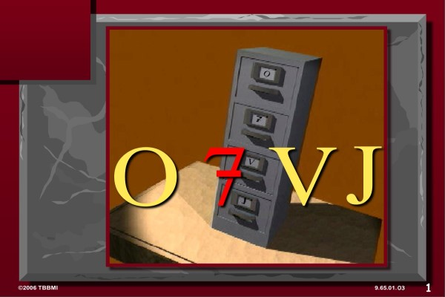

NAMKHALUI 9.65
BIBLE
NGASHȂNKAKHUI
Bible Ngashȃnkakhui Otsin Okthui hupta wui tamkachithei
Fort Worth, Texas
Dr. Rick Griffith • Singapore Bible College • Crossroads International Church Singapore • CICFamily.com • BibleStudyDownloads.org
01
Notes:
Title slide (no narration)

Slide 2
NAMKHALUI 9.65
BIBLE
NGASHȂNKAKHUI
Bible Ngashȃnkakhui Otsin Okthui hupta wui tamkachithei
Fort Worth, Texas
01
Notes:
Title slide (no narration)

Slide 3
LUMASHANMIDA NGANAMILU… KHAYEIRUM HILI NAWUI MOBILE PHONES, BEEPERS KALA KHANGATA-TEI AKAP KATONGA AKHON MASHOK NGASAKLO. CHIWUIVANG NGAWUI NGASOTNAOBINGNA NALI NINGSHIRA!
02
1
9.65.01.
Notes:
[AZINGSHONG HOTLȃMACHU EINA CHUKHAIDA KHALEICHI PROJECTOR ON SALAGA CHANG-YANGKHAVAINA, LAGA KASINGPȃ NA ARA MATHANG-MATHANG NAMVȃPAI HAORA KACHI THEIKHAVAINA.]
//// [KACHITHEI]
LUMASHANMIDA NGANAMILU… KHAYEIRUM HILI NAWUI MOBILE PHONES, BEEPERS KALA KHANGATA-TEI AKAP KATONGA AKHON MASHOK NGASAKLO. CHIWUIVANG NGAWUI NGASOTNAOBINGNA NALI NINGSHIRA!

Slide 4
©
Bible Ngashȃn Kakhui Otsin Okthui hupta
Angazun wuivang Kapangkȃ kahai mibing
Dr. John Hannah
Distinguished Professor of Historical Theology
Research Professor, Historical Theology
Dallas Theological Seminary
Dallas, Texas
Dr. Rick Griffith
Doctor of Ministry Director
Assoc. Professor in Biblical Studies
Singapore Bible College
Republic of Singapore
Dr. Mark Bailey
President
Dallas Theological Seminary
Dallas, Texas
John Maisel • Kurt Nelson
President • Exec. Vice President
East/West Ministries
Dallas, Texas
Dr. William R. Bright
Late Founder
Campus Crusade for Christ
Orlando, Florida
Vasily Dimitrievski
Director for Russia
Global Missions Fellowship (e3)
Penza, Russia
Rev. Douglas Valenzuela
Senior Pastor, Conservative Baptist Missions
Chiesa Battista Evangelica di Casoria
Naples, Italy
Dr. Ted Kitchens
Senior Pastor
Christ Chapel Bible Church
Ft. Worth, Texas
Karyn Granger
Director of Bible Studies
Southwest Christian Schools
Ft. Worth, Texas
Dr. Kenneth Horton
Senior Pastor
McKinney Memorial Bible Church
Ft. Worth, Texas
03
©2006 TBBMI
9.65.01.
Notes:
ANGAZUNWUIVANG KAPANGKȃ KAHAI MIBING

Slide 5
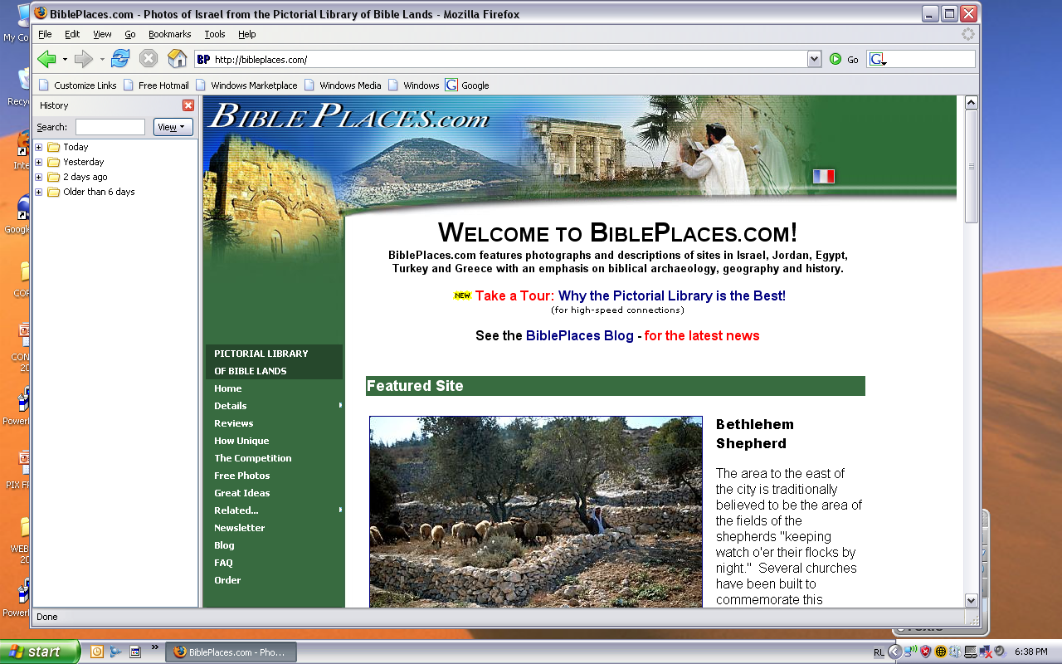
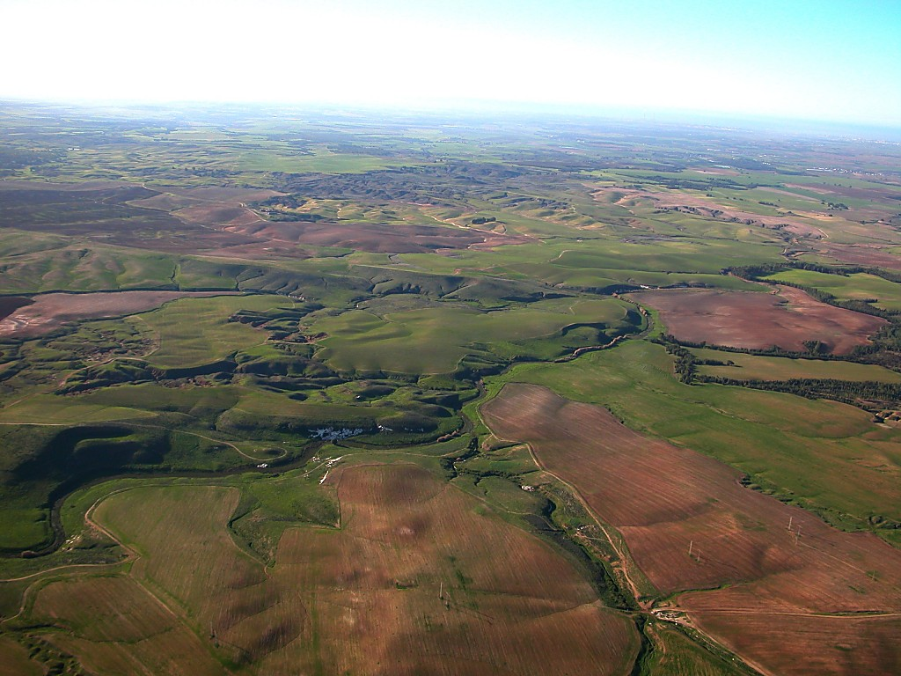
BIBLE NGALEIWUI AMA HAIKHAVAI LAIRIKSHIM
Pictorial Library of Bible Lands, kachi phashokme Todd Bolen li BIBLE NGASHȂN KHAYANG ngayeirum hili ama sichin khangasak wuivang Ishiwui otsinna tarakkha ningshiya. BNK katambing na BiblePlaces.com chili photo thing-thing zangda khalei chi zangyang mikhavai katomdalei: amabingchi Kadhara Ngalei, Aegean kala Mediterranean Kongphei eina thuilaga Vareshi wui shitkasang angayung kakhuipam Europe Aze hkt. samphangra. BiblePlaces.com na ojabing kala ama namkashokbingli ama mathalak kahai tarrakha samphangmipaira. Websiteli zangyang milu! Ningshishi haira, Todd!
04
9.65.01.
Notes:
Hili tamchithei khavai wuivang 150 Bible ngaleiwui ama hi BiblePlaces.com website wuieina sichin khavai khamaya mikahaina. Todd Bolenwui katomkhami chiwuivang ningshiya!

Slide 6
BIBLE
NGASHȂNKAKHUI
Bible Ngashȃnkakhui Otsin Okthui huptawui tamkachithei
Fort Worth, Texas
www.biblebasically.org
05
Notes:
Khayeirum hi Dr John Fryman, Fort Worth, Texas, USA, na khuikashok na kala Dr Rick Griffith, Singapore Bible College wui katamnao bingna khalat kashok na.

Slide 7
Bible Ngashan Khayang kachi otmei hi John E. Fryman, Ph.D na
phaningkhui laga phakashokna.
Mashun © 2006 The Bible…Basically Ministries Intl. Inc., Ft. Worth, Texas
Mashun katonga ngakhȃm kahaina. Lairik hi United States of America wui mashun ain wui athishurda ngȃk kahaina. Kachilikha eina tangda mapu wui khamayȃ lairik mazangla namkashok hi masapaimara, kha kachikatha lairik kakapili teomeikha ngasun kakhuiva mayaya.
Kachikatha akhum kaikha wuivang rinsit eina khamaya mikahai bing chi katamnao bingna darkar kasa athishurda namshokluipaiya.
Otsin hina Dr. Todd Bolen, The Master's College, Jerusalem, Israel, kala Pictorial Library of Bible Lands (BiblePlaces.com) li ama sichin khavai khamaya khamiwuivang ningshiya. Kadesh-Barnea wui amabing chi Dr. Leen Ritmeyer, Hawthornedene, Australia wui khamaya khuilaga sikachinna. Khangatei miwui ama kala khangata-tei ot khamaya makhuila kasing zangkasa thei akha otsin hina ngalangda chithei mikhavai podalei.
Hili rinsit eina zangda khaleibingwui tharrin chi kashap eina tangda chitheira. Khamay makhuila amabing kala kapi kahai bingchi mashichin khavai kashap eina tangda hotnaya.
Ojabing, akap-akai kasingbing kala/maningkha chishutmebing na PowerPoing slidebing wui ama ngathaung-ngathava kasa, maningkha tamkachithei hiwui khari-khanao khangachei, tuiyȃr kateili namkashok, maningkha kachikatha computerwui akap-akai eina, kachiho, digital maningkha Internetwui arȃ sichinlaga hkt.hi namshokme bingwui khamaya makhuila masapaimara.
United States of America li khuikashokna. International Rights Reserved.
06
©2006 TBBMI
9.65.01.
Notes:
MASHUNZA CHITHEIKHAMI: HORKAHAI KALA THARRIN KHALEI KACHITHEI
Khayeirum hi kakup eina ngasoda nathumli powerpoint wui CD ava-va miser-ra chithada sada nathum nala mibingli tamchitheilo. Kha lairik anȃpȃ hili khikhala ngacheikhavai masamilo.

Slide 8


(Kharin: Bible hi Ningphun eina Theikhavai!)
BIBLE NGASHȂNKAKHUI
®
AKHUM AKHA
"BIBLE LAIRIKKOM"
KAHȂR
07
©2006 TBBMI
9.65.01.
Notes:
TBB AKHUM KHAREWUI MINGTHONKASANG
KHARIN: BIBLE HI NINGPHUN EINA THEIKHAVAI!

Slide 9
?
HIBINGWUI APONG HI KHIMAMEI
Ithumwui khayeirum hi kaphaning haklȃk eina haophoksa!
Vareshi Kachidawui Mashungzȃ
Vareshi kachidawui shitkasang arȃ
Bible li pheisin salaga kapikahai lairik kachida:
Bible Worshim Kachidawui Lairikshim
Yarui Kachidawui Lairikshim
Mi Kachidawui Lairikshim
University Kachidawui Lairikshim
Okathuili leidakhalei kachidawui
Atui-lȃ Kachidawuili
KALA
Bibleli Pheisin Sȃlaga Khamachuk
Okathuili khalei shitkasanga kala mashitkasanga kachida
08
15
©2006 TBBMI
9.65.01.
Notes:
Ithumwui okathui hi ngachakyang eina ngaphongzatta kala chili pȃnda khalei mikumo na – marak-khali aremali – phabta khava hotnaya! Athumna ngahȃn-na kala athumwui khangahȃn chili Vareshibing na ngahȃnkȃ mishap-pa. Kha ngahȃnda khalei kachungkhana ngahȃnkȃ khami chili manganȃngai mana… maningkha athumhi mashȃlak rang kachina. Shitkasang bingna ngara-rik eina theiya kachiva ngahȃn kakȃ katonga hi Varewui Tui… Ȃwui Bible li mihaidalei.
//// Chitahda sada… ithumwui khayeirum hi kaphaning haklȃk eina haophoksa!
//// Hibingwui apong hi khimamei
//// Vareshi kachidawui mashungzȃ,
//// Vareshi kachidawui shitkasang arȃ,
//// Bible li pheisin salaga kapikahai lairik kachida,
//// Bible worshim kachidawui lairikshim,
//// Yarui kachidawui lairikshim,
//// Mi kachidawui lairikshim,
//// University kachidawui lairikshim,
//// Okathuili khalei ngalei kachidawui,
//// Atui-lȃ kachidawuili,
//// Kala…langmeikhȃrda…
//// Bible li pheisin sȃlaga khamachuk
//// Okathuili khalei shitkasanga kala mashitkasanga kachida?
//// (DIZ KHANGAHAN KHUDAM)

Slide 10
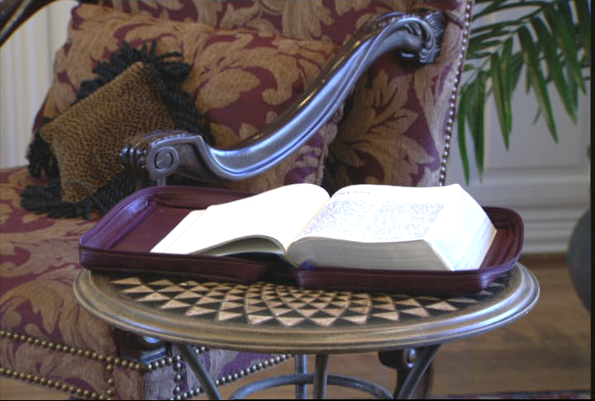
ITHUMWUI SHITKASANGWUI KHAMATAIYA TUINGASHIT LAIRIK
Katamli K ana. 6
2
09
Notes:
Ω9.65.01.09 [2] BIBLE MUNMEIDA
Ngahankakȃ? Lairik hipahi: Vareshiwui shitkasang hi lairik hiwui athishurda ichi-chȃ wui shitkasangla hili pheisin saya… Chithalala…shitkasang chi makhangachei khamashungli pheisin saya! Varewui Tui hiya shitkasangwui maramli khamashungbing mathȃlak eina ngarȃn kahai kapikahaina.
//// Ithumna hithada hopaiya: ITHUMWUI SHITKASANGWUI KHAMATAIYA TUINGASHIT LAIRIK!
Chithalala, okathui kuimareida, mathȃlak eina phȃkhangathing and kala kathei-kashana chitheiya kachiva -- mi KACHUNGKHA wuivanga – khamashung kala Bibleli wui khararchan hi thotrinchanli zatkhara hi hak-khamahȃ kala phaningla makakhuiya otna.
//// Mahaophokranglaga atok-atai kateokha: yashong azingwui achithekli TBB katamnaoli khangachon lairikli nakhalatta yangkhui khavai angazun sangmihaidalei.

Slide 11
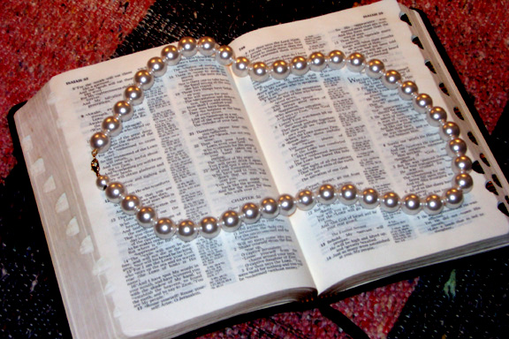
Dr. Henrietta Mears.... na ȃwui lairik "What The Bible Is All About"li hiwui maramli hithada kapiya.
Katamli K ana. 6
10
Notes:
Ω9.65.01.10 [0] AMAN KASAK NGALUNG RUIH KHUILAGA HȂRKAHAI BIBLE TUNGLI KAHAI
20th Century wui kaphaowa Bible Oja akha, Henrietta Mears.... na ȃwui lairik "What The Bible Is All About" li hiwui maramli hithada kapiya.

Slide 12
Mi kachungkhawui Bible kathei hi aman kasak ngalung ruihkhui kahai thaya. Kha mi kachungkhawui ningli…
Katamli K ana. 6
11
Notes:
Ω9.65.01.11 [0]
ȃna hanga… Mi kachungkhawui Bible kathei hi aman kasak ngalung ruihkhui kahai thaya …kha mi kachungkhawui ningli…

Slide 13
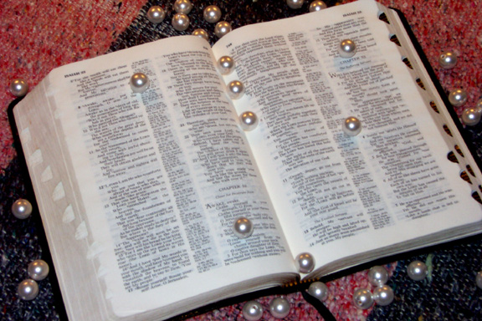
…khara chi chat khahai thaya. Mathalak eina kapikahai Biblewui khararchan chi masho-ngachei ngasak haowa kala pangapa haowa!
Katamli K ana. 6
12
Notes:
Ω9.65.01.12 [0]
…khara chi chat khahai thaya. Mathalak eina kapikahai Biblewui khararchan chi masho-ngachei ngasak haowa kala pangapa haowa. Aman kasak ngalungbing chi ngateingasak haowa… masho-ngachei haowa… chaiyang haowa. Chithada sada ngalung aman kasak-kawui cha ruihkhui laga kahai chiwui khamatha chi matheirar thuwa.

Slide 14
Katamli K ana. 6
13
Notes:
Ω9.65.01.13 [0] [AMA NGATHA KHANGASAK: AMAN KASAK-KA NGALUNG BINGCHI ȃNING SAK-SAK EINA RUIHKHUI KAHAI CHA UNGSAKHANGASAK. AMAN KASAK NGALUNG 47 HI MAMȃNG RANGLAGA SHOKRASARA.]
Kathada ithumna aman kasak-ka ngalungwui cha chi ruihkhuilui paira? Chi takam eina … ithumna kathada Biblewui azernaobing hi ngasunkhuira, katonga chi ngarumda, chithada sȃda aman kasak ngalungwui cha thada lunggui bingwui ichicha wui apam athishurda… maron-maron eina… Bibleli kapikahai kachangkhat shok-kahaibing wui khangashik… khiwuivang khala chiakha kachangkhat shok-kahaibing ava-ava hi Biblewui phongkhamili ngasunserra… zingkum 4,000 wui alungli?
Biblewui maramli kathei katonga khuingatokli mathalak eina ngaran akha ithumna phabta phok-ka …

Slide 15
Vare Tuiwui Kathuk
Apong Tarȃkha eina Khalatshok Kapai
Manglȃ Kathara wui Thankhami Maningkha Chizakhami
14
2
Notes:
Ω9.65.01.14 [2]
… Vare Tui wui kathuk
//// apong tarȃkha eina khalatshok kapai… kala
//// Manglȃ Kathara wui thankhami maningkha chizakhami… Ȃna ithumli Ȃwui Tui tamchithei khavai atam kachida ngaraida khalei.
Chikatha mashȃlak kahai, ngararik kahai Bible wui awor chi tȃnkhui shaprala? Ngahȃn kakȃ: Mah... sapaiya... thȃklak eina kala themlȃk eina.

Slide 16
?
?
?
Varewui matak-khak kahai Ngatangkhamiwui angarȃn
achȃlakhawui Abraham kala Israel
Jishu Krista kharȃ
Church Kapharȃ
?
?
?
?
?
?
15
5
Notes:
Ω9.65.01.15 [5] CHȂ EINA BIBLE TABLE TUNGLI
Lairik hipa hili, hithada pȃkhavai ithumli hȃnghaiya…
//// Ithumna phabta kapai eina kapimi kahai Varewui matak-khak kahai Ngatangkhamiwui angarȃn… hibing hina arȃng salga…
//// … achȃlakhawui Abraham kala Israel wui kumei… zingkum 4,000 shakha Middle East li shok-kahai…
//// … shok-kahai katonga chi Jishu Kristawui pao kaphȃ wui otsinli ungmalao kashok …
//// … kala church phȃkashok. Khararchan hili ithumwui sharukva Jishu Kristawui Pao Kaphȃ hi phabta khavai… ithumwui atamli tashungda.
//// Kha, wuk-kakhanangpava, mi kachungkha wuivanga, hiya matheilakrang kaji lam kathȃ ngasaya. Kachangkhatva, kachunga wuivanga, aworwui ngachee-ngachamlȃk kahai apam ngasaya.

Slide 17
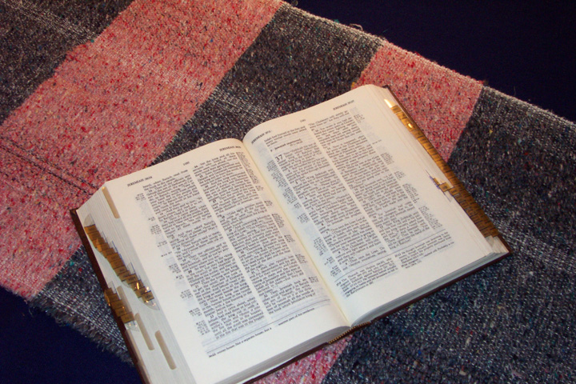
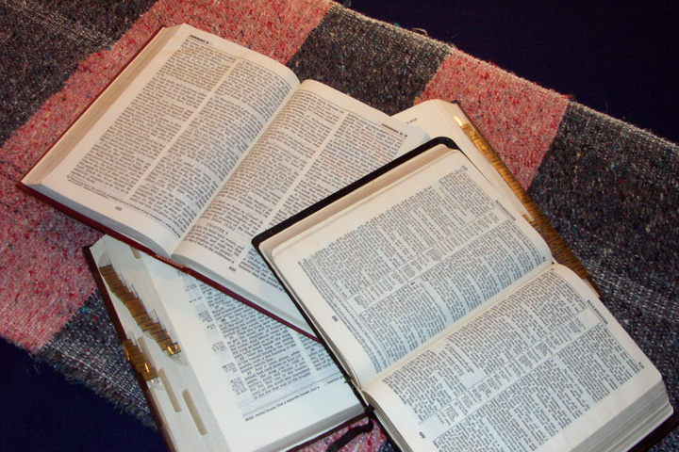
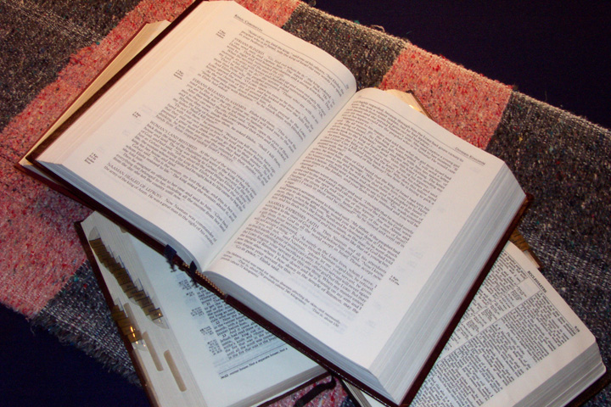
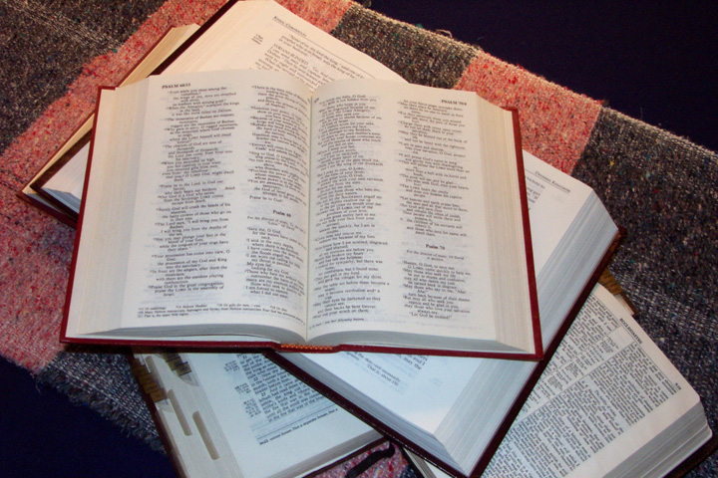
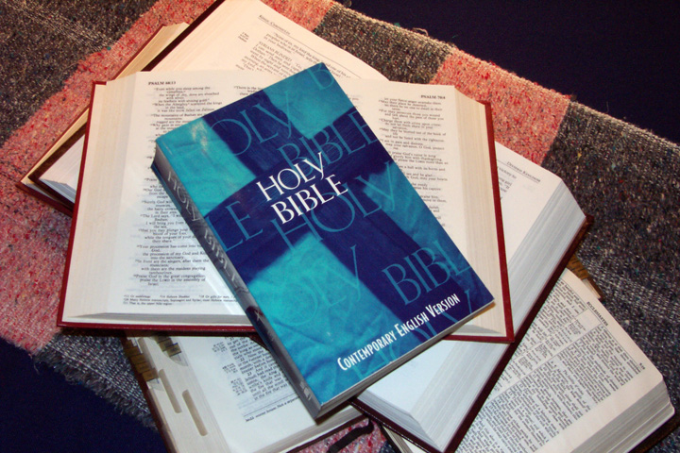
  BIBLE BING CHILI THADA YANGLO!
16
Notes:
Ω9.65.01.16[0] RING-NGASAK KALA KHORKAHAI BIBLE BING
Bible bing chili thada yanglo! Namluishit kahai katonga… khalatshok kahai katonga… sophayolak kahai mishangbing wuivang rinsit eina namishokmi kahai… OKATHUI PEIDA!

Slide 18
Kala berȃ chi chili haophok-ka
CHI HAKLȂK KAHAI HANGKHAVAI MAKHALEI PAKHANGAPȂNA
• Kuplak eina kahȃng thing-thing zanga
• Asak-avȃt shȃ-shȃ zanga
• 750,000 Tui
• 1,200 Kapikasang
• 31,000 Tuizȃ
• Mashan Kharar Namluishit kahai
& Khalatkashok
17
7
Notes:
Ω9.65.01.17 [7]
Kala berȃ chi chili haophok-ka. Mi kachungkha wuivanga… chili shitkasanga bingla zangkahainei …
//// Bible hiya haklȃk kahai hangkhavai makhalei pakhangapana.
//// Kuplak eina kahȃng thing-thing zanga...
//// Asak-avȃt shȃ-shȃ zanga...
//// Tui million akhawuili sharuk kathum... many exotic and unfamiliar...
//// 1,200 kapikasang...
//// 31,000 tuizȃ...
//// kala mashȃn kharar namluishit kahaibing kala khalatshok kahaibing... tui mashing ayur- ayȃ-yȃ okathui hupta...
Katonga chi ngarumda yangakha, hikatha otshot hina akap-akai kashunglak kahaiwui mangȃ eina lairik kapȃlila kala lumshilaonilala thȃklȃk eina sakhuiserpai kachi okthotbing wuivanga berȃ kahak-ka ngasȃya.

Slide 19
KHIPANA KHI SA?
KHIPANA KHI HANG?
lAIRIKBING
KHIWUIVANG?
MIBING
TARIK
KHIPȂLI MANING KHA KHILI NGASHIK?
18
7
Notes:
Ω9.65.01.18 [7]
Hili ngateihang kahai wuk-kakhanang kaikha...
//// lairikbing katonga hi khisavai-usi...
//// mibing katonga, 3,000 athum katonga...
//// tarik katonga...
//// kala khipana khi hang...
//// athumna kasȃchi khiwuivang kasȃ...
//// khipȃna khisȃ...
//// kala khipȃli maning kha khili ngashik?

Slide 20
NGACHONLU!
KHIPANA KHI SA?
KHIPANA KHI HANG?
lAIRIKBING
KHIWUIVANG?
MIBING
TARIK
KHIPȂLI MANING KHA KHILI NGASHIK?
19
7
18
Notes:
Ω9.65.01.19 [0]
Kachangkhat eina, mi kachung khawuivanga, athuma thada ngavaohaowa, "NGACHONLU! Phabmakatȃ hiwui eina ili thȃnshok milu… I mȃngchao haira!"

Slide 21
NGACHONLU!
I MAKHUIRAR THURA!!!
CHIWUIVANG EINA... YAOKAHOMALI SANGASAK
HAORA!
20
Notes:
Ω9.65.01.20 [0]
Kala athum pheikhar akha vȃmeida kakhuibing... athumna hȃng, I MAKHUIRAR THURA! CHIWUIVANG EINA... YAOKAHOMALI THADA SANGASAK HAORA… Maningkha thot hili Bible themlȃk kahai mili.

Slide 22
KHIPANA SAKDA KHUIKHAVAI LEI?
21
Notes:
Ω9.65.01.21 [0]
Kala latluida... KHIPȂNA SAKDA KHUIKHAVAI LEI? [Toilȃk eina ithum hi ningngaluikhui laga tanghaowa]

Slide 23
THAKHA KHI?
22
Notes:
Ω9.65.01.22 [0]
Kala mathangpȃ khangahȃnva... THȂKHA KHI? [Kha khiwuivang eina ithumna Bible heirap eina yangkakhui dȃkȃr sahao?]

Slide 24
"Ithumwui shitkasang hi hibing hili masȃkȃrang lakha eina tangdava kachangkhat shok-kahai chi, khikha maninglui mana kha phȃb eina kakhalat, mangmutshitsang kala chitha maraowa da kakhalat ngasahaora."
Miles Stanford
Principles of Spiritual Growth
kachangkhat shok-kahai chi,
phȃb eina kakhalat
mangmutshitsang
chitha maraowa da kakhalat
23
4
Notes:
Ω9.65.01.23 [4]
khangahȃn chili phaolȃk kahai Vareshi lairik kakape akhana ngahankai... Miles Stanfordna kahang nganȃlu:
"Ithumwui shitkasang hi hibing hili masȃkȃrang lakha eina tangdava
//// kachangkhat shok-kahai chi, khikha maninglui mana kha
//// phȃb eina kakhalat,
//// mangmutshitsang kala
//// chitha maraowa da kakhalat."

Slide 25
shitsangpailak kahai katam…
"Ithumna kathei chili lȃngda ithumna mashitsang mara,
kala ithumna shitkasang chili chuimeida ithumna maokthuirar mara."
Albert Mohler, Yaruiwo
The Southern Baptist Seminary Louisville, KY
24
3
Notes:
Ω9.65.01.24 [3]
Kala shitsangpailak kahai katam hili majukyanglu …
//// Dr. Albert Mohler, Louisville, Kentucky li khalei Southern Baptist Seminarywui yaruiwo na hi kapiya …
//// "Ithumna kathei chili lȃngda ithumna mashitsang mara …
//// … kala ithumna shitkasang chili chuimeida ithumna maokthuirar mara. Aruihon thot Vareshi kachungkhana zatkhanȃ chili chamnȃkahai hi khiwuivang khala chiakha shimli rano kala churchli rano Bible hi mathalȃk eina mahȃkashok kala matamkachithei wuivang na… Thot hiwui mibinghi Bible theikhavai lungsanglȃk eina kahao phalungra, maningkha Vareshi kachungkhana Sodom eina Gomorrah hi ringphalȃk eina pȃnhaowa kachi ngachee-ngachȃmlȃk kahai kaphaning eina kupsangra."

Slide 26
Arava yang-usa!
(kala class kachida razang khavai salu khiwuivang khala chiakha ningchuk kadhar hi rida tamkahai bingli ngasun serra!)
25
1
Notes:
Ω9.65.01.25 [1]
China ithumli mangȃshong tamkida khalei chili rȃngasak-ka. Ithum arava Bibilewui shongzȃ: BIBLE kaho shongzȃ haophok haosa. Hi Bibleli kapi kahai lairik KATONGA hi sham-meida thȃlȃk eina tamkhui khavai, chithada sȃda nali BIBLEWUI ATHISHURDA MACHUK NGASAK KHAVAI kala nanala mi kateilila ngaraikachȃ aworchi tamchithei shapkhavai katamna!
Nali naningwui khutlai kadhar mira kala china nawui kala mikateiwui mirinli Varewui Tui kala ȃwui pao hi dharmeida yangkhui ngasakra… shitkasanga bingwui vangla kala mirinwui kakhalat phazat mahungda khalei bingwui vangla!
//// Arava yang-usa… kala class kachida razang khavai salu khiwuivang khala chiakha ningchuk kadhar hi rida tamkahai bingli ngasun serra!

Slide 27
Bible Ngashȃnkakhui
®
hi khamachuk wui arȃna!
26
Notes:
Ω9.65.01.26 [0]
Rimeikapta ithumna Biblewui khararchan hili THOTCHAN HI THALAK eina tamkhuisa… china nali ngararik eina Bible hi dharmeida machuk-khui ngasakra!

Slide 28
Bible Ngashȃnkakhui
®
Bible hi ning eina theikhavai nana tamkhui LȂKRA!
27
Notes:
Ω9.65.01.27 [0]
Bible hi ning eina theikhavai nana tamkhuira!

Slide 29
Bible Ngashȃnkakhui
®
MATAILȂK KAHAI AKHA: Nana mi kateili tamchithei khavai tamra!
C 7 S J
Jishu maramli hangchithei khavai phȃlȃk kahaina!
28
1
Notes:
============================================
Ω9.65.01.28 [1]
Matailȃk kahai akhala: nanala mi kateili tamchithei shapkhavai na tamkhuira!
//// Kala nali kuimareida kapambingli Jishu maramli hangchithei khavai phȃlȃk kahai haokaphokna!
Arava, yangusa…

Slide 30
Bible Ngashȃnkakhui
®
"Nawui Bible Lairikom"
chi hȃsa
29
Notes:
Ω9.65.01.29 [0]
…khare china risa… "Nawui Bible Lairikom" chi hȃsa.

Slide 31
BIBLE
LAIRIKKOM
30
Notes:
8.O.01.30 [0]
Ithumwui ngasotnao akhali ina zakmai chitheingaiya, Mike. Mike hi church li vauki chihaira. Ȃhi "Bible awor ningphunwui Lairikom" singlaga shimlungli zanghaira… aih… thada!

Slide 32
BIBLE
LAIRIKKOM
BIBLE
LAIRIKKOM
31
Notes:
Ω9.65.01.31 [0]
Ȃ chili zattalei… churchli zangkhavai ningphunwui Bible Lairikom singlaga…

Slide 33
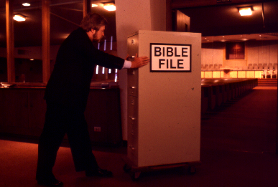
BIBLE
LAIRIKKOM
BIBLE LAIRIKKOM
32
31
Notes:
Ω9.65.01.32 [0]
... Kala Mike na shimlungli ngatarti eina zanghaowa, awui ningli Lairikom Haikhavai Akong chi shologa hanphutpamli maningkha khorum khavai alungthungli zanghaira.

Slide 34
BIBLE
LAIRIKKOM
33
Notes:
Ω9.65.01.33 [0]
Mikena pao hashokme maningkha tamme china tamchithei khavai ngaranlaga pamzang haowa. Mikena awui Bible Lairikom haikavai akhong chi shokhavai ngaranna…

Slide 35
34
Notes:
Ω9.65.01.32 [0]
… awui ning li! …….Aih, a chili pamdalei... yaokahomma maningkha ojana hangkida khaleibing chi awui ningli namsang khavai ngaranping eina leidalei.

Slide 36
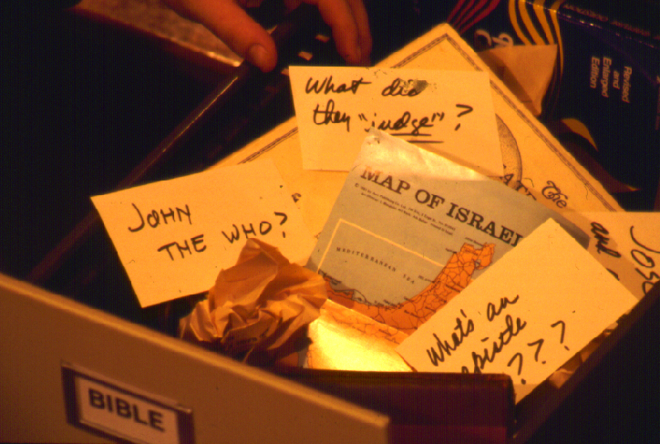
?
Chithada sada... kahȃng katonga chi kachieina mashungkhui khavai haophora... kala tarȃkha nguida hangmi kahaibing chi?
?
?
?
35
5
Notes:
Ω9.65.01.33 [5]
Ana ȃwui ningwui Bible Lairkom chi kasho tharan… chansam sada kahangmaya…ama-amȃ maphakhui mana!
//// John Kachipȃ? Baptist? Methodist? Catholic? Maningkha Jihudi pȃchilȃ? Katongachi khi khala?
//// Kala okathuili athumna khi bichar sada? Da athum bichar kasȃbing chi khipalong khala? Athumli khipȃna kapangkȃ?
//// Kala Israelwui kachikathȃ-thȃ map... chi pakhangapȃ Bibleli kazang ngaleina! Na chi ili hangkidava, da Mikena hanga, chi chipȃchi aruihon khabarli kala TV kashok ngaraikachȃ apam chi maningmala?
//// Kala "Chithibing chi?".... phȃkhangathing na chitheiya kachiya mi kachungkhana CHITHI chi SAKHANGATHA wui pareivana! Mah, kachikathȃva chithada phaninglak-ka!
//// Chithada sada... kahȃng katonga chi kachieina mashungkhui khavai haophora... kala tarȃkha nguida hangmi kahaibing chi?

Slide 37
I khikhala MAtheimana!
Kachiwui eina I haophokra
36
Notes:
Ω9.65.01.36 [0]
Mi chungkhameinava hithada hanga, Chungkhameina "I khikhala matheimana!"
…So..."Kachiwui eina I haophokra?"

Slide 38
7
Katamli K ana. 8-14
37
Notes:
Ω9.65.01.37 [0]
Mashing 7 wui eina ithumna haophoksa. Kha munmeida yanglu kala 7 chili shitkahai nana theira.

Slide 39
7
7
Katamli K ana. 8-14
1
38
Notes:
Ω9.65.01.38 [1]
Kala chi darkar saya! Shitkahai china nali kachikatha akha phaningung ngasakra. Minute akhawui thili mashing 7 nana akhum khanisada ngayarkhai haora: 4 kala 3.
//// Langmeida, amabing chi yangkata eina ngasoda, tarȃkhava 7li shitkahai arȃng kachidawui yȃshong achithekli nana theira… satheichup kaji phaningung rȃshum ngasak kaji ithum sichin khavai ningwui khutlaibing.

Slide 40
NAWUI BIBLE
LARIK-KOM
7
O
7
V
J
Katamli K ana. 8-14
39
Notes:
Ω9.65.01.39 [0]
Arava otsan oko chi chipui khavai ithum majuksa. Hina NAWUI BIBLE LAIRK-KOM ngasȃra! Ithumna tamki kachili rimeida khayang.

Slide 41
7
O
NAWUI BIBLE
LARIK-KOM
7
V
J
EMBEDDED MOVIE SEQUENCE NOT AVAILABLE IN THIS NAMKHALUI
Katamli K ana. 8-14
40
Notes:
[SANGMIHAIDA KHALEI AMACHI 9.6 PC WUIVANG NAMKASHOKLI MAZANGMANA…]
Ω9.65.01.40 [0] AMACHI NGAREOKHAVAI 2 MINUTES, 30 SECONDS NGARAILU. AMACHI KAKUPLI, COMPUTERWUI KEYBOARDLI KAKȃ SPACE BARLI MATHANGPȃ CHI SHOK-KHAVAI KATHUM SHIDA NAMLU. SINGDA KHALEI COMPUTER CHILI AMACHI MASHOK-KHA MATHANG ZATTȃ HAOLU.

Slide 42
LAIRIKKOM 10
7
1
2
3
O
4
5
6
7
7
8
V
9
10
J
Katamli K ana. 8-14
41
Notes:
[SANGMIHAIDA KHALEI AMACHI MANGAREOPAIKHA HI SICHINLU…]
Ω9.65.01.41 [0] (NGWUIRASO THȂDA KHORKAHAI LAIRIKKOM)
Haophok khavai sada, otsan okoli lairikkom 10 eina chipuikhavai majuklu. Nakhalattawui Bible Larikkom hi naningwui lairikkom tharȃli sangkhavai nana kazipra. Khaleilaga lairikkom 10 ava-va chili nana machut khavai aming kapihaora. Chieina…ara haophok-khavai…kala…

Slide 43
"Nawui Lairikkom" kahȃ
7
7
7
7
7
7
7
7
O
7
J
O
V
J
V
J
O
V
J
V
Katamli K ana. 8-14
4
42
Notes:
Ω9.65.01.42 [4]
Hili ithumna haophokra... mashing akhamang eina…. 7.
China ithum ningwui kȃngkhuina. Shamlȃk kahai - kashit kahai mashing 7.
//// Mathang sȃda... mashing chili ABC mayek kathum eina chuklu. Apam horzakda naningli mathalȃk eina tipsanglo:
O 7 V J
Mayekbing chi latlui-latluida ningli tipsangkhavai pȃnglȃk eina pȃlu... Khiwuivang khala chiakha hina Bible semkakȃ kala khararchanwui matailȃk kahaiyana:
//// "O 7 V J....
//// O 7 V J....
//// O 7 V J...etc."

Slide 44
7
"Nawui Lairikkom" kahȃ
7
= 4+3
Katamli K ana. 8-14
2
43
Notes:
Ω9.65.01.43 [2]
Arava... Europepashiwui arȃ sichinlaga kagapi mashing '7'.
//// Nana phaningungdaleira mashing 7 li kashitchi... Chi matailak kahai phaningung khavaina— ning eina theikhavai. Ningli hailu. Mashing chili kashitta china 7 hi akai khanishida khaingasak-ka. Chiwui vang eina, Nakhalatta ngahȃnlu: kachikathȃ mashing khanina 7 hi ngayarkhaipai khala?"
//// Ungtȃkapai ngahȃn kakȃ akhava… kala mashungmeithui kaji pȃchi…va: 4 eina 3.

Slide 45
7
O 4 3 V J
O 4 3 V J
Katamli K ana. 8-14
1
44
Notes:
Ω9.65.01.44 [1]
Chieina, O 7 V J arȃli, 7 chi 4 kala 3 kha-onli, ithumna
O 4 3 V J.
Kharwui thȃda, ngachei kahai mashingbing chi mthȃlȃk eina ningphun sȃkhavai latlui-latluida palu.
//// O 4 3 V J.

Slide 46
5 Matailȃk Kahai Tuiyarbing:
7
O = OKATHUI
4 = MIBING
3 = YARUIPȂN
V = VARI KAHAI
J = JISHU
Katamli K ana. 8-14
5
45
Notes:
Ω9.65.01.45 [5]
Arava, O 4 3 V J hili rinlaga, kakhalat thuklak kahai tuiyar phangȃ ngasȃ ngasak haira. Hibing hina naningwui Bible Larikkom haokaphok ngasȃra. Hangkahaibing chi hili mihaidalei…pangda pȃshoklu…
//// O = OKATHUI KASEM
//// 4 = 4 MI
//// 3 = 3 YARUIPȂN
//// S = VARI KAHAI
//// J = JISHU.
Khangarȃn hi Bible haophok khavaina! Kakhalat thuklȃk kahai kala tuiyar phangȃ china kasha eina kagapi kala Bible wui matailȃk kahai arȃn ngasaya.

Slide 47
7
5 Matailȃk Kahai Tuiyarbing:
O = OKATHUI
4 = MIBING
3 = YARUIPȂN
V = VARI KAHAI
J = JISHU
Katamli K ana. 8-14
6
46
Notes:
Ω9.65.01.46 [6]
Akhashida...pȃngda…
//// O = OKATHUI KASEM
//// 4 = 4 MI
//// 3 = 3 YARUIPAN
//// S = VARI KAHAI
//// J = JISHU.
Ara ithumna kakhalat thuklak kahai tuiyar bingchi munmeida meikhaisa.
//// OKATHUI KASEM,
hina khangachȃ eina atungli leiphalungra, khiwuivȃng khala chiakha… Bible wui khararchan chili haokaphokna.

Slide 48
5 Matailȃk Kahai Tuiyarbing:
7
O = OKATHUI
4 = MIBING
3 = YARUIPȂN
V = VARI KAHAI
J = JISHU
Katamli K ana. 8-14
47
Notes:
Ω9.65.01.47 [0]
Kakhanepȃ yang ngarumsa:
4 MI.

Slide 49
MI 4 BING CHIYA:
7
ABRAHAM
JOSEPH
MOSES
JOSHUA
Katamli K ana. 8-14
5
48
Notes:
Ω9.65.01.48 [5]
“Mi 4" chi rinsit eina hithada kapisa, hithada:
//// ABRAHAM
//// JOSEPH
//// MOSES
//// JOSHUA
Aminghi khari-khano athishurda ningphun sakakhui khavai latlui-latluida pȃlu kala hi kannara:
//// "A-J-M-J ... A-J-M-J ... etc."

Slide 50
A Judge Must Judge
7
ALI
JAHEI
MILU
JOH!
Katamli K ana. 8-14
49
Notes:
Ω9.65.01.49 [0]
Amingbing chi khari-khano athishurda nana kathada phungphaira?
Shampat kahai tuipeng..."ALI JAHEI MILU JOH." Tuiyar kachidawui khare mayek: AJMJ hina.

Slide 51
MI 4 BING CHIYA :
7
A BRAHAM
ALI
J OSEPH
JAHEI
M OSES
MILU
J OSHUA
JOH
Katamli K ana. 8-14
8
50
Notes:
Ω9.65.01.50 [8]
Amingbing chin nana mathȃlȃk eina maphungrang laga latlui-latluida palu:
//// "ABRAHAM,
//// JOSEPH,
//// MOSES kala
//// JOSHUA."
Kala hili latluida naningwui khutlai…
//// ALI
//// JAHEI
//// MILU
//// JOH.

Slide 52
OKATHUI to Joshua
7
OKATHUI
ABRAHAM
JOSEPH
MOSES
JOSHUA
Katamli K ana. 8-14
5
51
Notes:
Ω9.65.01.51 [5]
Chithada sada, matungmeithui kajiwui eina:
//// OKATHUI KASEM
//// ABRAHAM
//// JOSEPH
//// MOSES
//// JOSHUA
Hina nawui Bible Lairikkom katharli matailak kahai MI MATI hi peingasak haira. Bible li kazang khangatei mi tarȃkhala leifaya, kha hibing himang eina ithumna Bible Lairikkom hi kasemna. Aming matihi latlui-latuida tarȃkhashida ningphun sakhavai palu.

Slide 53
5 Matailȃk Kahai Tuiyarbing:
7
C = OKATHUI
4 = MIBING
3 = YARUIPȂN
S = VARI KAHAI
J = JISHU
Katamli K ana. 8-14
52
Notes:
Ω9.65.01.52 [0]
Kakhalat thuklak kahai kakathumma:
3 YARUIPȂN.

Slide 54
R W N
7
Katamli K ana. 8-14
2
53
Notes:
Ω9.65.01.53 [2]
Naningwui khangatei khutlai… nana khi hora
//// kuikhamarei chiwui kahunga akhum chirala?
//// Chi "rwn" hoya, R-W-N da pȃnan sȃya. Mayek hina khare YARUIPȂN 3 phaningung ngasakka.

Slide 55
3 YARUIPAN KATHUM CHIYA:
7
RAMNGAZAN
WUNGNAO
NARKAHAI
Katamli K ana. 8-14
6
54
Notes:
Ω9.65.01.54 [6]
The three YARUIPAN are…
//// RAMNGAZAN
//// WUNGNAO
//// NARKAHAI.
Kharewui thada tuiyarbing hi latlui-laluida tarȃkhashida palu.
RAMNGAZAN, WUNGNAO, NARKAHAI...
RAMNGAZAN, WUNGNAO, NARKAHAI.
Kala ningwui khutlai hili:
//// R
//// W
//// N.

Slide 56
OT Review
7
OKATHUI
ABRAHAM
JOSEPH
MOSES
JOSHUA
RAMNGAZAN
WUNGNAO
NARKAHAI
Katamli K ana. 8-14
55
Notes:
Ω9.65.01.55 [0]
Arava leidakhalei chili YARUIPȂN 3 kathumhi ngarumsang laga, ithum hibing hi leiya:
OKATHUI KASEM
ABRAHAM
JOSEPH
MOSES
JOSHUA
RAMNGAZAN
WUNGNAO
NARKAHAI

Slide 57
YANGLUISA…
7
7
YANGLUISA...
O 7 V J
O 4 3 V J
Katamli K ana. 8-14
3
56
Notes:
Ω9.65.01.56 [3]
Tuiyarbingwui khari-khanao chi haNluida yangsa…
Mashing akha chiwui chiena haophokda
//// 7.... wui eina…
//// O 7 V J...
hi onhaowa...
//// O 4 3 V J.
Mashing kala mayek hibing hi Bible wui arȃn sȃkhavai ningli TUIYAR THARȂ semkhuiya.

Slide 58
The Basics
7
OKATHUI
4 MIBING
3 YARUIPȂN
VARI KAHAI
JISHU
Katamli K ana. 8-14
57
Notes:
Ω9.65.01.57 [0]
O 4 3 V J is then expanded into:
OKATHUI KASEM
4 MI
3 YARUIPȂN
VARI KAHAI
JISHU.

Slide 59
The Last Two Folders
7
OKATHUI
ABRAHAM
JOSEPH
MOSES
JOSHUA
RAMNGAZAN
WUNGNAO
NARKAHAI
VARIKAHAI
JISHU
Katamli K ana. 8-14
2
58
Notes:
Ω9.65.01.58 [2]
Chiwui thili munmeida meikhaiya:
OKATHUI KASEM
ABRAHAM
JOSEPH
MOSES
JOSHUA
RAMNGAZAN
WUNGNAO
NARKAHAI.
Naomeithuda, ara, ithumna ngarumsang haosa: //// VARI KAHAI kala
//// JISHU.

Slide 60
Naningwui Kathar "Bible Lairikkom"
OKATHUI
OKATHUI
ABRAHAM
ABRAHAM
ABRAHAM
ABRAHAM
JOSEPH
ABRAHAM
MOSES
JOSEPH
JOSHUA
RAMNGAZAN
MOSES
WUNGAO
NARKAHAI
JOSHUA
VARI KAHAI
JISHU
RAMNGAZAN
WUNGAO
NARKAHAI
VARI KAHAI
JISHU
Katamli K ana. 8-14
59
11
Notes:
Ω9.65.01.59 [11] Arava ningwui Bible Lairikkomli tharȃ chili tuiyar tharȃ chi machut khavai ningli phunghaolu –
//// nawui ningli. Ningli nana phungkahai ama chi hithada leira. Kala chibing chiya...
//// OKATHUI KASEM //// ABRAHAM //// JOSEPH //// MOSES //// JOSHUA //// RAMNGAZAN //// WUNGNAO //// NARKAHAI //// VARI KAHAI… kala… //// JISHU. Arava naningli tharzȃri eina kala khari-khanao athishurda tipsanghaira--- phaningung khavai kala nana darkar kasȃ chili sichin khavai. Arava chanjam khateomeikha phaningungpai khavai...

Slide 61
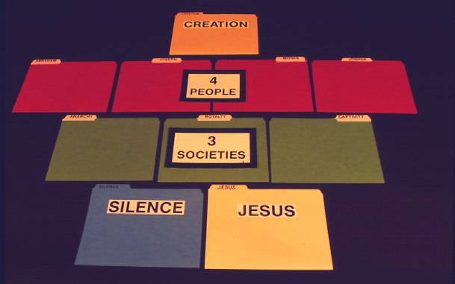
7
OKATHUI
Manuel pg. 8-14
60
Notes:
Ω9.65.01.60 [0]
Bible wui Lairikkom tharȃ chi LAIRIKWUI LAIRIKKOM thada ara ithumna theikahai… Okathui kasem…

Slide 62
7
OKATHUI
4 MIBING
Manuel pg. 8-14
61
Notes:
Ω9.65.01.61 [0]
…Mi mati chi…

Slide 63
7
OKATHUI
4 MIBING
3 YARUIPȂN
Manuel pg. 8-14
62
Notes:
Ω9.65.01.62 [0]
…Yaruipȃn kathum chi…

Slide 64
7
OKATHUI
4 MIBING
3 YARUIPȂN
VARI KAHAI
JISHU
Manuel pg. 8-14
63
Notes:
Ω9.65.01.63 [0]
… chiwui thili Vari kahai kala Jishu kharȃ… Katonga hi chek-chinlȃk eina naning wui lairikkom li leikahaina!

Slide 65
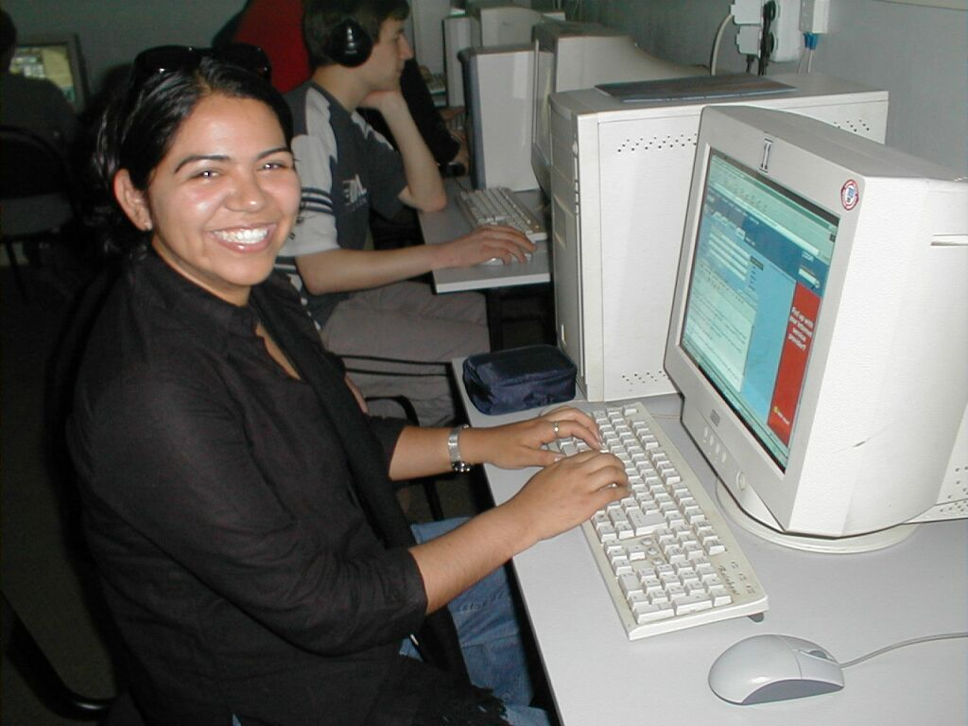
7
Okathui hi ngachei kachangkhat haira.
Katamli K ana. 8-14
64
Notes:
Ω9.65.01.64 [0]
Naningwui Bible Lairikkom li apong khangatei eina hithadala phaningpaiya. Ithum kachungkha thada, quilava hipȃhi thangkachida pung tarȃkha computer li pamma.

Slide 66



7
OKATHUI
OKATHUI
ABRAHAM
ABRAHAM
ABRAHAM
ABRAHAM
ABRAHAM
ABRAHAM
JOSEPH
JOSEPH
ABRAHAM
ABRAHAM
MOSES
MOSES
JOSHUA
JOSHUA
RAMNGAZAN
RAMNGAZAN
WUNGAO
WUNGAO
NARKAHAI
NARKAHAI
VARI KAHAI
VARI KAHAI
JISHU
JISHU
65
Notes:
Ω9.65.01.65 [0] Chithada sada... ritlȃk kahai lairikwui lairikkom thada phaningki kachiliva computerwui cassette kala hard drive li sangkahai lairikkom thada khuisa.

Slide 67
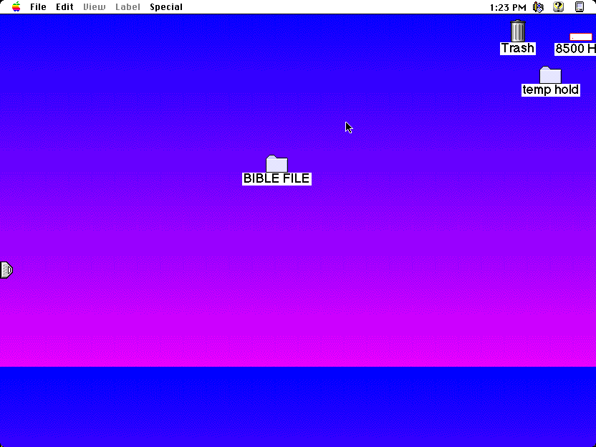
BIBLE LAIRIKKOM
66
Notes:
Ω9.65.01.66 [0] Hi computerli ama shok-khavaina da phaninglu – nawui lairikkom kazip khavai, khangachȃ eina, Bible Lairikkom da. Ning eina semkahai Lairikkom kazip khavai chili khanishida namlu….

Slide 68
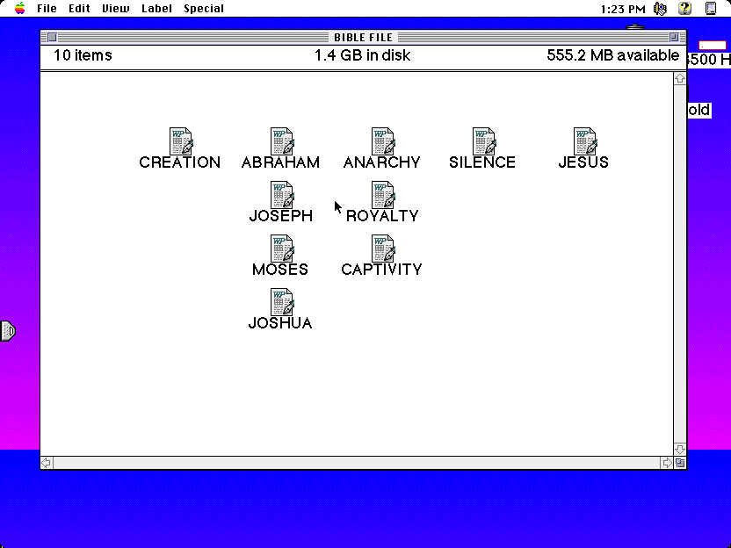
C
OKATHUI
ABRAHAM
RAMNGAZAN
VARI KAHAI
JISHU
JOSEPH
WUNGAO
MOSES
NARKAHAI
JOSHUA
67
10
Notes:
Ω9.65.01.67 [10]
… thakha nana hi samphangra... lairikkom tharȃ, ming thȃkahai, khari-khanao athishurda… kala ithishurda palu…
//// OKATHUI KASEM
//// ABRAHAM
//// JOSEPH
//// MOSES
//// JOSHUA
//// RAMNGAZAN
//// WUNGNAO
//// NARKAHAI
//// VARI KAHI
//// JISHU.

Slide 69
{
}
O 7 V J
C
OKATHUI
ABRAHAM
RAMNGAZAN
VARI KAHAI
JISHU
4
MIBING
JOSEPH
WUNGAO
3
YARUIPȂN
MOSES
NARKAHAI
JOSEPH
68
Notes:
Ω9.65.01.68 [0] Kala, ama mathasang khavai computer wui khangachon eina, icham-cham kahai shim sȃki kachithȃda lairikkom chili ngarumsang paira. Ara ithumna theiching kahai ningwui khutlai... O 7 V J kala chiwui MI 4 kala YARUIPȂN 3.

Slide 70
NANINGWUI BIBLE LAIRIKKOM!
OKATHUI
ABRAHAM
JOSEPH
MARARSHAP
MOSES
JOSHUA
RAMNGAZAN
SHAMPAT EINA
WUNGAO
NARKAHAI
VARI KAHAI
JISHU
NGANARSHANTIT
69
4
Notes:
Ω9.65.01.69 [3] Chithada sada ara Bible hi mashungda naningli haikhavai khamataiya arȃ bingchi… naningli leihaira… Bible sakȃkhavai khamataiya bing… kathada SHITKASANGWUI PONGLI KAPI KAHAI KHAMATAIYA BING HI kazip hailikhala.
//// Chi namashȃwui Ningwui Bible Lairikkomna!
Hiwui eina thuida, ithumna semra
//// mararshȃp kahai,
//// shamlak kahai,
//// kala nganarshantit kahai Vare Tui wui map… pheikar kachida zatrashum kahai hi hili pheisin salaga ningli yeksangkahaina.

Slide 71
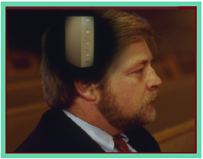
Ara Bible Ngashȃnkakhui, hili nawui ningli
•"Bible Lairikom"da lei kachi theihaira
• Shokhavai Ningwui Chabi "Bible Lairikkom"…O 7 V J
1. KHI SHOKHAO?
KHANGAHȂN KATHUM NGAHANKȂ KHAVAI
2. KHIWUIVANG CHI SHOKHAO?
3. KATHADA BIBLE LI KAPIKAHAI CHI CHITHADA KAPIHAO?
70
4
Notes:
Ω9.65.01.70 [4] PHAHAIRA. Ara, ithum mangȃ zat mamandalei. Atam hitharan… BIBLE LAIRIKKOM kachi theikakhuiva leihaira… kala ningwui sho chi shokhavai chi…O 7 V J. Bible hi apong kathar eina machuk khavai ara shongfa mathada semhaira, katonga chi athumwui apam-apam athishurda.
//// Ithumna matailȃk kahaiya khangahan kathumli ngahaka shaphaora:
//// KHI shokhao…
//// KHIWUIVANG chi shokhao…kala naomeithuida…
//// KATHADA, KHINA kala KHIWUIVANG Bible li kapi kahai chi chithada kapihao… lairik chikhalatta wui khare-khaonao.

Slide 72
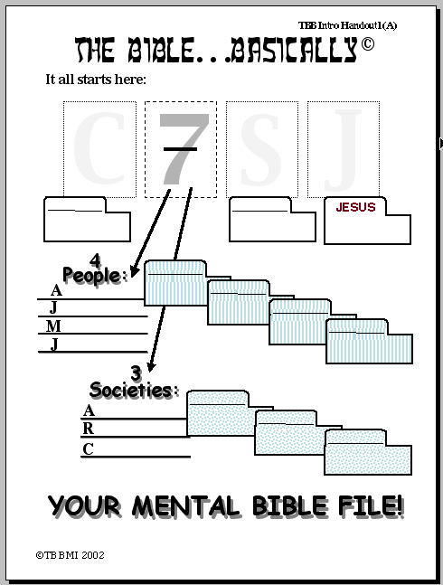
Bible Ngashȃnkakhui
Katongachi hili haophok serra:
O
7
V
J
OKATHUI
VARI KAHAI
JISHU
4 MIBING:
{
ABRAHAM
A
BRAHAM
JOSEPH
J
OSEPH
MOSES
OSES
M
JOSHUA
OSHUA
J
{
3 YARUIPAN:
KATAMLI KHANGACHON #01
R
RAMNGAZAN
AMNGAZAN
WUNGAO
W
UNGNAO
NARKAHAI
N
ARKAHAI
NANINGWUI BIBLE LAIRIKKOM!
©2006 TBBMI
9.65.01.
20
71
Notes:
Ω9.65.01.71 [20]
Ara Katamnaoli Khangachon Lairikwui Mashing Akha chili yanglu. Anȃ china kathada khutlai hibinghi naningli hairakhalada phaningung khavai kasȃli ngachonra... chithada sȃda mibingli kathada tamchitheira khala da nana kasha eina ngasoda.
//// Kahak-ka O eina haophokda…
//// OKATHUI KASEM kachi wuivang…
//// mashing 7… 7 china mi mati kala yaruipȃn kathum wui mahut sȃda khanganing.
Chithada sada…khareli…MATI chi
MIBING…
//// ABRAHAM chi khipȃlong…
//// chiwui thili awui Lairikkomli ngarumsanghaolu …
//// JOSEPH…
//// JOSEPH wui lairikkom li
//// MOSES…
//// awui Lairikkomli…kala khanaowali…
//// JOSHUA…
//// Bible Lairikkomli HAKLȂK KAHAI MI MATI kala athumwui lairikkomli kupsanghaira. Chiwui thili YARUIPȂN KATHUM…
//// RAMNGAZAN wui eina haophokda…
//// kala chiwui lairikkom haikhavai chi…
//// WUNGNAO…
//// kala chiwui lairikkom haikhavai chi …
//// NARKAHAI chili kupsangda…
//// kala chiwui lairikkom haikhavai.
Ara ithumna kupsang haora …
//// V na
//// VARI KAHAI… kala
//// ithumwui kaphaning katongawui malaokashok…J na JISHU.

Slide 73
02
Bible Ngashȃnkakhui
Ara… Bible Lairikkom hi shokhavai hotnalu, nakhalattala maningkha mikateili khangahan sangarok laga hotnalu.
Bible Lairikkom shokhavai chabi hi:
O 7 V J
"O"na :
OKATHUI
7 = 4+3 ngayarkhai kha:
4 MIBING & 3 YARUIPAN
MIBING MATI chiya:
ABRAHAM JOSEPH MOSES
JOSHUA
KATAMLI KHANGACHON #02
YARUIPAN KATHUM chiya:
RAMNGAZAN WUNGAO NARKAHAI
OKATHUI
ABRAHAM
"V" na:
VARI KAHAI
JISHU
JOSEPH
"J" na:
...
JISHU
MOSES
Chiwuivang eina, nawui tuiyar… kala lairikkom tharȃ… chiya:
JOSHUA
RAMNGAZAN
WUNGAO
NARKAHAI
NANINWUI BIBLE LAIRIKKOM!
VARI KAHAI
JISHU
©2006 TBBMI
9.65.01.
9
72
Notes:
Ω9.65.01.72 [9]
Kala hili KATAMLI NGACHON KHAVAI MASHING 2… And here is STUDY HELP NUMBER 2… hipa hi nana ngaheokhavai sichin paira—maningkha nana BIBLE LAIRIKKOM chi mi kateili tamkachithei tharan napangli singpaira.
//// Khare sada lairikkom chi shokhavai chȃbi:
//// O 7 V J…
//// Mayek O china OKATHUI KASEM CHITHEI KHAVAINA.
//// 7 hi 4 eina 3 khangarumli ngaraichaya… mi mati wuivang kala yaruipȃn kathum wuivang.
//// MI MATI…ABRAHAM, JOSEPH, MOSES, JOSHUA.
//// YARUIPȂN KATHUM… RAMNGAZAN, WUNGNAO, NARKAHAI.
//// Mayek V china VARI KAHAI chitheiya
//// Mayek J china JISHU KRISTA wuivangna.
//// NAOLȂK eina TUIYAR THARȂ. China nawui Biblewui Lairikkom haikhavai tharȃna. Khanaowa sad akhashida hanluida paluilu:
OKATHUI KASEM, ABRAHAM, JOSEPH, MOSES, JOSHUA, RAMNGAZAN, WUNGNAO, NARKAHAI, VARI KAHAI, and JISHU.

Slide 74
7
73
Notes:
Ω9.65.01.73 [0]
Kala katongachi hili haophok serra… kashit kahai mashing 7 wui eina. Ara nana icham-cham kahai ningwui khutlaiwui kankhanȃ chi theihaira. Chi kachangkhat phȃlȃk kahaiwui veikhur akhana!

Slide 75
O
Bible Ngashȃnkakhui
®
7
V
"Your Bible Lairikkom" shokhavai chabi
J
74
Notes:
Ω9.65.01.74 [0] Ara meikhai khavai mangȃshong ithumna zatusa "Nawui Bible wui Lairikkom shokhavai chȃbi" – ithumna chili SHAMLȂK KAHAI THOTACHAN da hoya. BIBLE… NGASHȂN KAKHUI ngayeirum katam pung hili, hi nana shakhui ki kachina…

Slide 76
Ara nana mazapyang haira… ithumna hi yanglui-ura…
•"Bible Lairikkom" da leiya da kathei
•"Bible Lairikkom" shokhavai ningwui chabi… O 7 V J
•Bibleli shok-kahai matailak kahai khararchan theikhavai Ningwui Map
•Bible "KHARARCHAN" wui khamataiya: "Icham-cham kahai thotchan"
•Abrahamli Pheisin sakahai Bible khararchan kapi kahai wui eina haophokda JISHU Krista wui Otsin tashungda
•Bible wui Shimsak "Khararchanli" rinlaga kapikahai
•Kachama kala Kadhara wui Lairikbing kala Tuiguibing
 
8
75
Notes:
Ω9.65.01.75 [8]
//// BIBLE LAIRIKKOM wui arȃ hila nathumli chithei haira kala…
//// Lairikkom chi shokhavai ningwui chȃbi…Chiwui thili…
//// Achȃlakha Israel ngaleiwui map ning eina yek-khavai tamra…china mathang sada tamra.
//// Chiwui thili KHARARCHAN WUI KHAMATAIYA BING, ICHAM-CHAM KAHAI THOTCHAN da mingthon kahai… Chi KHI SHOKHAO kachiwui khangahȃn ithumna ngahȃnkȃra
//// Chiwui thili Kahak-ka khangarȃn ABRAHAM LI PHEISIN salaga kasa chi pheingarumra… Bible hi KHIWUIVANG kachi maramli …
//// china ithumli Bible wui khamataiya shimsak arȃn kathȃ ngasara…
//// Kachama kala Kadhara Tuingashitli kapi kahai tuiguibing yangarumlaga kupsangra.
//// Kala vashung chaoda, ngahahang eina theira– haokaphok eina thuilaga kakup eina tangda– KACHI KATHAVA AKHAVA HILI SHOKDALEI; HAK-KHAMAHȂ SHOKKAHAI BING RȂTHEIDALEI. Varivarȃ otna ngalangzar saya kala arui rashungda ot sadalei!
Ara aman saklak kahai theikakhui chi tamkhavai atam rahaira!
Achȃlakha Israel ngalei wui map nakhalatta yekkhavai tamra…KALA CHI NANING EINA!

Slide 77
NAMKHALUI 9.65
BIBLE
NGASHȂNKAKHUI
Bible Ngashȃnkakhui Otsin Okthui huptawui tamkachithei
Fort Worth, Texas
www.biblebasically.org
76
Notes:
Title slide (no narration) Ω9.65.01.76 [0] TBB PHAKHO AKHOM

Slide 78
77
©2006 TBBMI
9.65.01.
Notes:
Ω9.65.01.77 [0] KHANUK WUI SLIDE

Slide 79


Bible Ngashȃnkakhui • BibleStudyDownloads.org
Hiwuili zangdakhaleihi tamkachitheiwui aponglinai. Kachisat binghi kalemeina samphangpaira
Notes:
The Bible…Basically (bb)

