Slide 1

VERSION 9.65
LAISHIBA… TONGMELANG RAJEM
A Presentation of The Bible…Basically Ministries International Inc
Fort Worth, Texas
www.biblebasically.org
A Presentation of The Bible…Basically Ministries International Inc.
Fort Worth, Texas
www.biblebasically.com
Dr. Rick Griffith, Singapore Bible College
www.BibleStudyDownloads.org
9.65.01.
©2004 TBBMI
01

Slide 2
YOUR ATTENTION PLEASE… KINDLY SILENCE ALL CELL PHONES, BEEPERS AND OTHER COMMUNICATION DEVICES DURING THE TEACHING SESSIONS. YOUR FRIENDS IN THE CLASSES WILL THANK YOU!
02
1
9.65.01.
Notes:
Same as text above

Slide 3
©
The Bible…Basically Ministries Int'l
Committee of Reference
Dr. John Hannah
Distinguished Professor of Historical Theology
Research Professor, Historical Theology
Dallas Theological Seminary
Dallas, Texas
Dr. Rick Griffith
Doctor of Ministry Director
Assoc. Professor in Biblical Studies
Singapore Bible College
Republic of Singapore
Dr. Mark Bailey
President
Dallas Theological Seminary
Dallas, Texas
John Maisel Kurt Nelson
President Exec. Vice President
East/West Ministries
Dallas, Texas
Dr. William R. Bright
Late Founder
Campus Crusade for Christ
Orlando, Florida
Vasily Dimitrievski
Director for Russia
Global Missions Fellowship (e3)
Penza, Russia
Rev. Douglas Valenzuela
Senior Pastor, Conservative Baptist Missions
Chiesa Battista Evangelica di Casoria
Naples, Italy
Dr. Ted Kitchens
Senior Pastor
Christ Chapel Bible Church
Ft. Worth, Texas
Karyn Granger
Director of Bible Studies
Southwest Christian Schools
Ft. Worth, Texas
Dr. Kenneth Horton
Senior Pastor
McKinney Memorial Bible Church
Ft. Worth, Texas
03
©2006 TBBMI
9.65.01.
Notes:
This seminar has been approved by many respectable leaders in the western world.

Slide 4


The Pictorial Library of Bible Lands
Our ministry is deeply indebted to Todd Bolen, creator of the Pictorial Library of Bible Lands, for his generous permission to use photo resources throughout THE BIBLE…BASICALLY®. TBB users are urged to visit BiblePlaces.com and explore the thousands of photo resources available: from the Holy Land, throughout the Aegean and Mediterranean Basin to Southern Europe where the Christian faith took root. BiblePlaces.com offers teachers and visual producers an incomparable array of high-resolution digital photographic resources. Please visit! Thanks, Todd!
04
9.65.01.
Notes:
This presentation has been granted use of almost 150 pictures from the BiblePlaces.com website. We thank Todd Bolen for his support!

Slide 5
VERSION 9.65
LAISHIBA… TONGMELANG RAJEM
A Presentation of The Bible…Basically Ministries International Inc.
Fort Worth, Texas
A Presentation of The Bible…Basically Ministries International Inc
Fort Worth, Texas
www.biblebasically.com
www.biblebasically.com
9.65.01.
©2004 TBBMI
04
Notes:
This seminar was produced by Dr John Fryman of Fort Worth, Texas, USA, and translated by students of Dr Rick Griffith at Singapore Bible College.

Slide 6
The Bible…Basically Project was conceived, developed
and produced by John E. Fryman, Ph.D.
Copyright © 2006 The Bible…Basically Ministries Intl. Inc., Ft. Worth, Texas
All rights reserved. This work is protected under the copyright laws of the United States of America. No part or section may be reproduced in any form without permission in writing from the author or copyright owner, except in the case of brief quotations embodied in critical articles or reviews.
Those sections for which permission is specifically provided in the text may be reproduced locally as student need requires.
The ministry is indebted to Dr. Todd Bolen, The Master's College, Jerusalem, Israel, and Pictorial Library of Bible Lands (BiblePlaces.com) for permission
to use extensive photo resources throughout this production. Photography of Kadesh-Barnea is used with permission of Dr. Leen Ritmeyer, Hawthornedene, Australia. Should the copyrighted material of others be noted without our knowledge or proper attribution, the ministry requests an immediate notice. The specified content attribution will be properly adjusted. Every effort was used to avoid unauthorized use of text and graphics.
Teachers, media operators and/or other facilitators may not alter any PowerPoint slide, animation effect, or order of presentation in any way, in any language edition, or in any computerized application from any image storage facility, transmission, digital or Internet technique except by permission of the producers.
Produced in the United States of America. International Rights Reserved.
06
©2006 TBBMI
9.65.01.
Notes:
At biblestudydownloads.com you can download all of the PPT for this seminar so you can teach it to your own people. However, as this copyright page notes, we ask you not to change any of the content.

Slide 7


(Nükjidong: Laishiba Tokolok Agi Rajema Angatettsü Atema !)
LAISHIBA… TONGMELANG RAJEM
®
TAPU KA
“Laishiba Kaketpong”
Lapokyim
07
©2006 TBBMI
9.65.01.
Notes:
Our goal during this seminar is to mentally manage the Bible.

Slide 8
?
KECHI LEMANGTEM AJANGA ITEMYA ANGUR…
ASENOKI IBA MAPAYA SHISA RASA TULUBA NUNG LAPOKA TENZÜKTI!
Kristian Ajak Tangatetba
Kristian Ajak Tamangba Yimya Tentet
Laishiba Dak Amendaker Züluba Kakettem Ajak:
I Lai O Shisashidak Kaketnang Ajak Nung
Ajak Atema Kaketnang Ajak Nung
Kija Kaketnang Ajak Nung
Shisashirmong Riju Kaketnang Ajak Nung
Alima Nung Yimtitem Ajak Nung
Oshi Ajak Nung
ASER
Anüng Longtet Limatem Ajonga Nung Laishibaren Nung
Yimsü Amangertem aser Mamangertem Ajak Tangatetba
08
15
©2006 TBBMI
9.65.01.
Notes:
Our lonely planet floats in space while men on its surface struggle – sometimes in vain – to understand it! They ask the questions for which Christians have the valid answers. But too many of the questioners either will not listen…or else have never heard. Believers know very well that the answers have been given between the covers of God's Word…His Bible.
//// So with that fact in mind…let's launch this seminar with one massive thought!
//// What is the source of
//// every Christian doctrine,
//// Every Christian belief system,
//// In every Biblically based book in
//// Every seminary library,
//// Every public library,
//// Every personal library,
//// Every University library,
//// In every country in the world,
//// In almost every language,
//// And…besides all that…
//// The source of every biblically based thought of
//// every believer and nonbeliever across our planet?
//// (DIZ QUESTION MARK)

Slide 9

ASEN TAMANG TONGMELANG TANGATETBA KULI SHITITEM
Teka indang Kaket. 6
09
2
Notes:
The answer? This book: Because Christian belief is built on personal faith in this Book... However…that faith is also built upon solid fact! The Word of God is an organized record of the facts of the faith.
//// We can call it: the BASIC DOCUMENT OF OUR FAITH!
However, around the world, well-grounded research and experience shows that -- for MOST people -- the facts and historical progression of scriptural storyline are a great and lasting mystery.
//// And a housekeeping note to begin: at the lower right-hand corner of many slides you'll see a reference to locations in the TBB student handbook for your personal reference.

Slide 10

Lai Züluba Kaket, Laishiba Ya Kechi Atema, Ta Asüba Nung!
Dr. Henrietta Mears-i Yamai Zülu…
Teka indang kaket. 6
10
Notes:
One of the great Bible teachers of the 20th Century, Henrietta Mears....wrote about this idea in her book, "What The Bible Is All About." She said…

Slide 11
Nisung aika atema Laishiba tangatetba shisatsüji:
Perem zük tezü tajunga ka rür ayuba amai.Saka tazünger aika molungjang atemabo…
Teka indang kaket. 6
11
Notes:
SAME
Most people's Bible knowledge is like a string of fine pearls…but in many readers' minds…

Slide 12

…azük arüba süngzüji tokdangadoker, Laishibai angatetdaktsünüba otsürenji atongsa-a doker mesüra mezüsa-a doker!
Teka indang kaket. 6
12
Notes:
…the bead string is broken. The organized progression of the Biblical storyline is disorganized and confused. Each fine gem is separate…disorganized…just strewn about all around. It is impossible to appreciate the beauty of that complete necklace of lovely pearls.

Slide 13
Teka indang kaket. 6
13
Notes:
How can we restring the lovely pearls? In the same way…how can we reassemble the pieces of SCRIPTURE, bringing them together so that, just like the pearls, each piece is in its proper place...one leading to another…each gem or biblical fact placed in ITS proper relationship…as each relates to every other one in that grand panorama of biblical revelation…stretching across 4,000 years?
Only with an organized, mentally accessible knowledge base of Scripture can we begin to comprehend …

Slide 14
Lai O Tarok
Tetezü Tejangja angatetba
Tanüla Temeshi taroktiba agi Leniba
14
2
Notes:
…the depth of Scripture
//// the nuances of its meaning…and
//// the deeper leadings or instructions from the Holy Spirit…Who stands ready to teach us through every page of His Word.
Can that kind of comprehensive, coherent knowledge of Scripture be accomplished? Answer: Yes...it can be done...both swiftly and efficiently.

Slide 15
?
?
?
Tsungremer Talangzükba Sendong
Abraham aser aki Putu Isreal
Kibuba Yisu Krista jungkai adokba
Arogotem asoba
?
?
?
?
?
?
15
5
Notes:
In this one book, we are told how to see…
//// The glorious wholeness of God's Plan of Redemption recorded for us in words we can understand…framed by…
//// …the drama of old Abraham and ancient Israel…beginning in the Middle East some 4,000 years ago…
//// ….culminating in the appearance and gospel ministry of the Lord Jesus Christ…
//// …and the birth of the Church. Our part of the story is to understand the movement of the Gospel message of Jesus Christ …progressing right down to our own time.
//// But, sad to say, for the vast majority of people, this is often unfamiliar territory. In fact, for many, it's a downright intellectually fearful place.

Slide 16





  ITEM LAISHIBA TEM AJIANG!
16
Notes:
Just look at all these Bibles! All the versions…all the translations…
the special editions for special groups of Bible readers…ALL AROUND THE WORLD!

Slide 17
Aser item ajanga tebilemtsütemji tenzük!
ITEMYA MEBENTETBA TEMANGMANGTSÜ TULUJI !
•Tangatettsü Meyirjang aika
• Zulujang Yimya Noklang aika
• 750,000 Oren
• 1,200 Tapu
• 31,000 Tekong
• Mezüngmaba Telemsatem
aser Temeyipzükba tem
17
7
Notes:
And that's where the problem begins. For many people…believers included…
//// the Bible is a huge and unruly puzzle.
//// It has thousands of details...
//// hundreds of characters...
//// three/quarters of a million words...many exotic and unfamiliar...
//// 1,200 chapters...
//// 31,000 verses...
//// and those countless versions and translations...in unnumbered languages all across the planet...
Taken together, this situation produces an enormous problem for readers more accustomed to today's quick-in, quick-out approach to reading and to literature and entertainment in our age of high technology.

Slide 18
SHIBAI KECHI INYAK?
SHIBAI KECHI ASHI ?
KAKET
KECHIBA?
NISONG TEM
ANUGO TEM
SHIBA/KECHI DAK SENDAKTEPA ALI?
18
7
Notes:
Here are some typical worries...
//// what about all those books...
//// all those people, all 3,000 of them...
//// all the dates...
//// and who said what...
//// why did they do what they did...
//// who did what...
//// and what relates to whom or what?

Slide 19
YARIANG!
SHIBAI KECHI INYAK?
SHIBAI KECHI ASHI?
KAKET
KECHIBA?
NISONG TEM
ANUGO TEM
SHIBA/KECHI DAK SENDAKTEPA ALI?
19
Notes:
In fact, for many folks, they just yell, " HELP! Get me through this puzzle…because I'm really lost!"

Slide 20
YARIANG!
NI KÜ SASA MAKITETER!!!
ANUNGI… SANNÜKER NEMJI SÜDAKTSÜDI!
20
Notes:
And many of them go one step farther...they say, I JUST CAN'T TAKE IT! SO...I'LL JUST LET THE PASTOR DO IT…Or whoever the Biblical expert in their world might be at the time.

Slide 21
SHIBAI HAU DA ALI?
21
Notes:
And then again...WHO CARES?
[Often we end up apathetic]

Slide 22
ANUNGI KECHA MASÜ?
22
Notes:
And the next question might be...SO WHAT? [But why do we need an overview of Scripture?]

Slide 23
tamangi
“Asen tamangi ochi nung yanglua melira, item ajak ya tebilemba, takzutapongba aser asutsu sudi ta bilemba ka dang asütsü."
Miles Stanford
Tanela Ainba nung Tenüngdaktsü Yimyatem
tebilemba
takzutapongba
asutsu sudi
23
4
Notes:
One answer comes from a great Christian writer...hear the words of Miles Stanford:
"Unless our faith is established on
//// facts, it is no more than
//// conjecture,
//// superstition and
//// presumption."

Slide 24
Angatettsü asoshi akanga amendakdak…
“Asenoki metetba dak alaka oa mamangtsüla,
Aser asenoki amangba dak alema tua malitsüla"
Albert Mohler, President
The Southern Baptist Seminary Louisville, KY
24
3
Notes:
And think about this anchor point of study…
//// Dr. Albert Mohler, president of The Southern Baptist Seminary in Louisville, Kentucky, wrote this…
//// "We will not believe more than we know…
//// …and we will not live higher than our beliefs. The many fronts of Christian compromise in this generation can be directly traced to biblical illiteracy in the pews and the absence of biblical preaching and teaching in our homes and churches…This generation must get deadly serious about the problem of biblical illiteracy, or a frighteningly large number of Christians will go on thinking that Sodom and Gomorrah lived happily ever after."

Slide 25
Anungi...asenonki yangi odi!
(Aser tesayuba agütsüba mapang ka ta tezudok keciaser tesayuba ka nungi kaji raloktetba angazüka aotsü!)
25
1
Notes:
Which brings us to the study that lies ahead. We are about to embark on a Biblical voyage named: THE BIBLE…BASICALLY. It's a quick tour through ALL of Scripture, leaving you well equipped to THINK BIBLICALLY and to help others acquire that same skill!
You will have a new set of mental tools that can reshape your view of God's Word and his message for your life and the lives of others around you…both believers and those still searching for life's answers!
So here we go…and try to attend every session or class because each new idea steadily builds on those that have gone before!

Slide 26
Laishiba ya…tongmelang
®
agi bilemdanga angatetba yimya ka lir!
26
Notes:
TBB is new way of thinking Biblically!
CHANGED FROM THE ORIGINALS (TQC)
Old: We'll first learn THE QUICK CHRONOLOGY of the Biblical story line…that will lead you directly into a new way of thinking Biblically!

Slide 27
Laishiba ya…Tongmelang
®
Agi Nai tokolok agi Laishibaji rajema agatettsü asoshi angazüktsü !
27
Notes:
You'll be learning to mentally manage your Bible!
CHANGED FROM THE ORIGINALS (TQC)

Slide 28
Laishiba…Tangmelang Rajem
®
TONGTIPANG TELEMSATEPBA KA : Iba nung yagi nai kar dang langabo sayutettsü!
T 7 O Y
Kulisütsü asoshi maonga tajung!!!
28
1
Notes:
And there's an important subtext going on here also: you will be learning something that you can teach to others!
//// And what an opening for witnessing to others around YOU!
So, here we ago…
CHANGED FROM THE ORIGINALS (TQC)

Slide 29
Laishiba…Tongmelang Rajem
®
"Nü Laishiba Kaketpong"
Lapokyim
29
Notes:
…with first things first…Let's begin by opening up "Your Bible File."
CHANGED FROM THE ORIGINALS (TQC)

Slide 30
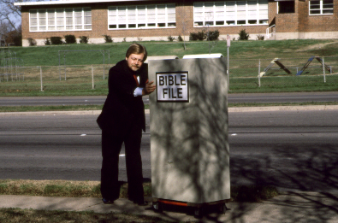
LAISHIBA
KAKETPONG
30
Notes:
I'd like to introduce you to our friend, Mike. Mike is about to go into church. He's entering the building with a "Bible File" of information already in his head...well…somewhat!

Slide 31
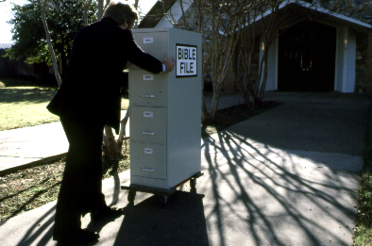
LAISHIBA
KAKETPONG
31
Notes:
There he is…walking up the sidewalk right into church with his mental Bible File...

Slide 32
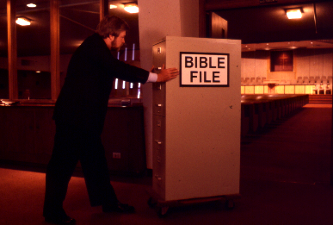
BIBLE
FILE
LAISHIBA KAKETPONG
32
31
Notes:
... And Mike goes straight into the building, pushing that File Cabinet in his head right into the sanctuary or worship center.

Slide 33
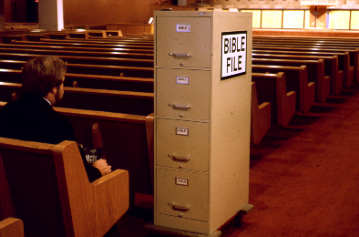
LAISHIBA
KAKETPONG
33
Notes:
Mike sits himself down ready for the preacher or the teacher to begin. And Mike is getting ready to open his Biblical file cabinet…

Slide 34
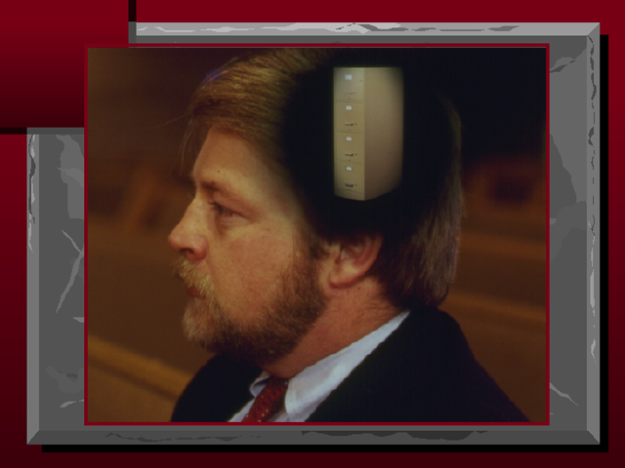
34
Notes:
…up there in his head! …….Well, there he sits... his Bible file all primed to plug into whatever the pastor or teacher is about to say.

Slide 35
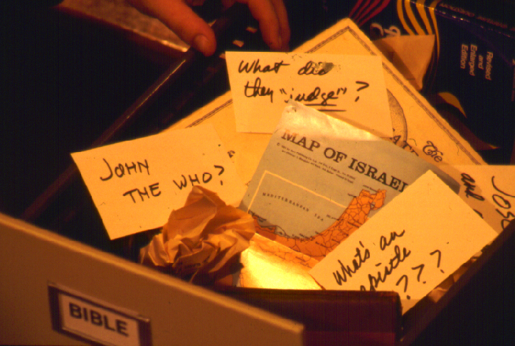
?
ANUNGI…NAI ITEM OSANGTSÜSANGTEM ASER AIBELEN TESAYUBATEM…KONG NUNGI TENZÜKA KODASER BENTETTSÜ?
?
?
?
35
5
Notes:
When he opens up his mental Bible File…figuratively speaking of course…it is a mess!
//// John the Who? Baptist? Methodist? Catholic? Maybe Jewish? What's that all about?
//// And what in the world did they Judge? Who were those judges anyway? Who elected them in the first place?
//// And ANY map of Israel...now that's a place of Biblical confusion! You mean to tell me, Mike says, that that is the very same place as today's Israel, the one in the newspapers and on TV?
//// And the "Epistles?"....truly, research shows that many people think that an EPISTLE was the wife of an APOSTLE! Yes, some really do think that!
//// So...where do you begin to sort out all that information...and a great deal of MISinformation?

Slide 36
Ni kodaser kong nungi tenzuktsü!
Ni kenyongi shisa kecha maka?
36
Notes:
Most folks will say, "I have absolutely no idea!"
…So..."Where do I begin?"

Slide 37
7
Teka indang kaket 8-14
37
Notes:
Let's start with the number 7. But look closely and you'll see that dash through the stem of the 7.

Slide 38
7
7
Handbook pg. 8-14
1
38
Notes:
And that's important! The dashed line will remind you of something. In just a minute you'll divide that number 7 into two others: 4 and 3.
//// Also, as the visuals move along, many of them will have that 7 with a dashed line through its stem up in the right hand corner of each frame….a handy, continuing reminder of the mental tools we are learning to use.

Slide 39

NÜ
LAISHIBA KAKETPONG
7
T
7
O
Y
Teka indang kaket 8-14
39
Notes:
Now let's think again about a filing cabinet. This will be YOUR BIBLE FILE! Here is a look ahead to where we are going in this study.

Slide 40
NÜ
LAISHIBA KAKETPONG
7
C
7
S
J
Teka indang kaket 8-14
40

Slide 41
Kaketpong 10
7
1
2
3
T
4
5
6
7
7
8
O
9
10
Y
Teka indang kaket 8-14
41
Notes:
As a starting point, begin thinking about 10 file folders in a filing cabinet.
You are going to organize your own Bible File into a collection of these ten mental file folders.
Very soon you'll be applying labels to each of those 10 file folders. So…now to begin…and…

Slide 42
“Nϋ Laishiba Kaketpong"
Lapoklim
7
7
7
7
7
7
7
7
7
T
7
Y
T
O
Y
T
T
O
Y
O
Y
O
Teka indang kaket. 8-14
42
4
Notes:
We begin right here...with the single number…. 7.
That's our mental anchor point. Simply the number 7 with that all-important dash through the stem.
//// Next step...surround that number with three alphabet letters. Set them firmly in place in your mind:
C 7 S J
Repeat the letter group aloud several times as you embed it in your mind... Because this is the very core of the Bible's organization and time-line flow:
//// "C 7 S J....
//// C 7 S J....
//// C 7 S J...etc."

Slide 43
“Nϋ Laishiba Kaketpong"
Lapoklim
7
7
= 4+3
Teka indang kaket. 8-14
43
2
Notes:
Now...about that European style '7'.
//// You'll remember that it has a dash through its stem... That's an important reminder — a mind clue. Keep it mentally handy. That small dash divides the length of the 7's stem into two parts. So, ask yourself the question: "What two numbers does 7 easily split into?"
//// One possible answer…and the right one…is: 4 and 3.

Slide 44
7
“Nϋ Laishiba Kaketpong"
Lapoklim
T 4 3 O Y
T 4 3 O Y
Teka indang kaket 8-14
44
1
Notes:
So, in the C 7 S J formula, by changing the 7 to a 4 and a 3, we have
C 4 3 S J.
As before, repeat that changed sequence aloud several times to help it hold tightly in your mind for easy recall.
//// C 4 3 S J.

Slide 45
Tongti O 5 mesüra Orentem:
7
T = TEYANGLUBA
4 = NISUNGTEM
3 = LOKTI TENTET
O = OLA MADOKI
Y = YISU
Teka indang kaket 8-14
5
45
Notes:
Now, based on C 4 3 S J, we enlarge that idea into five key words or phrases. They will become the foundation of your mental Bible File. Here they are…say them aloud…
//// C = CREATION
//// 4 = 4 PEOPLE
//// 3 = 3 SOCIETIES
//// S = SILENCE
//// J = JESUS.
And that's an organizational plan for the entire Bible! Those five words and phrases create an abbreviated outline map of the entire Bible's basic design.

Slide 46
Tongti O 5 mesüra Orentem:
7
T = TEYANGLUBA
4 = NISUNGTEM
3 = LOKTI TENTET
O = OLA MADOKI
Y = YISU
Teka indang kaket. 8-14
46
6
Notes:
Once again...aloud…
//// C = CREATION
//// 4 = 4 PEOPLE
//// 3 = 3 SOCIETIES
//// S = SILENCE
//// J = JESUS.
We will now go back through the phrases, expanding them still farther.
//// CREATION,
of course, remains at the top of the list naturally…because the Bible story itself begins right there.

Slide 47
Tongti O5 mesüra Orentem:
7
T = TEYANGLUBA
4 = NISUNGTEM
3 = LOKTI TENTET
O = OLA MADOKI
Y = YISU
Teka indang kaket. 8-14
47
Notes:
We then take the next phrase from the list:
4 PEOPLE.

Slide 48
NISUNG 4 TEMJI:
7
ABRAHAM
YOSEP
MOSA
YIHUSUA
Teka indang kaket. 8-14
48
5
Notes:
Let's break apart "4 PEOPLE" into 4 specific people, in this order:
//// ABRAHAM
//// JOSEPH
//// MOSES
//// JOSHUA
It's helpful to remember the word order by repeating several times the first-letter order of the words:
//// "A-J-M-J ... A-J-M-J ... etc."

Slide 49
Obendanger Kati Obendang agütsütsüla
7
OBENDANGER
KATI
OBENDANG
AGÜTSÜTSÜLA!
Teka indang kaket. 8-14
49
Notes:
How can you remember the order of those letters and the names?
This simple sentence..."A JUDGE MUST JUDGE." The first letters of each word: AJMJ and then you have it.

Slide 50
NISUNG 4 TEMJI:
7
A BRAHAM
OBENDANGER
Y OSEP
KATI
M OSA
OBEDANG
Y IHUSUA
AGÜTSÜTSÜLA
Teka indang kaket. 8-14
50
8
Notes:
Just remember to repeat the four names aloud to yourself several times until you feel the rhythm of the words:
//// "ABRAHAM,
//// JOSEPH,
//// MOSES and
//// JOSHUA."
And here again is that mental tool…
//// A
//// JUDGE
//// MUST
//// JUDGE.

Slide 51
Yihusua nem
Teyangluba
7
TEYANGLUBA
ABRAHAM
YOSEP
MOSA
YIHUSUA
Teka indang kaket. 8-14
51
5
Notes:
So, from the top of the list we now can say:
//// CREATION
//// ABRAHAM
//// JOSEPH
//// MOSES
//// JOSHUA
This step completes the main FOUR PEOPLE of your new Bible File. Of course, there are dozens of other Biblical characters, but these are the only ones we are using to build the Bible File right now. Repeat the four names aloud several times until they are firmly set mentally.

Slide 52
Tongti O 5 mesüra Orentem:
7
T = TEYANGLUBA
4 = NISUNGTEM
3 = LOKTI TENTET
O = OLA MADOKI
Y = YISU
Teka indang kaket. 8-14
52
Notes:
The next phrase of that beginning list is:
3 SOCIETIES.

Slide 53
OYA
7
Teka indang kaket 8-14
53
2
Notes:
Another memory tool now…what do you call
//// that red section of the perimeter of a circle?
//// It's called an "arc," spelled A-R-C. Those letters, then, remind you of the first letters of 3 KINDS OF SOCIETIES.

Slide 54
LOKTI TENTET 3 JI:
7
OZÜNG ANEMER
YIMSÜSERTEM
ALARTEM
Teka indang kaket. 8-14
54
6
Notes:
The three societies are…
//// ANARCHY
//// ROYALTY
//// CAPTIVITY.
As before, please repeat that word order several times.
ANARCHY, ROYALTY, CAPTIVITY...
ANARCHY, ROYALTY, CAPTIVITY.
And the mental tool here:
//// A
//// R
//// C.

Slide 55
TL Reprangshiba
7
TEYANGLUBA
ABRAHAM
YOSEP
MOSA
YIHUSUA
OZÜNG ANEMER
YIMSÜSERTEM
ALARTEM
Teka indang kaket. 8-14
55
Notes:
Now we add the 3 SOCIETIES group to the others, and we have:
CREATION
ABRAHAM
JOSEPH
MOSES
JOSHUA
ANARCHY
ROYALTY
CAPTIVITY

Slide 56
Reprangshiba…
7
7
REPRANGSHIBA...
T 7 O Y
T 4 3 O Y
Teka indang kaket 8-14
56
3
Notes:
To review the entire sequence so far…
Beginning with the single number
//// 7....
leading to…
//// C 7 S J...
which becomes...
//// C 4 3 S J.
These numbers and letters are then used to develop a mental list of TEN WORDS that will form a dependable mental outline of the entirety of Scripture.

Slide 57
Tongmelang
7
TEYANGLUBA
4 NISUNGTEM
3 LOKTI TENTET
OLA MADOKI
YISU
Teka indang kaket. 8-14
57
Notes:
C 4 3 S J is then expanded into:
CREATION
4 PEOPLE
3 SOCIETIES
SILENCE
JESUS.

Slide 58
Tatempangboba Kaketpong
Ana
7
TEYANGLUBA
ABRAHAM
YOSEP
MOSA
YIHUSUA
OZÜNG ANEMER
YIMSÜSERTEM
ALARTEM
OLA MADOKI
YISU
Teka indang kaket. 8-14
58
2
Notes:
Then further expanded into:
CREATION
ABRAHAM
JOSEPH
MOSES
JOSHUA
ANARCHY
ROYALTY
CAPTIVITY.
Finally, now, we add: //// SILENCEand//// JESUS.

Slide 59
Nü Tokolok Nung Tasen “Laishiba Kaketpong”
TEYANGLUBA
TEYANGLUBA
ABRAHAM
ABRAHAM
ABRAHAM
ABRAHAM
YOSEP
ABRAHAM
MOSA
YOSEP
YIHUSUA
OZÜNG ANEMER
MOSA
YIMSÜERTEM
ALARTEM
YIHUSUA
OLA MADOKI
YISU
OZÜNG ANEMER
YIMSÜSERTEM
ALARTEM
OLA MADOKI
YISU
Teka indang kaket 8-14
59
11
Notes:
Now it's time mentally to apply those ten words as labels to ten mental folders in your new Bible File –
//// right up there in your head. That mental picture might look something like this. And there they are...
//// CREATION//// ABRAHAM//// JOSEPH//// MOSES//// JOSHUA//// ANARCHY//// ROYALTY//// CAPTIVITY//// SILENCE…and…//// JESUS.
Now it's organized in a neat and orderly package in your mind --- ready for recall and use as you need it. Now just a few more
examples to drive home the point...

Slide 60
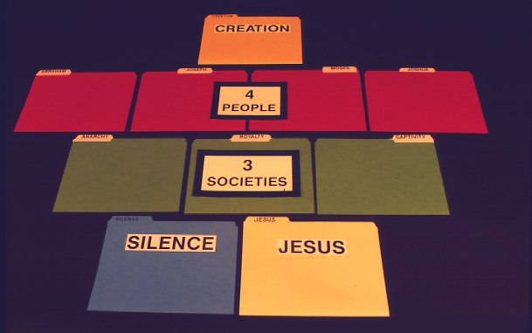
7
TEYANGLUBA
Manuel pg. 8-14
60

Slide 61
7
TEYANGLUBA
NISUNGTEM
4
Manuel pg. 8-14
61

Slide 62
7
TEYANGLUBA
NISUNGTEM
4
LOKTI TENTET
3
Manuel pg. 8-14
62

Slide 63
7
TEYANGLUBA
NISUNGTEM
4
LOKTI TENTET
3
OLA MADOKI
YISU
Manuel pg. 8-14
63

Slide 64

7
ALIMA KANGA MELENSHIOKO!
Handbook pg. 8-14
64
Notes:
Here is yet another way to think of your Bible File. Like many of us, this young woman spends hours every day at her computer.

Slide 65



7
TEYANGLUBA
CREATION
ABRAHAM
ABRAHAM
ABRAHAM
ABRAHAM
ABRAHAM
ABRAHAM
YOSEP
JOSEPH
ABRAHAM
ABRAHAM
MOSA
MOSES
YIHUSUA
JOSHUA
OZÜNG ANEMER
ANARCHY
YIMSÜSERTEM
ROYALTY
ALARTEM
CAPTIVITY
OLA MADOKI
SILENCE
YISU
JESUS
65
Notes:
So...instead of thinking just of file folders as heavy folded paper, think about them as computer files on a floppy disk or on a computer hard drive.

Slide 66

LAISHIBA
KAKETPONG
66
Notes:
Imagine this as the main screen of your own computer monitor – with a data folder you created named, naturally, Bible File. Double click on that imaginary folder….

Slide 67

C
TEYANGLUBA
ABRAHAM
OZÜNG ANEMER
OLA MADOKI
YISU
YOSEP
YIMSÜSERTEM
MOSA
ALARTEM
YIHUSUA
67
10
Notes:
…and you would get this...the ten sub-files, all as folders, named, in
order…and say them along with me…
//// CREATION
//// ABRAHAM
//// JOSEPH
//// MOSES
//// JOSHUA
//// ANARCHY
//// ROYALTY
//// CAPTIVITY
//// SILENCE
//// JESUS.

Slide 68
T 7 O Y
C
{
}
TEYANGLUBA
ABRAHAM
OZÜNG ANEMER
OLA MADOKI
YISU
NISUNGTEM
4
YOSEP
YIMSÜSERTEM
LOKTI TENTET
3
MOSA
ALARTEM
YIHUSUA
68
Notes:
And, with some computer graphics, you might even add the basic building plan over those folders. The now a familiar mental tool... C 7 S J And its 4 PEOPLE and 3 SOCIETIES.

Slide 69
NÜ TOKOLOK NUNG LAISHIBA KAKETPONG!
TEYANGLUBA
ABRAHAM
YOSEP
TASHI TAIT
MOSA
YIHUSUA
OZÜNG ANEMER
YIMSÜSERTEM
AJAK TERENNEMTET
ALARTEM
OLA MADOKI
YISU
PERIA AGATETBA
69
4
Notes:
So there you have the basic building blocks of a complete biblical filing system…in your head…the basic building plan of the Bible…how THE BASIC DOCUMENT OF THE FAITH is organized.
//// It's your personal Mental Bible File!
From this point on, we will construct a
//// sturdy,
//// comprehensive,
//// and coherent mental map of God's Word…each step of its progress built on this reliable basic mental mapping idea.

Slide 70

Joko dangbo nai Tongmelang agi Laishiba agatetba nungi…
•"Laishiba kaketpong ka,“ aser iba
• “Laishiba kaketpong“ lapoktsü asoshi Tokolok sabi meteta lir… T 7 O Y
1. KECHI ATALOK?
TASUNGDANGBA ASEM LANGZÜTSÜ LIR
2. KECHIBA IBAJI ATALOK?
3. LAISHIBA NUNG KETA ALIBA TAPU ASER TEKONGTEM AJANGA IBA NUNGIKOMA TASHI AGÜTSÜ MESÜRA YANGLUTSÜR?
70
4
Notes:
O.K. Now we're on our way. By this time…you have that idea called THE BIBLE FILE…and the mental key to open it…C 7 S J. The way is clear now for building a new and organized approach to thinking about your entire Bible, everything in its place.
//// We'll be able to answer three fundamental questions:
//// WHAT happened…
//// WHY it happened…and finally…
//// HOW the WHAT and the WHY influence the shape and content of Scripture…the organization of the book itself.

Slide 71
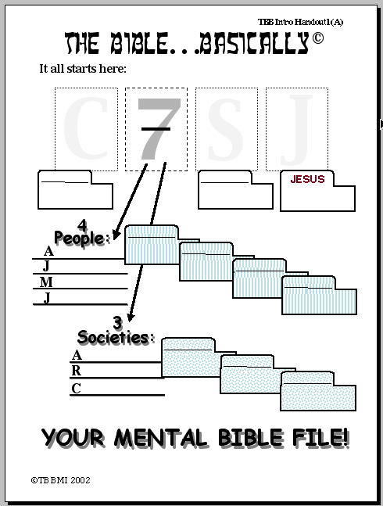
Laishiba…Tongmelang Rajem
Yangii tenzuker:
T
7
O
Y
TEYANGLUBA
OLA MADOKI
YISU
Nisung 4 :
ABRAHAM
{
YOSEP
A
BRAHAM
MOSA
Y
OSEP
JOSHUA
OSA
M
SHISATSÜ BUSHIBA YARIBA #01
IHSUA
Y
Loti tentet 3:
{
OZÜNG ANEMER
O
YIMSÜSERTEM
ZÜNG ANEMER
Y
ALARTEM
IMSÜSERTEM
LARTEM
A
NÜ INDANG TOKOLOK LAISHIBA KAKETPONG!
©2006 TBBMI
9.65.01.
20
71
Notes:
Now look at Study Help Number One in the student handbook. That sheet will help you to embed in your thinking how to keep these tools on the front of your mind…while also learning how to teach others.
//// Beginning with a large C…
//// for CREATION then…
//// the Number 7…the dashed line is already there…7 standing for the four people and then the three societies. So…first…the FOUR
PEOPLE…
//// who are ABRAHAM…
//// then added to his File Folder…
//// JOSEPH…
//// onto the JOSEPH folder
//// MOSES…
//// his Folder…and finally…
//// JOSHUA…
//// finishing out the FOUR GREAT PEOPLE and their file Folders in the Bible File. Then on to the THREE SOCIETIES…
//// beginning with ANARCHY…
//// and its folder…
//// ROYALTY…
//// and the folder…
//// finishing with CAPTIVITY…
//// and its folder.
Now we'll finish it out…
//// S for
//// SILENCE…and
//// the culmination of all our thinking…J for JESUS.

Slide 72
02
Laishiba…Tongmelang Rajem
Joko… nü teka agi nü tekolok Laishiba kaketpongi lapoktsü merangang, mesüra perüa, mesüra nüsasa kar dang asendang dangang .
Nü Laishiba kaketpong lapoktsü sabiji:
T 7 O Y
Ojang “T" tetezüji:
TEYANGLUBA
7 = 4+3 :
NISUNGTEM 4 LIKTI TENTET 3
Nisung Pezü temji:
ABRAHAM YOSEP MOSA
YIHUSUA
SHISATSÜ BUSHIBA YARIBA #02
LOKTI TENTET ASEM temji:
OZÜNG ANEMER YIMSÜSERTEM ALARTEM
TEYANGLUBA
ABRAHAM
Ojang “O" tetezüji:
OLA MADOKI
JESUS
JYOSEP
Ojang “Y" tetezüji:
YISU
...
MOSA
Kechiaser, nü indang ojang ter… aser nü indang kaketpong terji… itemya:
YIHUSUA
OZÜNG ANEMER
YIMSÜSERTEM
ALARTEM
Nü indang Tokolok Laishiba kaketpong!
OLA MADOKI
YISU
©2006 TBBMI
9.65.01.
9
72
Notes:
And here is STUDY HELP NUMBER 2….this is the one you can use for your own review-- or to hold in your hand while you teach THE BIBLE FILE idea to others.
//// First the key to open the file:
//// C 7 S J…
//// The letter C stands for CREATION.
//// 7 equals 4 plus 3…for the four people and the three societies.
//// FOUR PEOPLE…ABRAHAM, JOSEPH, MOSES, JOSHUA.
//// THREE SOCIETIES…ANARCHY, ROYALTY, CAPTIVITY.
//// The letter S standing for SILENCE
//// The letter J representing JESUS.
//// FINALLY the TEN WORDS. And there are your ten file folders in your new Bible File. Repeat them one last time:
CREATION, ABRAHAM, JOSEPH, MOSES, JOSHUA, ANARCHY, ROYALTY, CAPTIVITY, SILENCE, and JESUS.

Slide 73
7
73
Notes:
And it all begins right here...the number 7 with that now familiar dash through its stem. Now you know the value of that simple mental tool. It is truly A GATEWAY IDEA!

Slide 74
LAISHIBA… TONGMELANG RAJEM
T
®
7
“Nü Laishiba kaketpong " Lapokba Sabi
O
Y
74
Notes:
Now it's time to move forward toward expanding this "key to opening up Your Bible File" -- for what we will call THE QUICK CHRONOLOGY. Through the next hours of THE BIBLE… BASICALLY training, here is what you'll learn…

Slide 75
Jokoerla nai menakdangteta kümerji…asenok joko ilen yagi aotsu…
•"Laishiba kaketpong ka,“ aser iba
• “Laishiba kaketpong“ lapoktsü asoshi Tokolok sabi meteta lir… T 7 O Y
•Laishiba nung Tongtibang Tatalokbatem kong atalok itemji tokolok nung alinük shisadangba yanglua alitsula
•Laishiab's “OTSÜ“ taroktem: "Tarensen terenzükba yakta metetba"
•Abraham Mapang Lai tesayuba tamendakdak nungi tenzüker Kibuba Yisu Khrista tenzükbamapang tashi
• “Otsü“ dak sendakba nung Laishiba Tenzükba Yanglubaren
•Tejen Lai aser Tasen Lai Kakettem aser Omen tem
 
8
75
Notes:
//// We've introduced the THE BIBLE FILE idea and…
//// The mental key to open that file…Then…
//// You'll learn to make a mental map of the Ancient Near East…that's next.
//// Then the so-called STORY CORE of Scripture, titled THE QUICK CHRONOLOGY…That's the WHAT HAPPENED question to be answered.
//// Then we'll explore the ABRAHAMIC FOUNDATIONS of the Great Plan…the WHY of Scripture…
//// leading to an understanding of the Bible's basic architectural layout…
//// ending with a brief look at the Old and New Testament Books and their general themes or ideas behind them.
//// And through it all, it will become obvious– from start to finish – that SOMETHING IS HAPPENING HERE; GREAT EVENTS ARE TRANSPIRING. God was busy at work then and continues right up to this present moment!
Now it's time to move on into a very valuable experience!
you'll learn to make your own map of the Ancient Near East…AND RIGHT OUT OF YOUR OWN HEAD!

Slide 76
VERSION 9.65
LAISHIBA… TONGMELANG RAJEM
A Presentation of The Bible…Basically Ministries International Inc. Fort Worth, Texas
A Presentation of The Bible…Basically Ministries International Inc
Fort Worth, Texas
www.biblebasically.com
www.biblebasically.org
76
©2006 TBBMI
9.65.01.
Notes:
Title slide (no narration)

Slide 77
77
©2006 TBBMI
9.65.01.

