Slide 1
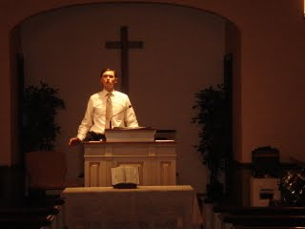
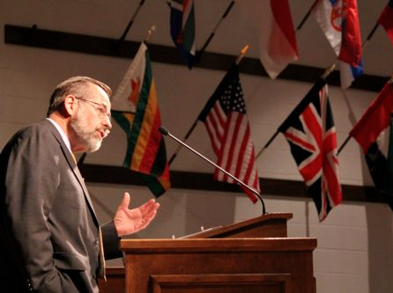
Pungno Kyaklan:
Ero-ro Lanka
Pungno Kyaklan1 Ekha lanso
Dr Rick Griffith • Singapore Bible College
BibleStudyDownloads.org

Slide 2


Our People
Susan teaches church women
Notes:
I also lead the woman's Precept Bible study at our church

Slide 3

LADIES BIBLE STUDY ON
1-2 THESS
USA • Singapore • New Zealand • Holland

Slide 4

Thailand • Mongolia • Myanmar • Indonesia
Notes:
INTERVIEWER: And Susan, what ministries has the Lord granted you?
SUSAN: I have been teaching the wives of leaders at SBC. These 5 women come from 5 different nations!
SUSAN: I also lead the woman's Bible study at our church

Slide 5
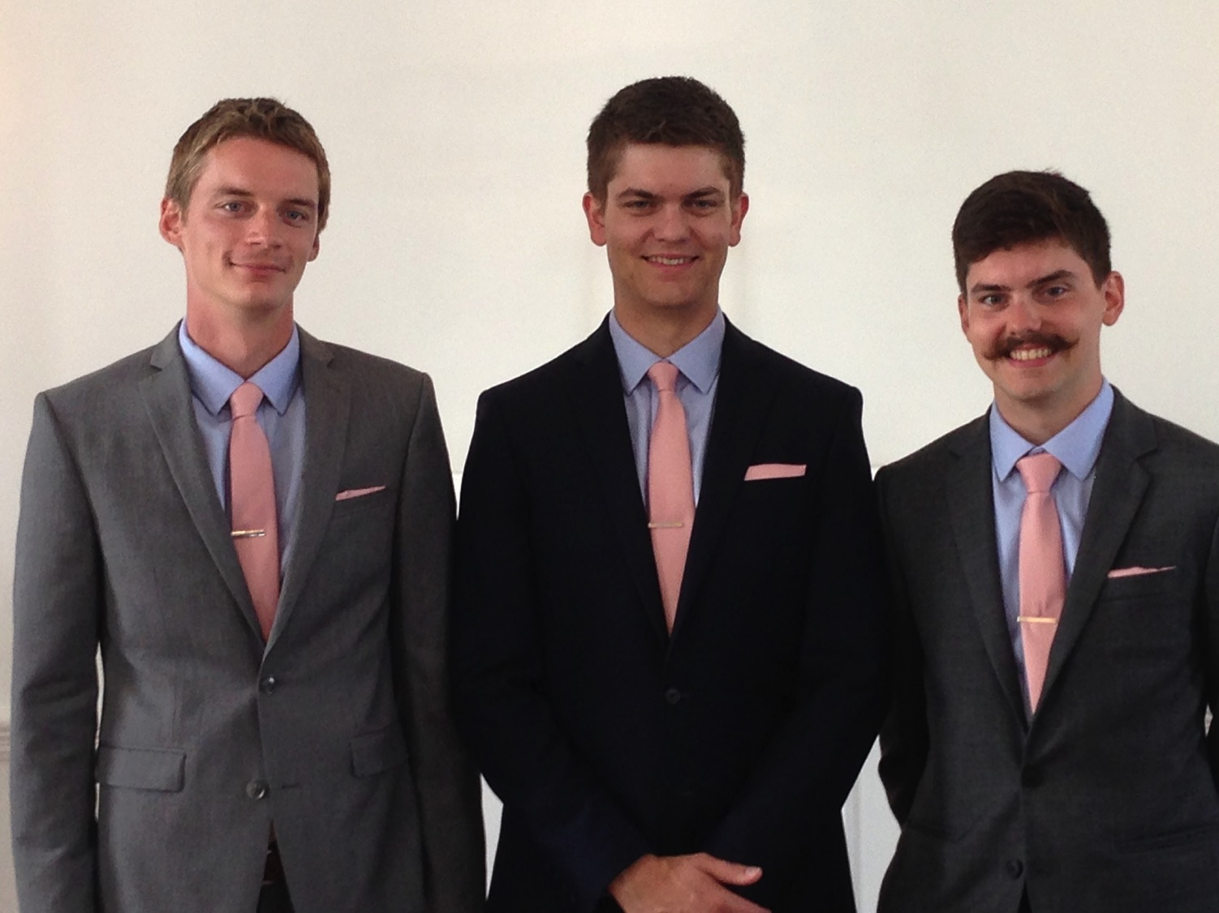
Our Three Sons

Slide 6
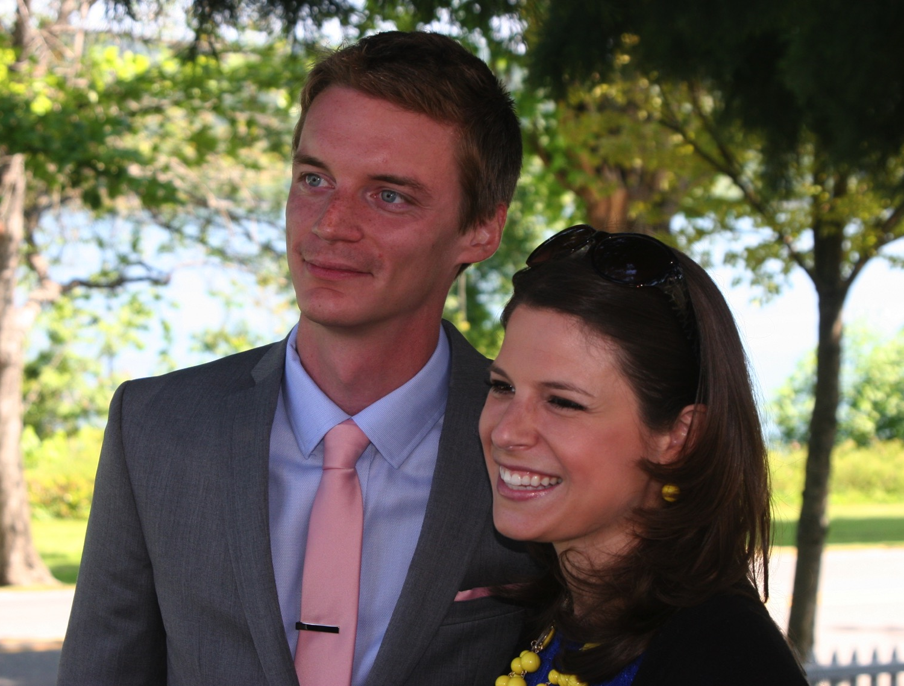
Kurt elhi jo Shisho-khophi tona IT
9g

Slide 7
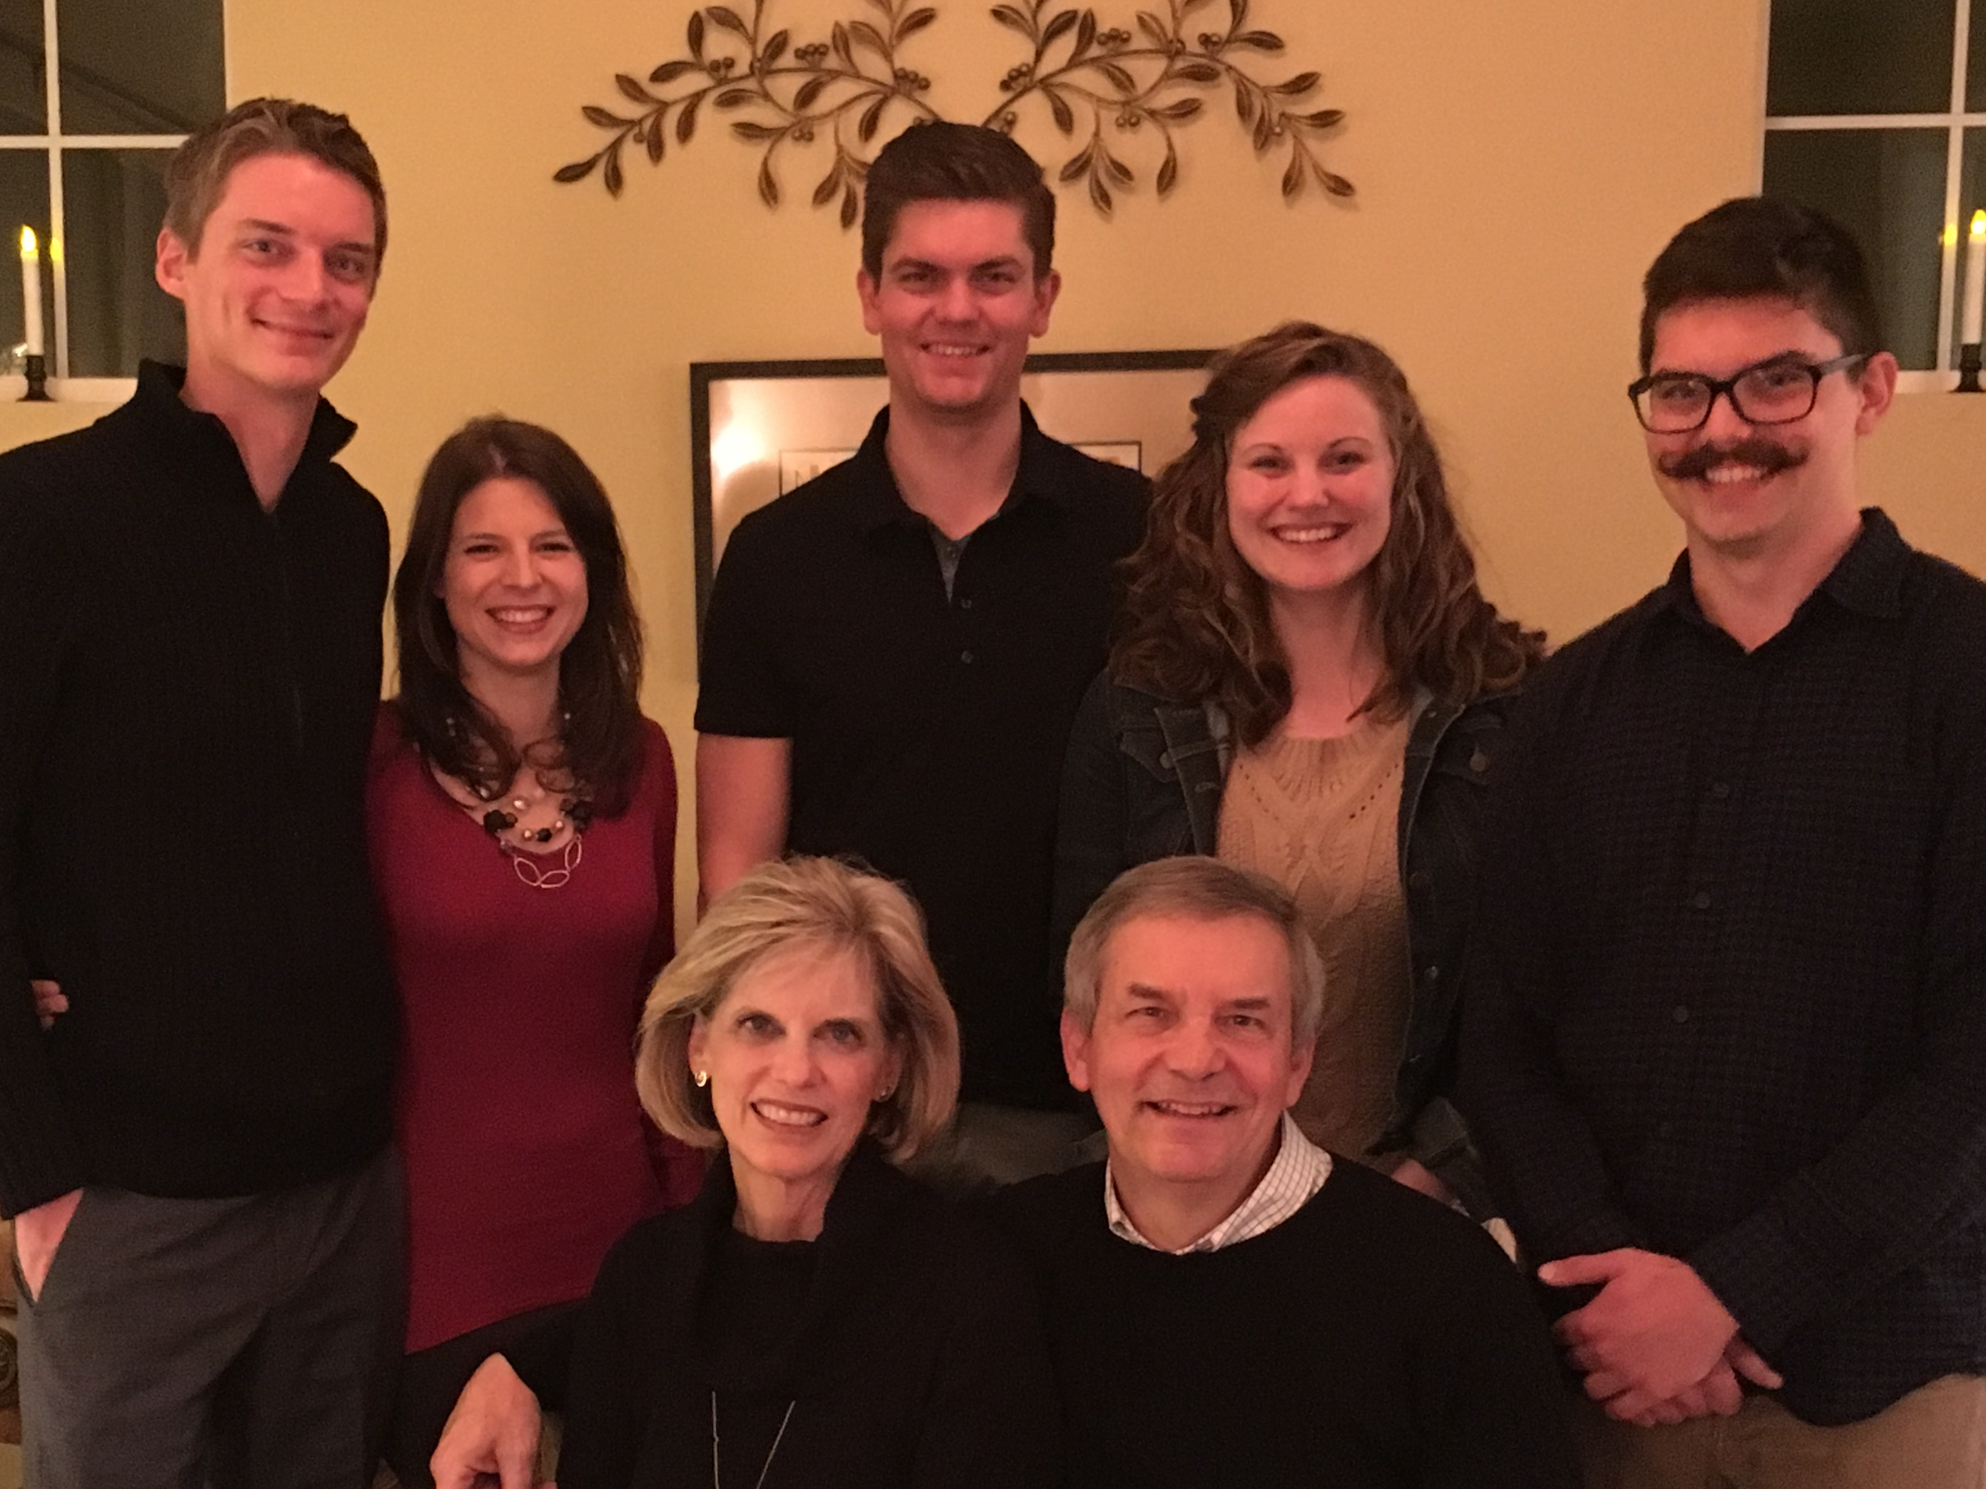
The Griffiths
9 Jan 2016
2017
Stephen & Katie (27)
John
(24)
Kurt & Cara (30)
Susan & Rick

Slide 8
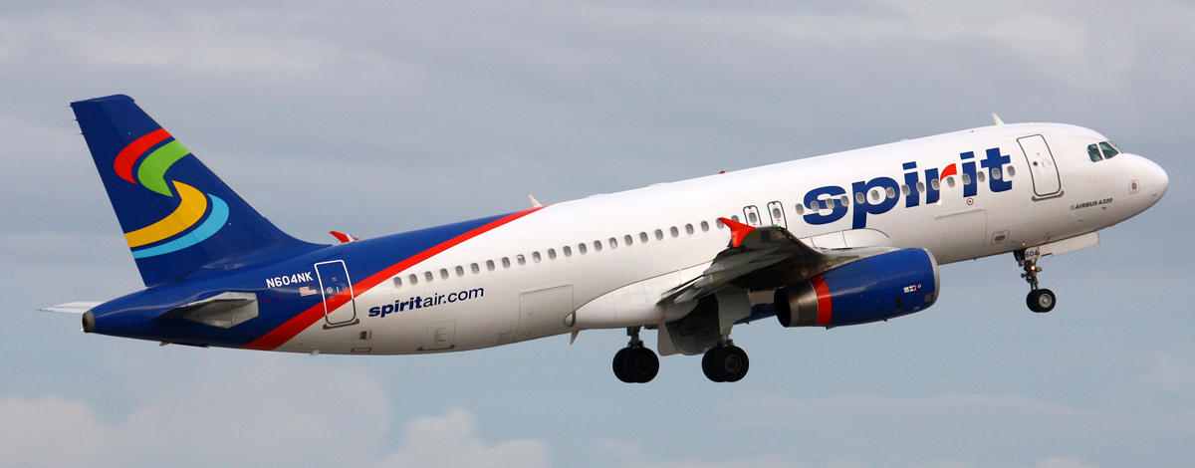
Spirit Airbus A320
8
Stephen jo Epyaruli- Erui

Slide 9
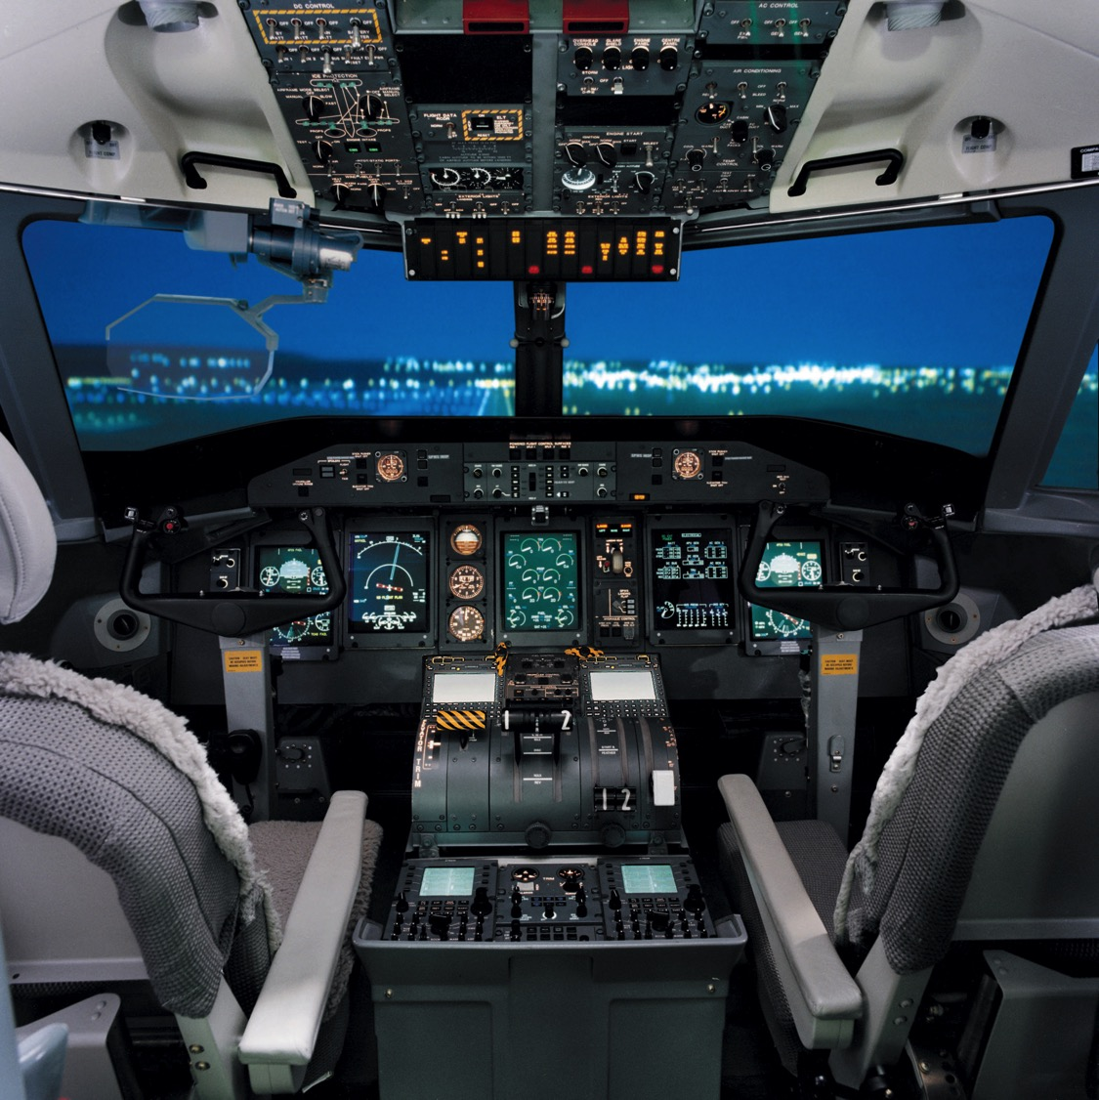
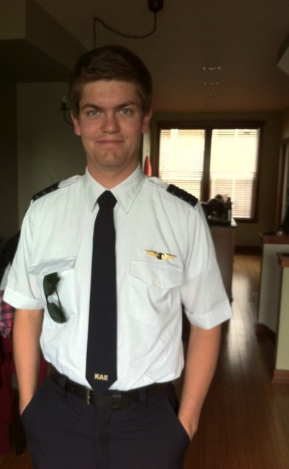
Stephen jo Spirit Epya zodoro at Boise, Idaho jilo elhi tsoala
6

Slide 10
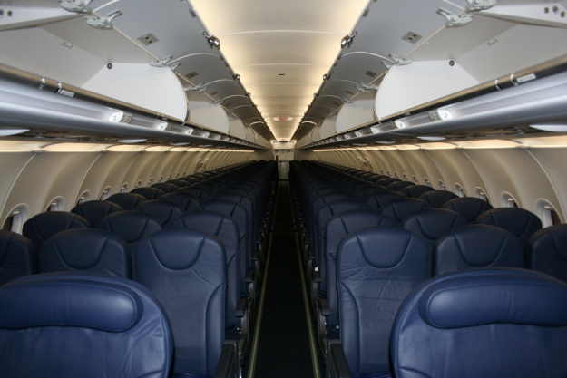
Stephen flies 174 passengers
8

Slide 11
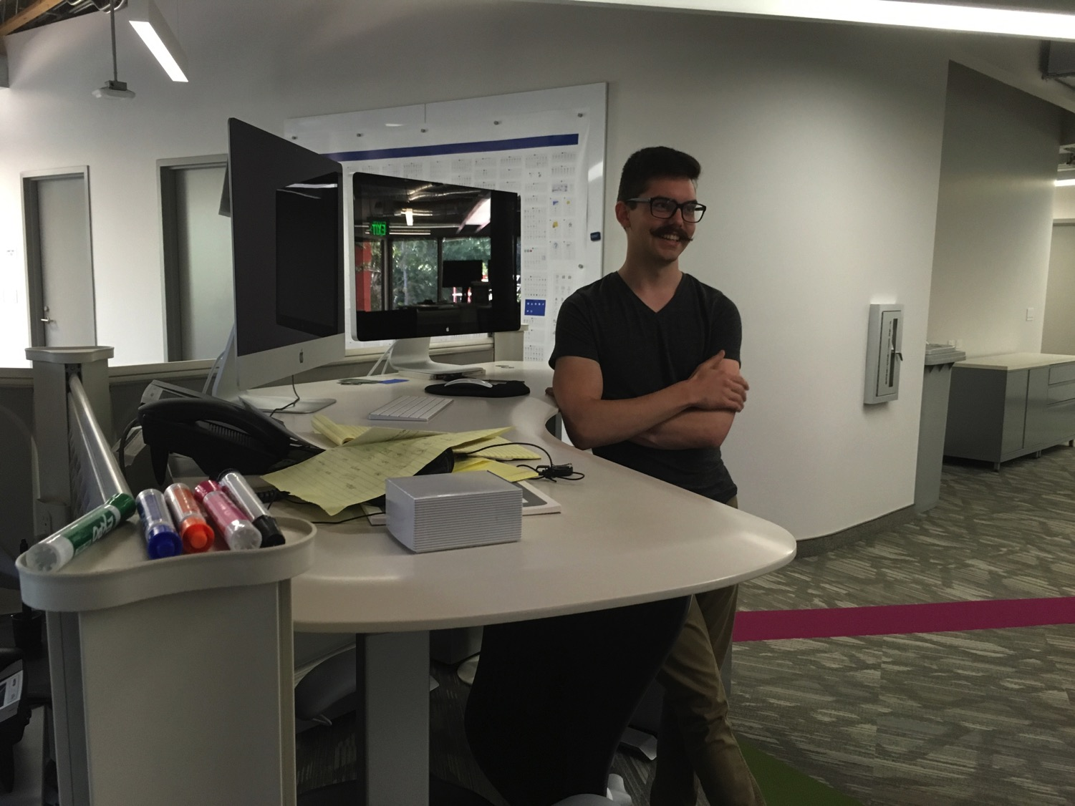

John (24) is a graphic artist in Redlands, California
8

Slide 12

E-Wothok yansasa…

Slide 13
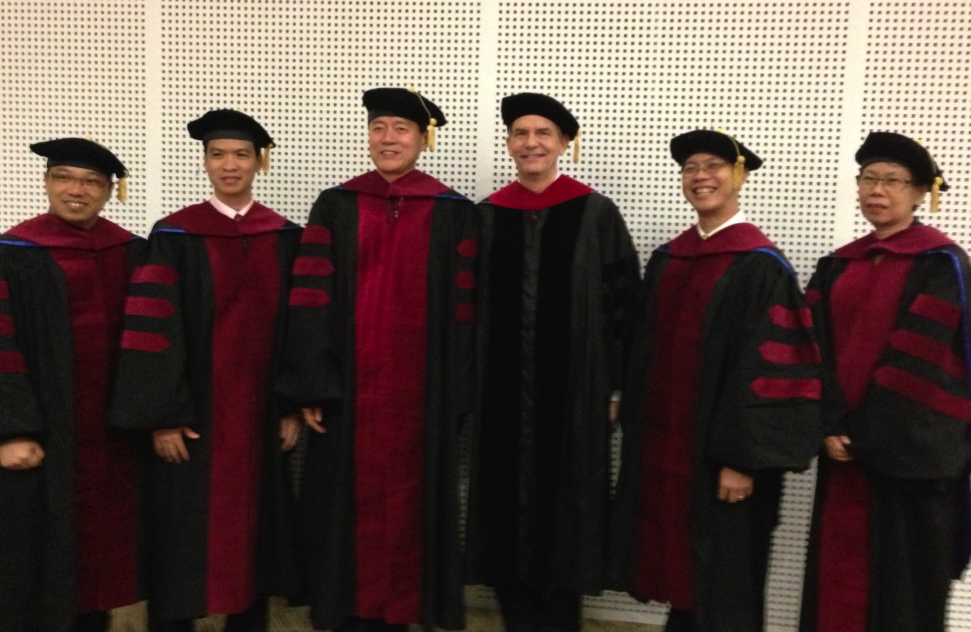
I direct the SBC Doctor of Ministry studies (DMin)
9
Notes:
I'm also the director of the doctoral program at SBC that trains about 80 seminary professors and pastors throughout Asia in English and Chinese. Generallly each year about 5 of them received their Doctor of Ministry degree.

Slide 14

SINGAPORE BIBLE COLLEGE
9
Notes:
I've served as a seminary professor with 30 other faculty at Singapore's largest training school: Singapore Bible College

Slide 15
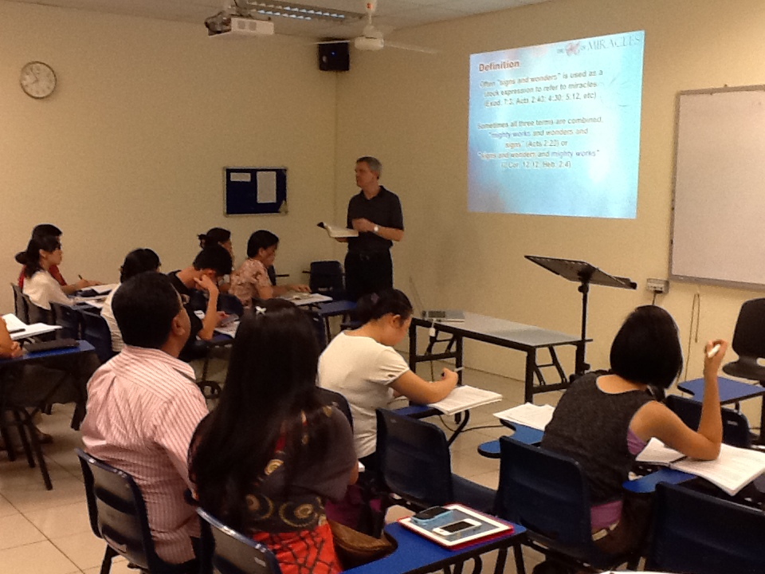
Singapore Bible College Students
9
Notes:
Most of these students are first-generation Christians eager to share the gospel with their own people!

Slide 16
SBC Tsemjak ana pungno jiang
(English • Bahasa • Chinese)
Rhui-eze
OT NT
Backgrounds
WOT WNT
Potsow-Yi
Ekhumkho Omon Ojyu-ya
Pungno
Pungno kyaklan 1 Pungno Kyaklan 2
Notes:
I get to teach these leaders every book of the Bible in survey courses, plus backgrounds to both the OT and NT, three areas of theology, and how to preach.

Slide 17
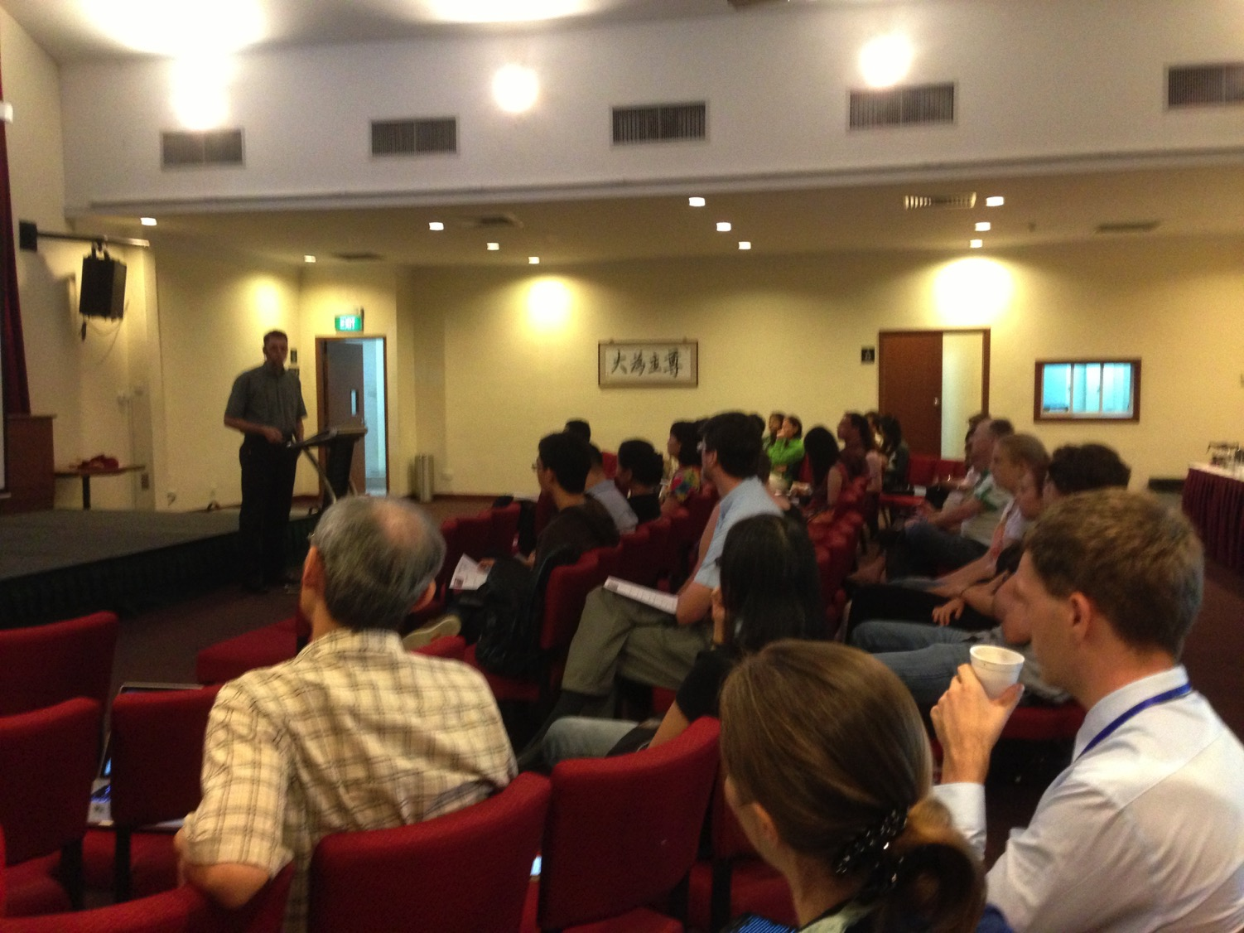
Our People
9
Kyong 50 Yantsü 9 lona
October 2017

Slide 18


Crossroads People Jan 2017
UK
RUSSIA
FRANCE
MONGOLIA
GERMANY
ITALY
JAPAN
NETHERLANDS
KOREA
LEBANON
HONG KONG
TAIWAN
CANADA
CHINA
MYANMAR
EGYPT
INDIA
USA
MALAYSIA
PHILIPPINES
ZIMBABWE
SINGAPORE
NEW ZEALAND
CIC
INDONESIA
Notes:
Our Jan 2017 church 51 people stem from 12 different countries around the world (46 vcards). Canada (Gloria Lee), Netherlands (Desiree), Mark Lass (Germany), Hong Kong (Larry Pun), Cynthia, Pashauli (India), Yoshie & Kaori (Japan), Naomi & Ping (Malaysia), Raymond (Myanmar), Miriam (USA), Micah, Jasper (Philippines), Singapore (Albina), Sarah (UK)
This does not include people who have recently attended only once: Dowon (Korea)
Nor does it include missionaries living back in their countries but still are members of CIC: Maple (Taiwan), Budmaa (Mongolia)

Slide 19
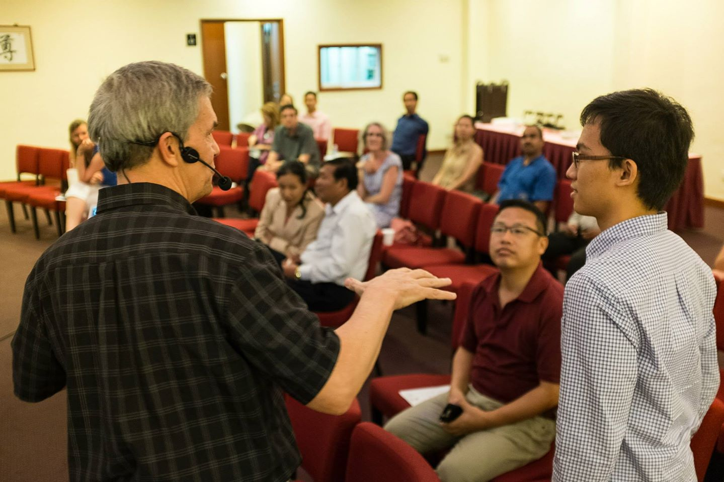
Our People
9
2017: 37 people from 12 nations
Notes:
We also helped start Crossroads International Church in 2006 where I serve as the pastor-teacher.

Slide 20

Our People
9
Preaching through Scripture
Notes:
RICK: Yes, we helped start Crossroads International Church in 2006 and I serve as the pastor-teacher.

Slide 21

Our People
9
SBC students serve at church
Notes:
One special joy is mentoring my students who serve with us at church and led ministries to youth, children, home groups, and the worship team.

Slide 22
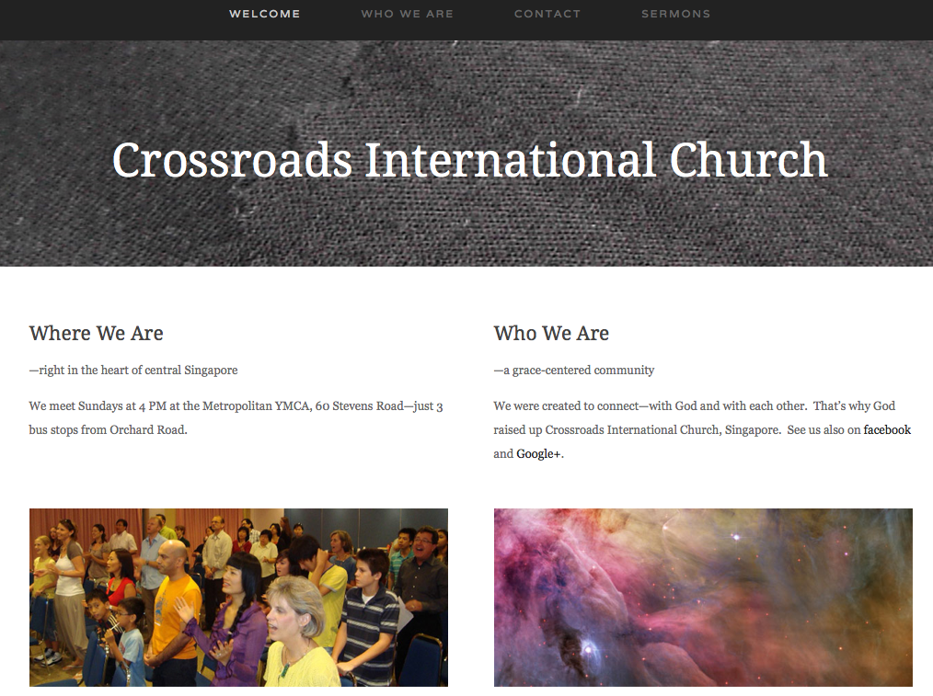
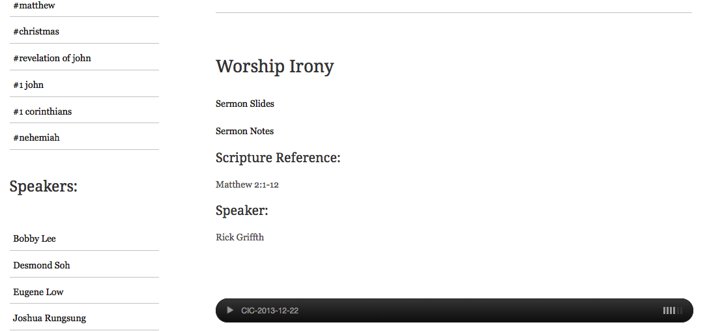
www.cicfamily.com
www.cicfamily.com

Slide 23
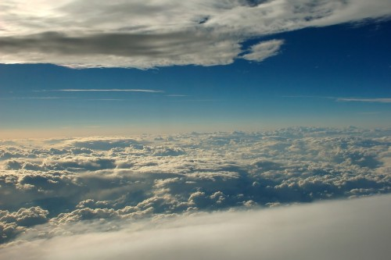
Potsow Yi etho ji (Isa. 55:8-9)
Opvϋi na phyoala, “a nchumri jo nte nchumri esua tuv meka. Osi a lanka jiango nte lanka jiang lona echumpo.”
⁹Kuvto Potsuo jiango limha jilona n phyotao ntssonkacho sana ji esua, a lanka osi nchumri jiango nte nchumri osi lanka jiang lona ntssonkata.

Slide 24

Potsow Yi etho ji (Isa. 55:10a)
“Ayi jo sheryu osi eryu jiang esua tuv hojiang na oyakina jo-chhochi liko ji etsonala.

Slide 25
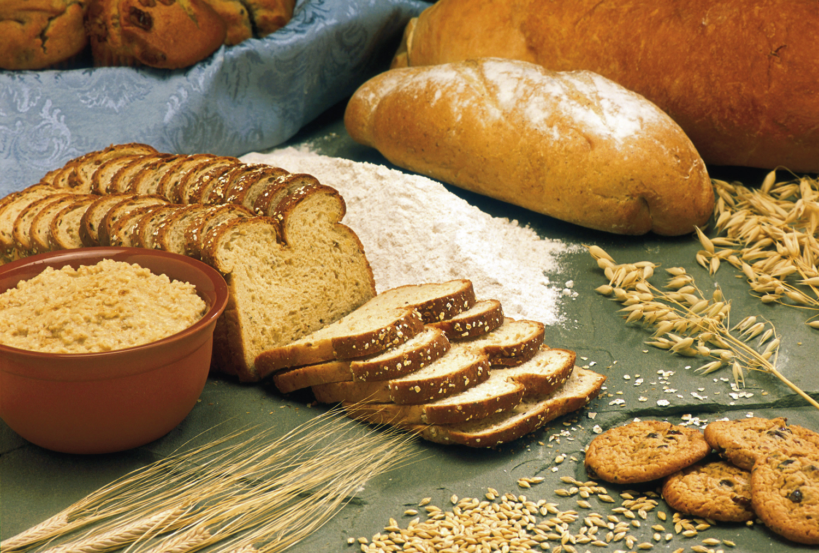
Potsow Yi etho ji (Isa. 55:10b )
“Osi yolan halan jiang rankatokala, hoji yakchia etsoyu tona moju mono eyingu tsukona to litokala.

Slide 26
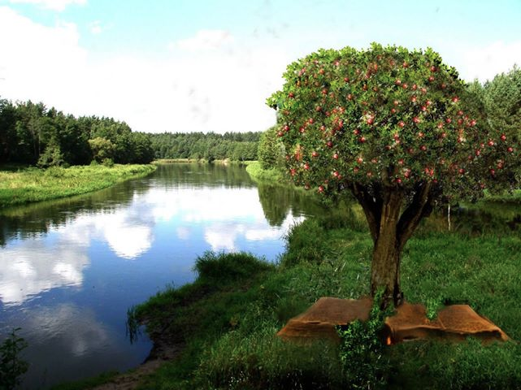
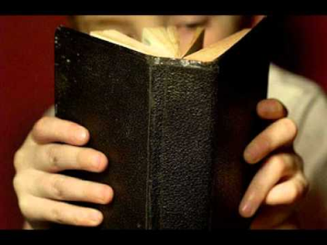
Potsow Yi etho ji (Isa. 55:11 )
Hoji esua a yi kvumoe ana ntio nsanchokchia sana jina ana ntio etssov tumkacho sana jiang n khyae n sina tssov; Ana ntio etssov tsukona wotokasana ji ephan topvuto tssov.

Slide 27

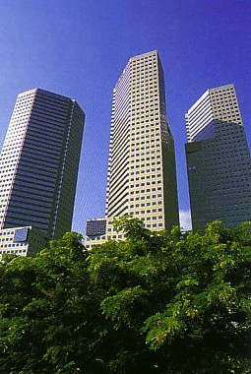
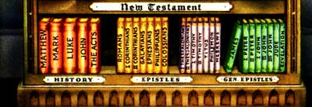
Our Course Goal
Ete Mhanka : Ophon rontav!

Slide 28

Tsemjak Echukroa
v
Pungno lan elaroena kuvtoli nsungruv sana, ovungtsoa
  Kako ji njum tsotoe na eroroe kichev,
  Pungno kyaklan ji tsungchev,
  Pungno ji eru nkoni zev,
  Nzanchi ethev elio jiang thechiv (ntolo tsutsav, ejuka, dongphi, benka, ethak, etc.),
  Erani vav, osi
  Echung eni oyi pungnov osi echung eni hungrina oyi nsamuv.
(mostu eruv, Oyi opvu, monologue, wothok, yanpiyanthan, & echu nungra pungno) jianjo Pungno Lanka 2 jilo shikav

Slide 29


Tsemjak Etum
v
Tsemjak shi ethak lo jo ni na shiang ntsithakuv…
A. Ntio tona Ntioli Eroroe pungnoa sana ji pithiv shikuv
Pungno eroro tona pungno lanka ji nsungruthiv shikuv
Elochi, otsuk, tona ethak to ji ezochev shikvu
Ekhen nli na pungnov benkata
Ejuka pithiv shikuv
F. Motsu ji kuvtoli tsutav sana piv shikuv
G. Motsϋ pungno mhonkathukuv tsukona zui zeta
H. Pungnoa (“ntio”) chuti tona mostu-eru
I. Pungnoa (“Ntioli”) shijo ntsa, etsohunga, ntsunga, etuma (eliana etum ji page 25).

Slide 30
Eteumezu mezhu:
Pungno kujo…
25
Ntsa
Etsohunga
Ntsünga
Etuma

Slide 31
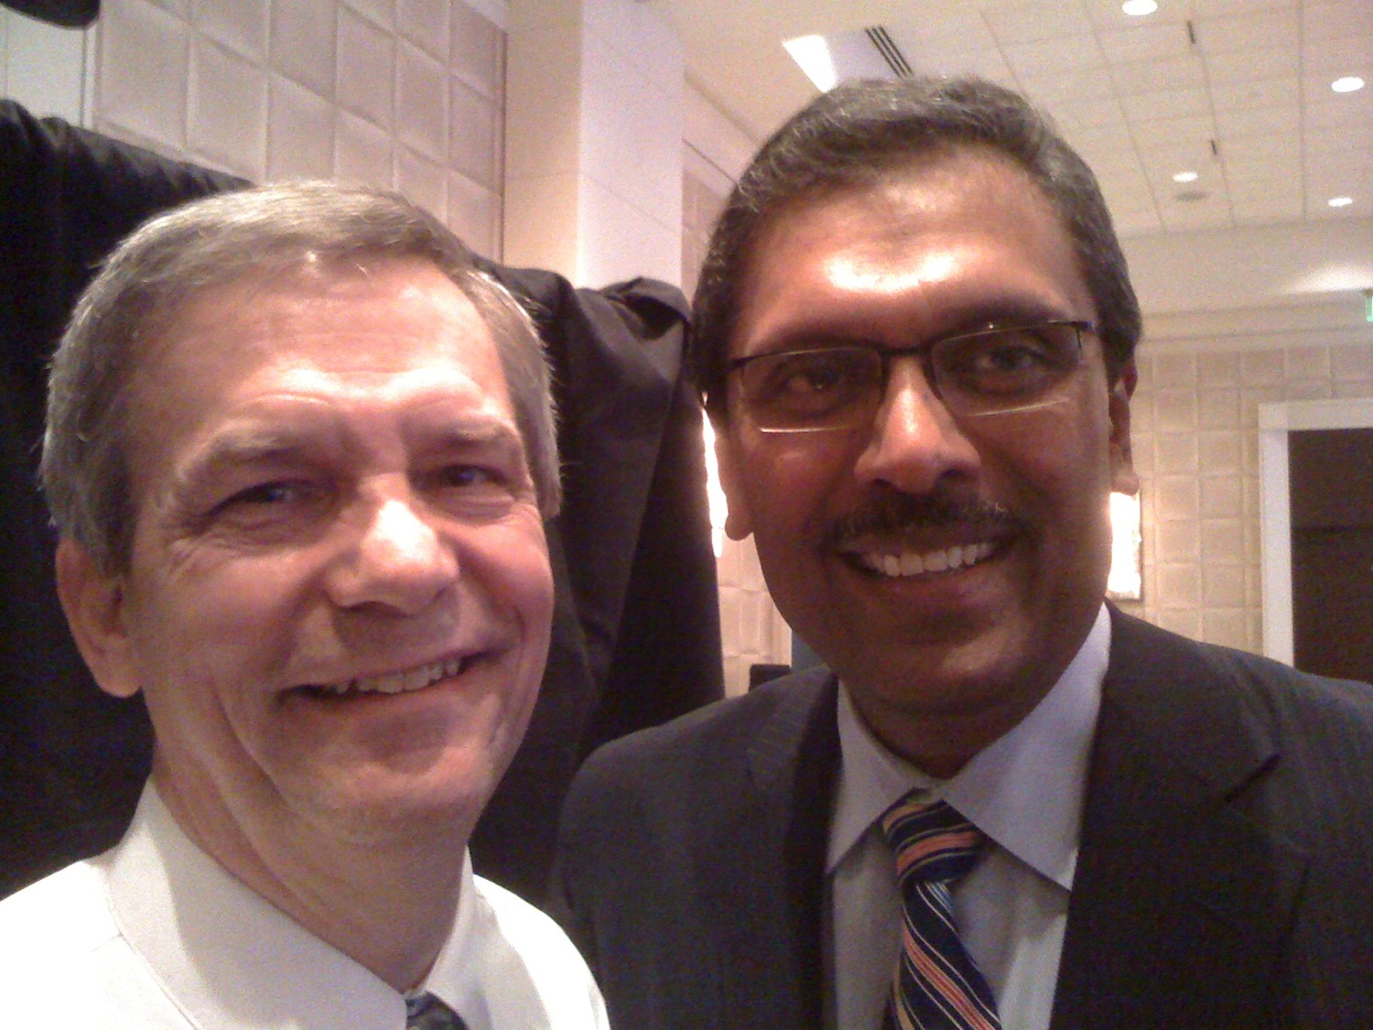
Dr. Rick & Dr. Ramesh Richard

Slide 32



Tsemjak Ethelan eli
v
Ekhao (10%)

Slide 33

Ni ovungo to ekhao elhi ji
Page 20 kako teruv shi khakhana

Slide 34
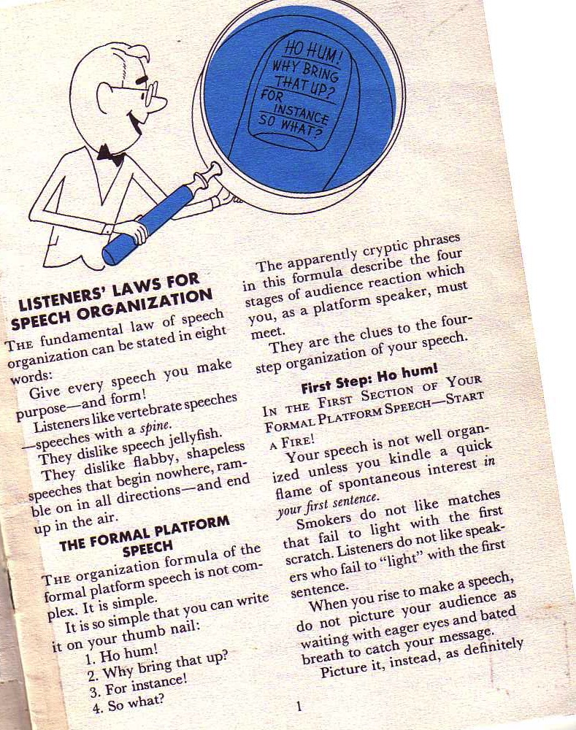
Borden ji Elaina
10-11
Oyi tiza na oyinsan yizung ji picheta :
Ni oyinsan ji etelanla eli tona zenka pia!
Richard Borden, Kuvtoli oyinsamuv sana ji lanka, 1

Slide 35
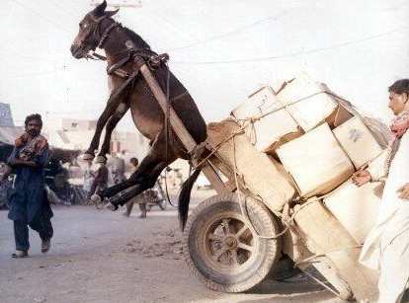
SBC Tsemjak Ethelan eli
v
Ekhao (10%)
Elhi (15%)

Slide 36

DISCIPLESHIP
"…make disciples of all nations…" (Matt. 28:19)
But how?
Notes:
We all know that our basic calling is to make disciples among the nations.

Slide 37



Oyam jiangha kuvtoli pungnoa sana ezotava!
Ana ehungpvϋi khosha yolona ntio pungnocho sana ntena zothaka. Hoji pungnoyi ji longtsuka eli osi oyam pungnothi kyon thungi ezoa (2 Tim. 2:2 ).
Surui
Paul
Timothy
Enhika eli kyon
Thanpo

Slide 38
Pungno Elhi 1997-2013
Rakyo = meta kuvlo ana shi tsemjak ji pungnothakcho sana
MONGOLIA
JORDAN
KOREA
CHINA
NEPAL
MYANMAR
INDIA
THAILAND
VIETNAM
MALAYSIA
SRI LANKA
SINGAPORE
INDONESIA
Notes:
From 1997-July 2013 God has seen fit to grant me the privilege to train pastors in 12 other countries on 50 trips. I have taught Homiletics in 8 of these.

Slide 39


Preaching (Homiletics) link at BibleStudyDownloads.org
Get this presentation for free!
Notes:
Preaching (pr)
Homiletics

Slide 40
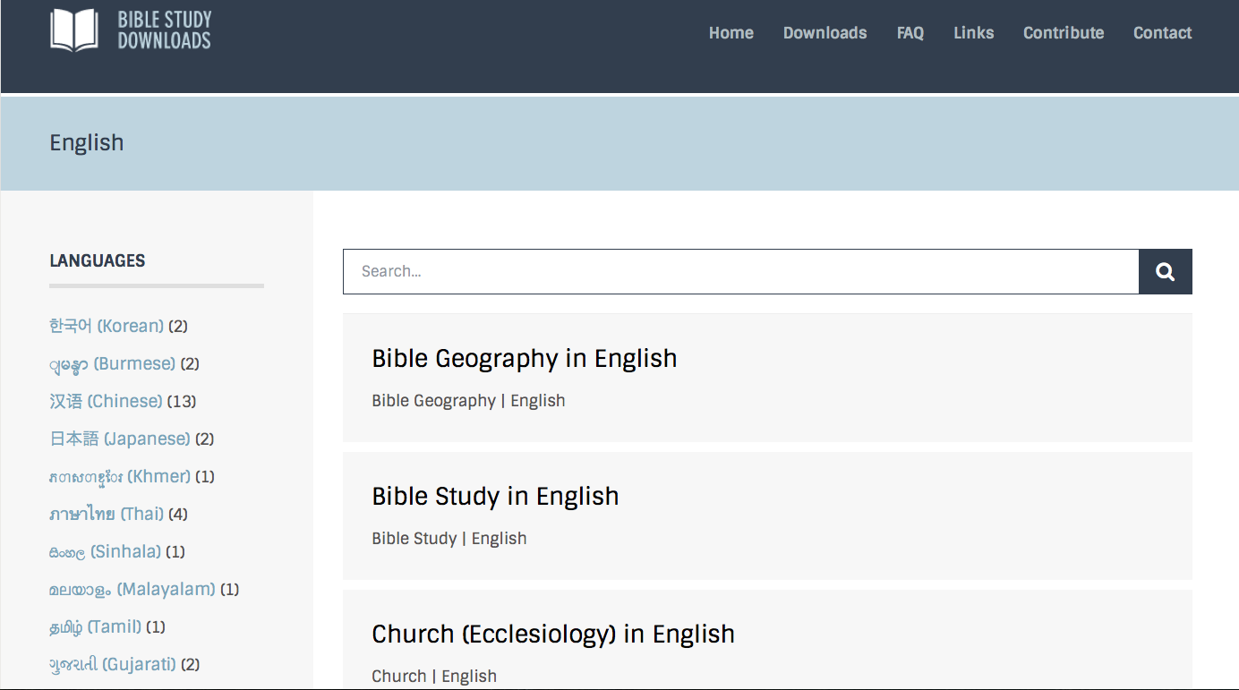
BibleStudyDownloads.org
7
Notes:
This has resulted in Bible teaching and study materials—mostly PowerPoint—in 42 languages! All a teacher needs to do is to click on a file and it downloads for free to teach any book of the Bible and many other subjects.

Slide 41
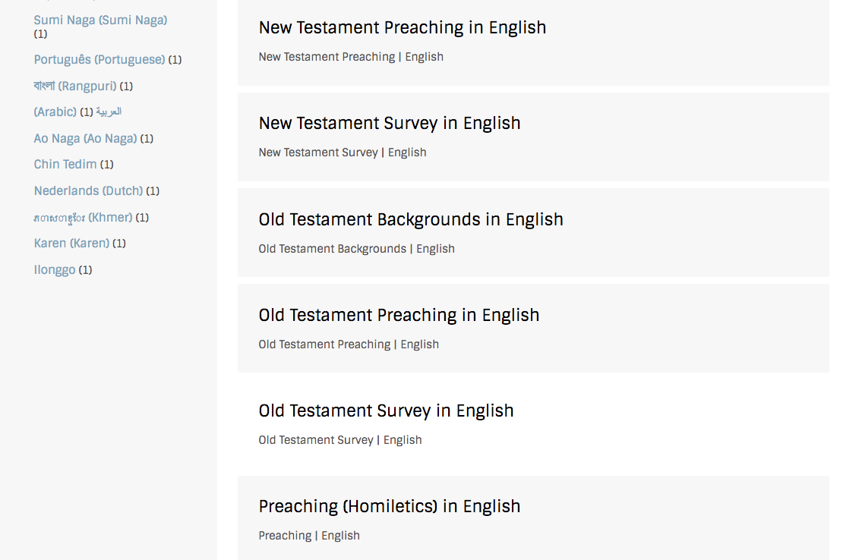
BibleStudyDownloads.org
7
Notes:
This has resulted in Bible teaching and study materials—mostly PowerPoint—in 42 languages! All a teacher needs to do is to click on a file and it downloads for free to teach any book of the Bible and many other subjects.

Slide 42
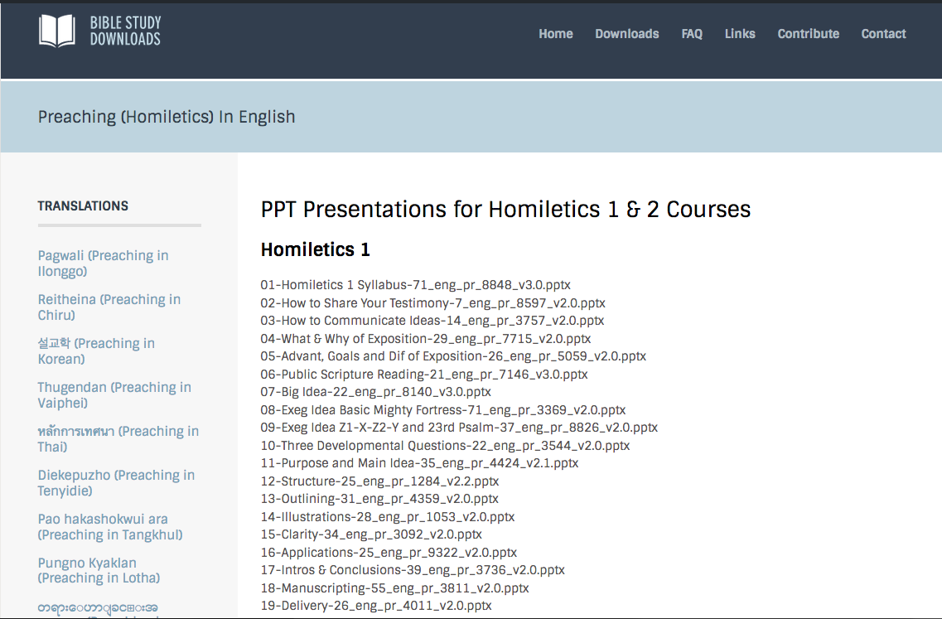
BibleStudyDownloads.org
7
Notes:
This has resulted in Bible teaching and study materials—mostly PowerPoint—in 42 languages! All a teacher needs to do is to click on a file and it downloads for free to teach any book of the Bible and many other subjects.

Slide 43
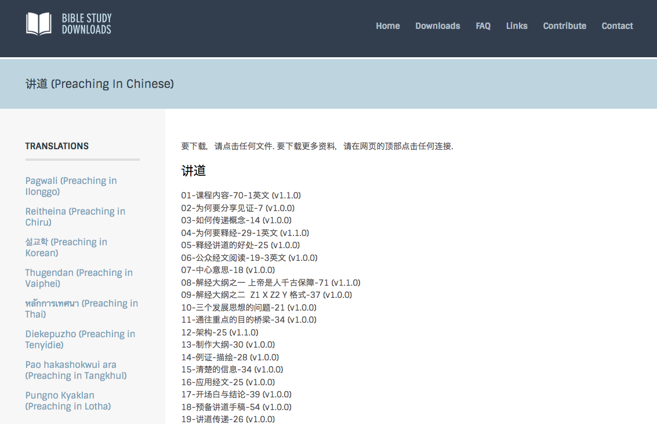
BibleStudyDownloads.org
7
Notes:
This has resulted in Bible teaching and study materials—mostly PowerPoint—in 42 languages! All a teacher needs to do is to click on a file and it downloads for free to teach any book of the Bible and many other subjects.

Slide 44
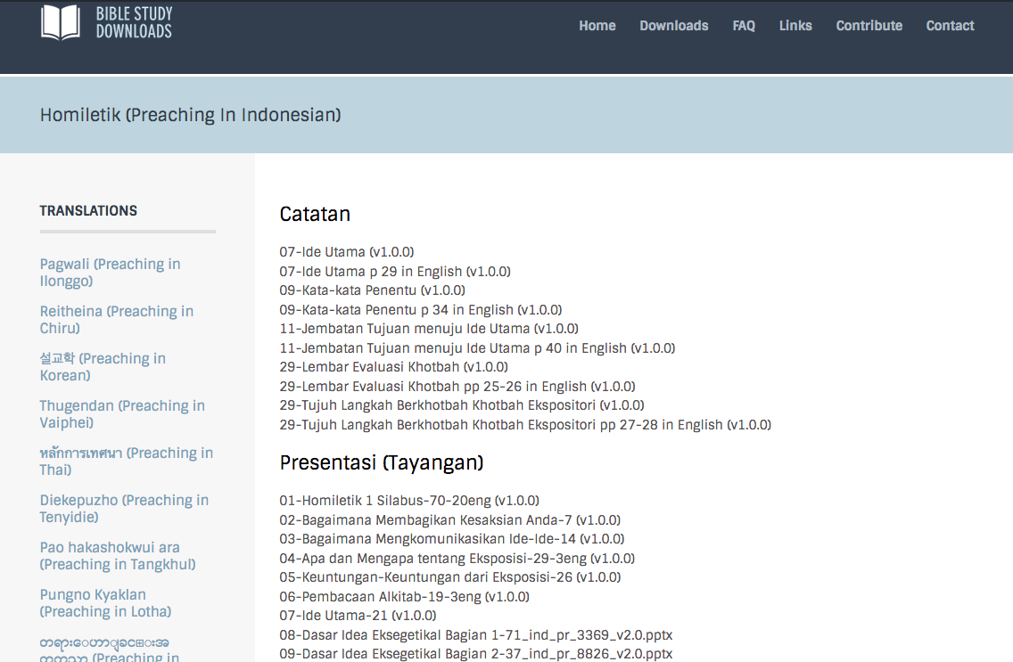
BibleStudyDownloads.org
7
Notes:
This has resulted in Bible teaching and study materials—mostly PowerPoint—in 42 languages! All a teacher needs to do is to click on a file and it downloads for free to teach any book of the Bible and many other subjects.

Slide 45
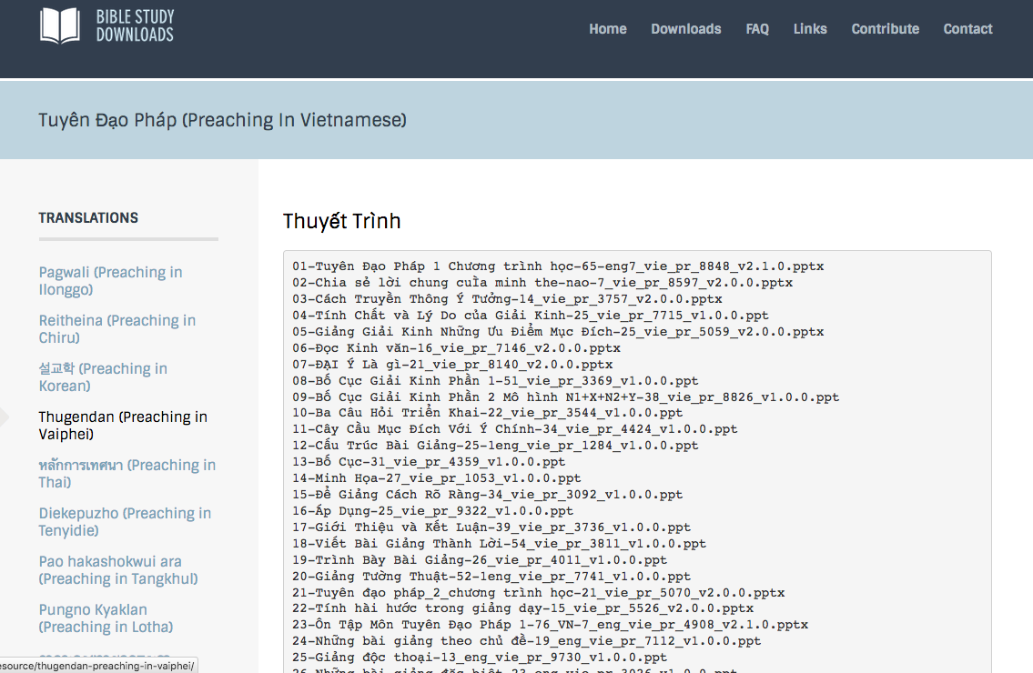
BibleStudyDownloads.org
7
Notes:
This has resulted in Bible teaching and study materials—mostly PowerPoint—in 42 languages! All a teacher needs to do is to click on a file and it downloads for free to teach any book of the Bible and many other subjects.

Slide 46
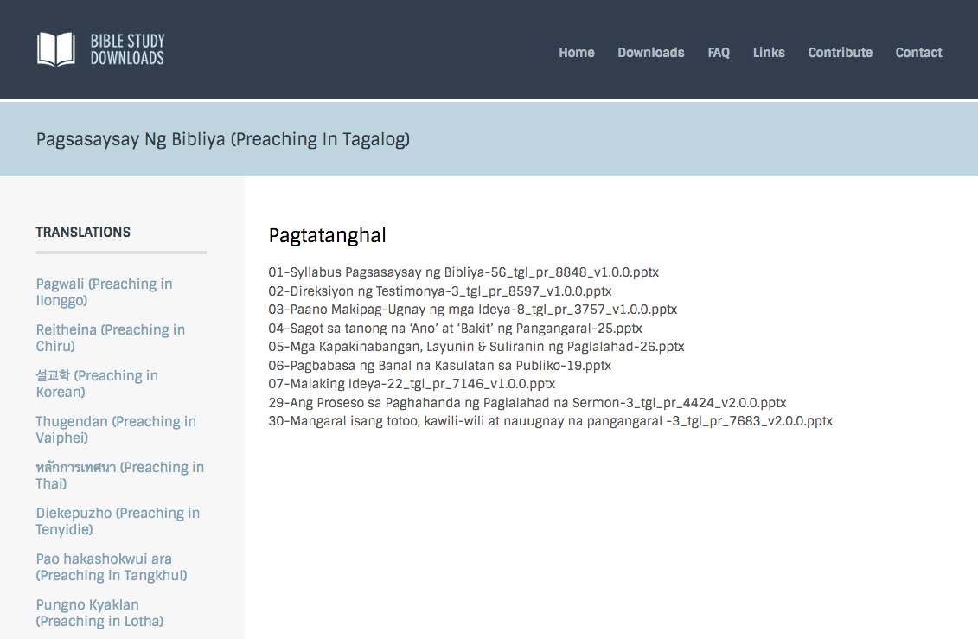
BibleStudyDownloads.org
7
Notes:
This has resulted in Bible teaching and study materials—mostly PowerPoint—in 42 languages! All a teacher needs to do is to click on a file and it downloads for free to teach any book of the Bible and many other subjects.

Slide 47
Homiletics Project Sign Up List
Name | HP | Translate |  |  | Teach
 |  | HOM | HSB | Language | HOM | HSB | Language
X | X | X |  | X
X | X |  | X | X
X | X |  |  |  | X |  | X
X | X |  |  |  |  | X | X

Slide 48
SBC Tsemjak Ethelan eli
vi
Ekhao (10%)
Elhi (15%)
Etsuka elhi (25%)

Slide 49

12 Okhe na eramo elhi
vii
Shi yakchia oyi nsan tsukona ni methakiala

Slide 50
Ntioli ni kija ehungpvui pivla?
16
Ni ekum motsu erui ji elao
Ni no hojilo tsotioji
Wothok elhi olan chonchi
Dr Rick Griffith, Singapore Bible College
www.biblestudydownloads.com

Slide 51
Kija ehungpvui
16
Ekum Dongphi sulo:
Ni nchumri
Dongphi
Chukchuka erana!
Ekum Dongphi:
Share the event
Ntio longtsu-cho la
Chukchuka erana!
Ekum ndongphithung
Ni nchumri
Ni tsolan-phyolan
Chukchuka erana!
Oyi opvu
ji kheti vata

Slide 52
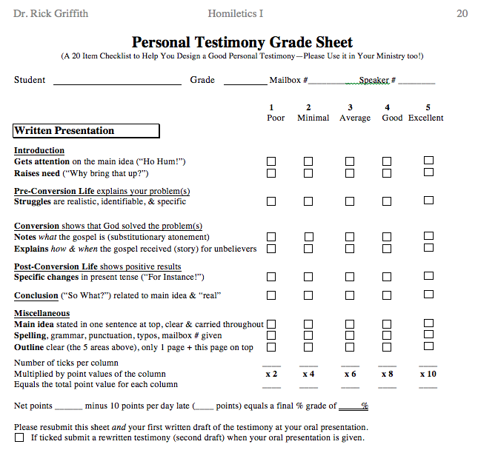
Testimony Grade Sheet
20
Benka
Ekum ndongphi tthung
Ekum dongphi
Ekum dongphi sulo
Ethak
Thanpolipo

Slide 53
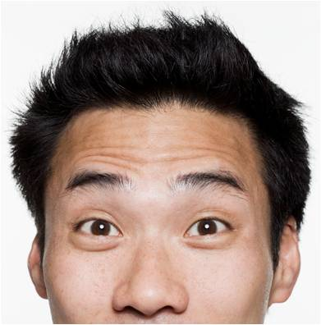
Ni Etsuka elhi ji ocho piv?
Dr Rick
Dr Clive

Slide 54
SBC Tsemjak Ethelan eli
vii
Ekhao (10%)
Elhi (15%)
Etsuka Elhi (25%)
Oyi-nsan (50%)

Slide 55


Oyi-nsan ranka
vii
Benka (1 min.)
Kija ehungpvui (2-3 min.)
Oyi-eyen yi-nsan (2 min.)
Chuti Pungno (15 min.)
Motsu eru pungno (15 min.)

Slide 56
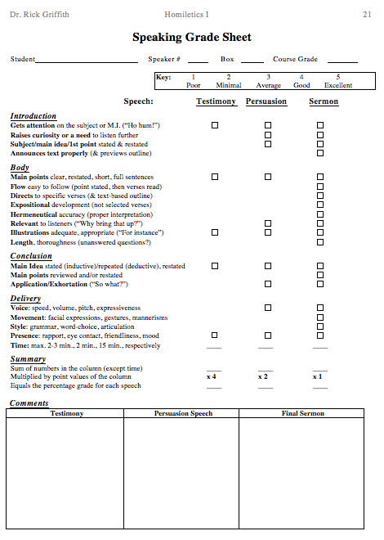
Oyi nsan
Esekata ji
21
"Ho hum!"
Oyi Opvu
“Ejuka!"
Oyi Opvu
Pfutson

Slide 57
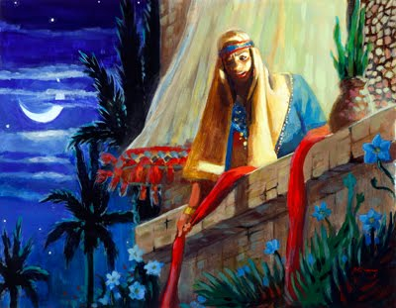
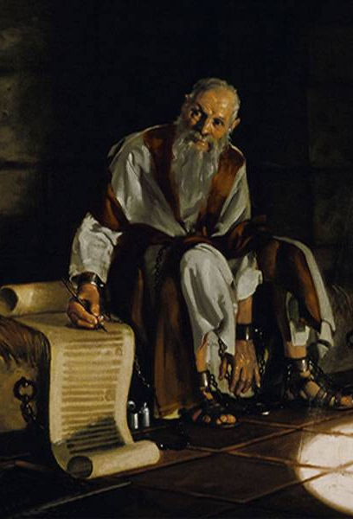
Ni motsu pungno eni
vi
Chuti
Elaro
1-2 verses
Joshua
Etsukuv
1 chapter

Slide 58
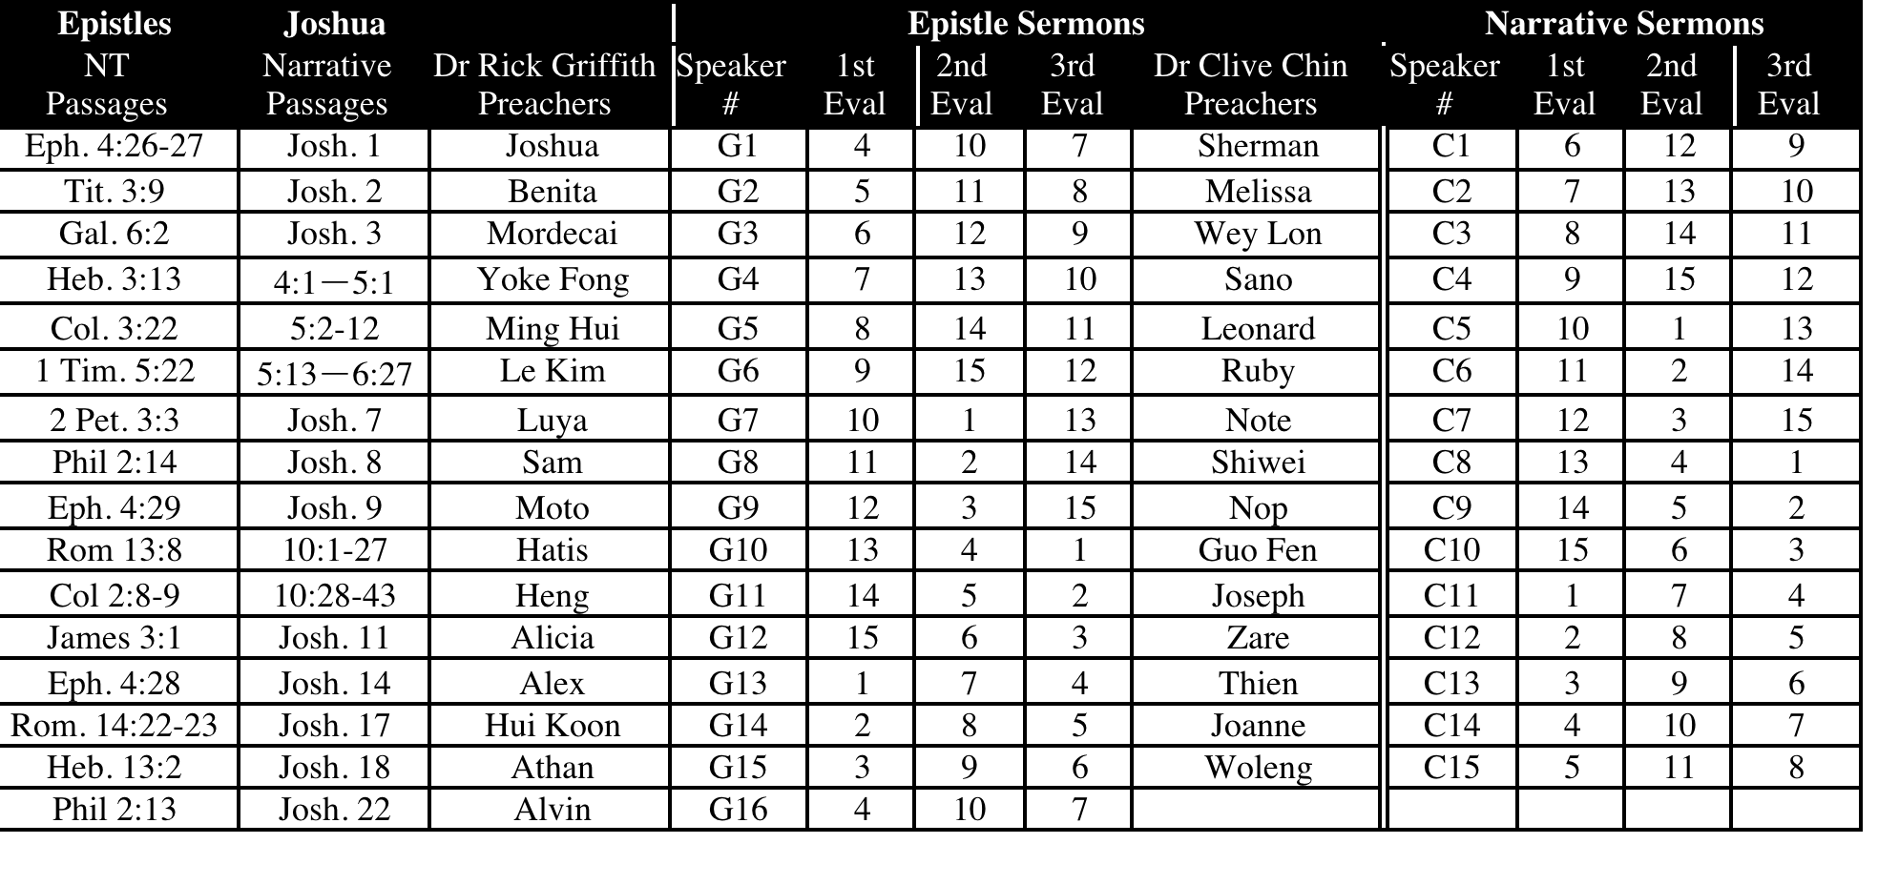
SBC Oyi-nsanden & Ezeiden 2013
vi
July-Nov 13

Slide 59
Chuti pungno yiren(15 min.)
B
Rom 13:8
Nte yuta lo nzanta ji yaka ochi thÜngiha ntia epvukai tivatava, ntiotssole oyan nzamo kyon jina shikhu ji penthukthaka.
Rom 14:22-23
²²Ni kija engathe ji ni lo vanthuka, ni tonaPotsow to yutalo. Kyon ochona ombona elana to longtua tssoathung ombobo n lan n piasana hoji mmhontsowo. ²³Khatolia kyon ochona khathunga nchumsi ombona tsoana ombona n lan piala, ntiotsole ombo elhi ji longtsuka lona n chiyicho sana jijo mmen.
Gal 6:2
²Nte oha hankyiptava, tona hoji lona Christa shikhu ji pentukala.

Slide 60
Chuti pungno yiren(15 min.)
B
Eph 2:10
¹⁰Etena enunga vamo shijo Potsow na e kumthukcho. Ombobo Christa Jisu yakchia elhi mmhom tssoa evamo e kumthukthaka. Potsow na ete tsukona methako ekumlan ji shi.
Eph 4:26-27
²⁶Nina lum tsuka tssona mmen etssowo lum titsuka. ²⁷Eng n rhethung enyipi sia, osi n mhon ji yuta tipia.
Eph 4:28
²⁸Efui jina efu esam lia, ombo khe jiang ntso elhi lo ombo nkanphithuki oyam ethelan eli jiang ha ombo khi nzanthuka.
Eph 4:29
²⁹Nte ochia pungina oyi n mhon tichiyithuka. Yitsung ji rakchei ethelan lia osi rontacheo nsana, tona ni yi ezoe jiang na mmha hungu.

Slide 61
Chuti pungno yiren(15 min.)
B
Eph 6:4
⁴Opvupoeden, nte ngaro jiang lumbum tssatssoyio ti tssoyitava, tolia christian etssophyo osi pungnolan jiang lo sokatava.
Phil 2:13
¹³Potsow na nte lo elhi tssoa vana, ombo emathao elhi jiang nte chokathuka osi hojiang nte nchumchethuka vanala.
Phil 2:14
¹⁴Ntena ntio elhis sana ti phyochophyoritava
Col 2:8-9
Ejungjung osi polaroa pungno yi rulonta motsu jiang, osi Chris lona meku limha lo lungkum yi jiang khi ochina ha nte ti sosorathuka. Ntiotssole ombo lo kyon tsuk jilo Potsow tathi ji penria jua; osi omon thungoi esapui osi etho topvu pono kuri

Slide 62
Chuti pungno yiren(15 min.)
B
1 Tim 2:11-12
¹¹Eloe jiangjo soka benkae kupo evanden, noyinga osi oyam kyuchi ekumo evam lia.¹²Eloe jiang na pungnoe tssoa, epoe pono opvui tssov ana elan n piala; onteno yingto vam shikhu..
1 Tim 5:22
²²Ni tsuk mmhon ji tsukona oju tae ti yua, etsoyu otsuko vanthuku junung ro ju ha tara jo yua.
Titus 3:9
⁹Khatola ethev n lio ekhieranta jiang sitava, pochung motsu jiang, shikhi ji tsukona pangta jiang sitava, jiang topvu ethev n lio tae.
Heb 3:13
¹³Nthomotsu lona ‘Nchung’ to phyoji ete tsukona elithung nandang jo ete ochia mmen jina kyakthechi Potsow mhadungo lumbum n khungthuku tsukona ete ete lum tssonkayita vantav lia.

Slide 63
Chuti pungno yiren(15 min.)
B
Heb 13:2
²Nte ki jiang lankon sothev ti mhechotava, hojito sothei ejoma na n tsiv lanben sotherathaka.
1 Peter 2:2
²Ngakaro vanpancho esua yuta topvu lo omon thungoe shiroju, yantava, ntena hoji yui rankae nte shanchowo tssoa.
1 Peter 3:7
⁷Nte longtsui tsukona jo olung shi elumoto tssentu tsotso; khatola n longtsui jiang tsukona jo “olung kuwoe kitssoe jiang na ethev n li to sicho sana hoji topvu lo ethev elitso ji kumi sicho.
2 Peter 3:3
³Ovungtssoa, ntena ntsia tsungon okhao jilo jo tajo elum kyon, onte lum erung ephan evan jiang na oro nte emakav.

Slide 64
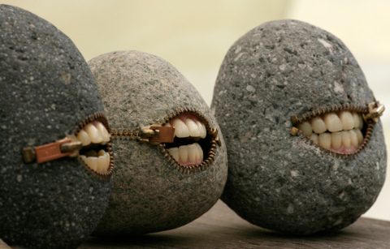
Nina mhona pungnoa tssona olung na lia pyav!
Luke 19:40 Ana nte ezoala, ontena yingto vana na olung shiangna tungkachiv.

Slide 65
Minute15 pungno eni jilo shiang piv shikuv…
vii
Ni oyi-nsan tsungon ji vungi…
Eru nkon Etsuka. 7 & 8 (or 11 & 12)
PPT lo pungno eru nkon ji pia
pungno eru nkon ji methaka
Eran kako ntsunga vathakuv
Pungno Tsungon jilo…
Nchumchephen tsutsialan vav shikuv
Pungno si nchuk eni sulo…
Nipopo ezio kako (p. 104)

Slide 66
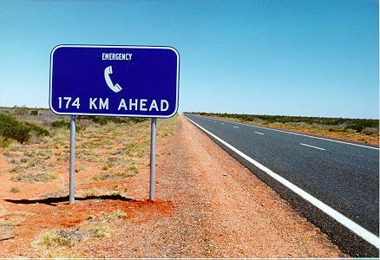
Elhi ngatheo licho tsona?
Nzanchiv tsukona enga!

Slide 67
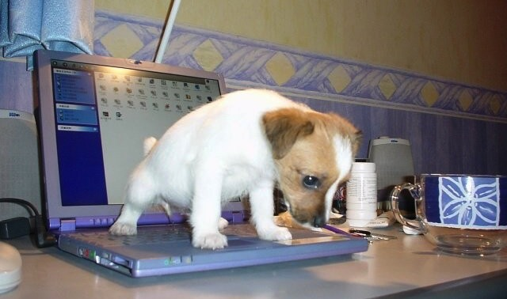
Rakae-zephen jilo ni etsuka elhi ji erankata
Nkumshon ji shia!

Slide 68
Thanpolipo elhi
xi
Copying Class Notes
Kuvlo ayam sana
SBC box L19 or phone (6559-1513)
Mobile number 9113-7090
Oki address jo SBC Block 2-302
Oki ezhuna janphen jo 6762-2011
E-mail: griffith@sbc.edu.sg
A elhi etso yuta jo…
Nzo otsi ha tsotav ka!

Slide 69
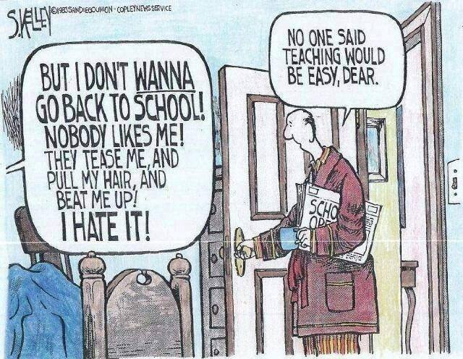
No one said preaching would be easy, Dear
But I don’t WANNA go back to church! Nobody likes me! They tease me, and pull my hair, and beat me up! I hate it!

Slide 70
Pungno Kyaklan • BibleStudyDownloads.org
Shi kako shji oman njuna khia!
Notes:
Preaching (pr)
Homiletics

Slide 71
Black

