Slide 1


ETE BIBLE…
ELAROENA
Designed by Dr. John Fryman, Texas, USA • BibleBasically.org
Taught by Dr. Rick Griffith, Singapore Bible College
All files in many languages for free download at BibleStudyDownloads.org

Slide 2

NA MOSA TSUKONA ECHUMPORO METHAK
I
II
III
IV
V
VI
VII
VIII
IX
X
NTSATA EHEN KHOCHUK KAKO JI LO NA:
EKHA NZANCHI #15
“MOSA NTSATA"
METHAK
SHI JO KVUTO?
9.65.05B.
©2006 TBBMI
01
Notes:
We'll be using Study Help #15 for this
//// look at The MOSAIC COVENANT or MOSAIC LAW in the book of Exodus.
//// What about this arrangement? We must consider it in order to have the complete picture.

Slide 3
I
II
III
IV
V
VI
VII
VIII
IX
X
MOSA
KHOCHUK
SINAI
N - K - T
“N-K-T"
M - C - C
KADESH BARNEA
40
Ntsanruk
Kyonshae
Tssolanphyolan
PUNGNO 5
02
1
Notes:
In the MOSES Bible File, remember the item M-C-C?
//// M-C-C: standing for MORAL...CIVIL...CEREMONIAL parts of the new Law. Many scholars and teachers have organized the Mosaic Law into those main parts…as God dictated Moses—twice, by the way – atop Mt. Sinai.

Slide 4
YUTA-SUKYING JI NCHUMCHETA!
I
II
III
IV
V
VI
VII
VIII
IX
X
• EJIPI ISRAEL EZII EKUM: NZYU 400
• JULI & NZONTSU TSUKARANKA MATAROA
• OPVUI THUNGOI NA JO: YICHUNGYI?
TOKUMA…
• ISRAEL KYON JIANG CHUNGI TONA OPVUI ONTE CHUNGI SHENTAKOTA JILO, MOSA NTSATA JI EKHO OPVU TSOTSO KUMALA
03
4
©2006 TBBMI
9.65.05B.
Notes:
Remember also the context for these Laws.
//// The Israelites had been in Egyptian bondage for four long centuries...hard labor...
//// poor or very little cultural and civic development...probably deeply lacking in experience in relating to each other in a civilized society...having no time for development of higher levels of interpersonal relationships..
//// And certainly, little direction on how to maintain a growing relationship with their Creator God. ..the God of Abraham, Isaac, and Jacob. It had become a mystery…perhaps only a distant memory.
//// So…the Mosaic Law then becomes a major step in the development of the Israelites as they mature in their relationship to God while learning to behave among themselves as the Chosen People.
SO YOU SEE…THERE IS ALWAYS A CONTEXTUAL REASON FOR EVERY BIBLICAL EVENT OR INSTRUCTION.

Slide 5
I
II
III
IV
V
VI
VII
VIII
IX
X
Echumpota Ji:
Mosa Ntsata ji BENKA
osi
OCHUM licho !
04
1
Notes:
But there is one most important distinction between the Abrahamic and the Mosaic arrangements. And here it is…
//// ….the MOSAIC COVENANT had a beginning --- as did the Abrahamic, of course --- but THE MOSAIC also had an END. As of this moment, the Abrahamic Contract is still running while the Mosaic ended at Calvary…as we will shortly see!

Slide 6
"MOSA NTSATA"
"MOSA NTSATA"
MOSA
I
II
III
IV
V
VI
VII
VIII
IX
X
“N"
KHOCHUK YIREN 20:
YIZUNG TARO JIANG
“Yizung Taro Jiang"
“Yizung Taro Jiang"
NTSANRUK
Eren Ovungo Ji–
Opvui Thungi Elhi(Yiren 1-12)
Opvui Ni Potsow
Ombo yaka potsow echumbo nvan
Kisu mekana Ombo esua nvan
Potsow echumbo khumvu mek
Opvui mying ji nthoa vantuka
Emong ji nthoa vantuka
Tsungon tirok elji tssoa
Emong Tsungon lo jo esana...
05
12
Notes:
Here's a quick tour of the parts of the Mosaic Covenant from
//// the 20th Chapter of Exodus, sometimes called the Decalogue…
//// containing the familiar TEN COMMANDMENTS...
//// Beginning with M...for the MORAL parts of the Mosaic Covenant...THE LAW...or, in Hebrew, the Torah.
The MORAL part of the law is traditionally divided into two TABLES...
//// …the first table being the Israelites' duties to God...Exodus 20, verses 1-12:
//// Briefly, Moses is given directions for proper respect to "the Lord your God.”(Intro)
//// that there should be no other gods before him... (TC1)
//// no idols or likenesses of him (TC2)
//// no worship of other gods...
//// attention to the sanctity of the Lord's name... (TC3)
//// keeping the Sabbath Day holy... (TC4)
//// working only six days...
//// and resting on the Sabbath. This is the FIRST TABLE...man's duties to God alone

Slide 7
“MOSA NTSATA"
I
II
III
IV
V
VI
VII
VIII
IX
X
“N"
KHOCHUK YIREN 20:
YIZUNG TARO JIANG
"Yizung Taro Jiang"
NTSANRUK
Eren Ovungo Ji –
Opvui thungi Elhi Jiang (Yilan 1-12)
Eren Enio Ji–
Kyon Thungi Elhi Jiang(Yilan 13-17)
Opvuopo jiang Yikrachi
Sario Elhi Jiang:
Lungtha
Efurama
Efu
Ejung Ephyo
Oyam Eloi/Eboi osi Tsutsailan Jupomo ji...
06
7
Notes:
Then verses 13-17 – The Second Table -- are directed to duties to Man.
//// Such as honoring our parents...
//// and the several forbidden acts...
//// murder...
//// adultery...
//// stealing...
//// lying...
//// and coveting the persons and things belonging to others

Slide 8
"MOSA NTSATA"
I
II
III
IV
V
VI
VII
VIII
IX
X
KHOCHUK YIREN 20:
YIZUNG TARO JIANG
“N"
"Yizung Taro Jiang"
Eren Ovungo Ji –
Opvui thungi Elhi Jiang (Yilan 1-12)
Eren Enio Ji–
Kyon Thungi Elhi Jiang(Yilan 13-17)
“K"
YIREN 21–24:
OKHOLO SHIKHVU JIANG
KYONSHAE
Kija Elan
Ejueli/Esutsaelan Elan
Kija Ntsanruk tsukona Ethev Liojiang...
07
4
Notes:
Now the FIRST "C" of the M-C-C idea...the CIVIL part of the Mosaic Law...these are the so-called Social ordinances….
//// CHAPTERS 21 THROUGH 24....in other words....how to get along with one another...out in the desert, later in their settlements...because the wilderness wanderings are lying just ahead in Israel's dramatic future. Here we find the Lord's fundamental directions regarding
//// personal rights...
//// property rights...and
//// basic ideas for personal integrity. The Social Ordinances.

Slide 9
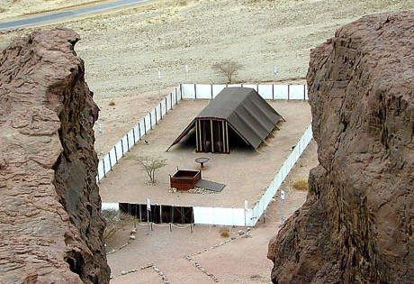
" MOSA NTSATA "
I
II
III
IV
V
VI
VII
VIII
IX
X
KHOCHUK YIREN 20:
YIZUNG TARO JIANG
“N"
"The Yizung Taro Jiang"
Bakos, Saro osi Milondong
The First Table –
Duties to God (Verses 1-12)
Special Ordinances
Oki Etssov Jiang
Yongmen na roncho Thanphen osi Kikhyo
The Second Table –
Duties to Men (verses 13-17)
A System of Worship
Pvuti-ekum ji
Pvuti-ekum Nthoche
“T"
Guidelines for Living
CHAPTER 21-24:
THE SOCIAL ORDINANCES
Orhum mmhom Thanphen osi Khumo Eroi jiang
Elhi Etssoi ji tona Emong Tsungon ji to...
“T"
CHAPTERS 25–31:
NTHO RANKI SHIKHVU JIANG
TSSOLANPHYOLAN
08
11
Notes:
And the FINAL "C" of M-C-C...this one representing the CEREMONIAL part of the Law.
//// Chapters 25-31: called the Tabernacle Ordinances…that ancient worship center shown here in a modern model out in today's Israeli desert…built according to the Old Testament directions. And again we must remember that these new regulations were being provided for a people just coming out of four centuries of debilitating slavery and a culturally stunted growth.
//// These SPECIAL ORDINANCES were given to turn the people directly to the worship of their God while providing them
//// with A SYSTEM OF WORSHIP in the new Tabernacle, along with the new
//// GUIDELINES FOR LIVING among themselves, alone, and in the conditions of the desert wilderness.
//// Which included…the Tabernacle's Ark, Table and Candlestick
//// Directions for its General Construction,
//// The Bronze Altar and the Court,
//// Its Priesthood for its ritual services,
//// Consecration of the Priesthood,
//// The Altar of Incense and the Worshippers, and
//// The Workmen in relation to the Sabbath.

Slide 10
“MOSA NTSATA" TSSORHYU CHO:
I
II
III
IV
V
VI
VII
VIII
IX
X
“N"
YIREN 20:
YIZUNG TARO JIANG
“K"
YIREN 21–24:
OKHOLO SHIKHVU JIANG
“T"
YIREN 25–31:
NTHO RANKI SHIKHVU JIANG
09
3
Notes:
So...the Mosaic Covenant, summed up…in its three distinct parts…
//// THE DECALOGUE…M…the MORAL PART…
//// THE SOCIAL ORDINANCES…C…the CIVIL PART…and
//// THE TABERNACLE ORDINANCES…another C…the CEREMONIAL PART…all given to Moses by the Lord…and then to the people...in all of their complexities and far-reaching implications -- even into our own day.

Slide 11
Mosa Ntsata jiang Etsyuchi jiang
1. Esungaro elhinsung.
2. Kiaman meko ntsata.
3. Hoji etum ji Jisu Khrista wothuk elhi chum lo pencho. Jilo na Thakchi cho.
4. Kvuthung Ntho Mon ji limha lo sothe cho sana, Shikhvu ji longtsui den topvu ekum osi lumbum lo licho.
9.65.05B.
4
©2006 TBBMI
10
Notes:
So…what were some of those implications of the Mosaic Covenant?
At least…these four…
//// the Mosaic Covenant was a TEMPORARY arrangement. It had a beginning and it had an end.
//// It was a CONDITIONAL agreement. You do THIS, God will do THAT. And then…some 1500 years later…in Jerusalem…on Calvary…
//// ….it had served its purpose at the conclusion of Jesus Christ's ministry. It ended there. Finally…
//// After the Holy Spirit was introduced into the earth – following the Lord's Ascension -- the Mosaic Law became an internalized part of the life and heart of each believer. Jeremiah had foretold that enormous change in man's heart when He announced the New Covenant.
Jesus himself attested to his place in the history of the Law…

Slide 12
MATHI 5:17
Jisu na phyocho:
“Ana zenkhying yi jiang tona shikhvu ji to kji silo rocho to ti nchumtava; Ana jiang monthuklo rocho mek tolia benthuko rocho."
Ana jiang monthuklo rocho mek tolia benthuko rocho."
11
1
Notes:
In Matthew 5:17, he said..."Do not think that I have some to abolish the Law or the Prophets.
//// I HAVE NOT COME TO ABOLISH THEM BUT TO FULFILL THEM." Remember in the JESUS FILE, where we mentioned the implications of the Cross? This statement is at the core of that enormous event…a profound shift in man's relationship to his Creator through the new Gospel ministry of the Messiah.

Slide 13

Abraham Etsa ji
Gen. 12:1-3
ANRAHAM NTSATA
Ntsata
Gen. 15:9-18
Ntsata jiang chungi ntsata jiang zetav
ENHUNGAHA EKHA NZANCHI #14
The Very "Backbone" of Biblical Revelation
12
©2006 TBBMI
9.65.05B.
Notes:
Now…using Study Help #14…let's return to dig a little deeper into that backbone of Biblical revelation…THE ABRAHAMIC COVENANT. We'll develop the so-called amplified sub-covenants of God's UNCONDITIONAL COVENANTAL PROGRAM with man …

Slide 14
Abraham Etsa ji
Ben. 12:1-3
ABRAHAM ECHUMCHAK
Echumchak ji
Ben. 15:9-18
EKUMECHUNG
OTSOINA
KIAMAN
Ben. 13:15
Ben. 13:14-16
Ben. 15:9-18
META
MOTJU
MMHA
Ben. 12:1
Ben. 12:2
Ben. 12:3
©2006 TBBMI
Bible Hungthuk “Chenryu” ji
9.65.05B.
13
Notes:
…the LAND, SEED AND BLESSING aspects of the Abrahamic arrangements….and their qualities as:
//// ETERNAL, LITERAL, and UNCONDITIONAL.

Slide 15
META
ECHUMCHAK
ABRAHAM ECHUMCHAK
Echumchak ji
Ben. 15:9-18
Abraham Etsa ji
Ben. 12:1-3
EKUMECHUNG
OTSOINA
KIAMAN
Ben. 13:15
Ben. 13:14-16
Ben. 15:9-18
META
MOTJU
MMHA
Ben. 12:1
Ben. 12:2
Ben. 12:3
Ntsata jiang chungi ntsata jiang zetav
©2006 TBBMI
Meta
Shikhfu. 30:1-10
Bible Hungthuk “Chenryu” ji
9.65.05B.
14
Notes:
Beginning with the Land Covenant...sometimes called by its earlier name, the Palestinian...
//// This is the first amplification of the Abrahamic Covenant…the land portion.

Slide 16
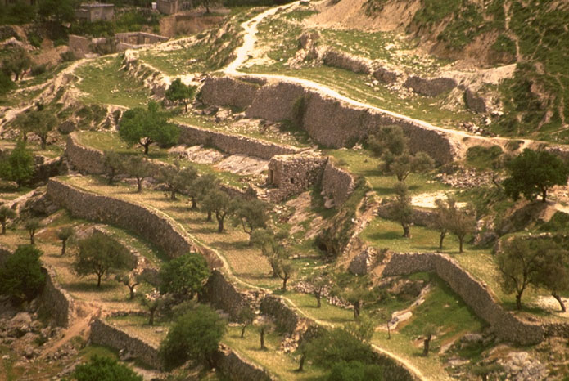
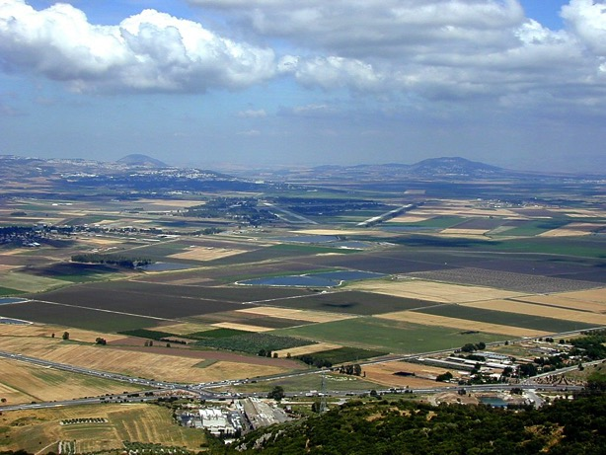
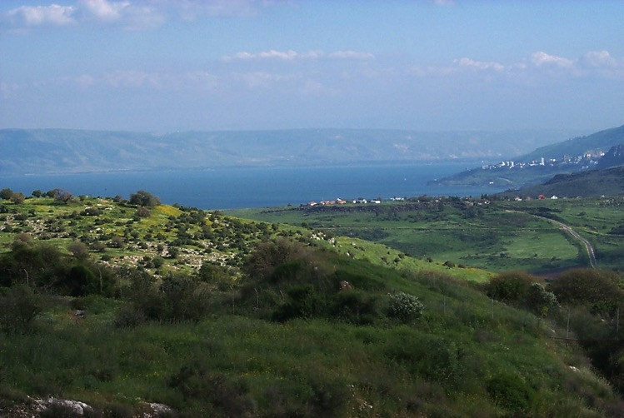
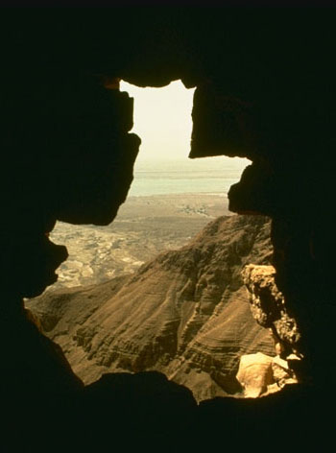
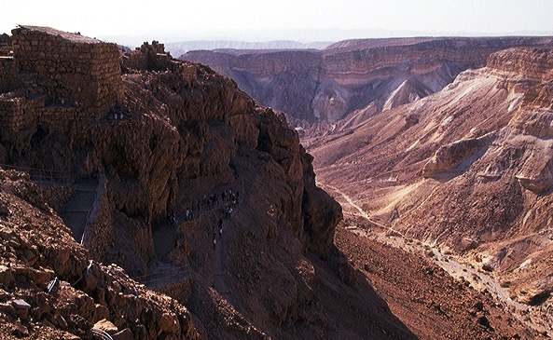
ABRAHAM META EJUELI JIANG
15
Notes:
First…take a look at the Land of Abraham's inheritance…remember that this was…and is…real acreage…real land…real lakes…farm fields…orchards…deserts and canyons. A place of great beauty and enormous wealth potential…

Slide 17
Shikhfu Enioto 30
META ECHUMCHAK
⁵ Osi nte motsüi jiang na vanthako meta ji ntena hoe vanlamka. Osi ombona nte motsüi jiang na kvüthüngha n hunghamo tata ejueli osi wokyong nte kumthoku ka.
⁶ OPVUI nte Potsow na ntena lümbüm totona ombo nzamo tssoa osi meta jilo harishia evamo tssoa jancho ezo lümbüm nte theyivka. (Lotha Bible)
16
2
Notes:
THE LAND PROMISE is recounted by Moses in Scripture at Deuteronomy 30, verses 1-10. In the heart of those ten verses lie these two:
//// ⁵ He will bring you to the land that belonged to your fathers, and you will take possession of it. He will make you more prosperous and numerous than your fathers.
//// ⁶ The Lord your God will circumcise your hearts and the hearts of your descendants so that you may love him with all your heart and with all your soul, and live.

Slide 18
MERITANGTANG OSI EJUELI META
17
Notes:
The words of that promise, made here to Moses, reflect God's earlier promises to Abraham, stating clearly that, in some distant day, both Israel AND Judah will return to their land to live in peace with their neighbors…a land of enormous beauty and material prosperity.

Slide 19
ABRAHAM ECHUMCHAK
Abraham Etsa ji
Ben. 12:1-3
Echumchak ji
Ben. 15:9-18
DAVID
ECHUMCHAK
EKUMECHUNG
OTSOINA
KIAMAN
Ben. 13:15
Ben. 13:14-16
Ben. 15:9-18
META
MOTJU
MMHA
Ben. 12:1
Ben. 12:2
Ben. 12:3
Ntsata jiang chungi ntsata jiang zetav
Meta
David
Shikhfu. 30:1-10
2 Sam. 7:4-16
Bible Hungthuk “Chenryu” ji
18
©2006 TBBMI
9.65.05B.
Notes:
Now...the Davidic Covenant...
//// ….an amplification of the SEED portion of the Abrahamic...
2 Samuel 7, verses 4-16.

Slide 20

DAVID ECHUMCHAK
NTSA ETHUM JIANG
2 Samuel 7
¹⁶ Elani ni tsoronichen vanrhyua yivka,osi ana ni ekhungyan ji linrhua yithoku ka. Ni yansa sa jiha ochum liv meka.
linrhua
ochum liv meka
19
6
©2006 TBBMI
9.65.05B.
Notes:
Again...at the heart of that scripture…
//// is the great Davidic Covenant and its three guarantees…
/// It has this statement: 2 Samuel 7:16…to David through his household prophet Nathan…God says, "Your house and your kingdom will endure forever before me; your throne will be established forever.".
To clarify:...
//// Your HOUSE.. or your lineage or family line...and your
//// KINGDOM...meaning actual real estate over which to govern...
//// and your THRONE...meaning a governmental administration...will be established…
//// …forever. Not just until the end of modern history, but forever...into eternity. So this verse then becomes a key idea in understanding Biblical eschatology or a study of The End Times.

Slide 21
Tona, enhungo, ni pobo engai zeta: David vantsu hojilo ocho na khokthev etuma?
20
©2006 TBBMI
9.65.05B.
Notes:
So, then, the question must be asked…AFTER King David's day…1000 B.C….who is qualified to sit on that Davidic throne?

Slide 22
EKHA NZANCHI#16
DAVID EKHUNGYAN
Jisu Christa Roza Pochung ji
21
1
©2004 TBBMI
8.0.05B.

Slide 23
DAVID LONA CHIYIO JIANG: Jisu Christa Roza Pochung ji*
*ELUM TERITOKI
22
1
Notes:
What about the genealogy of the Lord Jesus Christ, out of that line of David, according to Scripture? What do the scriptures have to say about all that? We are given a long and complex genealogy...
/// so this one will be vastly abbreviated.

Slide 24
DAVID LONA CHIYIO JIANG: Jisu Christa Roza Pochung ji*
ADAM EVE
Potsow Yi Kvulo Erani Lia:
Benkaden 3:20
*ELUM TERITOKI
23
Notes:
We begin with Adam and Eve, first recounted in Genesis 3:20...

Slide 25
DAVID LONA CHIYIO JIANG: Jisu Christa Roza Pochung ji*
ADAM EVE
Potsow Yi Kvulo Erani Lia:
Benkaden 4:1-2; 4:8
CAIN ABEL
*ELUM TERITOKI
24
1
Notes:
From their union came the brothers Cain and Abel.
//// And we know that Cain slew Abel because of Cain's jealousy of the gifts Abel made in sacrifice to the Lord. As a replacement for that murdered brother who was more favored by God, another son was born to Adam and Eve...

Slide 26
DAVID LONA CHIYIO JIANG: Jisu Christa Roza Pochung ji*
ADAM EVE
Potsow Yi Kvulo Erani Lia:
Benkaden 4:25
CAIN ABEL SETH
*ELUM TERITOKI
25
Notes:
He was Seth, the beginning of a godly line of men. AND RIGHT HERE is where the royal genealogy of Jesus Christ gets underway.

Slide 27
DAVID LONA CHIYIO JIANG: Jisu Christa Roza Pochung ji*
ADAM EVE
Potsow Yi Kvulo Erani Lia:
Benkaden 5:29
CAIN ABEL SETH
NOAH
*ELUM TERITOKI
26
Notes:
From Seth...followed Noah. By the way...dotted lines represent an abbreviation of all the Biblical names that actually occur during the long lines of descent. Scripture tells us the names of each one.

Slide 28
DAVID LONA CHIYIO JIANG: Jisu Christa Roza Pochung ji*
ADAM EVE
Potsow Yi Kvulo Erani Lia:
Benkaden 11:26
CAIN ABEL SETH
NOAH
ABRAHAM
*ELUM TERITOKI
27
Notes:
Eventually through this line...we arrive at Abraham.

Slide 29
DAVID LONA CHIYIO JIANG: Jisu Christa Roza Pochung ji*
ADAM EVE
Potsow Yi Kvulo Erani Lia:
Mathew 1:2-6
CAIN ABEL SETH
NOAH
ABRAHAM (Sarah)
*ELUM TERITOKI
DAVID
28
Notes:
And from Abraham, a thousand years later, appears David..

Slide 30
DAVID LONA CHIYIO JIANG: Jisu Christa Roza Pochung ji*
ADAM EVE
Potsow Yi Kvulo Erani Lia:
2 Samuel 12:24
CAIN ABEL SETH
NOAH
ABRAHAM
*ELUM TERITOKI
DAVID BATHSHEBA
29
Notes:
And...among other of David's several wives...appears Bathsheba.

Slide 31
DAVID LONA CHIYIO JIANG: Jisu Christa Roza Pochung ji*
ADAM EVE
Potsow Yi Kvulo Erani Lia:
2 Samuel 5:14
CAIN ABEL SETH
NOAH
ABRAHAM
*ELUM TERITOKI
DAVID BATHSHEBA
NATHAN SOLOMON
30
Notes:
Among the children of David and Bathsheba are these two sons: Nathan and Solomon. And here the line splits. Note that. It's a crucial place.

Slide 32
DAVID LONA CHIYIO JIANG: Jisu Christa Roza Pochung ji*
ADAM EVE
Potsow Yi Kvulo Erani Lia:
Luke 3:23 Plus Others
CAIN ABEL SETH
NOAH
ABRAHAM
*ELUM TERITOKI
DAVID BATHSHEBA
NATHAN SOLOMON
LUKE 3:23 (see other references)
MARY
31
Notes:
From the line of son Nathan, eventually appears Mary, the mother of Jesus.

Slide 33
DAVID LONA CHIYIO JIANG: Jisu Christa Roza Pochung ji*
LUKE 3:23 (see other references)
Luke 3:23: “Jisu na ombo nzyu 30 haruma tssoale, elhi benkai tssocho. Kyon na heto ombo nchumicho, ombo Joseph tsoe ji." (NIV)
"Luke jo Mary lona chiuio jiang yana vancho. Oyi khophi elumoto na [kyon echumpo echumpo chungi] Luke jo Mary pochung jiang erancho to phyola, ompvu ha David pochung lona chiyicho to hojitsukona Jisu jo Joseph lona tae mek na, Mary thungoi na ha Shanchopvui etsov etum elan lia (ntioli la tona, ombo otsoi eramo ji tssocho)."
Louis Barbieri, The Bible Knowledge Commentary, eds. John Walvoord & Roy Zuck (Victor Books, 1983), 212.
32
1
Notes:
Luke wrote about this in his Gospel. In his third chapter, verse 23: "Now Jesus himself was about 30 years old when He began His ministry. He was the son, SO IT WAS THOUGHT, of Joseph."
//// This further explanation from two eminent Bible scholars: "Luke was tracing the line of Mary. Many interpreters [among varied other positions…] argue that Luke was giving the genealogy of Mary, showing that she also was in the line of David and that therefore Jesus was qualified as the Messiah, not only through Joseph (since he was the oldest legal heir) but also through Mary."

Slide 34
DAVID LONA CHIYIO JIANG: Jisu Christa Roza Pochung ji*
ADAM EVE
Potsow Yi Kvulo Erani Lia:
Mathew 1:16
CAIN ABEL SETH
NOAH
ABRAHAM
*ELUM TERITOKI
DAVID BATHSHEBA
NATHAN SOLOMON
MARY JOSEPH
33
Notes:
And from Solomon's side...the line of descent leads directly to Joseph, Jesus' FOSTER-father. And then the climactic event of the ages...from Joseph and Mary, through the intervention of the Holy Spirit in Mary's womb…

Slide 35
DAVID LONA CHIYIO JIANG: Jisu Christa Roza Pochung ji*
ADAM EVE
Potsow Yi Kvulo Erani Lia:
Mathew 1:16
CAIN ABEL SETH
NOAH
ABRAHAM
*ELUM TERITOKI
DAVID BATHSHEBA
NATHAN SOLOMON
MARY JOSEPH
JISU KHRISTA
34
Notes:
…the Lord Jesus Christ enters the earth. And, you might say, "well…we all know that. What is the importance of such an emphasis on it?" Answer: earthly kingship presents two requirements...

Slide 36
DAVID LONA CHIYIO JIANG: Jisu Christa Roza Pochung ji*
ADAM EVE
CAIN ABEL SETH
NOAH
ABRAHAM
DAVID BATHSHEBA
NATHAN SOLOMON
EJEN LONA CHIYICHO
SHIKHU LONA CHIYICHO
WOPAN Elan ji
Luke 3:23-38
SHIKHU Elan ji
Mat 1:1-17
MARY JOSEPH
JISU KHRISTA
35
3
Notes:
FIRST…a family qualification by right of a bloodline succession.
//// SECOND…there must also be a legal qualification by right of traditional succession.
//// The family right and blood line through Mary – the mother of Jesus – as it is laid out in Luke's gospel, third chapter, verses 23-38,
//// While the legal line of Jesus' father – Joseph -- appears in detail in Matthew's Gospel, chapter 1, verses 1-17.
Much has been written all about this...far more than can be described here. So you are encouraged to dig into these ideas. They are rich with meaning, significance and credibility toward establishing the Lord's place in the great Plan of the Ages.

Slide 37
DAVID LONA CHIYIO JIANG: Jisu Christa Roza Pochung ji*
ADAM EVE
CAIN ABEL SETH
NOAH
ABRAHAM
DAVID BATHSHEBA
NATHAN SOLOMON
WOPAN Elan ji
Luke 3:23-38
SHIKHU Elan ji
Mat 1:1-17
EJEN
ELAN
MARY JOSEPH
JISU KHRISTA
36
Notes:
So...to sum up...
Mary, Jesus' birth mother, supplies his bloodline directly back to the throne of David...and beyond.

Slide 38
DAVID LONA CHIYIO JIANG: Jisu Christa Roza Pochung ji*
ADAM EVE
CAIN ABEL SETH
NOAH
ABRAHAM
DAVID BATHSHEBA
NATHAN SOLOMON
WOPAN Elan ji
Luke 3:23-38
SHIKHU Elan ji
Mat 1:1-17
EJEN
ELAN
SHIKHU
ELAN
MARY JOSEPH
JISU KHRISTA
37
Notes:
...and Joseph…as the foster-father and a descendant of King Solomon… has the right of legal succession to bestow upon his foster son, Jesus. A remarkable evidence of the credibility and reliability of the Scriptural record.

Slide 39
Criswell, W. A.
Danker, Frederick
Ellis, E. Earle
Fitzmeyer, Joseph
Godet, F. A.
Hendricksen, William
Hoehner, Harold
Ironside, F. A.
Marshall, I. Howard
McGee, J. Vernon
Morgan, G. Campbell
MacArthur, John
Scofield, C. I.
Swindoll, Charles
Unger, Merrill
Walvoord, John
Zuck, Roy
Jisu pochung tsukona eranpvui elumoto jiang yolo ejoma:
38
©2006 TBBMI
9.65.05B.
Notes:
Here is a list of only a few of the dozens of authors who have written extensively on the genealogy of Jesus Christ as it is presented in the Gospels of Matthew and Luke. There are many, many more than these!

Slide 40

NI NA ECHUNGA TIA JISU EPOK TONA EKUM TO JI ECHUMPORO WOE NA TSSOKHUKA TO NCHUMI ZEZE HAN?
NTSINA PUKCHO ALO?
EKHA NZANCHI#17
39
2
©2006 TBBMI
9.65.05B.
Notes:
With Study Help #17 in hand…place yourself here in a rocky field outside Bethlehem where a shepherd tends his flock –– as it has been for thousands of years on this same land…just outside that ancient little town where Jesus was born. From here you could have seen and heard the angelic announcement of his miraculous birth! Which leads to another another question…
//// Have you ever considered the astonishing statistical probabilities of the birth and life of Jesus Christ?
//// Was it just an accident of birth?

Slide 41
NI NA ECHUNGA TIA JISU EPOK TONA EKUM TO JI ECHUMPORO WOE NA TSSOKHUKA TO NCHUMI ZEZE HAN?
*
NTSINA PUKCHO ALO?
NTSATA EHEN JILO: PHYOCHO 300 PONI NA JISU EROV JI OMBO EPOK, EKUM TOLI DONPHEN LONA DOMVU JI TO JIANG PENCHO…
NTSATA EHEN JILO: PHYOCHO 300 PONI NA JISU EROV JI OMBO EPOK, EKUM TOLI DONPHEN LONA DOMVU JI TO JIANG PENCHO…
EKHA NZANCHI #17
*Source: Josh McDowell, Evidence That Demands A Verdict, 1972, page 175; Peter Stoner, Science Speaks, Moody Press, 1963.
40
Notes:
In the Old Testament…more than 300 references to a coming Messiah were fulfilled upon the birth, life and crucifixion of Jesus Christ. So then, with that said, according to established scientific techniques of probability and statistics.

Slide 42
HOTO PHYOSI JO…
NKOLO TONA ENHUNGA TO CHUNGI KYON TSUKA EKUM VANA YICHOLO TSSENCHI VACHO 8 PENCHEV TSUKONA JO LANKA KVUTA LIA?
_{JANLAN:}
_{100 QUADRILLION (10} ¹⁷₎
_{LO MOTSUNGA}
_{1:100,000,000,000,000,000}
*Source: Josh McDowell, Evidence That Demands A Verdict, 1972, page 175; Peter Stoner, Science Speaks, Moody Press, 1963.
41
2
Notes:
What, then, are the chances of only EIGHT predictions being fulfilled in the life of any one individual between then and now?
//// The answer: one chance in 100 quadrillion…or…10 to the 17th!
//// and here is what that number looks like typed out!
If you think that is incredible…here comes another one.

Slide 43
EKHO MOTSUNGA OVUNGI WOA…
KYON TSUKA EKUM VANA YICHOLO TSSENCHI VACHO (300 JIANG LONA) 48 PENCHEV TSUKONA JO LANKA KVUTA LIA?
_{JANLAN:}
₁₀¹⁵⁷ _{lo motsunga}
1:10,000,000,000,000,000,000,000,000,000,000,000,000,000, 000,000,000,000,000,000,000,000,000,000,000,000,000,000, 000,000,000,000,000,000,000,000,000,000,000,000,000,000, 000,000,000,000,000,000,000,000,000,000,000,000
*Source: Josh McDowell, Evidence That Demands A Verdict, 1972, page 175; Peter Stoner, Science Speaks, Moody Press, 1963.
42
3
Notes:
Another measure of scientific probability…
//// Then…with just 48 of the 300 predictions being fulfilled in the life of any one individual between then and now:
//// The answer: one chance in 10 to the 157th!
//// Typed out…here you are!
Before your very eyes…statistical probabilities produced by a world-renowned scientist…according to established scientific procedures of statistics and probability.

Slide 44
DAVID LONA CHIYIO JIANG: Jisu Christa Roza Pochung ji*
ELANI KHI EKHA NZANCHI #16
MARY
JOSEPH
Luke 3:23-38
Mat. 1:1-17
• EJEN THUNGAWOE NA
• Sulamoe na Adam nandang
Mary yakchia,
Nsaka Jeyiala
• Kija Pochung,
Mary yakchia
• David Wopan jilona Moju
(2 Sam. 7:12-13; Rom. 1:3)
• MESAO,
SHIKHU THUNGAWOE NA
• Abraham lona ovungoe
David Tsoe,
Joseph Yakchia
• Shikhu thungawoe na
• Jehodi jiang tsukona
Hungthuk
Jisu Khrista Mesaeden Epok Lan
43
16
Notes:
Now…with all this said, let's summarize the ROYAL GENEALOGY OF JESUS CHRIST…along with Study Help 16…
//// ….Mary…produced the bloodline for the Messiah.
//// ….This Lucan genealogy traces the Lord's bloodline
backward to Adam.
//// ….through Mary.
//// ….it's the lineal descent.
//// ….It's a personal genealogy…
//// ….through Mary.
//// ….A seed of the House of David…
//// ….All of it recounted in 2 Samuel and Romans.
Meanwhile…from Joseph's side…
//// ….This is the Royal
//// ….Legal line.
//// ….Moving forward from Abraham…
//// ….As a son of David…
//// ….through Joseph…
//// ….the Legal Line…
//// ….As a revelation to the Jew…
//// ….both lines of descent then producing….THE ROYAL BIRTH …INTO THE EARTH…OF THE LORD JESUS CHRIST.

Slide 45

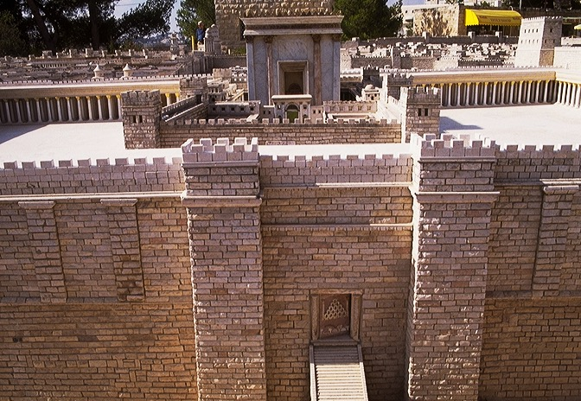
JISU ECHUNGI JERUSALEM EHEN JI SHI ESUA TUV VANCHO
JISU ECHUNGI HERODIAN KHUMPHEN JILO ENGCHIROLAMOE RHEYILAN JI
44
Notes:
Taken together, we can see that when Jesus entered
the City of Jerusalem on Palm Sunday he was approaching…the eastern entrance to the great Herodian Temple with the apparent purpose –– so the people thought –– of actually claiming the Throne of David as his own.

Slide 46

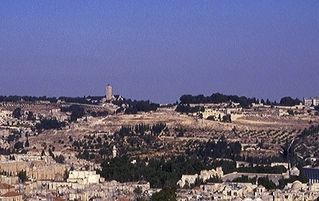
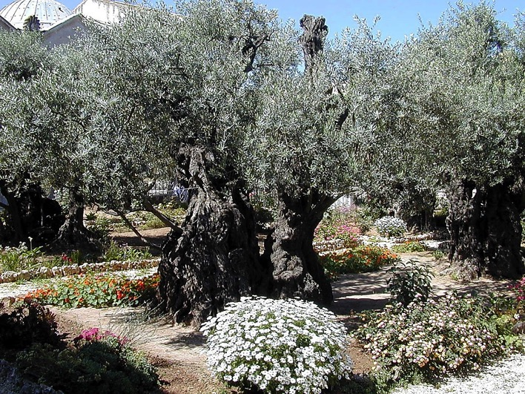
ESAPVUI HEROD NA “KHUMPHEN ENIOTO” JI
OLIVES PHUNGLAN JILO
GETHSEMANE PHARI JILO OLIVE DONG EHEN
45
2
Notes:
It all happened here… in the massive armed precincts of Herod's great Temple on the same site as Solomon's earlier Temple and before that, the mountaintop where Abraham was instructed to sacrifice Isaac 2000 years earlier…
….and on the Mount of Olives…in the outskirts of the ancient city of Jerusalem…
…and the Lord's agony in the Gethsemane garden.

Slide 47
ABRAHAM ECHUMCHAK
Abraham Etsa ji
Ben. 12:1-3
Echumchak ji
Ben. 15:9-18
ECHUMCHAK
ETHAN JI
EKUMECHUNG
OTSOINA
KIAMAN
Ben. 13:15
Ben. 13:14-16
Ben. 15:9-18
META
MOTJU
MMHA
Ben. 12:1
Ben. 12:2
Ben. 12:3
Ntsata jiang chungi ntsata jiang zetav
Meta
David
New
Shikhfu. 30:1-10
2 Sam. 7:4-16
Jer. 31:31-34
Bible Hungthuk “Chenryu” ji
46
1
©2006 TBBMI
9.65.05B.
Notes:
Now...the Davidic Covenant...
//// ….an amplification of the SEED portion of the Abrahamic...
2 Samuel 7, verses 4-16.

Slide 48
Jeremiah 31
NTSATA ETHAN JI
ROYALTY
(1000 B.C.)
Jeremiah
yuta-sukying jo tsukshia vancho…
S - D - S
•CHISOTAO JI •
Jukiwoe Jolowoe
Israel
Judah
10 2
ZENKHYINGDEN
19-J 20-R
200 350
"Judah ji Ezup lo vancho"
Assyria Babylon
47
2
Notes:
We'll become more familiar with Jeremiah further on. But for now…Jeremiah is the Bible's central figure in delivering the New Covenant announcement…a new arrangement just over the prophet's historical horizon from his Old Testament time!
//// Think about the prophet's severe circumstances at the time he was writing…They are right there in the ROYALTY FILE FOLDER. Jeremiah appeared in the time of THE PROPHETS.
The United Kingdom had split apart. Jerusalem was soon to be destroyed by the approaching Babylonians. In spite of those terrible times, Jeremiah pronounced a message of incomparable brilliance and optimism…a piece of "good news" that would echo through the coming centuries...awaiting only the appearance of Messiah to fulfill his vision.
//// …Yes…Jeremiah's circumstances were severe…JUDAH WAS IN CRISIS!

Slide 49
Jeremiah 31
NTSATA ETHAN JI
³¹ OPVÜI na phyoala, "Ana Israel kyon jiang thüngi /Jukiwoe Ekhungyan/ tona Juda kyon jiang /Jolowoe Ekhungyan/ to thüngi ntsata ethan nsüngrüv yuta ji tsathaka.”
(Lotha Bible)
48
4
Notes:
Here are those amazing words from Jeremiah 31... This is THE NEW COVENANT announcement! Pay close attention to every word!
//// Calling out verse 31 specifically..."The time is coming," declares the Lord, "when I will make a NEW COVENANT with the house of Israel"…the Northern Kingdom… "and with the house of Judah"…the Southern Kingdom.
//// A new covenant…
//// with Israel…the Northern Kingdom, now dispersed…
//// and with Judah…the Southern Kingdom…a nation to go into captivity but with a promised return to the Land of Abraham's inheritance.

Slide 50
Jeremiah 31
NTSATA ETHAN JI
³² Hoji jo ana Ejip metae na okhena onte erüsi chiyiathüng onte pyimtsü motsüi jiang thüngi ntsatao ehen ji esüa tüv mek. A ji onte tsoerapvüi esüa tssocho khatola, ontena ntsatao ji n vacho.
(Lotha Bible)
49
Notes:
"It will not be like the covenant I made with their forefathers when I took them by the hand to lead them out of Egypt, because they broke my covenant though I was a husband to them, " declares the Lord."

Slide 51
Jeremiah 31
NTSATA ETHAN JI
³³ "Ana Israel thüngi ntsata ethan vav sa evamo jijo shi esüa tssov," Opvui na phyola.
"Ana a shikhfü ji onte yulo lithoku osi hoji onte lümbümi erankayiv. Aiyo onte Potsow tssov osi ontena a kyon tssov."
(Lotha Bible)
50
1
Notes:
This is the covenant I will make with the house of Israel after that time, declares the Lord.
//// [THIS PHRASE IS TYPED OUT ON SCREEN FOR EMPHASIS.] "I will put my law in their minds and write it on their hearts. I will be their God and they will be my people." Notice that this newly announced Covenant will be with BOTH HOUSES OF THE DIVIDED KINGDOM...BOTH JUDAH AND ISRAEL.
[John Walvoord, Roy Zuck; The Bible Knowledge Commentary – Old Testament Edition; Victor Books, 1985; page 1171

Slide 52
Ntsata Ethan Phyosochio Ji
¹⁹ Jitosi ombona hümri tsakae montsso pisi mpvüroe onte pia ezocho, "Shijo a tsük nte tsükona pio ji. Ntena a nchümchev tsükona shi tssotava."
Luke 22:19-20
²⁰ Ontena tsoyu tasi sülo elani opvü motsünga tsakane bensi phyocho,
"Opvü shi jo ntsata ethan a ejen na metha ko ji; shijo nte tsükona tsüchuko ji.
(Lotha Bible)
51
4
Notes:
Now move over to the New Testament...for the announcement at that time…
//// …The 22nd chapter of Luke...verses 19-20. At that final supper with his friends…Jesus
//// ..."took bread, gave thanks and broke it, and gave it to them, saying, "This is my body given for you; do this in remembrance of me."
//// ²⁰In the same way, after the supper he took the cup, saying, "This is the …
//// …new covenant in my blood, which is poured out for you."

Slide 53
Ntsata Ethan Phyosochio Ji
Mathew 26:26-28
²⁶ Ontena tsota vanathüng Jisu na hümri khikae mmhayithoksi mpvüroe ombo sürüi jiang pia ezocho, "Khi tsotava, shijo a tsük ji."
²⁷ Elani ombona opvü mo tsünga tsakae Potsow monzo pisi heto ezoa pilancho, 'Nte topvüna shi yutava,
²⁸ ntiotssole shijo a ntsata ejen, kyon elümoto nlan siyiv tsükona ezamo ji.
52
4
Notes:
And then again...in the 26th chapter of Matthew...verses 26-28:
//// ²⁶While they were eating, Jesus took bread, gave thanks and broke it, and gave it to his disciples, saying, "Take and eat; this is my body."
//// ²⁷Then he took the cup, gave thanks and offered it to them, saying, "Drink from it, all of you.
//// ²⁸This is my blood of the covenant, which is poured out for many for the forgiveness of sins.
//// Again…the Lord said clearly…MY BLOOD OF THE COVENANT!

Slide 54

Sunset from Kursi
SHILO JO NTIO TSSOA YIA VANCHO ATO?
WHAT IS HAPPENING HERE?
JANLAN: LUYINGPVUO TONA LUYINGO ONI CHUNGI SHENTAKOTA DONGPHI TSUPHOV!
53
1
©2006 TBBMI
9.65.05B.
Notes:
WHAT IS HAPPENING HERE? Jeremiah was announcing…and Jesus is establishing…
//// …the arrival of a profound change in the relationship between the Creator and His Created! Meaning…in a very practical sense.

Slide 55
Ntsata Eheni “HOTO-TSSOCHEV” to nchumri ji olan thanpo echonchiyithaka……
54
©2006 TBBMI
9.65.05B.
Notes:
The ancient HAVE-TO mentality of the Old Testament and THE LAW had given way…

Slide 56
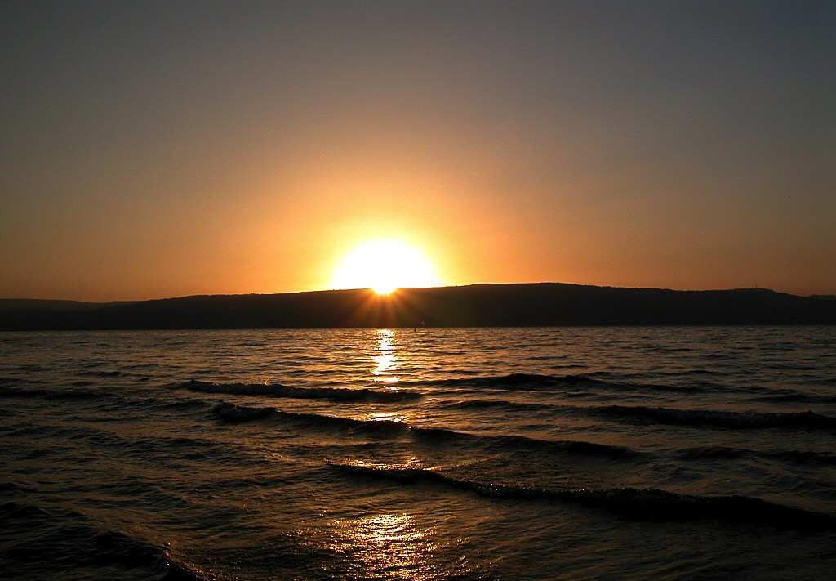
Sunset over Sea of Galilee
Ntsata Eheni “HOTO-TSSOCHEV” to nchumri ji olan thanpo echonchiyithaka……
…Ntsata Ethan lo jo ”HOTO-ETSSOHUNGA” to nchumri kumi sicho.
Kvutoli khi? Ntioli la tona, Lumbum chungi na jupomo Ntho Mon ji — Shanchopvui ji Yithen Mhom jilo na longtsui jiang topvu thingi picho!
55
1
©2006 TBBMI
9.65.05B.
Notes:
The ancient HAVE-TO mentality of the Old Testament and THE LAW had given way. …to the WANT-TO mentality of the New Testament and the Gospel! A profound change, indeed. From the "HAVE-TO" OF LEGALISM – "Do this, do that" according to the strict Mosaic Regulations -- TO THE "WANT-TO" OF THE GENTLE INDWELLING HOLY SPIRIT!
//// How? Because of the internalized urgings of the Holy Spirit… ….to be available to every believer and living in every believer's heart...to be available with the coming of the Messiah and His inauguration of the New Covenant. An approach to God no longer based on human performance on the outside…as in the time of The Law. But now…INSIDE THE HEART OF EVERY BELIEVER!…the time of THE NEW COVENANT!

Slide 57
Sunset over Sea of Galilee
SHIKHU
JILONA OLAN ECHONCHIYICHO
KHONZAN
56
©2006 TBBMI
9.65.05B.
Notes:
Summed up:
LAW HAD GIVEN WAY TO GRACE!
A time of enormous spiritual change had arrived. That change was destined to cause schism and friction – indeed, an explosion – in the Jewish community to which the Lord would be appearing…as the New Testament records tell us! It's effect on world history would be profound!

Slide 58

ENHUNGO ETE NA ENGATHETALA KVUTATA OPVU SANA BIBLE MOTSU LAN JIANG YAKCHIA…
CREATION
ABRAHAM
JOSEPH
MOSA
JOSHUA
NZO-NGA
LANPVUTSON
RHANCHO ELHI JI CHUNGCHUNGA RHUMAV TSUKONA!
SAYAKUPO
NOYING
JISU
57
Notes:
Now we can understand the importance of the Biblical story line toward grasping THE GRAND PANORAMA OF REDEMPTION! Here also we can see in hindsight the foundation of the Church coming into view.

Slide 59
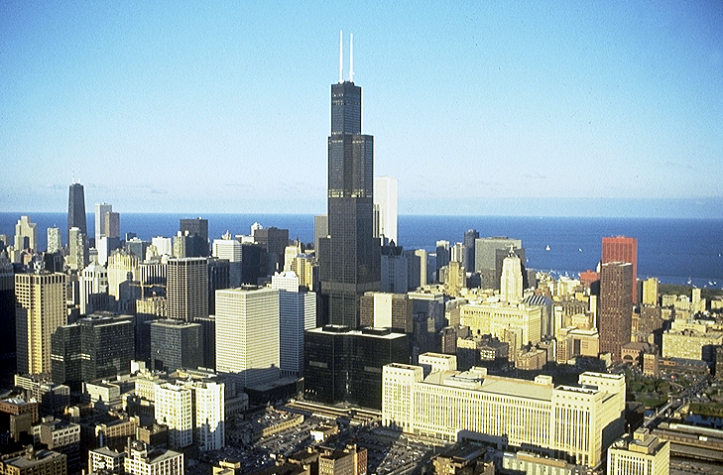




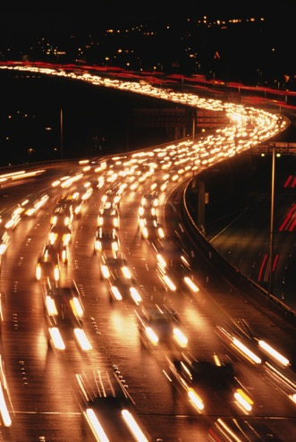
ENGAO:
NCHUNG TSSOTHIMORANG ECHUNGREN SHILO, JISU EJEN-THAN JIJI KVUTO?
58
Notes:
Now...one final question...in our world of high technology, satellites and computers, the Internet…for many the concept of a blood sacrifice or the meaning or necessity of Jesus' blood sacrifice is downright disturbing. What about that? To clear up this issue…let's turn again to God's Word.

Slide 60
“EJEN” ji Yichak ji...
Hebrews 9:15-22
¹⁵Jitsükona Potsow na etsao kyon jiangna kümali mmha
Potsow phyochak yantso
ji hungthokvü tsükona Khrista ntsata ethan methakthaka.
— Shijo kyon jiangna ntsata ovüngo jilo vanathüng onte wori yakchia echü rhükao jiang shanchov tsükona Khrista na chüthako ji tsükona.
59
2
Notes:
Hebrews 9 tells us...
¹⁵For this reason Christ is the mediator of
//// a new covenant, that those who are called may receive
//// the promised eternal inheritance — now that he has died as a ransom to set them free from the sins committed under the first covenant.

Slide 61
¹⁶Kvüthüng lüm erüngna thungthan etssov tüv yi chiyiana otsotso kyon jina chücho to zetav lia.
“EJEN” ji Yichak ji...
Hebrews 9:15-22
¹⁷Ntiotssole lümerüng thungthan ji eküm evanthüng jo nlochehan, khatola ombo chüsanati ochi ji lochetala.
60
1
Notes:
¹⁶In the case of a will, it is necessary to prove the death of the one who made it,
//// ¹⁷because a will is in force only when somebody has died; it never takes effect while the one who made it is living.

Slide 62
“EJEN” ji Yichak ji...
Hebrews 9:15-22
¹⁸Hoji tsükona ntsata ovüngo ji mpa ejen etheo chon chicho.
61
Notes:
¹⁸This is why even the first covenant was not put into effect without blood.

Slide 63
¹⁹Moses na shikhfü jilo yizüng kvüta licho sana kyon jiang ovung tssoa ezothakale ombona mangsüro tona Nyanyan to ejen khi, oju tona süporo emyom esephen to khi shikhfü kako ji tona kyon jianglo to erhikacho osi phycho.
“EJEN” ji Yichak ji...
Hebrews 9:15-22
62
Notes:
¹⁹When Moses had proclaimed every commandment of the law to all the people, he took the blood of calves, together with water, scarlet wool and branches of hyssop, and sprinkled the scroll and all the people.

Slide 64
“EJEN” ji Yichak ji...
Hebrews 9:15-22
²⁰ "Shijo Potsow na nte epio Ntsata ejen jika."
²⁰ "Shijo Potsow na nte epio Ntsata ejen jika."
63
1
Notes:
²⁰ He said, "This is the blood of the covenant, which God has commanded you to keep."

Slide 65
“EJEN” ji Yichak ji...
Hebrews 9:15-22
²¹Hoji esüa ombona ejen ji khi süranki ji tona khümathüng tsütsaelan jiang topvü tolo erika cho.
64
Notes:
²¹In the same way, he sprinkled with the blood both the tabernacle and everything used in its ceremonies.

Slide 66
“EJEN” ji Yichak ji...
Hebrews 9:15-22
²²Shikhfü ji ephan ji olan topvü ejen taena ntssüngchecho osi ejen nthev jo mmen khi n sicho to phyokhoka.
65
Notes:
²²In fact, the law requires that nearly everything be cleansed with blood.

Slide 67
“EJEN” ji Yichak ji...
Hebrews 9:15-22
²²Shikhfü ji ephan ji olan topvü ejen taena ntssüngchecho
osi ejen nthev jo mmen khi n sicho to phyokhoka.
ejen nthev jo
66
1
Notes:
and without the shedding of blood there is no forgiveness.
So...finally...we come to understand that without
//// the shedding of blood...which represents the Creator's most precious gift to Man outside of His own son...the gift of life itself which resides in human blood.

Slide 68
“EJEN” ji Yichak ji...
Hebrews 9:15-22
Thung-than ji nju cho saliwo, nlan-siyi ji liv mek. Kvuthung ete Potsow na Calvary na echu ji khyothechi co sana tothung ombo na okhao to tssoa thung-than tssocho
ETE THUNGTSSOA!
67
Notes:
Without that sacrifice there is no forgiveness. Our Lord provided that ultimate sacrifice when he went to Calvary and became victorious over death itself…IN OUR BEHALF!

Slide 69
EKHA NZANCHI #14 & #32
Abraham Etsa Ji Gen. 12:1-3
Ntsata Ji
Gen. 15:9-18
ABRAHAM NTSATA
KUMALI
OPVU YI
NPILAMO
Gen. 13:15
Gen. 13:14-16
Gen. 15:9-18
META
MOTJU
MMHA
Gen. 12:1
Gen. 12:2
Gen. 12:3
Ntsata jiang chungi ntsata
Meta
David
Ethan
Deut. 30:1-10
2 Sam. 7:4-16
Jer. 31:31-34
Bible Hungthuk “Chenryu” ji
68
5
©2006 TBBMI
9.65.05B.
Notes:
So..with Study Helps 14 and 32 in hand…the Abrahamic Covenant can be seen now in its full grandeur...
//// …a Call to Abraham in Genesis 12…followed by…
//// …the making or "cutting" of the Covenant itself... in Genesis 15...
//// proclaiming its LAND, SEED AND BLESSING aspects....
//// …and seen to be ETERNAL IN ITS DURATION...LITERAL IN ITS MEANING...AND UNCONDITIONAL IN ITS APPLICATION...with each of the three parts amplified through later centuries
//// …in the form of the Land Covenant of Deuteronomy given through Moses...the Davidic Covenant of Second Samuel...and finalized in the New Covenant in the writings of Jeremiah.
//// THIS IS THE FULL IMPACT OF THE ABRAHAMIC COVENANT…THE VERY BACKBONE OF BIBLICAL REVELATION.

Slide 70



OYING SUNGO JI NCHUMCHE KA NUNG!
NTHO KAKO JIANG RONG ECHUMBO BITA KA
EKHA NZANCHI #08
69
© 2006 TBBMI
9.65.05B.
Notes:
One final time let's set up and thread that loom of Biblical chronology as shown in Study Help #8…

Slide 71
OYING SUNGO JI NCHUMCHE KA NUNG!
NTHO KAKO JIANG RONG ECHUMBO BITA KA
70
© 2006 TBBMI
9.65.05B.
Notes:
…15 threads on the loom... each vertical thread representing an event in the chronology and…

Slide 72
A FABRIC OF THE BIBLE'S CHRONOLOGY
7
POTSUOYAN ETHAN, LIMHA ETHAN
OLYU JI YANPIYANTHAN TOKHU
MESAO VANTSU EHUMO YITSSO
4P
3S
CHRISTAA LIMHA ESA YUTA
OPVUI ERO TSUNGON
J
K
A
J
M
J
N
L
S
S
71
© 2006 TBBMI
9.65.05B.
Notes:
…according to many...the progressive events of earth's history reach far out into the future until the end of time itself...

Slide 73
NTHO KAKO JIANG RONG ECHUMBO BITA KA
7
EKHUMKHO JI
MESAO VANTSU EHUMO YITSSO
OLYU JI YANPIYANTHAN TOKHU
POTSUOYAN ETHAN, LIMHA ETHAN
4P
3S
CHRISTAA LIMHA ESA YUTA
OPVUI ERO TSUNGON
J
K
A
J
M
J
S
L
S
S
ABRAHAM ECHUMCHAK
META ECHUMCHAK
DAVID ECHUMCHAK
ECHUMCHAK ETHAN
72
6
© 2006 TBBMI
9.65.05B.
Notes:
...and then on our loom are horizontal bands...those wide, strong bands representing:
//// THE ABRAHAMIC COVENANT...
//// THE LAND COVENANT…
//// THE DAVIDIC COVENANT...
//// AND THE NEW COVENANT.
//// And here between the time of the JESUS thread and the final five threads on the loom is our time frame of the Church…this is us…at work right now moving forward our part of the Kingdom of God
//// And after that time…there will be the final five threads to deal with…

Slide 74
NTHO KAKO JIANG RONG ECHUMBO BITA KA
7
OLYU JI YANPIYANTHAN TOKHU
MESAO VANTSU EHUMO YITSSO
OLYU JI YANPIYANTHAN TOKHU
POTSUOYAN ETHAN, LIMHA ETHAN
4P
3S
CHRISTAA LIMHA ESA YUTA
OPVUI ERO TSUNGON
J
K
A
J
M
J
S
L
S
S
OPVUI ERO TSUNGON
ABRAHAM ECHUMCHAK
CHRISTAA LIMHA ESA YUTA
META ECHUMCHAK
MESAO VANTSU EHUMO YITSSO
DAVID ECHUMCHAK
POTSUOYAN ETHAN, LIMHA ETHAN
ECHUMCHAK ETHAN
73
4
© 2006 TBBMI
9.65.05B.
Notes:
Five great landmarks of The Revelation…THE MARRIAGE SUPPER OF THE LAMB.
//// ….THE SECOND COMING OF CHRIST…
//// …THE EARTHLY REIGN OF CHRIST…
//// …THE GREAT WHITE THRONE JUDGMENT…
//// … and THE NEW HEAVEN AND THE NEW EARTH.

Slide 75
NTHO KAKO JIANG RONG ECHUMBO BITA KA
7
MESAO VANTSU EHUMO YITSSO
OLYU JI YANPIYANTHAN TOKHU
POTSUOYAN ETHAN, LIMHA ETHAN
4P
3S
CHRISTAA LIMHA ESA YUTA
OPVUI ERO TSUNGON
J
K
A
J
M
J
S
L
S
S
ABRAHAM ECHUMCHAK
META ECHUMCHAK
DAVID ECHUMCHAK
ECHUMCHAK ETHAN
74
© 2006 TBBMI
9.65.05B.
Notes:
And at the end of all time…the unconditional ABRAHAMIC COVENANT and its three sub-contracts or covenants with men are – in effect – sewn together. We are given very little information about the world and its existence after that time. Hints, of course. But the message there: concentrate on what the Lord wants us to do right now; don't spend a lot of time on the hereafter! There is enough work to do in the here and the now.

Slide 76
TOKUMA, ENGAV MOTSUNGA:
Nchung Echungren Ehtan shilo, nzyu 4,000 Potsow tona ombo shom Abraham oni echumchak-erantsung shi enhunga lia yikrachi pepitav la?(Gen. 12 & 15)
(Nchumchetava: Ete limha topvu lo Bible yi jiang elana osi mmhona khophicho elum lia!)
HO…OTSOTSO…ntiolila tona…
Potsow na ombo tsoe ISAAC thingi elani ezocho, Genesis 26.
Elani JACOB ha ezolancho, Genesis 35.
Elani JOSEPH Genesis 48.
MOSES thungi, Exodus 6…osi JOSHUA thungi Joshua 1.
Okhao to tssoa…opvu tsotso ji…
Echumchak jiang penthokvu Shanchopvui ji jorocho!
75
8
©2006 TBBMI
9.65.05B.
Notes:
Here, then, is a question:
//// In this sophisticated twenty-first century, should we honor that 4,000 year old legal, documented agreement between God and his friend, Abraham?
//// (Remember: it is found in every accurate Bible translation version or edition throughout the world.)
//// Yes…absolutely…because…
//// God repeated it to Abraham's son, Isaac in Genesis 26.
//// It was restated to Jacob in Genesis 35.
//// Again to Joseph in Genesis 48.
//// To Moses in Exodus 6…and to Joshua in Joshua 1.
//// Finally…most important…the Messiah arrived in fulfillment of it.

Slide 77
Tokuma…Shiang topvu phyochosui:
Ntio etssoinala tona, kiaman, otsotso Echumchak shiang ete Bible jilo mparata…ete na elhi etsov lia... kvutosanali!
76
1
Notes:
With all this said…
//// …Because these UNCONDITIONAL, LITERAL Promises are right there in your Bible…we MUST deal with them…somehow!

Slide 78
Ntsa
Ntsa
“Ete longtsu ji lo shenkai nvav jo, shi ji
,
mekana
tai tssov."
Miles Stanford
Principles of Spiritual Growth
haton
haton
hungkarenka
hungkarenka
hungka longtsu
hungka longtsu
77
4
Notes:
As Miles Stanford said earlier…"Unless our faith is established on
//// …facts, it is no more than…
//// …conjecture….
//// …superstition and…
//// …presumption."
He had it absolutely right! All of our work and study in THE BIBLE…BASICALLY is aimed squarely toward establishing many of the irrefutable basic facts of our faith just as they appear in the pages of its BASIC DOCUMENT.

Slide 79
Shiang lo na ekyocheta je:
1. Nchung echungren nnsuta kuma nkhayi.
2. Ntsata Ehen kuma mhechoi sitav.
3. Kichuk tsutsata yichak jiang eroroi penphia wotav, limha ochyu ovung jiang hungchia.
78
3
Notes:
So once again we have some choices that must be made.
//// …First…We can ignore these ancient promises as IRRELEVANT. Or…
//// …Second…We can forget about them because, after all, they are in the OLD TESTAMENT! Or…
//// …Third…We can intelligently explore their meaning and implications in terms of the future of this planet.

Slide 80
Ni na ekyochuko jiang:
1. Nchung echungren nnsuta kuma nkhayi.
2. Ntsata Ehen kuma mhechoi sitav.
3. Kichuk tsutsata yichak jiang eroroi penphia wotav, limha ochyu ovung jiang hungchia.
Tolia, ni na #3 ji ekyoana,…ni na
4. Shiang ji ni ochyuovung osi Jisu Khista nini shentakota tsukona kvuto khiv sana methaka
79
1
Notes:
But if you choose Number Three, then…you must deal with…
//// …Number Four…Decide what they mean for YOUR future and YOUR relationship to Jesus Christ.

Slide 81
Kija Engav Tsuphov ji:
Potsow Yi jo otsotso memek?
Ni janlan ji hetuv lia hetuv lia, engav ethan kichuki chiala.
80
2
Notes:
HERE THEN IS THE CRUCIAL, PERSONAL QUESTION…
//// …Is God's Word true or not?
//// …And no matter what your answer, a new question logically follows…and it is most the crucial of any possible question.

Slide 82
Jisu shi ete na kvuto liyitav la?
81
Notes:
WHAT DO WE DO WITH THIS JESUS?

Slide 83
“Iyo helo jo, kyon na Opvui echi zhuva zhuva yi phyota vamo ji danglanchiv tsukona eranala:
‘Ana heto khichoala, Jisu jo ntsanruk pungnoe elum mmhom nchua khatolea Potsow jo Mek.'
Shijo oyi motsunga ete na kvuthunga li nphyov shikvu.
Kvuthungalia kyon-sha tsuka jina Jisu na phyov jiang phyo lia, ntsanruk pungnoe mhomvu jo tssov mek.
Ombo jo zhuvai—kyon nchua honoju vupshuk cho esua tuv—Tomekana ombo jo mmhemi tsungrhamvu ji tssov.
NI na mhonali ekyochev.
Shi kyon shi jo otsotso Potsow Tsoe; tomekana ombo ji zhuvae mekana jilo na nmhonka."
C.S. Lewis, Mere Christianity, 40-41
82
7
Notes:
Hear this from that stupendous enormous Christian intellect of C.S. Lewis where he wrote…
//// …"I am trying here to prevent anyone saying the really foolish thing that people often say about Him – Jesus -- : they say
//// …"I'm ready to accept Jesus as a great moral teacher, but I don't accept His claim to be God.'
//// …That is the one thing we must not say.
//// …A man who was merely a man and said the sort of things Jesus said would not be a great moral teacher.
//// …He would either be a lunatic—on a level with the man who says he is a poached egg—or else he would be the Devil of Hell.
//// …You must make your choice.
//// …Either this man was, and is, the Son of God; or else a madman or something worse."

Slide 84
Tokuma engav shi enhungaha:
Jisu shi NI na kvuto liyiv la?
83
Notes:
So…once again…comes the question: WHAT DO YOU DO WITH THIS JESUS? It is the single most crucial decision to be made in the life of any one human being.

Slide 85

Enhungo Ete Bible…Elaroena shi shlo jo, ni kichuki, shi nnchuma vamvu…
• “Bible chungchak“ Okyak ji
• ”Bible Chungchak”…L 7 N J jiang chunchiv tsukona Nchumri jabi ji
• Bible jilo tssowo jiang Kichuki na chanizephen
• Bible “Motsu” Opvutsotso ji: “Nzyu ephan erangtsung"
• Abraham Soyingkaphen, Potsow yi jiang na Jisu Elhi jiang lo nsaka sosi ewoala.
84
1
Notes:
All right…take a deep breath! We've made a lot of progress…by now you have in mind
//// ….THE BIBLE FILE idea…
//// ….the key to open your file…
//// ….ability to make your own map of the Middle East…
//// ….you have THE QUICK CHRONOLOGY story line, the very core of Scripture…and now
////…the Abrahamic Foundations of Scripture that lead us directly from the Old Testament into the New Testament ministry of the Lord Jesus Christ.
//// Now – more than ever before –– we're in a position to bring together the varied parts of the Bible, itself…the actual book…how it is structured and organized, based on the THE BIBLE FILE ideas of chronology and the Abrahamic Foundations of Scripture.
//// Now we can explore how the book itself is arranged…logically and progressively.

Slide 86
ETE BIBLE…
ELAROENA
A Ministry Presentation of The Bible…Basically Inc. Fort Worth, Texas
85
© 2006 TBBMI
9.65.05B.

Slide 87


The Bible…Basically link at BibleStudyDownloads.org
Get this presentation for free!
Notes:
The Bible…Basically (bb)

Slide 88
81
9.65.05B.
©2006 TBBMI
86

