Slide 1


Lotha
ETE BIBLE…
ELAROENA
Designed by Dr. John Fryman, Texas, USA • BibleBasically.org
Taught by Dr. Rick Griffith, Singapore Bible College
All files in many languages for free download at BibleStudyDownloads.org
©2004 TBBMI
9.65.01.
01

Slide 2
Benkaden 11:26 lona pankae 25:8
Yuta ji heto harum tssov:
ABRAHAM-JOSEP 2000 B.C.
yuta topvu
nzyu 500
harumalo echi
Okhekako pg. 19-24
01
1
Notes:
Enhunga jo …. Bible yuta ephanina penkavka. Abraham yuta: nzyu 2000 vungi. Ete na khata erowo ji…
//// … yuta ekyongo lojo nkonrhui , nzyu 500 jina echaki vata kha wotavka.
Yuta osi nzyu jiang ji matunga wotavka. Ni engathe ephanina.
2135-1960 BC Abraham ekum vamoji.

Slide 3
7
“Ana Juda
Metae jovo "
LYUYUNGIO
ABRAHAM
ABRAHAM
ABRAHAM
JOSEP
ABRAHAM
MOSA
JOSHUA
TSSOLUP
Roza Pfüchi
RHUMAE EVAMO JI
Kyon ovungo nchyu mezhu
Yinging
JESU
Okhekako pg. 19-24
02
Notes:
Nchumchephen nzyu jiang, ANA JUDA METAE JOVO , ABRAHAM esia… kyon nvhyu mezhu jilo ovungo ji.. LIYING MOTSU ji sulo. Shi jo ABRAHAM motsü ji.

Slide 4
Gen. 12:4
chekatav
tsukona
MS
6
N(A)
H
META MMHOM
SG
C
ER
B
J
MN
DS
PENKAPHEN JI...
E
U
KB
MS
PG
RS
Okhekako pg. 19-24
03
1
Notes:
Benkaden kako jilo oren 12, ABRAHAM ‘ekum yuta’ ji benkatala – ur meta Chaldees jilo – eng choralamoi erü ekuk jilo "U" ji . Hojilo jo ntho kako jilo na ezoa evamo jijo erampvüi jina penkatathung motsu tona kako shi to shentae ezoa evamo ji .
//// osi meta jijo emhkthav ejueli lira mmhom eng chorolamoe jilo tssocho,
Osi the Euphrates hayitsü jilo na benkae Mediterranean jumang na ndang tssocho…
Osi yuta yuta lojo etena ntsithakcho meta mying ha hungvü ka.

Slide 5
chekatav
tsukona
Meta 10
MS
6
4
N(A)
H
IRAQ
IRAN
KUWAIT
SAUDI ARABIA
SYRIA
ISRAEL
TURKEY
EGYPT
SG
GALILEE JUMANG
C
ER
B
CANAAN
J
MN
DS
NILE ZHUKHVU
OMA JUMANG
E
EGYPT
U
KB
SINAI META..
MS
PG
RS
Okhekako pg. 19-24
04
14
Notes:
Nina meta kvui sana jo hungthak khoka.
Meta shiang esia
//// Canaan ….. Nchung Israel meta, osi eng rhelamoe , Palestine,
//// Galilee jumang,
//// osi echu mekna Ma-jumang…ndho kako jina phyoa esia.
//// elani Egypt tona
//// Emhokthav Nile zukhvü.
//// Sinai to etsao jmang chungi meta jiang , meta shijo limhatsü na ntsia thungcheta.
tokhatolea ete shanlan, ete yuta lojo,
//// Iraq jiha
//// Iran jiha
//// Kuwait
//// Saudi Arabia
//// Syria
//// echungren ethan Israel osi eng erhelamoe jumang hayi jiang
//// Turkey and
//// nchung etena ehungoEgypt

Slide 6
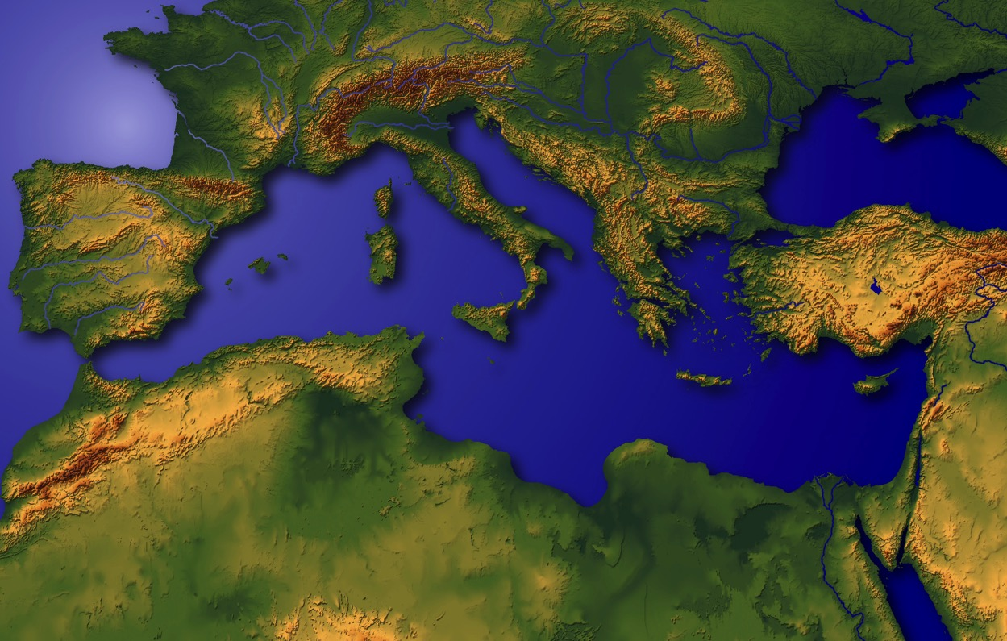
“Limha nla ji "
Okhekako pg. 19-24
05
1
Notes:
Meta shijo limha ji nla to sta la.
Meta shilona elanlani to ritssoe jiang na yakphia rumphicho,
//// enhunga yuta shilojo Canaan/Palestine/Israel shiang meta jiang lojo ezup etsü yakchia limha na ntsia .

Slide 7
Benkaden. 11:28
chekatav
tsukona
MS
N(A)
H
SG
C
ER
B
J
MN
DS
E
KB
U
MS
CHALDEES meta jiang : echungren
ehen tssolan phyolan
MESOPOTAMIA jilo;
ABRAHAM ki
PG
RS
Okhekako pg. 19-24
06
1
Notes:
ABRAHAM motsü ji jumang na füchumcho Persian jilo na benkav, meta ehen jilo – Ur meta Chaldees.
//// Abraham tona ombo wopan jiang na Mesopotamia meta jilo vancho.
Shijo ekukeru jilo "U" to eramo ji.
Motsü ji benkatathung nina ha ekukeru jiang zeta .

Slide 8
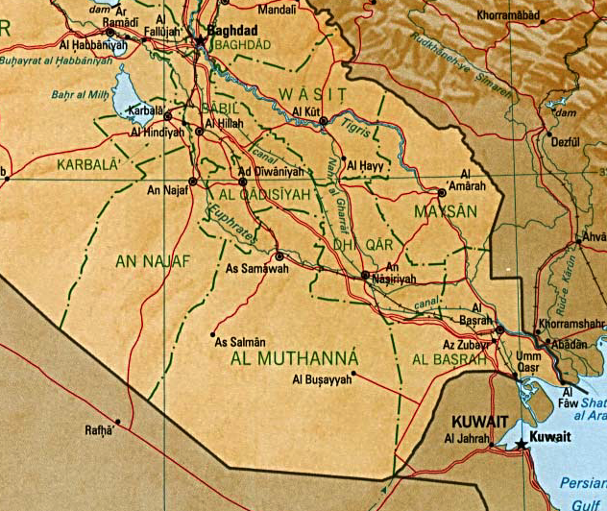
7
BABYLON
UR
Nchumcheta! Persian ritsso ji Iraq meta jilo
Okhekako pg. 19-24
07
6
Notes:
Shijo enhunga shanlan jilo eruekuk jiang. Nchumcheta shijo nkolo Persia ritsso tssotav ji 1990 harumalo…
Osi Saddam Hussein ji iraq ritsso jilo na khi esio ji.
//// elani Tigris zhukhvü jiha etena ntsia…
//// … osi Euphrates…
//// … nchung tsungono Baghdad…
//// …Kuwait jo jumang na hajum cho Persia meta jilo …
//// …elani khumkowoe jo…Babylon meta ehen ji…
//// … osi ete motsü ji benkaphen jo … Ekhungyan ehen UR to etsao ji.

Slide 9
7
Mesopotamia meta
SUMERIA kyon jiang na yanchetemo ji…
Erandemo osi zotoro jo
BENKADEN…
AZA
MOZHü
HUNGJANRUJAN
KITSSOE
BENKADENI YANTSU LONGJUNG
Okhekako pg. 19-24
07a
4
Notes:
Eng choralamoe meta shianglo jo – Persia meta --
Benkaden ntsinrang osi tssolan phyolan ovungo jiang.
//// nken ethum meta hayitsü shijo,
//// Mesopotamia to etsao jilo,
//// sumeria kyon jiang na erandencho osi zotoro jo jiha tsutsacho . Osi shilo etena hungala.
//// ntsinrang benkaden …aza ji … mozhu-mono ji… hungjanrujan osi kitssoe jiha.
//// meta ehen eyan ntsinrang jiang na ha yantsü ehen lia to yanchecho…
Yantsu ehen osi kyon vanlanyilan jiang, yuta emhokthav yakchia, nchung ete na vanchukchi thaka.

Slide 10
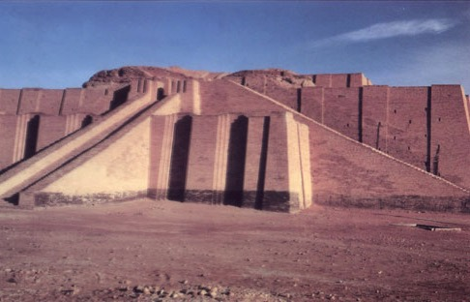
Benkaden 10:10; 11:28
"Ziggurat" shi jo Ur meta Chaldees, enhunga Iraq jilo
Okhekako pg. 19-24
08
Notes:
Shi esia babel kitsu mekana ziggurat, shiang jo Abraham na evamo yuta jiang lo jo elumoto hungcho. Chaldees meta jianglo. 2000 B.C jiang lojo., Ur jo emhokthav yantsu, limhatsü ntsinrang khiphen, tssolan-phyolan, shicho-khophi osi kisü khumta evamo emung meta. Tokhatolea shi nchumi zeta: ntio tssolan phyolan ji yakchia – etena ntsia, kichok etho -- ji yakchia emhokthav osi ezehungthav kitsu jiang tssochukchui vacho alo ? Shiang esia nchumi zetana nkolo echungren ntsinran, tssothi mori osi vanlan yilan ji kyon jiang na kvuto vanta rocho sana emhuka!

Slide 11
Benkaden kako. 11:31
ABRAHAM WOPAN:
• TERAH (opo)
•ABRAHAM (ABRAM)
• SARAH (ombo eng, SARAI)
• LOT (ABRAHAM rüi)
Okhekako pg. 19-24
09
5
Notes:
//// ntho kako jina ABRAHAM to etsao ji motsu ezoala, ombo wopan osi ombo to Ur meta Chaldees jilo vancho.
//// wopan jilo erantsowo opo…Terah.
//// Terah tsokhying Abram, ochu-ovungi jo Potsow na , ABRAHAM to tsayicho, ombo motsü ji kvuto ntssungrunga erani locho sana.
//// ABRAHAM eng ji mying jo Sarah (Sarai)...
//// ABRAHAM rui Lot ha vancho

Slide 12

7
ABRAHAM
ABRAHAM
ca. 2000 B.C.
Kyon nchyu mezhu jilo ovungtsowo jijo:
ABRAHAM
AJMJ
Benkaden kako 12 ji sulo
Okhekako pg. 19-24
10
3
Notes:
Tona etena ABRAHAM motsü jilona benkatav ka.
Nina zeta evamo kisu jiha chekata vana...
//// enhunga shanlan shilona benkae yuta-nzyu jiang ephanina zeta woa tssona kako jiang longo enungaha kakko teriv motsunga liv ka. Kako teriv ji yakchia nina mhona engatheta yanchev. Nina shanlan yuta kvulo sana nina ntsiv ka.
//// Abraham motsu jijo yilan 12 ji suloti ezoala...
//// yuta: nzyu 2000 B.C vungi... Kyon nchyu mezhu jilo ovungo ji.
Kyon nchyua ABRAHAM to etsao ji yakchia, Potsow na lhinsung ethan benkacho.
Ombo osi ombo liying jiang yuta lo shenta-khota. Abraham yakchia bible motsü ji benkacho. Hungthuk Kako Ji njanthung na ndang jo , elani limha osi limhatsü jiang topvü

Slide 13
7
Gen. 12: 1-3
ABRAHAM
ABRAHAM
ca. 2000 B.C.
Etsa ji
Kyong nchyu mezhu jilo ovungtsowo ji:
ABRAHAM
Etsao ji
AJMJ
Benkaden kako 12 ji sulo
Okhekako pg. 19-24
11
Notes:
Emhokthav motsu ji Benkaden kako 12 ji sulo Potsow na Abraham ji , UR meta ji sisi, Meta ethani yile to ezowo ji

Slide 14
7
Benkaden 12: 1-3
ABRAHAM
ABRAHAM
ca. 2000 B.C.
Etsa Ji
AE
AJMJ
Ben. 12:1-3
ABRAHAM
Etsa ji
POTSOW NA ABRAHAM JI NPILAMO ECHUMCHAK PICHO !
Okhekako pg. 19-24
12
Notes:
Shijo Potsow na kyon pono elhi ethan etssowo yuta jiang lo emhokthav ethelan eli elhi tssowo jiang. Ni elhi kako jilojo AE to erani mpata, ji yichak jo ABRAHAM ECHUMCHAK– Osi hojiang ji Benkaden kako 12... yiren 1-3 to jiang lo mpata. Hoji jo Npilamo Echumchak ji !

Slide 15
Npilamo Echumchak
7
ABRAHAM
ABRAHAM
ca. 2000 B.C.
The CALL
AC
L - S - B
AJMJ
Benka 12:1-3
Meta
Motjü
ABRAHAM
The CALL
L - S - B
Mmha
NPILAMO ECHUMCHAK JINA NTSA YI KUMCHO !
Handbook pg. 19-24
13
Notes:
Osi…ABRAHAM kako jilojo, akhor shiang ekhyima ...M...M...M...: META...MOTJU... OSI MMHA. Shiang jo oyi jiang yichak. Bnekaden kako jilo, Yilan 12, oren 1-3, Potsow na NPILAMO ECHUMCHAK JI ABRAHAM PICHO… osi hoji na NTSA YI ji kumcho !

Slide 16
7
Benkaden kako 12
Opvui na Abraham ezocho,
“Ni epok meta, wopan kitsuk, osi nipo ki jiang sisi meta motsunga ana ni ejuvka, hoji yia.
1
“Ana tsoronichen khosha nipiv ka osi onte ji jipo tsophov kumka. Ana ni mmha yia ni thungche thokvuka, osi nino mmhao tssov ka.
2
ABRAHAM
Etsa ji
“ Ochuangna ni mmhayi toka sana ana onte mmhayiv, tolea ochoang na ni rhuyi randankata sana ana ha onte rhuyikav osi ni yakchia ana jipo topvu mmhayiv ka."
M-M-M
3
Okhekako pg. 19-24
14
3
Notes:
Benkaden kako yilan12, oren 1-3 Potsow na Abraham ji Olan ethum lona Echumchak picho:
//// Opvui na Abraham ezocho,
“ Ni epok meta ji sisi yia, Wopan kitsuk sosi nipo ki jiang, Osi ana META MOTSUNGA ana ni ejuvka.
//// “Onte ji jipo tsophov kumka
osi ana ni mmhayiv ka;
ana ni mying ji tsupho tokvuka,
osi ni yakchia ni jipo topvu mmhayiv ka.
//// Ocho na ni mmhayia sana ana hojiang mmhayivka,
Osi ochoangna ni rhuyirandan kata sana ana hojiang rhuyikav;
Osi ni yakchia ana jipo topvu mmhayiv ka."

Slide 17
7
Benkaden kako 12
Opvui na Abraham ezocho,
“Ni epok meta, wopan kitsuk, osi nipo ki jiang sisi meta motsunga ana ni ejuvka, hoji yia.
1
META
2
“Ana tsoronichen khosha nipiv ka osi onte ji jipo tsophov kumka. Ana ni mmha yia ni thungche thokvuka, osi nino mmhao tssov ka.
MOTJU
ABRAHAM
Etsa ji
."
M-M-M
3
“ Ochuangna ni mmhayi toka sana ana onte mmhayiv, tolea ochoang na rhuyi randankata sana ana ha onte rhuyikav osi ni yakchia ana jipo topvu mmhayiv ka."
MMHA
Okhekako pg. 19-24
15
3
Notes:
Echumchak ji jo Ntho kako jilo Opvu ji :
//// Bnekaden jo META echumchak ji… ji sulo jo…
//// MOTJU JI
//// Elani MMHA ji to, osi hoji jo “M-M-M" to ABRAHAM kako jilona hunga la.

Slide 18

Abraham Echumchak
(“ETSA JI")
BENKADEN KAKO 12:1-3
ABRAHAM
META
MOTJU
MMHA JI
Etsa ji
M - M M
12:1
12:2
12:3
“M-M-M"
Okhekako pg. 19-24
16
3
Notes:
Enhungo khatav elio jijo… Echumchak ethum ji junga khatav ka…the M-M-M ABRAHAM kako jilo…
//// Ovungtssoa… ECHUMCHAK #1: BENKADEN KAKO 12:1... META MOTSUNGA — OKI, jehudi kyon jiang na enhunga shanlan shi jana monkhum yikrachi vata evamo ji.
//// ECHUMCHAK #2: BENKADEN KAKO 12:2... MOTJU — Tsoronichen khosha elio ji ... Emhoko jijo Abraham tona ombo eng Sarah oniata na sona vanthaka osi onte na ngaro motsunga tia nvahan.
//// ECHUMCHAK OKHAO TO : Vokhata3: Be]ENKADEN KAKO 12:3... MMHA ji Abraham tona ombo tsoronichen jiang picho. Elani, Potsow na ombo mmha ji yakchia, limha lo evamo kyon topvu mmhayicho. ABRAHAM OSI OMBO TSORONICHEN TAI MEK! Yitsung ji engatheta, Kianzan to ephyowo ji .

Slide 19
Abraham Echumchak
(“Etsa Ji")
Benkaden kako 12:1-3
Olan etum lona Echumchak ji!
ABRAHAM
META
MOTJU
MMHA
The CALL
L - S - B
• OPVU YI
• KUMALI
• NPILAMO
17
3
Notes:
Enhungo ...M-M-M-... META, MOTJU, and MMHA to ethum shi lumbumi thei hansi... Ete na shiang shi ekhyimpa cheta... Olan ethum lona Abraham Echumchak jo ntio kvuto sana ete na rakae zecheta...
//// Ovungtssoa… Emhokthav Echumchak jijo -- -- Yitsung ji kvuto sana merukana hoji esia (Literally).
//// Hoji jo KUMALIA, ochum nlio , osi hoji jo Potsow ombo tathi jina tssochev to phyocho, osi okhao to...
//// Echumchak jijo NPILAMO mekana NRYULAMO... Ji yichak jo Abraham osi ombo tsoronichen jiang na ochu-ovungi heto vana wovo-heto vana wovo, Potsow na, yuta jilo… ELANI PHYOALA: YUTA JILO… ombo echumchak topvu peniv.
Motsu shi ovungi zeta woa na, ete na bible ji kvutowoe na Npilamo osi nryulamo Echumchak jina erani licho sana etena hunvu ka.... Potsow osi ombo shom Abraham ji oni yuta lo shenta ji.

Slide 20
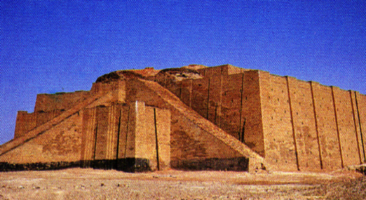
Gen. 11:31
Chekatav tsukona
Longtsü jilona
ontena yitacho!
MS
N(A)
H
SG
C
R
B
J
MN
ABRAHAM
DS
Etsa Ji
M - M- M
E
KB
U
MS
PG
RS
Okhekako pg. 19-24
18
2
Notes:
Echumchak ji Kvuthung Abraham picho sana… wopan topvu Ur meta Chaldees jilo na yi sicho.
//// onte ekum rumo osi ejueli jiang khi pentasi - tssokhuka kyon khosha, ekumrumo osi suki. Bibleli na ezoa evamo jijo Abraham wopan jo ejueli vancho. Elani nina eru-ekuk ji zeta tssona hakhvua erani elio jilo rakata.
ethelan eli yi jo:
//// ABRAHAM osi ombo wopan jiang na LONGTSü LONA YICHO ! Onteno Potsow na etssuchui evao meta jilo yita vana.
khatolea ontena kvuthung Ur meta Chaldees ji sisi yitacho sana, onteno kvulo yita vancho sana ntsi. Onteno Abraham na sosi jancho ezo osi Potsow nkoha ji yakchia khochui yitacho.

Slide 21

Gen. 11:31-32
CHEKATAV TSUKONA
MS
N(A)
H
SG
C
ER
B
J
MN
ABRAHAM
DS
The CALL
L - S - B
E
KB
U
Babylon Yantsu ji
MS
PG
RS
Okhekako pg. 19-24
19
Notes:
Ete na phyokhoka onte na Babylon yantsu ji yakchicho to, Ur juran ji mhae... Kvui yantsu jilo Abraham tsoronichen jihudi kyon jiang evungki na vung sana jilo na zeta tssona.

Slide 22
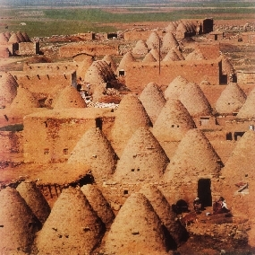
Gen. 11:31-32
Chekatav tsukona
MS
N(A)
H
Abraham opo, TERAH, ji HARAN metae na chucho.
SG
C
ER
B
J
MN
ABRAHAM
DS
Etsa Ji
M - M- M
E
KB
U
“Tssa-ki" yantsu Harran jilo (Turkey) nchung
MS
PG
RS
Okhekako pg. 19-24
20
1
Notes:
Ontena yita vancho, tae tolojo Haran meta jilo rhowocho…
… Enhunga ejan Turkey meta jilo lia.
//// yuta esungaro Haran meta jilo vanta vanathung , ABRAHAM's opo, Terah, ji chui sicho.

Slide 23
Benkaden. 12:5
Chekatav tsukona
MS
N(A)
H
SG
C
ER
B
J
MN
ABRAHAM
DS
The CALL
L - S - B
E
KB
U
MS
PG
RS
Okhekako pg. 19-24
21
Notes:
Elani , Potsow na ABRAHAM jancho, Haran meta ji sisi ombo na meta kvui echumchaki vayicho sana hojilo. Osi hoji meta jo Canaan, mekana enhunga echungren jilo Israel to etsao ji.

Slide 24

7
Kvuthung Abraham na meta jilo rhowocho sana …
ombo nzyu 75 tssoe sicho…
Ombo eng , Sarah, jo 65.
Khatolea …ngaro mmhayiv jijo echumchak lia
ABRAHAM
Etsa JI
M - M- M
Okhekako pg. 19-24
22
4
Notes:
Enhuhngo etena zetavka!
//// Ombo na kvuthung meta jilo rhowocho sana,
//// ABRAHAM jjo nzyu 75 penthakcho osi
//// ombo eng , Sarah, jo 65.
//// khatolea, Potsow na onte ngaro mmhayiv to ezocho alo ? Ntoto ?
Toalo Potsow na Pani onpoe ji yikvua emakayia alo ? Sontsungra ?

Slide 25
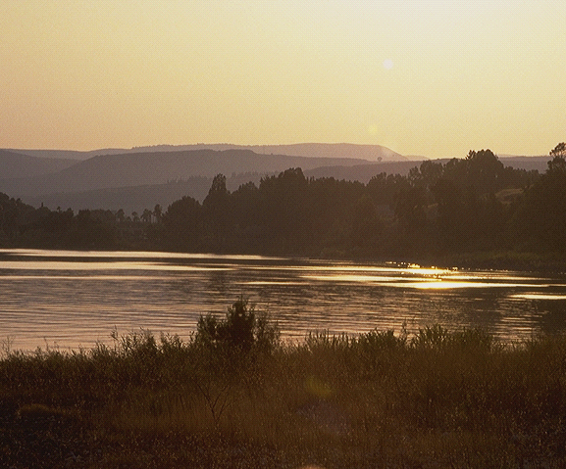
7
Gen. 15:6
_{ABRAHAM NA POTSOW} _{ECHUMCHAK JI LONGTSUCHO} : META, MOTJU, OSI MMHA!
_{META}
_{MOTJU,}
_{MMHA}
Benkaden kako15:6!
Potsow na Abraham
etsungkaya evamo jijo
longtsu !
Eto longtsu tsotso ji tae!
ABRAHAM
Esta jii
M - M- M
Okhekako pg. 19-24
23
3
Notes:
Ho…ABRAHAM na Potsow Echumchak ji longtsua wocho META, MOTJU, OSI MMHA
//// Benkaden kako 15:6 jilo na ezoa evamo jijo Abraham na Longtsu ji licho...
//// … Potsow naha hojito longtsu ji otsotso longtsu to nchumia vancho alo.
//// eto longtsu tsotso ji tae! Shijo Potsow na ombo oshom ehen ji yakchia limha jilo rhancho hansitemo ji.

Slide 26
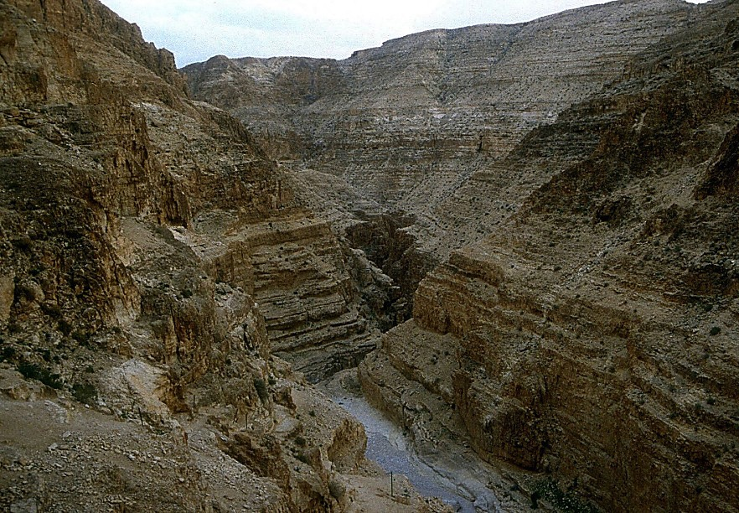
7
Benkaden 16:1-4
ABRAHAM NA POTSOW LONGTSU CHO!
To Tssoasayia: Abraham tona Sarah ji nvankem sicho.
"Abraham… Hagar (Sarah nrüi ) ji pono ni etancho tssoa!"
ABRAHAM
Etsa ji
M - M- M
Okhekako pg. 19-24
24
3
Notes:
//// Abraham na longtsua evamo jijo Potsow na ntio echumchak vayicho sana ombo tssoyiv. Osi hojito nzyu ji yia vancho.
//// Potsow na Echumchak lia salia…ABRAHAM osi Sarah toji ngaro mmhayiv to echumchaki elio tsukona ji nvankem sicho. Ji yuta lo,
//// Sarah na ABRAHAM ji Egypt kyon (sarah nrui) Hagar ji pono etancho tssole to ezocho, Potsow Echumchak ji penthokvu tsukona. Hojiang yuta lojo shiang esia tssota rocho.

Slide 27
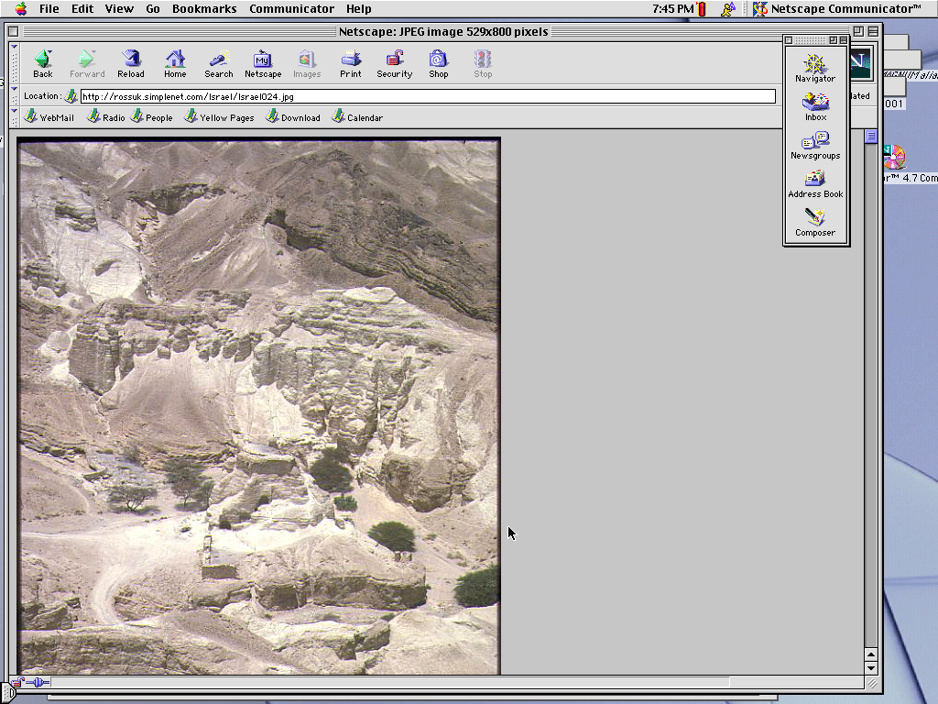
7
Gen. 16:11-12; 17:20-21
Yuta jilo…Abraham ji opo kumi sicho.
Omying jo: ISHMAEL.
(ISHMAEL jo ECHUMCHAKI elio ji ngaro mek).
ABRAHAM
Etsa Ji
M - M - M
okhekako pg. 19-24
25
3
Notes:
//// hoka, yuta jilo...ABRAHAM na Hagar yakchia ngaro vancho.
//// tsokhying ji mying jo ISHMAEL.
//// Khatolea, Potsow na phyocho, ngaro jijo Potsow na Echumchaki elio Abraham tsoronichen tssoa eyiv tsukona tsoe ji mek.

Slide 28
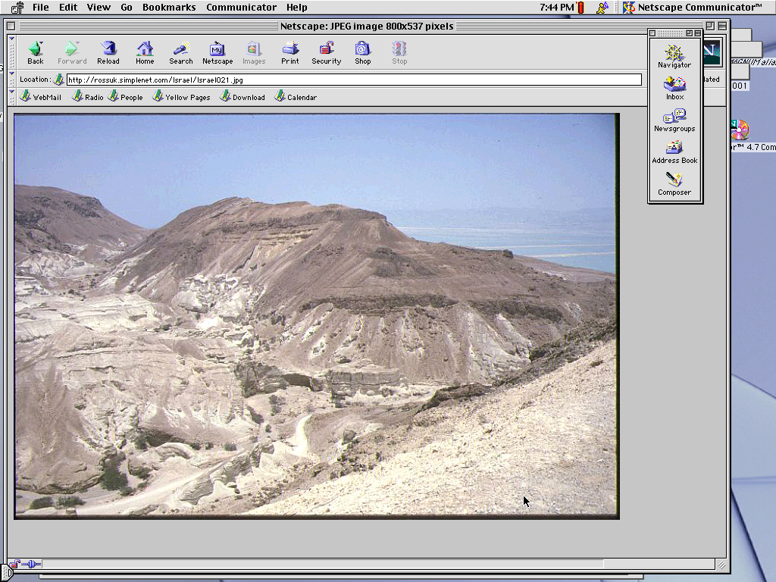
7
Gen. 17:19
Enhungo…Abraham jo nzyu 85 …Sarah jo 75.
Nzyu 15 sulojo…
SARAH YAKCHIA ABRAHAM TSOKHYING VANCHO.
OMYING: "ISAAC"
ABRAHAM
Etsa Ji
M - M - M
Okhekako pg. 19-24
26
4
Notes:
//// Enhungo , ABRAHAM jo 85; Sarah, 75.
//// nzyu15 sulojo ...
//// … Potsow na echumchako ji esia ABRAHAM na tsokhying vancho...Sarah yakchia.
//// ombo mying jo ISAAC, osi Hebri yi na khophi zetatssona omying ji yichak jo ema (laughter). Hoka, ABRAHAM na nchumo jijo, Sarah onpoe na enhungati ngaro vamo jijo emhoktav emahunga.

Slide 29
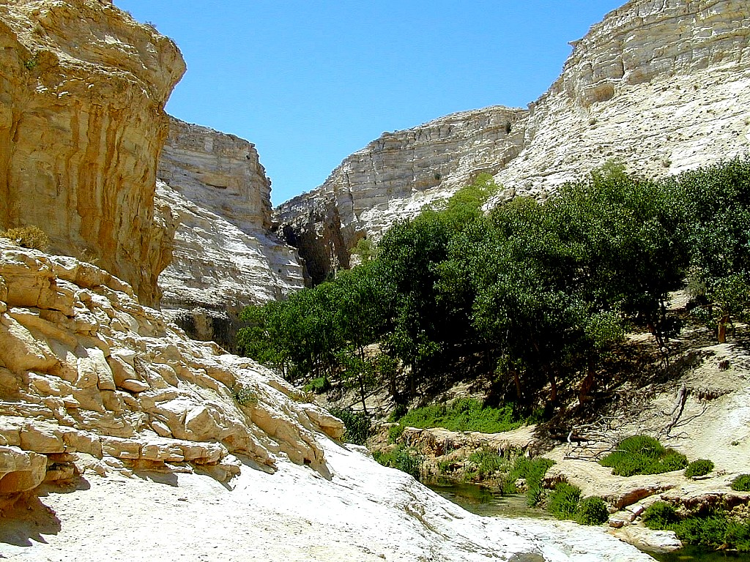
7
Gen. 17:21
Isaac jo otsotso- songa nhyaka evamo tsokhing ji…
… ocho yakchia Potsow echumchak ji peni yiv sana…
ABRAHAM
Etsa ji
M - M- M
…ISAAC wopan ji yakchia !
okhekako pg. 19-24
27
2
Notes:
ISAAC jo otsotso songa nhyaka evamo tsoe ji…
//// …ocho yakchia Potsow na ABRAHAM thungi echumchak evao ji pem sana …
//// … OMBO wopan ji yakchia.

Slide 30
7
Gen. 17
ABRAHAM
ABRAHAM
ca. 2000 B.C.
ETSA JI
AC
M - M - M
AJMJ
I - I
Benka 12:1-3
ABRAHAM
Etsa ji
M - M- M
I - I
ISHMAEL tona ISAAC
Okhekako pg. 19-24
28
Notes:
Tokuma… akhor I tona I toji ABRAHAM kako jilo na hunga la . Abraham tsokhying ….ISHMAEL tona ISAAC...
Yuta opvu shilo jo… engkongthav Jihudi tona Arab ritsso ji nzyu 4,000 years vungi tssocho... 2000 B.C. harumalo.

Slide 31
7
ABRAHAM
ABRAHAM
ca. 2000 B.C.
The CALL
AC
L - S - B
AJMJ
Benka. 12:1-3
I - I
ABRAHAM
Etsa Ji
M-M-M
I - I
ARAB KYON JIANG
ISHMAEL
JIHUDI KYON JIANG
ISAAC
okhekako pg. 19-24
29
2
Notes:
Ntiotssole...
//// …ISHMAEL jo nchung jana Arab kyon jiang opo…ABRAHAM yakchia…
//// khtolea ISAAC jo, nchung tsungono jo Jihudi kyon jiang opo … hojiha ABRAHAM yakchia.

Slide 32
7
ABRAHAM
ABRAHAM
ca. 2000 B.C.
The CALL
AC
L - S - B
AJMJ
Benka. 12:1-3
I - I
ABRAHAM
Etsa Ji
M-M-M
I - I
ARAB KYON JIANG
ISHMAEL
JIHUDI KYON JIANG
ISAAC
okhekako pg. 19-24
30
Notes:
Oyo tona pani jeni yuta loha elumoto nzothe-ngathe licho. Osi ete na kvuthung enhunga yuta shilo zeta sana, etena hungala echungren ehemo ABRAHAM suki motsu nzyu 4,000 vungi etsowo jiang nchung jana tssoa vana! ABRAHAM jo e omotsu osi e motsu dendeni rutaphen ka to jihudi kyon elani Arab kyon jiang na hoala.

Slide 33
7
Benkaden 22:2; 2 Chr. 3:1
TSOKHYING OCHOLA?
“Osi Potsow na phyocho, ‘ Ni tsokhying, , ni tsonthi, Isaac, ochojo ni nzamo sana, woa meta Moriah jilo. Osi ombo ji erung than esia thani sia, ana ni ezov ka phonglan kvui na tham sana.’" Benkaden kako 22:2
ABRAHAM
Etsa Ji
M-M-M
I - I
NIV ekha yilan: Hebri kako jilona jo, "Isaac" to tsao ocho ombo na nzana sana hoji ombona na oyi engaecho “Kvui nina nzana sana," osi hoji lona ntssonkata: “ni tsokhying, ni tsonthi, kvui nina nzana sana-- Isaac." Isaac jo tsonthi ji “echumchak tsokhying ji."
2 Echungta 3:1 eranpvui jina ezoala phonglan kvui sana [Nchungo hoji jo Dome of the Rock to tsala].
okhekako pg. 19-24
31
3
Notes:
Engav tsukona jo : Potsow echumchak ji ephanina Onilo tsokhying kvui ji Abraham tsoronichen tssovla ? Benkaden kako 22:2 jilo zeta…
//// “Potsow na phyocho, “ Ni tsoe ji sosi, tsonthi , Isaac, ocho jo ni nzamo sana, osi woa Moriah meta jilo. Osi ombo ji erungthan esia thana, ana ni ezov ka phunglan kvui sana."
//// NIV jilo na zecheta: "Hebri yi ji ephanina jo, "Isaac“ ji sulojo “ ni nzamo ji,“ osi hojilona pankae phyocho: “ ni tsoe, ni tsonthi, ocho jo ni nzamo sana – Isaac." Isaac jo tsonthi ji “ echumchak ji tsoe."
//// elani, Echungta enio jilo 3:1 Potsow na Moriah jilo khumphen elio ji ethangcho, kvuijo,nchung, Moslem Dome of the Rock ji tsala.“ meta ji zelantavka ovungoe.

Slide 34
7
Gen. 17:20-21
WHICH SON?
“ Osi Ishmael jo, ana nizoyi thaka. Engata ana ombo mmhayithaka, osi tsungthi ethitokvuka, osi tsoronichen khosha mhhayia thichetokvuka. Ombo lona mesatso 12 thichevka, osi ana ombo ji jipo tsophov kumthokvuka. Khatolea ana a nstata jijo ni tsoe Issac vav ka, osi ombo ji nzyu etsao jilo yuta hetothung Saraah lona Bokuka” Gen. 17:20-21 (NKJV)
ABRAHAM
Etsa JI
M-M-M-
I - I
Khatolea a ntsata jijo issac vavka
okhekako pg. 19-24
32
2
Notes:
Khatolea Ishmael ji mhechoe nsi … metalo!
//// Bnekaden kako 17: 20-21…"Osi Ishmael jo, ana nizoyi thaka. Engata ana ombo mmhayithaka, osi tsungthi ethitokvuka, osi tsoronichen khosha mhhayia thichetokvuka. Ombo lona mesatso 12 thichevka, osi ana ombo ji jipo tsophov kumthokvuka. Khatolea ana a nstata jijo ni tsoe Issac vav ka, osi ombo ji nzyu etsao jilo yuta hetothung Saraah lona Bokuka.

Slide 35
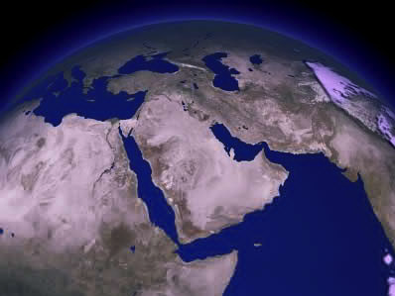
Yantso ji nchung ejutae zeta…
ISAAC
ABRAHAM
ISHMAEL
The CALL
L - S - B
I - I
Ntoli hetata echumbotacho la ?
okhekako pg. 19-24
33
3
Notes:
Tantso ji nchung ejutae ezev tsukona ethelan lia…
//// eto phyotana …Ishmael tsoronichen jiang na meta nzoni vamo jijo hetata… eng erhelamoe .
//// khatolea… Isaac tsoronichen jiang ji … Israel meta ntumoro jilo.
//// Nto tsukona hetatala?

Slide 36
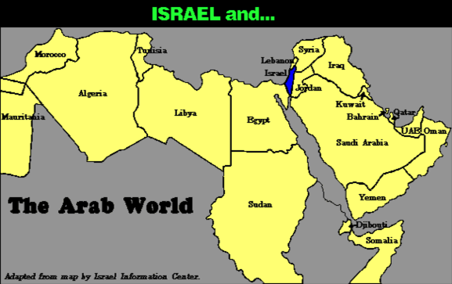
7
Eru-ekuk ji ejutae zeta…
Israel osi…
ABRAHAM
Etsa Ji
M-M-M
Arab Limha
I - I
Okhekako pg. 19-24
34
Notes:
Phyota salio… Eru-ekuk ji ejutae zeta… nchung Israel tona Arab meta jiang!

Slide 37
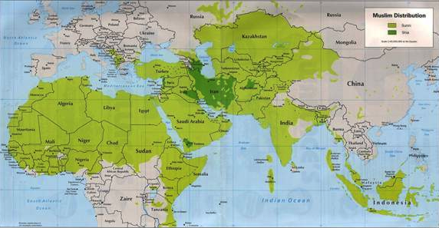
7
Eru-ekuk ji ejutae zeta…
ABRAHAM
Etsa Ji
M-M-M
I - I
MOHAMMED osi ISAAC!
Okhekako pg. 19-24
35
Notes:
Khatolea shiloji ntosana na elhi tssoa vana. Eng chorolamoe jiang ji Ishmael tsoronichen jilo ejukae zeta, ochona Islam ji yanchecho sana… osi Isaac ji zeta , Israel kyon jiang emhokyhav opo, osi Ishmael ongo!

Slide 38
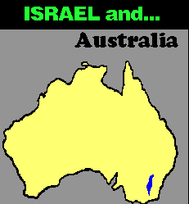
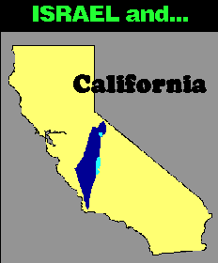
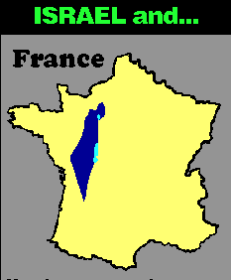
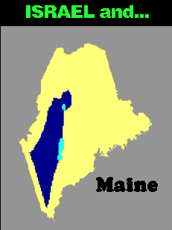


7
Eru-ekuk ji ejutae zeta…
ISRAEL osi…
ISRAEL osi…
Australia
ISRAEL and…
France
California
ISRAEL osi…
ISRAEL osi…
Singapore
ABRAHAM
The CALL
L - S - B
I - I
Maine
Maps drawn to same scale with Israel in blue
Handbook, pages 19-24
4
36
9.65.03b.
Notes:
Nchung limha eru-ekuk ji ephaninajo… ntumoro Israel meta ji
Australia…
//// Israel osi France…
//// Israel osi United States' Maine meta ji…mekana
//// Israel osi California.
//// Singapore tona Israel to etsu-ekon mekana esi-nzo jo khetita tuv.

Slide 39
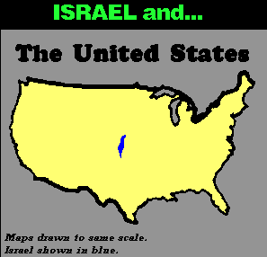
7
ISRAEL tona…
THE UNITED STATES
ABRAHAM
ETSA JI
L - S - B
I - I
Shijo lalan cho la?
Okhekako pg. 19-24
37
Notes:
Osi okhao to… Israel ji United States ji topvu ejuta leha… khumkiwoe osi jolowoe … eng chorolamoe osi erhelamoe: etsu-esu ji zeta tssona, Isaac tona Ishmael to oni yuta lo elumoto echumpo lia! ntolila? Shijo kvutoli engathetavla?

Slide 40
7
"…Ishmael kyon jiang ji meta elumoto picho osi ejueli jiha israel kyon jiang lon kyongkata. Shijo otsotso, onte na erani elio ji zena, meta jiha mitju na phyonchua mmhayicho enhunga echungren ji chani zena. Elani omoni shancho jiha Ishmael tsoronichen jiang jo chochui vayicho.
ABRAHAM
ETSA JI
L - S - B
I - I
Hal Lindsey, The Everlasting Hatred: The Roots of Jihad (2002), 65
okhekako pg. 19-24
38
Notes:
Hal Lindsay 2002 kako jilo zeta tsona, The Everlasting Hatred: The Roots of Jihad:
"…Ishmael kyon jiang ji meta osi eju-eli khosha picho, Israel kyon jiang pomoe. Shijo otsotso kako erani elio jiang zeta tssona, elani mitju tssolea elumoto mmhayicho. Elani omoni shancho jiha Ishmael tsoronichen jiang jo chochui vayicho.

Slide 41
7
"…Ishmael kyon jiang ji meta elumoto picho osi ejueli jiha israel kyon jiang lon kyongkata. Shijo otsotso, onte na erani elio ji zena, meta jiha mitju na phyonchua mmhayicho enhunga echungren ji chani zena. Elani omoni shancho jiha Ishmael tsoronichen jiang jo chochui vayicho.
Khatolea Potsow echumchak , kvui jo omon shancho ji sana, jijo issac osi ombo tsoronichen tsukona tae. Oso lona Issac ji mmhayiv to ezowo jijo, oso lona mmha ji yakchia Ombo na kvuthung limhatsu ji tsa sana hojithung omonina yana evov tsukona.[Ekyimphacho]
ABRAHAM
ETSA JI
L - S - B
I - I
Hal Lindsey, The Everlasting Hatred: The Roots of Jihad, 2002, p. 65
Okhekako pg. 19-24
39
Notes:
"Khatolea Potsow echumchak , kvui jo omon shancho ji sana, jijo issac osi ombo tsoronichen tsukona tae. Oso lona Issac ji mmhayiv to ezowo jijo, oso lona mmha ji yakchia Ombo na kvuthung limhatsu ji tsa sana hojithung omonina yana evov tsukona.

Slide 42
7
LEBANON
Mediterranean Sea
ISAAC tsoronichen
SYRIA
Sea of Galilee
IRAQ
Haifa
Nazareth
Netanya
JORDAN
Tel Aviv-Jaffa
AMMAN
JERUSALEM
Jericho
Gaza
Hebron
Dead Sea
ABRAHAM
Beersheba
Etsa Ji
ISRAEL
M-M-M
I - I
ISHMAEL tsoronichen
EGYPT
SAUDI ARABIA
Eilat
Al' Aqaba
Gulf of Aqaba
ISHMAEL osi ISAAC nchung Israel meta jilo
Okhekako pg. 19-24
40
2
Notes:
Osi ekhungyan ehen nchung shilo jo…
//// Shilo, Isaac tsoronichen
//// Ishmael tsoronichen nchung ejan lia vana – ochum nlio ritsso ji Abraham su-ranki jilo na penkacho, Palestine ehemo mekana Canaan – mekana Israel – hoji tsukona nkolo. Jihudi Israel jo Ishmael tsoronichen jiang na liphongtsu topvu lona hachumi vana ! Shi ji nchung nchumi zeta tssona emhukthav.

Slide 43
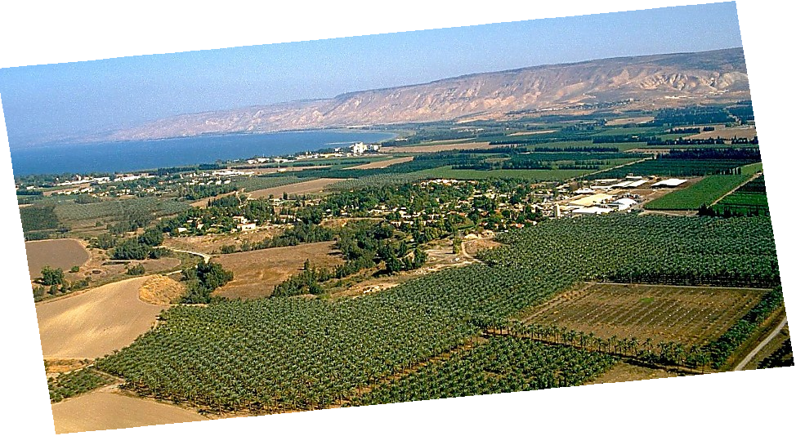
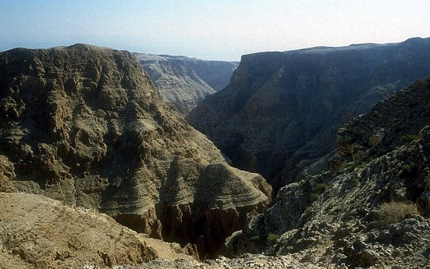
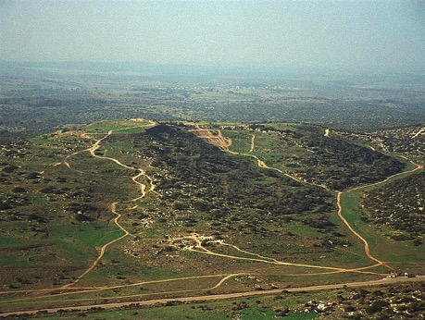
Benkaden kako 13:10-11; Ex 3:8
A PORTION OF ABRAHAM'S PROMISE,,,
ABRAHAM
The CALL
L - S - B
I - I
THE MARVELOUS BEAUTY OF CANAAN…
THE LAND OF HIS ANCIENT INHERITANCE!
Jordan zukhvu Israel longjung lo
Okhekako pg. 19-24
41
1
© 2006 TBBMI
9.65.03b.
Notes:
Osi nchungo meta jiang shiang … khatolea echumchak ji lanka teriv lona tae…. Jordan zhukhvu Israel meta jilo.
//// Echumchak ji meta jiang ! Meta Lizu mmhom jolowoe jilona…“ shurutju tona tssakiju" to jiang jo limha ejueli jiang yolo benkaden mmha ji tae.

Slide 44
7
Ex. 2:24
ABRAHAM
ABRAHAM
ca. 2000 B.C.
ETSA JI
AC
M - M - M
AJMJ
I - I
Ben. 12:1-3
J - E
12
ABRAHAM
Etsa Ji
M-M-M
I - I
J - E
12
Echumchak yi ji !
Jacob jo echumchak ji tsoe ji !
Okhekako pg. 19-24
42
7
Notes:
Motsu ji ekhyolaka yitav ka. ISAAC, ABRAHAM tsoe Sarah yakchia, jo Potsow echumchak tsoe ji.
//// ISAAC na tsokhying eni vancho: JACOB osi ESAU (J and E on the ABRAHAM File Folder). JACOB ji yakchia Npilamo Echumchak ji lia yivka.
//// Jacob, na tsokhying 12 licho (Abraham kako jilo akhor 12 ji).
//// Osi, jisulo... Echumchak ji shenta ji...is
//// Abraham
//// Isaac
//// Jacob osi
//// Jacob tsokhying nchyu 12 jiang.

Slide 45
7
Ben. 35:23-26; Benkaden. 34:1
ABRAHAM
ABRAHAM
ca. 2000 B.C.
ETSA JI
AC
M- M - M
AJMJ
I - I
Ben. 12:1-3
J - E
12
12
ABRAHAM
1
10
Etsa ji
M-M-M
I - I
6
J - E
8
12
4
5
13
7
11
3
9
2
Okhekako pg. 19-24
43
Notes:
Shilona JACOB tsoe 12 jiang hunuka, ombo osi eng 4 ji yakchia osi nzyu elumoto vanta sanati. Ete na ombo tsoe motsunga lilana hunguka, taro ethumo toji… tsolo nchua. Tsokhying 12 ochojo Jacob tsoeden sana hojiang na Israel jipo 12 ji kumcho.

Slide 46
7
Gen. 35:24
ABRAHAM
ABRAHAM
ca. 2000 B.C.
Etsa Ji
AC
M-M-M-
AJMJ
I - I
Ben. 12:1-3
J - E
12
ABRAHAM
Etsa Ji
M-M-M
I - I
J - E
12
11
Handbook pg. 19-24
44
Notes:
Khatolea Jacob tsokhying nchyua ji che zeta – Taro ehao toji, okhao jiang yolo – osi ombo tsoe jiang lo ocho jo elumoto nchumcheta sana. Hoji tsoe ji motsu jo topvu na ntsiv ka:

Slide 47
7
Gen. 35:24
ABRAHAM
ABRAHAM
ca. 2000 B.C.
Etsa Ji
AC
M-M-M
AJMJ
I - I
Ben. 12:1-3
J - E
12
ABRAHAM
Etsa Ji
M-M-M
I - I
J - E
12
JOSEP!
11
Okhekako pg. 19-24
45
Notes:
Ombo JOSEP to tsacho. Emhukthav kyon–– eluto ruta rothaka echungren echungren –
Osi ombo motsu ji yakchia ntho kako jilo nchyu mezhu ji motsu jilo shenta la:

Slide 48
7
Gen. 1 through 25
LUYUNGIO
TSSOSORA
Epoe tona eloe ovungo
1st Sin
C
Yidhen ovungo ji
Wopan ovungo
ROZA PFUCHI
(1000 B.C.)
Lungthaden ji
Juvak/sungruka
Kitsu
(2000 B.C.)
ABRAHAM
(2000 B.C.)
OKHO ETHUM
L 7 S J
Etsa Ji
AC
M-M-M
I - I
J - E
12
CAPTIVITY
7 = 4 + 3
JOSEP
ABRAHAM
ETSA JI
KYON 4
L - S - B
I - I
MOSA
(1500 B.C.)
(500 B.C.)
J - E
S
S
yINGTO
12
JESU
J
JOSHUA
46
2
Notes:
Enhuhngo ete na kako mezhuo to thakthaka:
//// Ovungo jijo LIYING,
//// Ji sulojo ABRAHAM, Nchyu mezhu jilo ovungo ji.

Slide 49
7
AJMJ
kyon
Nchyu mezhu
jilo
Nchyu enio
jijo
?
47
Notes:
Enhungo ete na kako ehemo jilo, kyon nchyu enio ji lo rhowotav ka.… Ntho kako ethumo jilo.
“ Yitssoe jina oyi tssov shikhvu" jilo na pankae, ombo mying jo akhor J jilo na pankatala… osi hojijo…

Slide 50
7
Gen 30:24
AJMJ
Kyon 4
jilo
enio
tojijo ?
"JOSEP"
48
Notes:
Josep. Ntho kako jilo omying shi esia thungche nvan, ethelan eli, emhukthav kyon
ochojo– ombo Potsow longtsu osi zenka ji yakchia -- kyon ji thongphi siyicho.

Slide 51
7
Benkaden kako 30:24
Tsungon matang:
ABRAHAM-JOSEP 2000 B.C.
49
Notes:
Osi yuta jijo … etena nzyu ji 2000 harumalo vatavka. Luma junga etsungtav ethev nli, enhuhngajo.
Tokuma elumoto sanga mmoka yuta nzyu jiang ji ti emhokta. Ntho kako ji nzyu ephaninajo … otsae na … yuta to harum tssov toji tae ka. Ovungi zeta wotavka.

Slide 52
7
Gen. 30:24 through Gen. 50:26
LYUYUNGIO
”Ana
JUDA
METAE
JOVO"
ABRAHAM
ABRAHAM
ABRAHAM
JOSEP
ABRAHAM
MOSA
JOSHUA
TSOLUPPHYOLUP
ROZA PFUCHI
RHUMAE EVANMO JI
YINGYING
JESU
Okhekako pg. 24-25
50
Notes:
Osi enhunga jo Josep motsu ji zeta wotavka.
“YITSSOE JINA OYI TSSOV SHIKHVU"… ovungo "J" jijo : JOSEPH.

Slide 53
7
JOSEP
ABRAHAM
Kyon 4
jilo
kyon enio
toji:
JOSEP
AJMJ
Okhekako pg. 24-25
51
Notes:
JOSEP motsu ji kako shilo na zetavka osi hojilo eni sechui elio ji erantav tsukonaka. Khyingroe ochojo opo na elum nzancho sana jijo JACOB to tsacho — junga osi elumoto nzancho…

Slide 54
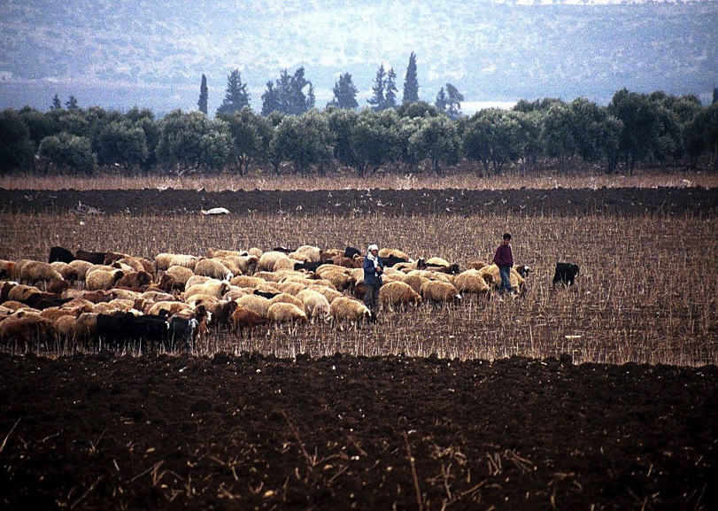
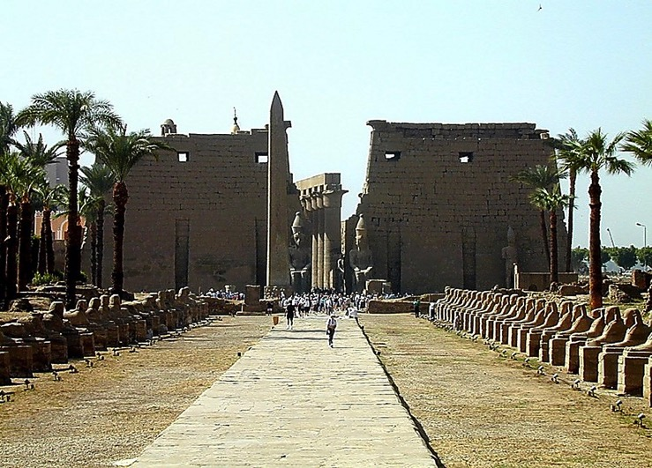
Gen. 37:16-18
Luxor khumphen, Egypt
JOSEP
Dothan li jiang lo oli rhuki jiang, Israel
Okhekako pg. 24-25
52
1
Notes:
… ombo ota jiang na elumoto mhyiktsso rakicho. Nchung tsungono olirhuki jiang, Dothan meta Israel jolowoe …
//// JOSEP ots jiang na okyak tssocho, Egypt yantsu jilo yia evamo shisho khophi jiang ndungo yeni sicho.

Slide 55
Benkaden kako 37:28
JOSEP
Okhekako pg. 24-25
53
Notes:
Egypt metae jilo cheyi sanati jo … ejueli osi emhokthav kitsu jiang yolojo… osi elumoto ojang oru sulojo …JOSEP jo elumoto kichuk ejui osi sataronta jilo elumoto tssothi morui to zechecho. Ombo na ekhyolaka ntsi sicho osi ombo ekum jilo Opvui ji ha nmhechocho.

Slide 56
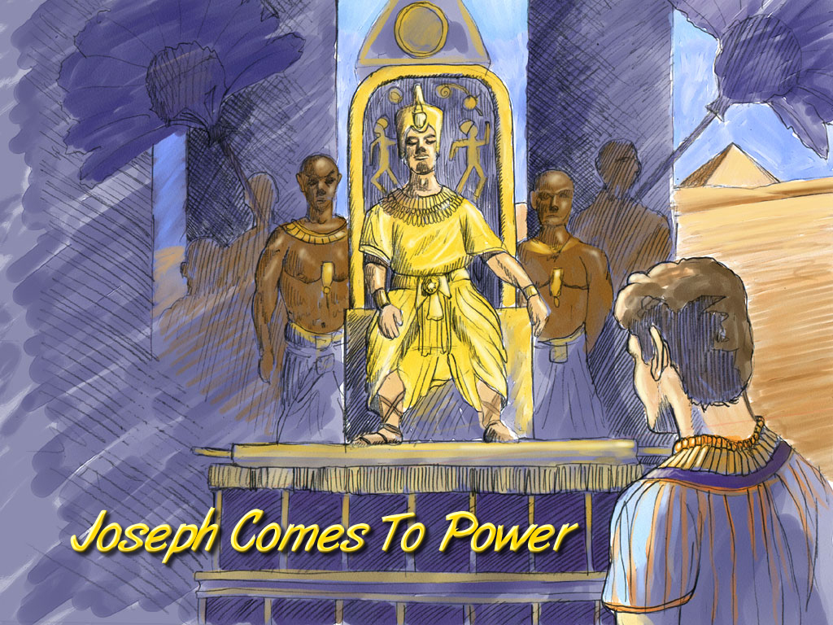
Gen. 41:41-46
JOSEPH
Joseph Comes To Power
Josep ji etho lo vancho
Okhekako pg. 24-25
54
Notes:
Josep ji Egypt kyon jiang yolo tsophoe kumcho. Egypt metae Sataronta jilo tsuphotsowo ji kumcho, Pharaoh roza ji kupi jo ombo tssocho.

Slide 57
Gen. 42:2
chekatav
tsukona
MS
N(A)
TSSUKHANG!
H
SG
C
ER
B
J
MN
JOSEP
DS
E
KB
U
KHOSHA!
MS
PG
RS
Okhekako pg. 24-25
55
1
Notes:
Jithung ji Canaan meta jilojo tssikhang hangkhang tssocho.
//// osi hojilona tsnchoe evam tsukona, JOSEP opo, JACOB (enhungo Israel to tsala), otssi eshiv tsukona ombo tsoe ochoang sana Egypt meta jilo wothukcho. KHUMKIWOE JO TSSIKHANG… JOLOWOE JO KHOSHA (Ni eruekuk jilo zeta, Canaan meta jilona penkae Egypt ejan.)

Slide 58
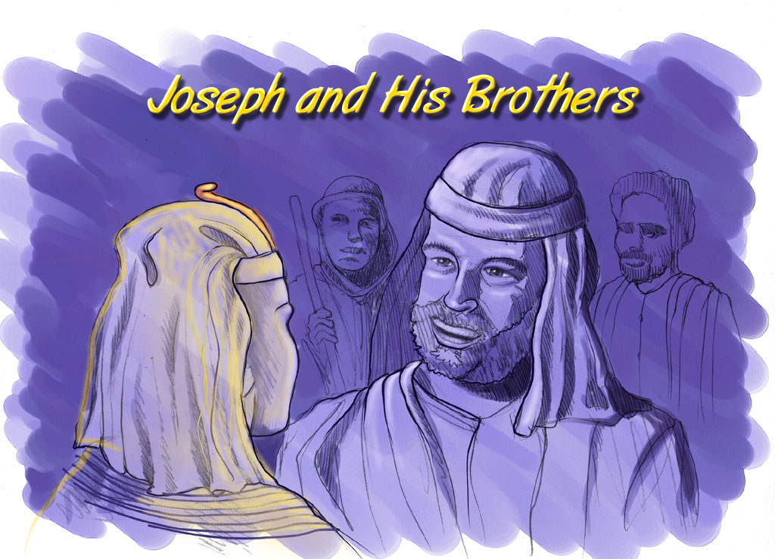
Gen. 42:7
Josep osi ombo otae jiang
JOSEP
Joseph and His Brothers
Okhekako pg. 24-25
56
Notes:
Motsu ji ephanina jo – Benkaden motsu ji kha woa tssona – otae ochung na ombo yencho sana hoji jo Egypt meta jilo tsuphotsowo etsui ji kumthaka.

Slide 59
Gen. 46:3-7
chekatav
tsukona
MS
N(A)
H
SG
C
ER
Wopan jiang naha wocho…
WOPAN JINA LIPHONGTSU KUMVU !
B
J
MN
JOSEPH
DS
E
KB
U
MS
PG
RS
Okhekako pg. 24-25
57
Notes:
Wopan jina ha kumalia Egypt meta jilo vanrae sicho. Osi jilo ... Hebri wopan jina… emhokthav yantsu tsophov kumi sicho, osi hoji jo Israel kyon jiang.

Slide 60
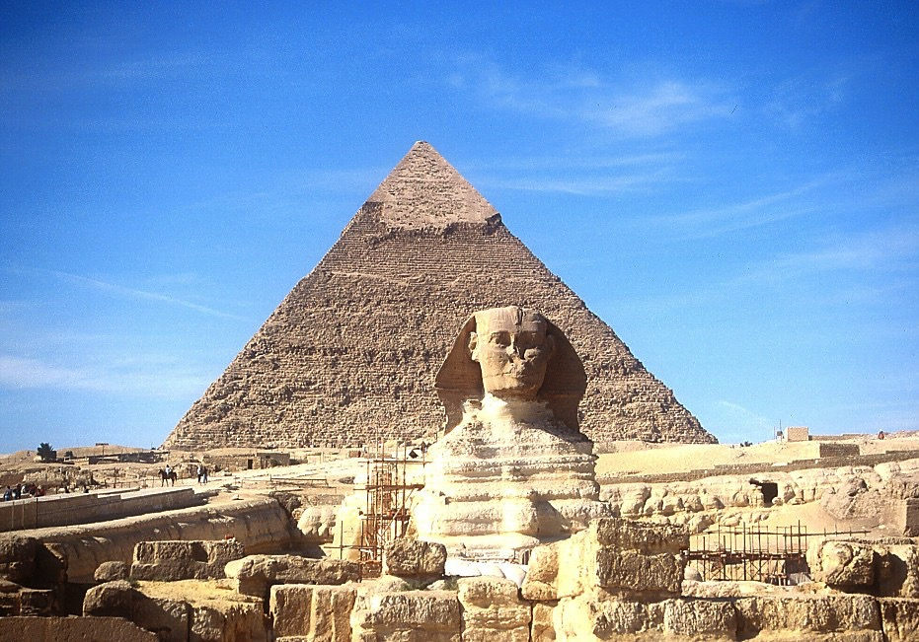
7
JOSEPH
Sphinx osi Great Pyramid toji
Okhekako pg. 24-25
58
Notes:
Yuta esungaro tsukonajo, ontena Egypt kyon jiang ndungo shenta khota mhom osi yikrachita vanta vancho. Ntiotssole sataronta jilo tsuphoe jiha onte wopan etssowo ji tsukona ! Nkhkontsu ontena Sphinx osi Egypt meta lo pyramid jiang ha emhoki zetae mpitona liv.

Slide 61
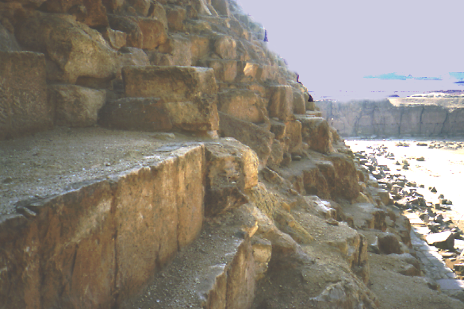
7
JOSEPH
Emhokthav Pyramid longtsung jiang
Okhekako pg. 24-25
59
Notes:
Nchungo etena Pyramid jiang ha mpanngi zecheta : kitsu shiang tssotav ji Josep wopan jiang na ezu kumi tssotav jiang alo? Tssokhuka… kako jiang zena…

Slide 62
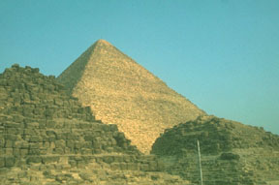
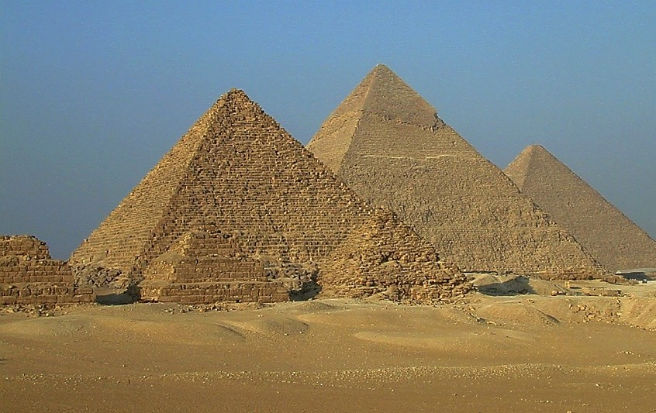
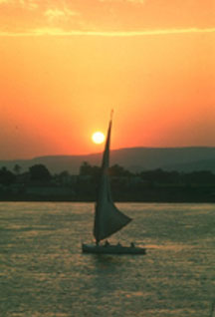
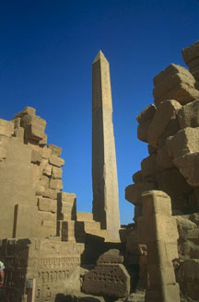
7
ISRAELITE KYON JIANG NA HUNGCHO…
JOSEP
…EMHUKI ESIO EGYPT META .
Okhekako pg. 24-25
60
Notes:
Yuta ezungaro sulojo Josep ji chui sicho, meta emhoko shiang ji
Shiang meta tssoe elio jiang yuta lojo Egypt meta jilo tongphi tongru lia thung tssov, hebri kyon jianglo -- mekana Israel kyon jiang, Josep wopan ehemo jilo jiang.

Slide 63
Ex. 8:8-10
JOSEP
ABRAHAM
EZU
The SECOND
of the
4 PEOPLE
is:
AJMJ
Notes:
osi ombo chu sanati jo, Josep na elumoto elhi tssoe elio jiang mechoe sicho.
//// Osi ji yuta jilo jo, kyon vokha jiang, Israel kyon jiang ji ranka cho – kyon elumoto puchecho –
[NOTE: wopyak tiying “ ngaro jiang " hungala]
– osi hoji yakchia vantayilan jilo elumoto ezuptae sicho. Osi liphongtsu sataronta jilo ha elumoto ezup li sicho. Hojina… emhokelum ji tangi esiv tsukona…
//// Israel kyon, Josep tsoronichen, jiang jiEGYPT meta jilo EZU kumi sicho
//// Israel kyon jiang jo Egypt meta jilo vancho nzyu 430 arhuma. Hoji lo yuta ekyong tsowo jo emhokthav ezup EZU ekumo lo vanta vancho.

Slide 64
7
Gen. 1:1 through Ex. 1:6
LIYING
TSSOLUP
Epoe tone eloe
1st Sin
C
Yidhen ovungo
Wopan ovungo
ROZA PFUCHI
(1000 B.C.)
1st Murder
Jukhyo/sungruka
kitsu
(2000 B.C.)
ABRAHAM
(2000 B.C.)
OKHO ETHUM
J 7 S J
The CALL
AC
L - S - B
I - I
J - E
12
VUNGI ELIO JI
7 = 4 + 3
JOSEPH
JOSEP
Slavery
Slavery
430
430
KYONG MEZU
MOSA
(1500 B.C.)
(500 B.C.)
S
S
YINGTO
JESU
J
JOSHUA
Okhekako pg. 24-25
62
Notes:
Enhungo… Ntho kako ji ...
LIYING, ABRAHAM, and JOSEP…

Slide 65
7
AJMJ
Kyon mezhu jilo ethum tojo:
?
63
Notes:
… enhungo kyon ethumoto ji phyotavka.
Shi emhokthav kyon jijo – AKHOR TSOPHOV NA ERAMOJI M – osi jijo…

Slide 66
7
Ex 2:10
AJMJ
Kyon ethumo tojo:
"MO SA"
64
Notes:
...MOSA.
Ombo yuta jilojo, Potsow na motsu ehemo jilo omying ntssontsowo jilo ekhyong kachi cho, MOSA, ombo rhanchopvui ji…
Kyon jiang ji Egypt meta jilo ezu tssota evamo jilona sosi Abraham echumchak meta jilo sosi rheyio ji.

Slide 67


Ntho Kako… silo hungu ka..BibleStudyDownloads.org
Yantso shi kyaman khia!
Notes:
The Bible…Basically (bb)

Slide 68
65
©2006 TBBMI
9.65.03b.

