Slide 1


Lotha
ETE BIBLE…
ELAROENA
Designed by Dr. John Fryman, Texas, USA • BibleBasically.org
Taught by Dr. Rick Griffith, Singapore Bible College
All files in many languages for free download at BibleStudyDownloads.org
©2004 TBBMI
9.65.01.
01

Slide 2



(Helo jo nto tsocho la)
Ntho KAKO
^{HüNGRüI NA}
®
Chongchak ethümoto
Ekhyo laka ntho kako erenta jiang zeta ka"
02
©2006 TBBMI
9.65.03a.
Notes:
Chongchak ethümoto… osi shilo jo ete na lyichong jilo rhowo tavka… Motsü ochongtsowo jilo. Jijo etena ETHOKA EJÜ to tsatavka. Etona ndang jo Ntho kako jilo“Ntio tssocho sana” … hungrüi na erancho.

Slide 3

-
L
7
Y
J
03
1
Notes:
Benkaden… ekhyolaka zetav… tiying ji jo akhor ji sechicho …
//// … L Y tona J tona hachümi vana.

Slide 4
7
Nchumcheta...
L 7 Y J
=
4 3
04
1
Notes:
Ni nchumchethukphen… 7 jijo omhatsowo ayiwoe… hojilo tae vam nchuma thung enzanchiv tsukona…
//// … 7 ji 4 tona 3 to chiroe si cho.

Slide 5
7
Nchumcheta…
L 7 YJ
L 4 3 Y J
05
Notes:
Hoji na L 4 3 Y J to kumi sicho…

Slide 6
7
Nchumcheta...
L 7 Y J
L 4 3 Y J
LYUYUNGIO
KYONG MEZU
OKHO ETHUM
YINGYING/NOYING
JESU
06
Notes:
…. Hojito cheka mongo cheyi sicho
LYUYUNGIO… KYONG MEZU (4) … OKHO ETHUM (3) …. NOYING/ YINGYING… JESU.

Slide 7
7
LYUYUNGIO
ABRAHAM
JOSEP
MOSA
JOSHUA
Tssolup phyolup
Roza Pfüchi
Rhümae evamo ji
YINGYING
JESUS
07
Notes:
Tae tolojo… Ntho kako ji chumchak taro .
A sürüa phyoa : LYUNGIO, AHRAHAM, JOSEP, MOSA, JOSHUA, TSSOLUP PHYOLUP, ROZA PFÜCHI, RHÜMAE EVAMO JI , YINGYING and JESU.

Slide 8
Chumchak jiang
10 Meta jang
MS
LYUYUNGIO
6 4
ABRAHAM
N (A)
H
JOSEPH
MOSES
Meta ji
SG
C
JOSHUA
Tssolup phyolup
MN
B
J
Roza Pfüchi
Rhümae evamo ji
"THE STAGE
OF THE
ACTION!"
D S
YINGYING
U
E
JESU
KB
RS
MS
PG
08
1
Notes:
Osi enhungo… Ni lumbumi eng chorolamoi erü ekük ji vasi – TSSOLAN SAPHÜNG JILONA – osi
//// NTHO KAKO CHUMCHAK ji ephanina erancho… ji sulo jo nto la ?

Slide 9
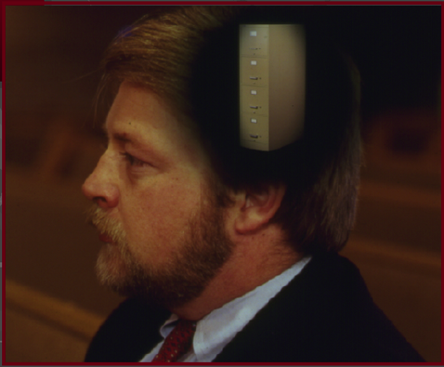
7
LYUYUNGIO
ABRAHAM
ABRAHAM
ABRAHAM
JOSEPH
ABRAHAM
MOSA
JOSHUA
Tssolup phyolup
Roza Pfüchi
Rhumae evamo ji
YINGYING
JESU
•ete na lumbumi na nchum cheta!
•nzoa ntsitacho mek...
•kisü tsophov ji.
•Ntho kako nzontsü sechak.
09
4
Notes:
/// Nchumcheta, ovungo, eruekuk ji ete na lumbumi thei hansi. Etena ntho kako jilo ntsa taro ji nchumcheta woa tssona emhokta nchum-nrü osi ntsi-nrang kyurhupvü tssokhoka ! Khatolia, etejo elae na eranpvüi ji kako lona tara tae zetav.
//// etejo elae na mekna !
//// Kisü tsophov ji zetav sala…
//// …Nhtho kako nzantsü sechak ji tae. Osi jijo ntho kako ji emhokthav tssentsü oman elio jiang .
Nte na taeto ntssiv ka, Potsow na ombo liying kako jilo NTIO JO NTIO KVULO SANA.

Slide 10

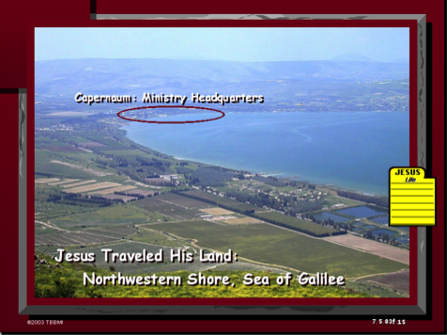
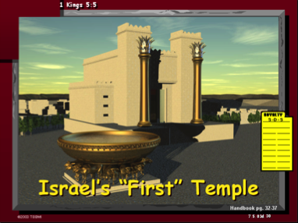
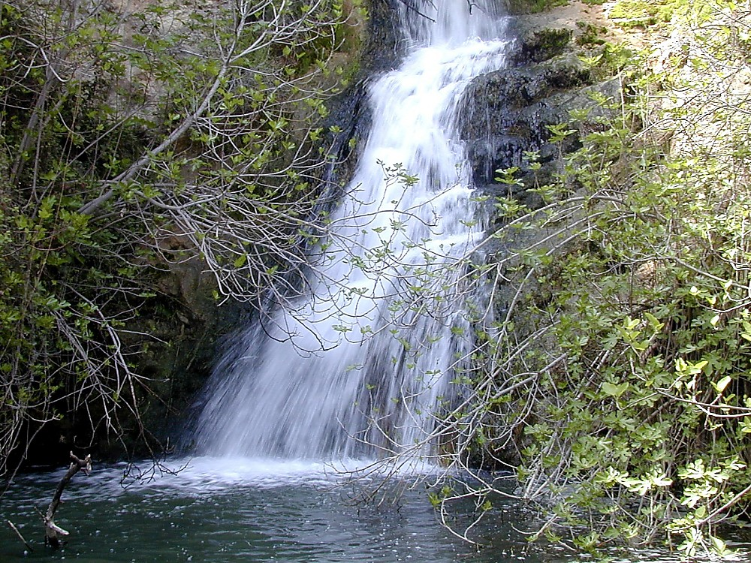
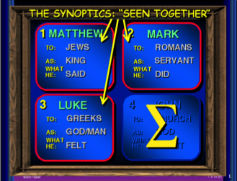
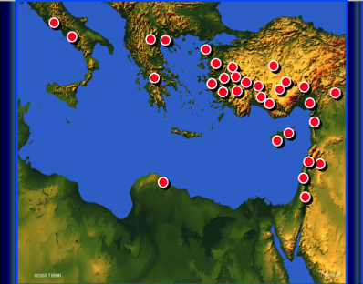
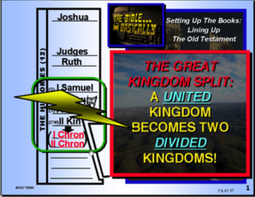
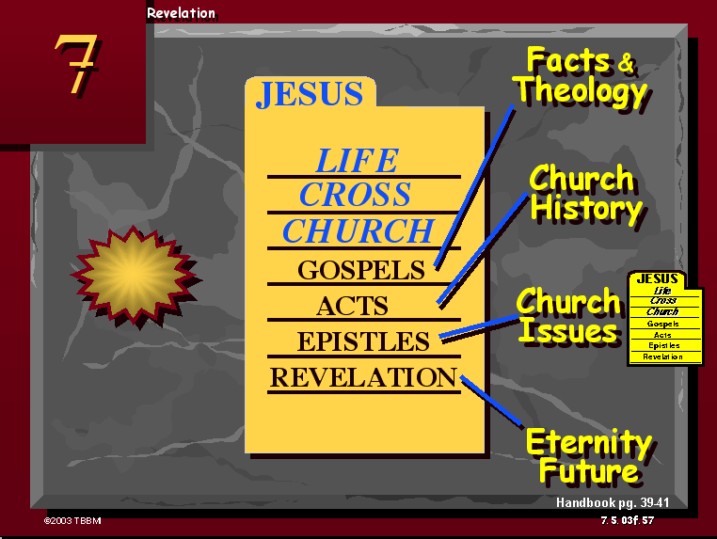

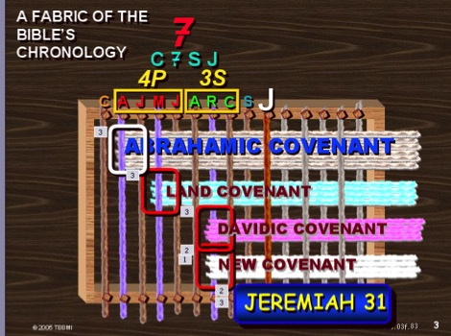
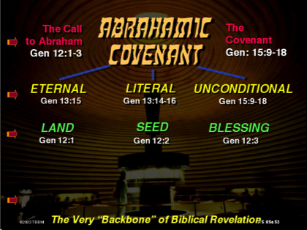
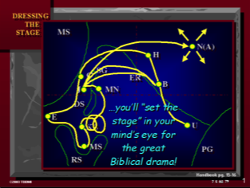
10
Notes:
Kako taro ji yakchia- kisü elümoto yakchia… etetna enhungo yiren jiang ntsiv ka, kako ji motsü osi yuta nto lo erancho sana. Ete opvü tumka ji lumbumi vata : Kako ji motsü opvü jiang tae ntsi khitav, jilo thephata kyon opvü ethelan elio jiang. Tssoe elio osi kyon elümoto jo mpav meka. Khtatolia onte jo ethelan nli to mek. Osi shiang jo etena khata wota thung yakchiv ka.

Slide 11
LYUYUNGIO
ABRAHAM
ABRAHAM
ABRAHAM
JOSEPH
ABRAHAM
MOSES
JOSHUA
Tssolup phyolup
Roza Pfüchi
Rhumae evamo ji
YINGYING
JESU
11
Notes:
Osi etena kvüthüng kako ji zeta jowa sana -- Ntho kako ji ephanina – nina shentachev ka-
Kyon osi motsu ji – Chumchak taro jilo—
Nina ntsithakok ji ephanina.

Slide 12
7
LYUYUNGIO
ABRAHAM
ABRAHAM
ABRAHAM
JOSEPH
ABRAHAM
MOSES
JOSHUA
Tssolup phyolup
Roza Pfüchi
Rhumae evamo ji
YINGYING
JESU
12
Notes:
Benkaden jijo LIYING kako. Shi jo chumchak bebnkaden ji

Slide 13
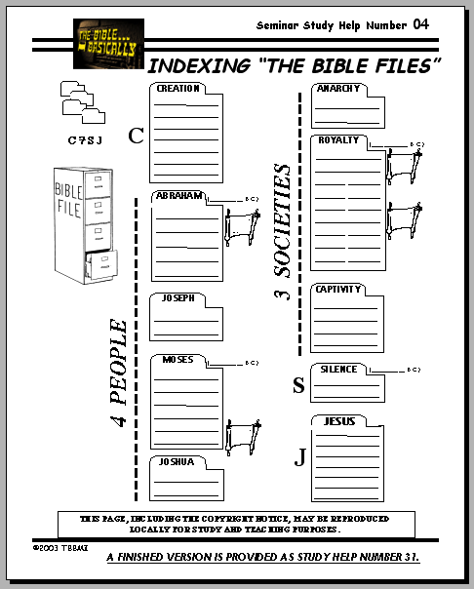
7
Gen. 1 through 11
CREATION
ABRAHAM
ABRAHAM
Lyuyungio
ABRAHAM
JOSEPH
ABRAHAM
MOSES
JOSHUA
ANARCHY
ROYALTY
CAPTIVITY
Kho kha thung un zanchiphen #04
SILENCE
JESUS
13
1
Notes:
Ntho kaka etssyukaphen – kako kha thung un zanchiphen 4 kako ji lia tssona --- hoji lo zeta etena kako ovungo jilo rheyiathung.
Ntho kako topvü hojilo mpata. Etena Benkaden kako jilona zeta woathung ne nzanchivka.
//// Enhungo Ntho kako ji nzoaka lana zetav ka, oyi ekhyima, yithako jiang zechia, jithung ji Ntho yiren jiang ha lumbumi thei hansi kha evov ethev lia.

Slide 14
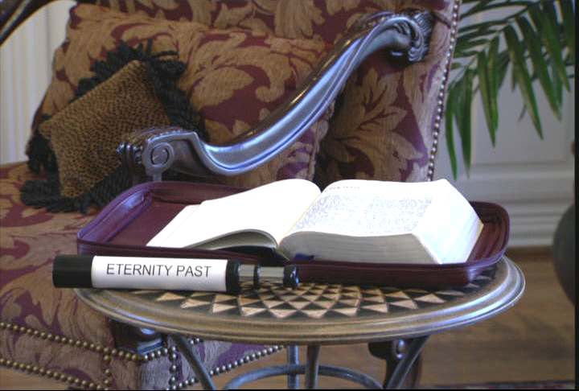
7
BEN. 1–11: Ochum Unlio Yithakcho
Ochum unlio yithakcho
Okhe kako pg. 17-19
14
1
Notes:
LIYING KAKO jilo jo, ekhyolaka, etena Benkaden kako 11 ji zetacho. Limhatsü liyingo jiang ji hungcho… ji sulojo…
//// Motsü ehentsowo jiang hungcho…

Slide 15
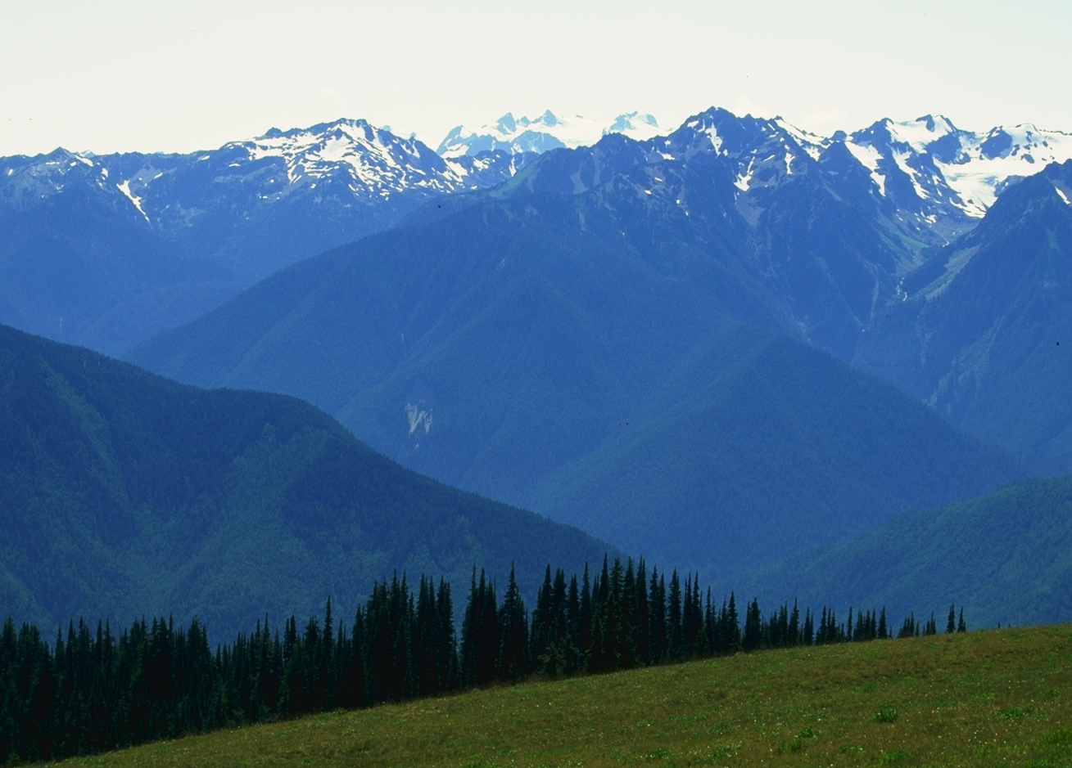
Ochum Unlio yithako jaing chani zetaka...
Okha kako pg. 17-19
15
Notes:
Ochum nlio yithako yuta jiang evon-nrhüi chani ezeo, jitona ekoni phunglan yinsung chani zeta evamo jito elumoto khetita.
Etena phonglan ekoni jana ren-nrhui elio jiang hungchia la

Slide 16
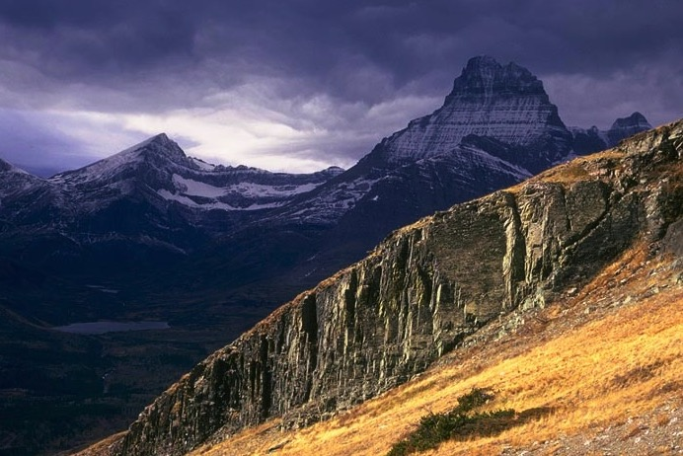
Ochum Unlio yithako jaing chani zetaka...
Okhe kako pg. 17-19
16
1
Notes:
Phunglan jiang yuta lo hayi meta elumoto lia.
It is obvious that a great deal of land lies between the peaks.
//// khatolia ete na kvüthung hayi meta jiang lo chowa sana jithung ti hayi jiang ji chancheta hungala. Elani phunglan tona phunglan to yuta jiang lo kvütata konta cho sana ji ha hungala.

Slide 17

Gen. 1:1
“benkaden jilo..."
17
1
©2006 TBBMI
8.0.03a.
Notes:
Jina… kvüthung etena LIYING KAKO jilo rhowa sana… Benkaden kako 1:1 …
//// … ete no “ Benkadeni…” Yitsüng shiloji n-zücheo ejong osi yuta topvü echi motsu ji ehongthukala…

Slide 18
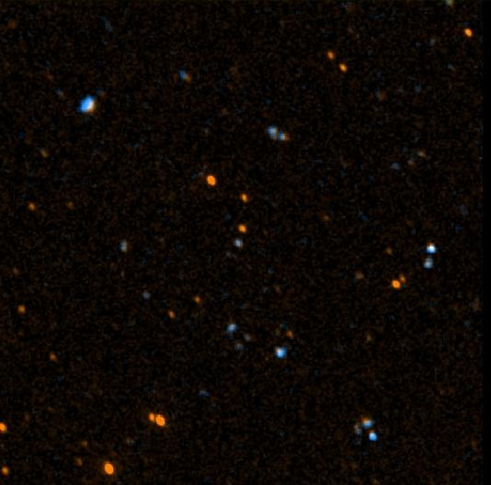
Johan 17:5
“opo enhungo ni ndüngo pfutsson apia; limha n-liyingthung na ni ndüngo lio pfütsson ji."
18
©2006 TBBMI
8.0.03a.
Notes:
Benkaden mostü jilo jo limha n-liyingthung rakae ehongthokcho. Jesu naha hojiang phyoa ete ezocho. Ete naha hojito tssov to ntsia ntio tssole ombo na Opo Potsow ji engacho -- Johan kako 17 jilo – Ombo Thanthungiv tsükona “ Limha n-liyingthung na ni ndungo pfutsson ji” Johan 17:5

Slide 19

John 17:5
“opo enhungo ni ndüngo pfutsson apia; limha n-liyingthung na ni ndüngo lio pfütsson ji."
19
©2006 TBBMI
8.0.03a.
Notes:
Benkaden mostü jilo jo limha n-liyingthung rakae ehongthokcho. Jesu naha hojiang phyoa ete ezocho. Ete naha hojito tssov to ntsia ntio tssole ombo na Opo Potsow ji engacho -- Johan kako 17 jilo – Ombo Thanthungiv tsükona “ Limha n-liyingthung na ni ndungo pfutsson ji” Johan 17:5

Slide 20
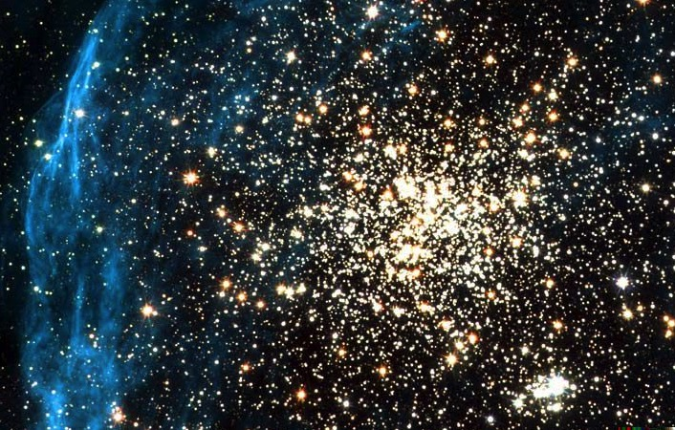
John 17:5
“opo enhungo ni ndüngo pfutsson apia; limha n-liyingthung na ni ndüngo lio pfütsson ji."
20
©2006 TBBMI
8.0.03a.
Notes:
Benkaden mostü jilo jo limha n-liyingthung rakae ehongthokcho. Jesu naha hojiang phyoa ete ezocho. Ete naha hojito tssov to ntsia ntio tssole ombo na Opo Potsow ji engacho -- Johan kako 17 jilo – Ombo Thanthungiv tsükona “ Limha n-liyingthung na ni ndungo pfutsson ji” Johan 17:5

Slide 21

John 17:5
“opo enhungo ni ndüngo pfutsson apia; limha n-liyingthung na ni ndüngo lio pfütsson ji."
21
©2006 TBBMI
8.0.03a.
Notes:
Benkaden mostü jilo jo limha n-liyingthung rakae ehongthokcho. Jesu naha hojiang phyoa ete ezocho. Ete naha hojito tssov to ntsia ntio tssole ombo na Opo Potsow ji engacho -- Johan kako 17 jilo – Ombo Thanthungiv tsükona “ Limha n-liyingthung na ni ndungo pfutsson ji” Johan 17:5

Slide 22
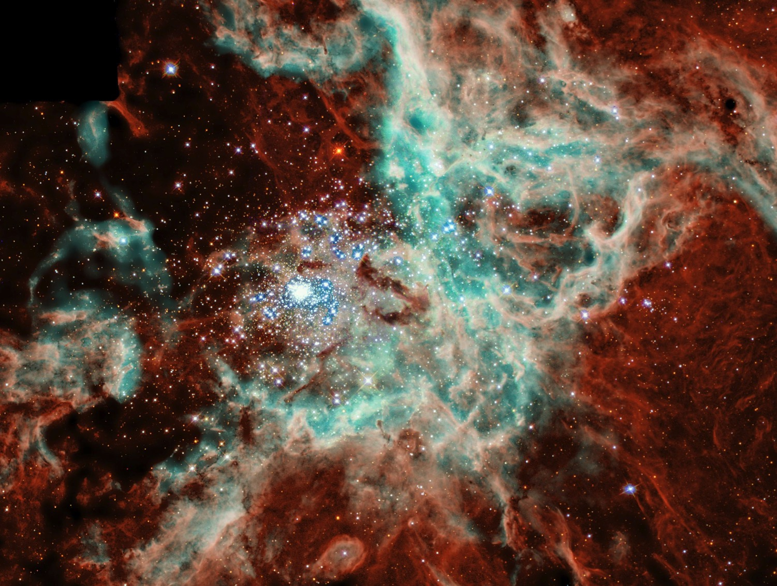
John 17:5
“opo enhungo ni ndüngo pfutsson apia; limha n-liyingthung na ni ndüngo lio pfütsson ji."
22
©2006 TBBMI
8.0.03a.
Notes:
Benkaden mostü jilo jo limha n-liyingthung rakae ehongthokcho. Jesu naha hojiang phyoa ete ezocho. Ete naha hojito tssov to ntsia ntio tssole ombo na Opo Potsow ji engacho -- Johan kako 17 jilo – Ombo Thanthungiv tsükona “ Limha n-liyingthung na ni ndungo pfutsson ji” Johan 17:5

Slide 23
Job 38:4-18
“Ana Limha ji liyingathung nino kvulo vanchola?"
CREATION
23
©2006 TBBMI
8.0.03a.
Notes:
Osi… ndonsi na limha shilo kyon jiang na onte tsocho-penta yakchia limha kangtsükangrü li sia tssona, Liyingpvüi jina Job engao ji esia kyon jiang engathetokvü… “Nino kvülo vanchola ana limha kyurhyupvü jiang chumathungjo ?”

Slide 24
Abraham unro thung olan olan tsoa jang
Ben. 1–11
Benkaden kako. 3:15:…“ni kvüri ji ni ejuproyiv."
NIV lona khachacho: “ompvü tsoronichen na ni kvüri ji ni ejuproyiv, osi; tona noying epipvüi potsow na satan ji zakto nte jo kupi tssethechiv. Ete opvüi jesu nzan ji nte thungi lithokvüka
(Rom. 16:20)."
Lyuyungio
CREATION
Epoe osi Eloe ovungo ji
(Perfection)
Mmen ovungo ji
(Miss the Mark)
Lyuyungio
ABRAHAM
Motsu Mmhon ovungo ji
(Redeemer)
Olan 7
Wopan ovungo ji
(Contention)
Tatsung Nungtsung Ovungo ji
(Abject Sin)
Jüvaktsü/süngrüka
(Pgm #1: Noah)
Babel Vanjüng
(Pgm #2: Babel)
Okhe kako pg. 42-45
24
10
Notes:
Hojito…etena kvuthung kako ovungo ji chonchia sana, LIYING, Benkaden kako 1-11… Ntho kako chungchak kisu jijo pathe lia
//// ….olan tiying tsükona.
//// 2000 BC ntssothung — Abraham echong vungina to phyocheta — jijo benkaden kako ovungo taro ekha jilo mpata . […] LIYING motsü ji topvü osi limha shi elani oyak-potsü topvü erhüma limha liyingcho sülo benkaden kyon jiang na vanta erovo jiang topvü Benkaden kako jilo mpata, 1 lona penkae 11 ejan. Khatoliya Benkaden kako motsüna lona benkae taro ekha ejan ji hungrüi na erani mba li leha, hojiang jo orang na nshüchowo yitsüng tae osi ethelan elitsowo “denden yi” jiang epungnoala.
Ovüngo yi jiang benkatavka…
//// EPOE OSI ELOE OVUNGO JI.
Potsow na Epoe ji mmen nlio limha jilo phyoka-sanka nlina liyingi vanthukcho
//// MMEN OVÜNGO JI
Epoe ji ombo lum-erung etssowo yantsow ji picho. Ombo ji Satan na kyakthechüi mmen nlio ekum jilona mmen kyon kumthukcho, osi ombo ji mmen nlina liyingi evao ji “nvanjam” sicho. Liyingpvüi tona liyingi elio ji oni kontae sicho !
//// MOTSÜ Mmhon OVUNGO JI
kyon ji liyingdena thung kvüto mmen nlina osi mmen ntsi na vancho sana hoji esia kyon jiang elani kumlantokvü tsukona ombo na rhanchopvüi nchüa rothokvüka to benkadenina phyoe vacho.
//// Ethelan eli benkaden kako jilo 3:15: "… ombo na ni kvüri ji ejuproyiv osi nina ombo jo-nkhong ji njüyiv” NIV jilo yitsung shiang mpata: “ Ompvü tsoronichen na nrü ji kvüri ji ejüproyiv; Khrista na ezoe evao ji ephanina satan ji khyothechio ji esia … ekhyo kvüi longtsüi topvüna shumnhyata vancho sana hoji.”
//// WOPAN OVUNGO JI
Adam tona Eve oni na ngaro vancho. Onte yakchia otchü-ovüngi tsoronichen elümoto vana yi esio ji osi etjuphi jina kvütoli onte ji nzamo Opo osi Liyingpvüi jilo na kontae vanthukcho sana ji.
//// TATSÜNG NÜNGTSÜNG OVUNGO JI
Mmen ji elumoto etssaktav-mothav yakchia tssocho, hojijo Potsow na yantsow ntssontsowo epio kyon eküm khi siyio ji.
Elani kako taro ekha shilo motsu ehen olan eni ezoe lia. Osi hoji jo olan eni lona Potsow na kyon vanrhyulo vana thung motsü.
//// EMHOKTAV TJÜVAK OSI SÜNGRÜKA
Ovungo ji: Potsow na liyingo limha ji mmen na pyingthako jina ombo na limha ji moni esiv tsukona tumkacho…. Osi elani penkav tsukona. Kyon topvü monin sisi nchyu tiza tae enhyokacho, noah na sosi, Opo jilo ntsa lona longtsüa, ocho na otjü ji ngha yia thung süngrüka echumchak evayicho sana. Ji sülojo…
//// BABEL VANJÜNG
Enioto ji: kyon jiang na Potsow nkha-nziv oyaki vanjüng tssokachio ji. Osi Potsow na limha yisanlan jiang khotayicho osi kyon jiang tsanrorai sicho.

Slide 25
Cheka yilan: liyingthoko kako shijo Potsow na kyong liyingo osi mmen lona ekhungo motsu ji.
Kako shilojo ete Opo na kumalia ombo osi kyong yuta lo mmen nlina enhyankata shenta khota lithokvu tsukona tssoa evamoji.
“ Motsu yichong jijo ombona kholani erovsa ji. Postow motsu yichong tsowo ji" John Walvoord
Okhe kako pg. 17-19
25
©2006 TBBMI
8.0.03a.
Notes:
Ji tsukona Benkaden kako 1 – 11 : Liyingo motsü jijo Potsow na kyon liyingi vasi mmen lona ekhungo ji.
Shilo phyoe elio ji yichak jo, Opo na kumalia tumka elio jijo kyon na kvüthung benkadeni ji esia mmen n-lina Ombo ndungo shenta khota lilam sana hoji. John Walvoord na erancho : “ Kholani eyio jijo tumka opvü tsowo ji, Ntho motsü yichong ji.”

Slide 26

7
Ben. 1 lona 11 na undang
Lyuyungio
ANARCHY
(Tssolup phyolup)
Epoe osi eloe ovungo ji
Mmen ovungo ji
C
Motsu Mmhon ovungo ji
Wopan ovungo ji
ROYALTY
(Roza Pfüchi)
(1000 B.C.)
Wopan ovungo ji
Jüvaktsü/süngrüka
Babel Vanjüng
Okho ethum
ABRAHAM
(2000 B.C.)
C 7 S J
CAPTIVITY
(Rhumae evamo ji)
7 = 4 + 3
JOSEPH
Kyong Mezu
MOSA
(1500 B.C.)
(500 B.C.)
S
S
SILENCE
(Yingying)
JESUS
(Jesu)
J
JOSHUA
26
Notes:
LIYING ji kako jijo thakthaka. Motsu 1 lona 11 jijo emhokthav kyon tssolan phyolan hungrüi na kako motsünga lo erancho to nchümi khia --- yitsüng hüngrüi na … khatolia omon etho ji yakchia ete na nchümphicheo jitüv. Ovungo Benka kako jijo thakthaka.

Slide 27


Ete Bible elaroe na ji helona hung BibleStudyDownloads.org
Ne na hi kako ji kya man hungka !
Notes:
The Bible…Basically (bb)

Slide 28
©2006 TBBMI
8.0.03a.
27

