Slide 1

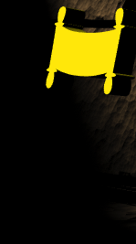
Lotha
ETE BIBLE…
ELAROENA
Designed by Dr. John Fryman, Texas, USA • BibleBasically.org
Taught by Dr. Rick Griffith, Singapore Bible College
All files in many languages for free download at BibleStudyDownloads.org
©2004 TBBMI
9.65.01.
01

Slide 2

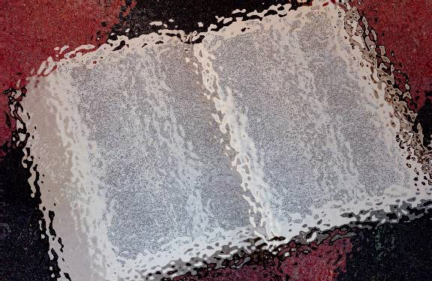

( Meta jiangjo kuvlola? )
ETE BIBLE… ELAROENA
®
ENIOTO
YUTA NSUCHO LANTA: ANCIENT NEAR EAST META JI KISU
02
©2006 TBBMI
9.65.01.
Notes:
In studying God’s Word…somewhere along the way a question always arises..."Where is that place,
anyway?"
So for the next step in building the BIBLE FILE...we'll learn to make a map of the Ancient Near East.
As a subtitle to this section, you might call it, "Dressing the Stage" of all the Biblical action. Let's start.

Slide 3
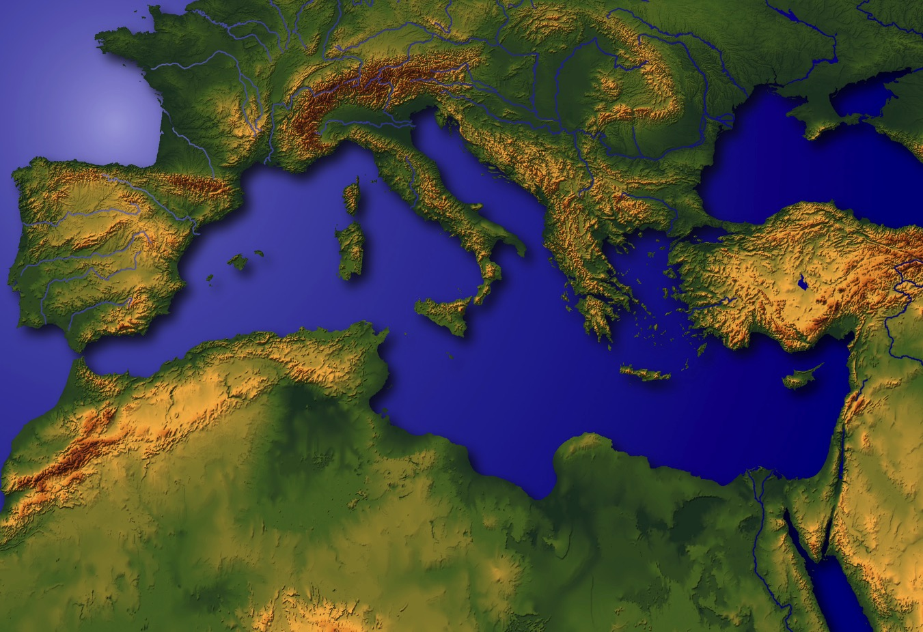
YUTA
ELANI
ZETAV
?
Mediterranean Yuta Bible lo erani elio jiang zetav
4
9.65.02.
4
03
© 2006 TBBMI
03
Notes:
So…LET’S DRESS THIS STAGE!
And here we are...this lonely ball floating in God's infinite space…a beautiful but troubled planet…
the scene of that great story line we’ll soon explore in THE QUICK CHRONOLOGY.
//// So a basic question is.…where, on this planet, did all those great events take place?
In studying God’s Word…it’s really helpful to know just WHERE the WHAT really happened…
and to have it in your own head!
//// Right there...in a far corner of what we call today's Middle East...
//// ….the great story was played out, beginning in that very ancient place with its
mysterious and exotic past…
//// …a part of the world that many have called a hinge of history…
this is the Mediterranean Stage of the Biblical Action.

Slide 4
Mediterranean jumang
LEBANON
SYRIA
Haifa
Galilee jumang
IRAQ
Nazareth
Netanya
Tel Aviv-Jaffa
AMMAN
JERUSALEM
Jericho
Gaza
Hebron
Echu Jumang
Beersheba
ISRAEL
JORDAN
EGYPT
SAUDI ARABIA
Eilat
Gulf of Aqaba
Al’ Aqaba
04
1
Notes:
With a closer view, you can locate the region in today's Mediterranean Basin, at its far eastern end…..
a close-up view of the Holy Land today…hotly divided politically and culturally between
//// …the Jewish and Arabic peoples.... for many reasons that we will uncover as
THE BIBLE…BASICALLY moves along.

Slide 5
MJ
N(A)
H
GJ
C
EZ
B
J
MN
EJ
E
KB
U
NOKSA SHI ETHELANELI!
MS
PG
TJ
Handbook pg. 15-16
1
05
Notes:
Now…the reasons for all this. You’re going to learn to make your own map of the Ancient Near East...
and you’ll use your map to trace the progress of the great Biblical epic...each step of the way...
//// ...just like this…step-by-step as each major section of the story line unfolds.

Slide 6
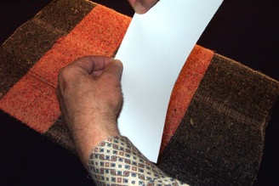
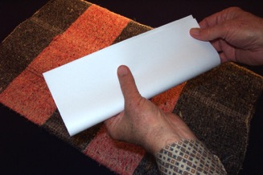
EKHAI NZANCHI #03a; (extra blank page #03b)
KAKOS
MOTSUNGA
KHI KHI
ECHUNGA
NSAKA CHUPA
Handbook pg. 15-16
06
Notes:
Study Help Number 3A and 3B in the student handbook give you blank pieces of paper
to use to make this map.
So please take one of those sheets of paper from the handbook...
then hold it horizontally...fold it lengthwise, once…

Slide 7
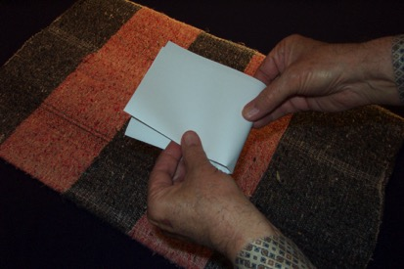
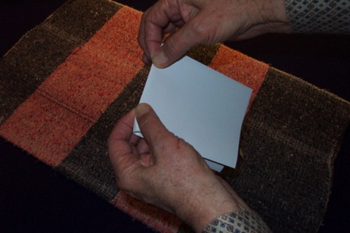
ELANELANI CHUPA…
…ECHUP ENI CHITHOKA.
Handbook pg. 15-16
07
Notes:
...then fold it over once again, so that as you unfold it you have a paper with two creases...
one vertical...one horizontal…representing North-South and East-West directions on your map.
Place it in front of you horizontally...or lengthwise.

Slide 8
Handbook pg. 15-16
3
08
Notes:
With the paper placed lengthwise, get ready to make your new map...to dress the stage...
of the Middle Eastern Biblical action.
//// As we move forward, watch for the addition of the yellow lines.
//// You’ll add those yellow line segments to your own map as we move forward.
Every new line you draw will be shown in yellow as you see here…
//// while the lines you’ve drawn earlier will change to darker colors like this green one.

Slide 9
OVUNGOTO: JUMANG 6
ENIOTO: META 10
ETHUMOTO: KUVOLSANA
Handbook pg. 15-16
2
09
Notes:
So now you know where we are headed...First you will learn to locate SIX of the main
water bodies mentioned in Scripture...
//// and second...only 10 of the most important geographic locations.
This will not be an overwhelming geography lesson. Have no fear of that.
And third…remembering
//// that the locations and distances are ONLY RELATIVE…ONLY APPROXIMATE.
But…close enough to build a reliable mental map of the land and water relationships in Scripture.

Slide 10
Handbook pg. 15-16
1
10
Notes:
On your paper...again, arranging the paper horizontally...in the upper left hand quadrant,
draw a large crescent or arc like the yellow line here…
//// followed by another crescent or arc in the lower right hand quadrant of the paper.
The yellow lines show you exactly how to do this.
Along the way you will also see what those locations look like today.

Slide 11
Handbook pg. 15-16
11
Notes:
Next comes the shape of something like a shepherd's hook,
beginning in the middle of that lower quadrant.
Draw the hook so that it almost reaches the edge of the upper crescent.

Slide 12
META MYING JIANG TIRANA...
OSI AKHOR
BENKADENMO JI
TAE ERANKATA!
Handbook pg. 15-16
12
Notes:
As we move through this map-making, it’s best that you use NO place names.
Instead use only the first letters of those names...not the entire words.
This will force your mind to recall the entire word as suggested by the first-letter labels on your map. Like this…

Slide 13
MJ
Handbook pg. 15-16
13
Notes:
Write MS inside the upper left hand quadrant...
and here is a photo at that water body at this present time.
//// Notice in the upper left hand corner a scriptural reference to this great body of water, known in ancient times as The Great Sea. Many other references or scriptural locations will appear in that same place as we move through the other visuals of The Bible…Basically

Slide 14
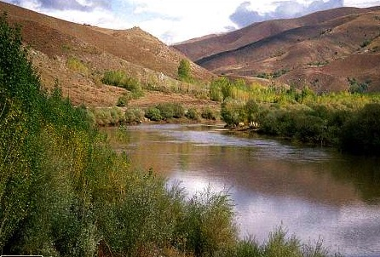
MJ
EZ
Handbook pg. 15-16
14
Notes:
...next…add an ER somewhere in the middle along the shepherd's hook…

Slide 15

MJ
EZ
PG
Handbook pg. 15-16
15
Notes:
...and finally, write in PG inside the lower right-hand quadrant.

Slide 16
MJ
MEDITERRANEAN JUMANG
EZ
EUPHRATES ZHUKHUV
PG
PERSIAN GULF
Handbook pg. 15-16
2
16
Notes:
These single letters represent the full names of the MEDITERRANEAN SEA in the upper left. Again…don’t write in the full word…just the letters…
//// EUPHRATES RIVER along the shepherd's hook...and
//// PERSIAN GULF in the lower right-hand quadrant.
So...three water bodies are located...three more to go: beginning in the lower left-hand quadrant of your map.

Slide 17
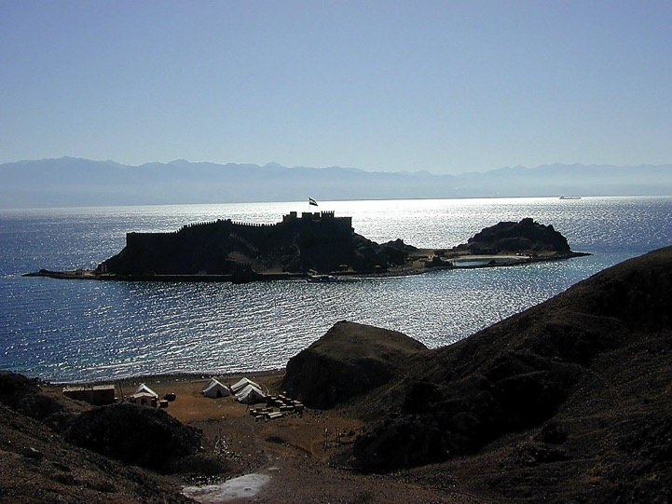
MJ
ER
PG
Handbook pg. 15-16
17
Notes:
…draw a figure that looks something like well-rounded rabbit's ears

Slide 18
MJ
ER
TCHUMYUNJUMANG
PG
TJ
Handbook pg. 15-16
18
Notes:
Inside the ears, and on the water surface, write in RS representing THE RED SEA.
And here’s a good picture of what THE RED SEA looks like today.

Slide 19
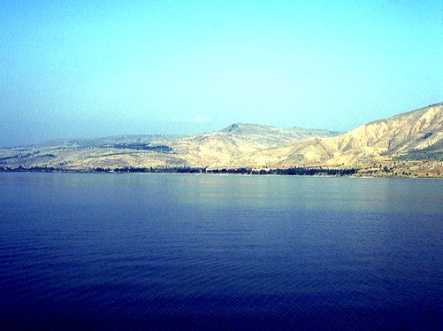
MJ
ER
PG
TJ
Handbook pg. 15-16
19
Notes:
Next move up to a place just below the shepherd's hook. Draw in two flattened oval shapes, a smaller one circled here…

Slide 20
MJ
ER
PG
TJ
Handbook pg. 15-16
20
Notes:
... above a larger one...with a single line connecting the two.

Slide 21
MJ
GJ
GALILEE JUMANG
ER
PG
TJ
Handbook pg. 15-16
21
Notes:
Near the smaller oval...mark it with SG, for THE SEA OF GALILEE.

Slide 22
MJ
GJ
GALILEE JUMANG
ER
EJ
ECHU JUMANG
PG
TJ
Handbook pg. 15-16
22
Notes:
At the larger oval, add DS for THE DEAD SEA.

Slide 23
MJ
GJ
EZ
EJ
JORDAN ZHUKHUV
PG
TJ
Handbook pg. 15-16
23
Notes:
Because the map will become a little crowded as we complete it, don't write in this river name...just know that the short line connecting the two ovals...the Sea of Galilee and the Dead Sea…is the famous and beautiful JORDAN RIVER. You’ll remember that! Our Lord was baptized in these same waters.

Slide 24
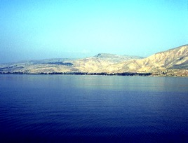

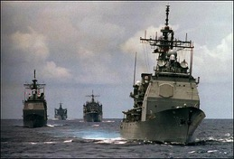
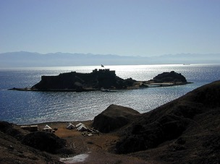
6
MJ
GJ
EZ
EJ
PG
JUMANG
TJ
Handbook pg. 15-16
7
24
Notes:
Now...we've identified and labeled six bodies of water plus a river, each one very important
toward dressing that stage for all the Biblical action to follow. We've placed the
//// MEDITERRANEAN SEA,
//// THE EUPHRATES RIVER,
/// THE PERSIAN GULF,
//// THE RED SEA,
//// THE DEAD SEA,
//// THE SEA OF GALILEE, with the JORDAN RIVER connecting those two bodies.
//// A total of 6 water bodies that make up your map.
OK...that's the water part of your map.

Slide 25

MJ
GJ
EZ
EJ
PG
TJ
Handbook pg. 15-16
25
1
Notes:
Now let's turn toward the land itself...the land that becomes the stage across
which this timeless Biblical drama unfolds.
//// Scripture describes the land of the Bible as this huge land spread across an enormous stretch of Middle Eastern earth.

Slide 26
META 10
10
MJ
GJ
EZ
EJ
META
PG
TJ
Handbook pg. 15-16
26
1
Notes:
We're going to identify 10 --and only 10 -- geographic locations on the land...each one pivotal in the progress of the Biblical story line of THE QUICK CHRONOLOGY that follows.
//// So here we go. At the top of your map, right in the middle, on top of the north-south crease in the paper, write in the phrase, 10 PLACES.

Slide 27
META 10
MJ
4
GJ
EZ
EJ
PG
TJ
Handbook pg. 15-16
27
Notes:
Under "10 places", on the right side of the north-south line, add the number 4 with an arrow pointing east...that is...to the right.
THE CIRCLE YOU SEE IS ONLY A GUIDE TO CALL YOUR ATTENTION TO THE CORRECT PLACES ON THE MAP AS WE MOVE ALONG.

Slide 28
META 10
MJ
6
4
GJ
EZ
EJ
Bible lo ethelan eli meta
PG
TJ
Handbook pg. 15-16
28
Notes:
Then on the left side, write in the number 6 with an arrow pointing to the left. We're now ready to identify those 10 specific land locations on this Biblical "Stage of the Action.”

Slide 29
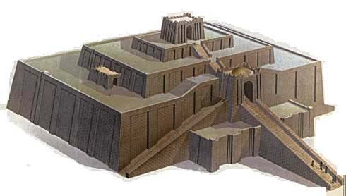
META 10
MJ
6
4
SG
ER
DS
U
PG
UR OF THE CHALDEES
RS
Handbook pg. 15-16
29
Notes:
Beginning on the eastern side of that north-south crease in the paper, down near the mouth of the Euphrates River, near where the river enters the Persian Gulf...write in a large letter, "U" ALONG WITH A VERY LARGE DOT FOR ITS APPROXIMATE LOCATION...standing for that great early city, UR of the Chaldees…famous for its ancient ziggurats or temple towers. Once again, we strongly recommend that you use only the first letters of the words...forcing your thinking to recall the entire word. Memory efficiency is nicely increased with such a simple tool.

Slide 30

META 10
MJ
6
4
GJ
EZ
B
DS
U
BABYLON
PG
RS
Handbook pg. 15-16
30
Notes:
So, U for UR...now we move upriver, perhaps about halfway upstream from the Persian Gulf. Write in a large B, another large dot…for the ancient city of Babylon, a city of maximum international importance in those far-away times.

Slide 31

META 10
MJ
6
4
H
GJ
EZ
B
DS
U
HARAN
(HARRAN,TURKEY)
PG
RS
Handbook pg. 15-16
31
Notes:
Next...somewhere out in that vast landscape, east of the river, write in a large H, for the ancient city of Haran, which, by the way, still exists to this day

Slide 32
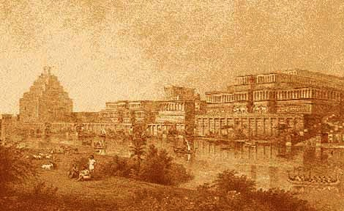
META 10
MJ
6
4
N(A)
H
GJ
EZ
B
DS
NINEVEH (ASSYRIA) MOSUL, IRAQ
U
PG
RS
Handbook pg. 15-16
32
Notes:
And finally, on the east side of the north-south coordinate, far to the east, write in a large N and in parenthesis a large A. These two letters stand for the city of Nineveh in the ancient kingdom of Assyria. Today’s modern Iraqi city of Mosul is located near this ancient site.

Slide 33
META 10
MJ
6
4
N(A)
H
GJ
EZ
B
EJ
U
PG
TJ
Handbook pg. 15-16
33
Notes:
Four sites identified....UR OF THE CHALDEES... BABYLON... HARAN...and NINEVEH IN ASSYRIA.

Slide 34
META 10
MJ
6
4
N(A)
H
CANAAN ENHUNGA
C
GJ
EZ
B
EJ
U
PG
TJ
Handbook pg. 15-16
34
1
Notes:
With the four locations east of the line identified, let's move to the six sites lying to the west of that north-south crease
//// Beginning with a large letter C placed between the Jordan River and the Mediterranean Sea. This letter stands for the entire region of CANAAN, before it came to be known as ancient Israel, or in later history, Palestine, and today, both as Israel and, once again, Palestine.

Slide 35
META 10
MJ
6
4
N(A)
H
GJ
C
JERUSALEM
ER
J
B
EJ
U
PG
TJ
Handbook pg. 15-16
35
Notes:
Near the north end of the Dead Sea, still west of the Jordan River, place a large J, for, of course, the city of Jerusalem...arguably one of the world's greatest and most conflicted cities in all of our planet's history.

Slide 36
META 10
MJ
6
4
N(A)
H
GJ
C
EZ
MN
B
J
MT. NEBO
EJ
U
PG
TJ
Handbook pg. 15-16
36
Notes:
Now move across the Jordan, still near the north end of the Dead Sea...place the two letters MN, representing Mount Nebo. We will identify the importance of this location when we develop The Quick Chronology.

Slide 37

META 10
MJ
6
4
N(A)
H
KADESH BARNEA
GJ
C
ER
B
J
MN
EJ
KB
U
PG
TJ
Handbook pg. 15-16
37
Notes:
Then...at a point below the south end of the Dead Sea, a place almost between the ears of the rabbit, write in KB...for the an ancient oasis named KADESH BARNEA, a picture as it appears today.

Slide 38
META 10
MJ
6
4
N(A)
H
EGYPT: The Giza Plateau
GJ
C
EZ
B
J
MN
EJ
E
KB
U
PG
TJ
Handbook pg. 15-16
38
Notes:
Two more locations to go...Near the top of the LEFT rabbit ear, write in a large E, for the kingdom of EGYPT...a land with infinite ancient mysteries and fascinating to us even today. And finally…

Slide 39
META 10
MJ
6
4
N(A)
H
MT. SINAI
GJ
C
ER
B
J
MN
EJ
E
KB
U
MS
PG
TJ
Handbook pg. 15-16
39
Notes:
...deep in between the two rabbit ears write in ANOTHER MS, only this time the letters stand for MOUNT SINAI. Now you have a complete map, in your head…

Slide 40
META 10
MJ
6
4
N(A)
H
10 META
GJ
C
EZ
B
J
MN
EJ
E
KB
U
MS
PG
TJ
Handbook pg. 15-16
40
2
Notes:
….the 6 on the western side of the map...
//// and the 4 on the east…illustrating the land relationships between
//// these ten monumentally important Biblical land sites.

Slide 41
Yitssoeden 20:1; 2 Sam 17:11; 1 Mesaeden 4:25
META 10
MJ
6
4
N(A)
H
“DAN
LONA
BEERSHEBA
NANDANG”
GJ
C
META JIANG
EZ
B
J
MN
EJ
E
KB
U
MS
PG
TJ
Handbook pg. 15-16
41
3
Notes:
One last addition. Throughout Scripture, we find repeated references to "The Land"...
//// such as in Judges 20:1. Notice again in the upper left hand corner of the frame that
Biblical reference to this term as it’s used in its Biblical sense.
Many more reference citations will be placed there as we move through this study.
So, as shown in the graphic, write in THE LAND in a large oval off the coast of Canaan,
then, extending out from
//// …the oval sketch in two lines...one slightly below the Euphrates hook.…
and another line, running downward between the Dead Sea and the rabbit ears.
The distance between those two lines is generally known as THE LAND throughout God's Word.
//// This is the area traditionally referred to as extending "from Dan to Beersheba.”

Slide 42
MJ
N(A)
H
GJ
C
EZ
B
J
MN
“NTIO
TSOCHO
SANA!”
EJ
E
KB
U
MS
PG
TS
Handbook pg. 15-16
42
Notes:
Now the map is complete. We've sketched in the barest outlines of the "stage of the Biblical action"...the approximate places where so many of these marvelous Biblical events occurred.

Slide 43
ENHUNGA… ECHUNGA ZECHOLANTA...
Handbook pg. 15-16
43
Notes:
Now here's a quick review…where exactly is that place again?

Slide 44
Handbook pg. 15-16
44
Notes:
A blank piece of paper...folded over twice, producing two creases.. NORTH/SOUTH...EAST/WEST.

Slide 45
Handbook pg. 15-16
45
Notes:
In the upper left hand quadrant, a large crescent…

Slide 46
Handbook pg. 15-16
46
Notes:
...followed by another in the lower right hand quadrant.

Slide 47
Handbook pg. 15-16
47
Notes:
Then the shape of something like a shepherd's hook, beginning in the middle of that lower quadrant. Extend the hook almost to the edge of the upper crescent. Remember, NO place names, ever. Only the first letters of the names...not the entire words. It’ll help your memory process.

Slide 48
MJ
Handbook pg. 15-16
48
Notes:
Write MS inside the upper left hand quadrant…

Slide 49
MS
EZ
Handbook pg. 15-16
49
Notes:
...ER somewhere along the shepherd's hook..

Slide 50
MS
ER
PG
Handbook pg. 15-16
50
Notes:
...and PG inside the lower right-hand quadrant.

Slide 51
MJ
(MEDITERRANEAN JUMANG)
EZ
(EUPHRATES ZHUKHUV)
PG
(PERSIAN GULF)
Handbook pg. 15-16
51
Notes:
These single letters stand for MEDITERRANEAN SEA...EUPHRATES RIVER...and PERSIAN GULF.

Slide 52
MJ
EZ
PG
Handbook pg. 15-16
52
Notes:
In the lower left-hand quadrant, draw the rabbit's ears.

Slide 53
MJ
EZ
PG
TJ
Handbook pg. 15-16
53
Notes:
Inside the ears, RS representing THE RED SEA.

Slide 54
MJ
EZ
PG
TJ
Handbook pg. 15-16
54
Notes:
Next move up to a place just below the shepherd's hook. Draw in the two flattened oval shapes…

Slide 55
MJ
EZ
PG
TJ
Handbook pg. 15-16
55
Notes:
…the smaller one…

Slide 56
MJ
EZ
PG
RJ
Handbook pg. 15-16
56
Notes:
... above a larger one...and that single line connecting the two ovals…

Slide 57
MJ
GJ
EZ
PG
RJ
Handbook pg. 15-16
57
Notes:
Near the smaller oval...SG, for THE SEA OF GALILEE.

Slide 58
MJ
GJ
EZ
EJ
PG
TJ
Handbook pg. 15-16
58
Notes:
At the larger oval, DS for THE DEAD SEA.

Slide 59
MJ
GJ
EZ
JORDAN ZHUKHUV
EJ
PG
TJ
Handbook pg. 15-16
59
1
Notes:
The short line connecting the two ovals...the famous JORDAN RIVER.
//// …Six bodies of water and one river...THE MEDITERRANEAN SEA, THE EUPHRATES RIVER, THE PERSIAN GULF, THE RED SEA, THE SEA OF GALILEE, THE DEAD SEA, and THE JORDAN RIVER connecting the two.

Slide 60
META 10
MJ
GJ
EZ
EJ
PG
TJ
Handbook pg. 15-16
60
Notes:
Now turning toward the land itself…At the top of your map, at the north-south crease in the paper, the phrase, 10 PLACES.

Slide 61
META 10
MJ
4
GJ
EZ
EJ
PG
TJ
Handbook pg. 15-16
61
Notes:
Under that, on the right side of the north-south line, the number 4 with an arrow pointing east, to the right.

Slide 62
META 10
MJ
6
4
GJ
EZ
EJ
PG
TJ
Handbook pg. 15-16
62
Notes:
On the left side, the number 6 with an arrow pointing to the left.

Slide 63
META 10
MJ
6
4
GJ
EZ
EJ
U
PG
TJ
Handbook pg. 15-16
63
Notes:
On the eastern side of the north-south line, near the mouth of the Euphrates River, "U"...for UR of the Chaldees. Remember, again, only first letters of the words to force your memory to be active in its recall.

Slide 64
META 10
MJ
6
4
GJ
EZ
B
EJ
U
PG
TJ
Handbook pg. 15-16
64
Notes:
Move upriver, halfway upstream from the Persian Gulf... B, for the ancient city of Babylon.

Slide 65
META 10
MJ
6
4
H
GJ
EZ
B
EJ
U
PG
TJ
Handbook pg. 15-16
65
Notes:
Out in the desert, east of the river, H, for the ancient city of Haran.

Slide 66
META 10
MJ
6
4
N(A)
H
GJ
EZ
B
EJ
U
PG
TJ
Handbook pg. 15-16
66
Notes:
On the east side of the north-south coordinate, far to the east, a large N and in parenthesis a large A...standing for the city of Nineveh in the ancient kingdom of Assyria.

Slide 67
META 10
MJ
6
4
N(A)
H
GJ
EZ
B
EJ
U
PG
TJ
Handbook pg. 15-16
67
Notes:
With four locations east of the line now identified…

Slide 68
META 10
MJ
6
4
N(A)
H
C
GJ
EZ
B
EJ
U
PG
TJ
Handbook pg. 15-16
68
Notes:
...we move to the six locations to the west. Beginning with a large letter C placed near the Jordan River...standing for the entire region of CANAAN.

Slide 69
META 10
MJ
6
4
N(A)
H
GJ
C
EZ
J
B
EJ
U
PG
TJ
Handbook pg. 15-16
69
Notes:
Near the north end of the Dead Sea, west of the Jordan River, J, for the city of Jerusalem.

Slide 70
META 10
MJ
6
4
N(A)
H
GJ
C
EZ
MN
B
J
EJ
U
PG
TJ
Handbook pg. 15-16
70
Notes:
Across the Jordan, near the north end of the Dead Sea, MN, for Mount Nebo.

Slide 71
META 10
MJ
6
4
N(A)
H
GJ
C
EZ
B
J
MN
EJ
KB
U
PG
TJ
Handbook pg. 15-16
71
Notes:
Half way between the south end of the Dead Sea, almost between the ears of the rabbit, KB...for the oasis of KADESH BARNEA.

Slide 72
META 10
MJ
6
4
N(A)
H
GJ
C
EZ
B
J
MN
EJ
E
KB
U
PG
TJ
Handbook pg. 15-16
72
Notes:
Near the top of the LEFT rabbit ear, a large E, for the kingdom of EGYPT... and finally…

Slide 73
META 10
MJ
6
4
N(A)
H
GJ
C
EZ
B
J
MN
EJ
E
KB
U
MS
PG
TJ
Handbook pg. 15-16
73
Notes:
...deep between the two rabbit ears... MS, for MOUNT SINAI.
And this map for dressing the stage of the Biblical action…

Slide 74
META 10
MJ
6
4
N(A)
H
GJ
C
EZ
B
J
MN
EJ
E
KB
U
MS
PG
TJ
Handbook pg. 15-16
74
1
Notes:
…requires only the 10 land locations ... just 10..no more, no less…
//// … and the 6 water bodies... These few locations will do the job for now. Except for one more item…

Slide 75
META 10
MJ
6
4
N(A)
H
META JIANG
GJ
C
EZ
B
J
MN
EJ
”DAN
LONA
BEERSHEBA
NANDANG”
E
KB
U
MS
PG
Yitssoeden 20:1
TJ
Handbook pg. 15-16
75
Notes:
And that is the..."The Land" as it is mentioned throughout Scripture.
The distance between those two lines is that region the Bible calls THE LAND –
… "from Dan to Beersheba"...generally the extent of God's promise to Abraham in the early chapters of Genesis. Much more about that as THE BIBLE...BASICALLY continues.

Slide 76
MJ
N(A)
H
GJ
C
EZ
B
J
MN
“NTIO
TSOCHO
SANA!”
EJ
E
KB
U
MS
PG
TJ
Handbook pg. 15-16
76
Notes:
And so: the grand "stage of the action" on which the vast Biblical drama was played out in the ancient times...an historic drama that continues working out the great Plan of the Ages up to and beyond this very moment.

Slide 77
NTIOLI SHIANG ZETACHO SANA...
Handbook pg. 15-16
77
Notes:
Now the reason for all this... First…

Slide 78
Khumkiwoe liko mhom lona benkae Jolowoe ethelan nlio meta nandang…
Handbook pg. 15-16
78
Notes:
…to know as intimately as possible – without going there – that the Bible Land is a real place, filled with vibrant life and beauty, with enormous geographic contrasts and challenges...from the fertility of the North to the desolation of the South…the place of Abraham’s ancient inheritance…with the drama extending right down to our own day.

Slide 79
MJ
N(A)
H
GJ
C
EZ
B
J
MN
EJ
…Ni kichuki ntio Tsocho sana shiang topvu thechie vata!
E
KB
U
MS
PG
TJ
Handbook pg. 15-16
79
1
Notes:
[A second reason for studying geography is] so that you’ll be able to set the stage in your mind’s eye for the great Biblical drama! To clearly understand...and be able to create for you…
//// …the line of progress as the Biblical story unfolds. Knowing those routes of travel and interaction with the land and the environment…it’s all a major key toward clarifying a unified understanding of Scripture. As you work through THE QUICK CHRONOLOGY just ahead, you will be learning about this route across the land and the progress of the Bible’s timeless story...the story that brings us the Gospel message of the Lord Jesus Christ!

Slide 80
MJ
KHETSEN
N(A)
ABRAHAM
H
JOSEPH
SG
MOSES
C
ER
JOSHUA
B
J
NZO-NGA
MN
LANPVUTSON
EJ
SAYAKUPO
E
NOYING
KB
JISU
U
MJ
PG
TJ
Handbook pg. 15-16
80
Notes:
So the basic pieces of the puzzle are in place...the ten folders of THE BIBLE FILE...CREATION THROUGH JESUS…along with this map called DRESSING THE STAGE -- which you can now draw for yourself. We're ready to start sorting out that enormous Biblical puzzle and we’ll sort it all out based on the grand story line of the Bible.

Slide 81
ENHUNGO NIPOPO NI KICHUKI ANCIENT NEAR EAST NOKSA JI NSUNGRI ZETA!
NOKSA NZANCHI KAKO#30
Handbook pg. 15-16
81
Notes:
Now it’s your turn…to make your own map of the ancient Near East from inside your own head! A completed map for reference in shown on Study Help Number 30. Blank pages for making your map are on Study Helps Number 3A and 3B.

Slide 82

Enhungo Ete Bible…Elaroena, ji khikhi ni nchumri lo…
•Engathe mhom “Bible Vaphen” Ji
•Nchumri chonchia “Ete Bible vaphen”…K 7 N J
•Ni Kichuki Noksa nsungria bible lo mbao meta jiang
•Bible “MOTSU” Olongo ji:“Ntio tsoa yithakcho sana”
1
82
Notes:
With the map drawn and stored away mentally...we're a lot closer to being able to answer the question:
"Where is that place, anyway?"
Our strong suggestion is that, on your own, you practice making this simple map four or five times.
//// After that, you, too, will know where that place is – or was -- after all!

Slide 83
Ntio tsoa yithakcho sana!
“Meta shijo kuvlola?”
“Nina meta jiang enhungo topvu nitsivlo nung!”
Handbook pg. 15-16
1
83
Notes:
By now you can make your own map of the Ancient Near East. You also have the idea called THE BIBLE FILE…the key to open it…and the map.
We know where we are going…
//// …and have arrived at the very core -- the heart -- of THE BIBLE...BASICALLY. We're ready now to explore THE QUICK CHRONOLOGY of Scripture's amazing storyline. And we move on along.

Slide 84
Lotha
ETE BIBLE…
ELAROENA
Designed by Dr. John Fryman, Texas, USA • BibleBasically.org
Taught by Dr. Rick Griffith, Singapore Bible College
All files in many languages for free download at BibleStudyDownloads.org
©2004 TBBMI
9.65.01.
01

Slide 85


The Bible…Basically link at BibleStudyDownloads.org
Get this presentation for free!
Notes:
The Bible…Basically (bb)

Slide 86
85
©2006 TBBMI
9.65.02.

