Slide 1
RAVRAAMEI KWM:
ABRAHAM-JOSEPH 2000 B.C.
MOUSI-JOSHUA 1500 B.C.
01
Notes:
Riatloumei–ganv: kalaihmei…ntauthu 1500 B.C e. Ntauhei aniu tingkwm 500 dou aniu tuang reymungc ganv thangc tat anaa gut bam tuang e. Ningtowlou o: tingkwm hei chak raraavloumei na de!

Slide 2
7
Tatpatmei (Tat) 2:10
DAMHMEI
ABRAHAM
ABRAHAM
"A
Jouc
Mai
Jamc e"
ABRAHAM
JOSEPH
ABRAHAM
MOUSI
JOSHUA
KAGUAKCMEI
GUANGHDIC
NYMLOUMEI
KARIMMEI
JISU
Bansinbuk kadip 26-29
02
Notes:
Ningtow baansin tei…A JOU MAI JAMC E…mihei rui lat riang khou naimei M, tumei thu…MOUSI tihei the. Kumna hei khou MOUSI thuap hei nang tuang Baible khukh rian khou tei naibam the.

Slide 3


7
Tat. 8:1
MOSES
ca. 1500 B.C.
AMEINUNC TATPAT KANDIU!
“MEICKANG 4” khourui KATHUMHMEI
tei:
AJMJ
MOUSI
40
Bansinbuk kadip 26-29
03
1
Notes:
MOUSI tumei thuap tei how the...meickang daihmei padeih khou kathumhmei the ...kalam mpeihna kathuap lungc khou tei haplou khang nai the.
Israelmei rui tingkwm phay mbu bangh swguangmei tangv, MOUSI tei “taancpatnimei bamv” tuang kalaa khou gut the. Kamei rui Pharaoh daeng khou kaluaih dat-datna guangna sa the…
//// “…AMEINUNC TATPAT KANDIU.” MOUSI rui Egypt ruc khou alun katangv -tangv swna kauc ndauhlou kanmei tangv nah rui Pharaoh tei Israelmeinunc ta mpatlou kan e.

Slide 4
7
Tat. 12:31
MOUSI
ca. 1500 B.C.
TATPATMEI!
TATPATMEI
“MEICKANG 4” khourui KATHUMHMEI
tei:
AJMJ
MOUSI
Tatpatmei
40
Bansinbuk kadip 26-29
04
1
Notes:
MOUSI rui zayloumei bangc khou Israelmei meickangdai kaniw kaikhunc kazauhna bangh swbammei khou rui Egypt mpatlou khang nuhlou the…kathaibammei nunc rui saaloumei thei layna kaniu sing tei crore kanei dou bam nuh e. Kumna mitihei TATPATMEI twna nthanna aniw thay e.
//// Kumna mihei Mousi thuap khou reyliangmei lam the.

Slide 5
KABAMV KAPUIMEI
Tat. 12:31; 19:2
MD
N(A)
H
GZ
C
ED
B
J
NC
MOUSI
DS
Tatpatmei
TATPATMEI!
E
KB
U
40
SC
PD
HD
Bansinbuk kadip 26-29
05
Notes:
Kahiak ntingmei rui dih hiak khou reynungc chaengtat kasuihmei tei ntau thu neihpat biak karih tangna dihba biak keyna Sinai chyng tuang kaguangcmei bamv khou key the… nang baanc rui hiaklou kanmei dichiak khou tei, achaw kameigaymei nu kumhmei kak raph khou tei the.

Slide 6
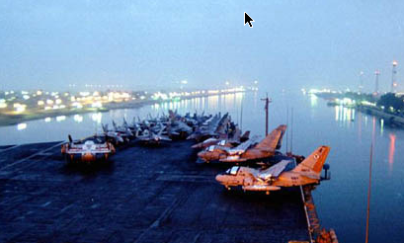
KABAMV KAPUIMEI
Tatpatmei 13:18
MD
N(A)
H
SG
C
ED
B
J
NC
NSEICDOU SUEZ DUIRIANG KAANPATMEI
MOUSI
TD
Tatpatmei
E
NTOU DUIPUI:
"YAM SUPH"
40
KB
U
SC
PG
HD
Bansinbuk kadip 26-29
06
2
Notes:
MOUSI rui zaylouna, Israelmeinunc tei kaguangcmei ganv khou Haenghmei Duipui twna kawmei duipui tat kaan the.
/// Kumetiki, kathai bammei mpeyna rui – khatni, aniuni kalingmei tei thu –
Ntou Duipui e twna lwm e -- hamhthei Yam Suph twna kaw e. Mitei Egypt lev Sinai duikak dic tuang ramvrei khou naimei duibwng e, nkhamhna Nkhucmei Zeilatnunc twna tingkum phay phay mbumei tangv kaw guang dat kan e.
//// Mitei ntau kandih kwn gwai khou dihpwm tuang lanhguanhmei tiguang tangclou bammei Suez Duiriang naimei ramdwn tei e.
Ravguangc rui MOUSI ta nuhlouna Pharaoh tuang Egyptmei ricmeinunc rui alay guang bam sinih, meicnunc tateic duipui kaan patnah phuimei bamv khou zaypatlou the. Dui tei kalwnlung khou hanc guangdat pukhou Egyptmeinunc Israelmeinunc ta kathau tangc changhmak khou dui rui liakbin kan the.

Slide 7
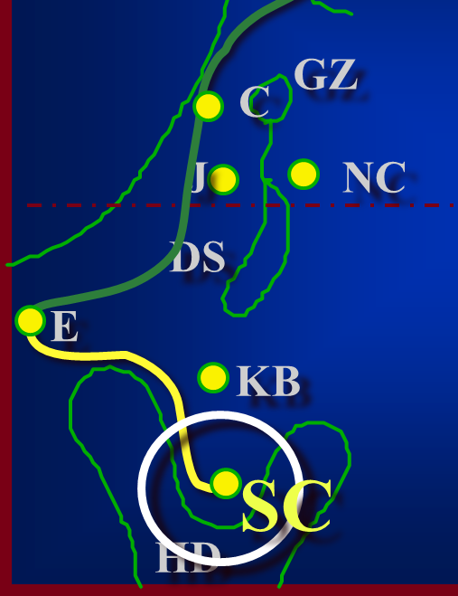
7
Tat. 19
MOUSI
ca. 1500 B.C.
TATPATMEI
SINAI
AJMJ
MOUSI
Tatpatmei
Sinai
40
Bansinbuk kadip 26-29
07
1
Notes:
Kabiak khat thang tei gayna kaanpatlana, MOUSI rui kabaanc nzat rui SINAI biak dinclana…Israelnacnunc ta dihba biak nzuanvna nduanghtat the.
//// Khit khitna kaniu tei SINAI CHYNG guang tangc the, Sinai duikak dic lungc thang...achaw nukak khoutei the.

Slide 8
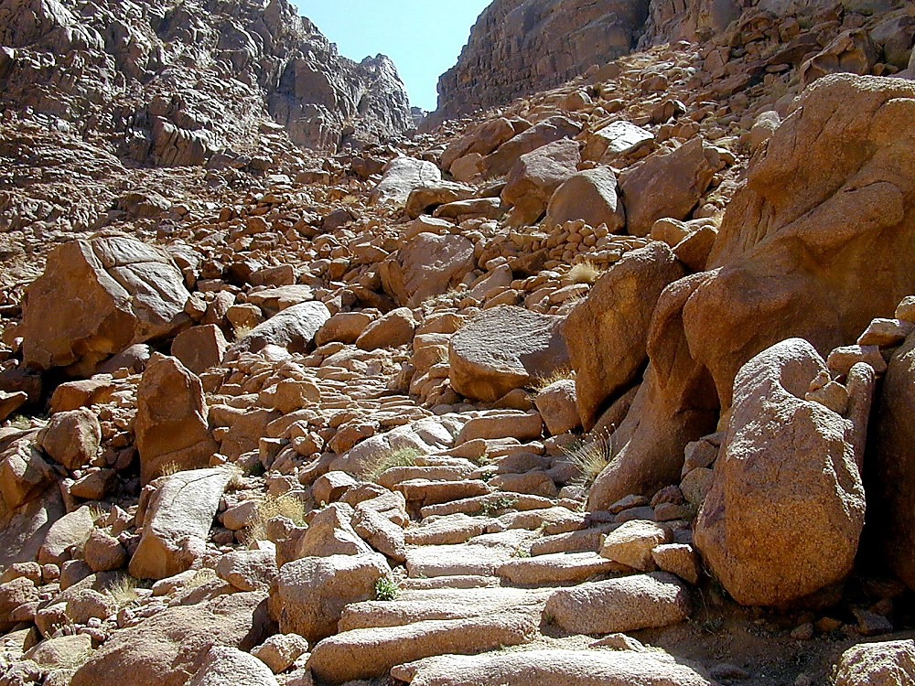
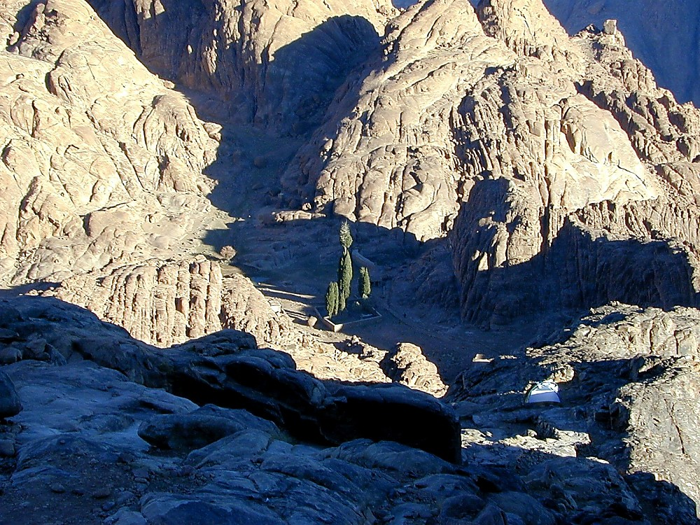

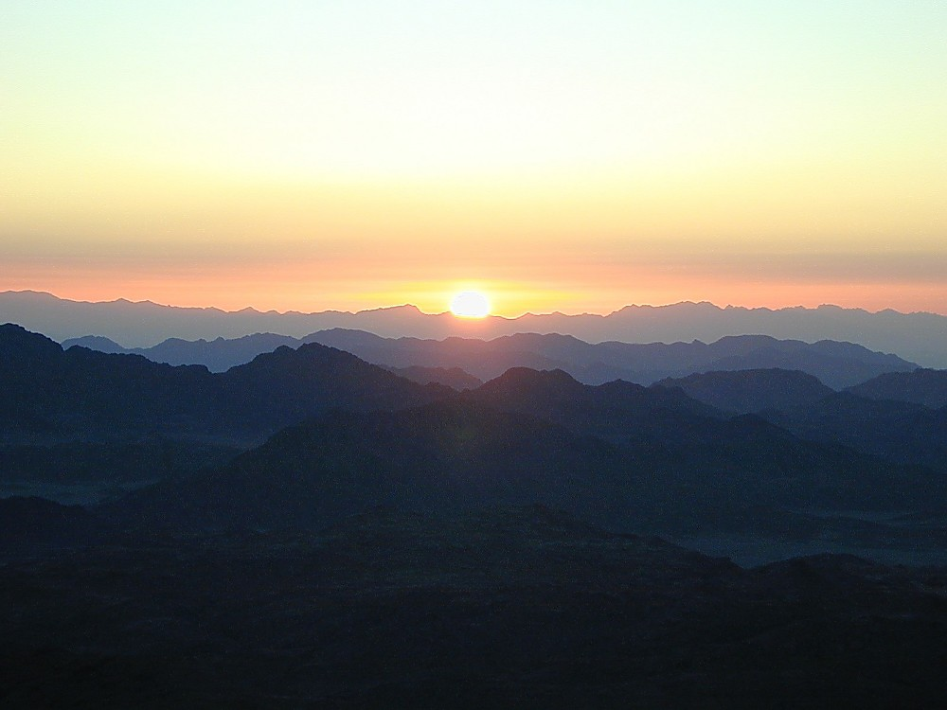
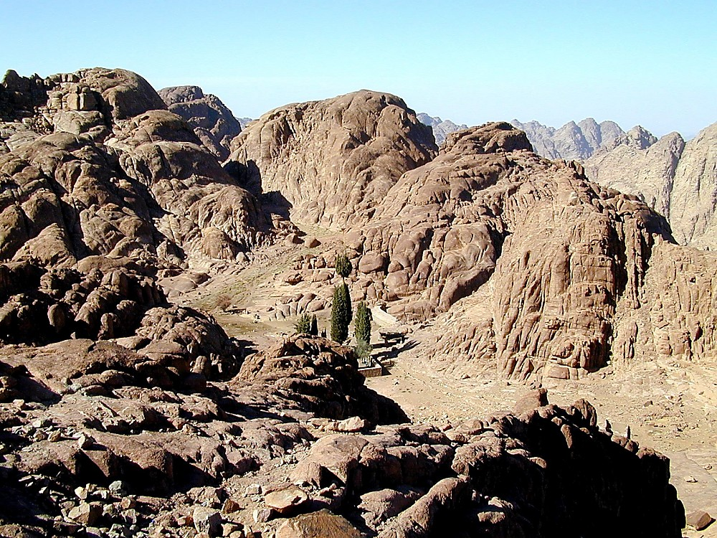
Tat. 19:2
MOUSI
Tatpatmei
Sinai
40
Sinai Chyng:
Kariak Latdanv tiloumei tuang kabiswmei bamv
Bansinbuk kadip 26-29
08
Notes:
Mihei kaguangmei Sinai Chyng bamv e, nseicdou tuang St. Catherine Ravkai daeng khou e. Katupna nseicdou tuang ravkalum tatmeinunc rui mituang chyng tuanv khou tei kaphat kuna Egypt khou neih patmei ta zauc raph-rap e tue. Makumhlou o kanganv kutanghmei chwn tisilou ngammei khatni manim kanmei ram howgay tei!
Mibamv khou Ravguangc rui katuang reyliangmei muczwng MOUSI khou kameicnunc ta kachuc kan e. Khou tei Kariak Latdanv, Ibrimei lat khou Torah twmei tei kaniu khang tilou kan e.

Slide 9
7
Tat. 20–31
MOUSI
ca. 1500 B.C.
TATPATMEI
SINAI
AJMJ
K - G - N
MOUSI
Tatpatmei
Sinai
K - G - N
40
GAYMEI RIAK
MEICNUNC THOUC
THOUHMUNG
Bansinbuk kadip 26-29
09
3
Notes:
Khouhei…Jehovah Ravguangc rui…Katuang riakdanv MOUSI khou kalangv kathunh swna tipat kan e: G…. M…. T
//// Gaymei riak,
//// Meicnunc Thouc
//// Thouhmung….
…Riakdanv tuang kalangv kathumh tei Ravguangc baanc kahak rui Mousi khang Sinai Chingc ruc khou tilou kan e…LIANGNEI SWNA!
MOUSI thuaph khou naimei hei latkaengnunc tuang thei-rei tei ningtowlou bam kho: G-M-T.

Slide 10
7
Tat. 20–31
RIAKDANV (TORAH)
Ravguang Tuang Nchamloumei Kalangv Kathumh Patmei:
MOSES
Exodus
Sinai
K - G - N
40
Bansinbuk kadip 26-29
10
Notes:
Ibrimei lat khou TORAH twna kawmei, Kaipouc tuang daicliangmei kaipat Israelmeinunc khang tiloumei hei kalangv kathumh patna dinc nuh khang kasiamhlou e.

Slide 11
7
Tat. 20–17
RIAKDANV (TORAH)
Ravguang Tuang Nchamloumei Kalangv Kathumh Patmei:
GAYMEI RIAK: Latdanv ruh; ntau-taw naibammei ngamvziu riak tuang bangbi e.
MOUSI
Tatpatmei
Sinai
K - G - N
40
Bansinbuk kadip 26-29
11
Notes:
Gaymei Riak twna langpatloumei riakdanv tei aniu rui Latdanv Ruh twna thay e. Mituang daickanmei riak hei ntau-tau naibammei ngamziu geihmei tuang bangbi e.

Slide 12
7
Tat. 21-24
RIAKDANV (TORAH)
Ravguang Tuang Nchamloumei Kalangv Kathumh Patmei:
GAYMEI RIAK: Latdanv ruh; Mihei ntau-taw naibammei ngamvziu riak tuang bangbi e.
MEICNUNC THOUC: Tukumhna khat khat kak khou gayna kathancmei charuang khou lungc nchamc ni.
MOUSI
Tatpatmei
Sinai
K - G - N
40
Bansinbuk kadip 26-29
12
Notes:
Riakdanv khou MEICNUNC THOUC tumei rui dinhcloumei hei– Ravguangc ngamziw bangc khou – meicnunc rui khat-khat khou tabui taanclou karina lungnicho twmei hei nthuk ranvmei lungcriak swna, guangnimei ganv khou sivpungramv khou bamni nrianhloumei dic guangtangc pukhou bamni piubam khang tumei hei e. Miganv khou tei, Israelmeinunc tei tingkwm 40 tazikramv khou ruan bam puni twmei thaymak bam khwan e. Tiki kaniw ta guangnimei kunghmei ganv khou tei ringc nuh khang Ravguangv rui tatnimei riak dinc chamdaanvlou khwan the.

Slide 13
7
Tat. 25-31
RIAKDANV (TORAH)
Ravguang Tuang Nchamloumei Kalangv Kathumh Patmei:
GAYMEI RIAK: Latdanv ruh; Mihei ntau-taw naibammei ngamvziu riak tuang bangbi e.
MEICNUNC THOUC: Tukumhna khat lev khat kak khou gayna kathancmei lungcriak lungc khou bam ni.
THOUHMUNG: Kathanhmei lunghriak lungc khou tukumhna Ravguangc ta kalwmni.
MOUSI
Tatpatmei
Sinai
K - G - N
40
Bansinbuk kadip 26-29
13
Notes:
Riakdanv tuang THOUHMUNG riak khou Ravguangc rui Kameinunc ta sipung ramv tuang kalumpui pheykai kathanc khou khatni katangv thangc Jerusalem khou kasiamh thaunimei ravkai daihmei khou tei tukumhna Kata kalum nina cho twmei dinclou e. Kathancmei kalummei thiak khou gutnimei nthuk kanmei thoucmung hei rui guangnimei kin khatni Messiah kak khou naimei riang ta dinc kasuakc lou e. Riakdanv lam khou para thei kathai mbu khith-khit gut bam kho.

Slide 14

Singchakh 20:13
KABAMV KAPUIMEI
MD
N(A)
H
GZ
C
ER
Ntau ganv Egypt tuang Kadesh Barnea khou zaengthaekc ramv
B
J
NC
MOUSI
TD
Tatpatmei
Sinai
E
K - G - N
KB
U
40
SC
PD
HD
Bansinbuk kadip 26-29
14
2
Notes:
Ravguangc rui kaniw khang Latdanv thanh tiloumei tangv, MOUSI rui zaat puinac kasiamh the,
//// kaniu ta KADESH BARNEA tuang zaeng nthaekbamv thangc nduangh ku the,
//// zaengthaek ramv gaymei ariu the – mihei Egypt tuang sypungramv khou, Israelmei ramvrei khou rui duh makna naimei bamv e. Kadesh Barnea khou kaniw bamkey lana, dihpy biak thangc tat khang Ravguangc rui nuhloumei ta nkhwan the— Abraham lunghpui ramc tei taanvna – Negeb tuang sikanmei sypungramv khatni Sinai tat kaan pat the.

Slide 15
7
Singchakh. 32:8; Riakdanv Kaluaihmei (Riak) 1:19
MOUSI
ca. 1500 B.C.
TATPATMEI
SINAI
AJMJ
K - G - N
KADESH BARNEA
MOUSI
Tatpatmei
Sinai
K - G - N
Kadesh Barnea
40
Bansinbuk kadip 26-29
15
Notes:
Kumhmei zaeng rui, KADESH BARNEA hei MOUSI tuang thuaph khou nai the. Nkhamhliang khou, meicnunc tei kaniw pupoununc khou nrianhloumei dic ABRAHAM, ISAAC khatni JACOB lunghpui dic tei nzuanv ngalanv dat the.

Slide 16

MOUSI KHANG LATLAM THANH KAGE NAI THE!
7
Singchakh 13
MOUSI rui zaatc khyn nunc ta kaw e.
MOUSI
Tatpatmei
Sinai
K - G - N
Kadesh Barnea
40
Tazikramv khou Kalumpui Pheykai
Bansinbuk kadip 26-29
16
2
Notes:
KADESH BARNEA khou bambam khou Israelmei zaat gwai tei KALANGV KALANGV swna kalumpui pheykai daeng bam nkwai bam khwan e – tazikramv khou nthuk kanmei kalumpui bamv tei… Sinai chyng khou RIAKDANV tuang THOUHMUNG lam tiloukanmei khou Ravguangc rui dinc nthan thiakloumei lungc khou kasiamh kan e.
//// Miganv khou tei…Mousi khang latlam thanh thay khang kage nai the! Gaymei zayloumei akhat rui taancpatnimei thouc lam khou ngangvlou nuhmei ningting hamhthei latlam nai khang kage nai the.
//// Ravguangc rui MOUSI khang latdanv tiguang the…. tumei thu zaatc 12 khyn gaan khat-khat kapahlou khang... khatni kaniu tatpat lana Canaan kandic guanrum tat khang tumei hei the.

Slide 17
7
Singchakh 13; Riak. 1:19-23
KABISWMEI LATHANV ASAEK…
“KADIC" kiu tukumh bo?
Meicnunc kiu thow thow?
Duithuak nunc lev duipuakkai nunc tho?
MOUSI
Tatpatmei
Sinai
Chyng lev Nwm tho?
K - G - N
Kadesh Barnea
40
Kathav gaymei laubamv?
Tabui taektu mphangbo?
Bansinbuk kadip 26-29
17
6
Notes:
Mihei kabiswmei lat thanv asaek e, Heikhang rui Mousi khang nganglou nuhmei lat dau kage nai khwan e…
//// Kadic kiu tukumh bo?
//// meicnunc kiu thow-thou?
//// Duithuak lev duipuakkai naidai?
//// Chyngnunc? Nwmnunc?
//// Kathav gaymei laubamv naidai?
//// Taektu kadyng khou mphang punih dai?

Slide 18
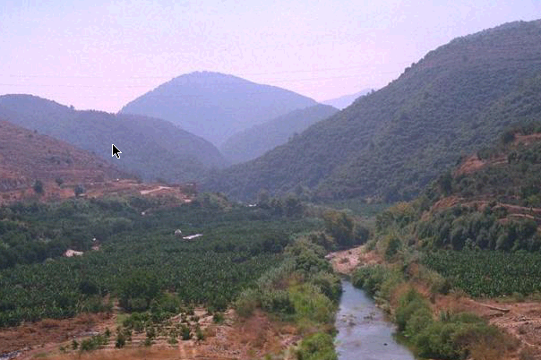
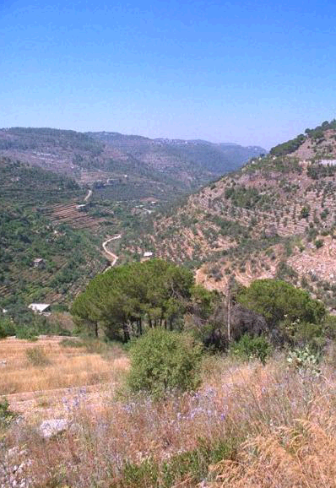
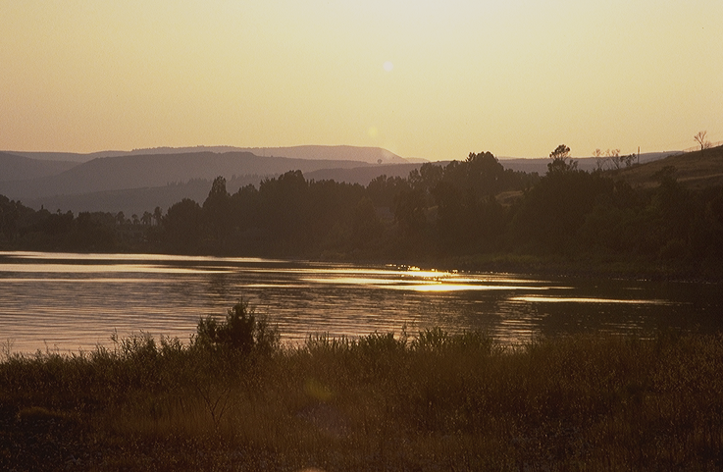
KABAMV KAPUIHMEI
Singchakh 13
MD
N(A)
H
DIHPY THANGC ASEICDOU LEBANON DICBA BIAK NZUANV KULANA…
GUANRUM TATMEINUNC CHAENGKAEMV
GZ
C
ER
B
J
NC
MOUSI
TD
Tatpatmei
Sinai
E
K - G - N
Kadesh Barnea
KB
U
40
SC
PG
HD
Bansinbuk kadip 26-29
18
Notes:
Kamei rui ngganvnunc tateic Canaan thangc tatna “kadic guanrum tat khang” nchamlou the. Kaniu tei dihba biak ngangh lana aseicdou tuang Lebanon dicba khou tangclou the. Guanrummeinunc tei, kathav gaymei khatni howgay kanmei, kandih lungcthau nuhmei tuang thiak raana naimei dic tat ariu the.

Slide 19
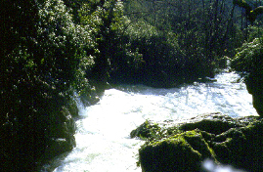
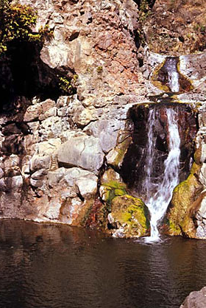
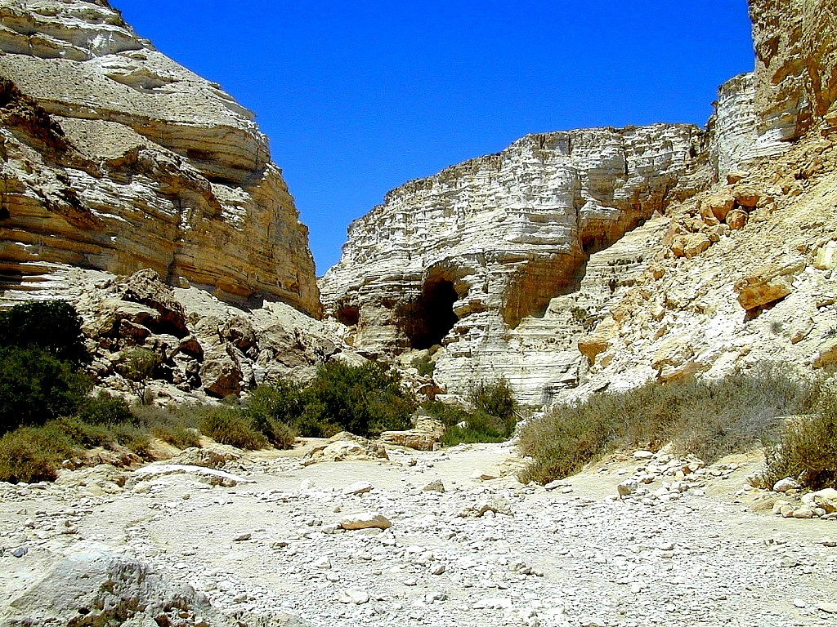
KABAMV KAPUIHMEI
Singchakh 13
MD
N(A)
… DICBA THANGC NGALANC KEYNA KADESH BARNEA TWN E.
H
GUANRUM TATMEINUNC CHAENGKAEMV
GZ
C
ER
B
J
NC
MOUSI
TD
Tatpatmei
Sinai
E
K - G - N
Kadesh Barnea
KB
U
40
SC
HD
Bansinbuk kadip 26-29
19
Notes:
Kaniu dihba biak tat karih keydatna – ngalanc guangdatmei chaengkaemv khou tei – katuakcmei mpeyna naiguangnimei khudamc how khwan the. Tabuizaeng cho? Kalamthu kadic tei zaat nthiamvmeinunc khatni guanghdicnunc rui padik the – Canaanmeinunc khatni zaatc bai-baihmei kangnunc khatni khwangnunc naibammei how the. Israelmeinunc tei Kadic khou gut khang rui kaniu ta athung lana– Ravguangc tuang latdanv loumei thei layna ramlaa gut khang e.

Slide 20
Singchakh 13:26-14:9
KABAMV KAPUIMEI
Latbamv tei mihei e:
MD
GUANRUMMEI RUHNAKANEI: POULOUMEI KANEI
GUANRUMMEI 10 : MEICGEIHMEI CHWN
GUAIHNOUDUI LEV NKHUAIHDUI DIC!
KADIC KHOU LAENGTUANGH NAI E!
EGYPT THANGC NGALANC THO!
GUANRUMMEI 2: MEICRAUMEI CHWN
GUAIHNOUDUI LEV NKHUAIHDUI DIC!
KADIC KHOU LAENGTUANGH NAI E!
RAVGUANGC ANIU BIAK BAM E!
N(A)
H
SG
C
ER
B
J
MN
MOUSI
TD
Tatpatmei
Sinai
E
K - G - N
Kadesh Barnea
KB
U
40
SC
PD
TATGUT DIKHO!!!!!
HD
Bansinbuk kadip 26-29
20
12
Notes:
Latbamv tei heikum khwan e…
//// Guanrummei gaanv ruhna kanei rui kaniw howloukanmei tei MOUSI khou poulou khang KADESH BARNEA ngalanc guang dat the. Pouloumei lat tei kaniu ram machak thei layna kalam baic taphtapmei kanei swna how e.
//// Geihmei rui samei: Guanrummei ruh rui saa e
//// “Guaihnoudui lev nkhuaihdui dic tei ariu dyng the.
//// Tiki khou tei kapumtan naimeinunc padikna lungcbam e... kadic khou tei laengtuangh nai e, twna saa the...hei zaengrui, kaniu mikzaw khou thu Israelnacnunc hei nkanah kumh tuang dithe. Mi guanrummei 10 tei Ravguangc rui katyloumei kumc kadic tei gut laangam puni twmei lwmmak khwan e— khatni milam tei raacna bam khang kaniw panty kan makge.
//// Kaniu ram dinlou thu: Egypt thangc ngalancdat lana ramlaanimei chamraeng gwai hei mpatlou khang twmei the.
//// Kumki, guanrummei kanei liamhloumei— kaney zanc JOSHUA khatni CALEB tw e—kaney raana chwn tithay e: saabammei latbamv tei nchumh the twna saa the.
//// Guaihnoudui lev nkhuaihdui dic the!
//// Laengtuangh nai e...twmei nchumh the.
//// Kumbamsinih, kaney rui kauc ndauh the, Ravguangc aniu daeng bam tuanc bam e. Kadic hei laagut ngam puni de!
//// HEIZAENG ANIU TATGUT DIKHO!
//// Naibam the...pouloumei lat kanei...chwn kanei...
Tiki meicnunc tei Ravguangc tuang gaekloumei khatni tiiloumei khou lwmlou dai?
Hamh the, kaniu lwmlou mak khe.
//// Meicnunc tei guanrummei GEIHMEI RUI POULOUMEI LAT biak layliangc khwan e! Kaniw tei pinglang tipui zaeng rui Ravguangc tuang nthanthiakmei chamraeng khatni latryan ta piumak khwan e.

Slide 21
Singchakh 14:20
KABAMV KAPUIHMEI
Latbamv tei mihei e:
MD
GUANRUMMEI RUHNAKANEI: POULOUMEI KANEI
GUANRUMMEI 10 : MEICGEIHMEI CHWN
GUAIHNOUDUI LEV NKHUAIHDUI DIC!
KADIC KHOU LAENGTUANGH NAI E!
EGYPT THANGC NGALANC THO!
GUANRUMMEI 2: MEICRAUMEI CHWN
GUAIHNOUDUI LEV NKHUAIHDUI DIC!
KADIC KHOU LAENGTUANGH NAI E!
RAVGUANGC ANIU BIAK BAM E!
N(A)
CHAENGTAT MAEK KHE!
H
SG
C
ER
B
J
MN
MOUSI
TD
Tatpatmei
Sinai
E
K - G - N
Kadesh Barnea
KB
U
40
SC
PD
HEIZAENG...TAT LAKHO!!!!!
HD
Bansinbuk kadip 26-29
21
Notes:
Latdau swna MOUSI rui Canaan tei gutna laa tho twna latdanvlou mak khwan e. KADIC GUTNIMEI CHAENGTAT TEI TATGUT MAK KAN E! KAGANV ASAEKC KHANG!

Slide 22
7
Singchakh 32:13
MOUSI
ca. 1500 B.C.
TATPATMEI
SINAI
AJMJ
G - M - T
KADESH BARNEA
40
MOUSI
Tatpatmei
Sinai
K - G - N
Kadesh Barnea
40
40
Bansinbuk kadip 26-29
22
Notes:
Mousi tuang thuap khou hei kasing 40 hei haphlou the.
Kaniw latpiumakmei khatni lwmmei nthiamvpui zaeng rui, Ravguangc rui Israelmeinunc ta tazikramv khou tingkwm 40 ruantat khang swlou the —

Slide 23
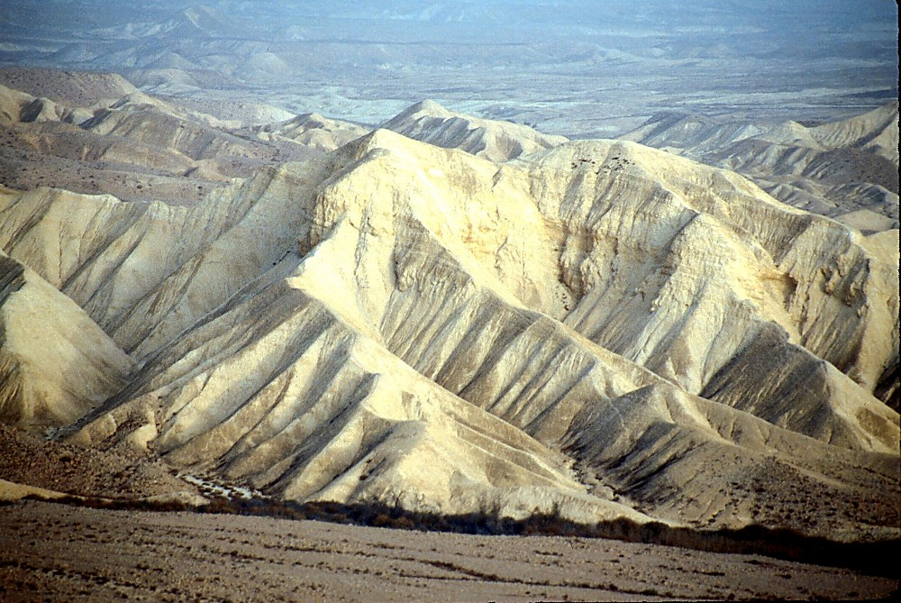
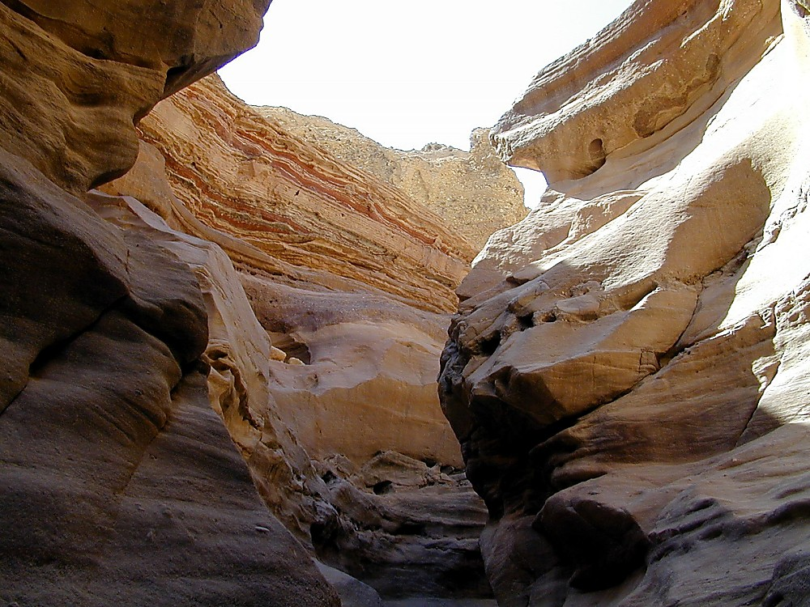
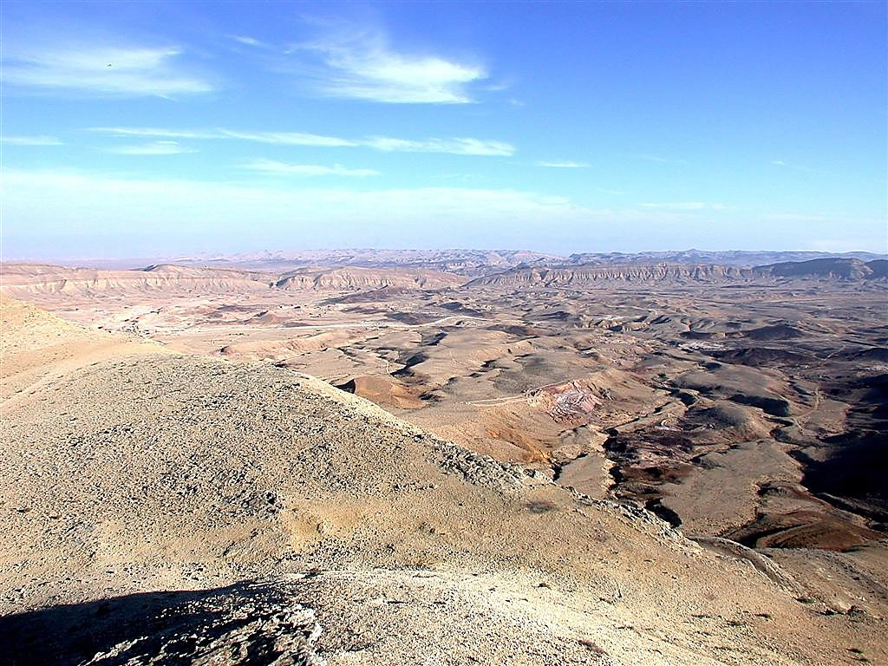
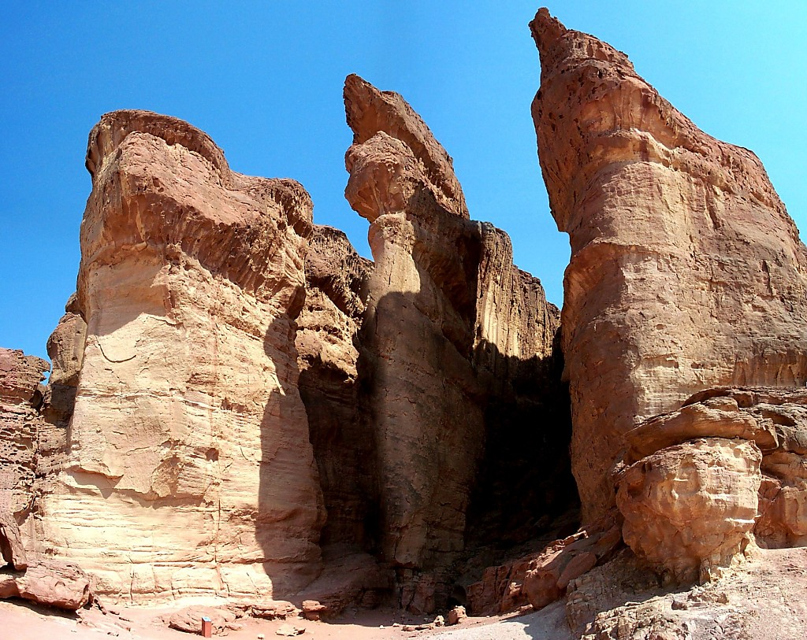
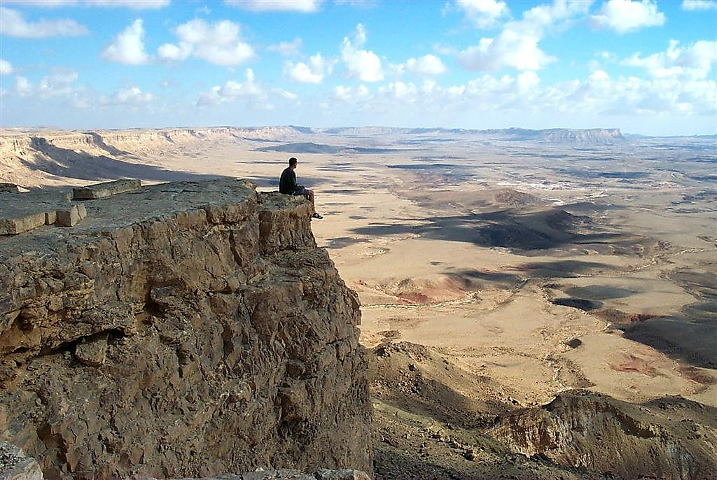
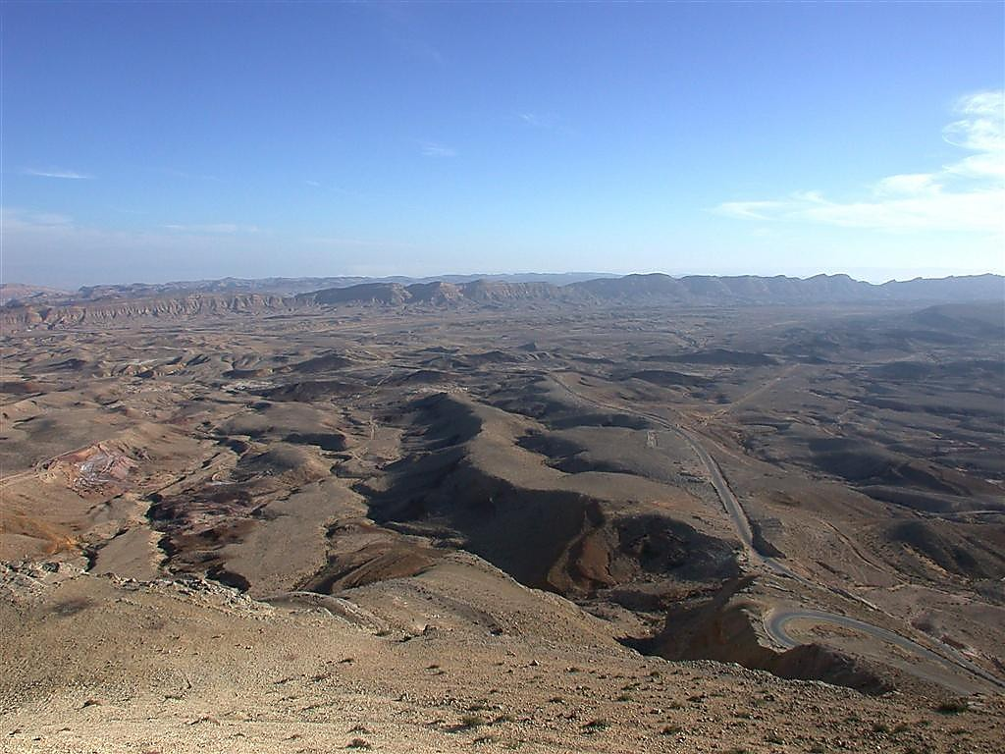
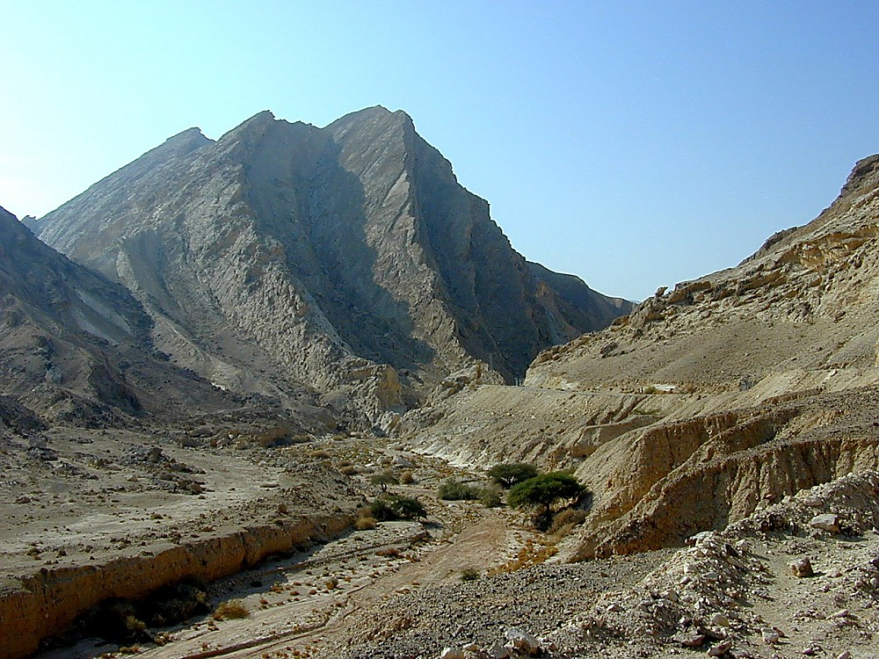
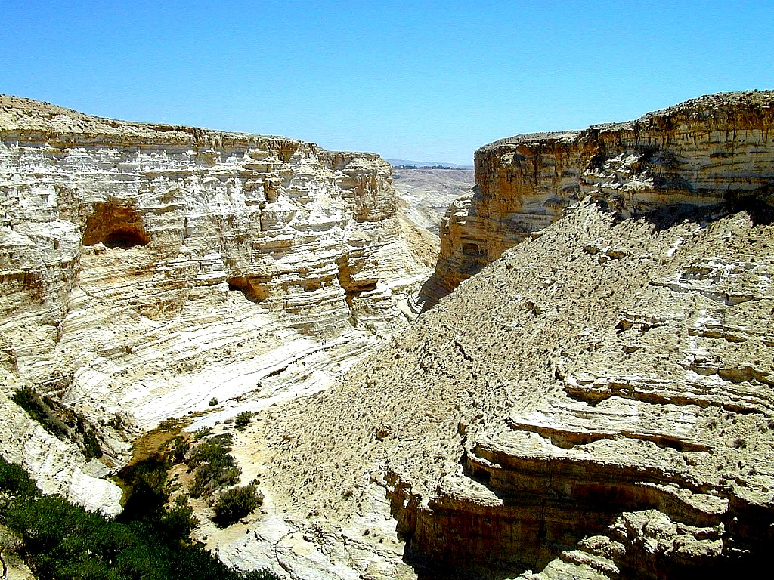
Singchakh 32:13
DRESSING
THE
STAGE
TINGKWM 40 TUTUANG CHO? MIBAMV KHOU?
TINGKWM 40 TUTUANG CHO? MIBAMV KHOU?
TINGKWM 40 TUTUANG CHO? MIBAMV KHOU?
MOUSI
Tatpatmei
Sinai
K - G - N
Kadesh Barnea
40
40
Bansinbuk kadip 26-29
23
1
Notes:
…chanwn swmei, latpiumakmei Israelnacnunc tingkwm nchuih ruc kukanmei gwai theicngam kanmak saanv ruan tat the. Meicgwaina mituang “lwmmakmei kin khourui” – meicgwaina, twmeithu, JOSHUA, Caleb – guanrummei “meicraumei latpow poumei” kanei kazauhmakna e – MOUSI khatni kakai kaikhunc ni kazauh mak ge.
//// Meicnunc rui thanv e… TINGKWM 40 TUTUANG CHO MIKHOU HEI? Nguay…tingkwm 40 raph the! Kumna kagwaina hei kaniw Ravguangc rui tilou pwnimei khatni tingsaeng chamvraeng ta lwmmei gaatmei zaeng e. Kumna amuclaknimei thu tingkwm 40 lungc khoutei, sypungramv chaengtat khou tei, Israelnanunc KATHANC mpeyna puancguang khwan e.

Slide 24
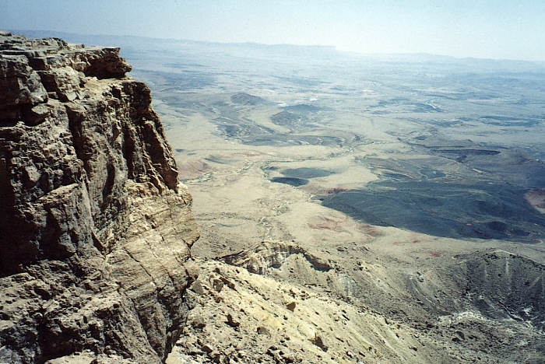
Singchakh 32:13
KABAMV KAPUIHMEI
AKUMHTINA?
LATLIAMMEI!
13
35
34
24
33
30
9
28
25
8
31
5
26
29
27
40
32
4
6
3
10
23
22
39
7
2
21
16
15
20
19
38
18
14
17
11
1
36
12
37
LWMMAKMEI!
MOUSI
Tatpatmei
Sinai
K - G - N
Kadesh Barnea
40
40
TAZIK RAMV KHOU RUANMEI
Bansinbuk kadip 26-29
24
3
Notes:
Kumna mitei tazikramv khou ruantatmei lam khou nthukna ningtownuhmei dwn akhat the…
//// TABUIZAENG Israelmeinunc ta tingkwm riakdei tazikramv khou ruantat khang swlou tuang cho?
//// Latpiumakmei lev lwmmakmei! Ravguangc zayloumei khou rui liammei khatni kamei rui gaeklou ngammei khatni gayna ganthaih Abraham khou nrianhloumei dic khou zayguanglou ngammei ngamv ta lwmmakmei zaeng e.
//// [MIKHOU KASING TUANG DUANC HEI PALUP KHANG MIKHIPDAK 20 DOU LAAPWNI.] kakhanh zauc kho. Tingkwm 40 saanv saengh tazikramv, Theihmei Duipui daeng khou ruantatmei tangv – tingkwm-tingkwm karamc guangmei tangv latow kanmei tei. Kaling e, mi timgkwmv nunc dak khou tei, Daihmei Mousi Israel ta zayduakloumeipu tei, katingkwm 120 luaikeynimei gei khou bam khwan e.

Slide 25
Riak. 32: 48-49
KABAMV KAPUIHMEI
MD
N(A)
H
GZ
C
ED
NC
B
J
NC
MOUSI
TD
Tatpatmei
Sinai
E
K - G - N
KB
Kadesh Barnea
U
40
40
SC
PD
HD
Bansinbuk kadip 26-29
25
Notes:
Heizaengrui kaniw tingkwm 40 KADESH BARNEA khatni NEBO CHYNG kak khou ruanna tatbam khwan e. Tiki Mousi ruina kahunungc lat liamlou tikhou rui, kamei kahak ni Nrianhloumei Dic gut tow kanmak khwan e. Nang tuang dic hiak khou ruantat kanmei chaengkaemv tei riatlou o.

Slide 26
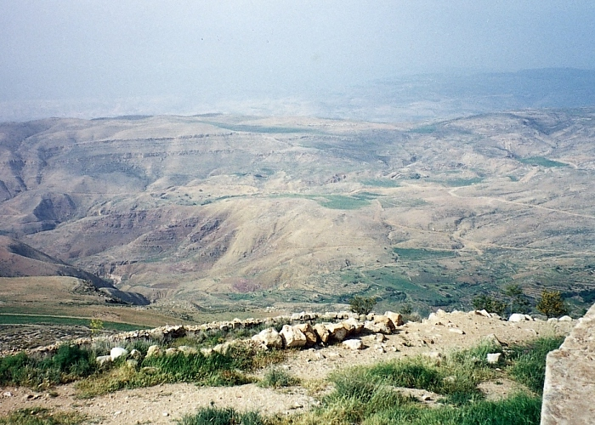
Riak. 34:1
MOUSI
Tatpatmei
Sinai
K - G - N
Kadesh Barnea
40
40
Nebo Chyng ruc khou rui
“NRIANHLOUMEI KANDIC“ zauc keymei
Bansinbuk kadip 26-29
26
1
Notes:
Tazikramv khou tingkwm 40 tatluai guang lana, Mousi rui meicnunc tatei Nebo Chyng gaengzaengc khou phungc guanglou the. Mousi nrianhloumei dic ta mibamv tuang chingc tuanvliang thang tei rui phaengctow kan e. Mousi dingbammei bamv khou aniu ni dingzauc e thei, mikumcna howpwni the…tiki kata teic mibamv khou gut khang nuhlou kanmak khe.
//// Ravguangc rui Mousi khou saa the mikiu thu Israelmeinunc ta Canaan kandic khou zaygutlana, ramlaanimei, khatni kabamv tei kaniu tuang ngamziu swnimei ganv kiu guang the.

Slide 27
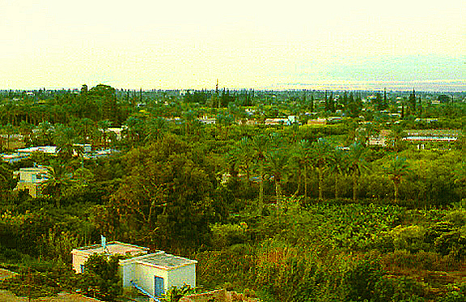
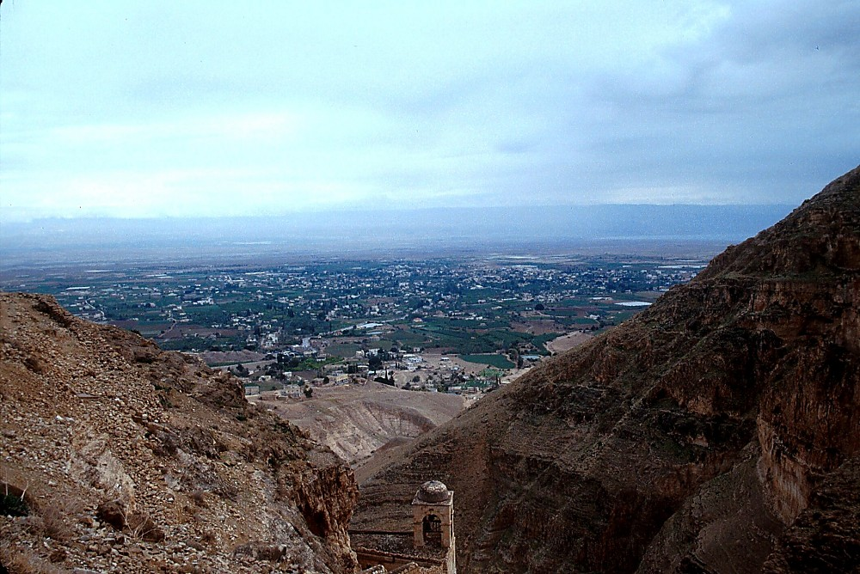
Riak. 34:1
Nebo Chyng Jordan kaanpatna
MOUSI
Tatpatmei
Sinai
K - G - N
Kadesh Barnea
40
40
Jericho Khourui...
Jordan Duibaek zauc kaan patna Nebo Chyng ta howmei
Bansinbuk kadip 26-29
27
1
Notes:
Nebo chyng tuang neihkey biak, Jericho khou thu zaengthaekc ramv tei kai dai-daihmei ta chakmak e thei, ntau suangc daicna how e... dui gaymei ramc e heitei…
////…tadan bang khatni kathav gaymei dic nai e. Khou hei neihpat biak thangc Jordan dui kaana naimei, Nebo Chyng kaanv hei ravraana machak patlou e.

Slide 28
7
MOUSI
ca. 1500 B.C.
TATPATMEI
SINAI
AJMJ
G - M - T
KADESH BARNEA
40
MOUSI
KL
Tatpatmei
PARY 5
Sinai
K - G - N
Kadesh Barnea
40
40
Pary 5
Kk. 30:1-10
KARIAKLATDANV KALUAIHMEI: KANEIMEI RIAK!
BAIC TAPH-TAPMEI KANIU TUANG ZAATC RIAK!
KATHANCMEI KHATNI ALAUC KIN KHOU
NRIANHLOUMEI DIC
KANIW HEI THOW CHO!
KANIW TUKUMHNA LUNGCNI
KANIW RACGUANC KIU THOW CHO?
Bansinbuk kadip 26-29
28
8
Notes:
Heikumlana… Mousi theicnimei huraph khou, Nebo Chyng khou kamei rui PARY 5 kaluanv swna raaclou kan e. Israelmeinunc ta kaniu rui tatnimei riak khatni kaniu tuang baic taph-tapmei dih ngamziw lam tiningtow kaluaihlou kan e. Kamei rui raaclou kanmei lam tei
//// kathancmei khatni alauc kin khang,
//// kaniu Racguangc lam dincloumei,
//// kaniu thow cho twmei saaloumei,
//// kaniu zaat tuang swmei dih ngamziw lam dincloumei,
//// kaniu nrianhloumei dic khou tukumh gut lungcnicho tumei lam e.
//// Mituang PARY 5 hei rui Kariaklatdanv kaluaihmei (Kk.) tuang latrik hei kasiamh e – mibaac thu “Kaneimei Riak” tutuang e. Dinhmei dwan hei luaikey e thei…
//// MOUSI rui KADIC LATDYNG daihmei phungcpatlou pwni… Kaganv kathuihna, Abraham zikziu khang tingsaeng latryan sw the. Mi dic ngamziu tei aseic nganv kandihpwm tuang agai-anim bammei lam tuang kanga swbam di he!
//// Makumlou o “KL” twmei latzy hei, MOUSI tuang thuap khou nkhamhmei swna – saenghmei khou KADIC LATDYNG twna lou the. Kk. 30: 1-10 khou, Hylouna nai e, Ravguangc tuang giugamakmei latryan Israel khang: Kadic ngamvziu hei nganvmakna katuang e. Mituang latryan ruina Ravguangc khatni Abraham kak khou swlou kanmei ABRAHAM LATDYNG tuang “kadic” lam dinclimc lou e.

Slide 29
7
Riakdanv kaluaihmei 30
KADIC (PALESTINMEI) LATRYAN NUNC
⁵ Kamei rui nangta nangpoucnunc dic khou phungcgutlou pwni, kumna nangniu rui mitei laapwni. Kamei rui nangta tilungc thaulou pwni kumna nangpoununc suang tigeiclou pwni.
MOUSI
Tatpatmei
⁶ Nang Kaipouc Ravguangc rui nang khatni nang zikziu khang lungh tuang swmei gic ruamclou pwni, kumpwkhou nang kata nanglung kapwm khatni nangdu kapwm rui nzian ngamna ringh khang e (NIV).
Sinai
K - G - N
Kadesh Barnea
40
40
Pary 5
Bansinbuk kadip 26-29
29
2
Notes:
Mikhou hei Kadic Latdyng tuang kalungthu swmei latbamv hei Kariaklatdanv kaluaihmei 30 khou nai the,
kalangv 5 lev 6…
5 "Kamei rui nang khang tilou pwni
//// nangpoucnunc dic khou, kumna nangniu rui mitei laapwni. Nangpoucnunc suangc tichingkhiuhlou pwni khatni kasing tigeiclou pwni.
//// Nang Kaipouc Ravguangc rui nang khatni nang zikziu khang lungh tuang swmei gic ruamclou pwni, kumpwkhou nang kata nanglung kapwm khatni nangdu kapwm rui nzian ngamna ringh khang e.

Slide 30

Abraham Latdyng
(“kawloukanmei")
Thaureymei 12:1-3
MOUSI
KADIC
KATHW
SUAIHIAM
Tatpatmei
Sinai
K - G - N
KADIC
Kadesh Barnea
40
40
Pary 5
Kariaklatdanv
kaluaihmei
30:1-10
30
Notes:
Kumna latdyng tei lev – Ravguangc tuang latryan kaluan keydatmei khou– Abraham latdyng tuang reymei dam tei sa katinloudatmei aniu how e—KADIC khang nrianhloumei lam tei e. Israelmei tuang lungc guangnimei lam lyanloumei khou, Abraham khou rui mphangnimei KATHW khatni SUAIHIAM dam teini Ravguangc tuang ningkunghmei zaat Kaguangcmei Latdyngmeinunc khang latryan mpeyna swlouna saa katinlou e. …tiki kagwai tei kalwnlung tuang Abraham latdyng khou kasuihlou e. Mousi ruina katuang pary panguh tei saa luai louna…kapantyni luailou kan the kumna Ravguangc rui kata phungctatna meic thaymakmei bamv thangc mbeihlou kan the.

Slide 31
7
Thau. 1- Riak. 34
DAMHMEI
KAGUAKCMEI
1mei ntumei
lev ngaanmei
1mei Paap
D
1mei Gaychamv
1mei Kaikhunc
(1000 B.C.)
1mei Meidow
GUANGHDIC
Duidai/Muangsing
Ramphaankai
ABRAHAM
Kawloukanmei
DIH ZAAT 3
D 7 K J
K - K - S
AL
I - I
J - E
12
NYMLOUMEI
7 = 4 + 3
JOSEPH
MOUSI
NYMLOUMEI
Tatpatmei
MEICKANG 4
Sinai
430
K - G - N
MOUSI
(500 B.C.)
Kadesh Barnea
Tatpatmei
K
S
KARIMMEI
40
40
Sinai
Pary 5
G - M - T
Kadesh Barnea
JISU
40
40
KL
Pary 5
J
JOSHUA
31
Notes:
Kumna ntauthu...DAMHMEI langv hei luailouna meic daihmei kathumh rak khou tatgut pwni the: ABRAHAM –kalunlung tuang Abraham latryan nunc ­– khatni JOSEPH lev MOUSI tuang tidaic thaubammei kady katinloumei Kadic Latdyng nunc khou the .
Ningtowlou o tumeithu aniu saenghmei lam kaphianh nituang hamh e…Parylwan natei zaucna Baibal kapwm tuang karou langvna tei kathai khang e. Lat khukh nunc khatni kalungc khou naimei katuang-tuang latbamv tei rui karou raek tei kasiamh lana, mikhou tei rui BAIHMEI Baibal tuang swmei latbamv saenghmei nunc guang goulou khang e. …kabamv…makumc dic hiak…mikhou hei bam kaningna Baibal makumc tei tiguang nthuihlou pwni!

Slide 32
7
Josh. 1:1
AJMJ
MEICKANG 4
khou
PADEIHMEI
tei:
?
32
Notes:
Ntauthu Meic Daihmei gaanv padeih rui kasiamhmei nkhamhliangmei lat khukh khou guang tangc the....
AJMJ lwan khou nkhamhliangmei e. Katangv khou naibammei nkhamhliangmei zanc nang ningtow dai?

Slide 33
7
Josh. 1:1
AJMJ
MEICKANG 4
khou
PADEIHMEI
tei:
"JOSHUA"
33
Notes:
Kazanc tei... “JOSHUA” tu e.

Slide 34
Josh. 1:1
RAVRAAMEI KWM:
ABRAHAM-JOSEPH 2000 B.C.
MOUSI-JOSHUA 1500 B.C.
34
Notes:
Katingdak tei Khrista kwm huthangc kwm15000 the twna chaklou kho. Kaluaih datna, mitei aniu ntau kathai khang thu biucsihmei kwm dithe.

Slide 35
7
Josh. 1:1
DAMHMEI
ABRAHAM
ABRAHAM
ABRAHAM
JOSEPH
"Ai
Jouc
Mai
Jamc e"
ABRAHAM
MOUSI
JOSHUA
KAGUAKCMEI
GUANGHDIC
NYMLOUMEI
KARIMMEI
JISU
Bansinbuk kadip 29-31
35
Notes:
A JOUC MAI JAMC E…nkhamhmei “J”…Baibal khukh khou kathuap lou rian keymei khou Joshua tumei thuap naibam the.

Slide 36
7
Josh. 1:1
JOSHUA
AJMJ
JOSHUA
Bansinbuk kadip 29-31
36
Notes:
Kumna…Israel tuang meicdaihmei JOSHUA rui MOUSI phaan lyn the. Ningtow kho JOSHUA hei tingkwm 40 huthangc guanrummei 12 rui Canaan guanrumtatmei khou tei lwmnuhmei guanrummei kanei Mousi khou meic raumei latpow pouloumei tei e....

Slide 37
KABAMV KAPUIHMEI
Josh. 1:4
MD
RAVGUANGC LATRYAN JOSHUA KHOU:
N(A)
H
SIVPUNG RAMV KHOU RUI LEBANON NGANV…
GZ
C
ED
B
J
NC
JOSHUA
TD
E
KB
U
...EUPHRATES KHOU RUI “DAIHMEI DUIPUI"
SC
PD
HD
Bansinbuk kadip 29-31
37
2
Notes:
Ravguangc rui Joshua khou latryan sw mbulou dat kan e.
//// Dihba tazikramv khou rui thauna Lebanon nganv naimei ramv gwai kakhang tipuni... kumna…
//// Euphrates Duithuak khou rui Mediterraniamei Duipui, reynungc Daihmei Duipui twna thaybammei bamv nganv teini tipuni. Tiki mi latryan swloumei kabaac thu Joshua khatni kapaahpatloumei zaat hei rui ramlaa gut tho tumei tuang e!

Slide 38
KABAMV KAPUIHMEI
Josh. 1:11
MD
N(A)
KADIC
H
"JOSHUA… TAT THO KUMNA KADIC TEI NANG KHANG SWTHO!"
GZ
C
ER
B
J
NC
JOSHUA
TD
E
KB
U
SC
PD
HD
Bansinbuk kadip 29-31
38
Notes:
Joshua ta “tat gutna Kadic tei laa tho” twna katilou the.

Slide 39
KABAMV KAPUIHMEI
Josh. 1:11
MD
N(A)
KADIC
H
NEBO CHINGV KHOU RUI… JOSHUA RICMEI JORDAN DUIBAEK KAAN NINA THE
GZ
C
ED
B
J
NC
JOSHUA
DS
Jericho/Ai
E
KB
U
SC
PD
HD
Bansinbuk kadip 29-31
39
Notes:
Mibaac thu Nebo Chyngramv khou rui Jordan Duibaek kaanpatna Canaanmei nunc Nrianhloumei Dic kapwm khou bam bammei gwai ta ngamlou nina the – Ruang khou rui Liang nganv tutuang e.

Slide 40
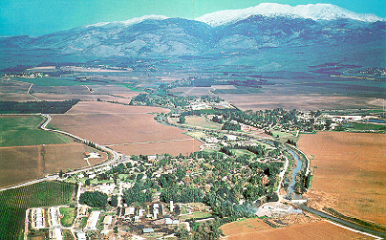
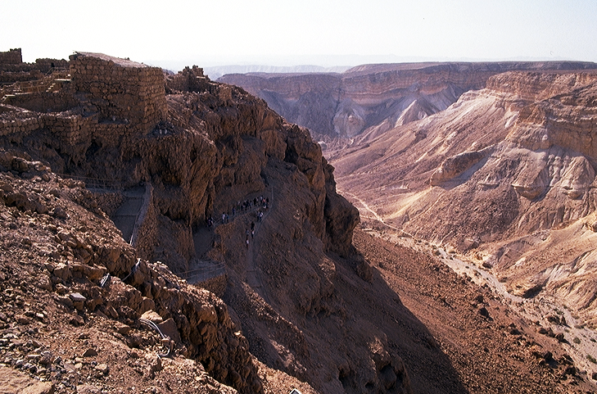
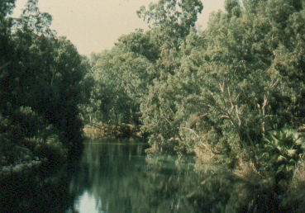

Josh. 1:16
Joshua Ramv lam khou kunghmei...
JOSHUA
Jericho/Ai
Bansinbuk kadip 29-31
40
4
Notes:
Kumna, Nebo chyng daeng khou naimei ramv kauhmei khou rui Zayloumei Joshua katuang ricmeita nduanghna gut the…
//// … kumna tiang-chanvmei ganv guangnimei khang ta chamdanv the! Kamei rui Israelmeinunc ta Jordan Duibaek zay kaana ntau naibammei bamv reynungc kaidai Jericho khou nduangh gut the.
//// Kaluaih datna, Ravguangc rui duidai khaemloudat muay the…ntauheithu, Ntou duipui tei hamh the, tiki Jordan Duibaek tei e…Ntau datni meicnunc tateic phuimei bamv khou kaanpat khang nuhlou the – Egypt khou rui tatpatdaicna patmei ganv khou MOUSI khou taanclou kanmei tei kumcna taanclou the.
//// Israelmeinunc tei Canaan kandic khou gut the, aseic tuang Israel dic khou ...kathav gaymei nzaengc khatni dui gaykanmei bamv dihpy biak khou rui...
//// …dihba biak tuang phuichuymei meiclunghmakmei tazikramv nganv e.
Nkhamhmei khou kaniw khang Nrianhloumei Dic tei guanglaa dat khang tatgut the....Dihpy khou rui Dihba nganv...Giugamakna ABRAHAM khang tingkwm phay mbu huthangc ABRAHAM LATDYNG khou nrianhlou kanmei kadic kagwai tei ntangh the.

Slide 41
7
Josh. 6-8
JOSHUA
JERICHO / AI
AJMJ
JOSHUA
Jericho/Ai
Bansinbuk kadip 29-31
41
Notes:
Reymei khou, kaniu rui kaidai nthukmei kanei laa khwan e, JERICHO, khatni mitangv tei kungc sihmei thiak khou AI kaidai ta athwng katwan gut the.

Slide 42

THEIHMEI DUIPUI
JORDAN DUIBAEK
NTAU TUANG JERICHO
JOSHUA
Jericho/Ai
REYNUNGC JERICHO
Jericho khou rui...
Neihpat biak Jordan Duibaek zauc kaan patna
Bansinbuk kadip 26-29
42
Notes:
Mihei aseic tuang Jericho the. Joshua ricmei ching ching rui rihpwan rihnaa piuna, duh thangcmei duithuak kaanpatna neihpatbiak tat gut lana guangnimei tingkwm chanei nganv rih adou bam nimei khang chamdaanv bammei tihei lungningmik khou how nthan na how nuh the.

Slide 43
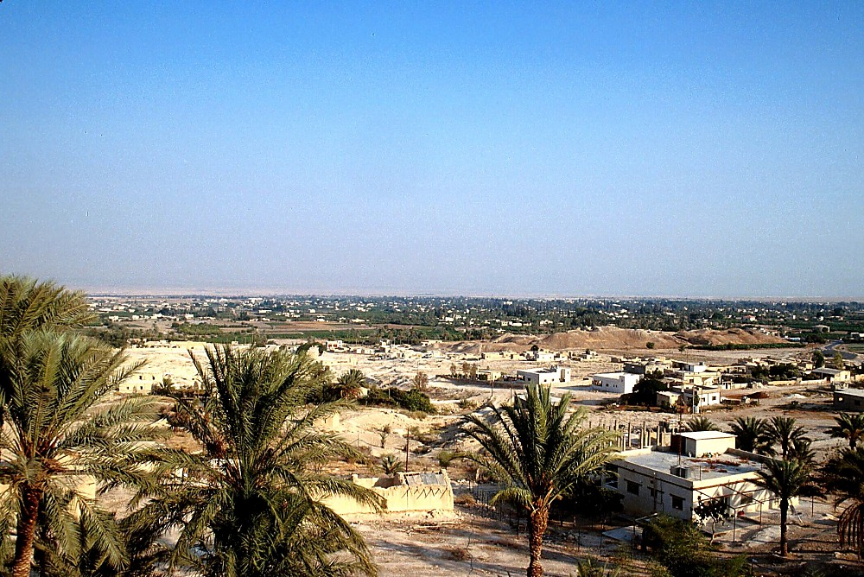
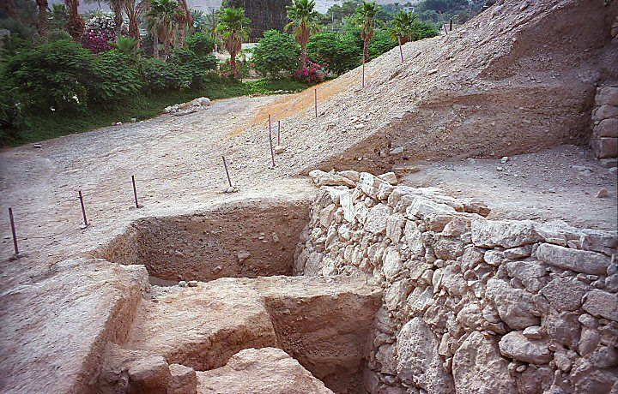
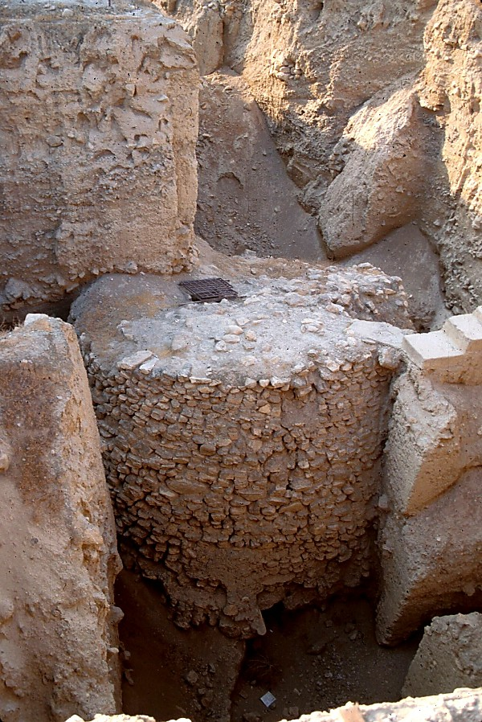
JOSHUA
Jericho/Ai
Jericho: Reynungc tuang nsaekloumei
Bansinbuk kadip 29-31
43
Notes:
Mi sypung hei reynunc nsaekclou duhmei Jericho kaidai– aseic nganv dingna bammei maengc e. Reynungc rigaanmeinunc rui Joshua ricmeinunc guangmei ta, khitkhitna Jericho raengc swpunkey nimei ta mikaanc tuang ramphaankai ruc khou tei rui kaniu ana guangmei ta zaucna bam nuh e…reydouc bam chowpatdatmei rui tithay e…

Slide 44
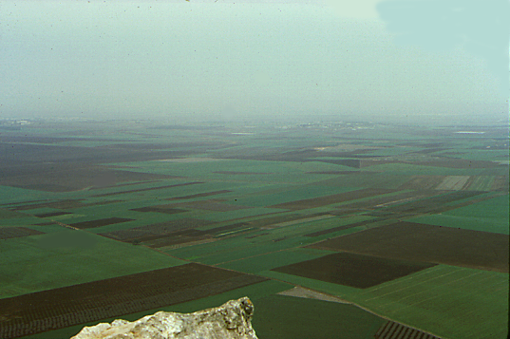
7
Josh. 17:16
Jezreel Nzaeng Tabor Chyng khou rui
JOSHUA
Jericho/Ai
Mihei guaihnoudui khatni nkhuaihdui kiu the!
Bansinbuk kadip 29-31
44
Notes:
Heizaeng rui, Joshua ricmeinunc tei tingkwm chanei key-key ngangh-ngangh bam khwan e. Mihei rui kazanc naikanmei Jezreel nzaengc Tabor chyng ruc khou rui zauc key ethei, ntau ganv khou thu mihei Israel tuang dihpy biak thangc Galilee ramv kalungc chuy khou naibam e. MIHEI KACHANGCNA GUAIHNOUDUI LEV NKHUAIHDUI E!

Slide 45
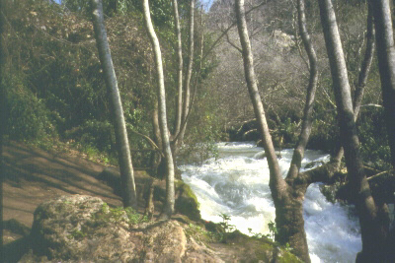
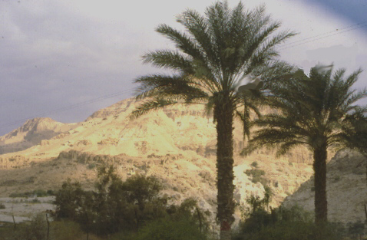
…Dihpy biak thangc Dan khou rui...
Tingkwm chanei kunghmei ric adoulana…
JOSHUA
Jericho/Ai
…Dihba biak Beersheba nganv...
Bansinbuk kadip 29-31
45
2
Notes:
Dihpy khou rui Dihba nganv tingkwm chanei kunghmei ric adou guangmei khou,
Joshua ricmeinunc tei pumhlwan khou ryanra daihmei geicna ariu khwan e….
//// dihpy thangcmei dic tei…dui gay, kathai gaymei bamv e….tiki dihba thangc thu, nsa karangmei tazikramv khwan e.
//// Dihpy thangc Dan khou rui dihba thang Beersheba nganv.
kaniu rui karamc ranv bamsinih, Joshua RICMEINUNC TEI RUI KADIC KHOU TEI RUI RAVGUANGC RUI KATILOU KUMC CanaanMEI GWAI TA ALAy GANc NGAMMAK kan e. Ravguangc rui katiloumei piu nthuihmakmei zarng rui nkhamh khou Israelmei tuang guangnimei kandic dwan khou suaidaihmei sw the.

Slide 46
7
Josh. 14:5
JOSHUA
JERICHO / AI
KADIC NZANHMEI
AJMJ
JOSHUA
Jericho/Ai
Kadic nzanhmei
Bansinbuk kadip 29-31
46
Notes:
Isralmeinunc tei rih ngam geicna ngamguang khwan e. Kumlana…JOSHUA ricmei gwai rui tingkwm chanei rih swguangmei luai guangna KADIC tei laagut ngam the…kumna Jacob nac mpouh ruhna kanei zanc lana phuakloumei Israelmei zaat ruhna kanei khang nzanhlou the.

Slide 47
7
Josh. 13:1-21; 13:43
Daihmei Duipui
ASHER
NAPHTALI
ZEBULON
Galilee Zeiclat
Zaat puina gwai lungkey the, Abraham kikta khang tiloumei kandic thanh khou tei lungh khang chamdaanv the.
Tabor Chyng
Carmel Chyng
ISSACHAR
JOSEPH NACNUNC
CANAAN KANDIC TEI NZANH KAN THE!
Gilboa Chyng
MANASSEH
MANASSEH
JOSHUA
EPHRAIM
Jericho/Ai
Kadic nzanhmei
DAN
BENJAMIN
GAD
LEVI: Lungh khang kaidai nah ti e; kaniu tei kalumpui pheykai zaucbam khang e!
JUDAH
Hebron
REUBEN
Theihmei Duipui
SIMEON
Bansinbuk kadip 29-31
47
13
Notes:
Kumna…zaat guay khang tei kadic nzanh nimei hei nchiwmei taanv hamh khwan e. Mitei zanh luai pukhou…
//// …zaat puinac-puinac khaklangc patna bamkey the, Abraham dic thanh khou tei lungc chada khang chamdanv the. Kadic nzanhloumei thei layna, naimei tei…
//// ASHER
//// ZEBULON
//// NAPHTALI
//// ISSACHAR
//// JOSEPH NAC MPOUH NEI RUI ZAAT KANEI SW THE…EPHRAIM LEV MANASSEH THE. THAYLOU O TUMEITHU MANASSEH TUANG RAMV TEI JORDAN DUITIN KANEIMEI KHOU NAI E.
Heitangv nai dat the
//// GAD
//// DAN
//// REUBEN
//// SIMEON
//// JUDAH lev
//// BENJAMIN.
//// Tiki LEVIMEI zaat khang thu... ramvdui timak khwan e... kaniu khang lungcnuh khang kaidai khatni kaniu tuang khouringc khang phuaihramv tilou khwan e. Levimeiunc tei kalumpui pheykai khou amuh sw khwan the kumna...hylouna naikumc..."...Kaipou khang rawna khaengmei tei...kaniu dam the, kamei rui nrianhloumei kumcna."

Slide 48
7
Latzanpoucnunc 17:6
The Great Sea
ASHER
NAPHTALI
ZEBULON
“Meic gwaina karaan-rana mikzuat khou nzihmei tei taanc the."
ISSACHAR
MANASSEH
MANASSEH
JOSHUA
EPHRAIM
Jericho/Ai
LEVI: Lungh khang kaidai nah ti e; kaniu tei kalumpui pheykai zaucbam khang e!
Kadic nzanhmei
DAN
BENJAMIN
GAD
JUDAH
REUBEN
SIMEON
Bansinbuk kadip 29-31
48
Notes:
Tiki miheini thaylou o, hylouna nai e twmeithu miganv khou tei “meic kapwm tei charai mikzuat khou nzih e twmei tei taanc the.” Kumna mituang nthukmei lat riang hei rui nrianhloumei dic khou Israelmei tuang kathancmei panty khou guangnimei kunghmei ta saa nsuklou e.

Slide 49
RAVRAAMEI KWM:
ABRAHAM-JOSEPH 2000 B.C.
MOUSI-JOSHUA 1500 B.C.
JOSHUA
Jericho/Ai
Kadic nzanhmei
49
Notes:
Heituang thouduak patkanmei tuang ravramei tingkwm hei makumhlou bam o. Kaganv tei ningtow gay khang tingkwm 500 kak swna tampatlou e:
• ABRAHAM lev JOSEPH: 2000 B.C geikhou.
• MOSES lev JOSHUA: 1500 B.C geikhou.

Slide 50

7
Thau. 1 – Josh. 24
DAMHMEI
KAGUAKCMEI
1mei ntumei
lev ngaanmei
1mei paap
C
1mei Gaychamv
1mei Kaikhunc
GUANGHDIC
(1000 B.C.)
1mei Meidow
Duidai/Muangsing
Ramphaankai
ABRAHAM
(2000 B.C.)
DIHZAAT 3
KAWLOUKANMEI
AC
D 7 K J
AL
K - K - S
I - I
J - E
12
NYMLOUMEI
7 = 4 + 3
JOSEPH
JOSHUA
Nymloumei
Jericho/Ai
MEICKANG 4
Kadic nzanhmei
430
MOUSI
(1500 B.C.)
(500 B.C.)
Tatpatmei
D
S
KARIMMEI
Sinai
G - M - T
Kadesh Barnea
JISU
40
40
LC
Pary 5
KL
J
JOSHUA
Jericho/Ai
Kadic nzanhmei
50
2
Notes:
Ntauthu aniw Baibal khukh tuang kapaek thu luailou the – Ravguangc lat tuang kabiswmei kathiak khatni kabam riatloumei. Aniu luailou the
//// DAMHMEI khukh, meickang padeih rui nzuanvna:
//// ABRAHAM, JOSEPH, MOUSI khatni JOSHUA…Abraham latdyng lev latdyng kalangv khat mikhou tei rui patdat reimei tei lev kariuna…mikiuthu Mousi douc tuang Kadic Latdyng tei e.

Slide 51
9.7.03c.
©2005 TBBMI
51

