Slide 1

Rongmei
KAGUANV 9.65
Baibal… Kabiswmei
Bibal…Kabiswmei Tanvduanv International Inc. Fort Worth, Texas tuang Lianvloumei Duanv
8.0.02.
©2004 TBBMI
01
Notes:
RAAH MAK HE

Slide 2


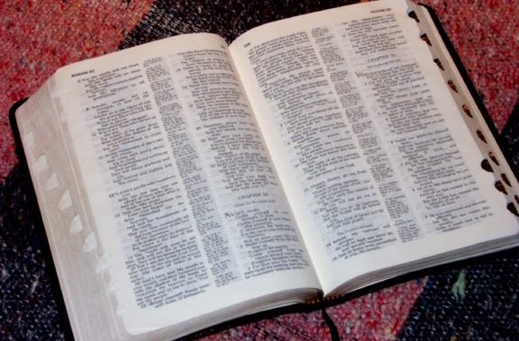
(Kabamv tei tabui thangc sih cho?)
BAIBAL…
KABISWMEI
®
KALANGV KANEI
KABAMV KAPUIHMEI:
REYNUNGC NEIHPAT DAENG DIC HIAKMEI
9.65.02.
©2006 TBBMI
02
Notes:
Ravguangc lat ncham pukhou…katwn akhat khou rui mi lat than hei nai tanh tan e...“Kabam tei tabui thangc sih cho ?"
Heizaeng rui BAIBAL KHUKH kasiamhmei khou kaluan keymei phaybamv thu...Reynungc neihpat daeng dic hiak chadamei hei the.
Mituang latlangv tuang latdwn swna, kumna kaw nuh e, Baibal taanv guay tuang “Kabamv kapuihmei". Kahouh lakho.

Slide 3
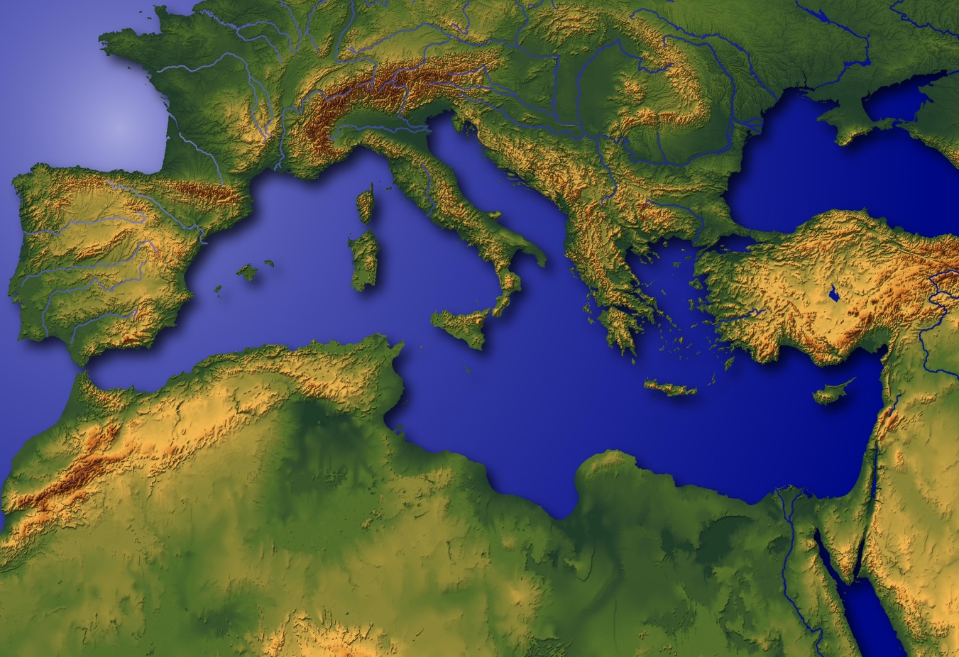
KABAMV KAPUIHMEI
?
Baibal taanv khang Mediterraniamei bamv
4
9.65.02.
4
03
© 2006 TBBMI
03
Notes:
Kumthina…KABAMV HEI KAPUIH DIKHO!
Aniu khouhei bam the... Ravguangc tuang kanganv maekmei tingpuk khou karana phuangc bammei bungc…howgay tiki katuakcmei kandic khou…
Pary dai tuang lwnlung ta asaanhmak khou KATUMHMEI RUANVRY khou rui kathai pwni.
//// heizaengrui kabiswmei lat thanv thu.… heipui dicbungc khou tabui twn, ruanvry daihmei guay hei patkancho?
Ravguangc lat kathaimei khou…TABUI TWN khatni TABUI sih patkan twmei thaymei hei gaeng e…
Nangpy khou nailouduhmei heini!
//// Hei tei the..kakwn liang khou aniu ganv khou Neihpatbiak tuang Kachung twna kawbammei...
//// ….Pary dai tei paluplou kan the, mituang reynungc kandic khou tei, katuang
Kadath-datmei lev baic taph-tapmei thiak patkanmei…
//// …ruanvry tuang kanga twna kawnuhmei kandih langv akhat e…
Mihei Baibal taanv tuang Mediterranian bamv the.

Slide 4
“Kabam Kapuihmei” hei hanh khang View > Master > Slide Master
Mediterranian Duipui
LEBANON
SYRIA
Haifa
Galilee Zeiclat
IRAQ
Nazareth
Netanya
Tel Aviv-Jaffa
AMMAN
JERUSALEM
Jericho
Gaza
Hebron
Theihmei Duipui
Beersheba
ISRAEL
JORDAN
EGYPT
SAUDI ARABIA
Eilat
Aqaba Dickak
Al' Aqaba
04
1
Notes:
Zauc guang diangc pukhou, kabamv tei aseicdou tuang Mediterranean Duibamv khou the, katuang neihpatbiak tin khou…..
Aseicdou tuang Nthanmei Dic ta zauc diangc pukhou…mitei ranvsihna dihluanv khatni lunghluanv tihei nzanhloumei hei
//// …Jihudimei khatni Arabmei kak khou e.... Kalam mpeyna khang e aniu BAIBAL KABISWMEI lev tat tamzuanna ndauhpatnimei hei.

Slide 5
MD
N(A)
H
GZ
C
ED
B
J
NC
TD
E
KB
U
DIH HIAK KHANG KAZAENGNUNC!
SC
PD
HD
Baansinbuk kadip 15-16
05
1
Notes:
Ntauthu…Miguay khang kazaeng. Reynungc Neihpat Daeng Dic hiak chada pwni the...
Kumna nangrana tuang dic hiak synswna Baibal ruanvry dai tuang luanv kasuih puni...phaykaam kathuic tei...
//// ...mihei kumcna…kakaam khat-khat swna kadai swmei paryriang langv tei laanc ndauh pwni.

Slide 6
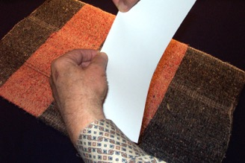
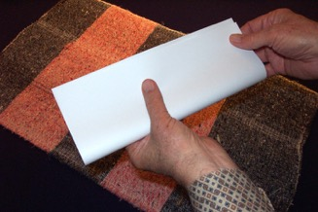
Kathai nkhavmei #03a; (kadip-raeng louhapmei #03b)
CHE KIAK
AKHAT
SIN
THO
LOU MPHAIHNA,
KASAENG BIAK KADIP GUAI O
Baansinbuk kadip 15-16
06
Notes:
Satra baansinbuk tuang kathai nkhavmei kasing 3A lev 3B rui nang khang hiakloumakmei chepaek nunc tipwni
Synswna dih hiak kasiamh khang.
Heizaengrui nzianlouna baansinbuk khou tei rui chepaek akhat laatho...
Heitangv sin mphaihlou tho...kasaeng biak tei kadip liang guai lou o…

Slide 7
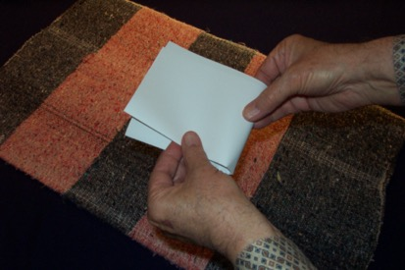
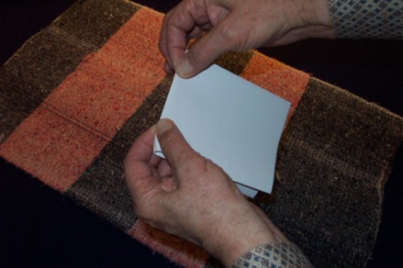
KADIP GUT GUAIDAT DIO…
…TARUTMEI HIAK KANEI TIPAT KHANG.
Baansinbuk kadip 15-16
07
Notes:
...kumlana kadip key guai datro, heitei rui laavpat dat pukhou kachaeng tarutmei kanei che khou tei nai khang e...
Kadung khat...kaphai akhat…dih-hiak khou tei Dihpy-Dihba khatni Neihpat-Neihkey lwn dinh khang e.
Nanghu khou lou mphaihlou tho...hamhthei kasaeng swna loutho.

Slide 8
Baansinbuk kadip 15-16
3
08
Notes:
Che tei kasaeng biak loulana, nang tuang dih-hiak kathanc kasiamh khang chamdaanv tho...kabamc tei kapuih khang...
Neihpatbiak tuang Kachung khou patmei Baibal taanv ta.
//// Tatgutna bam khou, lou mbumei nzinhmei hiak tihei machak zauc o.
//// heipui nzinhmei hiak rui kalangv tipatloumei bamvnunc hei nangtuang dic-hiak khou tei duancgutlou bam nina e.
Kahiak kathanc nang rui hiak key puisik mikhou howmei kumcna nzinhmei rui hiaklianvlou pwni…
//// khoutei hiaklou reymei chaeng tei kapaanv kalaicna zingckeyna heipui ndiakmei kumcna nguanh kan pwni.

Slide 9
REYMEI: DUIBAMV 6
KANEIMEI: KANDIH BAMV 10
KATHUMHMEI: KIDANUHMEI DU
Baansinbuk kadip 15-16
09
2
Notes:
Ntauthu aniu tabui twn tatgutbam cho twmei thay the...Reymei khou Latdyng khou hyloumei duibamv CHARUK
bamv phupat chada pwni...
//// kaneimei khou...kadai swliangmei kandic bamv 10 nah zauc pwni. Mihei nrit hakmei kabamlam tuang para sw nituang hamh e. Ping naengh e.
Kathumhmei khou…ningtowlounimei
//// kiu kabamv lev kadu hei thu KIDAMEI NADE…RAH-RAMEI NADE.
Tiki…ngangvlou nuhmei, Latdyng khou dih le dui kak khou naimei riang tuang makumc hiak kasiamh khang thu diangc sihmei dithe.

Slide 10
Baansinbuk kadip 15-16
10
1
Notes:
Nang tuang che ..kaluaihdatna, kaphai tamcloudat laki...kakwn padeihmei dip tuang karucmei mbaibiak khou tei,
Mikhou nzinhmei hiak tuang mbunghmei hiak daihmei hei kumcna hiaklou tho…
//// nchamcmei hiak akhat datni nzatbiak tuang kabangcmei kwn khou tei hiaklou dat pu o.
Nzinhmei chaengnei hei rui, tukumhna hiakni twmei lianvlou tuang e.
Tatgutna bam khou kabamv nunc tei ntau ganv khou kalwn kumh bo twmei ni how pwni.

Slide 11
Baansinbuk kadip 15-16
11
Notes:
Mitangv rui lauziugaenghmei tuang builuangv luihmei
Kabangc biak tuang mbunghmei chung khoutei rui hiakthau pwni.
Nkuanmei tei karuc khou naimei mbunghmei hiak ta kahi tangc duanc lou o.

Slide 12
KABAMV ZANC NUNC SINRIO ...
KABAMV TUANG
REYMEI LATKAENG
NA
SIN O...
LAT GUAYNA
HAMH E!
Baansinbuk kadip 15-16
12
Notes:
Dih hiak kasiamhmei duanv khou tatgutna bam khou, gayliangmei thu kabamv zanc KHATSINI sinmakmei hei the.
Mi phaan tei kazanc nunc tuang reymei lat-hiak natei sinna...latkaeng guay tei thu sinmakna lou dikho.
Reymei lat-hiak tei rui nang lung khou dih-hiak khou kabamvnunc zanc tei ti ningtowlou raph pwni de. Mihei kumcna…

Slide 13
MD
Baansinbuk kadip 15-16
13
Notes:
Kalangv padeihmei tuang mbaizat karucbiak lungc khou tei MD twna hylou tho...
Kumna mihei rui aseidou naibammei heipui duibamv maengc tei e.
//// Mbai tuang karuc khou naibammei Latdyng lat tihei thaylou o, mi duipui daihmei, Daihmei Duipui twna ni reynungc thaybam khwanmei ta saatowlou e. Latdyng bamv bai-baihmei ni mitwn tei howdat bam pwni Baibal…kabiswmei tuang kaluan keymei maengcnunc ariumei ganv khou.

Slide 14
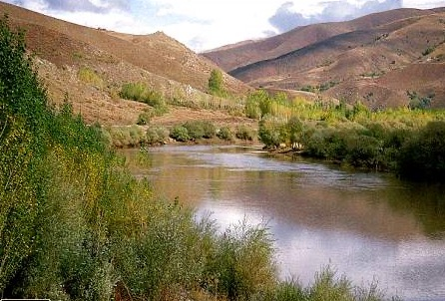
MD
ED
Baansinbuk kadip 15-16
14
Notes:
...katangv khou…ED twmei hiak heini builuang luihmei hiak chung zaengc khou haplou o…

Slide 15

MD
ED
PD
Baansinbuk kadip 15-16
15
Notes:
...Nkhamhmei khou, PD twna nzatbiak kabangc khou hiakloumei lungc khou hylou o.

Slide 16
MD
MEDITERRANIAN DUIPUI
ED
EUPHRATES DUITHUAK
PD
PERSIA DICKAK
Baansinbuk kadip 15-16
16
2
Notes:
Mbaibiak karuc khou Lat-hiak nei hei rui MEDITERRANEAN DUIPUI tuang zanc saenghmei khyn the. kaluaihdatna…zanh saenghmei tei hamhna…lat-hiak natei lou o…
//// EUPHRATES DUITHUAK rui builuang nkuanmei khou tei...
//// PERSIA DICKAK rui nzatbiak kabangc kwn khou.
kumhkhou...duibamv kathumh bamv thay the...kathumh nai dihe: dih-hiak mbaibiak kabangcmei kwn khou rui kahouh the.

Slide 17
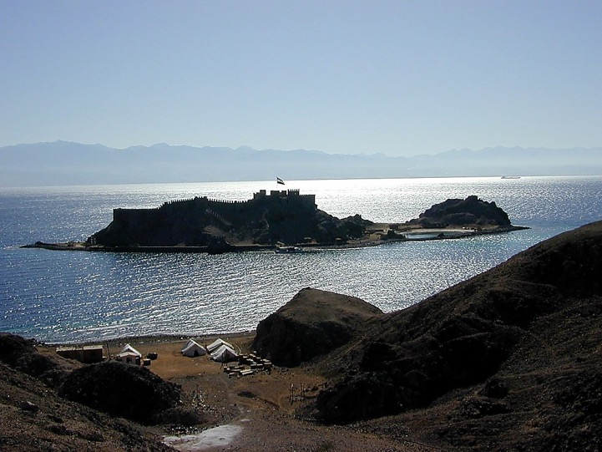
MD
ER
PD
Baansinbuk kadip 15-16
17
Notes:
…achaw nukuanc tii nguicloumei luihmei maeng akhat hiak tho

Slide 18
MD
ER
HAENGHMEI DUIPUI
PD
HD
Baansinbuk kadip 15-16
18
Notes:
Nukuanc lungc khou tei, khatni dui ruckhou tei, HD twna HAENGHMEI DUIPUI phaan hylou o.
Mihei rui nseicdou tuang HAENGHMEI DUIPUI maengc gaymei akhat re.

Slide 19
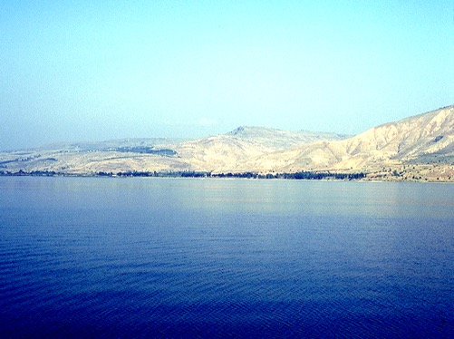
MD
ER
PD
HD
Baansinbuk kadip 15-16
19
Notes:
Katangv rui builwang bangc rap khou ngangh tho. Nzuanghmei gui kanei hiak tho, nthiamvmei tei nguimei lungc khou lianvlou e khou hei…

Slide 20
MD
ER
PD
HD
Baansinbuk kadip 15-16
20
Notes:
... Daicmaihmei ruckhou...kachaeng akhat rui kaneimei tatei alamlou e.

Slide 21
MD
GZ
GALILEE ZEICLAT
ER
PD
HD
Baansinbuk kadip 15-16
21
Notes:
Nthiamvmei guy daeng khou tei...GZ twna lou o, GALILEE ZEICLAT khang e.

Slide 22
MD
GZ
GALILEE ZEICLAT
ER
TD
THEIHMEI DUIPUI
PD
HD
Baansinbuk kadip 15-16
22
Notes:
Daihmei guy khou tei, TD twna THEIHMEI DUIPUI khang lou o.

Slide 23
MD
GZ
ER
TD
JORDAN DUIBAEK
PD
HD
Baansinbuk kadip 15-16
23
Notes:
Dih hiakluai key khou katitna katuakc nipui zaeng rui, heipui duibaek zanc hei hy ri tho...duinamei chaeng rui kaguy kanei tateic zay kariu e twmeina thaylou o...Galilee Zeiclat lev Theihmei Duipui ta…zay kariuloumei hei kazanc tatkanmei khatni howgaykanmei JORDAN DUIBAEK the. Mi hei nang ningtow pwni! Aniu Kaipou ta midui khou tei luplou kantuang e.

Slide 24
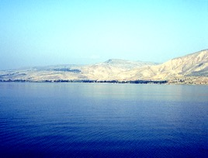

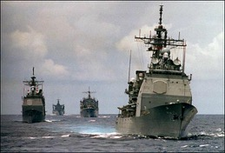

MD
DUIBAMV
6
GZ
ED
TD
PD
HD
Baansinbuk kadip 15-16
24
7
Notes:
Ntauthu...duibamv charuk lev duithuak kazauhna thaypatna kazanc ni ti the, mpeyna nthukmei raana the
Guangnimei Baibal taanv guay khang kabamv kapuih khang rui. Aniu rui loukanmei hei
//// MEDITERRANEAN DUIPUI,
//// EUPHRATES DUITHUAK,
/// PERSIA DICKAK,
//// HAENGHMEI DUIPUI,
//// THEIHMEI DUIPUI,
//// GALILEE ZEICLAT, khatni JORDAN DUIBAEK rui kahumei dui kanei ta tii alamloumei.
//// Duibamv 6 rui nang tuang dic hiak kasiamh thauloumei e.
Gaithe...mihei rui nang tuang dic hiak khou duibamv langv the.

Slide 25

MD
GD
ED
TD
PD
HD
Baansinbuk kadip 15-16
25
1
Notes:
Ntauthu kandih biak karih kho...midicnunc rui Baibal tuang kaganv nganv makmei
pary laam lianvpat bamnuh khang kabam sw the.
//// Latdyng rui Baibal dic ta Neihpat Mediterranian tuang saengc daihmei dic ta e twna dinc e.

Slide 26
KABAMV 10
MD
Kandih bamnunc
10
GZ
ED
TD
PD
HD
Baansinbuk kadip 15-16
26
1
Notes:
Kandih bamvnunc aniu rui 10 hei zaucpat pwni—kumna 10 na khang de ...kaguayna kasu swmei rana the Baibal pary luanv tuang KATUMHMEI RUANVRY tatkey pwnimei khou hei.
//// Tatgut zauc lakho. Dih hiak tuang karucliang khou, kachungraph khou tei, dihpy-dihba lianvmei che khou tarutmei hiak ruc khou, latkang swna hy tho, KABAMV 10.

Slide 27
KABAMV 10
MD
4
GZ
ED
TD
PD
HD
Baansinbuk kadip 15-16
27
Notes:
“Kabamv 10” bangc khou dihpy-dihba lianvmei chaeng tuang nzatbiak, kasing 4 lev luhpai neihpat biak souclou tho...heikiu thu...nzat biak e.
NANG NGUIMEI HIAK HOWBAMMEI HEI THU TATGUTNA BAM KHOU DIH-HIAK KHOU KABAMV NDWNMEI LIANVLOU KHANG NA DE.

Slide 28
KABAMV 10
MD
6
4
GZ
ED
TD
Baibal tuang “Taanv khang kabamv"
PD
HD
Baansinbuk kadip 15-16
28
Notes:
Kumlana mbaibiak khou rui, kasing 6 lev luhpai mbaibiak souclou tho. Ntauthu Baibal tuang “Taanv khang Kabamv” khou hei aniu kadic 10 hei nthanna soucpat khang chamdaanv the.

Slide 29
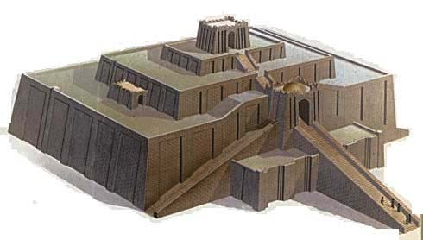
KABAMV 10
MD
6
4
SG
ER
DS
U
PD
CHALDIMEI TUANG UR
RS
Baansinbuk kadip 15-16
29
Notes:
Dihpy-dihba luang tuang neihpat biak khou rui kahouhna, kabangc khou Euphrates duithuak muangv rui Persia Dickak daeng gutzaicnimei twntei...lat-hiak daihmei "U" hei KATHW DAIHMEI AKHAT LEV KAGEI DINH KHANG HYLOU O...heitei rui kahunung kaidai, Chaldimei tuang UR khyn e…reynungc kazanc tatmei ziggurats hamhthei ravkai rigaan kai e. Kaluaih datna, reymei lat-hiakna tei synlou pudiu khang tancna kady e... Kumna nang makumc tani ranvna latkaeng kapwm tei tina ningtow khang e. Ningtowbam gay khang hei heikumhmei chiwnamei baansin rui sw ngam e

Slide 30

KABAMV 10
MD
6
4
GD
ED
B
TD
BABYLON
U
PD
HD
Baansinbuk kadip 15-16
30
Notes:
Kumna, U rui UR the...ntauthu karuc duithuak biak kalung ngangh kho, Persia Dickak chung hiancku khat twna. B daihmei hylou o, kathw daihmei akhat loudat muay o…reynungc Babylon kaidai khang, reykhou dihnunc alammei khou kasu swbam khwanmei bamv e.

Slide 31

KABAMV 10
MD
6
4
H
GD
ED
B
TD
U
HARAN
(HARRAN,TURKEY)
PD
HD
Baansinbuk kadip 15-16
31
Notes:
Katangv khou...mituang daickanmei ramvpaek tuang kabam khat khou, duithuak tuang neihpat biak khou, H daihmei akhat hylou o, mitei rui reynungc kaidai Haran khang e, mibamv kiu ntau nganv naibam dihe.

Slide 32
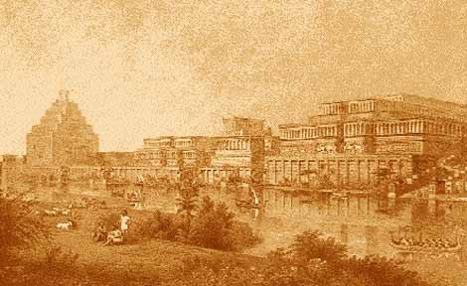
KABAMV 10
MD
6
4
N(A)
H
NINEVEH (ASSYRIA) MOSUL, IRAQ
GD
ED
B
DS
U
PD
HD
Baansinbuk kadip 15-16
32
Notes:
Kariamvmei khou, dihpy-dihba luang khou rui neihpat biak, katin chuymei khou, N hylou na karaek lungc khou A lou o. Mi lat hiak nei rui reynung Assyriamei guangcdic tuang Nineveh kaidai lianv e. Ntau ganv tuang Mosulmei tuang Iraq kaidai hei heipui reynungc bamv daeng khou e.

Slide 33
KABAMV 10
MD
6
4
N(A)
H
GZ
ED
B
TD
U
PD
HD
Baansinbuk kadip 15-16
33
Notes:
Kabamv padeih thaypat the.... CHALDEEMEI TUANG UR... BABYLON... HARAN...lev ASSYRIA KHOU NINEVEH.

Slide 34
KABAMV 10
MD
6
4
N(A)
H
NSEICDOU CANAAN
GZ
ED
C
B
TD
U
PD
HD
Baansinbuk kadip 15-16
34
1
Notes:
Kadwn padeih tei rui neihpat biak tuang riang thaypat the, dihpy-dihba luang khou rui neihkey biak tuang kabamv charuk biak tat kho
//// Lat-hiak C rui reyliangmei khou Jordan Duibaek lev Mediterranian Duipui kak khou lou tho. Mi lat-hiak rui CANAAN gaengvzaengc lianv e, mizanc hei reynungc Israel, Palestine twna thayguangmak khou khatni ntau ganv khou Israel hamh thei Palestine twna thaydat mak khou e.

Slide 35
KABAMV 10
MD
6
4
N(A)
H
G
C
JERUSALEM
ED
J
B
TD
U
PD
RS
Baansinbuk kadip 15-16
35
Notes:
Theihmei Duipui tuang dihpy daeng, Jordan Duithuak tuang neihkey biak, J daihmei lou o, nguay, Jerusalem kaidai khang e...kandih ruanvry khou ngamv nailiangmei khatni katuakcmei geicliangmei dic e twna kaphianh bammei bamv e.

Slide 36
KABAMV 10
MD
6
4
N(A)
H
GZ
C
ED
NC
B
J
NEBO CHING
TD
U
PG
HD
Baansinbuk kadip 15-16
36
Notes:
Ntau thu Jordan biak kalungpat kho, Theihmei Duipui tuang dihpy daeng muay de...NC twmei lat-hiak lou o, Nebo chyng khang e. Katumhmei Ruanvry kasiamh thau pukhou heipui bamv tuang thukh phupat pwni.

Slide 37

KABAMV 10
MD
6
4
N(A)
H
KADESH BARNEA
GZ
C
ER
B
J
NC
TD
KB
U
PD
HD
Baansinbuk kadip 15-16
37
Notes:
Heitangv...Theihmei Duipui tuang dihba liangmei bamv khou, achaw nu luihmei kak daeng khou, KB hy tho...reydouc tazikramv khou ndiakmei bamv KADESH BARNEA khang, aseicdou naibammei maengc e.

Slide 38
10 PLACES
MD
6
4
N(A)
H
EGYPT: Giza Luangcpy
GZ
C
ED
B
J
NC
TD
E
KB
U
PD
HD
Baansinbuk kadip 15-16
38
Notes:
Kabamv kanei gaat dihe...Achaw nu ruc MBAIBIAK khou, E daihmei hy o, mitei rui EGYPT khang e...mihei nganvmakmei reynungc ntheihlougeihmei puatnunc aseic nganvna charyn bammei e. Nkhamhmei rui…

Slide 39
KABAMV 10
MD
6
4
N(A)
H
SINAI CHYNG
GZ
C
ED
B
J
NC
TD
E
KB
U
SC
PD
HD
Baansinbuk kadip 15-16
39
Notes:
...Achaw nu kak chuymei khou SC twmei hy o, SINAI CHYNG khang e. Ntauthu nangpy khou dih hiak hiakluailou the…

Slide 40
KABAMV 10
MD
6
4
Kandih bamvnunc
10
N(A)
H
GZ
C
ED
B
J
NC
TD
E
KB
U
SC
PD
HD
Baansinbuk kadip 15-16
40
2
Notes:
….dih-hiak tuang neihkey biak thangc 6...
//// khatni 4 ruina neihpat biak khou…heipui nthuk kanmei Baibal bamv
//// ruh kak khou naimei riang ta lianv e.

Slide 41
Latzanpoucnunc 20:1; 2 Sam. 17:11; 1 Guanghnunc 4:25
KABAMV 10
MD
6
4
"DAN
KHOU RUI
BEERSHEBA
NGANV"
N(A)
H
KADIC
GZ
C
ED
B
J
NC
TD
E
KB
U
SC
PD
HD
Baansinbuk kadip 15-16
41
3
Notes:
Nkhamhliangna haploumei akhat. Latdyngpwm khou, aniu rui “Kadic” lam kaluaih-luaihna riu e...
//// Latzanpoucnunc 20:1 khou kumcna. Karaengv tuang mbaibiak karuc khou zauc o.
Heipui Baibal puatbamv khou mi latkaeng tihei Baibal kabaac khou synswlou e. Puatbamv baihmei mpeyna ni nchamkeymei duanv khou haplou pwni dihe. Heizaeng rui, maengh khou lianvlou kan kumc, KADIC twmei lat hei nzuanghmei gui lungc khou Canaan tin khou, heitangv, khou tei rui tiisaengcpatdatna
//// …kachaeng kanei tiipat kho...khat rui Eupharates tuang nkuanmei bangc khath tukhou.…
Kachaeng akhatdat rui, Theihmei Duipui khatni achaw nu kak khou keymei.
Kachaeng kanei kak tuang du tei geihmei khou Ravguangc latpwm khou KADIC twna thay e.
//// Mibamv tihei the “Dan khou rui Beersheba nganv” tisaengcpatmei twna kachaavna rui kaw e.

Slide 42
MD
N(A)
H
GZ
C
ED
B
J
NC
“TAANCPAT
KHANG
KABAMV!"
DS
E
KB
U
SC
PD
HD
Baansinbuk kadip 15-16
42
Notes:
Ntau thu dih hiak nthuih the. Aniu rui “Bibal taanv khang kabamv” hei kabangbi swliangmei khou hiaklou kan the...charynmei Baibal ruanvry azuh patkanmei bamvnunc tuang rav-ramei hiak e.

Slide 43
NTAUTHU… ZAUC KALUAIH PHEIH-PHEI KHANG...
Baansinbuk kadip 15-16
43
Notes:
Ntauthu katumcna zauc kaluaih datmei…mibamv kiu tabui khou sih cho?

Slide 44
Baansinbuk kadip 15-16
44
Notes:
Hiakloumakmei chepaek akhat khou...kadip liangneina, tarutmei luang kanei kadip pat khang e. DIHPY/DIHBA...NEIHPAT/NEIHKEY.

Slide 45
Baansinbuk kadip 15-16
45
Notes:
kakwn padeihmei dip tuang karucmei mbaibiak khou, nkuanmei chaeng…

Slide 46
Baansinbuk kadip 15-16
46
Notes:
... kabangc nzatbiak khou, nkuanmei chaeng akhatdatni…

Slide 47
Baansinbuk kadip 15-16
47
Notes:
Mitangv rui, lauziugaenghmei builuangv luihmei hiak kabangc biak tuang mbunghmei chung khoutei rui hiakthau pwni. Nkuanmei tei karuc khou naimei mbunghmei hiak ta kahi tangc duanc lou o. Ningtow o, Kabamv zanc hamhna, reyliangmei lat hiak natei de…latkaeng guay tei hamh e. Mitei rui nang makumhtow gay khang nkhavlou pwni.

Slide 48
MD
Baansinbuk kadip 15-16
48
Notes:
MD twna nzat karuc kwn khou hylou o…

Slide 49
MD
ED
Baansinbuk kadip 15-16
49
Notes:
... ...ED twna builuangv daeng khou hylou o...

Slide 50
MD
ED
PD
Baansinbuk kadip 15-16
50
Notes:
…khatni PD twna nzat kabangc lungc khou lou o.

Slide 51
MD
(MEDITERRANEAN DUIPUI)
ED
(EUPHRATES DUITHUAK)
PD
(PERSIA DICKAK)
Baansinbuk kadip 15-16
51
Notes:
Mi lat-hiaknunc hei rui dinhmei latkaengnunc kiu thu MEDITERRANEAN DUIPUI...EUPHRATES DUITHUAK...khatni PERSIA DICKAK e.

Slide 52
MD
ED
PD
Baansinbuk kadip 15-16
52
Notes:
Mbaibiak kabangc khou rui, achaw nukuanc luihmei maeng hiak o.

Slide 53
MD
ED
PD
HD
Baansinbuk kadip 15-16
53
Notes:
Nukuanc lungc khou, HD twna HAENGHMEI DUIPUI khang hy o.

Slide 54
MD
ED
PD
HD
Baansinbuk kadip 15-16
54
Notes:
Heitangv rui builuang nkuanmei bangc raph khou ngangh tho. Nzuanghmei guy kanei tei hiaklou tho...

Slide 55
MD
ED
PD
HD
Baansinbuk kadip 15-16
55
Notes:
…nthiamvmei tei…

Slide 56
MD
ED
PD
HD
Baansinbuk kadip 15-16
56
Notes:
... Daicmaihmei ruc khou...khatni kachaeng akhat miguy nei tatei zai kariulou khang…

Slide 57
MD
GZ
ED
PD
HD
Baansinbuk kadip 15-16
57
Notes:
Nthiamvmei guy daeng khou...GZ twna GALILEE ZEICLAT khang hy o.

Slide 58
MD
GZ
ED
TD
PD
HD
Baansinbuk kadip 15-16
58
Notes:
Daicmaihmei guy khou tei, TD twna THEIHMEI DUIPUI khang hy o.

Slide 59
MD
GZ
ED
JORDAN DUITHUAK
TD
PD
HD
Baansinbuk kadip 15-16
59
1
Notes:
Kaguynei ta tikariumei duimei hiak hei...kazanc tatmei JORDAN DUITHUAK e.
//// …Duipumc charuk lev duithuak akhat...MEDITERRANEAN DUIPUI, EUPHRATES DUITHUAK, PERSIA DUIKAK, HAENGHMEI DUIPUI, GALILEE ZEICLAT, THEIHMEI DUIPUI, khatni JORDAN DUITHUAK kanei ta tikariumei.

Slide 60
KABAMV 10
MD
GZ
ED
TD
PD
HD
Baansinbuk kadip 15-16
60
Notes:
Ntauthu kadic biak ziangrih kho…Dih hiak tuang karucliang, che khou dihpy-dihba luang khou tei, KABAMV 10 twna hy khang e.

Slide 61
KABAMV 10
MD
4
GZ
ED
TD
PD
HD
Baansinbuk kadip 15-16
61
Notes:
Mibangc khou, dihpy-dihba luang nzatbiak, kasing 4 lev luhpai neihpat biak tisouclou o.

Slide 62
KABAMV 10
MD
6
4
GZ
ED
TD
PD
HD
Baansinbuk kadip 15-16
62
Notes:
Mbaibiak rui, kasing 6 lev luhpai mbaibiak souclou khang.

Slide 63
KABAMV 10
MD
6
4
GZ
ED
TD
U
PD
HD
Baansinbuk kadip 15-16
63
Notes:
Neihpat biak , Euphrates Duithuak muangv daeng khou, “U” twna...Chaldeemei UR khang hy o. Ningtow kaluaihlou o, latkaeng tuang reymei lat-hiakna tei makumh pukhou ningpat khang karamh khang.

Slide 64
10 PLACES
MD
6
4
GZ
ED
B
TD
U
PD
HD
Baansinbuk kadip 15-16
64
Notes:
Persia Dickak khou rui duithuak ruc thuic kuna, kachung zaengc khou... reynungc kaidai Babylon khang B hylou o.

Slide 65
KABAMV 10
MD
6
4
H
GZ
ED
B
TD
U
PD
HD
Baansinbuk kadip 15-16
65
Notes:
Tazikramv khou patdatna, duithuak tuang neihpatbiak khou, reynungc kaidai Haran khang H lou tho.

Slide 66
KABAMV 10
MD
6
4
N(A)
H
GZ
ED
B
TD
U
PD
HD
Baansinbuk kadip 15-16
66
Notes:
Dihpy-dihba riang tuang neihpat biak katin chuy khou, N daihmei lev karaek lungc khou A daihmei...Reynungc Assyriamei guangcdic tuang kaidai Nineveh khang.

Slide 67
KABAMV 10
MD
6
4
N(A)
H
GZ
ED
B
TD
U
PD
HD
Baansinbuk kadip 15-16
67
Notes:
Kabamv padeih hei thaypat thena...

Slide 68
KABAMV 10
MD
6
4
N(A)
H
C
GZ
ED
B
TD
U
PD
HD
Baansinbuk kadip 15-16
68
Notes:
...neihkey biak tuang kabamv charuk biak patdat kho. C daihmei Jordan Duithuak daeng khou loumei rui kahouhna...mihei CANAAN gaengvzaengc khang e.

Slide 69
KABAMV 10
MD
6
4
N(A)
H
GZ
C
ED
J
B
TD
U
PD
HD
Baansinbuk kadip 15-16
69
Notes:
Theihmei Duipui tuang dihpy tuanv khou, Jordan Duithuak tuang neihkey biak, J twna Jerusalem khang lou o.

Slide 70
KABAMV 10
MD
6
4
N(A)
H
GZ
C
ED
NC
B
J
TD
U
PD
HD
Baansinbuk kadip 15-16
70
Notes:
Jordan kaanpatna, Theihmei Duipui tuang dihpy tuanv khou, NC twna Nebo Chyng khang lou o.

Slide 71
KABAMV 10
MD
6
4
N(A)
H
GZ
C
ED
B
J
NC
TD
KB
U
PD
HD
Baansinbuk kadip 15-16
71
Notes:
Theihmei Duipui tuang dihba lev achaw nukuanc kanei kak khou rui chung dou kuna, KB twna...tazikramv tuang ndiakmei bamv akhat KADESH BARNEA khang.

Slide 72
KABAMV 10
MD
6
4
N(A)
H
GZ
C
ED
B
J
MN
TD
E
KB
U
PD
HD
Baansinbuk kadip 15-16
72
Notes:
Achaw nu MBAIBIAK ruc khou, E daihmei EGYPT khang lou o... Khatni nkhamhmei khou…

Slide 73
KABAMV 10
MD
6
4
N(A)
H
GZ
C
ED
B
J
NC
TD
E
KB
U
SC
PD
HD
Baansinbuk kadip 15-16
73
Notes:
...achaw nu kak gutducliangmei khou... SC twna, SINAI CHYNG khang hy o.
Khatni heipui dic hiak hei Baibal taanv khang kabamv kapuih khang rui…

Slide 74
KABAMV 10
MD
6
4
N(A)
H
GZ
C
ED
B
J
NC
TD
E
KB
U
SC
PD
HD
Baansinbuk kadip 15-16
74
1
Notes:
…dihbamv 10 na kage nai e ... 10 na de… mbu ni nbumak, tah ni tahmak e…
//// … khatni duipumc 6 ... Ntau khang thu mibamv kasaekna rui nuh the. Tiki kadam akhat thu nai he…

Slide 75
KABAMV 10
MD
6
4
N(A)
H
KADIC
GZ
C
ED
B
J
NC
TD
"DAN
KHOU RUI
BEERSHEBA
NGANV"
E
KB
U
SC
PD
Latzan-poucnunc 20:1
HD
Baansinbuk kadip 15-16
75
Notes:
Mikiu thu...“Kadic" mihei Latdyng pwm khou hytowloumei thei layna e.
Kachaeng nei kak khou naimei du ta e Baibal rui KADIC twna kawbammei ramvlangv kiu –
… "Dan khou rui Beersheba nganv"...kachavna rui Abraham khou Ravguangc tuang ti saanvloumei latrianv hei Thaureymei tuang kahouhmei langv nunc khou nai e. Milam nunc hei BAIBAL...KABISWMEI rui tatkeyna bam khou kathaiminc bam pwni.

Slide 76
MD
N(A)
H
GD
C
ED
B
J
NC
“TAANV
KHANG
KABAMV!"
TD
E
KB
U
SC
PD
HD
Baansinbuk kadip 15-16
76
Notes:
Kumthena: gaykanmei “taanv khang kabamv" twmei khou hei reynungc rui Baibal laamlu palup guang kanmei tuang the...tatkanmei ganv tuang laamlu hei rui Kaanh azuh tuang chamraeng daihmei, aseic ganv tangv sini taancpat khang e.

Slide 77
NTAUTHU MI GUAY KHANG KAZAENG...
Baansinbuk kadip 15-16
77
Notes:
Ntauthu miguay khang kazaeng... Reymei…

Slide 78
Karaav gaymei Dicpy khou rui Dihba tuang tazikramv nganv…
Baansinbuk kadip 15-16
78
Notes:
…thay diangcna thaynuh khang rui – kabamv tatmak sini – tumeithu Baibal bamv hei kachangc de, ringc chuymei lev howgaymei, ramvbamv daihmei nunc lev kaniu tuang kunghmei...karaav gaymei Dicpy khou rui Dihba tuang tazikramv…Abraham tuang reynungc khou rui naibammei ramvdui…khatni mituang laamlu aseic nganv tatkeyna bammei e.

Slide 79
MD
N(A)
H
GZ
C
ED
B
J
NC
TD
…Baibal tuang daickanmei laamlu khang nanglung mik khou “kabam kasiamh " puni!
E
KB
U
SC
PD
HD
Baansinbuk kadip 15-16
79
1
Notes:
[Kabamv kathaibammei lam kaneimei kiu thu] mitei rui nanglungmik khou Baibal tuang daickanmei laamlu khang kabam duanv khang e! Kabaah thay nthan khang...khatni nangkhang ni kasiamh nuh khang e…
//// …Baibal pary ndauhpatmei khou kaduan tatgut bammei. Gin chaengluanv lev kadic khatni kabamv thiak ta alammei…mi guay hei Latdyng tuang akhatnaswmei ta tithay nthanmei khou daihmei sothing e. KATUMHMEI RUANVRY khang taancgut pukhou, heipui dic tuang luanv khatni Baibal tuang tingsaeng paryduanv thay guang puni...mi pary kiu aniu khang rui Poubauhmei Jisu Khrista tuang Gaychamv phungcguangmei e!

Slide 80
MD
DAMHMEI
N(A)
ABRAHAM
H
JOSEPH
GD
MOUSI
C
ED
JOSHUA
B
J
KAGUAKCMEI
MN
GUANGHDIC
TD
NYMLOUMEI
E
KARIMMEI
KB
JESUS
U
SC
PD
HD
Baansinbuk kadip 15-16
80
Notes:
Kumthei kakiak guay tei kabamv chaana nai the...BAIBAL KHUKH tuang kakhau ruh...JISU PAAN RUI DAMHMEI…heipui dic-hiak kazanc KABAMV KAPUIHMEI twmei kazauhna – ntauthu nangrana khang hiak nuh the. Baibal tuang kaguak daihmei hei ti ndwn dat khang aniu chamdaanv the kumna mihei Baibal tuang pary daihmei luanv thei layna taancpat khang e.

Slide 81
NTAUTHU NANGLIANG THE…
NEIHPAT DAENG DIC HIAK NANGRANA PY KHOU DUANH KHANG!
DIH-HIAK PWM HEI KATHAI NKHAVMEI #30 KHOU NAI PUNI
Baansinbuk kadip 15-16
81
Notes:
Ntauthu nang liang the…nangrana tuang swmei reynungc neihpat daeng nang makumc khou hiak khang! Zauclou khang dih-hiak pwm hei kathai nkhavmei 30 khou nai pwni. Hiakloumakmei chedip hei dih-hiak kasiamh khang rui Kathai Nkhavmei kadip 3A lev 3B khou nai pwni.

Slide 82

Ntauthu Baibal…kabiswmei khou rui, nanglung khou naimei hei…
•"The Bible File“ kawmei makumc
• “Baibal khukh“ laanh khang Lungning sothing…C 7 S J
•Kadaiswmei Baibal ruanvry dinhmei Lungning dic-hiak
•Baibal “PARY" Nga: “KATUMHMEI RUANVRY"
1
82
Notes:
Dih hiak hiakna makumc khou ryloumei lev...mi lat thanv hei daw nuh zaic pwni the:
“Mibamv kiu tabui thangc sih cho?"
Tancna katiulou niimei thu, nangraana rui, mituang chiwnamei dic-hiak hei hiak chada liang padeih panguh o.
//// kumhpui tangv, nangni thay pwni, twmeithu, Mibamv kiu heikhou naibudi ke– hamhthei naibam khuanv thi ke!

Slide 83
Katumhmei Ruanvry
“Hei guay tangv, mi bamv hei thay guang puni!"
“Kumsini, kabamv tei tabui thangc cho?"
Baansinbuk kadip 15-16
1
83
Notes:
Ntauphauhmei lungc khou nang raana tuang Reynungc Neihpat daeng dic hiak kasiamh thay the. BAIBAL KHUKH lam ni thay the…laancpat nimei sothing…khatni dih hiak.
Tabui khou tatbam cho twmei aniu thay the…
//// …kumna kanga tei gut tangc the -- kalungthu – BAIBAL…KABISWMEI tuang. Latdyng tuang charinmei KATUMHMEI RUANVRY luanv phugut khang ntau thu chamdaanv the. Kumna aniu mitei lev tatna bam the.

Slide 84
Rongmei
KAGUANV 9.65
Baibal… Kabiswmei
Bibal…Kabiswmei Tanvduanv International Inc. Fort Worth, Texas tuang Lianvloumei Duanv
8.0.02.
©2004 TBBMI
84

Slide 85
85
©2006 TBBMI
9.65.02.

