Slide 1

Bible…
Amolo Leino
Bible…Amolo Leino modo kocho
Ministries International Inc. Fort Worth, Texas
Designed by Dr. John Fryman, Texas, USA • BibleBasically.org
Taught by Dr. Rick Griffith, Singapore Bible College
All files in many languages for free download at BibleStudyDownloads.org
www.biblebasically.org
8.0.01.
©2004 TBBMI
04

Slide 2


Och - Esthar
7
CHIJIIPHE KOSO
AMAZHI CHILU
1st Pfoto ea NIto
1st Kama
C
1st Oko kazhii
1st Chilimei
MOVUCHILU
(1000 B.C.)
1st Sokatha
DD
Dzii Jii/Marei
Out Kokhu
ABRAHAM
(2000 B.C.)
3 SOCIETY
C 7 M J
Kokolo
AD
O - O - S
I - I
KD
J - E
12
CHIILI KOSOCHILU
7 = 4 + 3
JOSEPH
Kobukola
430
4 OMEI
MOSES
(1500 B.C.)
(500 B.C.)
M
MAKRA KOBU
Takapra
S
Sinai
M - M - C
Kadesh Barnea
JISU
40
40
LD
5 Ochikape
J
JOSHUA
Jeriko/Ai
Oji Dadutie
01
3

Slide 3

Josh. 14:5; 24:29; Och. 17:6
Odo kriitie...
Ojii sii omei kakrii no thelotie.
Ojii sii dadutie.
Joshua sii thitie.
Pfothe thelo koru omei hotie !
02
4

Slide 4
?
7
Ano kocho kali :
Adi sotie to NINO mochole….
03

Slide 5
Och. 17:6
7
ASHER
NAPHTALI
Ozhi Kajii
ZEBULON
Galilee Ozhi
Mt. Tabor
Mt. Carmel
ISSACHAR
“Omei li no pfonghi le adi no machi-e sii so-e.”
Mt. Gilboa
MANASSEH
MANASSEH
JOSHUA
EPHRAIM
Jeriko/Ai
Ojii Dadutie
DAN
BENJAMIN
GAD
JUDAH
Hebron
Kathi Ozhi
REUBEN
LEVI: Hriilokosii obu sii Inu kajii kolikhri koe.
SIMEON..
04

Slide 6
Och. 17:6
7
ASHER
NAPHTALI
Ozhi Kajii
ZEBULON
Galilee Ozhi
AMAZHI CHILU!
Mt. Tabor
Mt. Carmel
ISSACHAR
“Omei li no pfonghi le adi no machi-e sii so-e .”
Mt. Gilboa
MANASSEH
MANASSEH
JOSHUA
EPHRAIM
Jeriko/Ai
Ojii Dadutie
DAN
BENJAMIN
GAD
JUDAH
Hebron
Kathi Ozhi
REUBEN
LEVI: Hrilokosii obu sii Inu kajii kolikhri koe.
SIMEON
Handbook pg. 31-32
05

Slide 7
Och & Ruth
A M C
CHIIJIIPHE KOSO
ABRAHAM
JOSEPH
MOSES
JOSHUA
AMAZHI CHILU
MOVU CHIILU
CHIILI KOSO CHILU
MAKRAKOBU
JISU
Handbook pg. 31-32
7.2.03d.
©2004 TBBMI
06

Slide 8
Och. 17:6
7
AMAZHI CHILU
KOSII
SOCIETY
le
KARIRILI sii:
AMAZHICHILU
Omei khrumei no jii-o kobu pikocho khrumei yi siilomotie.
350
A M C
Handbook pg. 31-32
07

Slide 9
Och. 2:16-17
7
AMAZHI CHILU
AMAZHI CHILU
ociikakriikapimei
350
CHIIJII THOPFII ORAMEI HENO MOTA KOTU!
Handbook pg. 31-32
1
08

Slide 10
Och. 2:16-17
7
Othniel
Ehud
Shamgar
Deborah & Barak
Jair
Abimelek
Tola
Gideon
Jephthah
Ibzan
Elon
Abdon
Samson
Eli
Samuel
AMAZHI CHILU
Deborah ea Barak
OCHIIKARIKAPIMEI
Nile no phrocho phano pfoli… 13 ea 15 OCHIIJAJIRKAPIMEI bue DENI ISRAEL li
Gideon
AMAZHI CHILU
ociikakriikapimei
350
Samson
Handbook pg. 31-32
1
09

Slide 11
1 Sam. 7:15
7
ANA
ISRAELMEI OCHIIKAKRIKEPIMEI
PAJII HRULEI NO
...
KONONOLI EA KAJIIJIILI,
“SOLOKOSII OMEI,” SII...
SAMUEL
AMAZHI CHILU
Ochikakrikapimei
350
Handbook pg. 31-32
©2004 TBBMI
10

Slide 12
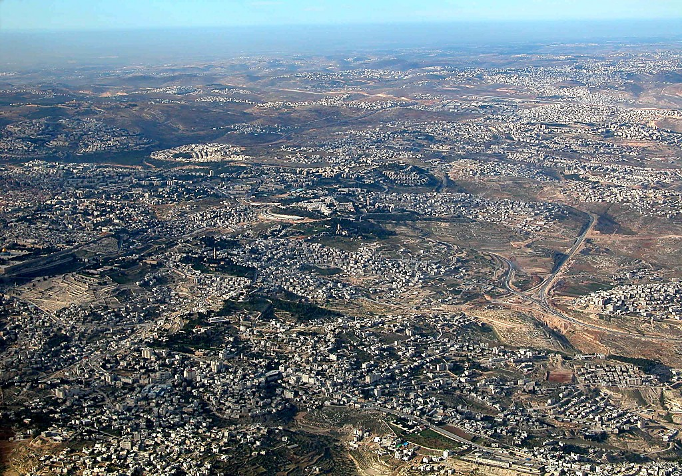
East Jerusalem and Mt of Olives aerial from s
1 Sam. 7:15
7
Nebi Samwil (Ramah Nghile)
BUT OF THE
MANY JUDGES
OF
ISRAEL...
Samuel: Orameichiili ea Ochiikakrikapimei; HPfozhii Inu ea Amono bu,Jerusalem Arupei
Temple Mount
THE LAST AND GREATEST,
THE “HINGE CHARACTER,” WAS...
SAMUEL
ANARCHY
Mt. of Olives
Judges
Bethany
350
Out zhi Okhu
Jeriko Lijii kaka
Handbook pg. 31-32
1
11
©2004 TBBMI
7.2.03d.

Slide 13
1 Sam. 8:4-19
7
AMAZHI CHILU
OCHIIKARIKAPIMEI
350
AMAZHICHILU
Ochiikakrikapimei
“AKHEUMEI MOVUMEI KALI DARKAR-E !”
350
350
“NI SIISII KOCHUCHUNO SOLE-O?”
Handbook pg. 31-32
2
12

Slide 14
1 Sam. 9:17
7
SAMSON
ISRAELMEI
OCHIIKAKRIKAPIMEI
13 HRIILINO...
DEBORAH
GIDEON
KONONOLI EA KAJIIJIILI,
“SOLOKOSII OMEI,” SII...
AMAZHI
CHILU
MOVU
CHILU
SAMUEL
Handbook pg. 31-32
1
13

Slide 15
M
A C
“MOVU CHILU”
14
2

Slide 16
Hriithoacharei - 1 Samuel 8:22a
7
CREATION
AMAZHICHILU
1st Pfoto ea Nito
Och
1st Kama
350
C
1st Okokazhii
350
1st Chihilimei
MOVU CHILUY
(1000 B.C.)
1st Sokatha
DD
Dzii Jii/Marei
Out Kkhu
ABRAHAM
(2000 B.C.)
3 SOCIETY
C 7 M J
Kokolo
AD
O - O - S
I - I
KD
J - E
12
CHILIKOSO CHILU
7 = 4 + 3
JOSEPH
AMAZHICHILU
Kobukolol
Och
430
350
4 OMEI
350
MOSES
(1500 B.C.)
(500 B.C.)
M
MAKRAKOBU
Takapra
S
Sinai
M - M- C
Kadesh Barnea
Jisu
40
40
LD
5 Ochikape
J
JOSHUA
Jeriko
Ojii Dadutie
4
15

Slide 17
HIPHA CHILU HEHI:
ABRAHAM-JOSEPH 2000 B.C.
MOSES-JOSHUA 1500 B.C.
AMAZHI CHILU-MOVU CHILU 1000 B.C.
16

Slide 18
1 Sam. 9:1-2 Movu 25:21
A M C
CHIIJIIPHE KOSO
ABRAHAM
JOSEPH
MOSES
JOSHUA
AMAZHI CHILU
MOVU CHIILU
CHIILI KOSO CHILU
MAKRAKOBU
JISU
Handbook pg. 32-37
17
©2004 TBBMI
7.2.03d.

Slide 19
ONGA SOTHOKOCHO
MO
N(A)
H
ADZIILOTIE Chiijiiphe thopfii no ichu-o Israelmei yi kani chijii ea khokro to pfoloe!
GO
K
ER
B
J
MN
KO
E
KB
U
MO
PG
KO
Handbook pg. 32-37
1
18

Slide 20

1 Sam. 9:1
7
MOVU CHILU
ca. 1000 B.C.
KOSII
SOCIETY
le
KAHINA
sii:
MOVU
CHILU
A M C
Handbook pg. 32-37
1
19

Slide 21
1 Sam. 15:1; 2 Sam. 2:4; 1 Mov 1:43
7
MOVU CHILU
ca. 1000 B.C.
S - D - S
SAUL
A M C
DAVID
MOVU
CHILU
S - D - S
SOLOMON
Handbook pg. 32-37
4
20

Slide 22
1 Sam. 16:13-14
7
MOVUCHILU
ca. 1000 B.C.
S - D - S
A M C
Movu Saul: mochomoro kobu omei!
Saul bu thelo koru duno Samuel yi koloe: nolu shupfo kobu Bethlehem zhii David
Movu Saul: mochomoro kobu omei!
Saul bu thelo koru duno Samuel yi koloe: nolu shupfo kobu Bethlehem zhii David.
MOVUCHILU
S - D - S
Handbook pg. 32-37
21

Slide 23
1 Sam. 16:1
7
MOVUCHILU
ca. 1000 B.C.
S - D - S
A MC
MOVUCHILU
S - D - S
Kolatu kokhumei Behlehem onghi le
Handbook pg. 32-37
1
22

Slide 24
7
MOVUCHILU
ca. 1000 B.C.
David zhi Ochikptho
S - D - S
DO
2 Sam 7: 4-16
1 Pfu 17:3-15
A M C
MOVUCHILU
S - D - S
Handbook pg. 32-37
1
23

Slide 25
7
DAVID ZHI OCHIIKOTHO
SOLOKOSII KOSII
2 Samuel 7
¹⁶ Ni chi ea ni movujii sii a nheine leno chisa chole, ea ni movubu sii chiisa sothulole.
chi
movujii
chisa chole
MOVUCHILU
movubu
chiisa
ROYALTY
S - D - S
S - D - S
Handbook pg. 32-37
5
24

Slide 26

Abraham zhi Ochiikotho
(“Kokolo ”)
Hriithoacharei 12: 1-3
OJII
ONA
SHIIHRA
Ojii
David
Ozhechu
30: 1-10
2 Samuel
7: 4 -16
Handbook pg. 32-37
25

Slide 27
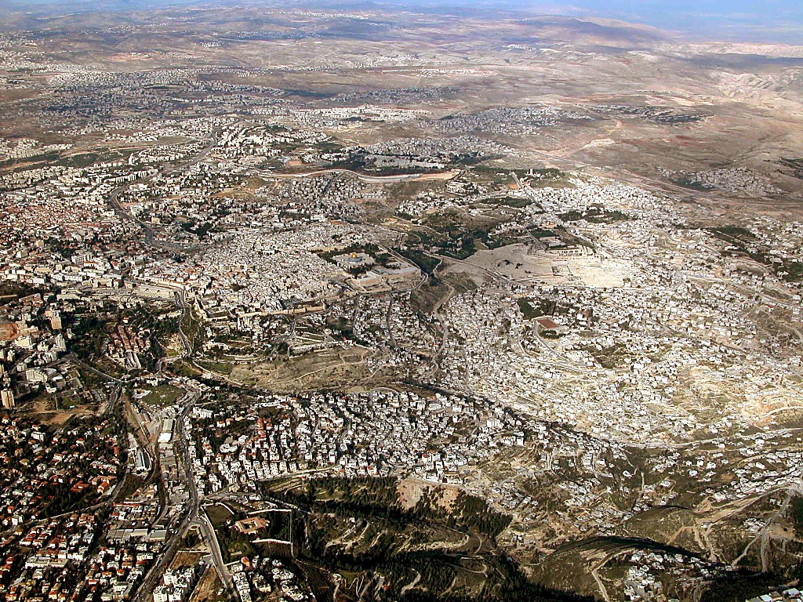
Jerusalem area aerial from south
2 Sam. 24:18-24; 2 Pfu. 3:1
Jerusalem: akhrupeino kokhru Temple Mount dzii
26
1
©2004 TBBMI
7.2.03d.

Slide 28

Old City aerial from north
2 Sam. 24:18-24; 2 Pfu. 3:1
Temple Mount: Jiiphe thofi no mozhu kocho totsii fii
27
©2004 TBBMI
7.2.03d.

Slide 29
2 Sam. 24:18-24; 2 Pfu. 3:1
Deni zhi oro kadatho Kokhru Dokhe
Araunah zhi oro kadatho kokhru dokhe…
David no hriilo-e…
Lipeo yi duno Rakothochi KARIRILI
sokoruduno!
Mount Moriah pile!
28
5
©2004 TBBMI
7.2.03d.

Slide 30

1 Mov 5:5
Movu David no mocho sodalo-e.
MOVUCHILU
S - D - S
Ana… pfona Solomon no sothole!
Handbook pg. 32-37
1
29

Slide 31

1 Movu 5:5
MOVUCHILU
S - D - S
Israel zhii “KARIRILI” Rakothochii
Handbook pg. 32-37
30

Slide 32
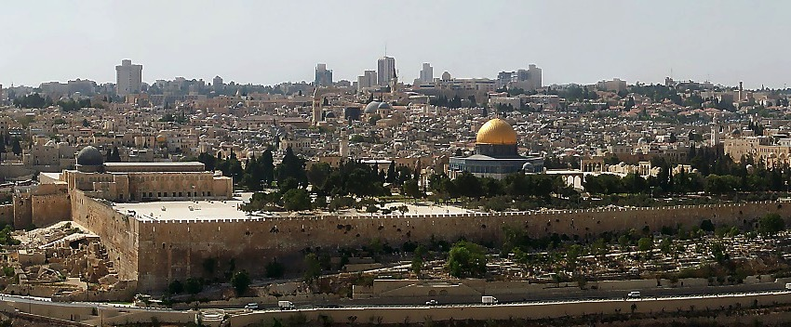
1 Movu 6:14-38
Ezhode Jerusalem zhii Rakothochii
Abraham no Isaak yi Shiila koru Obu…Mt. Moriah…Mt. Zion
ADI DOSO DENICHII HIHI SOTHULO-E?
OMI KO HO!
COMPUTER KO HO!
MOVUCHILU
ROYALTY
S - D - S
S - D - S
MAJIIKOCHO ONA-A-E HOE!
OMEI KOKHRO KOLIKHRI!
Handbook pg. 32-37
Handbook pg. 32-37
6
31

Slide 33

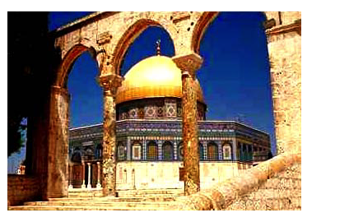
1 Movu 6:14-38; Mt. 21:12-23
Ezhode Jerusalem zhii Rakothochii
Abraham no Isaak yi Shiila koru Obu…Mt. Moriah…Mt
OHRUKAPRA OVO SOLO-E!
Chinghikolopei moe “Kakra chiivo”
Solomon no Koso “Karirili” Rakothochii
Ezhode Muslimtamei zhi Rakothobu
Herod no koso Rakothochii “Kahina” Jisu chilu chii
Handbook pg. 32-37
6
32

Slide 34

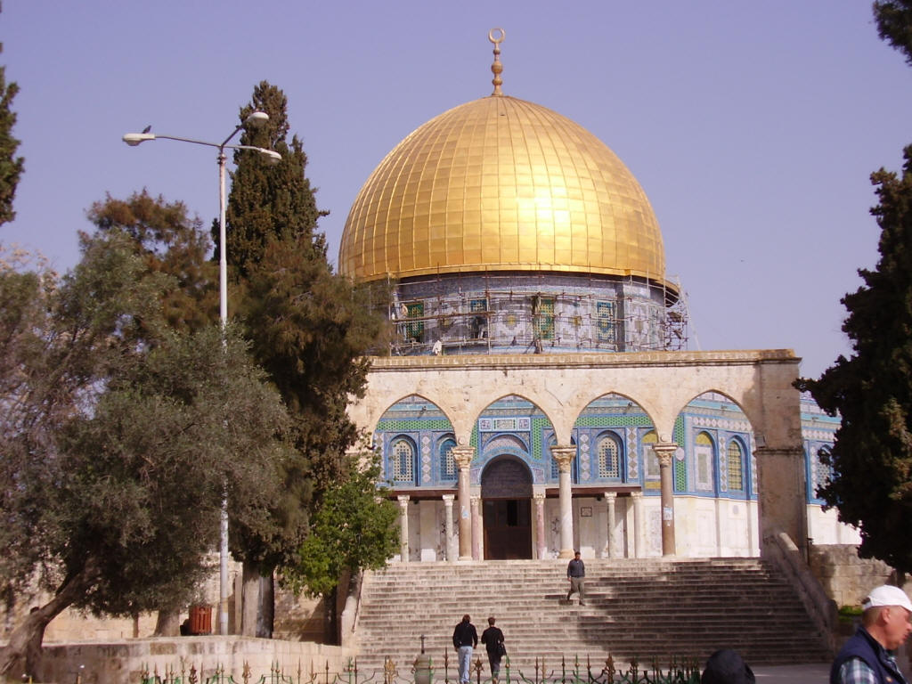
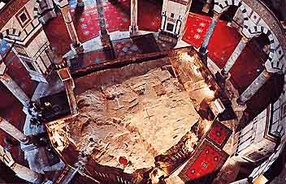
Jerusalem’s Temple Mount Today
Inside the Dome of the Rock
Dome of the Rock on The Temple Mount
Handbook pg. 32-37
32a
1
Notes:
Here is the octagonal shrine as you would approach it from the south, leaving the famed Al Aqsa Mosque, also held by Islam to be one of its most holy sites.
//// Inside the Dome, looking downward, is “The Rock” from which Mohammed is said to have gone to the “Seventh Heaven” on a ladder. The building is covered throughout with hundreds of colorful carpets, its ancient roof supported by a multitude of stone columns.

Slide 35
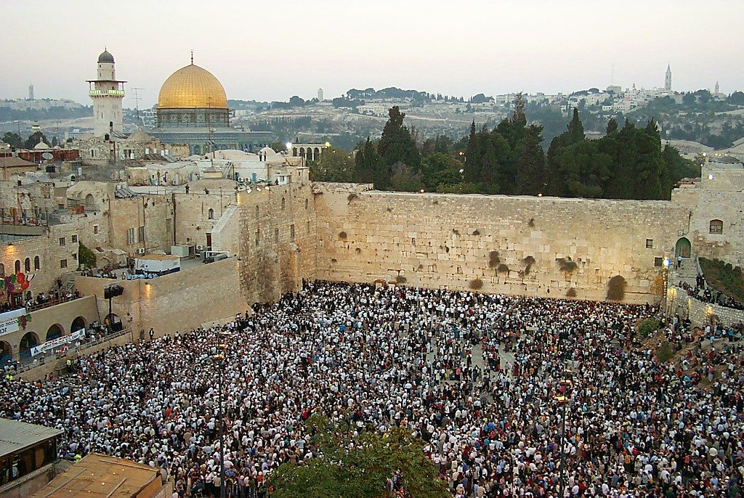
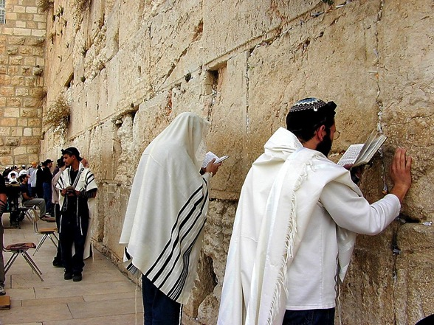
1 Movu 6:14-38
MOVUCHILU
S - D - S
Temple Mount zhii Chinghikolopei Chiivo
Handbook pg. 32-37
1
33

Slide 36

1 Movu 6:14-38
TEMPLE MOUNT ZHI JIISHUPFO KOBU MOTSIITEKOCHO!
• Rakuhepono
• Oramei zhi modokochopono
• Ozhihepono
• Ojiihepono
MOVUCHILU
S - D - S
• Christa yi modokochopono
Handbook pg. 32-37
6
34

Slide 37

1 Movu 6:14-38; Mt. 21:12-23
Ezhode zhii Temple Mount Jerusalem li: Chiijiiphe zhi Motsiistiili Bu
Handbook pg. 32-37
35

Slide 38

7
MOVUCHILU
ca. 1000 B.C.
S - D - S
DO
2 Sam 7: 4-16
1 Pfu 17:3-15
A M C
MOVUCHILU
S - D - S
SOLOMON: ITSII JIISHU-O MOCHOKOCHO!
KOPHROMOLI KASHII ITSII: KHA KORU OPHA .
Handbook pg. 32-37
6
36

Slide 39
1 Movu 9, 10, 11
7
MOVUCHILU
ca. 1000 B.C.
Sokothu!
Pisha pajii kokhro!
Pisha dzii kocho!
Ora kakri yi thokocho!
S - D - S
DO
2 Sam 7: 4-16
1 Pfu 17:3-15
A M C
MOVUCHILU
ROYALTY
S - D - S
S - D - S
Handbook pg. 32-37
4
37

Slide 40
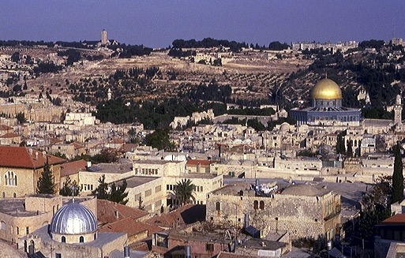
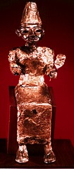

1Movu 11:4-8
7
Mount Olive jipfoki
MOVUCHILU
ca. 1000 B.C.
S - D - S
DO
2 Sam 7: 4-16
1 Pfu 17:3-15
A R C
Temple Mount
MOVUCHILU
S - D - S
ORAKAKRI YI KOTHO!
Handbook pg. 32-37
4
38

Slide 41
1 Movu12:25-14:20; 14:21-31
7
MOVUCHILU
ca. 1000 B.C.
S - D - S
DO
<< AKOKOCHO >>
ARUPEI AKHRUPEI
2 Sam 7: 4-16
1 Pfu 17:3-15
A M C
ISRAEL JUDAH
10 2
MOVUCHILU
S - D - S
••• AKOKOCHO •••
Arupei Khrupei
Israel
Judah
10 2
Handbook pg. 32-37
3
39

Slide 42
1 Movu 12:25-14:20; 14:21-31
7
ARUPEI MOVUJII:
ISRAEL
10 MEITA
SAMARIA
MOVUCHILU
S - D - S
••• AKOKOCHO •••
JERUSALEM
Arupei Khrupei
2 MEITA
Israel
Judah
10 2
AKHRUPEI MOVUJII:
JUDAH
Handbook pg. 32-37
1
40

Slide 43
1 Movu 17-22; Isaiah through Malachi
7
MOVUCHILU
ca. 1000 B.C.
S - D - S
DO
<< AKOKOCHO>>
ARUPEI AKHRUPEI
2 Sam 7: 4-16
1 Pfu 17:3-15
A M C
ISRAEL JUDAH
10 2
MOVUCHILU
ORAMEI CHILIMEI
S - D - S
•••AKOKOCHO •••
North South
Arupei Khrupei
Israel
Judah
10 2
ORAMEI CHILEMEI
Handbook pg. 32-37
41

Slide 44
Isaiah - Malaki
7
JONAH
MIKAH
MOVUCHILU
ca. 1000 B.C.
EZEKIEL
S - D - S
ZEPHANIAH
DANIEL
<< AKOKOCHO >>
ZECHARIAH
ARUPEI AKHRUPEI
JEREMIAH
ISRAEL JUDAH
AMOS
HABAKKUK
JOEL
10 2
MOVUCHILU
ORAMEI CHILIMEI
S - D - S
HAGGAI
••AKOKOCHO •••
ARUPEI AKHRUPEI
OBADIAH
Israel
Judah
10 2
ELISHA
10 2
ORAMEI CHILIMEI
HOSEA
ELIJAH
ISAIAH
NAHUM
MALAKI
Handbook pg. 32-37
42

Slide 45
7
MOVUCHILU
ca. 1000 B.C.
S - D - S
DO
<< AKOKOCHO>>
ARUPEI AKHRUPEI
2 Sam 7: 4-16
1 Pfu 17:3-15
A M C
ISRAEL JUDAH
10 2
KO
MOVUCHILU
ORAMEI CHILIMEI
S - D - S
••• AKOKOCHO•••
Kothu Ochiikotho
ARUPEI AKHRUPEI
Israel
Judah
10 2
Jer 31: 31-33
ORAMEI CHILIMEI
Handbook pg. 32-37
1
43

Slide 46
7
Jeremiah 31
KOTHU OCHIIKOTHO
³¹ “Hibvii-o chithu sii voeh,” tto Lipeo no pe, “ai no Israel ea Judah chihelimei yi sawo ochiikotho kothu kali sole.
MOVUCHILU
Israel ea Judah chihelimei yi sawo ochiikotho kothu kali sole.
S - D - S
••AKOKOTIEI•••
ARUPEI AKHRUPEI
Israel
Judah
10 2
ORAMEI CHILIMEI
MESSIAH SII KAPEPIWOTIE!
Handbook pg. 32-37
3
44

Slide 47
Abraham zhi Ochiikotho
(“Kokolo ”)
Hriithoacharei 12: 1-3
MOVUHCILU
OJII
SHIIHRA
S - D - S
OJII
ONA
SHIIHRA
ONA
•••AKOKOTIE•••
ARUPEI A KHRUPEI
Israel
Judah
Ojii
David
Kothu
10 2
ORAMEI CHILIMEI
Ozhechu Pe
30:1-10
2 Samuel
7:4 -16
Jeremiah
31:31-33
Handbook pg. 32-37
5
45

Slide 48
1 Movu 12 - 2 Movu 24
7
MOVUCHILU
ca. 1000 B.C.
S - D - S
DO
<< AKOKOCHO>>
ARUPEI AKHRUPEI
2 Sam 7: 4-16
1 Pfu 17:3-15
A M C
ISRAEL JUDAH
10 2
KO
MOVUCHILU
ORAMEI CHILIMEI
S - D - S
••AKOTATIE••
ARUPEI AKHRUPEU
20-J 20-R
Israel
Judah
Arupei: Jeroboam
Akhrupei: Rehoboam
10 2
ORAMEI CHILIMEI
20-J 20-R
MOVU KAZHII HOE
KAPOKO KOBU MOVU KAZHII
Handbook pg. 32-37
3
46

Slide 49
2 Movu 17:6
7
MOVUCHILU
ca. 1000 B.C.
S - D - S
DO
<< AKOKOCHO>>
ARUPEI AKHRUPEI
2 Sam 7: 4-16
1 Pfu 17:3-15
A M C
ISRAEL JUDAH
10 2
KO
MOVUCHILU
ORAMEI CHILIMEI
S - D - S
••AKOTATEI••
ARUPEI AKHRUPEI
20-J 20-R
Israel
Judah
Jer 31: 31-33
Israel
Judah
10 2
10 2
200
ORAMEI CHLIMEI
20-J 20-R
200
ASSYRIA
Assyria
Handbook pg. 32-37
47

Slide 50
2 Movu 17:6
ONGA SOTHOKOCHO
MO
N(A)
H
GO
K
EK
B
J
MN
MOVUCHILU
KO
S - D - S
••AKOTATEI•••
E
ARIPEI AKHRUPEI
ARUPEI MOVUJIIKHRU:
ISRAEL (722 B.C.)
JIHUDIMEI NO KANA CHIIJI THIIA TAKOTU
Israel
Judah
KB
U
10 2
ORAMEI CHILIMEI
20-J 20-R
200
Assyria
MO
PG
KO
Handbook pg. 32-37
1
48

Slide 51
ONGA SOTHOKOCHO
MO
Siitomatiwe… AKHRUPEI Movujii?
N(A)
H
GO
K
EK
B
J
MN
MOVUCHILU
KO
BABYLON TAMEI NO ASSYRIATAMEI YI VA LOTIE!
S - D - S
••AKOTATEI •••
E
ARUPEI AKHRUPEI
Israel
Judah
KB
U
10 2
ORAMEI CHILIMEI
20-J 20-R
200
Assyria
MO
PG
KO
Handbook pg. 32-37
2
49

Slide 52
2 Movu 25:21
7
MOVUCHILU
ca. 1000 B.C.
S - D - S
DO
<< AKOKOCHO>>
ARUPEI AKHRUPEI
2 Sam 7: 4-16
1 Pfu 17:3-15
A M C
ISRAEL JUDAH
10 2
KO
MOVUCHILU
ORAMEI CHILIMEI
S - D - S
••AKOTATEI •••
ARUPEI AKHRUPEI
20-J 20-R
Israel
Judah
Jer 31: 31-33
10 2
200
350
ORAMEI CHILIMEI
20-J 20-R
200
350
ASSYRIA
BABYLON
Assyria
Babylon
Handbook pg. 32-37
50

Slide 53
2 Movu 25:1-21
ONGA SOTHOKOCHO
MO
N(A)
H
GO
K
EK
B
J
MN
MOVUCHILU
KO
S - D - S
•••AKOTATEI •••
E
ARUPEI AKHRUPEI
Israel
Judah
KB
U
10 2
AKHRUPEI MOVUJII:
JUDAH (586 B.C.)
BABYLON LI SAKATA
ORAMEI CHIHILIMEI
20-J 20-R
200
350
Assyria
Babylon
MS
PG
RS
Handbook pg. 32-37
2
51

Slide 54
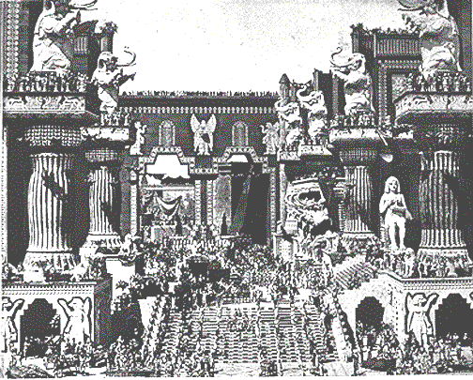
2 Movu 25: 1-21
MOVUCHILU
S - D - S
•••AKOTATEI•••
ARUPEI AKHRUPEI
Israel
Judah
10 2
ORAMEI CHILIMEI
20-J 20-R
200
350
Assyria
Babylon
Deni zhii Babylon Inu
“Hriilokahra” tikocho leino kanei
Handbook pg. 32-37
52

Slide 55
Hriithoacharei - Nehemiah
7
CHIIJIIPHEKOSO
AMAZHI CHILU
1st Pfoto ea Nito
Ochiikakrikapimei
1st Kama
350
C
1st Oko kazhil
350
1st Chihelimei
MOVU CHILU
(1000 B.C.)
1st Sokatha
S - D - S
DziIi Jii/Marei
••AKOKOCHO•••
DD
Out Kokhur
3 SOCIETY
ARUPEI AKHRUPEI
ABRAHAM
(2000 B.C.)
Judah
Israel
Kokolo
10 2
C 7 M J
O - O - S
AD
ORAMEI CHILIMEI
I - I
20-J 20-R
J - E
200 350
KD
Assyria Babylon
12
CHILICHILU
JOSEPH
MOVUCHILU
7 = 4 + 3
Kobukola
S - D - S
4 OMEI
430
••AKOKOCHO•••
ARUPEI AKHRUPEI
MOSES
(1500 B.C.)
Israel
Judah
M
MAKRA KOBU
(500 B.C.)
10 2
Takapra
S
ORAMEI CHILEMEI
Sinai
20-J 20-R
M - M- C
200
350
Kadesh Barnea
Assyria
Babylon
40
JISU
40
5 Ochiikape
LD
J
JOSHUA
Jeriko/Ai
Ojii Dadutie
53

Slide 56
7
C
A M
“CHILIKOSO CHILU”
Handbook pg. 37-38
1
54

Slide 57
2 Movu 25:21 Ezra heno1:3
A M C
CHIIJIIPHE KOSO
ABRAHAM
JOSEPH
MOSES
JOSHUA
AMAZHI CHILU
MOVU CHIILU
CHIILI KOSO CHILU
MAKRAKOBU
JISU
Handbook pg. 37-38
7.2.03d.
©2004 TBBMI
55

Slide 58
HIPHA CHILU HEHI:
ABRAHAM-JOSEPH 2000 B.C.
MOSES-JOSHUA 1500 B.C.
AMAZHI CHILU - MOVUCHILU 1000 B.C.
CHILIKOSO CHILU- MAKRA KOBU 500 B.C.
56

Slide 59
Isaiah 9:6-7
ONGA SOTHOKOCHO
Thopfii pfokodzii kolo…
MO
N(A)
H
GO
K
EK
B
J
MN
KO
JUDAH YI SOMOHOMOE!
E
ADIVANO?
KB
U
MO
Adivano tili: Kosokoso Messiah hi Judah meita vano vule to mosiiwotie.
PG
KO
Handbook pg. 37-38
8
57

Slide 60
2 Movu 25:21
7
CHILIKOSO CHILU
KOSII
SOCIETY
le
KOSIKOCHUNA
sii:
CAPTIVITY
A R C
Handbook pg. 37-38
58

Slide 61
Daniel 1
Deni zhii Babilon Inu
CHILI KOSO
Euphrates Korii
Babilon zhii Azhu kocho Toprii
Handbook pg. 37-38
59

Slide 62
7
CHILIKOSO CHILU
SO EA PFII KOCHO OBU
Handbook pg. 37-38
60

Slide 63
Jer. 29:10; Ezra 3:8; Neh. 2:5-6
7
CHILIKOSO CHILU
MOPFU 70
AZHII 3
A M C
CHILIKOSO CHILU
MOPFU 70
“JIHUDIMEI”
AZII 3
“JIHUDIMEI”
“SINAGOK”
“SINAGOK”
Handbook pg. 37-38
3
61

Slide 64
7
AZHII 3 ADAKHI KOVU
CHILIKOSO CHILU
Mopfu 70
Azhii 3
SO EA PFII KOCHO OBU
Handbook pg. 37-38
62

Slide 65
Ezra 1-2
7
CHILIKOSO CHILU
MOPFU 70
AZHII 3
A M C
MOPFU 100 / 50,000
CAPTIVITY
CHILIKOSO CHILU
70 Years
Mopfu 70
3 Treks
Azhii 3
100 Years / 50,000
Handbook pg. 37-38
63

Slide 66
Ezra 1:4
50,000 OMEI ADAKHIVULOE!
ANA OMEI PAJII KOSO ACHETEI, ADAKHEIMEI-YI PISHA NO SOKHRO PILO KORUDUNO.
CAPTIVITY
CHILIKOSO CHILU
Mopfu 70
70 Years
Azhii 3
3 Treks
100 Years / 50,000
Handbook pg. 37-38
1
64

Slide 67
Jer. 29:10; Ezra 3:8; Neh. 2:5-6
7
ZERUBBABEL
CHILIKOSO CHILU
EZRA
MOPFU 70
AZHII 3
MOPFU 100 / 50,000
Z - E - N
CHILIKOSO CHILU
CAPTIVITY
Mopfu 70
NEHEMIAH
70 Years
Azhii 3
3 Treks
100 Years / 50,000
Z - E - N
Handbook pg. 37-38
4
65

Slide 68
Jer. 29:10; Ezra 3:8; Neh. 2:5-6
7
ZERUBBABEL…adakhivu Lipeo zhii Rakothochii soikrithoe.
CHILIKOSO CHILU
MOPFU 70
EZRA…adakhivu Lipeo zhii Ozhii modoe.
EZRA
Z-E-N
AZHII 3
MOPFU 100 / 50,000
SOLOSIITE PFO
KOBU, ORAMEI YI ASHIILACHOMEI KOSII
Z - E - N
CAPTIVITY
CHILIKOSO CHILU
70 Years
NEHEMIAH…adakhivu Old testament amodomeikali soe, ea pfono inu zhii chiivo ea chkhubomii soikrithoe.
Mopfu 70
NEHEMIAH
3 Treks
Azhii 3
100 Years / 50,000
Z - E - N
Handbook pg. 37-38
3
66

Slide 69
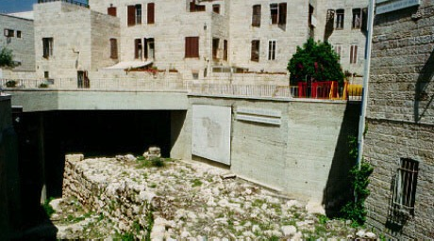
Neh. 3:8
7
7
Jerusalem:Nehemiah zhii Chiivo khula pracho
CAPTIVITY
CHILIKOSO CHILU
70 Years
Mopfu 70
3 Treks
Azhii 3
100 Years / 50,000
Z - E - N
Handbook pg. 37-38
67

Slide 70
ONGA SOTHOKOCHO
MO
ISRAEL
N(A)
H
JUDAH
GO
K
EK
B
J
MN
Old Testament chukoru hesii Israelmei apotatei; Jihudimei adakhivulotie.
CHILIKOSO CHILU
Old Testament chokoru hesii Israelmei apotatei; Jihudimei adakhivulotei.
CAPTIVITY
KO
Mopfu 70
70 Years
Azhii 3
3 Treks
E
100 Years / 50,000
100 Years / 50,000
U
Z - E - N
KB
Messiah vule tto
kapekapi sii “chiilu machi tto no vutuloe
Messiah vule tto
kapekapi sii “chiilu machi tto no vutuloe
Messiah vule tto
kapekapi sii “chiilu machi tto no vutuloe
Messiah vule tto
kapekapi sii “chiilu machi tto no vutuloe
MS
PG
RS
Handbook pg. 37-38
3
68

Slide 71
Hriithoacahrei - Esthar
7
CHIIJIIPHEKOSO
CREATION
AMAZHI CHILU
ANARCHY
1st Pfoto ea Nito
1st Man & Woman
Ochiikakrikapimei
1st Kama
Judges
1st Sin
350
350
350
1st Oko kazhil
350
C
1st Gospel
1st Chihelimei
1st Family
MOVU CHILU
(1000 B.C.)
1st Sokatha
ROYALTY
1st Murder
S - D - S
do
Dzii Jii/ Marei
S - D - S
Flood/Rainbow
••AKOKOCHO•••
Out Kokhu
••• SPLIT •••
Tower
ARUPEI AKHRUPEI
North South
(2000 B.C.)
Judah
Israel
(2000 B.C.)
Judah
Israel
ABRAHAM
(2000 B.C.)
ABRAHAM
3 SOCIETY
10 2
Kokolo
10 2
ko
The CALL
Ao
ORAMEI CHILIMEI
C 7 M J
O - O - S
THE PROPHETS
L - S - B
20-J 20-R
I - I
20-J 20-R
I - I
200 350
J - E
200 350
J - E
Assyria Babylon
12
Assyria Babylon
12
CHILIKOSO CHILU
JOSEPH
JOSEPH
CAPTIVITY
CHILIKOSO CHILU
7 = 4 + 3
MOPFU 70
CHILIKOSO CHILU
Kobukola
Slavery
AZHII 3
70 Years
Mopfu 70
430
Mopfu 70
430
MOPFU100 / 50,000
4 OMEI
3 Treks
Azhii 3
Z - E - N
Azhii 3
100 Years / 50,000
(1500 B.C.)
100 Years / 50,000
(1500 B.C.)
MOSES
(1500 B.C.)
MOSES
M
(500 B.C.)
Z - E - N
Takapra
MAKRAKOBU
Exodus
S
Sinai
Sinai
M - M - C
M - C - C
Kadesh Barnea
Kadesh Barnea
JISU
40
40
40
40
lo
5 Ochiikape
5 Sermons
J
JOSHUA
JOSHUA
Jeriko/Ai
Jericho/Ai
Ojii Dadutie
Land Divided
69
1

Slide 72
7.2.03d.
70

Slide 73


The Bible…Basically link at BibleStudyDownloads.org
Get this presentation for free!
Notes:
The Bible…Basically (bb)

