Slide 1
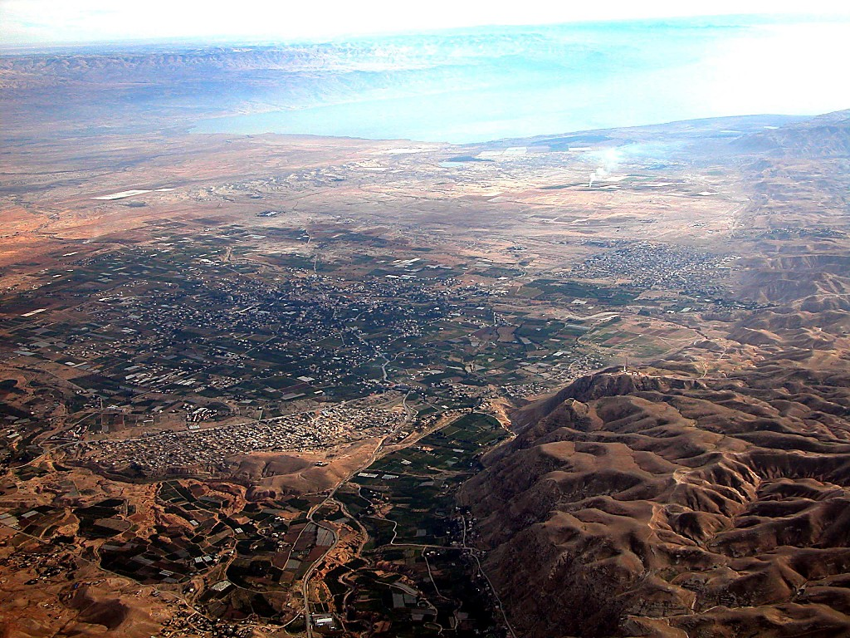
KATHI OZHI
JORDAN KORII
Moses-Joshua
EZHODE JERIKO
DENI JERIKO
Jericho lJordan korii leino chinghi kapra pie ni kocho
eino...
Handbook pg. 26-29
42

Slide 2
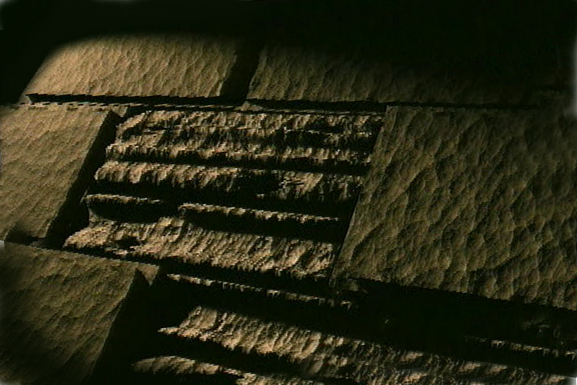
Bible…
Amolo Leino
Bible…Amolo Leino modo kocho
Ministries International Inc. Fort Worth, Texas
Designed by Dr. John Fryman, Texas, USA • BibleBasically.org Taught by Dr. Rick Griffith, Singapore Bible College All files in many languages for free download at BibleStudyDownloads.org
www.biblebasically.org
8.0.01.
©2004 TBBMI
04

Slide 3
HIPHA CHILU HEHI:
ABRAHAM-JOSEPH 2000 B.C.
MOSES-JOSHUA 1500 B.C.
01

Slide 4
7
Tak. 2:10
CHIIJIIPHE KOSO
ABRAHAM
ABRAHAM
“Ai Jisu
Moli Jihoe”
ABRAHAM
JOSEPH
ABRAHAM
MOSES
JOSHUA
AMAZHI CHILU
MOVUCHILU
CHIILIKOSO CHILU
MAKRAKOBU
JISU
Handbook pg. 26-29
02

Slide 5
Tak. 7-8
7
AMEIYIPENO TATIO!
MOSES
ca. 1500 B.C.
“4 OMEI”
le
KOSIINA
sii:
AJMJ
MOSES
40
Handbook pg. 26-29
1
03

Slide 6
7
Tak. 12:31
MOSES
ca. 1500 B.C.
TAKAPRA!
EXODUS
“4 OMEI”
le
KOSIINA
sii:
AJMJ
MOSES
Takapra
40
Handbook pg. 26-29
04

Slide 7
Tak. 12:31-18:27
ONGA
SOTHOKO
MO
N(A)
H
GO
K
EK
B
J
MN
MOSES
KO
Takapra
TAKAPRA!
E
KB
U
40
MO
PG
KO
Handbook pg. 26-29
05

Slide 8
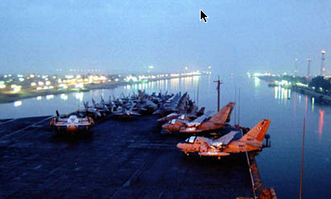
Tak. 13:18
ONGA
SOTHOKO
MO
N(A)
H
GO
K
EK
B
J
MN
MOSES
KO
SUEZ CANAL ZHIIOBU KODA KOCHO
Takapra
E
KB
U
40
OZHI ZHII PRONGHO:
“YAM SUPH”
MO
PG
KO
Handbook pg. 26-29
2
06

Slide 9
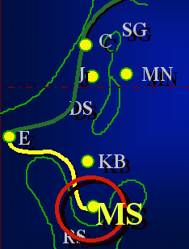
7
Tak 19
MOSES
ca. 1500 B.C.
TAKAPRA
SINAI
AJMJ
MOSES
Takapra
Sinai
40
Handbook pg. 26-29
1
07

Slide 10
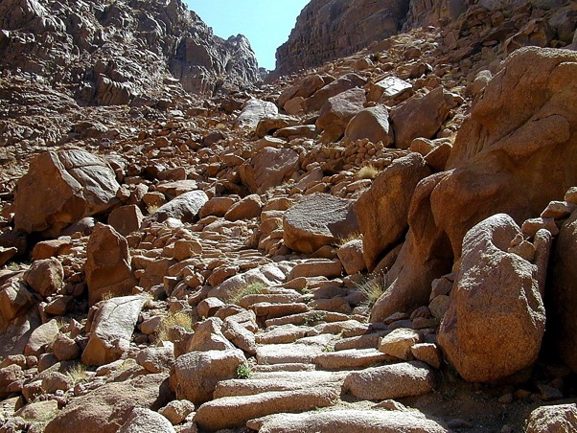
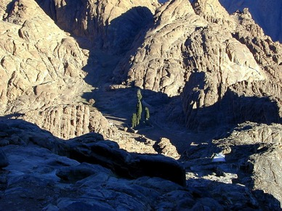
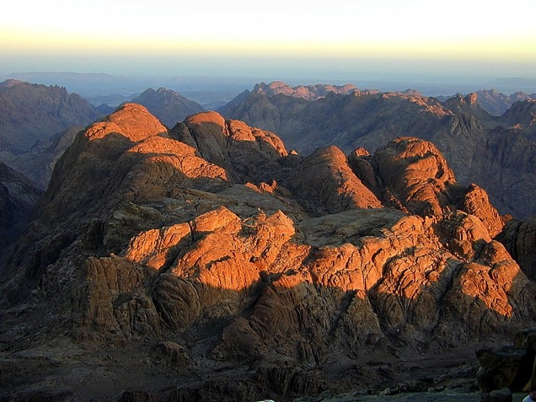
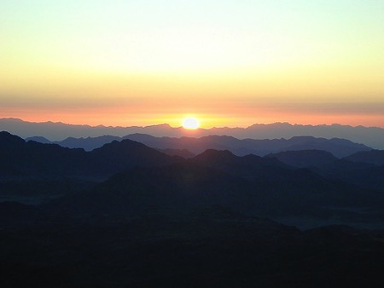
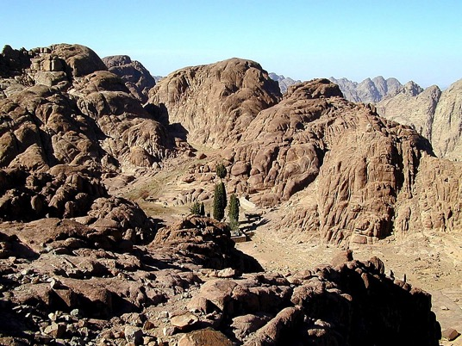
Tak. 19:2
MOSES
Takapra
Sinai
40
Mt. Sinai:
Ozhi kapi obu
Handbook pg. 26-29
08

Slide 11
7
Tak. 20-31
MOSES
ca. 1500 B.C.
TAKAPRA
SINAI
AJMJ
M - M - C
MOSES
Takapra
Sinai
M - M- C
40
MACHII LIJII
MOSOMEI
CHIINA KOSO OVO
Handbook pg. 26-29
3
09

Slide 12
Tak. 20-31
7
OZHI (TORAH)
Oramei hepono Modo kocho Ozhi Kosii leno:
MOSES
Takapra
Sinai
M - M - C
40
Handbook pg. 26-29
10

Slide 13
Tak. 20:1-17
7
OZHI (TORAH)
Oramei hepono Modo kocho Ozhi Kosii leno :
MACHI LIJII: Chia Ochii Kokha Chii; ezhode zhii ozhi koso zhii obi.
MOSES
Takapra
Sinai
M - M- C
40
Handbook pg. 26-29
11

Slide 14
Tak. 21-24
7
OZHI (TORAH)
Oramei hepono Modo kocho Ozhi Kosii leno :
MACHI LIJII : Chia Ochii Kokha Chii; ezhode zhii ozhi koso zhii obi.
MOSOMEI : Omei khruhi adi doso kothu meihrii li hi hrii zhu lole.
MOSES
Takapra
Sinai
M - M - C
40
Handbook pg. 26-29
12

Slide 15
Tak. 25-31
7
OZHI (TORAH)
A Godly Education In Three Parts:
MORAL: Chia Ochii Kokha Chii; ezhode zhii ozhi koso zhii obi.
CIVIL: Omei khruhi adi doso kothu meihrii li hi hrii zhu lole.
CHIINA KOSO OVO: Adi doso Oramei yi kotho vo solo le.
MOSES
Takaprax
Sinai
M - M - C
40
Handbook pg. 26-29
13

Slide 16
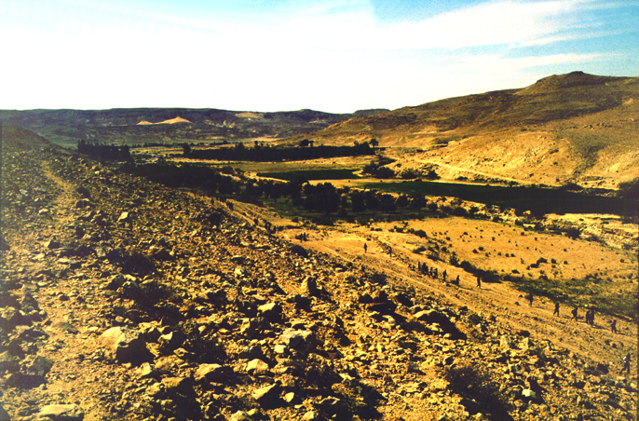
Kop. 20:13; Ozp. 1:19
ONGA
SOTHOKO
MO
N(A)
H
GO
K
EK
B
J
MN
MOSES
KO
Takapra
Odzii kodubu Kadesh Barnea li
Sinai
E
M - M - C
KB
U
40
MO
PG
KO
Handbook pg. 26-29
2
14

Slide 17
7
Kop 20:13; Deut. 1:19
MOSES
ca. 1500 B.C.
TAKAPRA
SINAI
AJMJ
M - M - C
KADESH BARNEA
MOSES
Takapra
Sinai
M - M - C
Kadesh Barnea
40
Handbook pg. 26-29
15

Slide 18
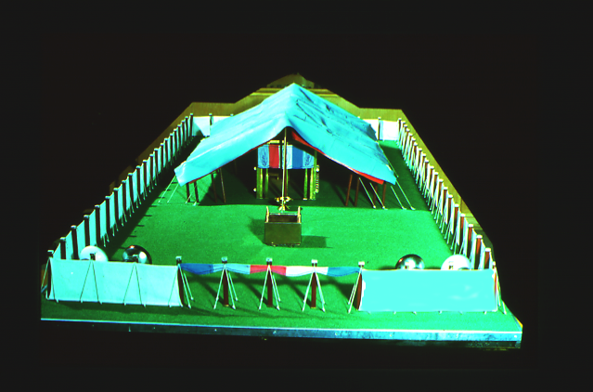
Kop. 13
7
MOSES HI KOTHU MOSIIKOCHO DARKAR TIE!
MOSES no omei motsii mei yiko-e.
MOSES
Takapra
Sinai
M - M- C
Kadesh Barnea
40
Ochiikotho siibvii Ive li
Handbook pg. 26-29
2
16

Slide 19
Kop. 13
7
SIIMOLI KASHII ANOKOCHO…
“OJII” sii kohibvii-o bue?
Adi meino bue?
Korii khru ye dziila khru?
Oji mate ye ive khru?
MOSES
Takapra
Sinai
Mara mati prakazhii ye oho morii hriilo koru?
M - M- C
Kadesh Barnea
40
Adi koto na bue?
Handbook pg. 26-29
6
17

Slide 20
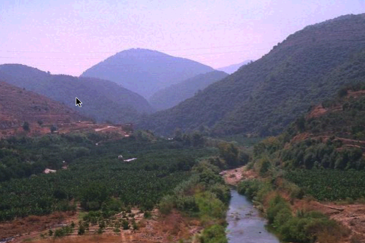
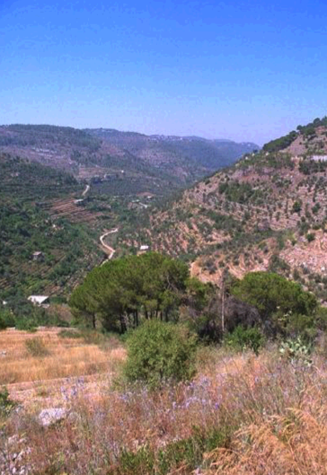
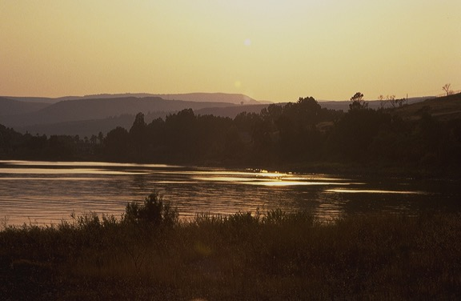
Kop. 13
ONGA
SOTHOKO
MO
N(A)
H
NARUPIE NO AKHRUPEI KOKRO EZHODE ZHII LEBANON…
GO
K
RUHRIMEI LIJII
ER
B
J
MN
MOSES
KO
Takapra
Sinai
E
M - M- C
Kadesh Barnea
KB
U
40
MO
PG
KO
Handbook pg. 26-29
18

Slide 21
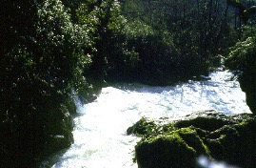
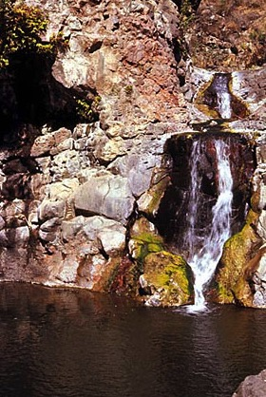
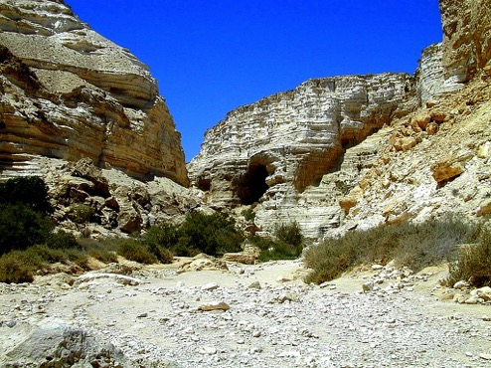
Kop. 13
ONGA
SOTHOKO
MO
N(A)
H
…AKHRUPIE NO ADAKHI KADESH BARNEA LE KOVU.
GO
RUHRIMEI LIJII
K
ER
B
J
MN
MOSES
KO
Takapra
Sinai
E
M - M - C
Kadesh Barnea
KB
U
40
MO
KO
Handbook pg. 26-29
19

Slide 22
Kop. 13:26-14:9
ONGA
SOTHOKO
Hibviitie:
MS
CHIRKAHI-O RUHRIIMEI: KAHI REPORTS
10 RUHRIIMEI: OMEI PAJII NO PFOKOLO
TUNEDZI YE LEIDZIIDU KRII-O KOBU OJI KOE!
OMEI KHROKOE
EJIPT LI ADAKHEI TILE SHE!
2 RUHRIIMEI : MOMEI KOTU NO PFOKOLO
TUNEDZI YE LEIDZIIDU KRII-O KOBU OJI KOE!
OMEI KHROKOE!
ORAMEI AKHRUMEI HI BUE!
N(A)
H
SG
C
ER
B
J
MN
DS
MOSES
Takrapra
Sinai
E
M - M - C
U
Kadesh Barnea
KB
40
MS
PG
RS
...TALESHIE !!!!!
Handbook pg. 26-29
12
20

Slide 23
Kop. 13:26-14:9
ONGA
SOTHOKO
Hibviitie:
MS
CHIRKAHI-O RUHRIIMEI: KAHI REPORTS
10 RUHRIIMEI: OMEI PAJII NO PFOKOLO
TUNEDZI YE LEIDZIIDU KRII-O KOBU OJI KOE!
OMEI KHROKOE
EJIPT LI ADAKHEI TILE SHE!
2 RUHRIIMEI : MOMEI KOTU NO PFOKOLO
TUNEDZI YE LEIDZIIDU KRII-O KOBU OJI KOE!
OMEI KHROKOE!
ORAMEI AKHRUMEI HI BUE!
N(A)
H
TAKORU SII NUTIE!
SG
C
ER
B
J
MN
DS
MOSES
Takrapra
Sinai
E
M - M- C
U
Kadesh Barnea
KB
40
MS
PG
RS
...TALESHIE !!!!!
Handbook pg. 26-29
12
20

Slide 24
7
Kop. 32:13
MOSES
ca. 1500 B.C.
EXODUS
SINAI
AJMJ
M - M - C
KADESH BARNEA
40
MOSES
Takapra
Sinai
M - M - C
Kadesh Barnea
40
40
Handbook pg. 26-29
22

Slide 25
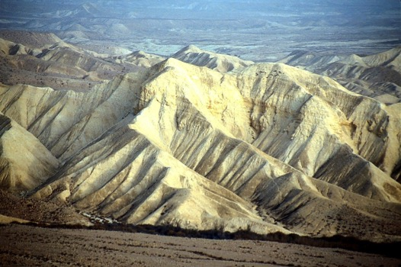
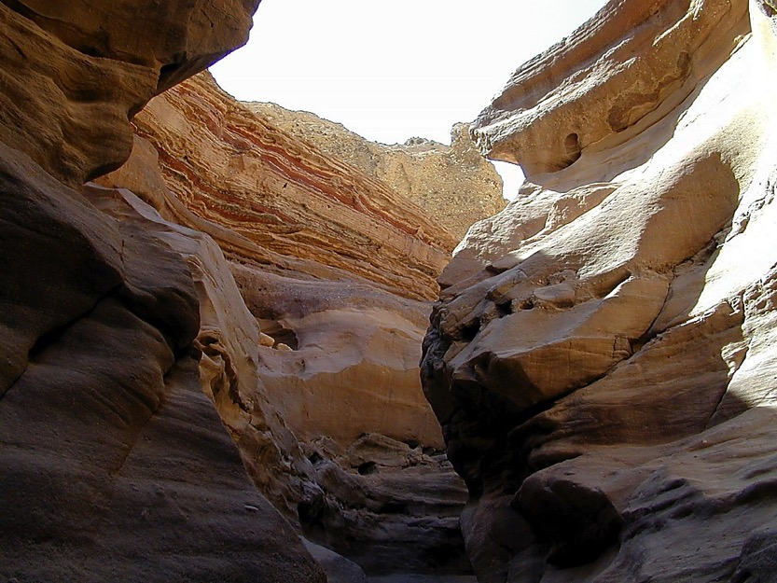
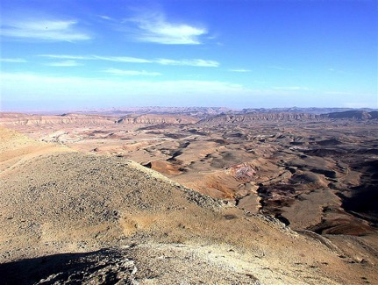
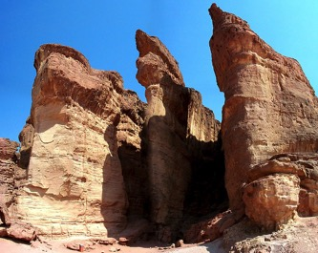
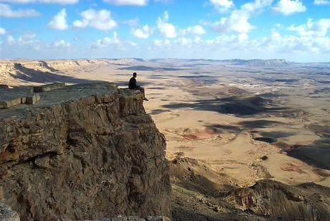
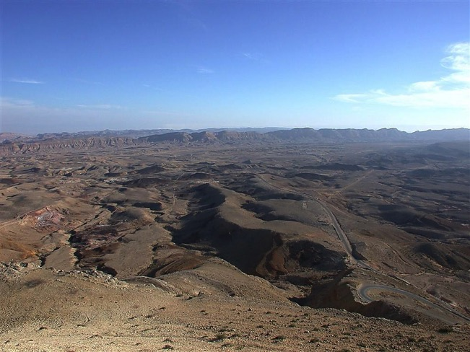
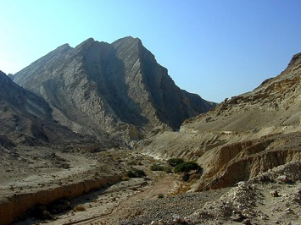
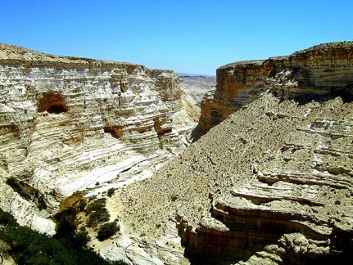
Kop. 32:49; 34:1
ONGA
SOTHOKO
MOFU 40 VAKU LIELE HA?
MOFU 40 VAKU LIELE HA?
MOFU 40 VAKU LIELE HA?
MOSES
Takapra
Sinai
M - M - C
Kadesh Barnea
40
40
Handbook pg. 26-29
1
23

Slide 26
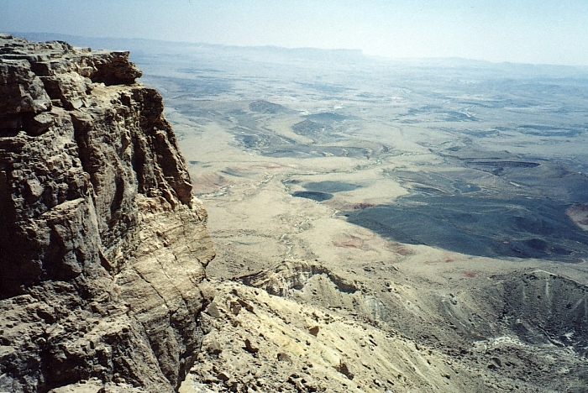
Kop. 32:49; 34:1
ONGA
SOTHOKO
ADIVANO?
OCHIIZIIKOBO!
MOLEKOMO!
MOSES
Takapra
Sinai
M - M - C
Kadesh Barnea
40
40
INGHI HRULI LI KOCHO
Handbook pg. 26-29
3
24

Slide 27
Kop. 32:49; 34:1
ONGA
SOTHOKO
MO
N(A)
H
GO
K
EK
MN
B
J
MN
MOSES
KO
Takapra
Sinai
E
M - M - C
KB
Kadesh Barnea
40
U
40
M
PG
KO
Handbook pg. 26-29
25

Slide 28
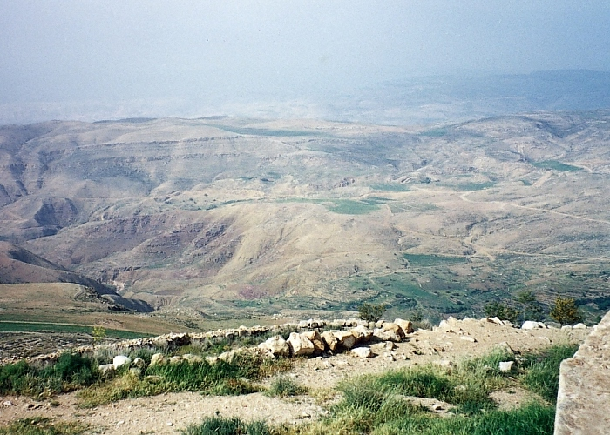
MOSES
Takapra
Sinai
M - M - C
Kadesh Barnea
40
40
“Kapekapi Ojii” mozu ni kocho Mt. Nebo leino
Handbook pg. 26-29
1
26

Slide 29
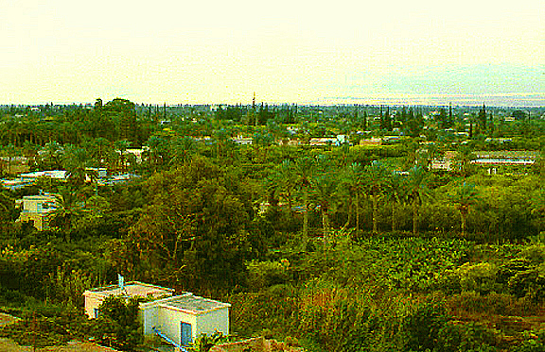
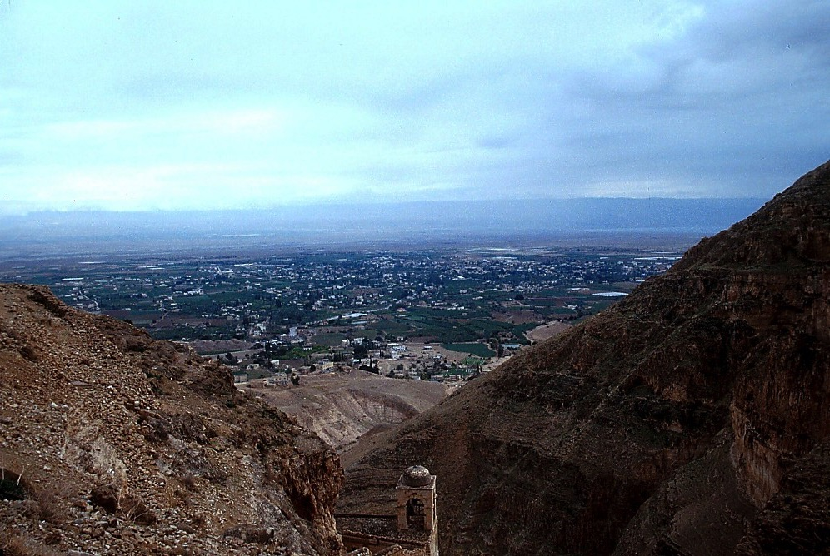
Jordan lieno mozu kani Mt. Nebo
MOSES
Takapra
Sinai
M - M - C
Kadesh Barnea
40
40
From Jericho...
Looking Across the Jordan River Toward Mt. Nebo
Handbook pg. 26-29
1
27

Slide 30
7
MOSES
ca. 1500 B.C.
TAKAPRA
SINAI
AJMJ
M - M - C
KADESH BARNEA
40
MOSES
OO
Takapra
5 OCHIIKAPE
Sinai
M - M - C
Kadesh Barnea
40
40
5 Ochiikape
Tak. 30: 1-10
KRII TE KOCHO KANA CHIIJII ZHII
OZHII!
TAKAPRA: OZHI KAHINA!
ADIDOSO HRII MOLI SHUE!
KOTHU YE OTE SHIILU KHRUMEI YI
OJII ZHII OCHIISOTHOKOCHO
PFOLEMEI RA THIKO-E?
ATHIMEI KO-E!
Handbook pg. 26-29
8
28

Slide 31
7
OZHECHII PE-IKRIIKOCHO 30
OJII SII (PALESTINE) KAPEKAPI
⁵ Ye nile Lipeo Oramei no nile pfope no thekowo chijile sii savupiwo nile peno mathelole ; ea nile yi peno nile pfupe dziino chovo ea hriizhipuwo mohriile.
⁶ Ea nile Lipeo Oramei no nile teonamei moletho hei sii motowle ; siitoko nile no nile Lipeo Oramei sii nile le ea kahrirei thopfii no leshile, siitoli hrilole. (NIV)
MOSES
Exodus
Takapra
Kadesh Barnea
Sinai
Sinai
M - C - C
M - M - C
40
40
40
40
5 Sermons
5 Ochiikape
Handbook pg. 26-29
1
29

Slide 32
Abraham zhii Ochiikotho
(“Kokolo”)
Hriithoacharei 12: 1-3
MOSES
OJII
ONA
SHIIHRA
Takapra
Sinai
M - M- C
Ojii
Kadesh Barnea
40
40
5 Ochiikape
Ozhechu Pe-Ikricho
30: 1-10
30

Slide 33
7
Hr. 1- Ozp. 34
CHIIJIPHEKOSO
AMAZHICHILU
1st Pfoto ea Nito
1st Kama
C
1st Oko kazhii
1st Chihilemei
MOVUCHILU
(1000 B.C.)
1st MSokatha
Flood/Rainbow
Tower
ABRAHAM
C 7 M J
Kokolo
AC
O - O - S
I - I
3 SOCIETY
J - E
12
CHILI KOSO CHILU
7 = 4 + 3
JOSEPH
MOSES
Kobukolo
Takapra
430
Sinai
4 OMEI
M - M - C
MOSES
M
(500 B.C.)
Kadesh Barnea
40
Takapra
S
MAKRA KOBU
40
Sinai
5 Ochiikape
M - M - C
Kadesh Barnea
JISU
40
40
LC
5 Ochiikape
J
JOSHUA
31

Slide 34
7
AJMJ
4 OMEI
le
PADINA
sii:
?
32

Slide 35
7
AJMJ
4 OMEI
le
PADINA
sii: :
“JOSHUA”
33

Slide 36
HIPHACHILU HEHI:
ABRAHAM-JOSEPH 2000 B.C.
MOSES-JOSHUA 1500 B.C.
34

Slide 37
Josh. 1:1
CHIJIPHE KOSO
ABRAHAM
ABRAHAM
ABRAHAM
JOSEPH
“Ai Jisu
Moli Jihoe”
ABRAHAM
MOSES
JOSHUA
AMAZHI CHILU
MOVUCHILU
CHILI KOSO CHILU
MAKRA KOBU
JISU
Handbook pg. 29-31
35

Slide 38
7
Josh. 1:1
JOSHUA
AJMJ
JOSHUA
Handbook pg. 29-31
36

Slide 39
Josh. 1:4
ONGA
SOTHOKO
MO
JOSHUA YI ORAMEI NO KAPEKAPI:
N(A)
H
FOJIIKAKI LEINOROM LEBANON KOTU…
GO
K
EK
B
J
MN
JOSHUA
KO
E
KB
U
...EUPHRATES LEINO “KAJI OZHI LI”
MO
PG
KO
Handbook pg. 29-31
2
37

Slide 40
Josh. 1:11
ONGA
SOTHOKO
MO
N(A)
“JOSHUA…
TALO OJII
SII THELO!”
OJII SII
H
GO
K
ER
B
J
MN
JOSHUA
KO
E
KB
U
MO
PG
KO
Handbook pg. 29-31
38

Slide 41
Josh. 1:11
ONGA
SOTHOKO
MO
N(A)
OJII SII
H
GO
MT. NEBO LEINO… JOSHUA EA PFOMEI JORDAN KORII MOTU MOLI SHU-E
K
ER
B
J
MN
JOSHUA
DS
Jericho/Ai
E
KB
U
MO
PG
KO
Handbook pg. 29-31
39

Slide 42
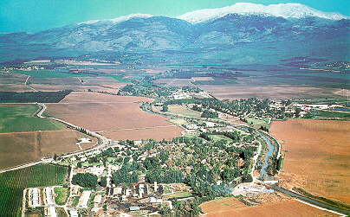
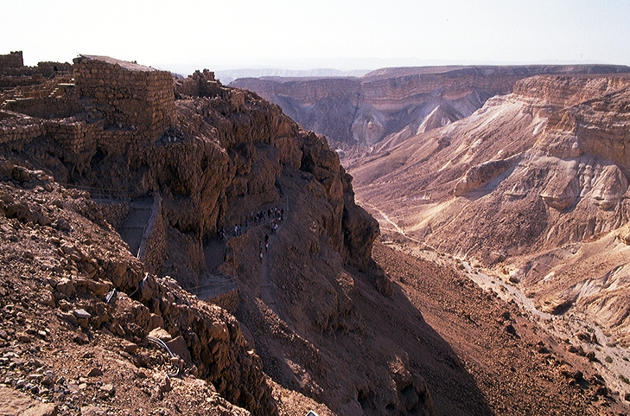
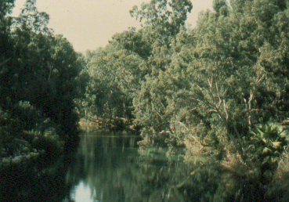
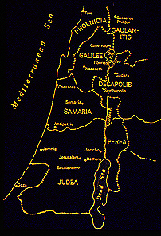
7
Josh. 1:16
Joshua no takapra li amazhi kade kocho...
JOSHUA
Jericho/Ai
Handbook pg. 29-31
4
40

Slide 43
7
Josh. 6:2; 8:26
JOSHUA
JERIKO / AI
AJMJ
JOSHUA
Jericho/Ai
Handbook pg. 29-31
41

Slide 44
KATHI OZHI
JORDAN KORII
EZHODE JERIKO
MOSES
Takapra
Sinai
M - C - C
DENI JERIKO
Kadesh Barnea
40
40
Jericho leino...
Jordan korii leino chinghi kapra pie ni kocho
Handbook pg. 26-29
42

Slide 45
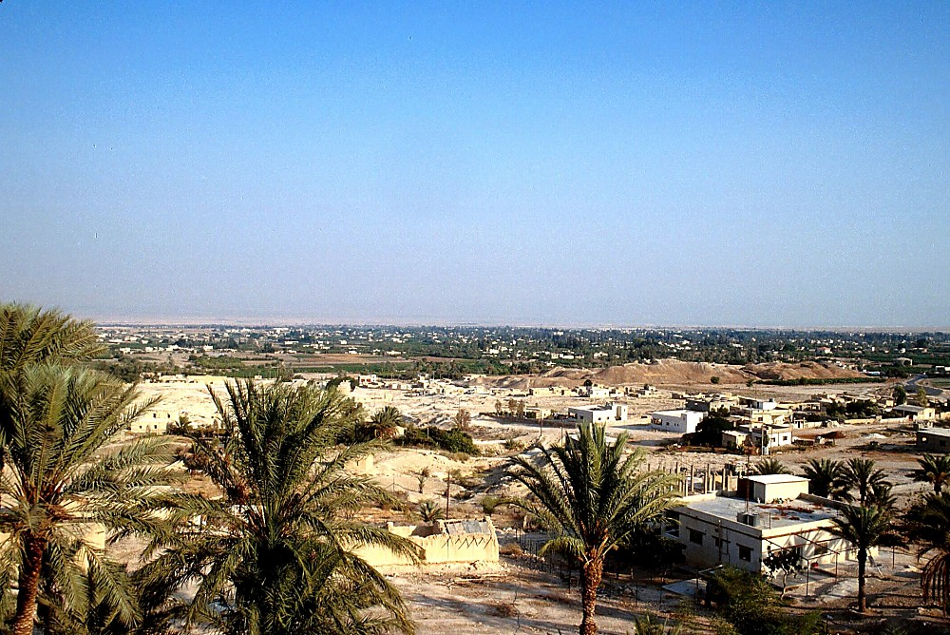
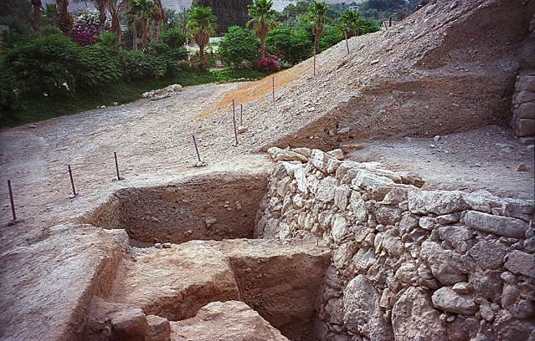
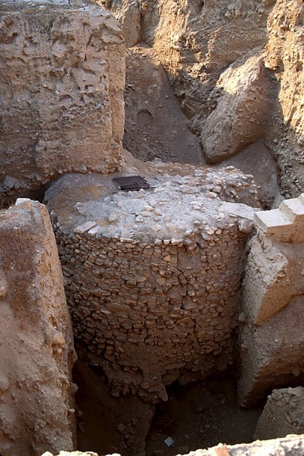
JOSHUA
Jericho/Ai
Jeriko: Deni zhii Ocha khru
Handbook pg. 29-31
1
43

Slide 46
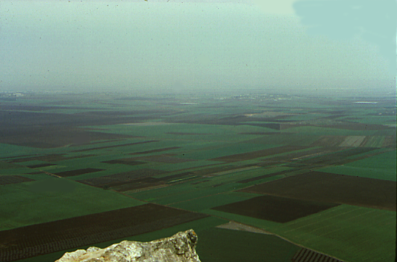
7
Josh. 17:16
Jezreel yi mozhu ni kocho Mount Tabor leino
JOSHUA
Jeriko/Ai
Hihino tunedzii ea lidziibu sii se!
Handbook pg. 29-31
44

Slide 47
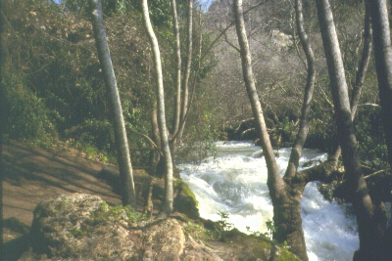
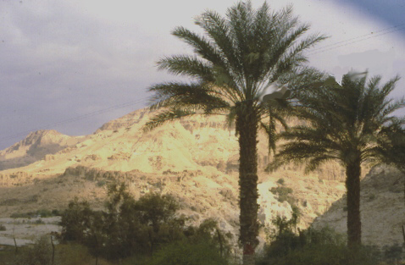
Josh. 3:1-12:24
Sii-o li…
…Ariipei Dan leino...
JOSHUA
JeriKo/Ai
Ojii Dadutei
…Akhrupei Beersheba kotu...
Handbook pg. 29-31
3
45

Slide 48
7
Josh 14:5
JOSHUA
JERIKO / AI
OJII DADU TIE
AJMJ
JOSHUA
Jeriko/Ai
Ojii dadu tie
Handbook pg. 29-31
46

Slide 49
7
Josh. 13:1-21:43; 13:14 (Levi)
Ozhi Kajii
ASHER
NAPHTALI
ZEBULON
Galilee Ozhi
Oja tali sii adziilotie ea pfokheumei thopfii sii Abraham no nikolo ozhi leino hriile to soda-o butie.
Mt. Tabor
Mt. Carmel
ISSACHAR
JOSEPH NAPHUTO KHRU
Mt. Gilboa
MANASSEH
KANANN CHIIJII SII DADU TIE!
MANASSEH
JOSHUA
EPHRAIM
Jeriko/Ai
OJI Dadu tie
DAN
BENJAMIN
GAD
JUDAH
Hebron
LEVI:
Inu kajii li kolikhrii hriiloe ochiikotho siibvii yi khu koru duno
KATHI OZHI
REUBEN
SIMEON
Handbook pg. 29-31
13
47

Slide 50
7
Och. 17:6
Ozhi Kajii
ASHER
NAPHTALI
ZEBULON
Galilee Ozhi
“ Omei li no pfonghi le adi no machi-e sii so-e.”
Mt. Tabor
Mt. Carmel
ISSACHAR
Mt. Gilboa
MANASSEH
MANASSEH
JOSHUA
EPHRAIM
Jeriko/Ai
Ojii Dadutie
DAN
BENJAMIN
GAD
JUDAH
Hebron
LEVI:
Inu kajii li kolikhrii hriiloe ochiikotho siibvii yi khu koru duno
Kathi Ozhi
REUBEN
SIMEON
Handbook pg. 29-31
48

Slide 51
HIPHA CHILU HEHI:
ABRAHAM-JOSEPH 2000 B.C.
MOSES-JOSHUA 1500 B.C.
JOSHUA
Jeriko/Ai
Ojii Dadutie
49

Slide 52
7
Hr 1 - Josh 24
CHIIJIPHE KOSO
AMAZHI CHILU
1st Pfoto ea Nito
1st Kama
C
1st Oko kazhii
1st Chihileilei
MOVU CHILU
(1000 B.C.)
1st Sokatha
Dzii Jii/Marei
Out Kokhu
ABRAHAM
(2000 B.C.)
C 7 M J
Kokolo
AO
O - O - S
I - I
3 SOCIETY
J - E
12
CHILI KOSOCHILU
7 = 4 + 3
JOSEPH
JOSHUA
Kobukola
Jeriko/Ai
430
Ojii Dadutie
4 OMEI
MOSES
(1500 B.C.)
M
(500 B.C.)
Takapra
S
MAKRAKOBU
Sinai
M - C - C
Kadesh Barnea
JISU
40
40
LO
5 SOchiikape
J
JOSHUA
Jeriko/Ai
Ojii Dadutie
50
2

Slide 53
51
©2004 TBBMI
7.2.03c.

Slide 54
The Bible…Basically link at BibleStudyDownloads.org
Get this presentation for free!
Notes:
The Bible…Basically (bb)

