Slide 1
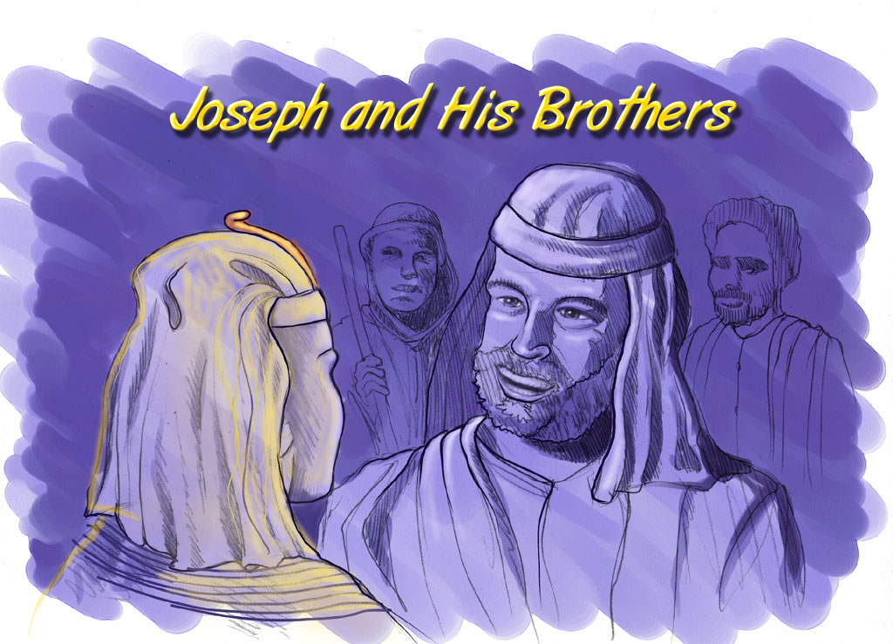
Abraham-Joseph
Joseph and His Brothers

Slide 2

Bible…
Amolo Leino
Bible…Amolo Leino modo kocho
Ministries International Inc. Fort Worth, Texas
Designed by Dr. John Fryman, Texas, USA • BibleBasically.org
Taught by Dr. Rick Griffith, Singapore Bible College
All files in many languages for free download at BibleStudyDownloads.org
www.biblebasically.org
8.0.01.
©2004 TBBMI
04

Slide 3
HIPHA CHILU HEHI:
ABRAHAM-JOSEPH 2000 B.C.
TARI THOPFII 500 HE SOTEI -MOPFU THOPFII AKROKOKHRU.
Handbook pg. 19-24
01
1

Slide 4
Hr. 37:2 - Hr. 50:26
7
“Ai Jisu
Moli Jiihoe”
CHIIJIPHE KOSO
ABRAHAM
ABRAHAM
ABRAHAM
JOSEPH
ABRAHAM
MOSES
JOSHUA
AMAZHI CHIILU
MOVU KOSO CHILU
CHIILI KOSO CHILU
4 OMEI
le
KARIRILI
MAKRA KOBU
JISU
Handbook pg. 19-24
02
1

Slide 5
Hr. 15:18
ONGA SOTHOKOCKO
MO
6
N(A)
H
GO
OJII AMANI
K
EK
B
J
MN
Sothukapra Obu ...
KO
E
U
KB
MO
PG
KO
Handbook pg. 19-24
03
1

Slide 6
Hr. 15:18
ONGA SOTHOKOCHO
10 OBU KHRU
MO
6
4
N(A)
H
IRAQ
IRAN
KUWAIT
SAUDI ARABIA
SAIRIA
ISRAEL
TURKEY
EJIPT
GO
K
GALILEE OZHI
EK
B
J
MN
KANAAN
KO
NILE KORII
MATI OZHI
E
EJIPT
U
KB
SINAI PENINSULA..
MO
PG
KO
Handbook pg. 19-24
04
14

Slide 7
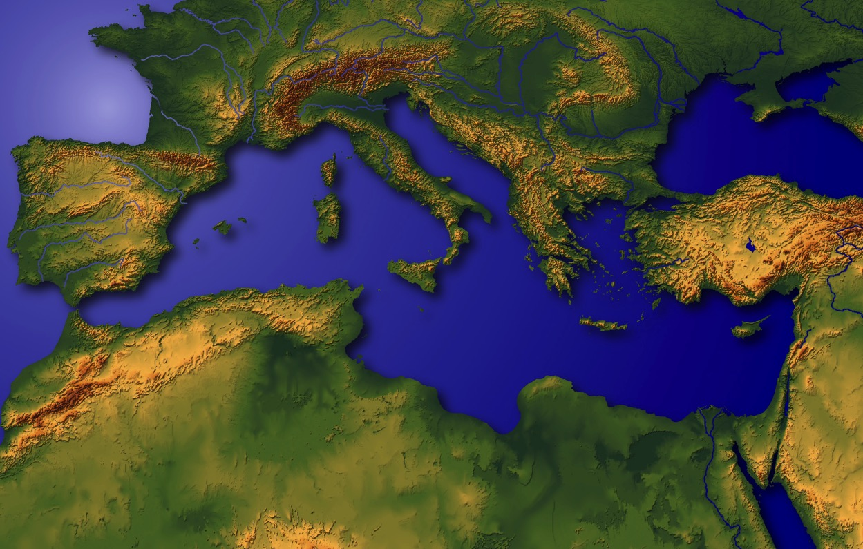
“Chijiiphe zii Pfolah”
Handbook pg. 19-24
05

Slide 8
Hr. 11:28
ONGA SOTHOKOCKO
MO
N(A)
H
GO
K
EK
B
J
MN
KO
E
KB
U
CHALDEESL LE UR:MESOPOTAMIA TAMEI ZHI DENI ZHII OZHI BU ; ABRAHAM ZHII CHIIJII
MO
PG
KO
Handbook pg. 19-24
06
1

Slide 9
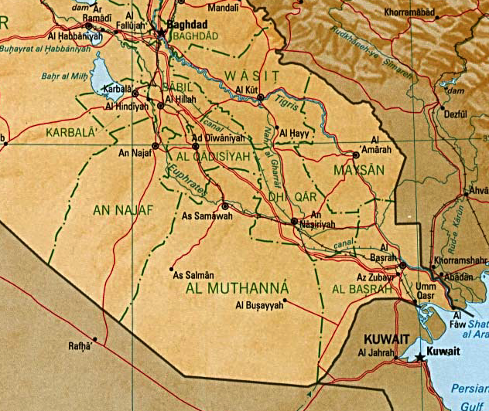
7
BABYLON
UR
MOMULO! Persian Gulf zhii Oru Iraq le Oru
Handbook pg. 19-24
07
6

Slide 10
7
The Mesopotamian Basin
SUMERIAN INVENTIONS…
WRITING AND THE WHEEL
BEGINNINGS…
LAW
MEDICINE
ASTRONOMY
ARCHITECTURE
EARLIEST URBAN CENTERS
Handbook pg. 19-24
07a
4
Notes:
Here in this Middle Eastern land – bordering the Persian Gulf --
were some of the earliest beginnings of mankind's discovery of an intellectual life.
//// In this triangular shaped valley,
//// called the Mesopotamian Basin,
//// the ancient Sumerians presented us the gifts of writing and the wheel. And here we see
//// the beginnings of basic concepts of civilization…of law…of medicine… of astronomy and architecture.
//// Archaeologists have also found evidence of some of the very earliest urban centers…
the communities and the cities that, through time, have led directly to the civilization and cultures we know today.

Slide 11
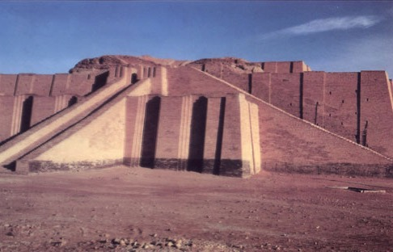
Hr 10:10; 11:28, 31
Hihino “Ziggurat” tiwe deni Chaldees tamei zhii Ur no Ezho de zhii Iraq
Handbook pg. 19-24
08

Slide 12
Hr. 11:31
ABRAHAM CHIIHI LEMEI:
• TERAH (OPFO)
•ABRAHAM (ABRAM)
• SARAI (HIPFO CHI, SARAI)
• LOT (ABRAHAM TE)
Handbook pg. 19-24
09
5

Slide 13

7
ABRAHAM
ABRAHAM
ca. 2000 B.C.
4 OMEI
le
KARIRILI
sii:
ABRAHAM
AJMJ
Hr 12 and Moshu khru
Handbook pg. 19-24
10
3

Slide 14
Hr. 12: 1-3
7
ABRAHAM
ABRAHAM
ca. 2000 B.C.
KOKOLO
OMEI 4
le
KARIRILI
sii:
ABRAHAM
KOKOLO
AJMJ
Hriithoachrei 12 ye Moshukhru
Handbook pg. 19-24
11

Slide 15
Hr. 12: 1-3
7
ABRAHAM
ABRAHAM
ca. 2000 B.C.
KOKOLO
AC
AJMJ
Hr. 12: 1-3
ABRAHAM
KOKOLO
ORAMEI NO ABRAHAM HE ICHO KOCHO!
Handbook pg. 19-24
12

Slide 16
7
ABRAHAM
ABRAHAM
ca. 2000 B.C.
KOKOLO
AC
O - O - S
AJMJ
OJII
Hr. 12: 1-3
ONA
ABRAHAM
Kokolo
O - O - S
SHIIHRA
ICHO KO-O SII CHAPEI OZHI KALI SOKORII!
Handbook pg. 19-24
13

Slide 17
7
HRIITHOACHAREI 12
LipeonoAbram he pe,
“Ni chi ni ji, ni chitamei, ni pfo chi thekhrei tiwoa, ai no niyi manepi koru chijile sii vutao.
1
“Ai no niyi meihrii kaji
akali mosole ea ai no niyi shihra pile, ea ni zhu somaji moso pile, suubviio ni shiihra kali sole.
2
ABRAHAM
ABRAHAM
KOKOLO
O - O - S
Niyi shihra kapimei yi sii aino shihra pile, ea niyi icha kapimei yi sii ai no icha pile; ea ni vano chijiphemei thopfii shihra nilewill
and achijiphemei thopfii shihra nile.”
3
Handbook pg. 19-24
14
3

Slide 18
7
HRIITHOACHAREI 12
LipeonoAbram he pe,
“Ni chi ni ji, ni chitamei, ni pfo chi thekhrei tiwoa, ai no niyi manepi koru chijile sii vutao.
1
OJII
ONA
“Ai no niyi meihrii kaji
akali mosole ea ai no niyi shihra pile, ea ni zhu somaji moso pile, suubviio ni shiihra kali sole.
2
ABRAHAM
ABRAHAM
KOKOLO
O - O - S
Niyi shihra kapimei yi sii aino shihra pile, ea niyi icha kapimei yi sii ai no icha pile; ea ni vano chijiphemei thopfii shihra nilewill
and achijiphemei thopfii shihra nile.”
3
SHIIHRA
Handbook pg. 19-24
14
3

Slide 19

Abraham zhii Ichokocho
(“Kokolo”)
Hriithoachrei 12: 1-3
ABRAHAM
OJII
ONA
SHIIHRA
KOKOLO
O - O - S
12:1
12:2
12:3
“O-O-S”
Handbook pg. 19-24
16
3

Slide 20
Abraham zhii Ichokocho
(“Kokolo”)
Hriithoachrei 12: 1-3
Motsiitsiili Obi Kosii !
ABRAHAM
OJII
ONA
SHIIHRA
Kokolo
O - O - S
• OCHA TO NO PFOKOKOCHO
• OCHII OSA
• OKHIKOHO
17
3

Slide 21
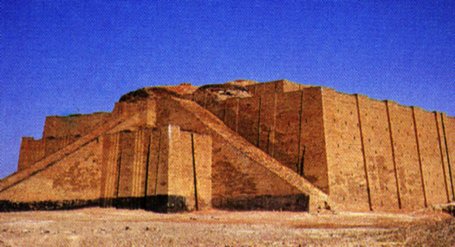
Hr. 12:4
ONGA SOTHOKOCKO
AMOLE LINO TATEI
MO
N(A)
H
GO
K
R
B
J
MN
ABRAHAM
KO
KOKOLO
E
KB
U
MO
PG
KO
Handbook pg. 19-24
18
2

Slide 22
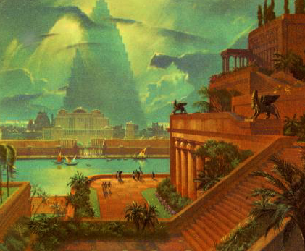
Hr. 11:31
ONGA SOTHOKOCKO
MO
N(A)
H
GO
K
EK
B
J
MN
ABRAHAM
KO
KOKOLO
E
KB
U
Jii te kocho Babylon Inu
MO
PG
KO
Handbook pg. 19-24
19

Slide 23
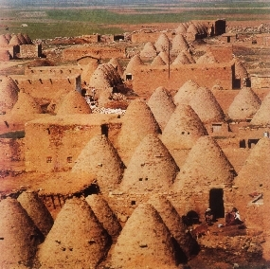
Hr. 11:31-32
ONGA SOTHOKOCKO
MO
N(A)
H
TSIIKOTU OPFO, TERAH, HARAN LINO THITIE.
GO
K
EK
B
J
MN
ABRAHAM
KO
KOKOLO
E
KB
U
MO
PG
Izhode “Olikro” bvii-o kobu Harran (Turkey) Inu
KO
Handbook pg. 19-24
20
1

Slide 24
Hr. 12:5
ONGA SOTHOKOCKO
MO
N(A)
H
GO
K
EK
B
J
MN
ABRAHAM
KO
Kokolo
E
KB
U
MO
PG
KO
Handbook pg. 19-24
21

Slide 25
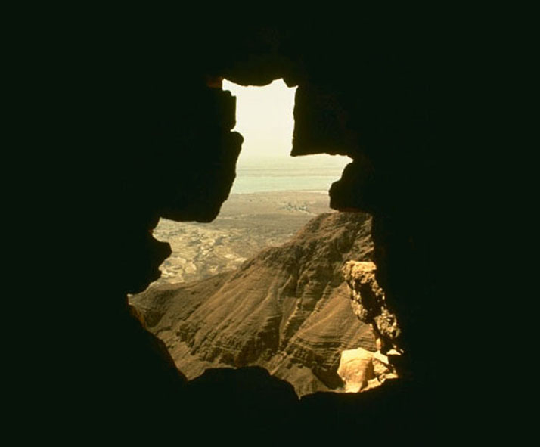
7
Abraham no Chiji… le kolo chi, pfohi mopfu 75 tie …
Ochi Sarai ae mopfu 65 tie.
subviimatie…ona hriile to icho pei!
ABRAHAM
Kokolo
O - O- S
Handbook pg. 19-24
22
4

Slide 26
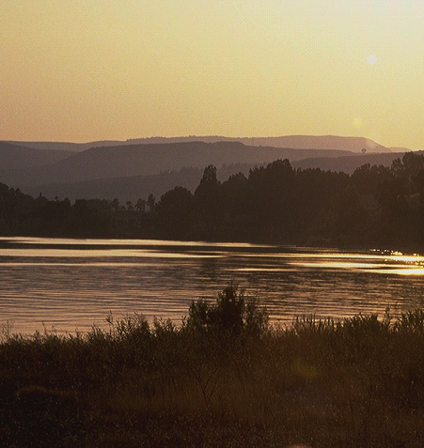
Hr. 15:6
7
ABRAHAM NO ORAMEI ZHI ICHO MOLELO-E: OJII, ONA, YE A SHIIHRA!
_{OJII}
_{ONA,}
_{SHIIHRA}
Hriithoacharei 15:6!
Oramei no Abraham zhii amole sii michu kocho to pfolo-e!
Molote kocho amole!
ABRAHAM
Kokolo
O - O - S
Handbook pg. 19-24
23
3

Slide 27
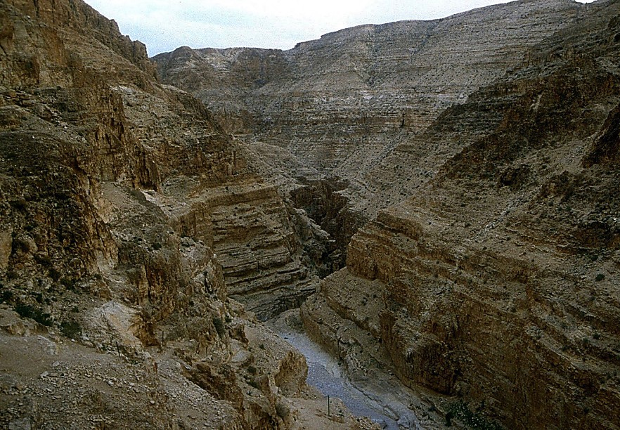
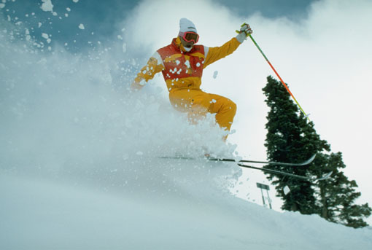
Hr. 16:1-4
7
ABRAHAM NO ORAMEI YI MOLELO-E!
Ana:
Abraham ye Sarai no khulohrotie.
“Abraham…Hagar yi pfolo!” (Sarai zhii chilipfiipei)
ABRAHAM
Kokolo
O - O - S
Handbook pg. 19-24
24
3

Slide 28
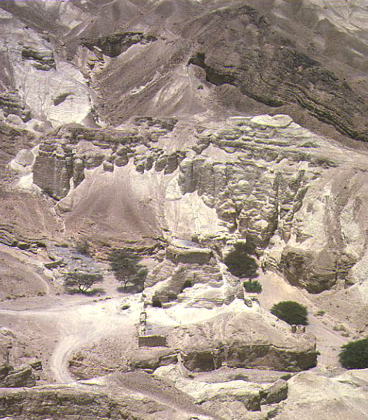
Hr. 16:11-12; 17:20-21
7
Chulu lino … Hagar vano Abraham zhi ona photo kali monolo-e.
Pfozhii sii: ISHMAEL.
(ISHMAEL HINO PILE TO PEKAHI ONA SII MOE .)
ABRAHAM
Kokolo
O - O - S
Handbook pg. 19-24
25
3

Slide 29
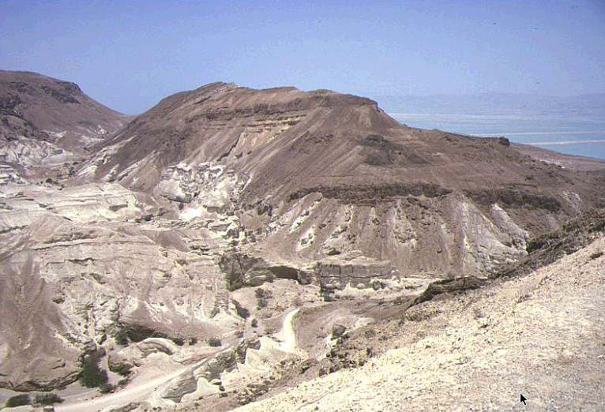
Hr. 17:19
7
Ichu-o …Abraham hi mopfu 85 pratie…Sarai no 75.
Icho-e mopfu 15 kali…
SARAH vano Ona kali ABRAHAM yi monopie.
OZHU SII: “ISAAC”
ABRAHAM
KOKOLO
O - O - S
Handbook pg. 19-24
26
4

Slide 30
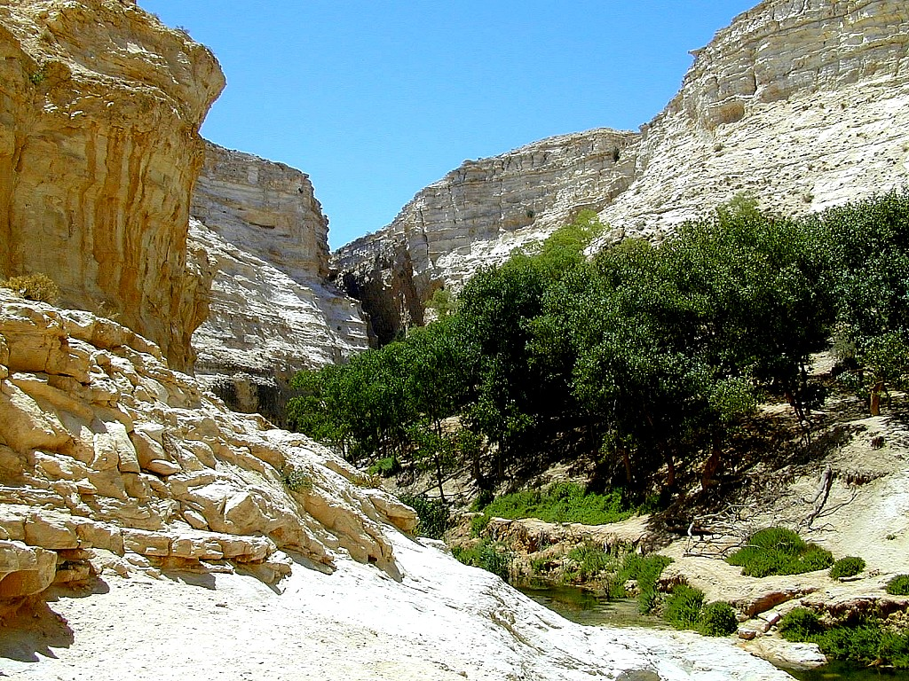
Hr. 17:21
7
Isaak hino mozhu kocho ona siise is…
… Pfova no Oramei no Abraham he icho kowo vutu lo koru duno…
ABRAHAM
KOKOLO
O - O - S
…ISAAK ZHI CHIHILEMEI VANO!
Handbook pg. 19-24
27
2

Slide 31
Hr. 17
7
ABRAHAM
ABRAHAM
ca. 2000 B.C.
KOKOLO
AC
O - O - S
AJMJ
I - I
Hr. 12: 1-3
ABRAHAM
Kokolo
O- O - S
I - I
ISHMAEL YE ISAAK
Handbook pg. 19-24
28

Slide 32
7
ABRAHAM
ABRAHAM
ca. 2000 B.C.
AC
The CALL
AC
L - S - B
AJMJ
Hr. 12: 1-3
I - I
ABRAHAM
The KOKOLO
O- O - S
I - I
ISHMAEL VANO
ARABTAMEI PRA-E
ISAAC VANO
JIHUDIMEI PRA-E
Handbook pg. 19-24
29
2

Slide 33
7
ABRAHAM
ABRAHAM
ca. 2000 B.C.
AC
The CALL
AC
L - S - B
AJMJ
Hr. 12: 1-3
I - I
ABRAHAM
The CALL
L - S - B
I - I
ISHMAEL VANO
ARABTAMEI PRA-E
ISAAC VANO
JIHUDIMEI PRA-E
Handbook pg. 19-24
30

Slide 34
Hr. 22:2; 2 Pfu. 3:1
7
ONA KONAHIH ?
“Oramei no pe, “Ni no olekashi, ni napfuto pfolio, Isaak yi salo, ea Moriah jipfokiva sawo tapralo , ea ai no mane kapi jipfote kali vahi omi deiwo raphrawo.”
Genesis 22:2
ABRAHAM
The CALL
L - S - B
NIV phrokocko lariibvii leno kape: :” Hebrew lariibvii li, “Isaak” no “nino olekashii,” thifii kocho hi so mostiilo koruduno-e: “ni na, pfoto pfolio, ni no olekashii -- Isaak.” Isaak hino “Pekapi ona sii se.”
I - I
2 Chr 3:1 Lariibvii korii nano jipfoki sii ezho de Rachiithochii jipfoki koe to pewe [ezhode zhii Otu zhii Okhu].
Handbook pg. 19-24
31
3

Slide 35
Hr. 17:20-21
7
ONA KONAHI?
“Ishmael duno nino kokho sii ai no anopei, ea ai no pfo yi shiihrapile ea pfo yi peno otona moso mozhowo mohriile ea pfo no movumei napfuto chia kaheio pfu sole, ea pfo yi meihrii kaji kali sole. Ana Ai no niyi duno Isaak heno ochiikotho sii sothule , Sarai no chaka icho chilu pahchi monpikoru ona sii.”
Hr 17:20-21 (NKJV)
ABRAHAM
kOKOLO
O - O - S
I - I
Ana Ai no niyi duno Isaak heno ochiikotho sii sothule
Handbook pg. 19-24
32
2

Slide 36
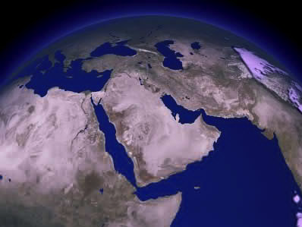
7
SHIHRA KAPI MAJII KOLIHIO IZHODE…
ISAAK
ABRAHAM
KOKOLO
O - O - S
ISHMAEL
I - I
ADI VANO KRII SHUTIE?
Handbook pg. 19-24
33
3

Slide 37
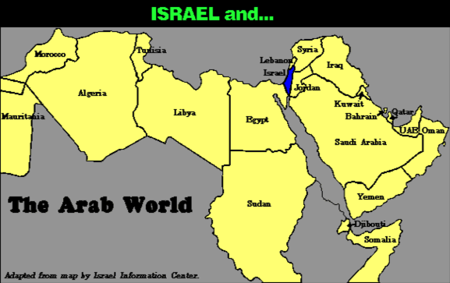
7
OCHIOJII HI MAJII KOLIHIO…
ABRAHAM
KOKOLO
O - O - S
I - I
Handbook pg. 19-24
34

Slide 38
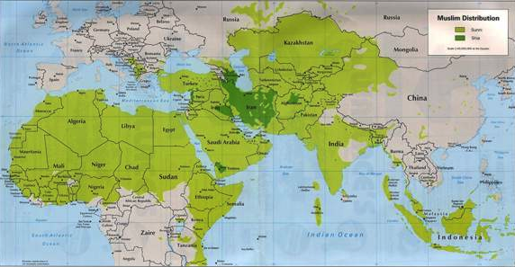
7
OCHIOJII HI MAJII KOLIHIO…
ABRAHAM
L - S - B
I - I
MOHAMMED NO ISAAK YI VA KOCHO!
Handbook pg. 19-24
35

Slide 39
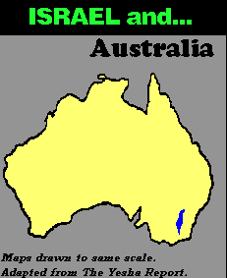
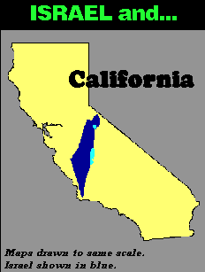
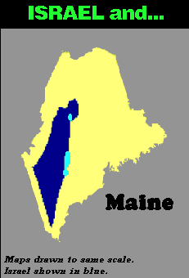
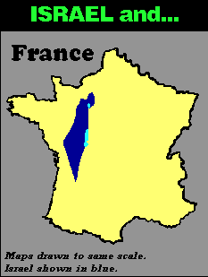
7
OCHIOJII HI MAJII KOLIHIO…
ISRAEL EA…
ISRAEL EA…
ISRAEL EA…
ISRAEL EA…
ABRAHAM
KOKOLO
O - O - S
I - I
Handbook pg. 19-24
36
3

Slide 40
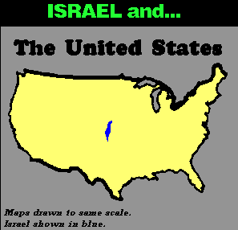
7
ISRAEL EA…
UNITED STATES
ABRAHAM
KOKOLO
O - O - S
I - I
HIHI MACHI-A MA?
Handbook pg. 19-24
37

Slide 41
7
“… Ishmael tamei yi sii ojii pajii pie ye oni onzii-ea pajiikoso pie. Hihi deni no kochuchu ko koe. Ezhode-ea shaki dzii le ni tewe. Ye pfokhrumei yi sii raku kolulo koru duno-ea pi hito-e.
ABRAHAM
KOKOLO
O – O – S
I - I
Hal Lindsey, “The Everlasting Hatred: The Roots of Jihad,” 2002, Pg 65
Handbook pg. 19-24
38

Slide 42
7
““… Ishmael tamei yi sii ojii pajii pie ye oni onzii-ea pajiikoso pie. Hihi deni no kochuchu ko koe. Ezhode-ea shaki dzii le ni tewe. Ye pfokhrumei yi sii raku kolulo koru duno-ea pi hito-e.
Ana Oramei zhii ochiikotho, raku vo khru, sii Isaak ye pfozhii oshu duno se. Pfo he kape kapi shiihra sii Oramei zhii raku leno tsiikolo ye pfohe vulo koru dunoe.” [Somotsiiwo tie]
ABRAHAM
Kokolo
O - O - S
I - I
Hal Lindsey, “The Everlasting Hatred: The Roots of Jihad,” 2002, Pg 65
Handbook pg. 19-24
39

Slide 43
7
LEBANON
ISAAC TE YE OSHU KHRU
Mediterranean Ozhi
SYRIA
Galilee Ozhi
IRAQ
Haifa
Nazareth
Netanya
JORDAN
Tel Aviv-Jaffa
AMMAN
JERUSALEM
Jericho
Gaza
Hebron
Kathi Ozhi
ABRAHAM
Beersheba
KOKOLO
ISRAEL
O - O - S
I - I
ISHMAEL & ISAAC IN TODAY’S ISRAEL
ISHMAEL TE YE OSHU KHRU
EJIPT
SAUDI ARABIA
Eilat
Aqaba zhii Gulf
Al’ Aqaba
ISHMAEL YE ISAAK EZHODE ISRAEL LI
Handbook pg. 19-24
2
40

Slide 44
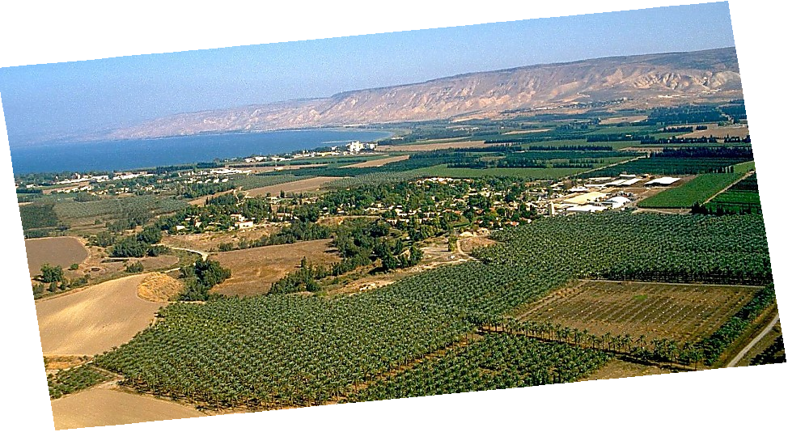
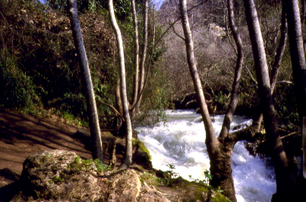
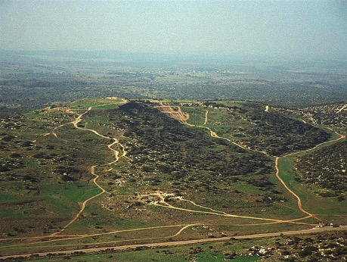
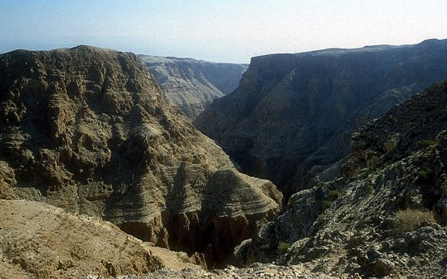
Hr. 13:10-11; Josh. 17:16
ABRAHAM YI KAPEKAPI TETO KALI,,,
ABRAHAM
KOKOLO
O - O - S
ONGA ZHIISHU KOCHO KANANN… PFOZHII DENI ZHII THIBU!
Handbook pg. 19-24
41

Slide 45
Tak. 2:24
7
ABRAHAM
ABRAHAM
ca. 2000 B.C.
KOKOLO
AC
L - S - B
AJMJ
I - I
Hr. 12: 1-3
Jakob hino Kapekapi Ona sii se!
J - E
KAPEKAPI OZHI!
12
ABRAHAM
KOKOLO
O - O - S
I - I
J - E
12
Handbook pg. 19-24
42
7

Slide 46
Hr. 35:23-26; Hr. 34:1
7
ABRAHAM
ABRAHAM
ca. 2000 B.C.
KOKOLO
AC
O - O - S
AJMJ
I - I
HR. 12: 1-3
J - E
12
12
10
ABRAHAM
1
KOKOLO
O - O - S
I - I
6
8
J - E
5
12
4
13
7
11
3
9
2
Handbook pg. 19-24
43

Slide 47
Hr. 35:24
7
ABRAHAM
ABRAHAM
ca. 2000 B.C.
KOKOLO
AC
O - O - S
AJMJ
I - I
Hr. 12: 1-3
J - E
12
12
10
ABRAHAM
1
KOKOLO
O - O - S
I - I
6
8
J - E
5
12
4
7
11
3
9
2
Handbook pg. 19-24
44

Slide 48
Hr. 35:24
7
ABRAHAM
ABRAHAM
ca. 2000 B.C.
KOKOLO
AC
O - O - S
AJMJ
I - I
Hr. 12: 1-3
J - E
12
ABRAHAM
KOKOLO
O - O - S
I - I
J - E
12
JOSEPH!
11
Handbook pg. 19-24
45

Slide 49
Hr. 1-35
7
CHUJIIPHE KOSO
AMAZHI CHILU
1st Man & Woman
1st Kama
C
1st Oko kazhii
1st Chihimi
MOVUCHILU
(1000 B.C.)
1st Sokatha
Dziijii/Marei
Out kokhu
(2000 B.C.)
ABRAHAM
(2000 B.C.)
KOKOLO
AC
C 7 M J
3 SOCIETY
O - O - S
I - I
J - E
12
CHIILI KOSO CHILU
7 = 4 + 3
JOSEPH
ABRAHAM
KOKOLO
4 OMEI
O- O - S
I - I
MOSES
(1500 B.C.)
(500 B.C.)
J - E
M
S
MAKARA KOBU
12
JISU
J
JOSHUA
46
2

Slide 50
7
AJMJ
4 OMEI
le
4 KAHINA
sii:
?
47

Slide 51
7
AJMJ
4 OMEI
le
4 KAHINA
sii:
“JOSEPH”
48

Slide 52
7
HIPHA CHILU HEHI:
ABRAHAM-JOSEPH 2000 B.C.
49

Slide 53
Hr. 37:2 - Hr. 50:26
7
CHIIJIIPHE KOSO
“Ai Jisu
Moli Jiihoe”
ABRAHAM
ABRAHAM
ABRAHAM
JOSEPH
ABRAHAM
MOSES
JOSHUA
AMAZHI CHILU
MOVU CHILU
CHILI KOSO CHILU
MAKRA KOBU
JISU
Handbook pg. 24-25
1
50

Slide 54
7
JOSEPH
ABRAHAM
4 OMEI
le
KAHINA
sii:
JOSEPH
AJMJ
Handbook pg. 24-25
51

Slide 55
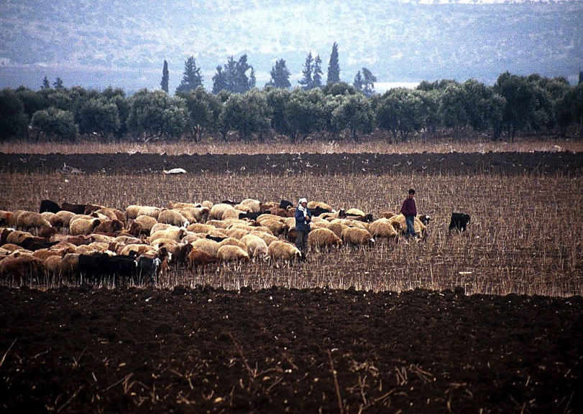
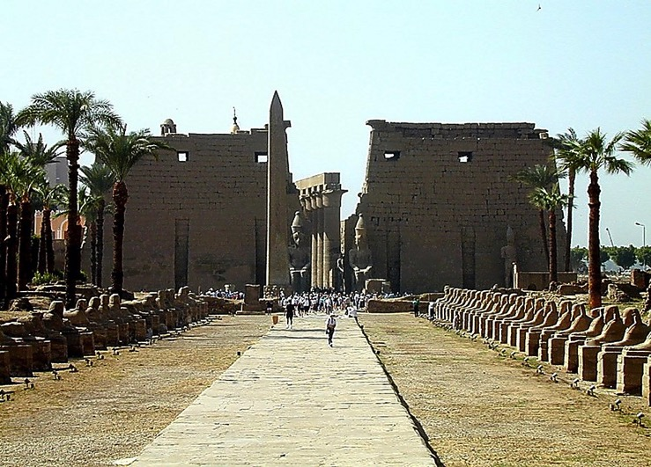
Hr. 37-41
Luxor Temple zhii Fagade, Ejipt
JOSEPH
Dothan li Kolayu kokhumei, Israel
Handbook pg. 24-25
1
52

Slide 56
Hr. 37-41
JOSEPH
Handbook pg. 24-25
53

Slide 57
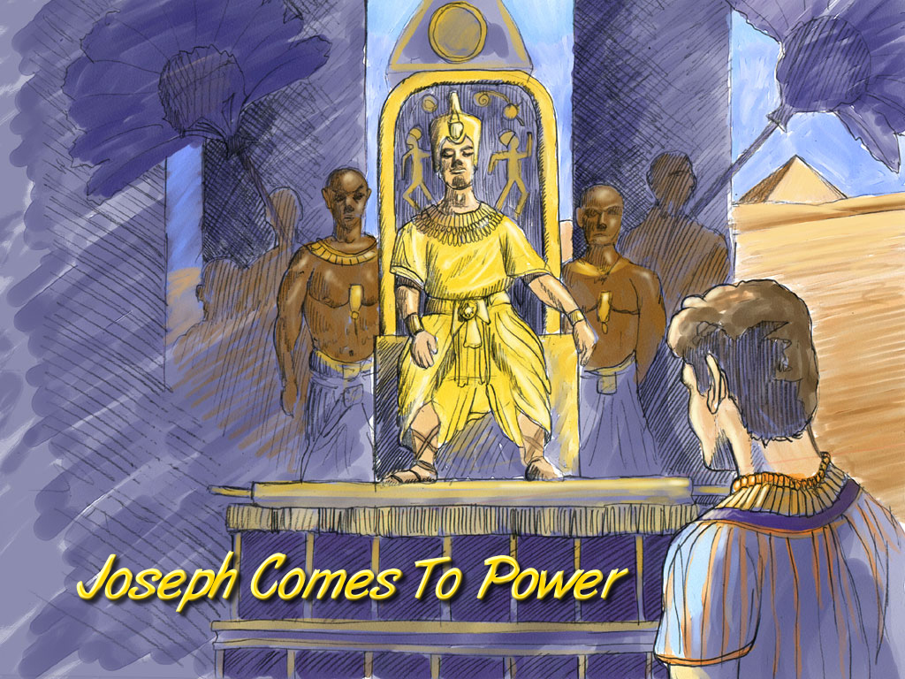
Hr. 41:41-44
JOSEPH
Joseph Comes To Power
JOSEPH NO MOVU SOLOTEI
Handbook pg. 24-25
54

Slide 58
Hr. 42:2
ONGA SOTHOKOCKO
MO
N(A)
OTOMAKRA!
H
GO
K
EK
B
J
MN
JOSEPH
KO
E
KB
U
PAJII KOBU!
MO
PG
KO
Handbook pg. 24-25
1
55

Slide 59
Hr. 37-41
JOSEPH EA PFO PINUOMEI
JOSEPH
Joseph and His Brothers
Handbook pg. 24-25
56

Slide 60
Hr. 46: 3-7
ONGA SOTHOKOCKO
MO
N(A)
H
GO
K
EK
B
J
MN
JOSEPH
KO
MOSHUSHU NO OTHIPFII KOCHO…
CHIIHILEMEI NO MEIHRIIKALI SOLE !
E
KB
U
MO
PG
KO
Handbook pg. 24-25
57

Slide 61
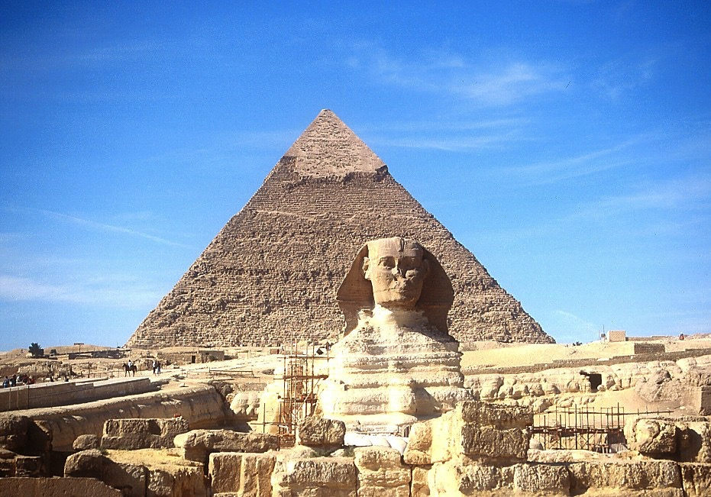
7
JOSEPH
‘Sphinx’ ye ‘Great Pyramid’.
Handbook pg. 24-25
58

Slide 62
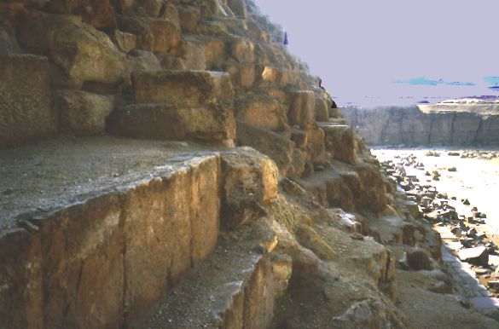
7
JOSEPH
Great Pyramid le out khru
Handbook pg. 24-25
59

Slide 63
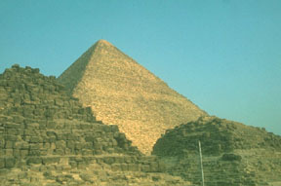
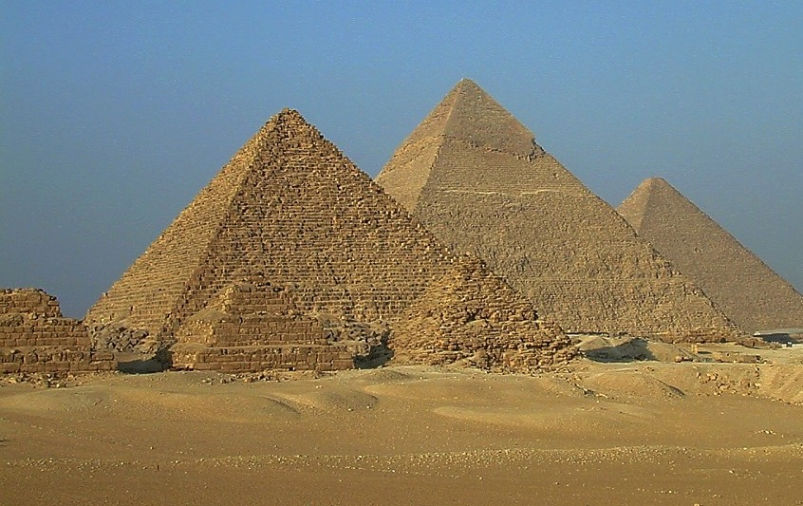
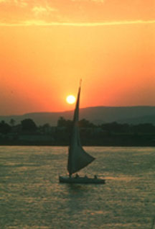
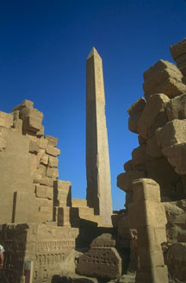
7
ISRAEL TAMEI NO…
JOSEPH
…EJIPTAMEI ZHI DENI ZHI ONGA NIE .
Handbook pg. 24-25
60

Slide 64
Tak. 12:40-41; Gal. 3:17
7
JOSEPH
ABRAHAM
KOBUKOLA KOCHO
4 OMEI
le
KAHINA
sii:
AJMJ

Slide 65
Hr. 1:1 - Tak. 1:6
7
CHIIJII PHE KOSO
AMAZHI CHIILU
1st Neto ye Pfoto
1st Kama
C
1st Oko kazhii
1st Chihilemei
MOVUCHIILU
(1000 B.C.)
1st Sokatha
Dzii Jii/Marei
Out Kokhu
(2000 B.C.)
ABRAHAM
(2000 B.C.)
KOKOLO
3 SOCIETY
C 7 M J
AC
O - O - S
I - I
J - E
12
CHIILI KOSO CHIILU
7 = 4 + 3
JOSEPH
JOSEPH
Kobukola kocho
Kobukola kocho
4 OMEI
430
430
MOSES
(1500 B.C.)
(500 B.C.)
M
MAKRA KOBU
S
JISU
J
JOSHUA
Handbook pg. 24-25
62

Slide 66
7
AJMJ
4 OMEI
le
KOSII KOCHU NA sii:
?
63

Slide 67
7
AJMJ
4 OMEI
Le
KOSII KOCHU NA
sii:
“MOSES”
64

Slide 68


The Bible…Basically link at BibleStudyDownloads.org
Get this presentation for free!
Notes:
The Bible…Basically (bb)

Slide 69
65
©2004 TBBMI
8.0.03b.

