Slide 1
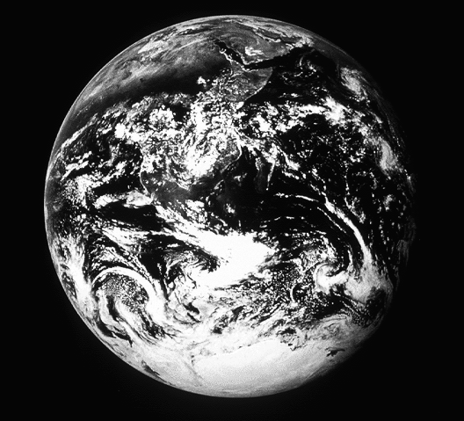
Creation
©2004 TBBMI
17

Slide 2
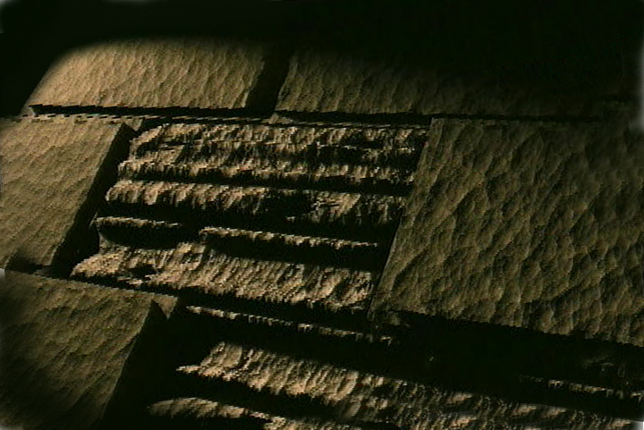
Bible…
Amolo Leino
Bible…Amolo Leino modo kocho
Ministries International Inc. Fort Worth, Texas
Designed by Dr. John Fryman, Texas, USA • BibleBasically.org Taught by Dr. Rick Griffith, Singapore Bible College All files in many languages for free download at BibleStudyDownloads.org
www.biblebasically.org
8.0.01.
©2004 TBBMI
04

Slide 3
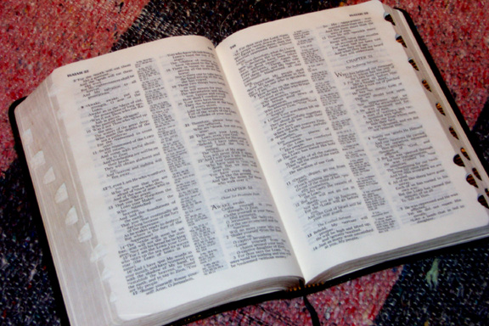
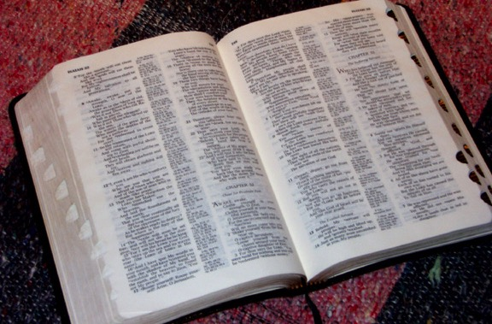
(ADI soti-e tikocho.)
Bible Amolo…Leino
®
OZHI KOSII
MOSII KOCHO: “KOTHOKOLA MOSHU MODZI NO KOLI KOCHO”
02
©2004 TBBMI
8.0.03a.

Slide 4
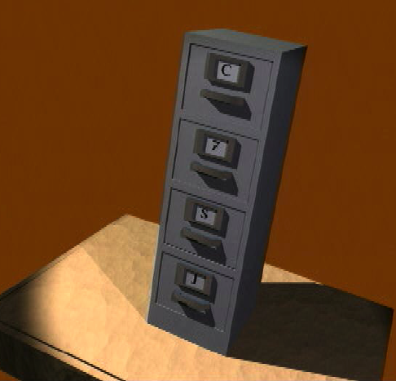
7
-
C
7
M
J
03
1

Slide 5
7
MOSII IKRII KOCHO KALI...
C 7 M J
=
4 3
04
1

Slide 6
7
MOSII IKRII KOCHO KALIA...
C 7 J
C 4 3 M J
05

Slide 7
7
MOSII IKRII KOCHO KALI...
C 7 M J
C 4 3 M J
CHIIJIIPHE KOSO
4 OMEI
3 SOCIETIES
MAKRAKOBU
JISU
06

Slide 8
7
CHIIJIIPHE KOSO
ABRAHAM
JOSEPH
MOSES
JOSHUA
AMAZHI CHILU
MOVU CHIILU
CHIILI KOSO CHILU
MAKRAKOBU
JISU
07

Slide 9
ONGA SOTHOKOCHO
10 OBU KHRU
MO
6 4
CHIIJIPHE KOSO
ABRAHAM
N (A)
H
JOSEPH
GO
MOSES
OBU SII
K
JOSHUA
AMAHZII CHILU
MN
B
J
MOVU CHILU
CHILIKOSO CHILU
“SO YE
PFII KAPRA
OBU!”
K O
MAKRA KOBU
U
E
JISU
KB
KO
MO
PG
08

Slide 10
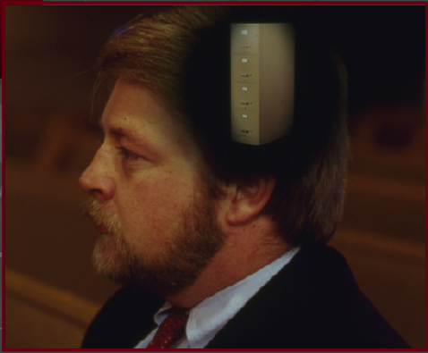
7
CREATION
ABRAHAM
ABRAHAM
ABRAHAM
JOSEPH
ABRAHAM
MOSES
JOSHUA
ANARCHY
ROYALTY
CAPTIVITY
SILENCE
JISU
•Ikhrumei itsii leino re building a mental map!
•Ikhrumei moshu shu no modo moe...
•Only the big picture.
•Bible hi hibvii-e tikocho kali.
09
4

Slide 11
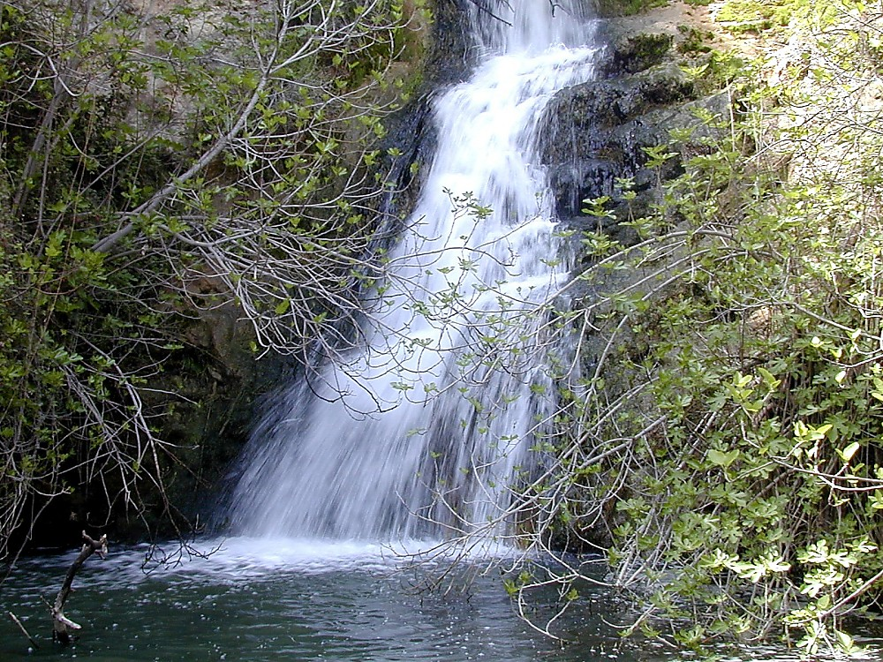
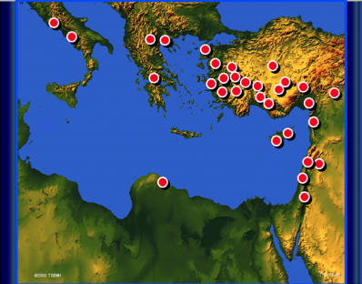
10

Slide 12
CHIIJIIPHE KOSO
ABRAHAM
JOSEPH
MOSES
JOSHUA
AMAZHI CHILU
MOVU CHIILU
CHIILI KOSO CHILU
MAKRAKOBU
JISU
11

Slide 13
7
CHIIJIIPHE KOSO
ABRAHAM
JOSEPH
MOSES
JOSHUA
AMAZHI CHILU
MOVU CHIILU
CHIILI KOSO CHILU
MAKRAKOBU
JISU
12

Slide 14
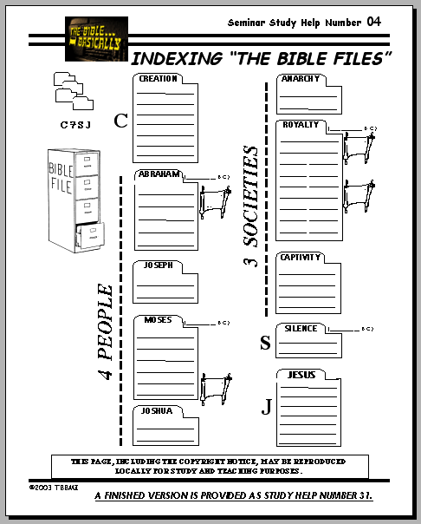
Hr. 1-11
7
CREATION
ABRAHAM
ABRAHAM
ABRAHAM
CHIIJIIPHE KOSO
JOSEPH
ABRAHAM
MOSES
JOSHUA
ANARCHY
ROYALTY
CAPTIVITY
SILENCE
JESUS
SOKHRO PILO KORU #04
13
1

Slide 15
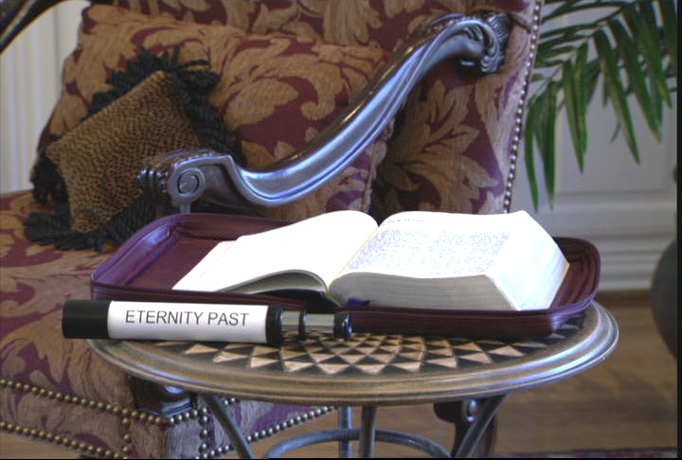
7
HR 1-11:OCHII OSA TAKOTU
Handbook pg. 17-19
14
1

Slide 16
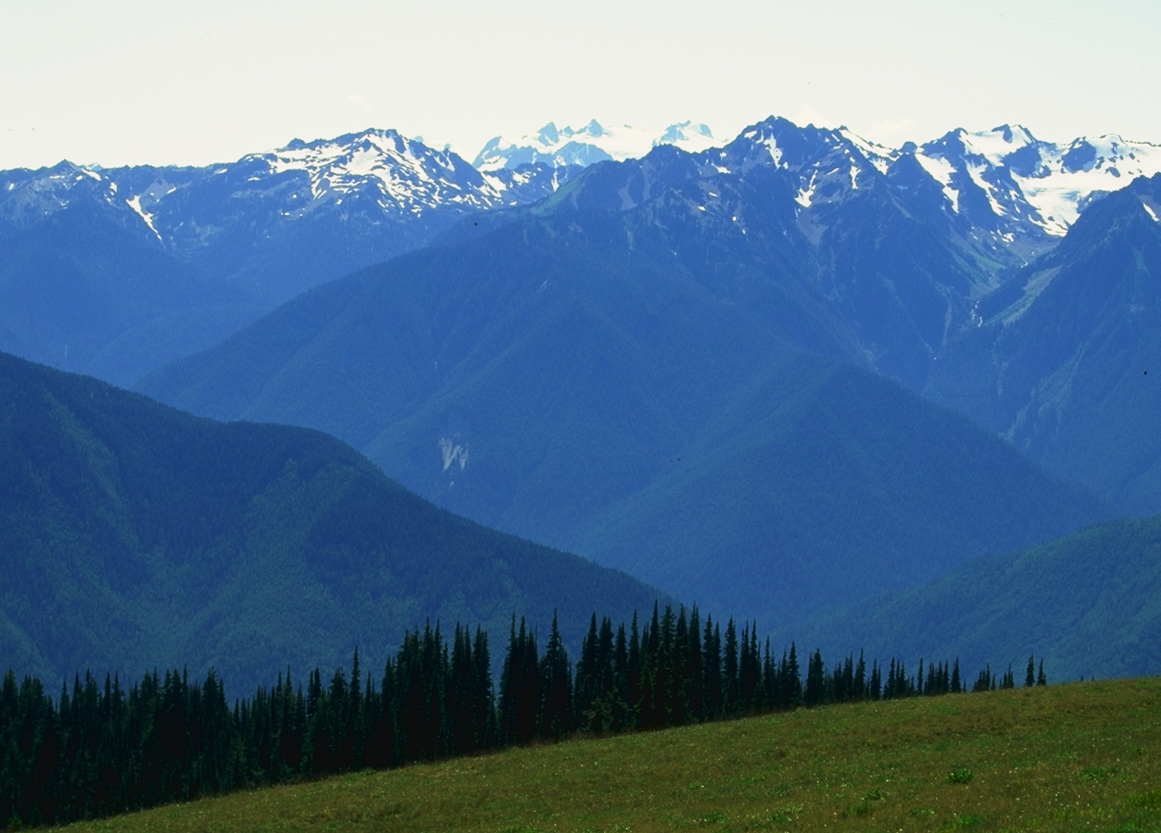
OCHII OSA TAKOTU CHILU PIE “MOZHU MAJII” KOCHO...
Handbook pg. 17-19
15

Slide 17
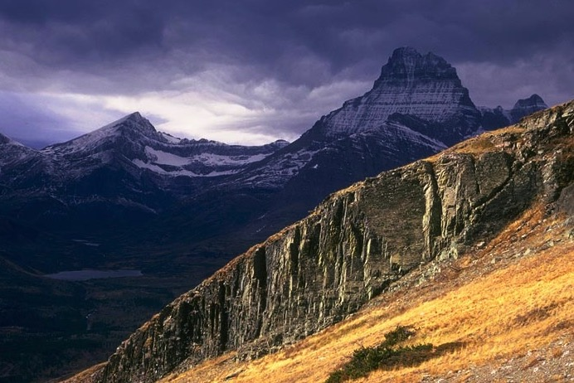
OCHII OSA TAKOTU CHILU PIE “MOZHU MAJII” KOCHO...
Handbook pg. 17-19
16
1

Slide 18
Hr 1:1
“acharei sii ...”
17
1
©2004 TBBMI
8.0.03a.

Slide 19
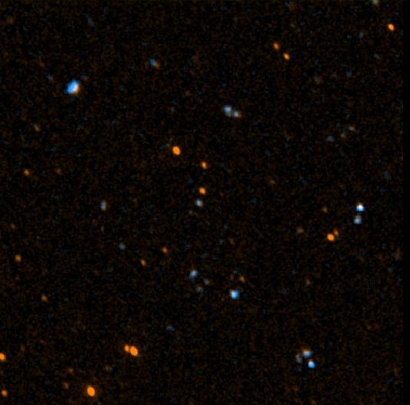
John 17:5
“Ea ichuo a Pfu, no ni acharei ojiphe sothokolo komo leno ahei he kobu azhupe kocho tino nhodzii no ayi azhupe pio.”
18
©2004 TBBMI
8.0.03a.

Slide 20
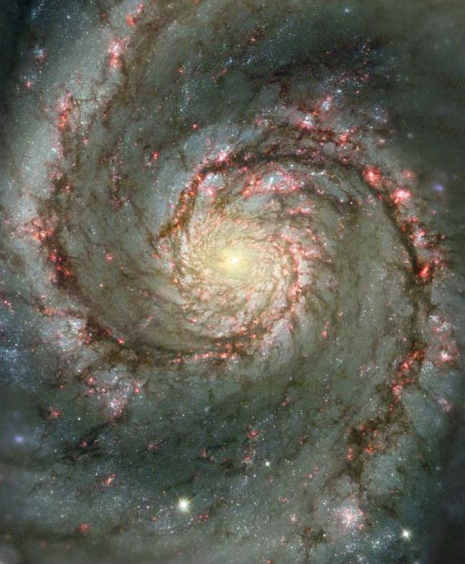
John 17:5
“Ea ichuo a Pfu, no ni acharei ojiphe sothokolo komo leno ahei he kobu azhupe kocho tino nhodzii no ayi azhupe pio.”
19
©2004 TBBMI
8.0.03a.

Slide 21
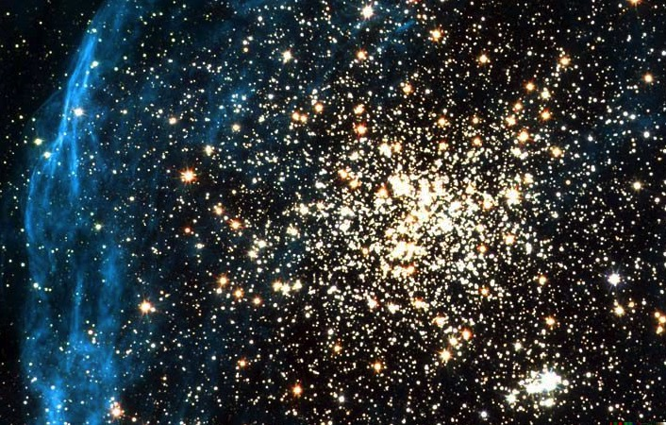
John 17:5
“Ea ichuo a Pfu, no ni acharei ojiphe sothokolo komo leno ahei he kobu azhupe kocho tino nhodzii no ayi azhupe pio.”
20
©2004 TBBMI
8.0.03a.

Slide 22
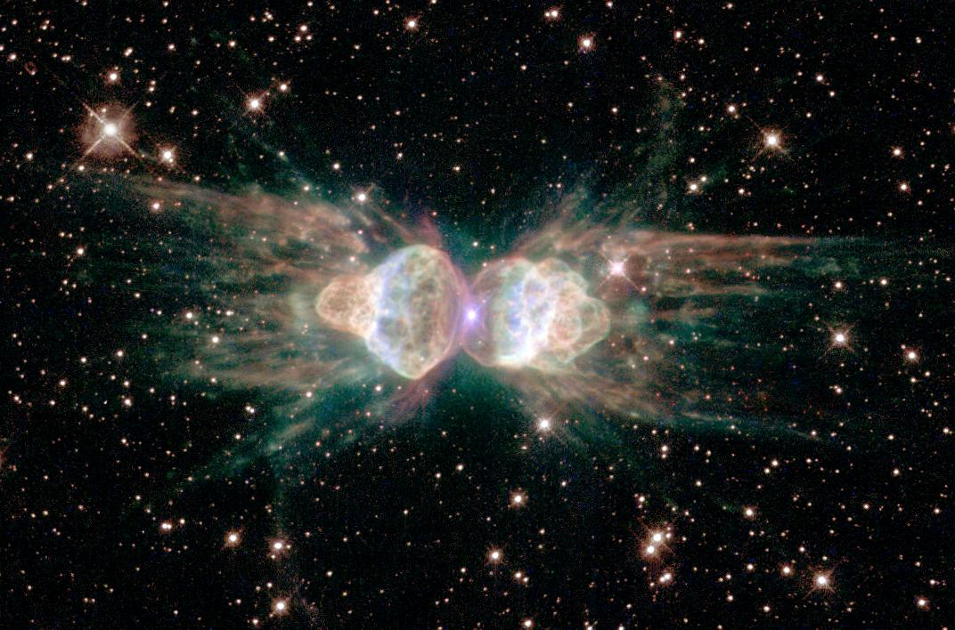
John 17:5
“Ea ichuo a Pfu, no ni acharei ojiphe sothokolo komo leno ahei he kobu azhupe kocho tino nhodzii no ayi azhupe pio.”
21
©2004 TBBMI
8.0.03a.

Slide 23
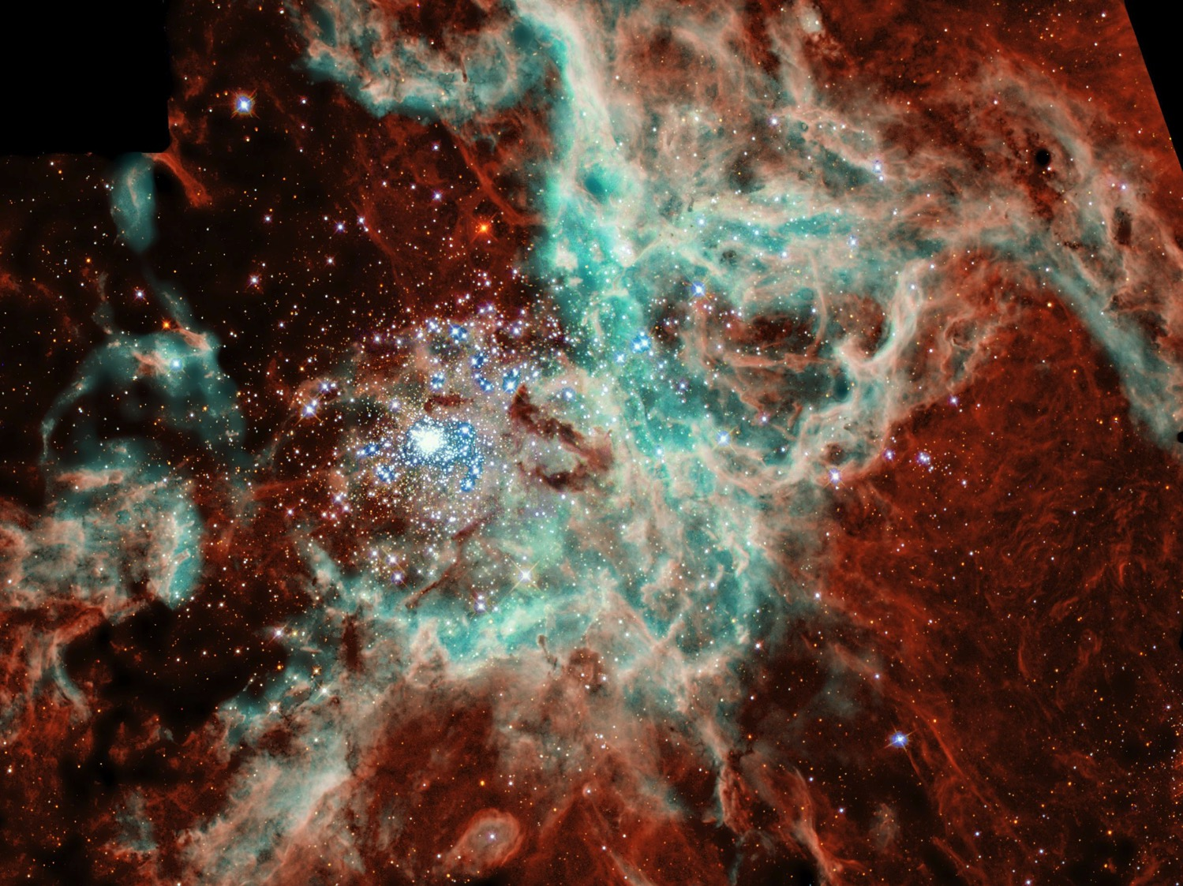
John 17:5
“Ea ichuo a Pfu, no ni acharei ojiphe sothokolo komo leno ahei he kobu azhupe kocho tino nhodzii no ayi azhupe pio.”
22
©2004 TBBMI
8.0.03a.

Slide 24
Job 38:4-18
“Ai no chajiphe bikhri khrikochochi ni adeichi bue?”
CREATION
23
1
©2004 TBBMI
8.0.03a.

Slide 25
Hr. 1-11
Hr 3:15:…”pfo no nipi izhu pile, ea nino pfo phiku vahi made pile.”
NIV leino pfokolo: “Neitopie vano kovu oto no khengho pi sii sokho-o le; Khrista no Satan dziino zhiilole to icho kocho alichu kolo -- amole mei thopfii no zhiilo azhu koru (Rom 16:20).
CHIIJIIPHE KOSO
Abraham chilu dzii thopfii
CREATION
1st OMEI & NETOMEI
(Perfection)
1st KAMA
(Miss the Mark)
CHIIJIPHE KOSO
ABRAHAM
7 OTA
1st OKO KAZHII
(Redeemer)
1st CHIHI MEI
(Contention)
1st SOKATHA
(Abject Sin)
DZII JII/MAREI
(Pgm #1: Noah)
OTU KOKHU
(Pgm #2: Babel)
Handbook pg. 42-45
24
10

Slide 26
Kodziileno: CHUJIIPHE KOSO zhii file hi Oramei no omei yi koso ye omei no mota kotu demoko koe.Hilihi Oramei no Omei yi peno acharei kama koho bu li adakhi vulo koru ea Pfo he ke pho bulo koru pekapi kali koe. “Bible li demoko hi adakhi vulo koru vanoe,Oko kazhii zhii kotho tholi nasu-e.” John Walvoord
Handbook pg. 17-19
25
©2004 TBBMI
8.0.03a.

Slide 27
Hr. 1-11
7
CREATION
AMAZHI CHILU
1st
Omei& Netomei
1st Sin
C
1st Oko kazhiil
1st Family
MOVU CHILU
(1000 B.C.)
1st Sokatha
Dzii jii/Marei
Out kokhu
ABRAHAM
(2000 B.C.)
3 SOCIETY
C 7 M J
CHIILI KOSO CHILU
7 = 4 + 3
JOSEPH
4 OMEI
MOSES
(1500 B.C.)
(500 B.C.)
M
S
MAKRA KOBU
JISU
J
JOSHUA
Handbook pg. 17-19
26

Slide 28
©2004 TBBMI
8.0.03a.
27

Slide 29
The Bible…Basically link at BibleStudyDownloads.org
Get this presentation for free!
Notes:
The Bible…Basically (bb)

