Slide 1

Bible…
Amolo Leino
Bible…Amolo Leino modo kocho
Ministries International Inc. Fort Worth, Texas
Designed by Dr. John Fryman, Texas, USA • BibleBasically.org
Taught by Dr. Rick Griffith, Singapore Bible College
All files in many languages for free download at BibleStudyDownloads.org
www.biblebasically.org
8.0.01.
©2004 TBBMI
04

Slide 2

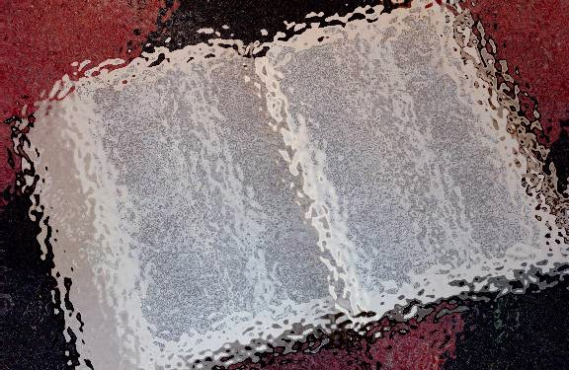

(Obu siina sii adi chii bu-e?)
Bible…Amolo Leino
®
Ozhi kahina
So-o pfii kowli onga thokapi: Deni chochii chari zhi kapra
02
©2004 TBBMI
8.0.02.

Slide 3
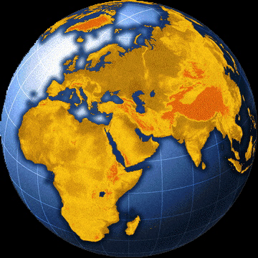
SO-O PFII KOWO OBU ONGA KOSO
?
Bible le so-o pfii kowo h Mediterranean fii he
03
4

Slide 4
SO-O PFII KOWO OBU ONGA KOSO
Mediterranean Ozhi
LEBANON
SYRIA
Haifa
Galilee Ozhi
IRAQ
Nazareth
Netanya
Tel Aviv-Jaffa
AMMAN
JERUSALEM
Jericho
Gaza
Hebron
Kathi Ozhi
Beersheba
ISRAEL
JORDAN
EJIPT
SAUDI ARABIA
Eilat
Gulf of Aqaba
Al’ Aqaba
04
1

Slide 5
SO-O PFII KOWO OBU ONGA KOSO
MO
N(A)
H
GO
K
EK
B
J
MO
KO
E
KB
U
HITHOPFIIE ADI VANO TILI!
MO
PG
RO
Handbook pg. 15-16
05
1

Slide 6
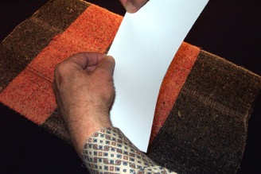
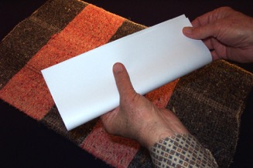
DRESSING
THE
STAGE
SO-O PFII KOWO OBU ONGA KOSO
LARII KALI
OBALI
PFOLO YE,
AVU KALI,
KOKHRI HIO,
SOKHRO PU PILO KORU #03a; (larii akro #03b)
Handbook pg. 15-16
06

Slide 7
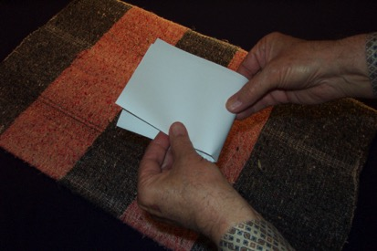
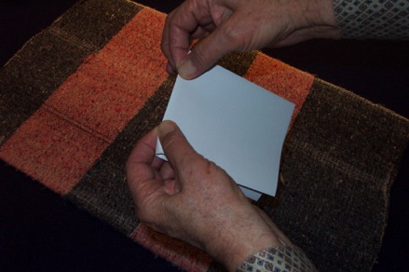
DRESSING
THE
STAGE
SO-O PFII KOWO OBU ONGA KOSO
AVU KALI KOKHRI PUHIO…
…KOKHRI HI KOTO ZHI OCHA PRAKORU DUNO.
Handbook pg. 15-16
07

Slide 8
DRESSING
THE
STAGE
SO-O PFII KOWO OBU ONGA KOSO
Handbook pg. 15-16
08
3

Slide 9
DRESSING
THE
STAGE
SO-O PFII KOWO OBU ONGA KOSO
KARINA: 6 ODZII BVII
KAHI KOCHU NA: 10 OBU KHRU
KOSII KOCHNA: OKO LEI KODO KOSO
Handbook pg. 15-16
09
2

Slide 10
DRESSING
THE
STAGE
SO-O PFII KOWO OBU ONGA KOSO
Handbook pg. 15-16
10
1

Slide 11
DRESSING
THE
STAGE
SO-O PFII KOWO OBU ONGA KOSO
Handbook pg. 15-16
11

Slide 12
DRESSING
THE
STAGE
SO-O PFII KOWO OBU ONGA KOSO
OZHII PFO MO...
OCHA KARINA KOLIKRHINO
PFOLO!
Handbook pg. 15-16
12

Slide 13
DRESSING
THE
STAGE
SO-O PFII KOWO OBU ONGA KOSO
MO
Handbook pg. 15-16
13

Slide 14
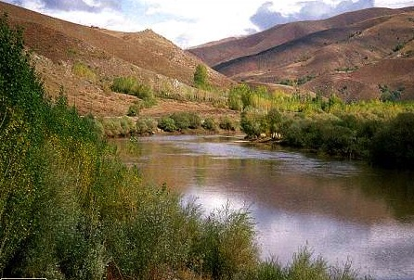
DRESSING
THE
STAGE
SO-O PFII KOWO OBU ONGA KOSO
MO
EK
Handbook pg. 15-16
14

Slide 15

DRESSING
THE
STAGE
SO-O PFII KOWO OBU ONGA KOSO
MO
EK
PG
Handbook pg. 15-16
15

Slide 16
DRESSING
THE
STAGE
SO-O PFII KOWO OBU ONGA KOSO
MO
MEDITERRANEAN OZHI
EK
EUPHRATES KORII
PG
PERSIAN GULF
Handbook pg. 15-16
16
2

Slide 17
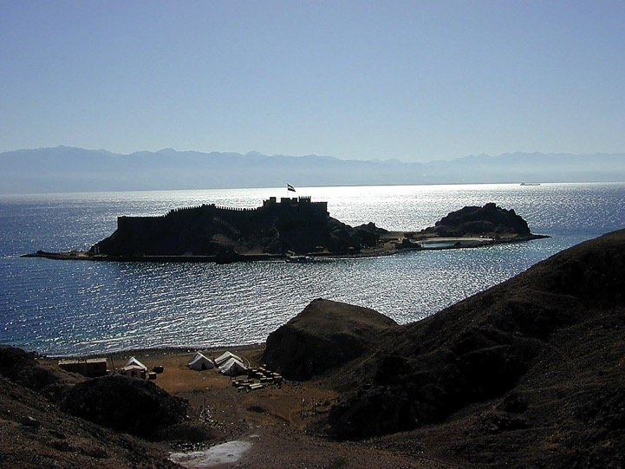

DRESSING
THE
STAGE
SO-O PFII KOWO OBU ONGA KOSO
MO
ER
PG
Handbook pg. 15-16
17

Slide 18
DRESSING
THE
STAGE
SO-O PFII KOWO OBU ONGA KOSO
MO
EK
KOHO OZHI
PG
KO
Handbook pg. 15-16
18

Slide 19
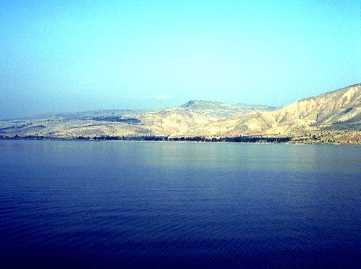
DRESSING
THE
STAGE
SO-O PFII KOWO OBU ONGA KOSO
MO
ER
PG
KO
Handbook pg. 15-16
19

Slide 20
DRESSING
THE
STAGE
SO-O PFII KOWO OBU ONGA KOSO
MO
EK
PG
KO
Handbook pg. 15-16
20

Slide 21
DRESSING
THE
STAGE
SO-O PFII KOWO OBU ONGA KOSO
MO
GO
GALILEE OZHI
ER
PG
KO
Handbook pg. 15-16
21

Slide 22
DRESSING
THE
STAGE
SO-O PFII KOWO OBU ONGA KOSO
MO
GO
GALILEE OZHI
EK
KO
KATHI OZHI
PG
KO
Handbook pg. 15-16
22

Slide 23
DRESSING
THE
STAGE
SO-O PFII KOWO OBU ONGA KOSO
MO
GO
EK
KO
JORDAN KORII
PG
KO
Handbook pg. 15-16
23

Slide 24
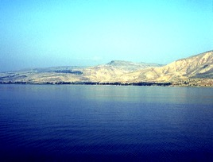

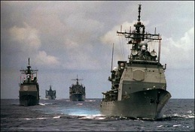
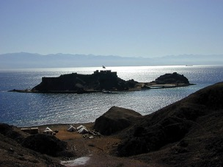
6
DRESSING
THE
STAGE
SO-O PFII KOWO OBU ONGA KOSO
MO
GO
EK
KO
ODZII BVII
PG
KO
Handbook pg. 15-16
24
7

Slide 25

DRESSING
THE
STAGE
SO-O PFII KOWO OBU ONGA KOSO
MO
GO
EK
“OBU SII”
KO
PG
KO
Handbook pg. 15-16
25
1

Slide 26
DRESSING
THE
STAGE
10
SO-O PFII KOWO OBU ONGA KOSO
10 OBUKHRU
MO
GO
EK
KO
Obu ye Ojii khru
PG
KO
Handbook pg. 15-16
26
1

Slide 27
DRESSING
THE
STAGE
SO-O PFII KOWO OBU ONGA KOSO
10 OBUKHRU
MO
4
GO
EK
KO
PG
KO
Handbook pg. 15-16
27

Slide 28
DRESSING
THE
STAGE
SO-O PFII KOWO OBU ONGA KOSO
10 OBUKHRU
MO
6
4
GO
EK
KO
Bible korii chiilu chii “So-o pfii kow-o”
PG
KO
Handbook pg. 15-16
28

Slide 29
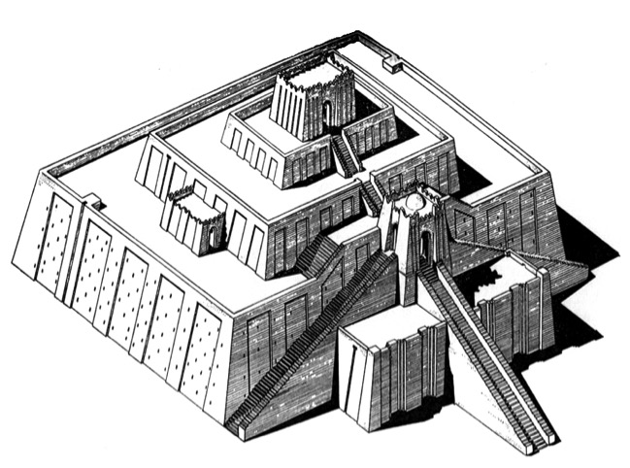
DRESSING
THE
STAGE
SO-O PFII KOWO OBU ONGA KOSO
10 OBUKHRU
MS
6
4
GO
EK
KO
U
PG
KO
CHALDEES ZHII UR
Handbook pg. 15-16
29

Slide 30

DRESSING
THE
STAGE
SO-O PFII KOWO OBU ONGA KOSO
10 OBUKHRU
MO
6
4
GO
EK
B
KO
U
BABYLON
PG
KO
Handbook pg. 15-16
30

Slide 31

SO-O PFII KOWO OBU ONGA KOSO
10 OBUKHRU
MO
6
4
H
GO
EK
B
KO
U
PG
KO
HARAN
(HARRAN,TURKEY)
Handbook pg. 15-16
31

Slide 32
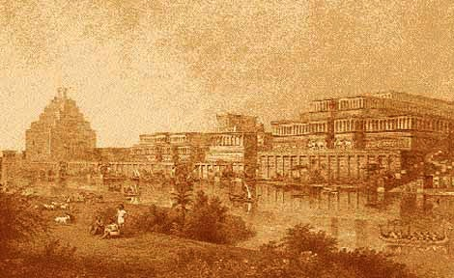
DRESSING
THE
STAGE
SO-O PFII KOWO OBU ONGA KOSO
10 OBUKHRU
MO
6
4
N(A)
H
GO
EK
B
KO
U
PG
KO
NINEVEH (ASSYRIA) MOSUL, IRAQ
Handbook pg. 15-16
32

Slide 33
DRESSING
THE
STAGE
SO-O PFII KOWO OBU ONGA KOSO
10 OBUKHRU
MO
6
4
N(A)
H
GO
EK
B
KO
U
PG
KO
Handbook pg. 15-16
33

Slide 34
DRESSING
THE
STAGE
SO-O PFII KOWO OBU ONGA KOSO
10 OBUKHRU
MO
6
4
N(A)
H
GO
K
IZHODE ZHII KANAAN
EK
B
KO
U
PG
KO
Handbook pg. 15-16
34
1

Slide 35
DRESSING
THE
STAGE
SO-O PFII KOWO OBU ONGA KOSO
10 OBUKHRU
MO
6
4
N(A)
H
GO
K
EK
JERUSALEM
J
B
KO
U
PG
KO
Handbook pg. 15-16
35

Slide 36
DRESSING
THE
STAGE
SO-O PFII KOWO OBU ONGA KOSO
10 OBUKHRU
MS
6
4
N(A)
H
GO
K
EK
MN
B
J
MT. NEBO
KO
U
PG
KO
Handbook pg. 15-16
36

Slide 37

DRESSING
THE
STAGE
SO-O PFII KOWO OBU ONGA KOSO
10 OBUKHRU
MO
6
4
N(A)
H
KADESH-BARNEA
GO
K
EK
B
J
MN
KO
KB
U
PG
KO
Handbook pg. 15-16
37

Slide 38
DRESSING
THE
STAGE
SO-O PFII KOWO OBU ONGA KOSO
10 OBUKHRU
MS
6
4
N(A)
H
EJIPT
GO
K
EK
B
J
MN
KO
E
KB
U
PG
KO
Handbook pg. 15-16
38

Slide 39
DRESSING
THE
STAGE
SO-O PFII KOWO OBU ONGA KOSO
10 OBUKHRU
MO
6
4
N(A)
H
MT. SINAI
GO
K
EK
B
J
MN
KO
E
KB
U
MS
PG
KO
Handbook pg. 15-16
39

Slide 40
DRESSING
THE
STAGE
SO-O PFII KOWO OBU ONGA KOSO
10 OBUKHRU
MO
6
4
N(A)
H
10 Obukhru
GO
K
EK
B
J
MN
KO
E
KB
U
MS
PG
KO
Handbook pg. 15-16
40
2

Slide 41
ochiikakrikapimei 20:1
DRESSING
THE
STAGE
SO-O PFII KOWO OBU ONGA KOSO
10 OBUKHRU
MO
6
4
N(A)
H
“DAN
NO
BEERSHEBA
KOTU”
OJII SII
GO
K
EK
B
J
MN
KO
E
KB
U
MS
PG
KO
Handbook pg. 15-16
41
3

Slide 42
DRESSING
THE
STAGE
SO-O PFII KOWO OBU ONGA KOSO
MEDITER-RANEAN OZHI
NINEVEH (ASSYRIA)
HARAN
GALILEE OZHI
EUPHRATES KORII
KANAAN
MOUNT NEBO
BABYLON
JERUSALEM
SO-O PFII KOWO THOPFII ZHII OBU!
KATHI OZHI
EJIPT
UR
KADESH BARNEA
MT. SINAI
PERSIAN GULF
KOHO OZHI
Handbook pg. 15-16
42

Slide 43
DRESSING
THE
STAGE
SO-O PFII KOWO OBU ONGA KOSO
ECHOW…SII KOLO KHRU KOTHO KOLA KOLEI HI LESHE...
Handbook pg. 15-16
43

Slide 44
DRESSING
THE
STAGE
SO-O PFII KOWO OBU ONGA KOSO
Handbook pg. 15-16
44

Slide 45
DRESSING
THE
STAGE
SO-O PFII KOWO OBU ONGA KOSO
Handbook pg. 15-16
45

Slide 46
DRESSING
THE
STAGE
SO-O PFII KOWO OBU ONGA KOSO
Handbook pg. 15-16
46

Slide 47
DRESSING
THE
STAGE
SO-O PFII KOWO OBU ONGA KOSO
Handbook pg. 15-16
47

Slide 48
DRESSING
THE
STAGE
SO-O PFII KOWO OBU ONGA KOSO
MO
Handbook pg. 15-16
48

Slide 49
DRESSING
THE
STAGE
SO-O PFII KOWO OBU ONGA KOSO
MS
EK
Handbook pg. 15-16
49

Slide 50
DRESSING
THE
STAGE
SO-O PFII KOWO OBU ONGA KOSO
MO
EK
PG
Handbook pg. 15-16
50

Slide 51
DRESSING
THE
STAGE
SO-O PFII KOWO OBU ONGA KOSO
MO
(MEDITERRANEAN OZHI)
EK
(EUPHRATES KORII)
PG
(PERSIAN GULF)
Handbook pg. 15-16
51

Slide 52
DRESSING
THE
STAGE
SO-O PFII KOWO OBU ONGA KOSO
MO
EK
PG
Handbook pg. 15-16
52

Slide 53
DRESSING
THE
STAGE
SO-O PFII KOWO OBU ONGA KOSO
MS
EK
PG
KO
Handbook pg. 15-16
53

Slide 54
DRESSING
THE
STAGE
SO-O PFII KOWO OBU ONGA KOSO
MO
EK
PG
KO
Handbook pg. 15-16
54

Slide 55
DRESSING
THE
STAGE
SO-O PFII KOWO OBU ONGA KOSO
MO
EK
PG
KO
Handbook pg. 15-16
55

Slide 56
DRESSING
THE
STAGE
SO-O PFII KOWO OBU ONGA KOSO
MO
EK
PG
KO
Handbook pg. 15-16
56

Slide 57
DRESSING
THE
STAGE
SO-O PFII KOWO OBU ONGA KOSO
MO
GO
EK
PG
KO
Handbook pg. 15-16
57

Slide 58
DRESSING
THE
STAGE
SO-O PFII KOWO OBU ONGA KOSO
MO
GO
EK
KO
PG
KO
Handbook pg. 15-16
58

Slide 59
DRESSING
THE
STAGE
SO-O PFII KOWO OBU ONGA KOSO
MO
GO
EK
JORDAN KORII
KO
PG
KO
Handbook pg. 15-16
59
1

Slide 60
DRESSING
THE
STAGE
SO-O PFII KOWO OBU ONGA KOSO
10 OBUKHRU
MO
GO
EK
KO
PG
KO
Handbook pg. 15-16
60

Slide 61
DRESSING
THE
STAGE
SO-O PFII KOWO OBU ONGA KOSO
10 OBUKHRU
MO
4
GO
EK
KO
PG
KO
Handbook pg. 15-16
61

Slide 62
DRESSING
THE
STAGE
SO-O PFII KOWO OBU ONGA KOSO
10 OBUKHRU
MO
6
4
GO
EK
KO
PG
KO
Handbook pg. 15-16
62

Slide 63
DRESSING
THE
STAGE
SO-O PFII KOWO OBU ONGA KOSO
10 OBUKHRU
MO
6
4
GO
EK
KO
U
PG
KO
Handbook pg. 15-16
63

Slide 64
DRESSING
THE
STAGE
SO-O PFII KOWO OBU ONGA KOSO
10 OBUKHRU
MO
6
4
GO
EK
B
KO
U
PG
KO
Handbook pg. 15-16
64

Slide 65
DRESSING
THE
STAGE
SO-O PFII KOWO OBU ONGA KOSO
10 OBUKHRU
MO
6
4
H
GO
EK
B
KO
U
PG
KO
Handbook pg. 15-16
65

Slide 66
DRESSING
THE
STAGE
SO-O PFII KOWO OBU ONGA KOSO
10 OBUKHRU
MO
6
4
N(A)
H
GO
EK
B
KO
U
PG
KO
Handbook pg. 15-16
66

Slide 67
DRESSING
THE
STAGE
SO-O PFII KOWO OBU ONGA KOSO
10 OBUKHRU
MO
6
4
N(A)
H
GO
EK
B
KO
U
PG
KO
Handbook pg. 15-16
67

Slide 68
DRESSING
THE
STAGE
SO-O PFII KOWO OBU ONGA KOSO
10 OBUKHRU
MO
6
4
N(A)
H
K
GO
EK
B
KO
U
PG
KO
Handbook pg. 15-16
68

Slide 69
DRESSING
THE
STAGE
SO-O PFII KOWO OBU ONGA KOSO
10 OBUKHRU
MO
6
4
N(A)
H
GO
K
EK
J
B
KO
U
PG
KO
Handbook pg. 15-16
69

Slide 70
DRESSING
THE
STAGE
SO-O PFII KOWO OBU ONGA KOSO
10 OBUKHRU
MO
6
4
N(A)
H
GO
K
EK
MN
B
J
KO
U
PG
KO
Handbook pg. 15-16
70

Slide 71
DRESSING
THE
STAGE
SO-O PFII KOWO OBU ONGA KOSO
10 OBUKHRU
MO
6
4
N(A)
H
GO
K
EK
B
J
MN
KO
KB
U
PG
KO
Handbook pg. 15-16
71

Slide 72
DRESSING
THE
STAGE
SO-O PFII KOWO OBU ONGA KOSO
10 OBUKHRU
MO
6
4
N(A)
H
GO
K
EK
B
J
MN
KO
E
KB
U
PG
KO
Handbook pg. 15-16
72

Slide 73
DRESSING
THE
STAGE
SO-O PFII KOWO OBU ONGA KOSO
10 OBUKHRU
MO
6
4
N(A)
H
GO
K
EK
B
J
MN
KO
E
KB
U
MS
PG
KO
Handbook pg. 15-16
73

Slide 74
DRESSING
THE
STAGE
SO-O PFII KOWO OBU ONGA KOSO
10 OBUKHRU
MO
6
4
N(A)
H
GO
K
EK
B
J
MN
KO
E
KB
U
MS
PG
KO
Handbook pg. 15-16
74
1

Slide 75
DRESSING
THE
STAGE
SO-O PFII KOWO OBU ONGA KOSO
10 OBUKHRU
MO
6
4
N(A)
H
OJII SII
GO
K
EK
B
J
MN
KO
”DAN
NO
BEERSHEBA
KOTU”
E
KB
U
MS
PG
Ochikakriikapimei 20:1
KO
Handbook pg. 15-16
75

Slide 76
DRESSING
THE
STAGE
SO-O PFII KOWO OBU ONGA KOSO
MEDITER-RANEAN OZHI
NINEVEH (ASSYRIA)
HARAN
GALILEEE OZHI
EUPHRATES KORII
KANAAN
MOUNT NEBO
BABYLON
SO-O PFII
KOWO
THOPFII ZHII
OBU!
JERUSALEM
KATHI OZHI
EJIPT
UR
KADESH BARNEA
MT. SINAI
PERSIAN GULF
KOHO OZHI
Handbook pg. 15-16
42

Slide 77
DRESSING
THE
STAGE
SO-O PFII KOWO OBU ONGA KOSO
HITHOPFII ADI VANO TILI...
Handbook pg. 15-16
77

Slide 78
Ariipei oji mara prakazhii leino pfo Akhrumei somashii kowo..
Handbook pg. 15-16
78

Slide 79
DRESSING
THE
STAGE
SO-O PFII KOWO OBU ONGA KOSO
MO
N(A)
H
GO
K
EK
B
J
MN
KO
…Bible li “hibvii tie tikocho” sii ichowo ni leleino mozhune khri ti lole!
E
KB
U
MS
PG
KO
Handbook pg. 15-16
79
1

Slide 80
DRESSING
THE
STAGE
SO-O PFII KOWO OBU ONGA KOSO
MO
CHIIJIIPHE KOSO
N(A)
ABRAHAM
H
JOSEPH
GO
MOSES
K
EK
JOSHUA
B
J
AMAZHI CHILU
MN
MOVU CHILU
KO
CHIILI KOSO CHILU
E
MAKRAKOBU
KB
JISU
U
MS
PG
KO
Handbook pg. 15-16
80

Slide 81
DRESSING
THE
STAGE
SO-O PFII KOWO OBU ONGA KOSO
ECHO WOLI NILE LANO NILE ITSII AMOCHO LEINO… CHINGHEI KAPRA
PEI ZHII CHARE
SII ZHI KOLEI HIO!
OJII CHARI NELO KORU OPO #30
Handbook pg. 15-16
81

Slide 82
SO-O PFII KOWO OBU ONGA KOSO
Kotho kola oshu ile meizhii ozhu korii
©
“Nino echu-o li obu sii adi chii bue cho sii siile!”
“Where is that place, anyway?”
Handbook pg. 15-16
1
82

Slide 83

Echu-o li Bible…Amolo Leino sii nino mocho-o bule…
•Itsii Kali “Bible File” tikocho
• “ Bible File”…C 7 M J Hruprakocho Itsii nasii
• Itsii leino Bible li Oko Kajii Khru hibviitie tikocho siikolo
• Bible zhii “DEMOKO” Kotholi: “Kotho kola oshu ile meizhii ozhii koru”
1
83

Slide 84
Bible…
Amolo Leino
Bible…Amolo Leino modo kocho
Ministries International Inc. Fort Worth, Texas
Designed by Dr. John Fryman, Texas, USA • BibleBasically.org
Taught by Dr. Rick Griffith, Singapore Bible College
All files in many languages for free download at BibleStudyDownloads.org
www.biblebasically.org
8.0.01.
©2004 TBBMI
04

Slide 85
85
©2004 TBBMI
8.0.02.

Slide 86


The Bible…Basically link at BibleStudyDownloads.org
Get this presentation for free!
Notes:
The Bible…Basically (bb)

